Slide 1
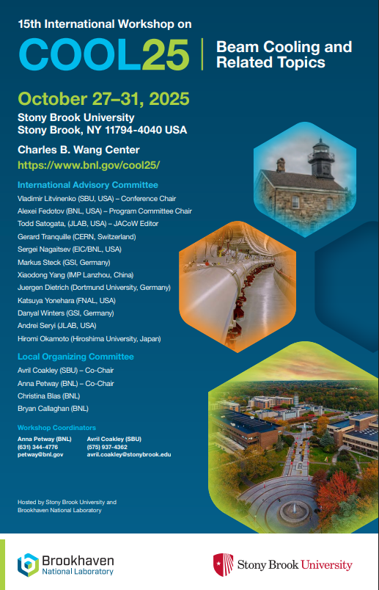
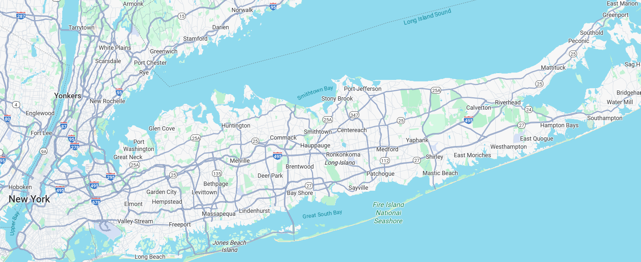
Welcome to COOL25!
Welcome to Long Island!
Welcome to Stony Brook!

Slide 2
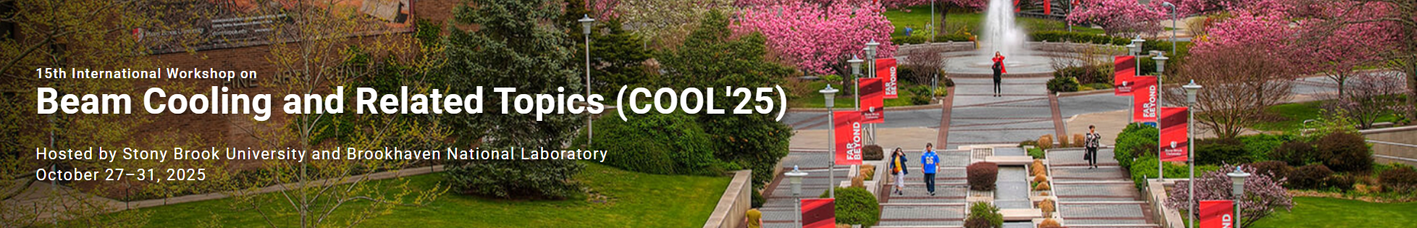
This is 15th Beam Cooling workshop, bi-annual meetings with the first one held in Montreux in 1993.
This is 3rd workshop held in the USA:
COOL05 (Galina, IL), COOL15 (JLAB, VA), COOL25 (Stony Brook, NY)
Making COOL25 scientific program was challenging due to ongoing geo-political situation with several cancelations, including some last-minute.
We have 43 oral talks this year with good representation on various beam cooling topics (electron, stochastic, muon, laser cooling and development of advanced beam cooling techniques) from various countries:
USA, Switzerland, France, Germany, China and Japan
2

Slide 3
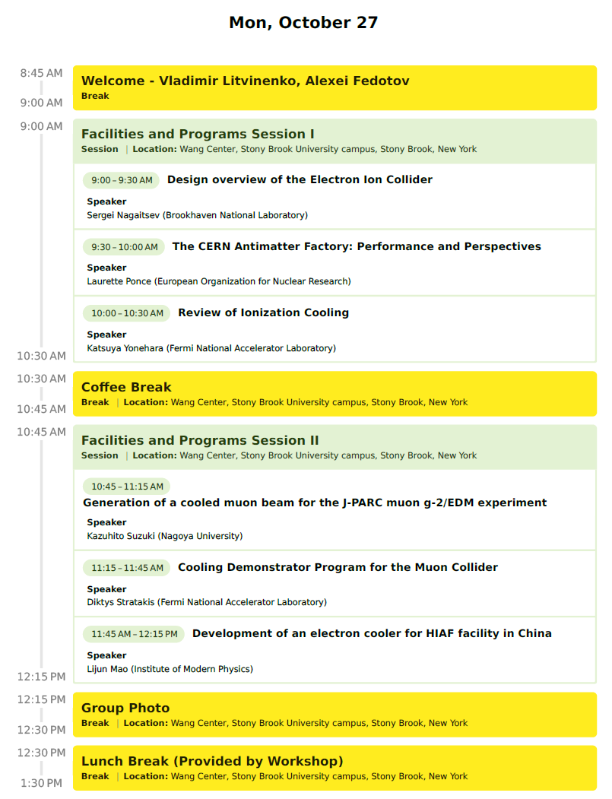
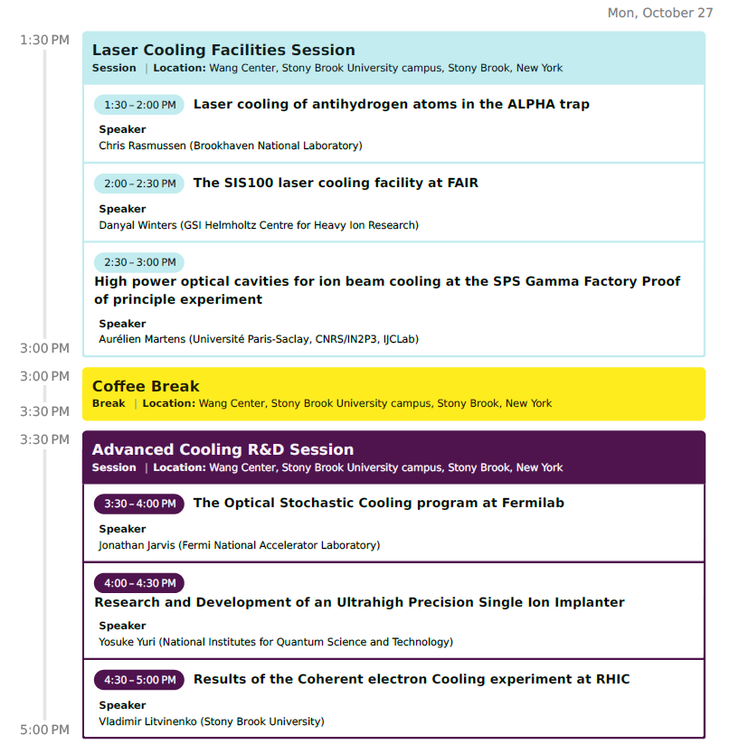
3

Slide 4
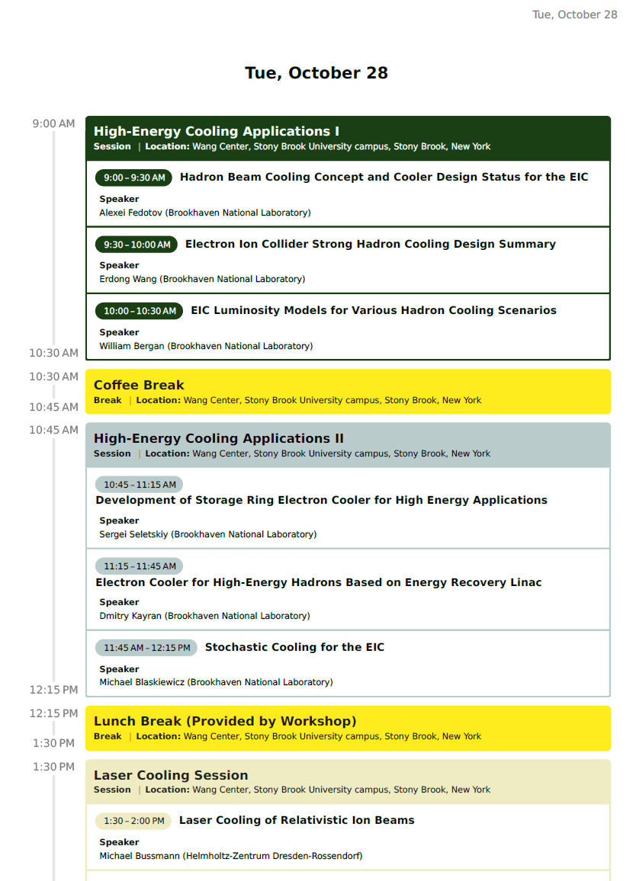
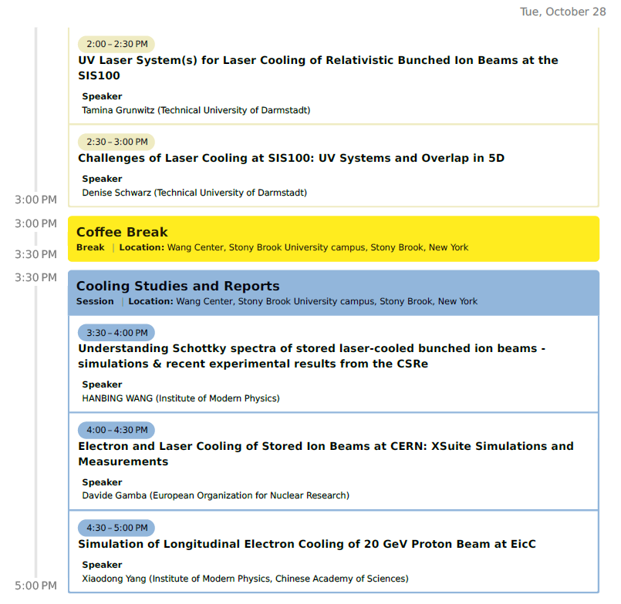
4

Slide 5
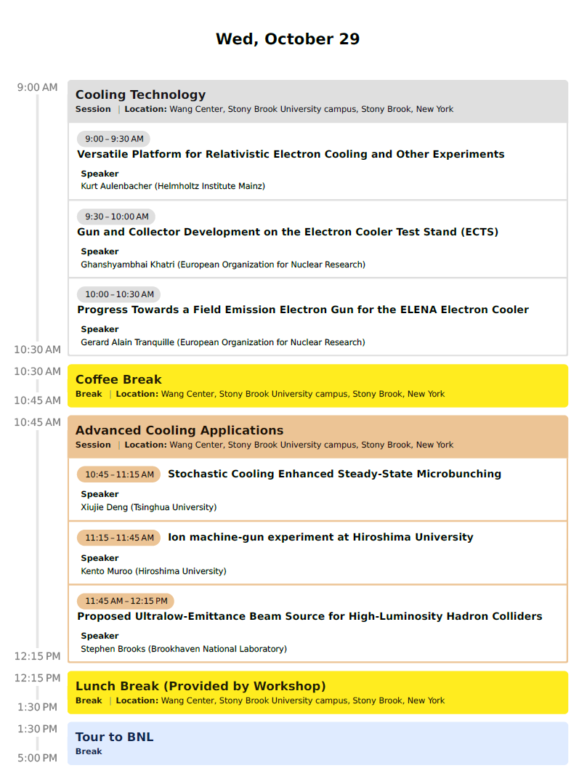
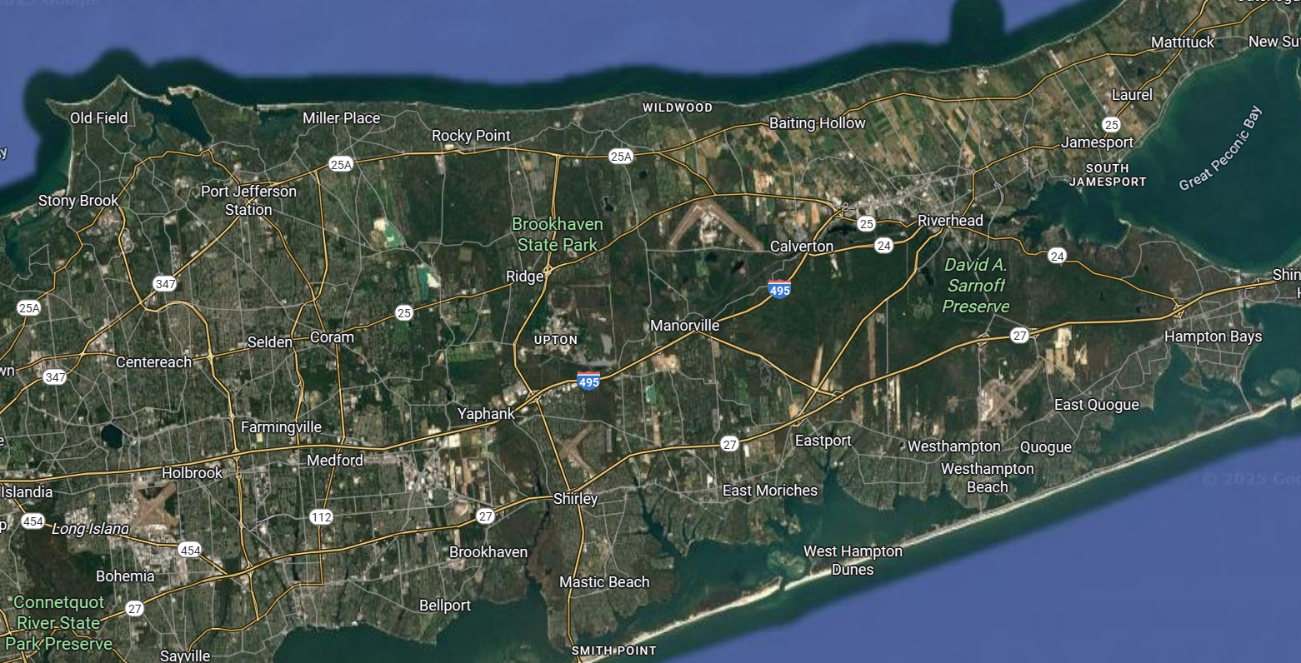
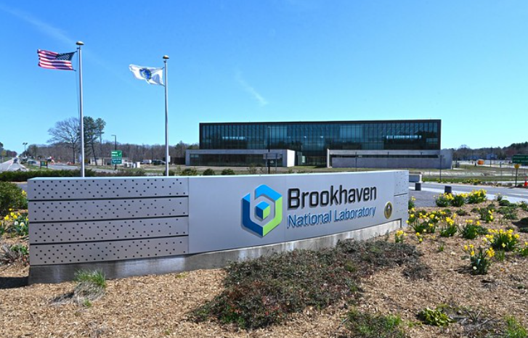
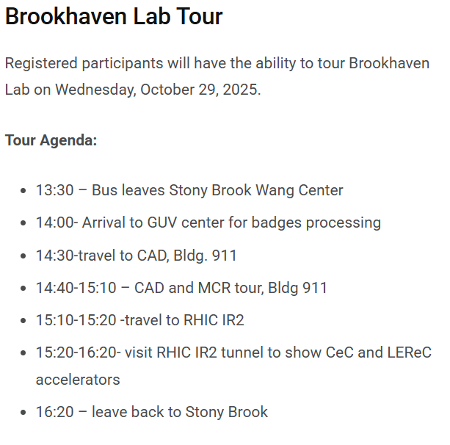
BNL
(RHIC)
5

Slide 6
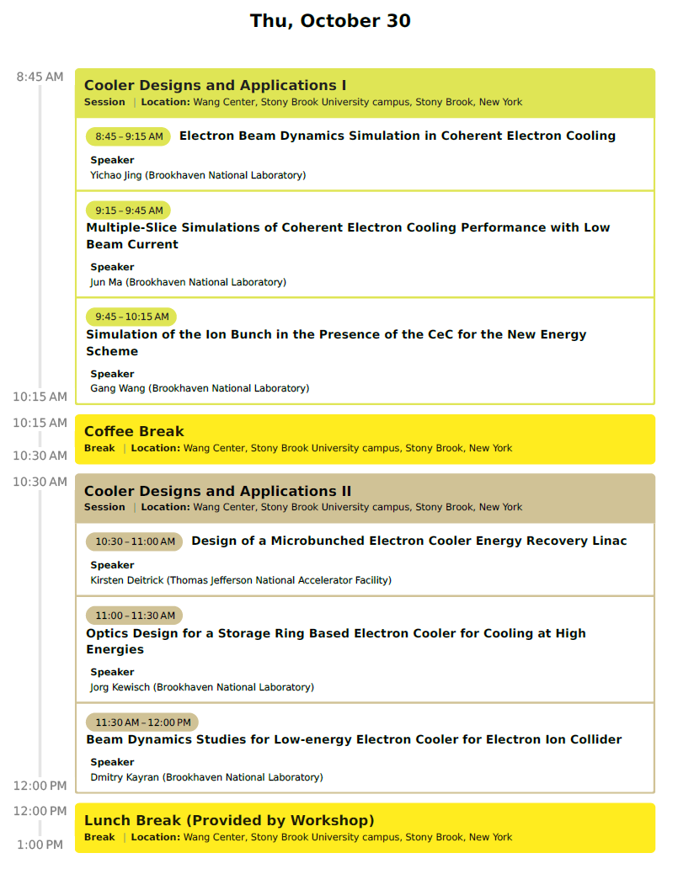
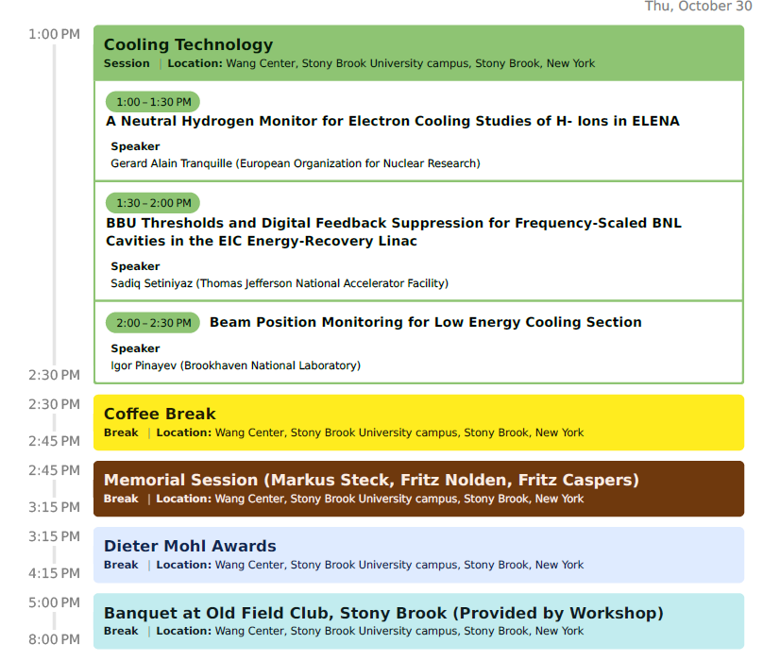
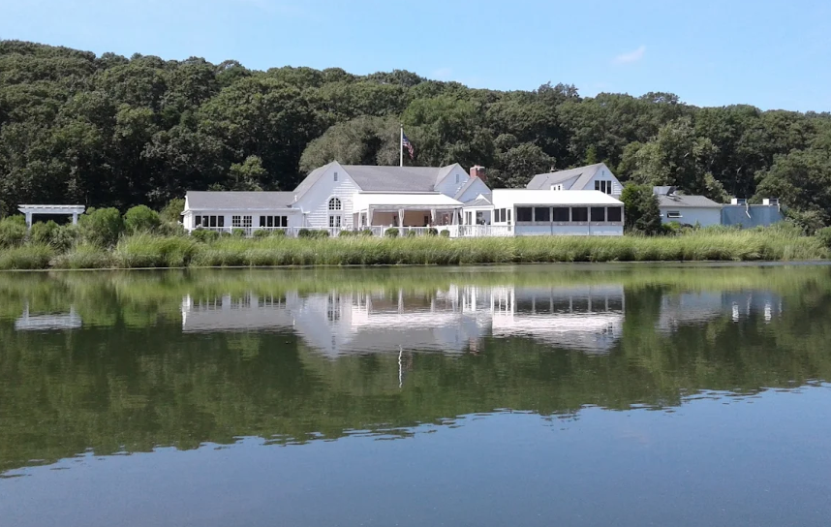
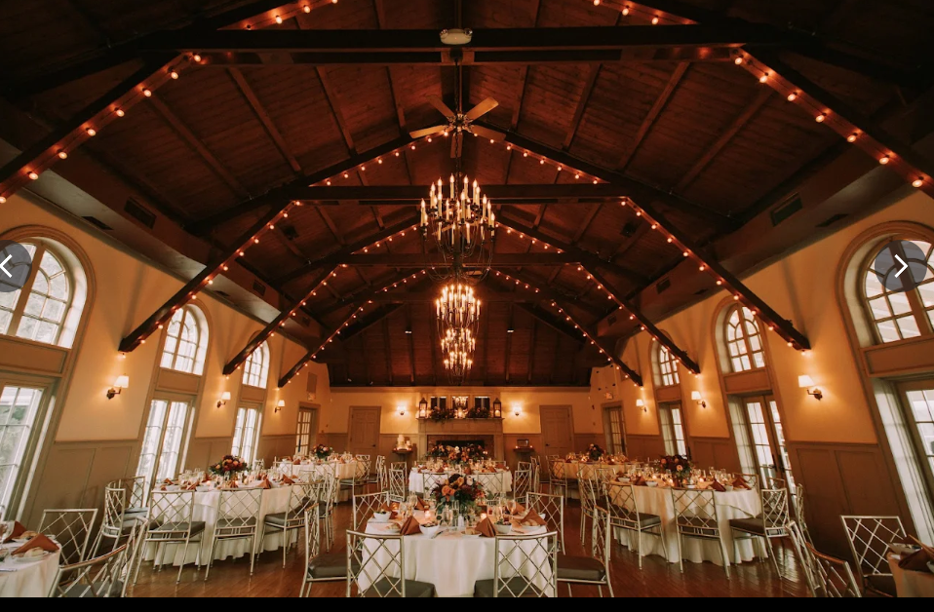
6

Slide 7
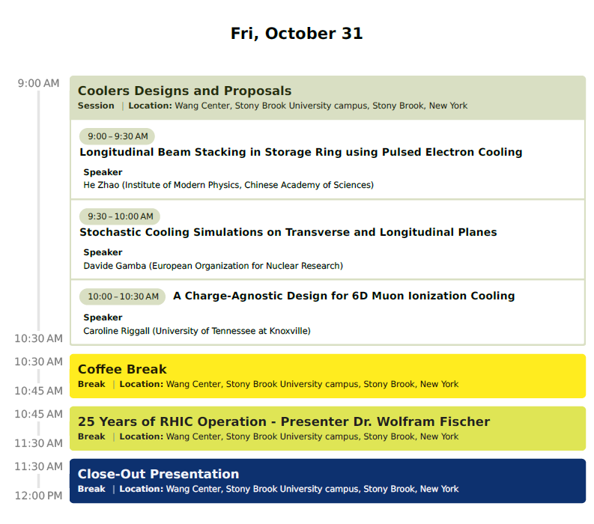
7

Slide 8
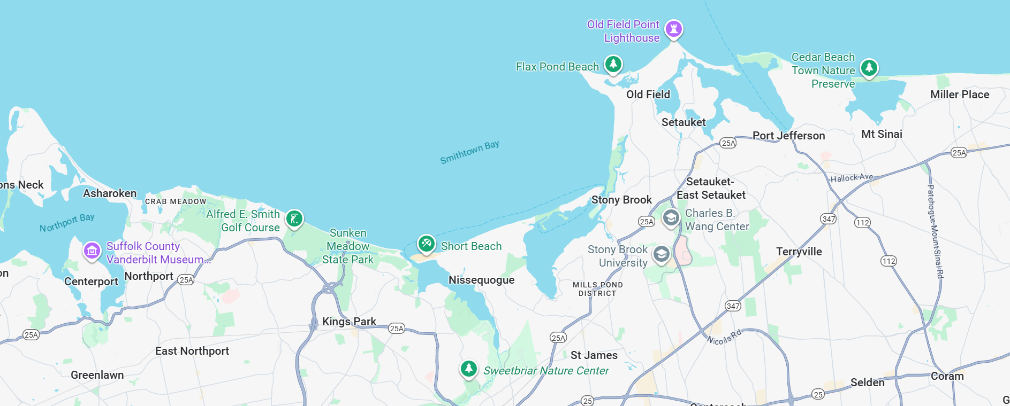
Long Island North Shore
Places to visit nearby: Port Jefferson, Avalon Park, Long Island Museum, West Meadow beach,
Vanderbilt museum…
West Meadow
Beach
Old Field Club
Avalon Nature
Preserve
8

Slide 9
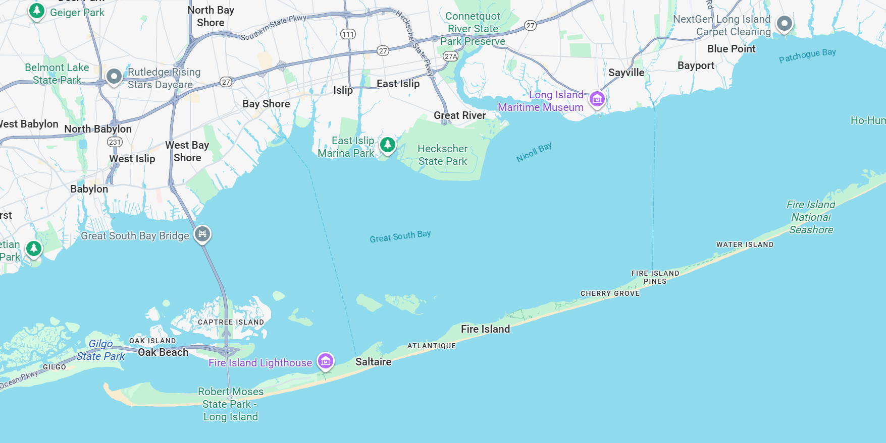
Long Island South Shore
Robert Moses State Park: Fire Island Lighthouse, Smith Point, Cupsogue Beach Park in Westhampton…
9

Slide 10
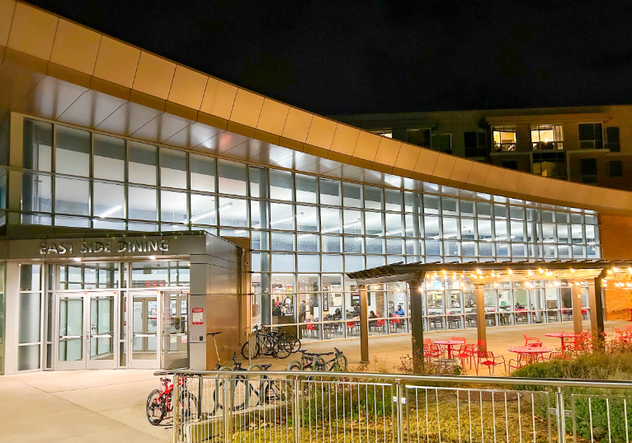
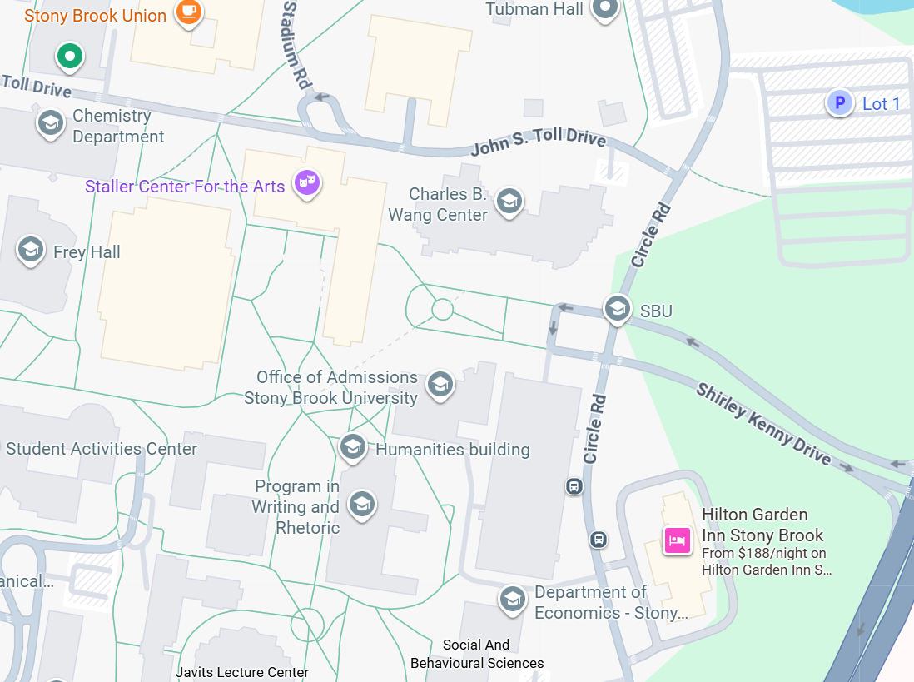
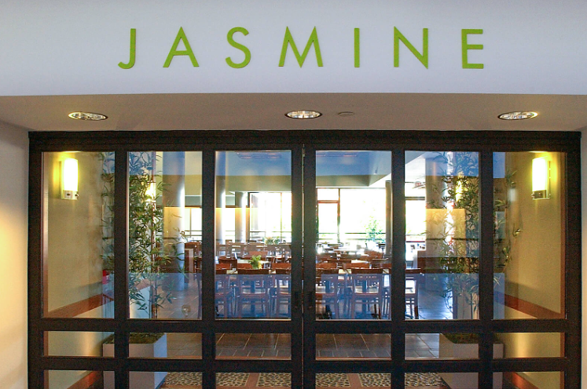

Food nearby
More restaurants across campus on the other side of Rail Road Station
East Side
Dining
10

