Slide 1
Electron Ion Collider Strong Hadron Cooling Design Summary
Erdong Wang, Electron Ion Collider
Brookhaven National Laboratory
Oct. 28th, 2025
COOL ‘25

Slide 2
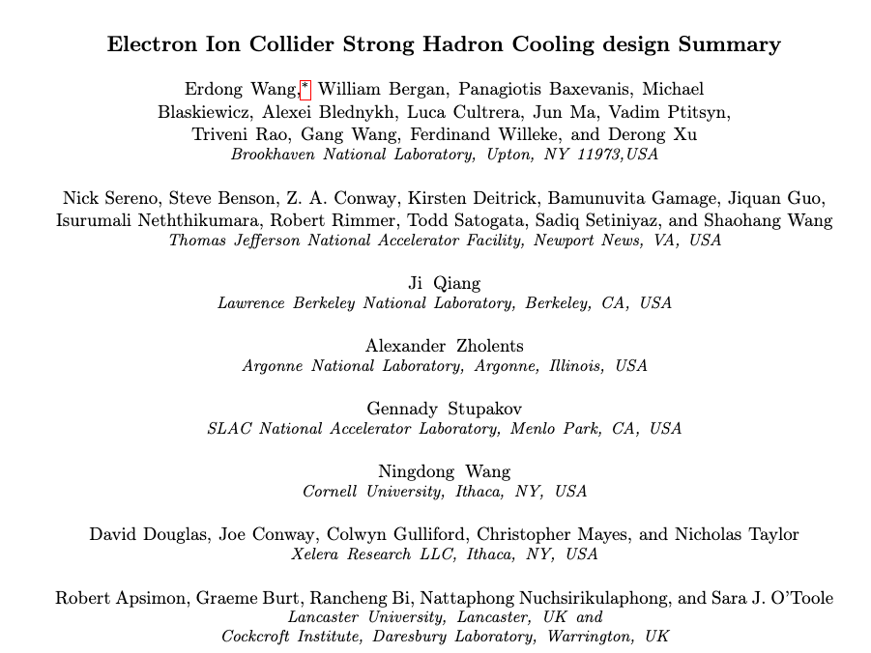
Motivation of this talk
https://www.osti.gov/biblio/2574100
The strong hadron cooling(SHC) design effort in the EIC is terminated.
High energy cooling R&D using other methods is being exploring with support from external funding.
This talk aims to summarize the 2020-2024 SHC design effort and challenges we faced.
A tech-note was published summarizing the 4-years design effort
In the EIC CDR: Strong hadron cooling is a Coherent electron Cooling using micro-bunched amplifier.

Slide 3
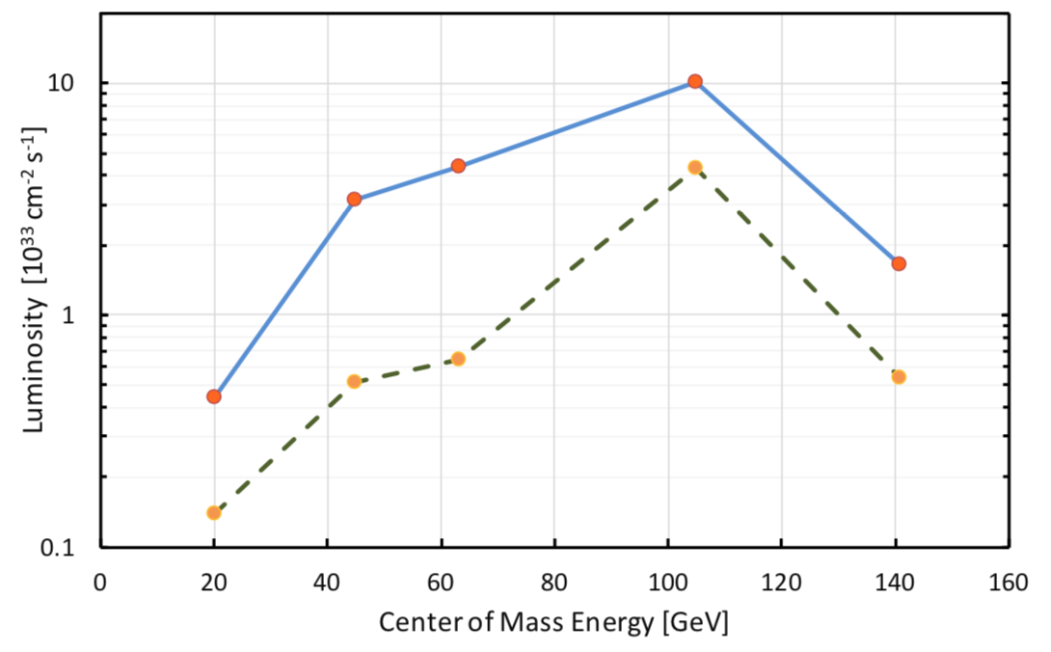
EIC cooling goal
The luminosity of lepton-hadron colliders in the energy range of the EIC’s benefits strongly (by a factor of ≈ 3-10) from cooling the transverse and longitudinal hadron beam emittance.
Cool the proton beam at 275 GeV and 100 GeV ;
IBS longitudinal and transverse(h) growth time is 2-3 hours. The Beam-beam growth time(v) is > 5 hours. The cooling time shall be equal to or less than the diffusion growth time from all sources.
Must cool the hadron beam normalized rms vertical emittance at injection from 2.5 um to 0.3 um within 2 hours.
with SHC
w/o SHC
Notes:
In evaluation of average luminosity, we should cool the vertical in first 2 hours in the store. We plan to maintain the collisions in the same time, by slowly adjusting down electron vertical beta-function in the IP as the proton vertical emittance decreases. After 2 hours the proton beam emittances should be at their design table values, then the cooler is retuned to maintaining these emittances against IBS.

Slide 4
EIC Cooling methods
Pre-cooler@24 GeV cooling time <1 hr
SHC time@100, 275 GeV ~2 hrs
Use a precooler(electron cooling) at injection energy to reduce the vertical hadron RMS normalized emittance from 2.5 um to 0.3 um within 2 hours or less of storage time at the injection energy of 24 GeV. Achieve the hadron collision emittance.
High energy(Coherent electron Cooling) is used to maintain high beam brightness by counteracting intra-beam scattering and beam-beam effects.

Slide 5
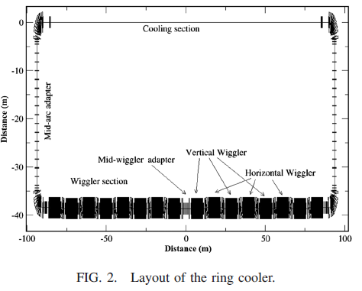
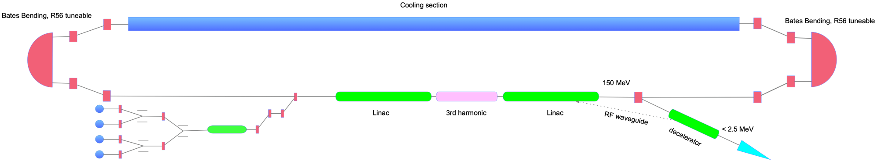
Hadron cooler considerations for EIC
Multiple choices of High energy coolers were discussed at EIC R&D stage and CD0
ERL-based coherent electron cooler
ERL-based Circulator Ring electron cooler
ERL-based single turn multiple guns electron cooler
Storage Ring electron cooler
S. Seletskiy: Development Of Storage Ring Electron Cooler For High Energy Application
D. Kayran: Electron Cooler For High Energy Hadrons Based On The Energy Recovery Linac

Slide 6
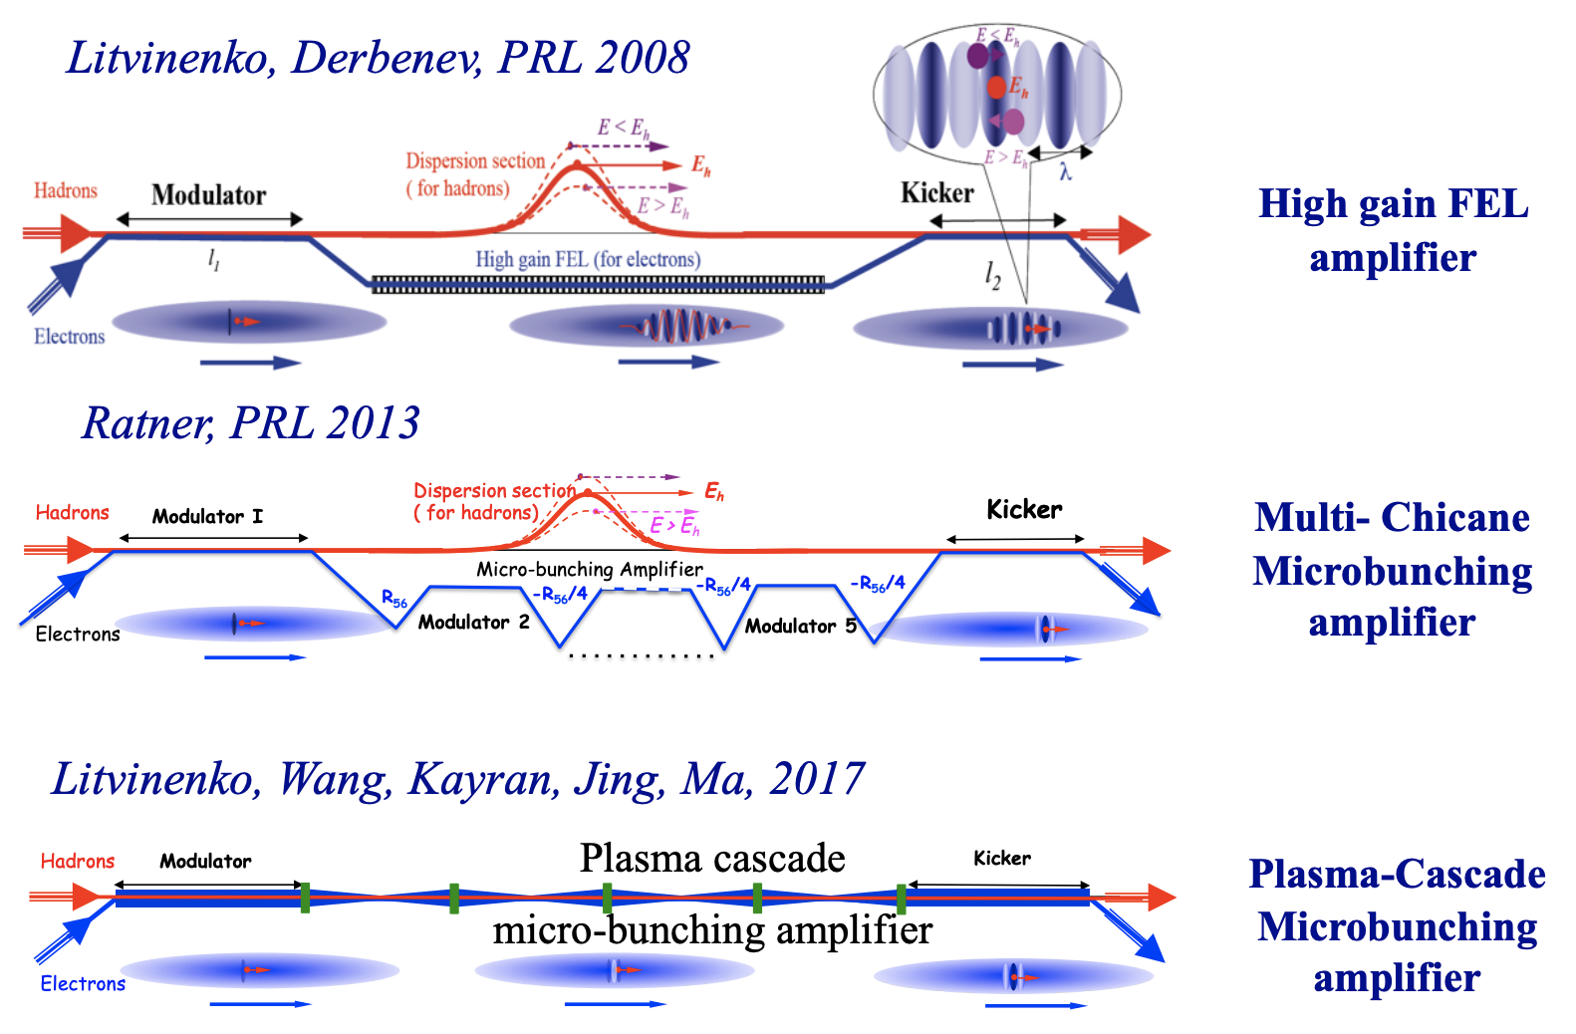
Coherent Electron Cooling proposed schemes
Coherent electron cooling is a variant of the stochastic cooling. It uses an electron beam as signal carrier, raising the bandwidth range from ~GHz to tens of THz.
2012-2018
There are several CeC schemes were proposed. The major difference between them is the amplification mechanism.
EIC CDR
Present test

Slide 7
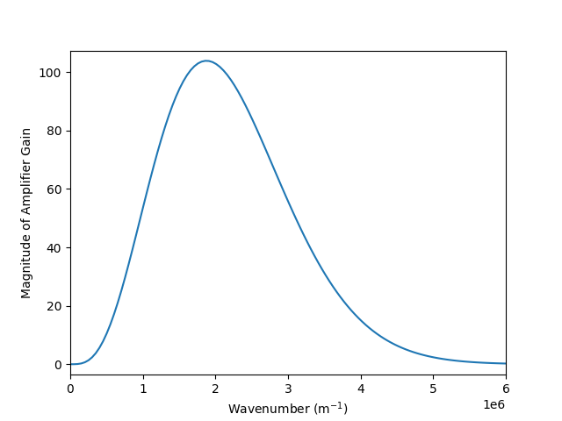
Micro-bunched electron cooling introduction
E<E₀
H⁺
Modulator
E>E₀
Kicker
R₅₆
R₅₆
R₅₆
e⁻
e
e
e
Modulator (M): density fluctuation in hadron beam causes energy modulation of e-beam
Amplification: e-beam energy modulations are amplified and converted to density fluctuations by chicane and straights
Hadron chicane: Controls hadron travel time with respect to electron path. Transfer to correlated energy modulation.
Kicker(K): longitudinal electric field of electrons reduces the hadron beam correlated energy spread.
7

Slide 8
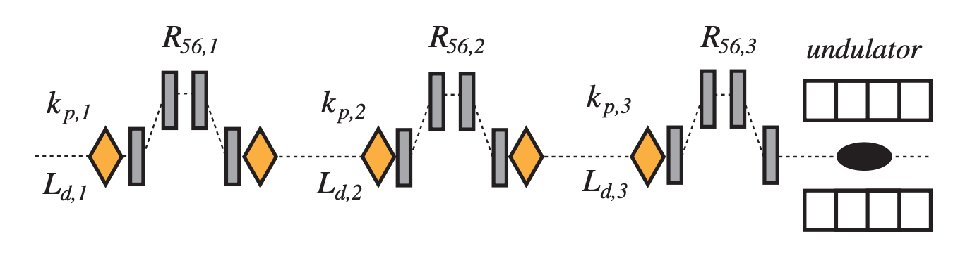
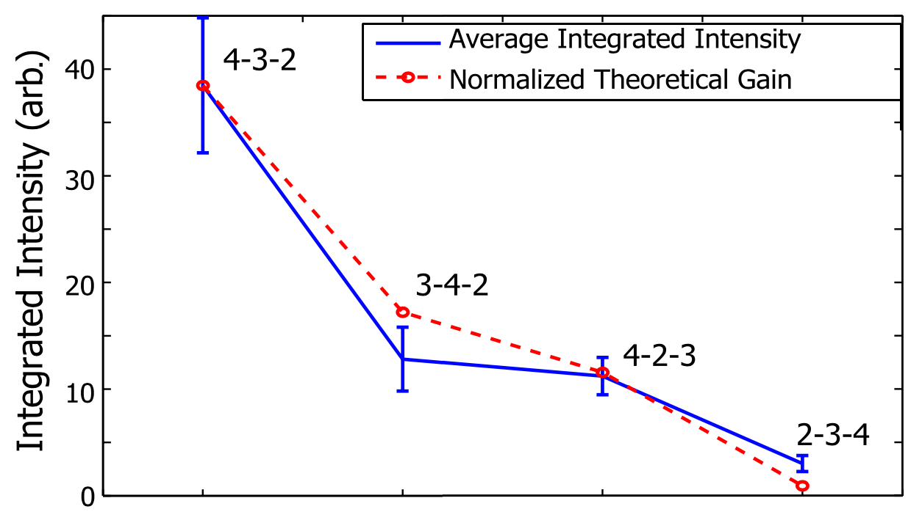
The chicane-drift amplifier was tested experimentally
Micro-bunched amplification is well known in FELs [Schneidmiller&Yurkov PRAB 13, 110701 (2010); Dohlus et al. PRAB 14, 090702 (2011)]. It has been tested experimentally at NLCTA facility at SLAC [Marinelli et al. PRL 110, 264802 (2013)].
Beam line for the NLCTA experiment. Beam energy is 72 MeV.
The amplification was inferred from the beam radiation in the undulator
Experiment #
Signal intensity increased when the chicane strength was optimized, showing good agreement with theory.
Estimated intensity amplification ∼ 3000

Slide 9
SHC Parameters table
@ Will Bergan
 | 100 GeV | 275 GeV
Modulator/Kicker length [m] | 33 | 33
Amplification length [m] | 49 x 2
e bunch charge [nC] | 1
e RMS Bunch length[mm] | 9 | 7
e slice energy spread(dp/p) | 1e-4 | 5.9e-5
e normalized emittance [mm-mrad] | 2.8
R56_e of 1st , 2nd and 3rd chicane [mm] | 23/-17/-18 | 12./-6.7/-6.8
Proton Energy spread | 9.7e-4 | 6.8e-4
R56 of proton chicane [mm] | 4.2 | 1.3
Proton H/V phase advance [rad] | 3.2/4.7 | 3.2/4.8
Proton H/V dispersion in M&K [m] | 0.0036/0.096 | 0.0019/0.067
H/V/L heating time [hrs] | 2/4/2.5 | 2/7/2.9
H/V/L cooling time [hrs] | 1.7/3.9/2.4 | 0.9/1.9/1.2
p
e
Fz(x, y, z)
y
x
z
r
Parameters table was generated using hybrid-model: Treat electrons as discs; Treat hadrons as point charges within modulator and kicker. Wake function W(xm,ym,xk,yk,dz).
The cooler parameters were optimized by a genetic algorithm on a cluster.
Verified by the 3D codes, such as SPACE

Slide 10
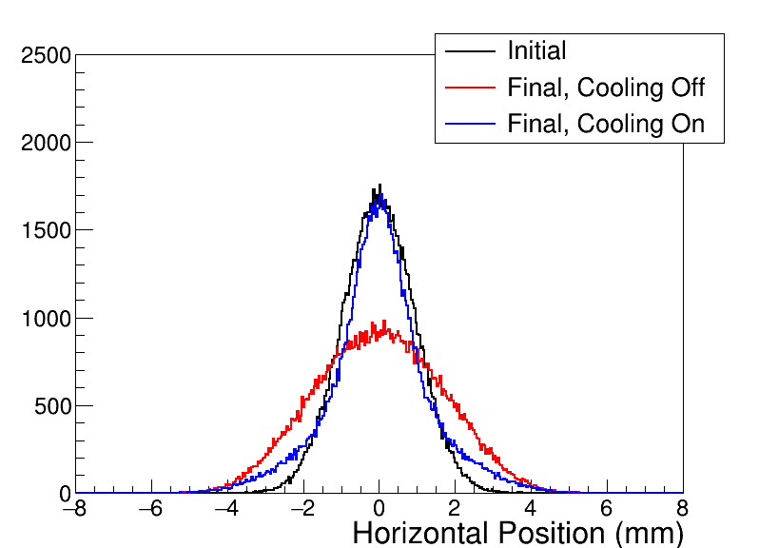
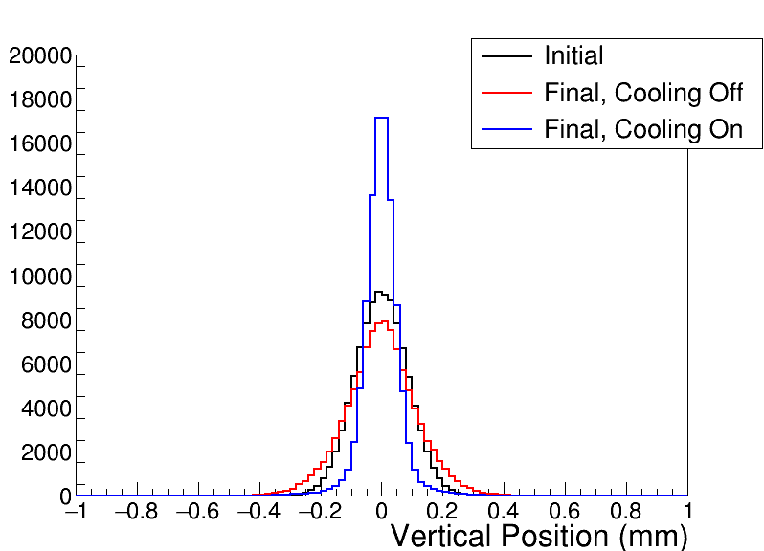
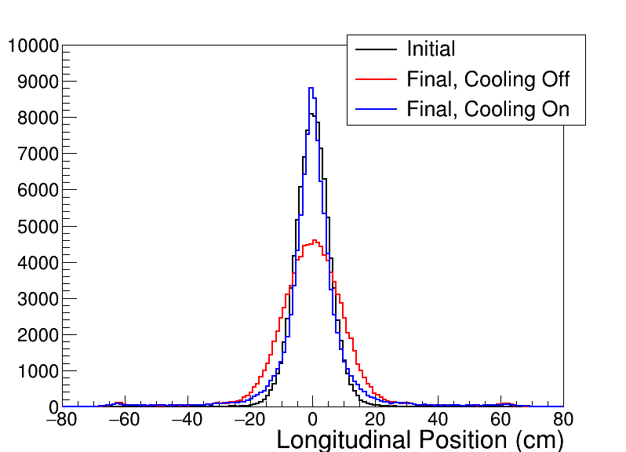
Initial and final hadron spatial distributions after 10 hours
Tracking for 10 hr with IBS and beam-beam emittance growth

Slide 11
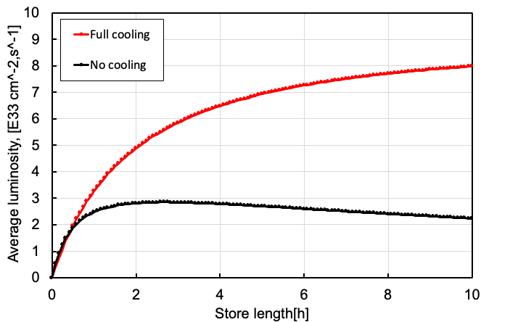
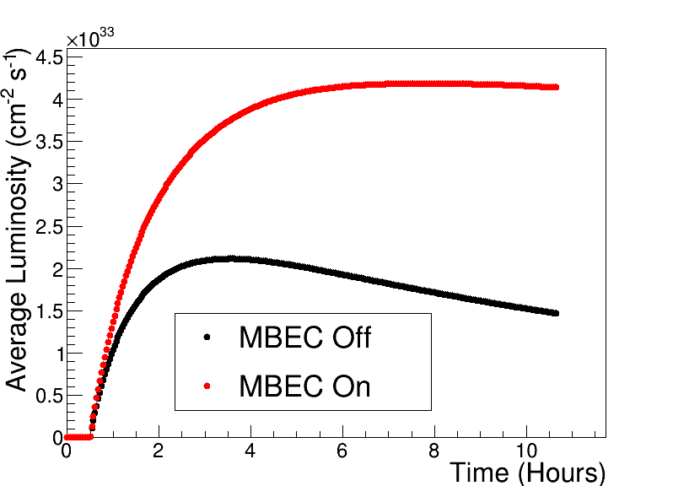
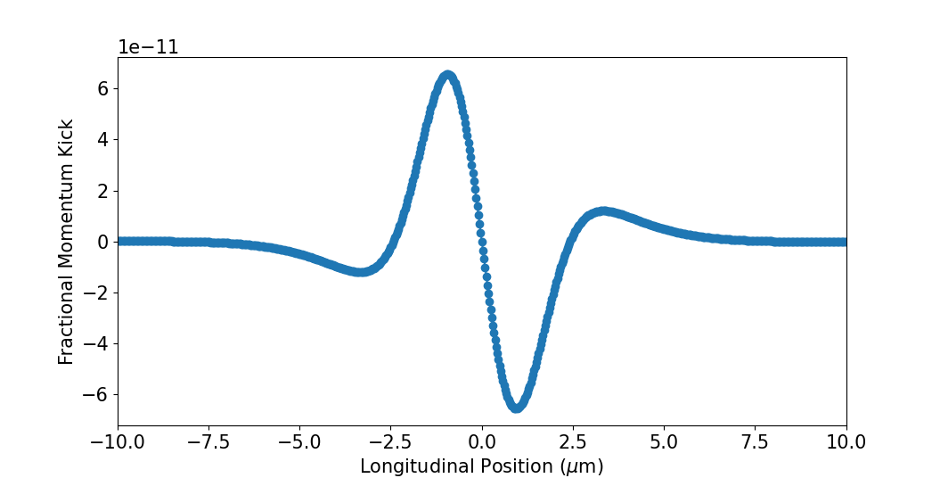
Luminosity with SHC
Ideal
We hoped to get 1e34 cm⁻²s⁻¹ average luminosity. However, with more realistic calculations, the average luminosity barely above 4e33 cm⁻²s⁻¹.
The electron bunch overlaps with the proton bunch’s center. This works well for cooling the core of the bunch, but not the tails.
Protons with large actions have large delays and see nonlinear or anti-cooling regions of the wake.
Beam loss was observed.
Realistic
linear region
anti-cooling region
linear region
For details see W. Bergan : EIC luminosity Models for Various hadron cooling scenarios

Slide 12
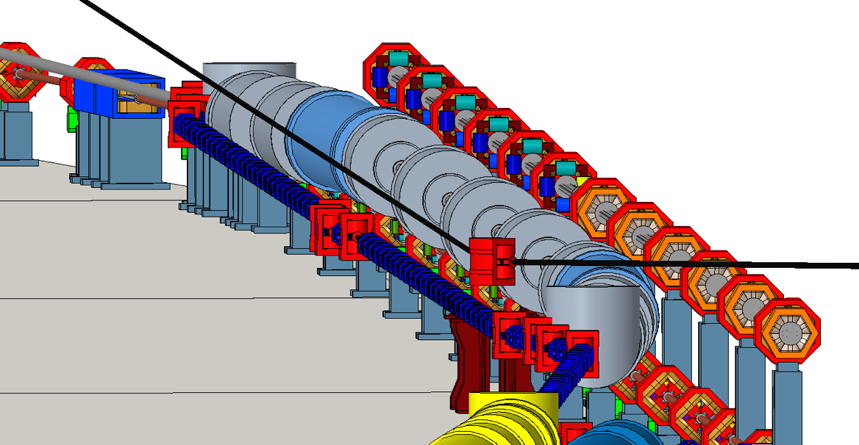
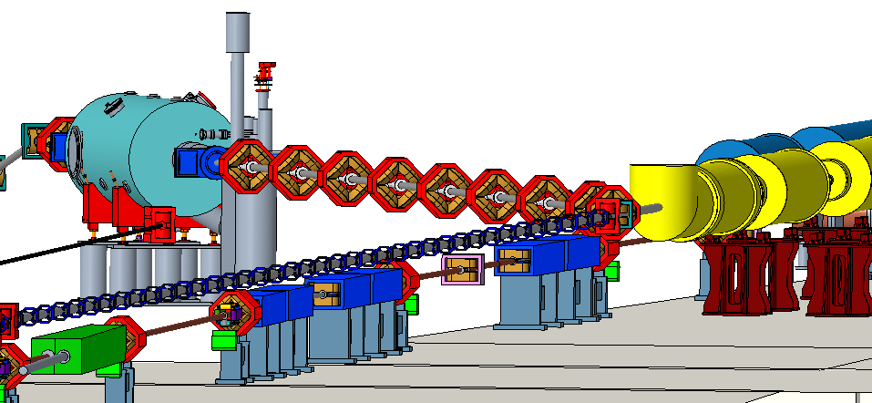
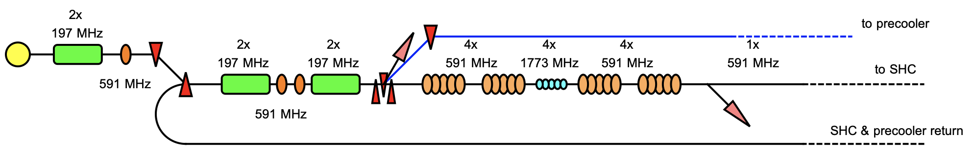
SHC/precooler facility layout
Modulator
Amplifier &Hadron
Laser heater section

Slide 13
Selected SHC design challenges
A high-current ERL to generate a beam with a uniform energy spread, and a super gaussian distribution.
A high-quality, high-current electron beam with a small energy spread, and low noise.
The total R56 (M to K) must be zero to avoid slice slippage.
Path length control for electrons and hadrons with sub-micron accuracy over the 150-meters cooling channel. An exquisite stability of the system.

Slide 14
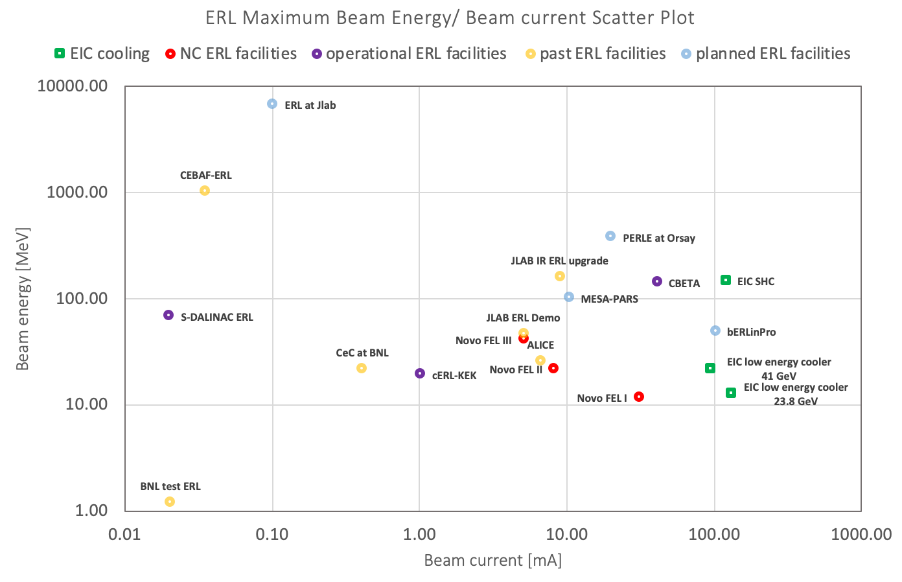
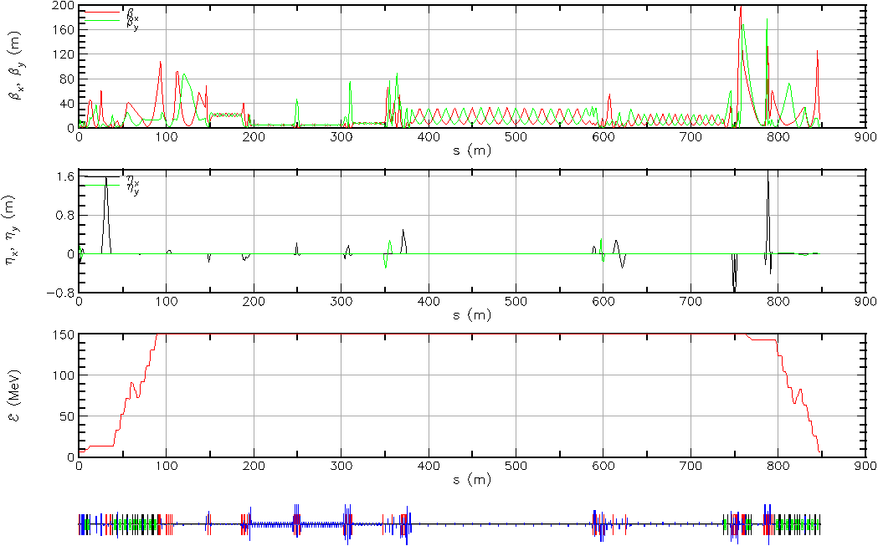
High current ERL
SHC ERL is beyond the state of the art.
High current/charge
electron source
beam halo/loss
BBU
CSR
Ion trapping
A full lattice has been developed. BBU, beam halo, beam loading were studied. The ERL design seems promising, with the exception of the sub-um longitudinal alignment requirement.
See the talks in this workshop
K. Deitrick: Design of a Microbunched electron cooler Energy recovery Linac
S. Setiniyaz: BBU thresholds and Digital Feedback Suppression in the EIC ERL

Slide 15
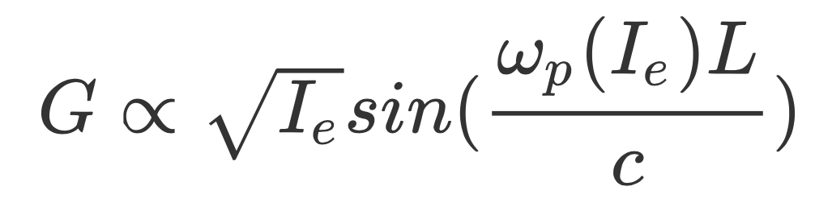
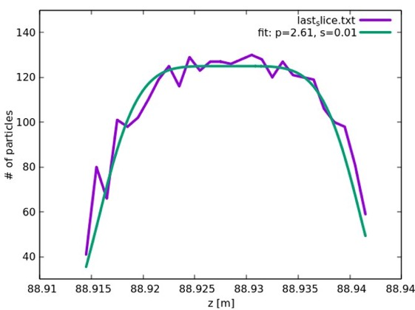
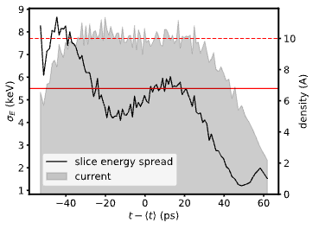
Creating a Super-Gaussian bunch in the Cooler
Initial Laser distribution in the gun
Electron bunch
Ion bunch
In amplifier:
3D GPT simulation | Beam parameters
Bunch charge | 1 nC
RMS emittance x/y | 2.6 mm-mrad
rms dp/p | 5e-5
Slice dp/p | < 3e-5
rms Bunch length | 7 mm
Super-Gaussian distribution at the end of Linac
BMAD
GPT
A uniform current along the bunch provides a higher cooling rate
The chicane’s T₅₆₆ is compensated here using 3rd harmonic RF gradient
While simulation shows sound results, what are the practical implication for commissioning?
Notes:
Small energy spread caused saturation in amplifier.
Factor 3-4 variation cause only a few slice can provide good cooling.

Slide 16
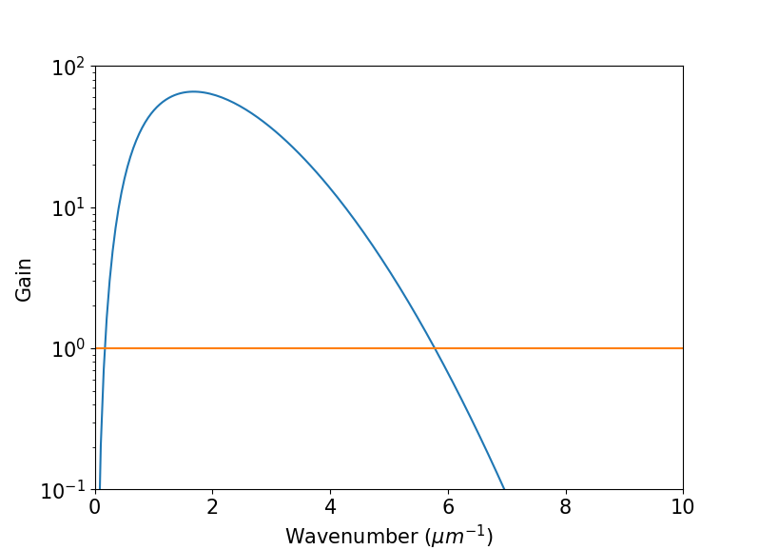
Uniform energy spread generation
Amplifier gain
Laser heater section
Factor 3-4 variation of energy spread causes only a few slices can provide good cooling.
At the end of Linac(150 MeV), the 98.5 MHz beam is propagated with a laser in an undulator
This increase the slice energy spread by 7.5 keV(5e-5), making it more uniform
1.06 um wavelength of laser heater will not be amplified.
laser heater wavenumber

Slide 17
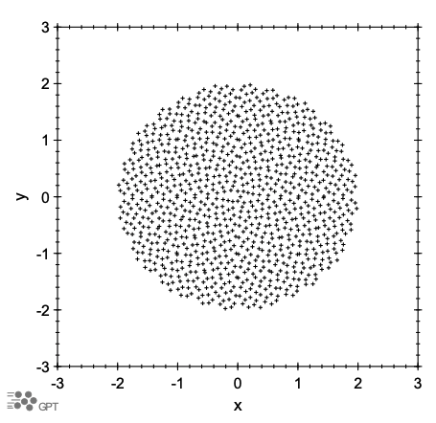
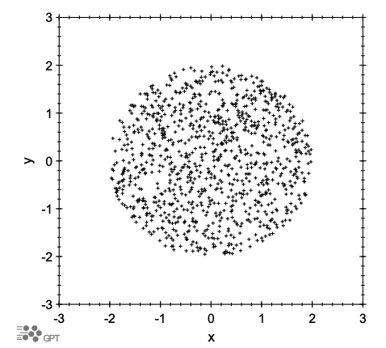
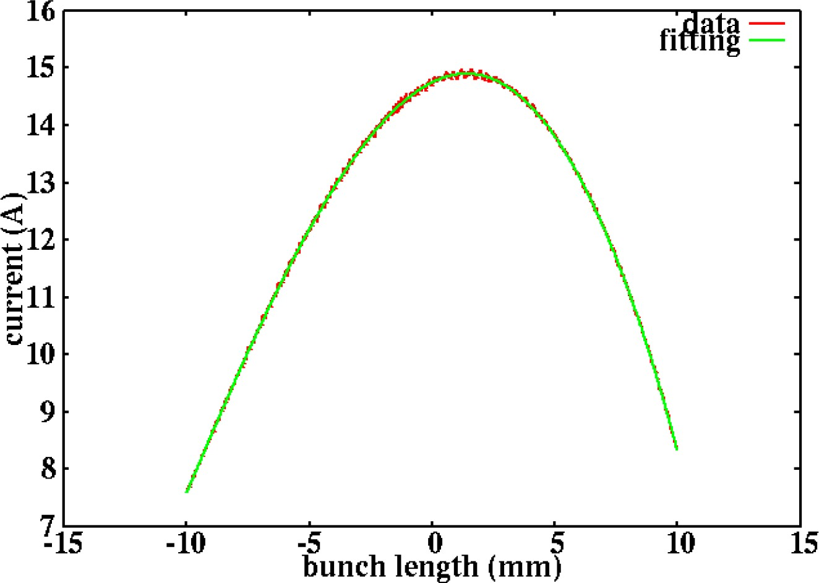
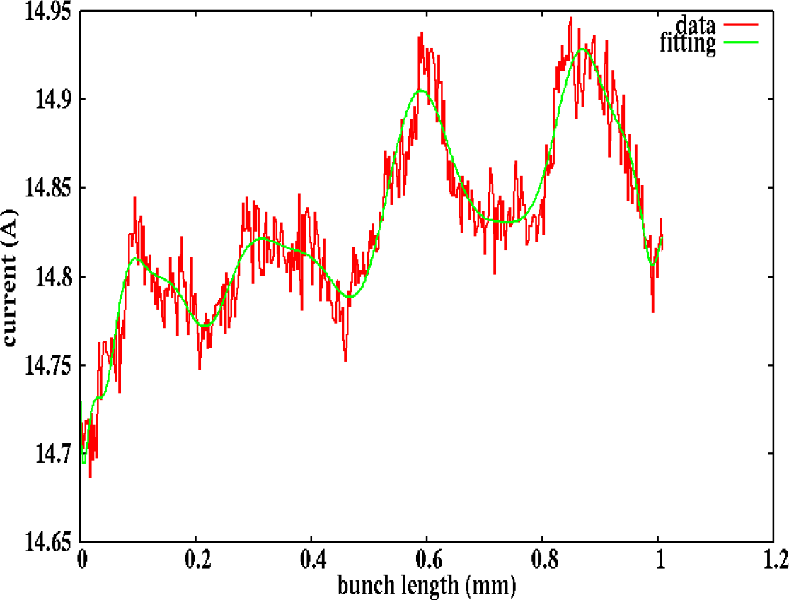
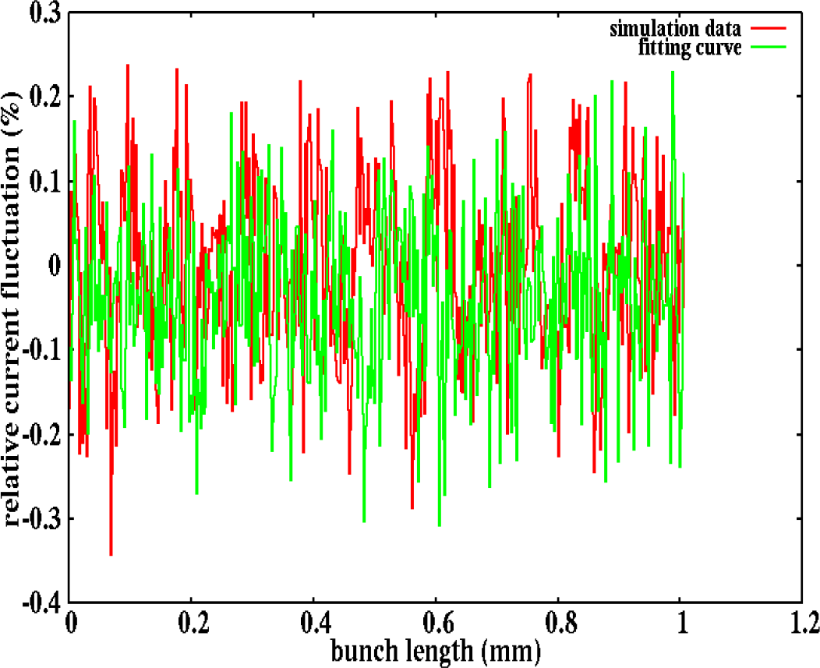
Beam noise simulation
Beam shot noise is created initially. The question is how to avoid an increase in noise.
Observed > 250 um modulation with noise amplitude 2x shot noise. It will not be amplified in the cooler.（The typical amplified signal is ~40 THz(3 um)).
This 250 um modulation will not affect the cooling rate.
current fluctuation through the linac and the merger is close to the shot noise level.

Slide 18
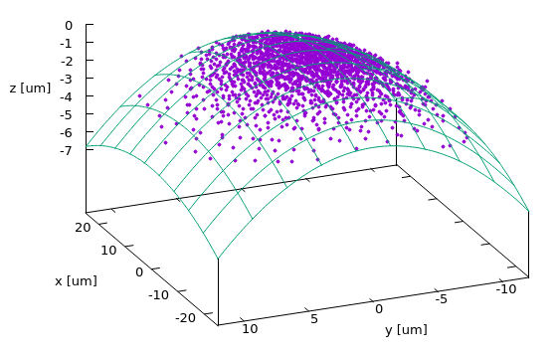
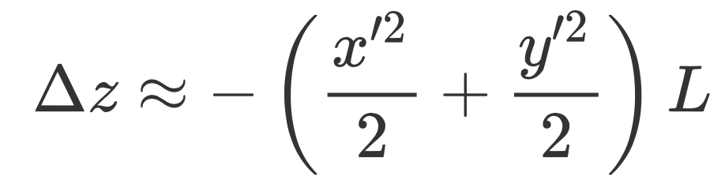
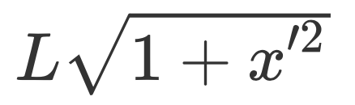

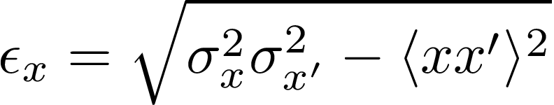
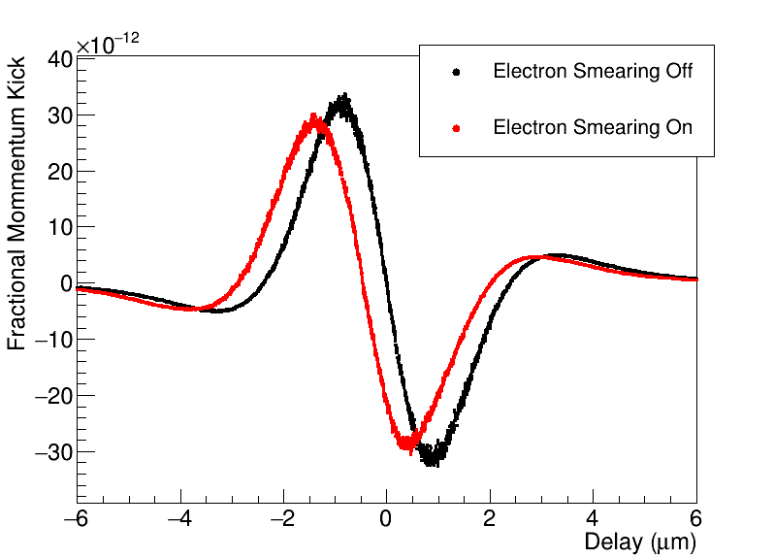
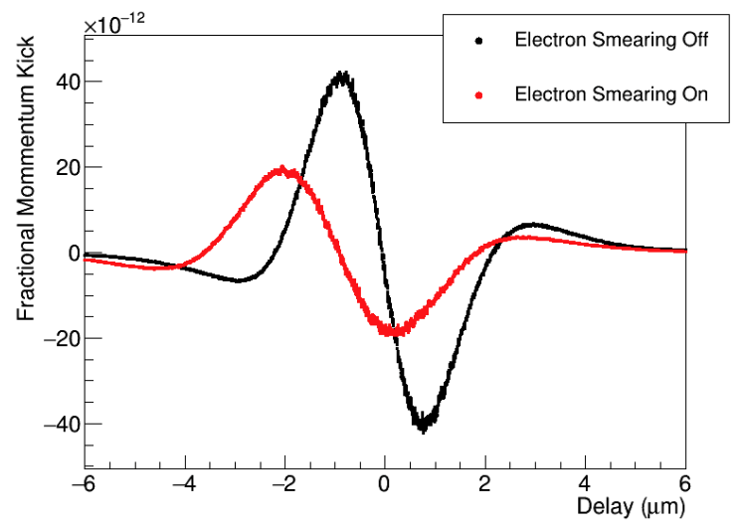
Electron beam divergence
Electron divergence causes a path length change that can accumulate over long distance with small beam sizes. This smear out the wake.
By increasing the beam size in the amplifier section one can reduce the impact on wake.
σ=220 um
σ=70 um

Slide 19
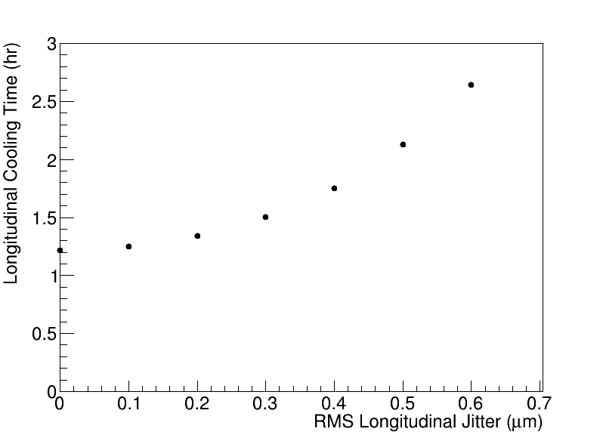

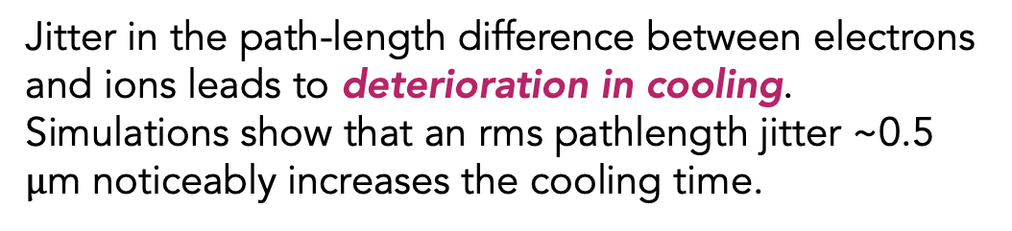





Unequal path lengths of electrons and protons
$$E<E_{0}$$
Jitter in the path-length difference between electrons and ions leads to deterioration in cooling. Simulations show that an rms pathlength jitter ~0.5 $μ$m noticeably increases the cooling time.
$$E<E_{0}$$
$$E=E_{0}$$
$$E=E_{0}$$
$$E>E_{0}$$
$$E>E_{0}$$
Contributions to the jitter:
Cooling section electron beamline PS stabilization ~ 3 ppm → longitudinal shift ~200nm
Longitudinal Space charge→ ~56 nm
CSR wake → ~140nm
Hadron bypass → ~um
Making the path lengths identical is crucial
S. Seletskiy, A. Fedotov, D. Kayran. “Effect of coherent excitation in coherent electron cooler”, arXiv:2106.12617 (2021).
Notes:
Because of we have chicane in amplification stage, one effect we find is unequal path length of electron and protons caused cooling time increase

Slide 20
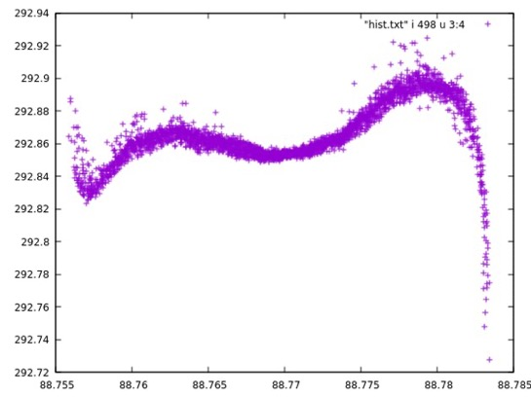
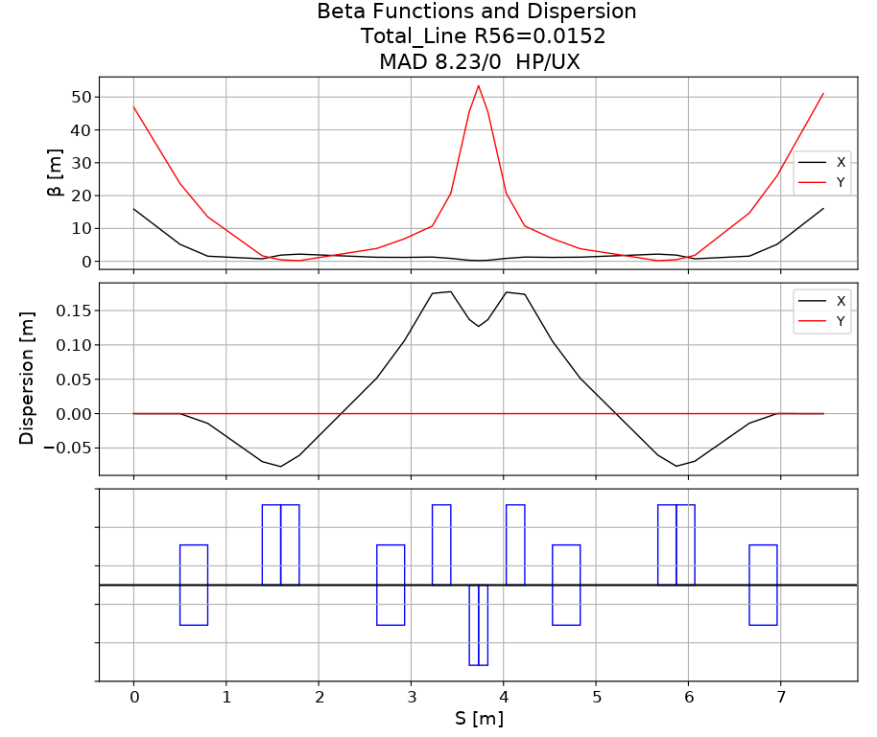
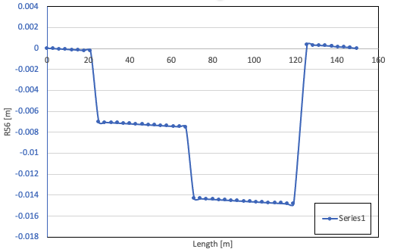
Chicanes of the amplification section
𝛿p
𝛿σ= R56 𝛿p
The micro-bunched amplification section has three chicanes.
To avoid slippage:
R56_e from Mid M to K is zero.
R56_e is tunable for each chicane.
σ
(1- 𝛿)σ
initial longitudinal chirp

Slide 21
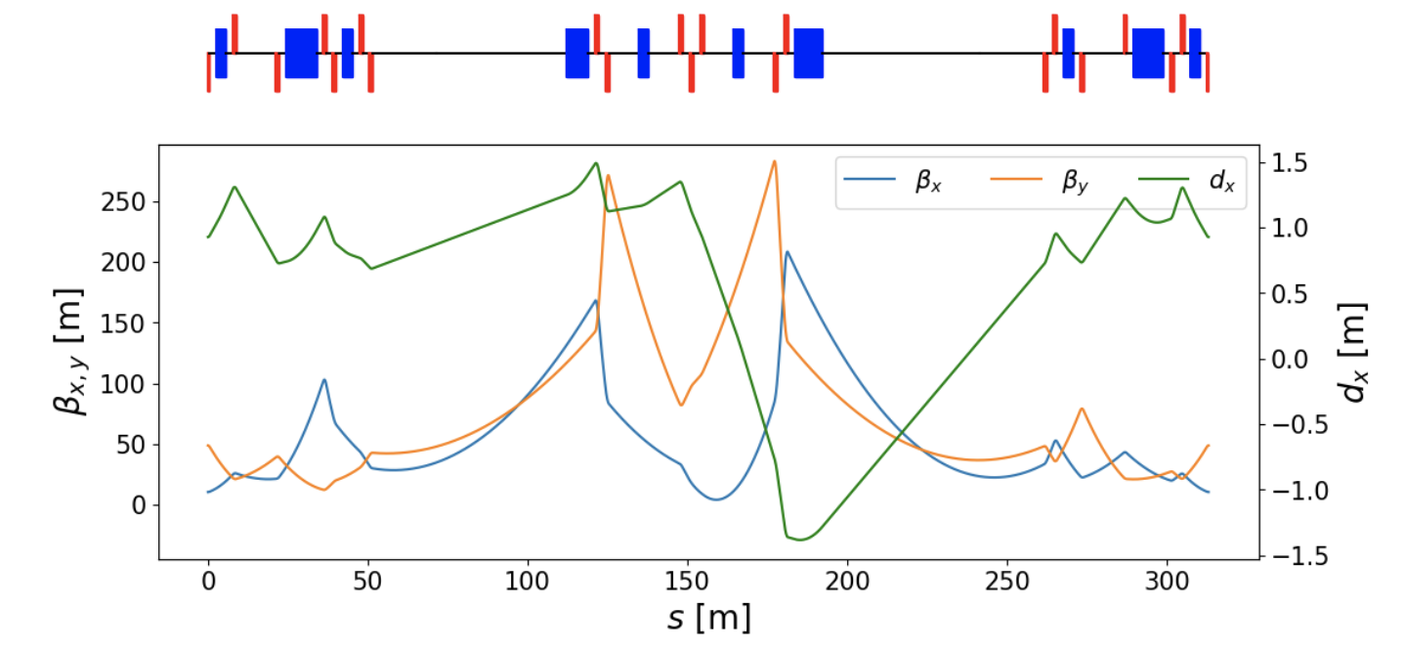
Hadron lattice :generate transverse cooling
SHC will use 35 meters of Modulator section and 35 meters of Kick section.
CeC only can provide the longitudinal cooling naturally.
Transverse cooling needs non-zero dispersion in the modulator/ kicker; A chicane is used between M/K to control the dispersion
A vertical cooling lattice can be achieved by using skew quadrupoles between dipoles in the middle section.

Slide 22
Major component development

Slide 23
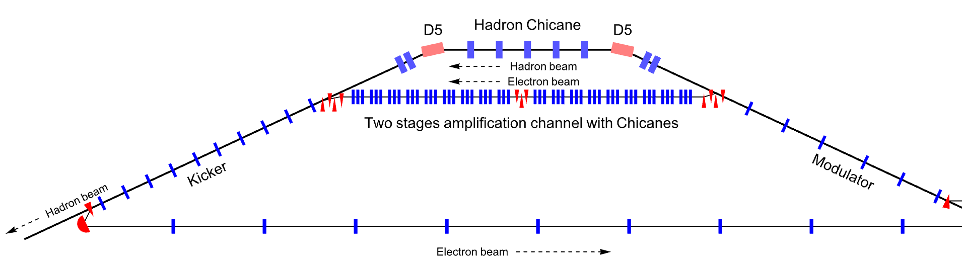
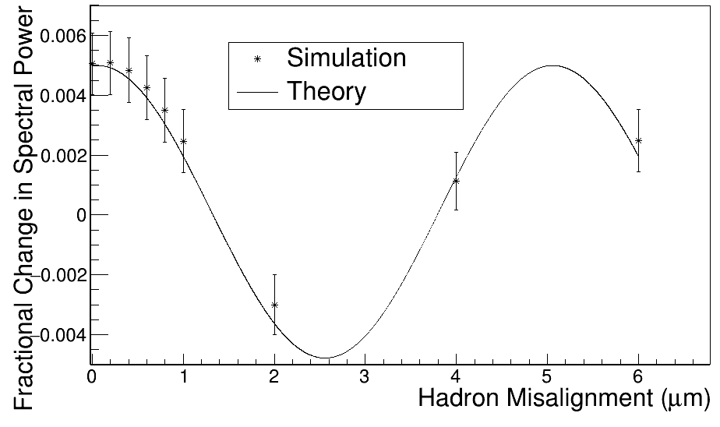
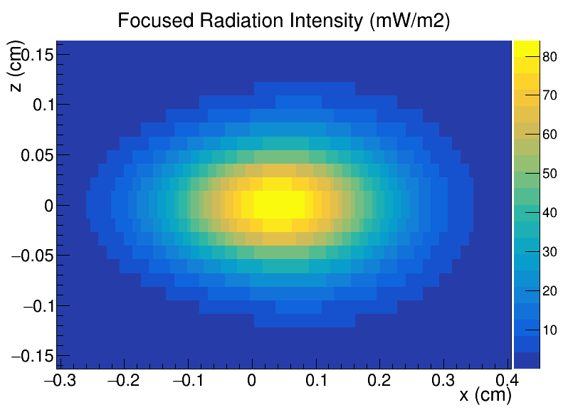
e-h longitudinal alignment
W. Bergan , et,al. PRAB 25.094401 (2023)
M 56
Schottky signal detector
Electron and hadron beams must be aligned longitudinally on sub-um scale.
A Correctional feedback system will be needed to stabilize the path length
At “detector” element downstream of kicker, the fractional change in hadron noise at wavenumber k is A cos(kΔz), where Δz is the electron/hadron misalignment, and A is some amplitude
Signal modification amplitude at 275 GeV and 5 um wavelength using synchrotron radiation from dipole placed ~10 meters behind the kicker.
Notes:
Fractional change in the spectral power in the hadron beam at the 3.6 µm wavelength for the fully nonlinear case. Good agreement between theory and simulation is observed. Hadron FFT signal, square of amplitude

Slide 24
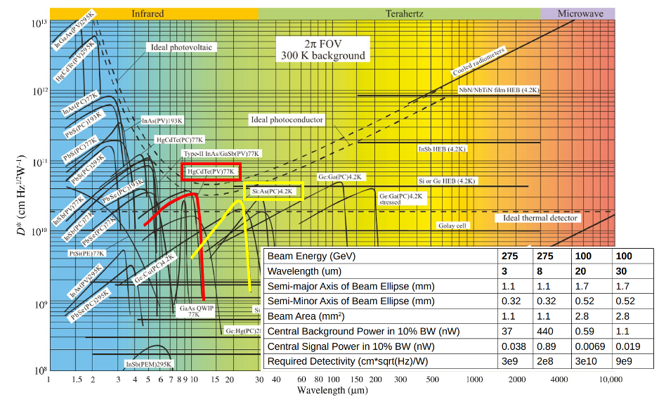

Detector to measure 5-30 µm radiation
275 GeV : 5-8 µm radiation can be detected by HgCdTe photo-detector. This is commercially available and operates at 77K.
100 GeV: 20-30 um can use Si:As Block-impurity-Band detectors. These are not commercially available, but were developed for James-Webb space telescope operating at 4 K. Alternatively, an optical parametric amplifier could be used to convert long wavelength radiation to a short wavelength.
Significant R&D will be needed.

Slide 25
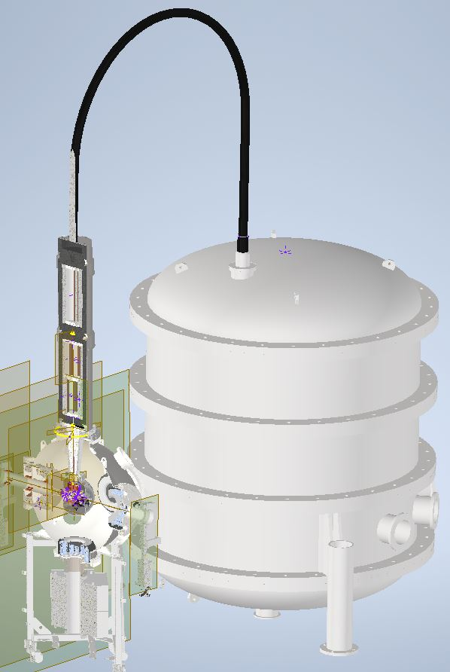
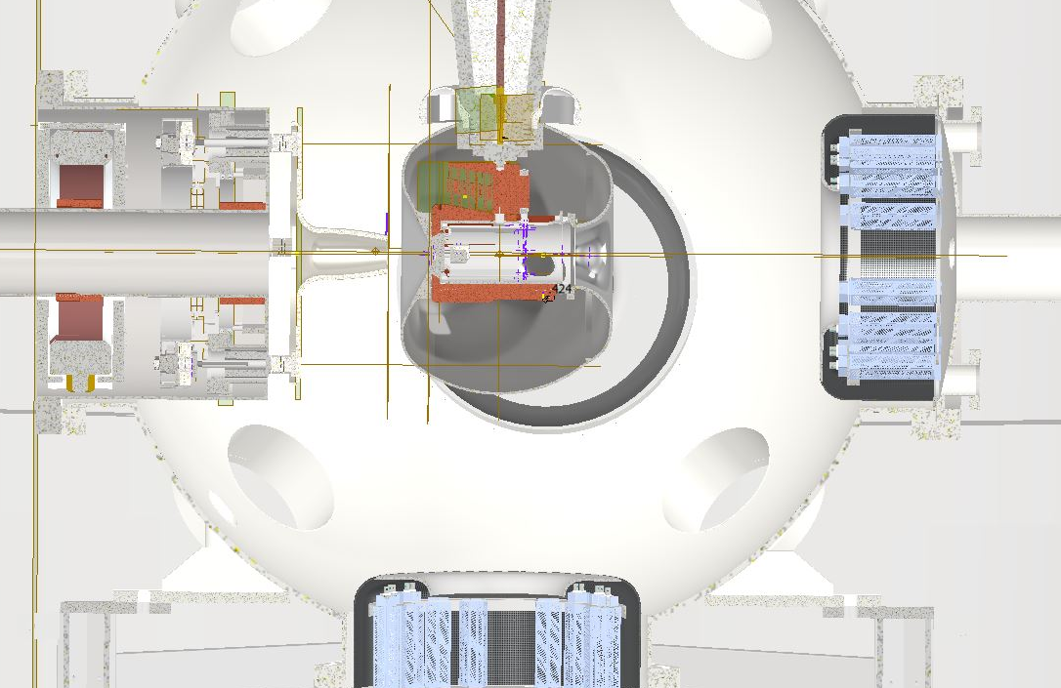
Strong Hadron Cooler e-source
 | World record | Goal
Voltage [kV] | 500 (KEK) | >500
Average current [mA] | 65 (Cornell) 50-60(BNL) | 100
Leveraging our polarized gun design/commissioning and LEReC gun operation experience, we are developing an SHC R&D gun. Its novel features:
150 mA, 600 kV high voltage power supply.
A 600 kV HV cable and a gun-attached resistor network to prevent cable storage energy from damaging the gun.
A Cathode heat sink with a cooling FC62 feedthrough can withstand up to 20 W of laser power.
The successful of epitaxial growth of K2CsSb on Gr/4H-SiC (9% QE), gives us the opportunity to generate a much smaller initial emittance and longer lifetime.
RHEED of 4nm
K2CsSb on Gr/SiC

Slide 26
Summary
From 2020-2024, the EIC strong hadron cooling collaboration made significant progress in designing a high-energy cooler based on Coherent Electron Cooling
Advanced modeling and simulation
Comprehensive ERL design
Critical R&Ds initiative
Despite this progress, significant technical risks and performance limitations remain with a full functional SHC.
The average luminosity would still fall short of the ultimate EIC requirement.
Critical challenges including beam stability, the high-current ERL operation, cooling measurement instrumentation could not be fully resolved within the project’s construction timescale.
The CeC principle has not been demonstrated in the experiment.
The effort to develop micro-bunched electron cooler has been stopped. Exploring other high energy cooling schemes.

Slide 27
Thanks for your attention!
BNL: W. Bergan, M. Blaskiewicz, P. Baxevanis, D. Holmes, J. Ma, S. Nagaitsev, S. Peggs, V. Ptitsyn, F. Willeke, G. Wang, V. Litvinenko, A. Fedotov, D.Xu
SLAC: G. Stupakov
Jlab: S. Benson, N. Sereno, K. Deitrick, D. Douglas, S. Setiniyaz
LBNL: J.Qiang
Xelera: C. Mayes, C. Gulliford, N. Taylor
Cornell: N. Wang

Slide 28
Back ups

Slide 29
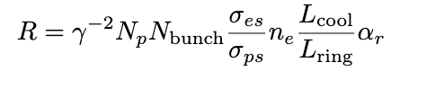
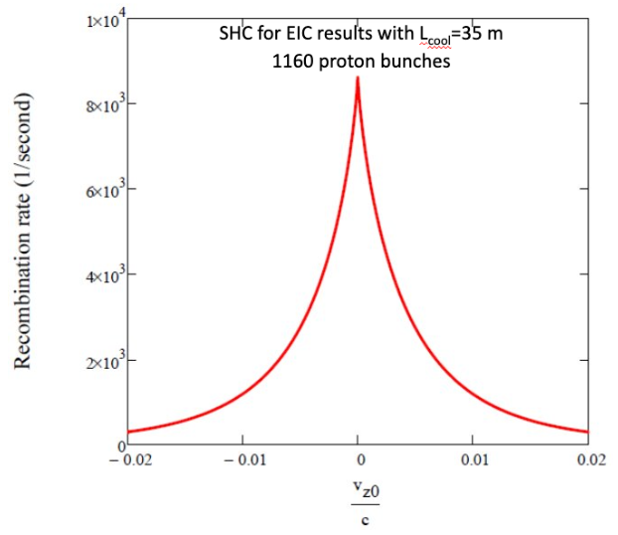
Velocity alignment
@ Gang Wang
Recombination monitor: When a proton picks up an electron with similar velocity, it recombines into a H atom and lost on the beam pipe wall.
This rate is on the same order of magnitude as expected for the CeC-X experiment.
Experimental testing was planned for the RHIC CeC-X experiment, but it has not yet been carried out.

Slide 30
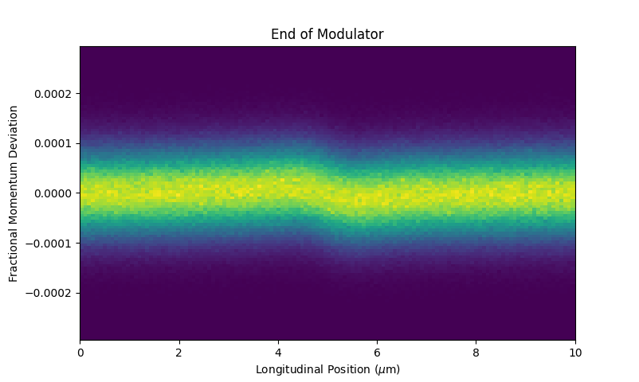
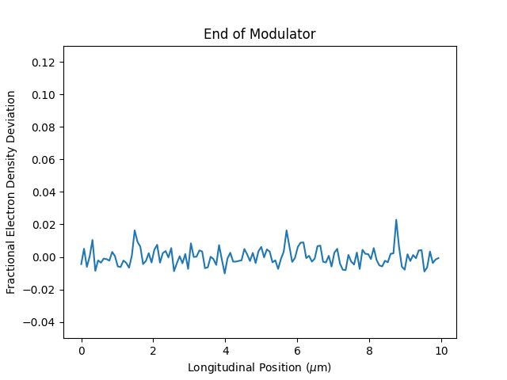
Modulator section
v
e
e
p+
The pickup (modulator)are implemented via the Coulomb interaction of the hadrons and electrons when 𝜸_{e}= 𝜸_{h}.
Electrons’ momentum is modulated around a proton or hadron density fluctuation.
e
Notes:
The signal is very small, it is impossible to see from the phase space.
To let audients better understand the the modulator impact and microbunch generation. Here I increased the proton charge by factor of 50 million

Slide 31
Multi-Turn Tracking
RF
Apply RF kick
Apply IBS and beam-beam
Evaluate emittances
Transfer Matrix
Transfer Matrix
Modulator
Kicker
Apply wake kick
Apply diffusion
(Both are
transverse-dependent)
Transfer Matrix
Delay
(Depends on coordinates in modulator)
31

Slide 32



Amplifier section-Chicane
Energy modulated beam
What is chicane: Chicane is one kind of lattice
that can provide longitudinal dispersion (R56).
Low Energy path
𝛿p
High Energy path
z
The chicane converts the energy-modulated bunch to many micro-bunches.
Micro-bunch has much higher longitudinal space charge.

Slide 33



Amplifier section-drift
E<E₀
H⁺
Modulator
E>E₀
Kicker
R₅₆
R₅₆
e⁻

Slide 34


Amplifier second chicane
E<E₀
H⁺
Modulator
E>E₀
Kicker
R₅₆
R₅₆
e⁻
0.12
1.0
Micro bunch density is increased ~ 8X

Slide 35

Kicker section
E<E₀
H⁺
Modulator
E>E₀
Kicker
R₅₆
R₅₆
R₅₆
e⁻
if one amplifier is not enough, we can have a second amplifier to get a higher gain.
Electron density in kicker
Micro bunched electron wake in kicker
Notes:
hadron momentum change/ proton momentum at 275 GeV through the kick

Slide 36


3D cooling codes development and comparison
See P. Baxevanis’s talk in detail
3D theory (solid): a frequency-domain approach based on the linearized Vlasov equation
3D simulation(dash): macroparticles with space charge force.
3D SPACE simulation(dash): parallel, relativistic PIC (used in CeC-X design)
Hybrid model(solid)
2-stages kicker ion at x=y=0
2-stages kicker ion at x=1.07σ
Four approaches give good agreement. The hybrid model used to design SHC can be trusted. The final cooling parameters have checked by the 3D codes.
Notes:
SPACE code is a parallel, relativistic, three-dimensional (3D), electromagnetic (EM) Particle-in-Cell (PIC) code.
6e+6 computational particles in the simulations. The longitudinal length is 3e-4 m (1 ps). The electron beam has Gaussian distribution in transverse planes and uniform distribution in longitudinal. Using open boundary in transverse and periodic boundary in longitudinal

Slide 37


Using laser heater to get uniform slice energy spread
End of Linac
3x
Laser heater section
 | Estimate parameters
Beam rms size | 150 um
Laser rms size | 210 um
Beam energy | 150 MeV
Full bunch length | 200 ps
Laser average power | 1.1 kW
Small energy spread caused saturation in the amplifier.
At the end of Linac(150 MeV), propagate 98.5 MHz beam with laser in an undulator
Increase in slice energy spread by 7.5 keV(5e-5).
23%

Slide 38

EIC cooling requirements
Luminosity of lepton-hadron colliders in the energy range of the EIC benefits strongly (factor ≈ 3-10) from cooling the transverse and longitudinal hadron beam emittance.
Cool the proton beam at 275 GeV and 100 GeV ;
IBS longitudinal and transverse(h) growth time is 2-3 hours. Beam-beam growth time(v) is > 5 hours. The cooling time shall be equal to or less than the diffusion growth time from all sources.
Must cool the hadron beam normalized rms vertical emittance at injection from 2.5 um to 0.3 um in 2 hours.
with SHC
w/o SHC
Integrated luminosity with cooling is > 3 x larger than without SHC.​
Notes:
In evaluation of average luminosity, we should cool the vertical in first 2 hours in the store. We plan to maintain the collisions in the same time, by slowly adjusting down electron vertical beta-function in the IP as the proton vertical emittance decreases. After 2 hours the proton beam emittances should be at their design table values, then the cooler is retuned to maintaining these emittances against IBS.

Slide 39

Cooling code using hybrid model
e
p
Fz(z)
p
e
Fz(x, y, z)
y
x
K
z
p-beam
cross sections
M
e-beam
cross sections
r
At CD1, quasi-1D model(G.S and P.B) :
A quasi-1D model was used to simplify analysis – p- and e-point charges are replaced by elliptical disks with 2D Gaussian distribution of charge over the surface of the slice.
Now, hybrid model(W.B):
Treat electrons as discs; Treat hadrons as point charges within modulator and kicker. Wake function W(xm,ym,xk,yk,dz)
With new hybrid model, the cooling time increased ~x1.7
Notes:
For 275 GeV, the protons are 0.59mm horizontal and 0.17mm vertical. The electrons in the modulator are 0.85mm horizontal and 0.31mm vertical. In the kicker, the electrons are 0.51mm horizontal and 0.15mm vertical.

Slide 40

Saturation
Finite electron current
Cannot create arbitrarily large electron density fluctuations
40

Slide 41


Hadron energy Drift
Off-energy hadron drifts are relative to the electrons in the modulator and kicker.
By shortening the modulator and kicker length and lengthening wake wavelength by strengthening electron chicanes, we can reduce the impact on the wake.
Old parameters
New parameters

Slide 42
3D cooling codes development and comparison
3D theory (solid): a frequency-domain approach based on the linearized Vlasov equation
3D simulation(dash): macroparticles with space charge force.
3D SPACE simulation(dash): parallel, relativistic PIC (used in CeC-X design)
Hybrid model(solid)
2-stages kicker ion at x=y=0
2-stages kicker ion at x=1.07σ
Four approaches give good agreement. The hybrid model used to design SHC can be trusted. The final cooling parameters will be checked by the 3D codes.
Notes:
SPACE code is a parallel, relativistic, three-dimensional (3D), electromagnetic (EM) Particle-in-Cell (PIC) code.
6e+6 computational particles in the simulations. The longitudinal length is 3e-4 m (1 ps). The electron beam has Gaussian distribution in transverse planes and uniform distribution in longitudinal. Using open boundary in transverse and periodic boundary in longitudinal

Slide 43




Transverse Cooling (x’ = D’ = 0)
M51 < 0
from modulator to kicker
D > 0 in kicker
If x > 0, then Δz < 0 and Δδ > 0, so ΔJ < 0.
If x < 0, then Δz > 0 and Δδ < 0, so ΔJ < 0.
Either way, transverse action is reduced.
Details for more realistic case in PRAB 22, 081003 (2019).
43

