Slide 1
Laser cooling of relativistic ion beams
Michael Bussmann, SIS100 laser cooling collaboration

Slide 2
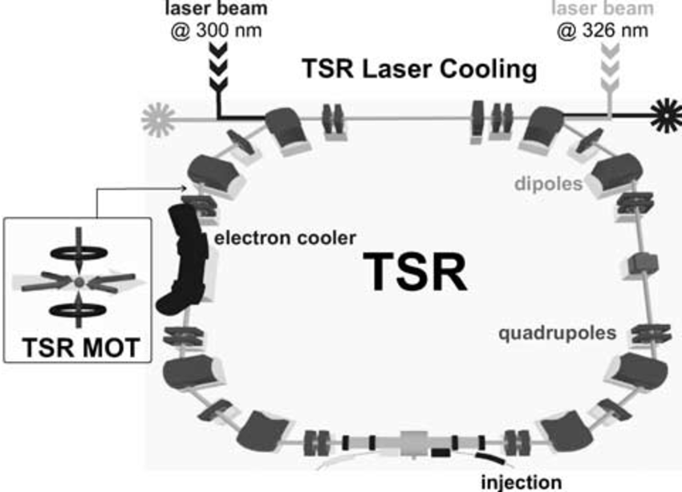
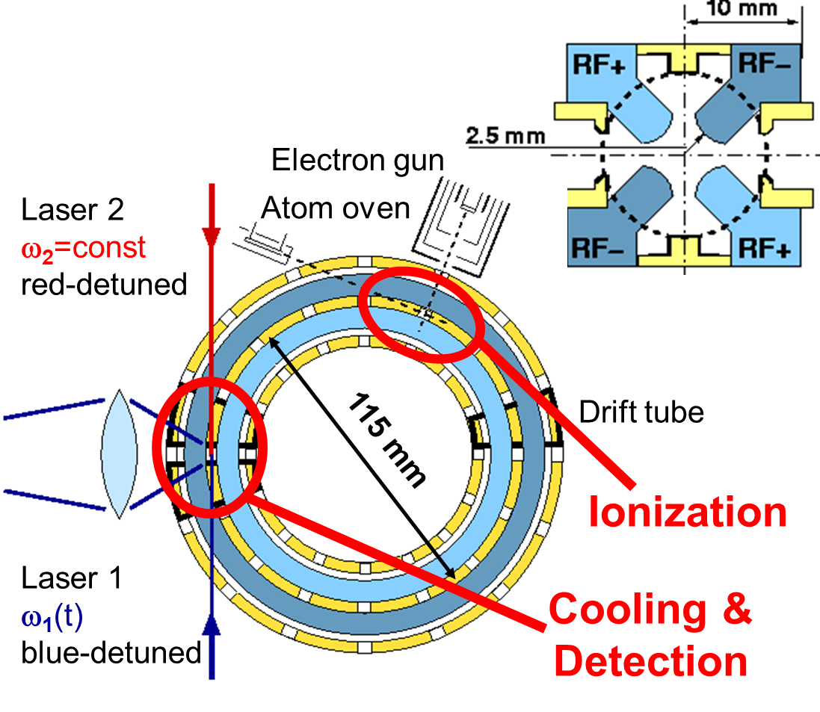
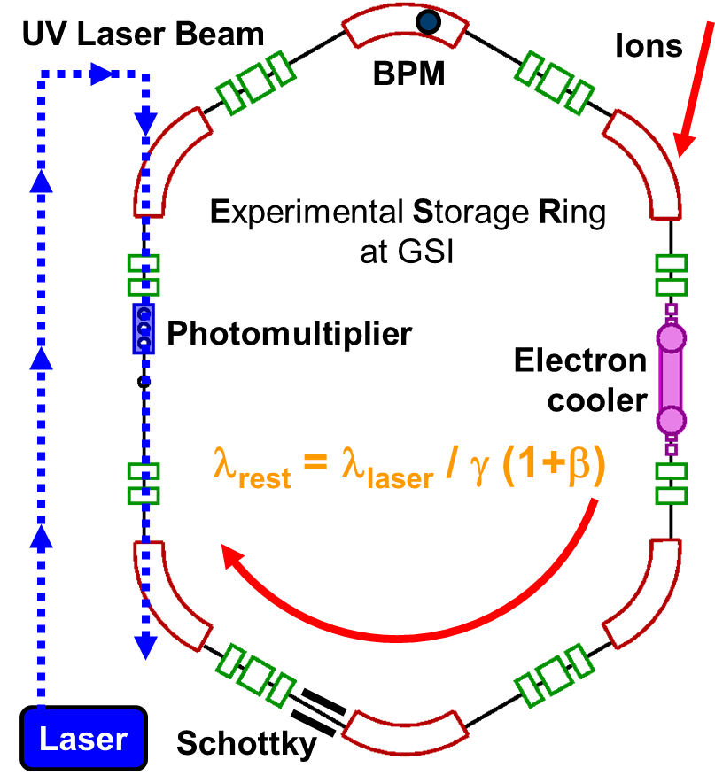
A long-term effort
From TSR (and others) to Pallas to ESR to CSRe and beyond

Slide 3
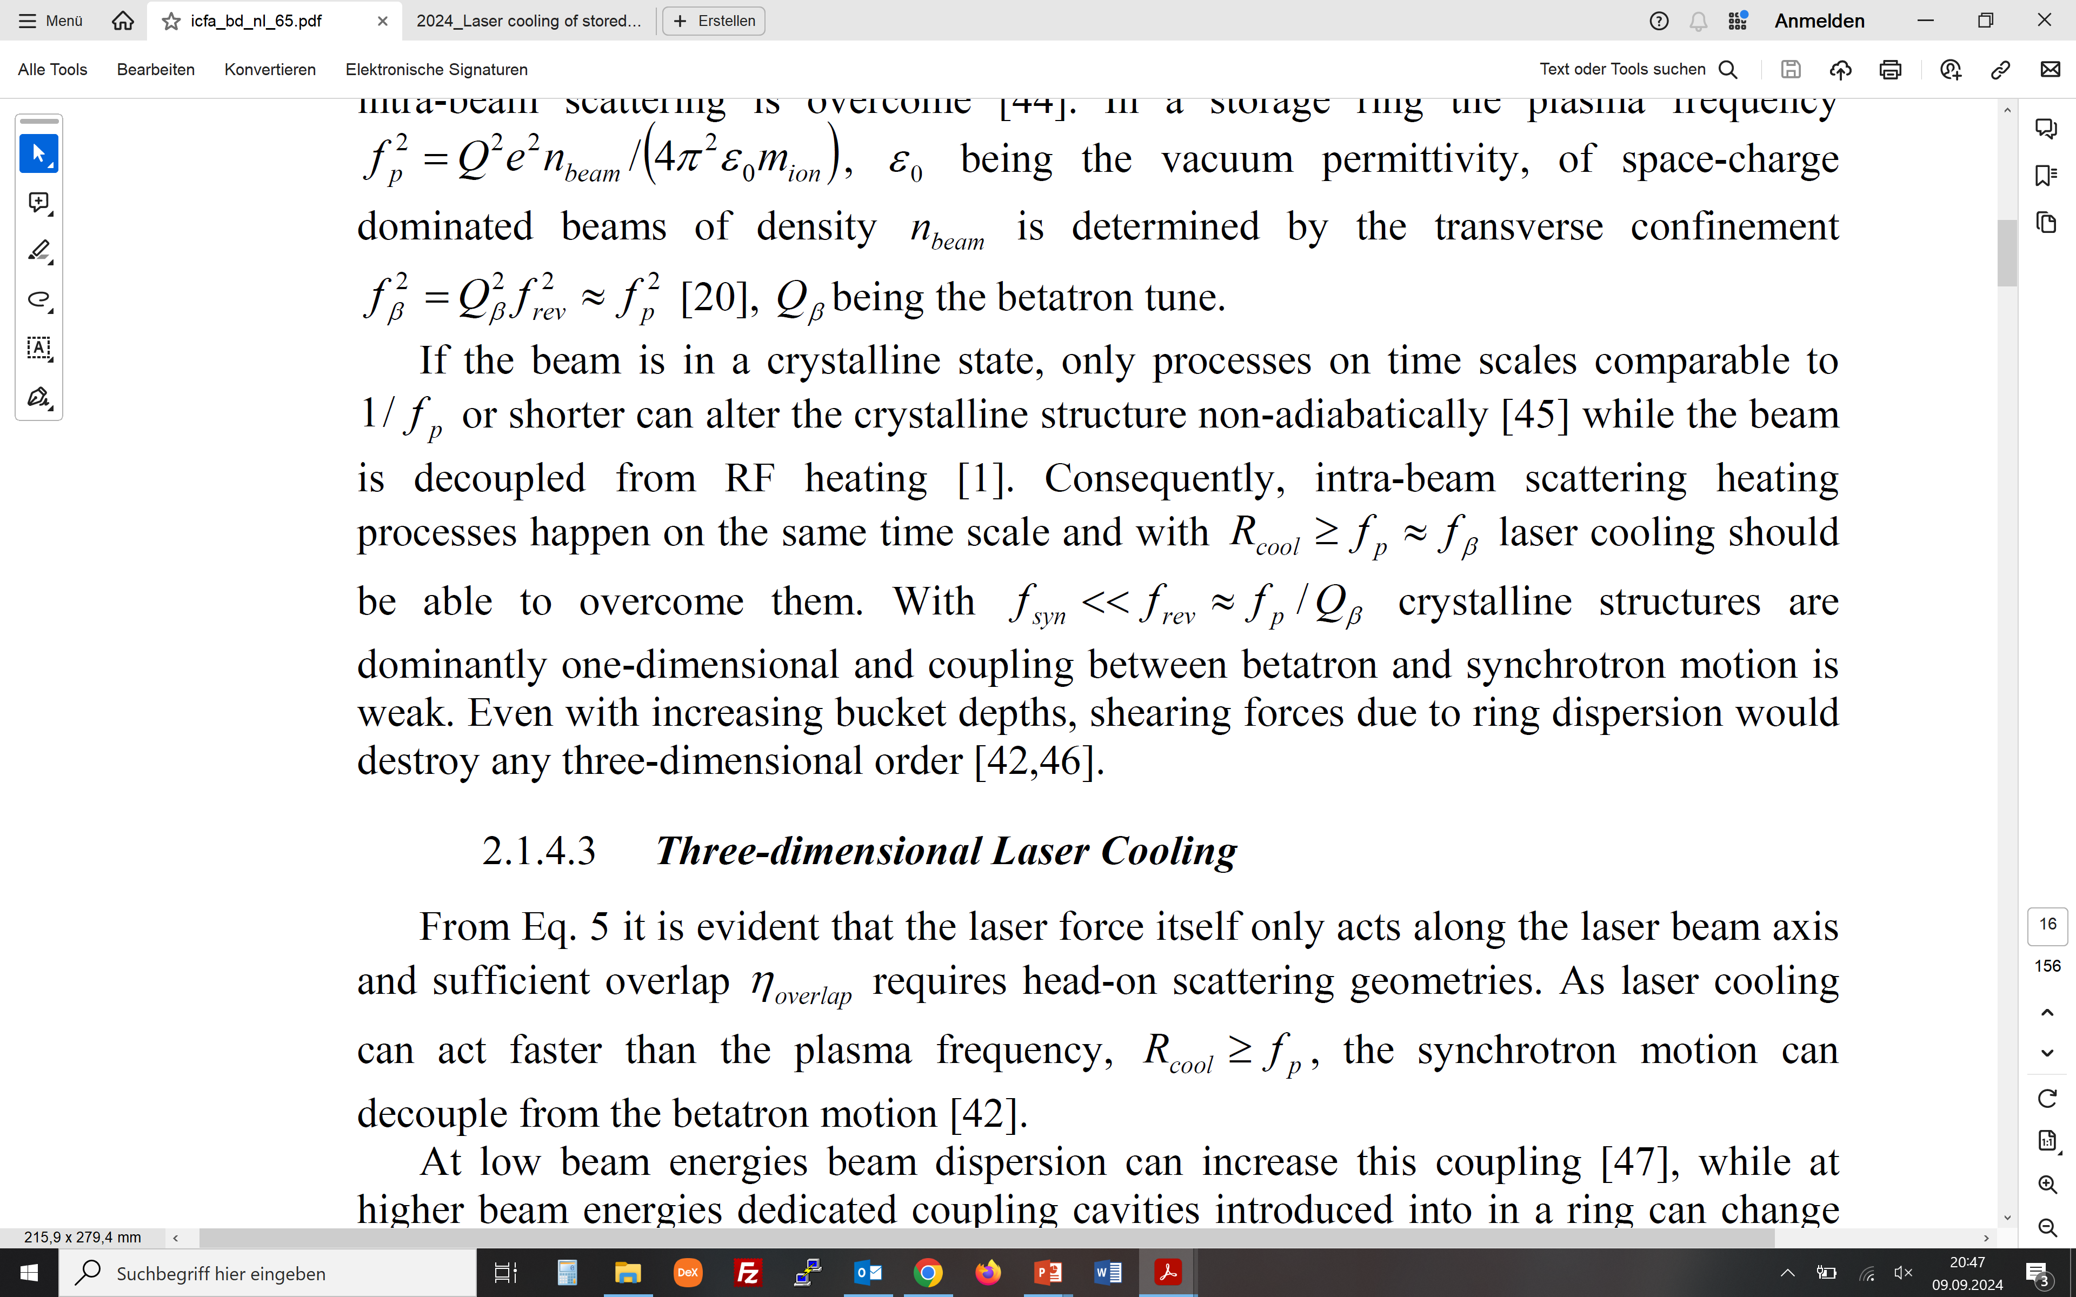
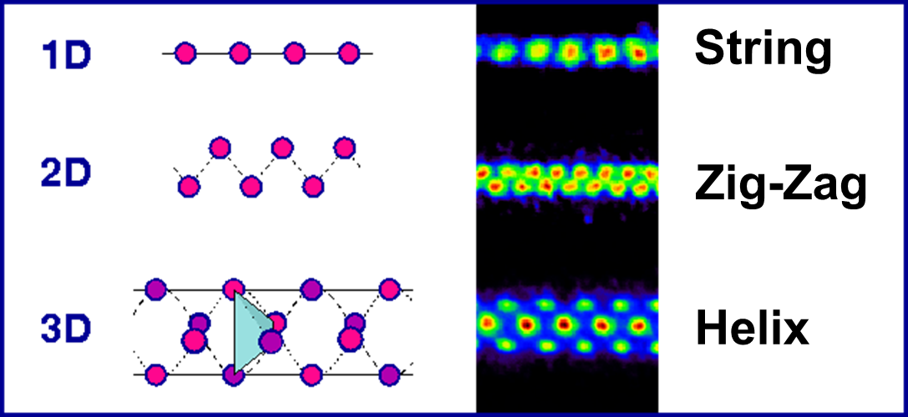
Why laser cooling of relativistic ion beams?
Cold relativistic beams, precision spectroscopy, crystalline beams
Achieves higher cooling rates than other techniques
Grows stronger with increasing ion energy (using more laser power)
Reaches smaller longitudinal momentum spread than other techniques
Produces interesting spectroscopic data „for free“ from many ions collectively
May lead to beam crystallization
(plasma frequency)
(betatron frequency)
(synchrotron frequency)

Slide 4
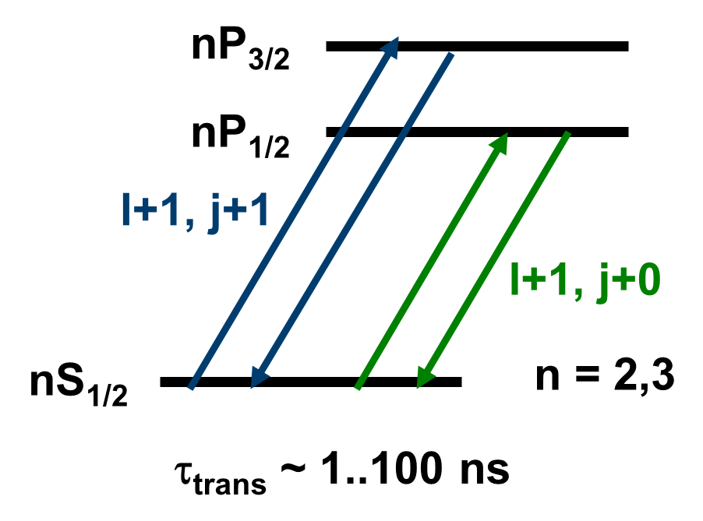
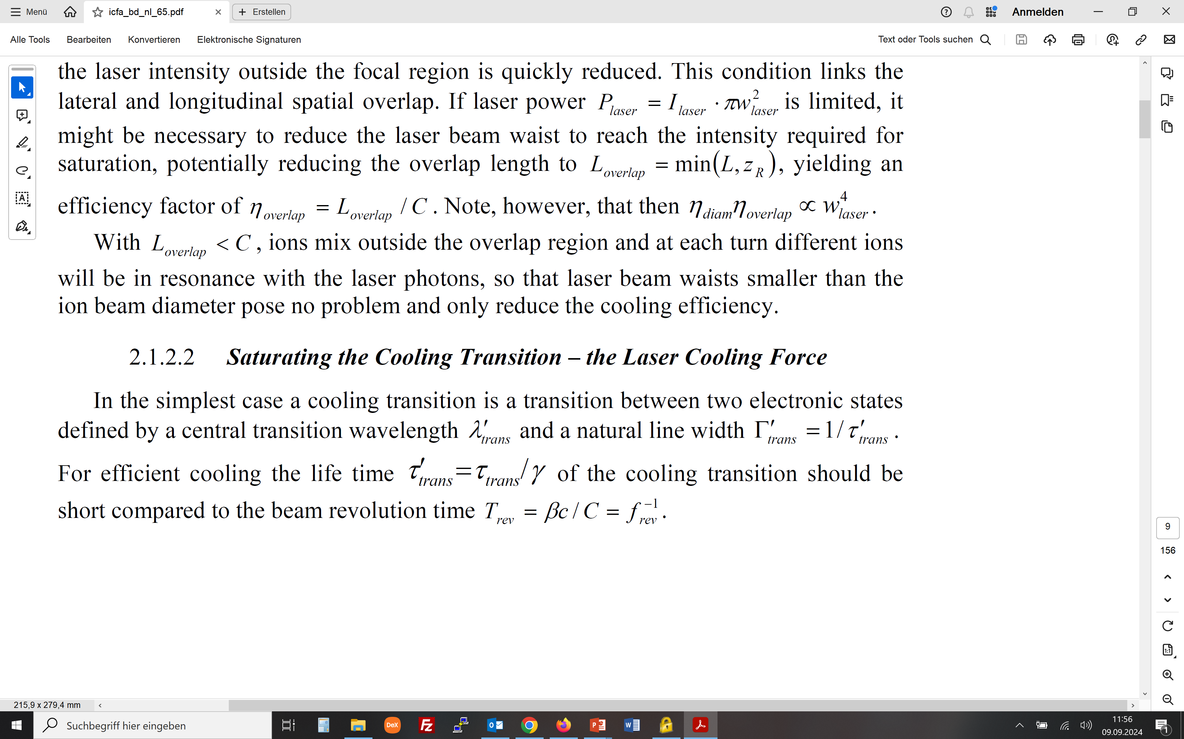
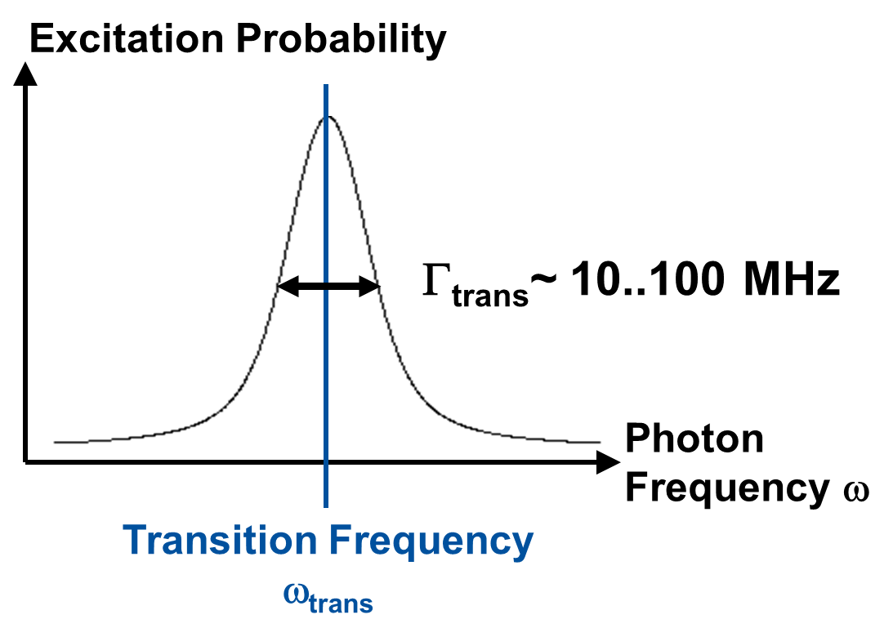
How to laser cool (relativistic) ion beams
Cooling transitions
We need a fast (see below) cooling transition
Li-like or Na-like, needs a certain charge state Q
(transition wave length in rest frame, UV, VUV, …)
(natural line width in rest frame)
<
(transition life time)
(beam revolution time in lab. frame)

Slide 5
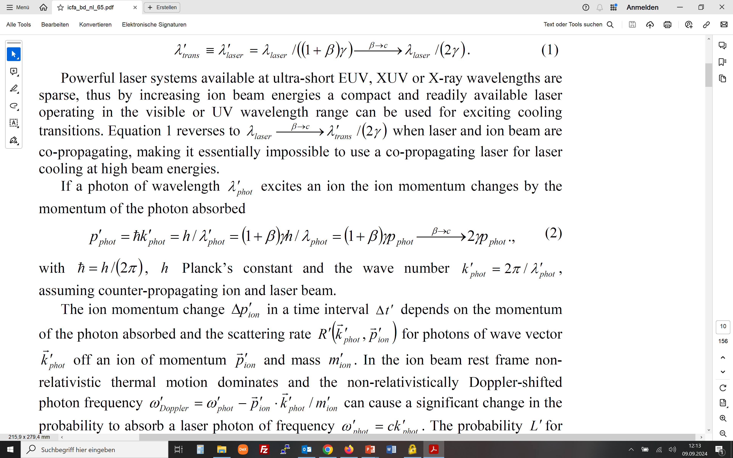
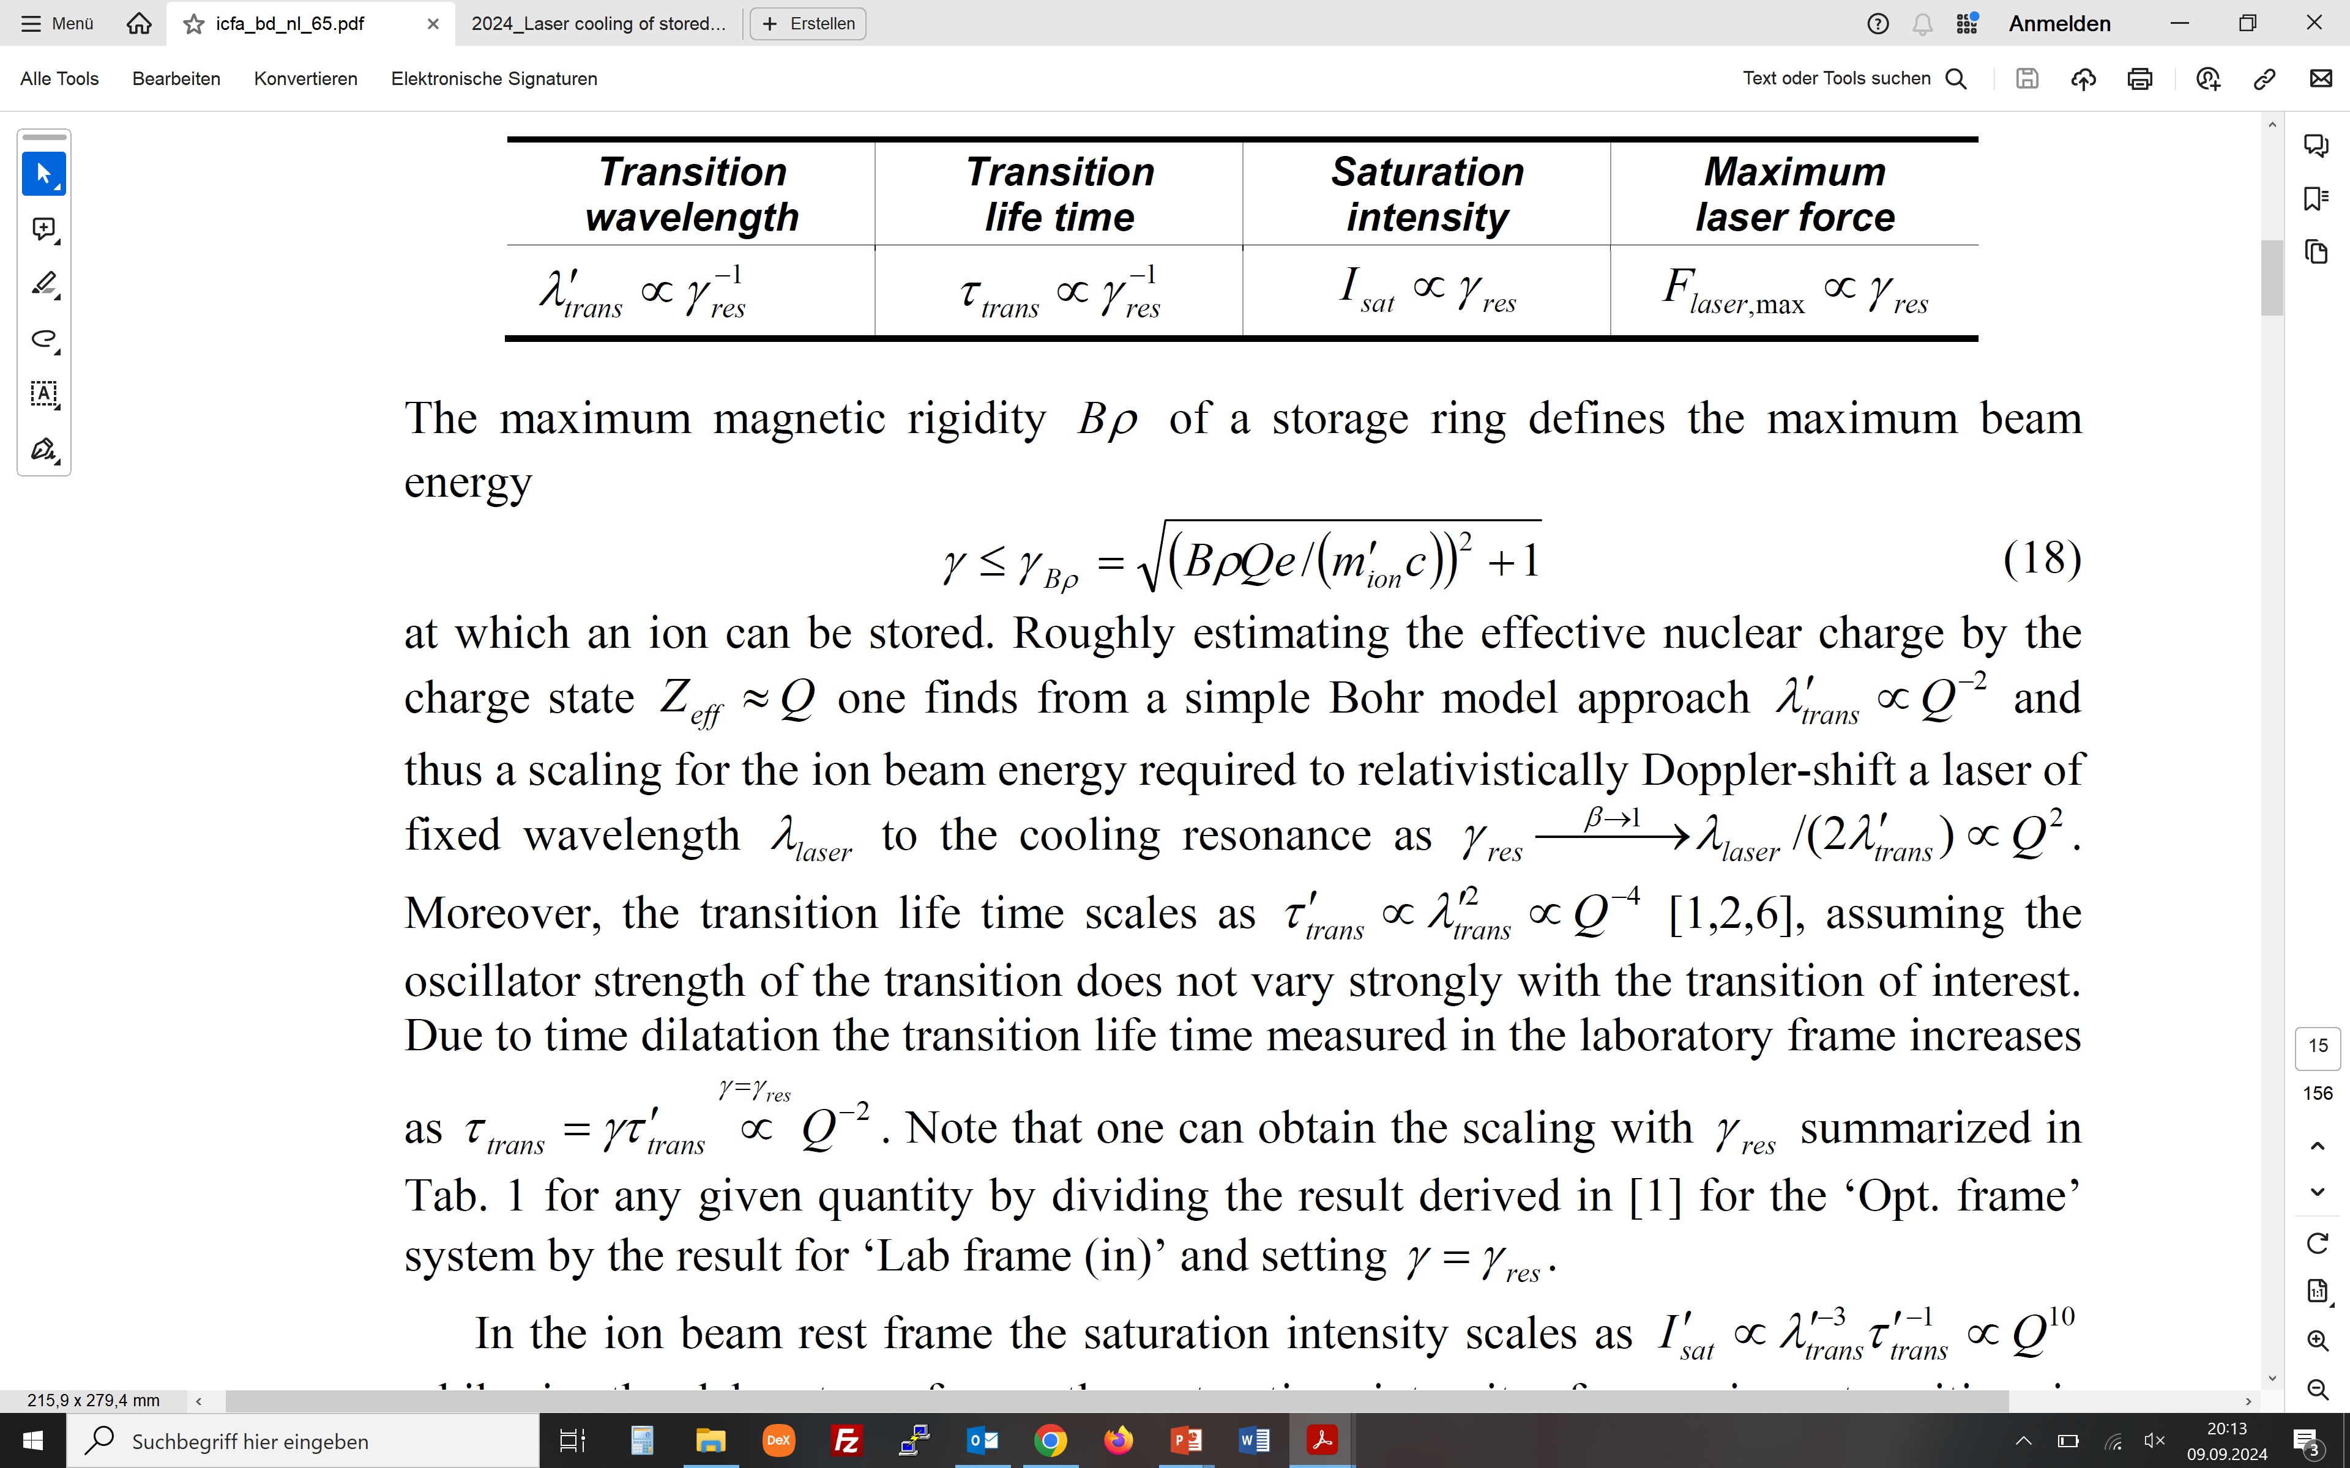
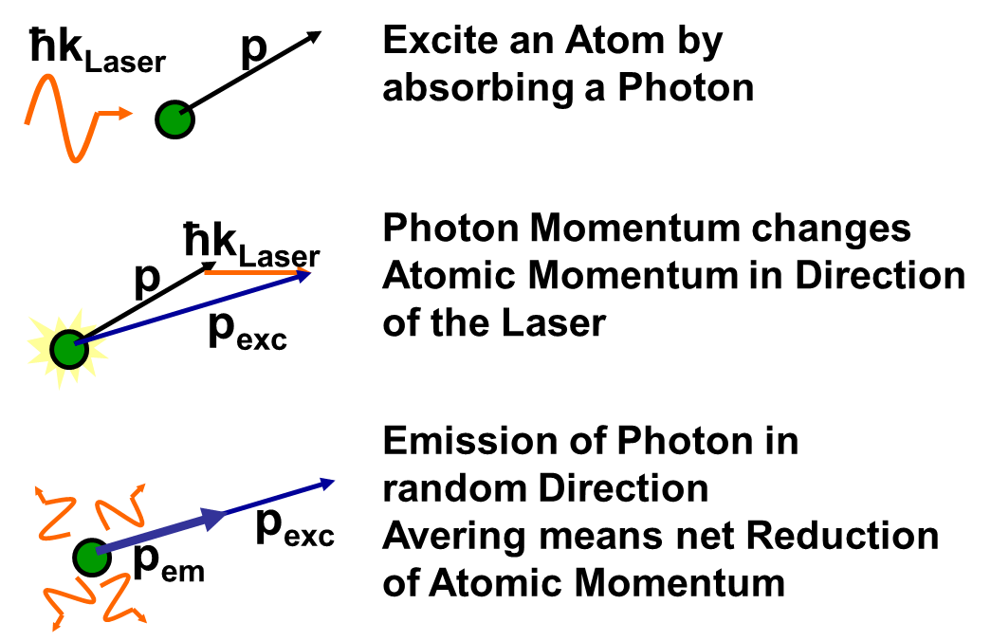
How to laser cool (relativistic) ion beams
Photon absorption and emission
(transition wave length in rest frame
vs laser wavelength in lab. frame)
(matching energy)
(photon momentum in rest/lab. frame)

Slide 6
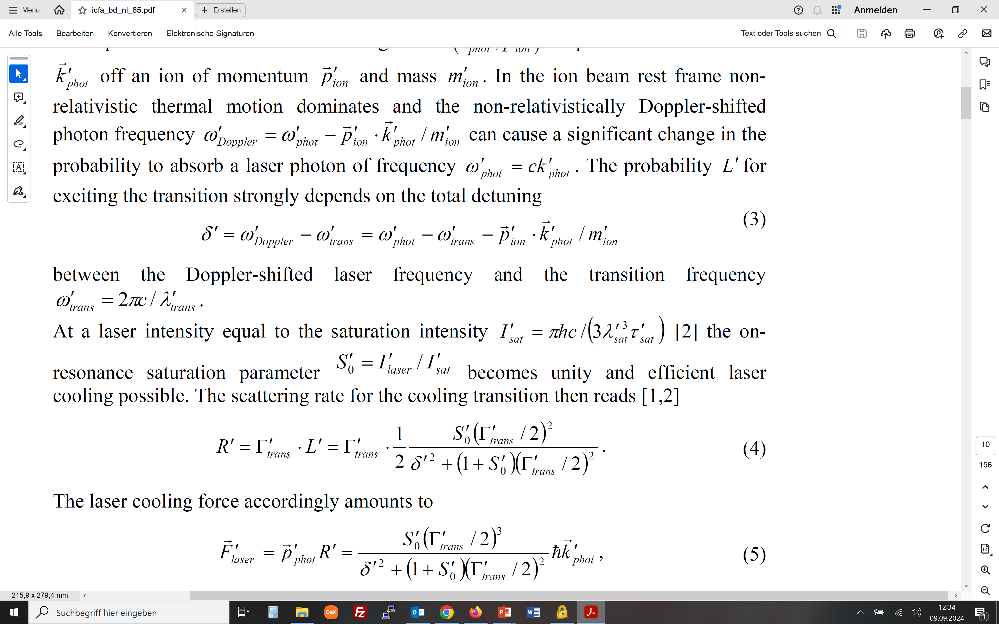
How to laser cool (relativistic) ion beams
Saturation intensity and cooling rate
(detuning in rest frame)
(Doppler shift and transition freq.)
(saturation intensity)
(saturation parameter)
(scattering rate)

Slide 7
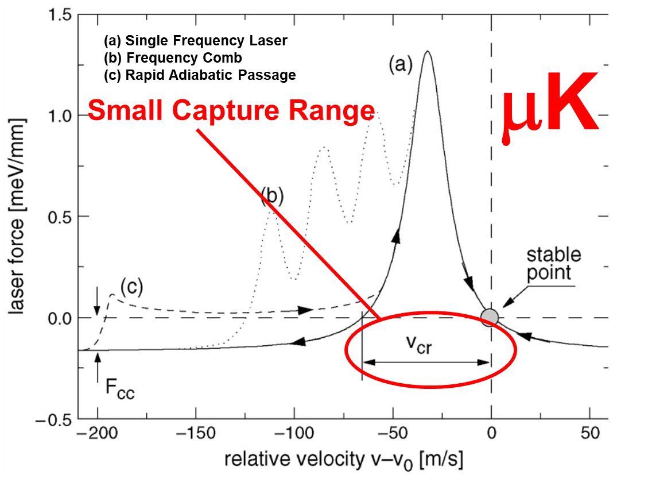
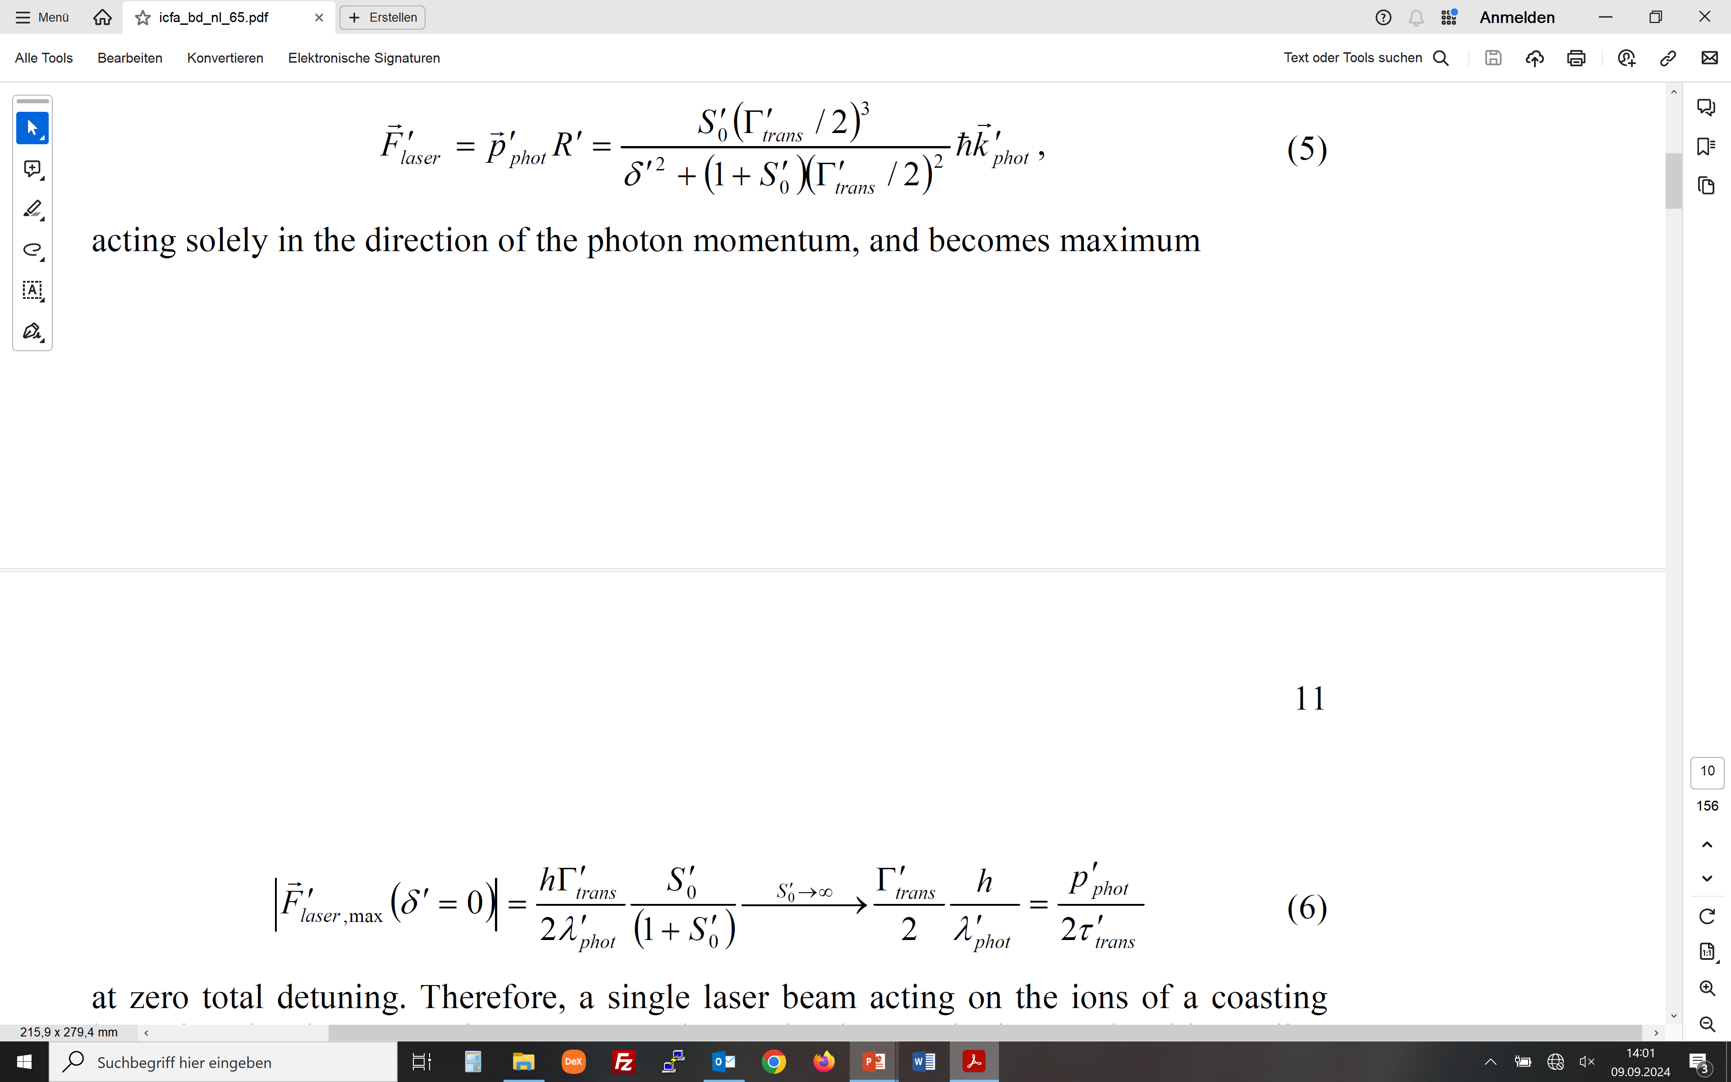
How to laser cool (relativistic) ion beams
Averaged laser force
(averaged laser force in rest frame)
(maximum laser force)

Slide 8
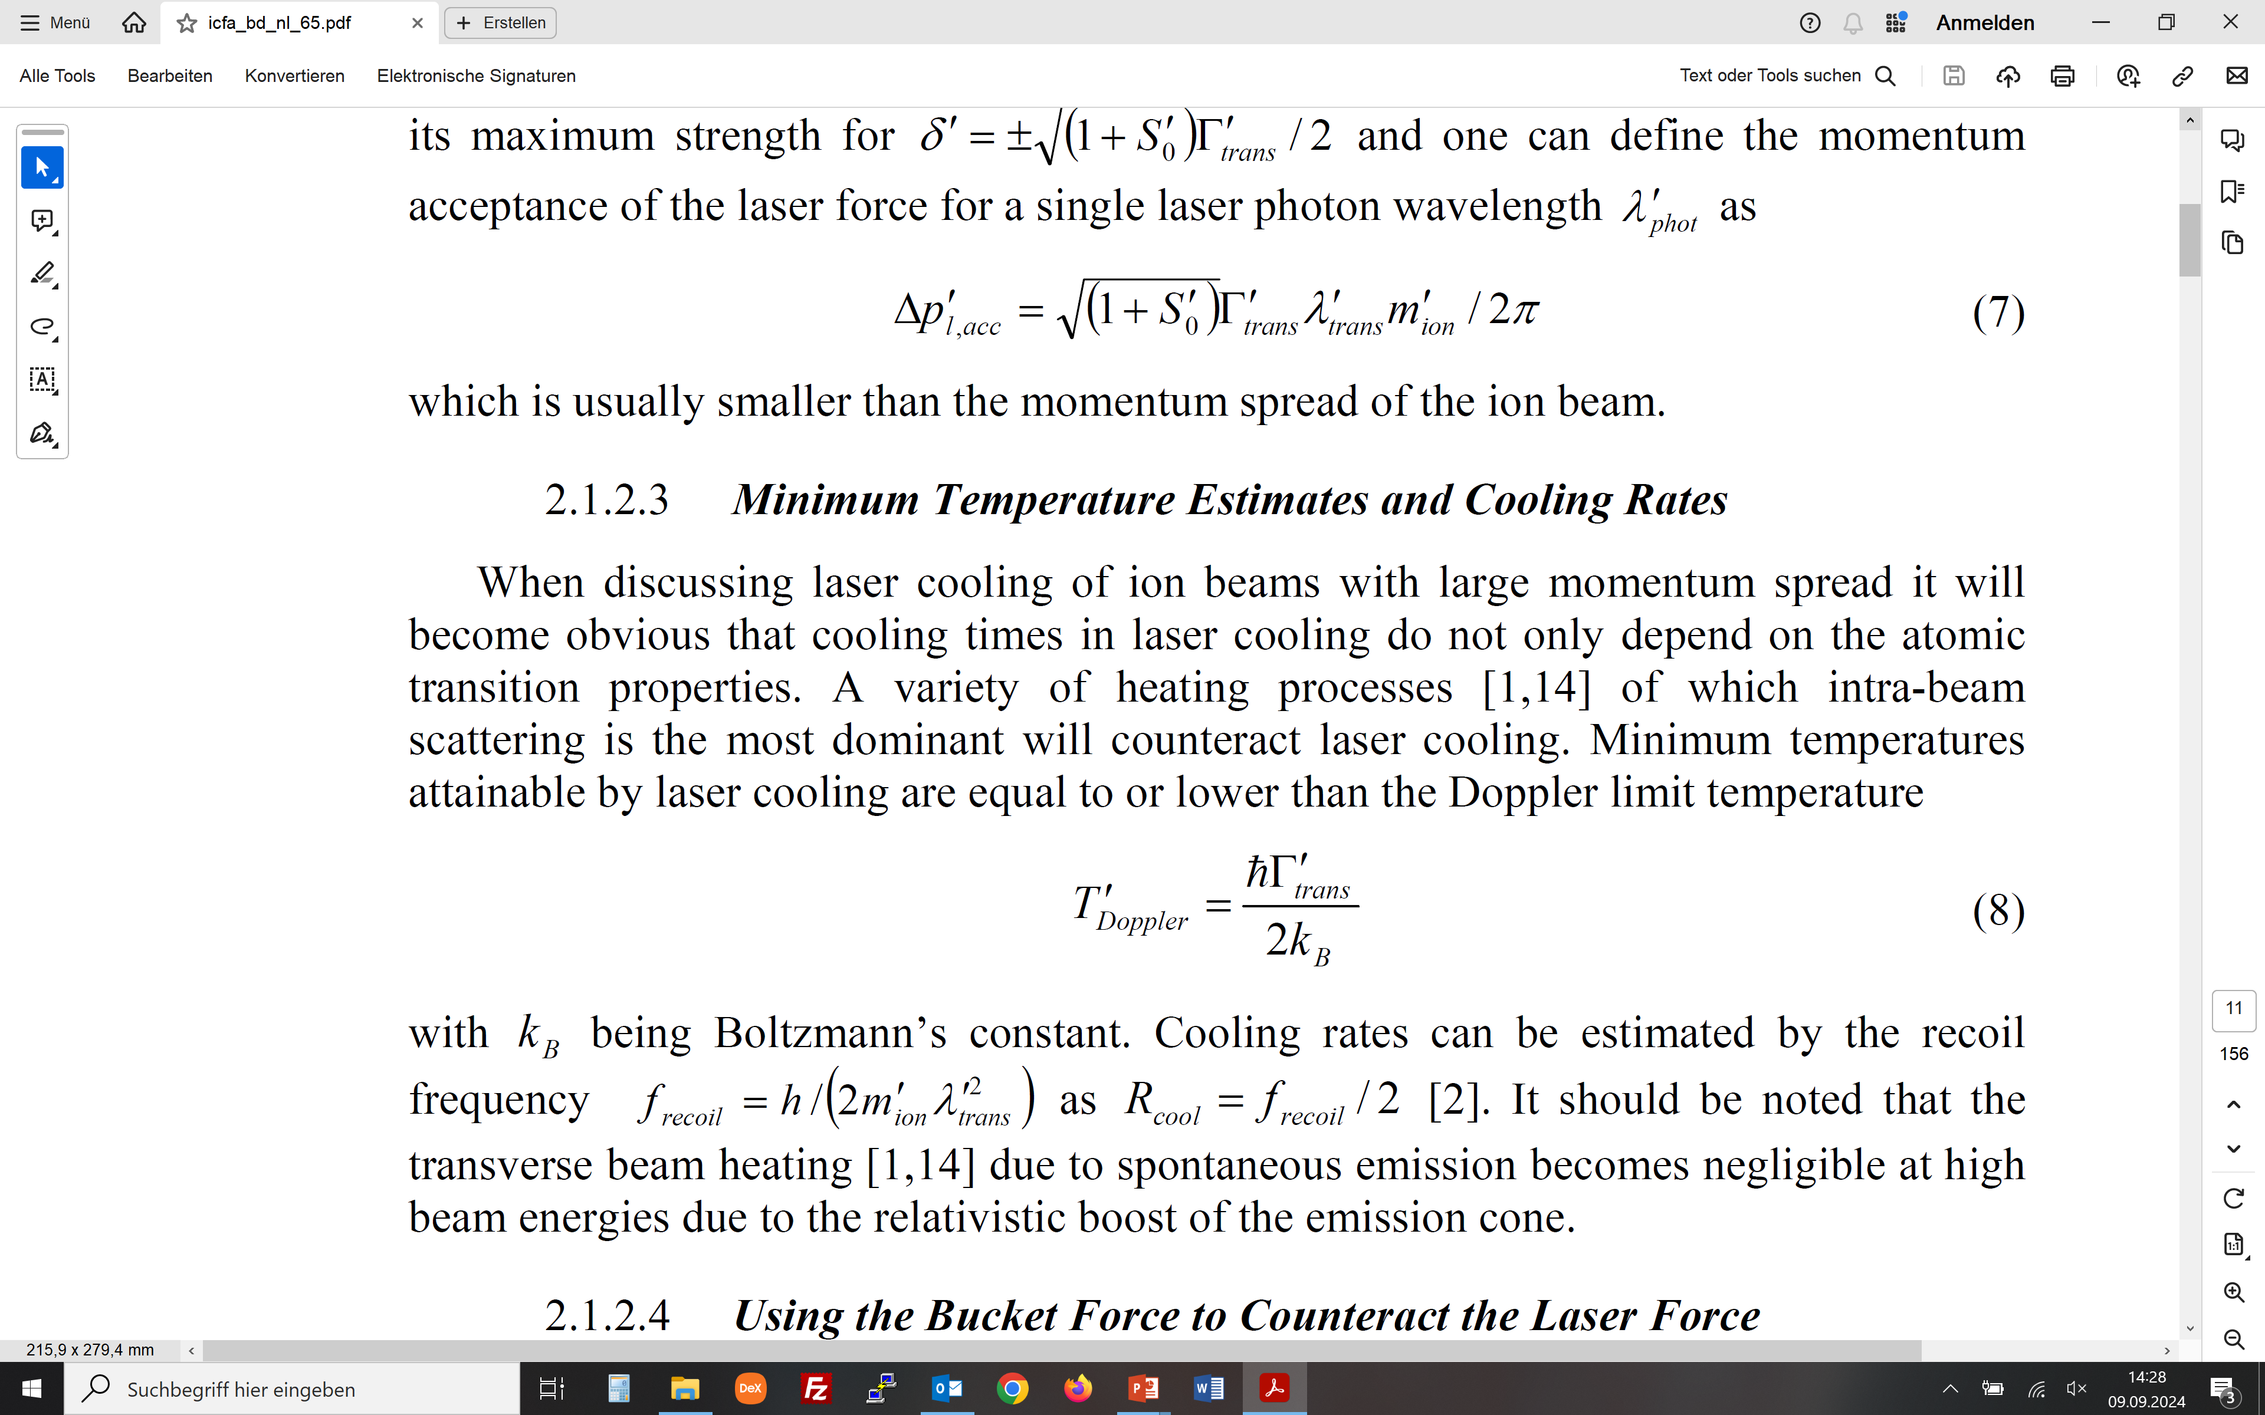
How to laser cool (relativistic) ion beams
Laser force acceptance and maximum cooling rate
(laser force momentum acceptance)
(minimum temperature)
(maximum cooling rate)

Slide 9
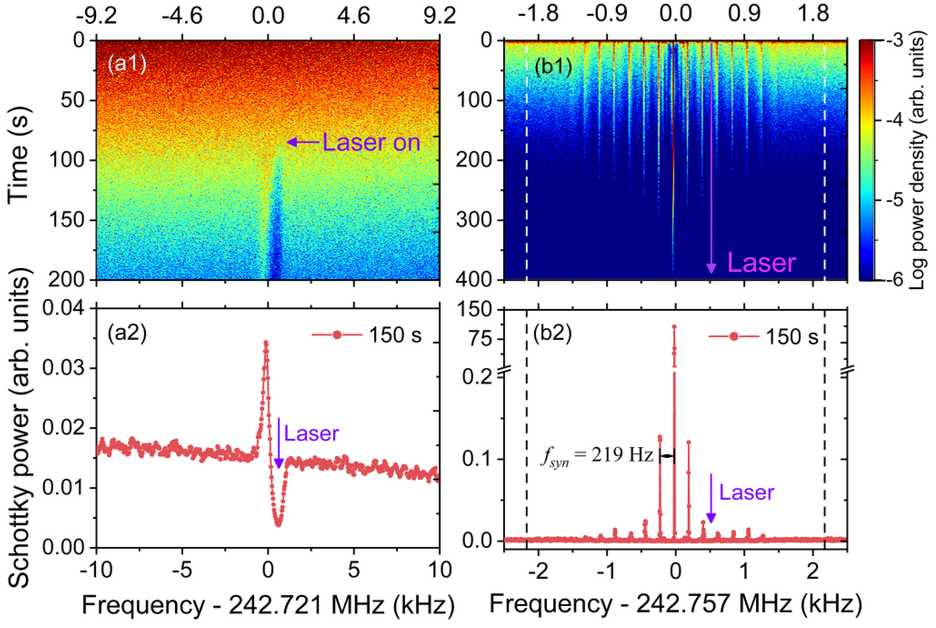
How to laser cool (relativistic) ion beams
Relativistic coasting beams need more than lasers
NIM A 1047, 167852 (2023)

Slide 10
How to laser cool (relativistic) ion beams
Betatron oscillations broaden the effective laser force acceptance
NIM A 1047, 167852 (2023)

Slide 11
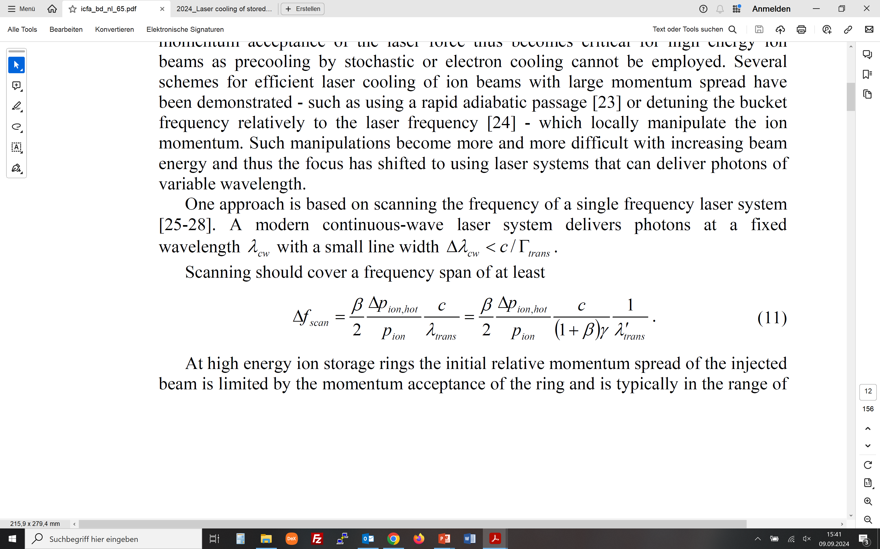
How to laser cool (relativistic) ion beams
Using the bucket force on a bunched beam to counteract the laser force
(detuning range in lab. frame needed to cool an ion beam
with a given momentum spread)
PRA 100, L010803 (2024)

Slide 12
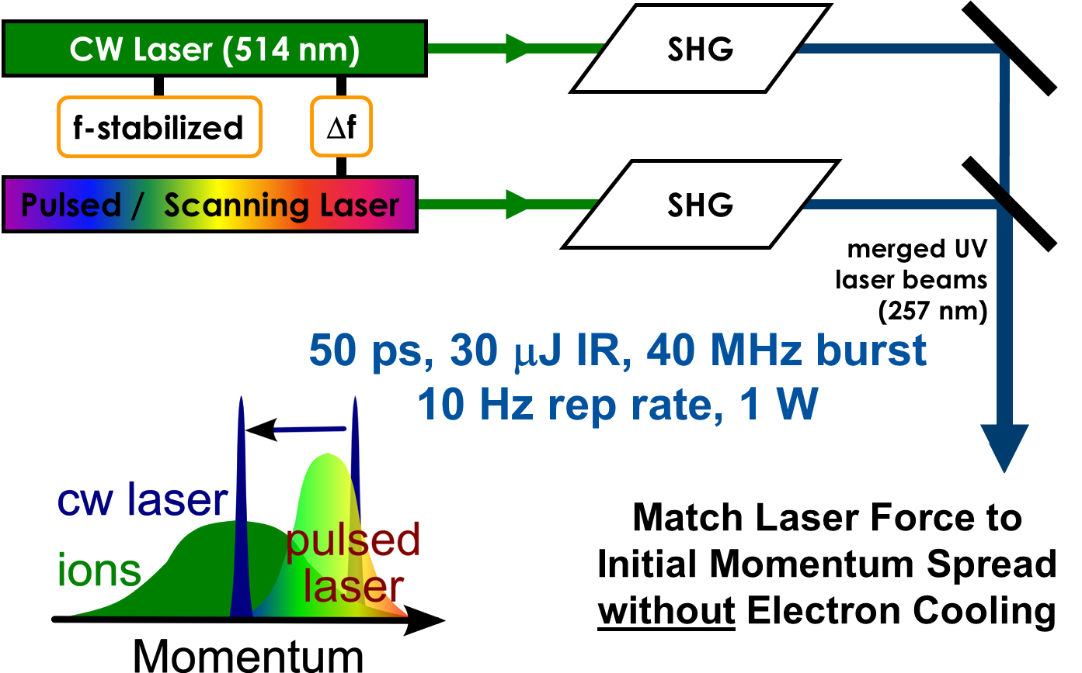
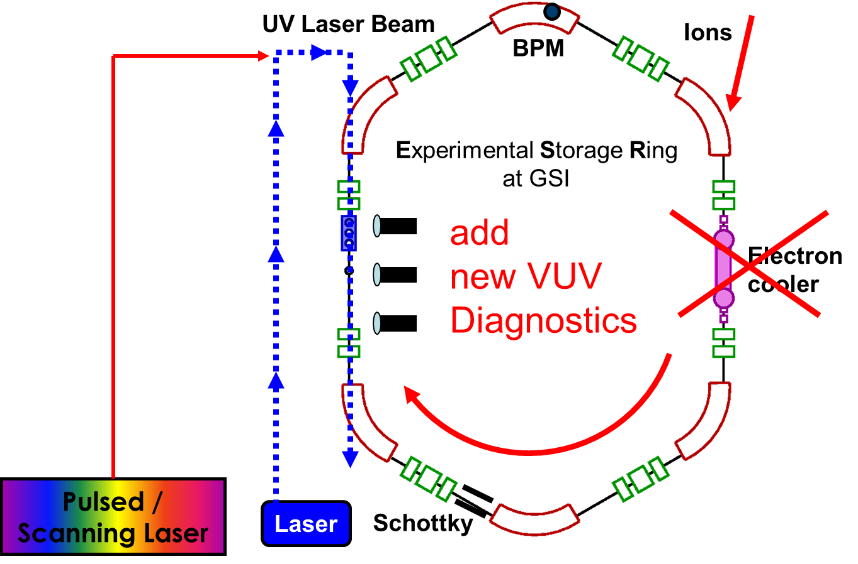
How to laser cool (relativistic) ion beams
Using pulsed lasers for broadband cooling of ion beams

Slide 13
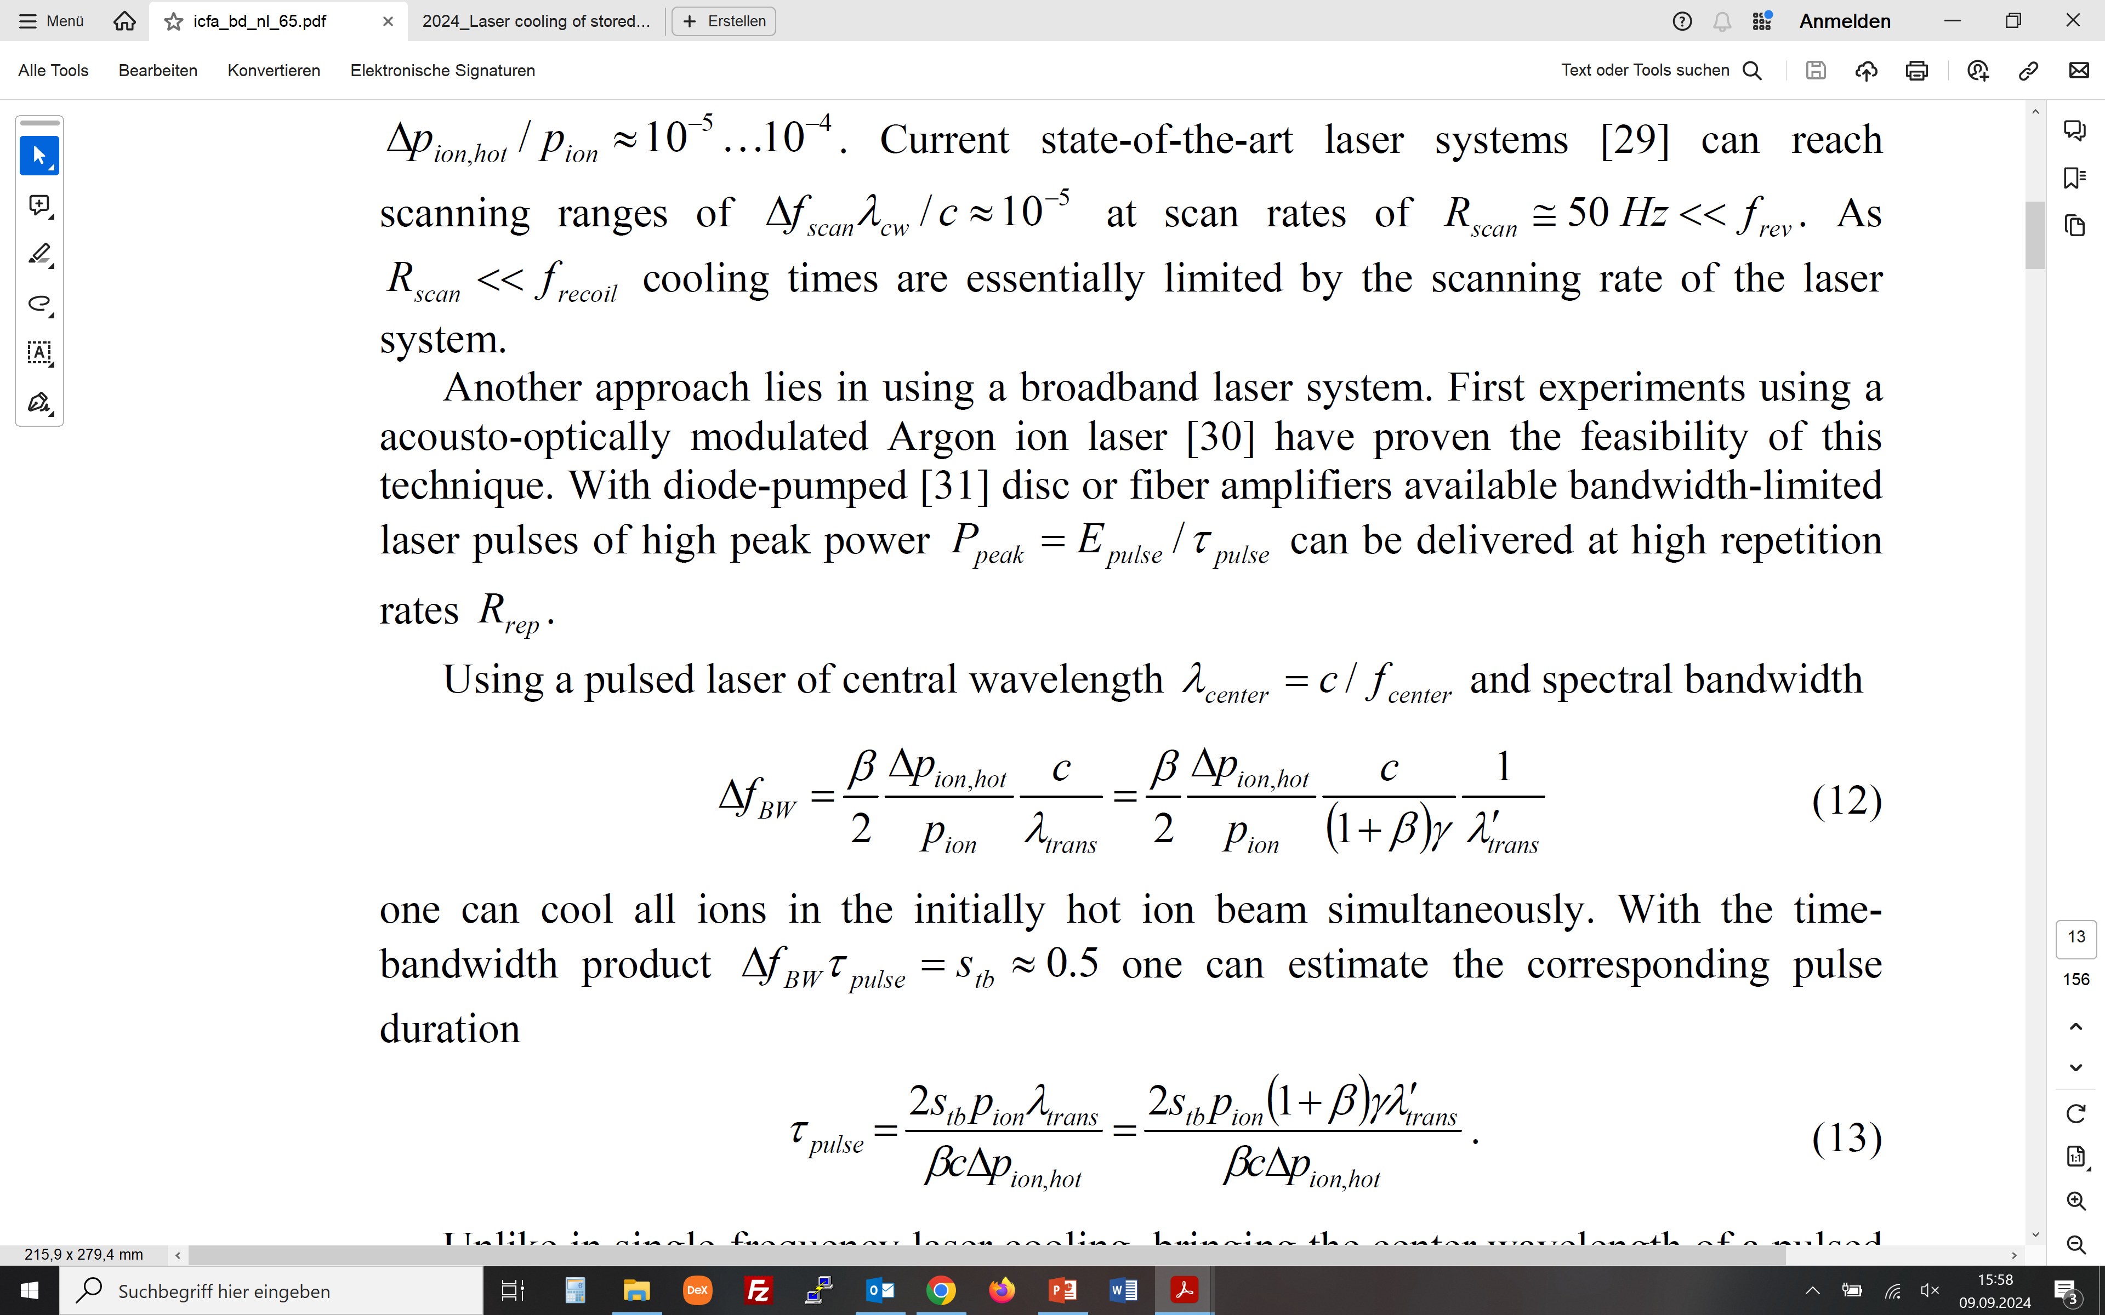
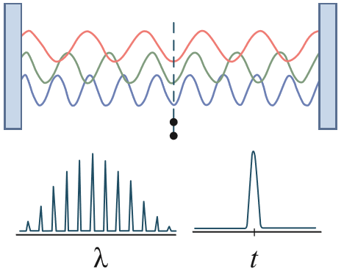
How to laser cool (relativistic) ion beams
A pulsed laser is many cw lasers working in parallel
(bandwidth of laser pulse needed to cool ion beam)
(laser pulse duration)

Slide 14
How to laser cool (relativistic) ion beams
Pulsed laser cooling prevents instabilities for intense ion beams
PhD Thesis Lewin Eidam
For intense beams pulsed laser cooling also prevents the microwave instability predicted for cw laser cooling

Slide 15
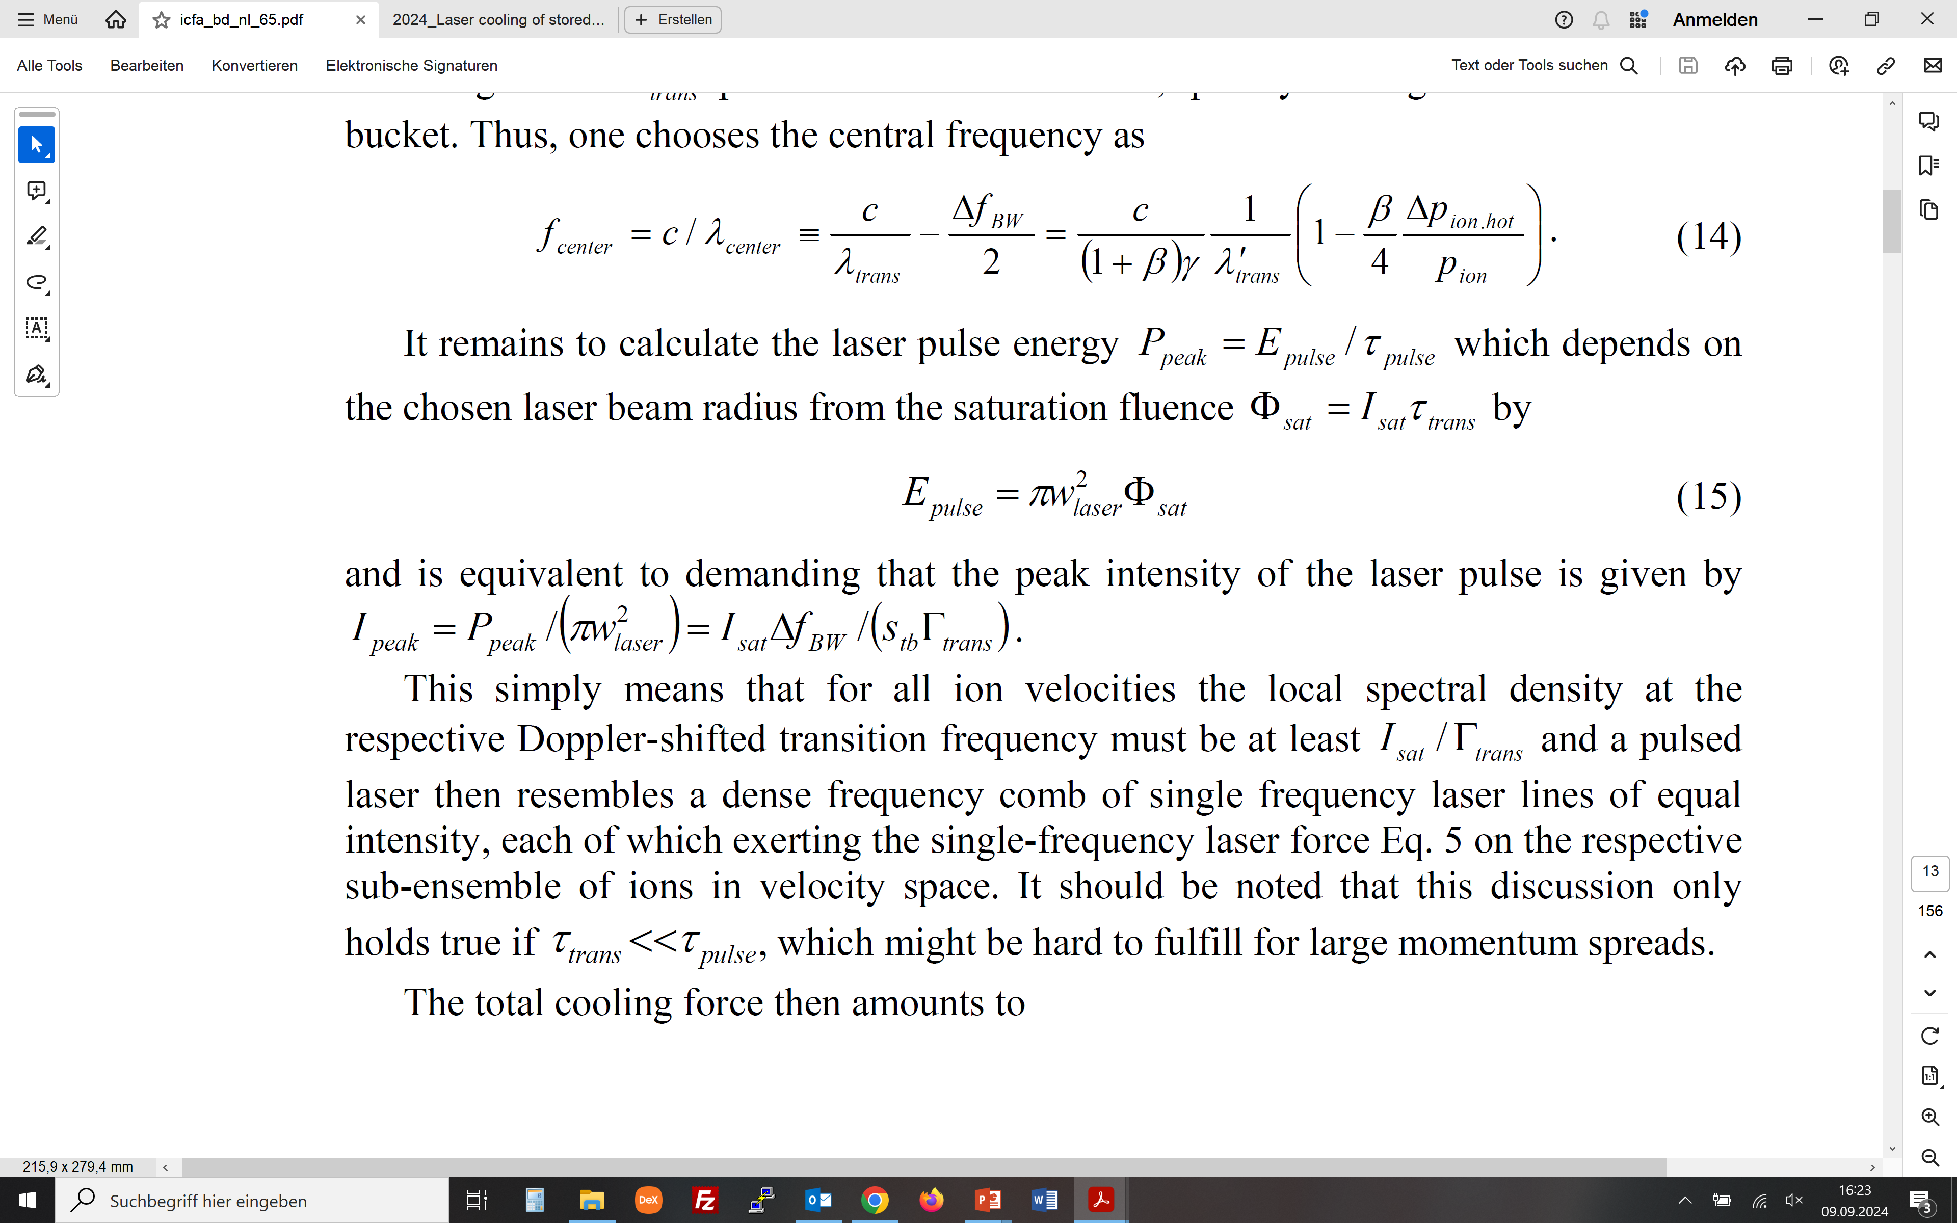
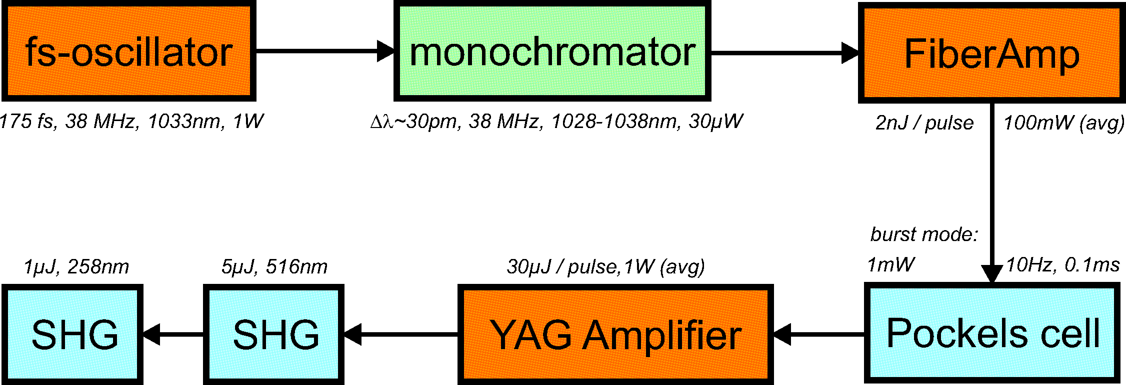
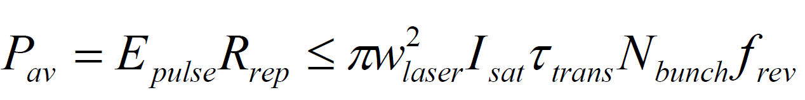
How to laser cool (relativistic) ion beams
Intensity and average power of pulsed laser system
(fluence at saturation)
(peak intensity)
(pulse energy)
(peak laser intensity)
(average laser power)

Slide 16
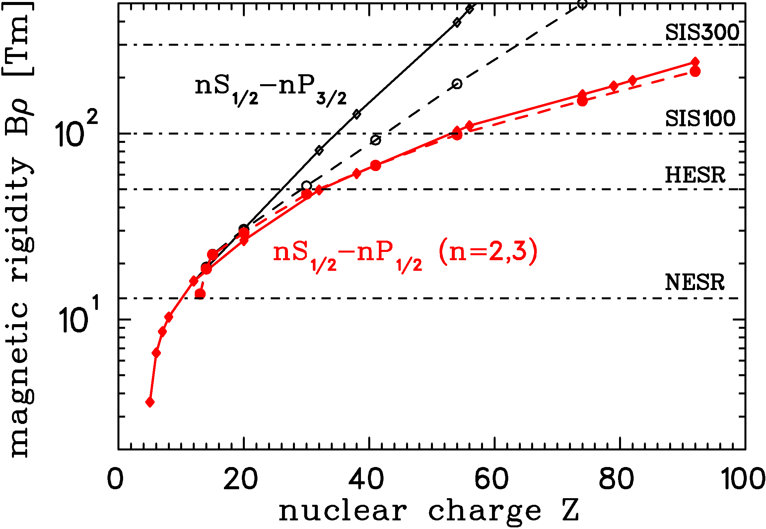
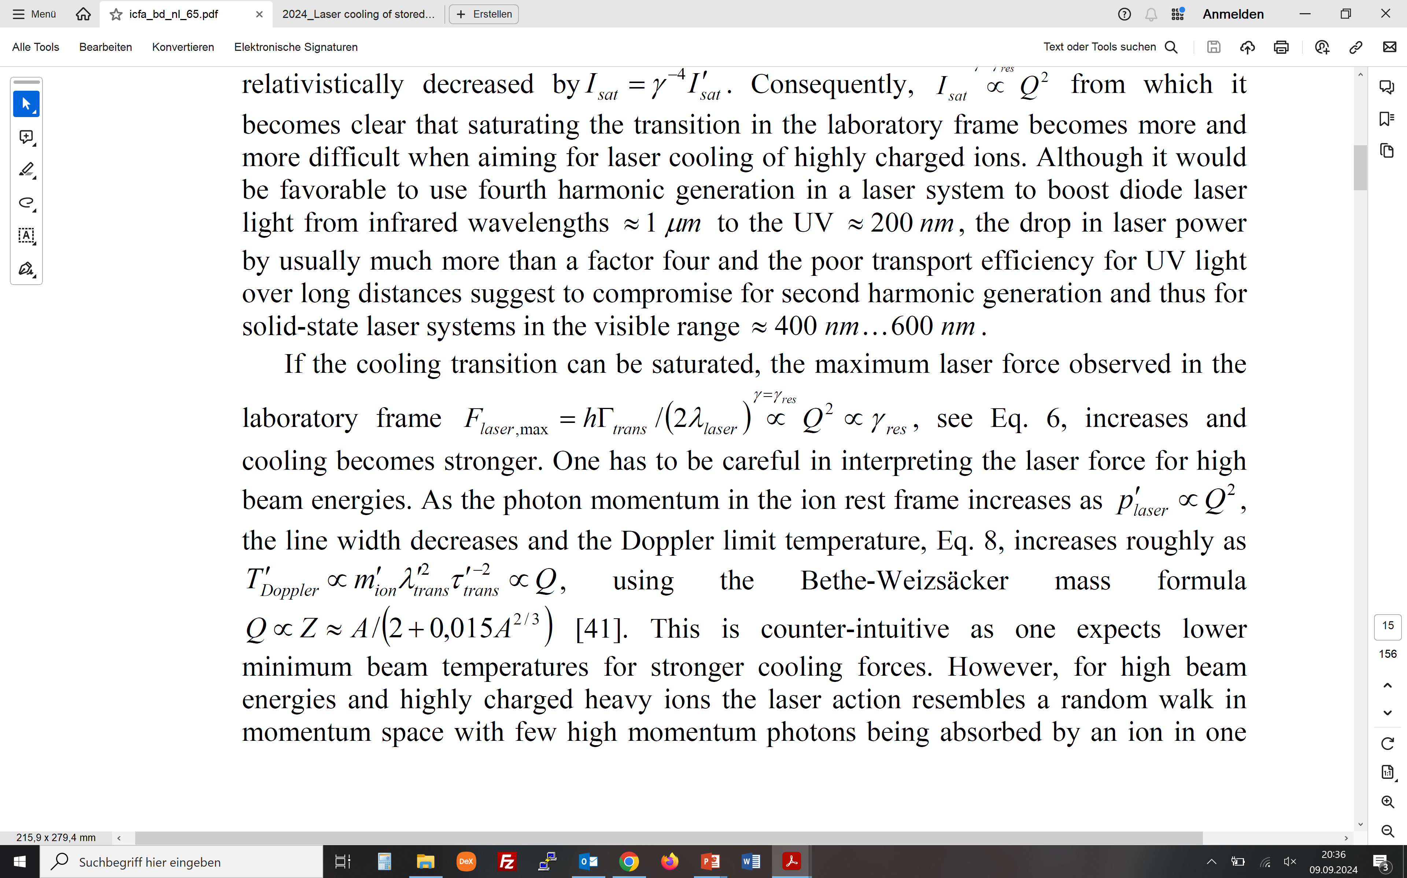
How to laser cool (relativistic) ion beams
Towards high ion beam energies and highly charged ions
(maximum laser force in laboratory frame)
(minimum temperature in rest frame)
rhombs/solid: Li-like
circles/dashed: Na-like
Example:
Li-like U⁸⁹⁺ at γ=25.86 means scattering of
roughly 4 photons per turn

Slide 17
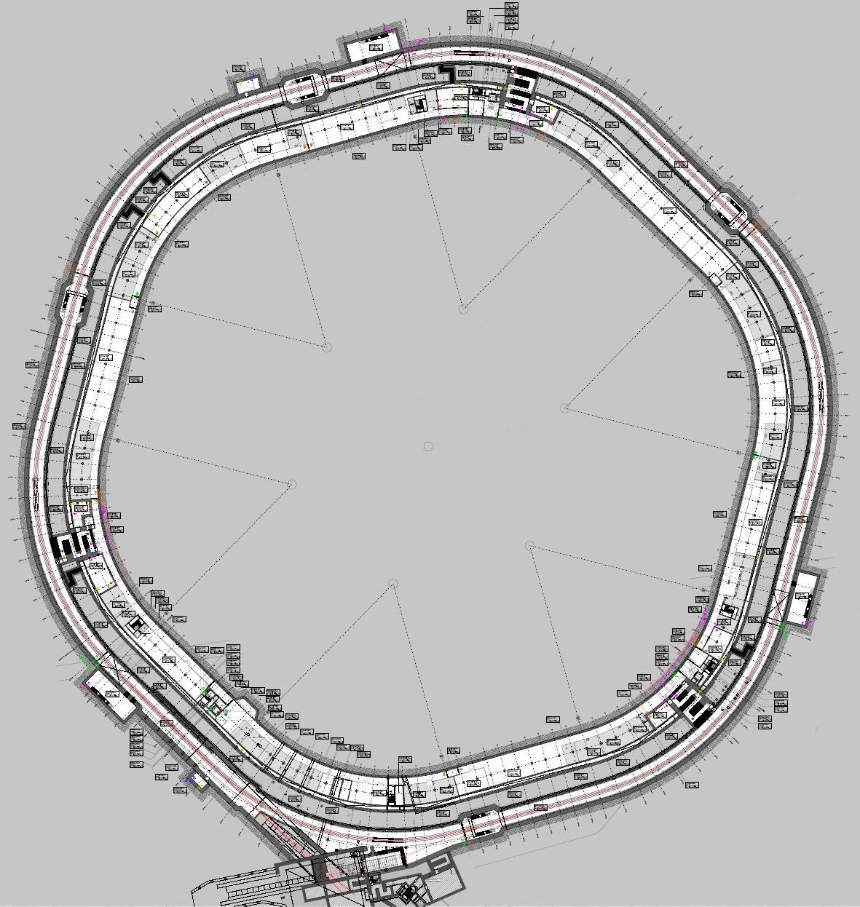
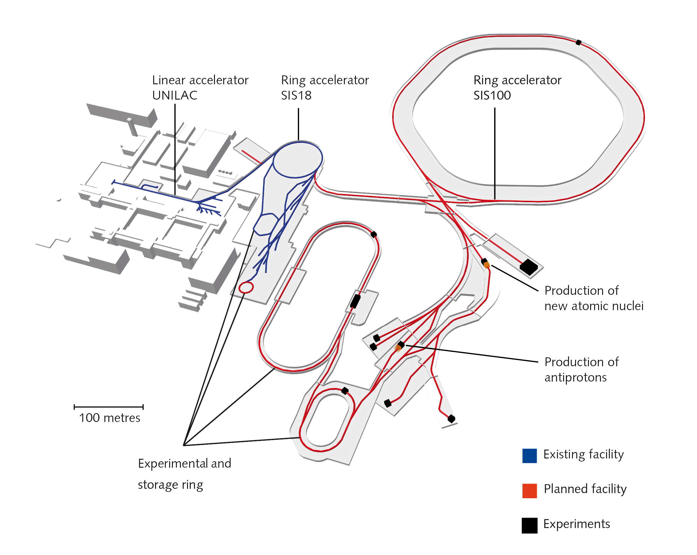
Laser cooling at SIS100
A dedicated laser cooling infrastruture
area for
laser cooling
laser cooling area
(& laser spectroscopy)
SIS100
ions

Slide 18
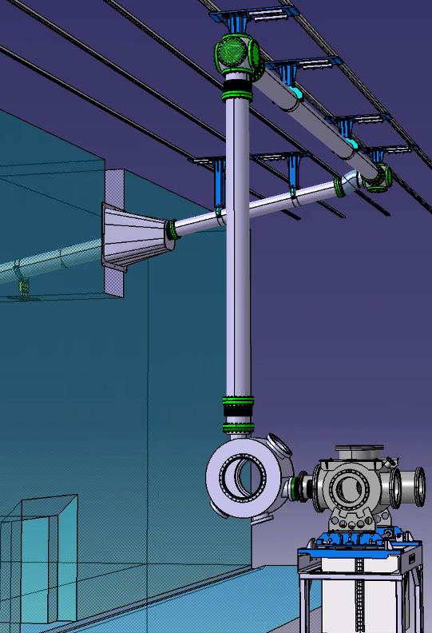
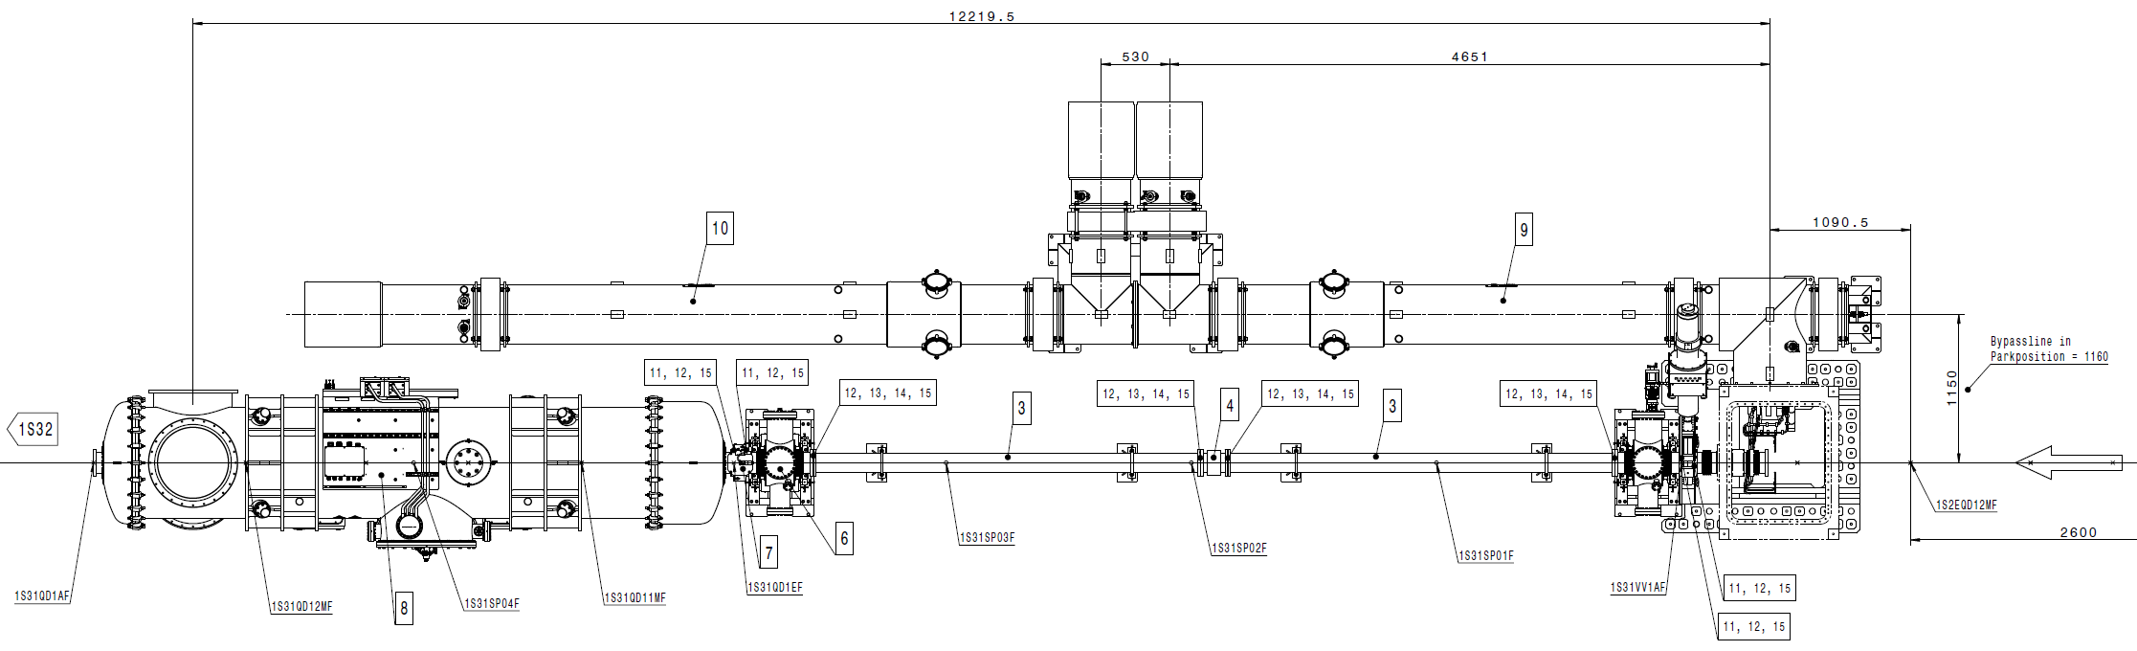
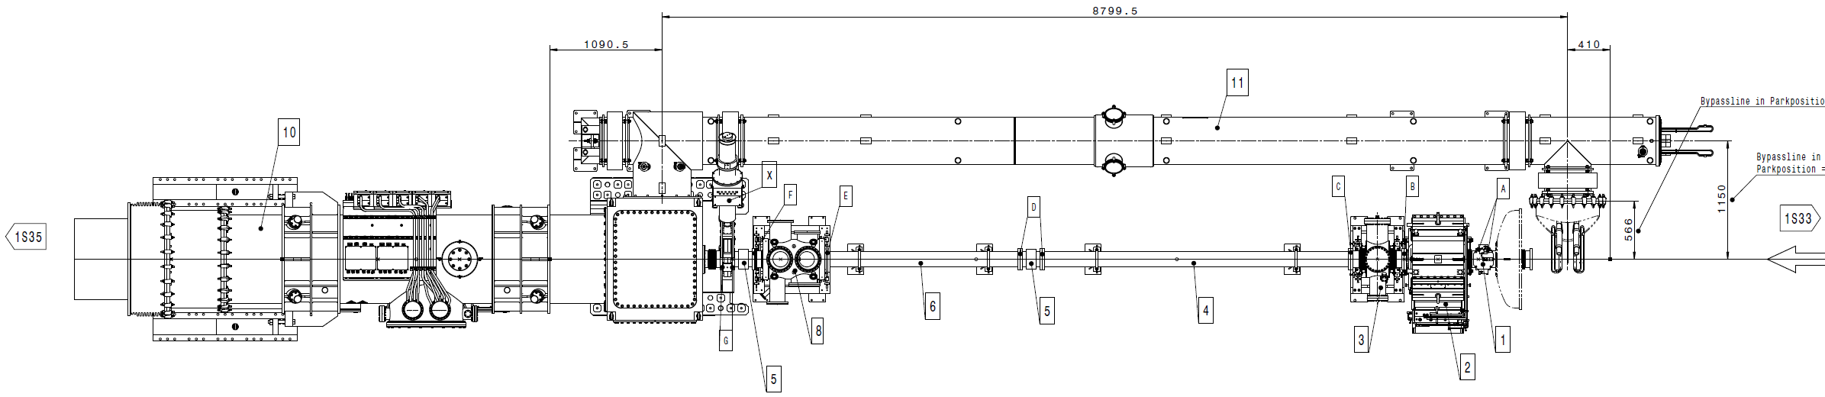
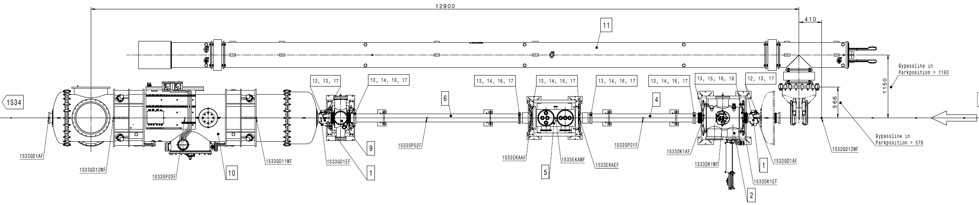
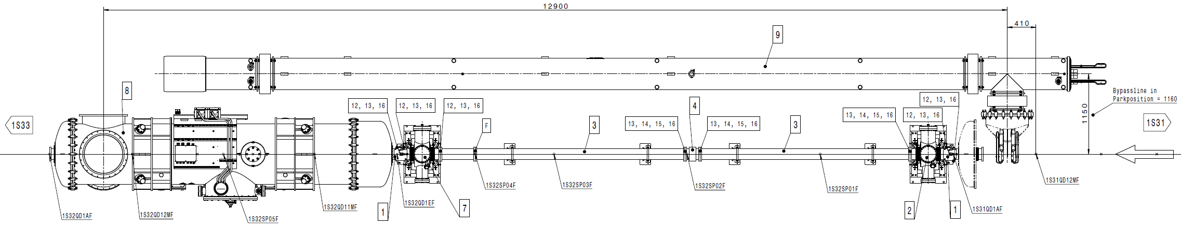
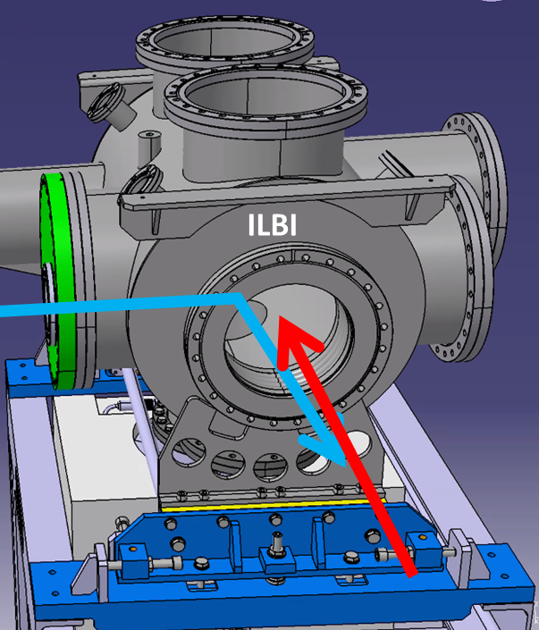
Laser cooling at SIS100
20m overlap vs. 1084m circumference (2%, 277,000 times a second)
T = 24.20 cm = 44.60 m
ion
beam
b
1.00 cm = 1.843 m
24.20 cm = 44.60 m
1S34
1S33
1S32
1S31
cavities
cavities
cavities
cavities
laser in
(ILBI)
fluorescence detection
(Uni Münster)
scraper 1
(DSA)
ion
beam
scraper 2
(DSB)
M
M
laser out
(ILAO)
3 laser
beams
~20 m

Slide 19
Laser cooling at SIS100
The SIS100 laser cooling collaboration
Michael Bussmann (Helmholtz-Zentrum Dresden – Rossendorf, CASUS)
Tamina Grunwitz (TU Darmstadt)
Jens Gumm (TU Darmstadt)
Volker Hannen (Institut für Kernphysik, Uni Münster)
Thomas Kühl (GSI, Darmstadt)
Sebastian Klammes (GSI Helmholtzzentrum für Schwerionenforschung GmbH(GSI))
Benedikt Langfeld (TU Darmstadt)
Ulrich Schramm (Helmholtz-Zentrum Dresden – Rossendorf)
Denise Schwarz (TU Darmstadt)
Dr Mathias Siebold (Helmholtz-Zentrum Dresden – Rossendorf)
Dr Peter Spiller (GSI Helmholtzzentrum für Schwerionenforschung GmbH(GSI))
Thomas Stöhlker (GSI Helmholtzzentrum für Schwerionenforschung GmbH(GSI))
Ken Ueberholz (Universität Münster(UMs-IKP))
Thomas Walther (TU Darmstadt)
Danyal Winters (GSI Helmholtzzentrum für Schwerionenforschung GmbH(GSI))

Slide 20
Fun with fluorescence
Photon time of flight
Depends on orbit, at best transversally cold beam
Depends on lifetime, at best the lifetime is much shorter than one roundtrip
Few photons in a single roundtrip, so must accumulate – beam lifetime, magnet stability
Larger ion distances help, so shallow buckets should help
Synchronization of laser pulse and bunching could make photon arrival correlations visible

Slide 21
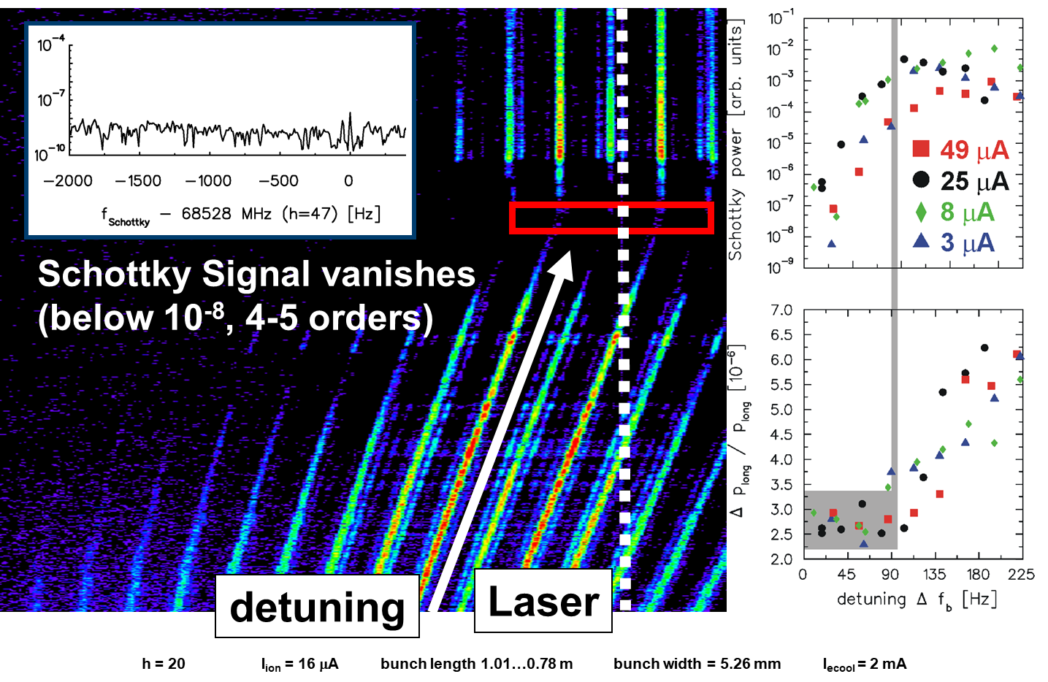
Why cooling relativistic ion beams with lasers is fun
Precision spectroscopy meets ultracold ion beams
Intrinsic Properties of
heavy, ‘few-electron’ Ions
Measure
absolute transition wavelength
ω ²_{rest} = ω_{laser} · ω_{X-ray}
ω_{in}
ω_{out}
Transition wavelengths for HCI known with less than 10⁻⁴ precision
Lorentz transformation

