Slide 1



Longitudinal beam stacking in storage ring using pulsed e-cooling
He Zhao
Institute of Modern Physics, CAS
October 27–31, 2025, NY, USA

Slide 2

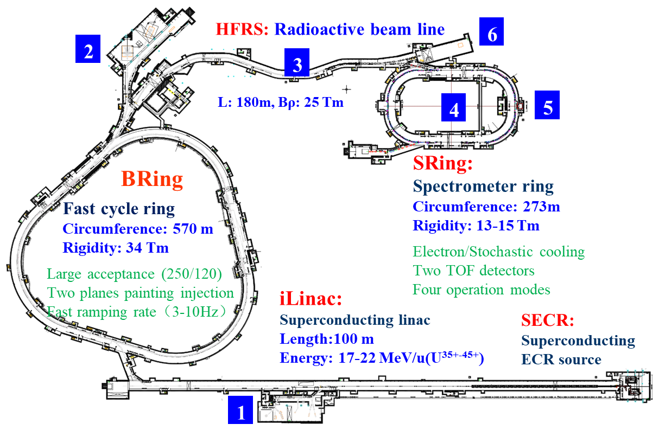
Introduction
Accumulation of RIBs or high-charged particles is required for various experiments in storage rings, such as in FAIR, NICA and HIAF project.
Experimental terminals
Low energy nuclear structure terminal
High energy experimental terminal
High energy fragment separator HFRS
High precision spectrometer ring SRing
Electron ion recombination terminal
Radioactive ion beam physics terminal
He Zhao, COOL25, NY, USA, October 27–31, 2025

Slide 3
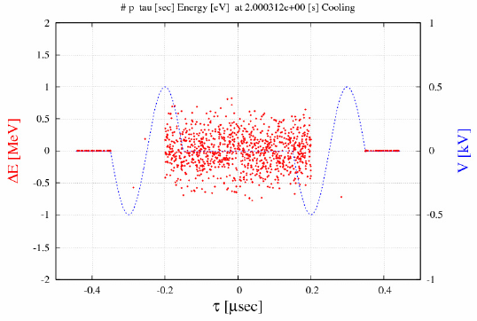
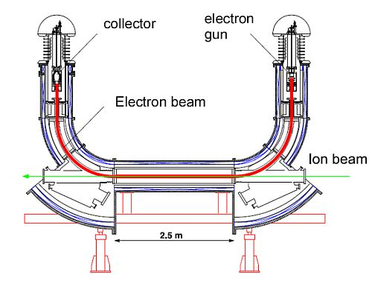
Introduction
Accumulation of RIBs or high-charged particles is required for various experiments in storage rings, such as in FAIR, NICA and HIAF project.
Around 2000s, the barrier bucket concept has been used and studied in a number of synchrotrons at Fermilab, BNL, KEK and CERN.
BB system + beam cooling
Pulsed e-cooler
Kicker
stable
unstable
stable
He Zhao, COOL25, NY, USA, October 27–31, 2025

Slide 4
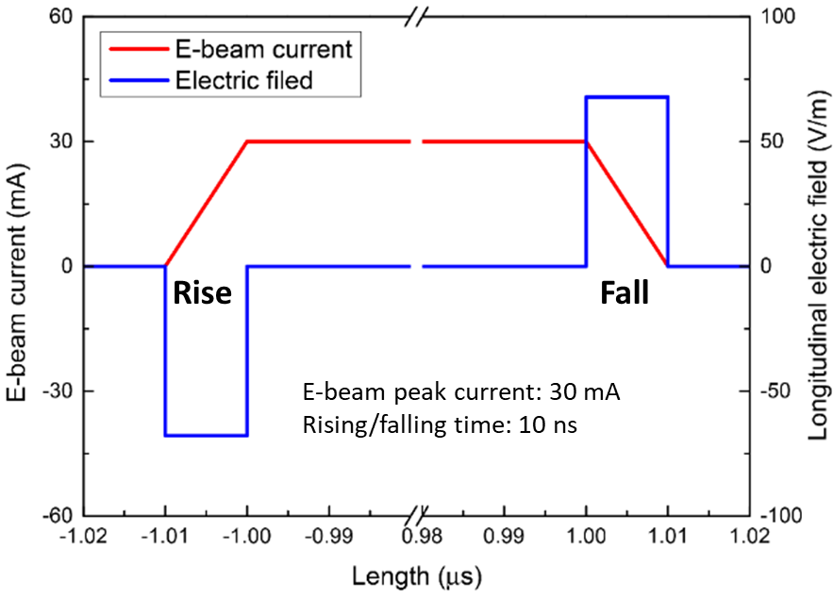
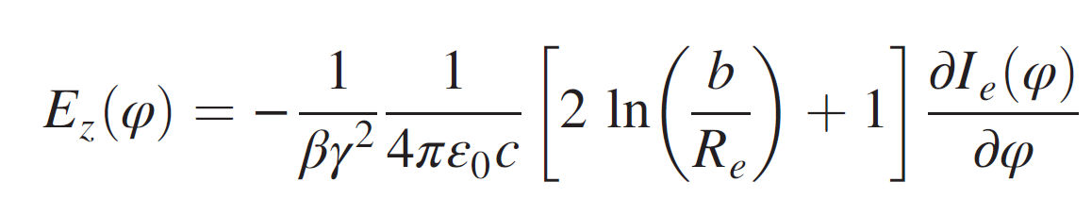
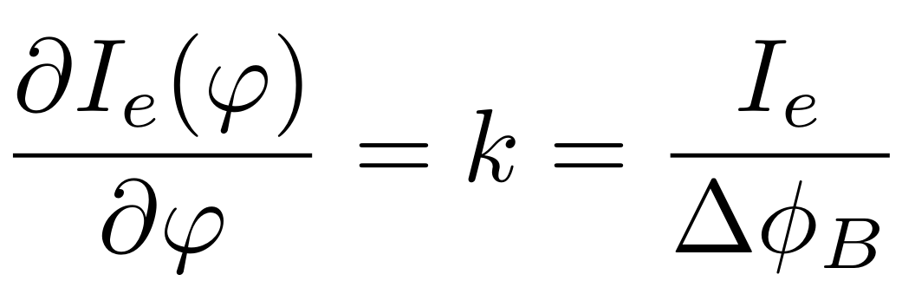
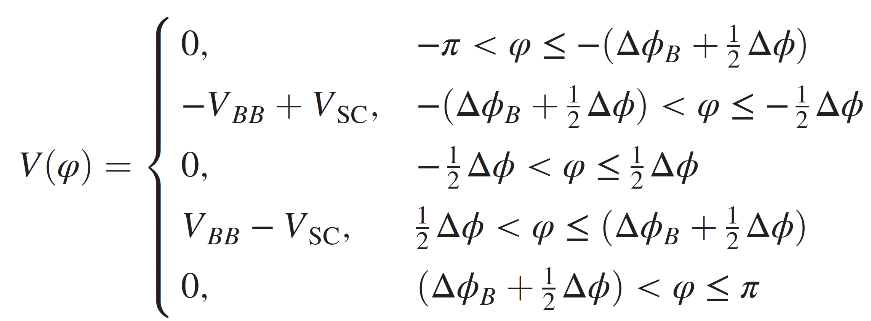
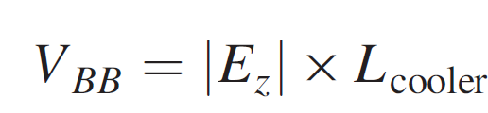
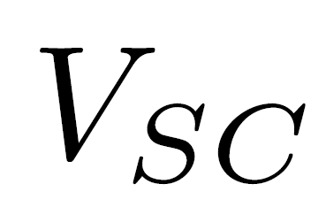


Barrier Bucket beam stacking
Barrier voltage of pulsed e-beam
Assuming a pulsed e-beam with the current varies linearly at the edges. So the longitudinal electric field due to space charge is
The barrier voltage is determined by the electric field E_{z} and the length of the cooler L_{cooler}
$$δ_{p}$$
: space charge of i-beam
This method requires that the stable area coincides with the cooling region, which means it only works for heavy ion beams below transition energy (η < 0).
$$φ$$
Rising
Pulse width (W_{p})
Falling
He Zhao, COOL25, NY, USA, October 27–31, 2025

Slide 5
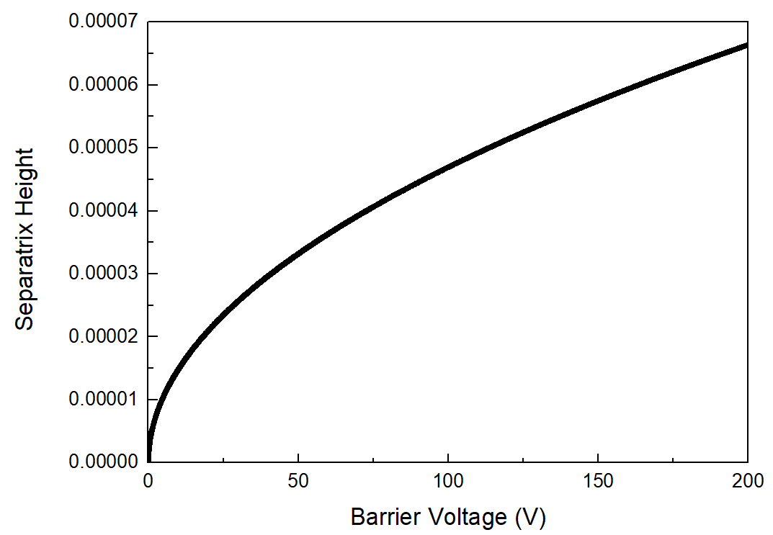
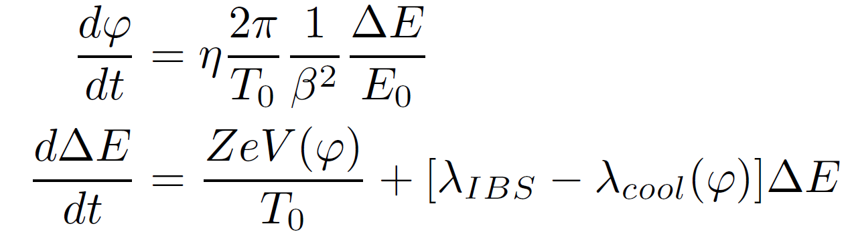
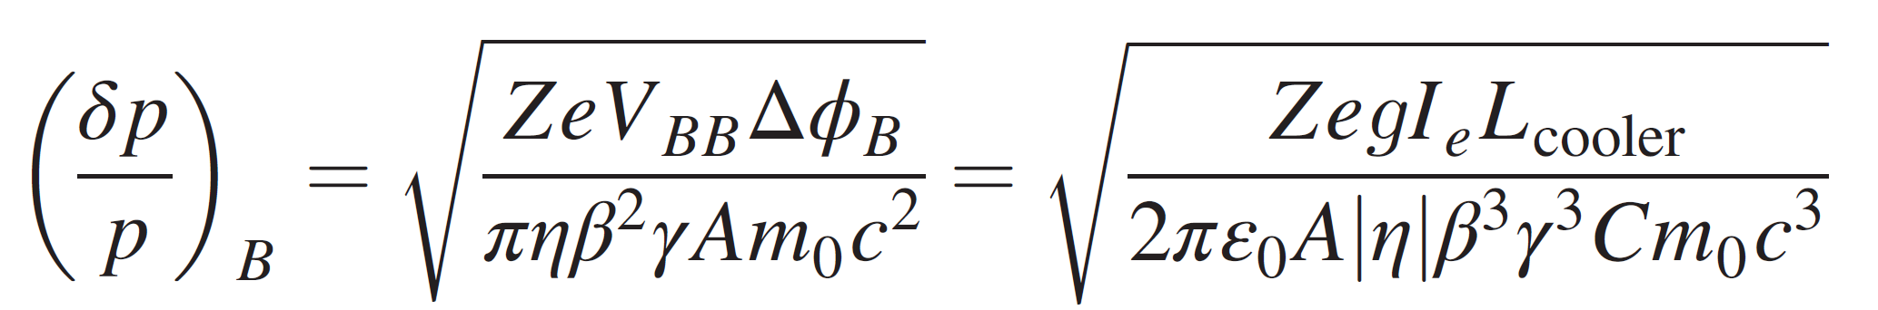
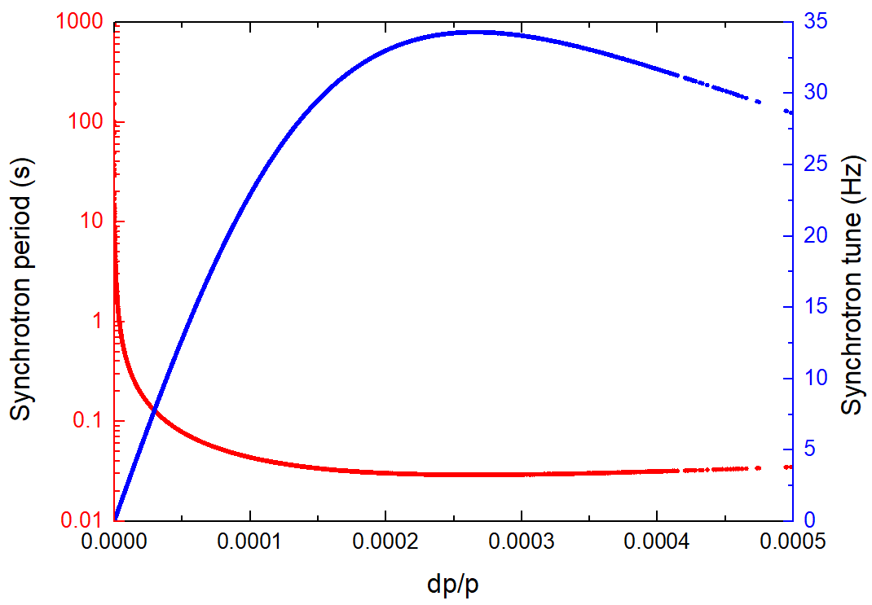
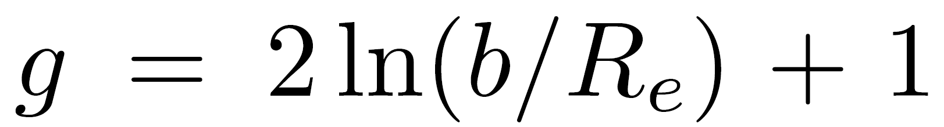
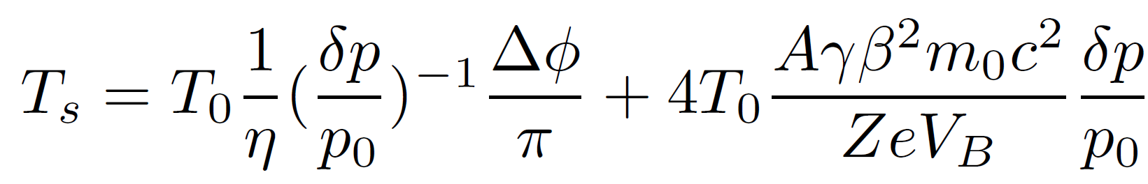
Barrier Bucket beam stacking
Barrier voltage of pulsed e-beam
740 MeV/u ¹³²Sn⁵⁰⁺
Particle motion in longitudinal phase space
bucket height =6.6e-5
Bucket height
geometric factor:
Ie = 2.0 A
Pulse width = 500ns
Rise time = 10ns
V_{BB} = 196 V
Synchrotron oscillation period
He Zhao, COOL25, NY, USA, October 27–31, 2025

Slide 6
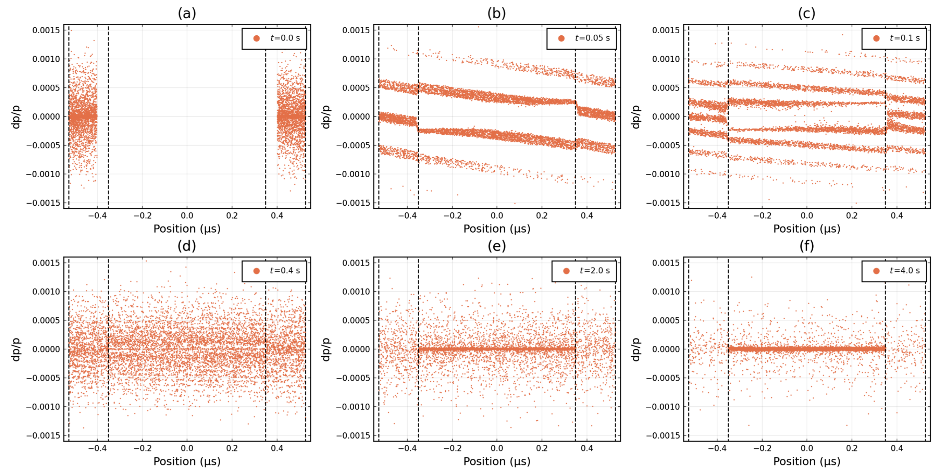
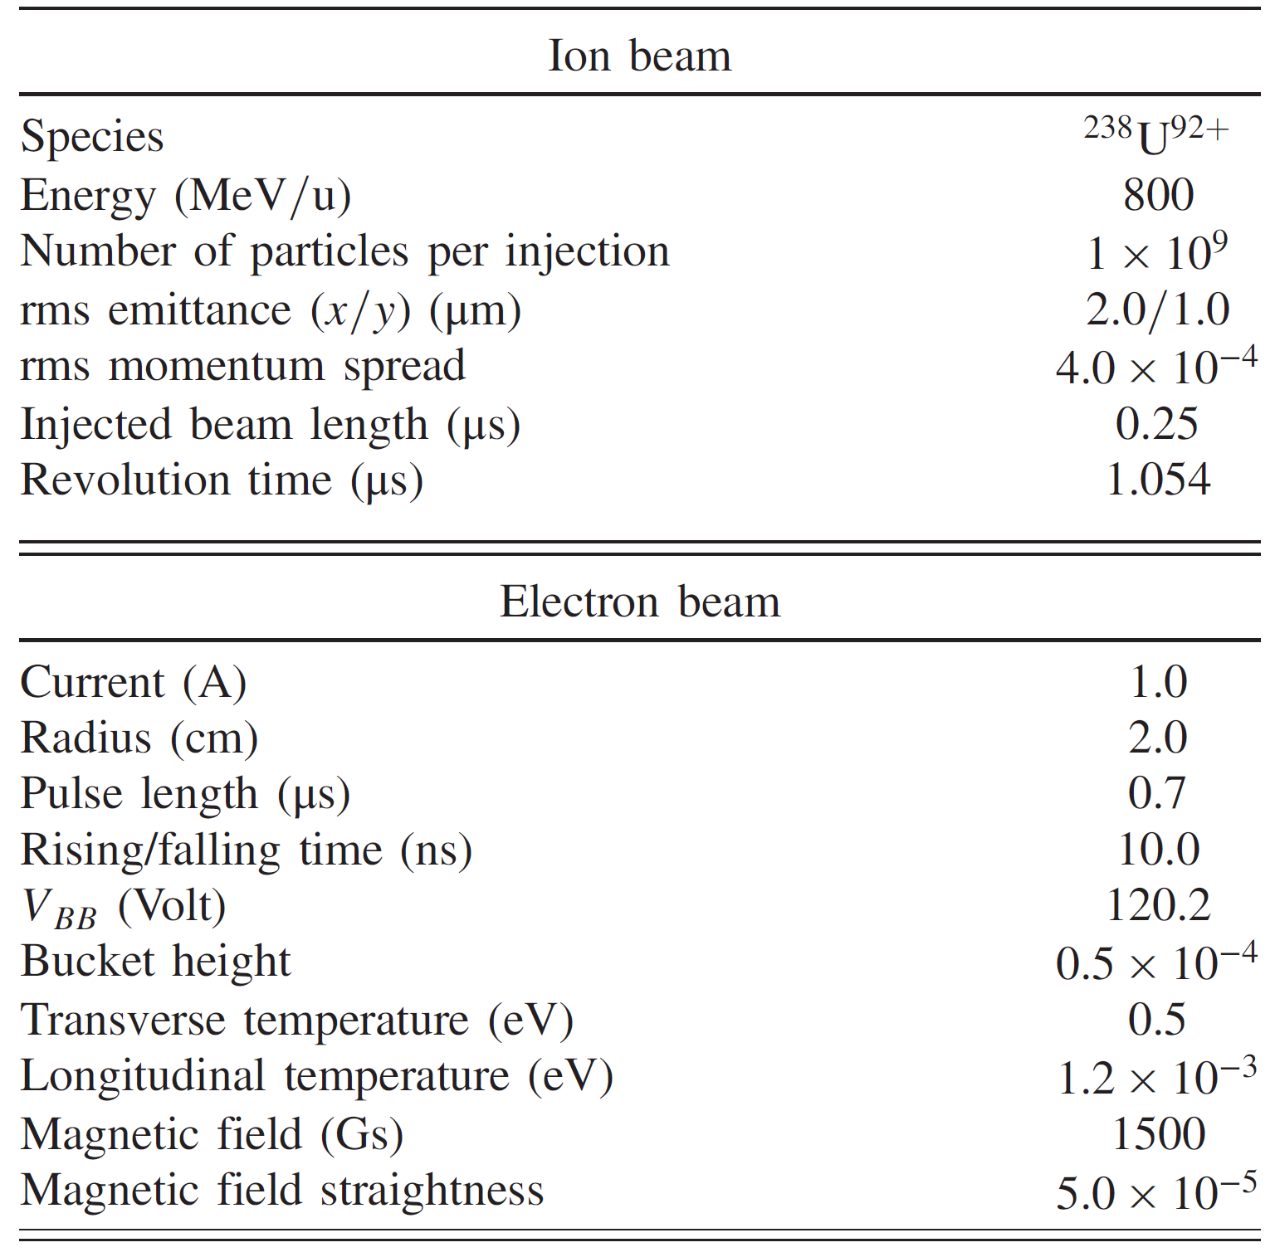
Cooling and accumulation simulation
Beam injection and cooling
The injected ion with would be finally cooled into the stable region, and confined by the barrier voltage.
The simulation includes BB voltage, IBS and ion space charge (longitudinal).
Beam parameters in SRing of HIAF
He Zhao, COOL25, NY, USA, October 27–31, 2025

Slide 7
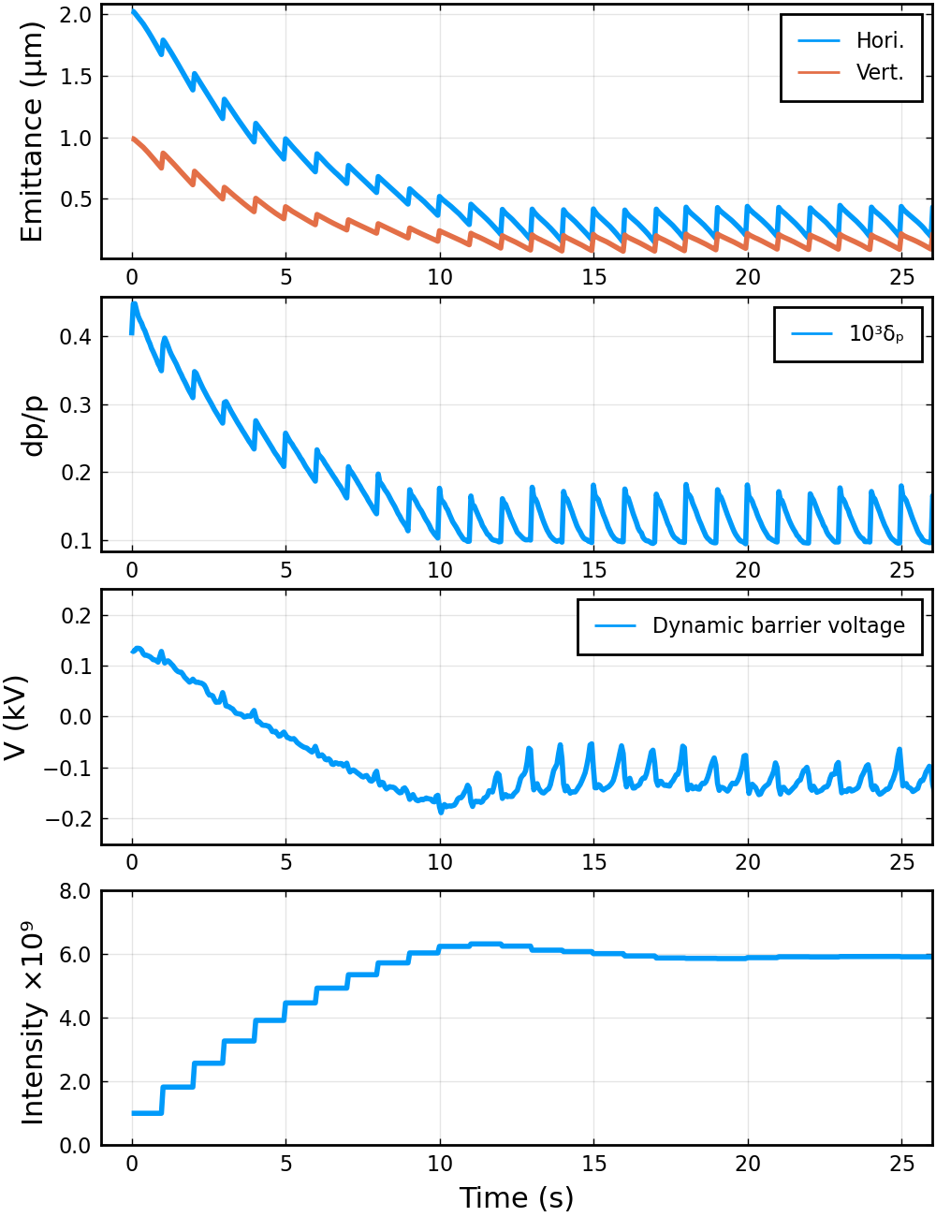
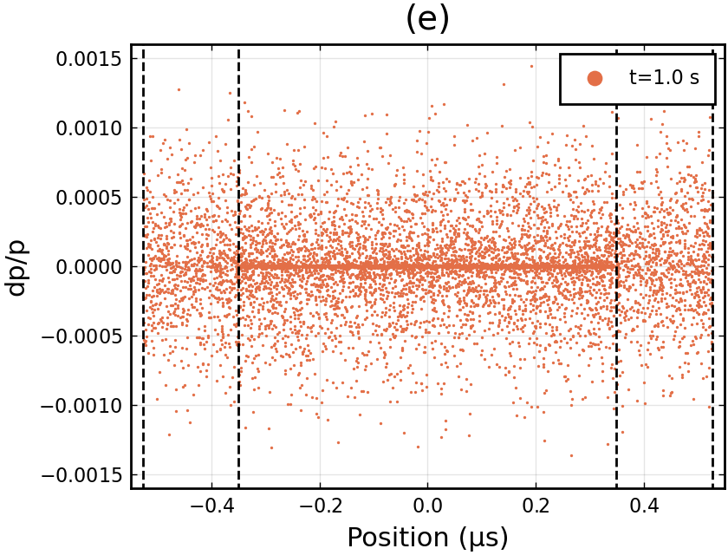
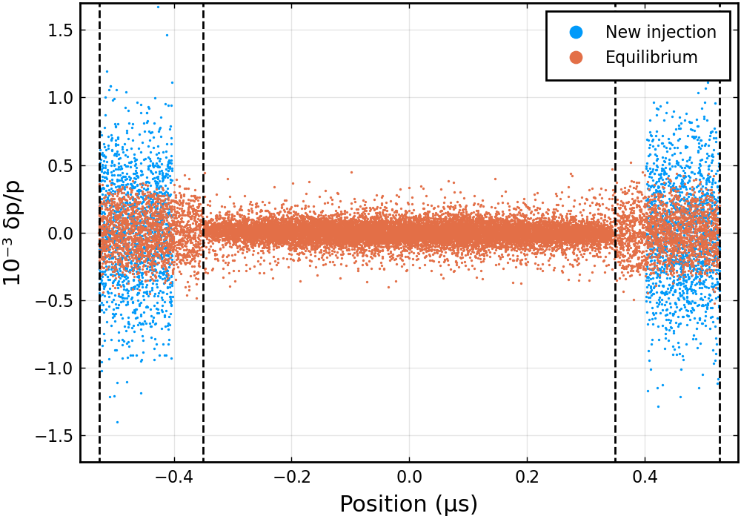
Cooling and accumulation simulation
Beam accumulation
The beam equilibrium momentum spread is the result of cooling and IBS effects, which is one of the main limitations of the beam stacking performance.
Another limitation is the space charge effect of the ion beam, a high charge intensity can seriously affect the dynamic barrier voltage and even cancel out the stable region.
t=25s
He Zhao, COOL25, NY, USA, October 27–31, 2025

Slide 8
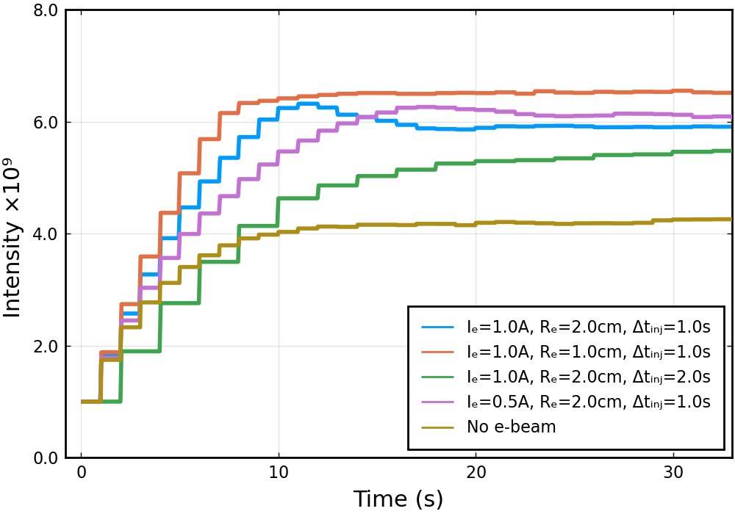
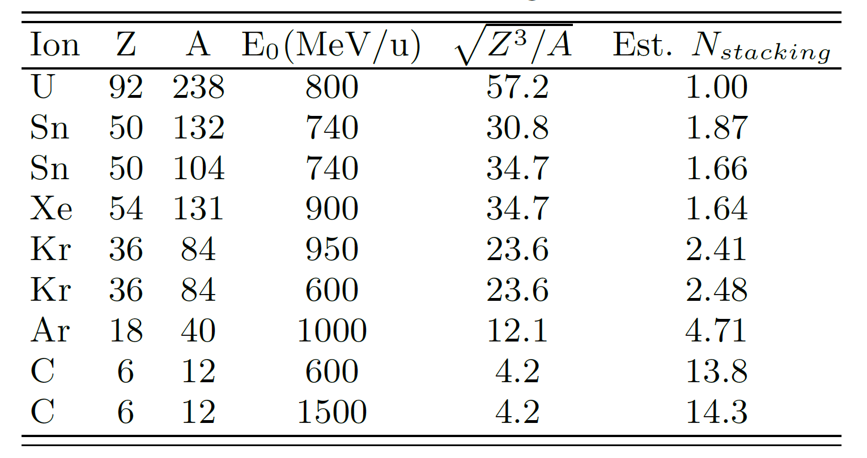
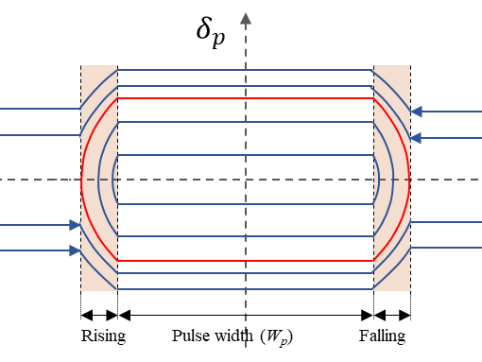
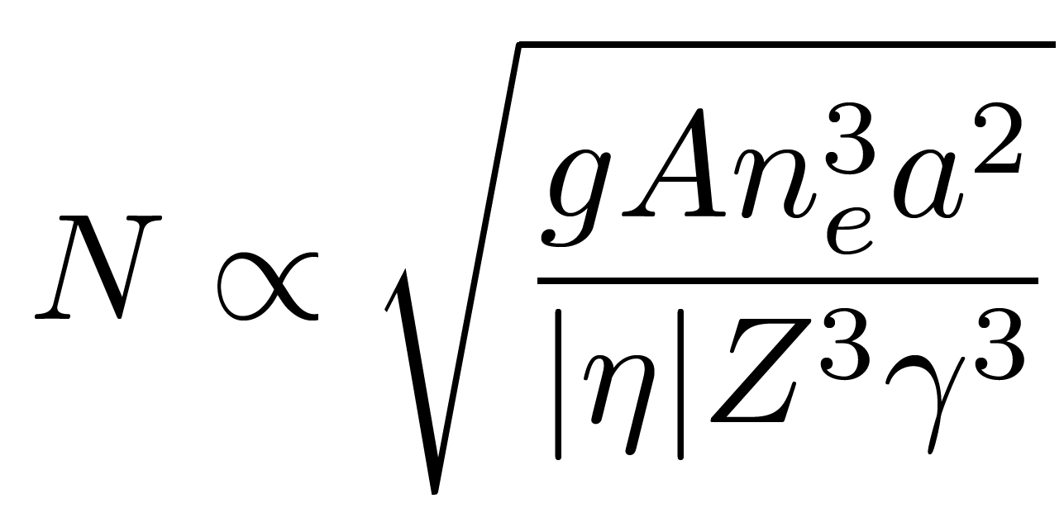
Cooling and accumulation simulation
Beam accumulation optimization
Considering space charge, the dynamic bucket height and factors such as injection cycle, IBS, and cooling efficiency make the stacking process complex, requiring careful parameter optimization.
Estimation of the stacking performance (IBS&Cooling)
He Zhao, COOL25, NY, USA, October 27–31, 2025

Slide 9
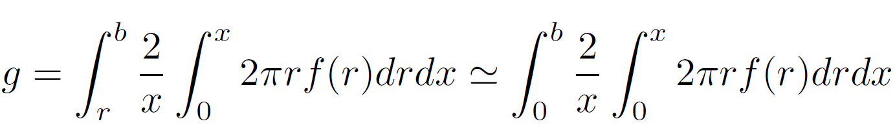
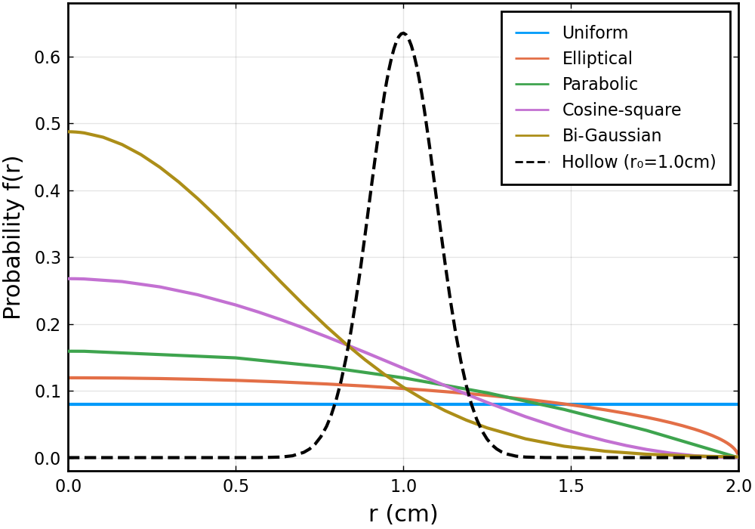
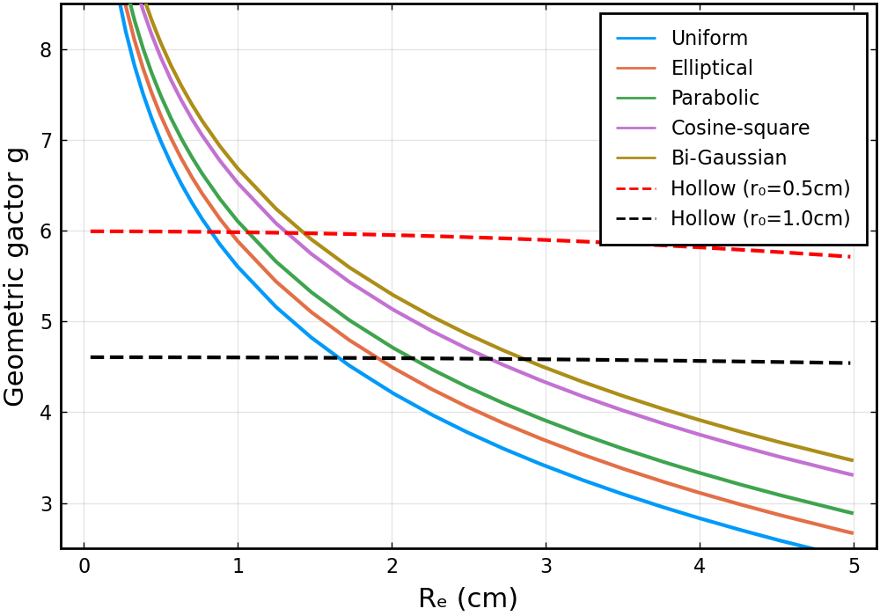
Cooling and accumulation simulation
Beam accumulation optimization
Barrier voltage: energy, e-beam pulse width and the geometric factor
E-beam distribution can be used to optimize the accumulation performance
He Zhao, COOL25, NY, USA, October 27–31, 2025

Slide 10
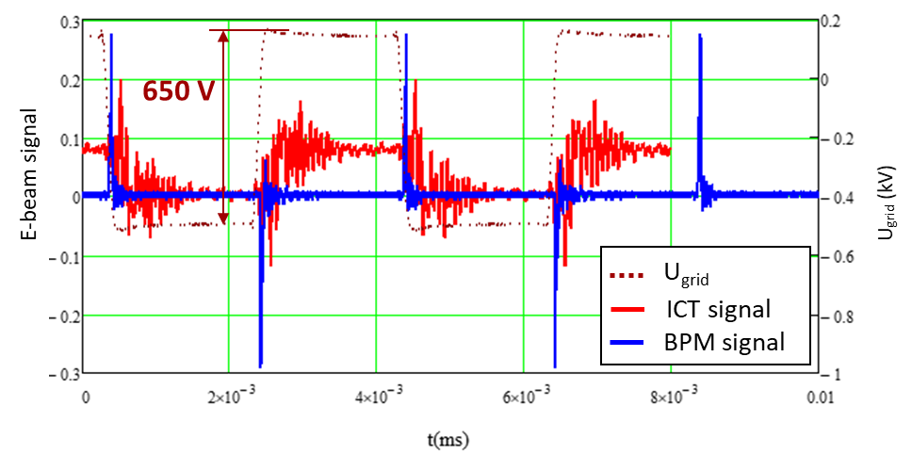
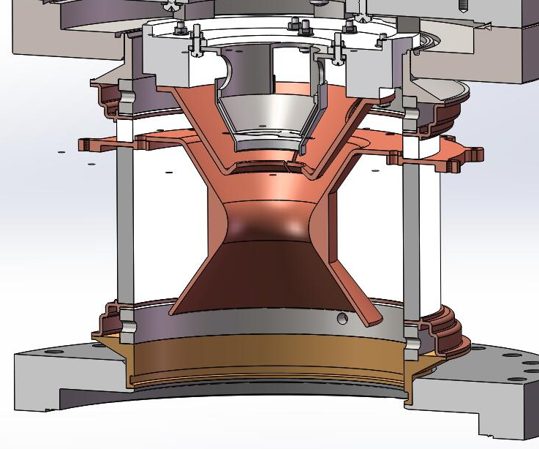
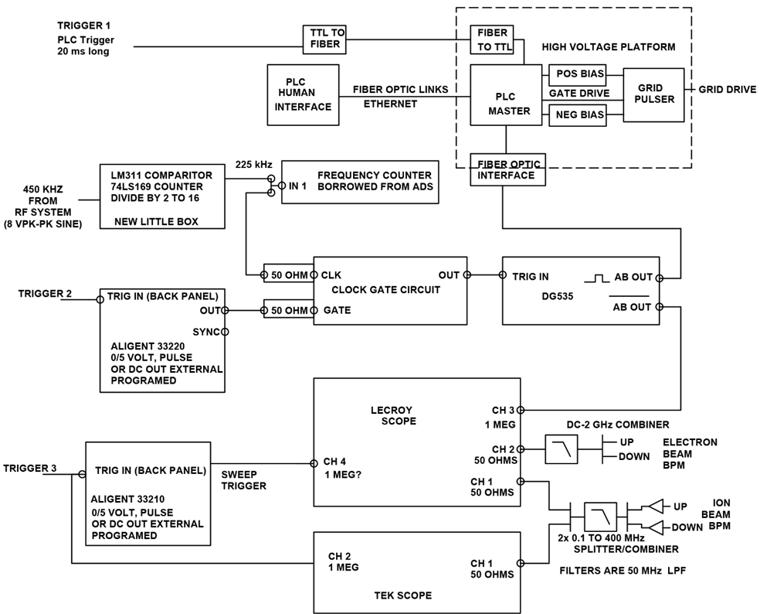
Pulsed e-beam generation
EC35 @HIRFL CSRm
The pulse generator is applied to provide a voltage on the grid to switch on/off the electron beam.
cathode
grid
anode
Pulsed electron beam can be measured by BPMs (blue) and ICT (red) in front of the collector.
L.J. Mao, COOL2017, TUP15
M.W. Bruker, Phys. Rev. Accel. Beams 24, 012801 (2021)
He Zhao, COOL25, NY, USA, October 27–31, 2025

Slide 11
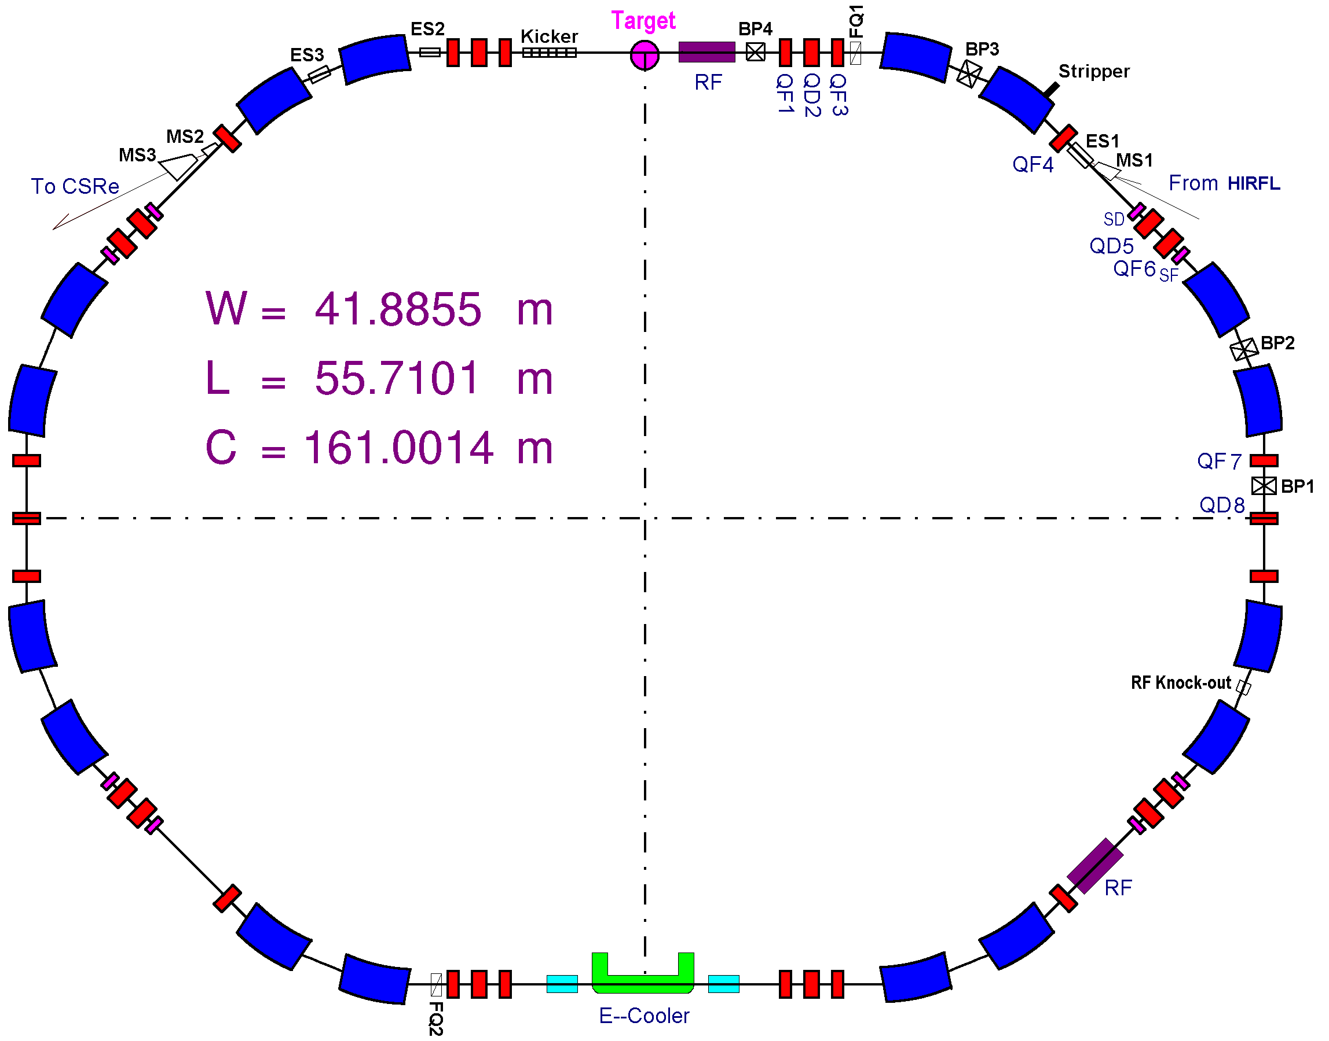
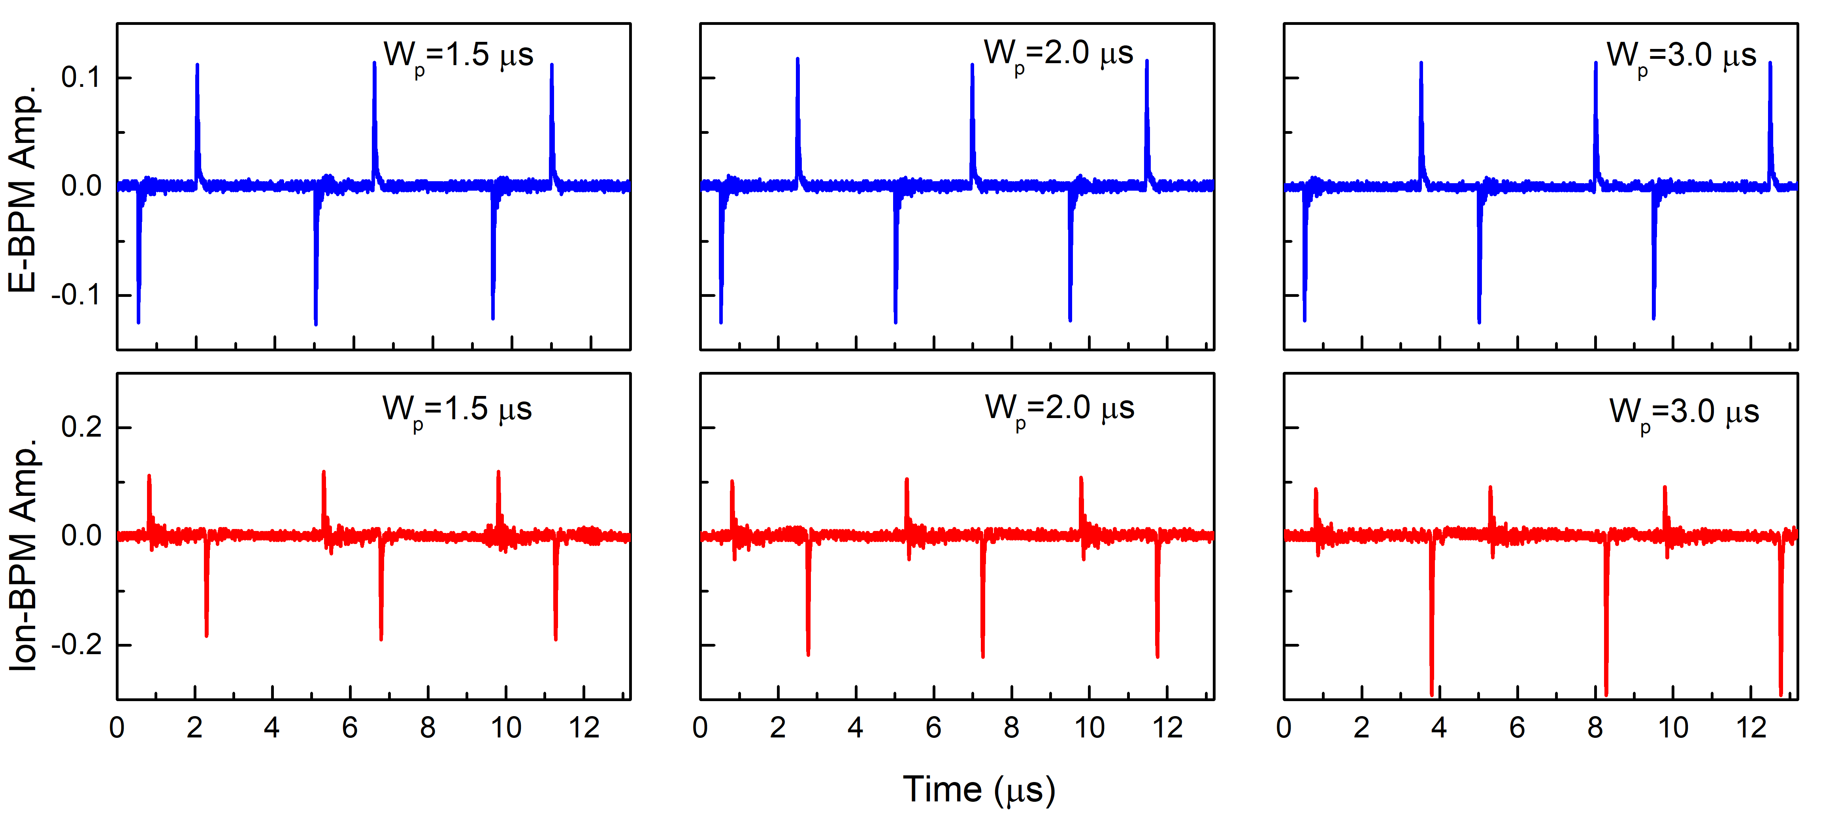
Cooling process using pulsed e-beam
Experiment @HIRFL-CSRm
Grouping effect – The coasting ion beam was been cooled to a pulse and the pulse width is same with the electron beam.
CSRm
7.0 MeV/u C⁶⁺ | Coasting
Particle number | 5.0 x 10⁸
Emittance (RMS) | */*
dp/p (RMS) | 2.0 x 10⁻⁴
Bunch length (RMS) | *
RF voltage | *
h | *
E-beam current (peak) | 30 mA
E-beam diameter | ~30 mm
Pulse width | 0.5-3.0 μs
Rising/falling time | 10 ns
He Zhao, COOL25, NY, USA, October 27–31, 2025

Slide 12
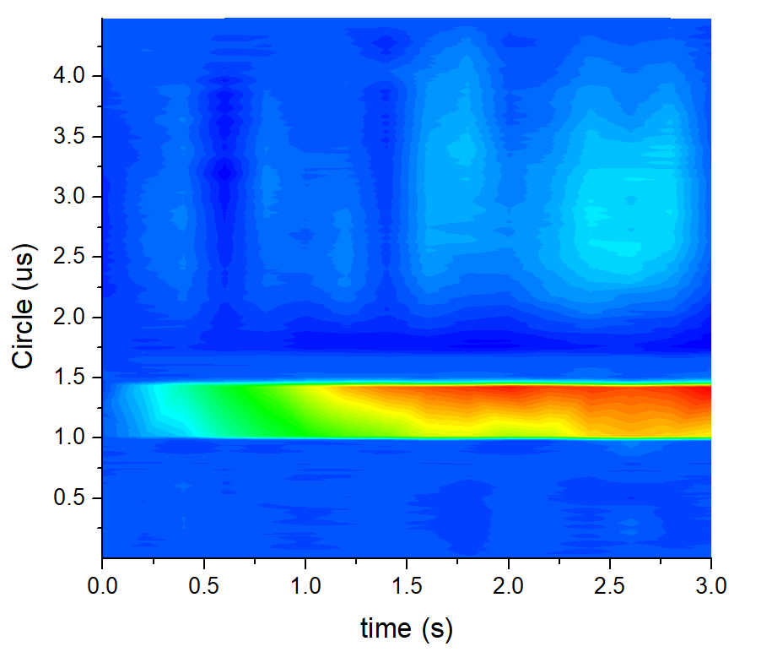
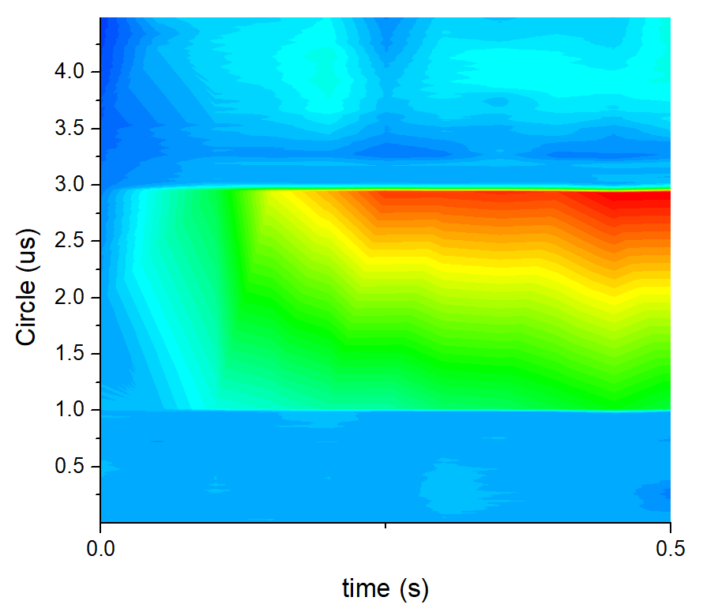
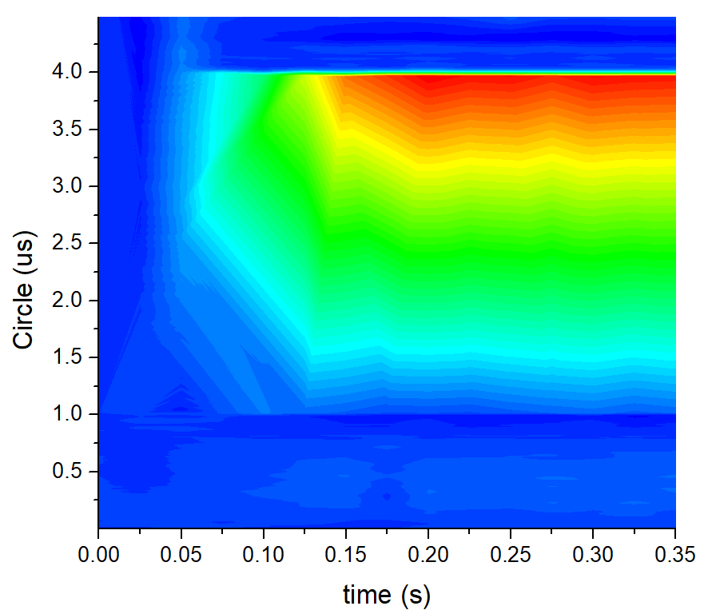
Cooling process using pulsed e-beam
Experiment @HIRFL-CSRm
Longitudinal beam profile of the ion beam is slowly grouped to a pulse during the cooling process
Nonuniform intensity distribution of the ion beam has been identified.
E=67.8 V/m
V_{BB}= 230.5 V
Bucket height =2.0e-4
W_{p}=3.0 μs
W_{p}=2.0 μs
W_{p}=0.5 μs
He Zhao, COOL25, NY, USA, October 27–31, 2025

Slide 13
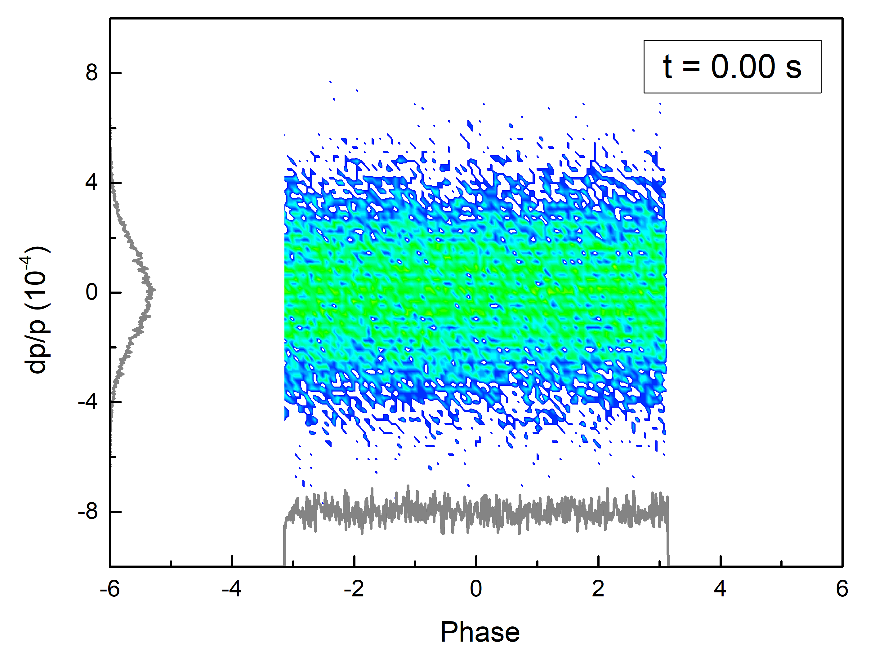
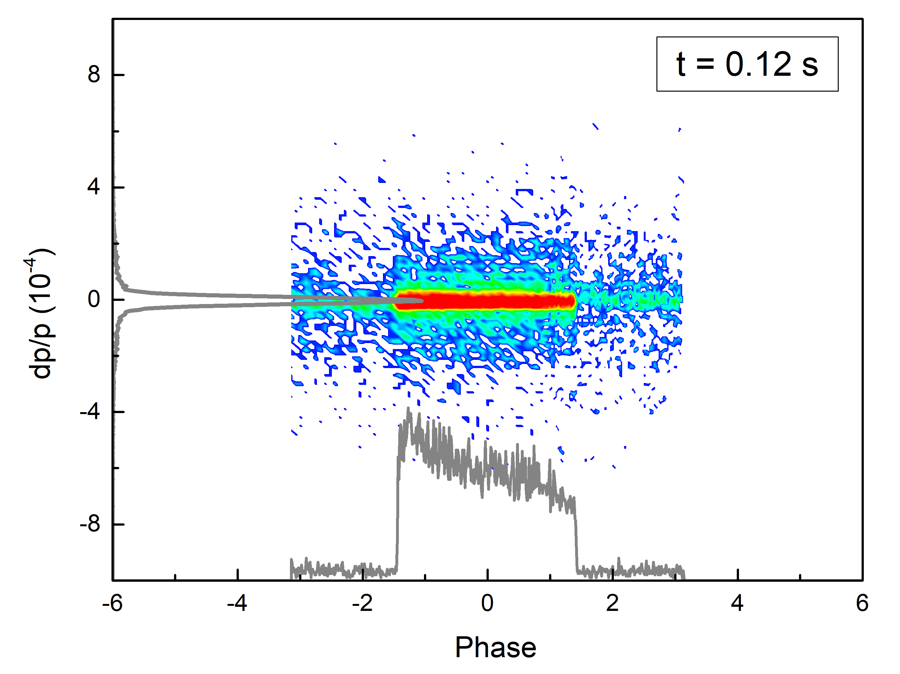
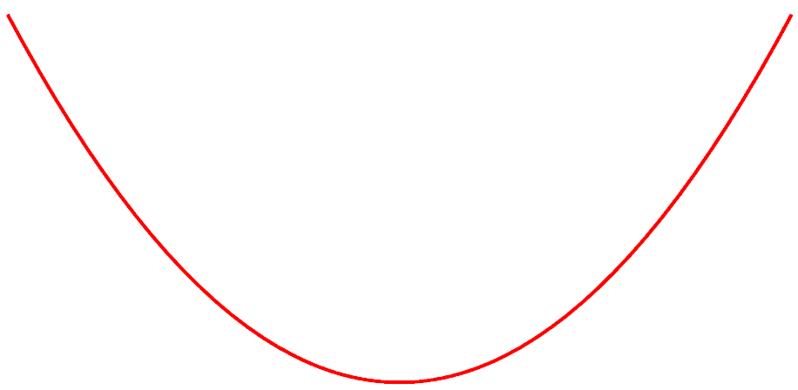
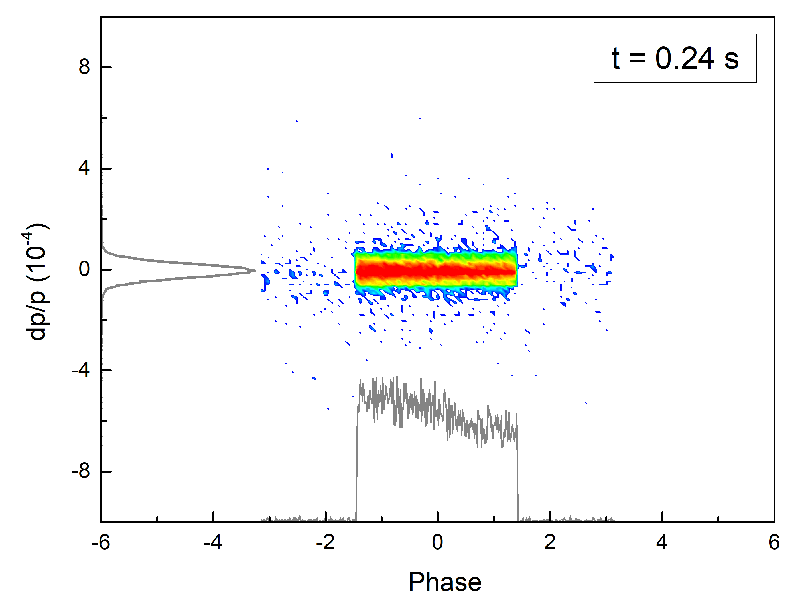
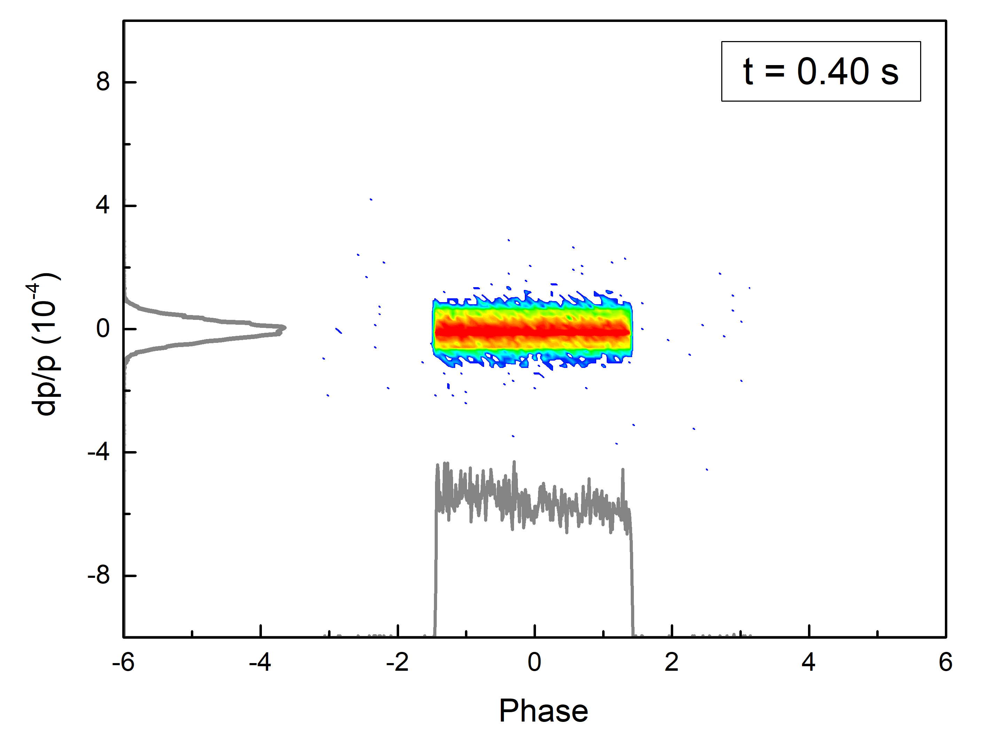

Cooling process using pulsed e-beam
Simulation
W_{p}=2.0 μs
Non-uniform distribution – the ions with a certain radius will be cooled to the positive momentum region in phase space
E-beam velocity deviation
$$\frac{ΔV}{V}$$
electron
r
ion
He Zhao, COOL25, NY, USA, October 27–31, 2025

Slide 14
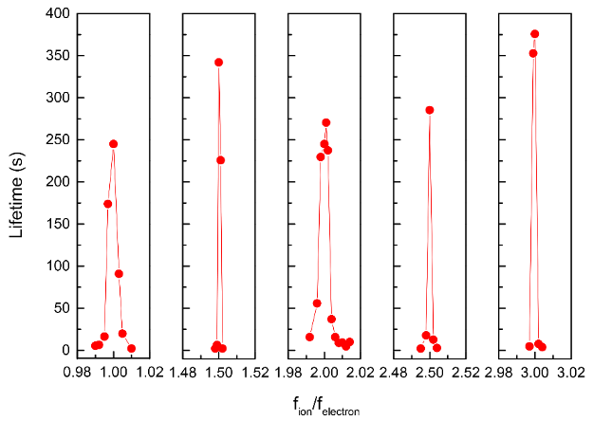
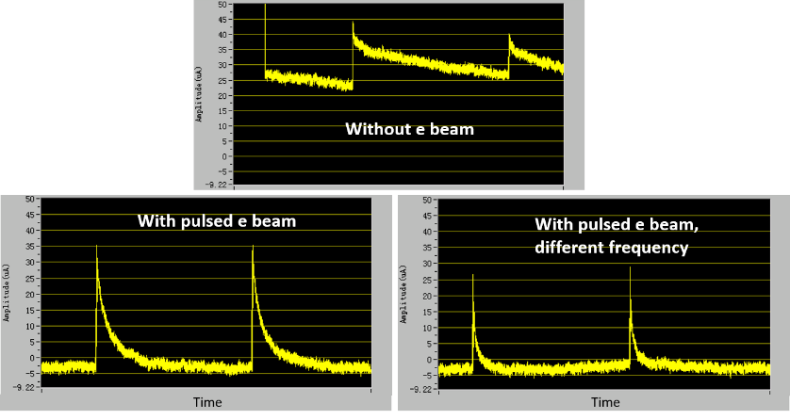
Cooling process using pulsed e-beam
Lifetime issue
Beam lifetime – The beam lifetime was strongly affected by the repetition frequency of pulsed e-beam. The frequency of e-beam should be integer or half integer of the ion beam revolution period for a stable beam.
Beam lifetime (s)
f_{ion}/f_{electron}
He Zhao, COOL25, NY, USA, October 27–31, 2025

Slide 15
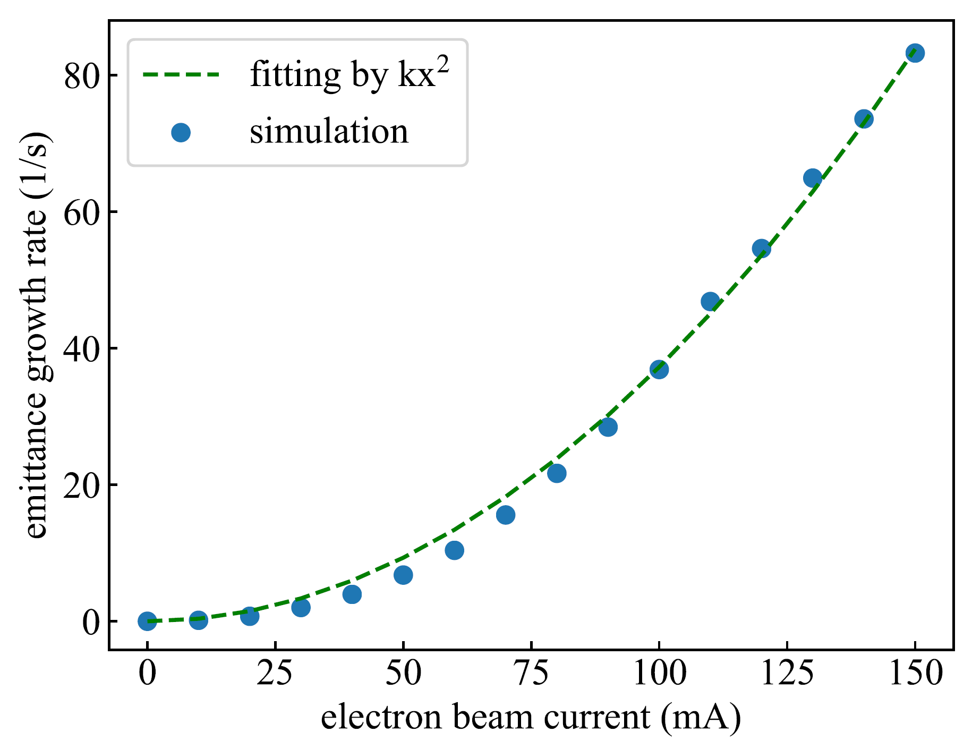
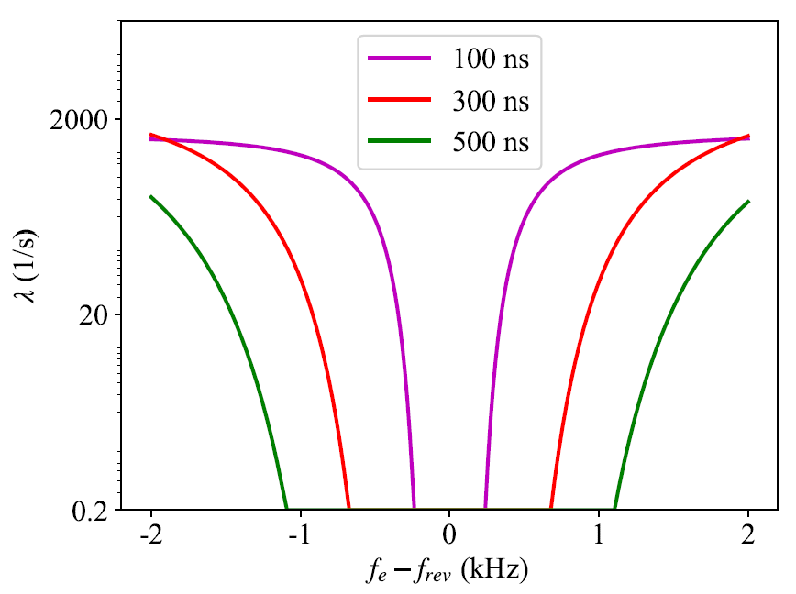
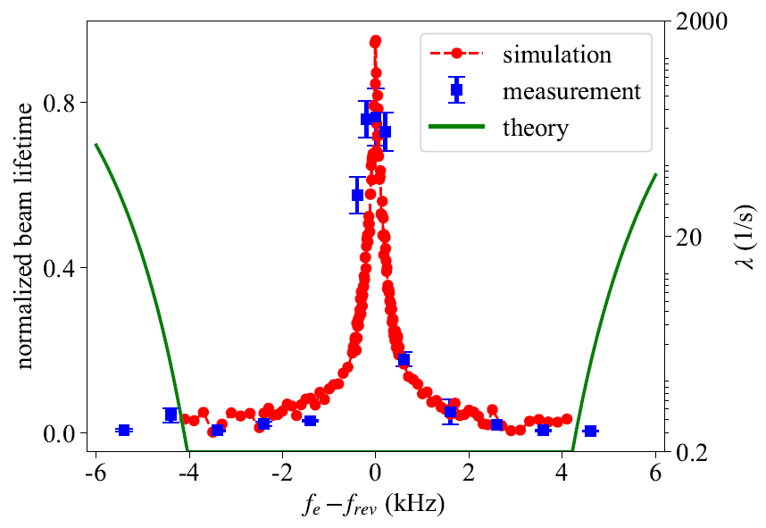
Cooling process using pulsed e-beam
Heating effect
E-beam space charge drives resonance in transverse direction and causes emittance growth
However, beam lifetime remains an issue
Resonance：
（∆ν_{peak} = 0.01, Q = 3.63, K = 7, ∆J/J = 1%）
Stable region：
G. Wang, Tech. Rep No. C-A/AP/536, BNL, 2015.
F. Ma, Nuclear Inst. and Methods in Physics Research, A 1033 (2022) 166731
He Zhao, COOL25, NY, USA, October 27–31, 2025

Slide 16
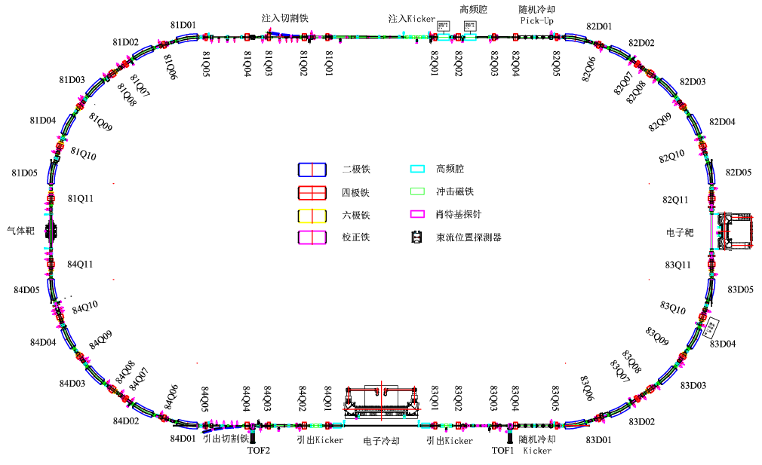
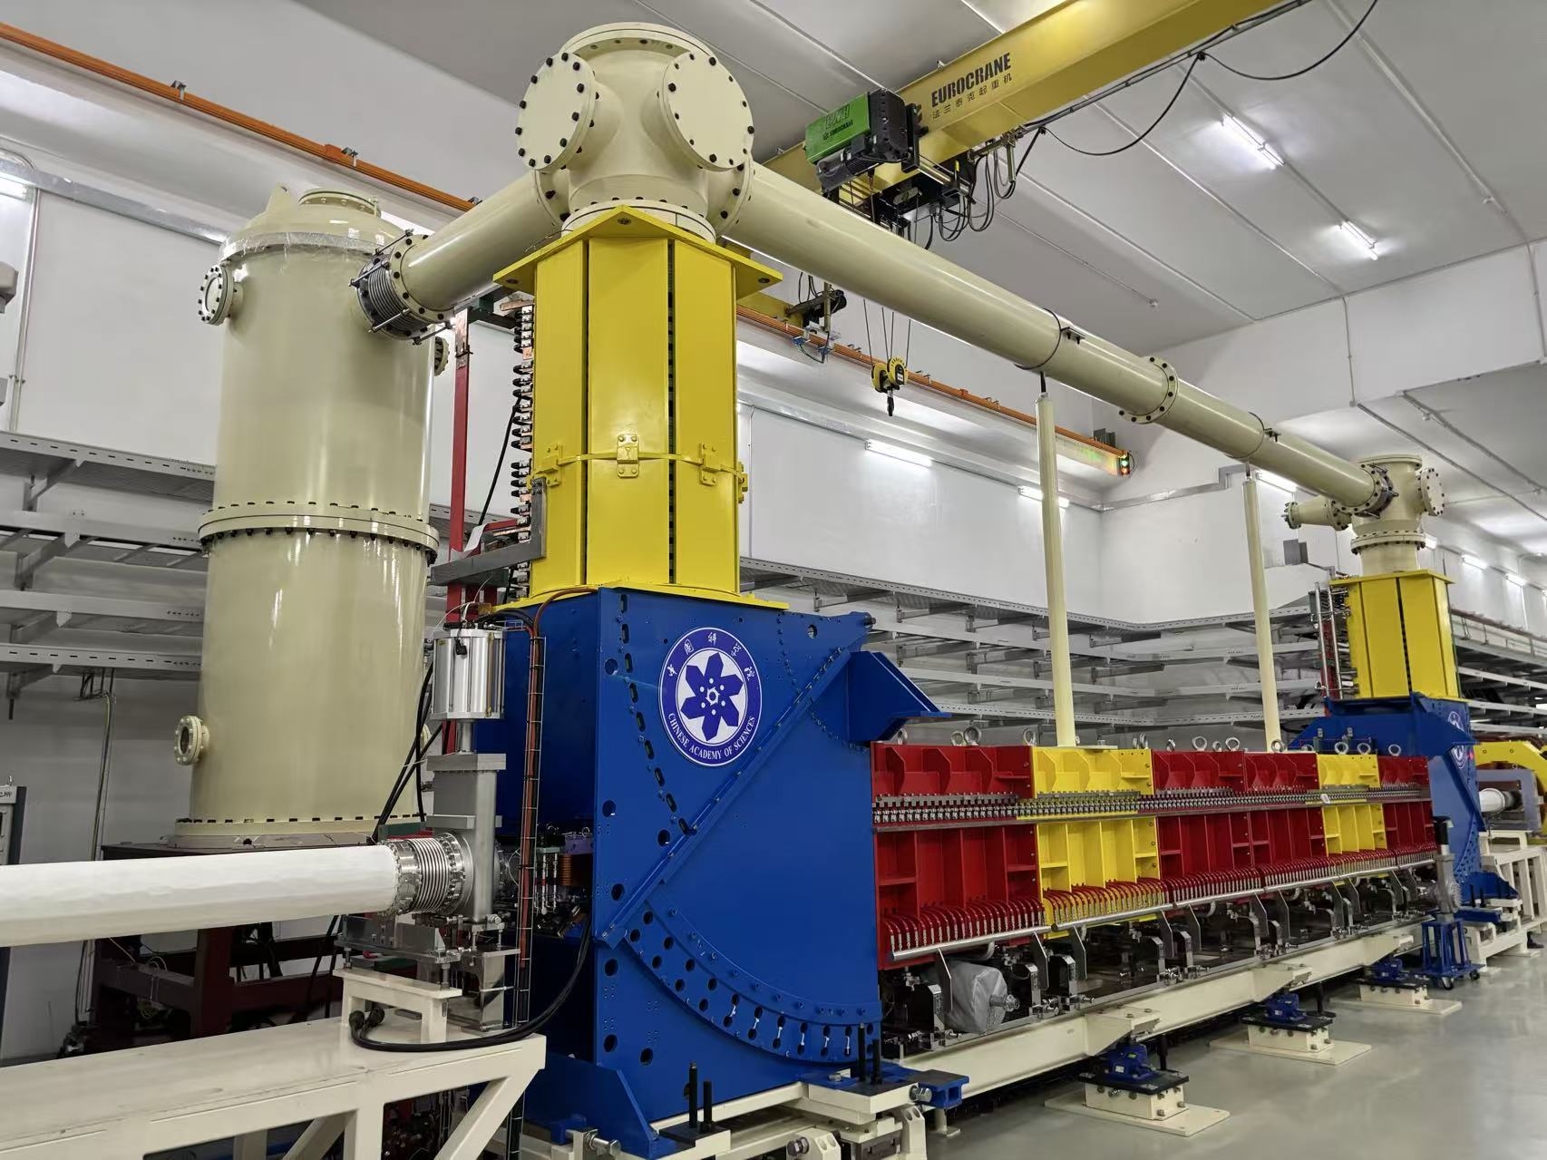
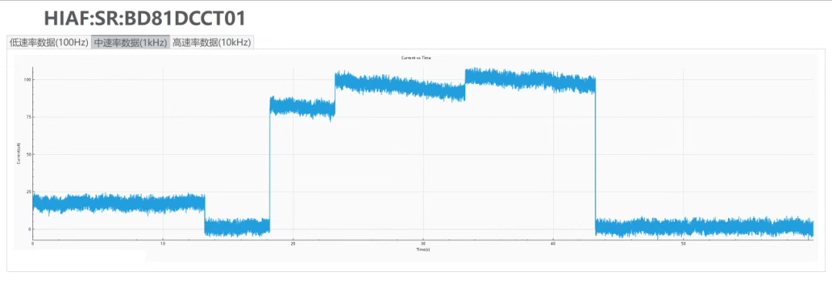
Future plan
HIAF SRing
ISO Mode
Ion spiese | RIBs（A<238）：neutron-rich, proton-rich
 | ¹³⁸Sn⁵⁰⁺（400.5MeV/u），¹⁰⁰Sn⁵⁰⁺（624.1MeV/u）
Normal Mode
Ion spiese | RIBs（A<238）：neutron-rich, proton-rich
 | ¹³²Sn⁵⁰⁺（740MeV/u），¹⁰⁴Sn⁵⁰⁺（740MeV/u）
IT Mode
Ion spiese | Fully stripped：H-like, He-like
 | ⁴⁰Ar¹⁸⁺，⁸⁴Kr³⁶⁺，¹³¹Xe⁵⁴⁺，²³⁸U⁹²⁺
He Zhao, COOL25, NY, USA, October 27–31, 2025

Slide 17
Summary
We propose a new beam stacking scheme based on pulsed e-beam, in which a barrier voltage and cooling effect can be realized simultaneously.
Simulation demonstrates that this approach is a promising technique for efficient beam accumulation in storage rings. Many factor will affect the process, optimization and limitation should be carefully addressed.
Experiment on HIRFL-CSRm have demonstrate the barrier voltage. And the results indicate that heating effect and beam lifetime are critical and should be further studied.
We expect this stacking method can be applied to accumulate RIBs and high-charged ions in low and medium energy storage rings for high-precision experiments, especially for the SRing of HIAF project.
He Zhao, COOL25, NY, USA, October 27–31, 2025

Slide 18
Thanks for your attention

