Slide 1


Beam dynamics studies for Low-energy Electron Cooler for Electron Ion Collider
Dmitry Kayran
A. Fedotov, Y. Jing, J. Kewisch, S. Seletskiy, G. Wang

Slide 2

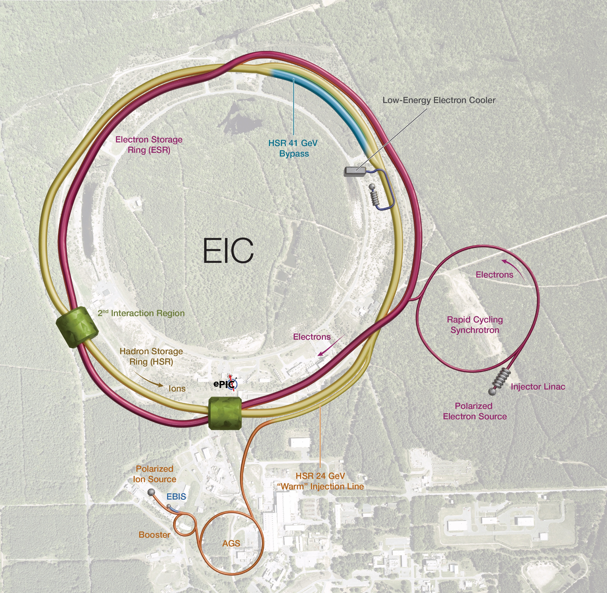
Outline
Required parameters
General layout
Beam Time structure
Longitudinal gymnastics
Transvers beam dynamics
Gun at lower voltage
Cathode off center operation
Laser jitter
Summary
RHIC IR2
LEC

Slide 3
Cooling Requirements for EIC
Low-Energy Cooling (LEC):
The goal of cooling at proton injection energy is to obtain initial proton parameters by cooling the vertical emittance from ~2 um to 0.3 um (rms normalized).
Cooling at injection energy of protons (24 GeV) requires a 13 MeV electron beam.
High-Energy Cooling (HEC) of protons:
High-Energy Cooling (HEC) system capable of fully counteracting emittance growth at collision energies (41, 100, and 275 GeV) would greatly improve luminosity in the EIC.

Slide 4
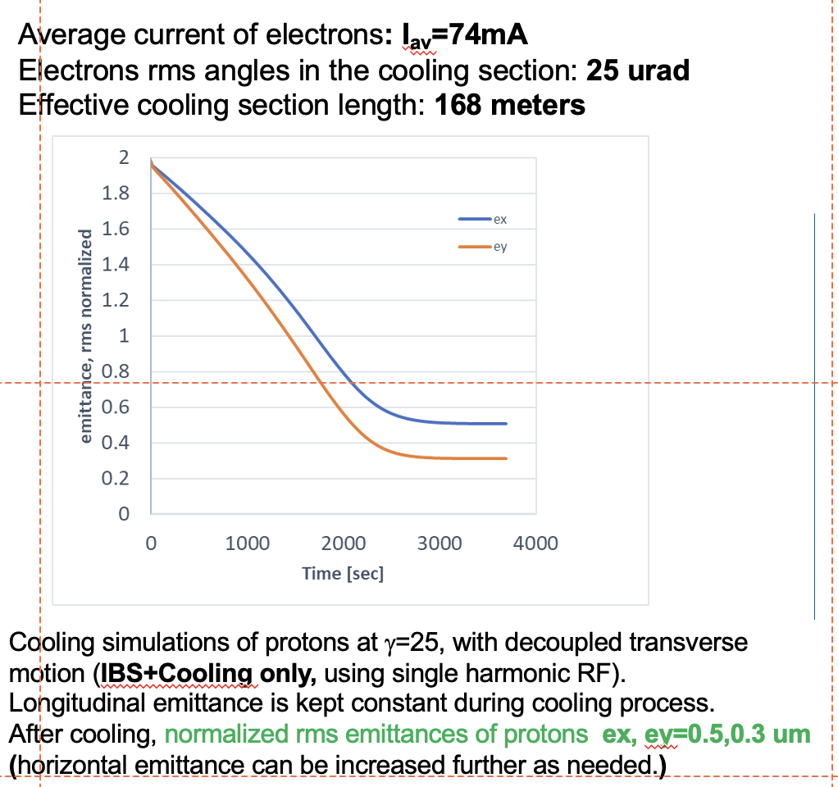
EIC LEC Required Parameters *
​ | electrons​ | protons​
Relativistic factor gamma | 25.4​ | 25.4​
RF frequency, MHz​ | 197​ | 24.6​
Cooling section length, m​ | 168​ | 168​
Cooling sections beta function, m​ | 150​ | 100-200​
Hadrons Dy, Dy’, m, rad​ | ​ | <1, <0.02​
Total charge per proton bunch, nC​ | 3​ | 45​
Electrons kinetic energy, MeV​ | 12.5​ | ​
Electron average current, mA​ | 74​ | ​
Normalized emittance, rms, um​ | <1.5​ | 2​
rms bunch length, cm​ | 4​ | 100​
rms dp/p​ | <5e-4​ | 6e-4​
Angles in cooling section, urad​ | 20-30​ | 20​
* See Alexei Fedotov’s talk, TUA1 at this conference

Slide 5
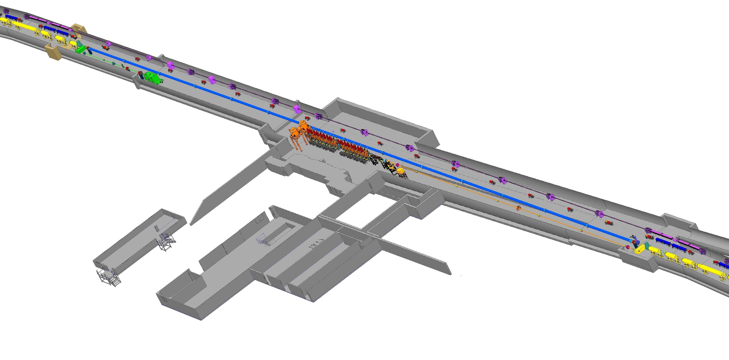
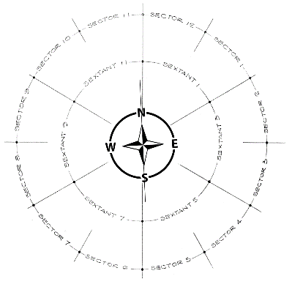
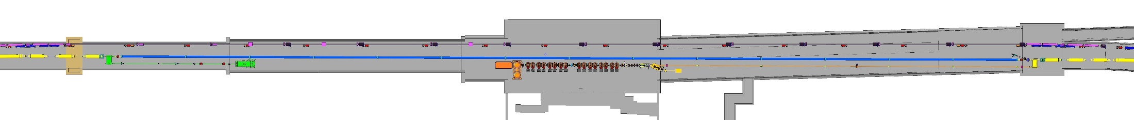
Low-Energy Cooler (LEC) Layout
2 o’clock
SECTOR 1
IP2
SECTOR 2
COOLING ~168 meter

Slide 6
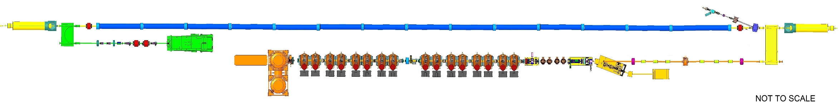

LEC schematic layout at IR2 @EIC
The LEC is scaled up version of LEReC: more RF cavities, longer cooling section, higher beam current.
RF diagnostics line with Deflecting cavity
180°Dipole
(U-turn)
LEReC Cooling Solenoids
180° Dipole
Spectrometer
Mu-metal shielding
Quad
cooling
RF diagnostic
hadron
hadron
hadron
e⁻
HSR
e⁻
HSR
e⁻
extraction
transport
injection
Injector test
SC Quad
PM
Cathode transport
PM
PM
Solenoids
Laser
197 MHz
130 kW Beam Dump
Extraction line
930 kW Beam Dump
4x 591 MHz
NCRF correction Cavities
Not to scale
DC Gun
400kV
Injector/linac
Test line
24MHz
RF cavity
16x 197 MHz
NCRF LINAC
Later we add one more 197 MHz cavity at the end of the transport line to allow fine energy and energy spread tuning
6

Slide 7
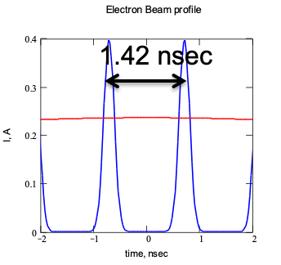
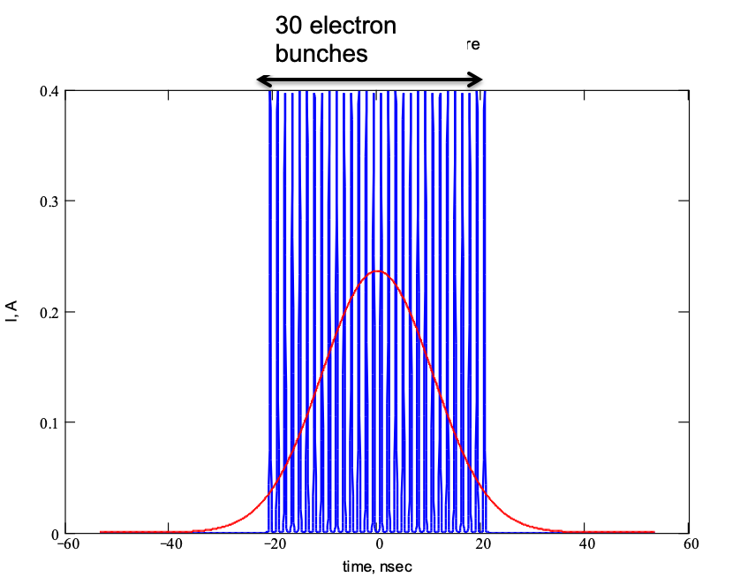
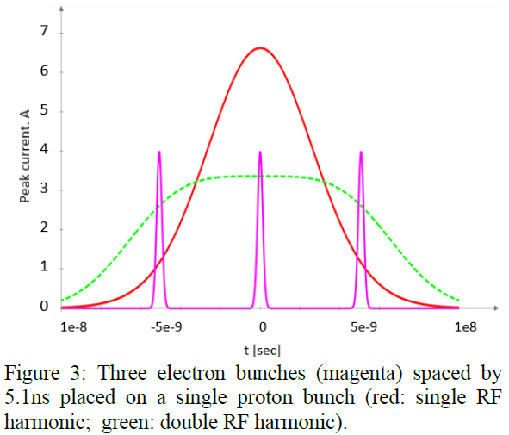
Beam time structure
LEReC used similar multi bunches electron structure to cool hadrons at RHIC
Use several electron bunches per hadron bunch to reduce bunch charge requirement per electron bunch
LEReC beam structure in the cooling section γ= 4.1 (E_{ke}=1.6 MeV)
LEC beam structure in the cooling section
γ= 25.4 (E_{ke}=12.5 MeV)
Electrons: f=704 MHz, RMS length=3 cm,
Q_e=100 pC , I_peak=0.4 A,
Hadrons: rep.rate 9.3 MHz, RMS length 3 m,
Electrons: f=197 MHz, RMS length=4 cm,
Q_e=1 nC , I_peak=4 A,
Protons: rep.rate 24.6 MHz, RMS length 1 m,

Slide 8
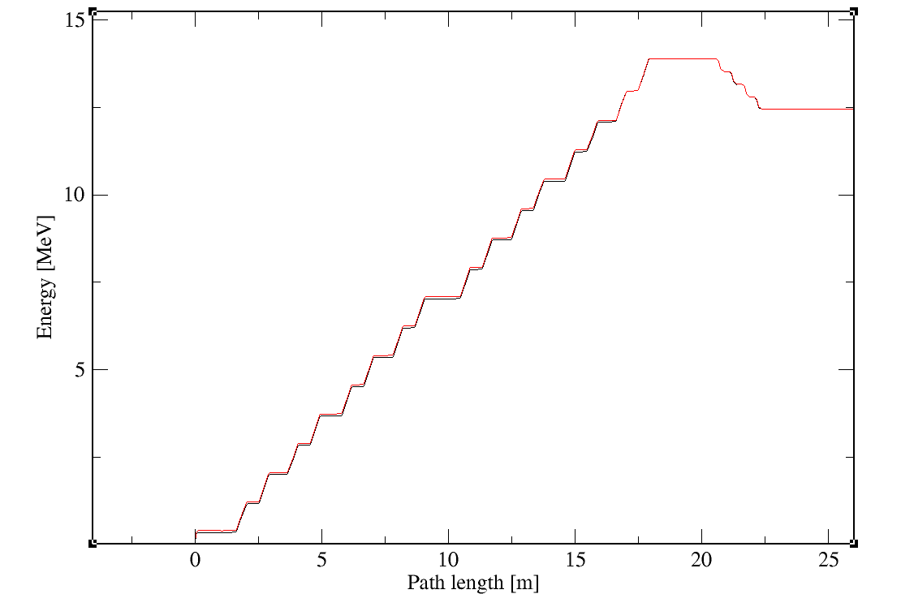
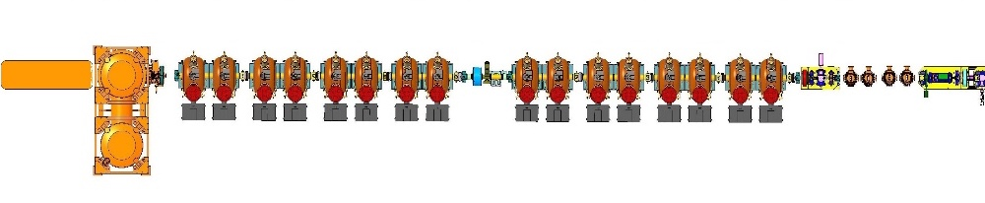
Layout description (Accelerator)
DC gun provides beams up to 0.4 MeV
Set of the 197 MHz NC cavities brings up energy and compensate space charge induced energy chirp
Set of 3rd harmonic NC cavities (4x591 MHz) corrects correlated energy spread and brings beam energy to the required energy
Low frequency 24 MHz cavity installed downstream in the transport line (not shown) to compensate effect of beam loading from 1st to 3rd bunch in the macro bunch
e⁻
DC gun
4x 591 MHz RF cavities
16x 197 MHz RF cavities

Slide 9
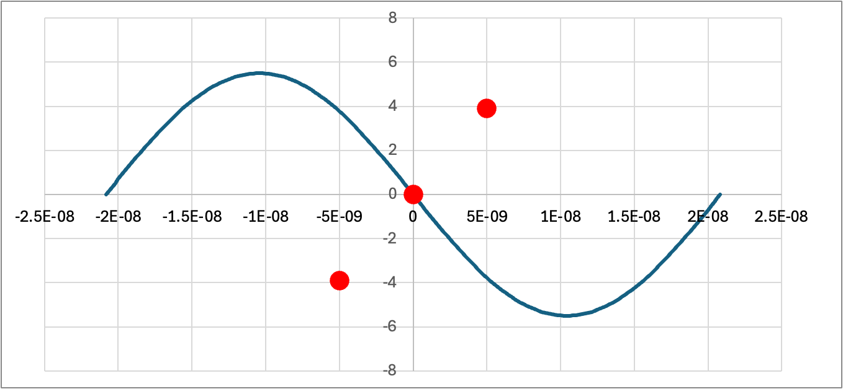
Beam loading effect on final beam energy
 | 197 MHz | 591 MHz
Frequency [MHz] | 197.0508 | 591.1524
Tuning range [MHz] | ±0.12 | -0.5~+1.0
Total Voltage [MV] | 13.6 | 1.5
# of Cavities | 17 | 4
Voltage per cavity [kV] | 800 | 400
R/Q cir. [Ω] | 170 | 96
Q0 | 48000 | 34000
FPC Qext | 24000 | 34000
Pcav [kW] | 60 | 25
Pbeam [kW] | 60 | -
RF power [kW] | 70+70 | 35
Wake Loss Factor [V/pC] | 0.167 | 0.275*
Voltage droop from 1 to 3 bunches [keV] | 0.32 | 0.55
For operation using 3x1nC bunches :
Energy difference between 1st and 3rd bunches could reach
Results of 17 (197 MHz) cavities
dE_{197MHz}= 5.6 keV
Results of 4 (591 MHz) cavities
dE_{591MHz}=2.2 keV
Maximum accumulated effect:
dE_{max}/E=7.8 keV/13 MeV=6x10⁻⁴
Will use low frequency (24 MHz) cavity 5 kV to minimize energy difference between e-bunches
dE [kV]
1
2
t [s]
3

Slide 10
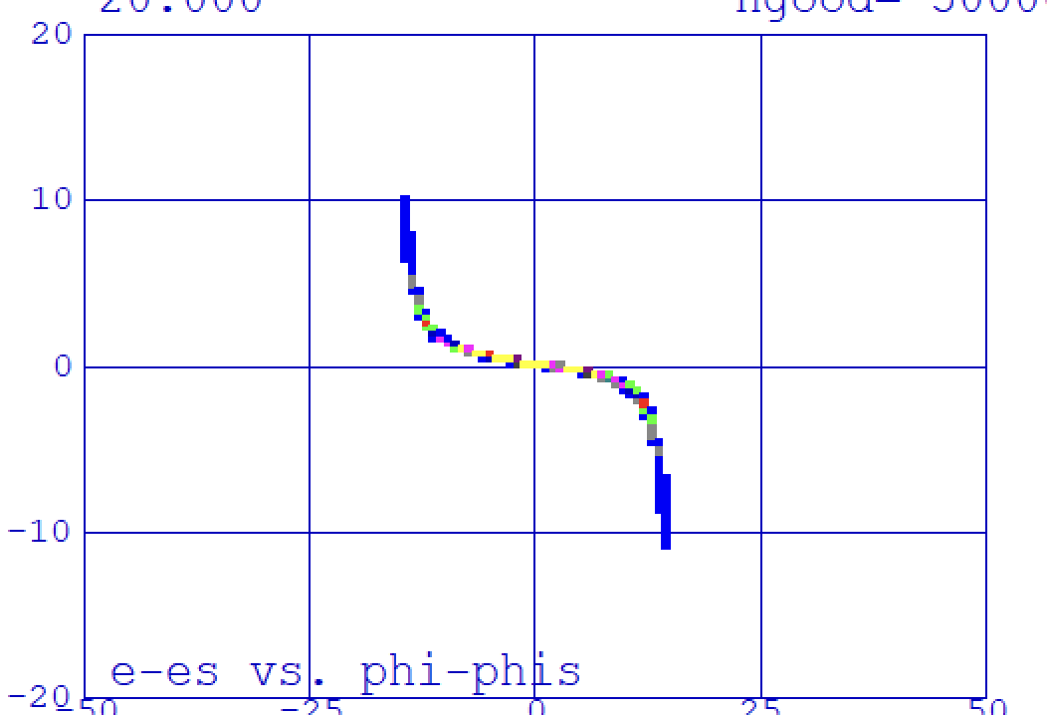
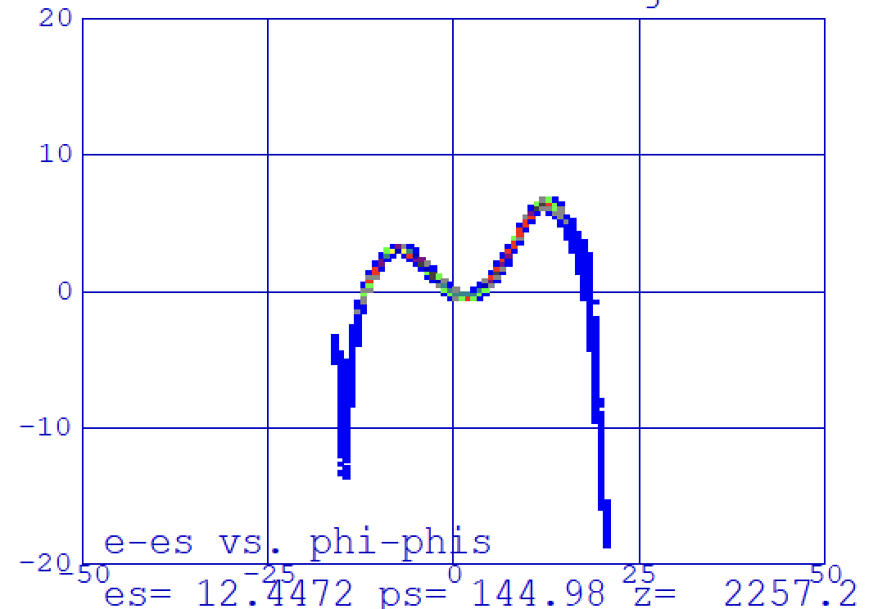
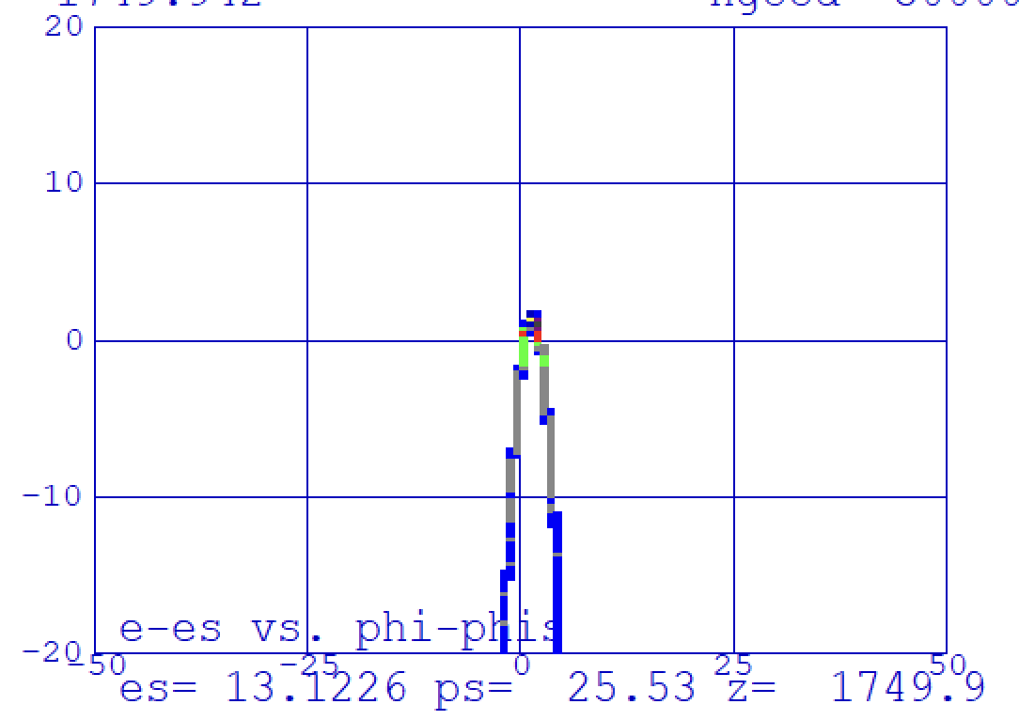
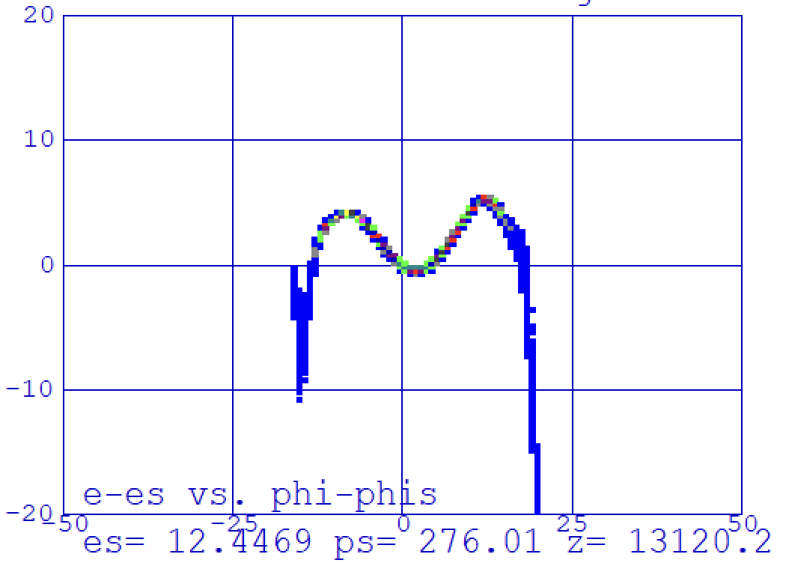
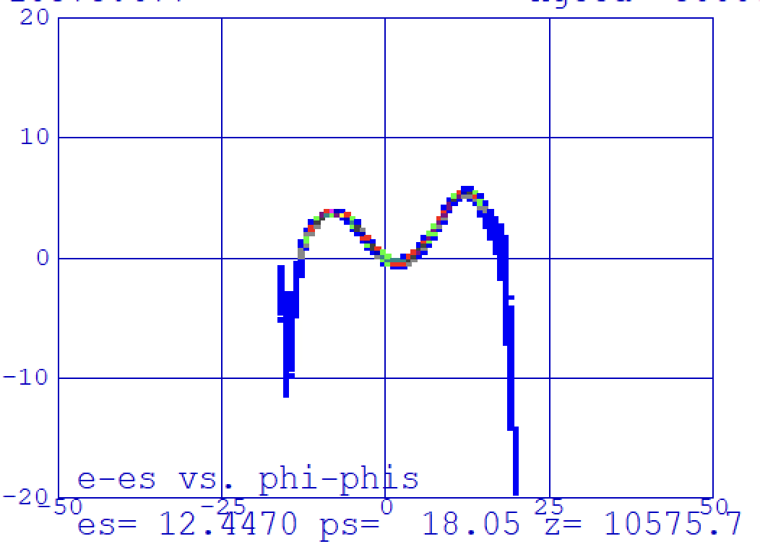
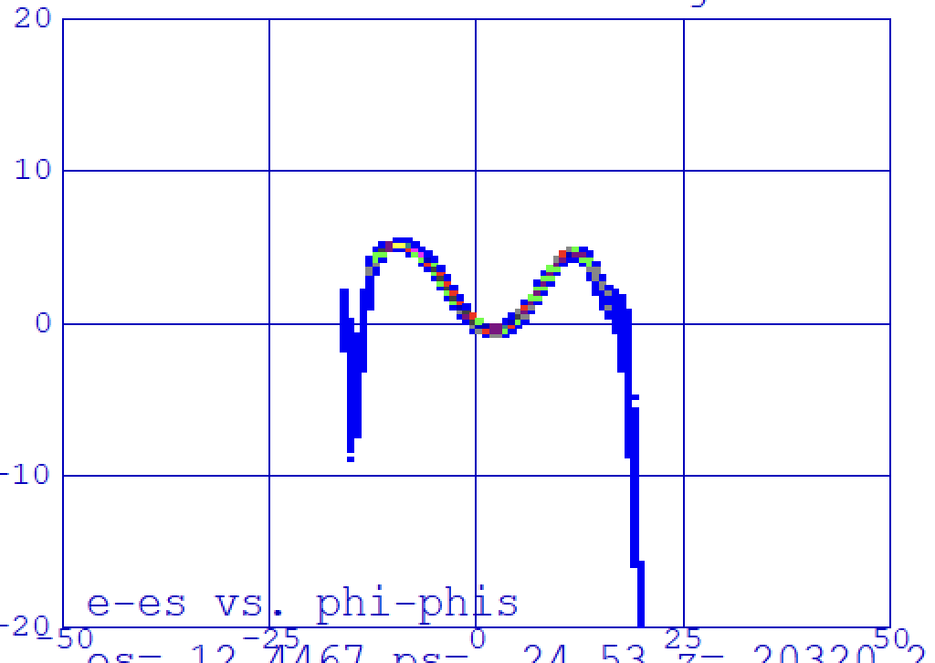
Longitudinal dynamics (phase space)
At the entrance to the 1st cavity
At the end to the 16th cavity
At the end of the LINAC
RMS energy spread ~2.5 e-4 along the cooling section
At the beginning of the cooling section
At the center of the cooling section
At the end of the cooling section

Slide 11
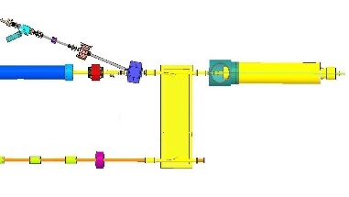
Layout description (transport and cooling section)
In transport line we use solenoids every ~10 m to control and match transvers bunch size from the accelerator to the cooling section
A single 180-degree (non achromatic) turn-around dipole
merges electron bunches with hadron bunches into
the cooling section
2 quadrupoles at each ends of the 180d dipole are
installed for fine matching electron bunches into the cooling section
In the cooling section, we placed solenoids every 12 m to keep angular spread under control and use u-metal shielding to cover rest of the colling section
12 m
12 m
12 m
12 m
12 m
12 m

Slide 12
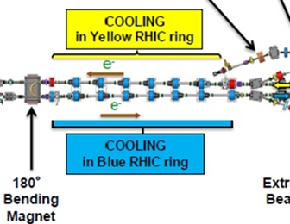
180 degree single magnet turn around
Same idea works well at LEReC: merging cooling sections in YELLOW and BLUE rings is single 180 degree magnet with 35 cm radius
R=65 cm
Energy spread: 5E-04
Bunch size /Angular spread in the cooling section : 3 mm /20 urad
Then requirement for the dispersion
D << 6 m and D’ << 0.04
By design after the magnet: D=1.3 m and D’=0
Beam dynamics simulations confirms there is no emittance degradation as a result of this dipole

Slide 13
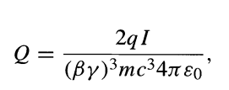
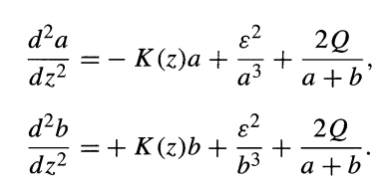
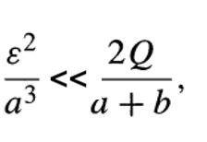
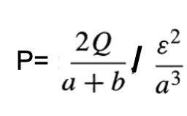
LEC: Space charge dominated beam dynamic
Envelope equation*
PLEC/LEReC = 2
where:
Space charge dominated regime
Space Charge effect term
Emittance effect term
Space Charge effect domination parameters
​ | LEC | LEReC
gamma​ | 25.4​ | 4.1​
Single bunch charge, nC​ | 1 | 0.1
Electron peak current, A​ | 4 | ​0.4
Emittance, rms, nm​ | 60 | 500​
Bunch size, rms, mm​ | 3​ | 4
P (space charge/ emittance) | 37 | 24
P_{LEC}/P_{LeRHIC}=1.6
*) https://cds.cern.ch/record/1120227/files/p115.pdf

Slide 14
Simulations approach
Space charge effect dominated beam dynamic from start to end
Beam dynamics simulation/optimization were conducted using code PARMELA
PARMELA is a well recognized code when space charge plays important role
The benchmark PARMELA simulation results with other codes (GPT, IMPACT-T) just started
The first prelaminar results shows a good agreement between PARMELA and IMPACT-T
For all simulation we are using initial bunch distribution: beer-can, with pulse length of 400 ps and radius at the cathode of 2 mm

Slide 15
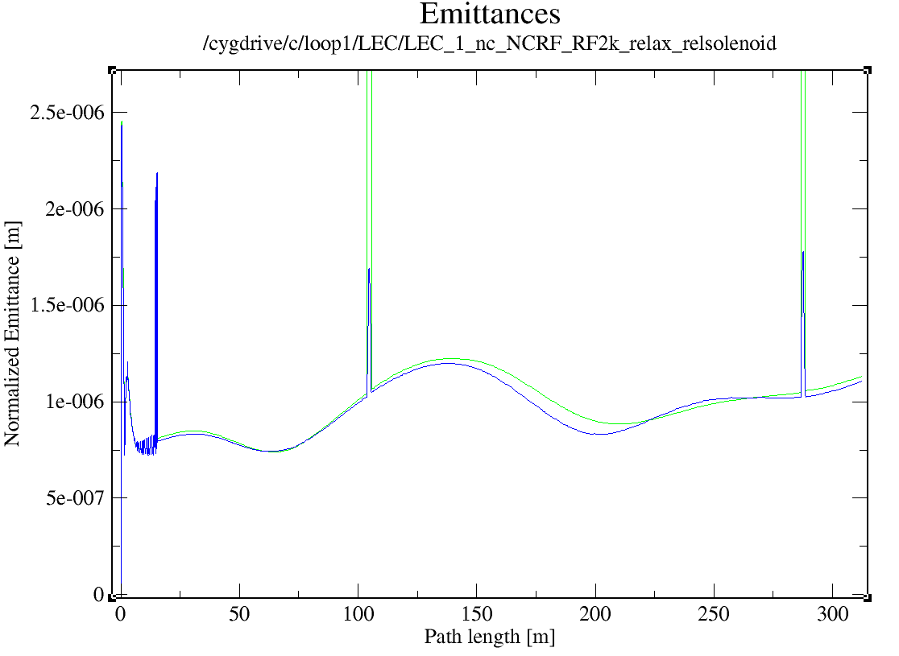
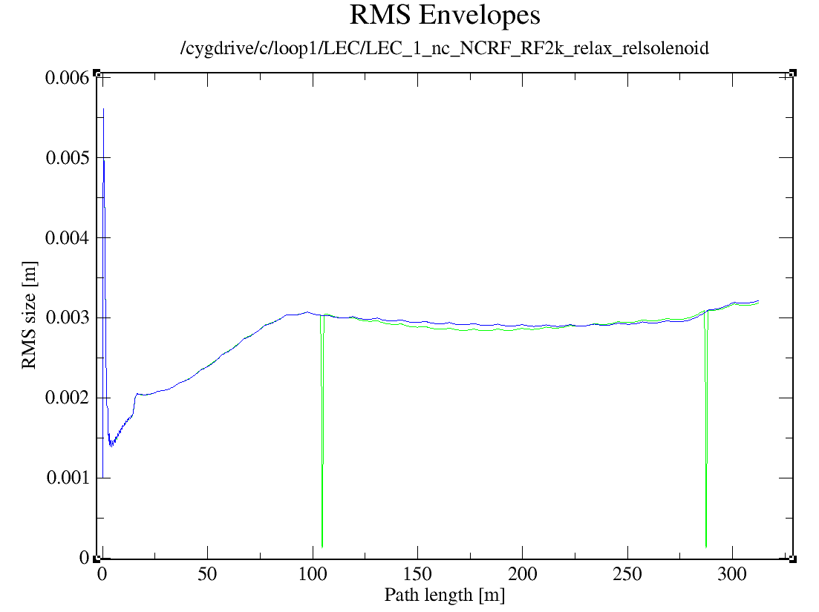
Gun-to-dump simulations results: single bunch charge of 1 nC
requirements
requirements
cooling section
cooling section
Results:
Normalized rms emittances <1.5um
RMS bunch size 3 mm.

Slide 16
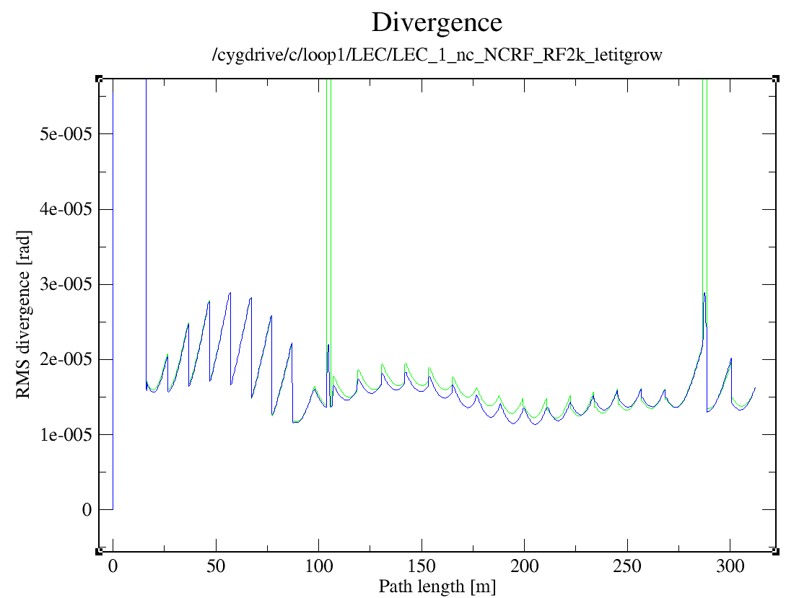
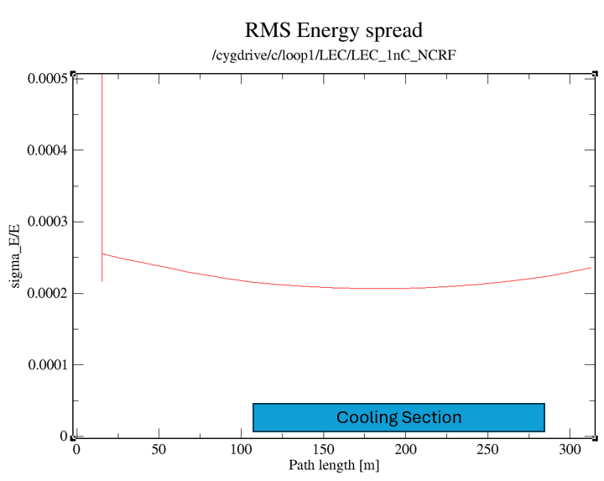
Gun-to-dump simulations results: single bunch charge of 1 nC (continue)
requirements
requirements
Cooling Section
Results:
RMS energy spread <4e-4
Electron beam divergence in the cooling <20 urad.

Slide 17
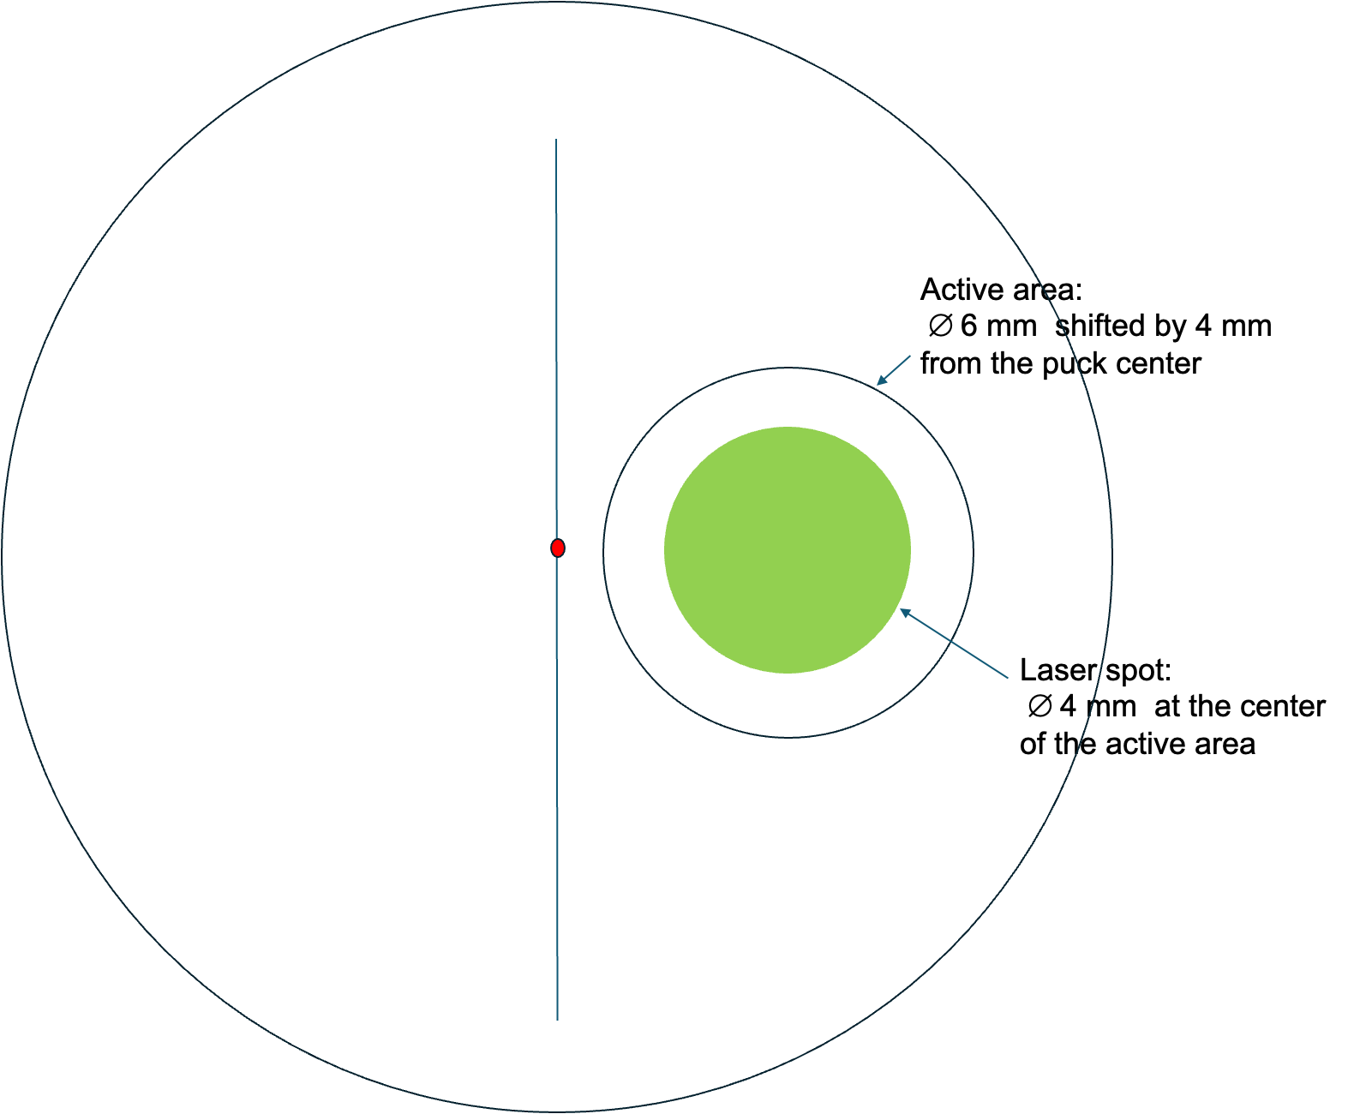
High current operation challenges and mitigations
LEReC experience (as well as other labs ) DC gun high current operates more stable at lower voltage and with laser spot shifted from the center at the cathode
For example:
LEReC DC gun 20 mA - 30 mA routinely (hours) operates at 375 kV and demonstrated operation up to 60 mA at 350 kV
Laser spot was shifted by 4 and 6 mm from the center
LEC required operation at up to 74 mA
More high current studies are planned for this RHIC run
We studied beam dynamics at lower voltage and with laser spot shifted at the cathode
Cathode ~9mm

Slide 18
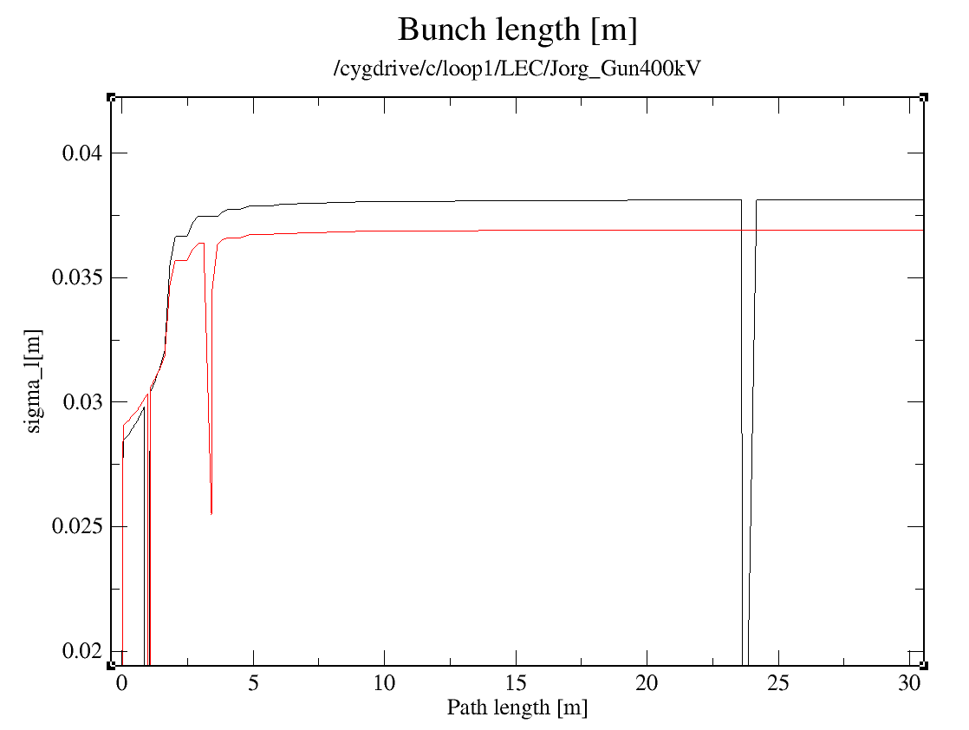
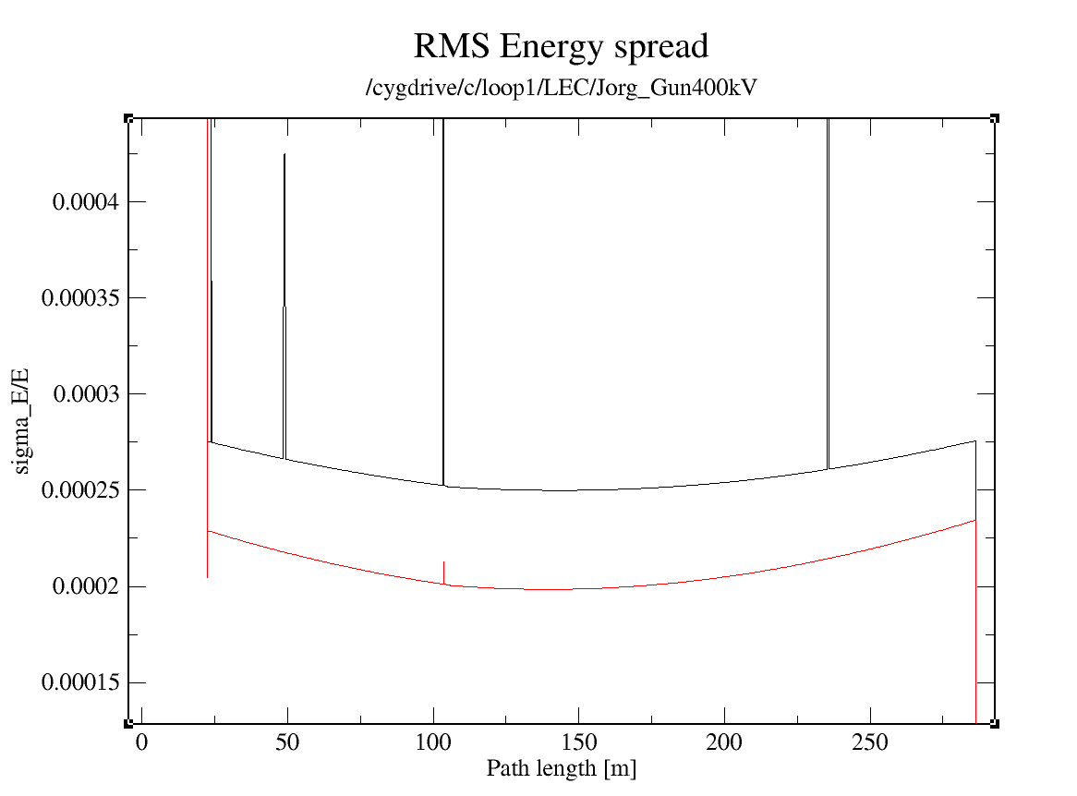
Side by side comparison: gun at 350 kV and gun at 400 kV
V_{gun}=350 kV
V_{gun}=400 kV
V_{gun}=350 kV
V_{gun}=400 kV
In the cooling section the bunch is slightly longer for the case with gun voltage of 350 kV vs 400 kV: 3.8 cm vs 3.65 cm
For longer bunches (gun voltage of 350kV), the energy spread is sightly higher: the minimum in the center of the cooling section: 2.5e-4 vs 2e-4
350 kV motivation to mitigate potential issue operate in CW modes

Slide 19
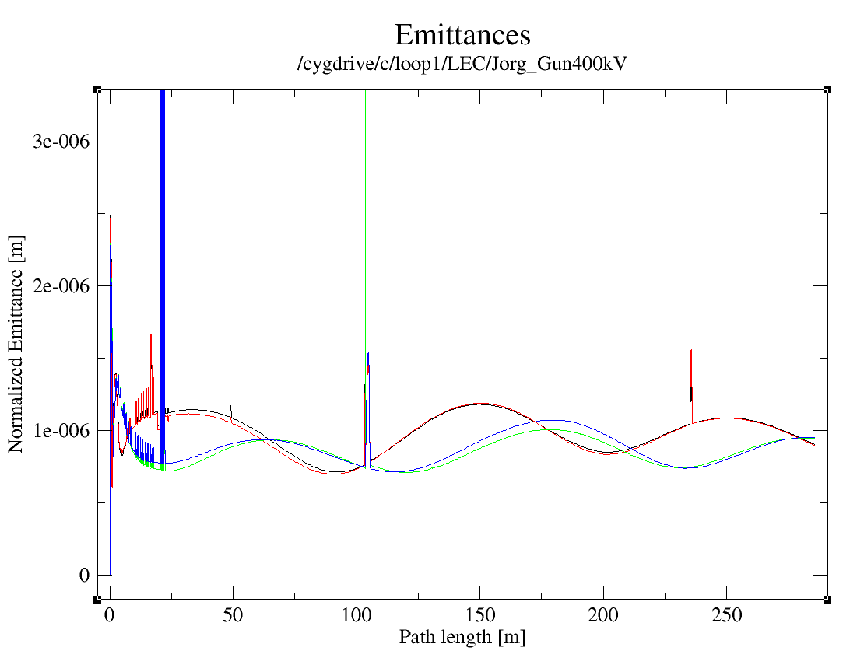
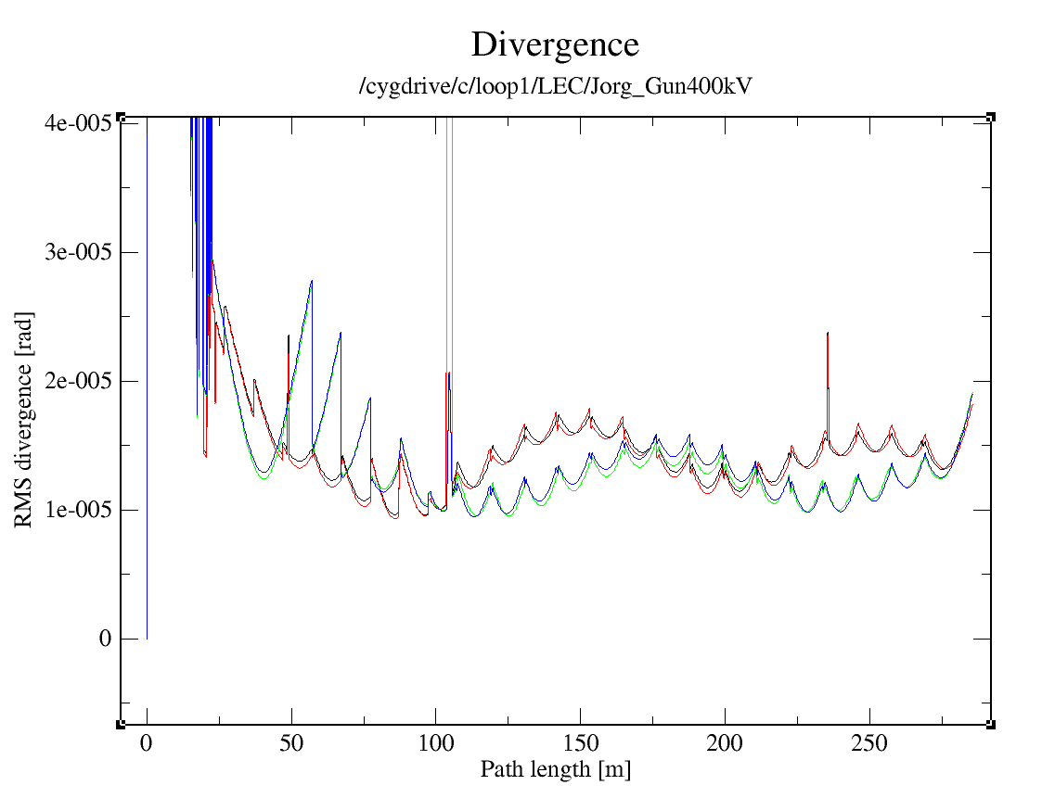
Side by side comparison gun at 350 kV and gun at 400kV (continue)
V_{gun}=350 kV
V_{gun}=350 kV
V_{gun}=400 kV
V_{gun}=400 kV
Results:
Normalized rms emittances <1.5um
Electron beam divergence in the cooling <20 urad.

Slide 20
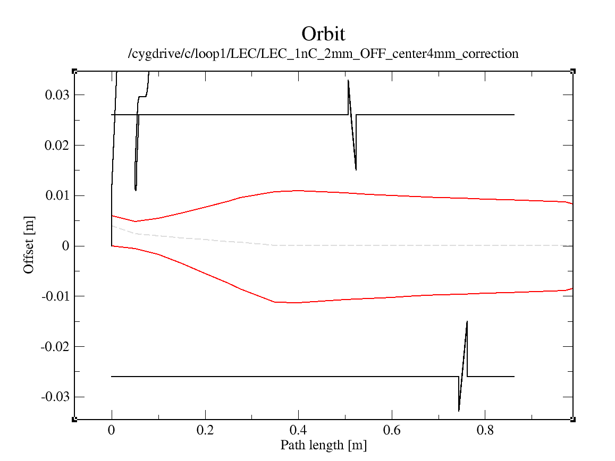
Operation with a laser spot shifted by 4 mm off the center
Laser out path
There is enough stay clear aperture with current LEReC laser box design
Bunch max/min particle trajectory
Gun axis
Cathode active area ∅ 6 mm shifted by 4 mm from the puck center
Laser in path

Slide 21
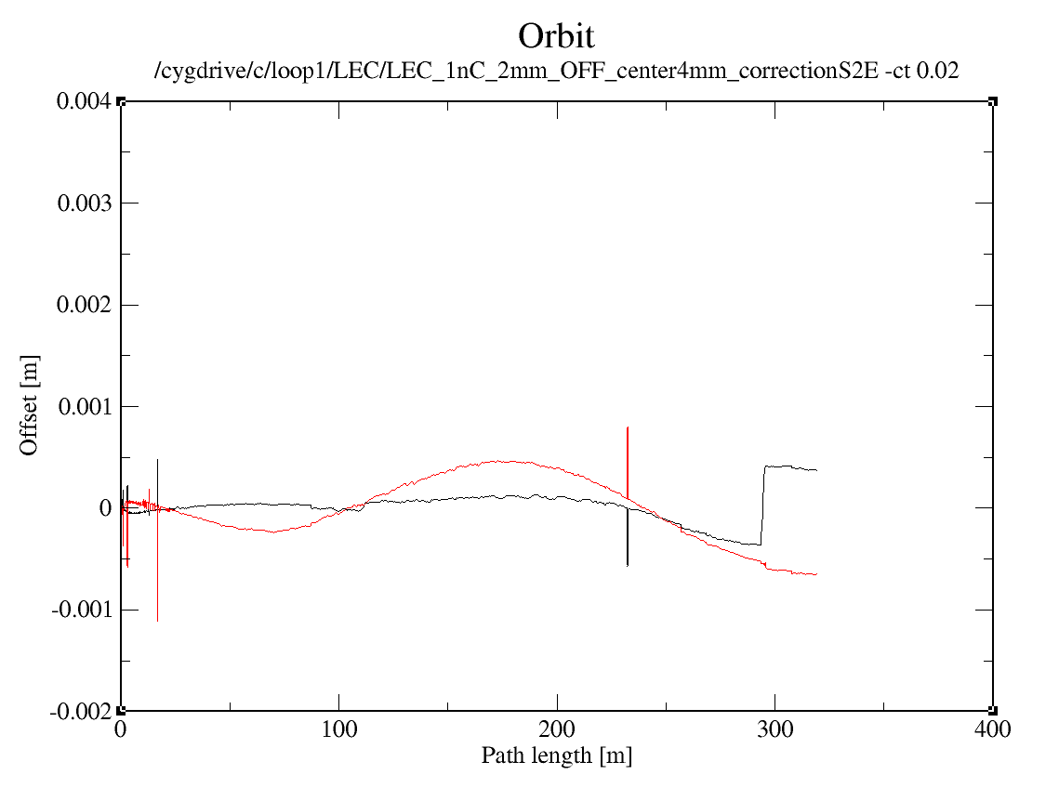
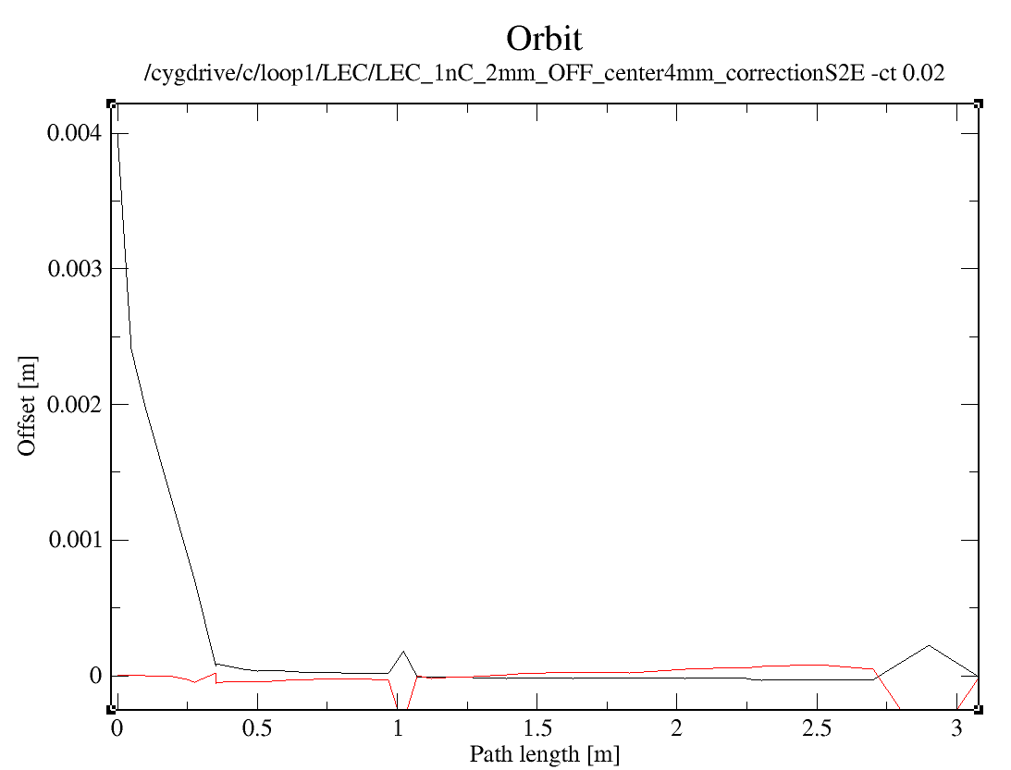
Gun-to-Dump simulations for bunch charge of 1 nC with 4 mm off center at the cathode
Zoom in to the gun region
Applying orbit correction right after the gun

Slide 22
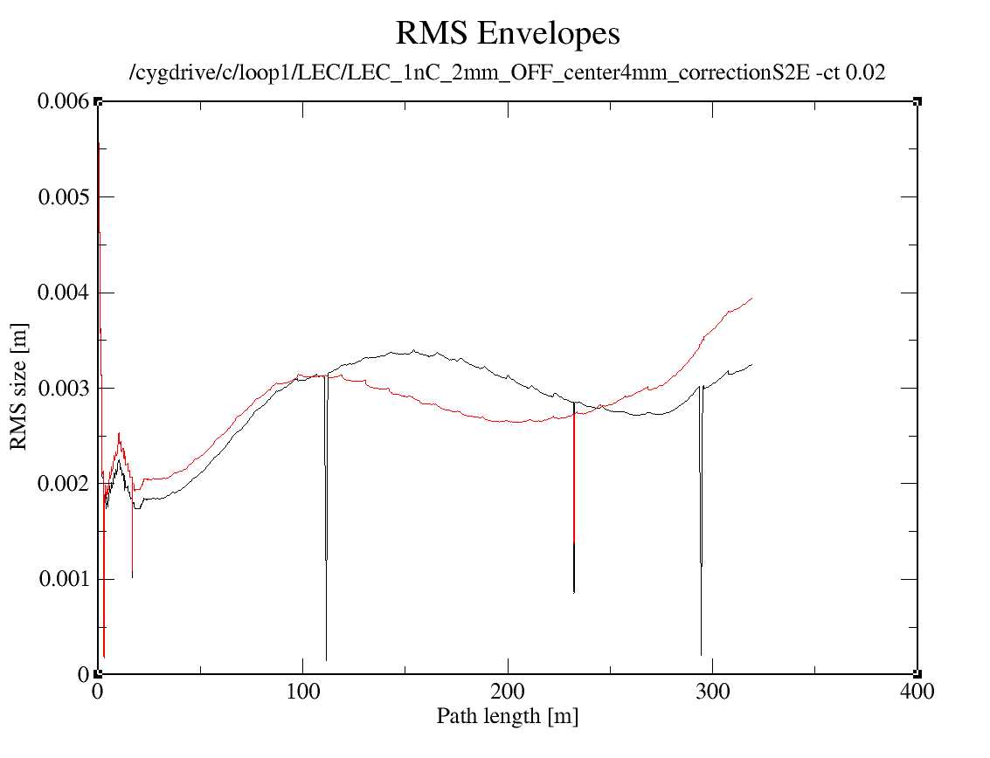
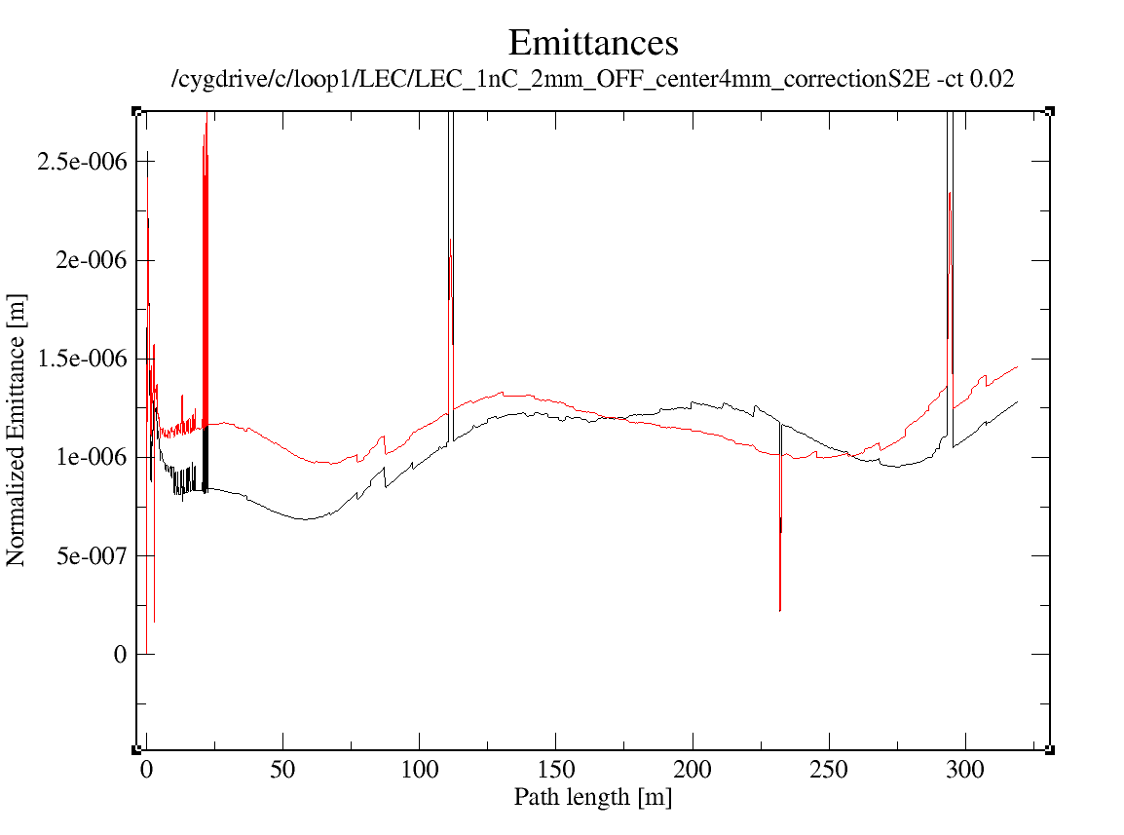
Gun-to-Dump simulations for bunch charge of 1 nC with 4 mm off center at the cathode (continue)
requirements
Bunch quality satisfied requirement emittance
The XY asymmetry is a result of initial DC gun focusing astigmatism due to off center operation.

Slide 23
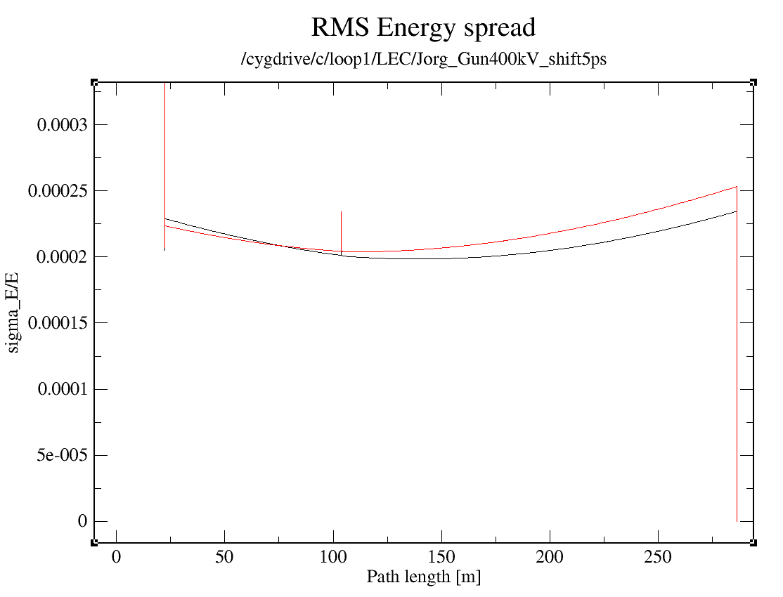
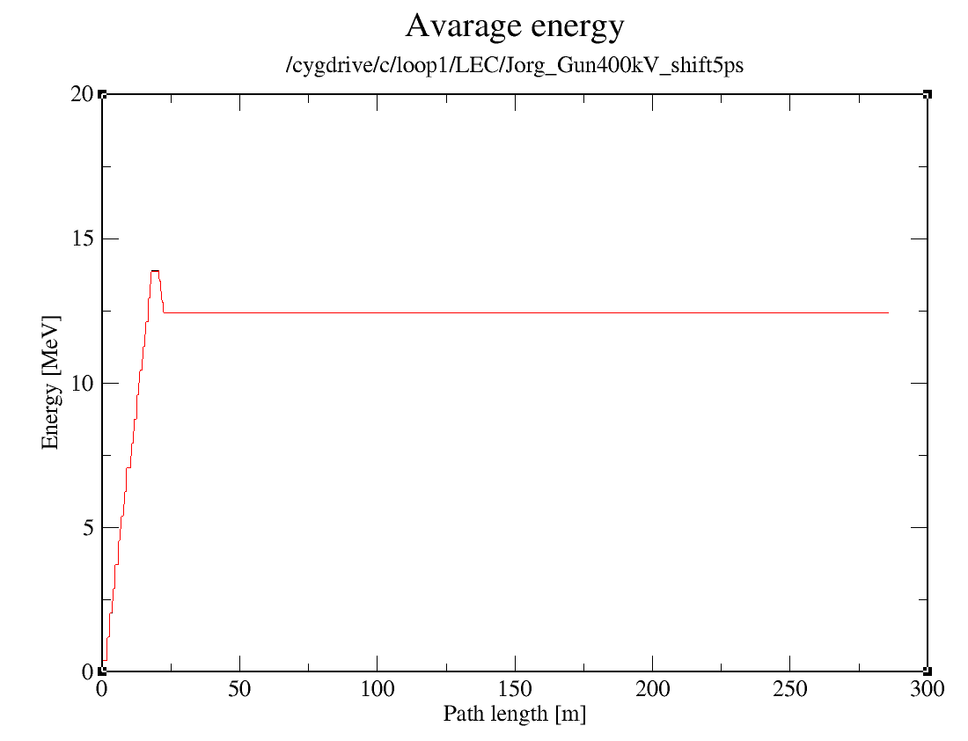
Laser arriving time shift effect on longitudinal beam dynamics
5 ps shift vs nominal operation
5 ps shift
Nominal operation

Slide 24
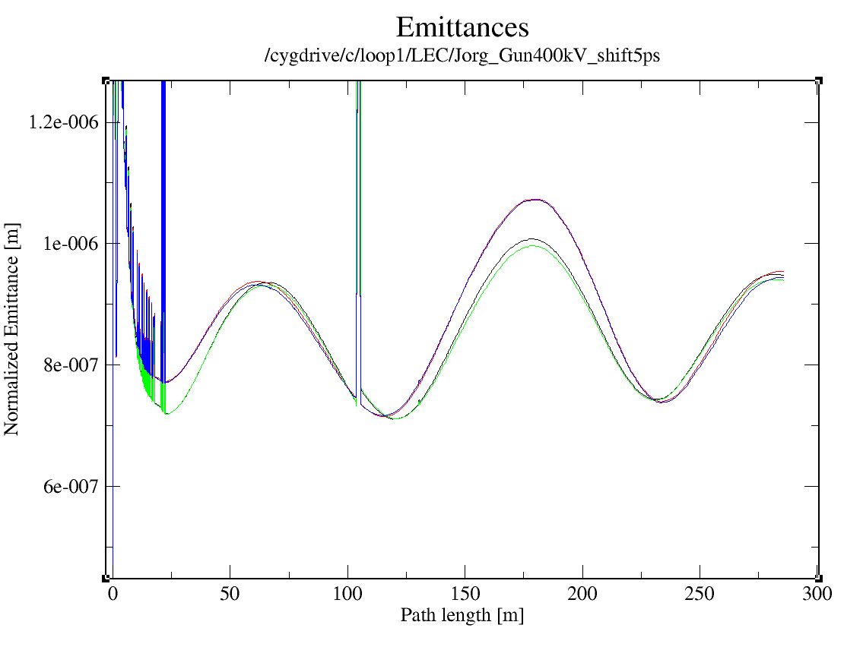
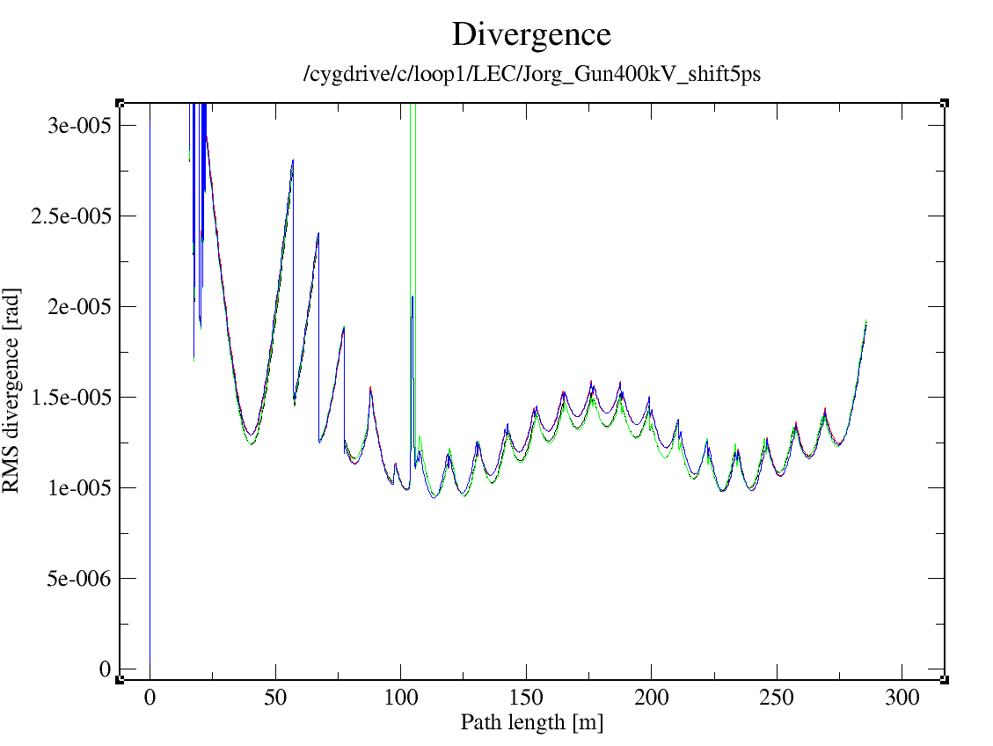
Laser arriving time shift effect on transvers beam dynamics (continue)
5 ps shift vs nominal operation
5 ps shift
Nominal operation

Slide 25
Summary
Current design of LEC accelerator and transport fulfills the bunch quality requirement in the cooling section
We checked that operation with 4 mm offset at the cathode satisfied LEC requirements
We start addressing other beam dynamics effects: such as beam loading, laser jitter, interaction with protons and more
Thank you for your attention!

Slide 26
Additional matirials

