Slide 1

Electron Cooler for High-Energy Hadrons Based on Energy Recovery Linac
Dmitry Kayran, Alexei Fedotov and Sergei Seletskiy
Brookhaven National Laboratory

Slide 2
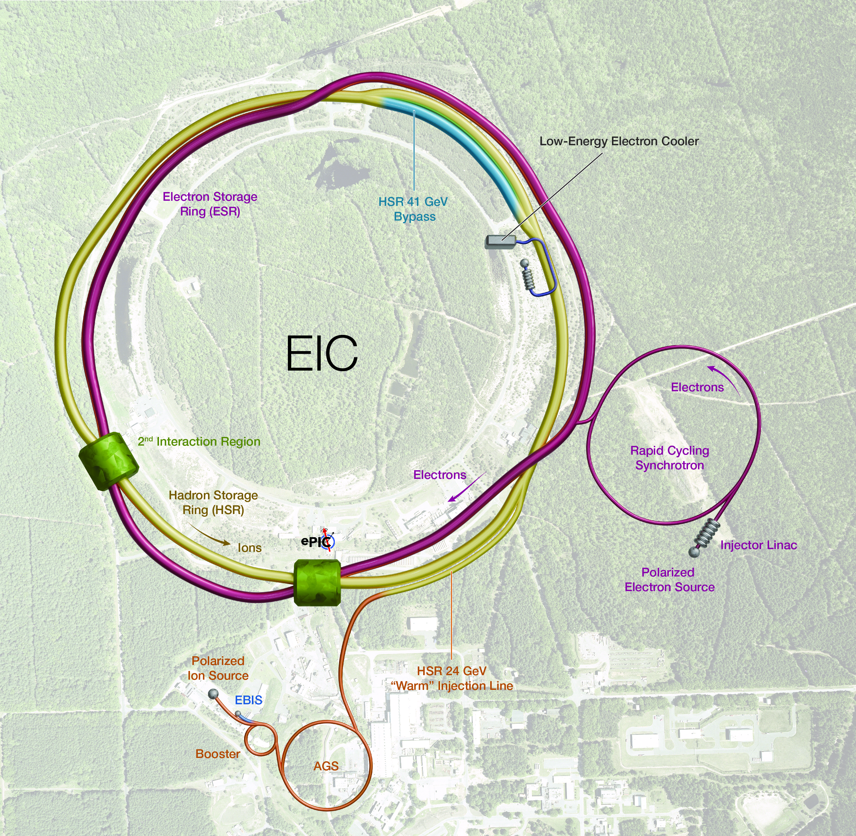
Outline
Motivation
Why regular electron cooler
Required beam parameters
Challenges and our vision
Conclusion

Slide 3
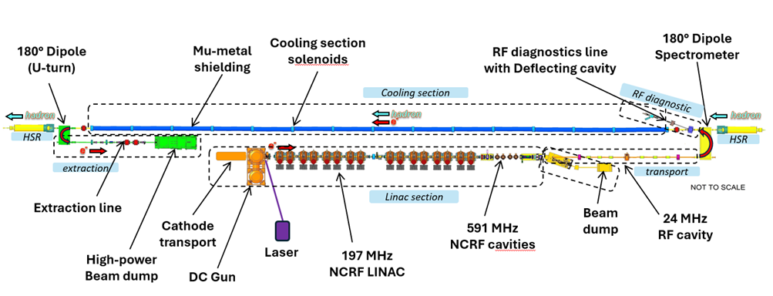
Hadron Cooling in the EIC
Hadrons will be cooled at injection energy of 24 GeV by using Low Energy Cooling (LEC) to achieve required parameters
Currently, no hadron cooling is planning at collision energies
However, it may be added in the future to increase the EIC average luminosity during store
If so , then cooler at Store Energy must be compatible with LEC long cooling section
LEC: RF linac based single pass accelerator on 13 MeV upto 74 mA average current
Alexei Fedotov, TUA1, this conference
Dmitry Kayran, THB3, this conference

Slide 4
EIC parameters and cooling goals
Strategy to get required luminosity
Use Low-Energy cooler to obtain initial proton beam parameters
Ramp up to the store energy
Provide cooling at store energy to compensate IBS (2-3 hours)) and other possible bunch degradation effects
Dmitry Kayran Electron cooler for high-energy hadrons in the EIC based on ERL COOL’25, Oct 28, 2025, Stony Brook, NY

Slide 5
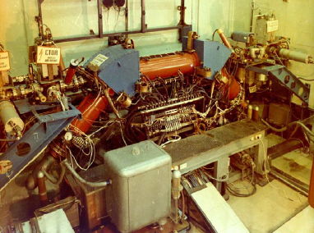
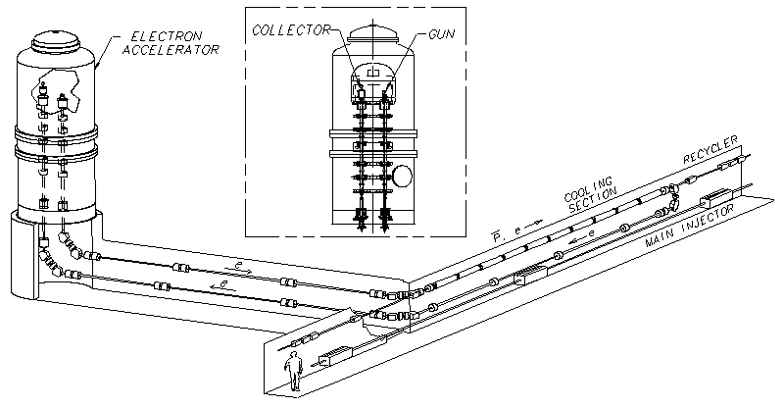
Why Electron Cooling?
S. Nagaitsev, et al. “Experimental Demonstration of Relativistic Electron Cooling”, Phys. Rev. Lett. 96, 044801 (2006)
Experimental
demonstration of electron cooling
at NAP-M
(Novosibirsk, 1974).
Electron Cooling is a well-established technique with 50 years of experimental experience
High Voltage DC coolers: (1974-): all DC electrostatic accelerators; all use magnetic field to confine electron beam (magnetized cooling). FNAL cooler (2005-11): Extension to relativistic energies (4MeV electrons), transport of electron beam without continuous magnetic field.
RF acceleration (High Energy approach): BNL LEReC electron cooler (2019-21): First RF-linac based electron cooler (concept directly extendable to higher energies). LEReC does not use any magnetization of electrons. LEReC was successfully used for RHIC operations in 2020-21 to cool ion bunches directly at collision energy.
LEC (13 MeV electrons): Under design right now to cool hadrons at EIC injection energy of 24 GeV.

Slide 6
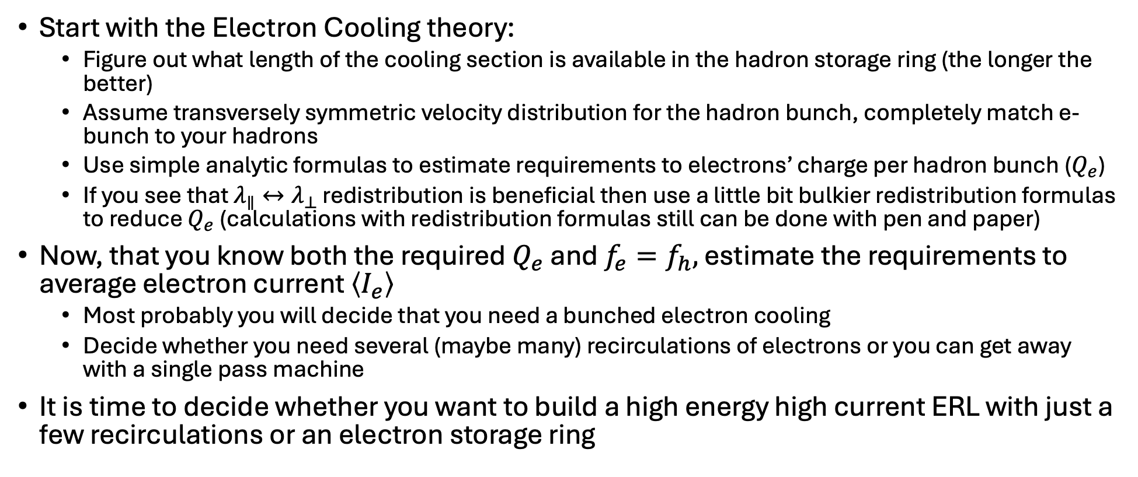
How to design High Energy Electron Cooler
Start with the Electron Cooling theory:
Figure out what length of the cooling section is available in the hadron storage ring (the longer the better)
Assume transversely symmetric velocity distribution for the hadron bunch, completely match e-bunch to your hadrons
Use simple analytic formulas to estimate requirements to electrons’ charge per hadron bunch ($Q_{e}$)
If you see that $λ_{∥}↔λ_{⊥}$ redistribution is beneficial then use a little bit bulkier redistribution formulas to reduce $Q_{e}$ (calculations with redistribution formulas still can be done with pen and paper)
Now, that you know both the required $Q_{e}$ and $f_{e}=f_{h},$ estimate the requirements to average electron current $\left\langle I_{e}\right\rangle$
Most probably you will decide that you need a bunched electron cooling
Decide whether you need several (maybe many) recirculations of electrons or you can get away with a single pass machine
It is time to decide whether you want to build a high energy high current ERL with just a few recirculations or an electron storage ring
Sergei Seletskiy "Advancing Electron Cooling to high energy”
C-AD physics seminar, at BNL on July 26, 2024

Slide 7
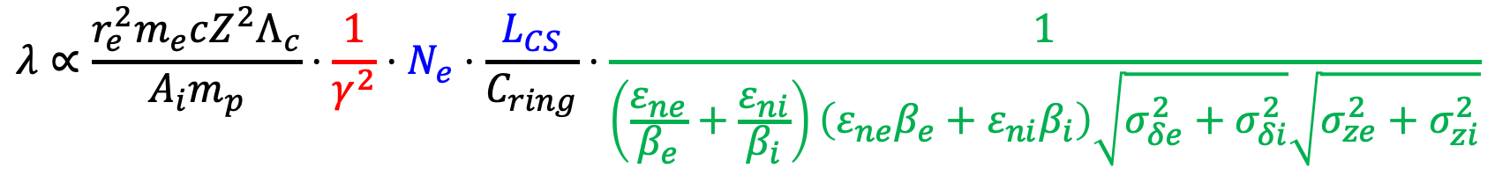
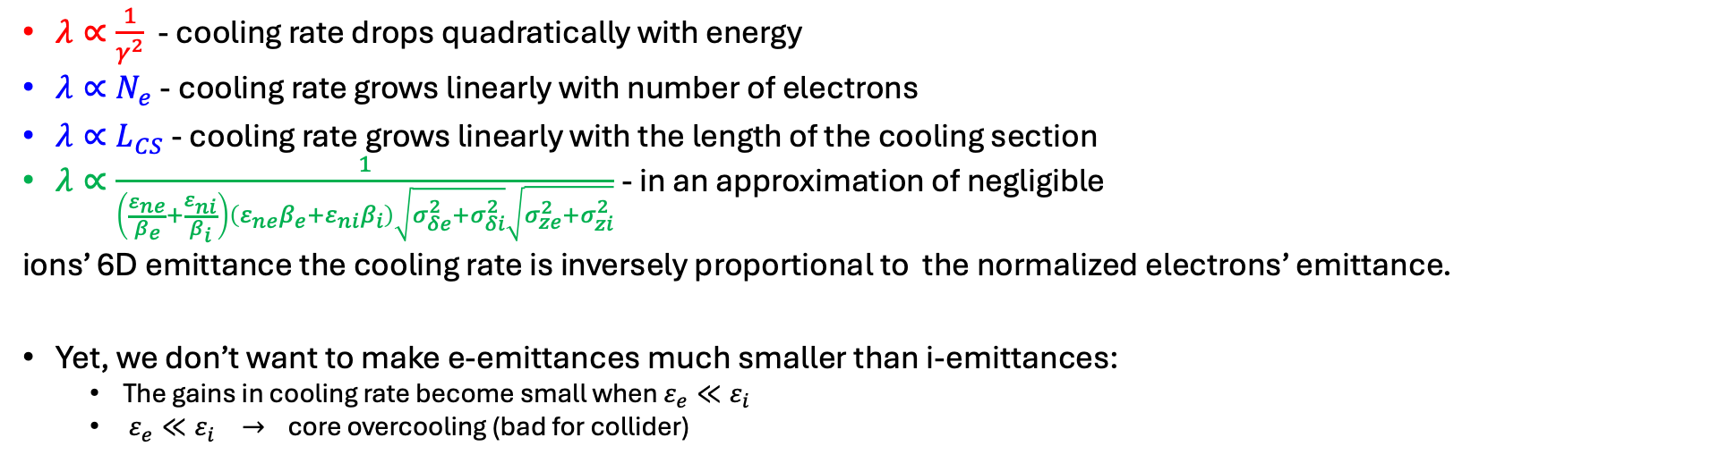
Cooling rate scaling with beam parameters
We need at ls 5 nC per bunch t o cool hadrons at 275 GeV
I
$λ∝\frac{1}{γ^{2}}$ - cooling rate drops quadratically with energy
$λ∝N_{e}$ - cooling rate grows linearly with number of electrons
$λ∝L_{CS}$ - cooling rate grows linearly with the length of the cooling section
$λ∝\frac{1}{\left(\frac{ε_{ne}}{β_{e}}+\frac{ε_{ni}}{β_{i}}\right)\left(ε_{ne}β_{e}+ε_{ni}β_{i}\right)\sqrt{σ_{δe}^{2}+σ_{δi}^{2}}\sqrt{σ_{ze}^{2}+σ_{zi}^{2}}}$ - in an approximation of negligible
ions’ 6D emittance the cooling rate is inversely proportional to the normalized electrons’ emittance.
Yet, we don’t want to make e-emittances much smaller than i-emittances:
The gains in cooling rate become small when $ε_{e}≪ε_{i}$
$ε_{e}≪ε_{i} →$ core overcooling (bad for collider)

Slide 8
Cooling rate scaling with beam parameters
Quick scaling from LEC parameters (Ee=13 MeV) to HEC (Ee=150 MeV) gives more then 2 order of magnitude reduction in the cooling rate
Fortunately for HEC we only need to provide cooling rate ~2 hours to compensate IBS.
With proper betafunction optimization we end up with a minimum 5 nC per the hadron bunch or about 500 mA average current in the cooling section
Reuse electron bunch several times significantly simplifies requirement for injector

Slide 9
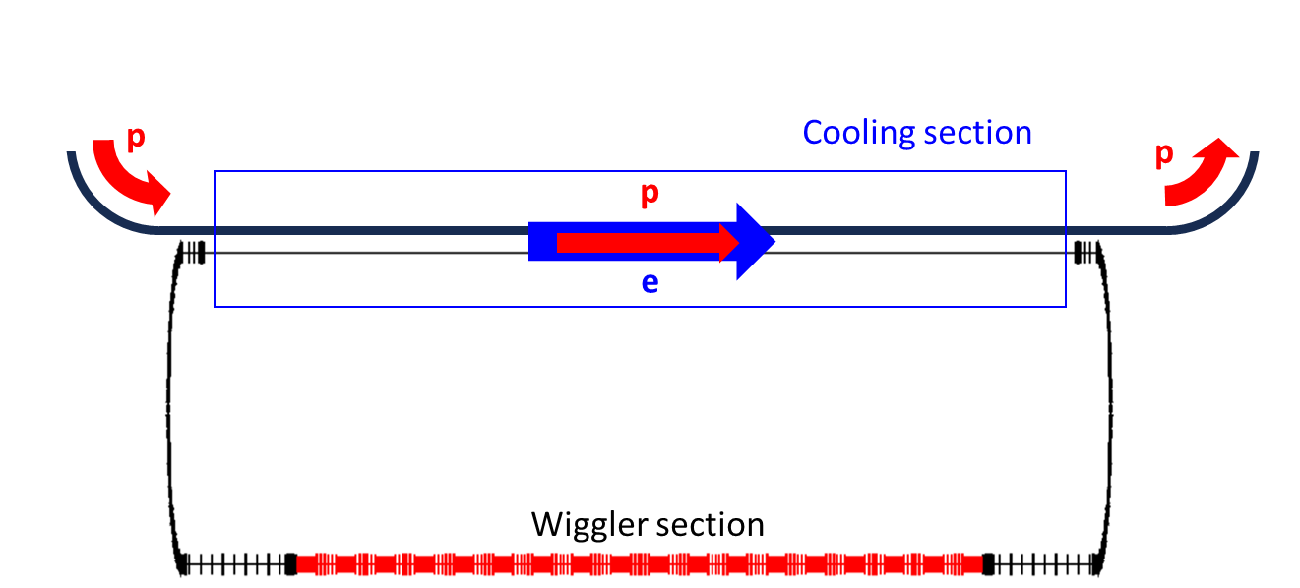
High-Energy Cooler based on reusing electron bunch MANY times
Ring based cooler use electron bunch a few million times
The feasibility studies are going on right now in collaboration between BNL and Cornell University
Many aspects have been considered already and some are still unedr consideration:
Self-space charge
Proton-electron focusing
Beam-beam scattering in the cooling section
To counteract IBS+BBS one needs strong damping wigglers
Low Energy High Current Ring instability
3-4 million turns
* Sergei Seletskiy, THB2, at this conference
BUT ring based cooler is hard to scale to cool hadrons of 100 GeV and 41 GeV

Slide 10
High-Energy Cooler based on reusing electron bunch several times
Why not combine extremely good quality of electron bunches from the LINACs while use this bunch several times?
p
ERL with passing through the cooling section a few times
Reduce requirement for injector
Less interaction with protons per e-bunch,
Better bunch quality for the same bunch charge
More flexibility to choose operational energy
e
A few turns
Fast kicker in
Fast kicker out
Beam dump
ERL
Injector

Slide 11
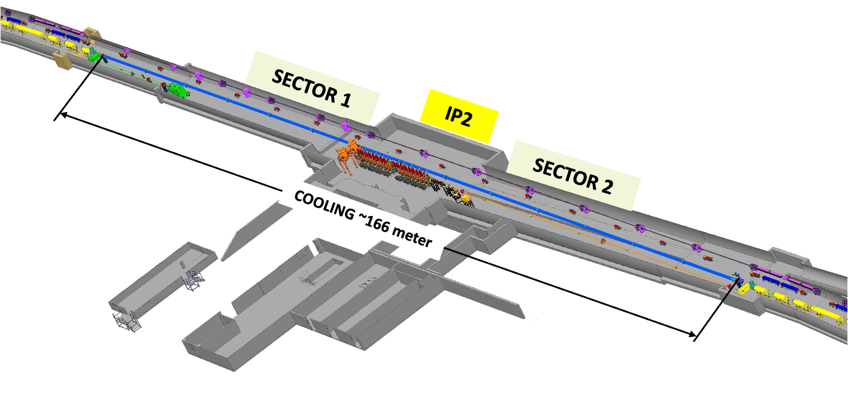
Cooler’s location
Both the pre-cooler and the top energy cooler are located at a 2 o’clock hall.
They must share the same section of the Hadron Storage Ring (HSR)
About 170 m of the HSR are available for the cooling section
ZOOM IN
13 MeV Low-Energy cooler

Slide 12
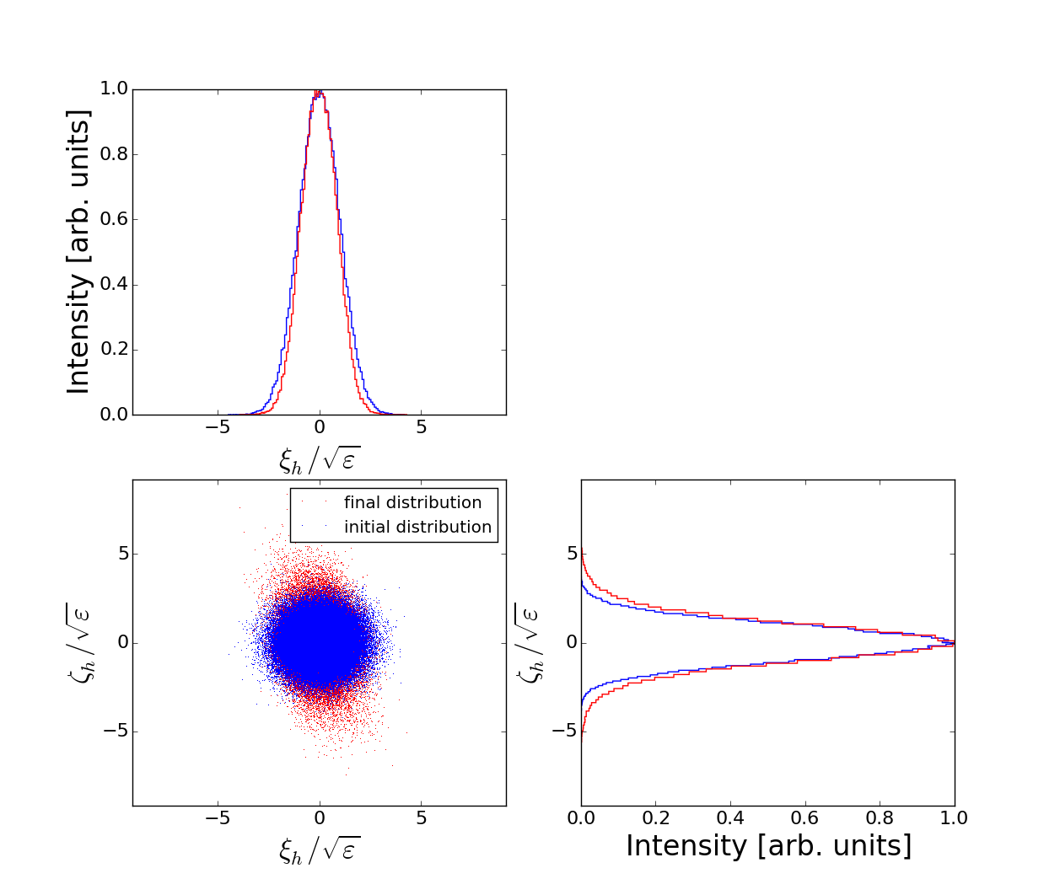
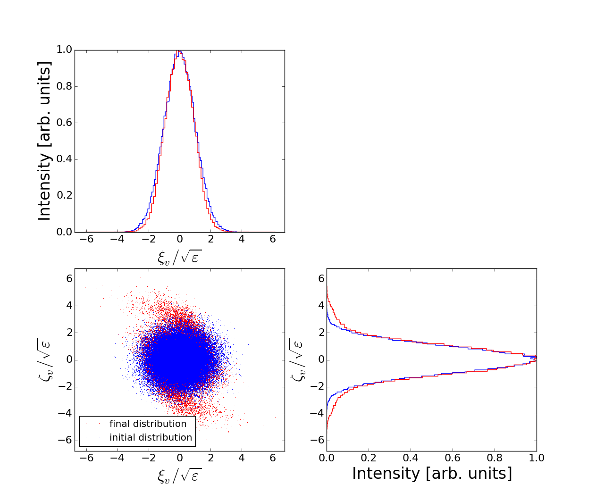
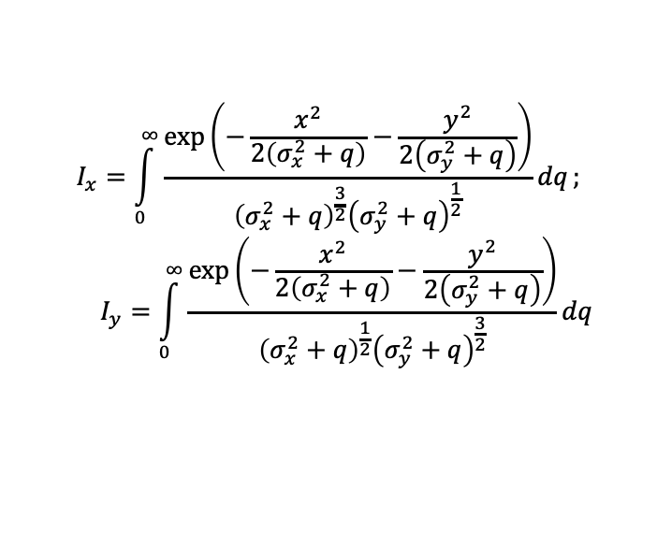
Numbers of turns consideration
How many times we can reuse electron bunch before its emittance degrades
is nonlinear space charge effect from protons to electron in the cooling section
$$I_{x}=\int_{0}^{∞}{\frac{\exp\left(−\frac{x^{2}}{2\left(σ_{x}^{2}+q\right)}−\frac{y^{2}}{2\left(σ_{y}^{2}+q\right)}\right)}{{\left(σ_{x}^{2}+q\right)}^{\frac{3}{2}}{\left(σ_{y}^{2}+q\right)}^{\frac{1}{2}}}dq};$$
$$I_{y}=\int_{0}^{∞}{\frac{\exp\left(−\frac{x^{2}}{2\left(σ_{x}^{2}+q\right)}−\frac{y^{2}}{2\left(σ_{y}^{2}+q\right)}\right)}{{\left(σ_{x}^{2}+q\right)}^{\frac{1}{2}}{\left(σ_{y}^{2}+q\right)}^{\frac{3}{2}}}dq}$$
Results of 6 turns tracking with 100k particles for cooling parameters at the 275 GeV storage energy shows :
the final distribution is well contained within $±6σ$

Slide 13
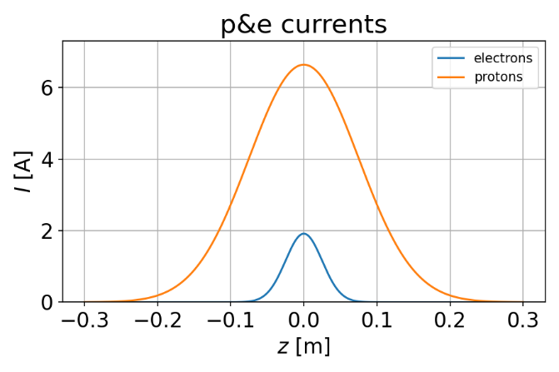
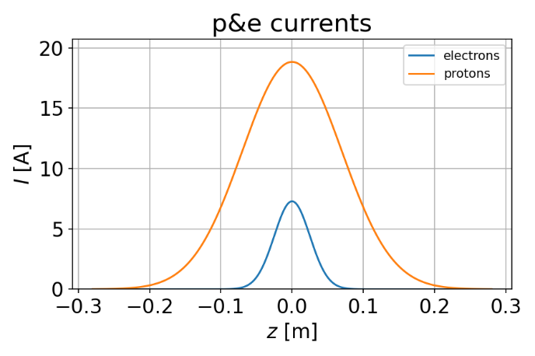
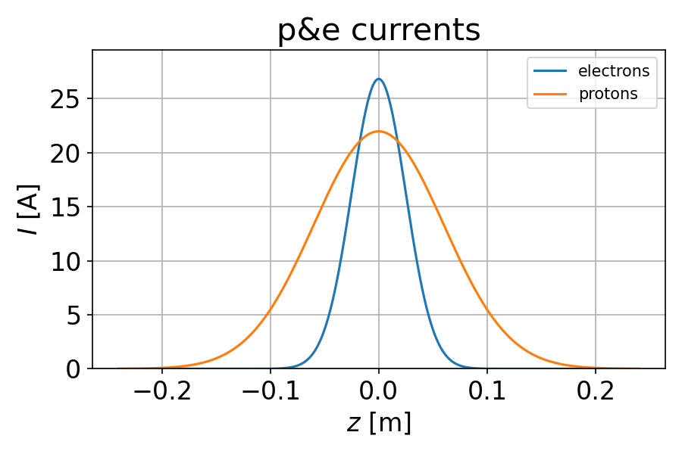
Basic required parameters for different protons energies at EIC*
Proton Energy , GeV | 275 | 100 | 41
Ne | 3.00E+10 | 1.25E+10 | 4.00E+09
Qe, nC | 5 | 2 | 0.64
Rms bunch length, cm | 2.5 | 2.5 | 2.5
Peak Current, A | 24 | 10 | 3
Rep rate, MHz | 98 | 98 | 98
I ave in CS, mA | 490 | 196 | 63
N _rec | 7-9 | 3-4 | 1
Iav Gun, mA | 70-54 | 65-49 | 63
Rms energy Spread in CS | 3.00E-04 | 3.00E-04 | 3.00E-04
RMS Angular spread in CS, rad | 5.20E-06 | 1.70E-05 | 2.60E-05
RMS Normilized Emittance, m | 2.00E-06 | 1.50E-06 | 1.50E-06
Cooling Time_x, hrs * | 1.8 | 1.9 | 2
Cooling Time_y, hrs * | 3.6 | 3.9 | 1.8
Cooling Time_z, hrs * | 2.9 | 1.6 | 1
41 GeV protons
100 GeV protons
275 GeV protons
The cooling rates assumed 177 m cooling cooling section and averaging by beta- and synchrotron oscillations of protons
*) After several rounds of optimization and cooling rates redistribution.
For details how to effectively use redistribution see Sergei Seletskiy’s talk TUB1 at this workshop

Slide 14
Challenges
& Mitigation
High average current operation of injector
High bunch charge operation
High peak current operation
Produce and preserve small energy spread and emittances for the high intensity
And how to provide a fast kick
Reuse the same bunch several times (fast kickers)
Use low frequency RF at least at low energy injection ~15 MeV
Do Not over compress bunch instead use bunch length comparable with hadrons bunch length 3-5 cm
Next slide

Slide 15
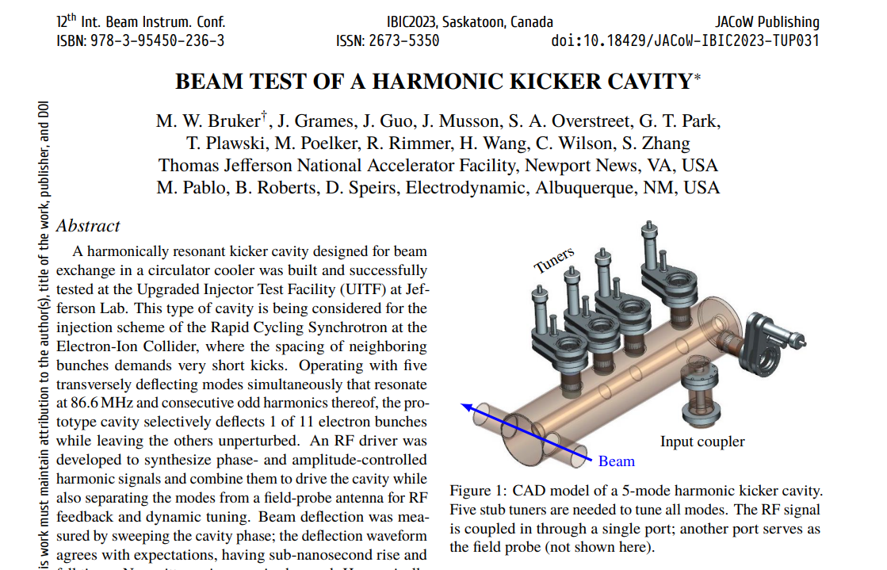
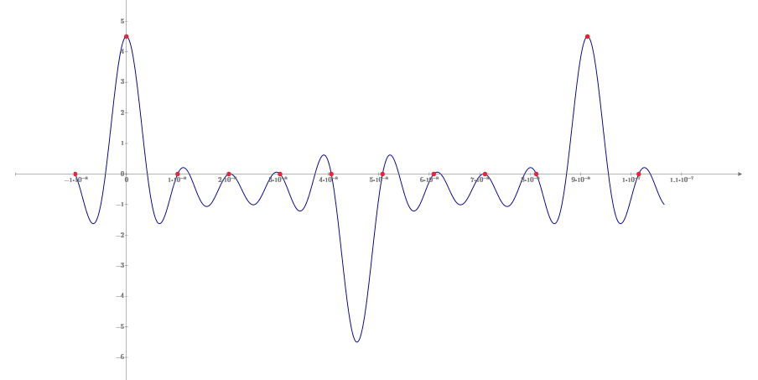
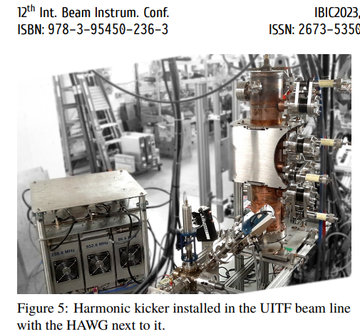
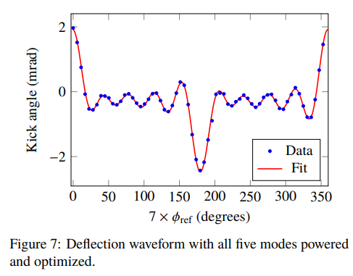
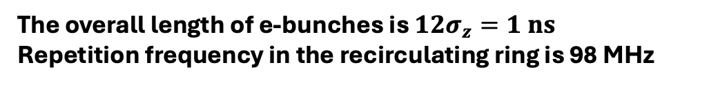
What about kickers?
Operation of harmonic kicker with beam was demonstrated at Jlab
The overall length of e-bunches is $12σ_{z}=1 ns$
Repetition frequency in the recirculating ring is 98 MHz
For the highest energy we would need to kick every 9th bunch in and out
Blue trace - RF wave form
Red dots - electron bunches
Kicker fundamental 10.95 MHz (1/9th of the proton bunches rep. rate 98 MHz)

Slide 16
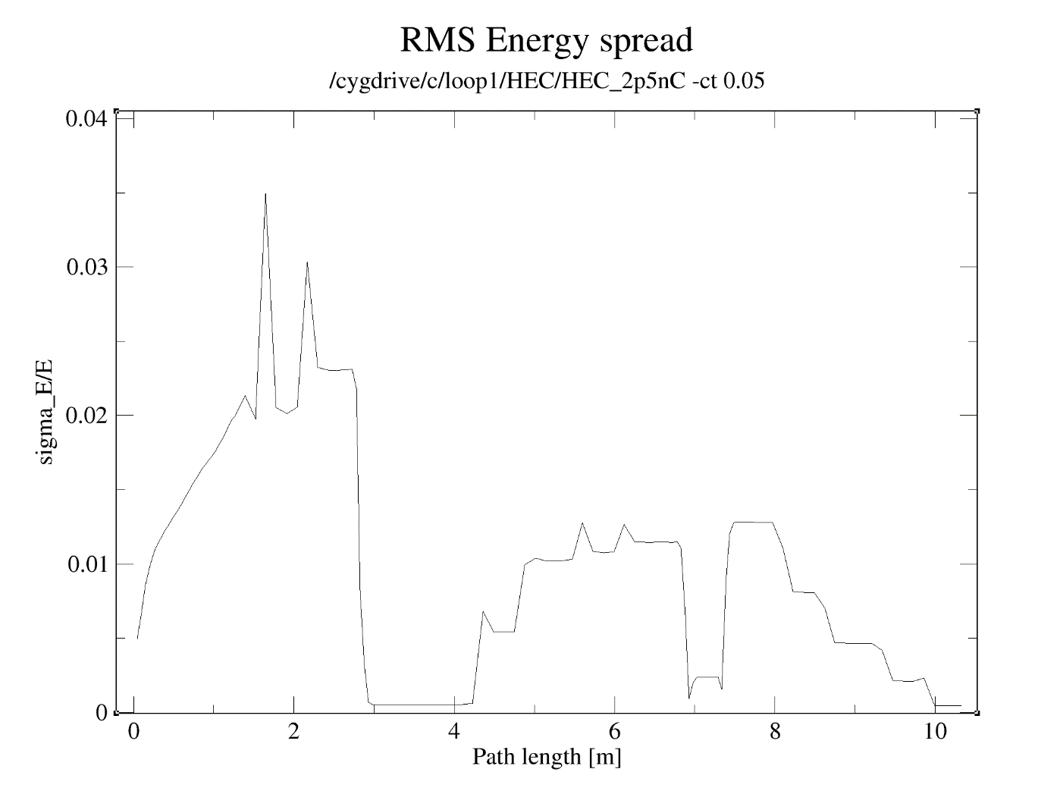
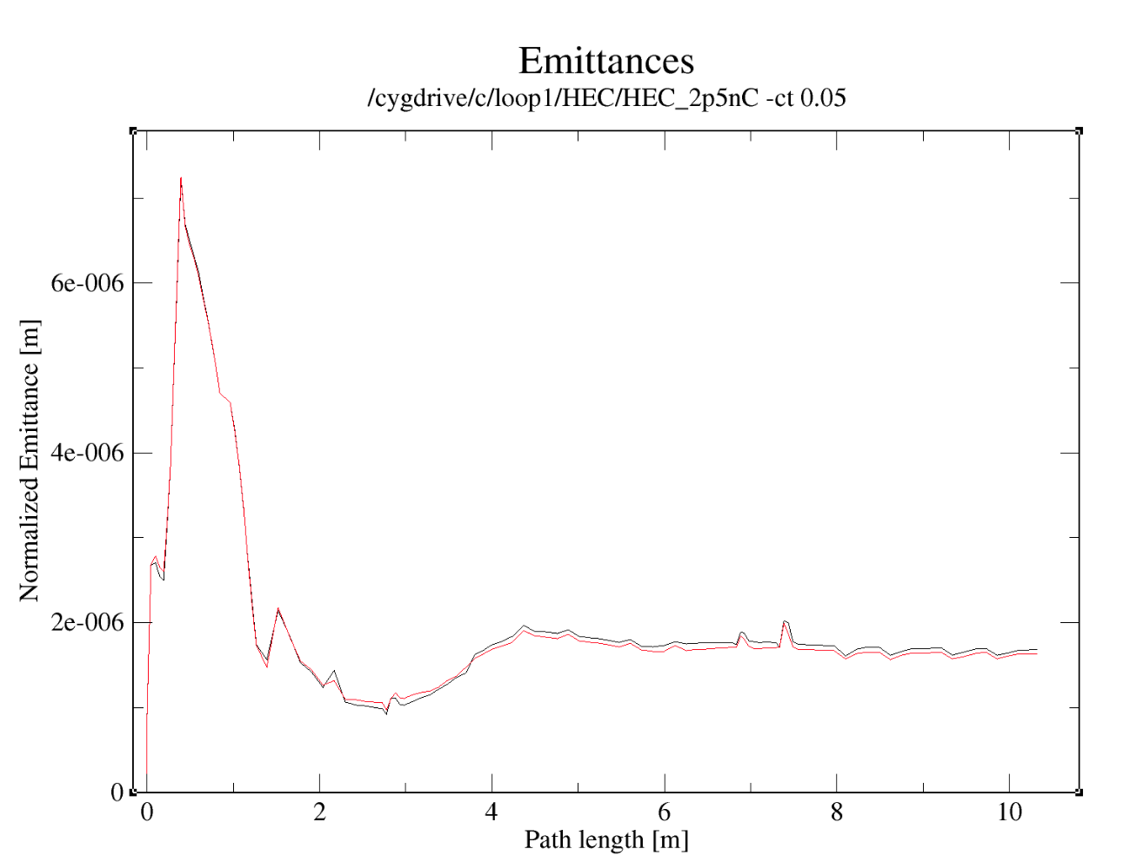
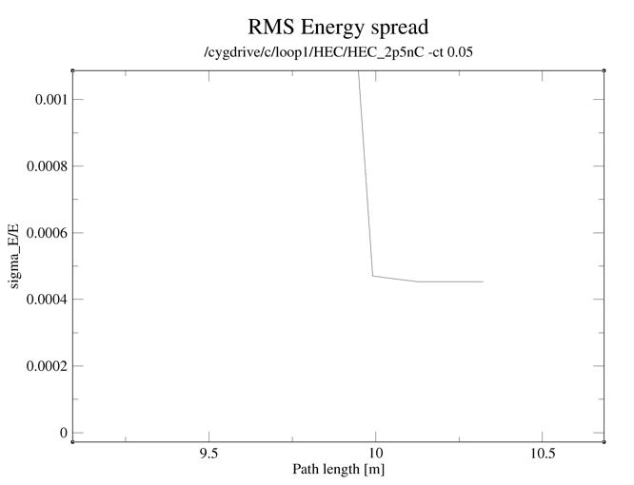
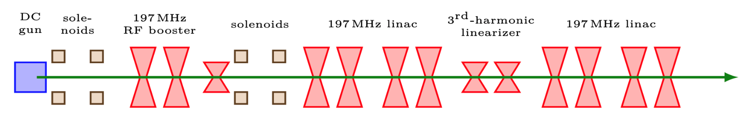
LEC 197MHz SRF Injector simulation for 2.5 nC bunch charge (example)
Rms energy spread 4.5e-4
Rms normalized emittance <2 um
For High-Energy cooler and 5 nC bunches we can use the same concept buy reduce RF frequency to 98 MHz
13 MeV

Slide 17
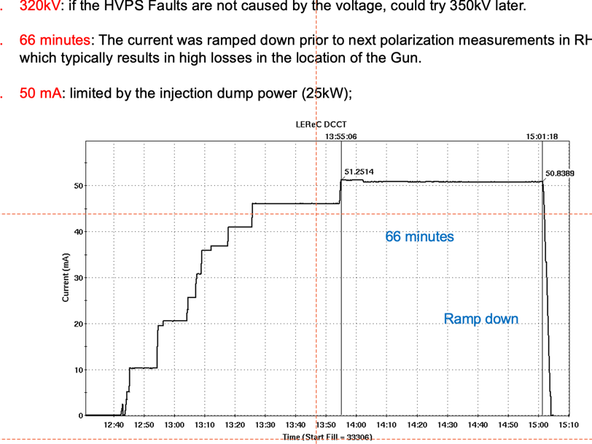
Why we are optimistic about regular cooling option based on ERL ( p1)
Injector with high current operation
DC Gun high current test: 50 mA stable operation for has been demonstrated in 2022
Short term 60 mA average current was achieved at lower Gun voltage in 2024
Until the last week we were limited by 25 kW beam dump power
After additional studies and test run just recently the LEReC injection beam dump power limit was increased to 32 kW
We plan to demonstrate 80 mA from the gun this year
Xiaofeng Gu at all “DC gun for Low Energy RHIC Cooler Project” presented at at ERL’2022

Slide 18
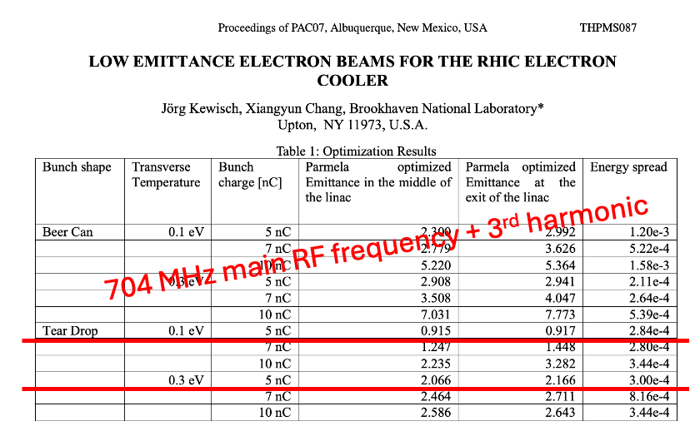
Why we are optimistic about regular cooling option based on ERL (p.2)
High Charge Bunch quality
Beam dynamics simulations for 1 nC and 2.5 nC bunches for the injector using low frequency RF (197 MHz ) shows good results
Then we compress and accelerate these bunches using 591MHz cavity
Operation with higher bunch charge of 5 nC per bunch might require use of lower RF frequency in injector (98 MHz)
Or consider using SRF gun
Long time ago similar studies were performed to use electron cooler for RHIC-II luminosity upgrade
Bunch quality was satisfied to (https://epaper.kek.jp/p07/PAPERS/THPMS087.PDF)
Jorg Kewish at all “Low Emittance Electron Beams For the RHIC electron cooler gun for RHIC Cooler Project” presented at at PAC’ 07

Slide 19
What if?
Q: What if ERL can only achieve required bunch quality for the less charge/current?
A: We know that the cooling rate is scaled linearly with a bunch charge then cooling will still compensate a portion of the IBS resulted heating
The regular cooling still capable to provide a boost to integrated luminosity

Slide 20
Conclusion
Regular electron cooling of hadrons at high energy required 100s of mA average electron beam current which is in order of magnitude what is currently demonstrated in ERLs
In order to, reduce injector operation current we proposed to use the same electron bunch several times
Bunch intensity and bunch quality requirement for 3 different energies has been discussed
At very first look, we think that with proper design of RF, longitudinal gymnastics and transport system such bunch quality could be achieve at least for two EIC operation energies
We understand that detailed studies of many different effects are needed
effect of wakes,
kicker impact to the bunch
quality, beam break up,
instabilities,
the list could go on and on…
Our work just started
Any cooperation are welcome
Thank you for your attention!

Slide 21
Back up slides

Slide 22
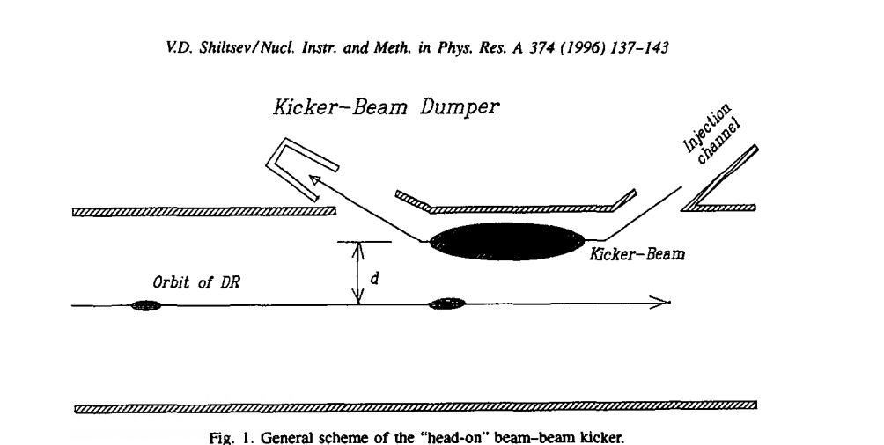
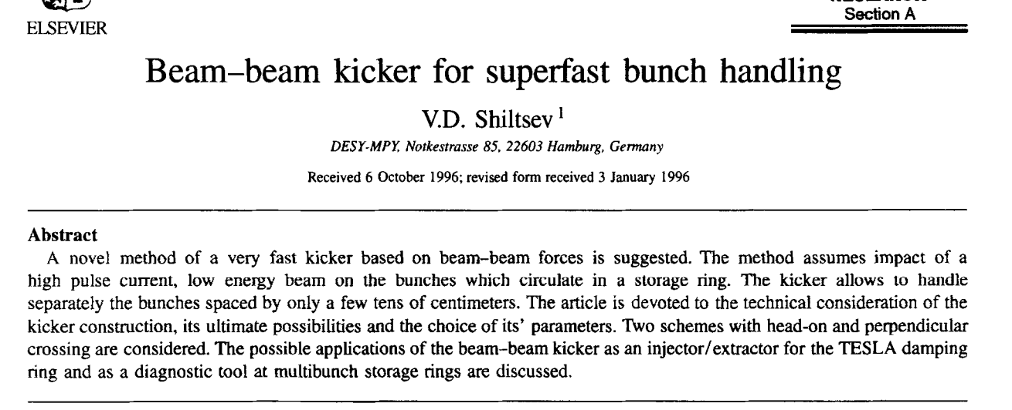
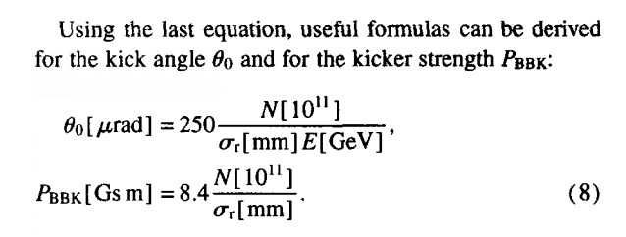
Use of a beam-beam kicker
Instead of RF harmonics-based transvers kicker we might consider to use beam-beam based kicker originally proposed by V. Shiltsev in 1996

Slide 23
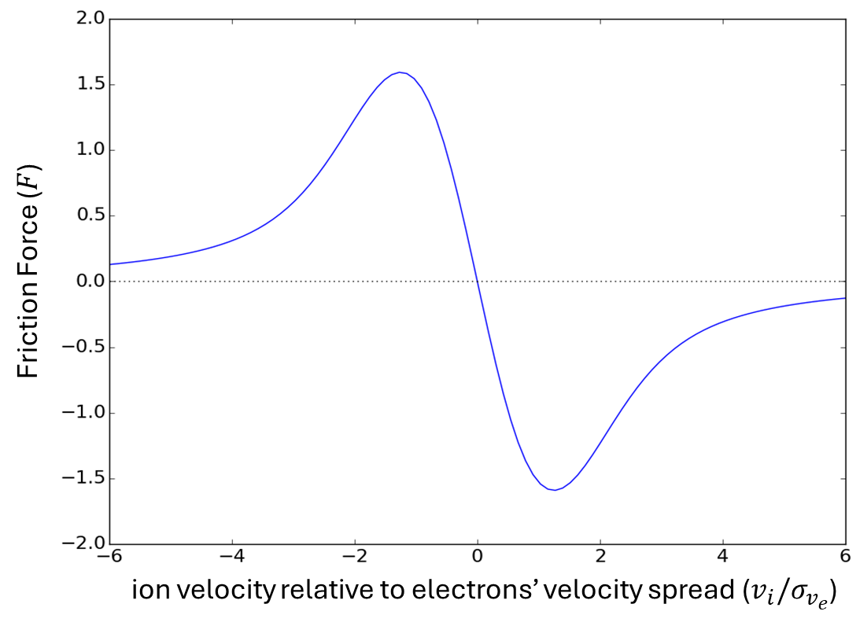
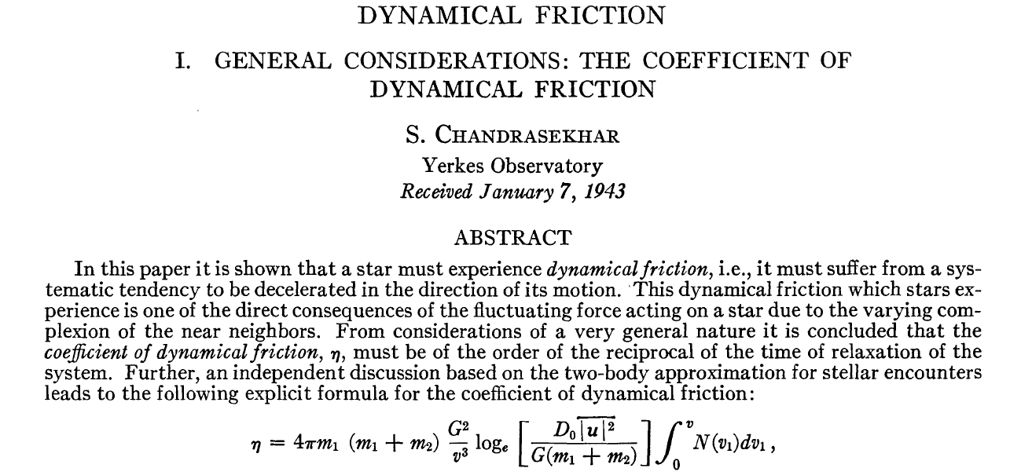
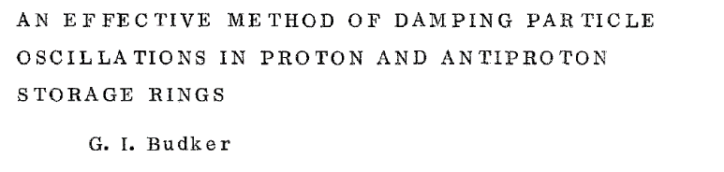
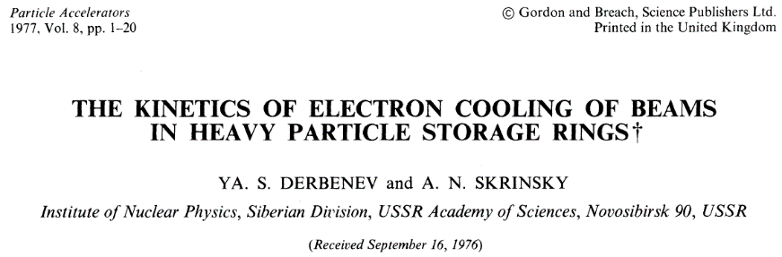
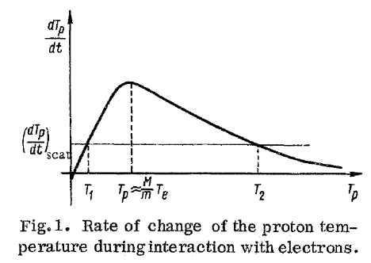

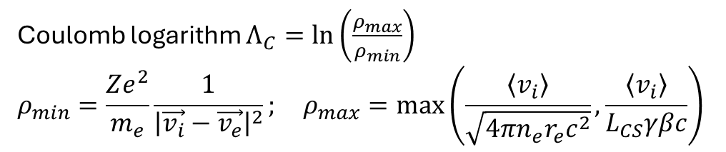
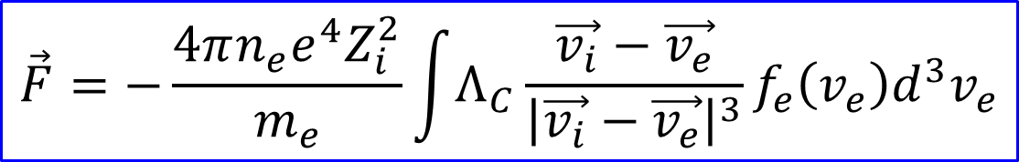
Friction force in Electron Cooling
density of electron bunch
ion velocity
electron velocity
$$\vec{F}=−\frac{4πn_{e}e^{4}Z_{i}^{2}}{m_{e}}\int{Λ_{C}}\frac{\vec{v_{i}}−\vec{v_{e}}}{{\left|\vec{v_{i}}−\vec{v_{e}}\right|}^{3}}f_{e}\left(v_{e}\right)d^{3}v_{e}$$
e-velocity distribution function
Coulomb logarithm $Λ_{C}=ln\left(\frac{ρ_{max}}{ρ_{min}}\right)$
$$ρ_{min}=\frac{Ze^{2}}{m_{e}}\frac{1}{{\left|\vec{v_{i}}−\vec{v_{e}}\right|}^{2}}; ρ_{max}=\max\left(\frac{\left\langle v_{i}\right\rangle }{\sqrt{4πn_{e}r_{e}c^{2}}},\frac{\left\langle v_{i}\right\rangle }{L_{CS}γβc}\right)$$
1943
1956; 1966
1977
S.T. Belyaev and G.I. Budker, Doklady Akad. Nauk SSSR, 107, 807 (1956).

Slide 24
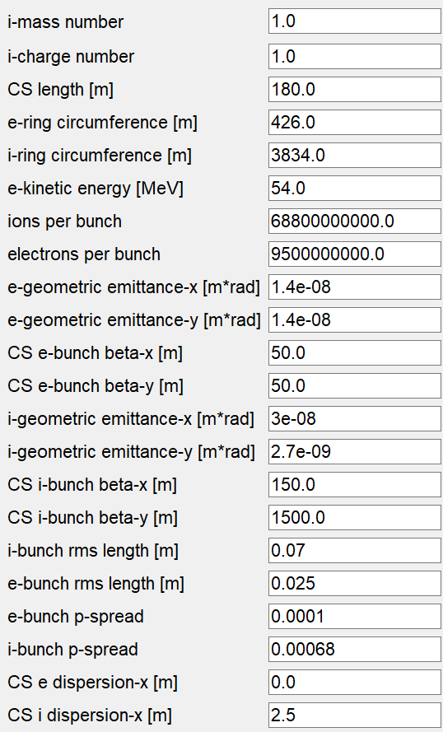

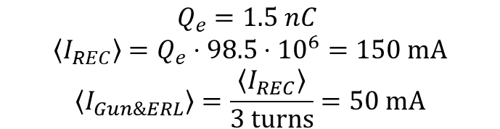
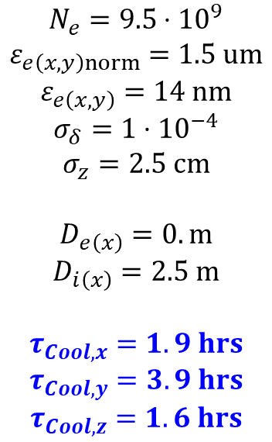
Parameters
$$N_{e}=9.5⋅{10}^{9}$$
$$ε_{e\left(x,y\right)norm}=1.5 um$$
$$ε_{e\left(x,y\right)}=14 nm$$
$$σ_{δ}=1⋅{10}^{−4}$$
$$σ_{z}=2.5 cm$$
$$D_{e\left(x\right)}=0. m$$
$$D_{i\left(x\right)}=2.5 m$$
$$τ_{Cool,x}=1. 9 hrs$$
$$τ_{Cool,y}=3.9 hrs$$
$$τ_{Cool,z}=1.6 hrs$$
$$Q_{e}=1.5 nC$$
$$\left\langle I_{REC}\right\rangle =Q_{e}⋅98.5⋅{10}^{6}=150 mA$$
$$\left\langle I_{Gun\&ERL}\right\rangle =\frac{\left\langle I_{REC}\right\rangle }{3 turns}=50 mA$$

Slide 25
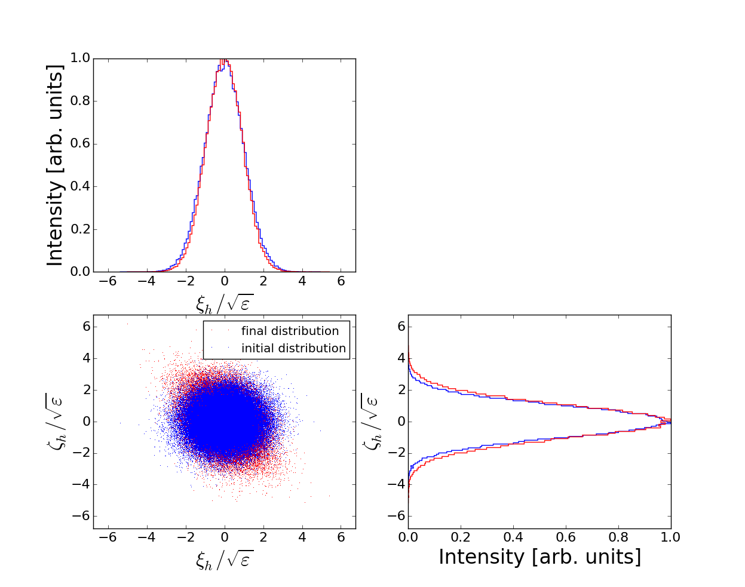
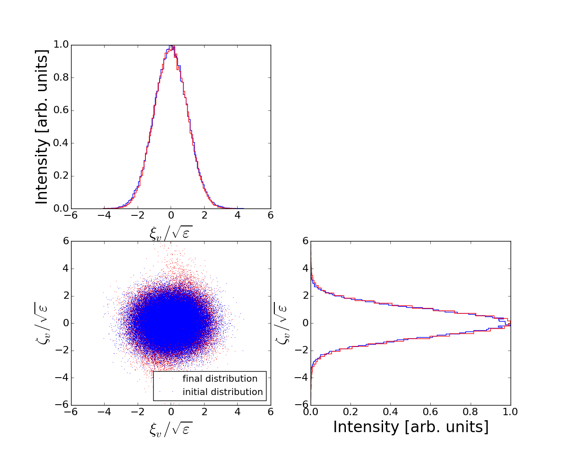
p-e focusing:
BBS & IBS:
less than 0.2% emittance increase from BBS; IBS is negligible
3 turn tracking with 100k particles:
the final distribution is well contained within $±6σ$

Slide 26
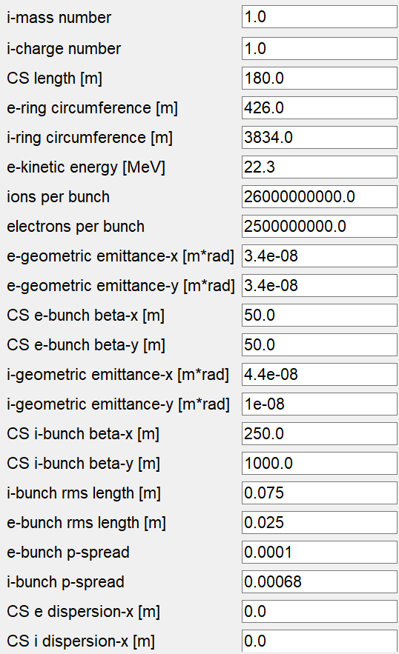
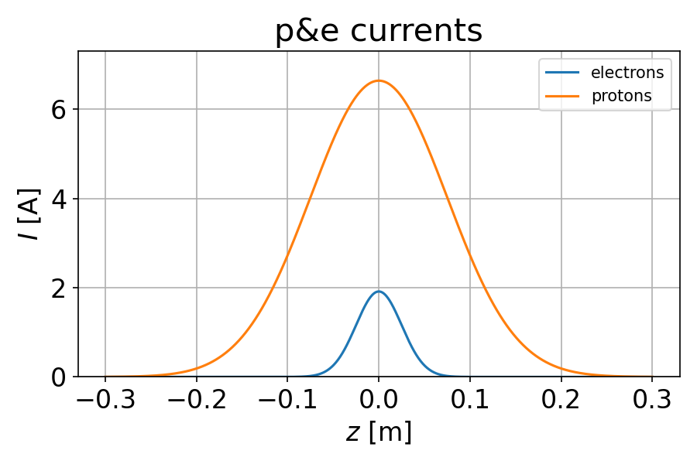
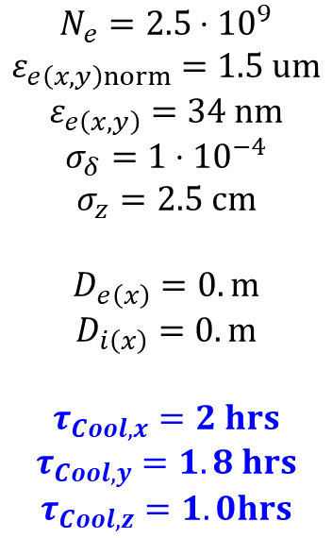
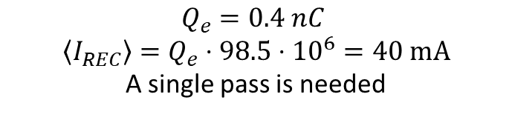
parameters
$$N_{e}=2.5⋅{10}^{9}$$
$$ε_{e\left(x,y\right)norm}=1.5 um$$
$$ε_{e\left(x,y\right)}=34 nm$$
$$σ_{δ}=1⋅{10}^{−4}$$
$$σ_{z}=2.5 cm$$
$$D_{e\left(x\right)}=0. m$$
$$D_{i\left(x\right)}=0. m$$
$$τ_{Cool,x}=2 hrs$$
$$τ_{Cool,y}=1.8 hrs$$
$$τ_{Cool,z}=1. 0hrs$$
$$Q_{e}=0.4 nC$$
$$\left\langle I_{REC}\right\rangle =Q_{e}⋅98.5⋅{10}^{6}=40 mA$$
A single pass is needed

