Slide 1
Beam Position Monitoring for Low Energy Cooling Section
I. Pinayev and S. Seletskiy
October 30, 2025

Slide 2
Outline
Motivation
Beam parameters (hadron and electron)
Signal levels and spectra analysis
Possible design choices
Expected performance
Operational procedures

Slide 3
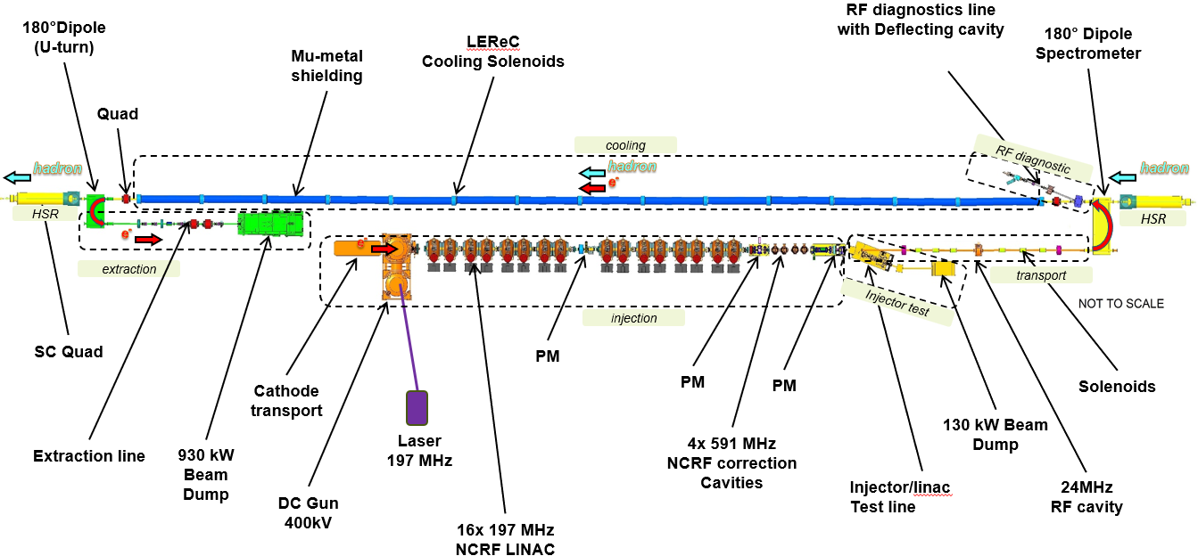
Cooling Section Layout
170 meters long
14 BPMs
Cooling with bunched beam
γ = 25.4
E_{p} = 23.8 GeV
E_{e} = 12.5 MeV
Proton bunch is stretched using harmonic cavity
Pipe diameter is 127 mm
Cable length can vary from 10 to 150 meters

Slide 4
Cooling Section BPM Functionality
Provide transverse alignment of the proton and electron beams with 35 microns accuracy
Provide a relative angular spread between the proton and electron beams with 20 microradian accuracy
Able to measure the hadron pilot bunches with with required precision
Capable of handling signal levels for the stored hadron beams
Minimal cross-talk between two BPM systems during cooling
Desirable to measure phase shifts between the signals induced by the proton and electron beams for the matching of the relativistic factors

Slide 5
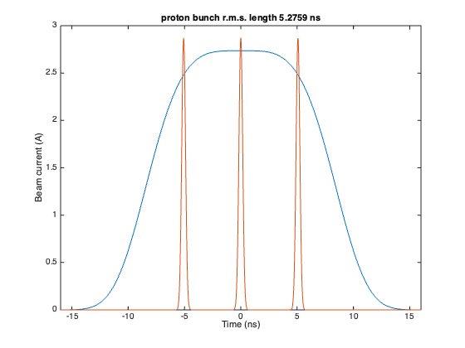
Beam Parameters
Hadron beam
Proton pilot 5 nC 2 ns
Gold pilot 5 ns 4.2 ns
Proton cooled (projected) γ=25.4 44 nC 3 ns flat top
Ramp 44 nC 2 ns
Protons at store 31 nC 200 ps (24.6245 MHz)
Protons at store 11 nC 200 ps (98. 5 MHz)
Protons during ramps 45 nC 200 ps (98.5 MHz)
Gold at store 6.3 nC 300 ps 98.5 MHz
Electron beam (projected)
Train of 3 bunches
Train repetition rate 24.625 MHz
Bunch separation 5.1 ns (197 MHz RF)
Bunch charge 1.2 nC
Bunch length 170 ps

Slide 6
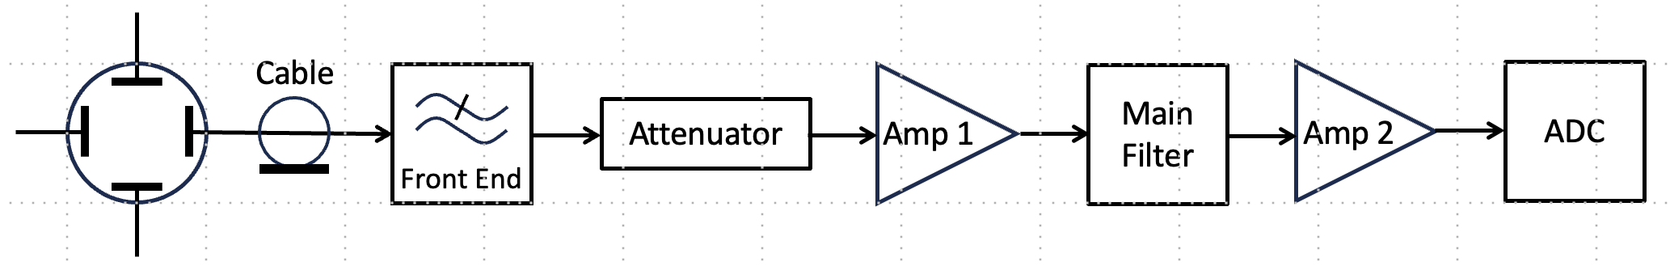
BPM Electronics Architecture
The signal from the pick-up electrode is delivered to the RF front-end
Front-end conditions the signal, eliminating unwanted frequencies and reducing the signal level to an acceptable level
Attenuator normalizes the signal, preventing overload in the amplifiers and ADC
The main filter provides the final frequency response of the analog part
The second amplifier compensates for losses in the main filter
ADC digitizes the signal and provides a stream of data for digital processing

Slide 7
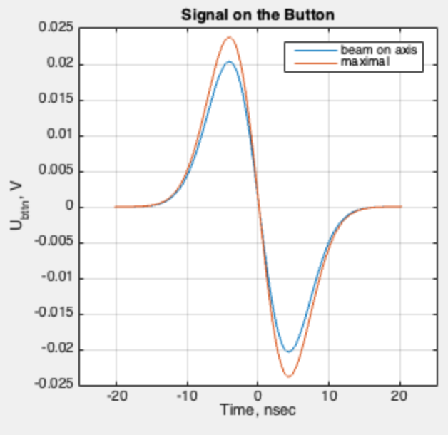
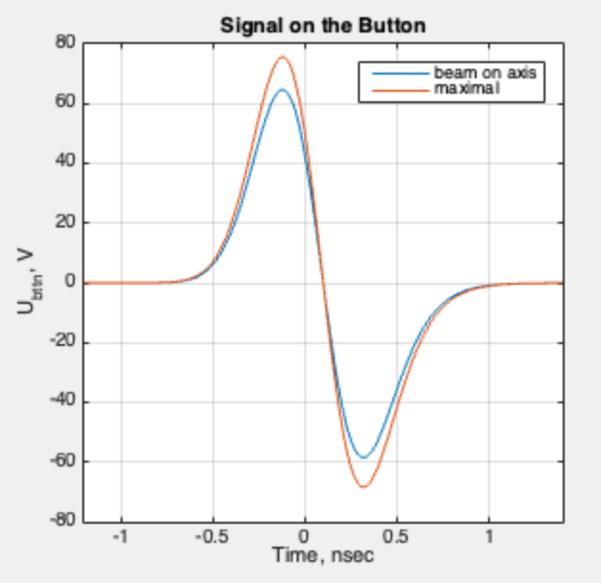
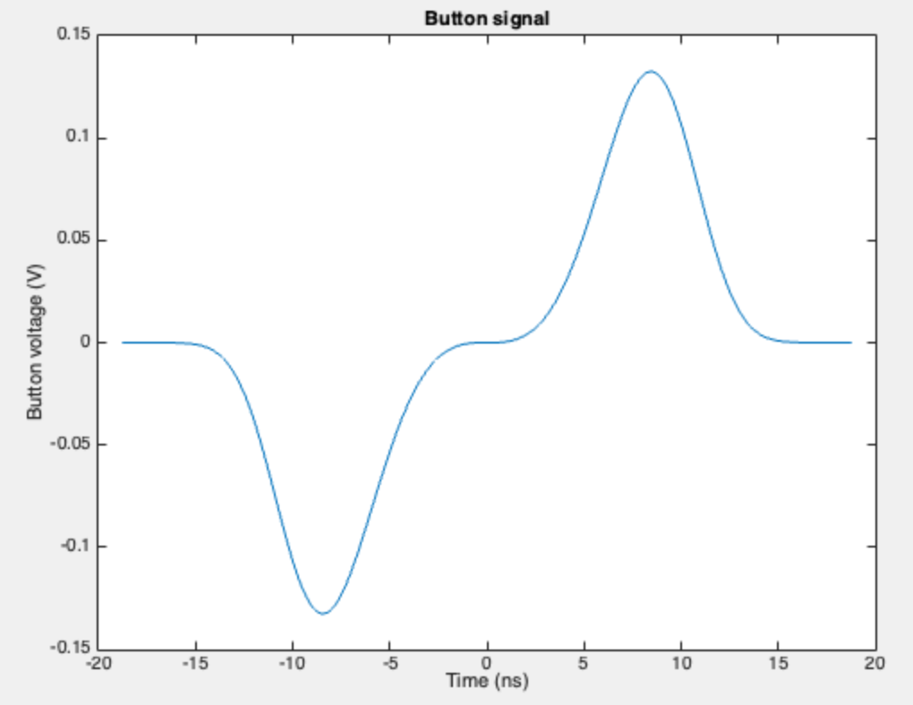
BPM Pickup Signal Levels for Protons
Gold pilot bunch. 5 nC, 4.2 ns long
Proton bunch. 44 nC, 0.2 ns long
Cooled Proton bunch. 44 nC

Slide 8
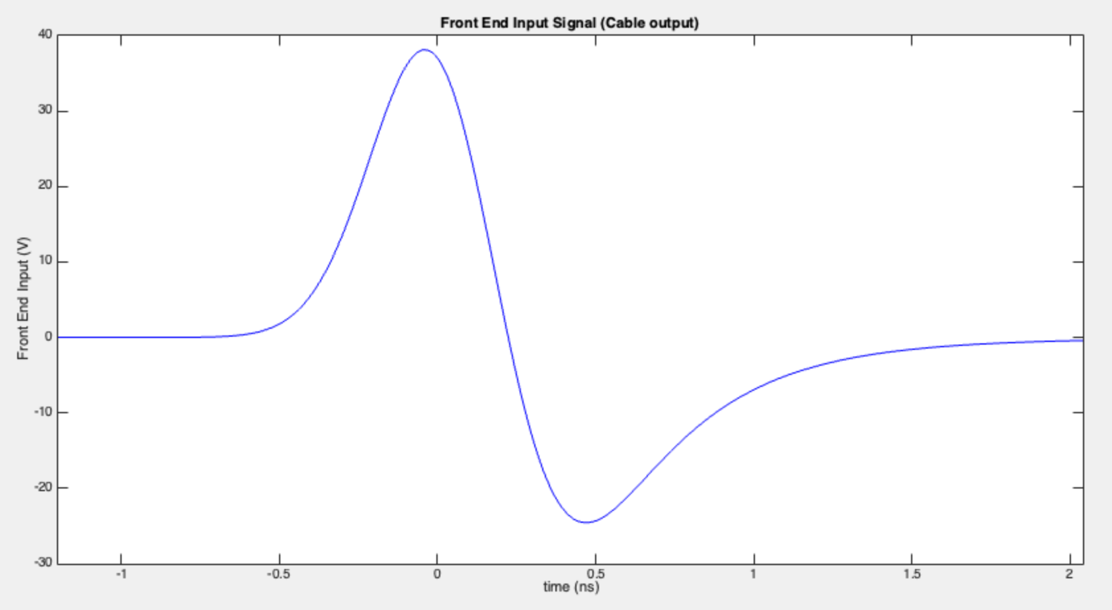
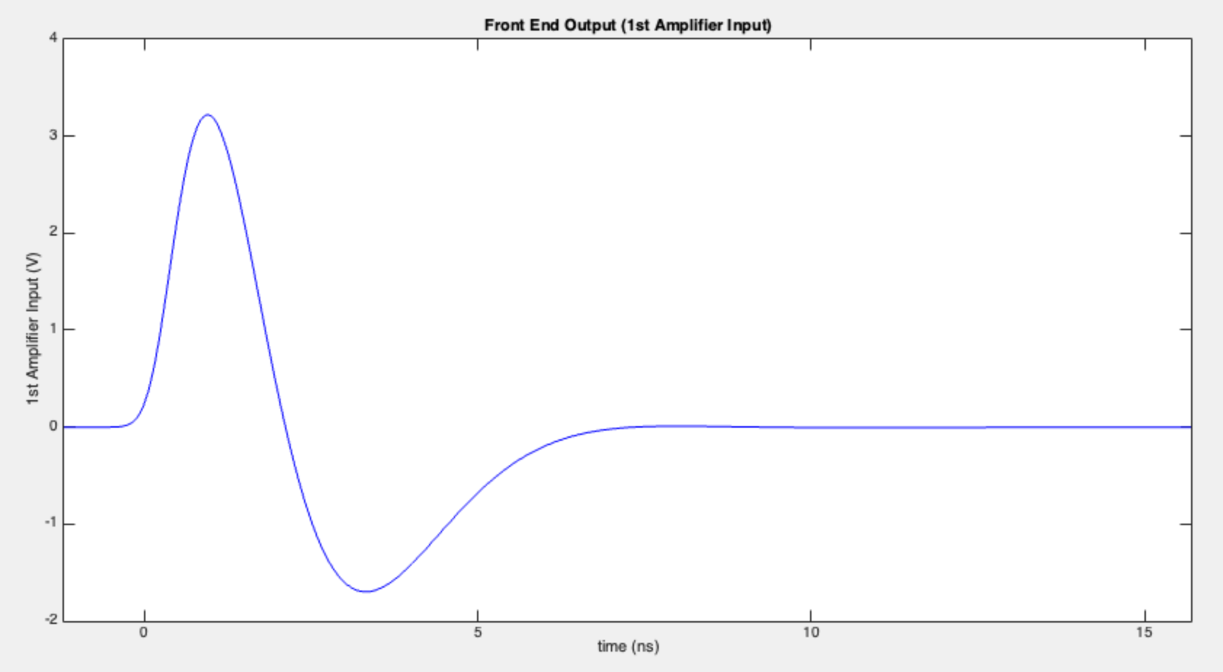
Signal Conditioning with RF Front-End of the Hadron BPM
Before front-end
After front-end
The low-pass front-end filter stretches the pulse and reduces the peak voltage

Slide 9
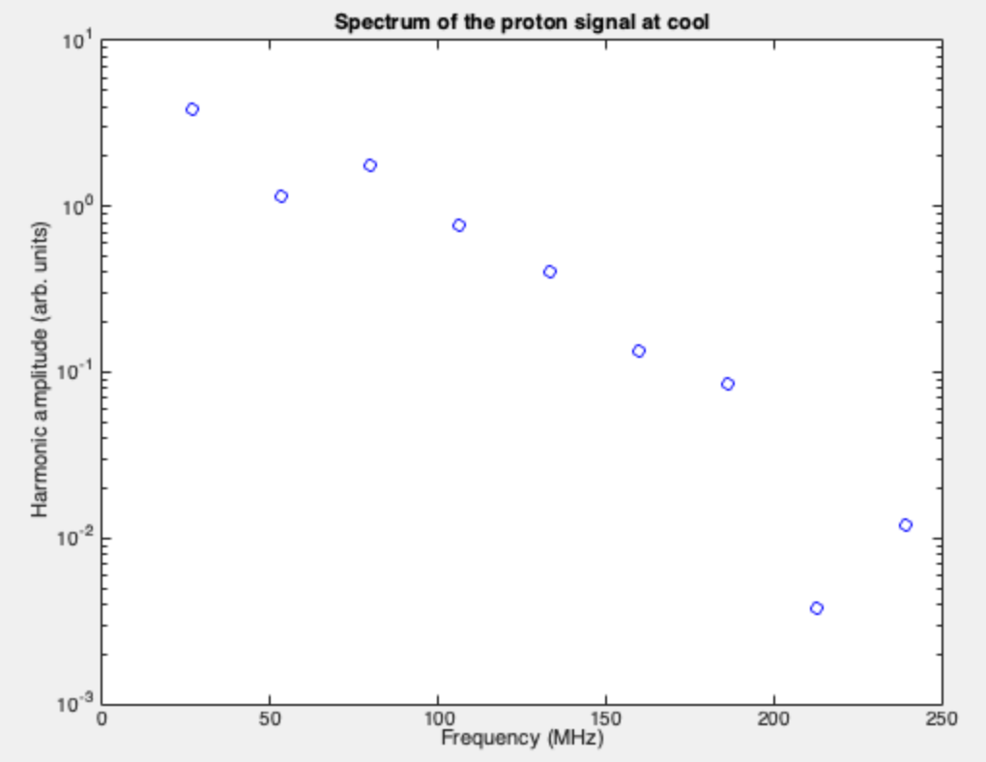
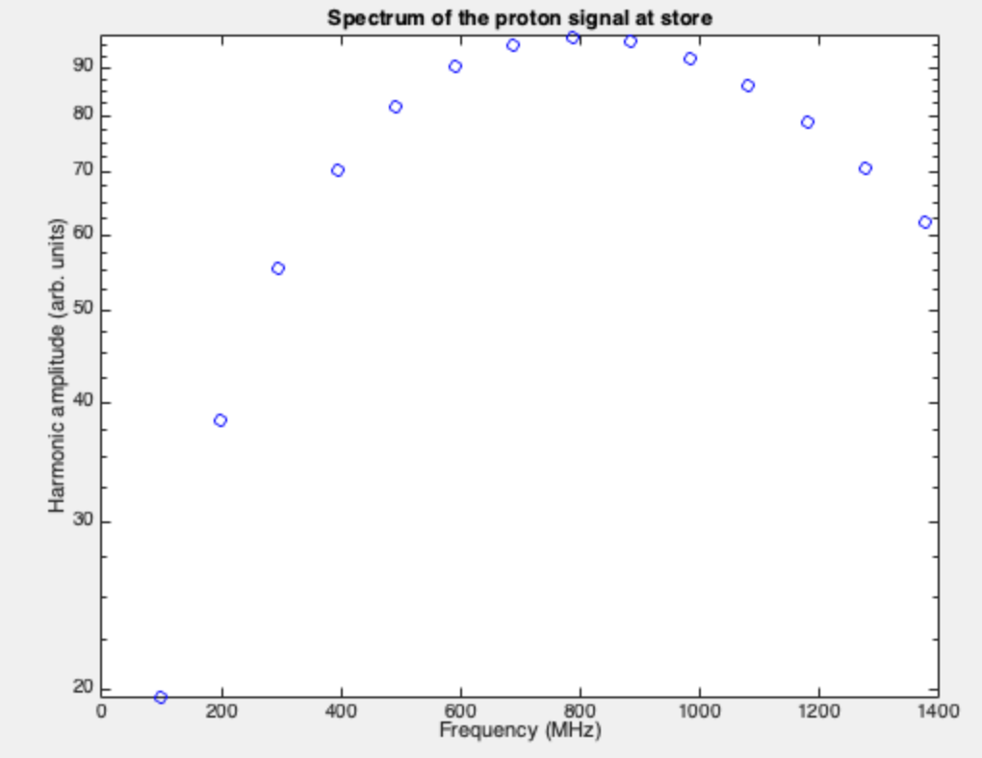
Spectra for the Proton BPM Signals
Proton signal spectrum during cooling. Maximum at 25 MHz. Dip at 50 MHz
Proton signal spectrum at the store. Due to the shorter bunch, the maximum is at 800 MHz.

Slide 10
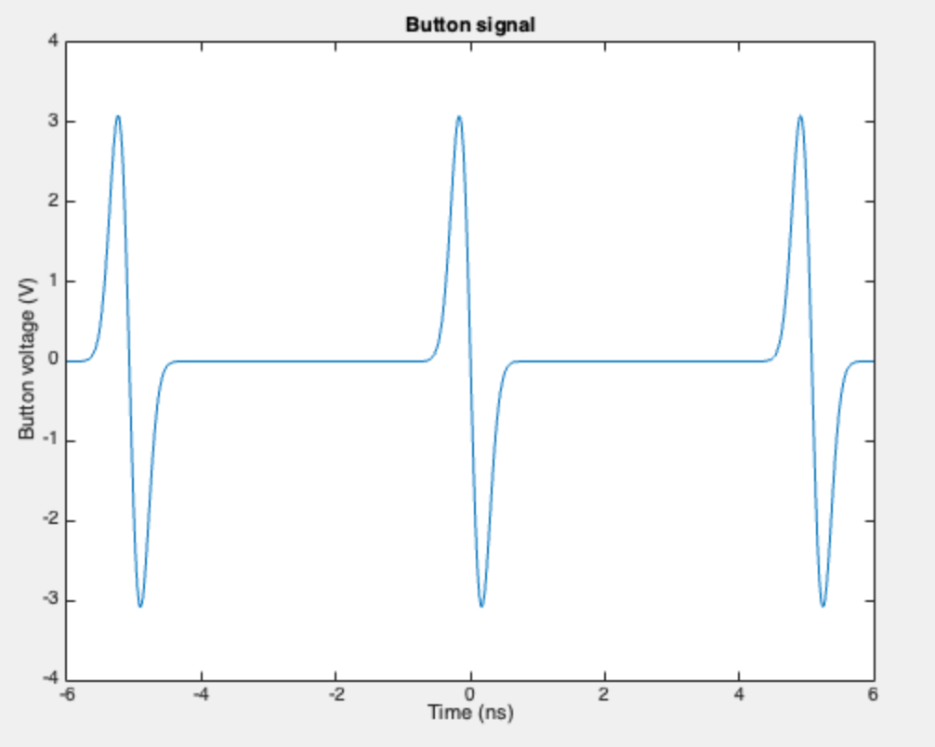
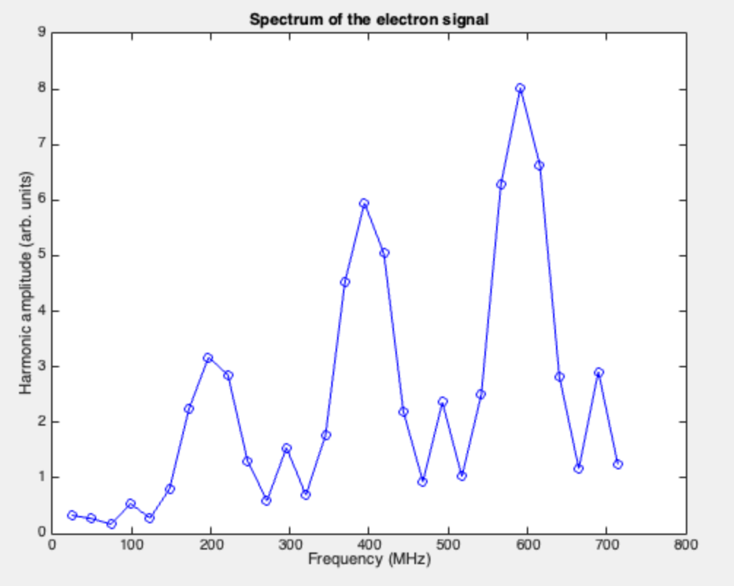
BPM Pick-up Signal Levels for the Electrons

Slide 11
Selection of Signal Processing
Proton beam
Sampling at the peak of the pulse (currently employed at RHIC) will require changing the clock phase, which is hard to implement
Narrowband processing does not work due to the different spectral content at cooling and the store
We will use the sum of the squares of the ADC readings to calculate pulse energy. To equalize the signal levels the low-pass filter will be used in the RF front end
Electron beam
Narrowband processing at 600 MHz is suitable because the proton signal is weak at cooling
The signal from the protons at the store is strong at 600 MHz and can be used for the BPM offset cross calibration

Slide 12
Noise Estimation for the Electron BPM
For the electron beam with a current of I_{e} = 88 mA (3.6 nC, 24.6 MHz), the signal level after 130 meters of LMR-240 cable is 5 mV r.m.s. (10 MHz BW filter centered at 591 MHz)
An amplifier with a noise figure of 2.6 dB has a thermal noise level of 4 μV. The corresponding SNR is 61.9 dB
For the ADC clock jitter of 70 fs, the SNR is 71.7 dB
11.4 ENOB corresponds to 68.4 dB SNR
The scaling factor is 32 mm, and the noise jitter for the single bunch is 30 microns
Averaging over 260 bunches (1 turn) reduces the noise position to 2 microns
For a 10 kHz BW required for orbit feedback, we have an extra gain of 3, bringing the noise below 1 micron

Slide 13
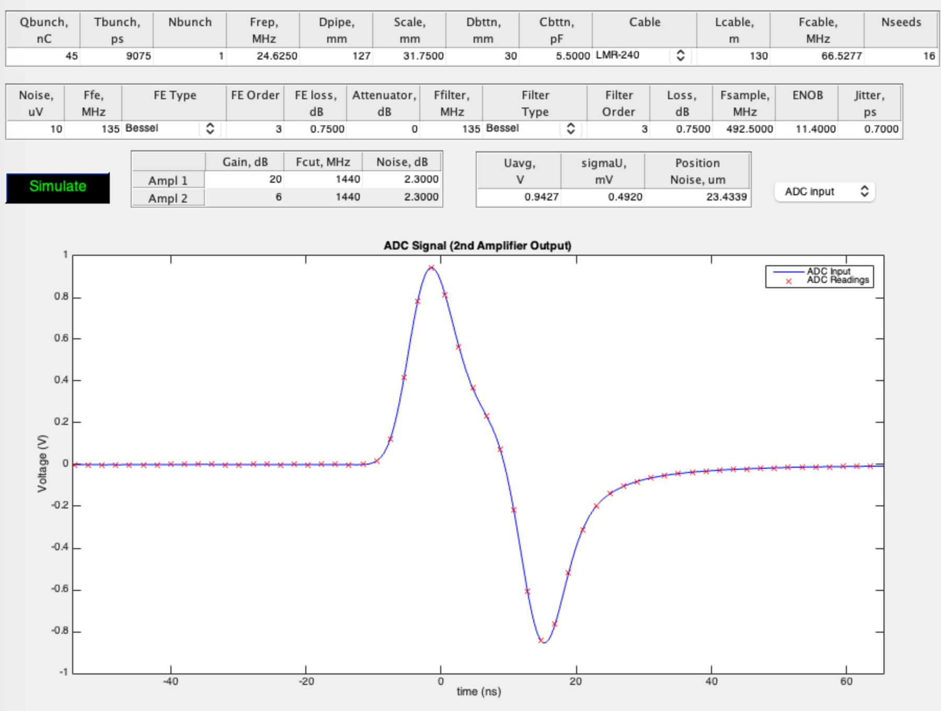
Noise Estimation for Proton BPM
Single-bunch measurement has a precision of 20 microns
For a single turn (260 bunches), resolution improves to 1.25 microns
For the orbit feedback, the precision is better than 0.5 microns

Slide 14
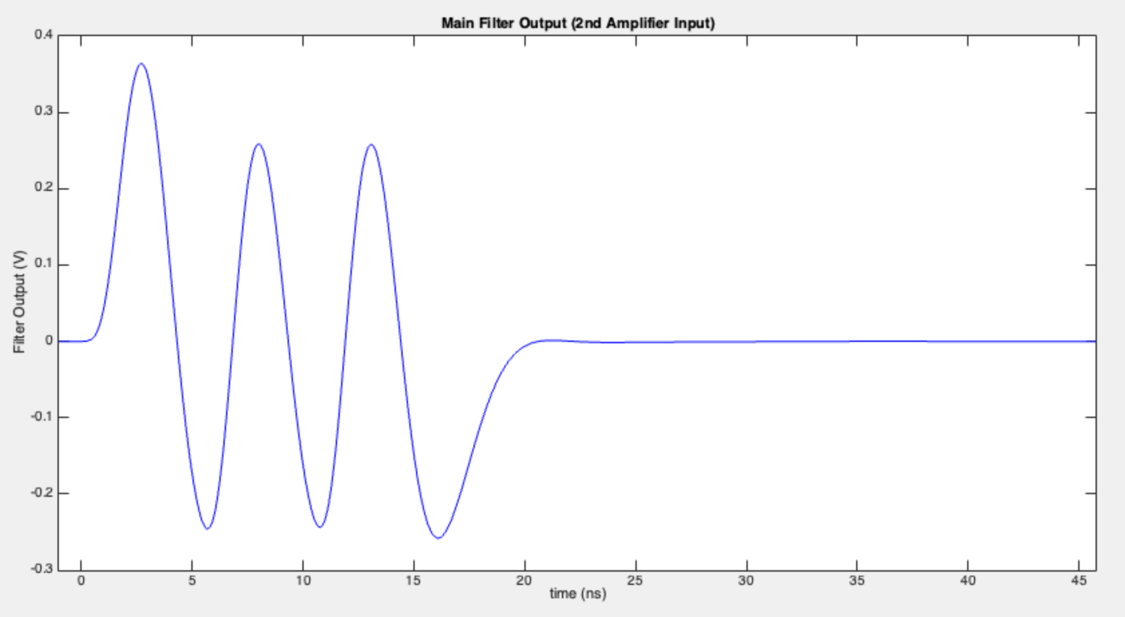
Offset Calibration for Two BPM Systems
Hadron and electron BPMs can have different electrical offsets due to the unequal losses in the cables and signal processing
The cross-calibration of the BPMs will be done when only one beam is present: either the proton beam at the store or the electron beam
The proton beam generates a factor 10 stronger signal and can be used continuously during operation
The electron beam can also produce a usable signal for hadron BPMs

Slide 15
Matching of the Relativistic Factors
The difference in the relativistic factors results in the phase shift between BPMs separated by drift L at the observation frequency F
We measure the phase offset with only one beam present. Then the second beam is injected, and we measure the phase change
For the Δγ/γ=10⁻⁴, the phase shift will be around 10⁻⁵ radians (0.0007º). While modern BPM systems can provide a sufficient signal-to-noise ratio, achieving such low drift in the cable might be challenging. Nevertheless, the system can complement the energy measurement with a dipole.
$$∆φ=2πF\frac{L}{c}Δβ≈2πF\frac{L}{c}\frac{1}{γ^{2}}\frac{∆γ}{γ}≈2π25×{10}^{6}\frac{150}{3×{10}^{8}}\frac{1}{{25}^{2}}\frac{∆γ}{γ}≈0.12\frac{∆γ}{γ}$$

Slide 16
Conclusion
The beam position monitors are expected to provide the required alignment of the electron and proton beams
The signals will be separated in the frequency domain
The cross-calibration of the electrical offsets is possible with either beam
Utilizing the phase measurement of the signals from two BPMs can help to match the relativistic factors

