Slide 1

Understanding Schottky spectra of stored laser-cooled bunched ion beams – simulations & recent experimental results from the CSRe
Hanbing Wang
2025.10.28
Institute of Modern Physics, Chinese Academy of Sciences
COOL2025 @ New York, USA

Slide 2
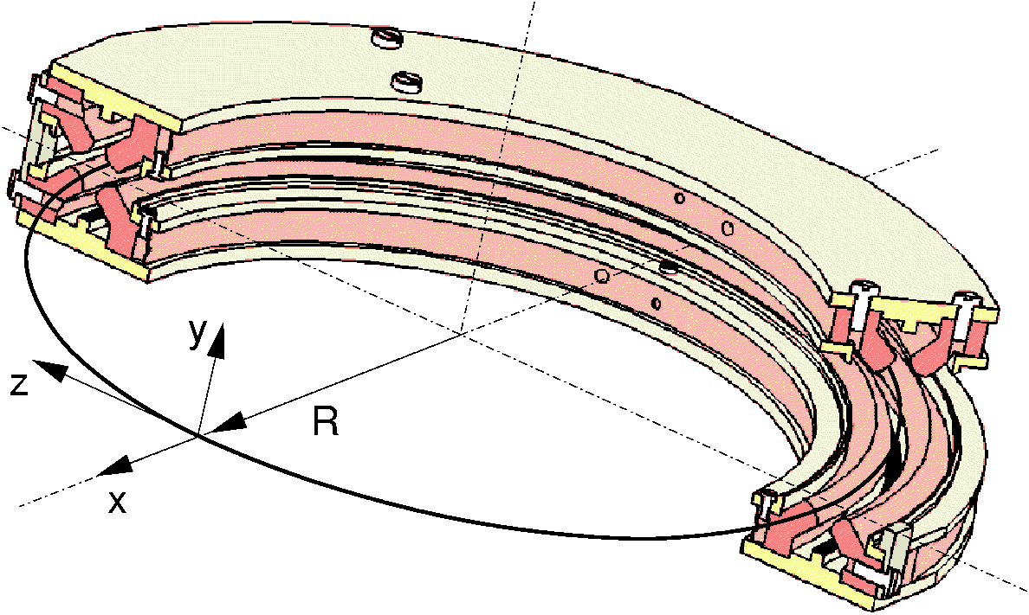
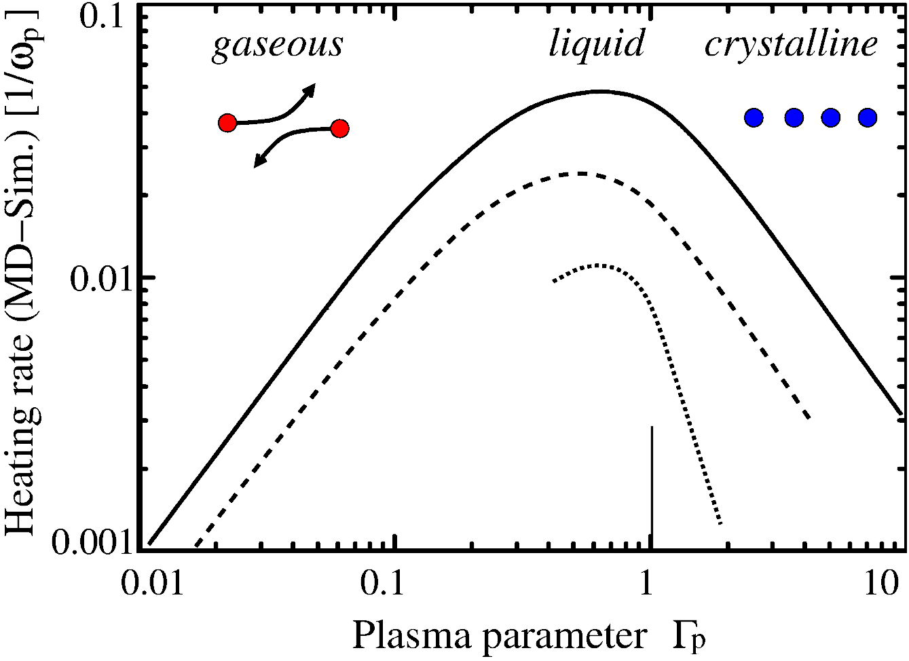
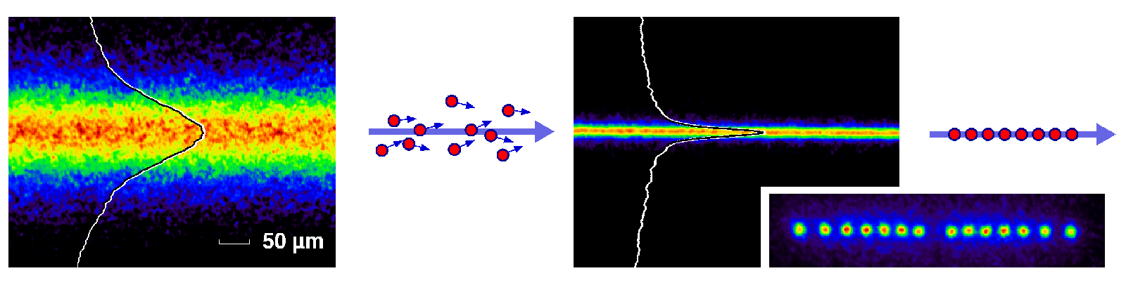
Motivation: Crystalline ion beams
PALLAS
Advantages of laser cooling :
Fast cooling speed
Strong cooling force
Ultra-low temperature and momentum spread: △p/p ~10⁻⁷
high phase-space densities
Crystalline ion beams at heavy-ion storage rings
Counter propagating laser beams
Fluorescence
detection
Crystalline beam
long-range order
²⁴Mg⁺
Laser-cooled ions at storage ring:
^{6,7}Li⁺, ⁹Be⁺, ²⁴Mg⁺,¹²C³⁺ → ¹⁶O⁵⁺
T. Schaetz et al. , Nature 412, 717(2001)
U. Schramm, et al., Progress in Particle 53 (2004) 583

Slide 3
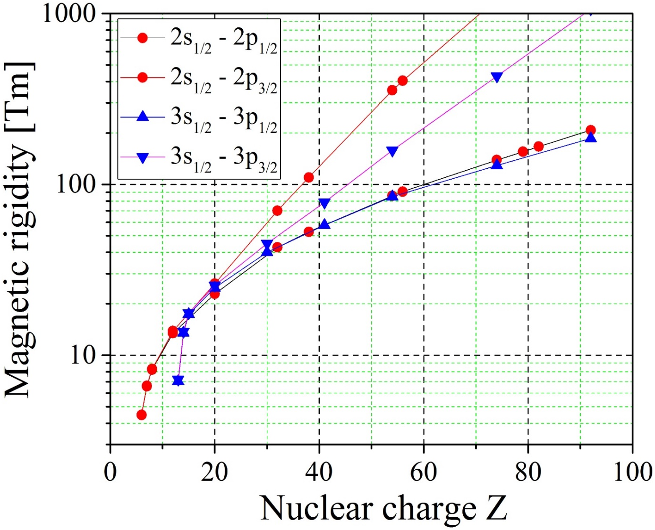
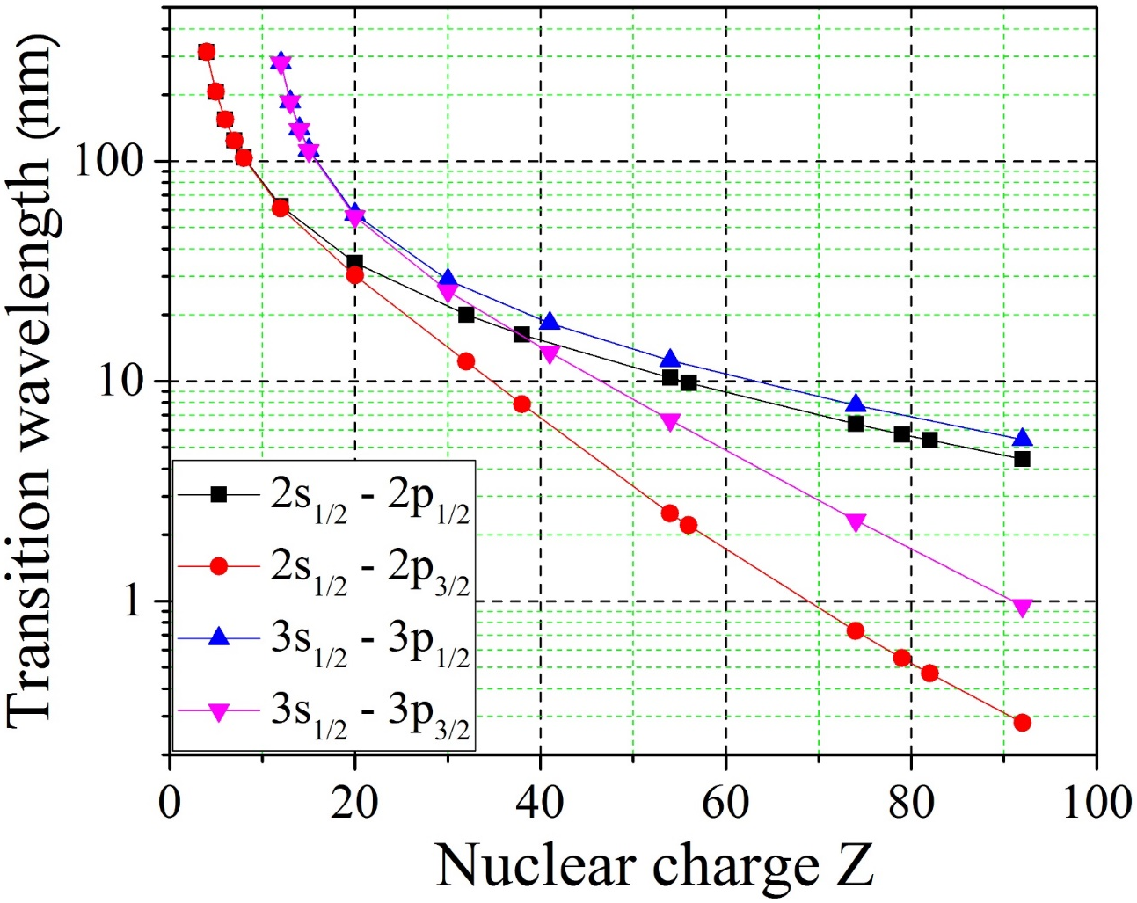
Motivation: Laser spectroscopy @ relativistic energy
Advantages of laser cooling :
Fast cooling speed
Strong cooling force: increases with beam energy ∝ γ²
Laser cooling of relativistic ions
Access to ground state transitions of heavy ions by huge Doppler shift
Precision laser spectroscopy of HCIs
Li-like and Na-like ions
SIS300
SIS100
HIAF BRing 34
HIAF SRing 15
CSRe 9.0
Li-like and Na-like @ 220 nm

Slide 4
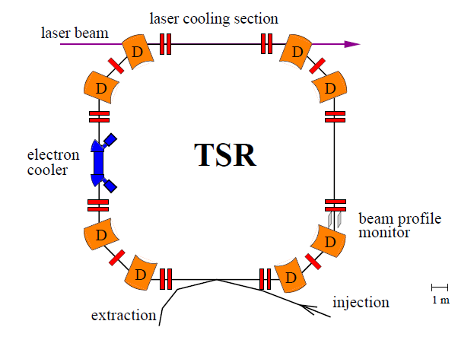
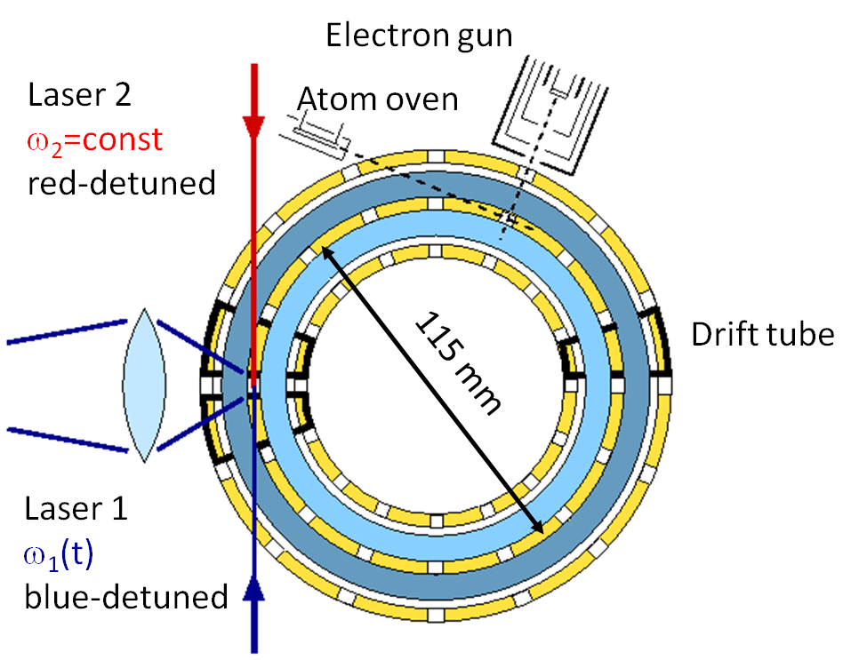
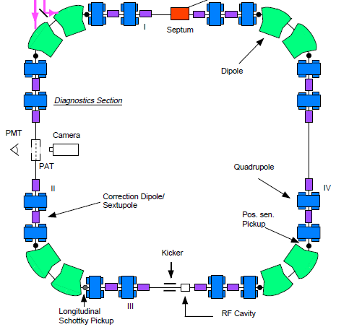
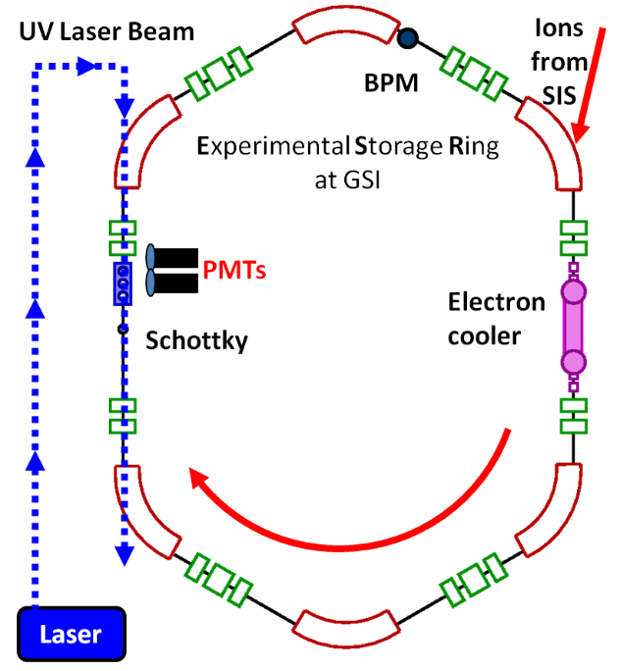
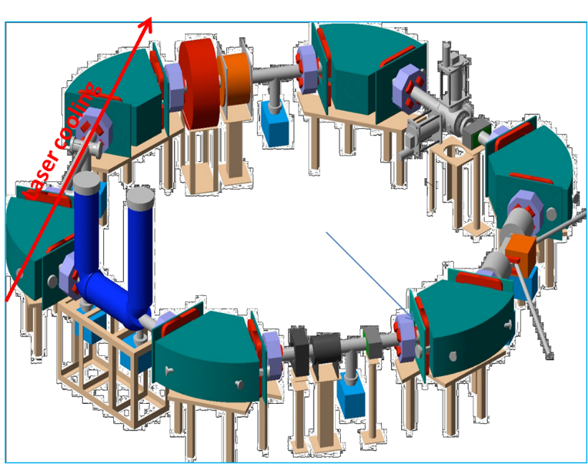
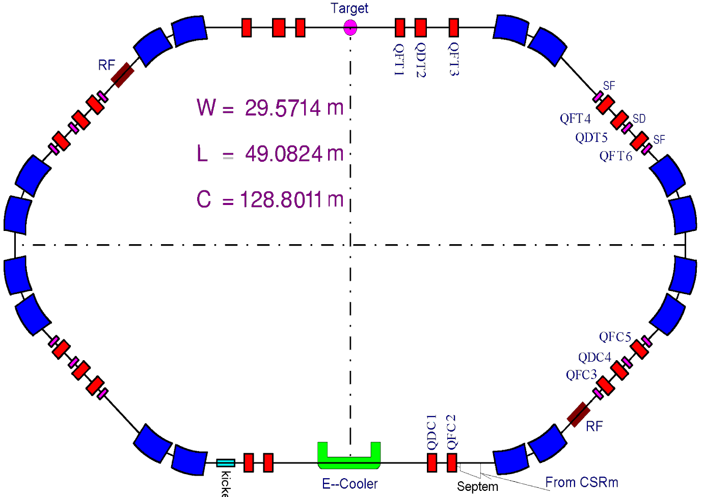
Laser cooling and precision laser spectroscopy @storage rings
ASTRID
PALLAS
^{6,7}Li⁺, ⁹Be⁺
⁷Li⁺
⁷Li⁺, ²⁴Mg⁺
²⁴Mg⁺
PMT
RF-Buncher
Schottky
CPM
ESR
S-LSR
CSRe
¹²C³⁺
⁷Li⁺, ¹²C³⁺, Pb⁸¹⁺, Bi^{80+,82+}
²⁴Mg⁺
¹⁶O⁵⁺
Electron cooler
laser

Slide 5
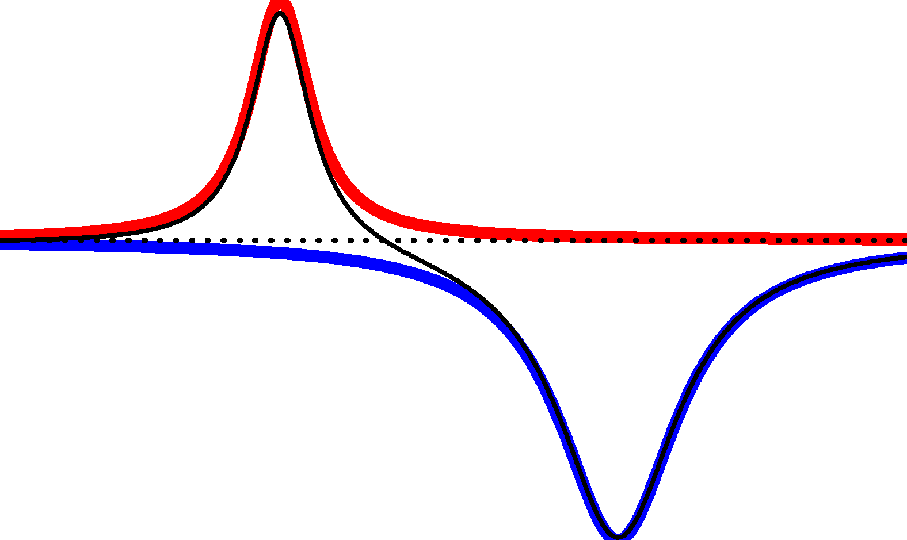
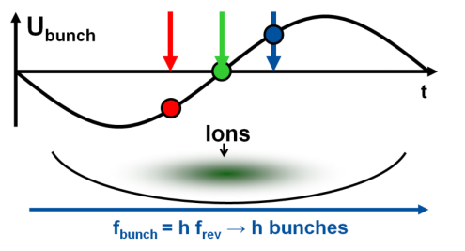
Principle: Laser cooling @ storage rings
F_{laser}
Stable point
v_{ion}=v₀
v_{ion}
Ion beam
Laser 1
Laser 2
Storage ring
275 MeV/u Li-like ¹⁶O⁵⁺ (β ≈ 0.64, γ ≈ 1.30)
U_{bunch}
Laser
Ions
t
_{2P}
_{2S}
f_{bunch} = h×f_{rev} → h×bunches
λ_{Laser}≈ 48 nm
λ₀ ≈ 103 nm
λ_{Laser} ≈ 220 nm

Slide 6
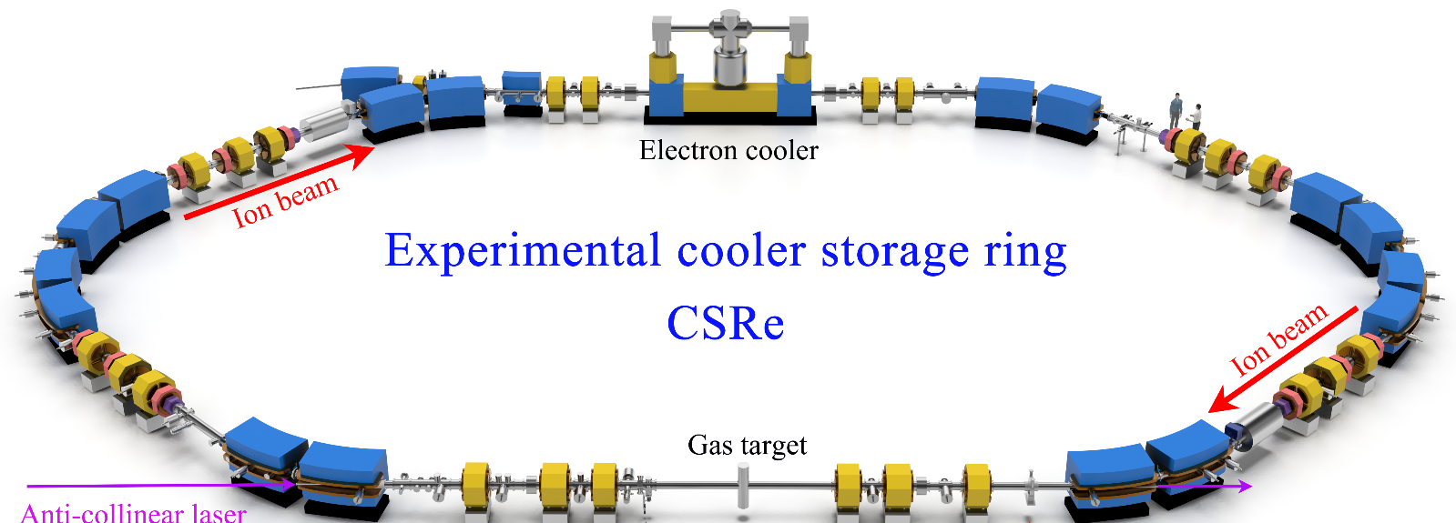
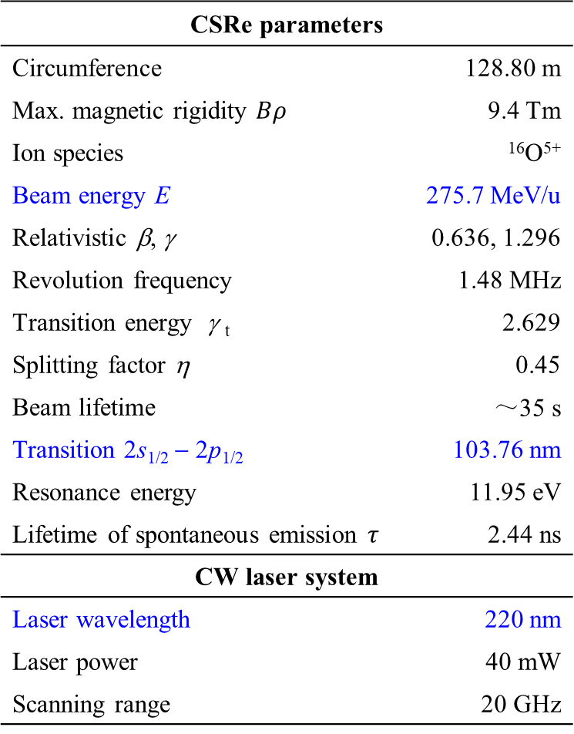

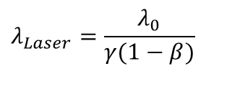
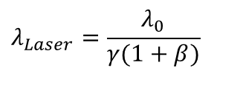
Experimental setup & parameters
CSRe parameters
Circumference | 128.80 m | 128.80 m
Max. magnetic rigidity $Bρ$ |  | 9.4 Tm
Ion species | ¹⁶O⁵⁺ | ¹⁶O⁵⁺
Beam energy E | 275.7 MeV/u | 275.7 MeV/u
Relativistic β, γ | 0.636, 1.296 | 0.636, 1.296
Revolution frequency | 1.48 MHz | 1.48 MHz
Transition energy γ _{t} | 2.626 | 2.629
Splitting factor η | 0.45 | 0.45
Beam lifetime | ～35 s | ～35 s
Transition 2s_{1/2} − 2p_{1/2} | 103.76 nm | 103.76 nm
Resonance energy |  | 11.95 eV
Lifetime of spontaneous emission $τ$ |  | 2.44 ns
CW laser system
Laser wavelength | 220 nm
Laser power | 40 mW
Scanning range | 20 GHz
Electron cooler
Ion beam
experimental Cooler Storage Ring (CSRe)
Laser cooling of 275.7 MeV/nucleon Li-like ¹⁶O⁵⁺
(β ⁓ 0.64, γ ⁓ 1.30)
Ion beam
Resonant Schottky pick-up
RF-buncher
cw Laser @ 220 nm
$$λ_{Laser}=\frac{λ_{0}}{γ(1−β)}$$
$$υ=βc$$
$$λ_{Laser}=\frac{λ_{0}}{γ(1+β)}$$
²P_{1/2}
²S_{1/2}
λ_{Laser} ≈ 220.0 nm
λ₀ ≈ 103.8 nm
λ_{Laser} ≈ 48.9 nm

Slide 7
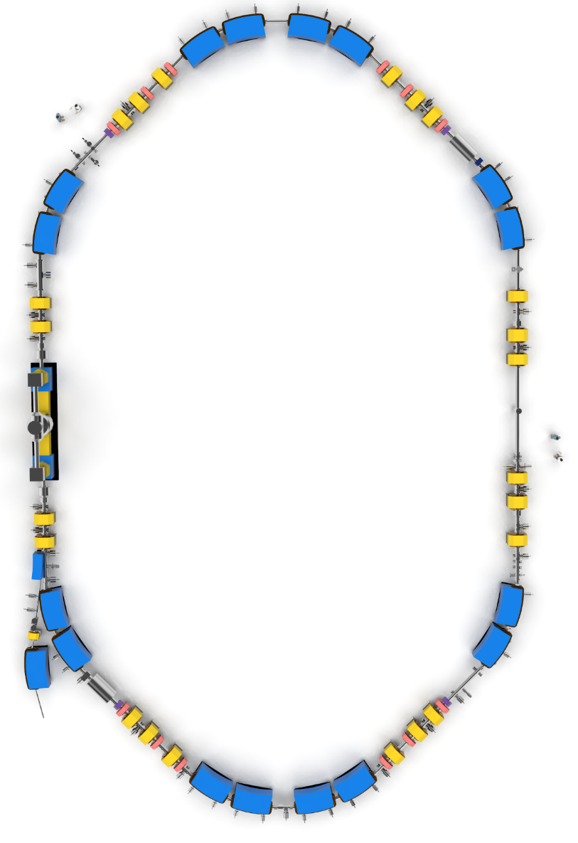
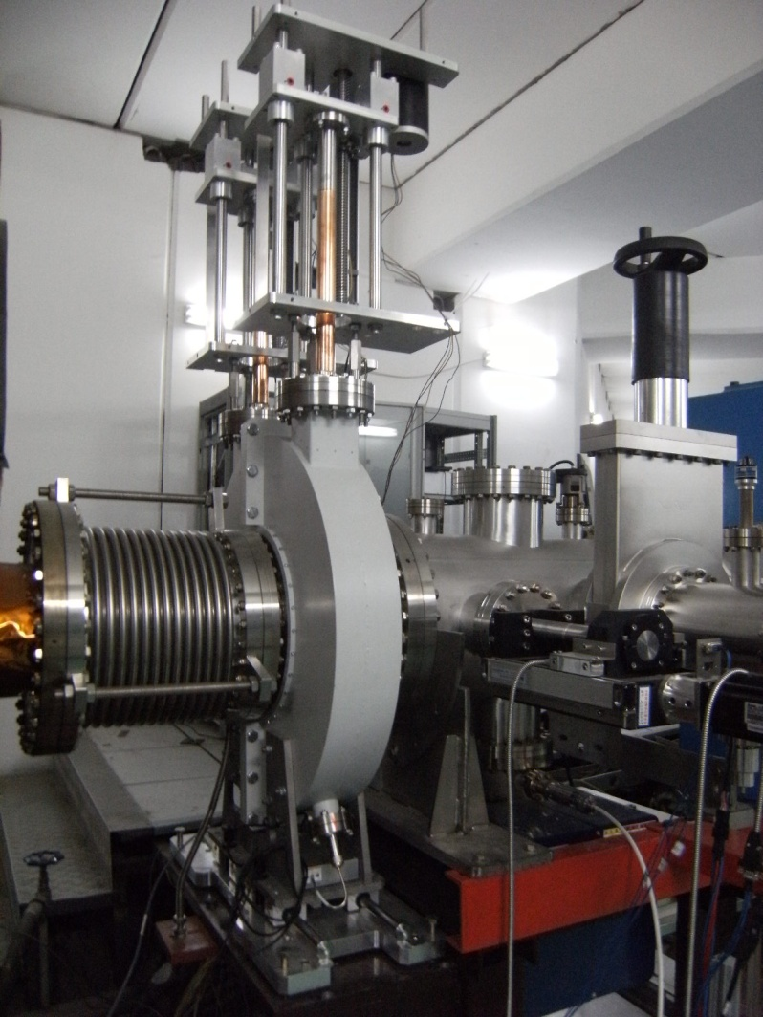
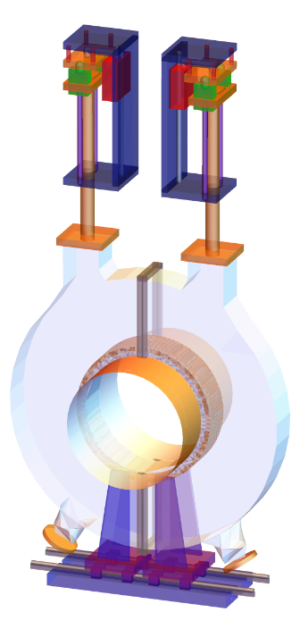
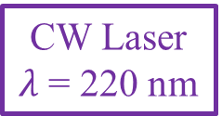
Schottky system @ HIRFL-CSRe
CSRe
Σ
Amp
FFT
Resonant Schottky pick-up
RF-buncher
Resonant
Schottky pick-up
I(t)
E-cooler
-4
-3
-2
-1
0
1
2
3
4
Time t/t_{rev}
I(f)
FFT
O⁵⁺ Ion beam
-4
-3
-2
-1
0
1
2
3
4
Injection
Frequency f/f_{rev}
CW Laser
$λ$ = 220 nm

Slide 8
Experimental results @ laser cooling of O⁵⁺ ion beams

Slide 9












Laser cooling of bunched ¹⁶O⁵⁺ ion beams
$$π$$
$$π$$
$$π$$
$$π$$
(a1)
(b1)
(c1)
(d1)
$$Δφ$$
0
$$Δφ$$
0
$$Δφ$$
0
$$Δφ$$
0
$$−π$$
Bucket
$$−π$$
$$−π$$
$$−π$$
0
0
0
0
Frequency
Frequency
Frequency
Frequency

Slide 10
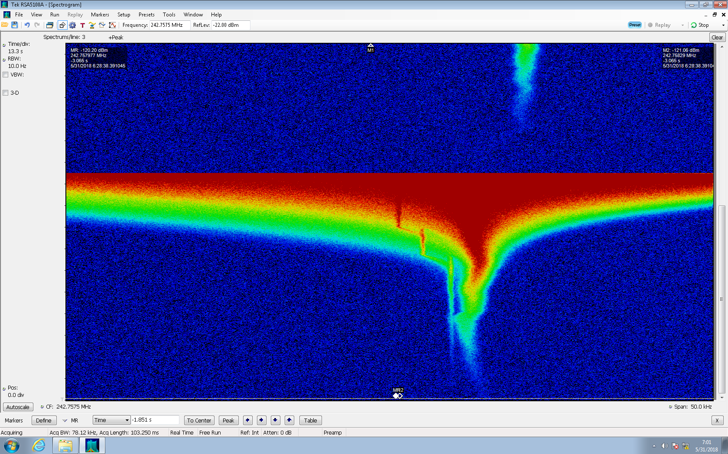
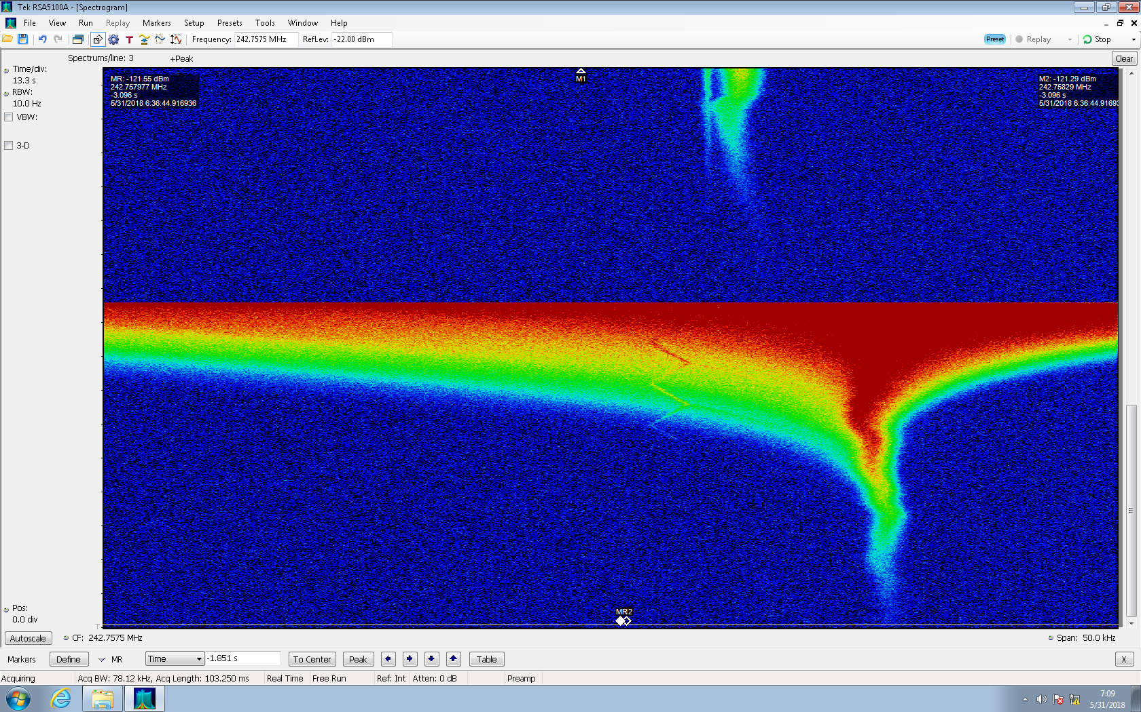
Laser cooling by CW laser and E-cooler
E-cooling peak
△p/p ~ 10⁻⁵
Time (s)
Laser-cooling peak
Laser
40 mW @ 220 nm
vs
E-cooler
500 mA @ 152 kV
△p/p ~ 10⁻⁶
-25
-12.5
0
12.5
25
-25
-12.5
0
12.5
25
f – 242.75954 M [kHz]
f – 242.75954 M [kHz]

Slide 11






Simulation method: phase space tracking
The motion of ions in the phase space
The motion of bunched ions in the longitudinal phase space
The trajectory of bunched ions under fixed laser in the longitudinal phase space
$$ΔP/P$$
$$ΔP/P$$
Bucket
CW laser
Bucket
Reference particle
$$U_{RF}$$
$$U_{RF}$$
$$φ$$
$$φ$$

Slide 12
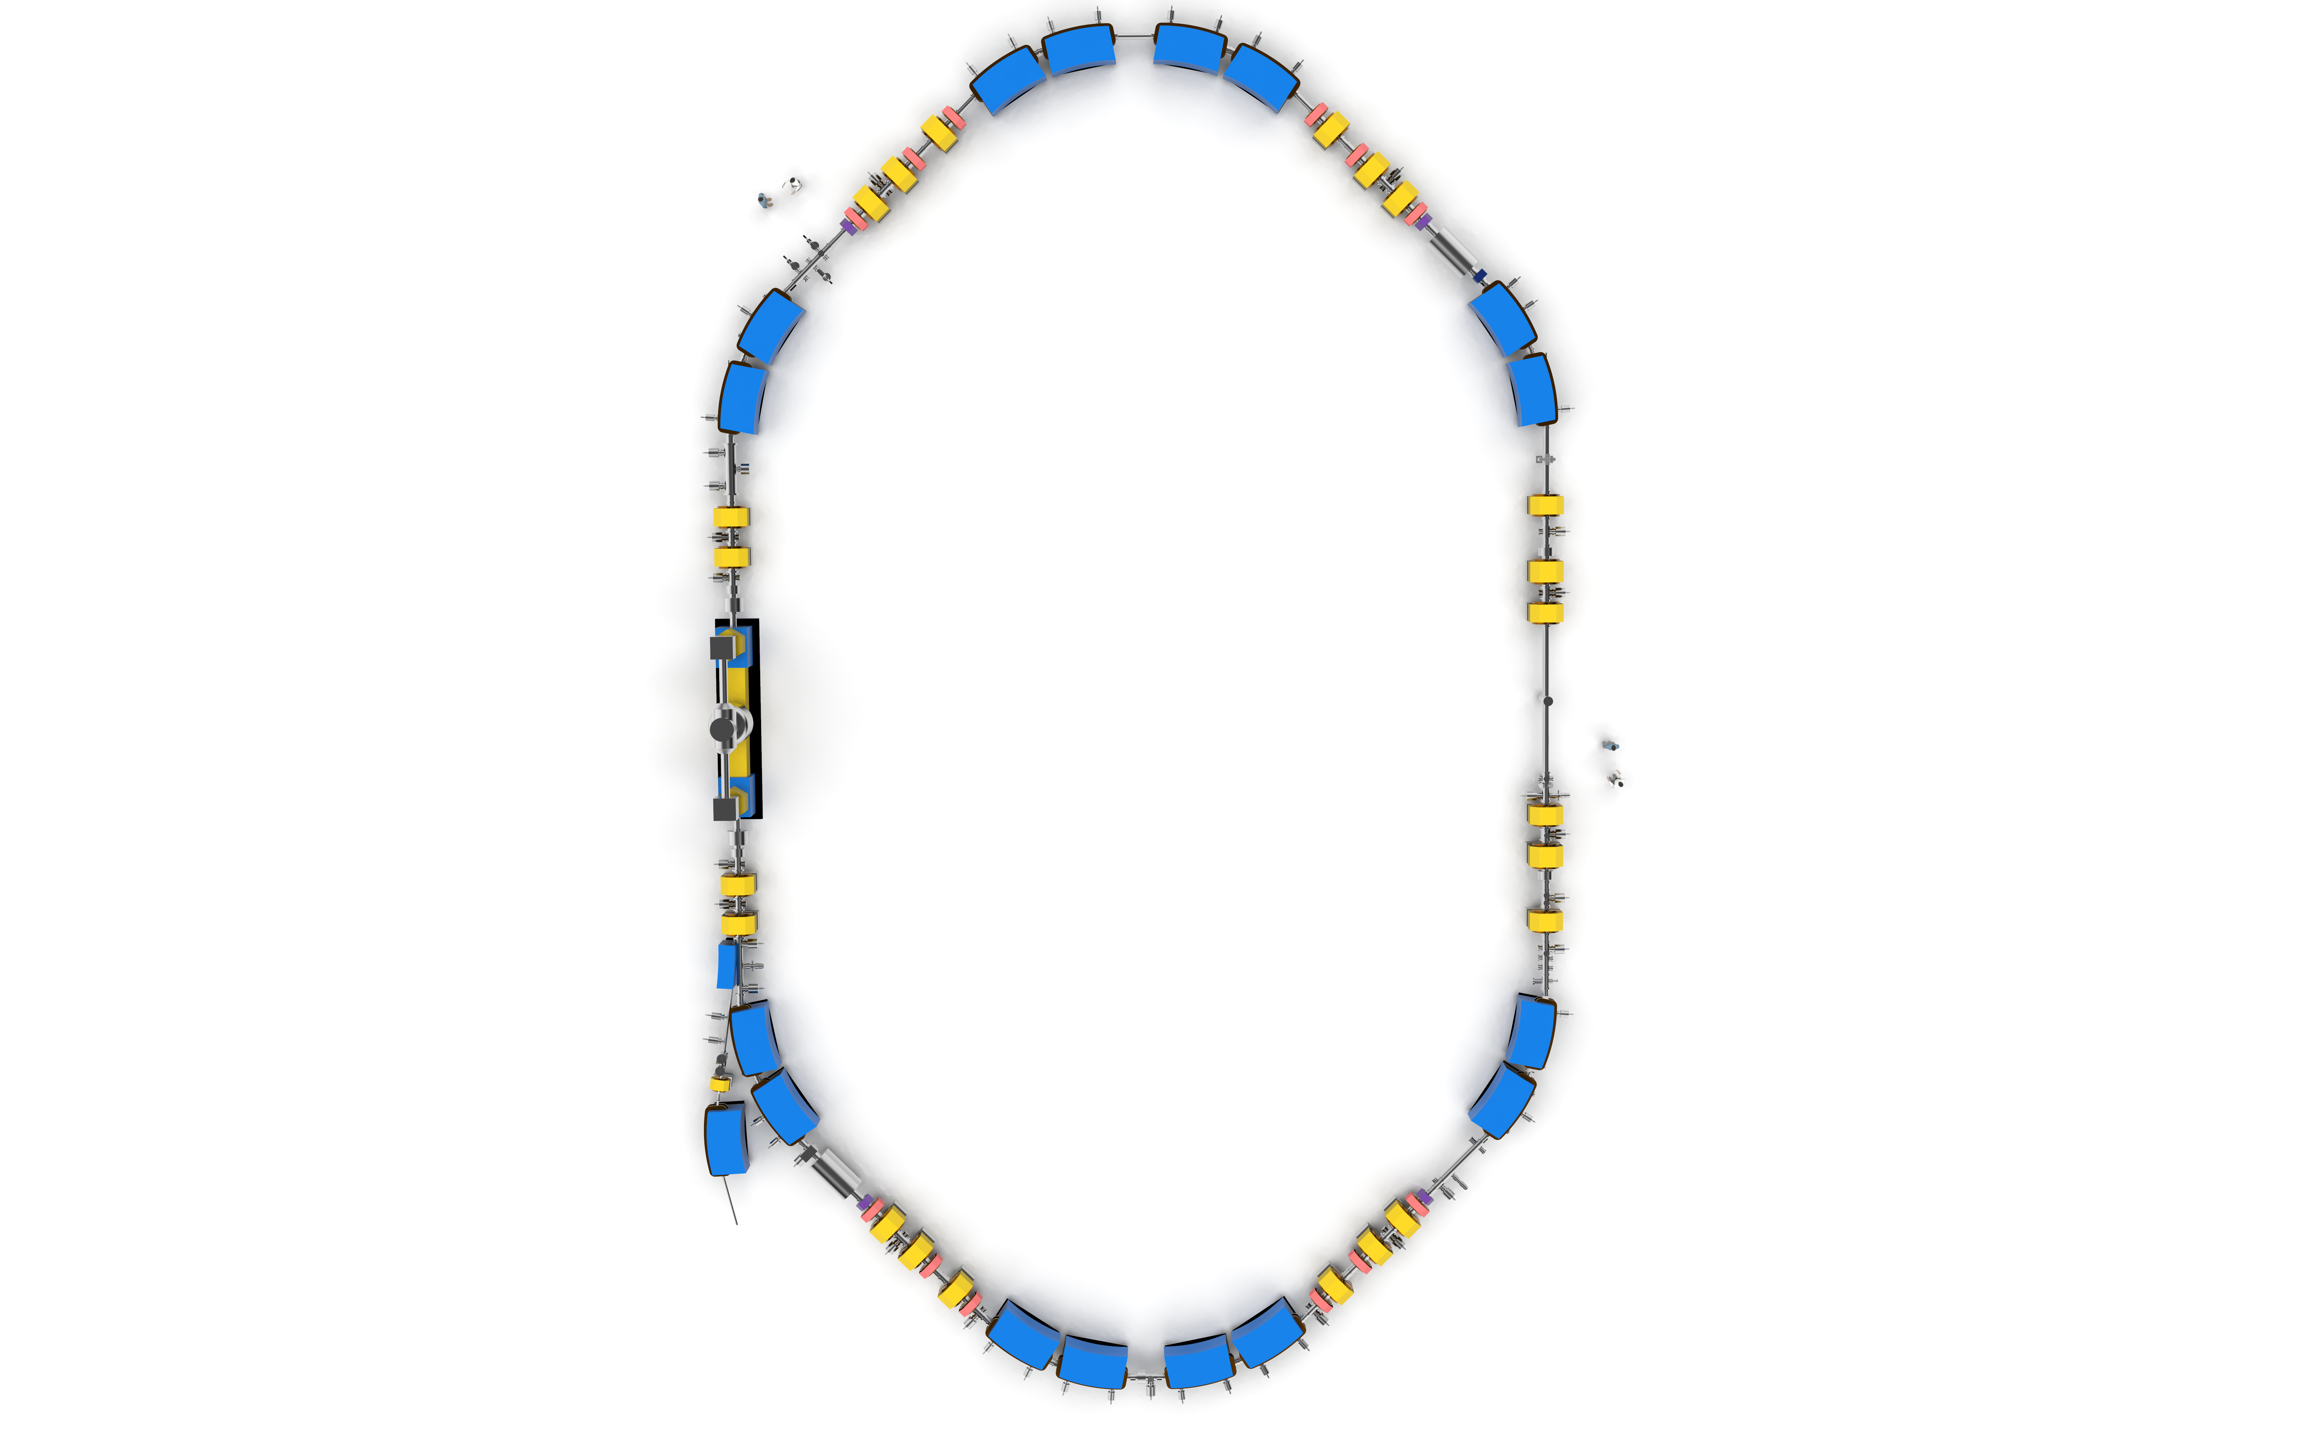
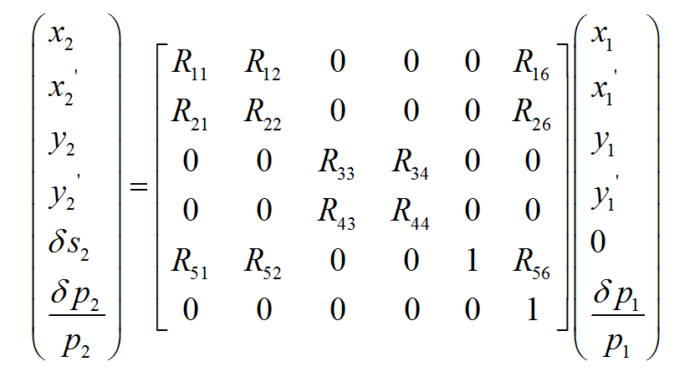
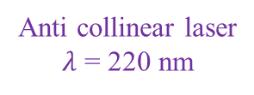
Simulation method
Laser interaction
RF-buncher modulation
RF-buncher
Before absorption
Ion beam
$$h/λ$$
$$θ$$
Schottky pick-up
$$γmβc$$
Experimental
cooler storage ring
CSRe
After absorption
Electron cooler
6-D motion in storage rings
$$γmβc−{hcosθ}/λ$$
After emission
Ion beam
$$θ^{′}$$
$$h/{λ^{′}}$$
Anti collinear laser
$λ$ = 220 nm
$$γmβc−{hcosθ}/{λ−{hcosθ^{′}}/{λ^{′}}}$$

Slide 13
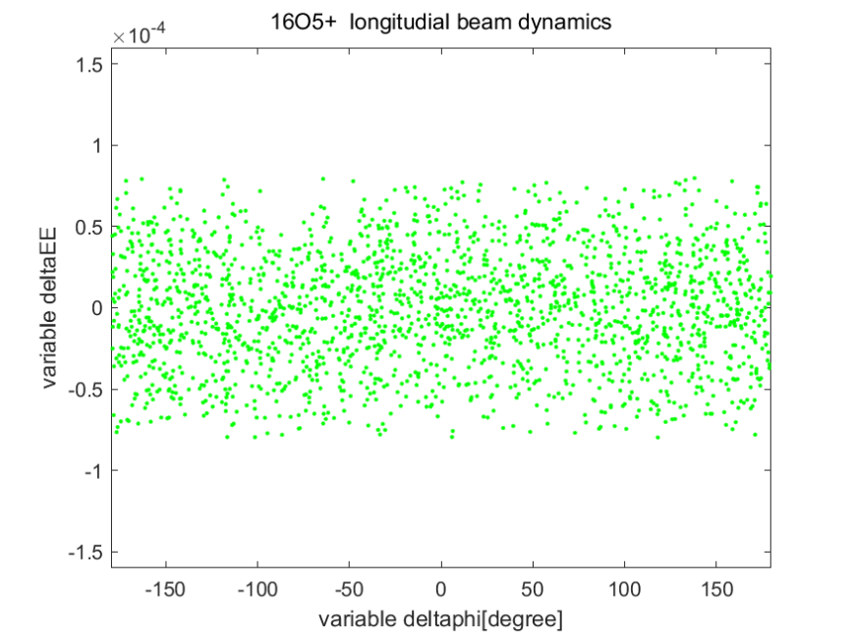
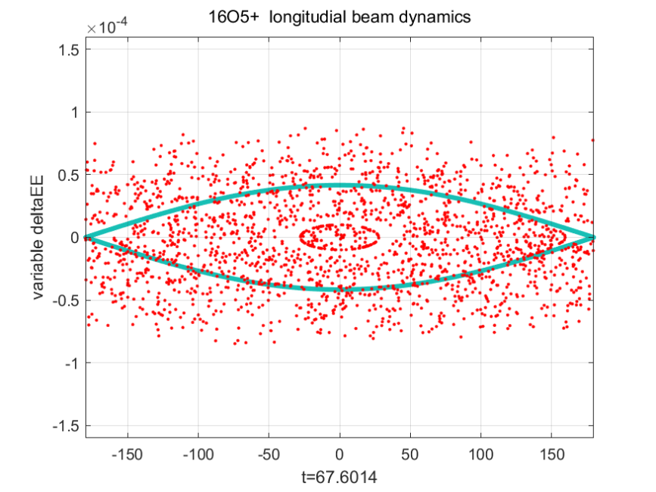
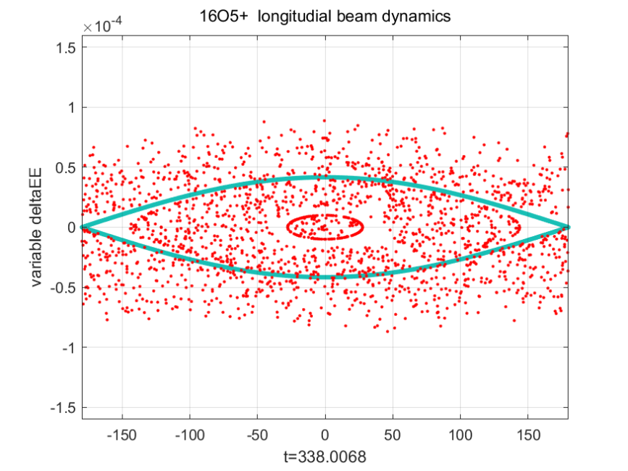
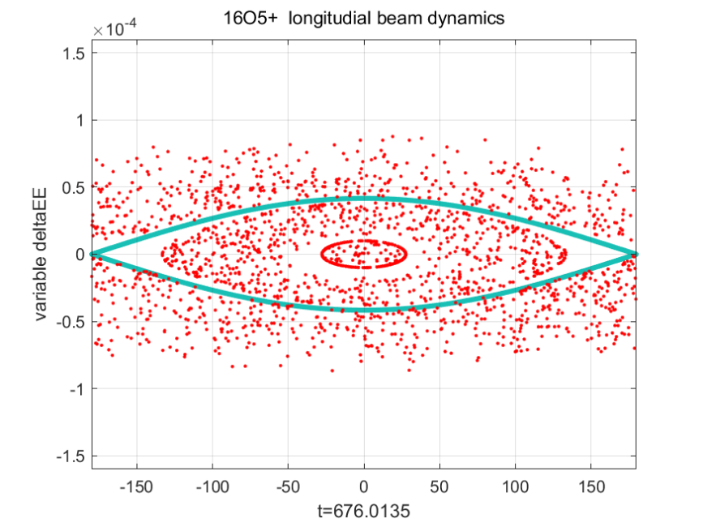
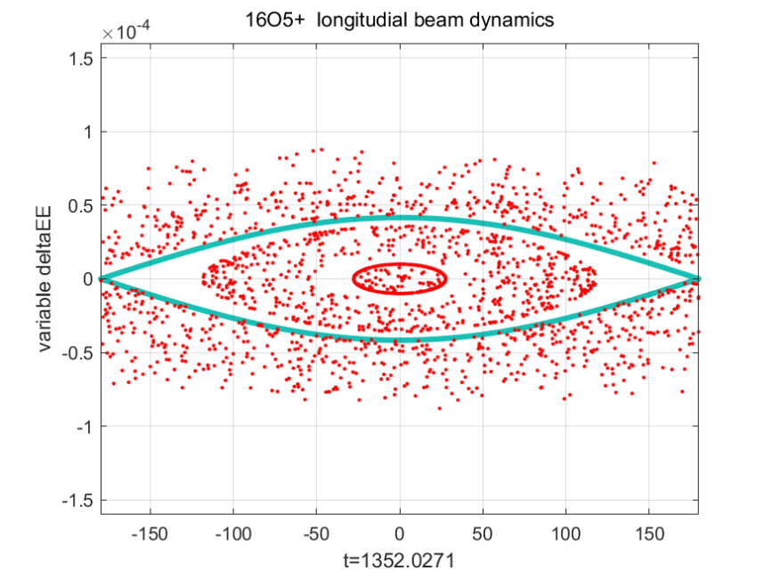
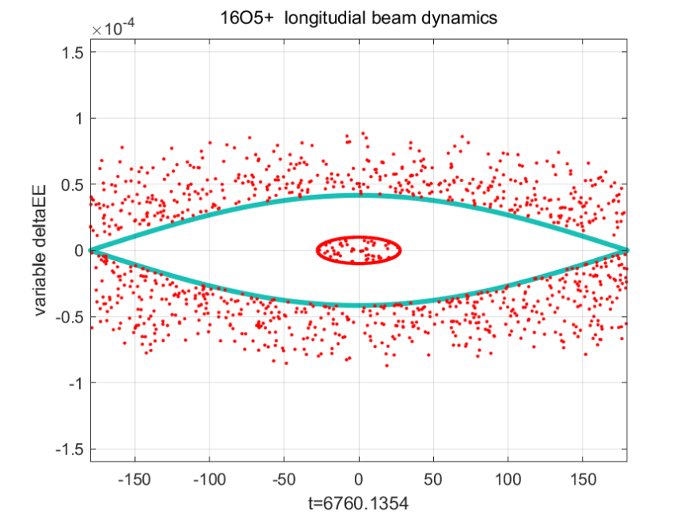












Simulation results: laser cooling process
10⁵ turns
2×10⁵ turns
$$ΔE/E$$
$$ΔE/E$$
$$ΔE/E$$
$$φ$$
$$φ$$
$$φ$$
5×10⁵ turns
10⁶ turns
10⁷ turns
$$ΔE/E$$
$$ΔE/E$$
$$ΔE/E$$
$$φ$$
$$φ$$
$$φ$$

Slide 14








Simulation results: laser cooling of bunched ¹⁶O⁵⁺ ion beams
$Δ$p/p
0
$$π$$
(a1)
$$Δφ$$
0
$$−π$$
Bucket
$$π$$
(b1)
$$Δφ$$
0
$$−π$$
$$π$$
(c1)
$$Δφ$$
0
$$−π$$
$$π$$
(d1)
$$Δφ$$
0
$$−π$$
0
Frequency

Slide 15
Simulation results: the coherent effect
Ultra-high power of the central peak appears only:
h_{bun}=40, change h_{obs}
h_{obs}: Observation harmonic
h_{bun}: RF-bunching harmonic

Slide 16
Simulation results: the coherent effect
Relationship between the Schottky power and number of ions
Integer
Non-integer
Power
Power of
Central peak
Power of
Sidebands
h_{obs}: Observation harmonic
h_{bun}: RF-bunching harmonic

Slide 17
Method 1. Fit the sidebands of the Schottky spectrum

Slide 18
Method 2. Calculate the r.m.s width of the Schottky sidebands
Momentum distribution vs RMS calculation
Momentum spread of laser-cooled O⁵⁺ ions
V. Balbekov, Longitudinal schottky spectra of bunched beams, Proceedings of EPAC 2004, Lucerne, Switzerland

Slide 19
Method 3. Sum the Schottky power of each sideband

Slide 20
Experimental results: Momentum distribution extraction
Experimental results
Extracted momentum distribution
Reconstructed Schottky spectra

Slide 21
Summary
1. First laser cooling of ¹⁶O⁵⁺ ion beams at the storage rings:
Highest charge state and energy
Shortest transition wavelength：103 nm
Laser cooling with a CW laser and the electron cooler
2. Simulation of laser cooling of ¹⁶O⁵⁺ ion beams at the CSRe.
Simulation of laser cooling process
Simulation of Schottky spectrum of laser-cooled bunched ¹⁶O⁵⁺ ion beams
3. Understanding Schottky spectra of stored laser-cooled bunched ion beams
Schottky spectrum of laser-cooled bunched ¹⁶O⁵⁺ ion beams
Coherent effect
Extraction of momentum distribution from Schottky spectrum of bunched ion beams

Slide 22





Acknowledge
IMP:
W.Q. Wen, H.B. Wang, D.Y. Chen, Z.K. Huang, D.M. Zhao, X.L. Zhu, X.N. Li, J. Li, L.J. Mao, R.S. Mao, T.C. Zhao, J.X. Wu, D.Y. Yin, J.C. Yang, Y.J. Yuan, and X. Ma*
Xidian University:
D. C. Zhang
GSI:
D. Winters, S. Klammes, S. Litvinov, L. Eidam
TU Darmstadt:
D. Kiefer, Th. Walther, B. Rein, G. Birkl
HZDR:
M. Bussmann, M. Loeser, M. Siebold, U. Schramm

Slide 23
Thanks for your attention！

Slide 24
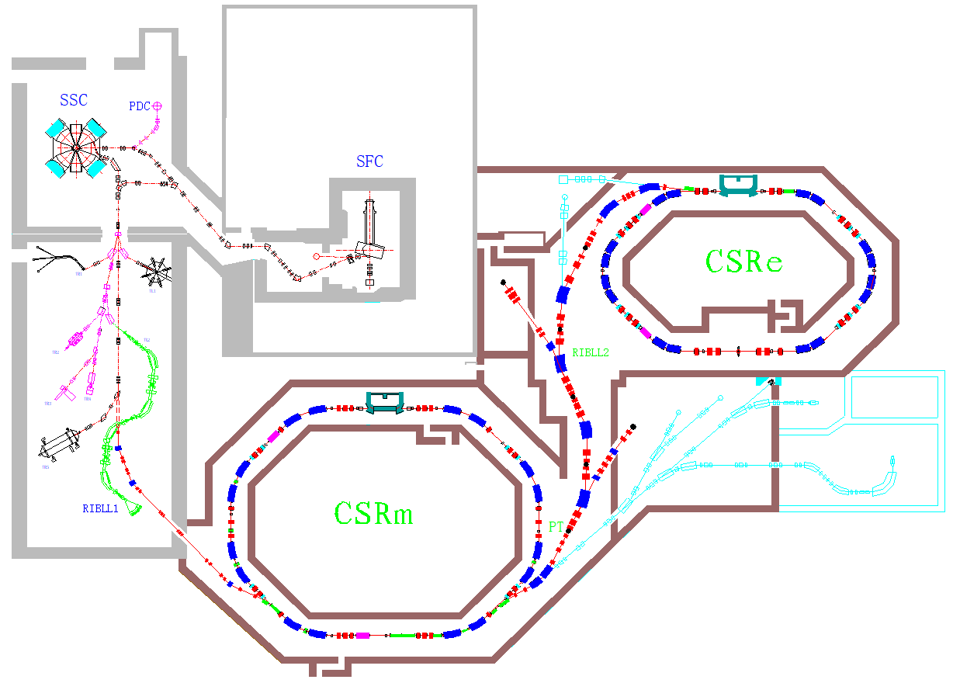
Storage ring: HIRFL-CSRe
SSC
100 AMeV (H.I.),
110 MeV (p)
SFC
10 AMeV (H.I.), 17~35 MeV (p)
DT
CSRe
ECR
CSRm
1000 AMeV (H.I.),
≤ 2.8 GeV (p)
RIBLL1
RIBs at tens of AMeV

Slide 25
Flow chart of the simulation method
Differential equations:
Input simulation parameters
Initialize momentum and phase
In laser interaction range?
N
Count the ions number in each phase section
Y
change p_{x}, p_{y}, and p_{z}
Apply Kaiser window
Calculate the momentum and phase in next period in 6D phase space
FFT
N
Final period reached?
Y
Result output

Slide 26
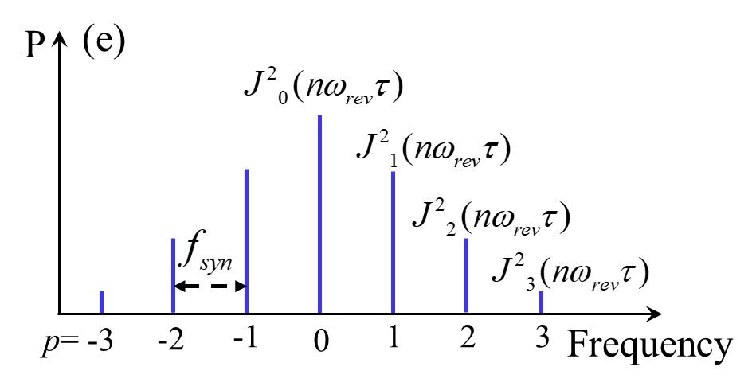

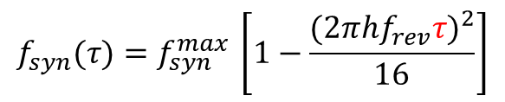


Simulation method
τ is the max oscillation time amplitude that an ion can reach. As shown in the figure, the ion in the red line has the same τ. It is a physical quantity always used in the description of the motion of the ions in time region.
τ
$$ΔP/P$$
$\hat{τ}(t)=τ⋅\sin{(}2πf_{syn}t+ψ)$
Besides, τ also relates to the Schottky power of the central peak and sidebands, and the positon of the central peak. As a result, we keep τ here but not the v₀.
$$f_{syn}(τ)=f_{syn}^{max }\left[1−\frac{{(2πhf_{rev}τ)}^{2}}{16}\right]$$
$$\hat{τ}$$
-10.2 ns
0 ns
10.2 ns
Tracking the motion of ions in phase space.
For bunched ions, the longitudinal dynamics equation is:

Slide 27
Experimental setup of Kr³⁰⁺ ion beams @ CSRe
Resonant
Schottky pick-up
RF-buncher
Experimental parameters
Circumference | 128.80 m
Ion species | ⁸⁶Kr³⁰⁺
Beam energy E | 100 MeV/u
Relativistic β, γ | 0.430, 1.107
Revolution frequency | 1.00 MHz
Transition energy γ_{t} | 2.629
Splitting factor η | 0.67
Beam lifetime | ～35 s
Harmonic number h | 40, 42, 48, 49
Observation harmonic | 240
HIRFL-CSRe
E-cooler
Kr³⁰⁺ Ion beam
Injection

Slide 28
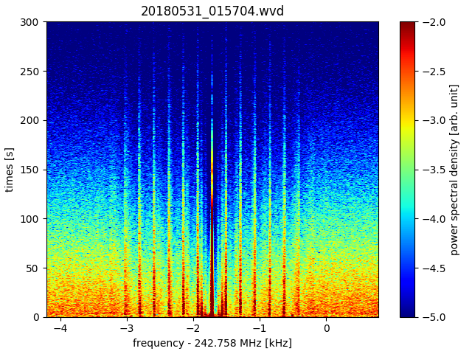
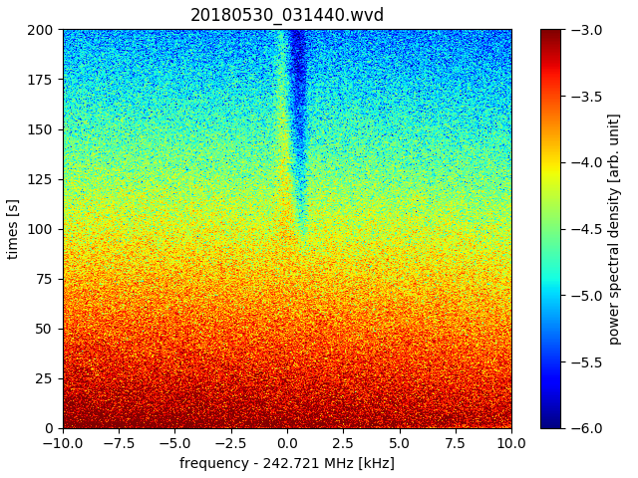
Experimental result: Coherent effect of O⁵⁺ ion beams @ CSRe
0
(a)
-2
75
-3
Time (s)
150
Power Density (arb. units)
-4
225
300
-5
(b)
Coherent peak
Sidebands

Slide 29
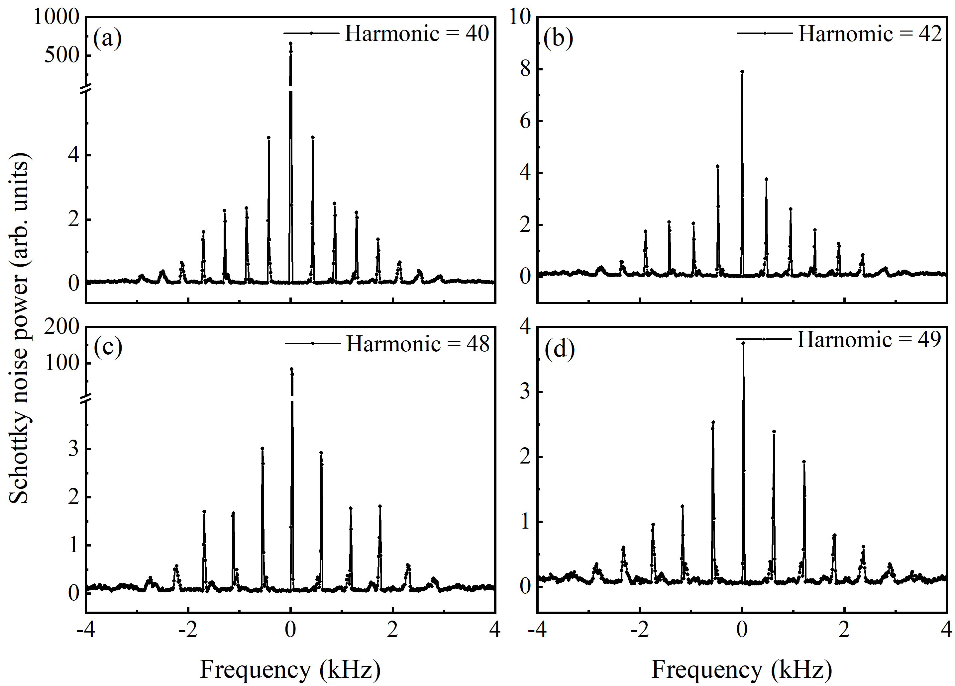
Experimental results of Kr³⁰⁺ ion beams @ CSRe
h_{obs}=240
Ultra-high power of the central peak appears only:
h_{obs}: Observation harmonic
h_{bun}: RF-bunching harmonic

Slide 30
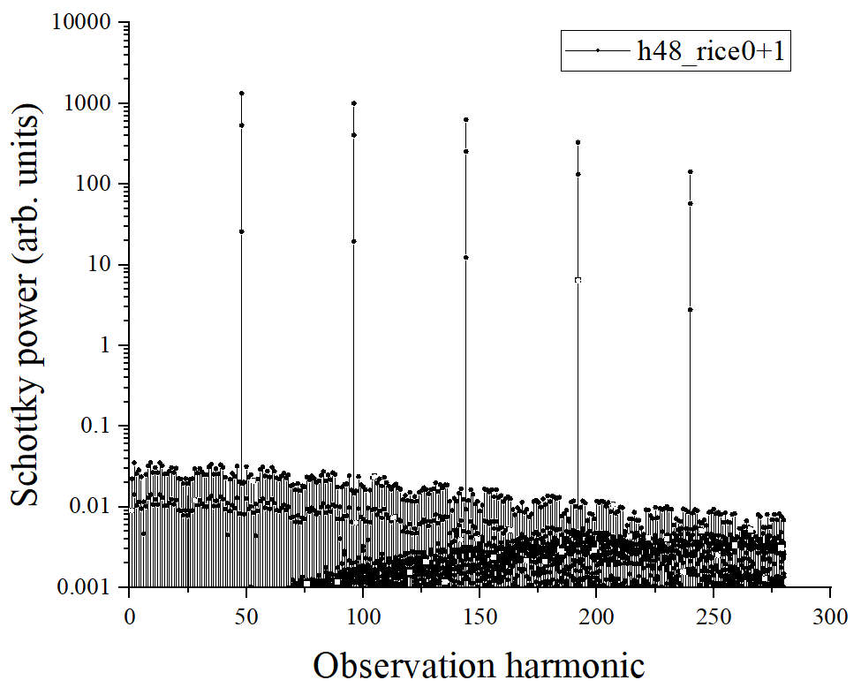
Simulation results: the coherent effect
h_{obs}=48，change observation harmonics

Slide 31
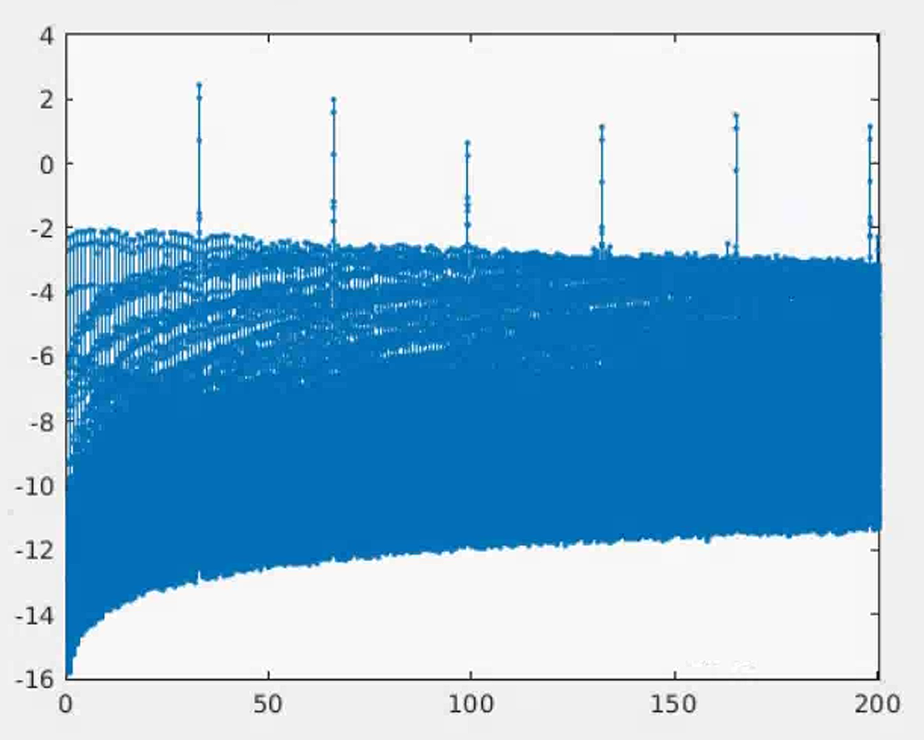
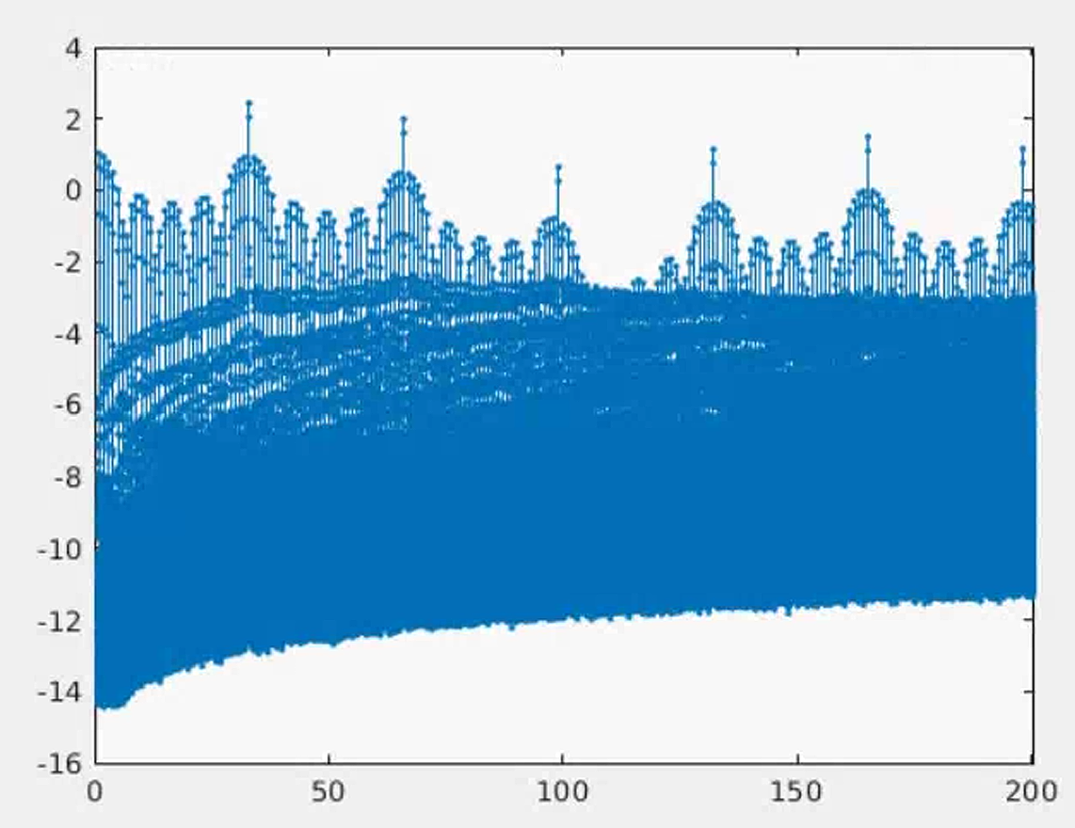
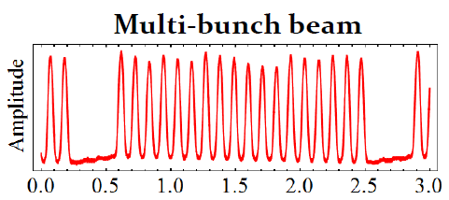
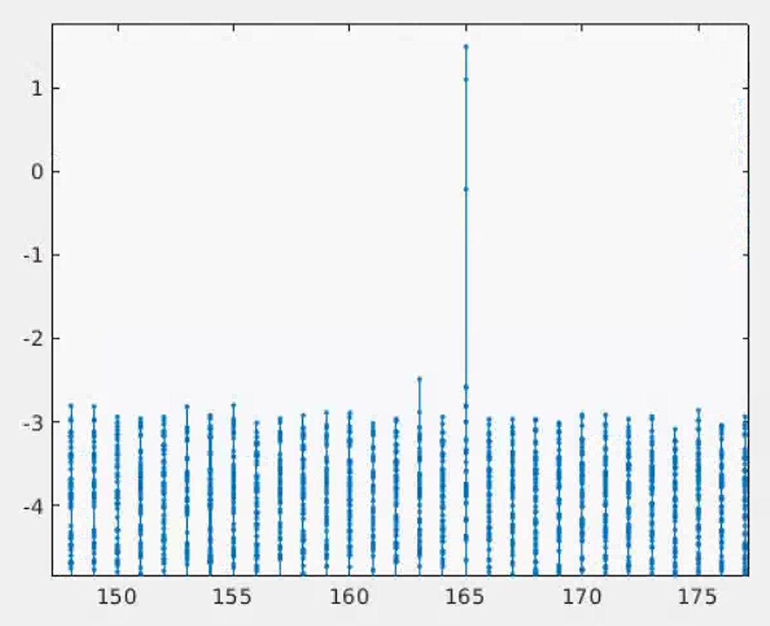
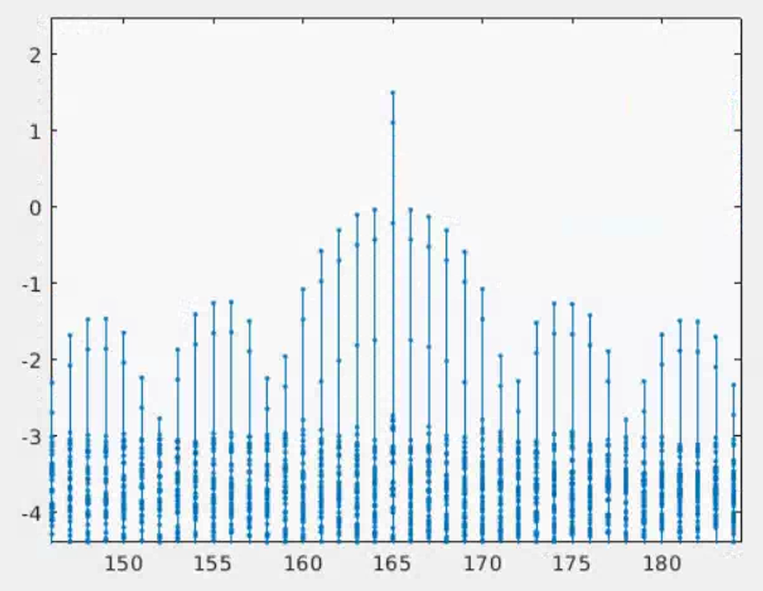
Coherent effect: Non-uniform distribution
Schottky power
Schottky power
Missing 5 bunches
Observation harmonics
Observation harmonics
Schottky power
Schottky power
Observation harmonics
Observation harmonics

