Slide 1

Simulation of the Ion Bunch in the Presence of the CeC for the New Energy Scheme
G. Wang, Y. Jing, V.N. Litvinenko, J. Ma and I. Pinayev
COOL’25, 10/30/2025, Stony Brook, New York

Slide 2
Outline
Introduction
Coherent electron cooling (CeC)
Plasma cascade amplifier (PCA)
CeC experiment at RHIC
The simulation of the PCA-based CeC experiment
Overall structure
Ion tracking procedures
Implementing the dependance of the cooling force on the ion’s 3D location
Results for the PCA-based CeC experiment in the new beam energy
Comparing results for the three PCA setups
Tolerance on the noises in the electrons
Tolerance on the energy jitter of the electron bunches
Summary

Slide 3
Coherent electron Cooling
Modulator
Amplifier
Kicker
Part 2. Density modulation is amplified using instability
Part1. Hadrons create density modulation in co-propagating electron beam
Part 3. Time-of-flight dependence on the hadron’s energy results in energy correction, i.e. cooling.

Slide 4
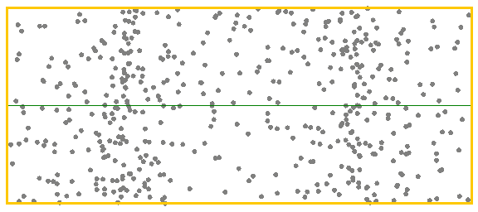
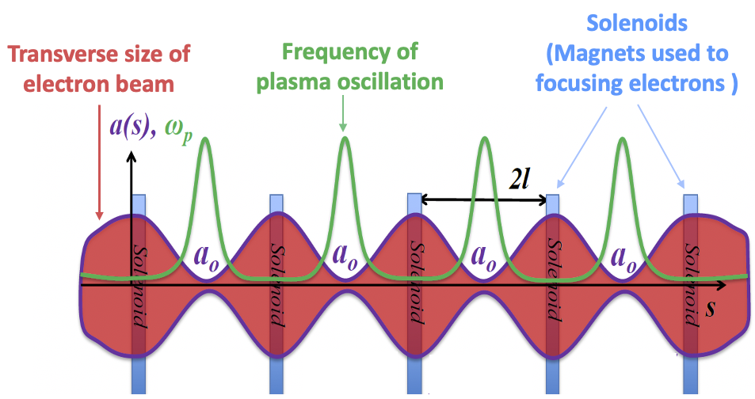


Plasma-Cascade Instability
Longitudinal plasma oscillation with periodically varying plasma frequency
Betatron motion in a FODO cell
Stability condition
$$k_{β}$$
$$k_{sc}$$

Slide 5
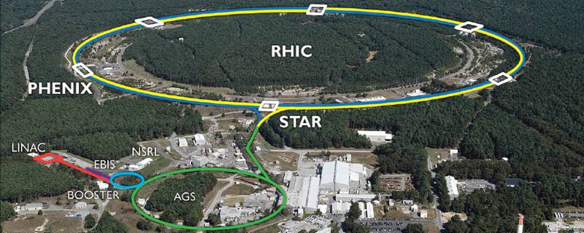
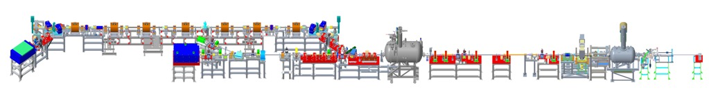
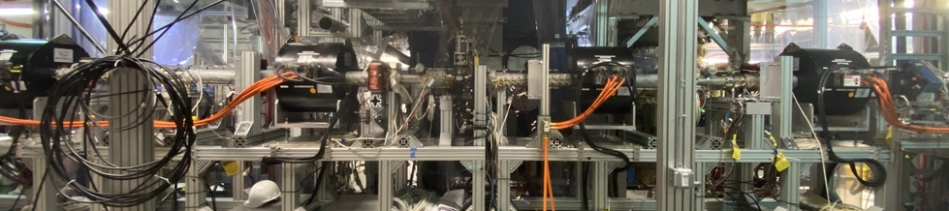
CeC experiment at RHIC
4-cell PCA
Kicker
Modulator
RHIC ion beam
Bunching cavity
Time-resolved diagnostics beamline
8.3 MV SRF linac
Ballistic bunch compression
1.25 MV SRF
photoelectron gun
Solenoids for Plasma-Cascade Amplifier
7

Slide 6
Overall Structure of CeC Prediction
Ion’s initial condition
x, x’, y, y’, t, E
… … … … … …
… … … … … …
Kicks due to CeC
dx’, dy’, dE
… … … …
… … … …
A. Prediction of the single pass kicks received by an ion in the cooling section
Interpolation
B. Long term prediction for circulating ions
CeC
Ion bunch

Slide 7
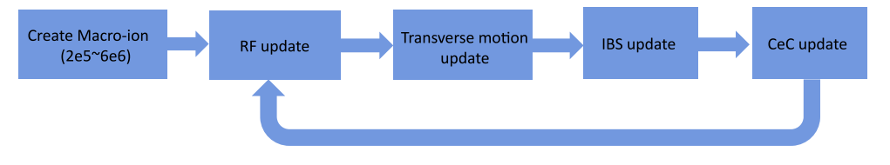

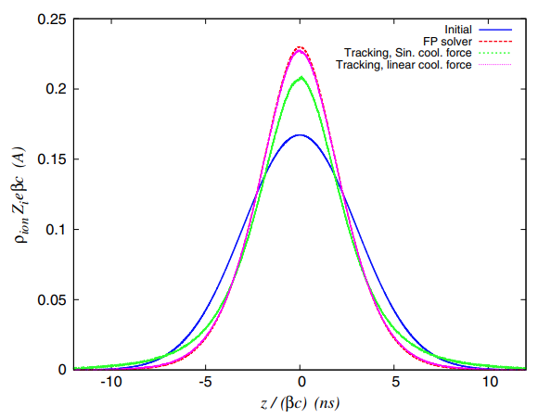

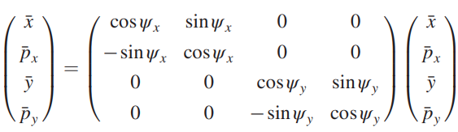
The ion tracking codes
The code was benchmarked with numerical solution of the Fokker-Planck equation for a linear cooling force.
RF update
Transverse betatron motion update
CeC update
IBS update

Slide 8
Ion beam parameters
We have developed the RHIC ramp for the CeC experiment with γ=19.5 on 9/17/2025.
During the CeC store, the ion bunches have intensity of 1e9.
To make the cooling easier, we plan to cool an ion bunch with intensity of 2e8.
Ion beam parameters
Energy, γ | 19.5
Bunch intensity | 2e8
RMS bunch length | 2 ns
Norm. RMS emittance | 2.5 mm.mrad
RF frequency | 28 MHz
RF voltage | 4.3 MV
Average beta function at IR2 | 11 m
Average RMS beam size | 1.2 mm

Slide 9
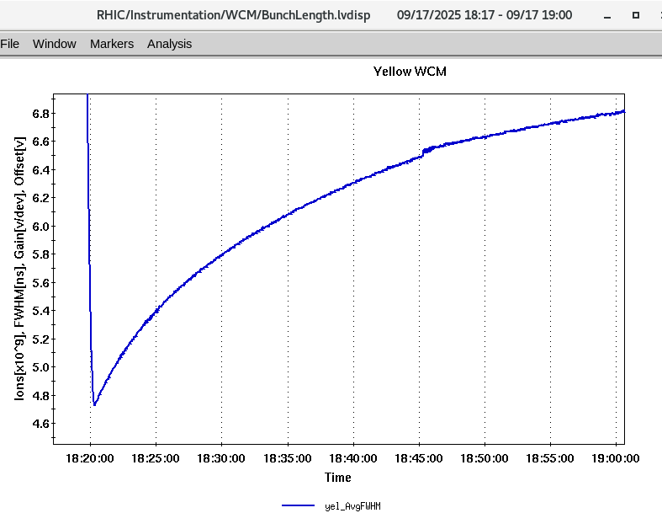
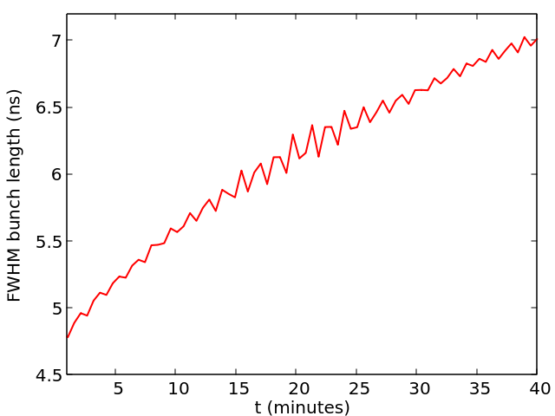
Benchmarking IBS algorithm with experiment
Intensity: 1e9

Slide 10
Electron beam parameters
The table shows what is needed to have sufficient PCA gain for cooling. In reality, the parameters such as peak current, slice emittance and local energy spread will not be uniform across the whole bunch.
Hence, it is crucial to have a significant portion of the electron bunch satisfy these requirement.
The ion tracking algorithm needs to apply different cooling force for ions at different location within the electron bunch.
Electron beam Parameter
Charge per bunch, nC | 0.8
Peak current, A | 20
Normalized emittance, RMS, μm | 1.25
Beam energy (inj), MeV | 1.71
Final beam energy, MeV | 10
Energy spread, RMS | < 2x10⁻⁴
Bunch rep-rate, kHz | 78

Slide 11
Dependance of the cooling force on the location of the ion
Slice 32
...
Slice 37
r₁
Slice 24
Slice 25
Slice 26
Slice 27
Slice 28
Slice 29
Slice 30
Slice 31
r₂
r₃
Electron bunch
...
r₁₁
44.8 ps
Courtesy to J. Ma

Slide 12
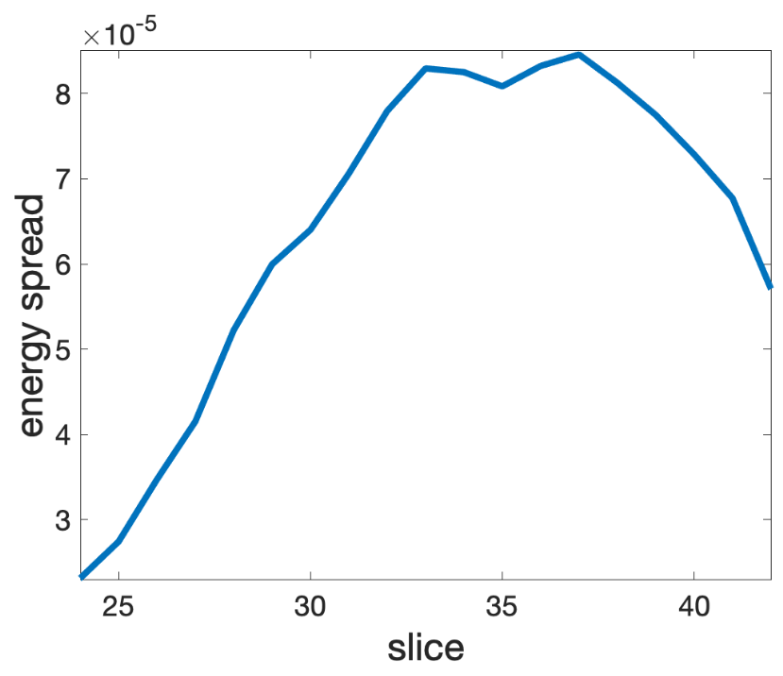
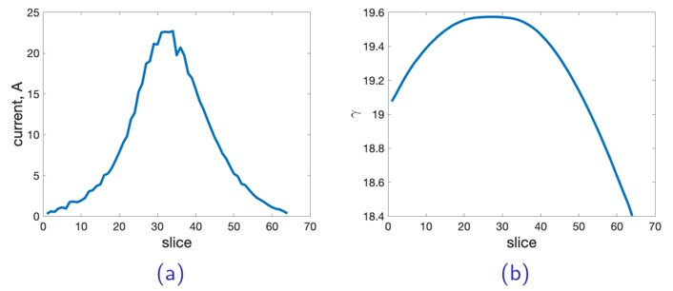
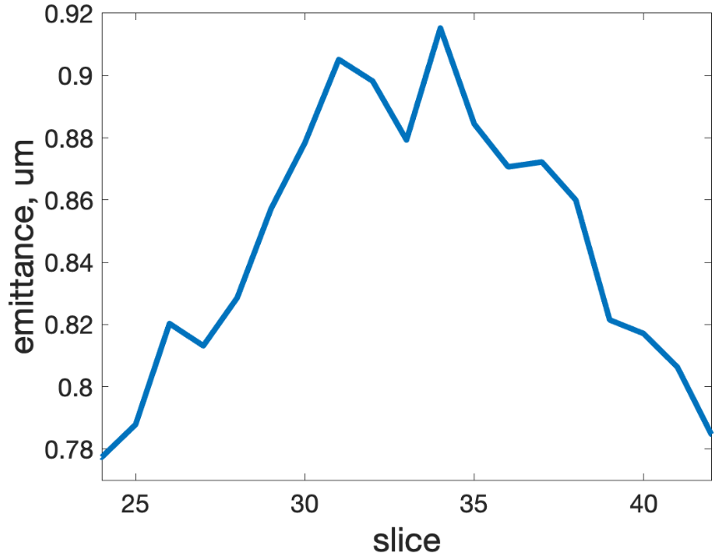
Electron beam parameters from simulation
The average energy starts to decrease after slice #31 which leads to slippage of the cooling wave-packet w.r.t. the ion to be cooled.

Slide 13
Three setups of the PCA
Sol7
Sol6
Sol5
Sol4
Sol3
Sol2
electrons
Sol1
Quad2
BPM5
BPM4
YAG
BPM3
Quad1
BPM2
BPM1
BPM7
BPM6
Trim12
Trim11
Trim10
Trim9
Trim8
Trim7
Trim6
Trim5
Trim4
Trim3
Trim2
Trim1
40.51 A | -80.68 A | 84.6 A | -84.6 A | 84.6 A | -80.68 A | 40.51 A
40.51 A | -80.68 A | 83.8 A | -83.8 A | 83.8 A | -80.68 A | 40.51 A
50 A | -82 A | 86.9 A | -86.9 A | 86.9 A | -82 A | 50 A
There are seven solenoids in the cooling section. Solenoid 1 controls the beam size at the CeC modulator. Solenoid 2 to solenoid 6 are key components for the plasma-cascade amplifier (PCA). Solenoid 7 controls the beam size exiting the common section.

Slide 14
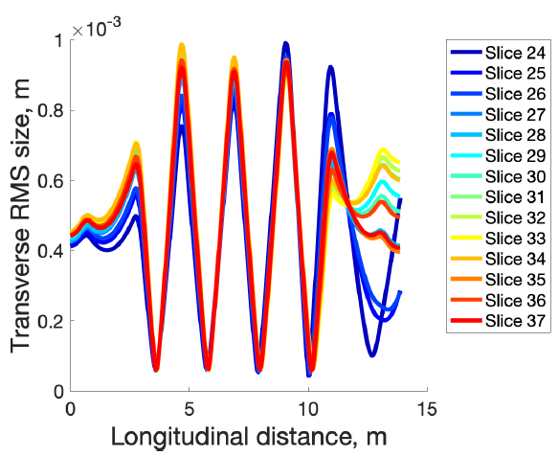
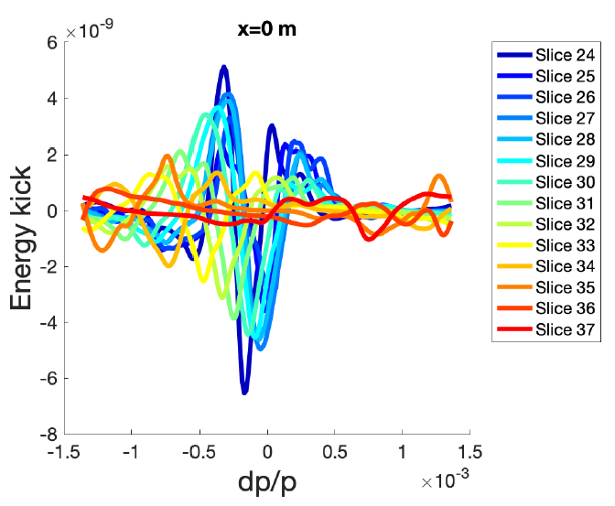
Setup 1: Dependance of cooling force on the longitudinal location of the ion
The cooling wakes from slice 31-37 have significant delay w.r.t. other slices and their amplitudes are significant. Setup 2 and setup 3 are attempts to reduce the amplitudes of these ‘anti-cooling’ slices.

Slide 15
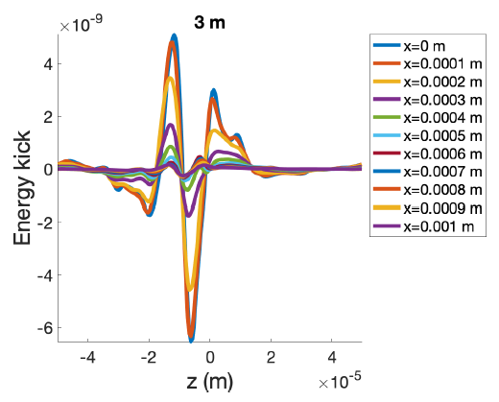
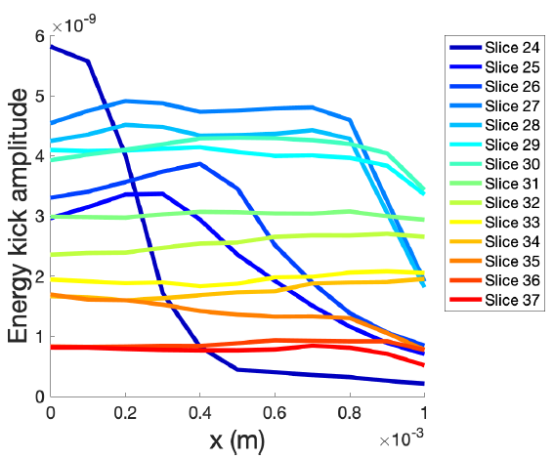
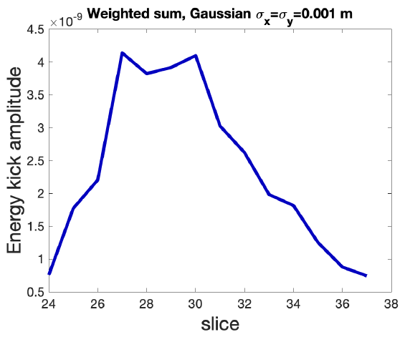
Setup 1: Dependance of the cooling force on the transverse location of the ion
Cooling wakes at different transverse location for slice #24
Amplitude of the cooling wakes as a function of the transverse location
Amplitude of the cooling wakes averaged over the transverse distribution of the ion beam

Slide 16
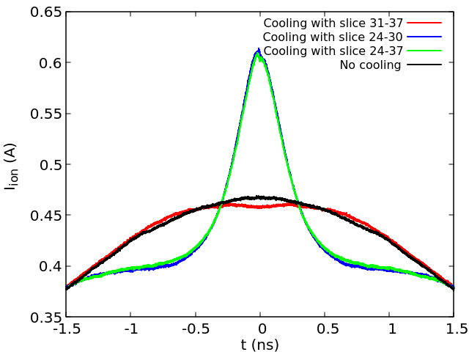
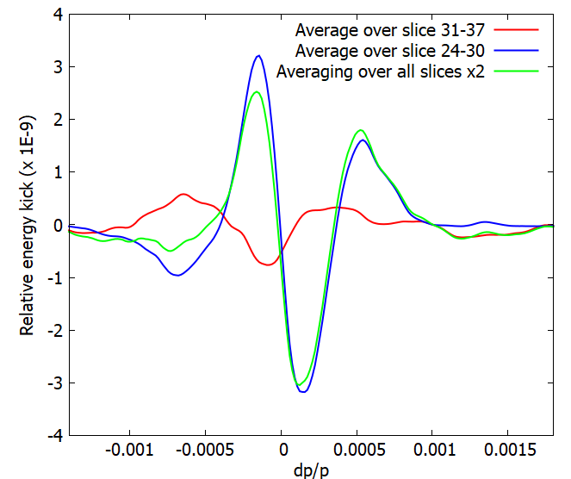
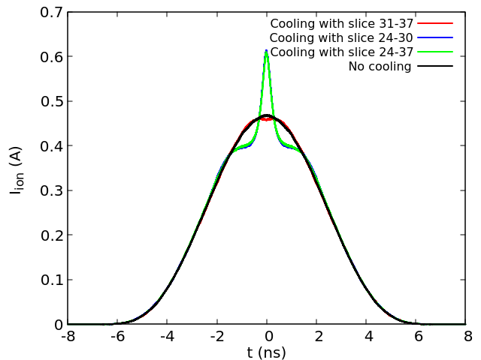
Ion beam Evolution for setup 1
While the amplitudes of the cooling wake for slice31-37 are not small, their average contribution to cooling tends to cancel each other and consequently, anti-cooling effects from these slices are insignificant.

Slide 17
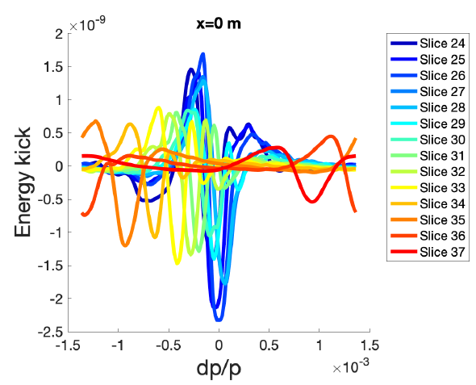
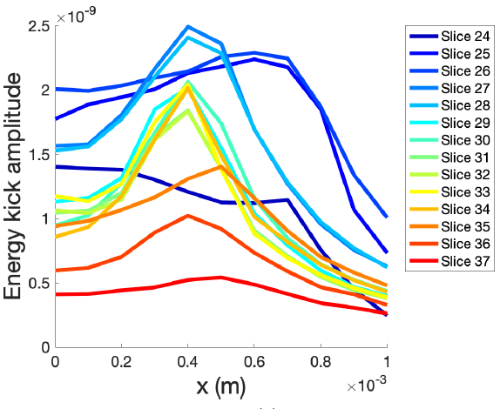
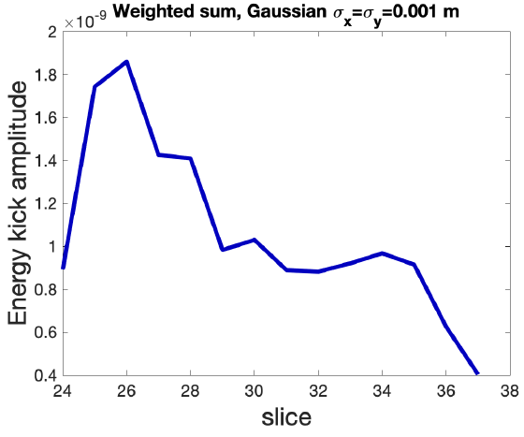
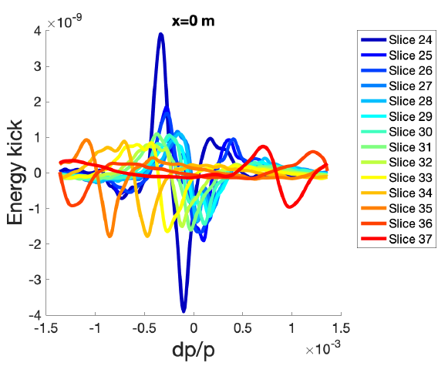
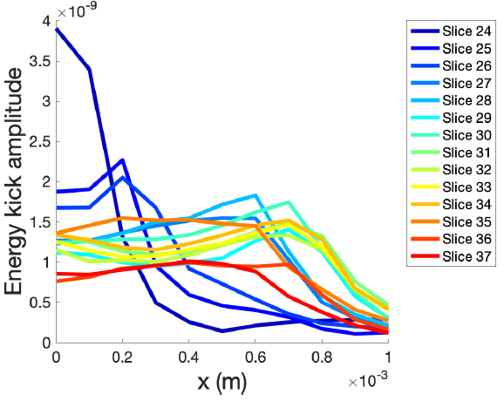
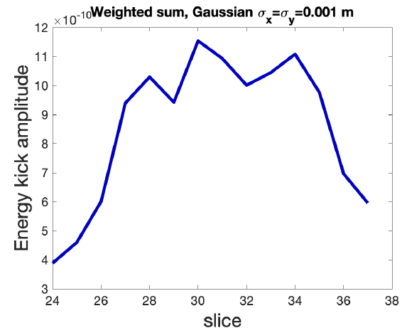
Setup 2 & setup 3
While trying to reduce amplitudes of the cooling force from ‘anti-cooling’ slices, setup 2&3 also reduced the cooling force for cooling slices.
In addition, for setup 3, the cooling force decays quickly with transverse offset.

Slide 18
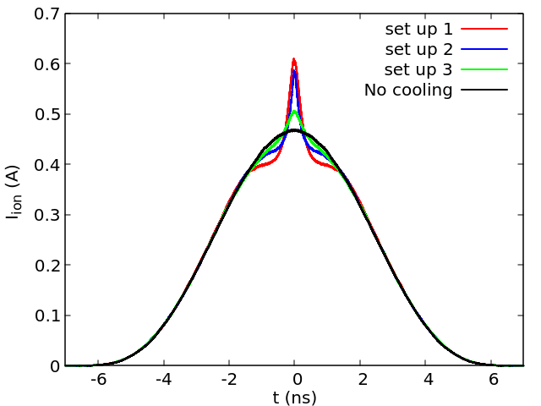
Comparison of three PCA schemes
Setup 1 looks most promising out of the three setups;
Cooling performance from setup 3 become much worse since not only the amplitude of the cooling force become smaller, the cooling force also decays quicker with the transverse offset of the ion.

Slide 19
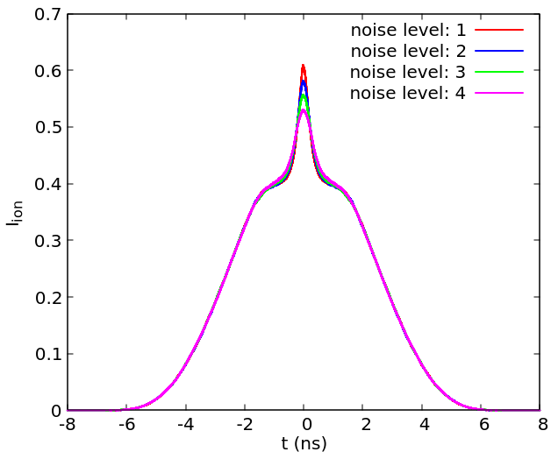
Tolerance on noise in electrons
In the presence of excess noise in the electron beam, the diffusive kicks due to the neighbour electrons become larger.
To implement this effects into the ion tracking, a factor R is introduced into the CeC updates algorithm
The effects from the noises in the electrons are weaker than what they were for the FEL-based CeC, since the coherent length is significantly shorter in the PCA-based CeC. (0.5 mm in FEL-based CeC and ~0.02 mm in PCA-based CeC)

Slide 20
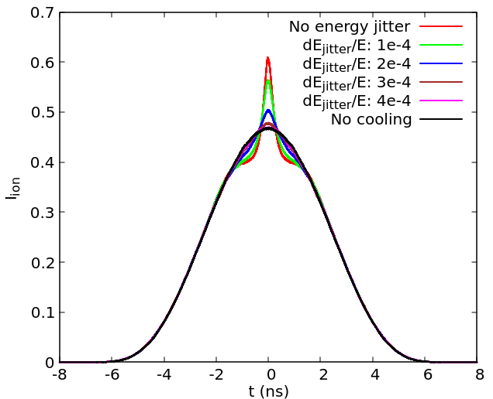
Tolerance on the energy jitter
If the presence of the energy jitter in the electron bunches, the relative position of the cooling wake will shift around w.r.t the ion to be cooled and hence reduce the cooling efficiency.

Slide 21
Summary
According to simulations with SPACE, the cooling force for the new energy scheme (gamma=19.6) have been increased by a factor of 4, compared with what was simulated for the previous energy scheme (gamma=28.6). In addition, the portion of the electron bunch contributing to cooling has also been increased from 10-15 ps to 22.4 ps.
With the significantly increased cooling force and increased portion of electrons participating in cooling, the modification of the profile of the ion bunch due to cooling should be observable after 4 minutes of cooling.
The preliminary studies show that the cooling performance in this scheme should not be significantly affected if the noise level in the electrons stays below four times of the Poisson noise.
The energy jitter of the electron beam has to stay below 1e-4 to avoid substantial reduction in the cooling performance.

