Slide 1

The CERN Antiprotons factory: performance and perspective
L. Ponce on behalf of the AD-ELENA operation and experts team
ACKNOWLEDGEMENT: M.E. Angoletta, L. Bojtar, C. Carli, J. Cenede, B.Dupuy, Y. Dutheil, A. Frassier, P. Freyermuth, D. Gamba, W. Hofle, L. Joergensen, G. Kathri, B. Lefort, O. Marqversen, S. Rey, D. Sittard, G.Tranquille
27 November 2025
Notes:
<number>

Slide 2
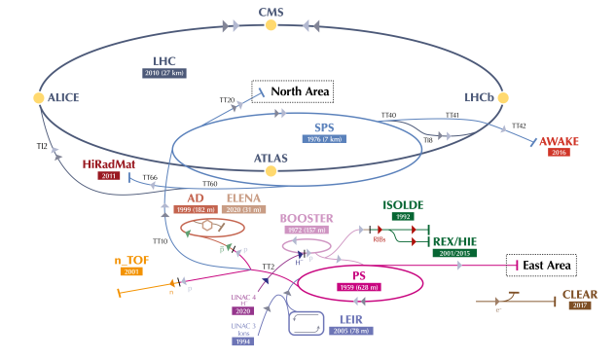
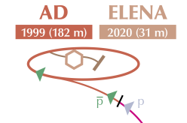
Outline
Introduction
Machines performance
Challenge: setting-up of the coolings
Perspectives of the complex
<number>

Slide 3







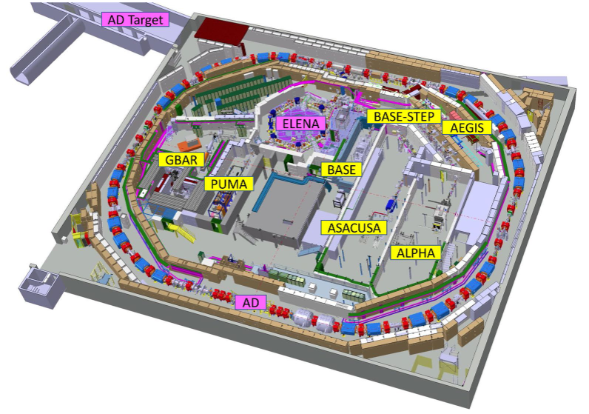
The AD/ELENA-Facility today
The only place in the world with low energy pbars in a synchrotron!
It seems unlikely to have similar capabilities elsewhere for the next 10-20 years
Serving 60 Research Institutes/Universities – 350 Scientists – 6 Active Collaborations
ASACUSA
Antiprotonic helium spectroscopy
BASE, BASE-STEP
Fundamental properties of the proton/antiproton, tests of clock WEP / tests of exotic physics / antimatter-dark matter interaction, etc...
PUMA
Antiproton/nuclei scattering to study neutron skins
AD ring length: 182 m
26 GeV protons on iridium target
antiprotons
Momentum selection (3.57 GeV/c) chicane
30 m
AD decelerator (to 5.3 MeV)
- since 1999 -
ALPHA,
Spectroscopy of 1S-2S in antihydrogen
ASACUSA, ALPHA
Spectroscopy of GS-HFS in antihydrogen
ALPHA, AEgIS, GBAR
Test free fall weak equivalence principle with antihydrogen
ELENA decelerator (to 100 keV)
- since 2018 -
antihydrogen
Electrostatic transfer line to experiments
- since 2021 -
<number>

Slide 4
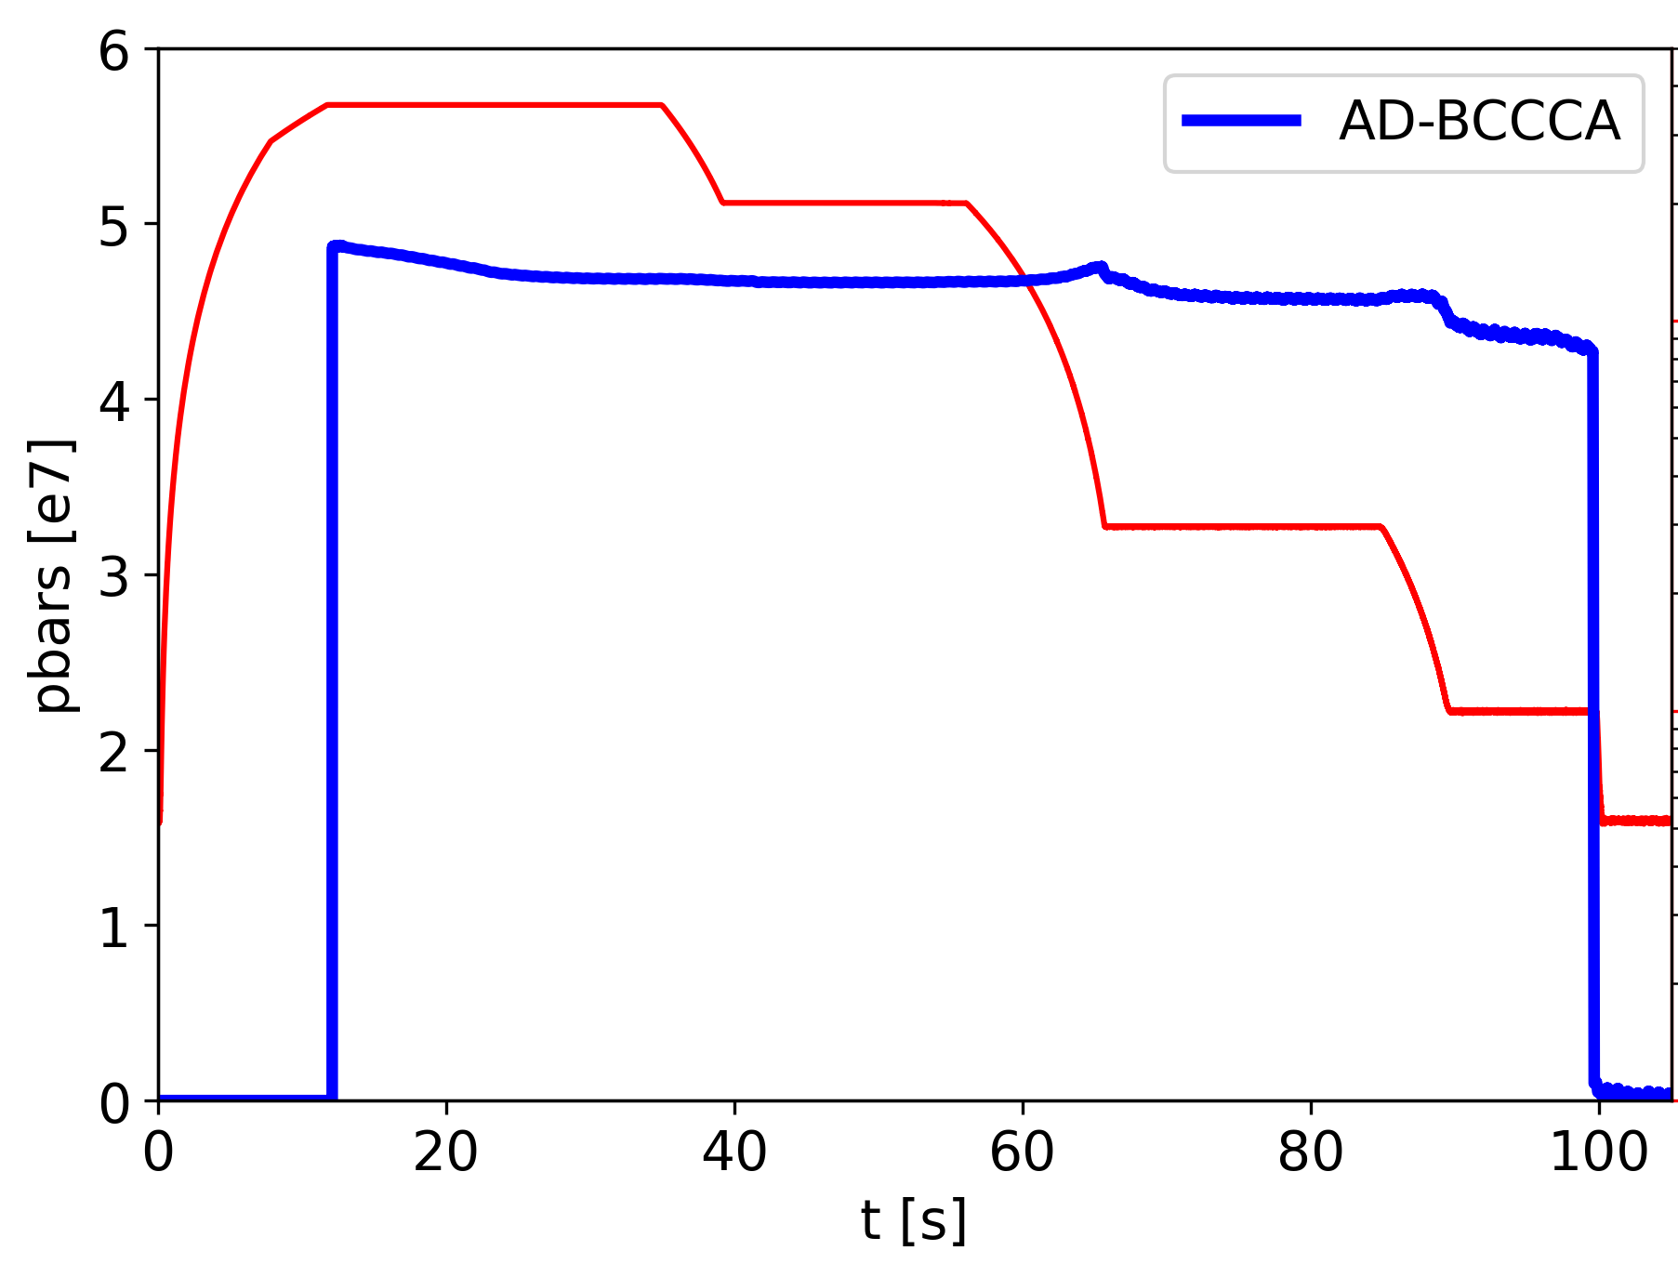
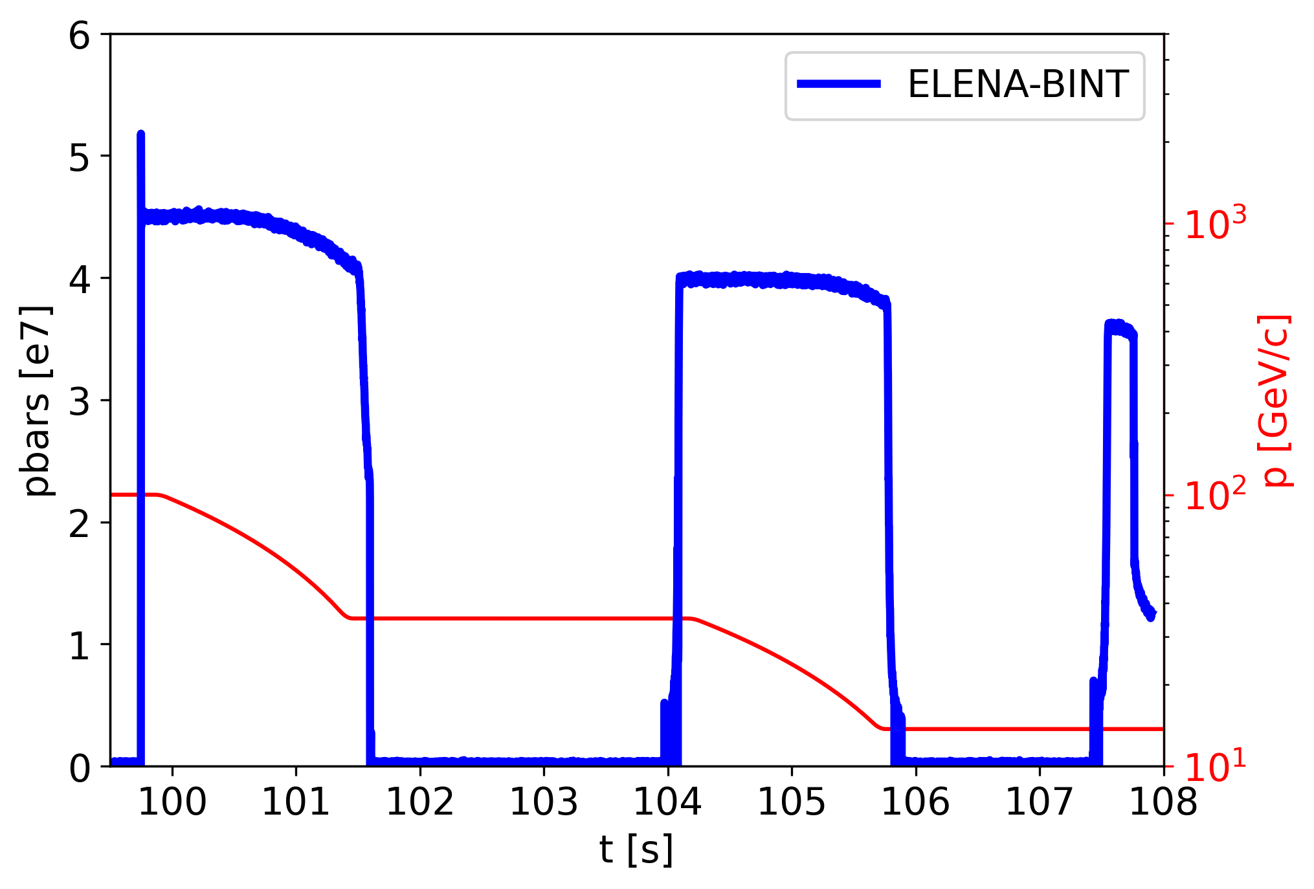
The AD and ELENA cycles today
Generating pbars from 26 GeV/c protons (yield of the order of 3e-6 pbar/p)
Up to 80% deceleration efficiency from 2.75 GeV (3.57 GeV/c) to 100 keV (13.7 MeV/c)
Thanks to several stochastic and electron cooling steps
Up to 5e7 pbars every 2 minutes delivered to experiments
p from
PS
p-pbar yield
AD Cooling and
Deceleration
Transfer to
ELENA
ELENA Cooling and Deceleration
to users
p
2e13
1.8e13
momemtum
AD s-cooling
ELENA e-cooling
AD e-cooling
PS eje
FTA9053
(AD target)
4
Notes:
<number>

Slide 5
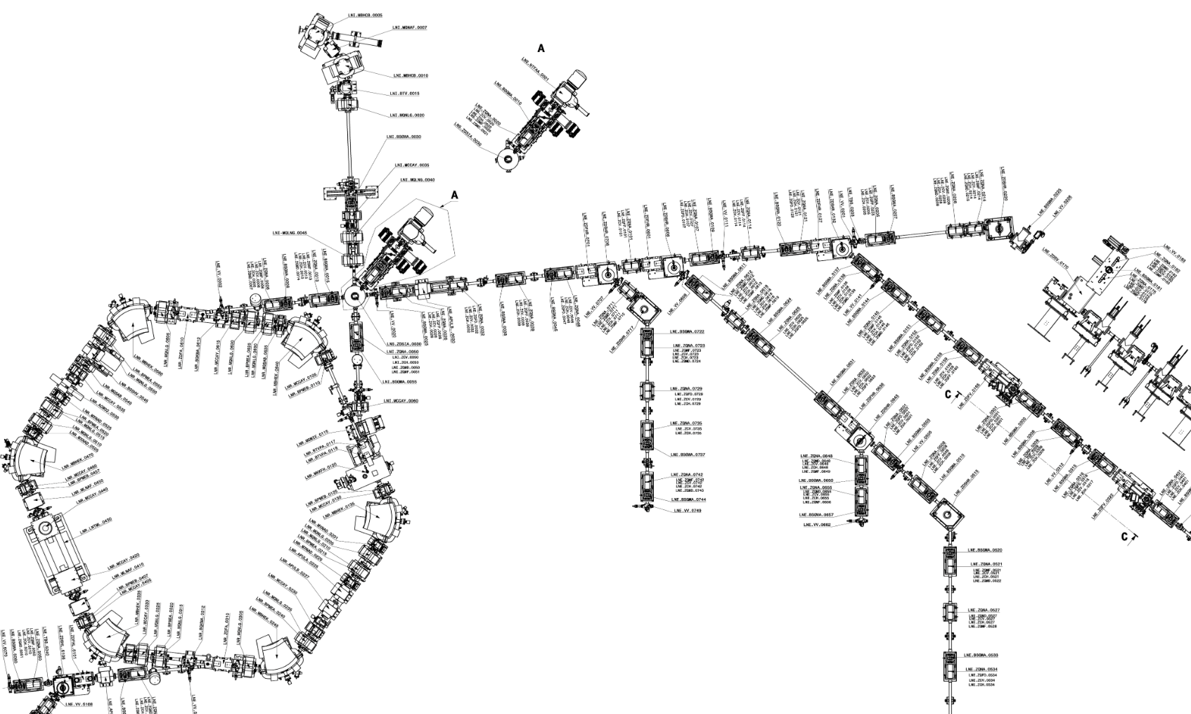
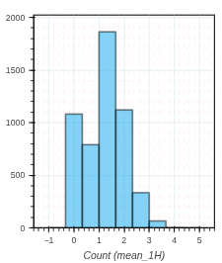
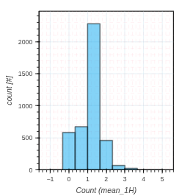
Beam Delivery to Users today
AD produces 1 bunch at 5.3 MeV
ELENA 4 bunches at 100 keV
<150 ns FWHM
<6e-4 RMS dp/p
<2.5 um emittances
Up to 4 experiments served at the same time with up to 1.3e7 pbars/bunch
24/7 beam availability was the key game changer for AD users
bunches “wasted” when less than 4 users requesting at the same time:
Installation of beam test line TELMAX
Note: ELENA can use H⁻ from a local source: instrumental for commissioning!
Pbars from AD
H⁻ from local source
2024
2025
Number of users
5

Slide 6
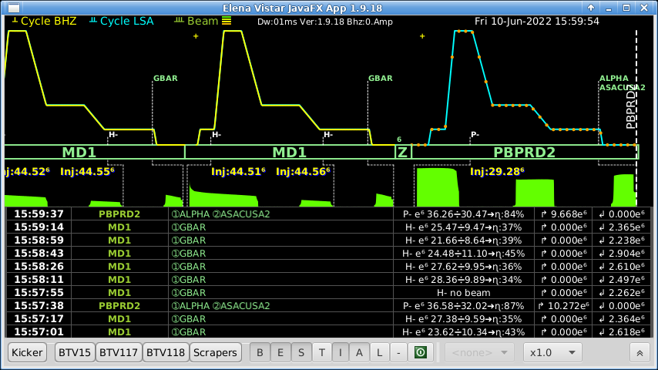
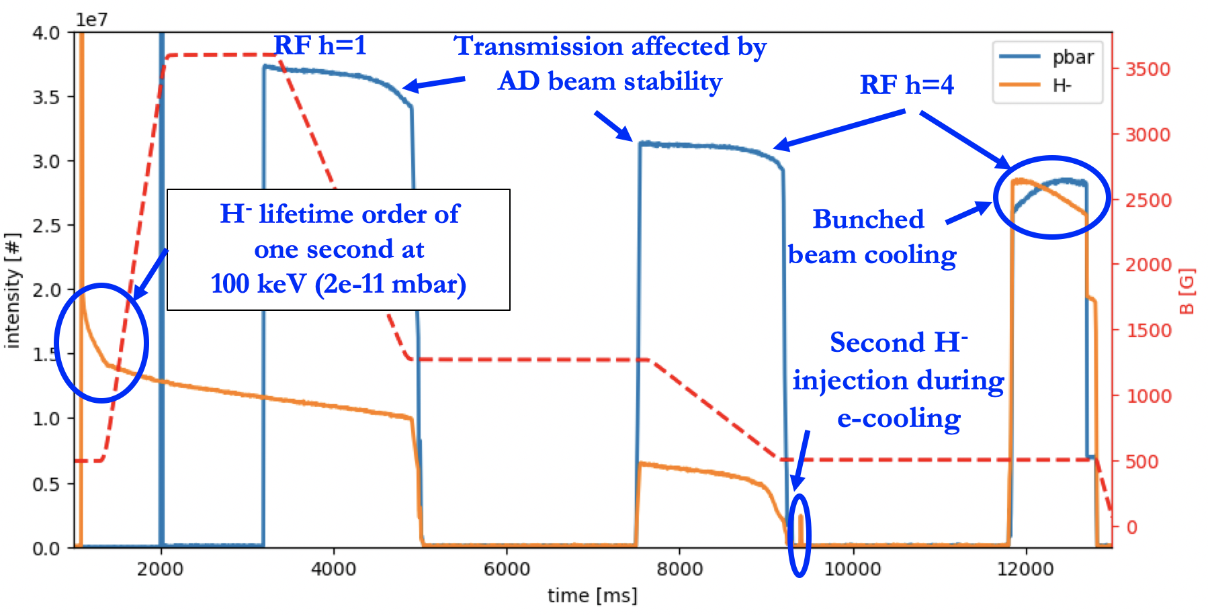
ELENA operation with H⁻ ions
ELENA cycle short compare to AD cycle (~2min)
H⁻ cycles possible between antiproton cycle
Pbars cycle is magnetically equal to the cycle with H⁻ ion beam to ease the setting-up:
Including e-cooling set-up
Operational deceleration cycle is 15 s long:
13.7 MeV/c plateau for H⁻ injection
Acceleration to 100MeV/c
100 MeV/c plateau for Pbars injection
Deceleration to 35 MeV/c on RF h=1,
Electron cooling of debunched beam at 35 MeV/c
Rebunching and deceleration to 13.7 MeV/c on h=4
Electron cooling of debunched beam at 13.7 MeV/c
Re-bunching on h=4 with e-cooling on
Setting-up with H- is instrumental in the success of ELENA
5
Notes:
<number>

Slide 7
AD/ELENA Performances
5

Slide 8
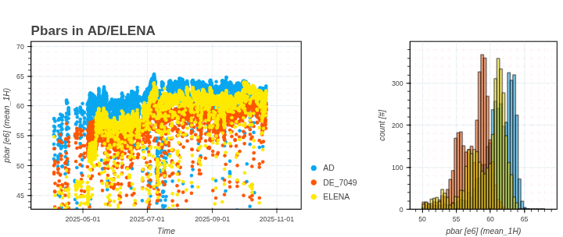
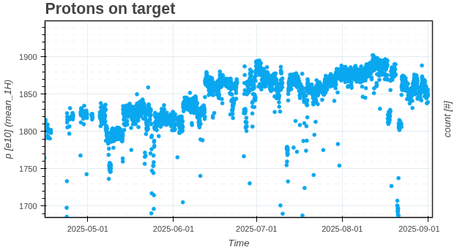
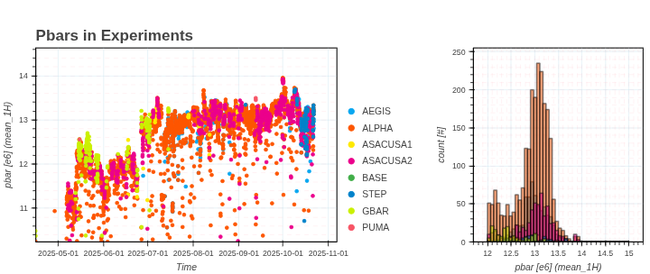
2025 at a glance
Main numbers:
Cruising around 6.4e7 pbars injected in AD with 1.85e13 protons on target
With deceleration efficiency around 94% in AD and 85% in ELENA, delivering 1.3e7 pbars per bunch to the users with a very good reproducibility along the year
5

Slide 9
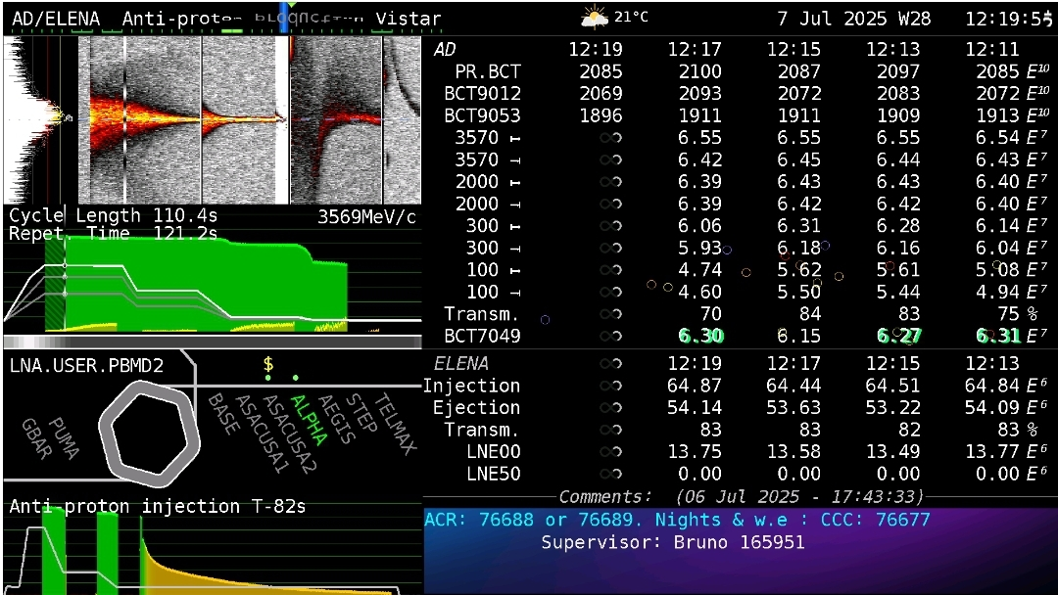
Records all along the path
New records established for:
Injected intensity in AD: 6.5e7 pbars
Extracted intensity from AD : 6.3e7 pbars (+50% compared to 2018)
Intensity per bunch extracted from ELENA: 1.37e7 pbars per bunch (more than twice the design value)
5

Slide 10
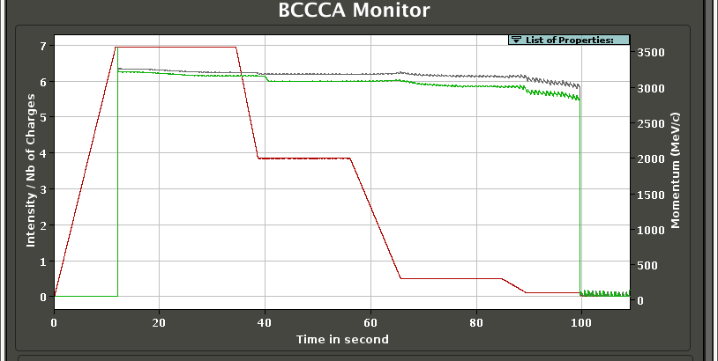
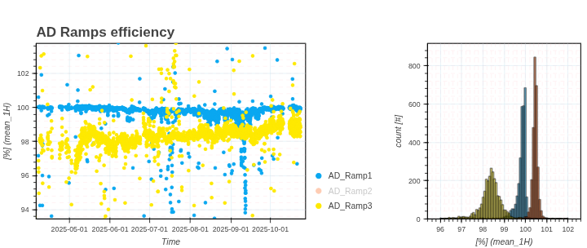
Beam performance: AD deceleration efficiency
Main losses and/or transmission fluctuations
AD Deceleration efficiency above 90%
Losses mainly during low energy part of the cycle:
Regular sublimation of AD ring to improve vacuum => allow to recover 3-5% in transmission
Strong dependance on coolings efficiencies:
Tuning of the coolings systems triggered by loss of transmission
3.57 GeV/c
Ramp 1
2 GeV/c
~16s e-cooling
s-cooling
Ramp 2
~9s e-cooling
Ramp 3
300 MeV/c
100 MeV/c
Note: artefact in the BCCCA data causing overestimated data for ramp2
10
Notes:
<number>

Slide 11
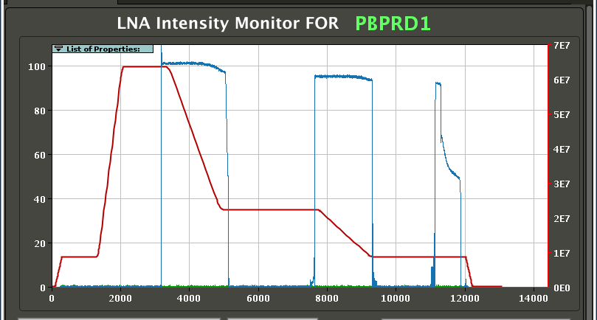
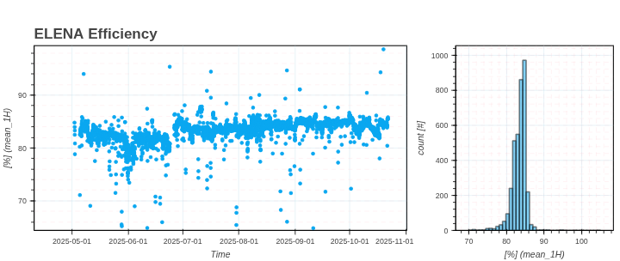
Beam performance: ELENA deceleration efficiency
ELENA deceleration efficiency around 85%
Main source of losses during first ramp linked to injected beam parameters (and so cooling in AD)
Stability improved with injection oscillation correction tools
Cycle optimized with H- source allowing machine development during physics time:
Change of working point
New extraction scheme for TELMAX
100 MeV/c
Momemtum (MeV/c)
e-cooling
Intensity/number of charges
35 MeV/c
13.7 MeV/c
11
Notes:
<number>

Slide 12
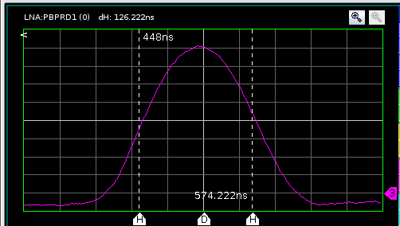
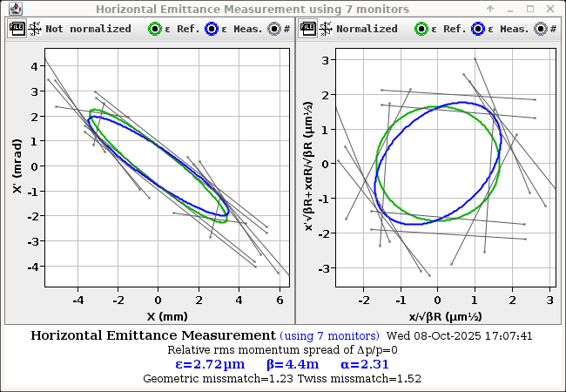
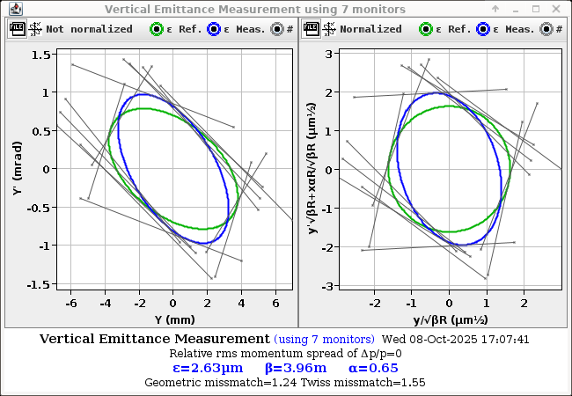
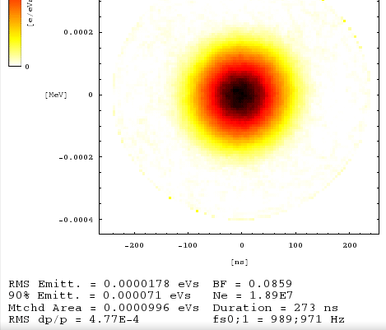
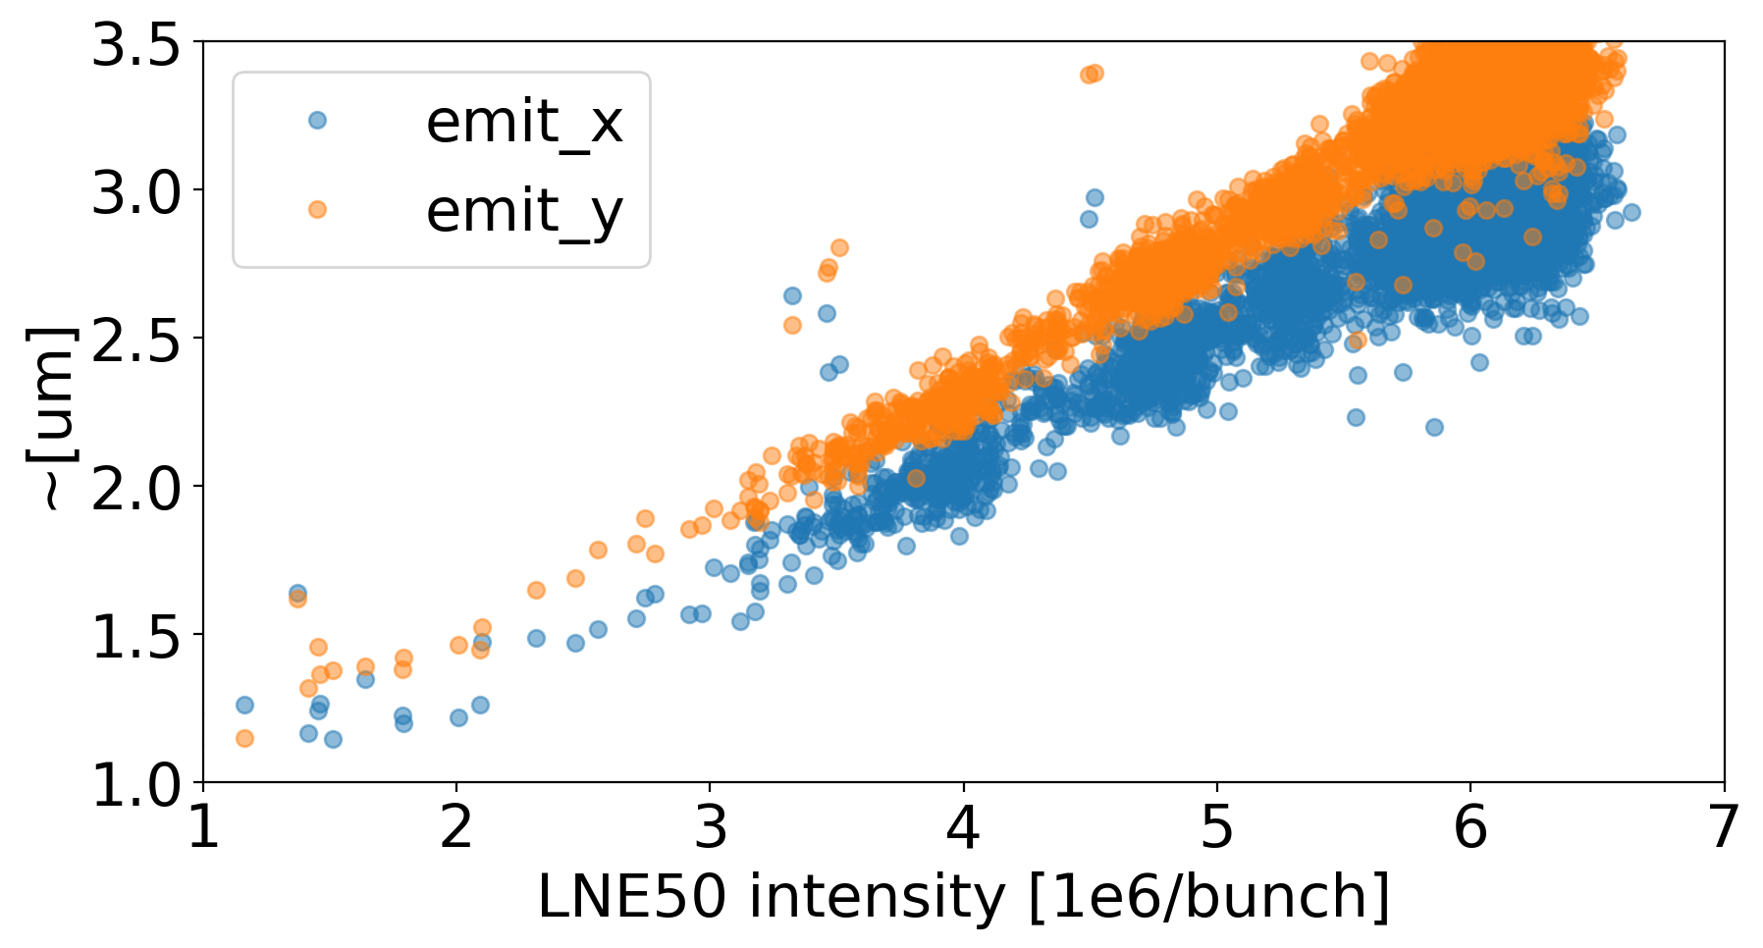
Beam performance: extracted beam parameters
FWHM ~150 ns
(Design ~200 ns)
Design: 5e-4 rms
Energy spread and bunch length within or better than design
Bunch length reduced for GBAR experiments with bunch rotation at expense of energy spread
Typical transverse emittances of 2.5 um rms are about factor 2 larger than design
Change of working point in 2024 allowing to reduce by a factor 2
But clear emittance-intensity dependance and we are running at more that 2 times the design values
=> Overall reached close to nominal beam characteristics with more than twice the design intensity
11
Notes:
<number>

Slide 13
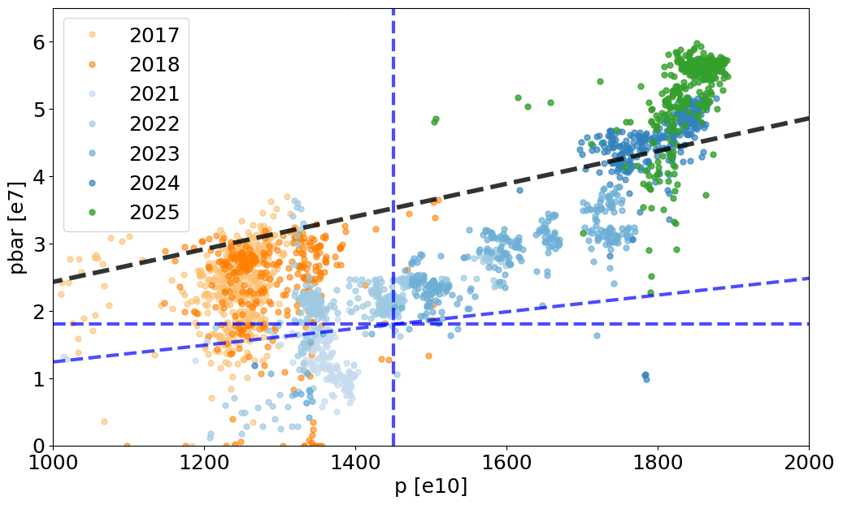
Overall performance of AD/ELENA Facility: pbars vs protons on target
Enhancing reliability, operability, and overall pbar flux
Enabled by Injectors upgrades (p intensity), and AD/ELENA investments (pbar yield and efficiency)
New targeted parameters:
3e-6 p-to-pbar yield 90% deceleration efficiency in both AD-ELENA
Pre-LS2 performance (with AD only)
ELENA Design Expectations:
1.45e13 ppp on target
1.8e7 pbars from ELENA
Note: Each point in the graph is the mean pbar/p intensity over 12 h periods
2024: ~2.7e18 p => ~6e12 pbars (10 pg of pbars!) in 1.5e5 shots => the highest integrated #pbars ever!
13
Notes:
<number>

Slide 14
Challenge for operation team:
setting-up of cooling systems
13

Slide 15
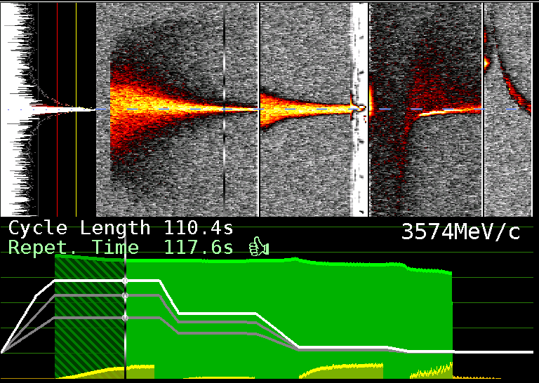
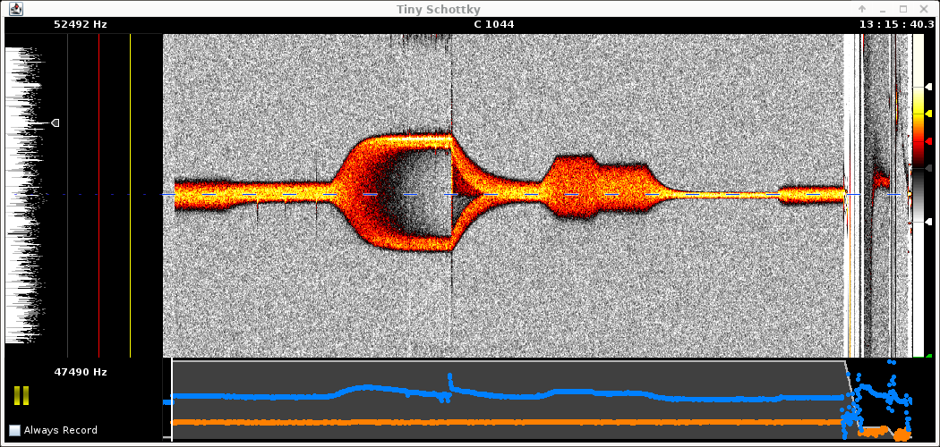
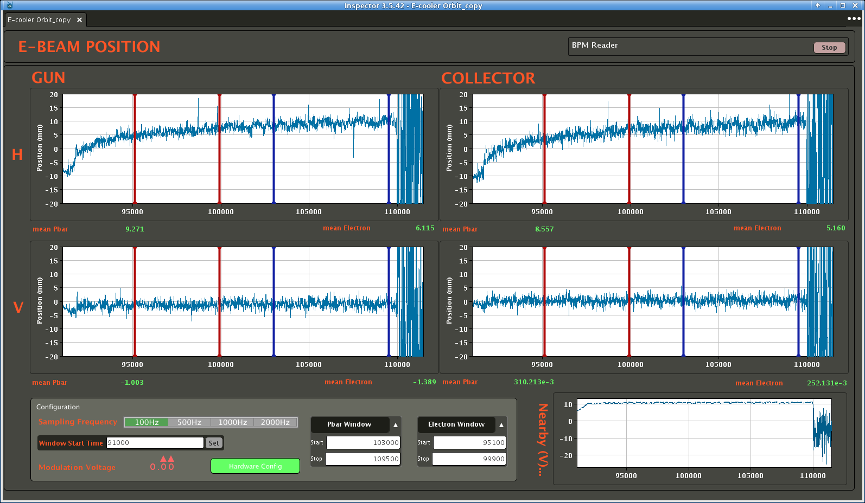
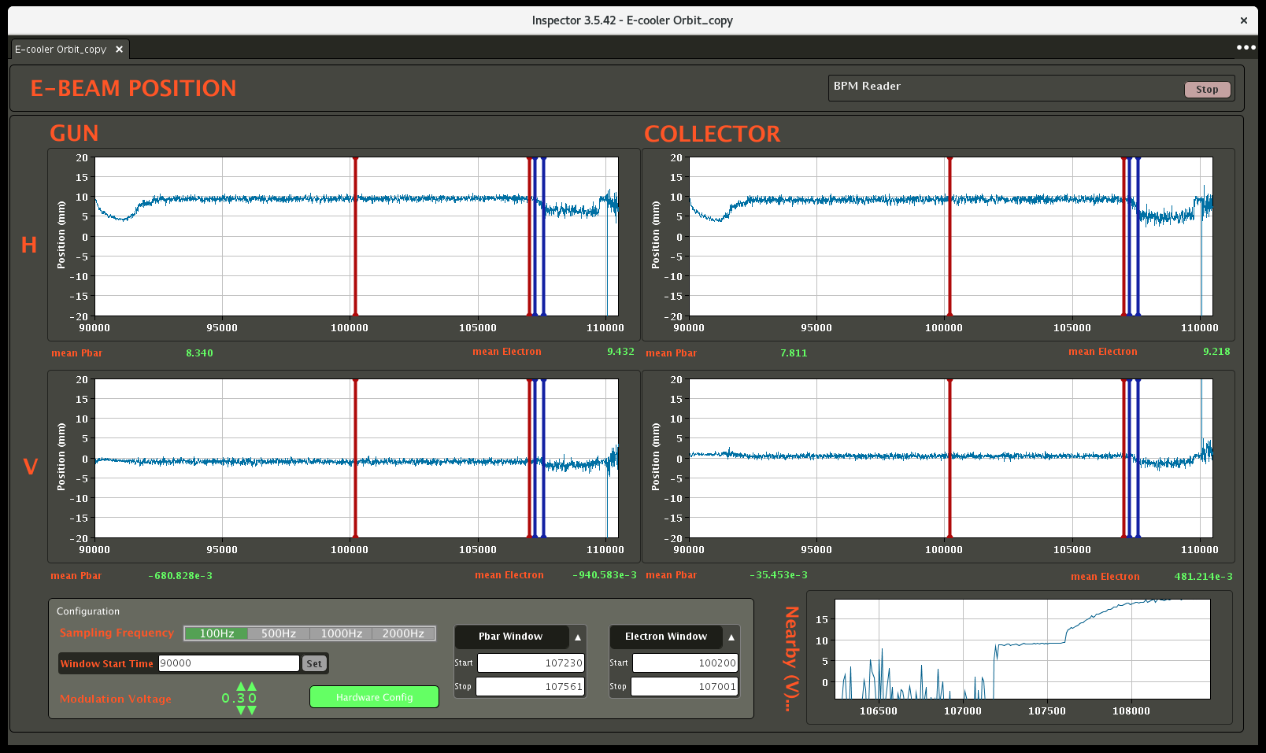
Tedious setting-up of Coolings = key of the success
Schottky and Intensity (BCCCA) in AD
Challenge in Beam Diagnostics in measuring very low intensity and low energy beams
Mainly relying on Schottky and Intensity measurements
i.e. indirect measurement of many possible faults/effects
Only destructive transverse beam profile measurements
Lengthy setting-up of cooling systems: Crucial for machine performances
Beam Transfer Function measurements on the plateaus for stochastic cooling:
Dedicated time for measurment in « pause » mode
Adjustment of pbars/e- overlap for e-cooling in both AD and ELENA:
Pbars orbit controls in offset and angle
ELENA can profit of the H⁻ cycle
Improved methodology and stability:
BTF automatic tool : reduce setting-up time from several hours to 30min
New Optical noth filter design with better temperature regulation, more parameters control
See L. Joergensen JACoW-COOL23-WEPAM1r3
See W.Hofle JACoW-COOL2021-S302
pbar orbit
e⁻ orbit
>10 mm H-orbit drift!
See poster S.Rey JACoW-COOL2023-THPOSRP22
15

Slide 16
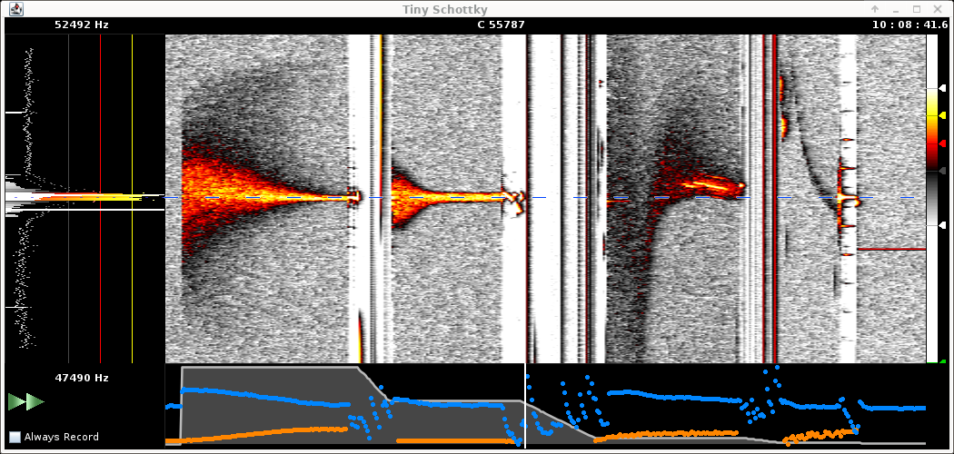
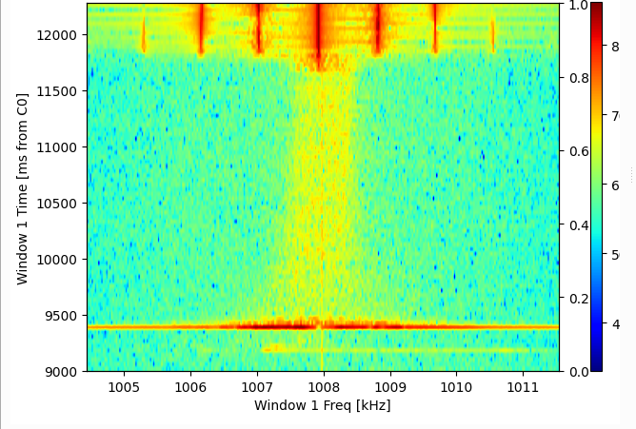
Instrumentation: Schottky signals
Gives real time information on the coolings performances:
Main instrument for setting-up and diagnostics
AD Schottky system:
Based on RF longitudinal pick-up
Spectrum analyser downmixed to around 50kHz on all cooling plateaus
ELENA Schottky System:
Combining several Beam Position Monitors signal
See O. Marqversen et al. at IBIC2021–WEPP04
Same input signal as the radial loop, not used during physics production
S-cooling 3.57GeV/c
S-cooling 2GeV/c
e-cooling 300MeV/c
e-cooling 100MeV/c
1e-3 dp/p
2e-3 dp/p
15
Notes:
<number>

Slide 17
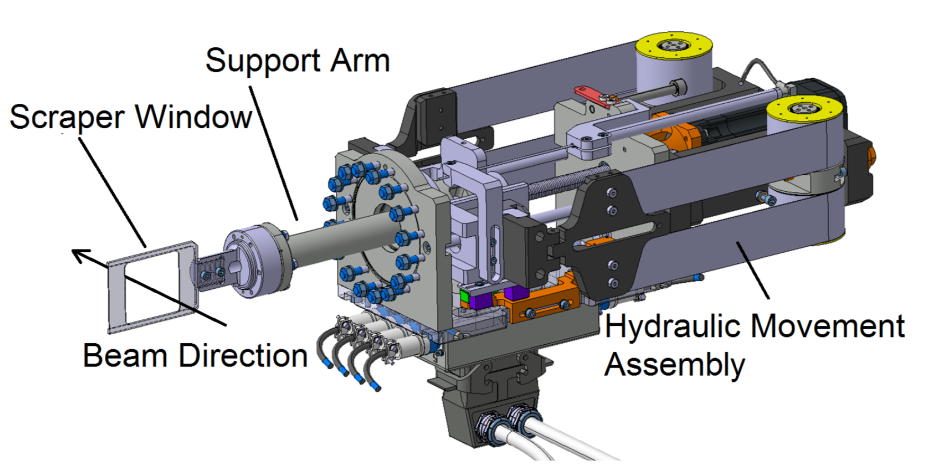
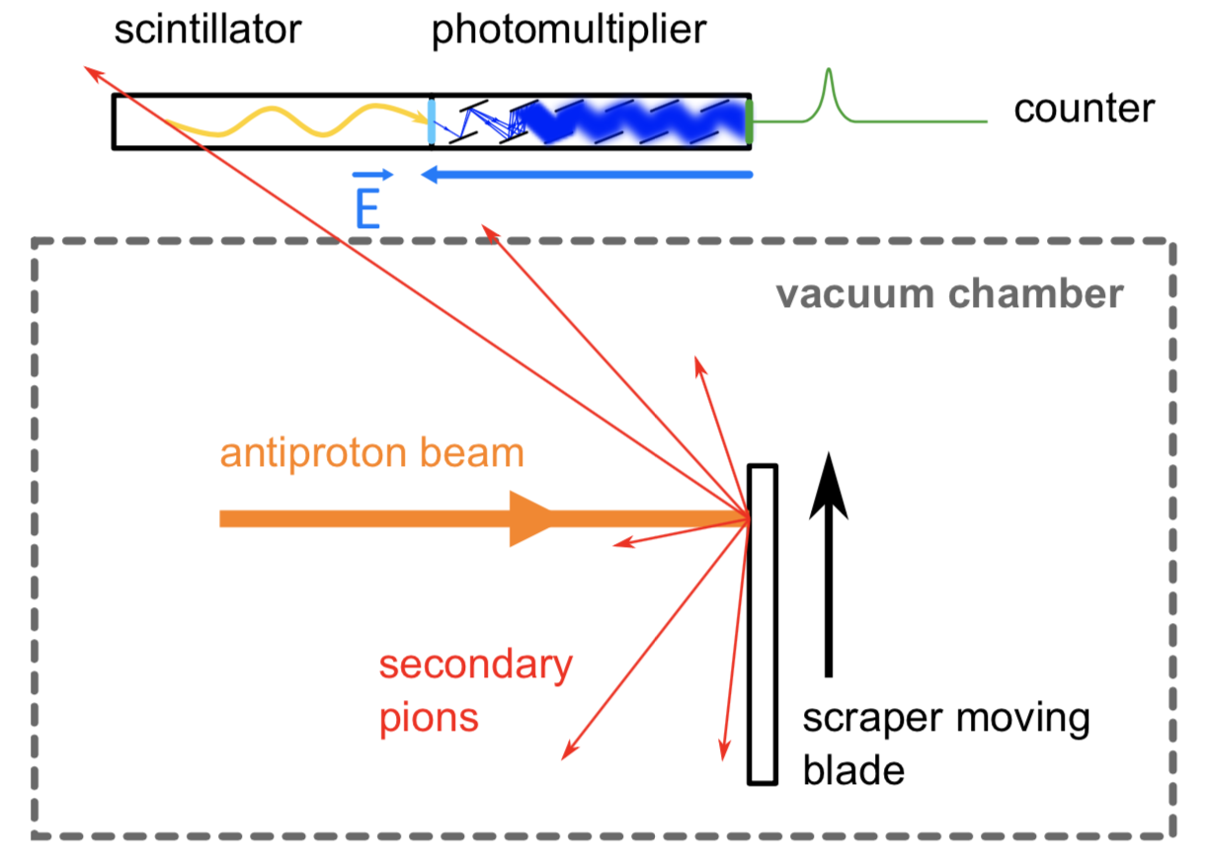
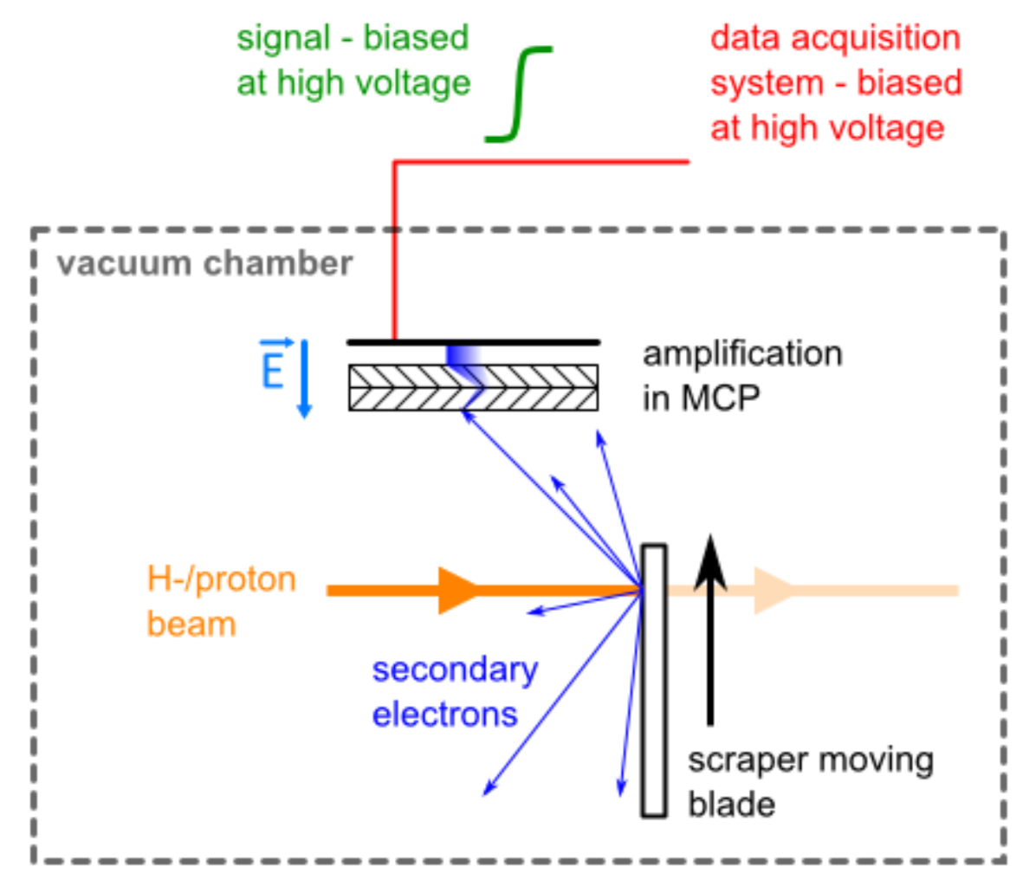
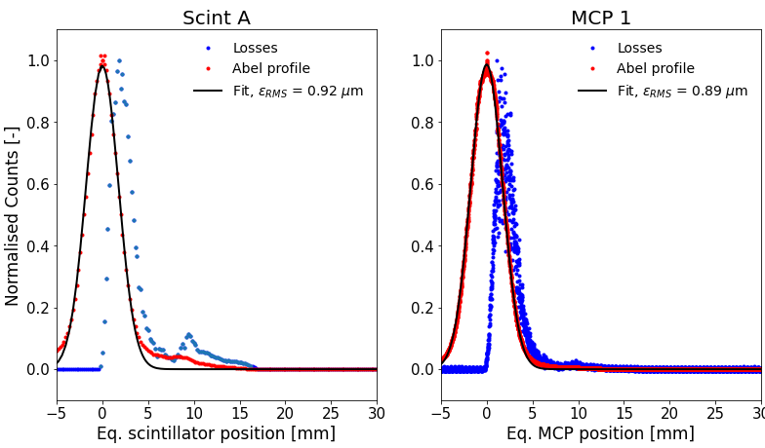
Instrumentation: transverse beam profiles
Mainly destructive measurements available based on scrapers:
Similar system with different Hardware in both AD and ELENA machines
Discrete measurements along the cycle, one plane at a time:
Any optimization is very lengthy process with an AD cycle length of 110s!
Reliability of signal retrieval and interpretation sometimes difficult:
Controls issues, synchronisation
A lot of beam time invested to develop operator independent measurement method to caracterize the emittance evolution in AD
Courtesy P. Grandemange (link)
see G. Russo @ HB2023
16
Notes:
<number>

Slide 18
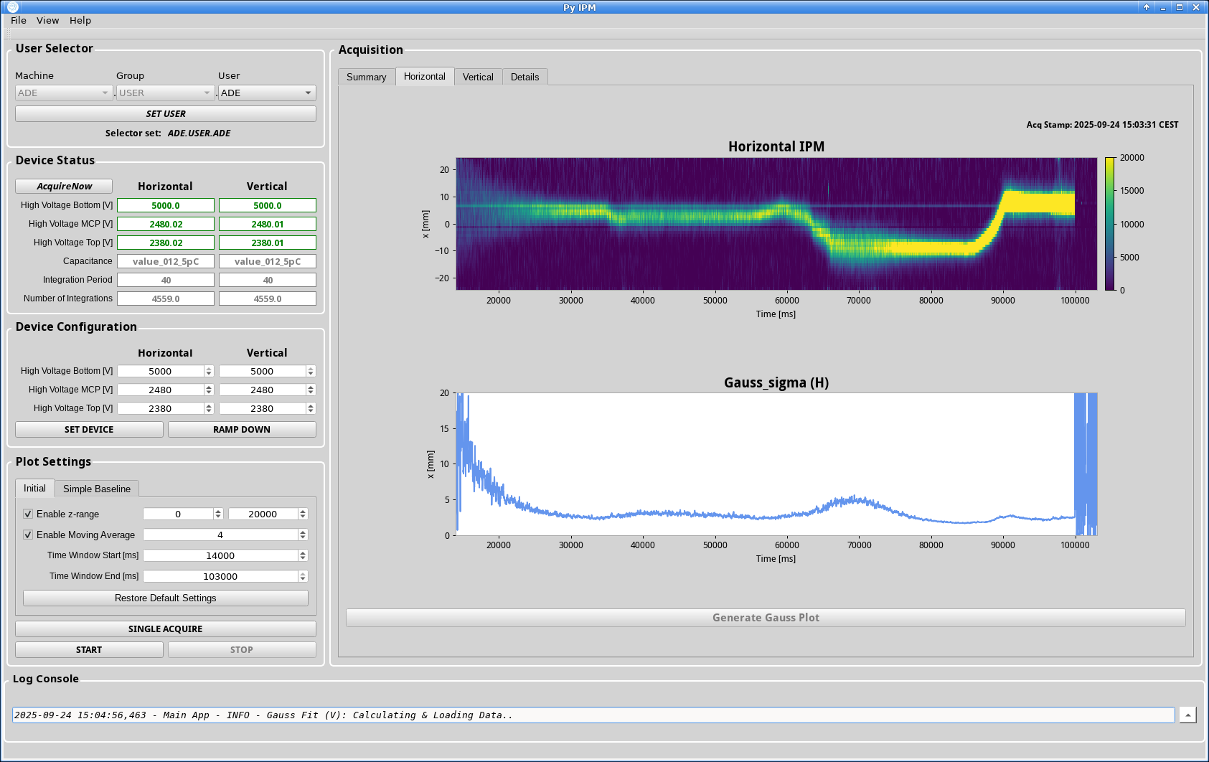
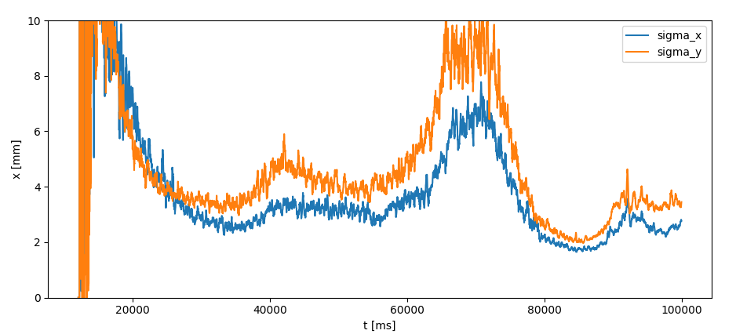
Instrumentation: transverse beam profiles
On-going development in non destructive method to be used in during physics production as alternative to the scrapers method
Ionization Profile Monitor in AD:
Gives both planes profiles all along the cycle, enhanced signal with gaz injection (affecting pbars lifetime)
Affecting trajectory of circulating beam => Need self-compensated devices or compensation scheme to be used during physics production
Neutral monitor installed at the end of e-cooler section in ELENA:
Only for H⁻
3.575 GeV/c
2 GeV/c
300 MeV/c
100 MeV/c
See presentation G. Tranquille at COOL25 (THC1)
18

Slide 19
What’s the future of the complex?
18

Slide 20
Current Facility perspectives: preparing the future
Hardware Aging, especially the AD!
AD made from hardware recycled from the Antiproton Collector (AC) constructed in 1986
Ongoing consolidation efforts since the facility's early days
Looking beyond the horizon
Present experiments have certainly another 10+ years of “things to do” with present pbar beams and physics program
Longer term: new (beam) requirements should come early 2026 based on letters of intend submitted by the user community to the SPSC
Higher pbar flux for faster pbar/Hbar accumulation
Higher(/lower) extraction energy and/or slow extraction for antineutron production, hexaquark investigations, Pontecorvo reaction investigation
Other types of particules to decelerate: completely new experiments
20
Notes:
<number>

Slide 21
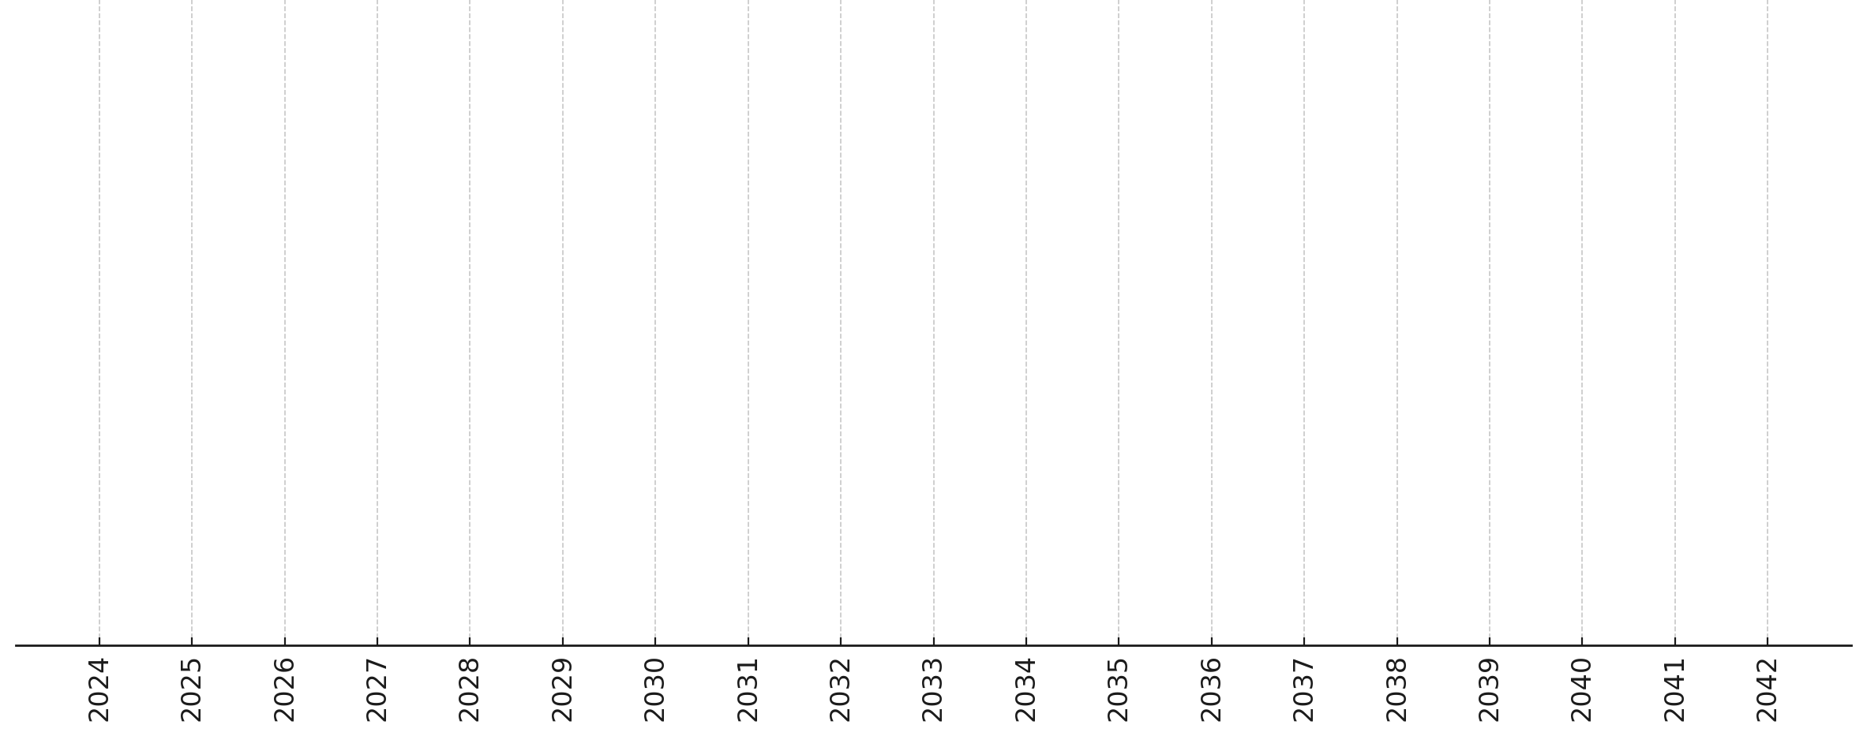
Overall Long-Term Timeline for AD/ELENA (being discussed)
Today
LS3 2026-28
LS4 2033
LS5 2039
End Run 6: 2042
… “Baseline” Beam Performance Consolidations
… “Baseline” Hardware Consolidations
… Guaranteeing Efficient, Safe and Sustainable Operation …
Collect Future User Needs… e.g.:
PBC Workshop – CERN – March 2024
FuPhy Workshop – Vienna – April 2024
AD beams @IPP – April 2024
EXA/LEAP - Vienna - August 2024
European Strategy Process – 31st March – outcome around mid 2026
Call for proposal by SPSC – 1st May 2025 – outcome at Research Board by mid 2026
Study and Implement needed upgrades, e.g.:
Low/high energy, multi-turn extraction
Antideuteron Production and Deceleration
Permit new, challenging experiments, e.g.:
Exotic Annihilation/Antineutron Experiments?
Completely new physics experiments?
Prepare the future of low/high energy antimatter physics at CERN…
20
Notes:
<number>

Slide 22
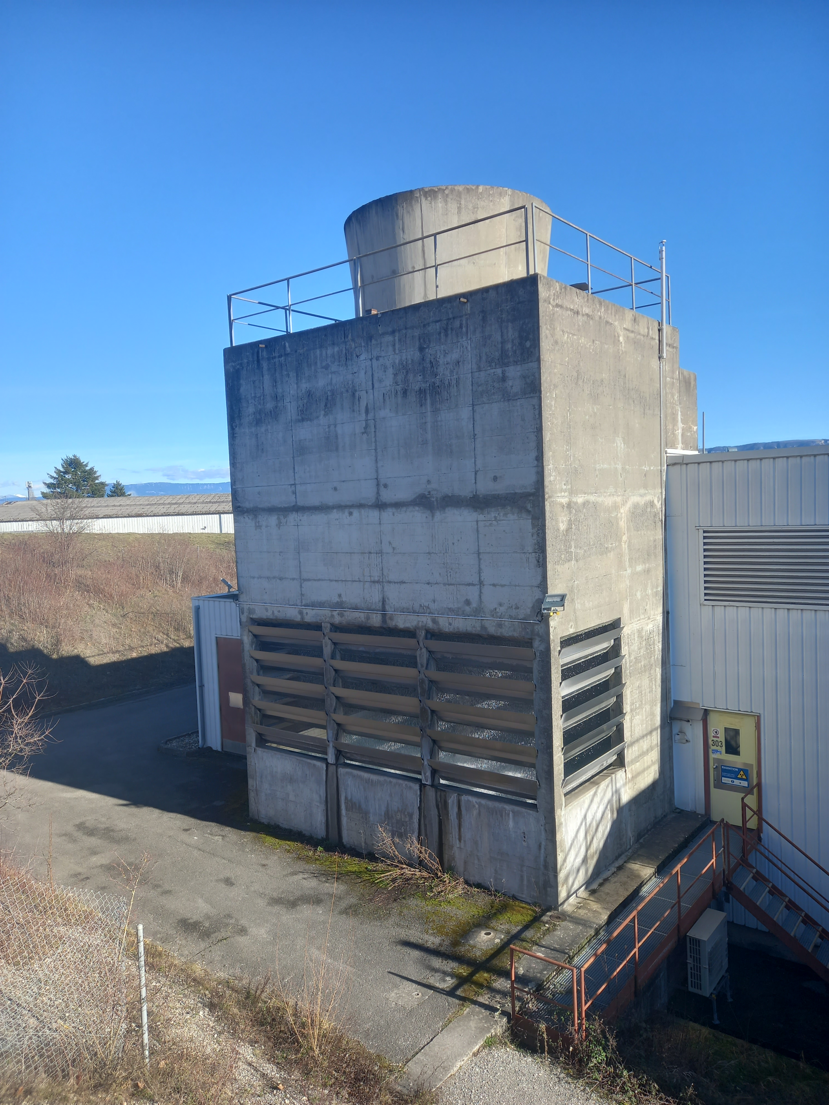

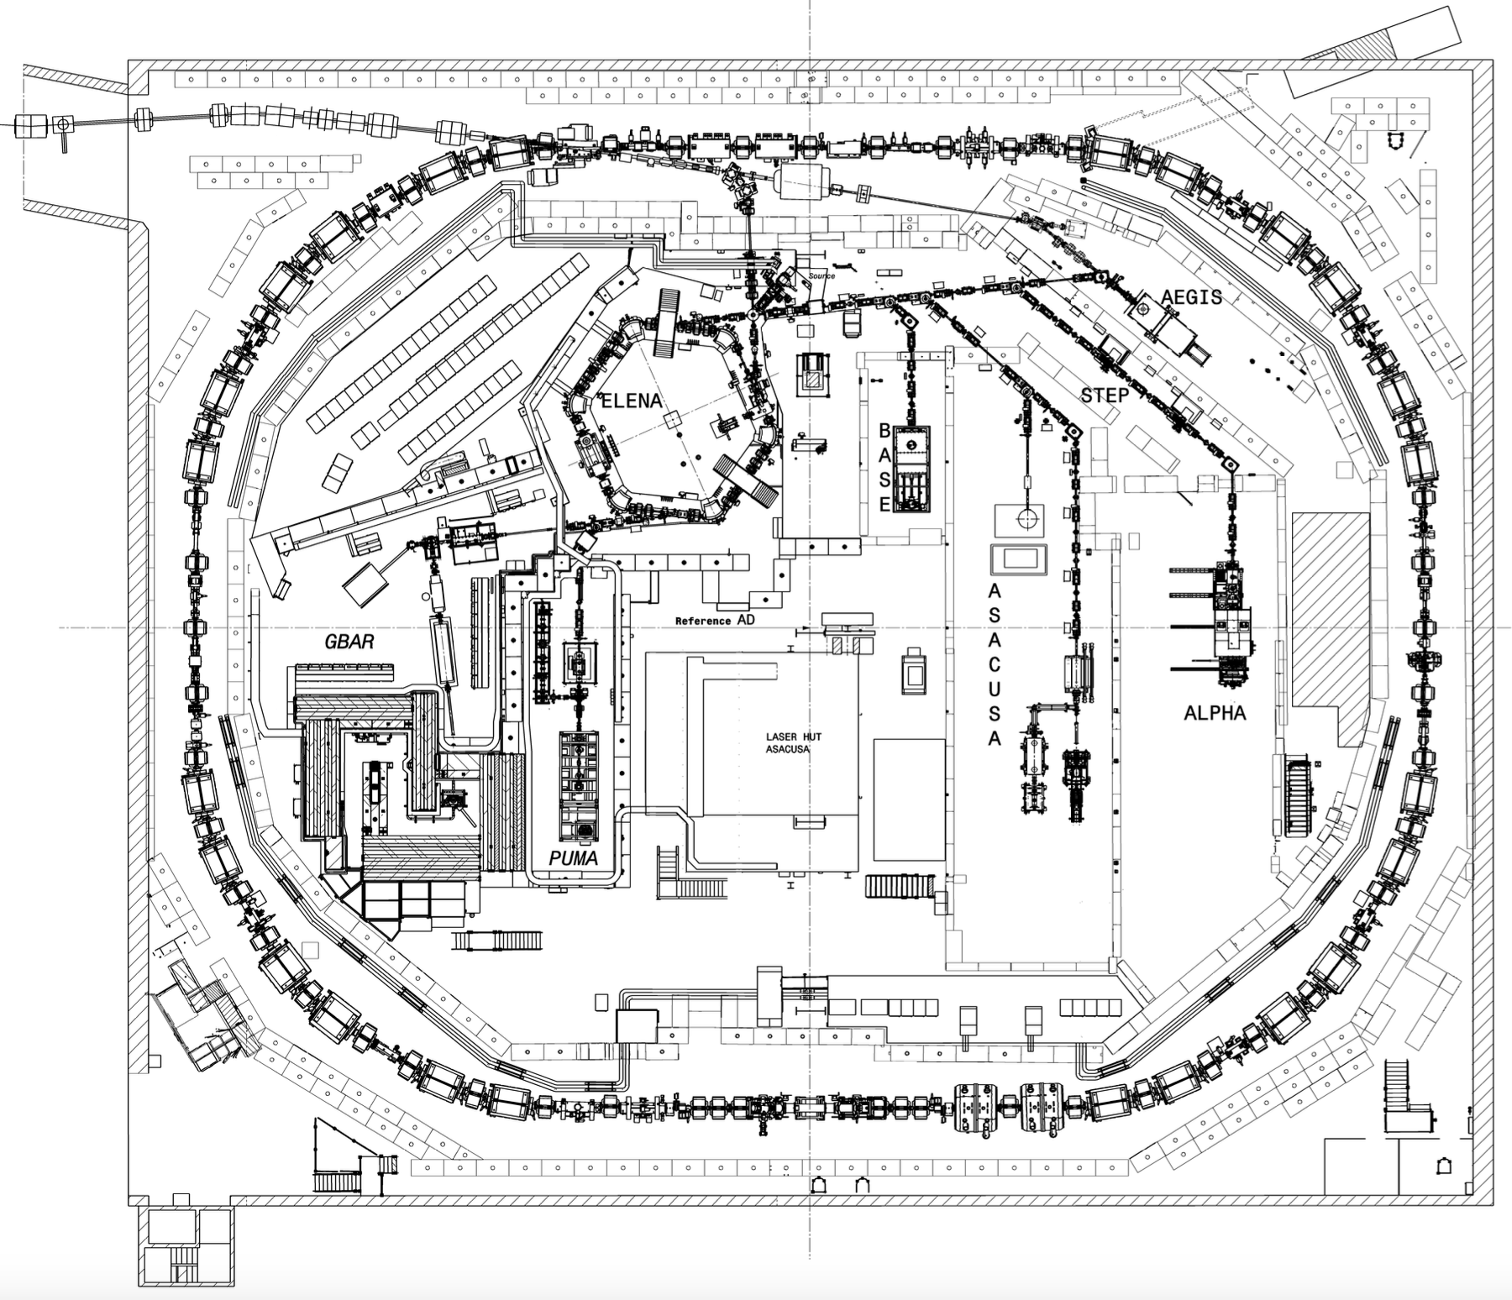
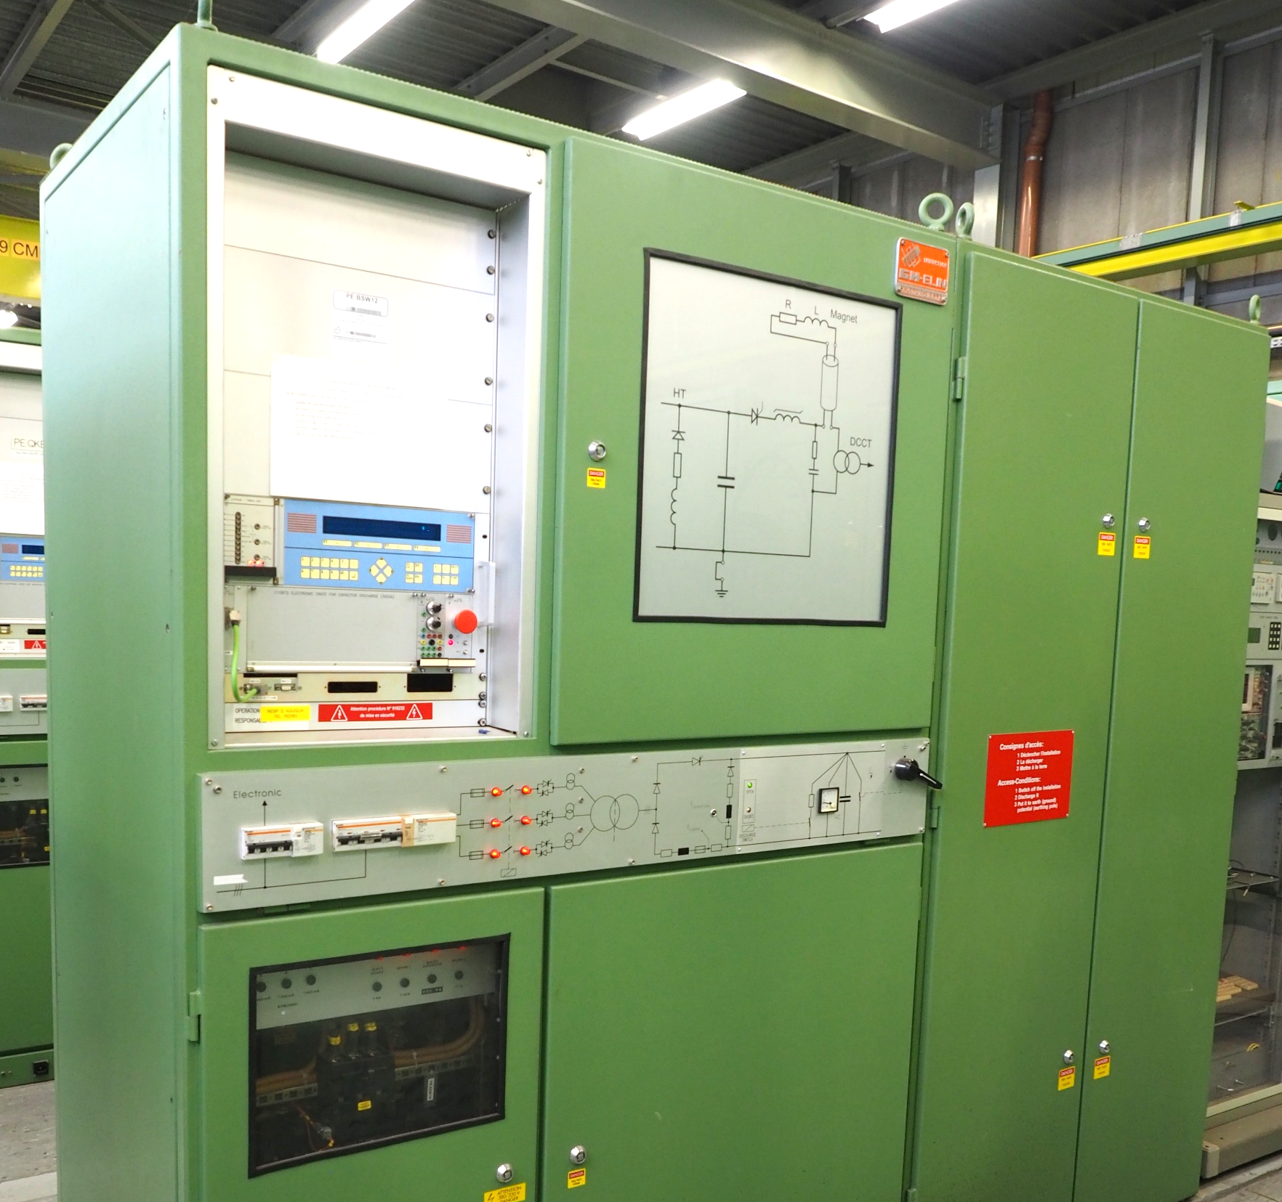
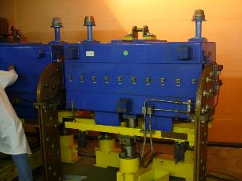
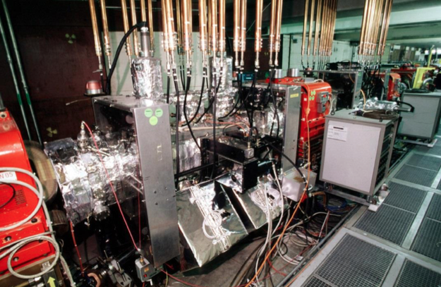
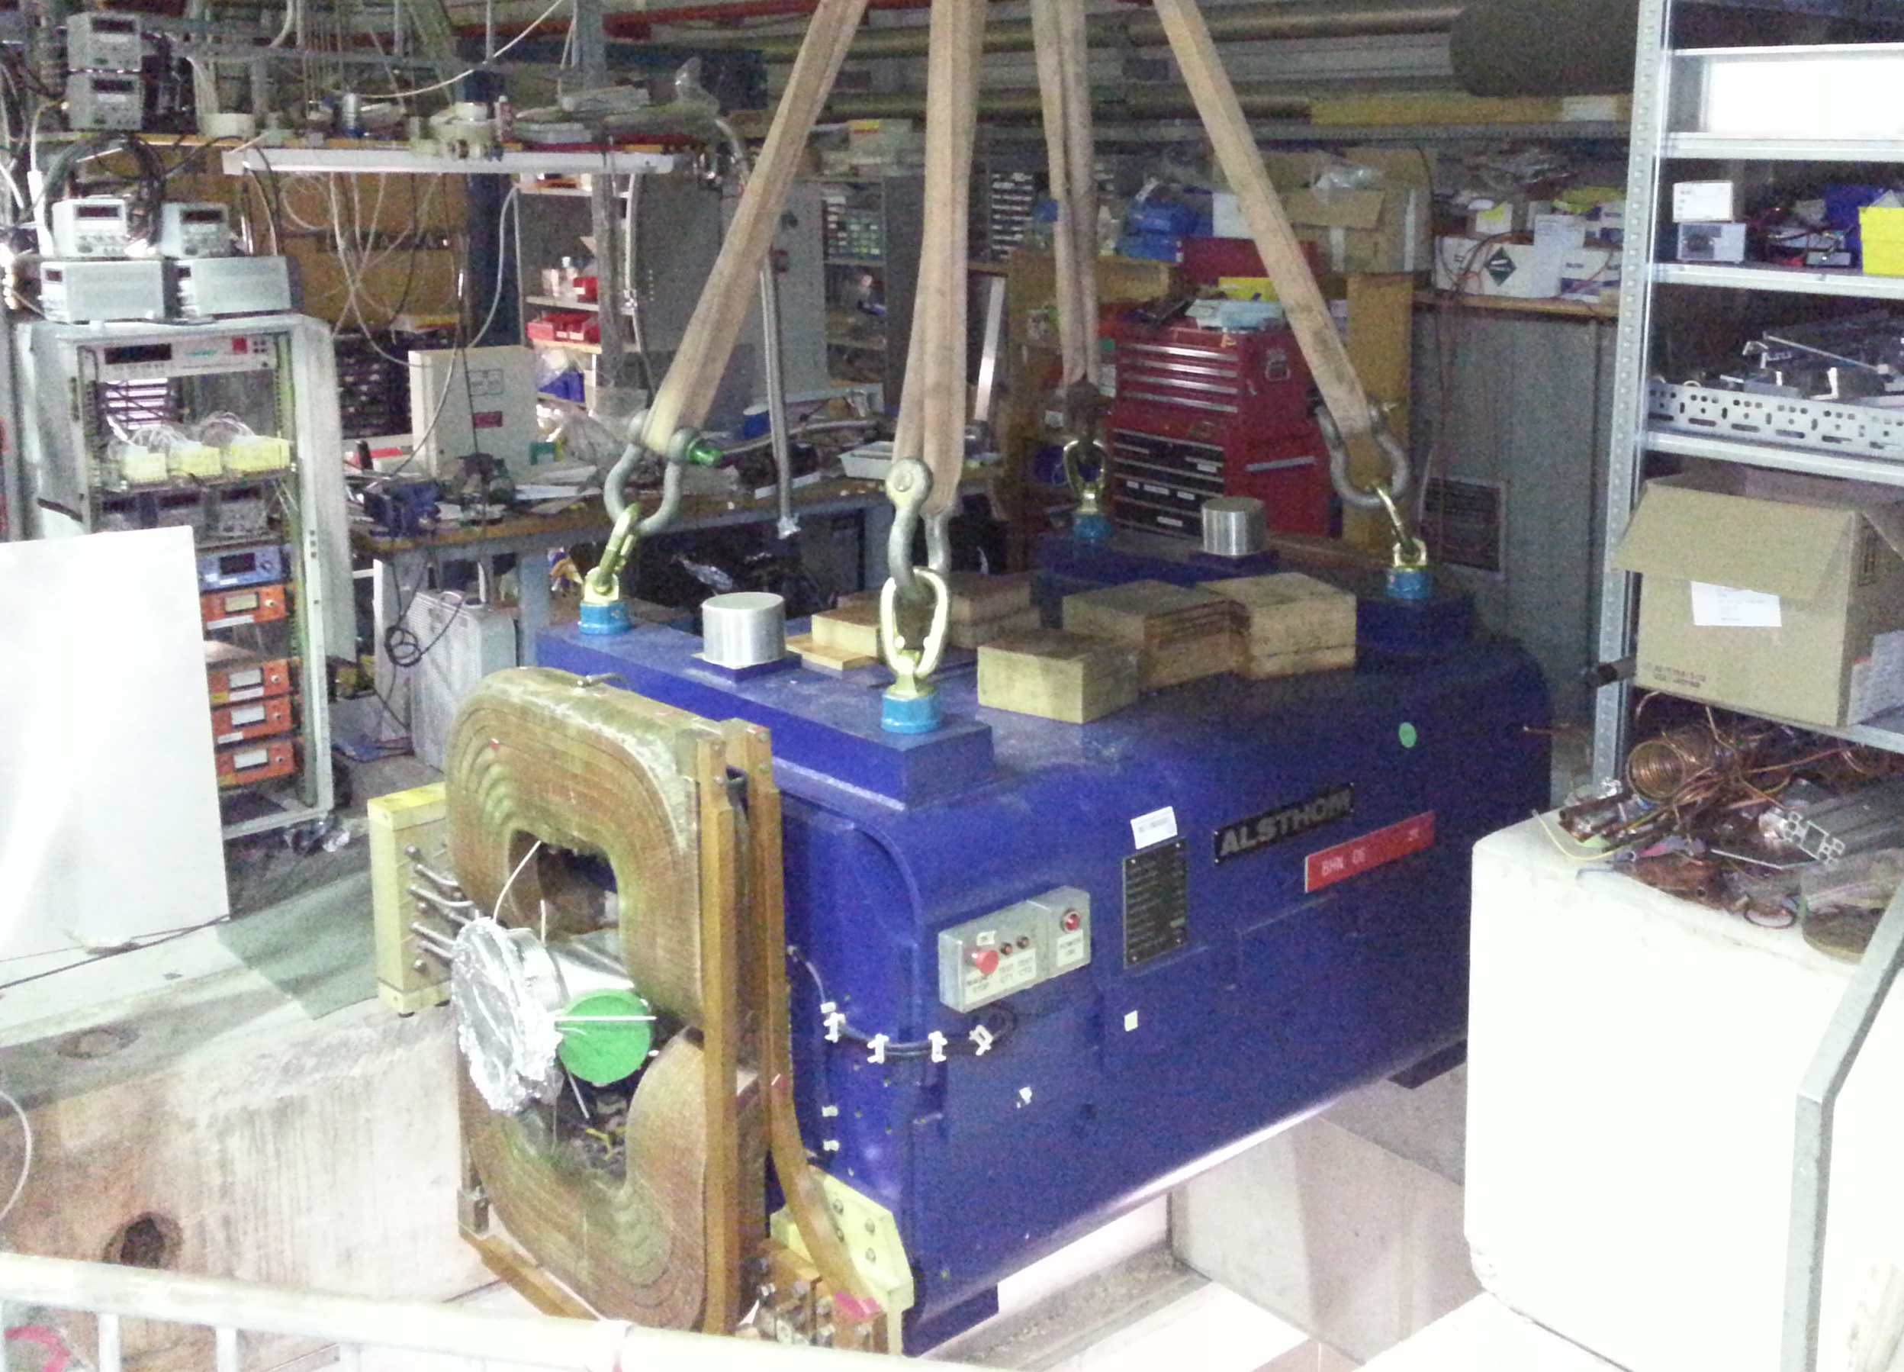
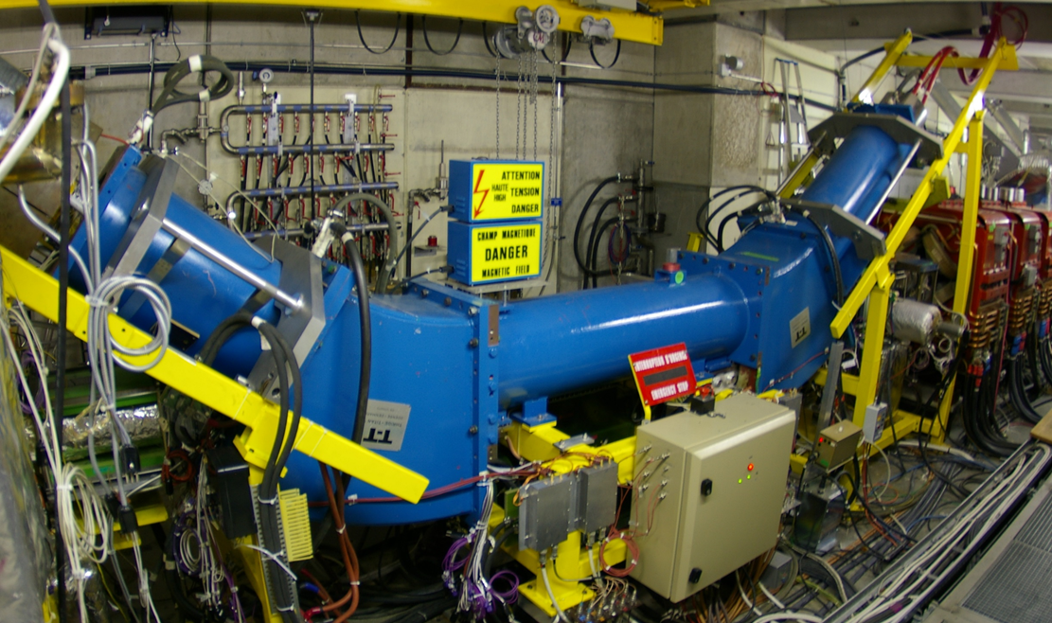
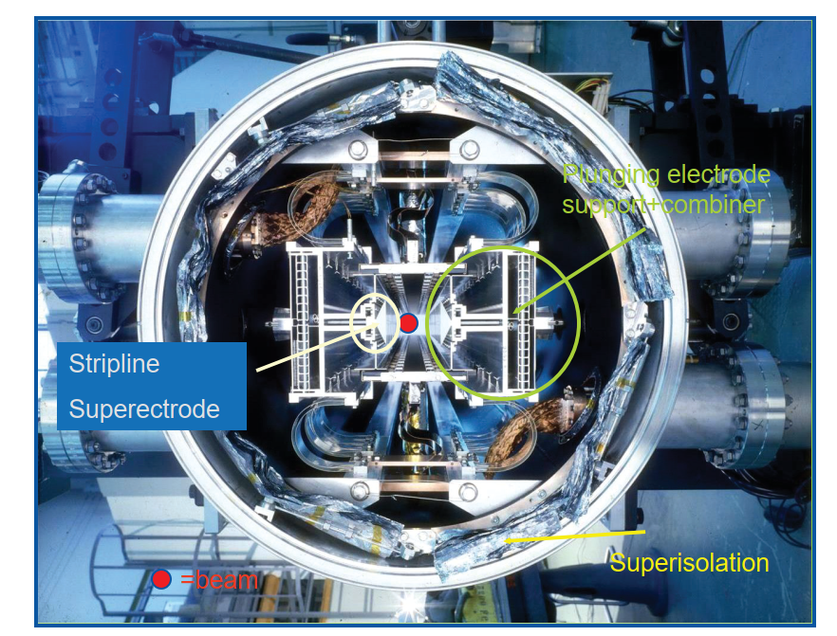
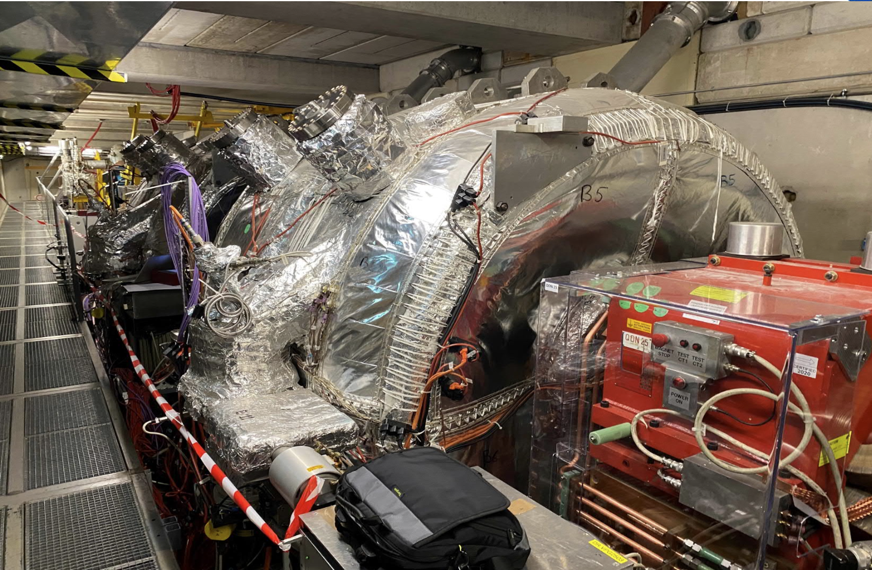
Hardware: Most Critical/Aged Items
Hardware: Most Critical/Aged Items
Outdated (and not very “green”) cooling and ventilation systems
Outdated Power Converters
Critical reliability and spare availability for s-cooling kickers and power amplifiers
Injection line magnets with high risk of breakdown and no spare
AD magnets consolidation being finalised
Outdated e-cooler design, critical in spare parts
S-Cooling pickup with no spares, limited know-how
Outdated LLRF and HLRF for C10 cavities
20

Slide 23
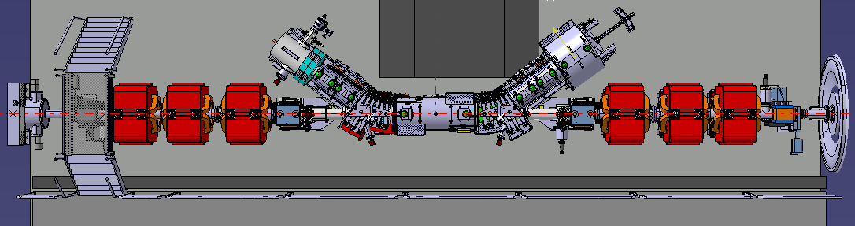
AD E-cooler Replacement during next Long Shutdown
Aims at:
Improve reliability and solve critical spare situation
Improve the current performance to aim at :
20% cycle length reduction
Reduce beam losses
Increase the max. e-cooler energy to 500 MeV/c
Several iterations on design to:
improve magnetic field quality
Electron beam magnetic expansion
Better control over beams relative trajectories
Faster switching of the electron beam on/off
Installation foreseen for 2027-2028:
Design is finalized
Gun and collector prototypes are being tested
Today’s e-cooler (from ICE times)
See presentation COOL25-WEA2 from G. Kathri
=> challenging beam commissioning after LS3
Latest e-cooler design
23

Slide 24
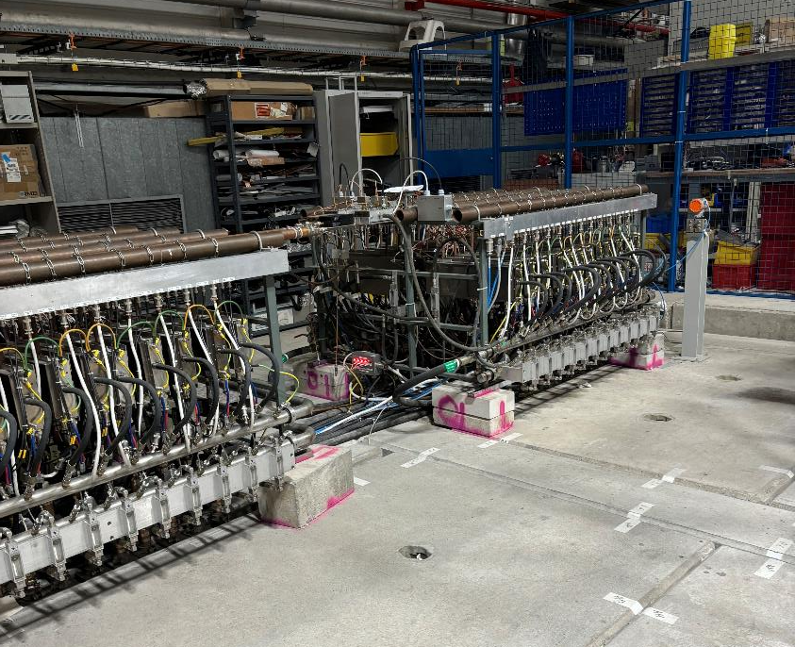
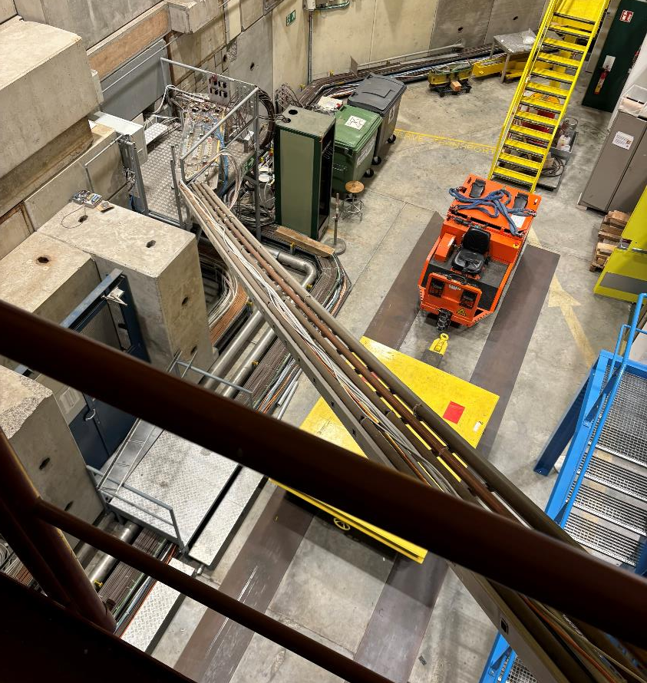
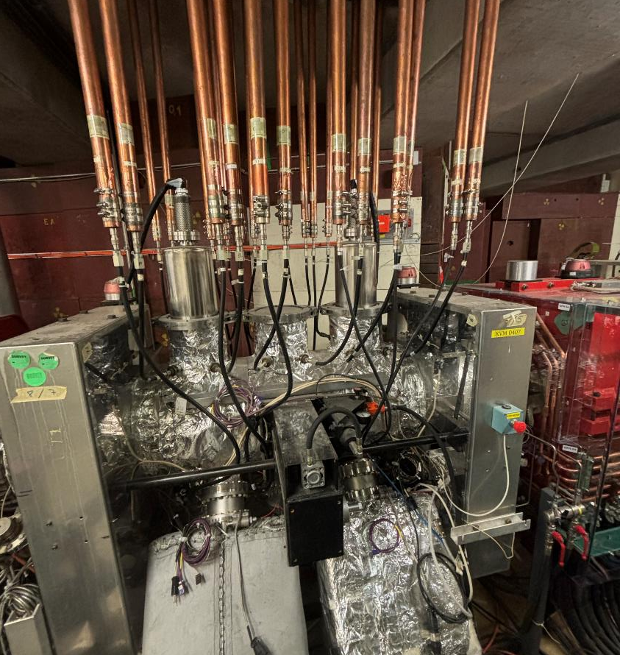
Stochastic cooling consolidation: from AC to AD
AC operated at fixed momemtum (3.5 GeV/C) converted to a decelerator (AD)
In AC featured stochastic cooling at three frequency bands, habitually designated band I, II and III:
Band I covering 800 MHz to 1.6 GHz for initial part of cooling with the high frequency band II and band III system switched on later in the cycle
from the initial stochastic cooling system only the band I was retained => slower cooling
Adaptation also included making the band I system to operate at 2 GeV/c, with some limitations
Stochastic cooling equipment needed to be adapted to the new higher standard vacuum requirements of AD due to deceleration of beam to low momentum
A kicker is fed with RF power by 24 coaxial transmission lines
Fritz’s platform close to the AD stochastic cooling pickups
Transmission lines going thru the middle of the Antimatter Factory
Rack containing 24 power amplifiers each
24

Slide 25





Possible future upgrades and improvements
Lowlevel consolidation
improved noise figure with new set of LNAs (keep these at ambient temperature)
shape correctly bandwidth to limit effect of noise at lower frequency limits of the system
roll-out and optimization of optical delay line notch filters series production for both energy plateaus
Power system
consolidate power system for higher operational efficiency and better power usage
New kicker design
fixed aperture
inverter or multi-cell design
Operational improvements
explored optimization of gain during cooling to balance transverse and longitudinal cooling
commission time of flight cooling to reduce losses between handover of bunch rotation system and stochastic cooling at 3.5 GeV/c
profit from new flexible electronic phase shifter
Need to (re)-Establish a Beam Dynamics simulation framework
Multi-electrode design with inverter
Thesis from D.Sittard https://repository.cern/records/w1p7v-5y637
Optical notch filter
slotted kicker design (L. Thorndahl)
See presentation COOL25 (FRA2) from D. Gamba
25

Slide 26
Summary
Continuous increased performances for both AD and ELENA since the start of ELENA physics era in 2021:
AD/ELENA is the unique facility worldwide
Consistently delivering 1.3e7 antiprotons per bunch at 100 keV bi-minute to 4 users at the same time within designed beam parameters (except transverse emittance)
High satisfaction across the physics user community
Regular progress on performances stability thanks to improved diagnostics and setting-up methods
Regular machine development time dedicated for systems tests/developments
Importance of the H⁻ operation of ELENA for efficient setting-up
Preparing the future of the facility:
Collecting possible future experimental requirements to intercept upgrade needs while pursuing the consolidation of aging hardware in both machines
Profitting of the consolidation to resolve longstanding limitations and improve performances
25

Slide 27
Spares

Slide 28
ELENA beam parameters summary
Parameter | design | Achieved in 2025
Qx/Qy | ~2.3/~1.3 | 2.295/1.315
Cycle duration [s] | 20 | 13
Injected intensity [pbars] | 3e7 | >6e7
Deceleration efficiency [%] | 60 | 85
Extracted bunches | 4 | 4
Bunch population [pbars] | 4.5e6 | > 1.3e7
Dp/p0 | 5e-4 | 4.5e-4
Bunch length (rms) [ns] | 75 | <75
Transverse emittances x/y [um] | 1.2/0.75 | ~2.7/~2.6
25
Notes:
<number>

Slide 29



Timeline
LS2 2019-2021
New AD Target
Major AD magnets and RF consolidation
…
2007
First feasibility study of ELENA
LS1 2013-2014
S-Cooling controls(?)
Instrumentation
1996
Design Study of the Antiproton Decelerator (AD)
2000
START of AD for physics
2009
START of
AD-CONS
2011
ELENA project
approved
2018
ELENA commissioning
2021
START of ELENA for physics
2010
1996
END of pbar physics @LEAR:
CERN to concentrate on low energy pbar physics only in AD
2002
First Hbar production and detection
2010
START of Hbar physics in traps
2017
Observation of 1S–2S transition in trapped Hbar
2021
laser-cooled Hbar and sympathetically cooled p
2023
Antimatter does not fall up…
Timestep between major results/changes: ~5-10 years
25

