Slide 1
Electron-Ion Collider
Sergei Nagaitsev
EIC Technical Director
COOL25
October 27, 2025

Slide 2
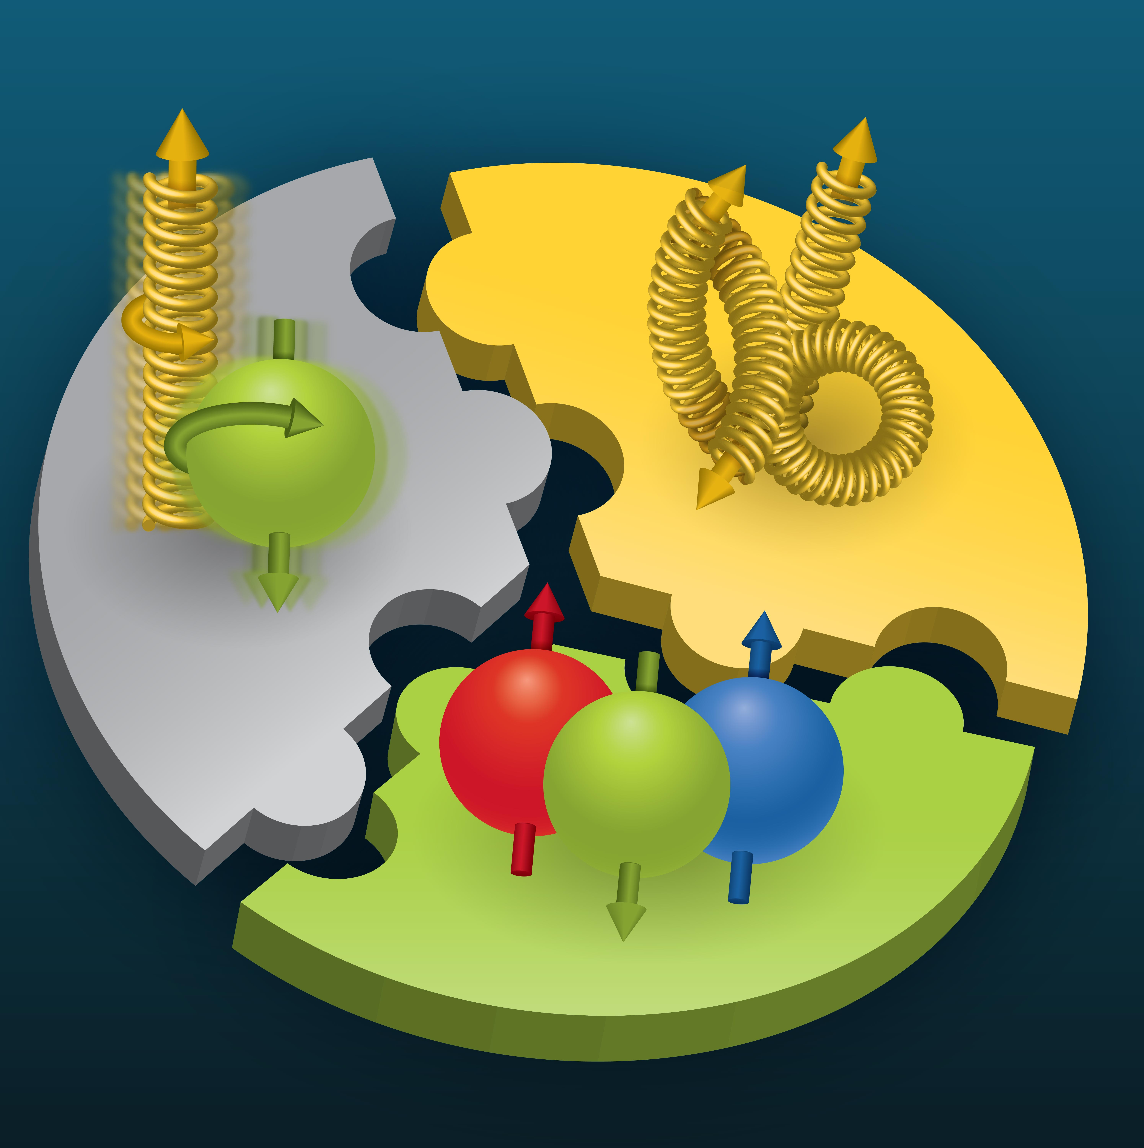

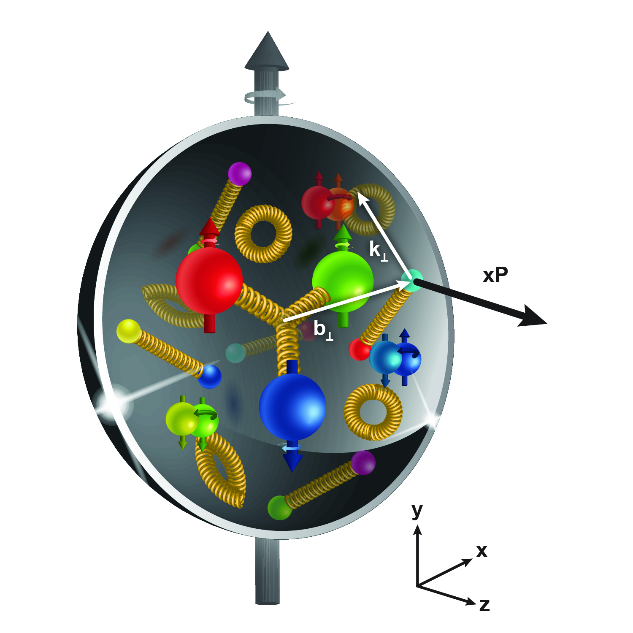
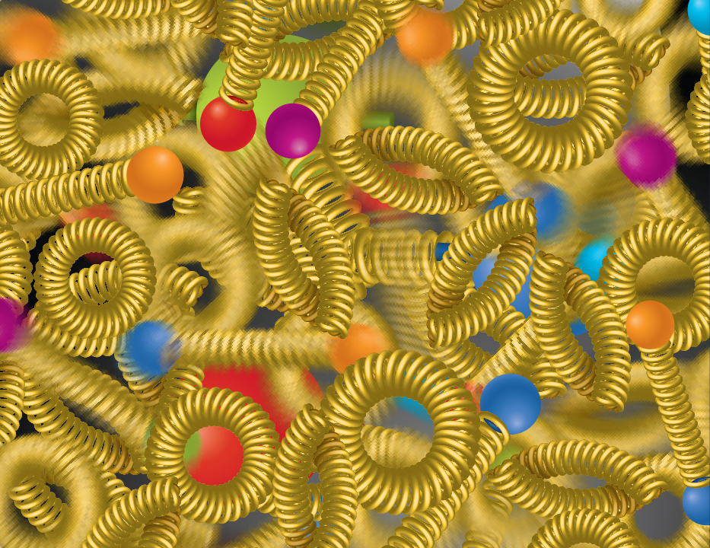
Compelling EIC Science Case
How do quarks, gluons, and orbital angular momentum contribute to proton spin?
Spin is a fundamental property of matter.
All elementary particles,
but the Higgs, carry spin.
Spin cannot be explained by a static picture, rather the interplay between the properties and interactions of quarks and gluons inside
the proton.
Does the mass of visible matter emerge from quark-gluon interactions?
Atom: Binding/Mass = 0.00000001
Nucleus: Binding/Mass = 0.01
Proton: Binding/Mass = 100
The EIC will determine an important term contributing to the proton mass, the so-called quantum chromodynamics (QCD) trace anomaly.
How can we understand QCD dynamics and the relation to confinement?
EIC will image quarks and gluons in 3D in space and momentum inside the nucleon and nuclei and uncover how the nucleon properties emerge from quarks and gluons and their interactions.
How do quark-gluon interactions create nuclear binding?
Is the structure of a free and bound nucleon the same?
How do quarks and gluons, interact with a nuclear medium?
How do the confined hadronic states emerge from these quarks and gluons?
Does gluon density in nuclei saturate at high energy?
How many gluons can fit in a proton?
How does a dense nuclear environment affect the quarks and gluons, their correlations and interactions?
=
gluon
splitting
?
gluon
recombination
National Academies of Sciences, Medicine, and Engineering, 2018 Consensus Study Report)
2

Slide 3
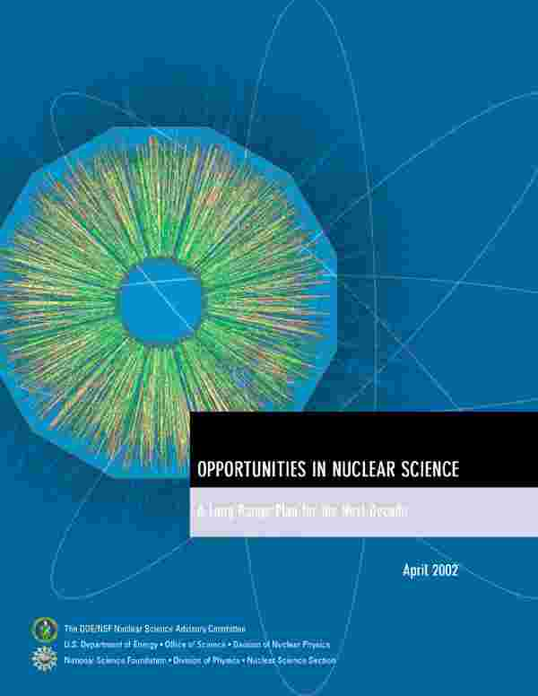
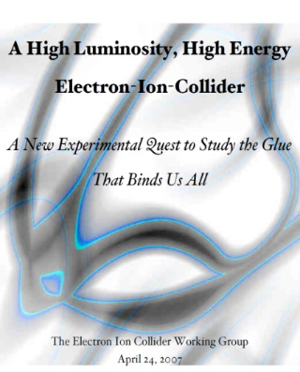
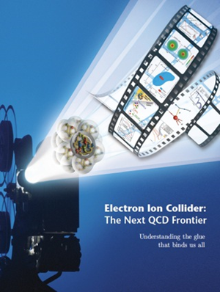

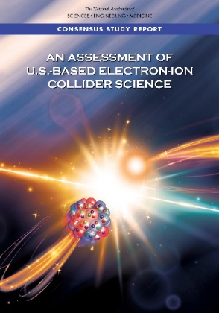

EIC Scientific Case Built Over Decades
2002
2007
2009
“We recommend the expeditious completion of the EIC as the highest priority for facility construction.” (Nuclear Science Advisory Committee, 2023)
2010
2012
Gluons and the Quark Sea at High Energies
2013
NSAC
2015
Major Nuclear Physics Facilities for the Next Decade
2018
2021
2023
March 14, 2013
“The science questions that an EIC will answer are central to completing an understanding of atoms as well as being integral to the agenda of nuclear physics today.” (National Academies of Sciences, Medicine, and Engineering, 2018 Consensus Study Report)
arXiv:2103.05419
EIC will be the only operating particle collider in the U.S. in the next decades.
3

Slide 4

EIC at Brookhaven National Lab

Slide 5
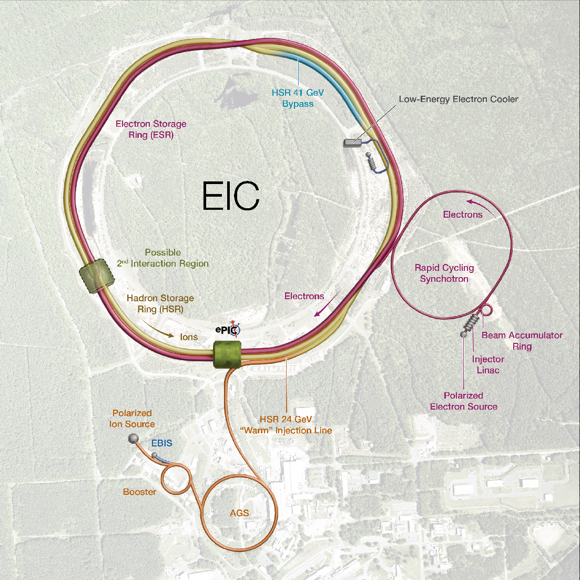

Slide 6
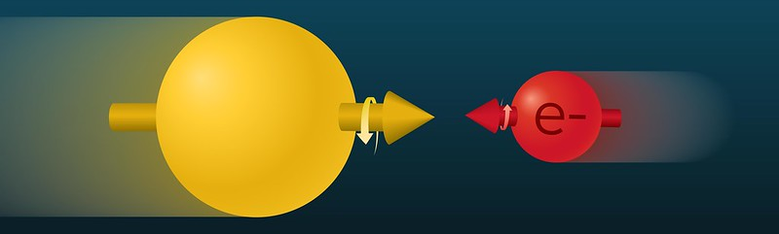
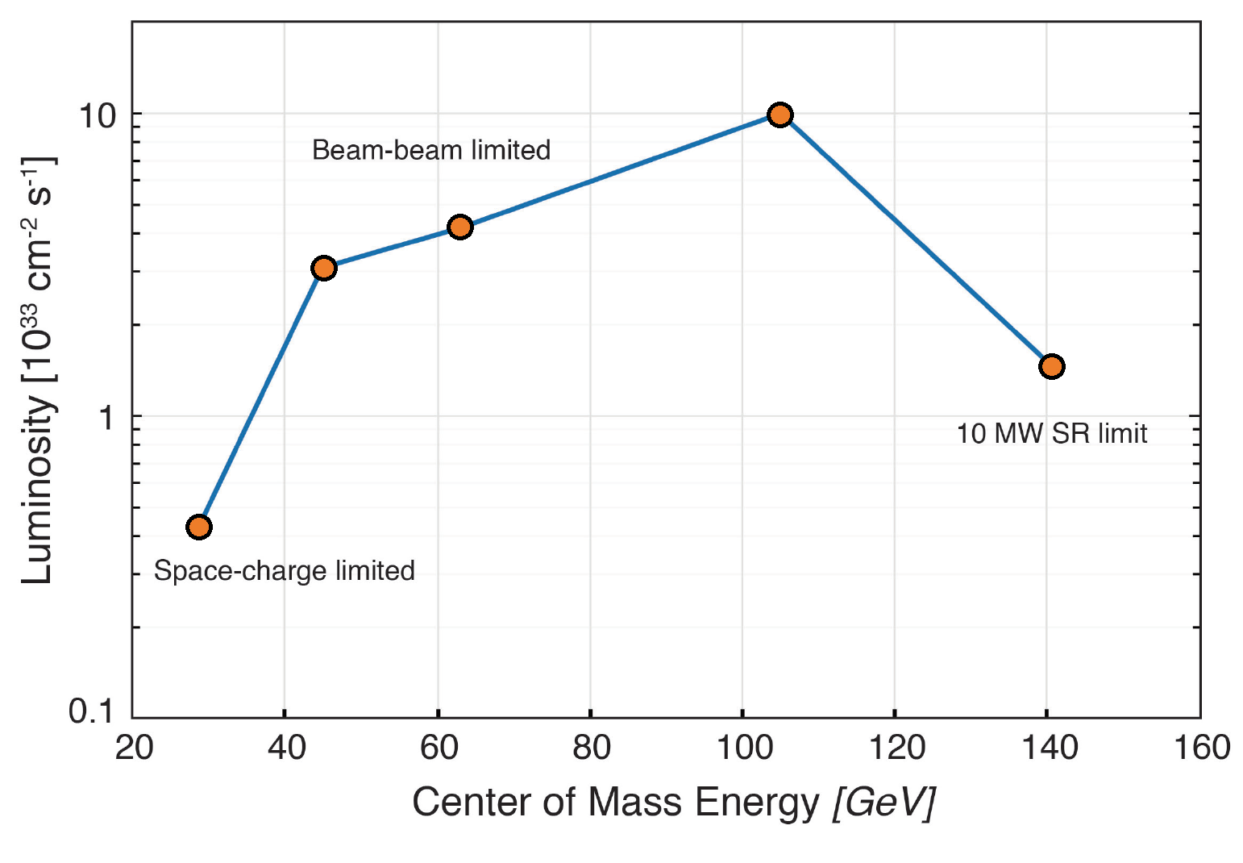
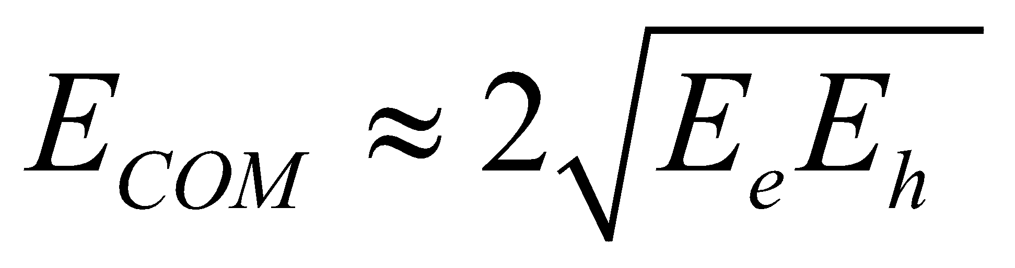
EIC Accelerator Performance Requirements
Center-of-mass energies: ~20 to ~140 GeV (e-p)
High degree of beam polarization: ~70%
Availability of ion beams: from proton to Pb
Luminosity: 10³³ – 10³⁴ cm⁻²sec⁻¹
Possibly more than one IR
Figure of merit: to
Based on the 2015 US NSAC Long-Range Plan
10x275
5x100
Bunch charges: 28 nC (10 GeV, e) and 11 nC (275 GeV, p)
10x100
18x275
5x41
EIC peak luminosities (CDR)

Slide 7
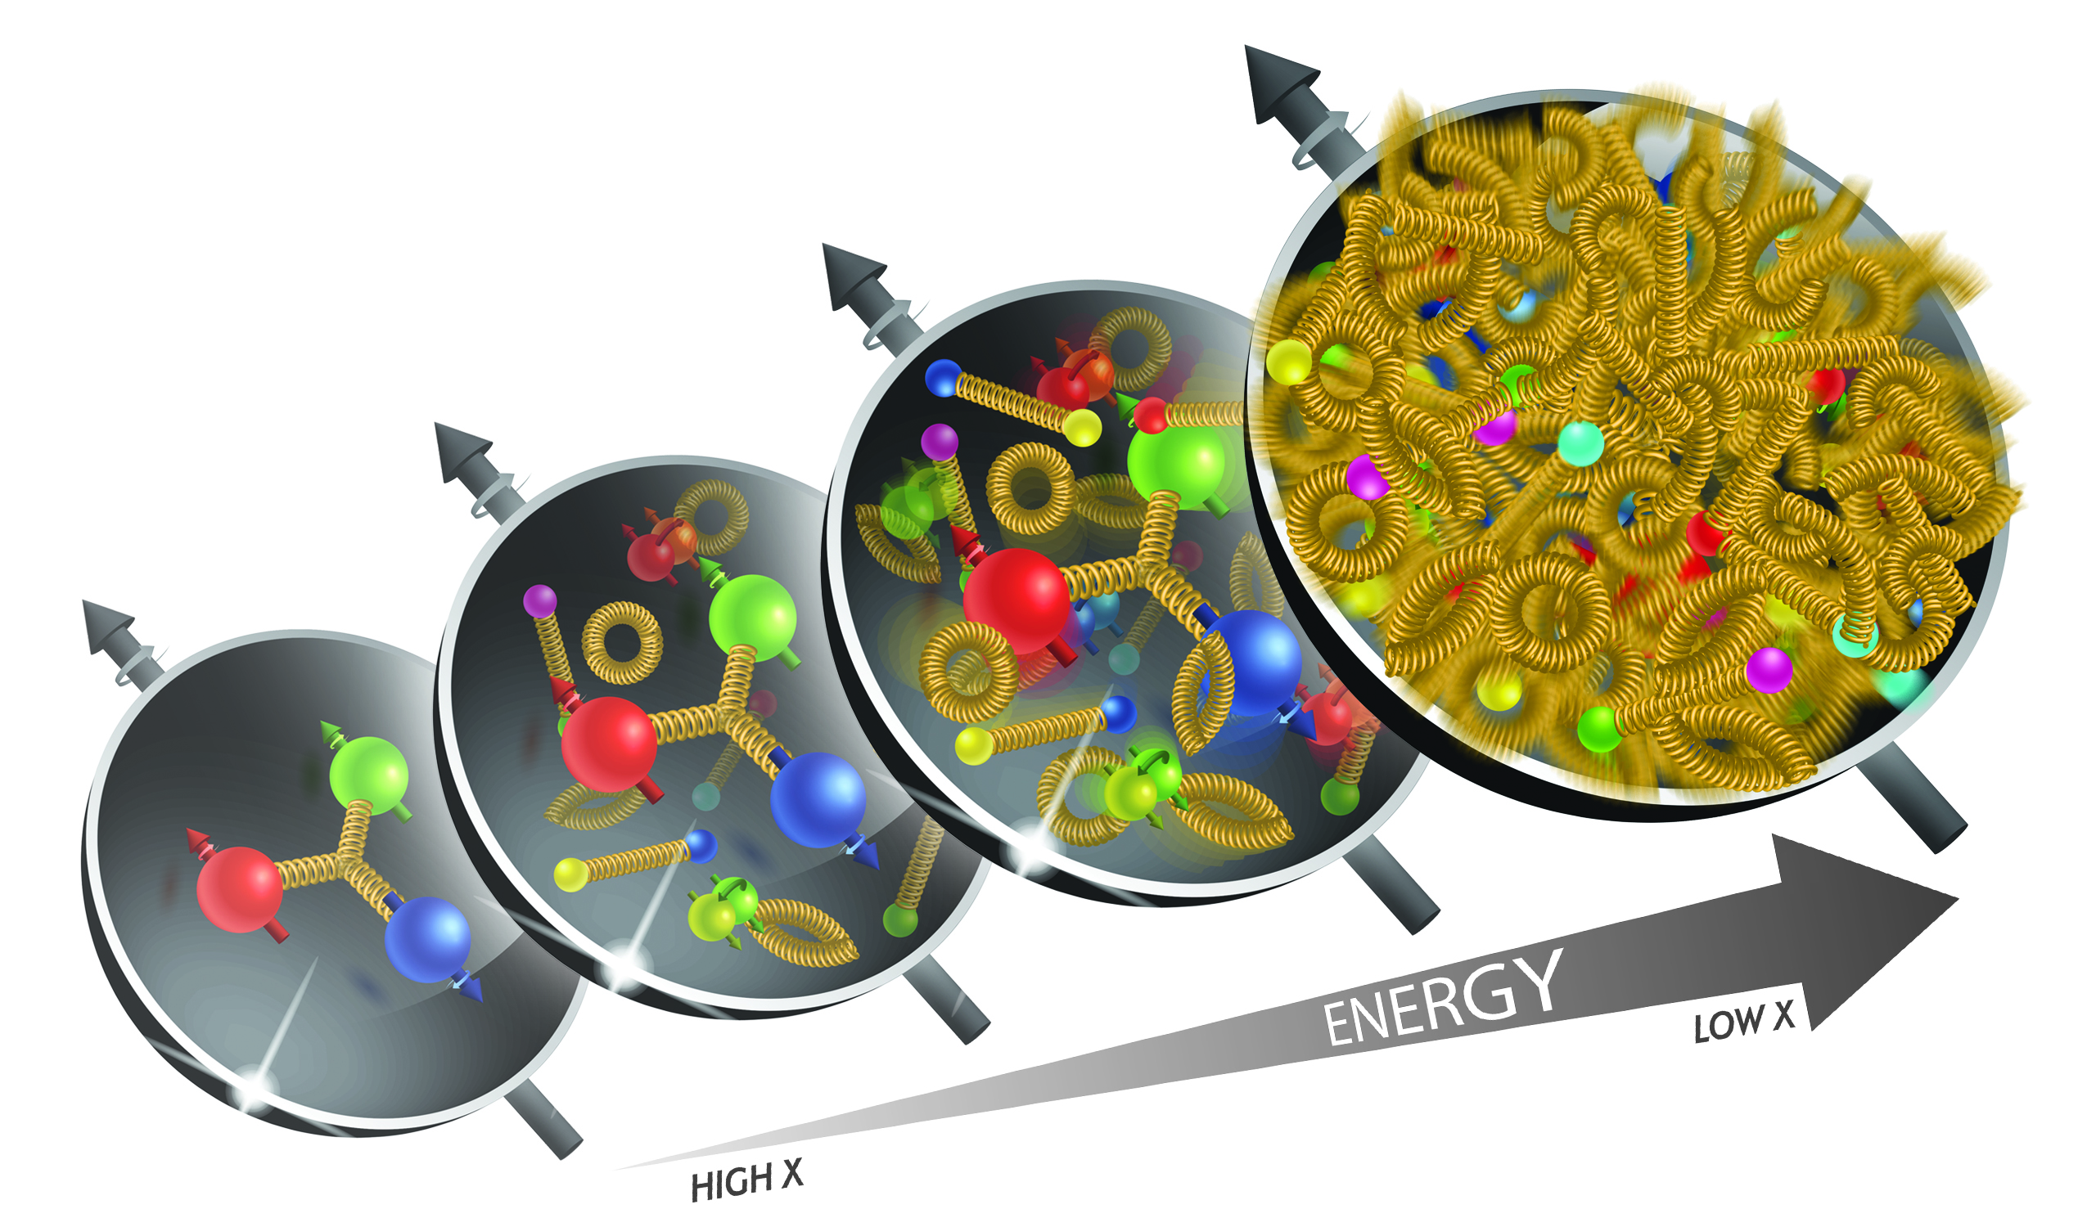
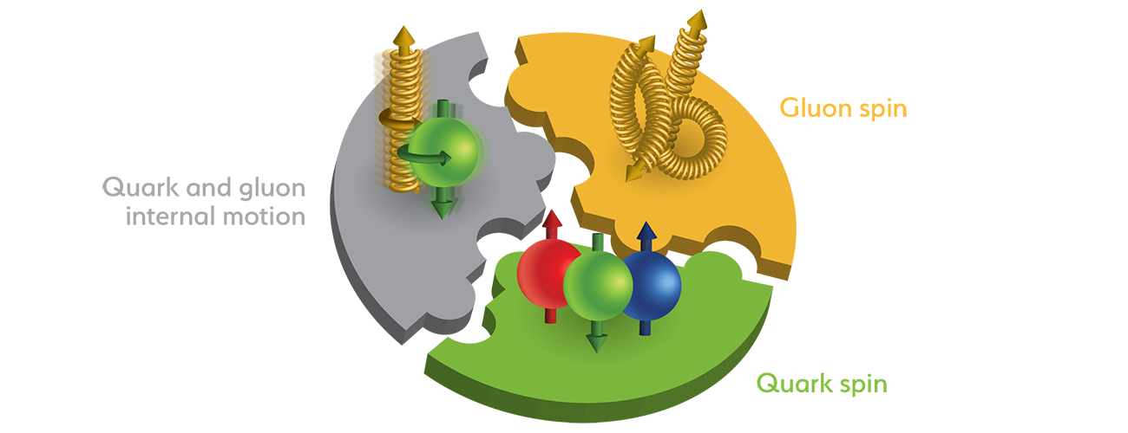
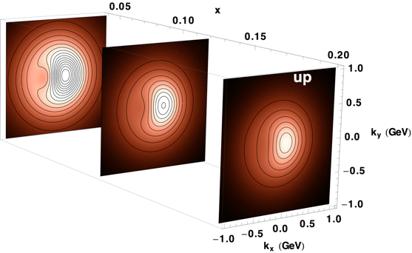
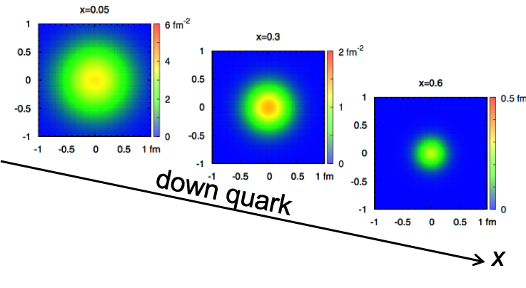
EIC Accelerator Performance
wide center-of-mass energy √s: 20 – 140 GeV :
map the out nucleon and nuclei structure from high to low x
polarized electron and hadron (p, He-3) beams:
access to spin structure of nucleons and nuclei
Spin vehicle to access the spatial and momentum structure of the nucleon in 3d
Full specification of initial and final states to probe q-g structure of NN and NNN interaction in light nuclei
nuclear beams: d to Pb
accessing the highest gluon densities → saturation
quark and gluon interact with a nuclear medium
high luminosity 10³³-10³⁴ cm⁻²s⁻¹ :
mapping the spatial and momentum structure of nucleons and nuclei in 3d
access to rare probes, i.e. Ws
large acceptance (0.2 – 1.3 GeV) through forward focusing IR magnets
spatial imaging of nucleons and nuclei
gluon emission
gluon recombination
?
=

Slide 8
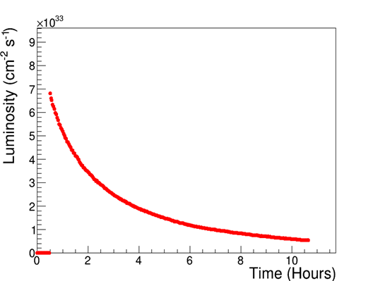
Luminosity performance
“Flat” proton bunches allow for high initial luminosity
CoM Energy (GeV) | Average Lumi (x10³³ cm⁻²s⁻¹) (per 4-hour store)
105 | 3
63 | 1.2
45 | 1
140 | 0.44
29 | 0.13
10x275
Optimal store duration
~4 hours
Average
Lumi
10x275
5x100
10x100
18x275
ESR fill
Detector Off
5x41
EIC peak luminosities (CDR)

Slide 9
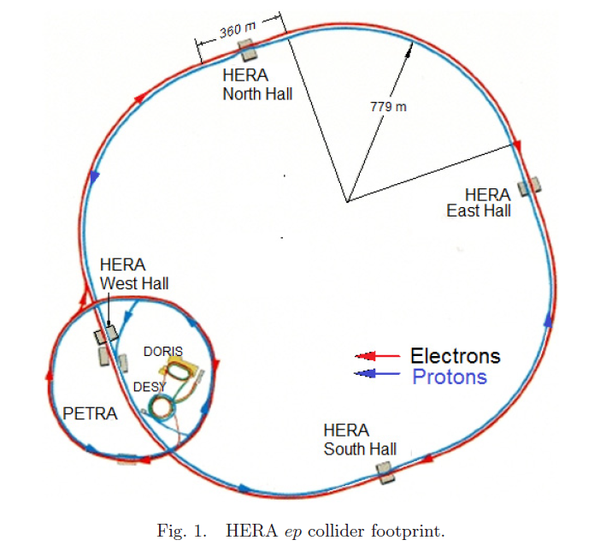
HERA (1992 – 2007)
920 GeV protons (unpolarized)
27.5 GeV electrons (self-polarized by
the Sokolov-Ternov effect)
HERA peak luminosity: ~5x10³¹ cm⁻²s⁻¹
The EIC is an electron – ION collider (HERA was an e-p collider)
Variable CoM energy (HERA was a fixed-energy collider)
EIC beams are polarized, starting from the source (HERA was not)
New modern particle detector
EIC luminosity is a factor of ~200 higher

Slide 10
HERA vs EIC: key parameters
HERA EIC FACTOR
Circumference (km) 6.3 3.8 1.7
Number of bunches 174 1160 6.7
Proton bunch charge (nC) 11.7 11 1
Electron bunch charge (nC) 5.3 28 5.3
Bunch length (cm), p/e 16/0.9 6/0.7
Beta at IP (cm), proton H/V (cm) 245/18 80/7.2
Beta at IP (cm), electron H/V (cm) 62/26 45/5.6
Proton emittance, (nm, rms) 4/4 11/1
Electron emittance, (nm, rms) 20/3 20/1.3
Energy (COM), GeV 320 105
Luminosity, x10³¹ cm⁻²s⁻¹ 5.3 1000 190
60
~3

Slide 11

Key EIC accelerator concepts
Ribbon-like (flat) hadron beam (11:1 transverse emittance/size ratio)
Large crossing angle (25 mrad)
Beam-beam limits for both beams (0.1 e/ 0.01 p)
Spin preservation from source to collisions (protons and electrons)
Very high bunch intensities and circulating beam currents (1 A (p), 2.5 A (e))
Upgrade path: high-energy hadron cooling at collisions
These are the key concepts that allow to attain luminosity of ~10³⁴ cm⁻²s⁻¹ and maintain high polarization at collisions over a broad range of CoM energies

Slide 12
Key EIC Accelerator Technology Areas
Hadron Beam Cooling
Spin-transparent optics
High polarization for both beams from source to collisions
Swap-out injection for electron bunches (at 1 Hz) to maintain high polarization in the ESR
SRF (Crab and elliptical) cavities
Large-size, complex geometries;
High-power; HOMs
Very tight phase and amplitude noise requirements
IR magnets (large aperture, one-of-a-kind SC magnets)
Instability and impedance control;
Vacuum chambers, beam screens, kickers, SRF cavities

Slide 13
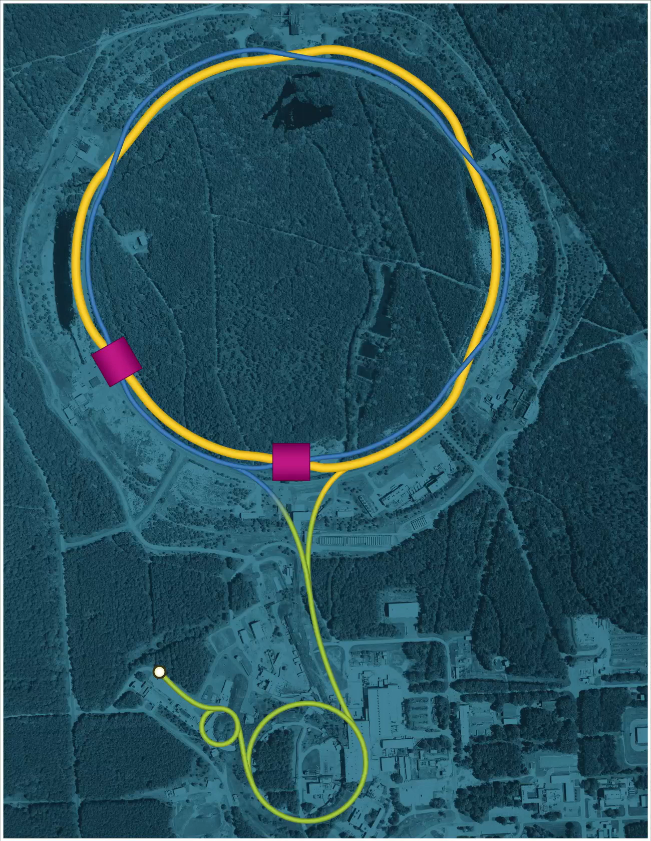
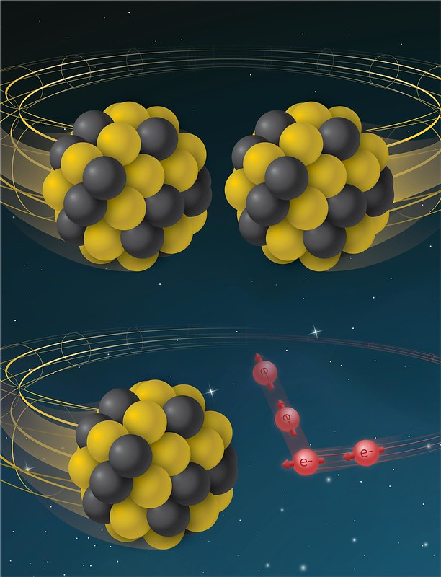
From RHIC to EIC
RHIC
RHIC
Ion species:
proton – Uranium
60% p polarization
EIC
Protons: ~40 – 275 GeV
Electrons: 5 – 18 GeV

Slide 14
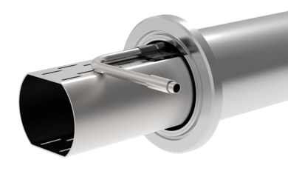
From RHIC (yellow ring) to EIC HSR
Tripled beam current, shorter bunch length, shorter bunch distance, ‘flat’ beams with small vertical emittance
EIC HSR to be composed of existing arcs of the Yellow RHIC ring (remove unused magnets)
Insert sleeves coated with copper and amorphous carbon into superconducting magnet beam pipes to improve conductivity and reduce secondary electron yield (-> electron cloud)
Add new RF cavities
Add hadron cooling to create flat beam
Add crab cavities, new IR SC magnets
Add a collimation system
Add extra ‘snakes’
Actively Cooled Beam
Screen Material procurement

Slide 15
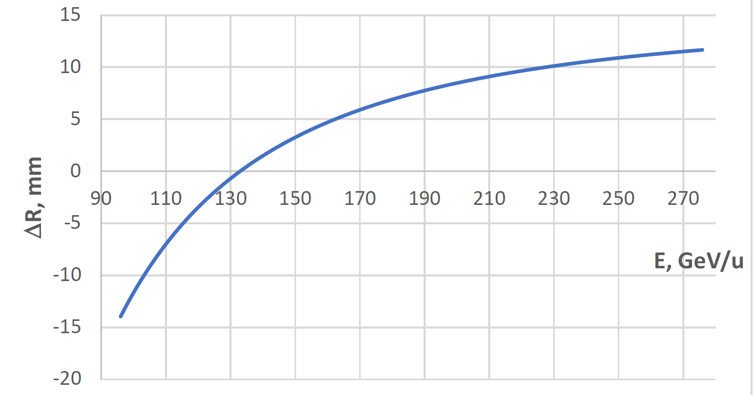

Beam Energy and Average Orbit Radius in the HSR
20 mm
130 GeV
100 GeV
store
275 GeV
70 mm $∅$ beam pipe
Since the electron revolution frequency is fixed, the hadron orbit must be adjusted with energy to keep the collisions in sync.

Slide 16
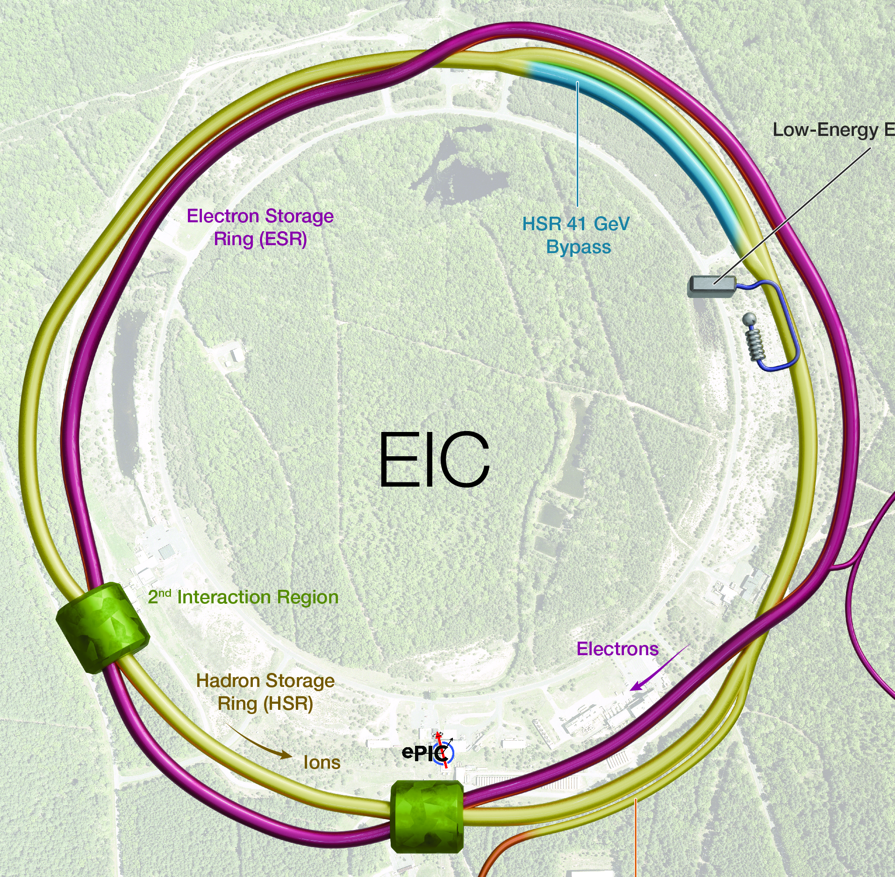
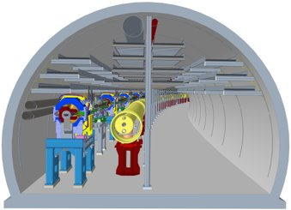
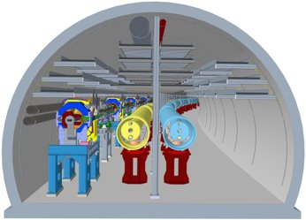
The 41-GeV ‘bypass’
This bypass provides access to the lowest EIC CoM energy, 29 GeV
Sector 1 without and with the 41-GeV bypass line

Slide 17
EIC hadron beam cooling
Low-energy cooling (LEC):
The goal of cooling at proton injection energy is to obtain initial proton parameters by cooling the vertical emittance from ~2 um to 0.3-0.5 um (rms normalized).
Cooling at injection energy of protons (24 GeV) requires a 13 MeV electron beam.
Our present design concept is similar to the existing RHIC LEReC system
High-energy proton cooling at collisions (possible future upgrade)
The goal of cooling at EIC proton collision energies of 41, 100 -- 275 GeV is to counteract the longitudinal and transverse emittance growth and to maintain the ‘flat’ proton beam. Several candidate concepts are being considered.
Ion beam cooling at collisions: Conventional microwave stochastic cooling
A. V. Fedotov et al. “Experimental Demonstration of Hadron Beam Cooling Using
Radio-Frequency Accelerated Electron Bunches”, Phys. Rev. Lett. 124, 084801 (2020)

Slide 18
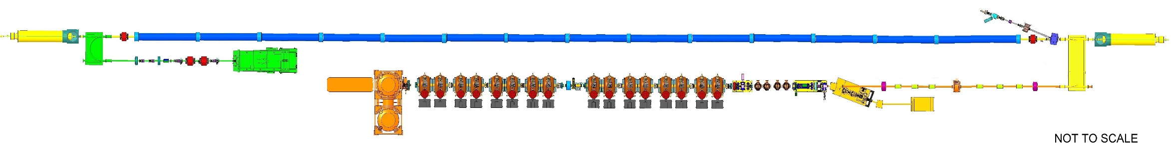
Low-energy Cooler Concept
24 GeV protons
12.5 MeV electrons
RF diagnostics line with Deflecting cavity
180°Dipole
(U-turn)
LEReC Cooling Solenoids
180° Dipole
Spectrometer
Mu-metal shielding
Quad
150 m cooling section
cooling
RF diagnostic
hadron
hadron
hadron
e⁻
HSR
e⁻
HSR
e⁻
extraction
transport
IR2 layout
(all within the
existing RHIC
Tunnel)
Injector test
injection
SC Quad
PM
Cathode transport
PM
PM
Solenoids
Laser
197 MHz
130 kW Beam Dump
Extraction line
900 kW Beam Dump
4x 591 MHz
NCRF correction Cavities
DC Gun
400kV
Injector/linac
Test line
24MHz
RF cavity
16x 197 MHz
NCRF LINAC
Compatible with future beam cooling upgrades at the collision energies
Not to scale

Slide 19
EIC Low Energy Cooler Parameters
LEReC key parameters for reference
 | electrons | protons
gamma | 25.4 | 25.4
RHIC RF frequency, MHz | 197 | 24.6
Cooling section length, m | 168 | 168
Cooling sections beta function, m | 150 | 100-200
Hadrons Dy, Dy’, m, rad |  | <1, <0.02
Total charge per proton bunch, nC | 3 | 45
Electrons kinetic energy, MeV | 12.46
Electron average current, mA | 74
Normalized emittance, rms, um | <1.5 | 2
rms bunch length, cm | 4 | 100
rms dp/p | <5e-4 | 6e-4
Angles in cooling section, urad | 20-30 | 20
electrons
4-5
704 MHz (9 MHz)
20 m
30 m
3 nC
1.6-2 MeV
30 (60 mA in tests)
<2 um
5 cm
<5e-4
<150 urad

Slide 20
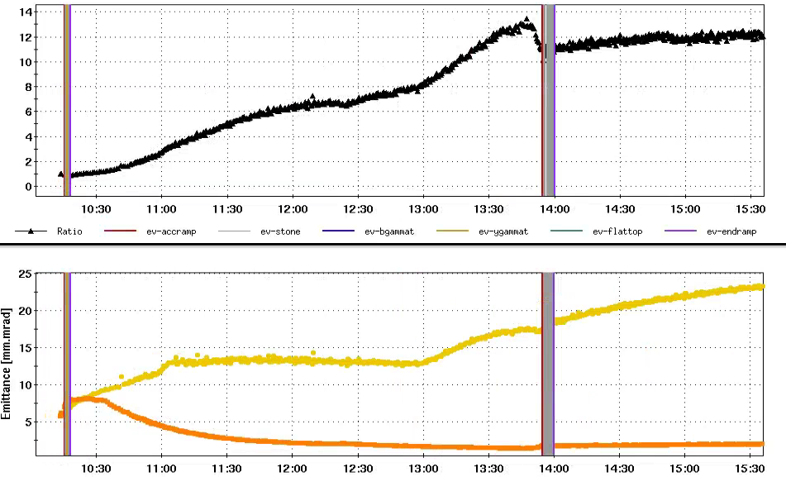
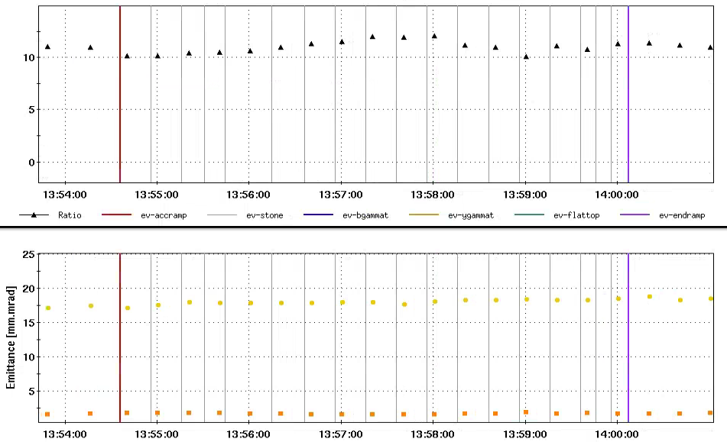
Flat Beam Acceleration Experiment in RHIC
July 23, 2025
Maximum transverse beam emittance ratio 13:1 was obtained with stochastic cooling at 31 GeV/nucleon
Transverse emittance ratio 11:1 was well maintained during acceleration from 31 GeV/nucleon to 100 GeV/nucleon
Flat beam was stored at 100 GeV/u with EIC/HSR tunes for ~2 hours, 11:1 emittance ratio was well maintained too
Entire store duration
31 GeV
During Acceleration
100GeV
Emittance Ratio
Emittance Ratio
Emittance ratio
100GeV
31 GeV
Emittance ratio
Horizontal Emittance
Horizontal Emittance
IBS growth
Acceleration
Vertical Emittance
Vertical Emittance
20

Slide 21
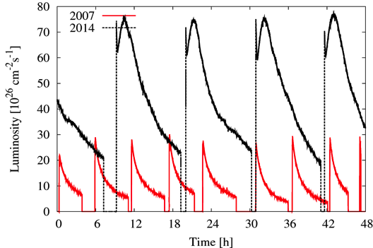
Conventional stochastic cooling at collisions
RHIC luminosity
3-D stochastic cooling (5-9 GHz).
~5x U-U and ~ 4x Au-Au luminosity improvements.
Cooling led to first increase of instantaneous luminosity and smallest emittance ever in a hadron collider.
Is not adequate for the EIC (protons), but will work with ions (after some upgrades)

Slide 22
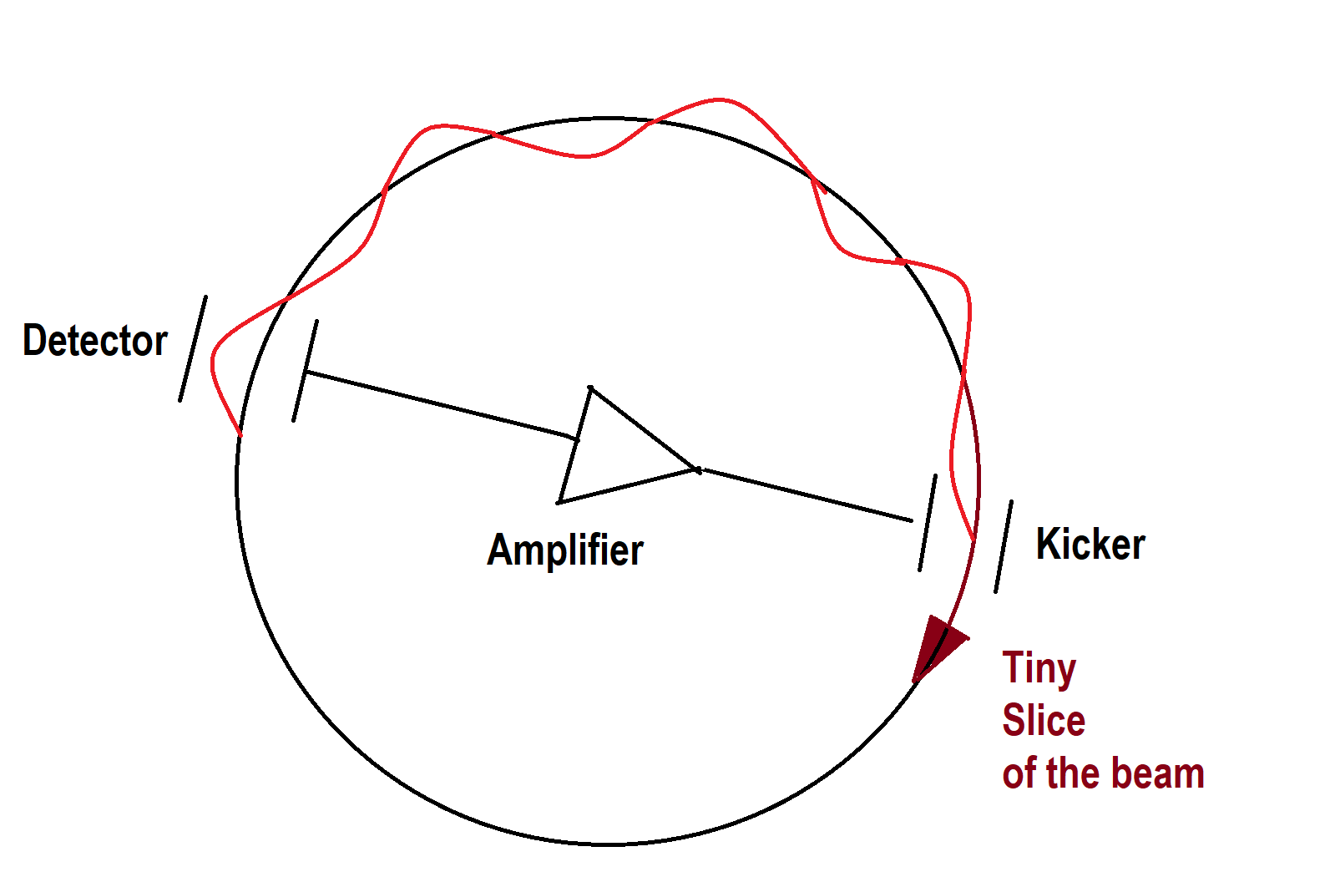
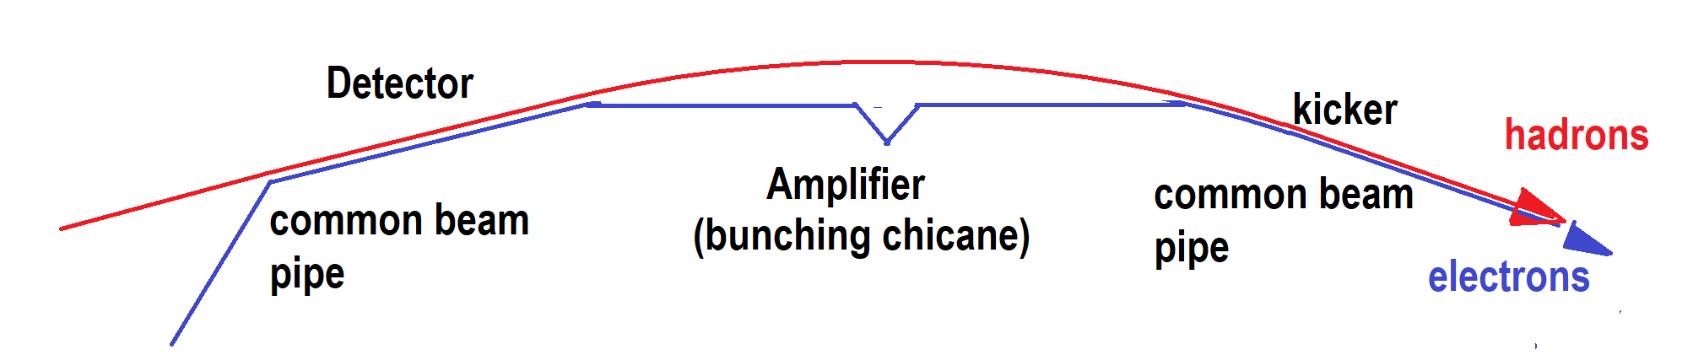
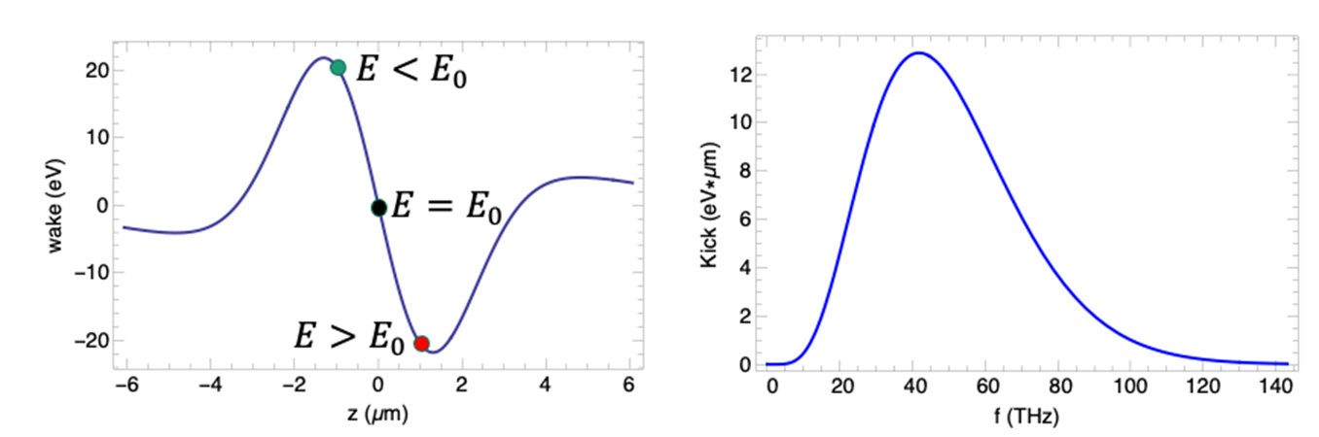
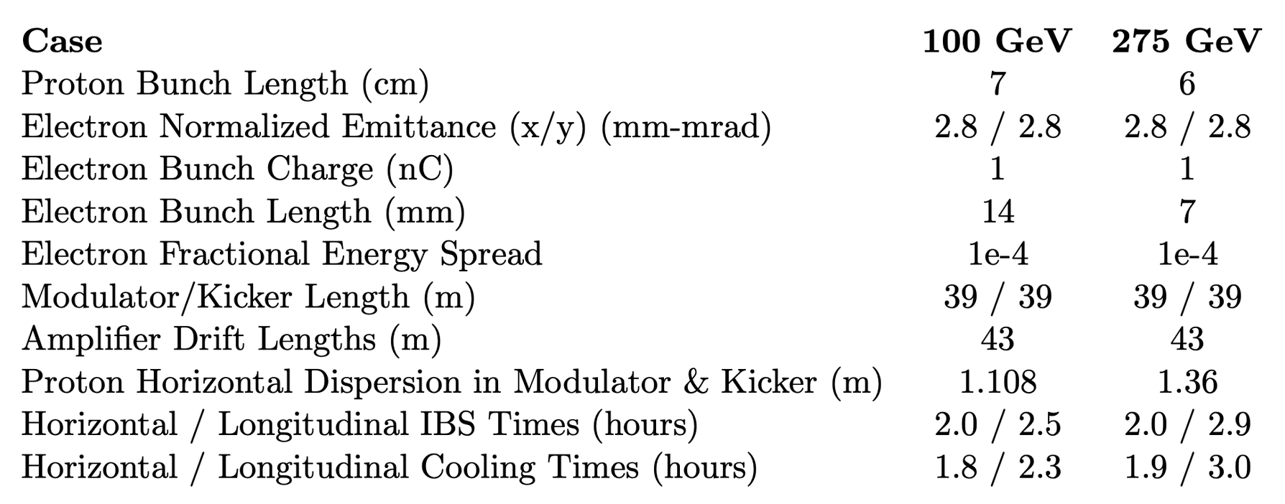
Possible EIC upgrade: proton cooling at collisions
H⁺
E<E₀
E>E₀
Modulator
Kicker
R₅₆
R₅₆
R₅₆
e⁻
The primary concept in the 2021 EIC CDR was based on coherent electron cooling with microbunching amplification
It’s a type of stochastic cooling based on transit time between the modulator and the kicker. Typical bandwidth of ~40 THz, compared to ~10 GHz (conventional SC).
This is a longitudinal-only cooling scheme. Cooling in x and y requires coupling/sharing of cooling.
Pre-cooling at injection energy is still required.

Slide 23
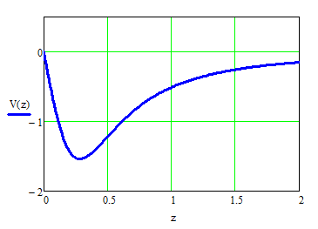
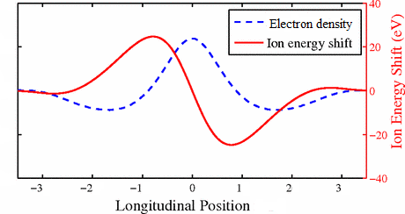
“Cooling” force for a proton at the center of the electron beam
Initial modulation after “Modulator”
Kick in the “Kicker” section
Amplification with
some limited BW
Predicted cooling times of about 1 hour for 275 GeV protons

Slide 24
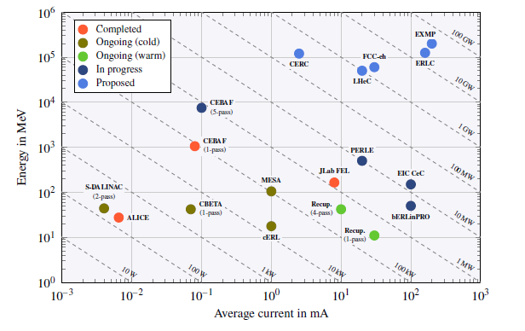
Main challenges of the CEC method
ERL landscape
High-current SCRF ERL
https://arxiv.org/abs/2207.02095
Low-noise electron beam
On-going experiments at BNL/SBU, Fermilab
Controlled broad-band amplification of density fluctuations
Some experience at FELs (narrow band) and CeC (BNL/SBU)
Longitudinal alignment of e-p beams to better than 100 nm over 100 m distance
No clear solution yet…

Slide 25
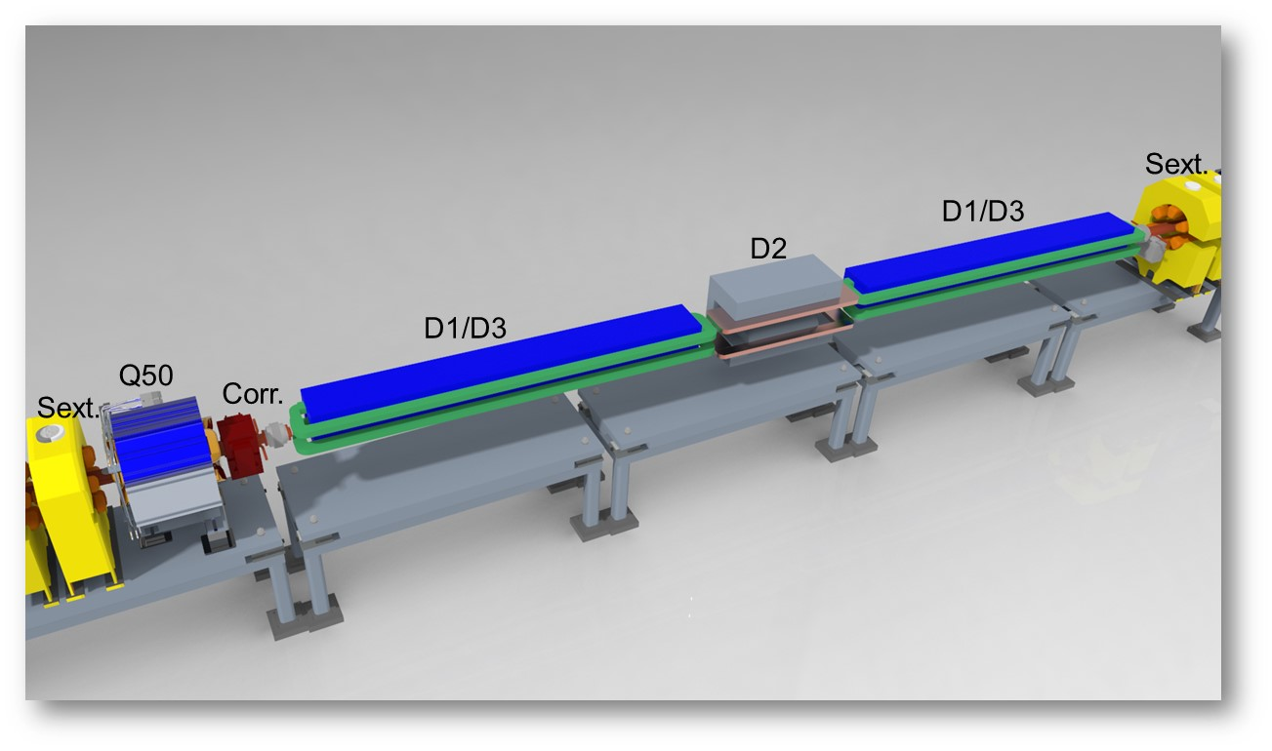
EIC Electron Storage Ring
Electron Storage Ring (ESR) consists of six FODO-cell arcs, and six straight sections (IRs)
High-intensity (28 nC), short (7 mm) bunches
add many interesting accelerator challenges
Circulating beam current ~2.5 A and the synchrotron
radiation power of ~10MW
HSR
EIC needs nearly constant (20 to 24 nm) emittance from
5 to 18 GeV for optimum luminosity, but equilibrium
emittance in an electron storage ring depends on beam energy.
We will use ‘super bends’ (reverse bends) for emittance
control below 10 GeV

Slide 26
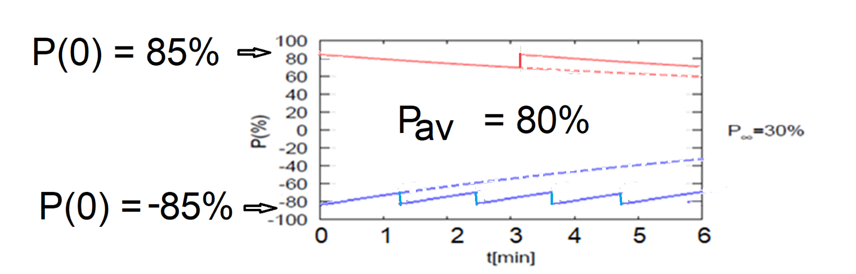
Electron polarization loss in the ESR
Frequent swap-out injection of bunches with high initial polarization of 85%
Bunch spacing is ~10 ns
Initial polarization decays towards P∞
At 18 GeV, every bunch is replaced (on average) after 2.2 min with RCS cycling rate of 1Hz
B P
B P
Refilled every 3.2 minutes
Refilled every 1.2 minutes
Re-injection
P_{av}=80%
P∞= 30%
(conservative)
P_{av}=80%
Re-injections

Slide 27
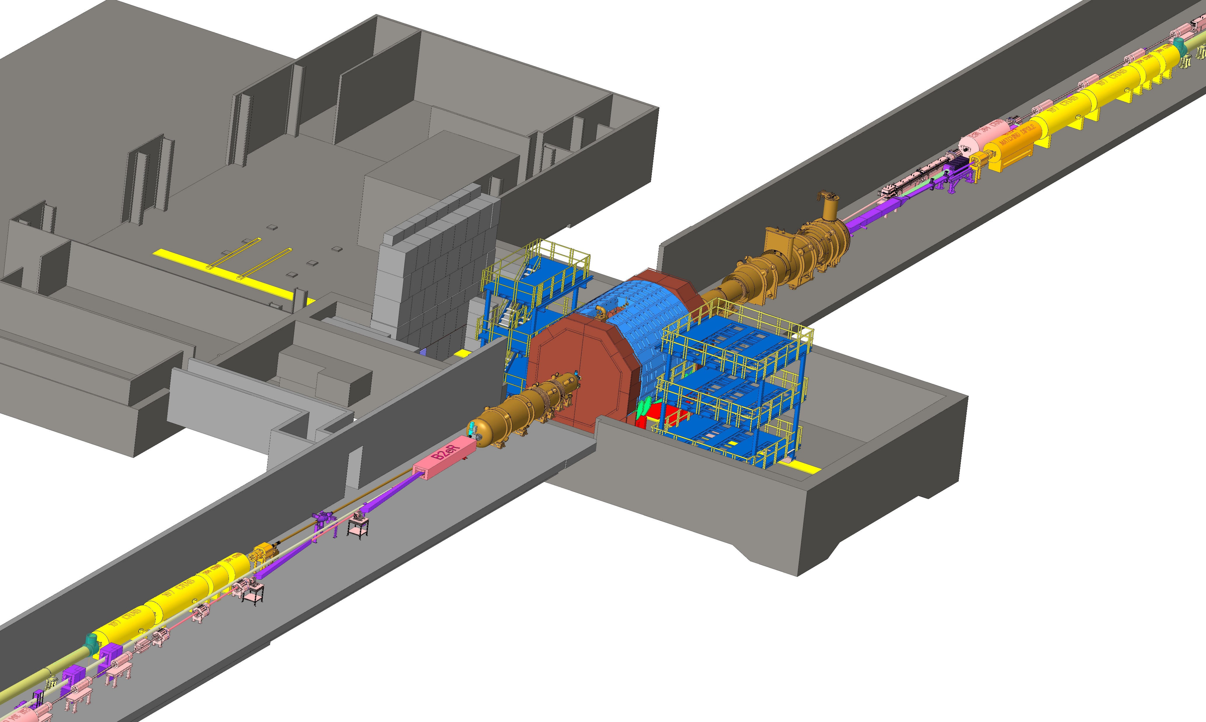
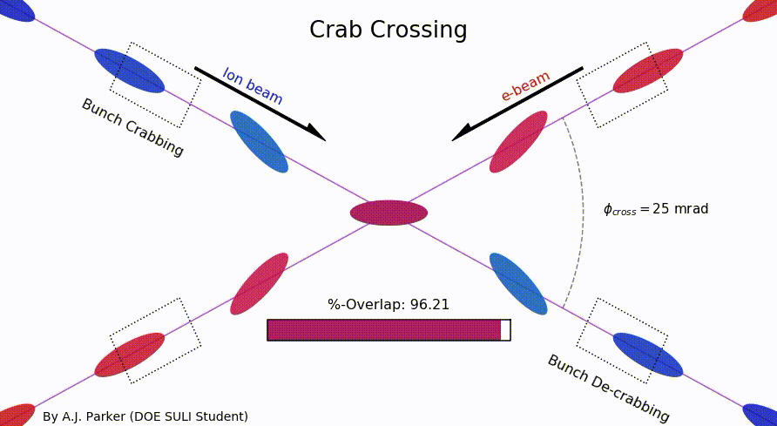
EIC IR Layout
High Luminosity:
25 mrad crossing angle
Small β* for high luminosity
with limited IR chromaticity contributions
Large final focus quadrupole aperture
Machine Detector Interface
Large detector acceptance
Forward spectrometer
No magnets within - 4.5 / +5 m from IP
Space for luminosity detector, neutron detector, “Roman Pots”

Slide 28
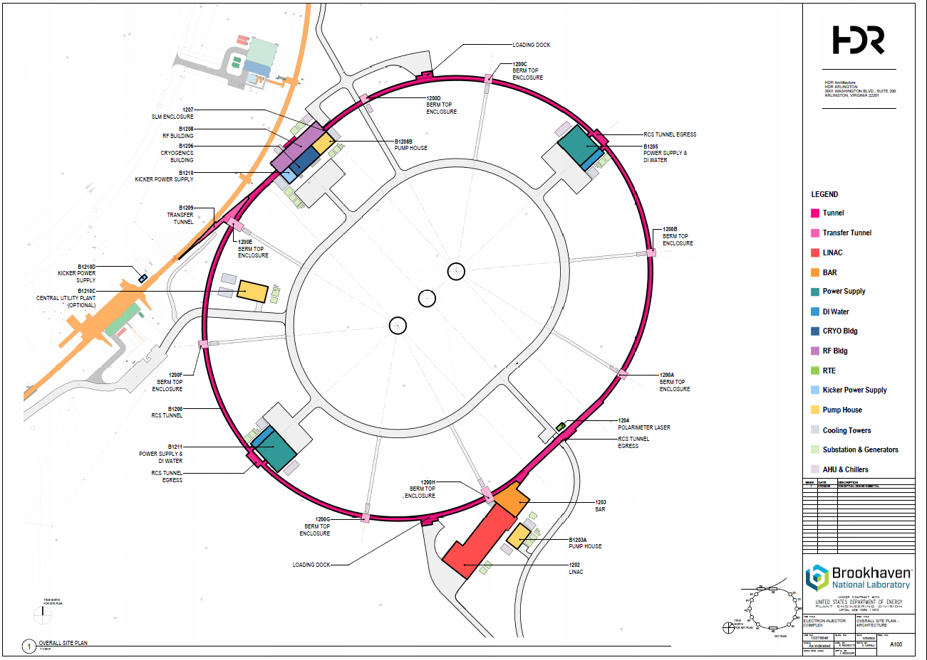
Electron Injector

Slide 29
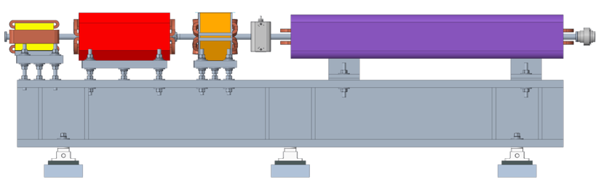
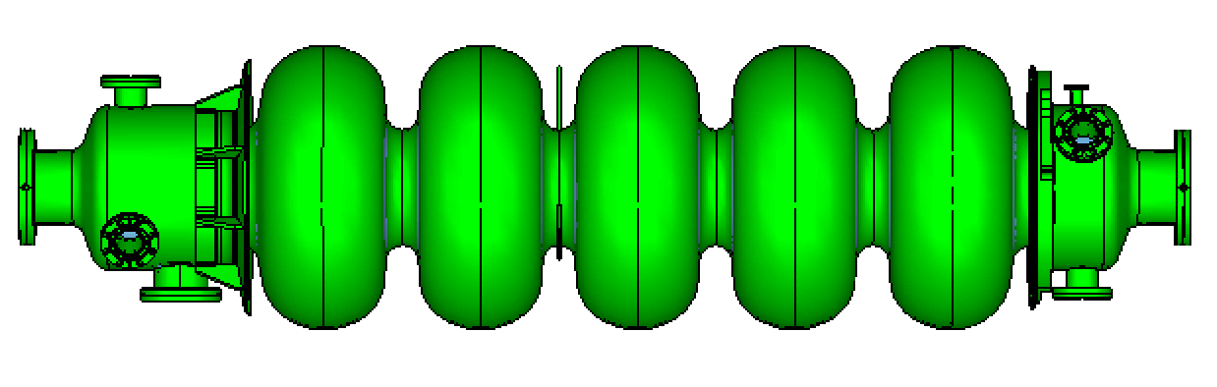
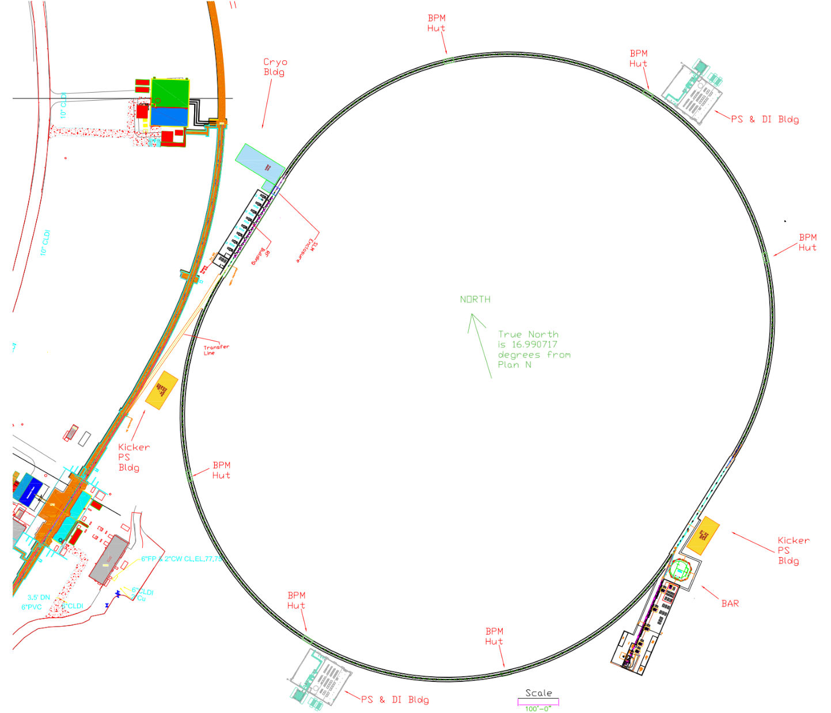
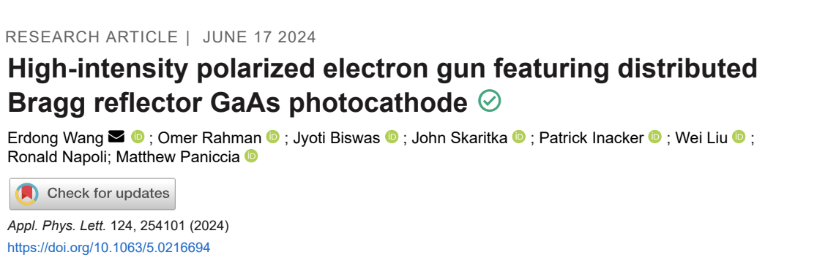
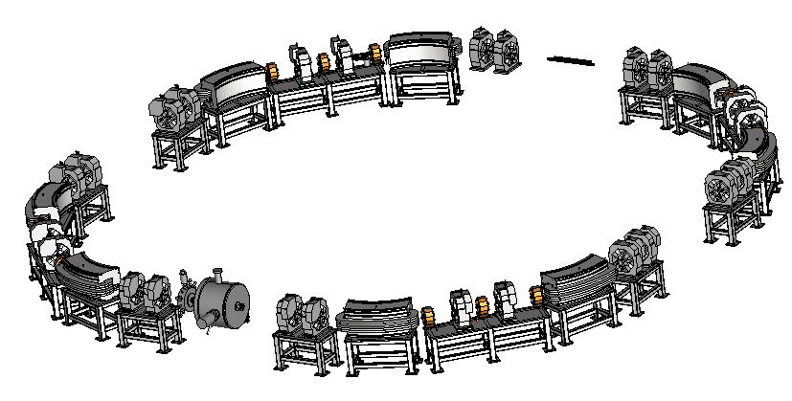
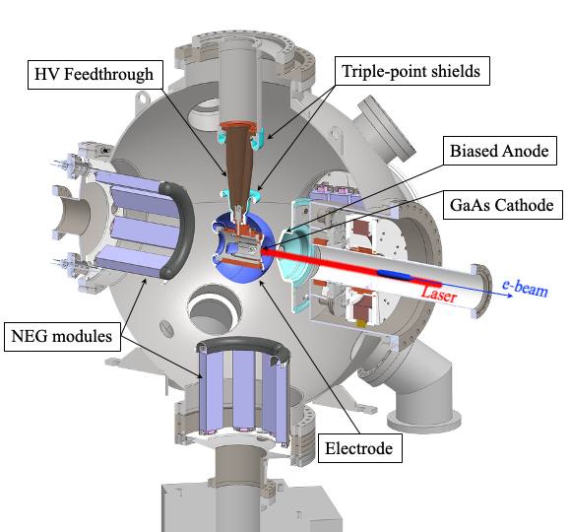
Electron Injector
Concept modeled after the ANL APS-U injector
Function: Deliver electron bunches of up to 28 nC at a 1 Hz repetition rate for injection into the ESR at various energies of 5 – 18 GeV.
RCS magnet assembly
Vacuum chamber: stainless steel, copper coated (50 um)
RCS SRF Cavity, 591 MHz
RCS
750 MeV – 18 GeV
28 nC, 1 Hz
85% polarization
1.4 km
Beam Accumulator Ring
750 MeV, 40 m
Polarized Electron Gun
1-nC, 30 Hz
S-band linac, 750 MeV, 30 Hz, 1 nC single bunch

Slide 30


Present EIC Concept (2025)
Ultimate EIC Performance Parameters:
High Luminosity: L= 10³³ – 10³⁴cm⁻²sec⁻¹
Highly Polarized Beams: 70%
Large Center of Mass Energy Range: Ecm = 28 – 140 GeV
Large Ion Species Range: protons – Uranium
Large Detector Forward Acceptance and Low-Background Conditions
Possibility to Implement a Second Interaction Region (IR)
Accelerator Status at a glance:
Polarized ion/proton source
Ion injection and initial acceleration systems – Linac (200 MeV), Booster (1.5 GeV), AGS (25 GeV)
Hadron Storage Ring (40-275 GeV) – HSR
Electron Pre-Injector (750 MeV linac)
Beam Accumulation Ring (750 MeV) – BAR
Electron Rapid Cycling Synchrotron (0.75 GeV – top energy) – RCS
Electron Storage Ring (5 GeV – 18 GeV) – ESR
Interaction Region(s) – IR
Hadron Cooling System
Protons: ~40 – 275 GeV
Electrons: 5 – 18 GeV
30

Slide 31
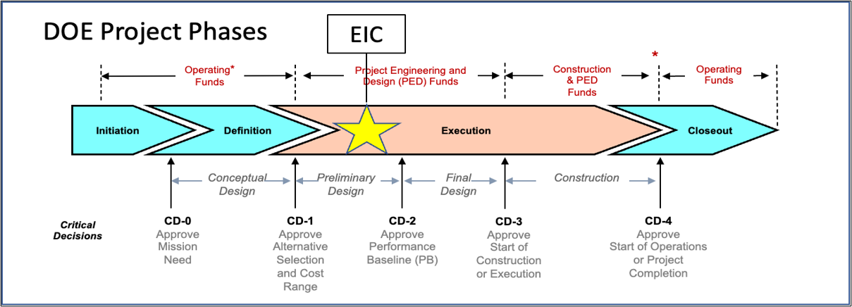
EIC Project: Critical Decisions and Plans
2019
2021
CD-2 and CD-3 in Preparation
CD-4 EF = 2034
CD-3A, Long-Lead Procurement, approved March 2024. Excellent use of IRA funding.
CD-3B, Long-Lead Procurement, approval planned for 2025.

Slide 32
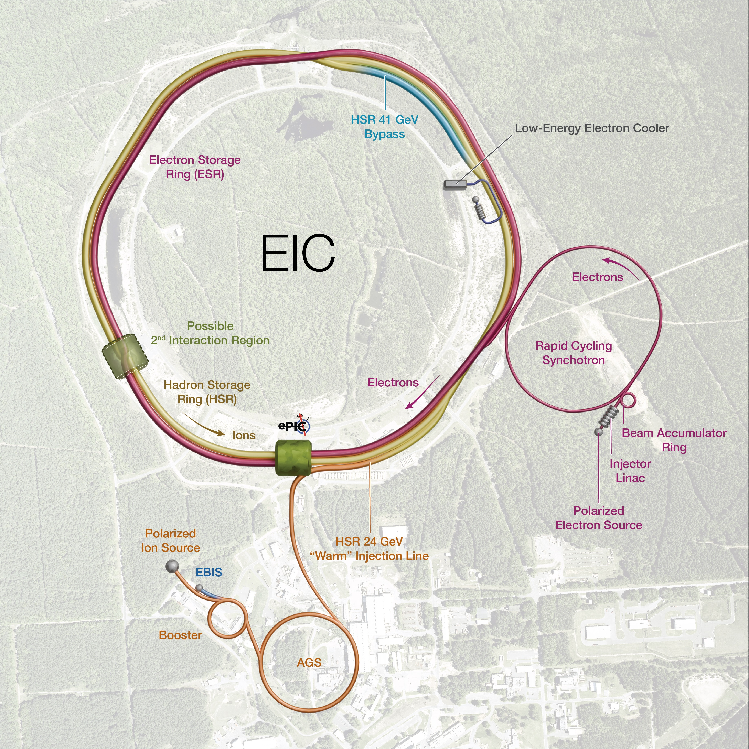
Subproject Strategy
Subproject strategy follows the maturity status
Accelerator Storage Rings (lowest risk)
Detector
IR
Electron Injector
Start Science Program
Energy and Luminosity Ramp-up
Integrated Project Office and Global Commissioning
Subprojects minimize dependencies, create well-defined interfaces, and well-defined physical boundaries.
The roll-up of subproject scope progressively elaborate a complete EIC facility.
CM
CM
CM
Cryoplant & Bldg

Slide 33
Proposal for EIC Science Program in the First Years
Year - 1
Year - 2
Year - 3
Year - 4
Year - 5
Start EIC Science
New Capability:
Commission electron polarization in parallel
Collider:
10 GeV electrons on 115 GeV/u heavy ion beams (Ag or Nb)
+Long. electron polarization
New Capability:
Commission proton polarization in parallel
Collider (base goal):
10 GeV long. polarized electrons on 130 GeV/u Deuterium
Collider (stretch goal):
Last weeks: 10 GeV long. polarized electrons and 130 GeV polarized protons
+Long. electron polarization
+ Proton polarization
New Capability:
Commission hadron spin rotators
Collider (base goal):
10 GeV long. polarized electrons on 130 GeV transverse-polarized protons
Collider (stretch goal):
Last weeks switch to longitudinal proton polarization
+ Long. electron polarization
+ Proton polarization
+ Hadron spin rotators
New Capability:
Commission hadron accelerator to operate with off-center orbits
Collider (base goal):
10 GeV long. polarized electrons on 100 GeV Au
Collider (stretch goal):
10 GeV long. polarized electrons on 250 GeV transverse and longitudinal polarized protons
+ Long. electron polarization
+ Proton polarization
+ Hadron spin rotators
+ Hadron beams with off-center orbits
Collider (base goal):
10 GeV long. polarized electrons on 100 GeV Au
Collider (stretch goal):
10 GeV long. polarized electrons on 166 GeV transverse and longitudinal polarized He-3
Time to construct the ELR subproject

Slide 34
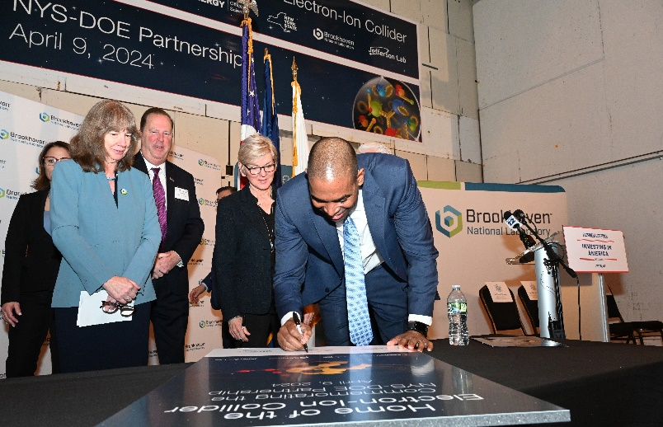
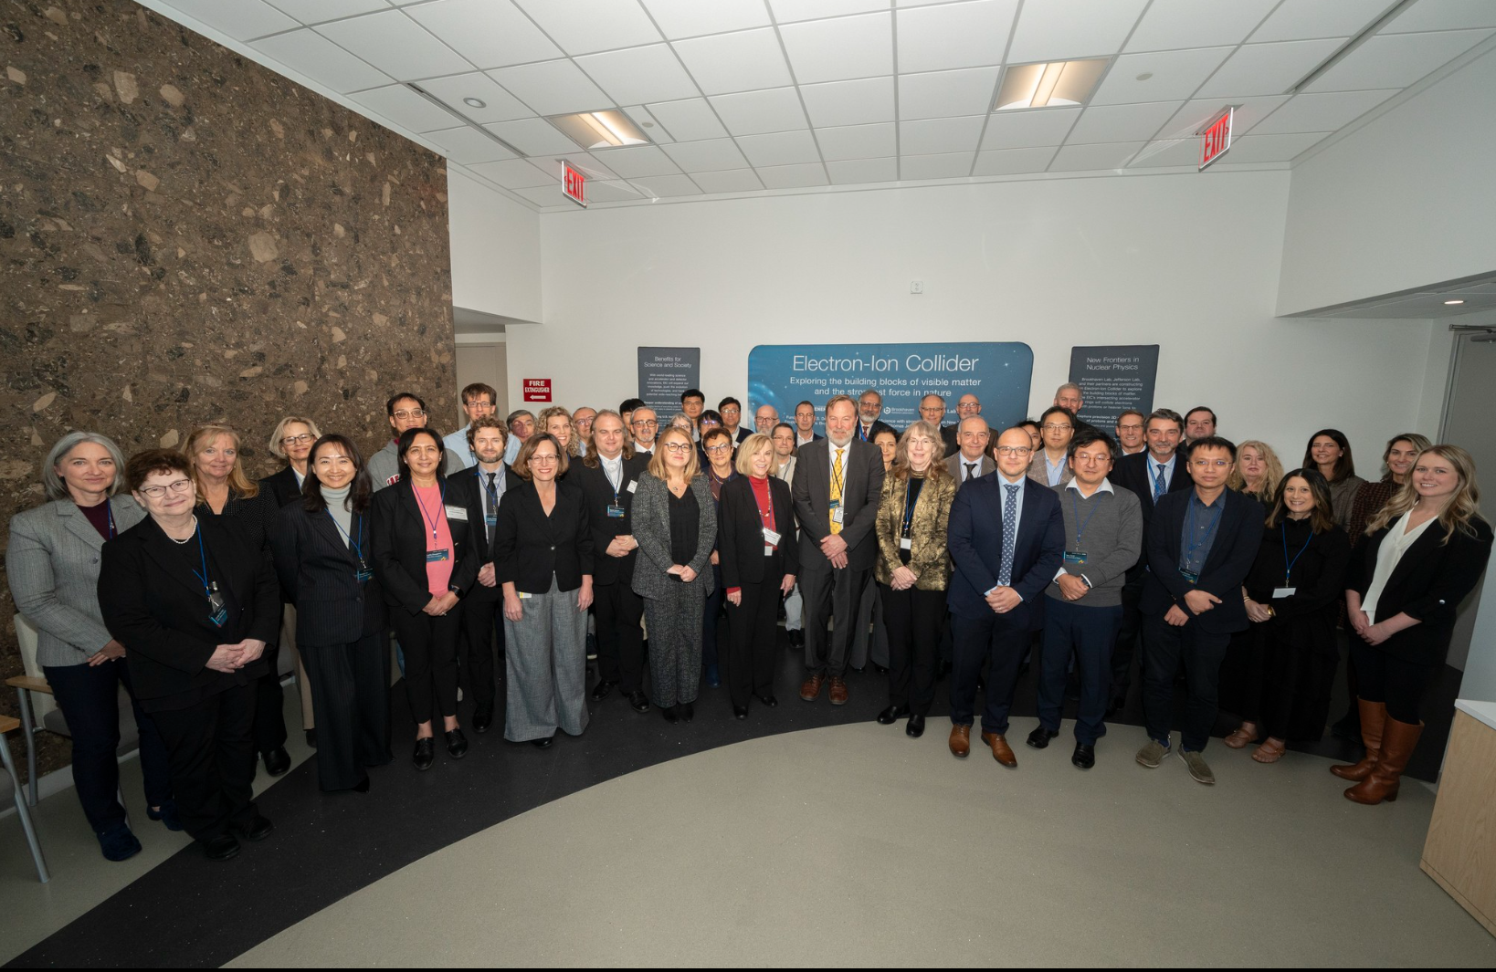

Strong Support from Partners & Collaborators
New York State committed $100M toward construction of EIC buildings and infrastructure.
EIC Accelerator Collaboration kicked off at IPAC’24 with over 150 participants expressing interest in contributing to the global EIC effort.
UK announced £58 million ($75M) for the EIC.
EIC Resource Review Board Meetings in Rome in May 2024 and at BNL in Oct. 2024. Strong participation from Canada, Czech Republic, France, India, Israel, Italy, Japan, Poland, South Korea, United Kingdom, and Taiwan. Recent meeting held in Prague in June 2025.
In-kind contribution goals represent ~30% of the Detector and ~5% of the Accelerator
34
34
34

Slide 35
Summary
EIC is a unique, high-energy, high-luminosity, polarized beam collider that will be one of the most challenging and exciting accelerator complexes ever built – the only new collider in the next decades.
All EIC design elements are progressing well!
Some project scope is well developed, designs are mature, ready to be executed as Long-lead procurements
Implementing sub-projects as our scope delivery strategy
We made several project design decisions to increase the design maturity and decrease risks.
There is no change to the current preliminary performance parameters and no change to the EIC cost objective.
We understand what we need to build in order to deliver the EIC!

