Slide 1


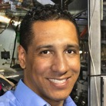

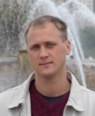

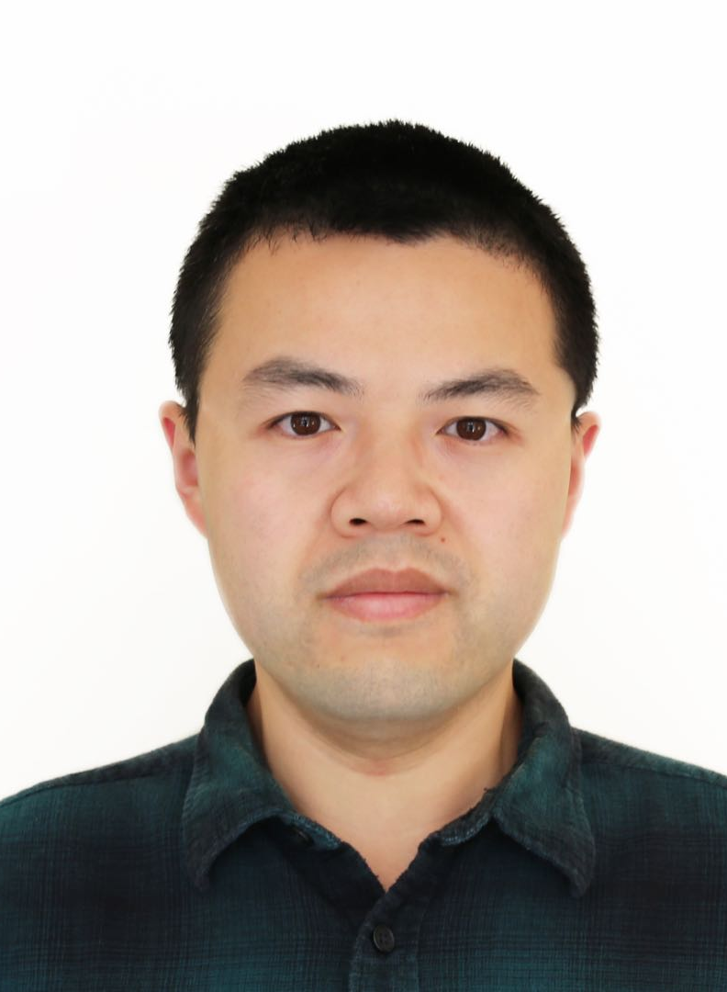





Results of the Coherent electron Cooling experiment at RHIC
Vladimir N Litvinenko, for CeC project team:
Nikhil Bachhawat, Jean Clifford Brutus, Yichao Jing, Dmitry Kayran, Jun Ma, Igor Pinayev, and Gang Wang
Stony Brook University and Brookhaven National Laboratory
COOL’25 Workshop, Stony Brook University, NY, USA – October 27, 2025

Slide 2
What is Coherent electron Cooling (CeC)
It is stochastic cooling of hadron beams with bandwidth at optical wave frequencies: 1 – 1000 THz. All CeC systems are based on the identical principles:
Hadrons create density modulation in co-propagating electron beam
Density modulation is amplified using broad-band (microbunching) instability
Time-of-flight dependence on the hadron’s energy results in energy correction and in the longitudinal cooling.
Transverse cooling is enforced by coupling to longitudinal degrees of freedom.
Amplification
Momentum correction
Imprint by hadrons

Slide 3
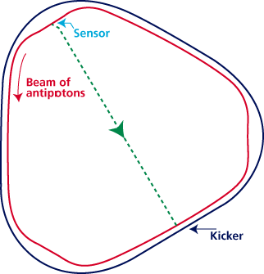
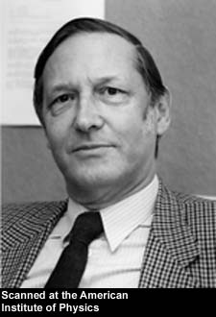
Critical conditions for the stochastic cooler
Linearity: Amplifier must be linear (no saturation) and low noise
Overlapping: Amplified signal induced by individual particle in the modulator (pick-up, sensor) must overlap with the particle in the kicker
Bandwidth: Cooling decrement per turn can not exceed 1/N_{s}, where N_{s} is number of the particles fitting inside the response time of the system: τ~ 1/Δf
Noise: noise in the system should not significantly exceed system signal introduced by shot noise in the hadron beam
S. van der Meer
1984 Nobel physics prize
RF stochastic cooling is reaching its limits at ~ 10 GHz bandwidth
S. van der Meer, Rev. Mod.Phys. 57, (1985) p.689
S. van der Meer, 1972, Stochastic cooling of betatron oscillations is ISR, CERN/ISR-PO/72-31
Notes:
Can it work for a bunched beam?

Slide 4
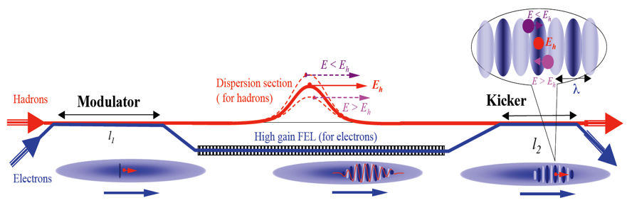
CeC schemes
Linearity: Amplifier must be linear (no saturation) and low noise
Overlapping: Amplified signal induced by individual particle in the modulator (pick-up, sensor) must overlap with the particle in the kicker
Bandwidth: Cooling decrement per turn can not exceed 1/N_{s}, where N_{s} is number of the particles fitting inside the response time of the system: τ~ 1/Δf
Noise: noise in the system should not significantly exceed system signal introduced by shot noise in the hadron beam
Litvinenko, Derbenev, PRL 2008
Can be tested experimentally at RHIC
High gain FEL amplifier
Ratner, PRL 2013
Multi- Chicane
Microbunching amplifier
Cooling test would require significant modification of the RHIC lattice & superconducting magnets
Litvinenko, Wang, Kayran, Jing, Ma, 2017
Plasma cascade
micro-bunching amplifier
Plasma-Cascade Microbunching amplifier

Slide 5
What is PCA? : Parametric instability caused by strong transverse focusing
“Standard” 4-cell PCA
Optimized PCA cell
Cell
PCA Gain per cell
Current
experiment
CeC for
275 GeV
EIC
Simulations of Coherent Electron Cooling with Two Types of Amplifiers, Jun Ma, Gang Wang, Vladimir Litvinenko, International Journal of Modern Physics A (IJMPA), Vol. 34 (2019) 1942029 (
Plasma-Cascade micro-bunching Amplifier and Coherent electron Cooling of a Hadron Beams, V.N. Litvinenko, G. Wang, D. Kayran, Y. Jing, J. Ma, I. Pinayev, arXiv preprint arXiv:1802.08677, 2018
Results of 3D simulations
with code SPACE
11

Slide 6
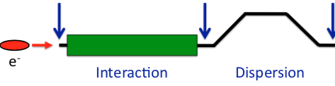
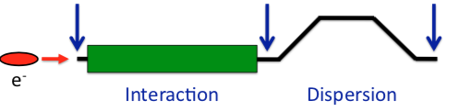
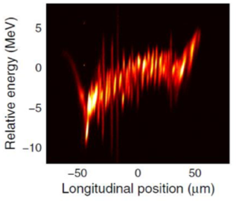
What is Plasma-Cascade Instability (PCI)? How is it different from the previously known micro-bunching instability (MBI)?
Kick
Drift
Kick
Drift
Kick
Drift
a(s)
R₅₆=L_{b}θ²
© D. Ratner
Kick
Drift
Kick
Drift
R ₅₆ =L_{d}/γ²
Interaction
Interaction
Dispersion
Dispersion
Dispersion
MBI
PCI
MBI: modulate effective mass (s-mobility) by bending beam trajectory (θ)
Modulate beam density by
changing beam radius
CeC
accelerator
PCI experiment
LCLS
5
0
5
Longitudinal position, psec
Both instabilities can be used a broad-band amplifier in CeC
8

Slide 7
CeC X at RHIC
2014-2017: built cryogenic system, SRF accelerator and FEL for CeC experiment
2018: started experiment with the FEL-based CeC. It was not completed: 28 mm aperture of the helical wigglers was insufficient for RHIC program with low energy 3.85 GeV/u Au ion beams
We discovered microbunching Plasma Cascade Instability - new type of instability in linear accelerators. Developed design of Plasma Cascade Amplifier (PCA) for CeC
In 2019-2020 a PCA-based CeC with seven solenoids and vacuum pipe with 75 mm aperture was built and commissioned. During Run 20, we demonstrated high gain Plasma Cascade Amplifier (PCA) and observed presence of ion imprint in the electron beam
We observed regular e-cooling in Run 21, but CeC cooling was washed out by large timing jitter of the seed laser and resulting 0.35% RMS e-beam energy jitter

Slide 8
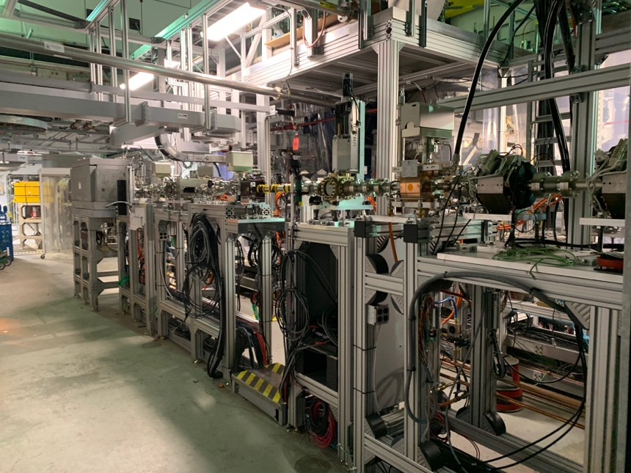
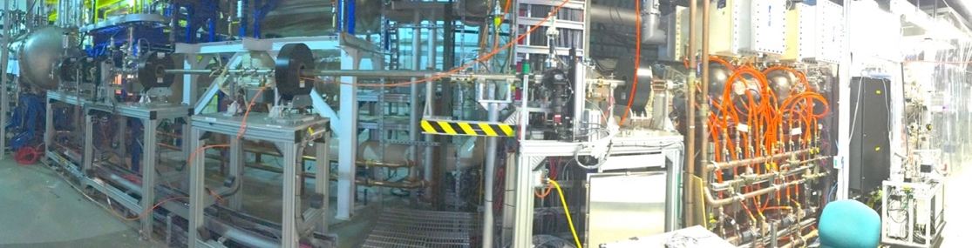
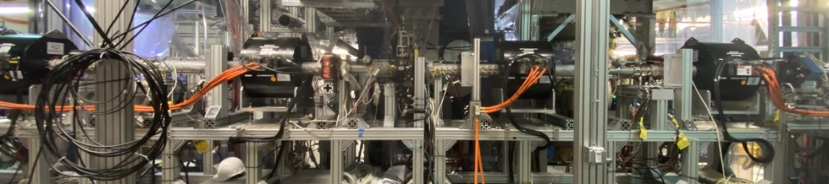
Unique SRF accelerator and CeC amplifier
1.25 MV SRF
photoelectron gun
CeC section – common with RHIC ion beam
13 MV SRF linac
10-20X
ballistic bunch compression
Time-resolved diagnostics beamline
Bunching cavity
Kicker
4-cell Plasma-Cascade Amplifier
Modulator

Slide 9
Main results obtained up to the date
Imprint of ion beam
We observed high gain in FEL system used for early version of CeC
We observed imprint of ion beam in the electron beam radiation
We observed high PCA gain at frequencies between 5 and 10 THz
We observed regular electron cooling – albeit very week – of 26.5 GeV/u ion beam – the highest energy electron cooling
We observed recombination between elections from CeC accelerator and 26.5 GeV/u ions
Beam parameters are either on the target – we are ready for CeC demonstration
Exponential rise of PCA gain
Recombination signal

Slide 10
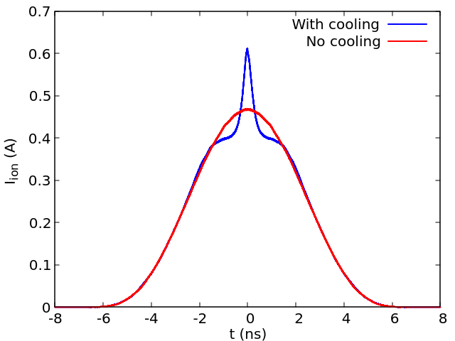
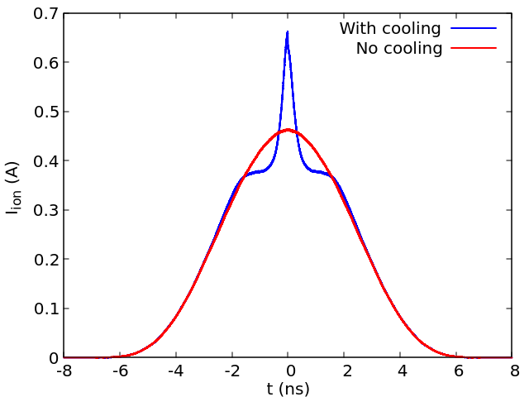
New mode of operation for Run 25
To maximize chances for success, we developed new mode of operation below the RHIC transition energy.
Lower energy of operation would provide for better quality of ion beam, easier choice for electron beam parameters and better stability
This mode of operation would also provide for significantly faster cooling
We plan to cool low intensity ion bunches to speed-up the studies
Simulation of cooling on the bunch with 2x10⁸ ions
after 4 minutes
after 8 minutes

Slide 11
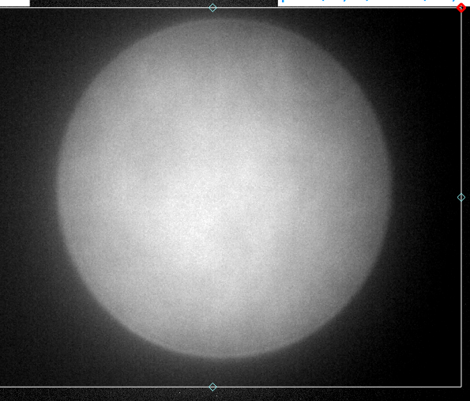
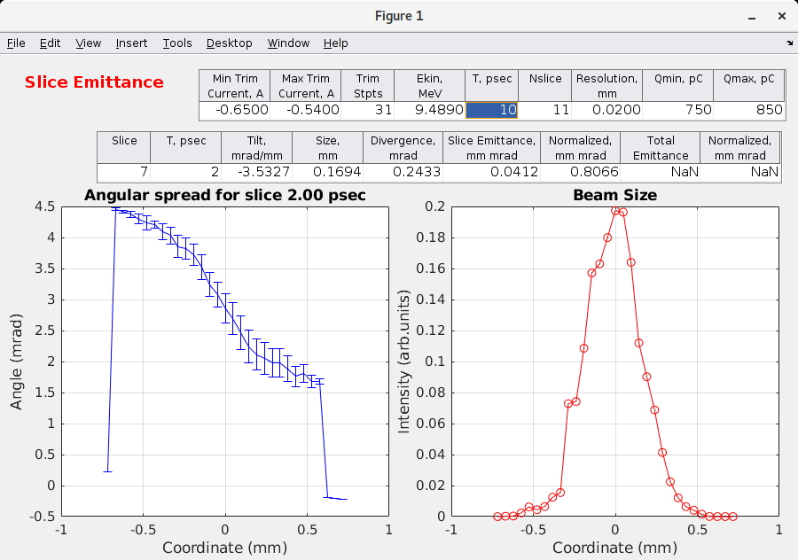
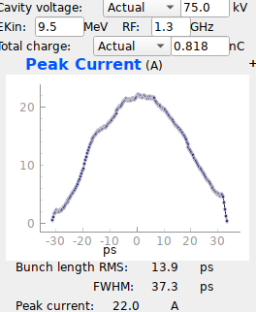
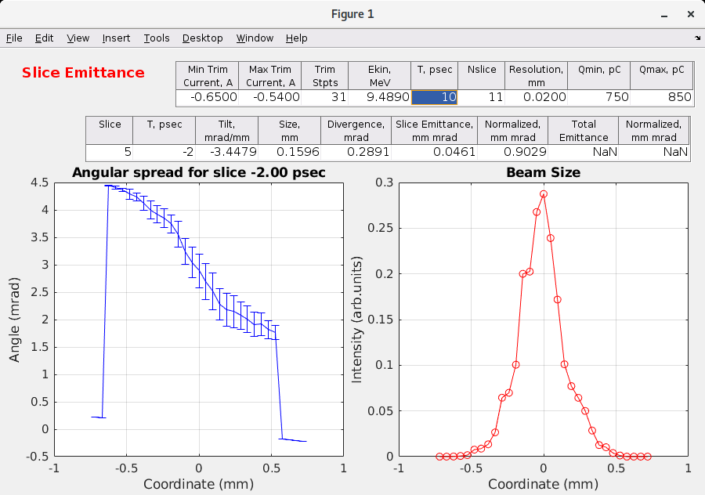
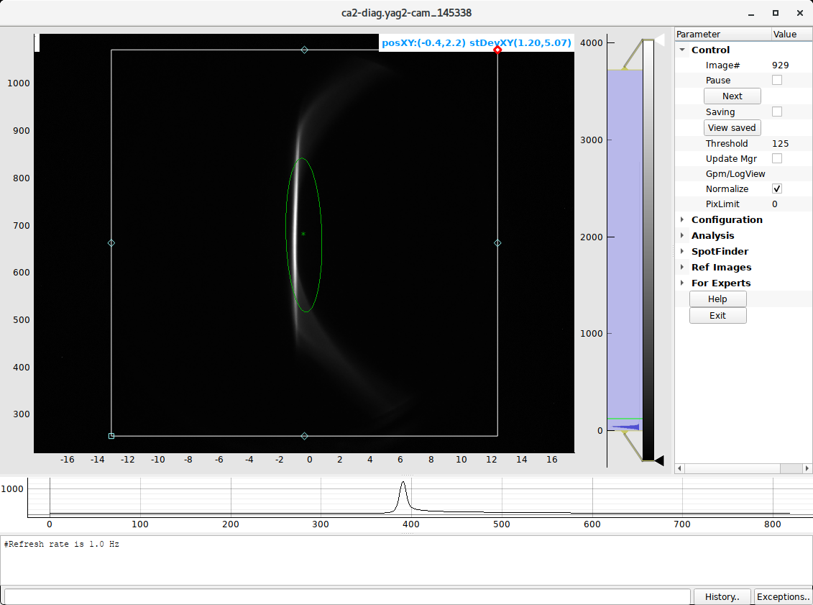
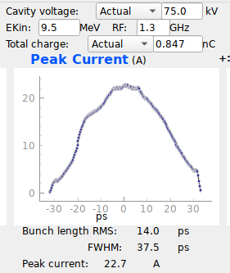
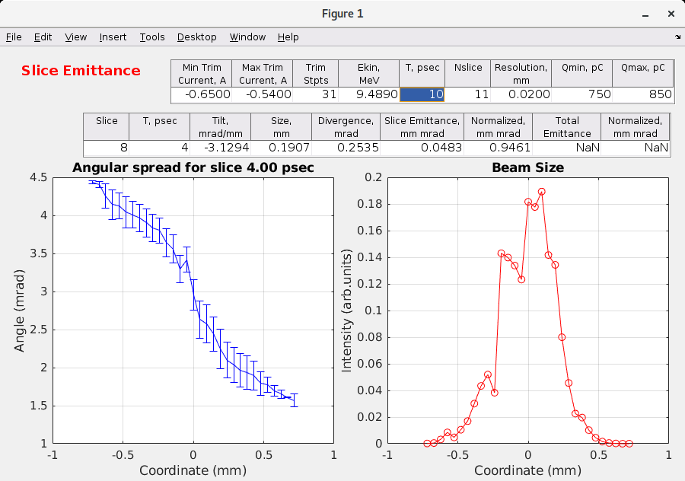
Simulations are goon but experimental data is more important: CeC operates with electron beam beam parameters equal to better than the requirements: sample from September 18, 2025
Required: ε_{norm} < 1.25 μm
0.807 μm
Peak current: >20 A
Δγ/γ =3.5 10⁻⁴
Time, psec
70
0.903 μm
Δγ/γ=10⁻⁴
0.946 μm
0
γ

Slide 12
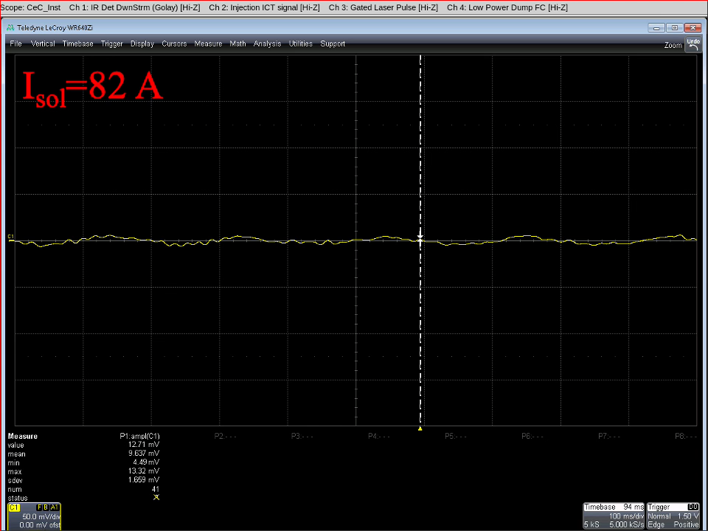
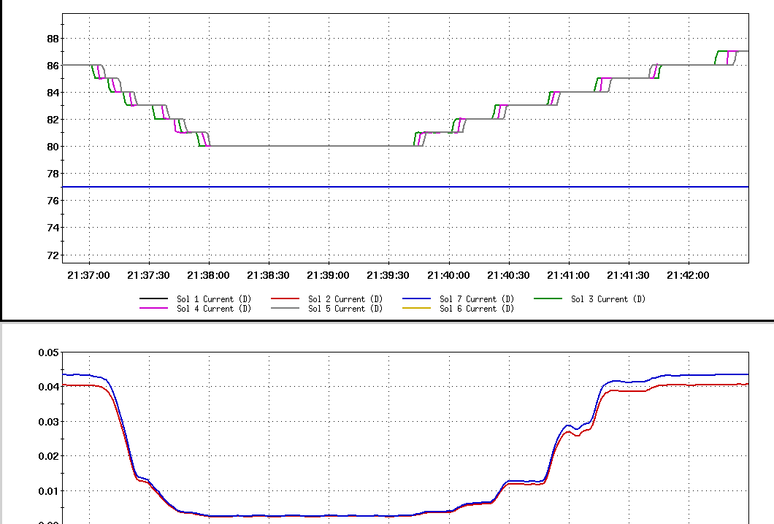
CeC guts: Plasma-Cascade Amplifier (PCA)
RHIC Yellow
Ion beam
Kicker
Plasma-Cascade Amplifier
Modulator
RHIC Yellow
Ion beam
THz radiation
Electrons
Electrons
Plasma-Cascade Amplifier is a parametric amplifier: strong focusing solenoids caused periodic modulation of the beam radius and corresponding modulation of plasma frequency. It results in exponential growth of density modulation induced by ions in the modulator.
Classical PCA: changing strength of PCA solenoids result in dramatic increase of the THz radiation: September 22, 2025
Current in PCA
solenoids
Measured THz power a.u.

Slide 13
Conclusions
Demonstration of Coherent electron Cooling remains a very challenging endeavor
All main components of the CeC process were successfully demonstrated:
Ion’s imprint into the e-beam density modulation
High gain Plasma-Cascade Amplification of the e-beam noise (and ion imprint)
Recombination of ions and electrons with matched relativistic factors
All beam parameters necessary for CeC demonstration are demonstrated
More details are in THA1, THA2 and THA3 talk on Thursday morning by Yichao Jing, Jun Ma and Gang Wang
The CeC accelerator performance is sufficiently stable
We are ready for CeC demonstration
The main challenge is allocation of dedicated time with ion beam for CeC project
In last 3 years CeC has 3.5 hours of time with ion beam at CeC energy
This is the last RHIC run and CeC system will be taken apart after the run ends
Two detectors are completing their physics program and ego to use every hour of RHIC operation
We are not giving up hope and exploring every possibility for a limited number of shifts for CeC demonstration
I want to thank everybody who participated and participating in CeC project: RHIC operators, colleagues from Accelerator Physics, RF, Vacuum, Instrumentation, Cryogens, Control, Mechanical systems and ES&F division, cathode team from Instrumentation Department, as well as the CeC operation team, for their dedicated and steadfast support of our attempt to demonstrate this stubbornly resisting phenomenon

Slide 14

Thanks to all involved in the CeC project
… never can get all of your photos…

Slide 15
Back-ups

Slide 16
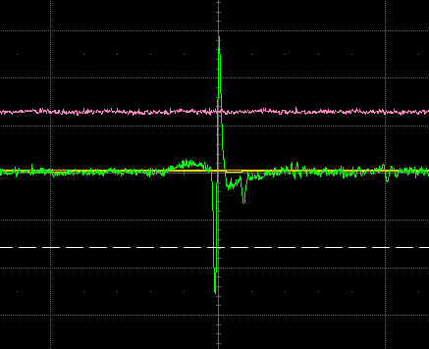
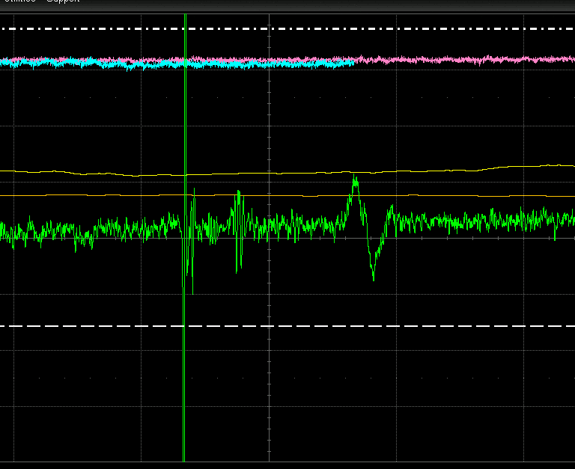
e-beam
Ion beam
Synchronization was achieved by observation of the signal from the BPM pick-up electrode in the FEL section.
Overlap (20 ns, 10 mV per division)
e-beam
Ion beam
No overlap (50 ns, 2 mV per division)

Slide 17
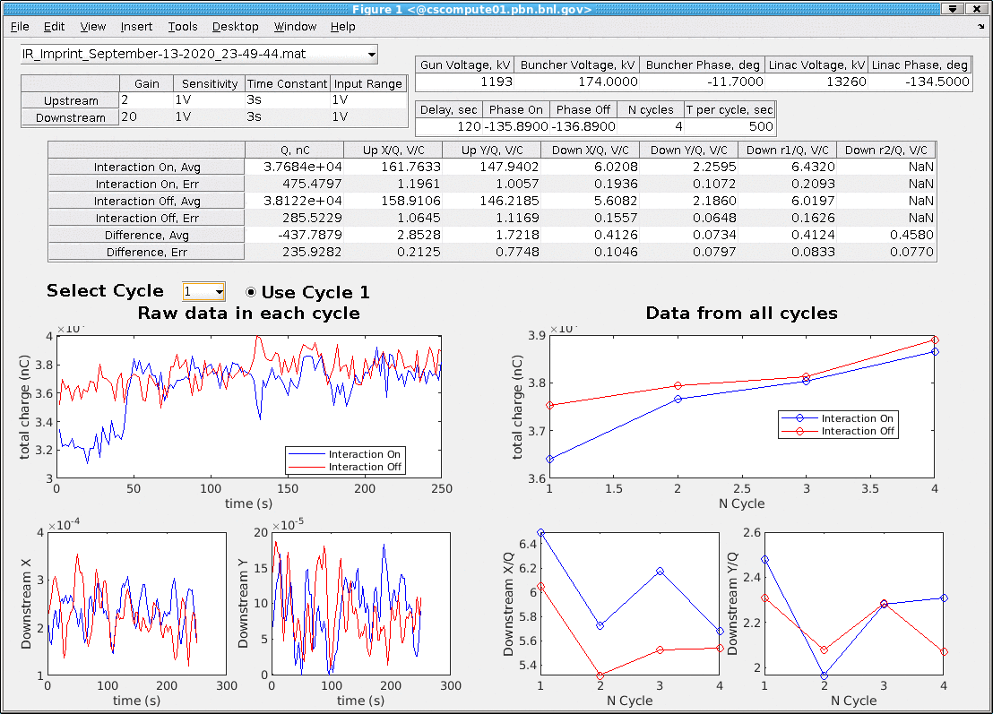
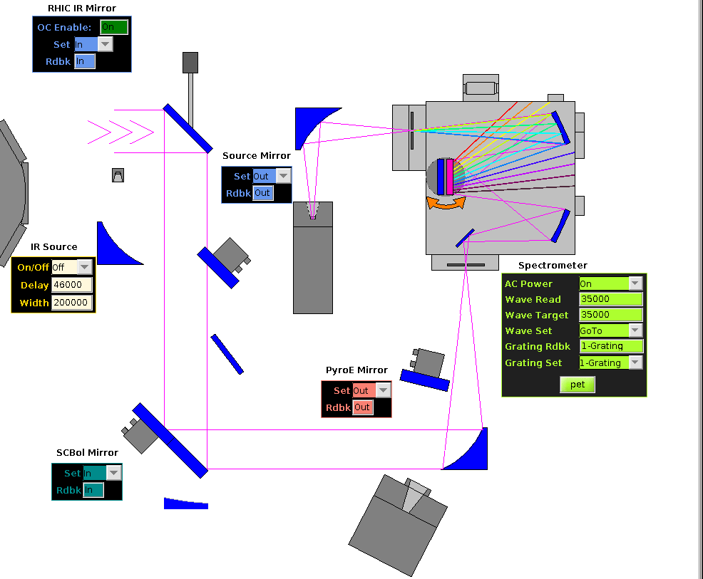
The Ion Imprint studies: Run 2020
✔
We observed clear presence of the ion imprint in the electron beam resulting in increase of the e-beam radiation at 35 μm with average imprint of
We applied PCA to boost radiation at 35 μm at the level detectable by current IR detectors after the spectrometer
Typical “good” measurement:
4 cycles with 500 measurements each
Downstream IR diagnostics
10 m from the radiation point
Upstream
Downstream

Slide 18
Recombination of electrons with Au ions: Run 2021
Experiment
Calculations
Resolution
FWHM, 4%
© of G. Wang
(γ_{e}-γ_{i})/γ_{i}
Triangular shape of the measured dependence allows to define matching of the relativistic factors with accuracy ~ 0.2%, which is significantly smaller than 4% FWHM.
This finding will reduce the range where we need to search for the CeC signature by 5-to-10 fold.
This results include convolution of the exact formula recombination cross-section (in the commoving frame) with distributions of two beams

Slide 19
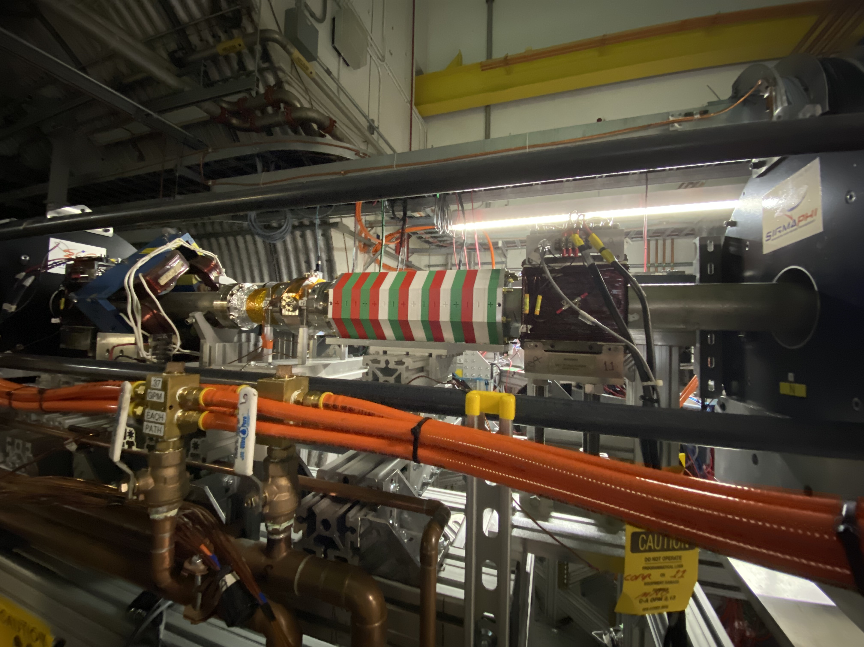
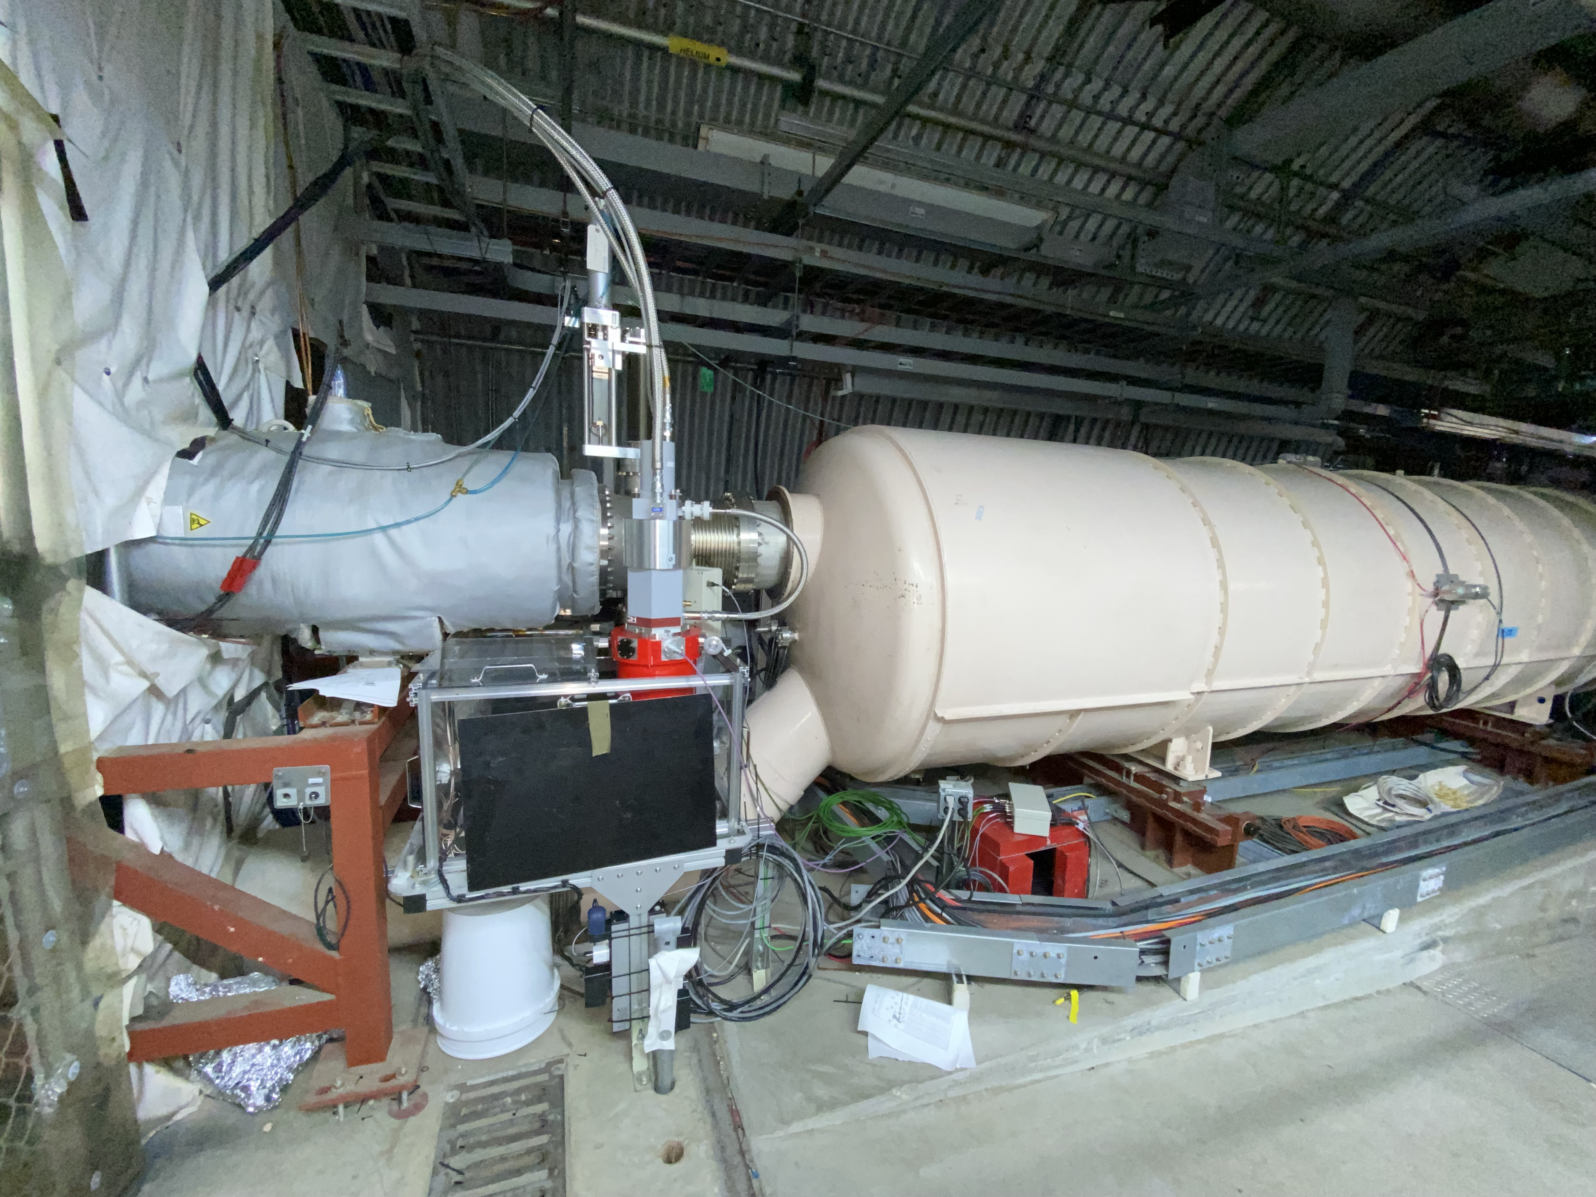
Diagnostics undulator and cryo-cooled IR detector
Parameter | Value | Units
Period | 8 | cm
Gap | 7.9 | cm
Peak field | 0.6 | kGs
Radiated power at 50% beam current | 4 | nW
Fundamental wavelength @ γ=19.57 | 115 | μm
Central frequency @ γ=19.57 | 2.6 | THz
Third harmonic | 7.8 | THz
F₃/F₁ | 0.04
Cryo-cooled and Golay IR detectors
Undulator generates radiation at 7.8 THz harmonic frequency, which is within the bandwidth of the Plasma-Cascade Amplifier (PCA)
This system allow us to optimize the PCA gain

Slide 20
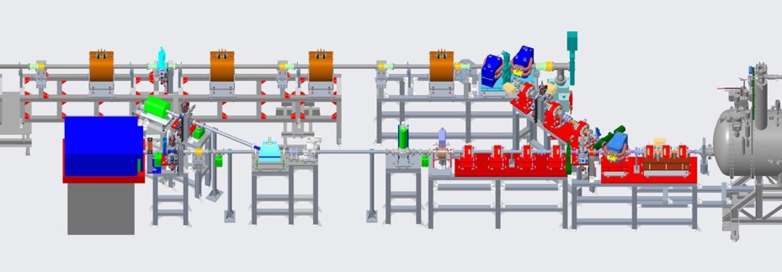

Time-resolve diagnostics beam-line: the key for accurate measurements of beam parameters

Slide 21
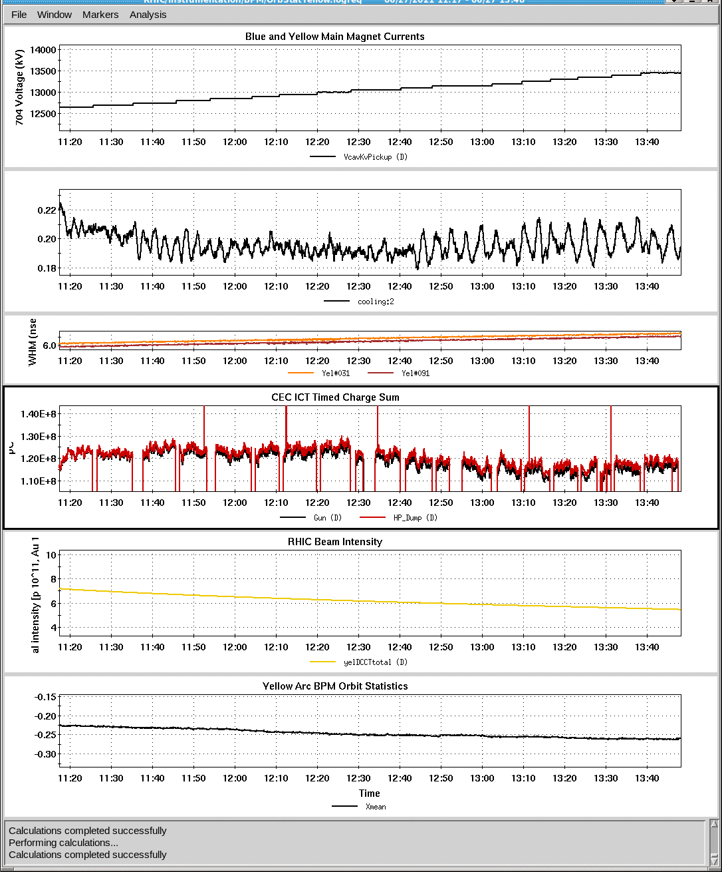
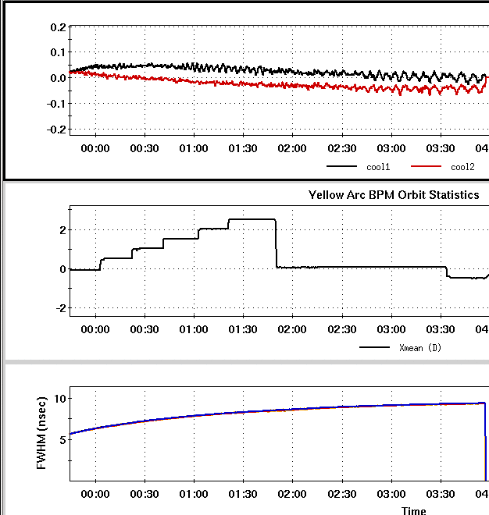
Search for CeC signature and observation of regular bunched electron cooling of 26.5 GeV/u Au ion beam
SRF linac voltage
cooling
e- cooling
No cooling
Ion beam trajectory radius
120 μA
Bunch length
Changing e-beam energy requires multiple adjustments
Adjusting ion beam energy – 1 mm x_{mean} corresponds to 0.1% change in the ion beam energy.
There was no attempt of improving regular non-magnetized electron cooling – we used the lattice optimized for PCA CeC - and the best electron cooling rate was ~ 100 hours. It is consistent with cooling rate estimation made by Dmitry Kayran and 90 hours cooling rate simulated by He Zhao
There is one exception – on the 4th of July CeC evening shift we observed cooling rate of 16 hours: this event is possibly a first indication of the CeC cooling, but it is not conclusive

Slide 22
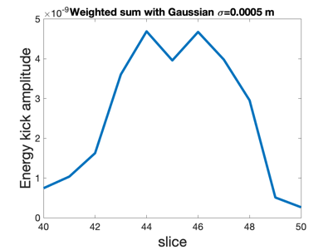
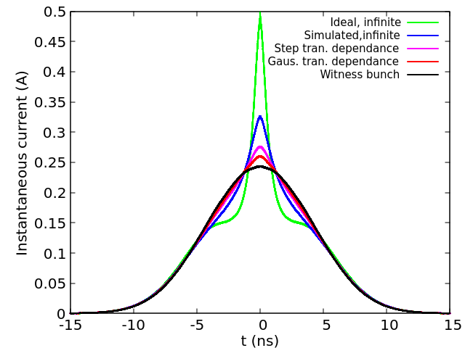
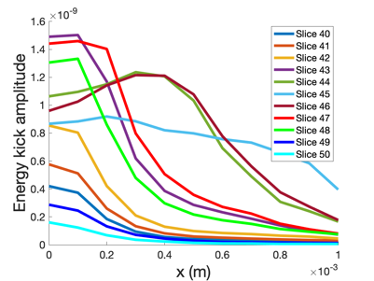
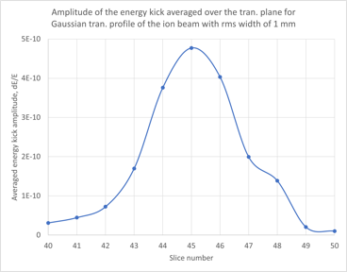
PCA CeC simulations: slice by slice, ion by ion
Simulations of electron beam are down using Impact T/Z code (Y. Jing, K. Shih) provide distribution of electron beam at the entrance of the CeC section
This information is used to simulate interaction of ions with individual slices: PCA gain and kick to ions is calculated as function arrival time and transverse position of ion (SPACE code, J. Ma)
This information is used used to simulate evolution of cooled ion bunch (G. Wang and his code) and compare it with reference (non-interacting) bunch
This is work in progress and preliminary findings will be reported at C-AD MAC next week by Dr. Gang Wang

Slide 23
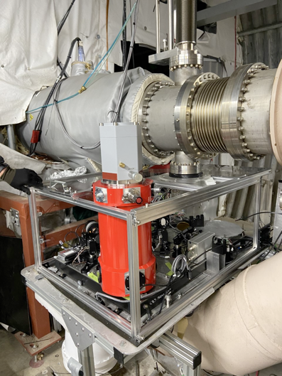
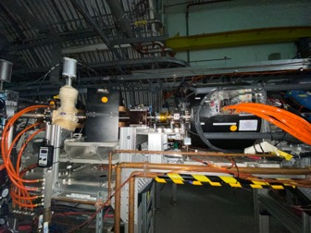
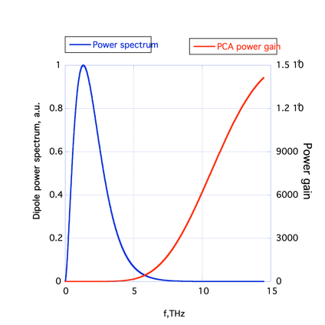
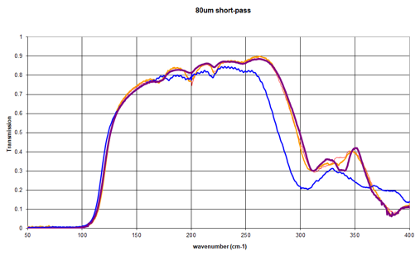
How PCA gain is measured?
10 meters
We used IR radiation from the bending magnet at the exit of the CeC section. Critical frequency of synchrotron radiation from the bending magnet is 0.4 THz
PCA gain peaks at 12THz and there is no gain below 3 THz
IR radiation is intercepted by 2” mirror 10 meters downstream
For there measurements, the radiation was delivered to two most sensitive IR detectors: broad-band Golay cell or cryo-cooled Bolometer.
IR filter with passband of 3.5-10 THz was used in front of the Golay cell to improve sensitivity at high frequencies (see next slide)
Signal from Golay cell was detected by lock-in amplifier synched with the electron bunch pattern (typically 5 Hz, five 100 msec bunch trains per second). We used 3rd order modulation-demodulation (MDM) technique to remove background unrelated to IR radiation, by periodically blocking IR using Mirror 1.
Signal from Bolometer was delivered in unsynchronous mode (140 kilo-samples per second) with respect to electron beam pattern. Analog signal was not available. We developed MatLab application for asynchronous detection of this digital pattern.
PCA gain was evaluated by comparing radiated power in the PCA lattice (strong solenoids) with relaxed lattice (weak solenoids) using the same setting of the CeC accelerator and the electron beam
IR Mirror
Mirror 1
Bolometer
Golay cell
IR filter

Slide 24
Search for CeC signature and observation of regular bunched electron cooling of 26.5 GeV/u Au ion beam
SRF linac voltage
cooling
e- cooling
No cooling
Ion beam trajectory radius
120 μA
Bunch length
Changing e-beam energy requires multiple adjustments
Adjusting ion beam energy – 1 mm x_{mean} corresponds to 0.1% change in the ion beam energy.
There was no attempt of improving regular non-magnetized electron cooling – we used the lattice optimized for PCA CeC - and the best electron cooling rate was ~ 100 hours. It is consistent with cooling rate estimation made by Dmitry Kayran and 90 hours cooling rate simulated by He Zhao
There is one exception – on the 4th of July CeC evening shift we observed cooling rate of 16 hours: this event is possibly a first indication of the CeC cooling, but it is not conclusive

Slide 25
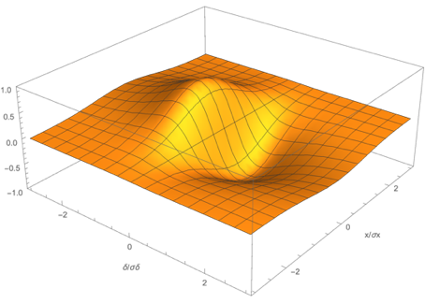
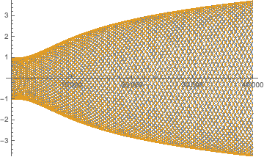
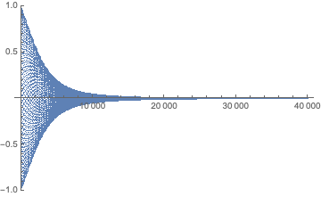
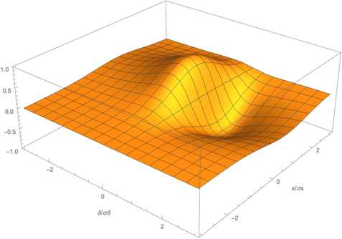
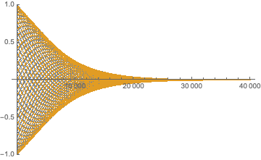
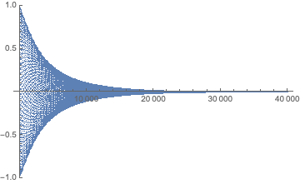
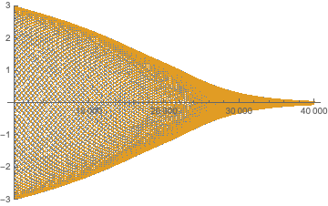
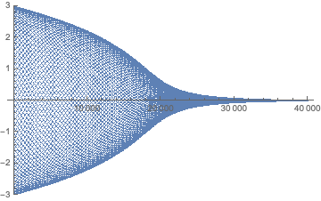
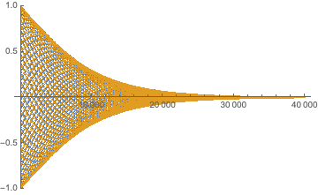
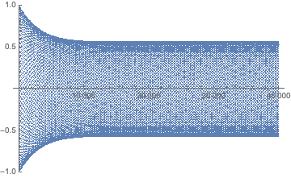
Distribution of cooling between longitudinal and transverse degrees of freedom – real kick
Kick
Wrong sign of displacement Δx = -0.75σ_{x}
δ
δ/σ_{δ}
x/σ_{x}
Δx = 0.75σ_{x}
zero energy kick at 0.4σ_{δ}
Kick
δ
x/σ_{x}
δ/σ_{δ}
Excessive shifting of zero-kick point to δ = 0.6σ_{δ}
Kick
δ
x/σ_{x}
δ/σ_{δ}
x/σ_{x}
δ/σ_{δ}

Slide 26
Distribution of cooling between longitudinal and transverse degrees of freedom – linearized kick
r = 0
r = 0.5
r = -0.5
r = -1
r = -1.5

Slide 27
Linearized case: cooling decrements
We will neglect transverse kicks, which are very weak in CeC
Sorry for repeating trivial formulae from my AP class
Can use a non-achromatic transport (time of flight dependence)
or transverse beam separation to couple longitudinal and transverse cooling

Slide 28
Encountered challenges
In Run 2018, while operating with FEL amplifier, we discovered that electron beam in the low energy (ballistic compression) section was developing very strong longitudinal instability. Detailed studies showed that this was Plasma-Cascade Instability caused by strong transverse focusing. We developed lattice of the CeC accelerator suppressing this instability and providing quiet electron beam with noise comparable with that of the shot-noise.
In Run 2021, we attempted to demonstrate CeC, but 5^{x}10⁻⁴ relative beam energy jitter - caused by 15 psec RMS time jitter of the seed laser pulses - prevented us from observing CeC. It simply was washed away.
Two additional challenges are coming from 113 MHz SRF gun axis offset from the CeC accelerator beam-line and from presence of transverse field components in 500 MHz bunching cavity. Time-dependent variation of beam centroid create additional complications in beam diagnostics as well as in creating compact e-beam
In Run 2022, a new seed laser with 3 psec RMS time jitter was incorporated, and we achieved beam parameters sufficient for observation of the CeC cooling. Unfortunately, two major failures, both caused by human errors, consumed 71% of the run time and we were unable to complete the experiment – we simply run out of time
Run 2023 had additional challenges: it was in the Summer and systems suffered from overheating and AC failures. It also was cut short by a accident with LiHe system in late June.
Main remaining challenge is large (5% RMS) jitter in the energy of the laser pulses and corresponding variations of the electron bunch charge. This jitter causes significant variation in space-charge dominated dynamics of the electron beam and should be eliminated for reliable measurements and demonstration of CeC

