Slide 1
Development of Storage Ring Electron Cooler for High Energy Applications
Sergei Seletskiy
J. Kewisch, J. Unger, A. Fedotov, G. Hoffstaetter, Y. Jing, D. Kayran
COOL'25 - the 15th International Workshop on Beam Cooling and Related Topics
October 26-31, 2025

Slide 2
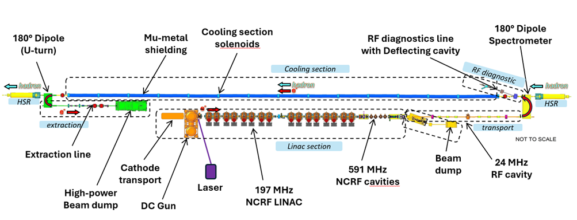

Cooling requirements for Electron Ion Collider (I)
Low-Energy Cooling (LEC):
Cooling hadrons at injection energy (24 GeV):
The goal of cooling at injection energy is to obtain initial proton parameters by cooling the vertical emittance from ~2 um to 0.3-0.5 um (rms normalized). This requires a 13 MeV electron beam.
The LEC is an RF-based, single pass electron cooler.
High-Energy Cooling of protons:
At EIC proton top collision energy ($γ=293$), cooling should counteract the longitudinal and transverse emittance growth.
A cooler must be compatible with the LEC.
Alexei Fedotov, TUA1, this conference
Dmitry Kayran, THB3, this conference
Sergei Nagaitsev, MOA1, this conference

Slide 3
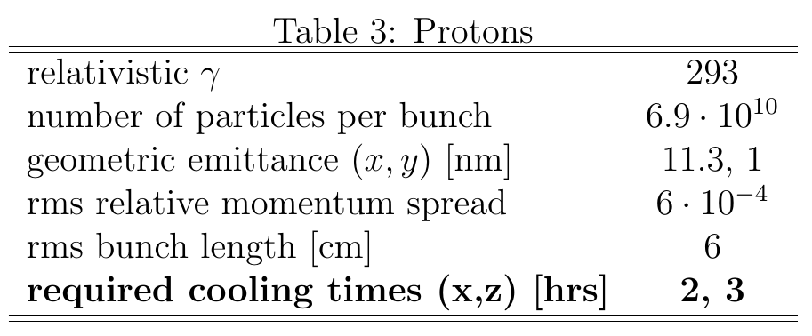
Cooling requirements for Electron Ion Collider (II)
Cooling protons at top energy:
A prospective cooler must counteract the IBS-driven longitudinal and transverse emittance growth and maintain close to initial beam emittances.
Electron cooling is a well-established technique at low energy. To bring it to high energies one can employ a RF-based electron cooling.
The two options for high energy RF-based electron coolers for the EIC are:
Ring Electron Cooler
ERL with several-turns’ storage ring
Protons
REC
(Dmitry Kayran, TUB2, this conference)

Slide 4
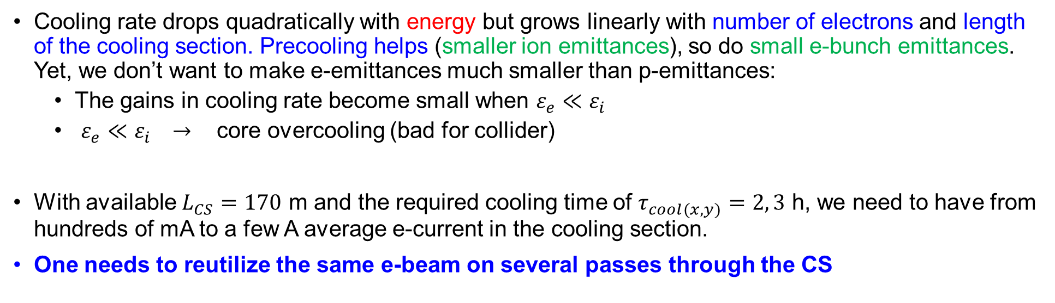
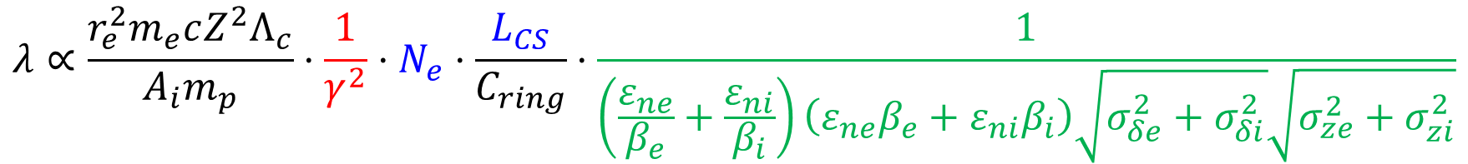
Bringing Electron Cooling to high energies
$$λ∝\frac{r_{e}^{2}m_{e}cZ^{2}Λ_{c}}{A_{i}m_{p}}⋅\frac{1}{γ^{2}}⋅N_{e}⋅\frac{L_{CS}}{C_{ring}}⋅\frac{1}{\left(\frac{ε_{ne}}{β_{e}}+\frac{ε_{ni}}{β_{i}}\right)\left(ε_{ne}β_{e}+ε_{ni}β_{i}\right)\sqrt{σ_{δe}^{2}+σ_{δi}^{2}}\sqrt{σ_{ze}^{2}+σ_{zi}^{2}}}$$
Cooling rate drops quadratically with energy but grows linearly with number of electrons and length of the cooling section. Precooling helps (smaller ion emittances), so do small e-bunch emittances. Yet, we don’t want to make e-emittances much smaller than p-emittances:
  The gains in cooling rate become small when $ε_{e}≪ε_{i}$
  $ε_{e}≪ε_{i} →$ core overcooling (bad for collider)
With available $L_{CS}=170$ m and the required cooling time of $τ_{cool(x,y)}=2, 3$ h, we need to have from hundreds of mA to a few A average e-current in the cooling section.
One needs to reutilize the same e-beam on several passes through the CS

Slide 5
Ring Electron Cooler idea
Keeping electrons in the electron storage ring for many turns helps to relax requirements to an average current from an injector
As stored electrons are cooling hadrons, the hadrons are heating-up the electron bunches. The electrons’ emittance will also be increased due to the IBS and other collective effects
Electrons’ emittance is kept constant with a help from damping wigglers
Our approach to the Ring Electron Cooler is the RF-based, non-magnetized cooling.
Non-magnetized, RF-based electron cooling was successfully employed in Low Energy RHIC Electron Cooler (LEReC), which provided cooling of gold ions (and substantially increased luminosity) during 2020-2021 RHIC run.

Slide 6
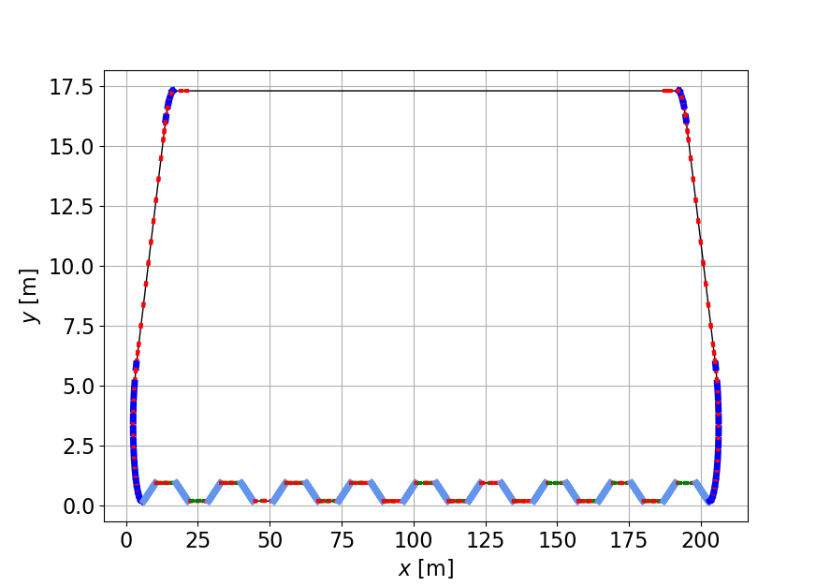
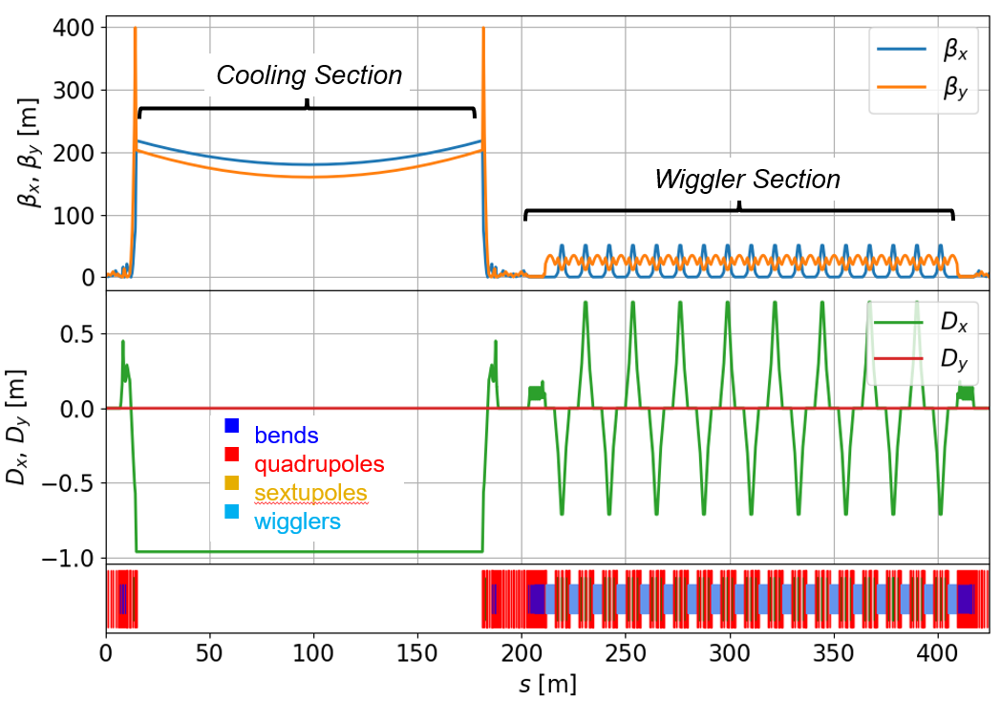
REC layout and lattice
Jorg Kewisch, THB2, this conference
Cooling Section
170 m long cooling section (layout is compatible with EIC LEC)
Ring circumference 426 m
140 e-bunches in the ring, each e-bunch makes 9 turns per 1 turn of hadrons in HSR
Electrons are cooled by radiation damping in a wiggler section (18 damping wigglers, each wiggler 4.2 m long)
RF Section
Injection Section
bends
quadrupoles
sextupoles
wigglers
Wiggler Section

Slide 7
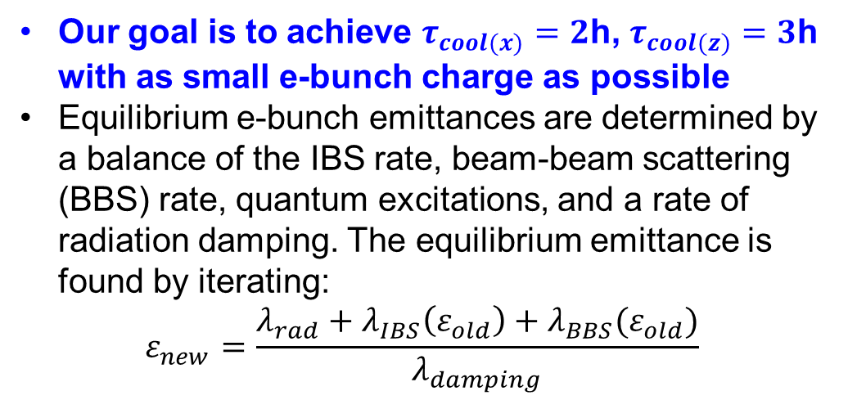
Factors driving REC design
Protons
Our goal is to achieve $τ_{cool(x)}=2$h, $τ_{cool(z)}=3$h with as small e-bunch charge as possible
Equilibrium e-bunch emittances are determined by a balance of the IBS rate, beam-beam scattering (BBS) rate, quantum excitations, and a rate of radiation damping. The equilibrium emittance is found by iterating:
$$ε_{new}=\frac{λ_{rad}+λ_{IBS}\left(ε_{old}\right)+λ_{BBS}(ε_{old})}{λ_{damping}}$$
Considerations of electron beam dynamics in the REC must include
  optimization of momentum and dynamic apertures (strongly affected by the choice of a wiggler field profile)
  proton-electron beam-beam effect
  self space charge
  optimization of electron and proton beams optical functions in the cooling section to both maximize the cooling and to minimize BBS rate and beam-beam parameter

Slide 8
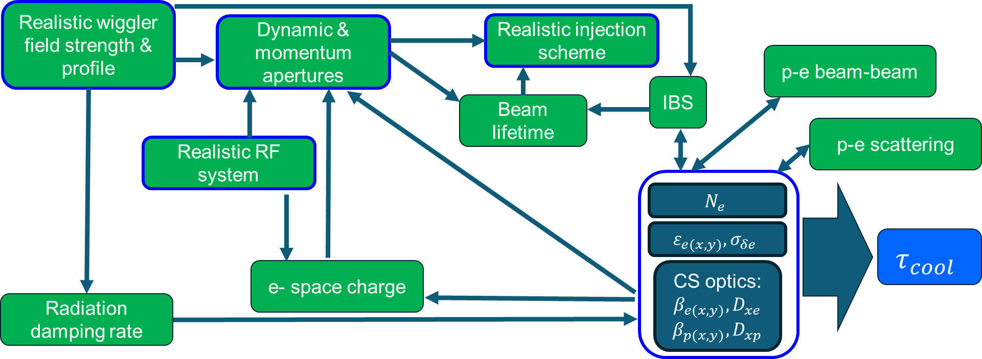

REC design is a multistep iterative process
Choosing field profile of damping wigglers (strongly affects dynamic and momentum apertures)
Finding equilibrium e-bunch parameters
Choosing e- and p-bunches parameters in the cooling section (affect cooling rate, proton-electron beam-beam focusing, p-e beam-beam scattering)
Checking resulting cooling rates, collective effects and beam lifetime.
Optimizing the REC dynamic and momentum apertures, adjusting the REC lattice.

Slide 9
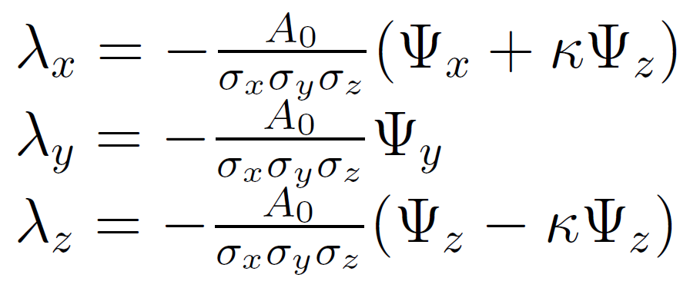
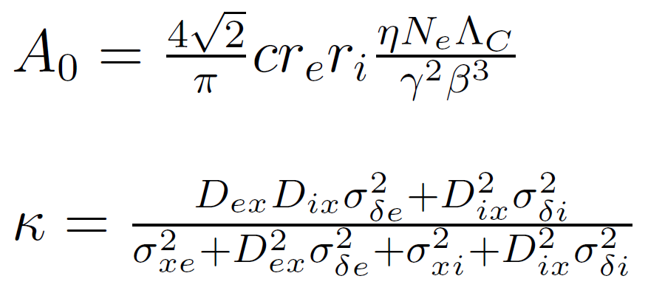
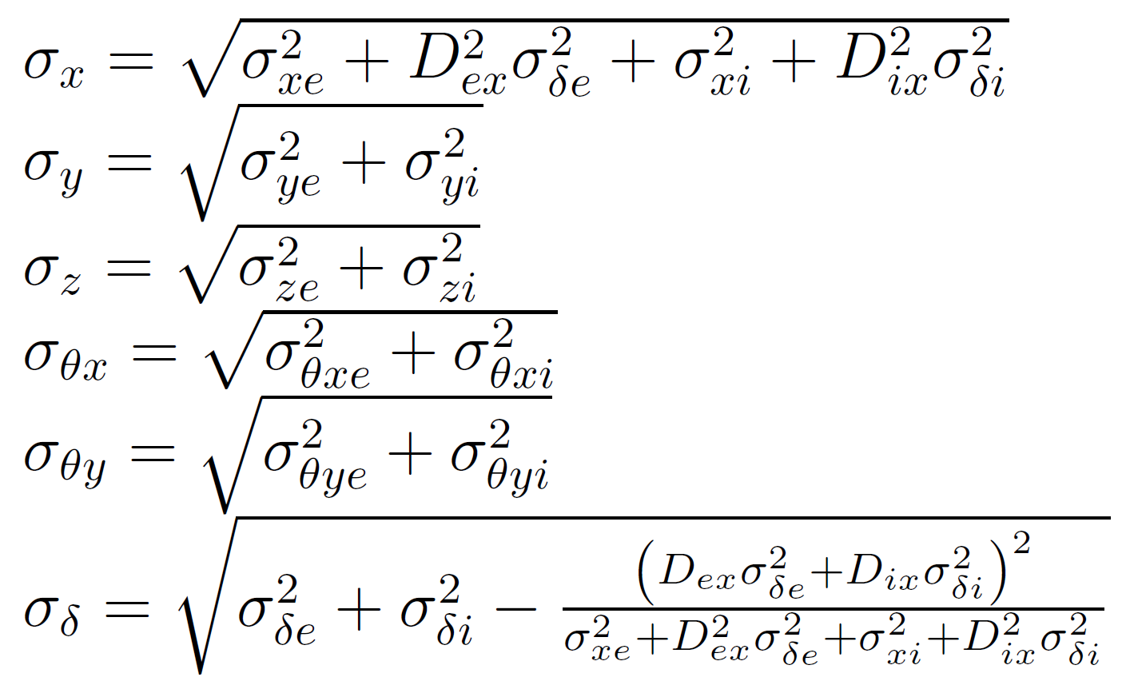
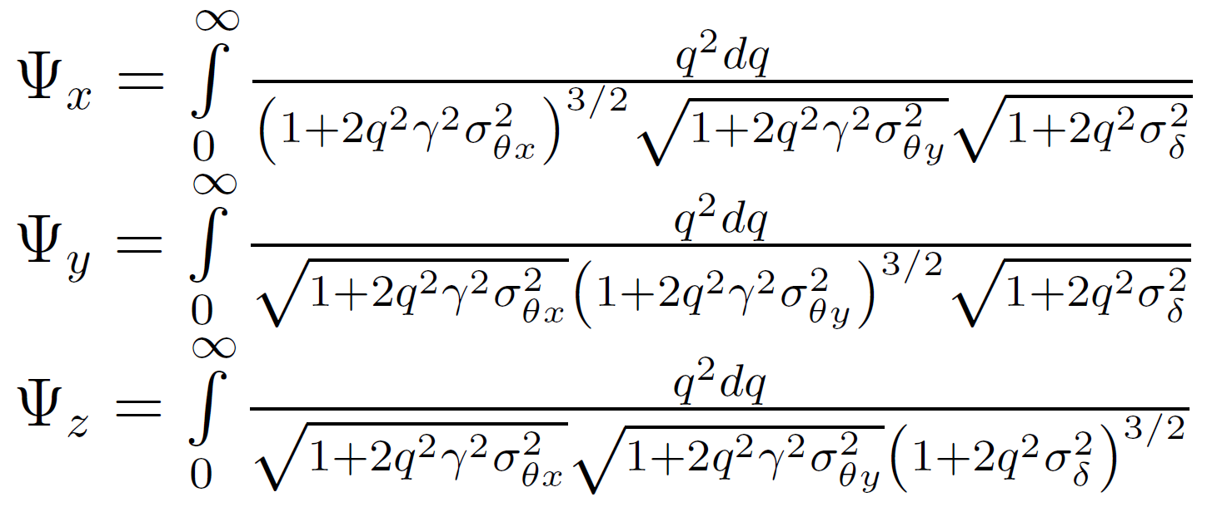
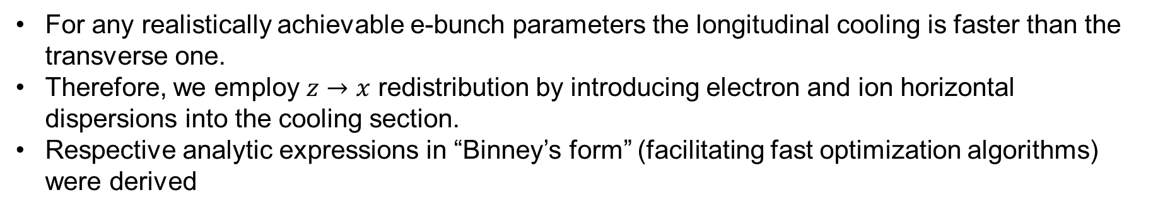
Electron Cooling with $z−x$redistribution
For any realistically achievable e-bunch parameters the longitudinal cooling is faster than the transverse one.
Therefore, we employ $z→x$ redistribution by introducing electron and ion horizontal dispersions into the cooling section.
Respective analytic expressions in “Binney’s form” (facilitating fast optimization algorithms) were derived
The paper is being prepared for publication

Slide 10
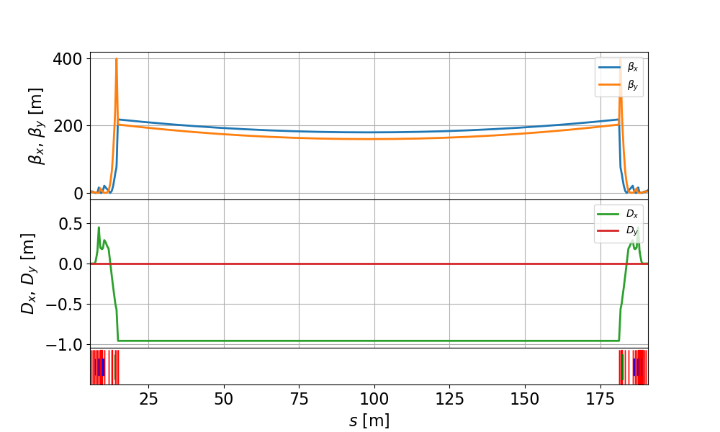
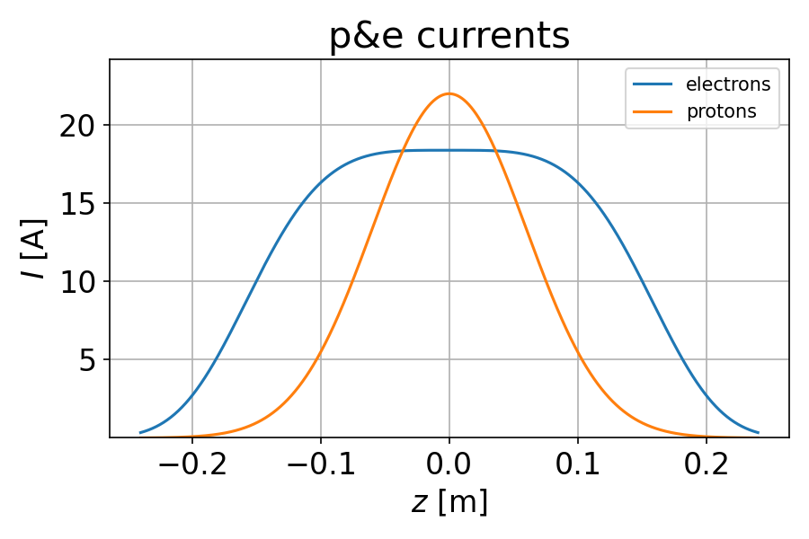
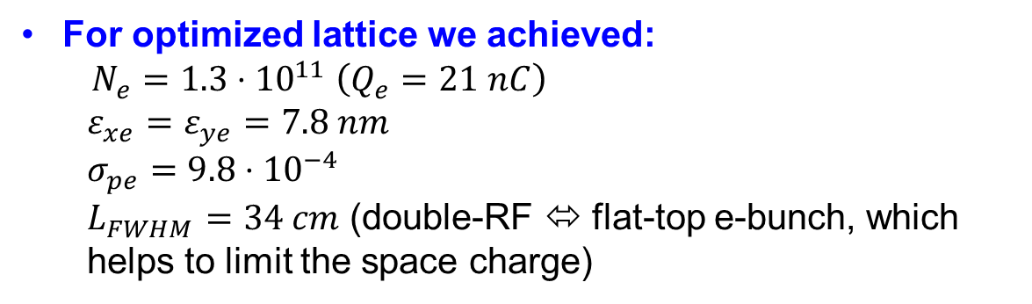
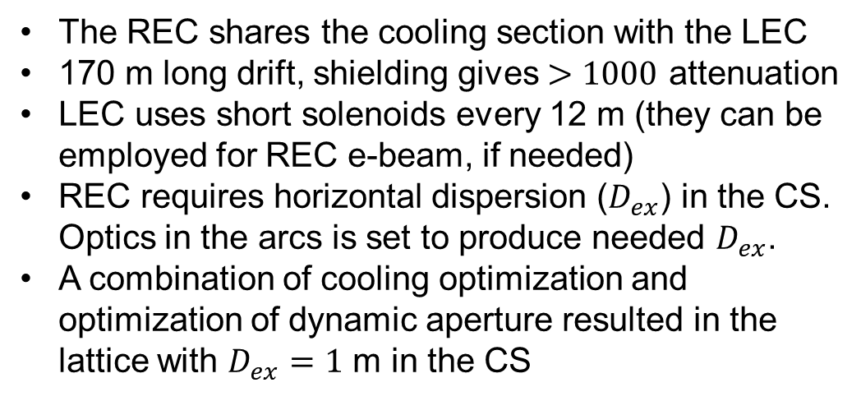
Cooling section optimization (I)
The REC shares the cooling section with the LEC
170 m long drift, shielding gives $>1000$ attenuation
LEC uses short solenoids every 12 m (they can be employed for REC e-beam, if needed)
REC requires horizontal dispersion ($D_{ex}$) in the CS. Optics in the arcs is set to produce needed $D_{ex}$.
A combination of cooling optimization and optimization of dynamic aperture resulted in the lattice with $D_{ex}=1$ m in the CS
Larger $N_{e}$ improves the cooling rate, but it also increases IBS, thus increasing e-bunch emittances and making cooling worse. We use a dedicated code, which allows us to find an optimal combination of bunch charge and 6-D phase space volume
For optimized lattice we achieved:
$N_{e}=1.3⋅{10}^{11} \left(Q_{e}=21 nC\right)$
  $ε_{xe}=ε_{ye}=7.8 nm$
  $σ_{pe}=9.8⋅{10}^{−4}$
  $L_{FWHM}=34 cm$ (double-RF ⬄ flat-top e-bunch, which helps to limit the space charge)

Slide 11
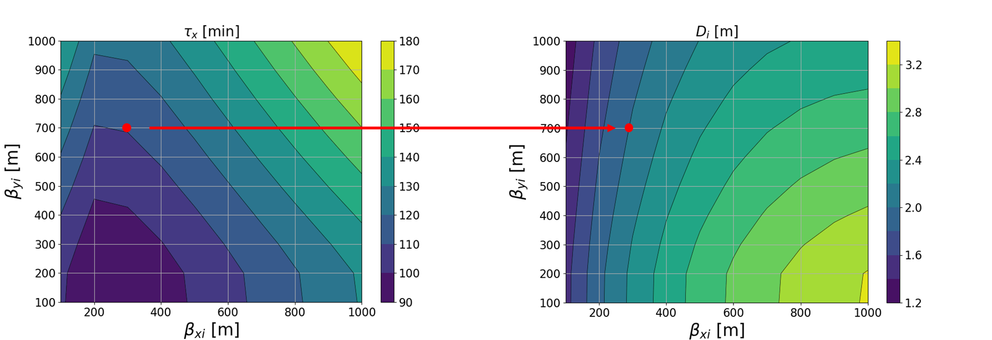
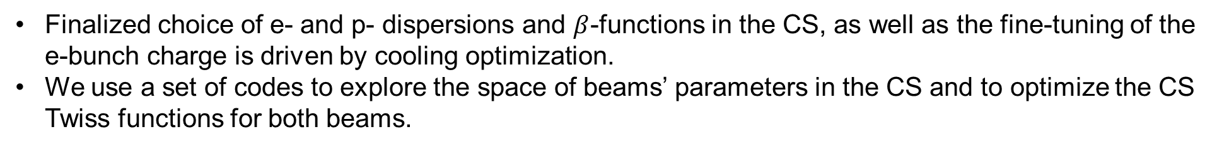
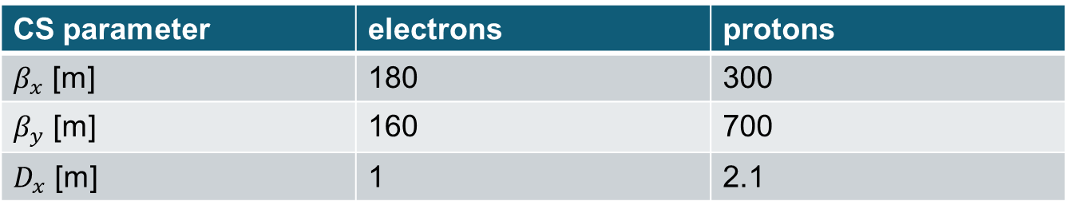
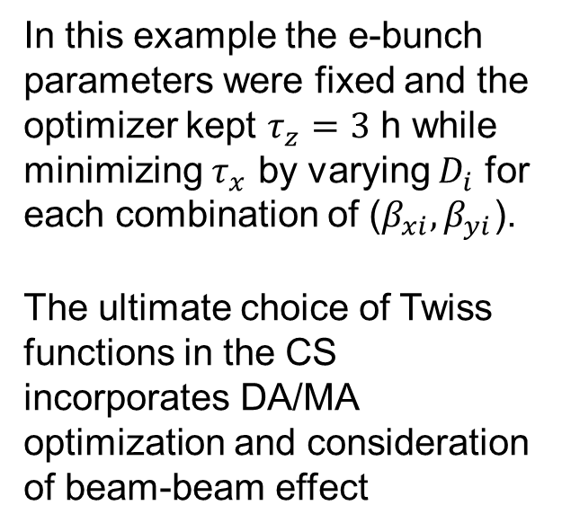
Cooling section optimization (II)
Finalized choice of e- and p- dispersions and $β$-functions in the CS, as well as the fine-tuning of the e-bunch charge is driven by cooling optimization.
We use a set of codes to explore the space of beams’ parameters in the CS and to optimize the CS Twiss functions for both beams.
In this example the e-bunch parameters were fixed and the optimizer kept $τ_{z}=3$ h while minimizing $τ_{x}$ by varying $D_{i}$ for each combination of ($β_{xi}, β_{yi}$).
The ultimate choice of Twiss functions in the CS incorporates DA/MA optimization and consideration of beam-beam effect
CS parameter | electrons | protons
$β_{x}$ [m] | 180 | 300
$β_{y}$ [m] | 160 | 700
$D_{x}$ [m] | 1 | 2.1

Slide 12
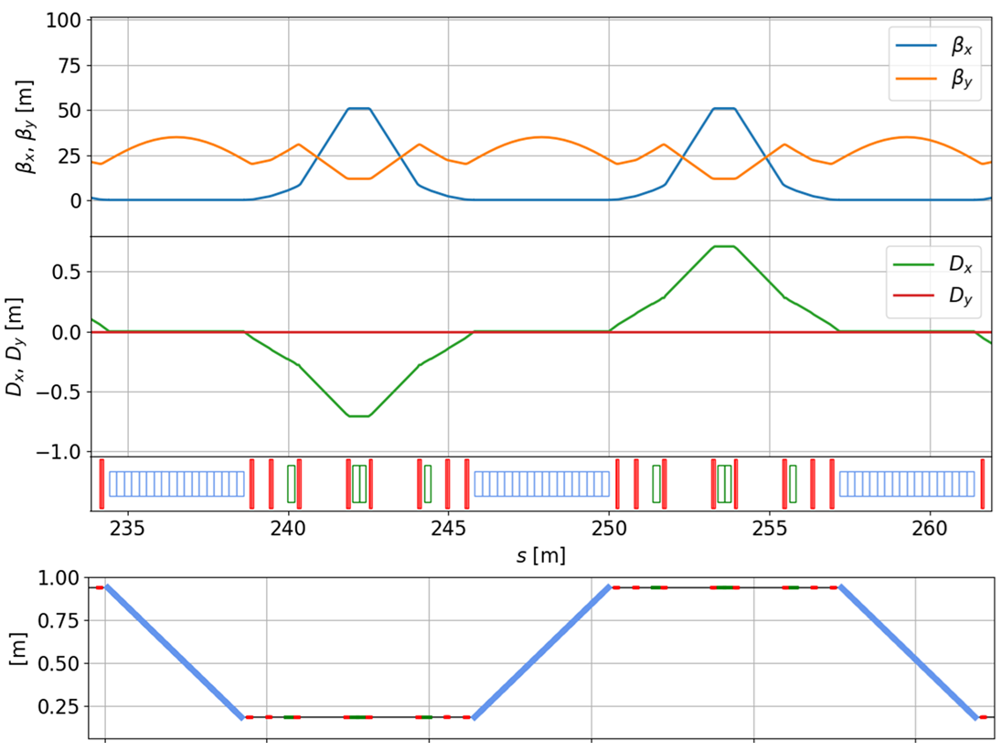
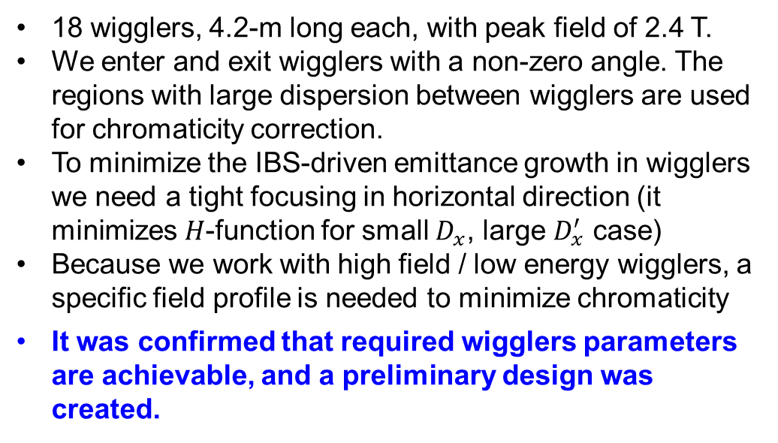

REC wigglers
18 wigglers, 4.2-m long each, with peak field of 2.4 T.
We enter and exit wigglers with a non-zero angle. The regions with large dispersion between wigglers are used for chromaticity correction.
To minimize the IBS-driven emittance growth in wigglers we need a tight focusing in horizontal direction (it minimizes $H$-function for small $D_{x}$, large $D_{x}^{′}$ case)
Because we work with high field / low energy wigglers, a specific field profile is needed to minimize chromaticity
It was confirmed that required wigglers parameters are achievable, and a preliminary design was created.
Wiggler parameter | value
Number of wigglers | 18
Length [m] | 4.2
Peak field [T] | 2.38
Period [m] | 0.2
Gap [cm] | 2
Radiated power (per wiggler) [W] | 674
$$x [m]$$
quadrupoles
sextupoles
wigglers
S. Seletskiy et al., BNL-225896-2024-TECH, 2024 https://technotes.bnl.gov/PDF?publicationId=225896
S. Seletskiy et al., TUP073, NAPAC25
https://prebys.physics.ucdavis.edu/NAPAC-25/proceedings/pdf/TUP073.pdf

Slide 13
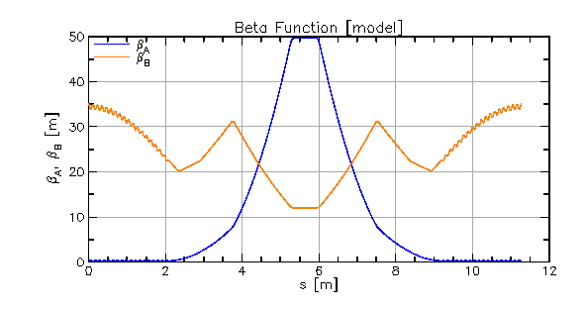
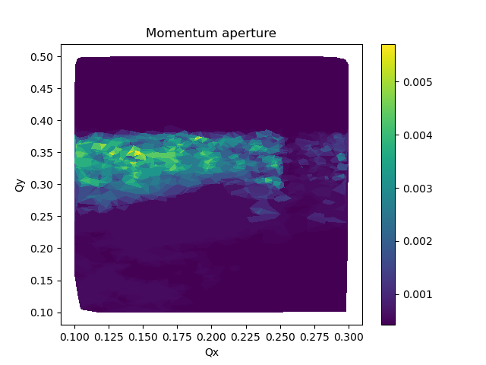
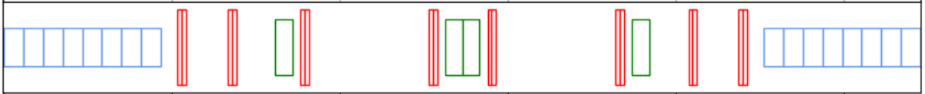
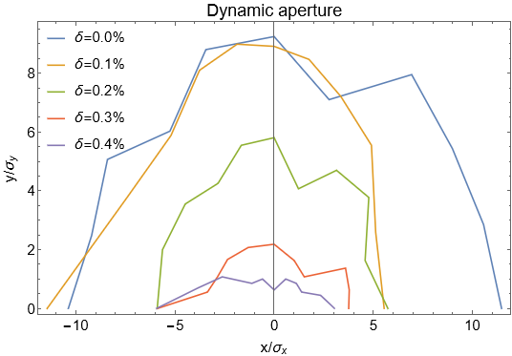
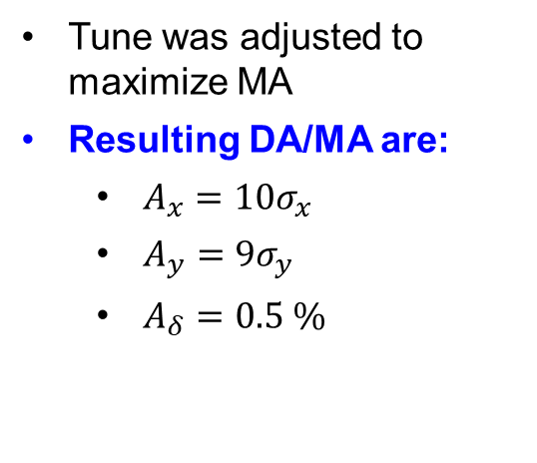
Dynamic and momentum aperture optimization
Optimization of wigglers’ field profile allowed to substantially reduce chromaticity and utilize weaker sextupoles
Phase advance over wiggler and sextupole blocks is an important parameter for dynamic aperture
Two families of octupoles were optimized to reduce non-linear motion
Tune was adjusted to maximize MA
Resulting DA/MA are:
  $A_{x}=10σ_{x}$
  $A_{y}=9σ_{y}$
  $A_{δ}=0.5 \%$
J. Unger et al., TUP031, NAPAC25
https://prebys.physics.ucdavis.edu/NAPAC-25/proceedings/pdf/TUP031.pdf

Slide 14
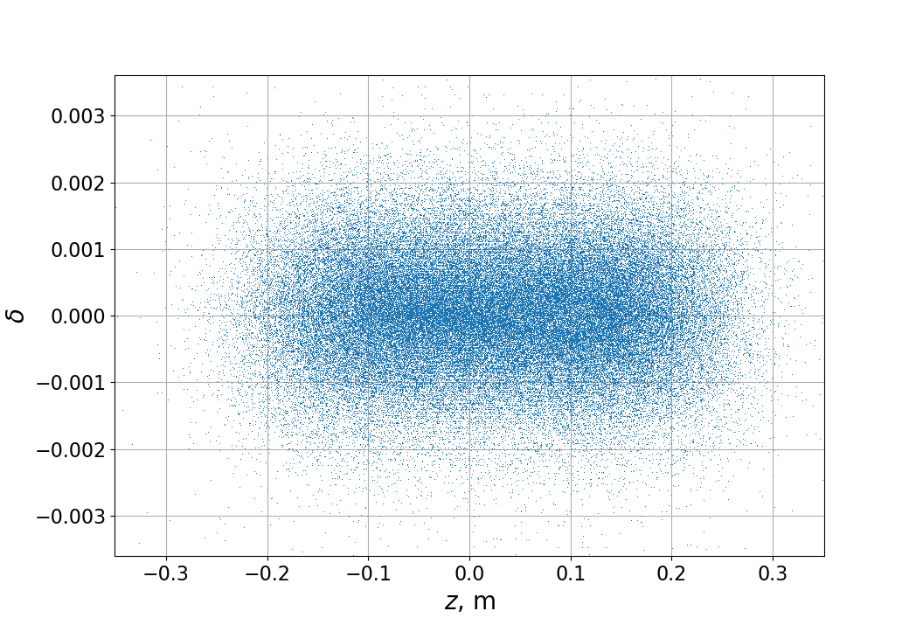
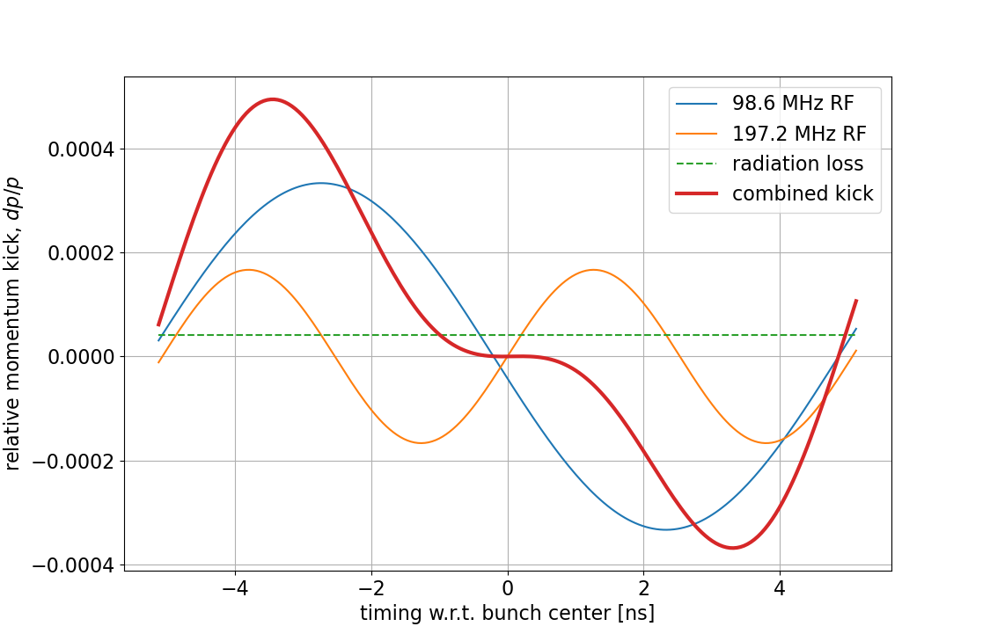
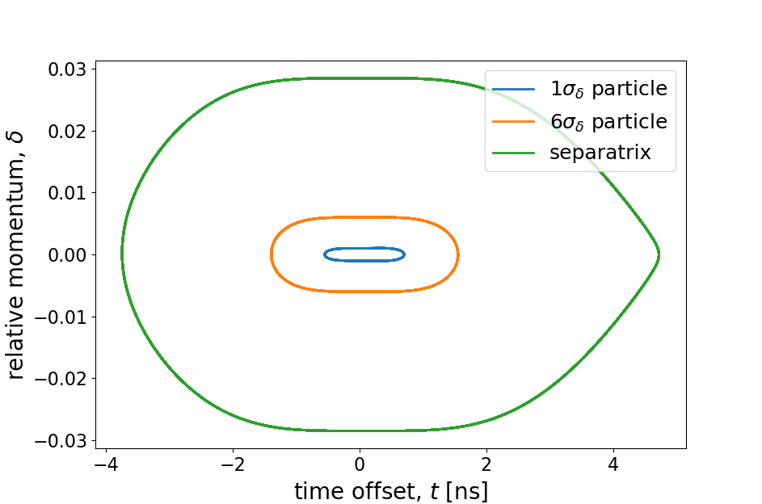
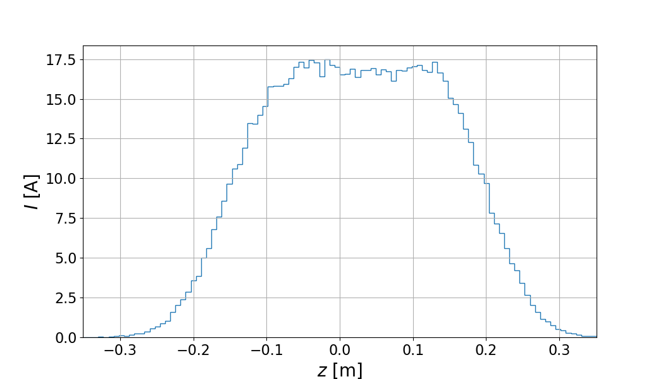
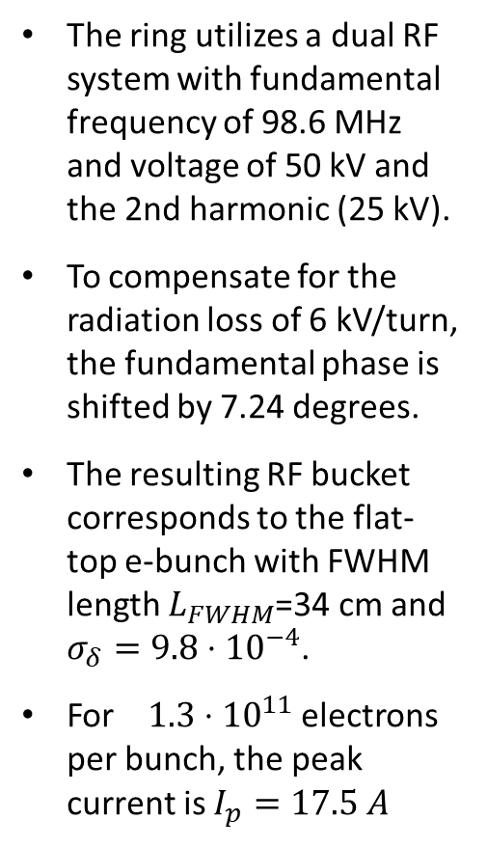
REC RF system
The ring utilizes a dual RF system with fundamental frequency of 98.6 MHz and voltage of 50 kV and the 2nd harmonic (25 kV).
To compensate for the radiation loss of 6 kV/turn, the fundamental phase is shifted by 7.24 degrees.
The resulting RF bucket corresponds to the flat-top e-bunch with FWHM length $L_{FWHM}$=34 cm and $σ_{δ}=9.8⋅{10}^{−4}$.
For $1.3⋅{10}^{11}$ electrons per bunch, the peak current is $I_{p}=17.5 A$

Slide 15
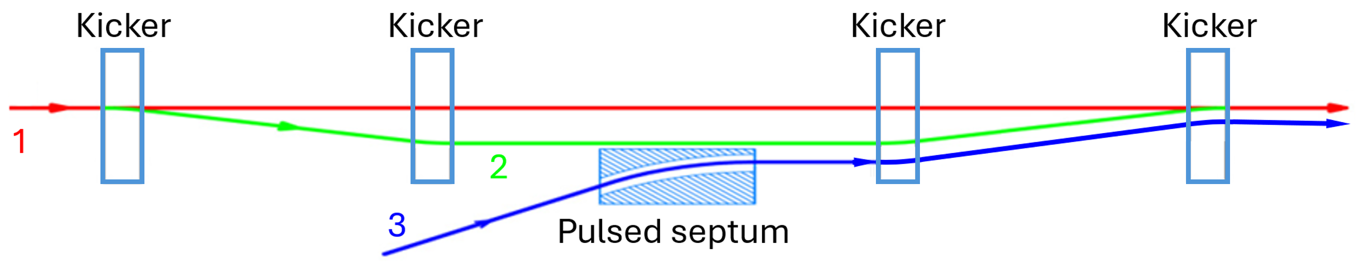
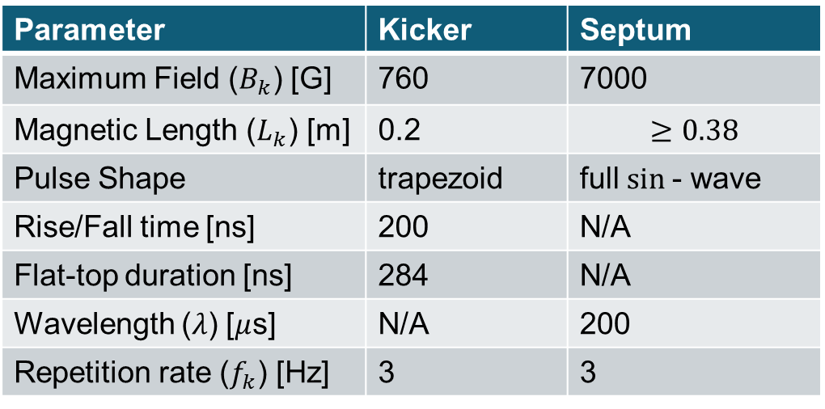
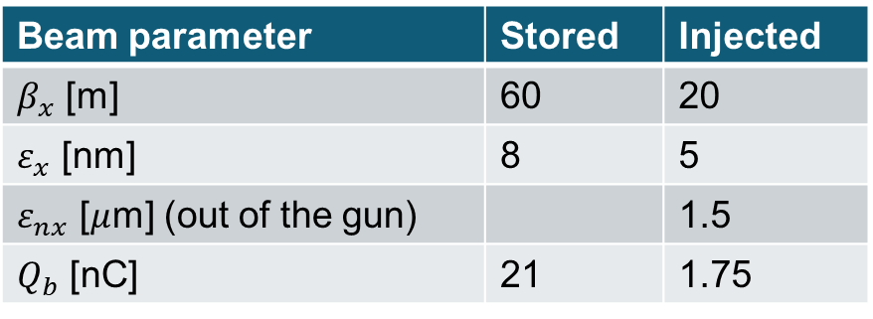
Injection scheme
Beam parameter | Stored | Injected
$β_{x}$ [m] | 60 | 20
$ε_{x}$ [nm] | 8 | 5
$ε_{nx}$ [$μ$m] (out of the gun) |  | 1.5
$Q_{b}$ [nC] | 21 | 1.75
2.5 m
Parameter | Kicker | Septum
Maximum Field ($B_{k}$) [G] | 760 | 7000
Magnetic Length ($L_{k}$) [m] | 0.2 | $$≥0.38$$
Pulse Shape | trapezoid | full $sin$- wave
Rise/Fall time [ns] | 200 | N/A
Flat-top duration [ns] | 284 | N/A
Wavelength ($λ$) [$μ$s] | N/A | 200
Repetition rate ($f_{k}$) [Hz] | 3 | 3
We are planning to have a top-off injection replenishing 10% of each bunch every 1.6 s.
Four kickers will create a closed bump bringing the stored beam closer to the injection septum. At the exit of the bump the injected beam will be displaced by 6 mm from the stored beam trajectory.
The injector will be running with $f_{inj}=3 Hz$ injecting into 1/5 of the ring (28 bunches) each time.
Initial injection can be performed with $f_{0}=5$ Hz frequency, filling up the ring in 20 s.

Slide 16
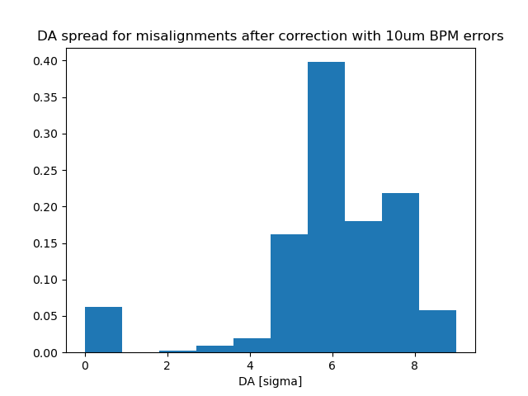
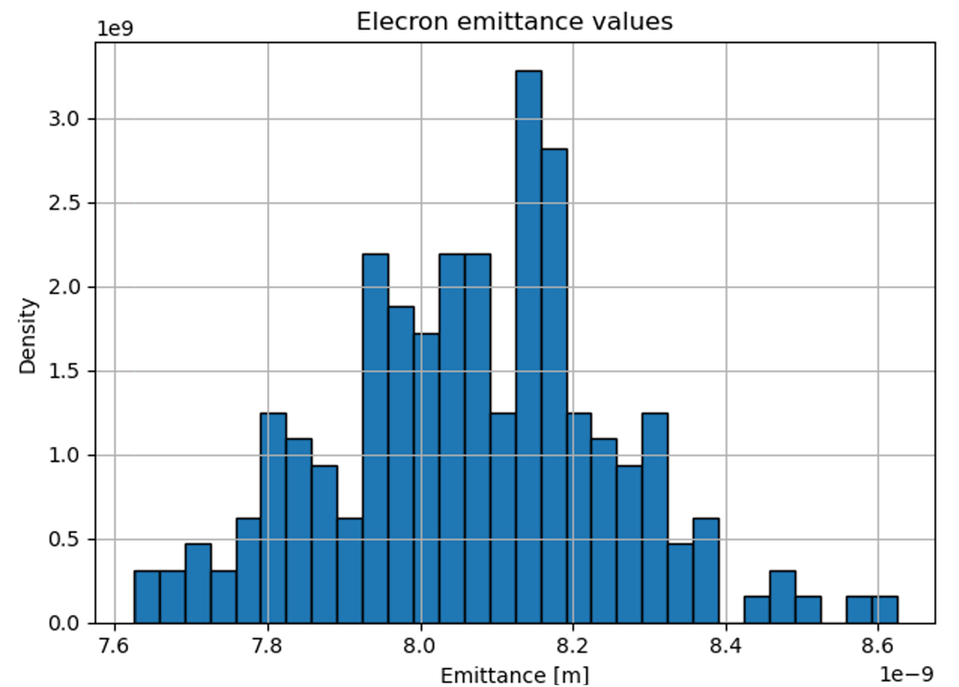
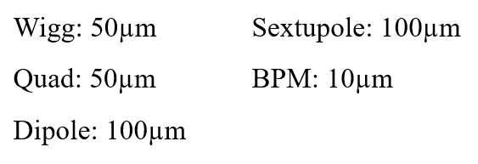
Misalignment tolerances
Error RMS values:
BPM and kicker at every quadrupole
Sextupoles set for linear chromaticity
Courtesy of J. Unger

Slide 17
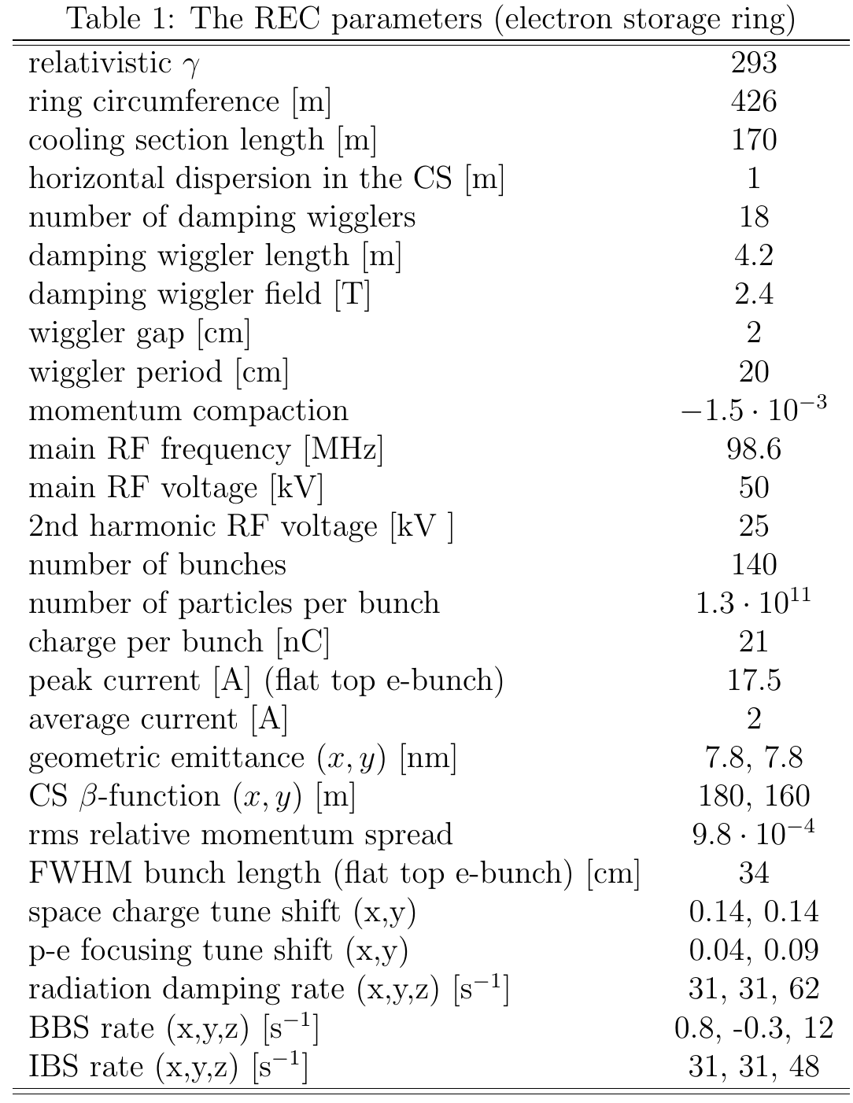
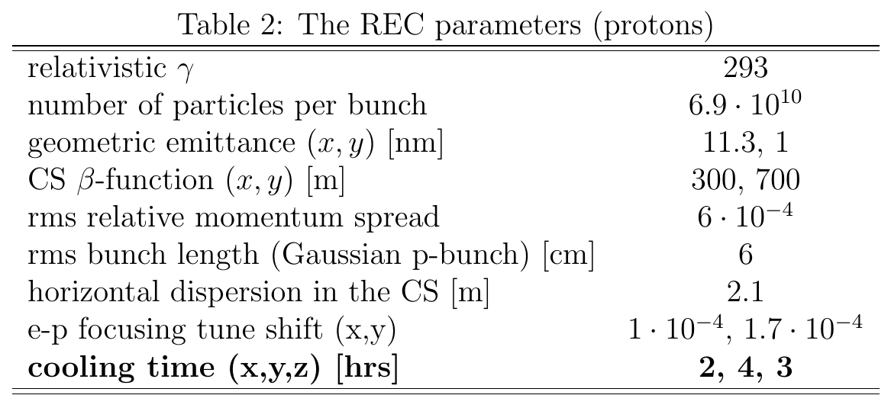
Parameters
Due to cooling optimization and optimization of REC lattice we reduced bunch charge, average current and peak current by a factor of ~2.5, as compared to the initial REC design
(H. Zhao, J. Kewisch, M. Blaskiewicz, A. Fedotov,
Phys. Rev. Accel. Beams 24, 043501, (2021)
https://link.aps.org/doi/10.1103/PhysRevAccelBeams.24.043501)

Slide 18
Summary
The Ring Electron Cooler is designed to provide the cooling required for the EIC operation at the top energy.
Optimization of the REC parameters allowed us to reduce the bunch charge and average current by a factor of ~2.5 as compared to preliminary REC design.
The realistic lattice for the REC compatible with the EIC Low Energy Cooler was developed and optimized. The damping wigglers with realistic fields and optimized chromaticity contribution were developed. The conceptual design of the injection and RF systems was devised.
A detailed study of various possible instabilities (CSR-driven microwave instability, transverse and longitudinal coupled-bunch instability, electron-ion instability etc.) in the REC is ongoing.
S. Seletskiy et al., “Ring Electron Cooler for Electron Ion Collider”, BNL-228463-2025-TECH, 2025.
https://technotes.bnl.gov/PDF?publicationId=228463

Slide 19
Additional slides

Slide 20
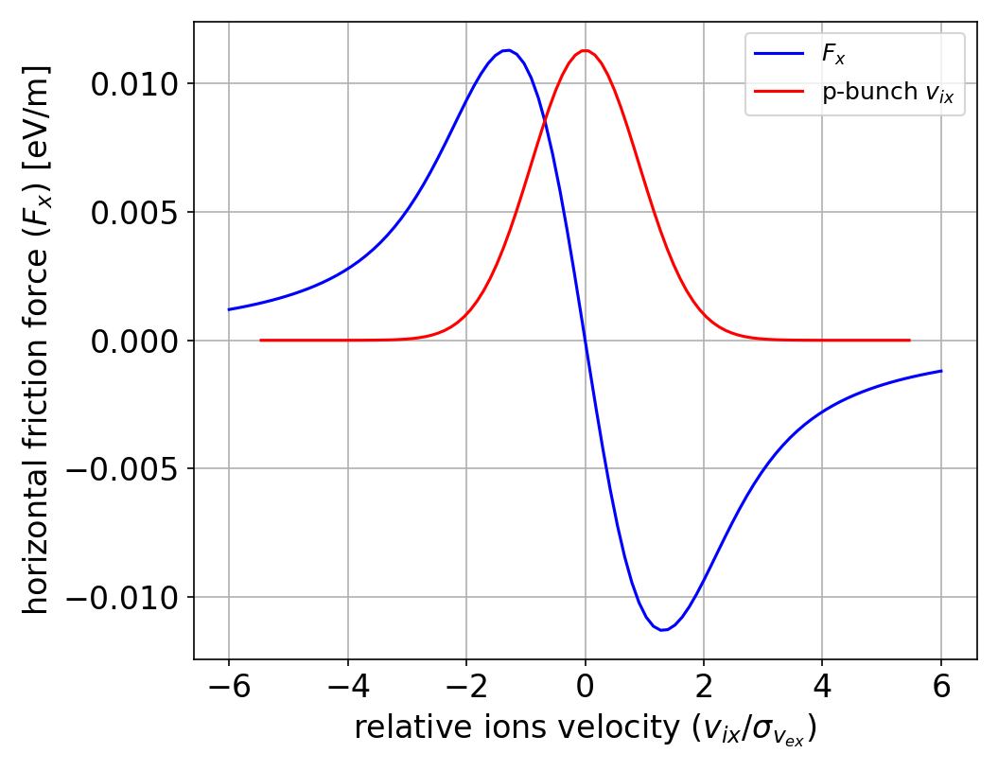
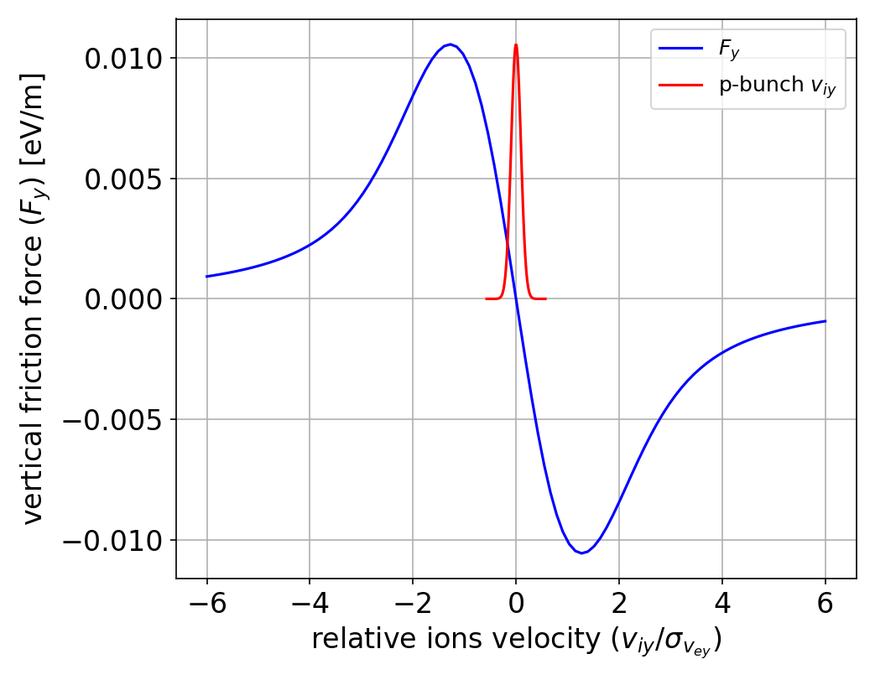
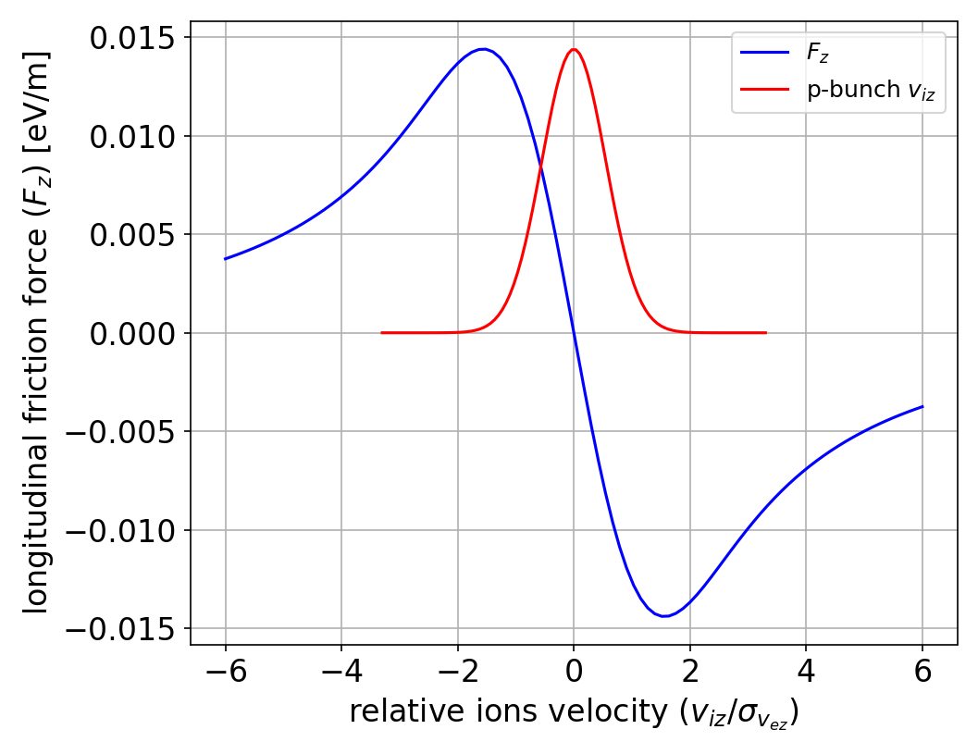
Cooling force

Slide 21
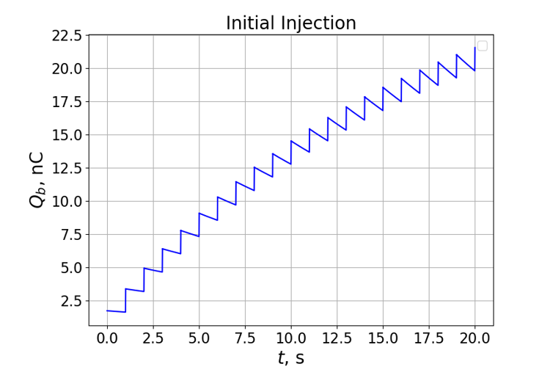
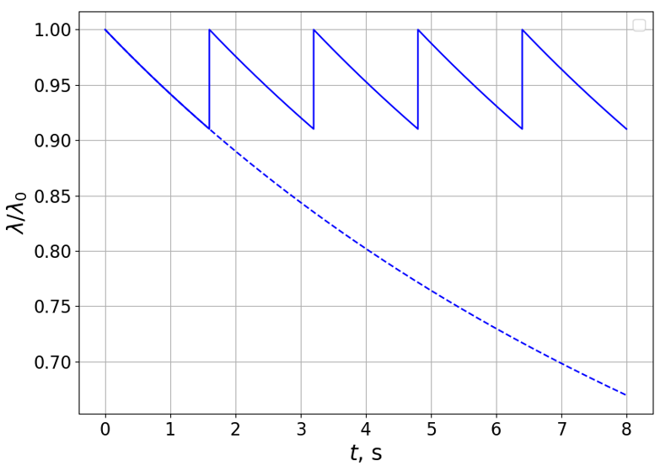
Injection

Slide 22
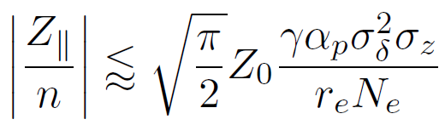
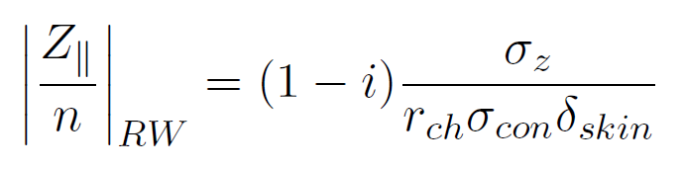
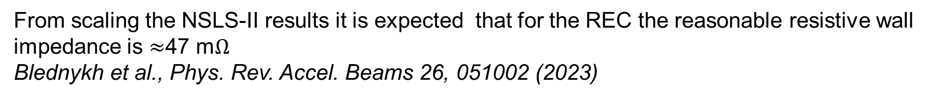
Longitudinal single bunch instability
The Keil-Schnell-Boussard criterion gives threshold of 78 m$Ω$:
For REC parameters the resistive wall impedance is $≈$25 m$Ω$:
From scaling the NSLS-II results it is expected that for the REC the reasonable resistive wall impedance is $≈$47 m$Ω$
Blednykh et al., Phys. Rev. Accel. Beams 26, 051002 (2023)
The remedy for possible problems with CSR impedance from the wigglers is smoothly varying the wiggler’s gap

Slide 23



Transverse mode-coupling instability
For REC parameters $Z_{⊥}^{thr}=5 kΩ/m$
From the Panofsky-Wenzel theorem the transverse resistive wall impedance is 3.8 $kΩ/m$:

Slide 24

Lattice
Cooling Section
Wiggler Section
bends
quadrupoles
sextupoles
wigglers

