Slide 1
A Neutral Hydrogen Monitor for Electron Cooling Studies of H⁻ ions in ELENA
Gérard Alain Tranquille
SY Department, CERN

Slide 2
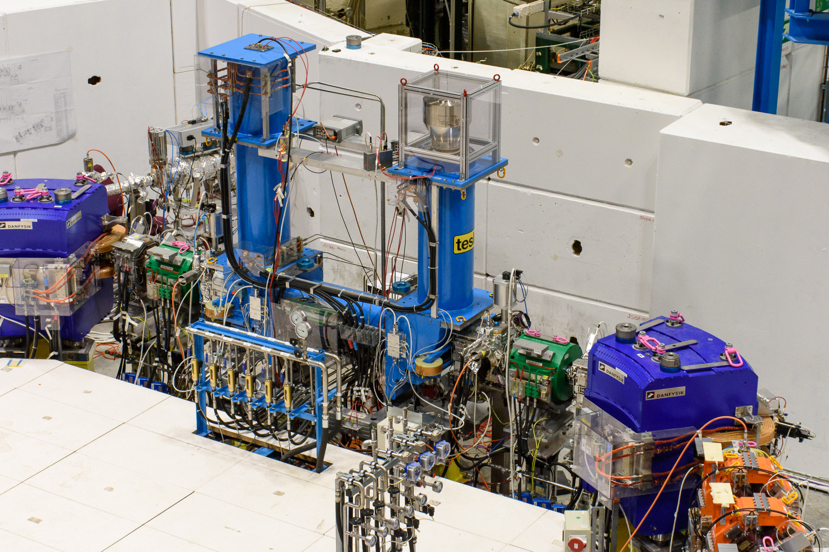
Why?
For commissioning at 100 keV with the proton source, optimisation of the electron cooler can be performed by measuring the recombination of electrons with the circulating protons.
The proton source has never been used on ELENA
H⁻ ions are injected for machine studies and commissioning experimental hardware
Stripping of H⁻ ions with the residual gas and cooling electrons gives some insight into machine performance

Slide 3
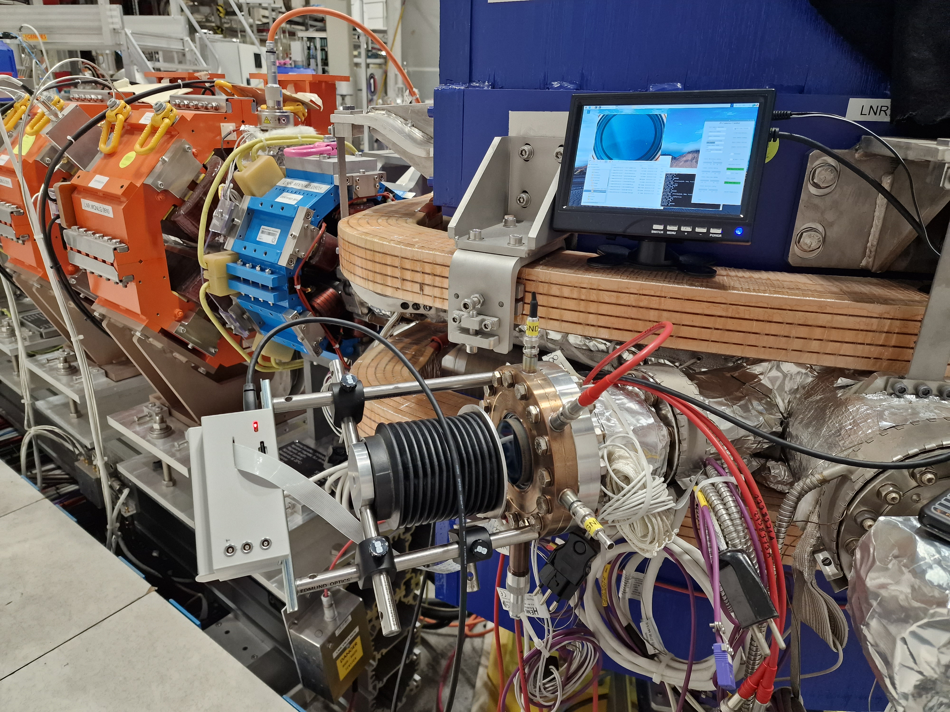
Hardware

Slide 4
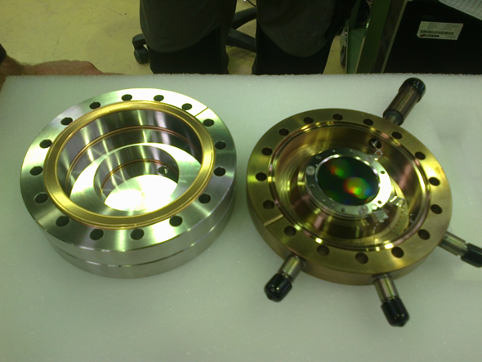
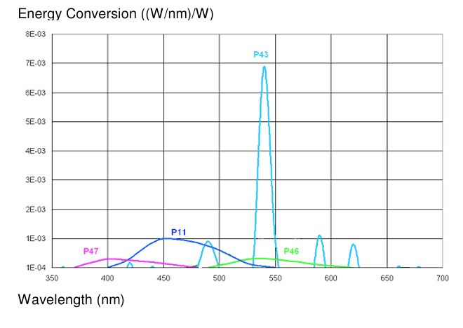
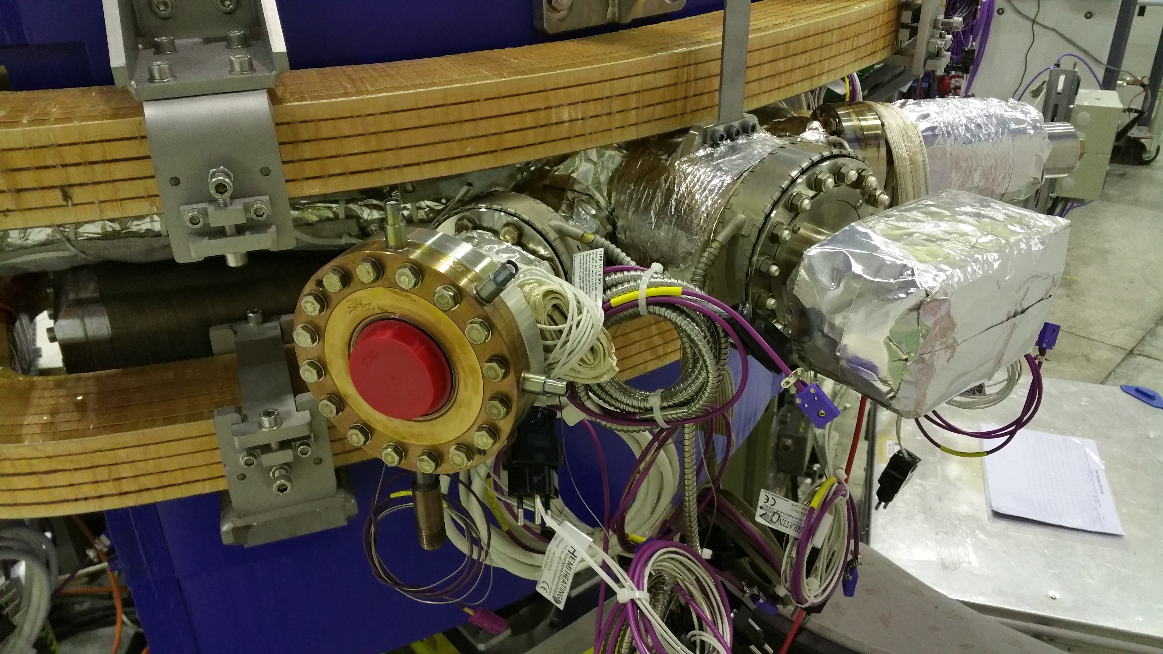
Beam Profiler
Chevron mounted MCP detector
MgO coating
Fibreoptic phosphor screen with P43
Direct image of cooled beam on CMOS camera

Slide 5
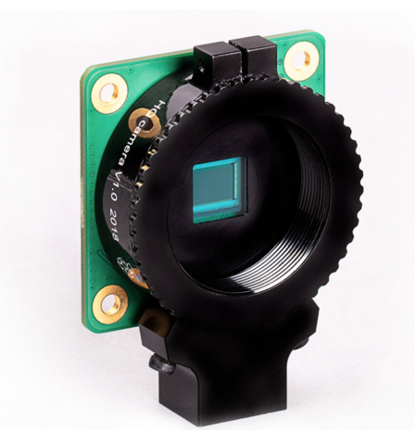
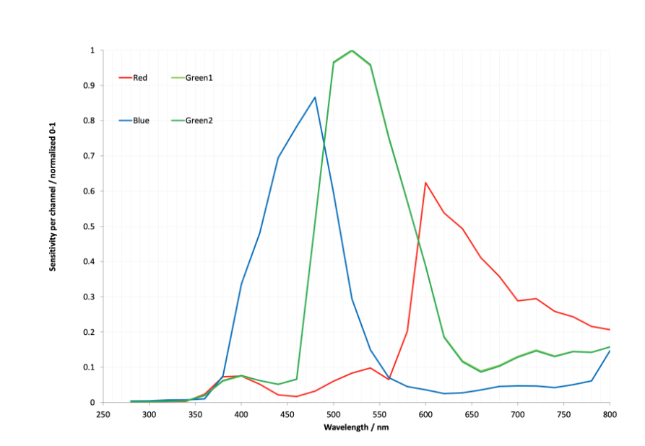
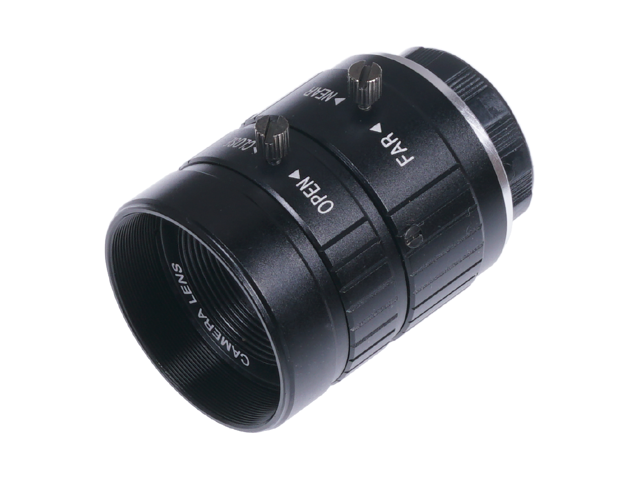

Camera System
Raspberry Pi HQ camera module
Sony IMX477 12 megapixels CCD
CS mount lenses: Fujion 25 mm
Rpi 6 mm wide angle

Slide 6
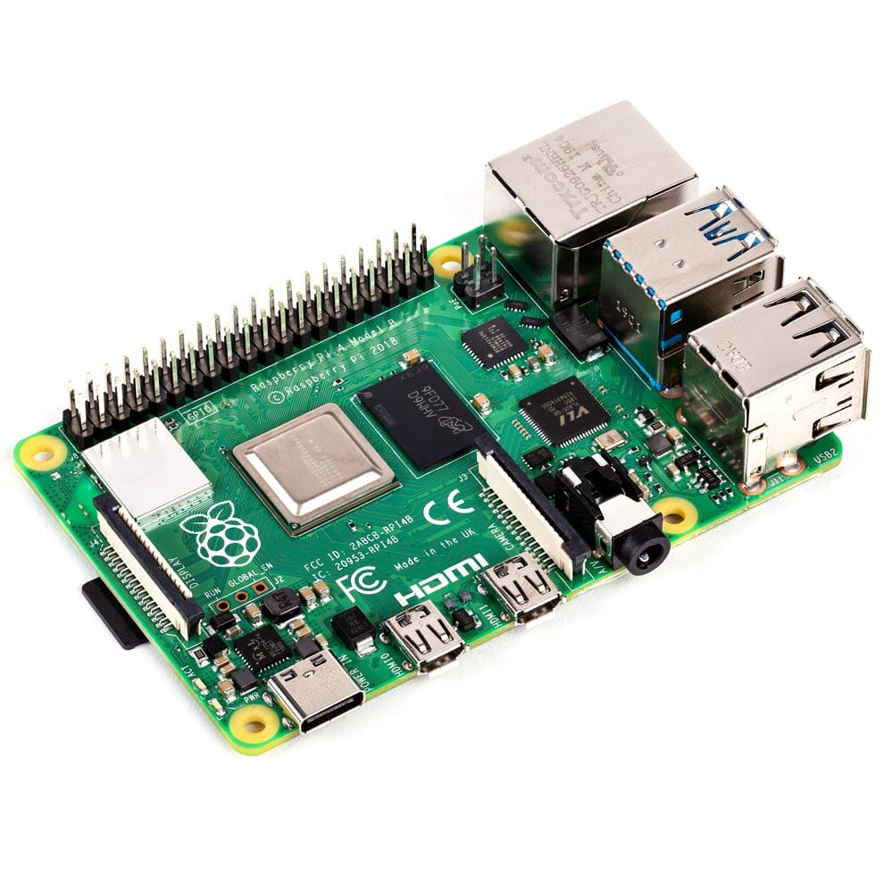
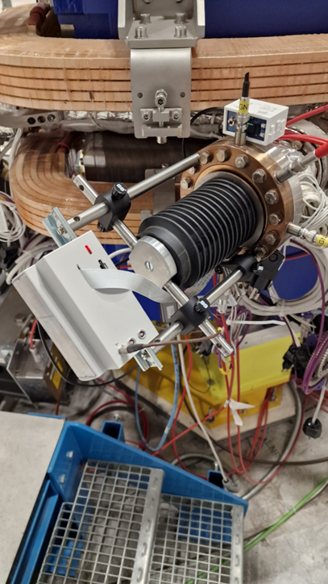
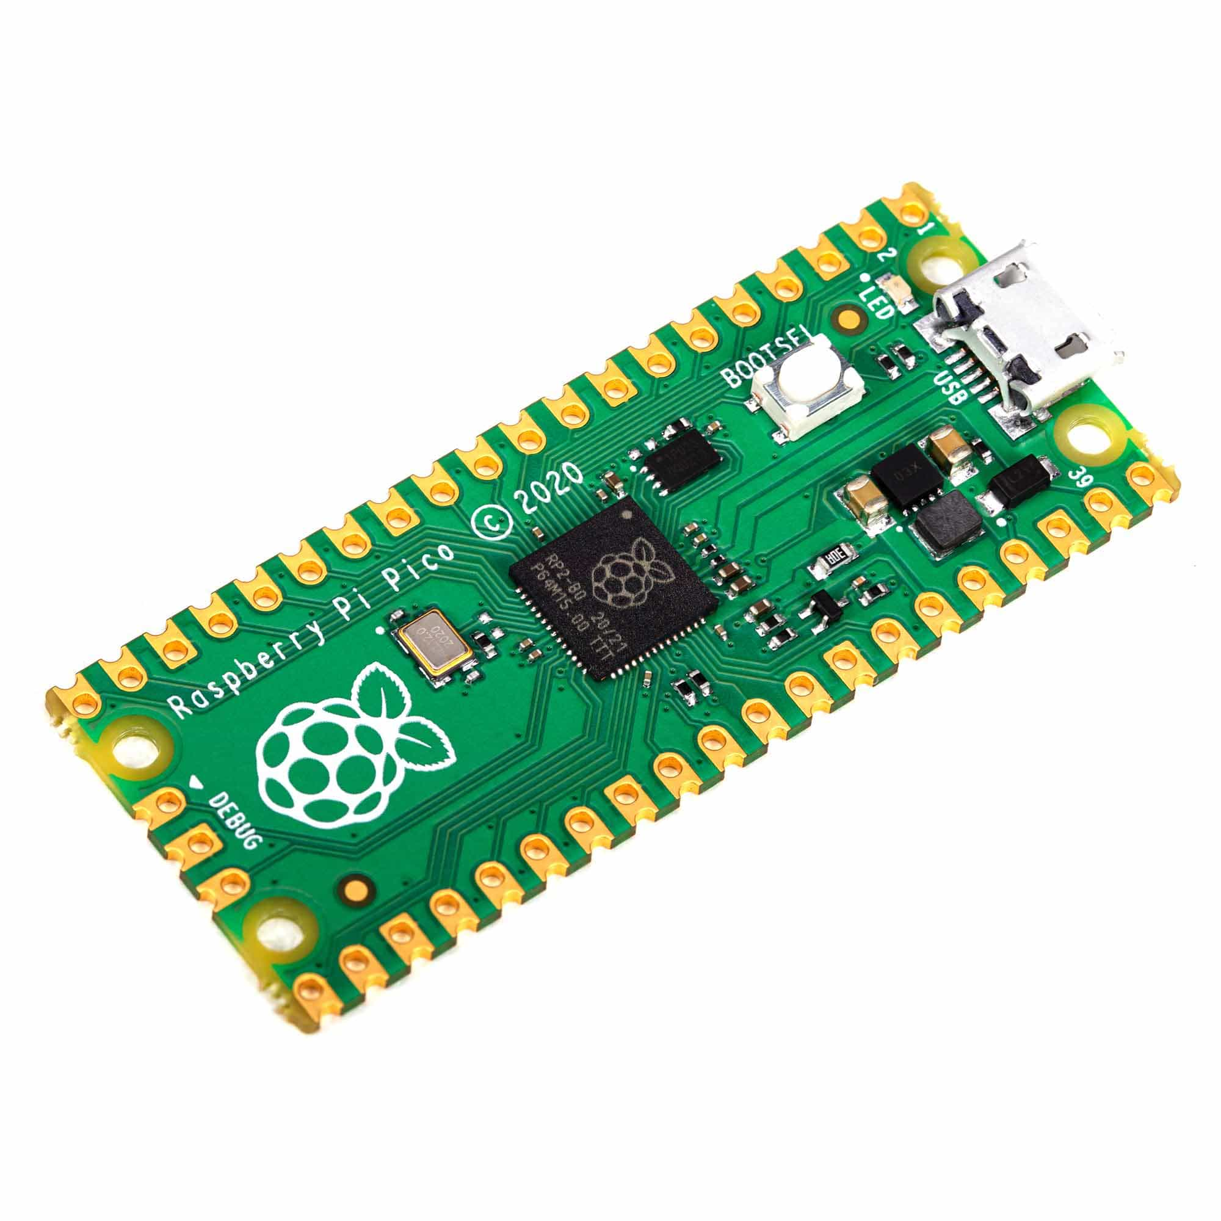
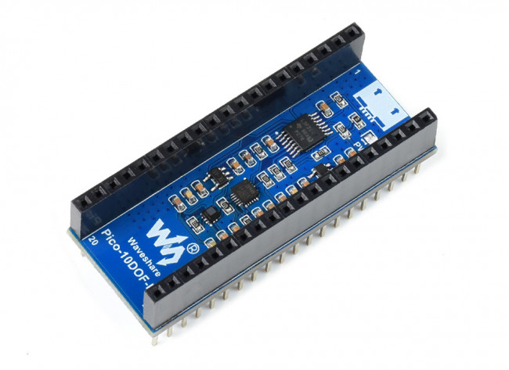
Controls & Data Acqusition
Raspberry Pi4 8GB micro computer
Direct control of HQ camera
Pi Pico & 10-DOF IMU Sensor Module (B field monitoring)
Control of high voltage power supplies via USB/ethernet

Slide 7
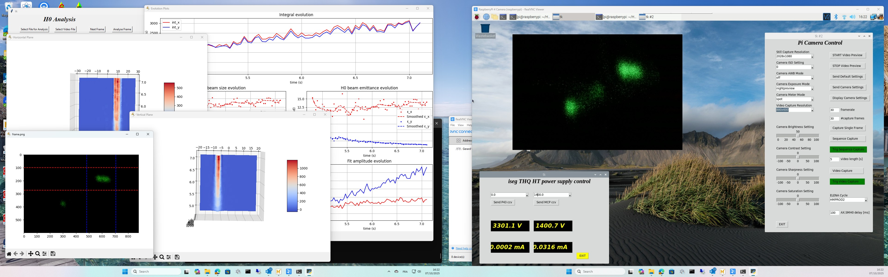
Software

Slide 8
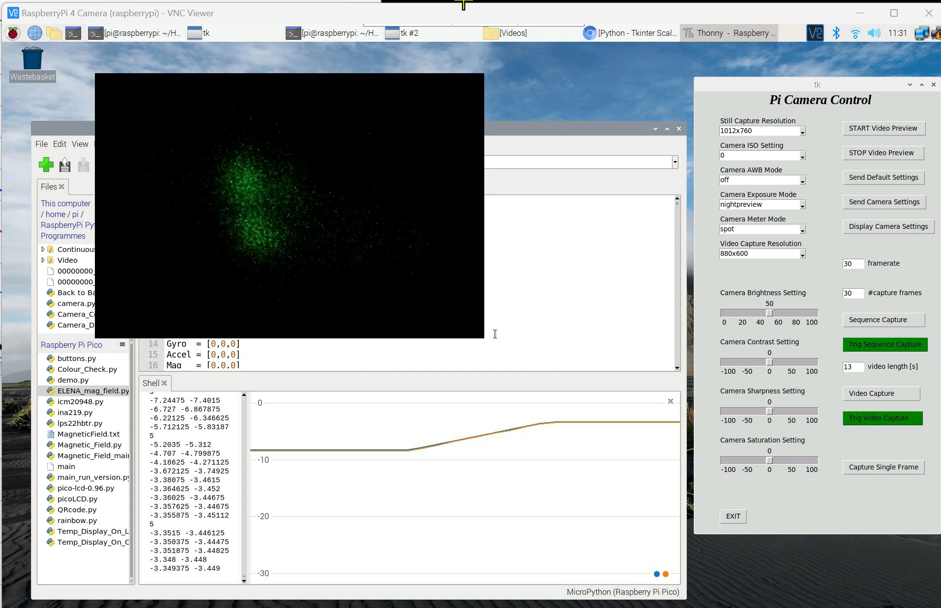
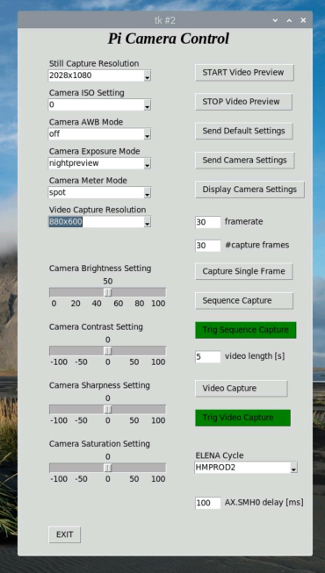
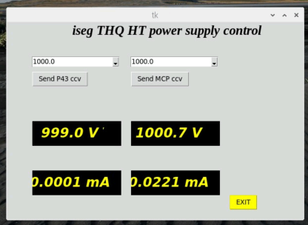
Camera & PS Control S/W
Python script for the camera settings and still/video capture
Script for the control of the iSEG high voltage power supply (mcp and P43 settings)

Slide 9
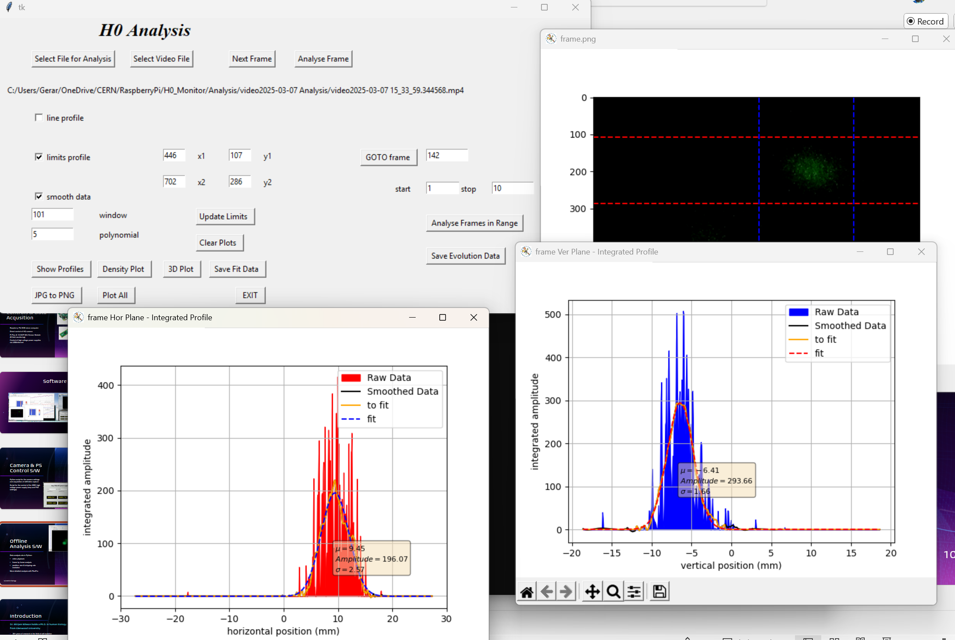
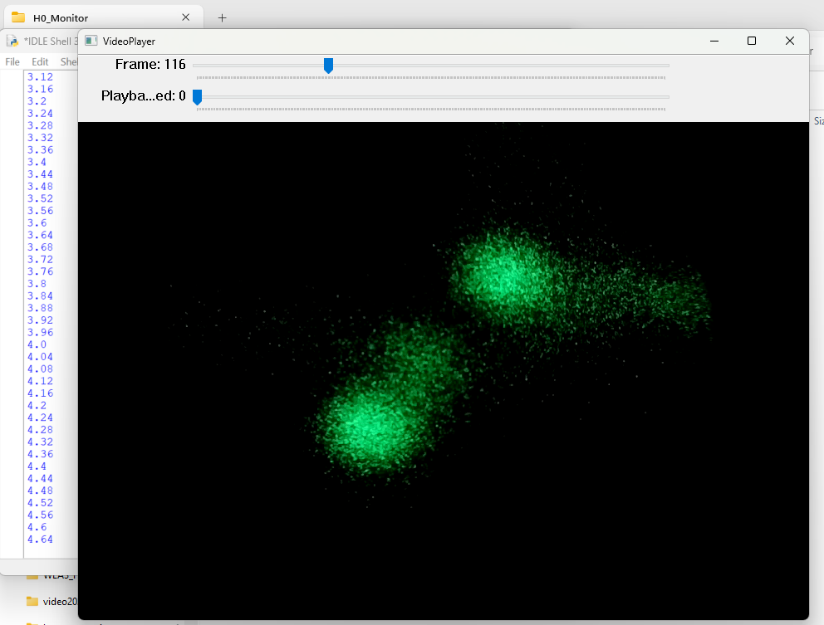
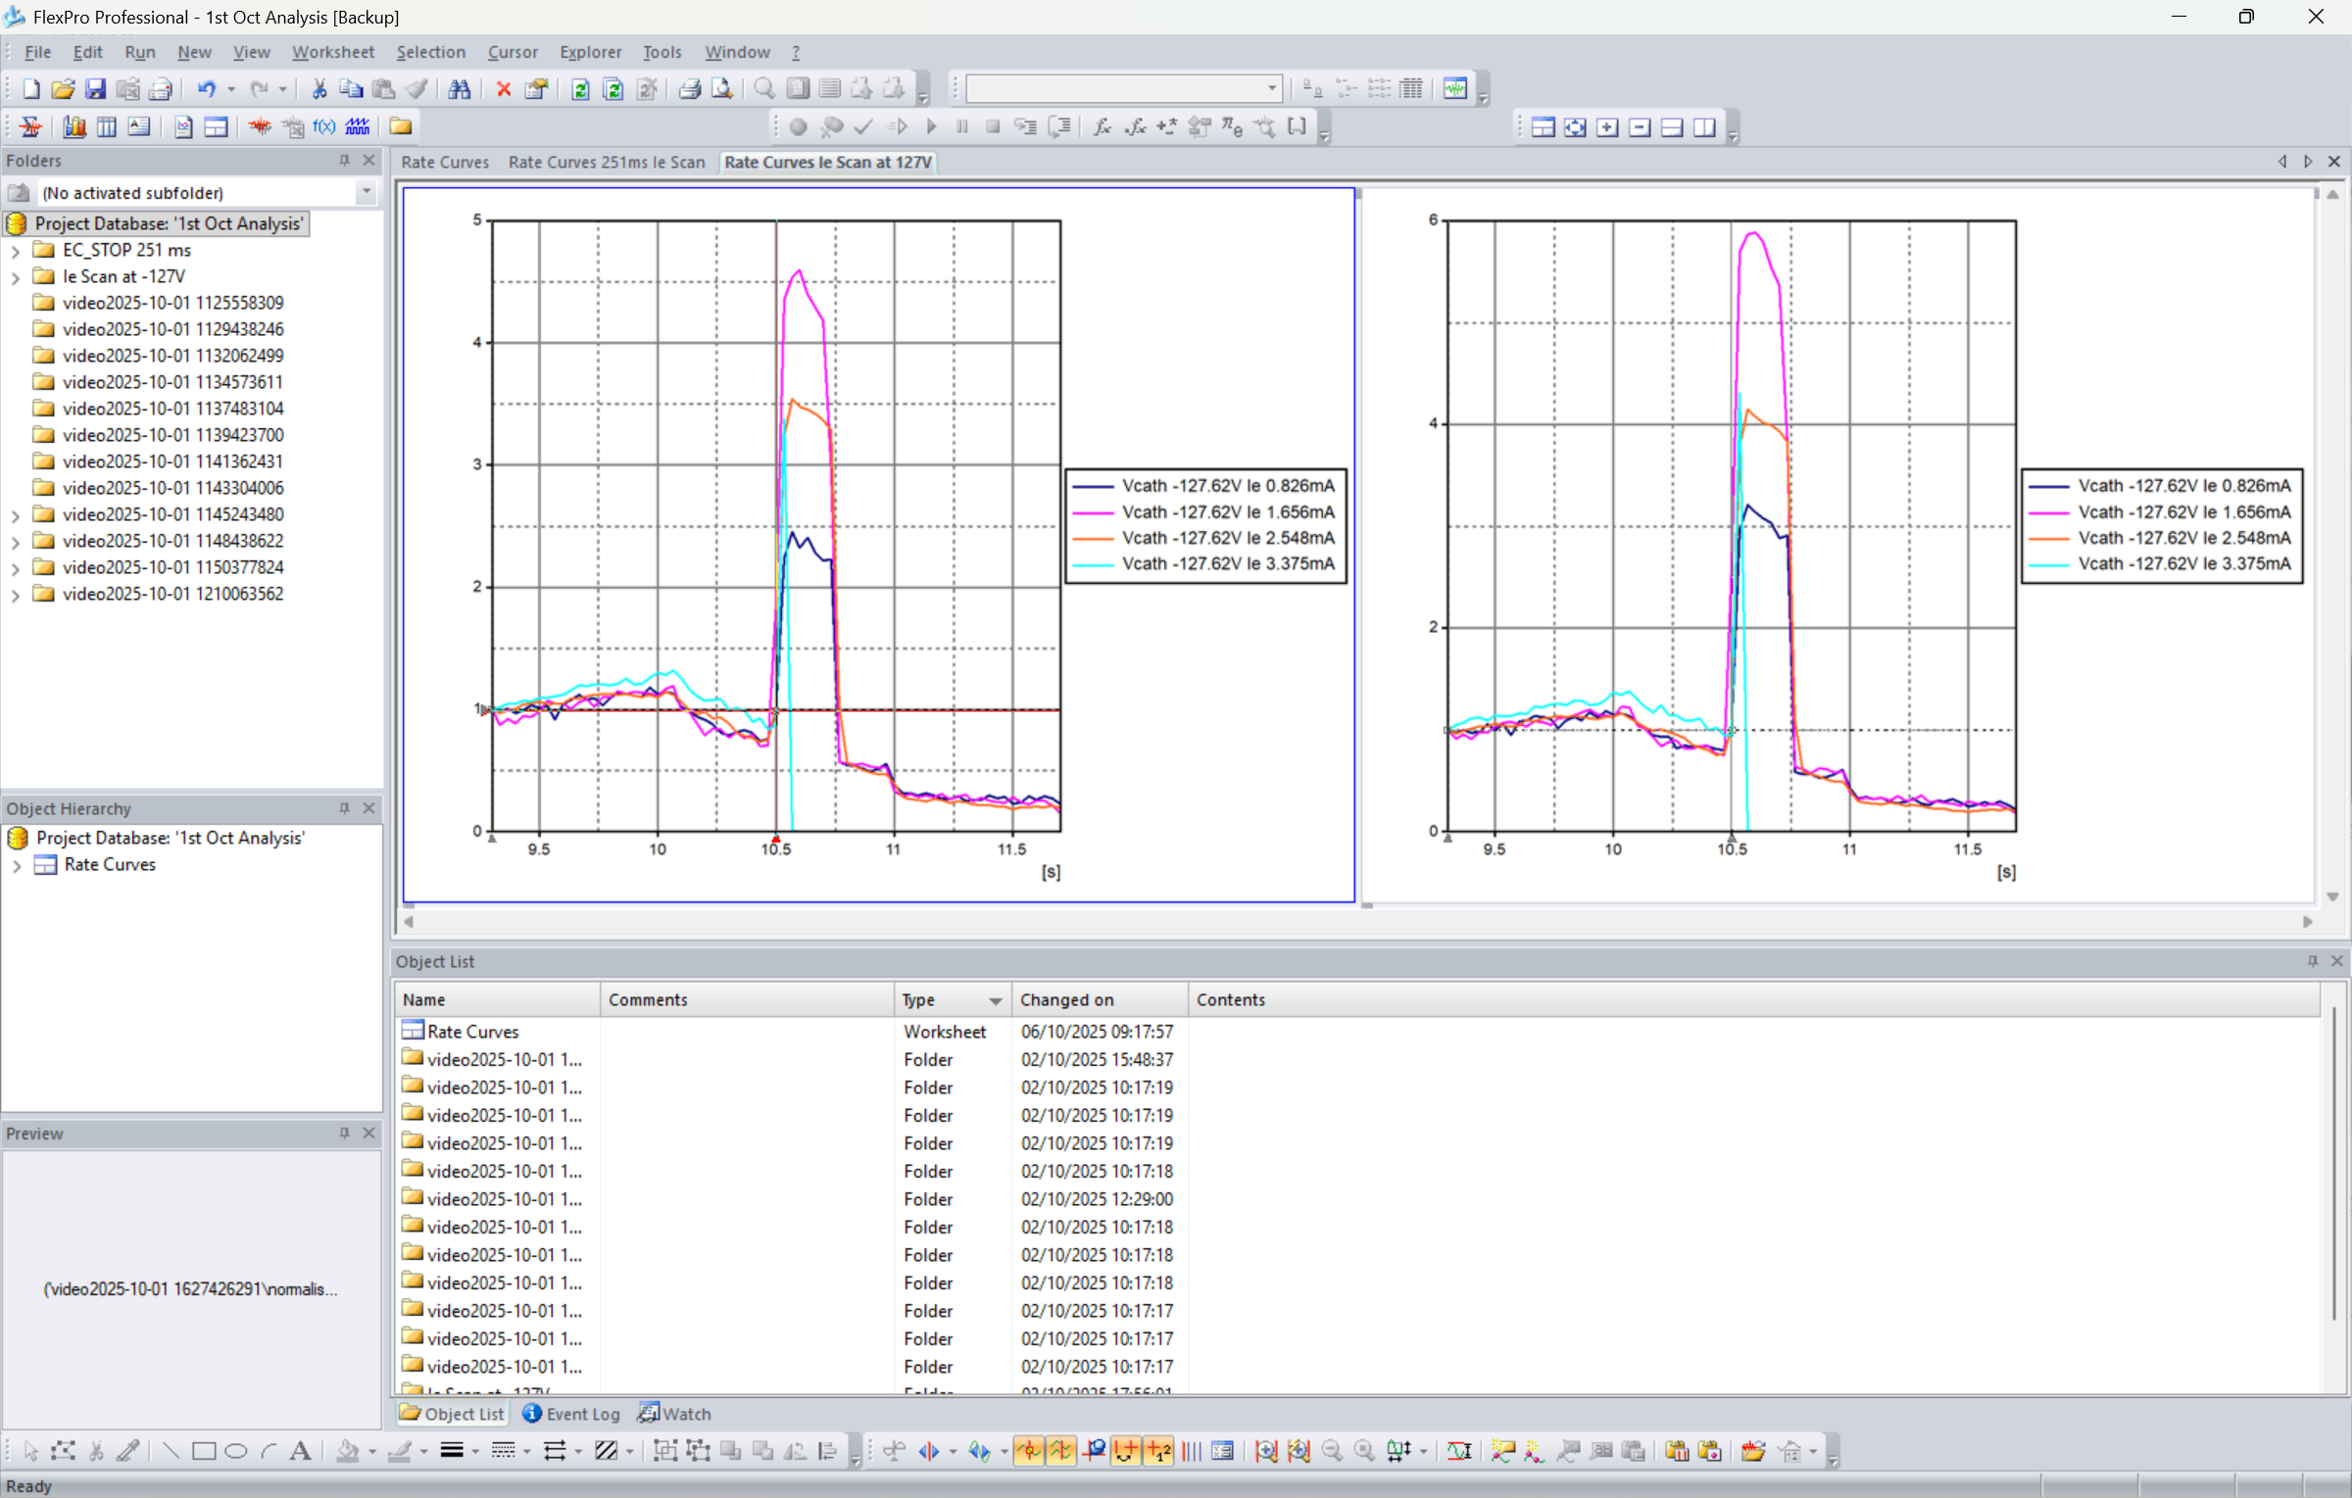
Offline Analysis S/W
Data analysis s/w in Python:
video playback
frame by frame analysis
position, size & stripping rate evolution
More detailed analysis with FlexPro 8

Slide 10
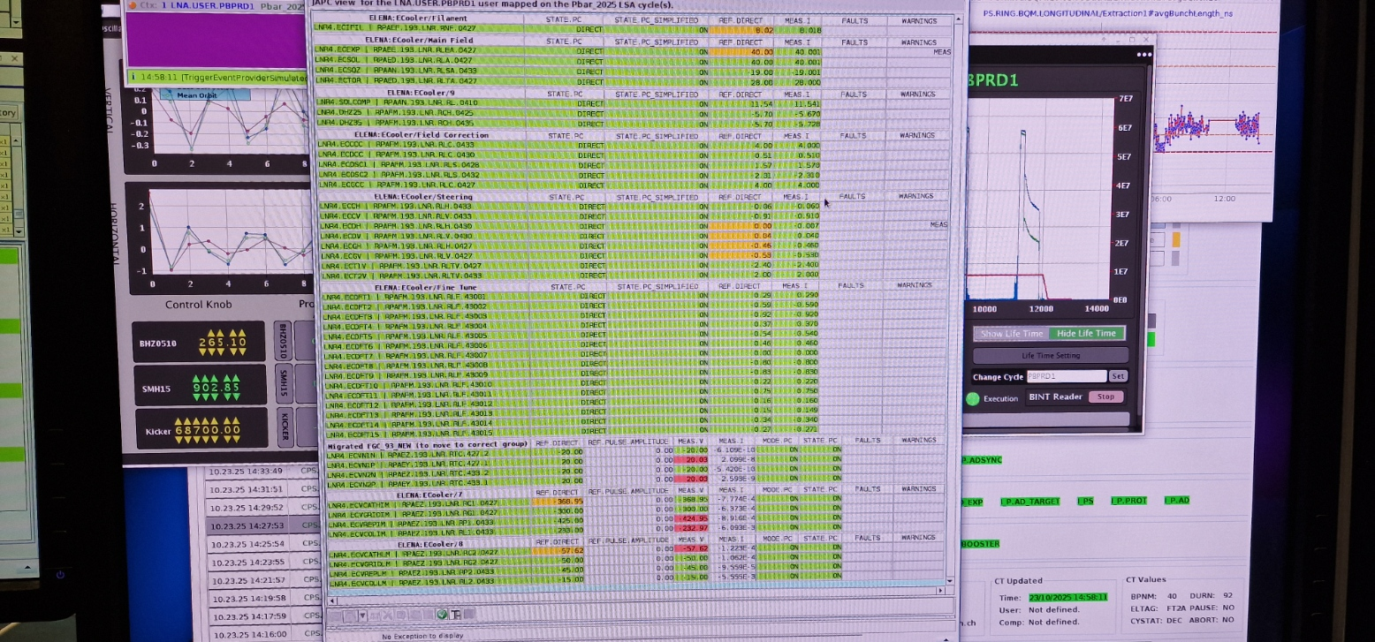
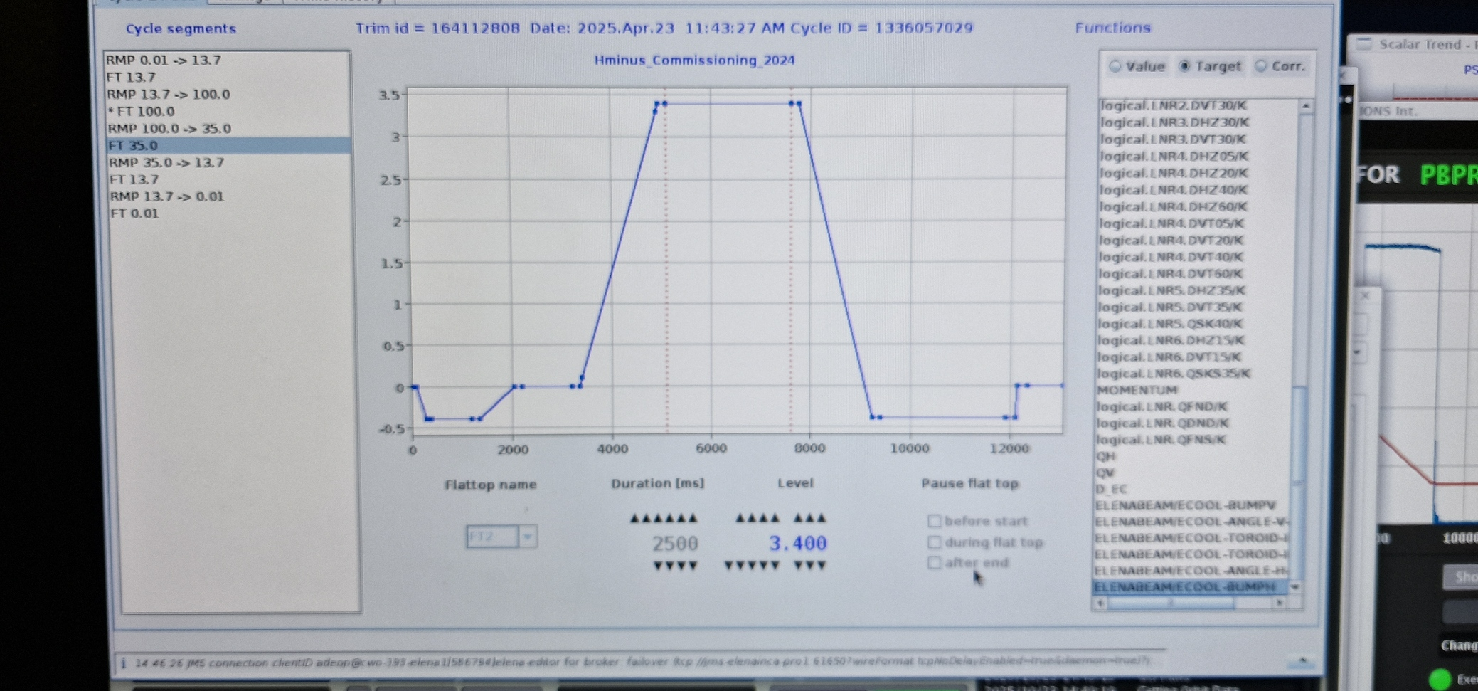
Measurements
H- beam scanned in position and angle on the two cooling plateaus
Some scans in electron beam position, intensity and electron beam expansion

Slide 11
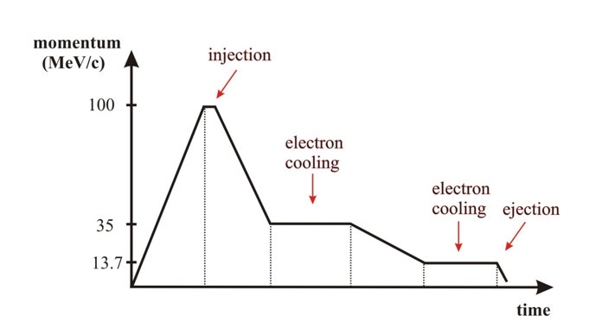
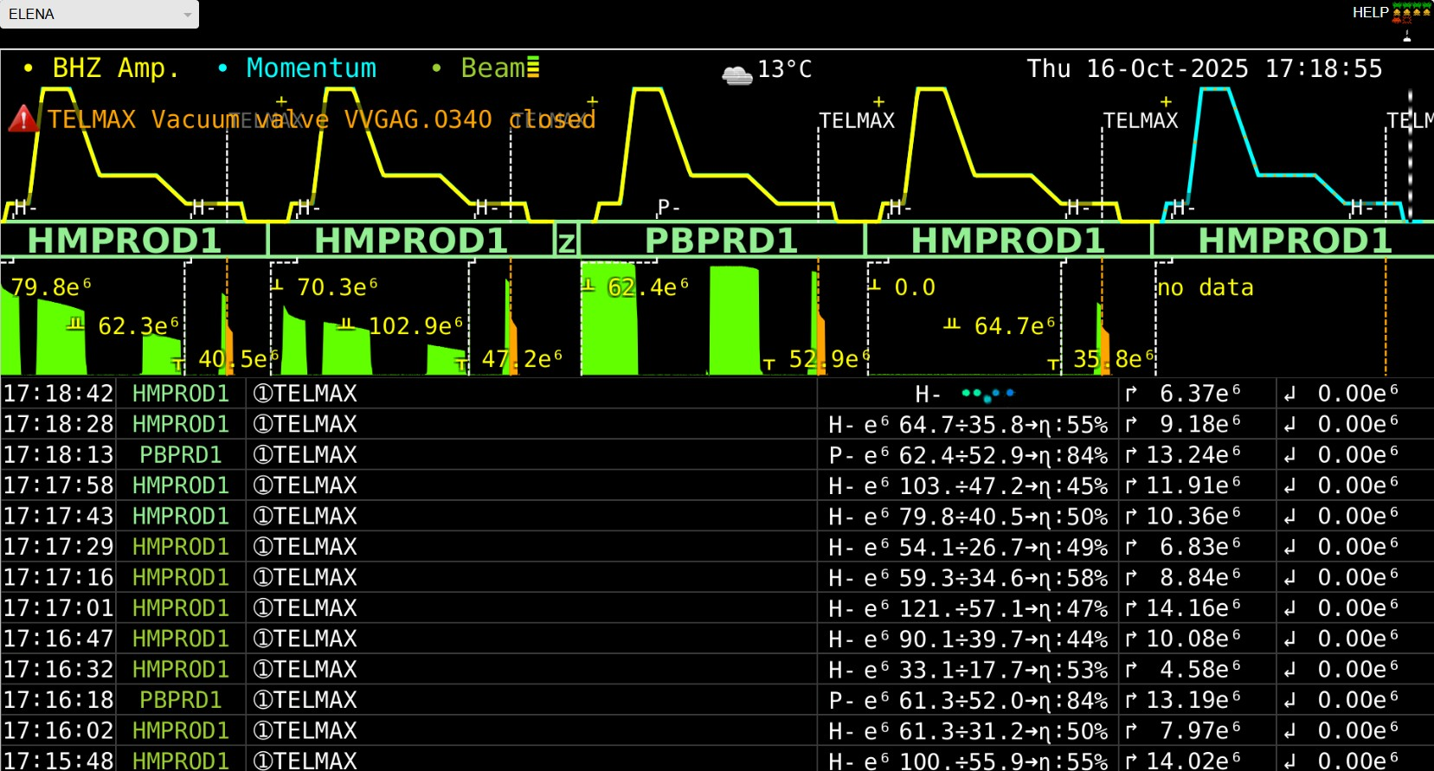
ELENA Magnetic Cycle
AD cycle length 110 s
ELENA cycle length 15 s

Slide 12
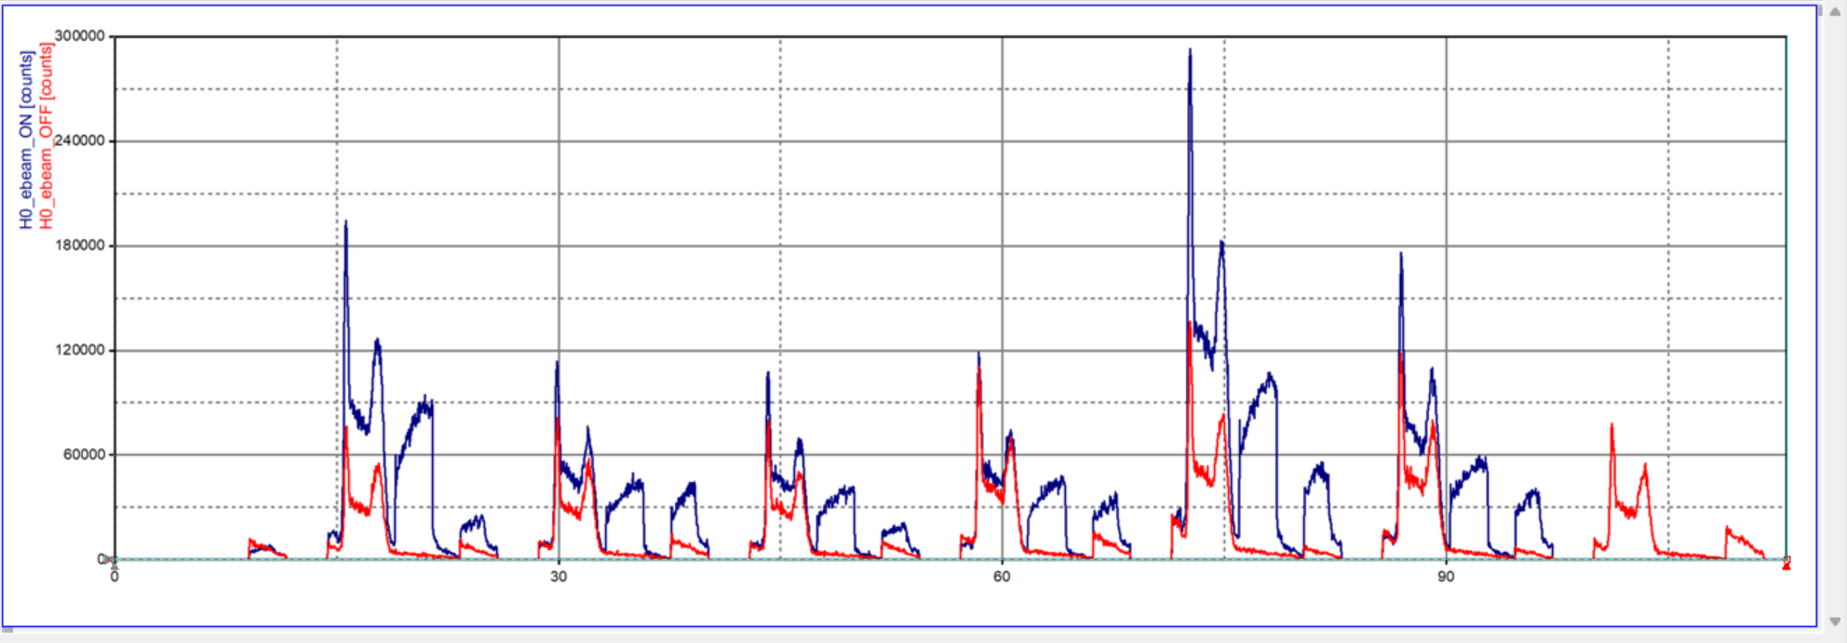
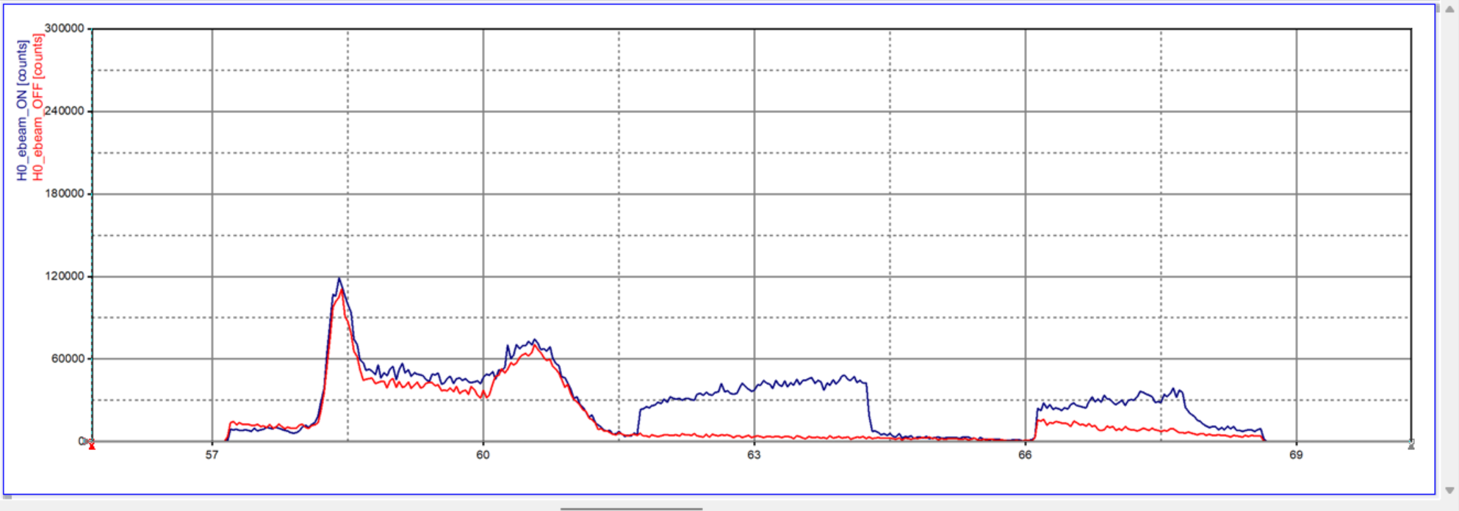
Can insert up to 7 ELENA H⁻ cycles per AD cycle
Stripping due to cooling electrons clearly seen

Slide 13
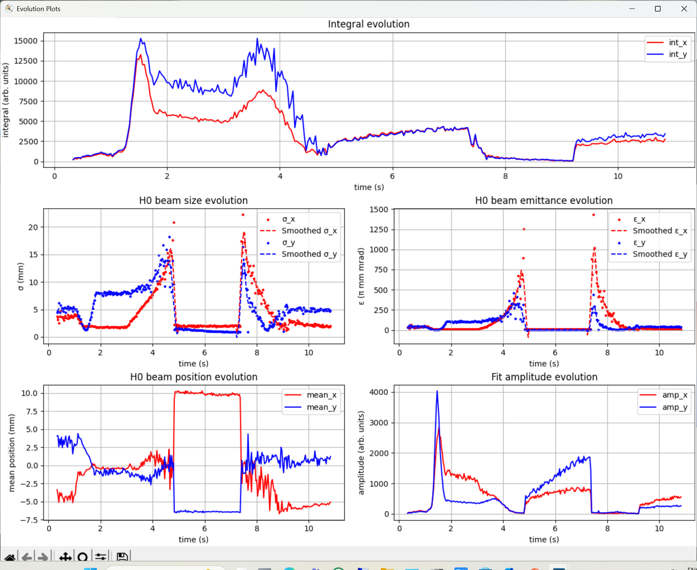
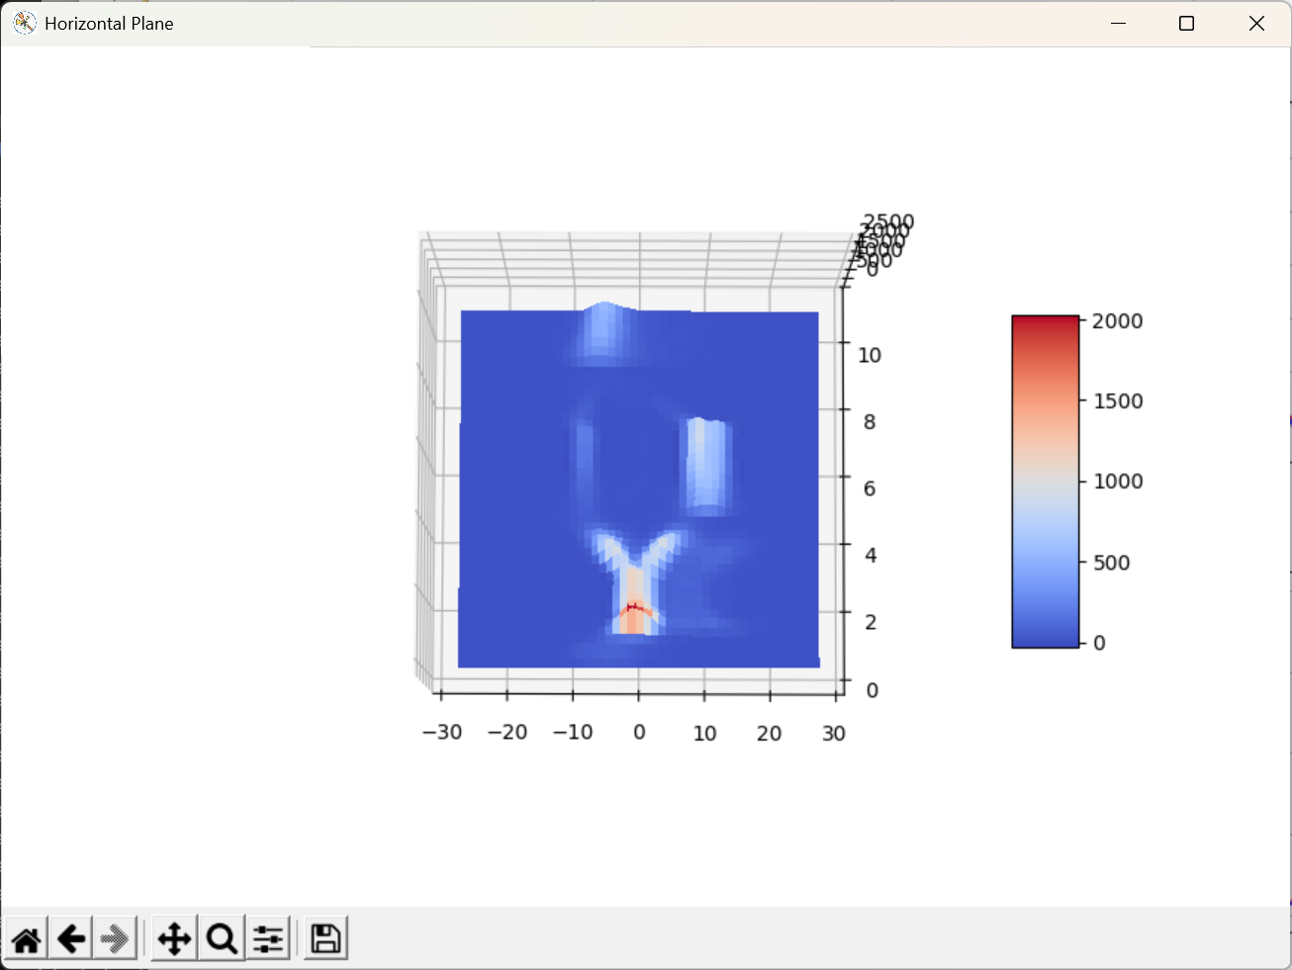
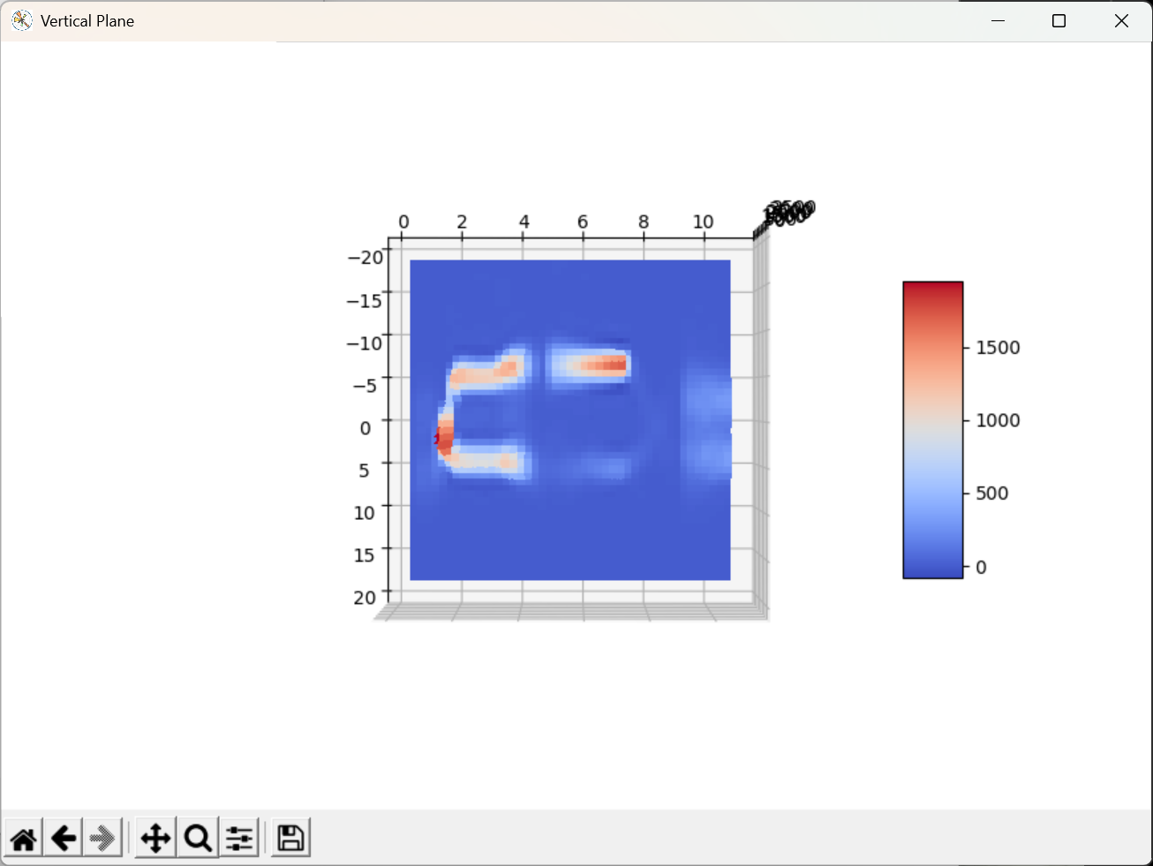
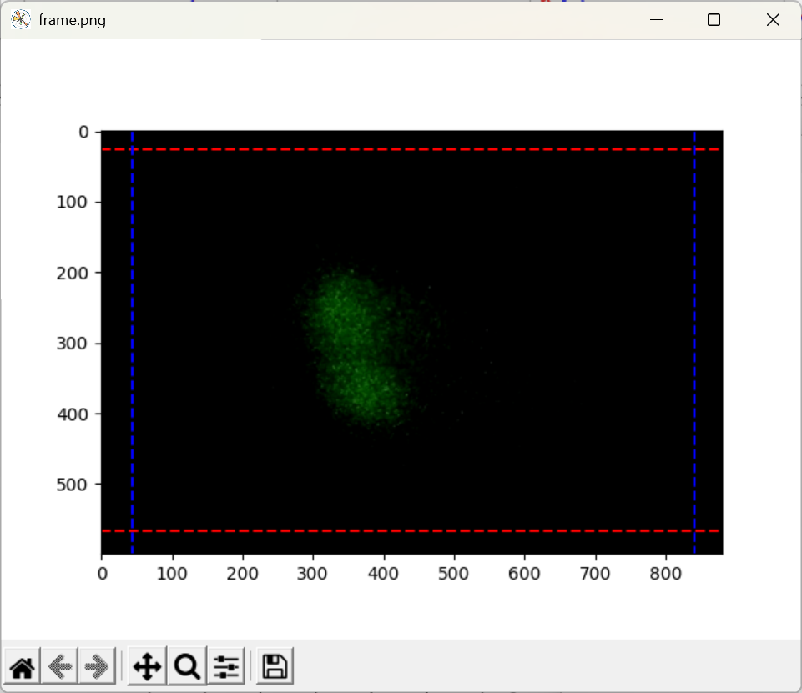
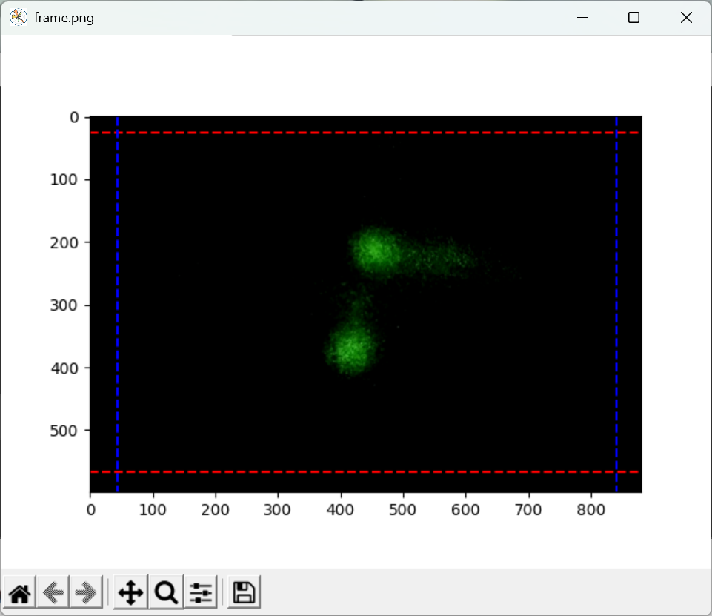
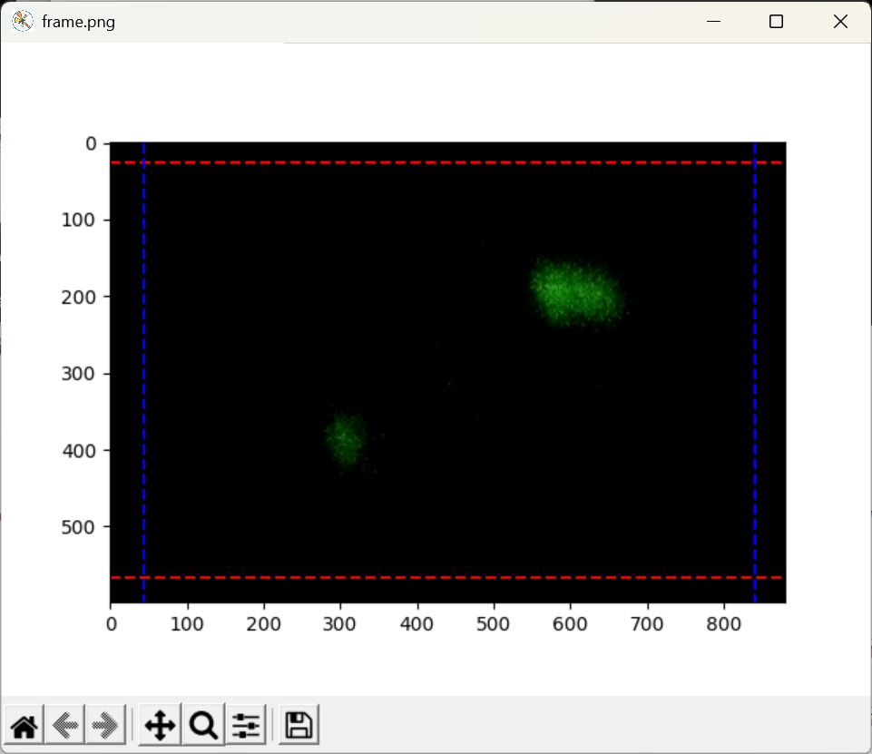
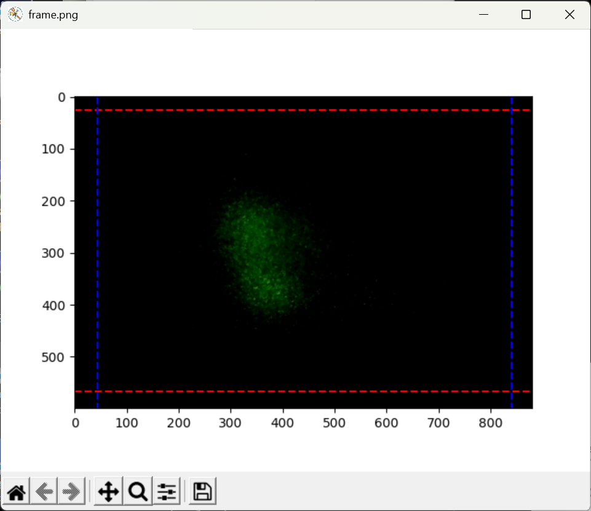
A Typical ELENA Cycle
Inj: 100 keV
5.3 MeV
368 keV
100 keV

Slide 14
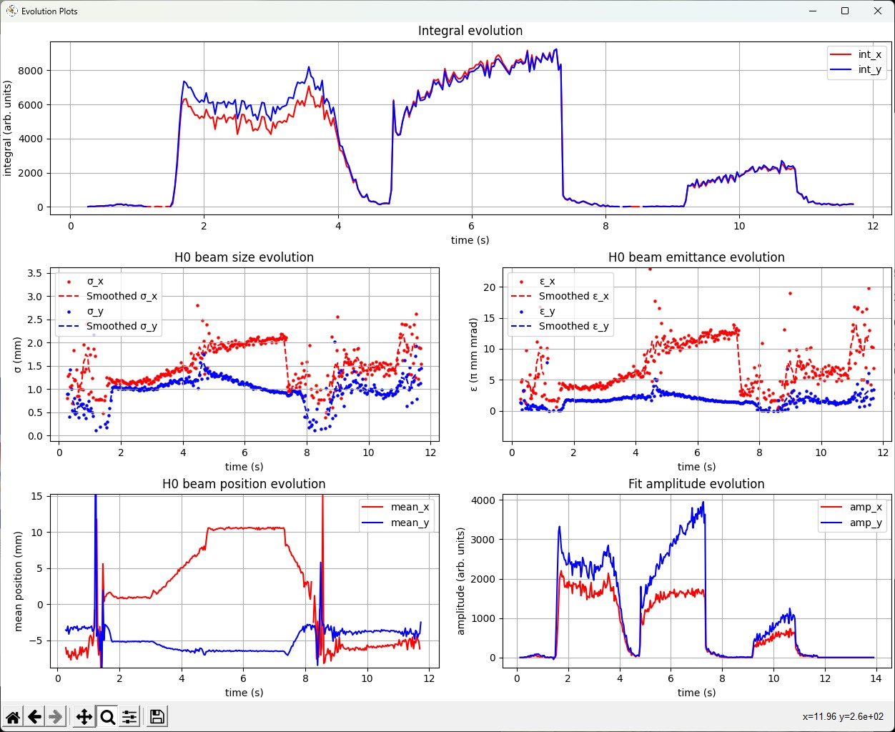
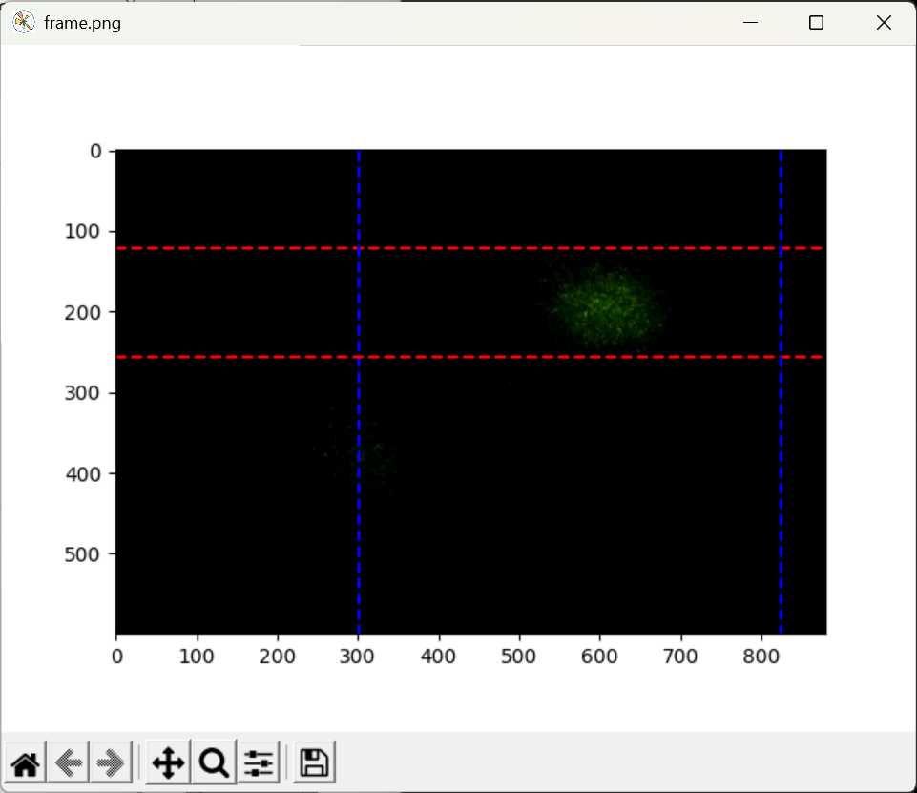
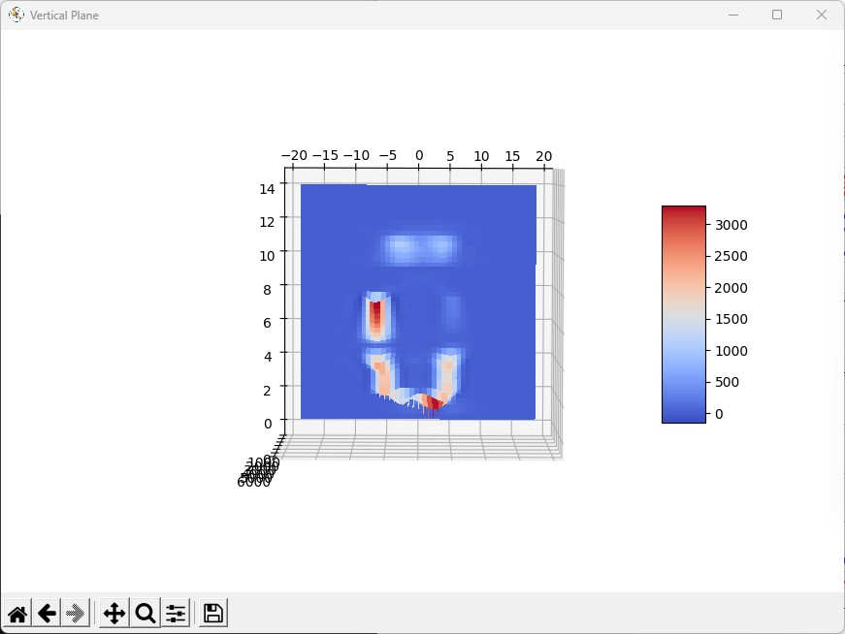
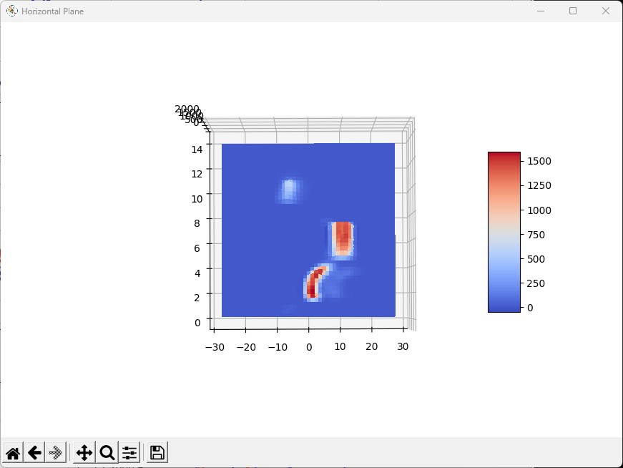
Selective analysis is needed to obtain the beam evolution on individual plateaus

Slide 15
Initial Machine Parameters
H- momentum (MeV/c) | Vcath (V) | Vgrid (V) | Ie (mA) | BUMPH | ANGLEH | BUMPV | ANGLEV
35 | -368.86 | -300 | 4.45 | 3.4 | 1.4 | 4.0 | 0.5
13.75 | -57.62 | -50 | 0.35 | -0.4 | -3.8 | 4.2 | -3.8

Slide 16
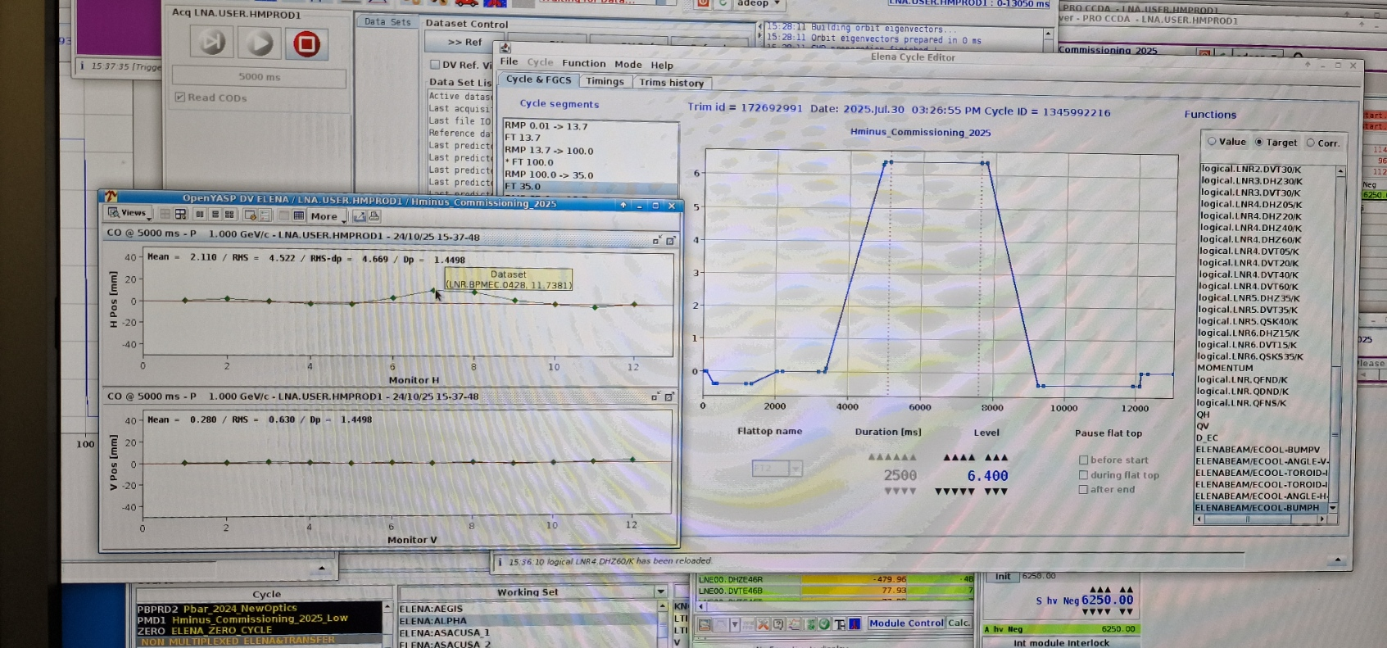
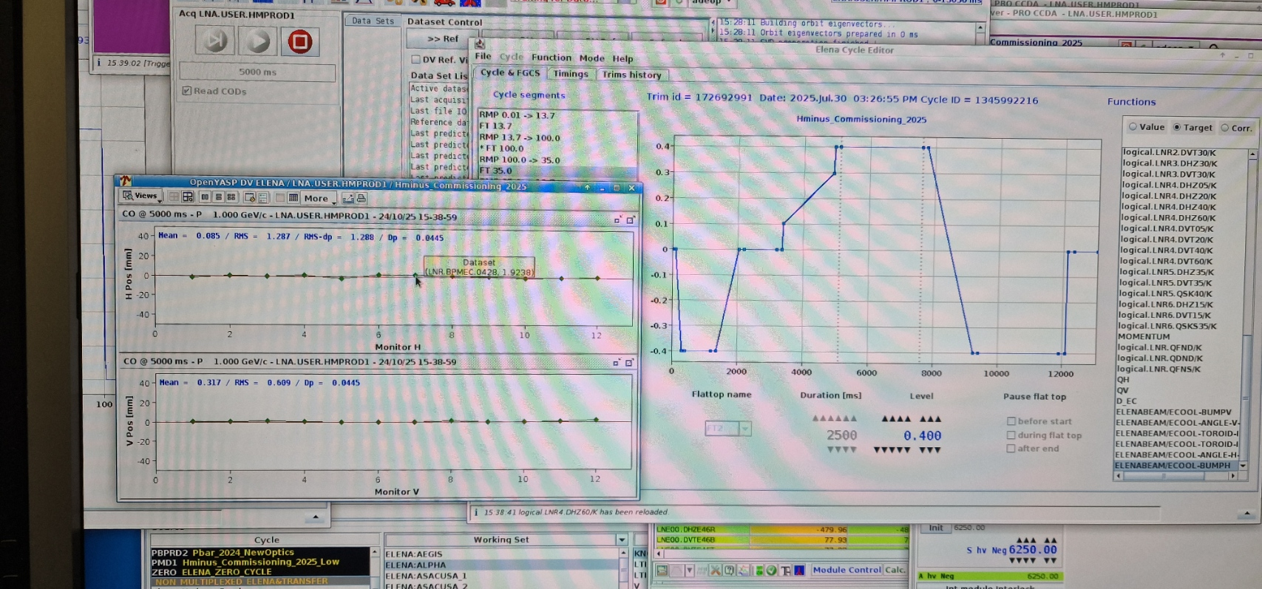
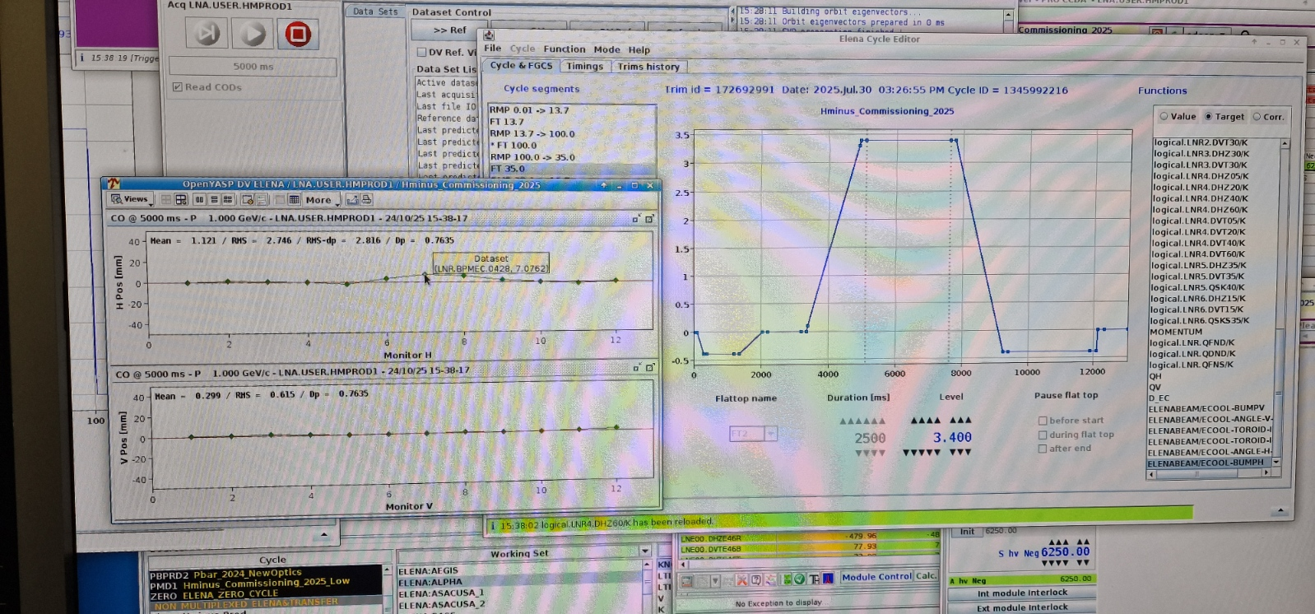
Horizontal Position Scan at 35 MeV/c
Horizontal position of the H⁻ beam bumped in (programmed) 1 mm steps (-5.6 mm to +7.4 mm)

Slide 17
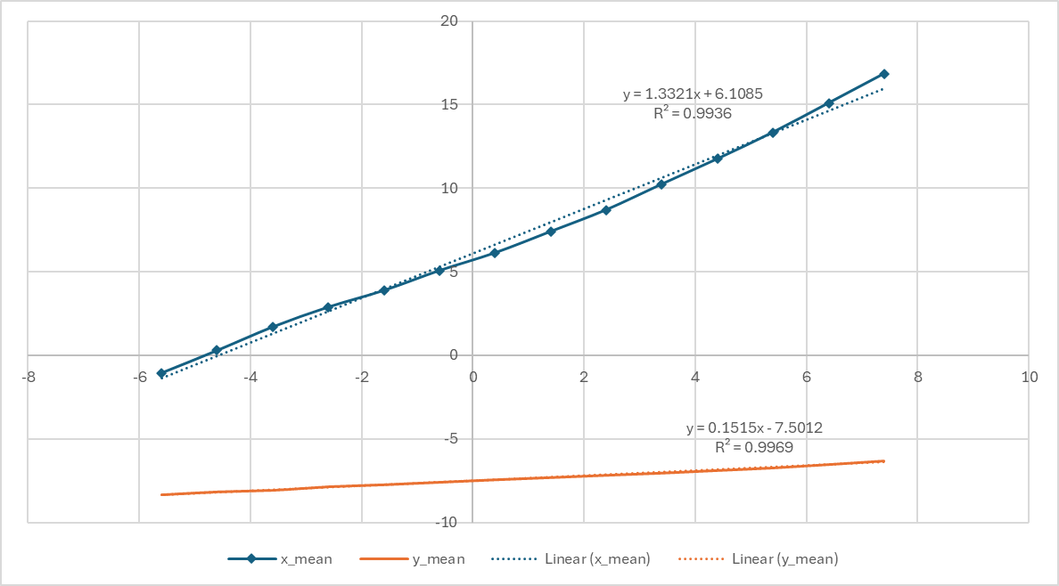
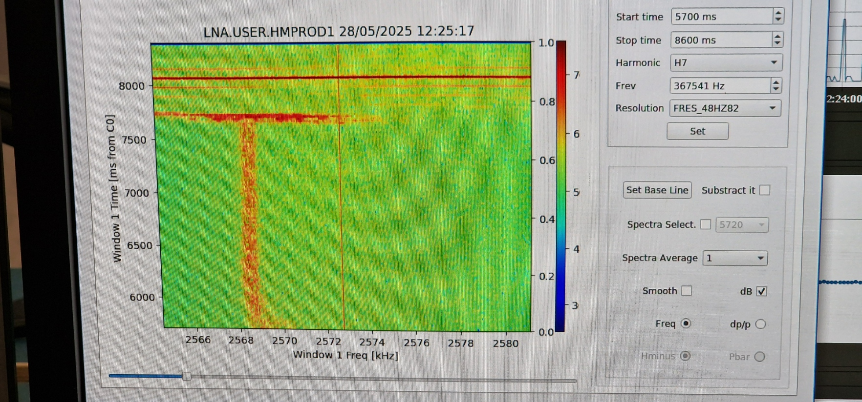
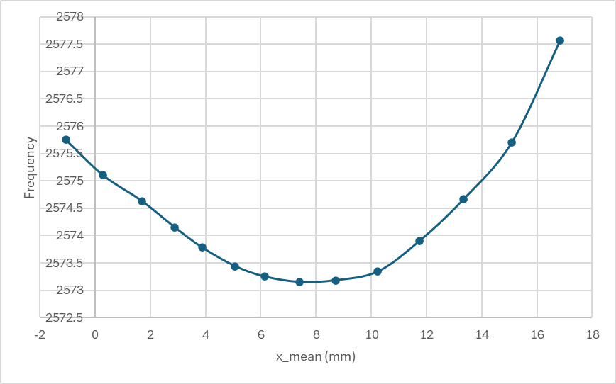
Measured position change vs programmed position bump
Revolution frequency vs beam position measured with the longitudinal Schottky monitor
Revolution frequency vs measured H0 horizontal position

Slide 18
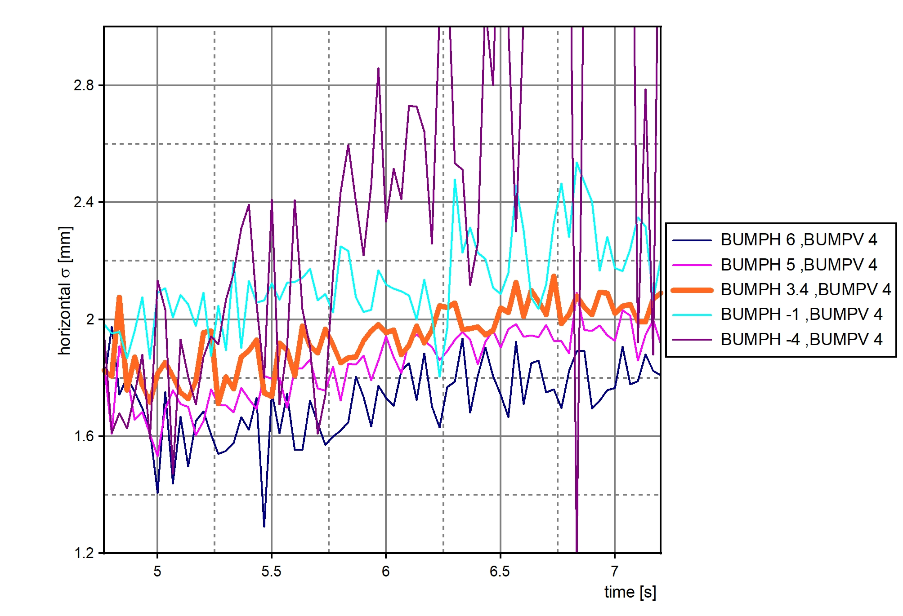
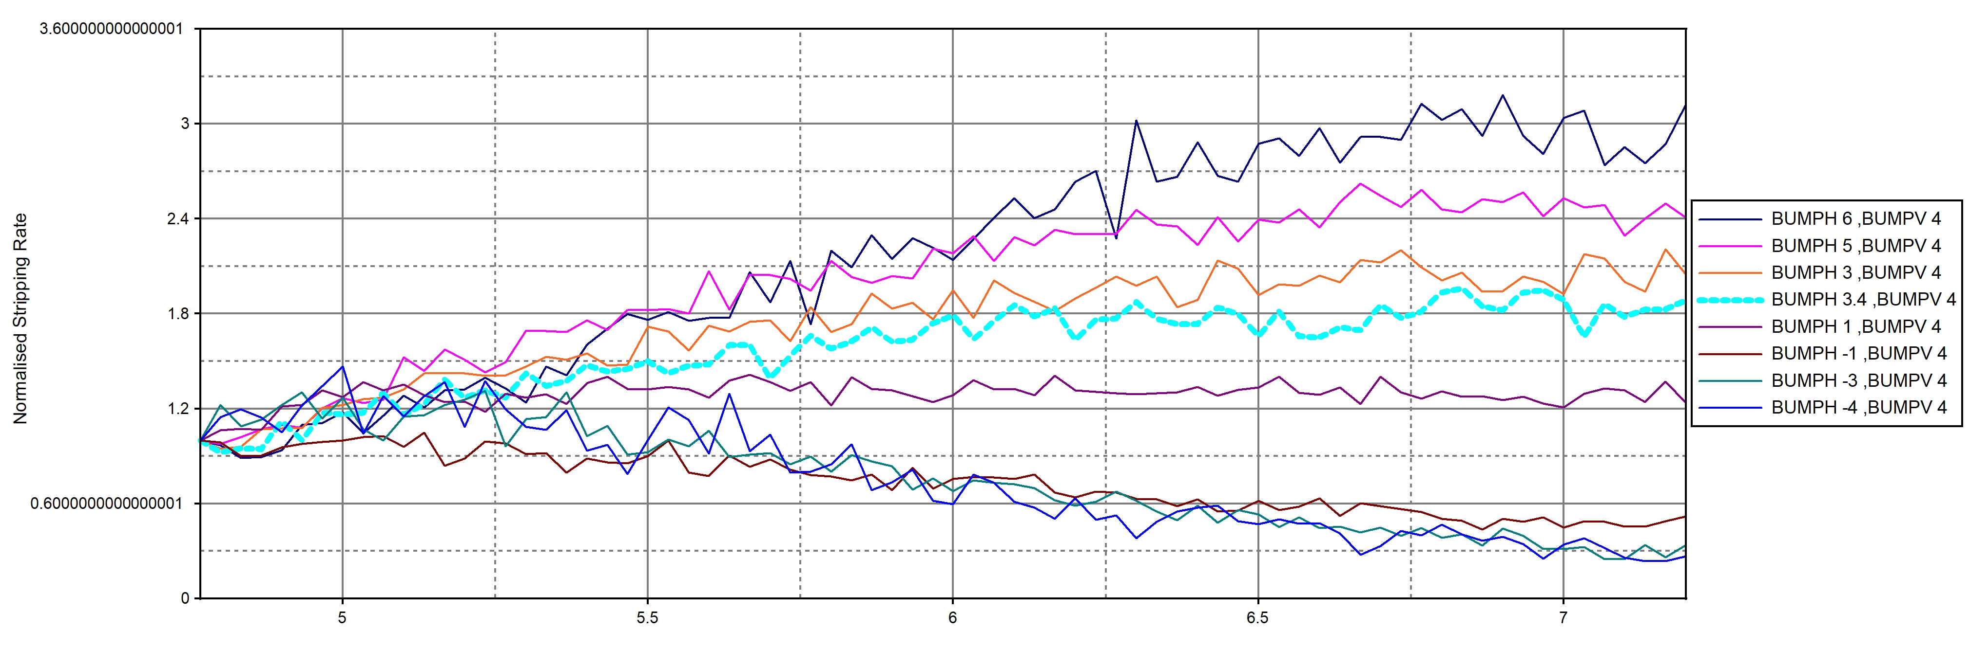
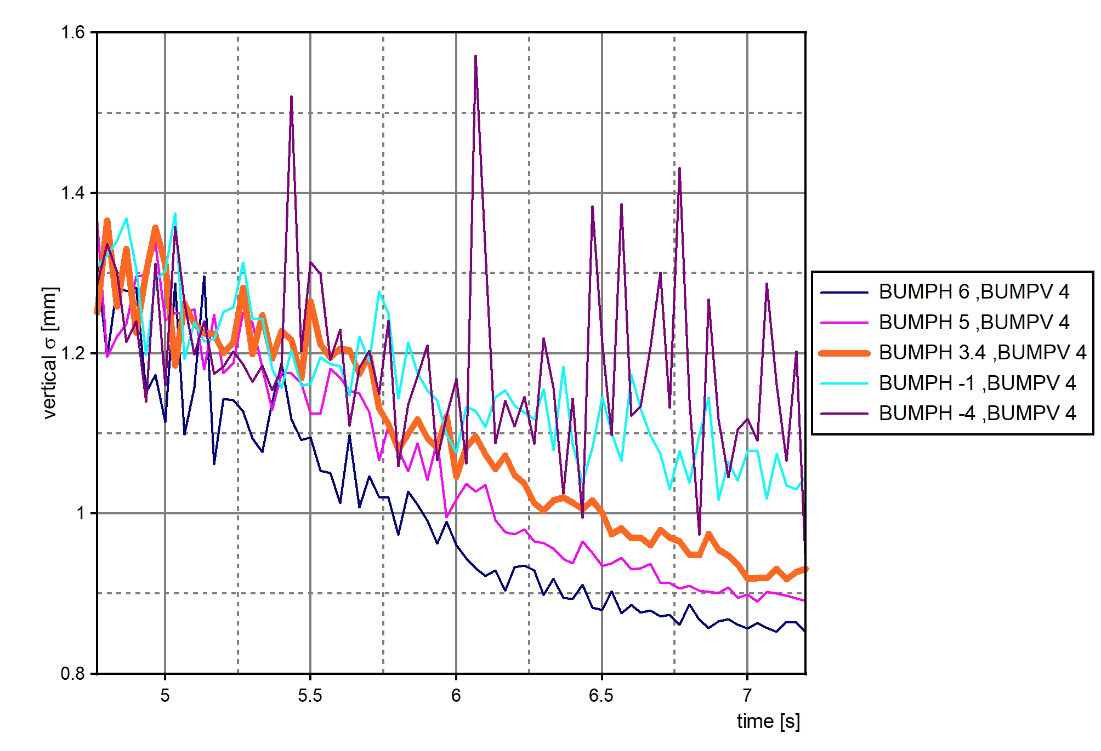
Beam size evolution f horizontal offset (BUMPH)
Stripping rate as a function of horizontal offset (BUMPH)

Slide 19
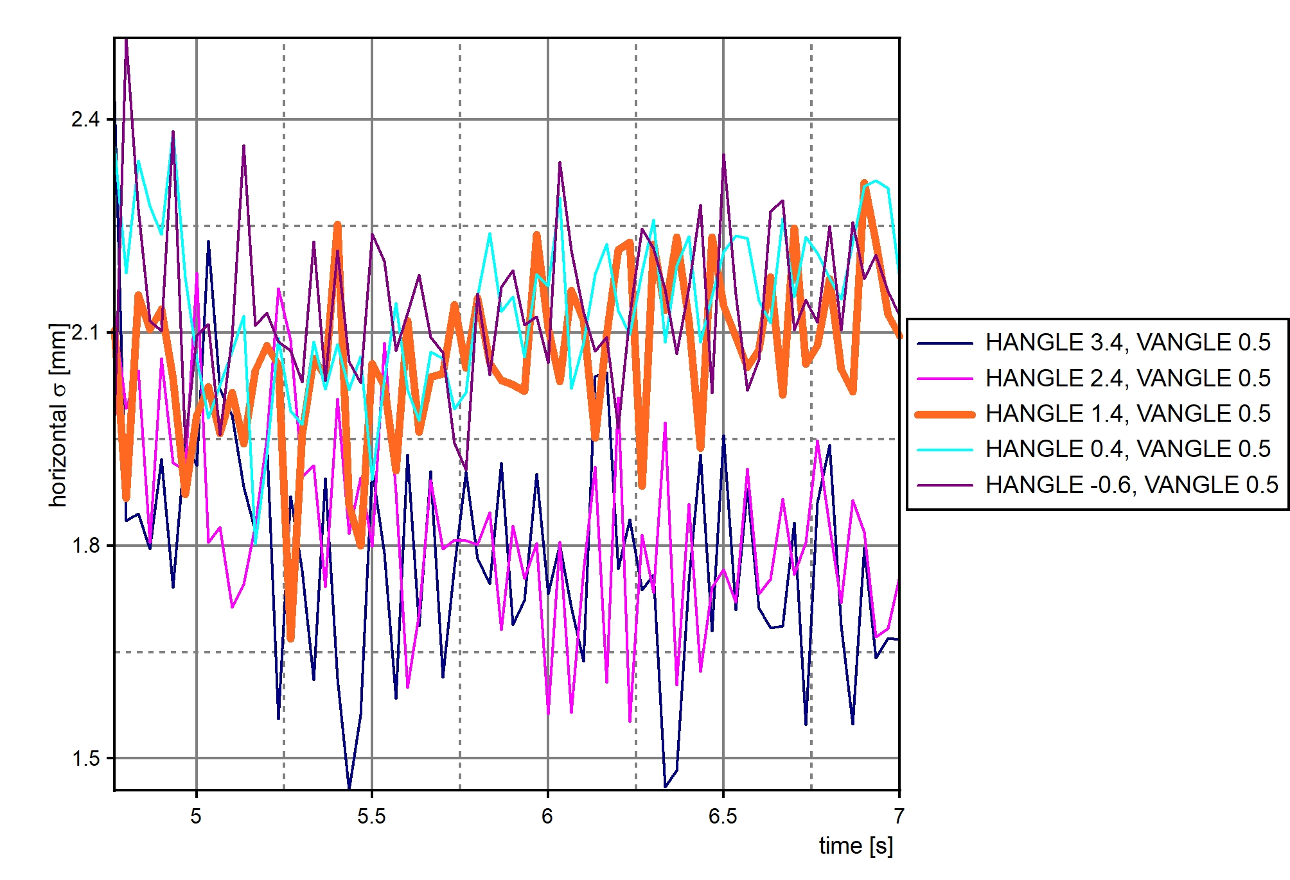
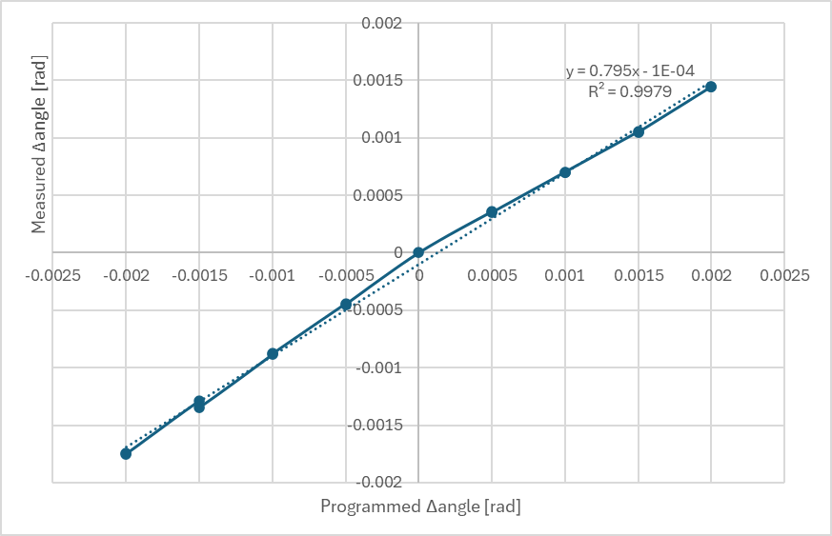
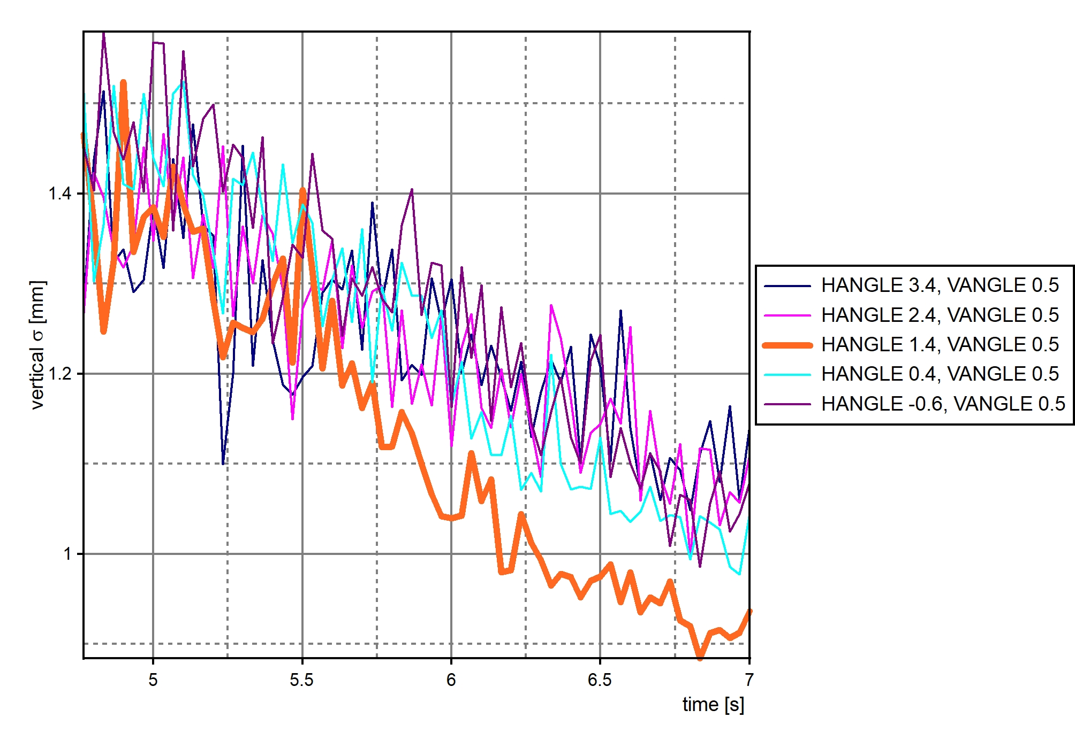
Horizontal Angle Scan at 35 MeV/c
Horizontal angle of the H⁻ beam bumped in (programmed) 0.5 mrad steps (3.4 mrad to -0.6 mrad, initial angle = 1.4)
Beam size evolution f horizontal angle (HANGLE)
Measured angle change vs programmed angle bump

Slide 20
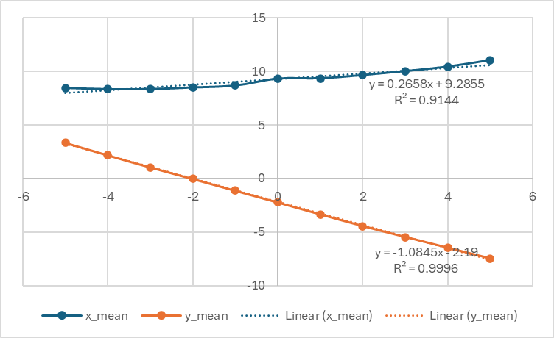
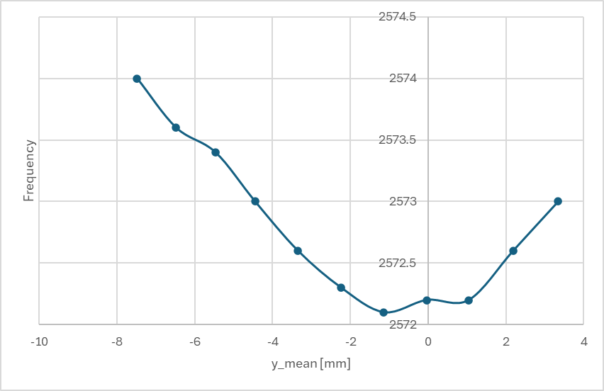
Vertical Position Scan at 35 MeV/c
Verticalal position of the H- beam bumped in (programmed) 1 mm steps (-5 mm to +5 mm)
Measured position change vs programmed position bump
Revolution frequency vs measured H0 vertical position

Slide 21



Beam size evolution f vertical offset (BUMPV)
Stripping rates as a function of vertical offset

Slide 22


Ie Scan at 13.75 MeV/c
Vcath (V) | Vgrid (V) | Ie (uA)
-57.62 | -50 | 348
 | -48 | 407
 | -46 | 460
 | -44 | 520
 | -42 | 590
 | -40 | 650
-60.32 | -40 | 750
Beam size evolution for varying electron currents
Cooler voltage settings

Slide 23




Horizontal plane Ie = 520uA
Vertical plane Ie = 520uA
Horizontal plane Ie = 348uA
Vertical plane Ie = 348uA

Slide 24



Electron Detachment Cross Section of H⁻ Studies
e⁻
ON
After the end of cooling at 13.7 MeV/c, the beam is bunched (to have an intensity measurement) and then the cooling is switched on again.
Ref.
ref

Slide 25


Scan of V_{grid} (I_{e}) with V_{vath} fixed at -127.62V
Scan of V_{cath} with V_{grid} fixed at -50V

Slide 26
Conclusions and Outlook
H0 monitor has been shown to be a useful tool to optimise the ELENA electron cooler
It is the only non-destructive instrument for beam size measurements on ELENA
However, measurements can only be made during dedicated machine experiment sessions due to the non-ppm power supplies used for the cooler
The preliminary measurements on the beam alignment indicate that there is definitely room for improvement
This needs to be confirmed with antiprotons (scraper measurements)
Influence on electron current and beam expansion needs to be further addressed
Electron detachment cross-section measurements will be investigated in more detail
The camera will be replaced with a standard SY/BI system and ported to the main control system during the next shutdown

