Slide 1
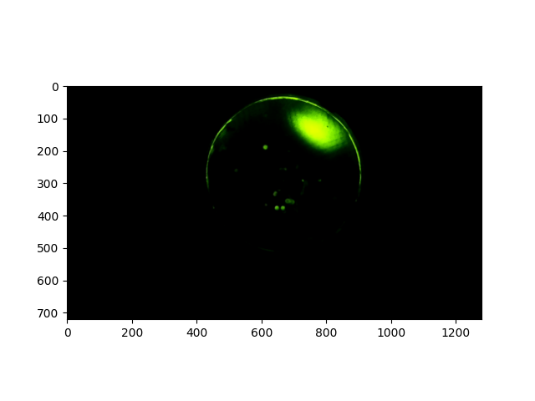
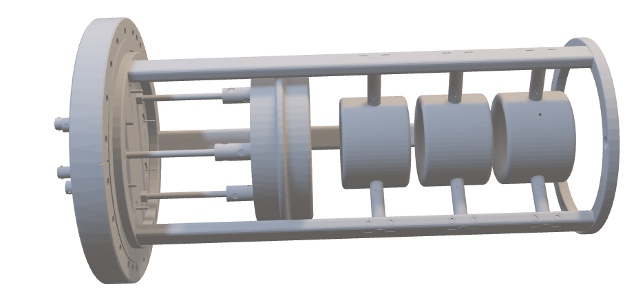
Progress Towards a Field Emission Electron Gun for ELENA
Gerard Alain TRANQUILLE,
CERN, Switzerland
Elisabeth-Sena WELKER,
CERN, Switzerland and TU Vienna, Austria
Notes:
AI-generated content may be incorrect. --- This presentation focuses on the development of a field emission electron gun tailored for ELENA. We will explore the scientific goals of ELENA, the role of electron guns, and the technical demands posed by this cutting-edge facility.

Slide 2
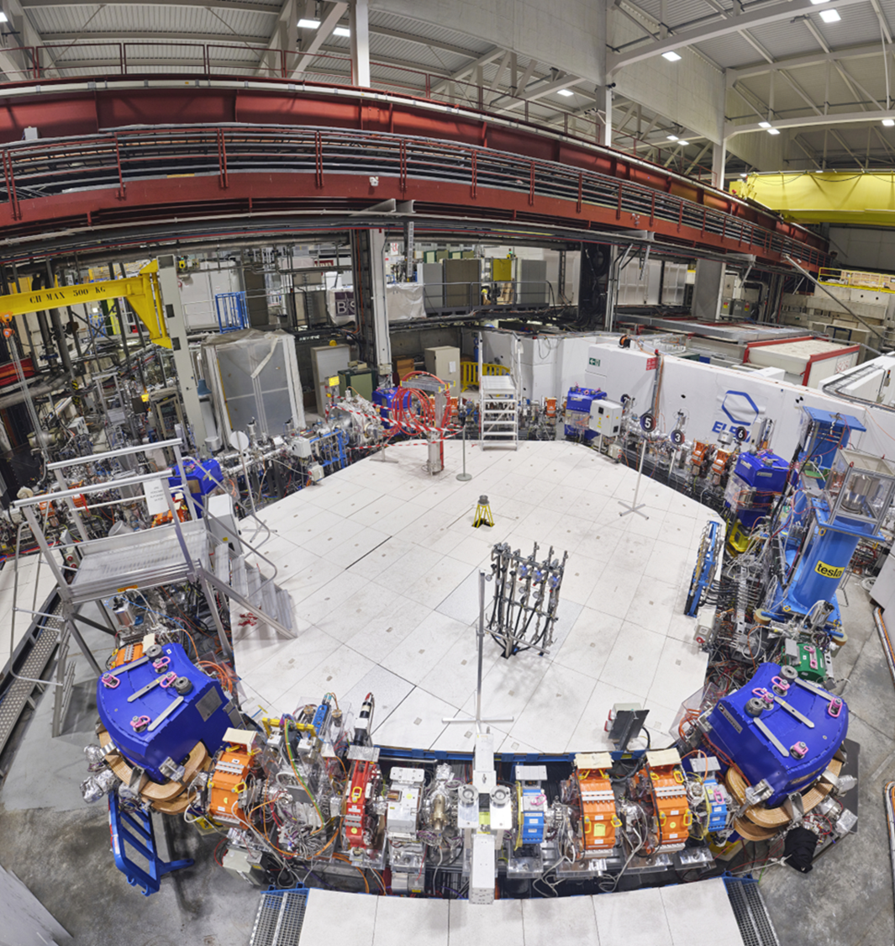
MOTIVATION
Generation of a “cold” electron beam for cooling at ELENA energies
Simplicity for operation
no filament heating
faster electron emission
Lower energy spread
Could also serve as a source for an electron beam scanner
Item | Value | Dimension
Momentum | 35 / 13.7 | MeV/c
Electron Beam Energy | 355 / 55 | eV
Electron Current | 5 / 1 | mA
B Gun | 1000 | G
B Drift | 100 | G
Toroid Bending Radius | 0.25 | m
Cathode Radius | 8 | mm
Electron beam Radius | (25) | mm
Cooling (drift) Length | 1.0 | m
Total Cooler Length | 1.93 | m

Slide 3
Presentation Outline
Fundamentals of Field Emission (FE) and Carbon Nanotube (CNT) Characterisation
FECNT Gun Design and Testbench
Cold Cathode Testbench Measurements
Notes:
We will begin with an introduction to ELENA and its electron source requirements. Next, we will review the fundamentals of field emission electron guns and their advantages. Then, we'll discuss recent progress in design and development, followed by integration and testing within the ELENA environment.

Slide 4
Fundamentals of Field Emission
Notes:
Field emission electron guns operate by emitting electrons through quantum tunneling under strong electric fields. This section explains the core physics, contrasting them with traditional electron sources to highlight their unique features.

Slide 5
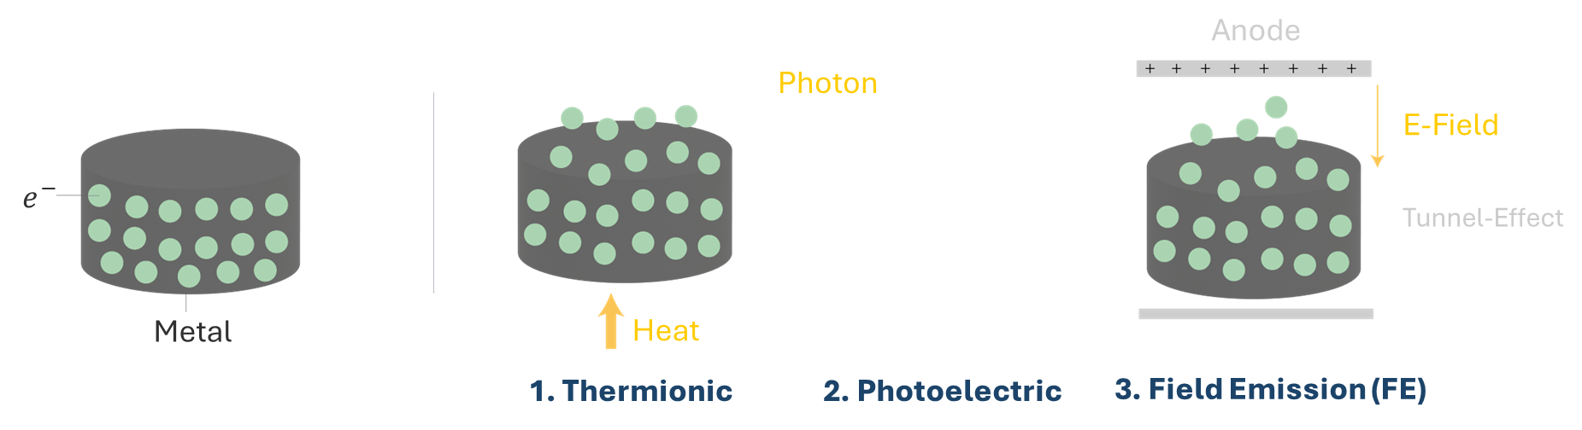
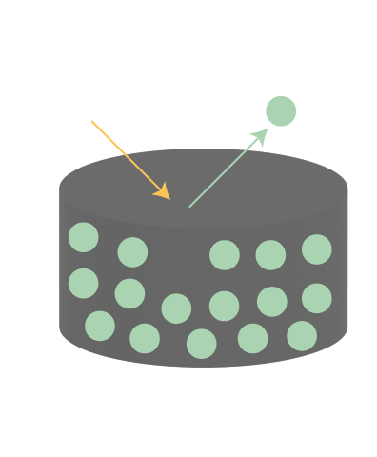
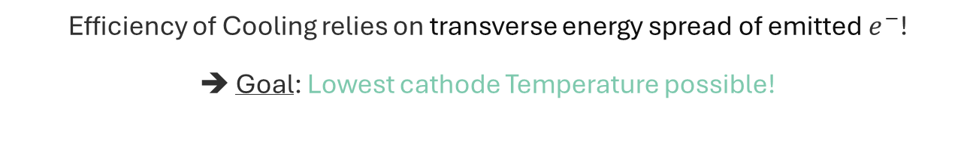
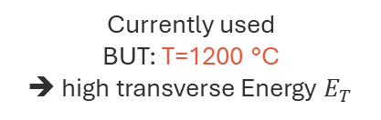
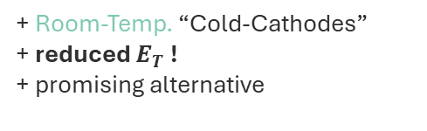
Field Emission
Efficiency of Cooling relies on transverse energy spread of emitted $e^{−}$!
➔ Goal: Lowest cathode Temperature possible!
3 ways of extracting electrons from the surface of a metal:
Currently used
BUT: T=1200 °C
➔ high transverse Energy $E_{T}$
+ Room-Temp. “Cold-Cathodes”
+ reduced $E_{T}$ !
+ promising alternative

Slide 6

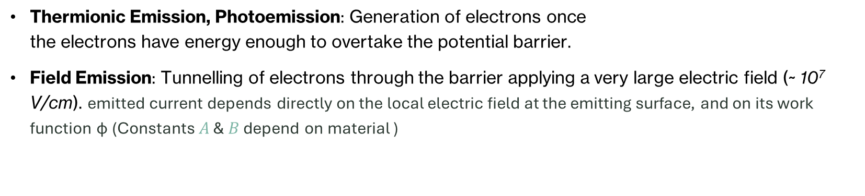
Thermionic Emission, Photoemission: Generation of electrons once the electrons have energy enough to overtake the potential barrier.
Field Emission: Tunnelling of electrons through the barrier applying a very large electric field (~ 10⁷ V/cm). emitted current depends directly on the local electric field at the emitting surface, and on its work function φ (Constants $A$ & $B$ depend on material )
$$J=AE^{2}exp⁡(−\frac{B}{E})$$
Source
Vacuum
Source
Vacuum
Workfunction
Barrier
Filled electron states
Filled electron states
Effect of applied electric field on potential barrier.

Slide 7
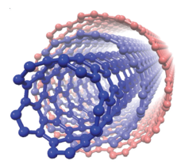
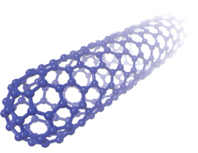
Carbon Nanotubes (CNT)
For flat surfaces the required electric field is too strong.
Possible solution: Field Enhancement with tips
PROS:
High aspect ratio -> High enhancement
Emit at low field, in order of some V/μm
Scalable production techniques
Chemical inertness and stable structure
CONS:
Small emitted current per tip
Screening effects
Impurities and defects
Multi-Wall carbon NanoTube (MWNT)
I = emission current (amps)
n = the number of tips
α = emitting area per tip (cm²)
β = field-forming factor (E= βV)
V = applied voltage (volts)
φ = work function (eV)
Single-Wall NanoTube (SWNT)

Slide 8
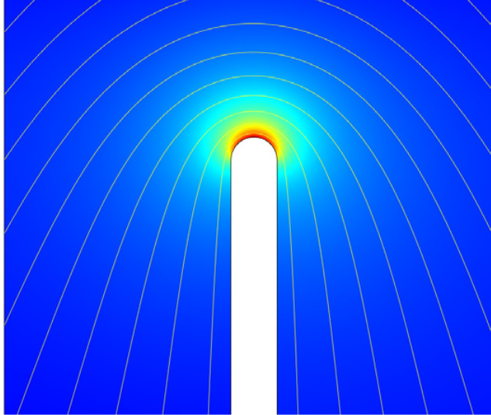
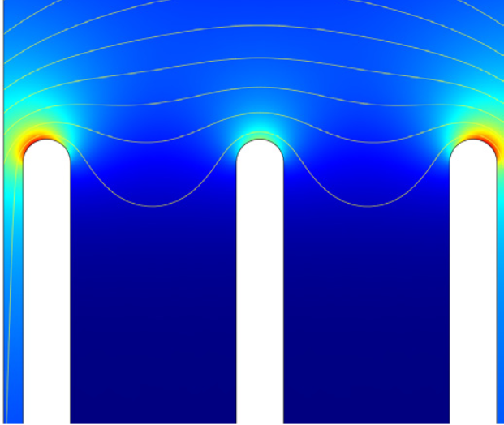
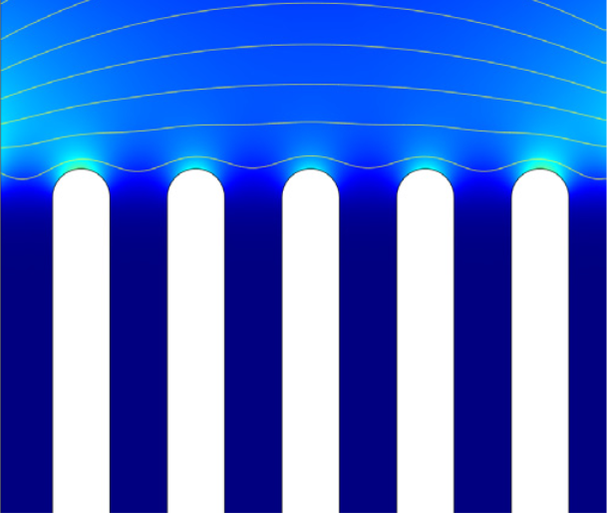
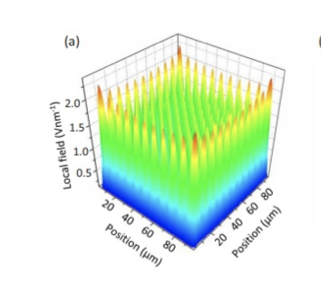
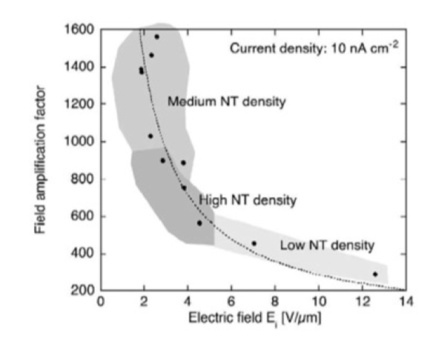
Single CNT
• Strongest E-field
• Complete electrostatic
field penetration
3 CNTs
• Significantly reduced E-field penetration
CNT array
• Screening effects are
significant
➔ when the nanotubes are densely packed, the field lines cannot fully penetrate, therefore limiting the field enhancement.

Slide 9
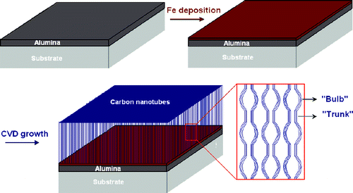
CNT synthesis by chemical vapor deposition (CVD)
Substrate Si wafer
Deposition of catalyst-support film (~10 nm of aluminium oxide (Al₂O₃))
Deposition of active metal catalyst film (0.5–3 nm of Fe) ➔ catalyst layer acts as nucleation sites for CNT growth
CNT synthesis by chemical vapor deposition (CVD)
The substrate with the catalyst is placed inside a reaction chamber with controlled environmental conditions.
The chamber is evacuated to remove any impurities and then filled with a precursor hydrocarbon gas (e.g., methane, ethylene, or acetylene) and a carrier gas (e.g., hydrogen).
The reaction chamber is heated => the carbon precursor gas decomposes into atomic carbon
Carbon Nanotube Growth: atomic carbons diffuse towards the catalyst particles on the substrate surface. => CNTs grow vertically aligned on the substrate due to the catalytic action of the metal particles.

Slide 10
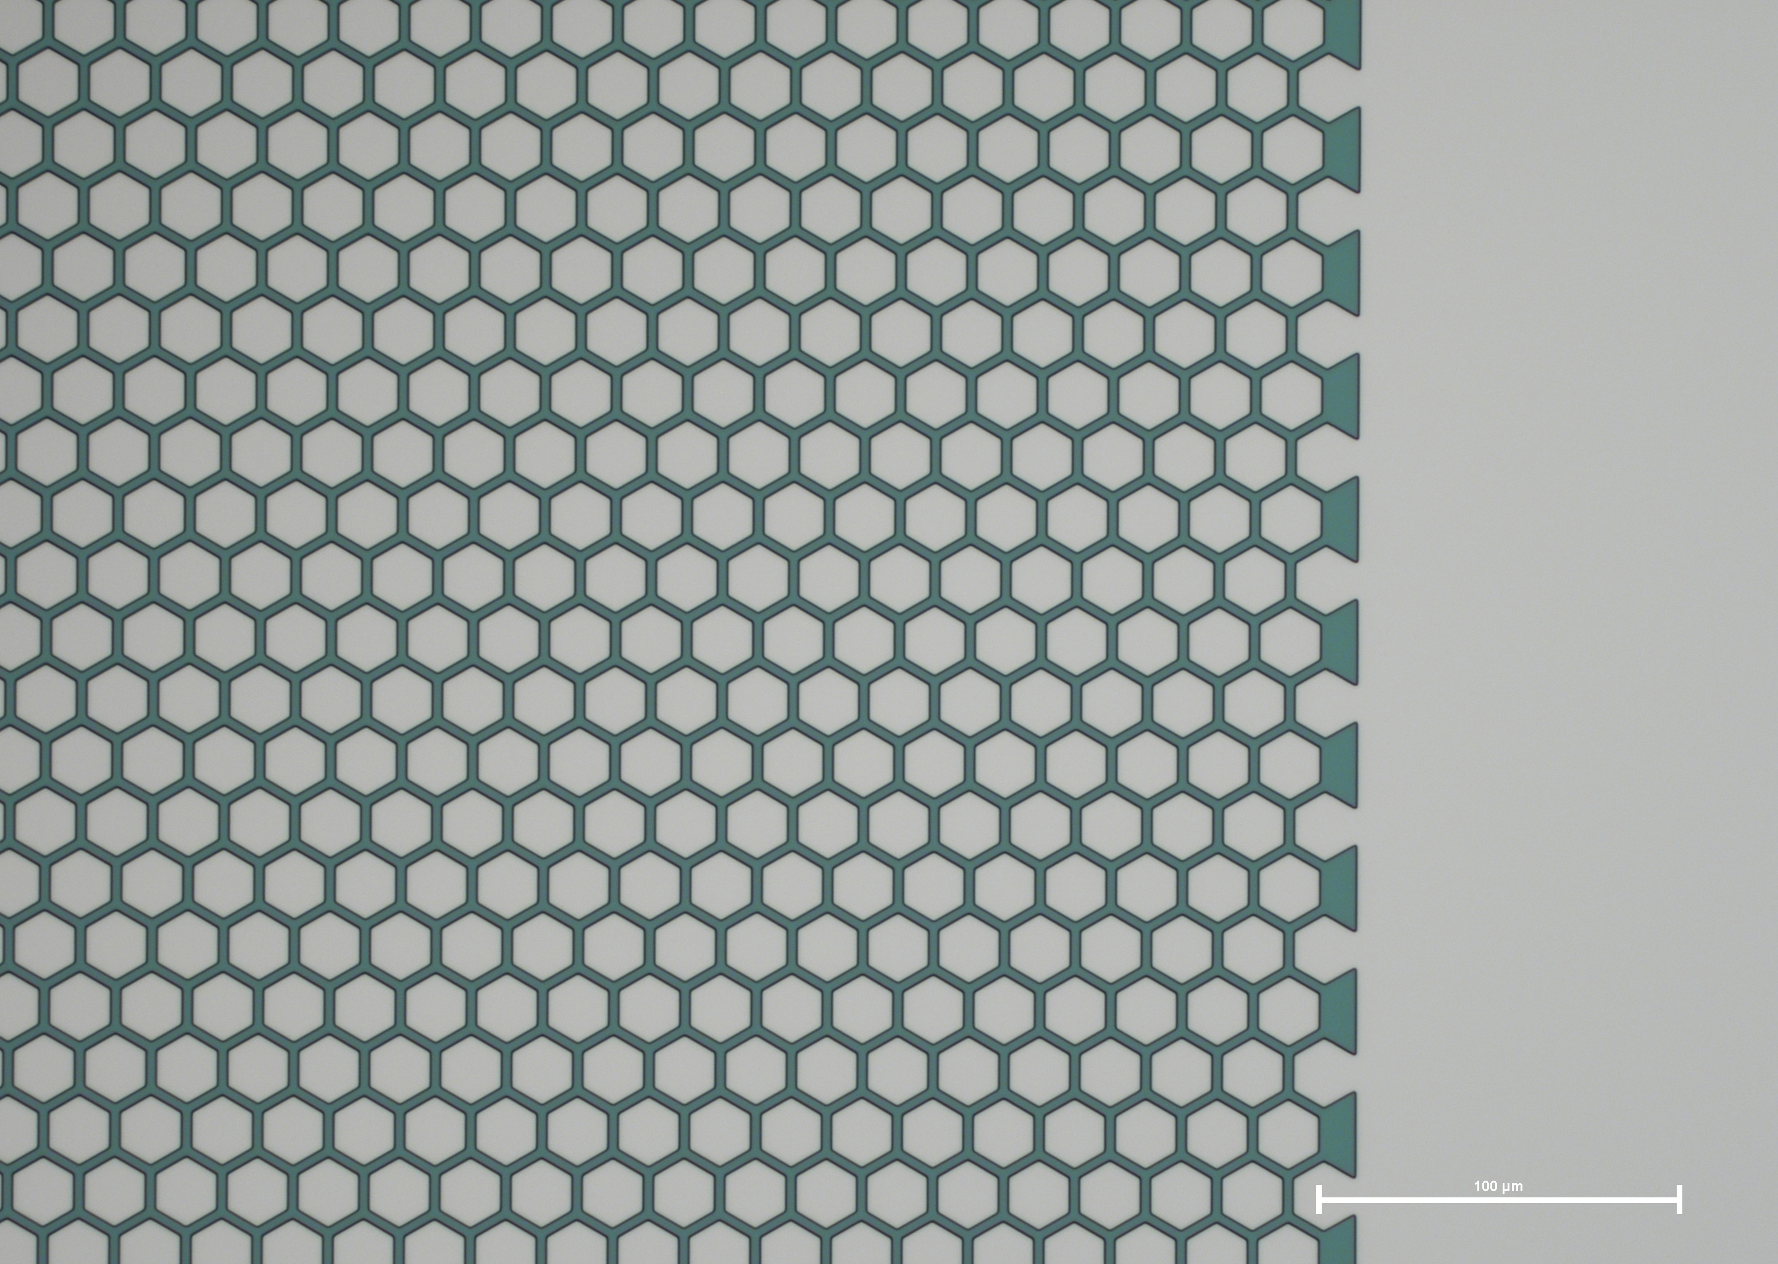
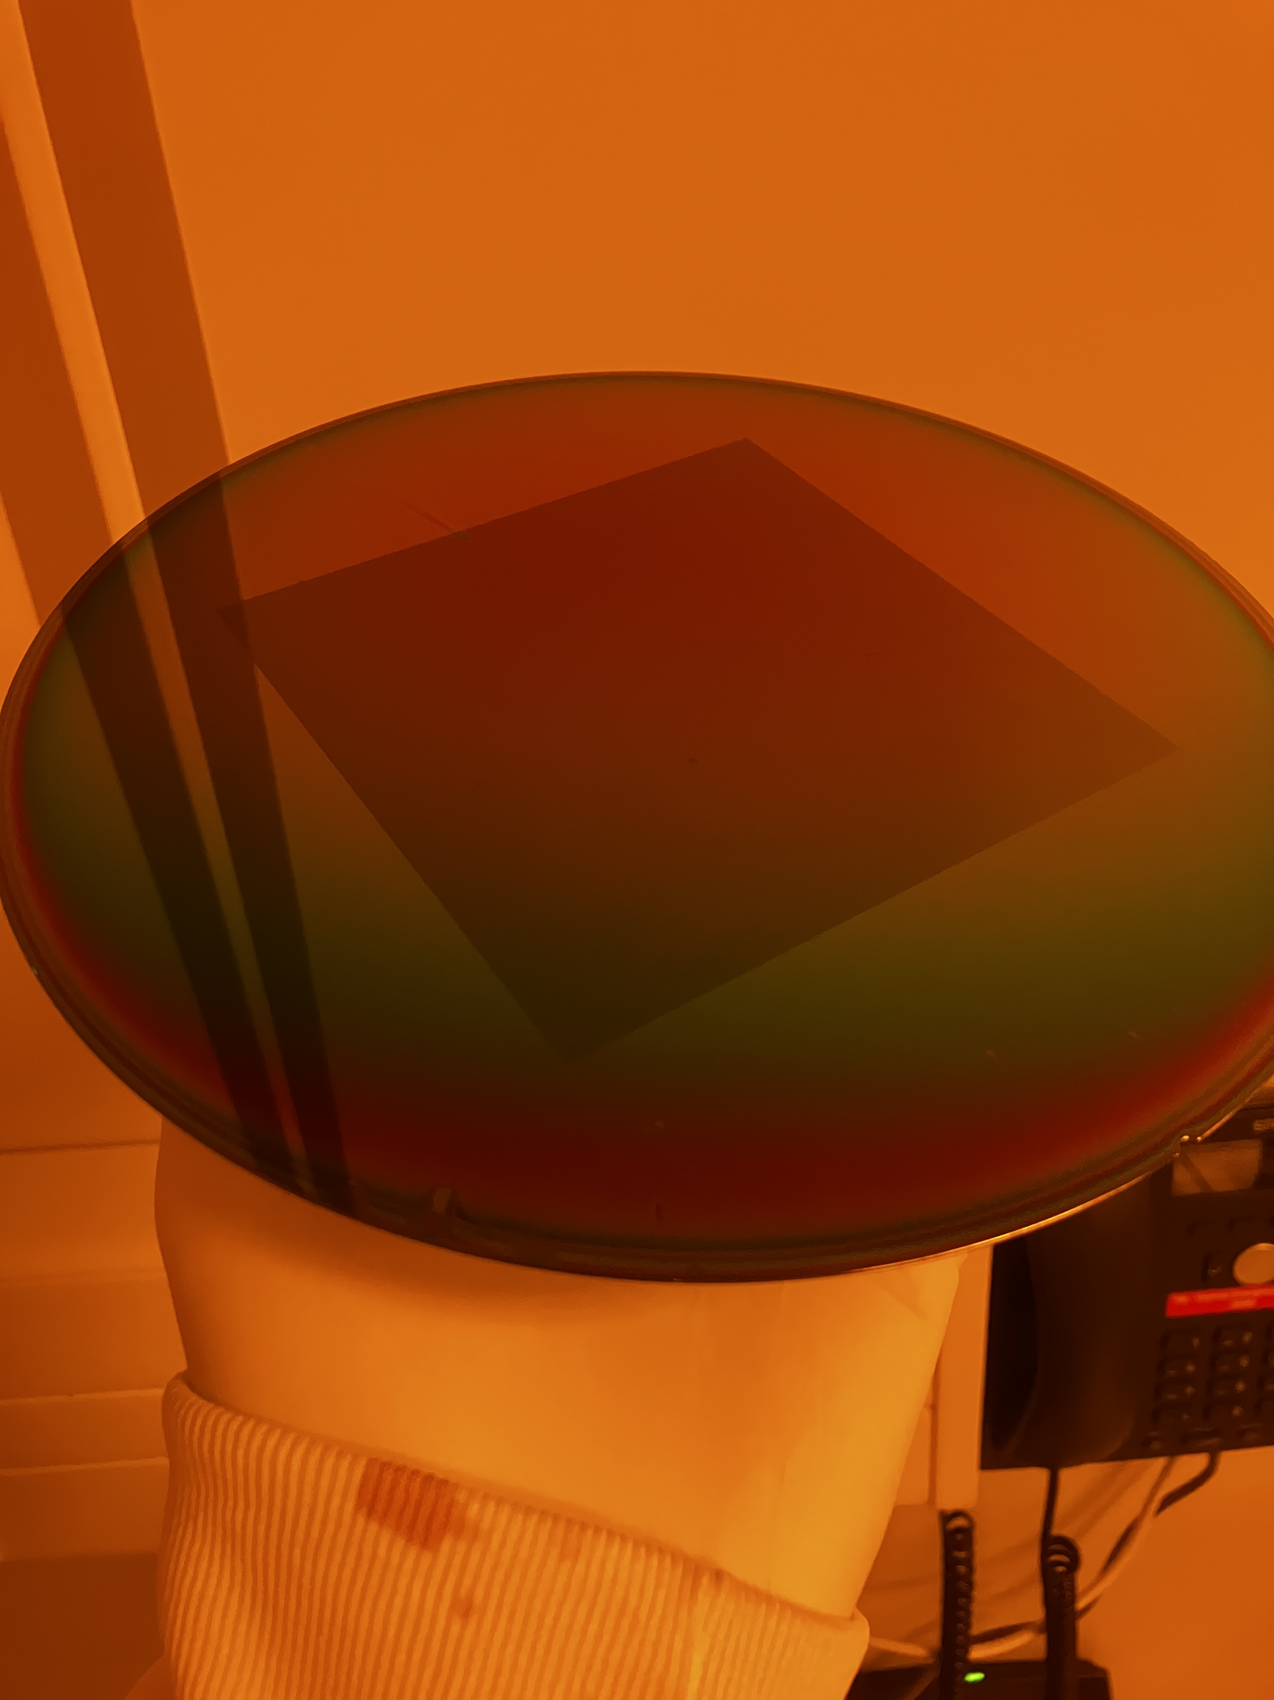
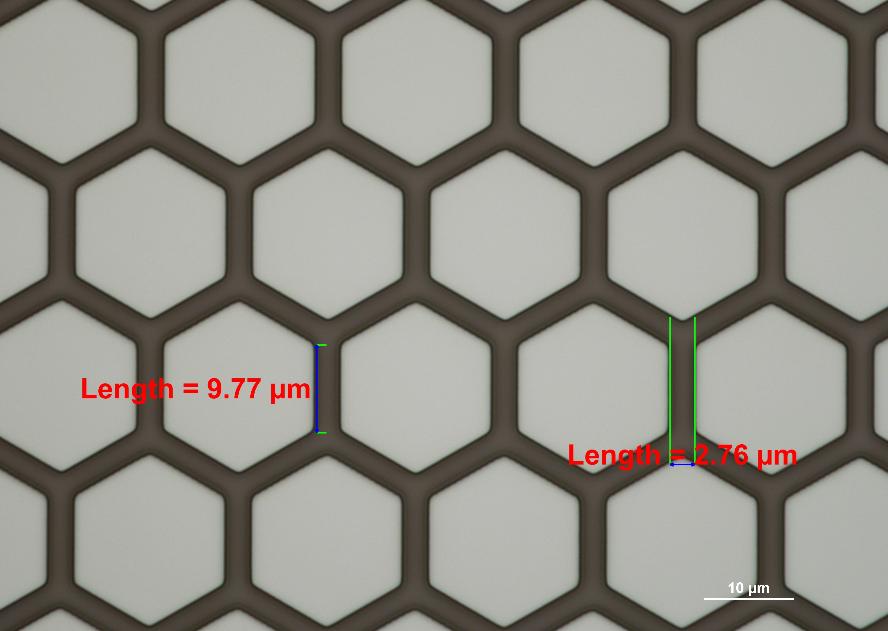

Slide 11

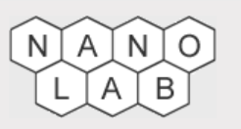
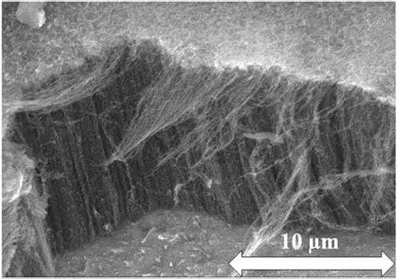
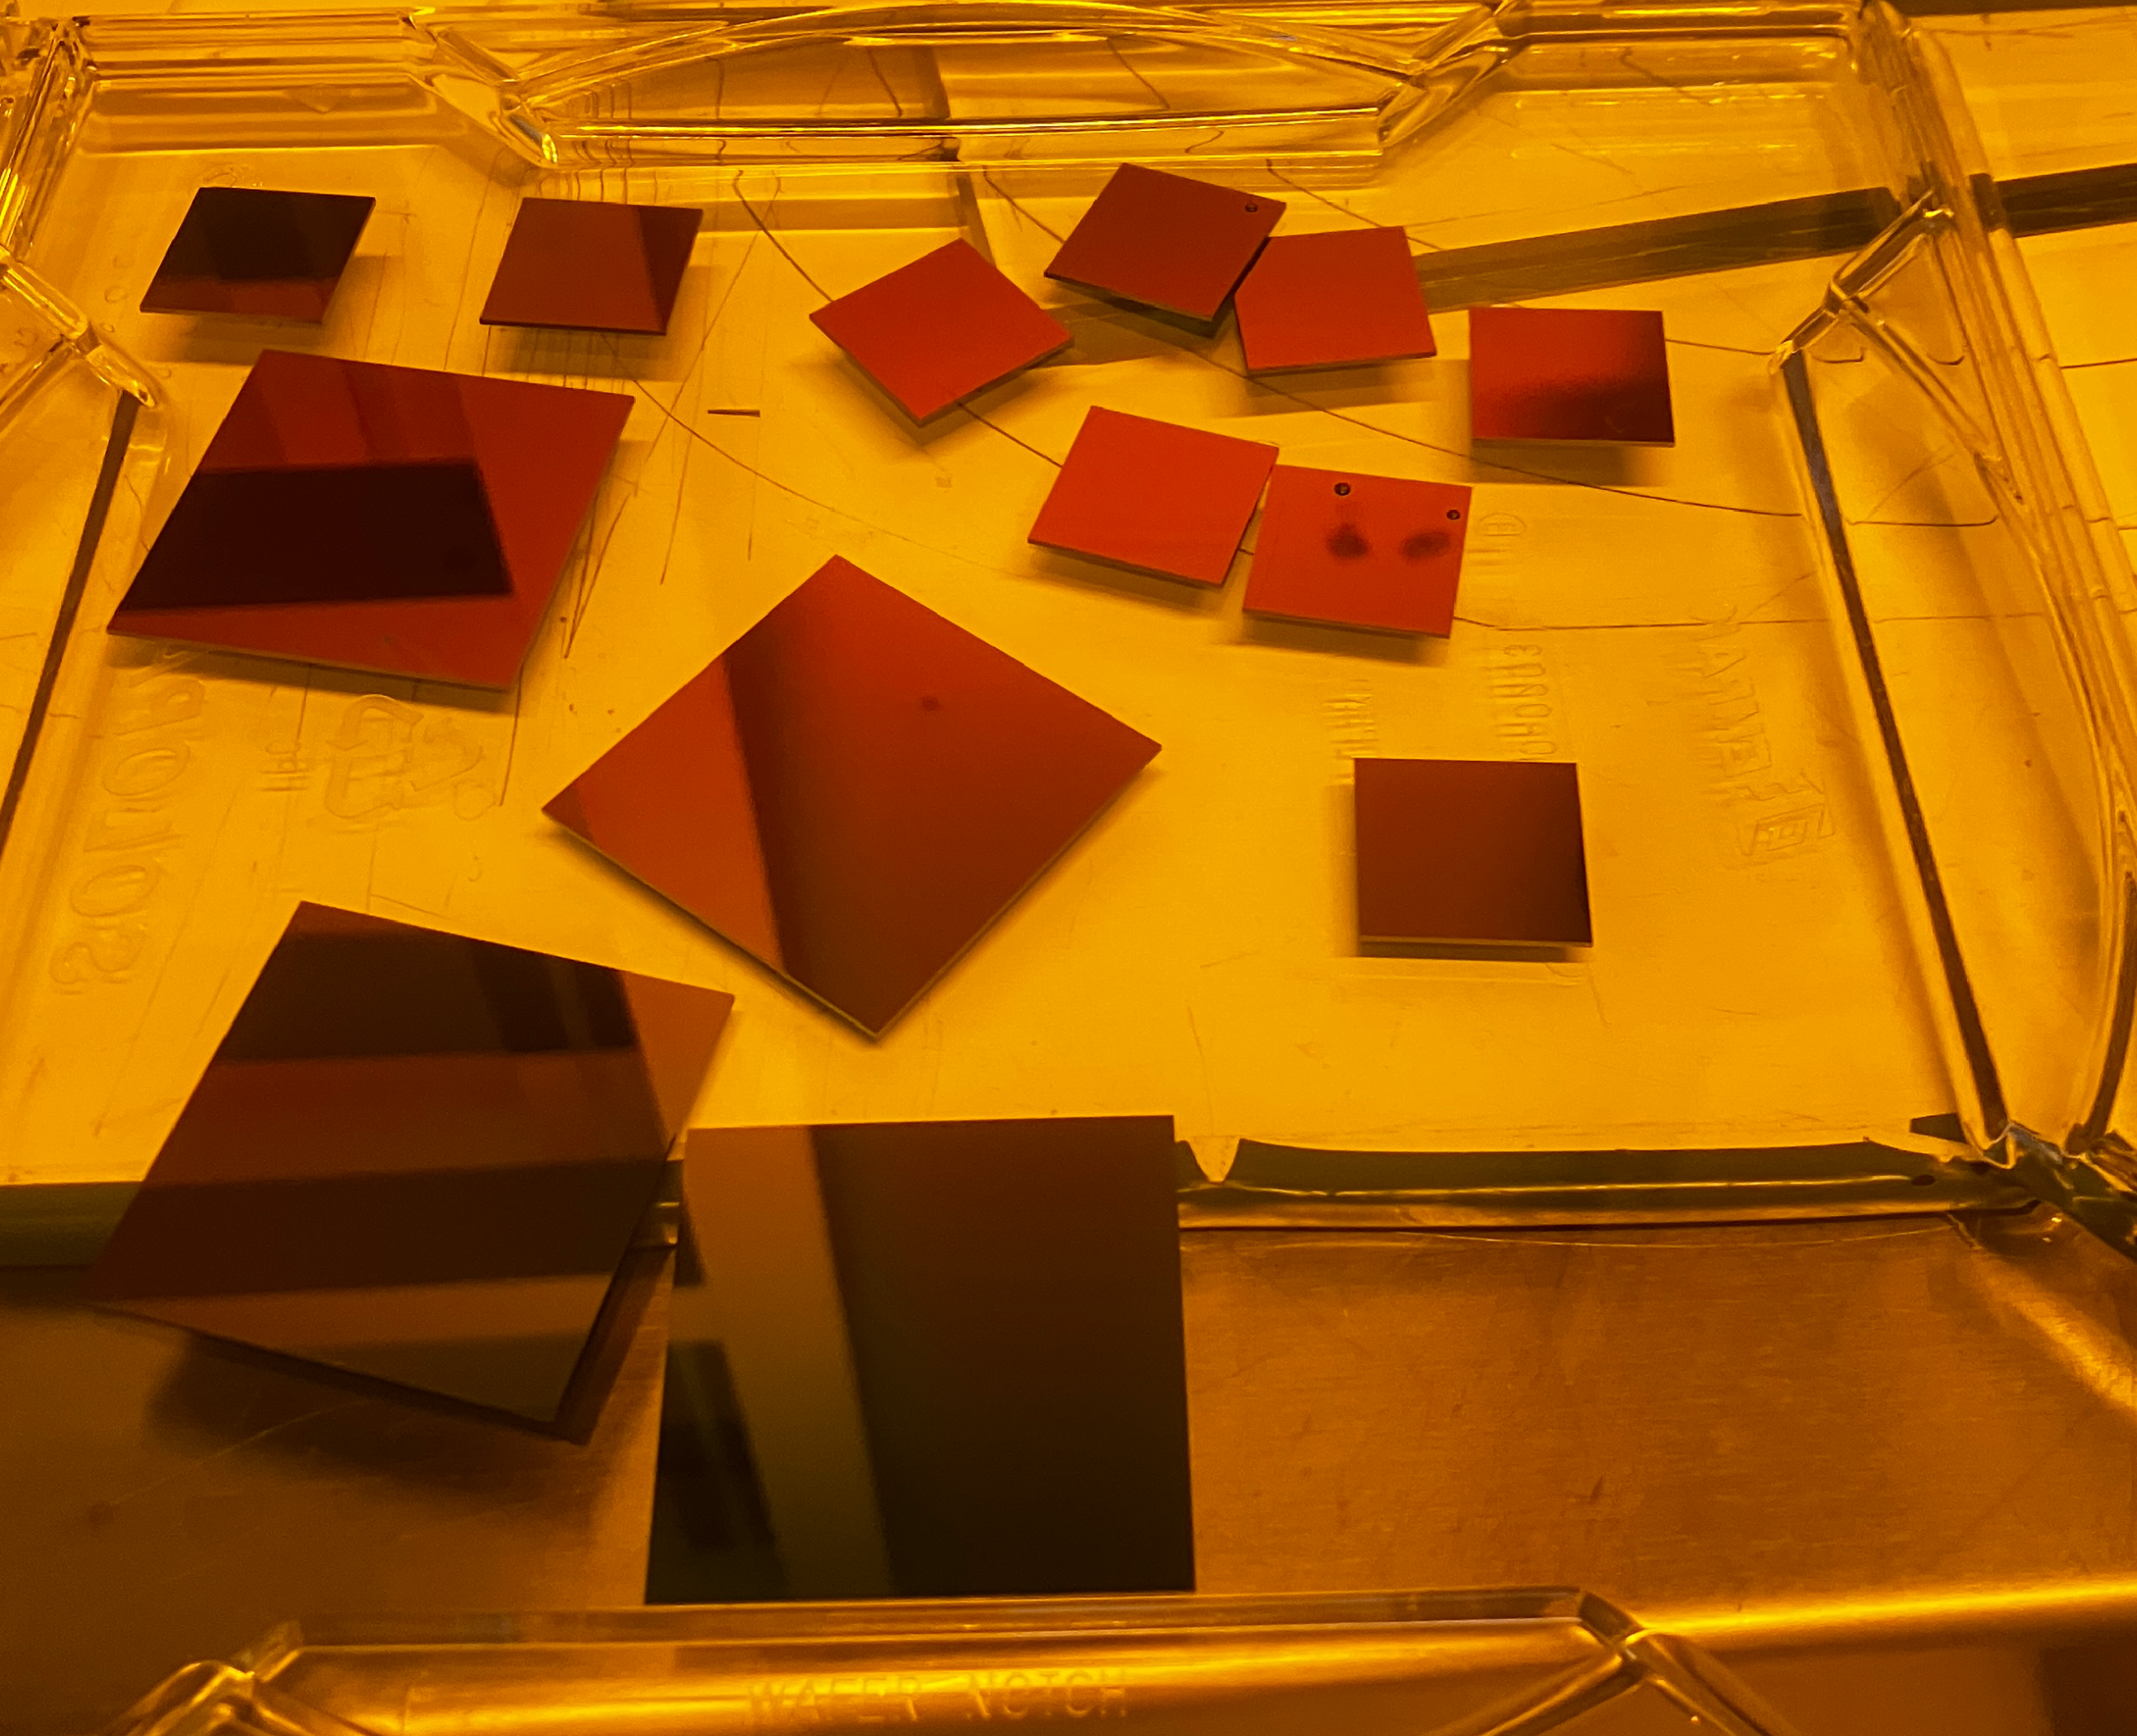
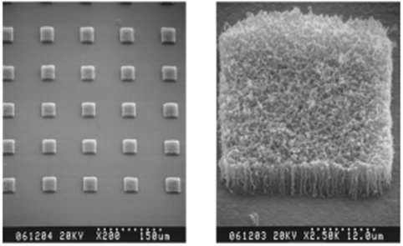

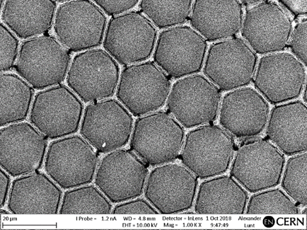

Slide 12
FECNT Gun Design and Test Bench
Notes:
Recent efforts have focused on selecting suitable materials, designing prototypes, and establishing testing protocols to meet ELENA’s demanding parameters for electron gun performance.

Slide 13
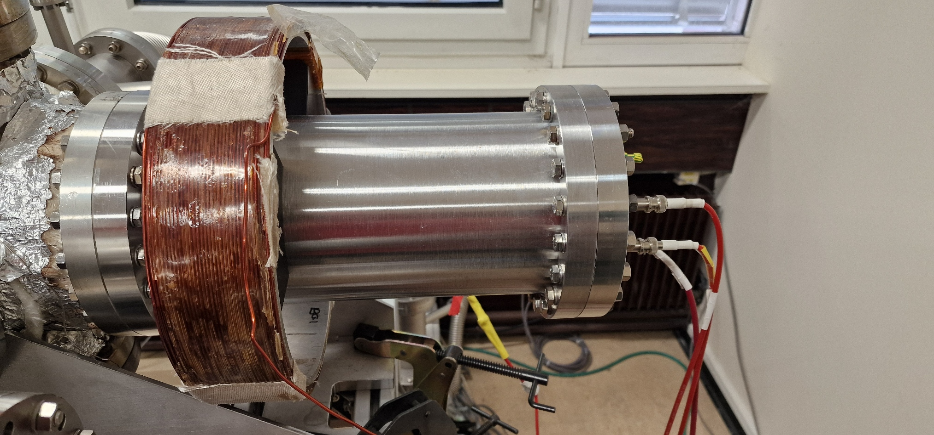
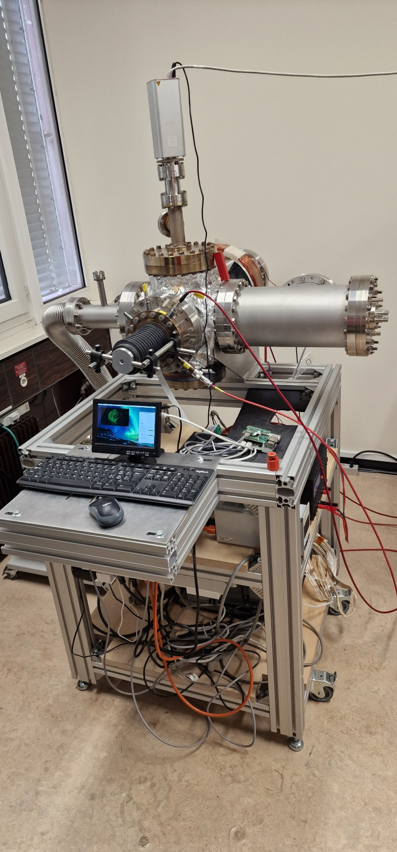
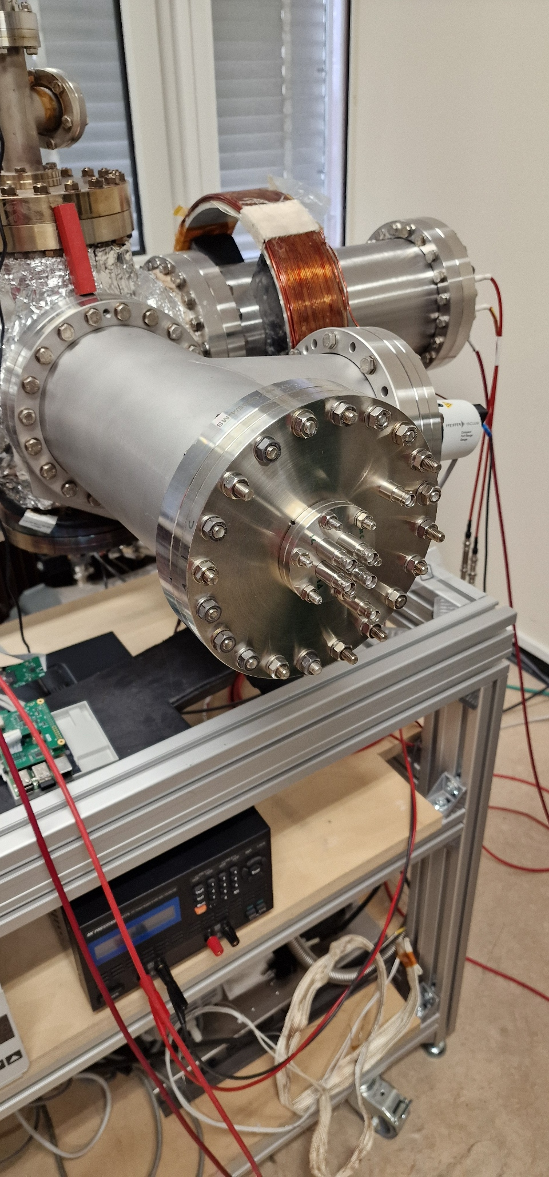
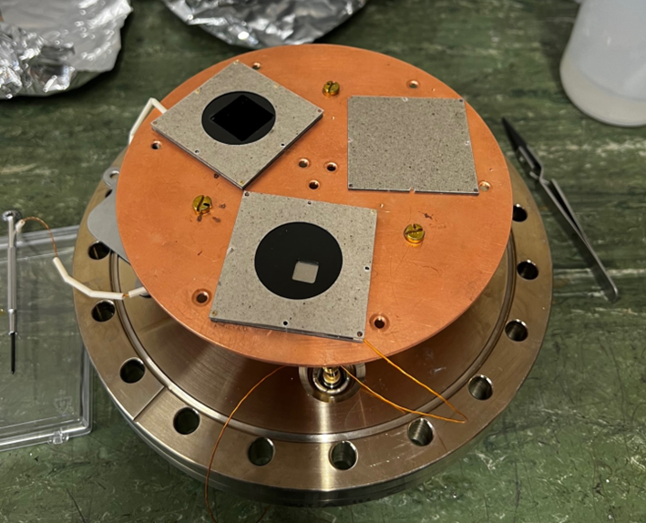
Cold Cathode Test Bench

Slide 14
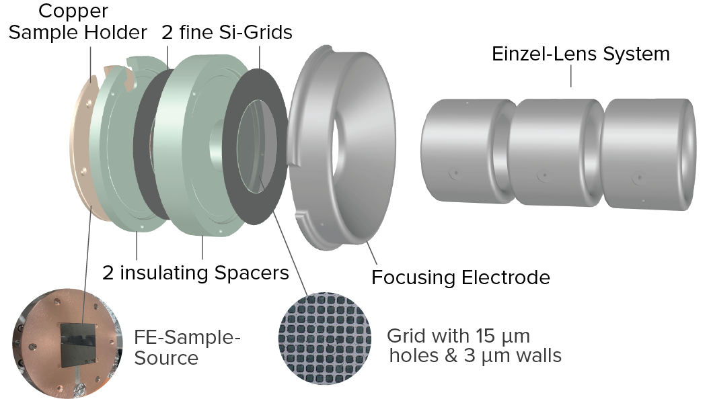
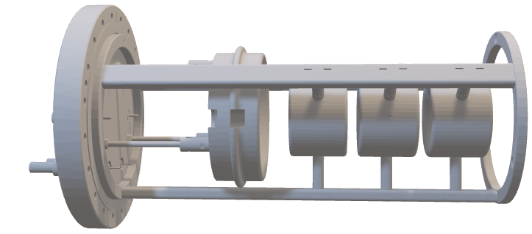
FECNT Design

Slide 15
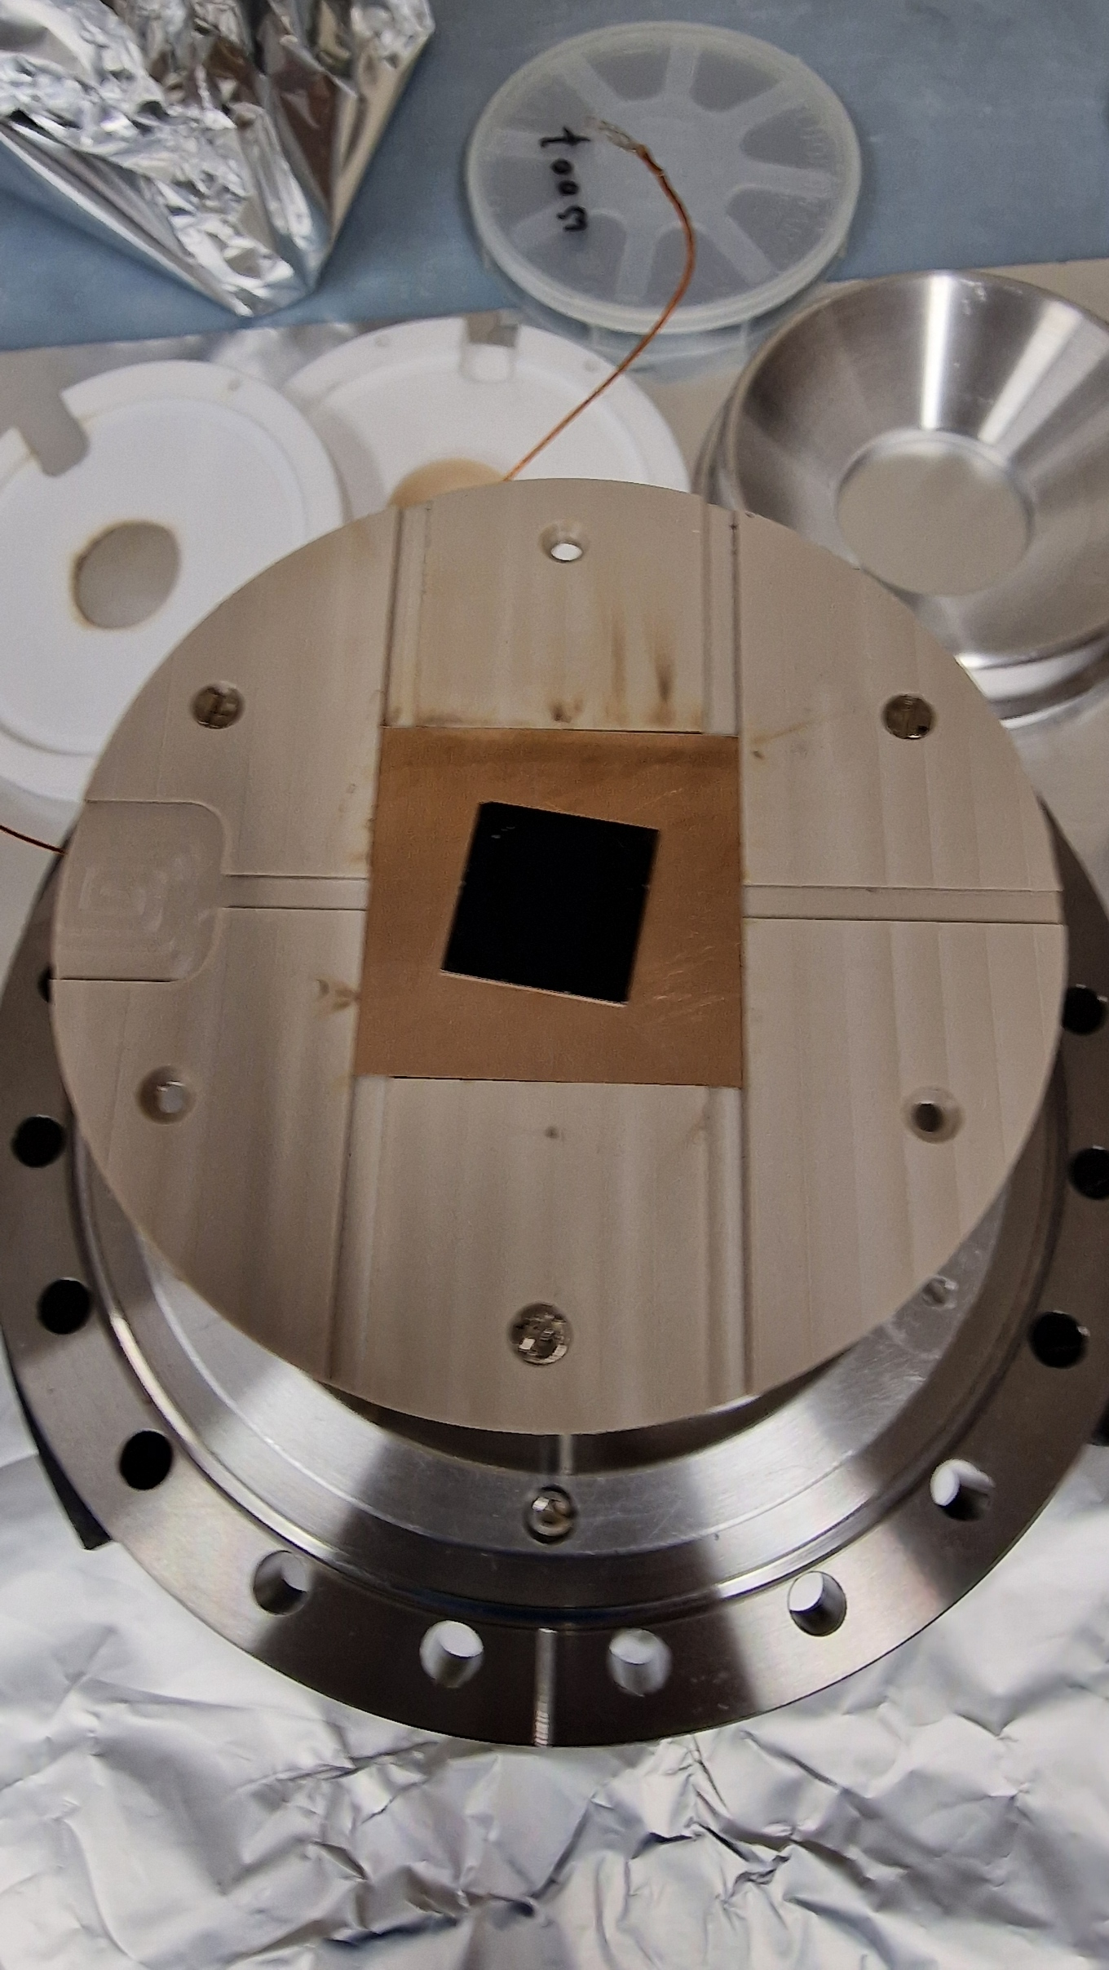
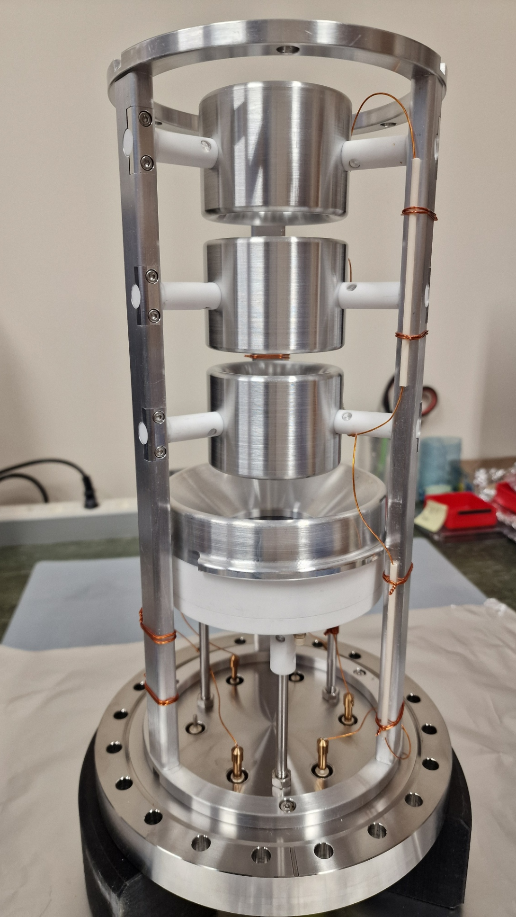
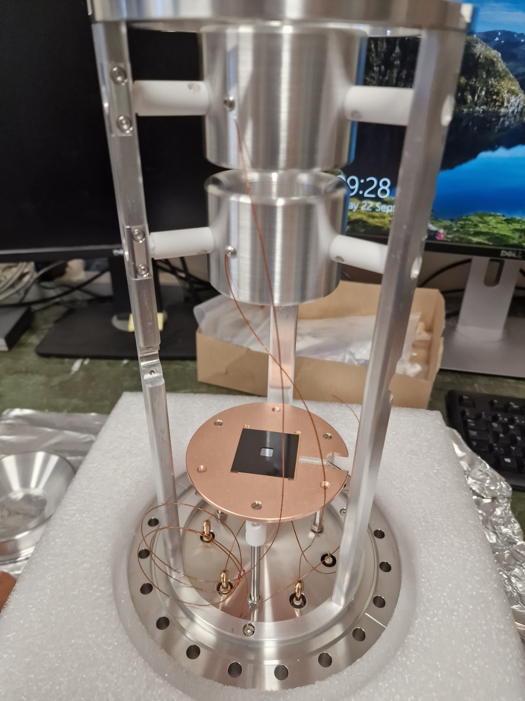
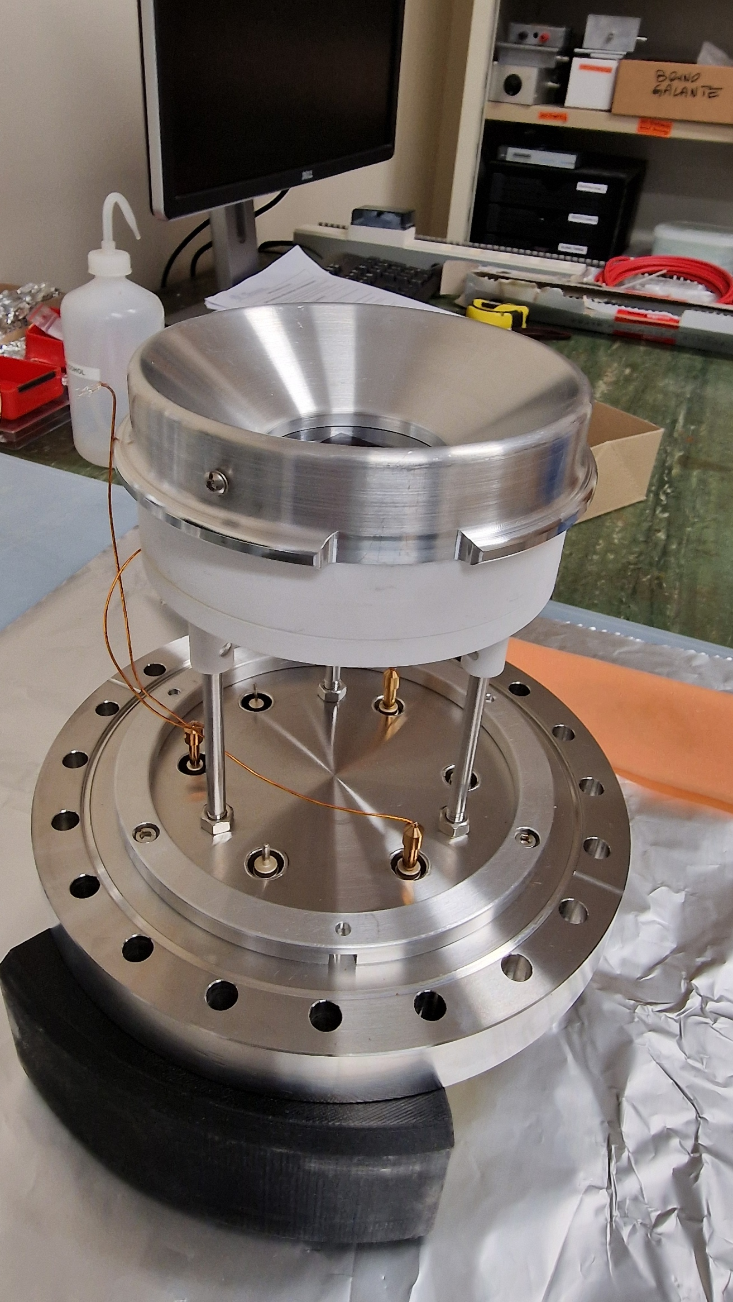

Slide 16
Cold Cathode Testbench Measurements
Notes:
Integrating the field emission gun with ELENA involves addressing vacuum compatibility, system interfacing, and operational testing to validate performance in realistic conditions.

Slide 17
Conditioning Test
Hexagonal (CNT1) array
0.91 V/µm
1.94 V/µm
2.51 V/µm
Square (CNT2) array
1.48 V/µm
2.4 V/µm
2.63 V/µm

Slide 18
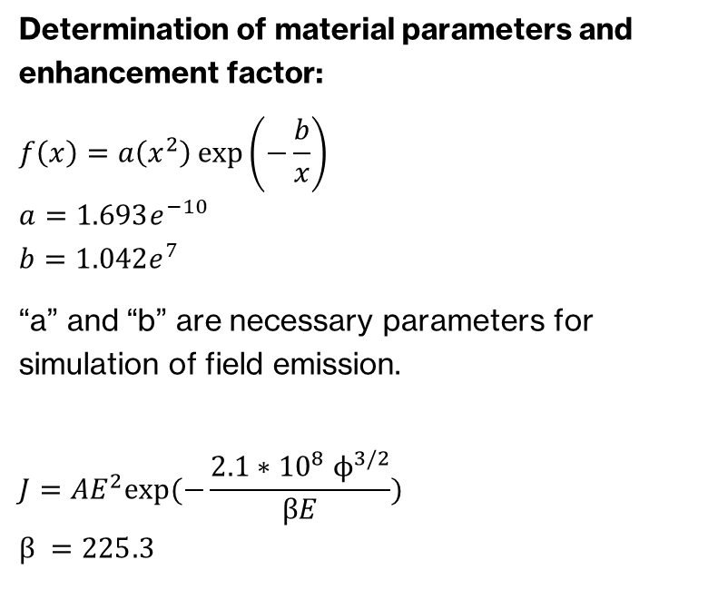
Fowler-Nordheim Plot
Determination of material parameters and enhancement factor:
$$f\left(x\right)=a\left(x^{2}\right)\exp\left(−\frac{b}{x}\right)$$
$$a=1.693e^{−10}$$
$$b=1.042e^{7}$$
“a” and “b” are necessary parameters for simulation of field emission.
$$J=AE^{2}exp⁡(−\frac{{2.1∗{10}^{8} ϕ}^{3/2}}{βE})$$
$$β =225.3$$

Slide 19
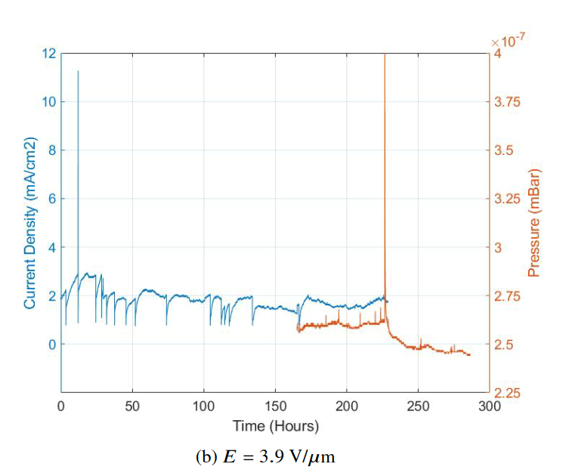
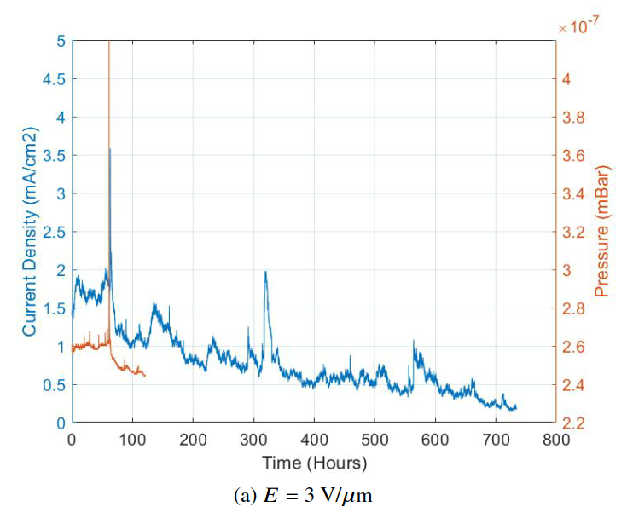
Lifetime test for CNT1 (a) and CNT2 (b)

Slide 20
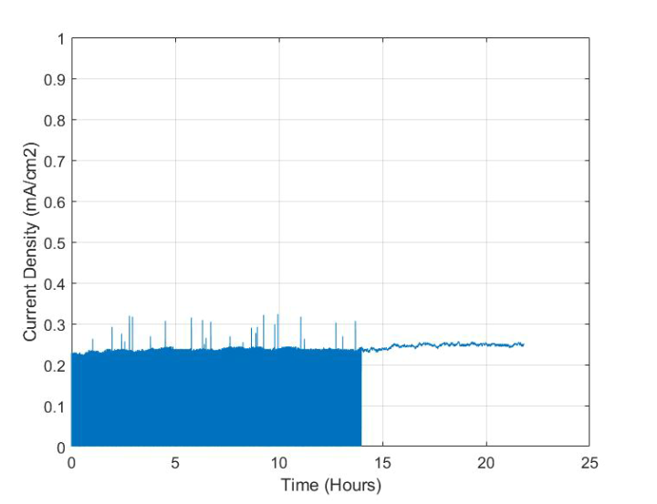
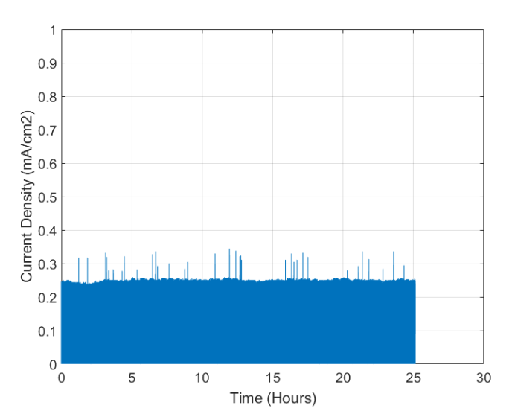
Emission Stability Test for Switching Mode for a CNT1-type Array. E = 2 V/μm

Slide 21
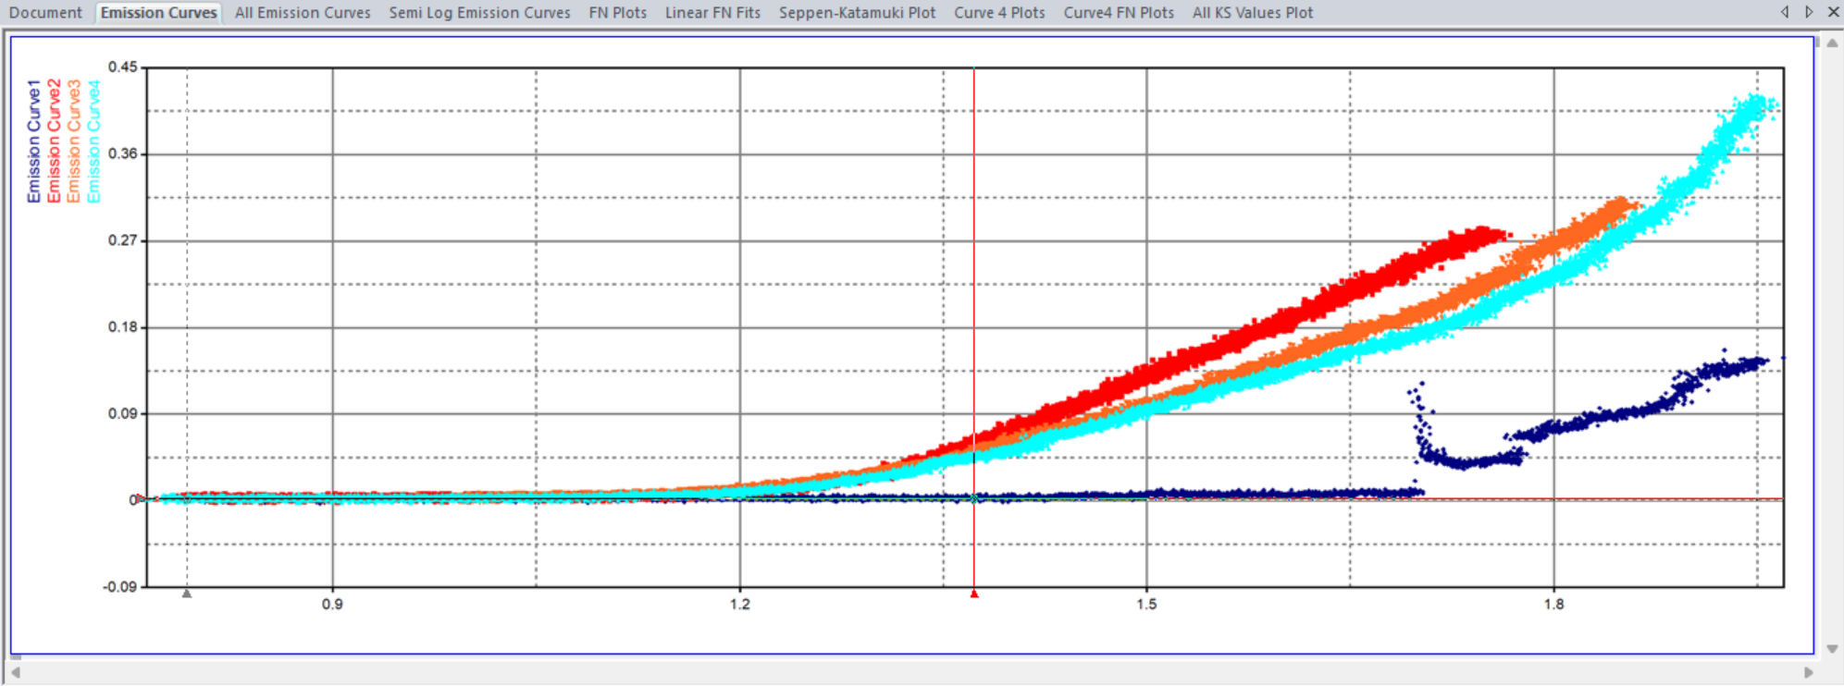
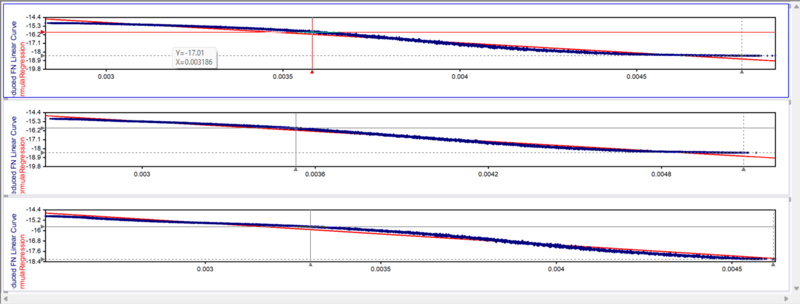
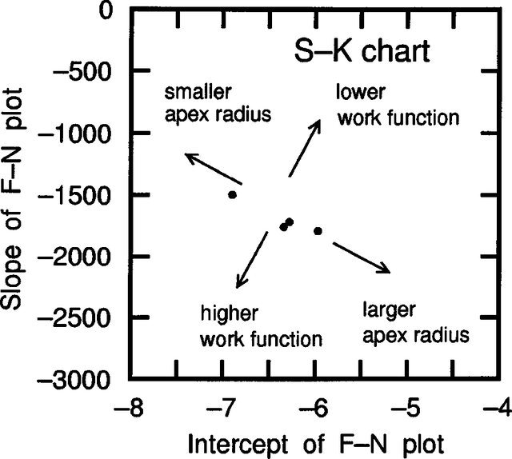
FN analysis of 7.1 cm² sample
Ln(I/E²) vs 1/E
IV plot
Linear fit to find slope and intercept
The change in the SK values between the ramps indicate significant structural damage to the tips
Seppen-Katamuki(SK) chart

Slide 22
Joule Heating:
The primary cause of rapid degradation at high currents is joule heating, worsened by the low inter-tube spacing within the VACNT array.
This leads to poor heat dissipation and thermal stress.
Electrostatic Screening:
In closely packed VACNT arrays, neighboring CNTs shield each other, reducing the effective emission area and the field enhancement factor (β)
As fewer VACNTs actively emit, localized heating increases, weakening the bond between VACNTs and the substrate.
This results in peeling of VACNTs from the substrate surface.

Slide 23

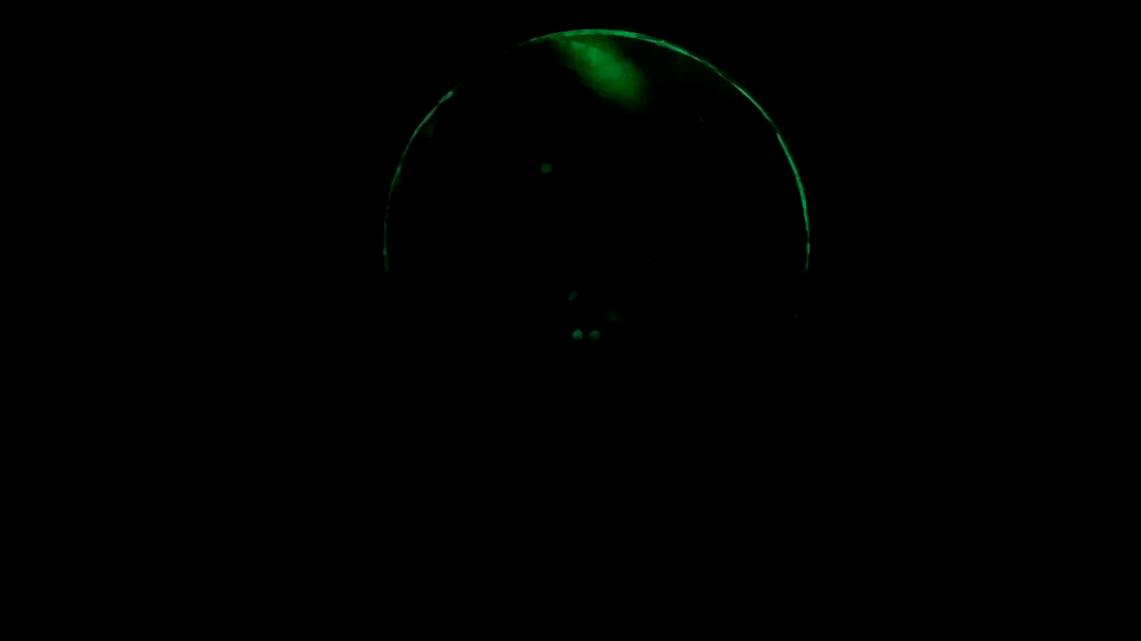
0.520 mA beam with a 0.64 cm² sample
(no Einzel lens)
0.36 mA beam with Einzel lens and magnetic steering

Slide 24

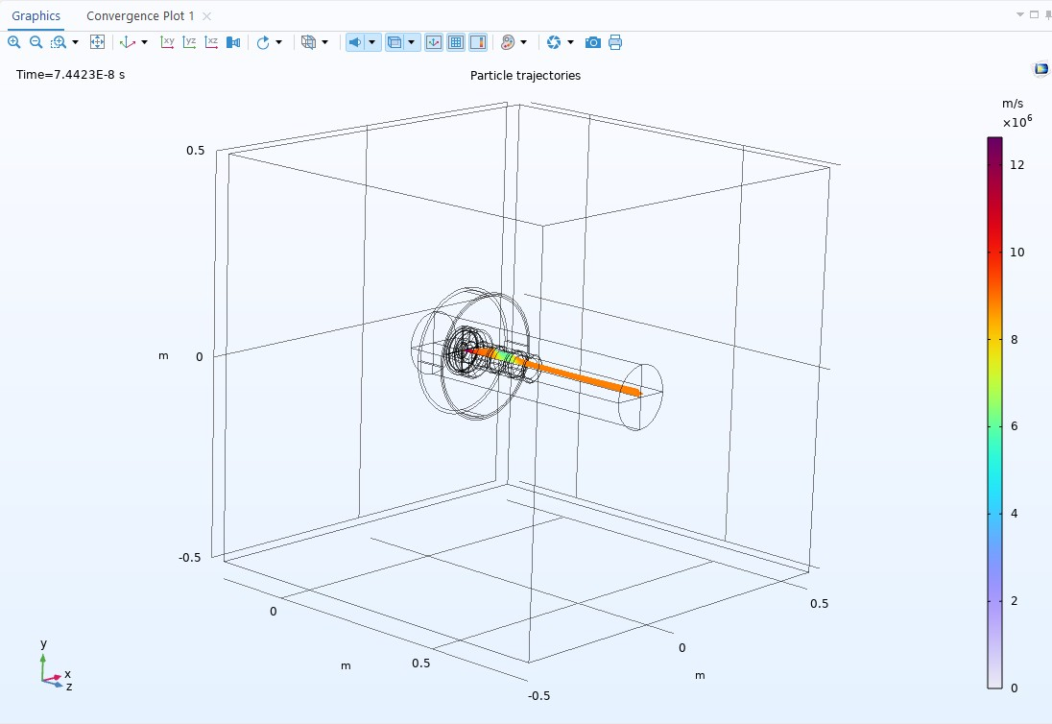
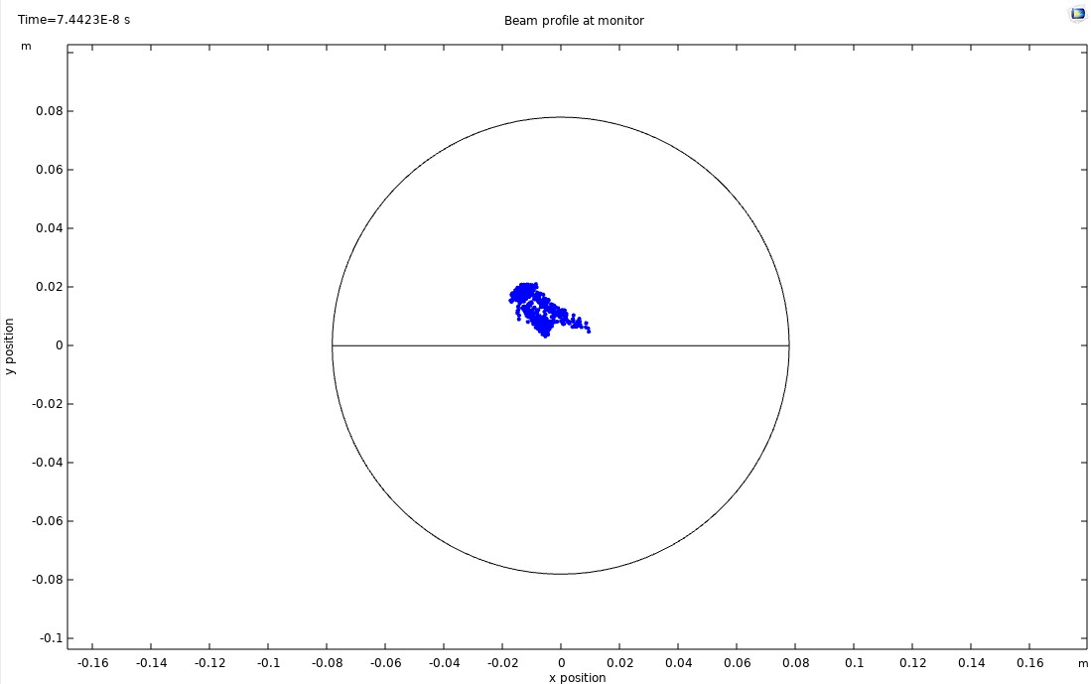
0.25 mA emission from a 0.64 cm² sample

Slide 25
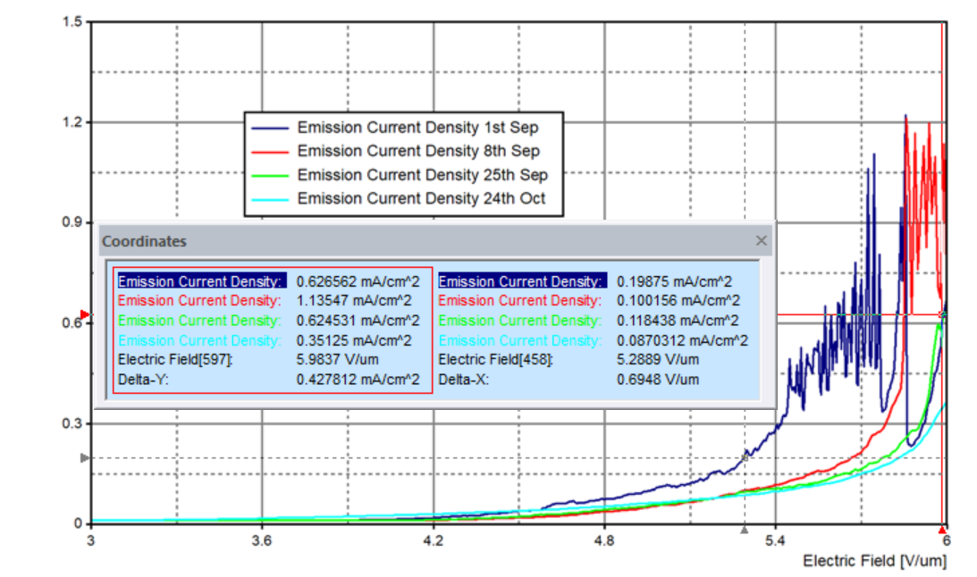
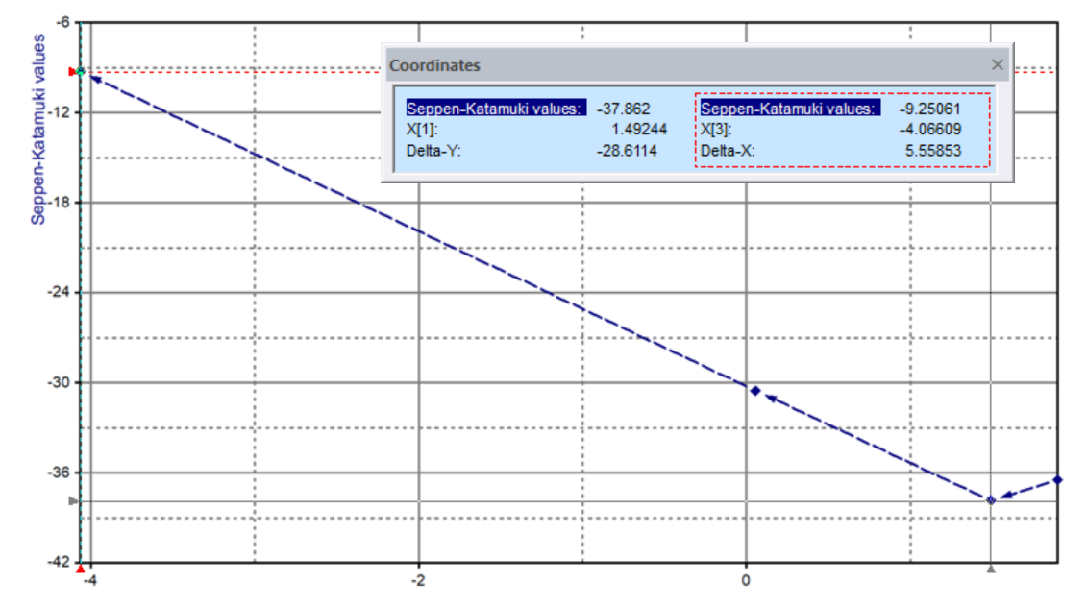
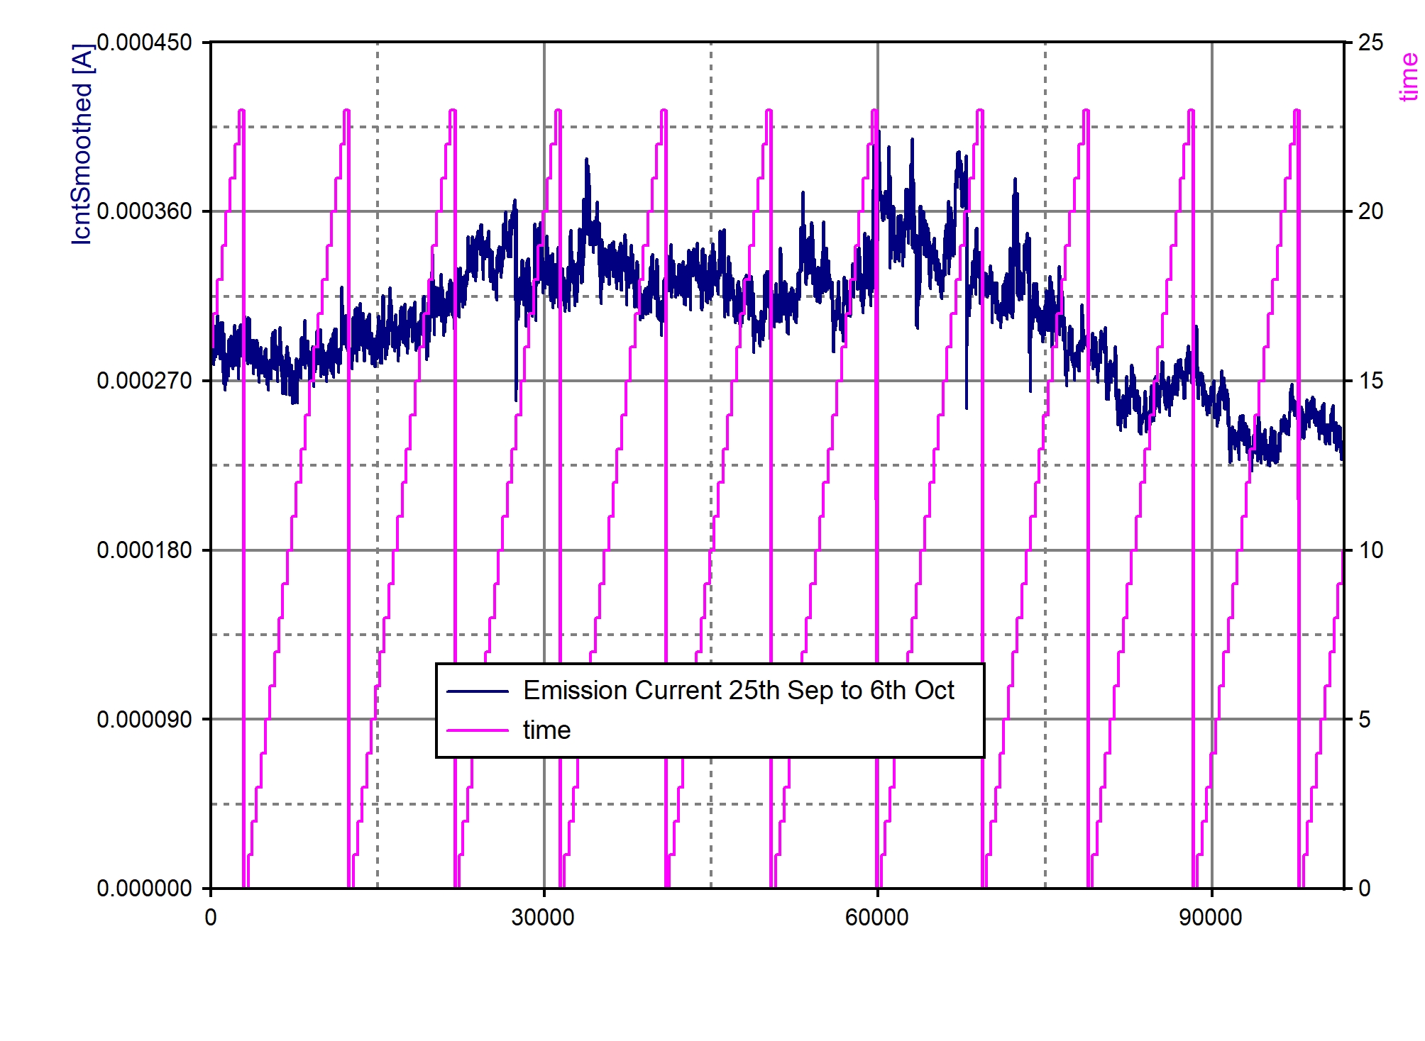
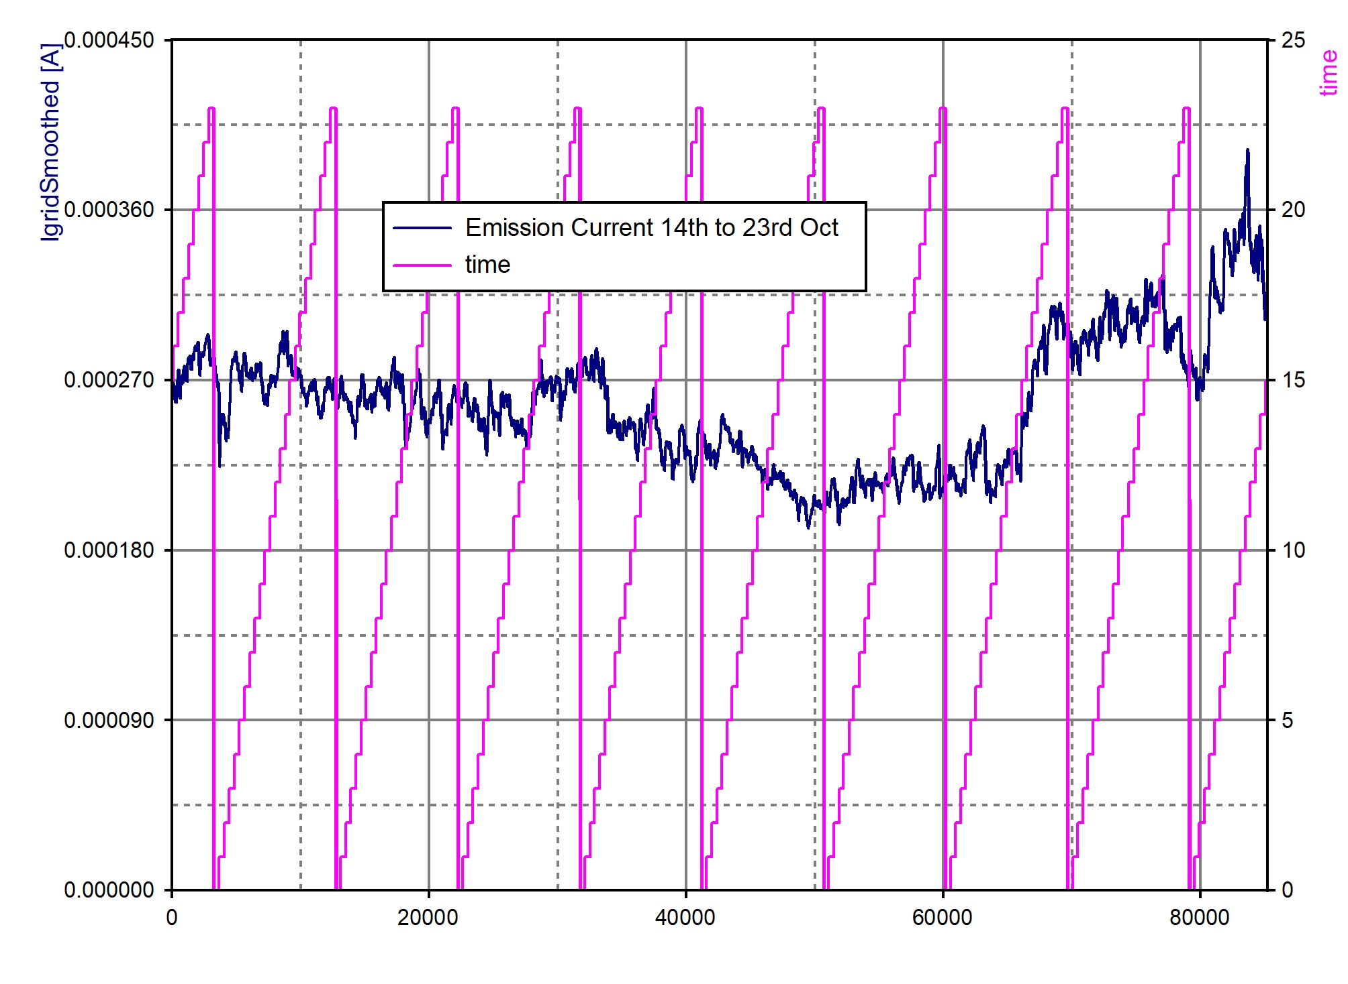
J [mA/cm²]
slope
intercept
SK chart
FN curves for 0.64 cm² sample
Longterm stability run 25th September to 23rd October for 0.64 cm² sample

Slide 26
Preliminary Conclusions
CNTs have been shown to be an attractive alternative to thermionic sources for the generation of electron beams
Conditioning of the CNT sample is important to obtain high emission current densities
Patterned arrays can reduce the screening effect and help avoid excess tip burn off
CNTs have a long lifetime but their long-term stability is questionable
Production of large area CNTs is difficult
The double-gridded electron gun has (finally) shown some promising results
Notes:
Developing a field emission electron gun for ELENA presents exciting opportunities and challenges. Continued advances in materials, design, and testing bring us closer to realizing reliable electron sources that meet ELENA’s stringent requirements.

Slide 27

Future Developments
Find a reliable supplier of large area patterned CNT samples
Revisit the gun design to move the focus electrode and extraction grid closer to the source
Investigate the use of Spindt cathodes
3 mA per tip, single emitters in pulsed mode
100 μA per emitter from small arrays routine
2000 A/cm² from small areas (few mA total)
330 mA total current from 50K emitters from 1 mm² area
Spindt Cathode
Architecture

