Slide 1
Electron and Laser Cooling of Stored Ion Beams at CERN: XSuite Simulations and Measurements
P.Kruyt^{1,2}, G. Franchetti^{1,2,3,4}, D.Gamba², J. Romain^{2,5}
¹Goethe University, Frankfurt, Germany; ²CERN, Meyrin, Switzerland; ³GSI, Darmstadt, Germany; ⁴HFHF, Frankfurt am Main, Germany; ⁵Grenoble INP Phelma, Grenoble, France
28/10/2025 – COOL’25, Stony Brook, New York (USA) - indico
Notes:
Electron and laser cooling are key techniques for improving the quality of stored ion beams in synchrotrons. This work presents simulations performed with XSuite to study electron and laser cooling in various CERN machines. The electron cooling simulations, based on the Parkhomchuk model recently implemented in XSuite, are benchmarked against existing codes. The laser cooling studies investigate the feasibility of implementing this technique in the CERN SPS, either to enhance ion beam brightness or as a step toward a potential Gamma Factory in the LHC. Additionally, an overview of experimental electron cooling measurements from various CERN facilities is presented, providing insights into the agreement between model predictions and observed cooling performance.

Slide 2
Outline
Motivation:
Beam cooling in stored ion beams at CERN
XSuite simulation framework
Electron cooling developments at CERN
Studies in LEIR, AD, and ELENA
Laser cooling in the SPS (Gamma Factory PoP)
Interplay between IBS and cooling
Present activities
Summary and outlook

Slide 3
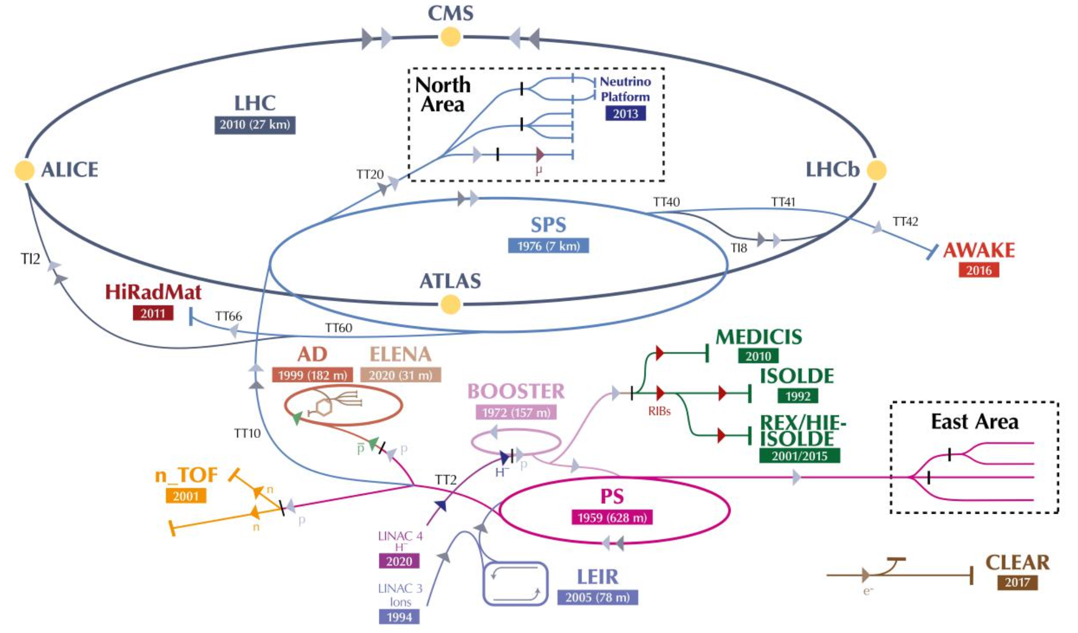
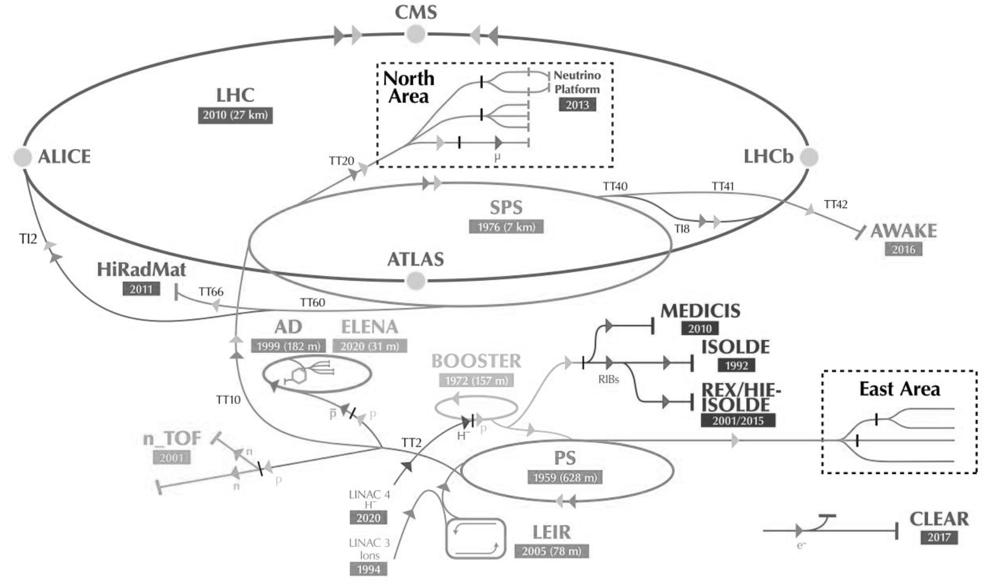
Motivation: Cooling at CERN
Beam cooling essential ingredient of several existing machines at CERN:
S-Cooling of pbars AD
See Vasileios’s on presentation
E-cooling of pbars in AD, ELENA
See Laurette’s presentation
E-cooling of ions in LEIR
For LHC and Fixed Target Exp.
New developments:
Gamma factory proposal
See Aurelien’s presentation
PoP experiment: unique opportunity for testing laser cooling at CERN
See LOI
Need for tools for predictive simulations including cooling
Unified environment for cooling + heating (IBS, SC, …)

Slide 4
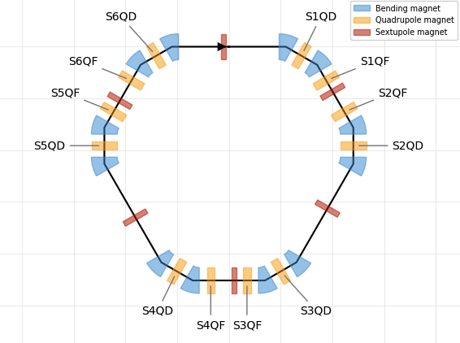
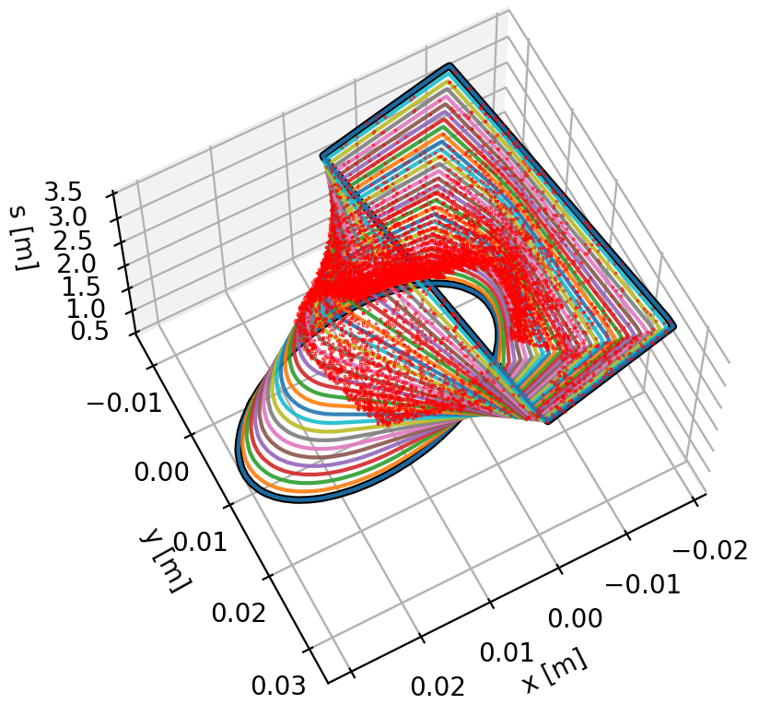
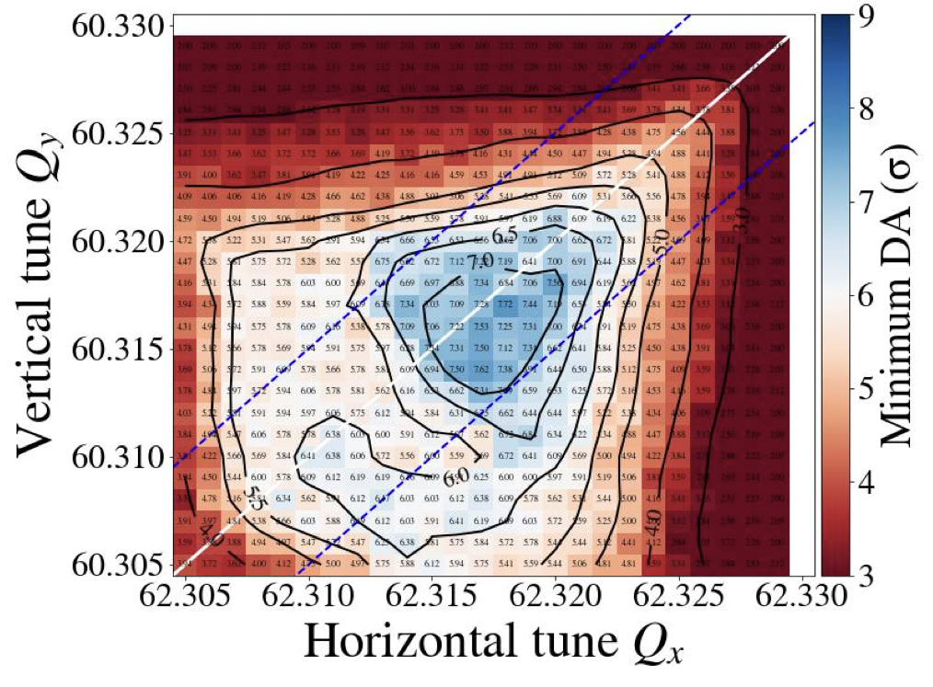
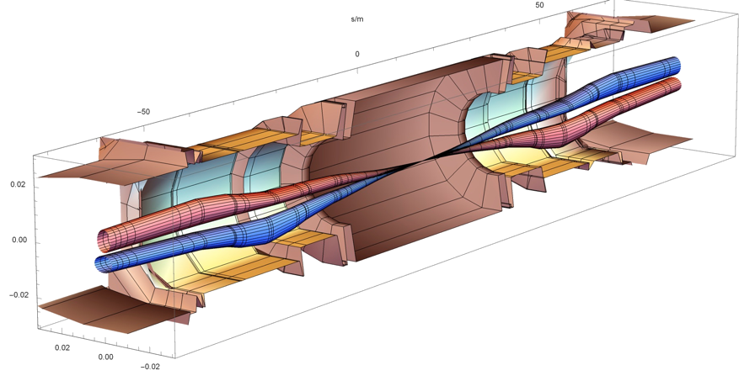
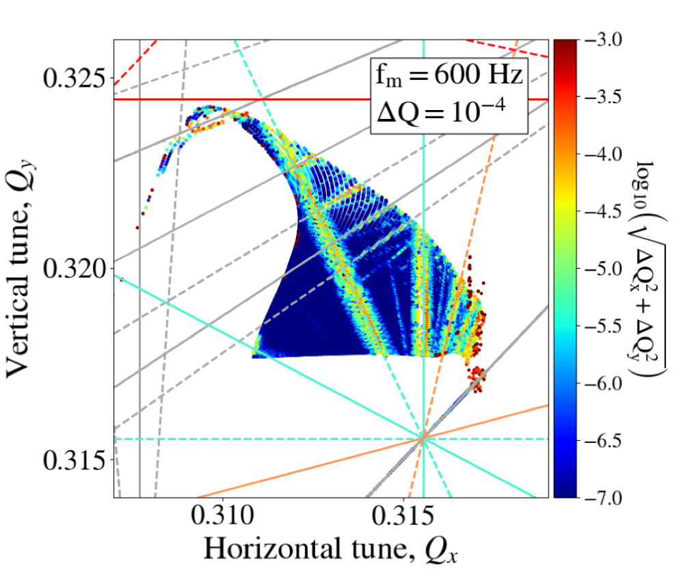
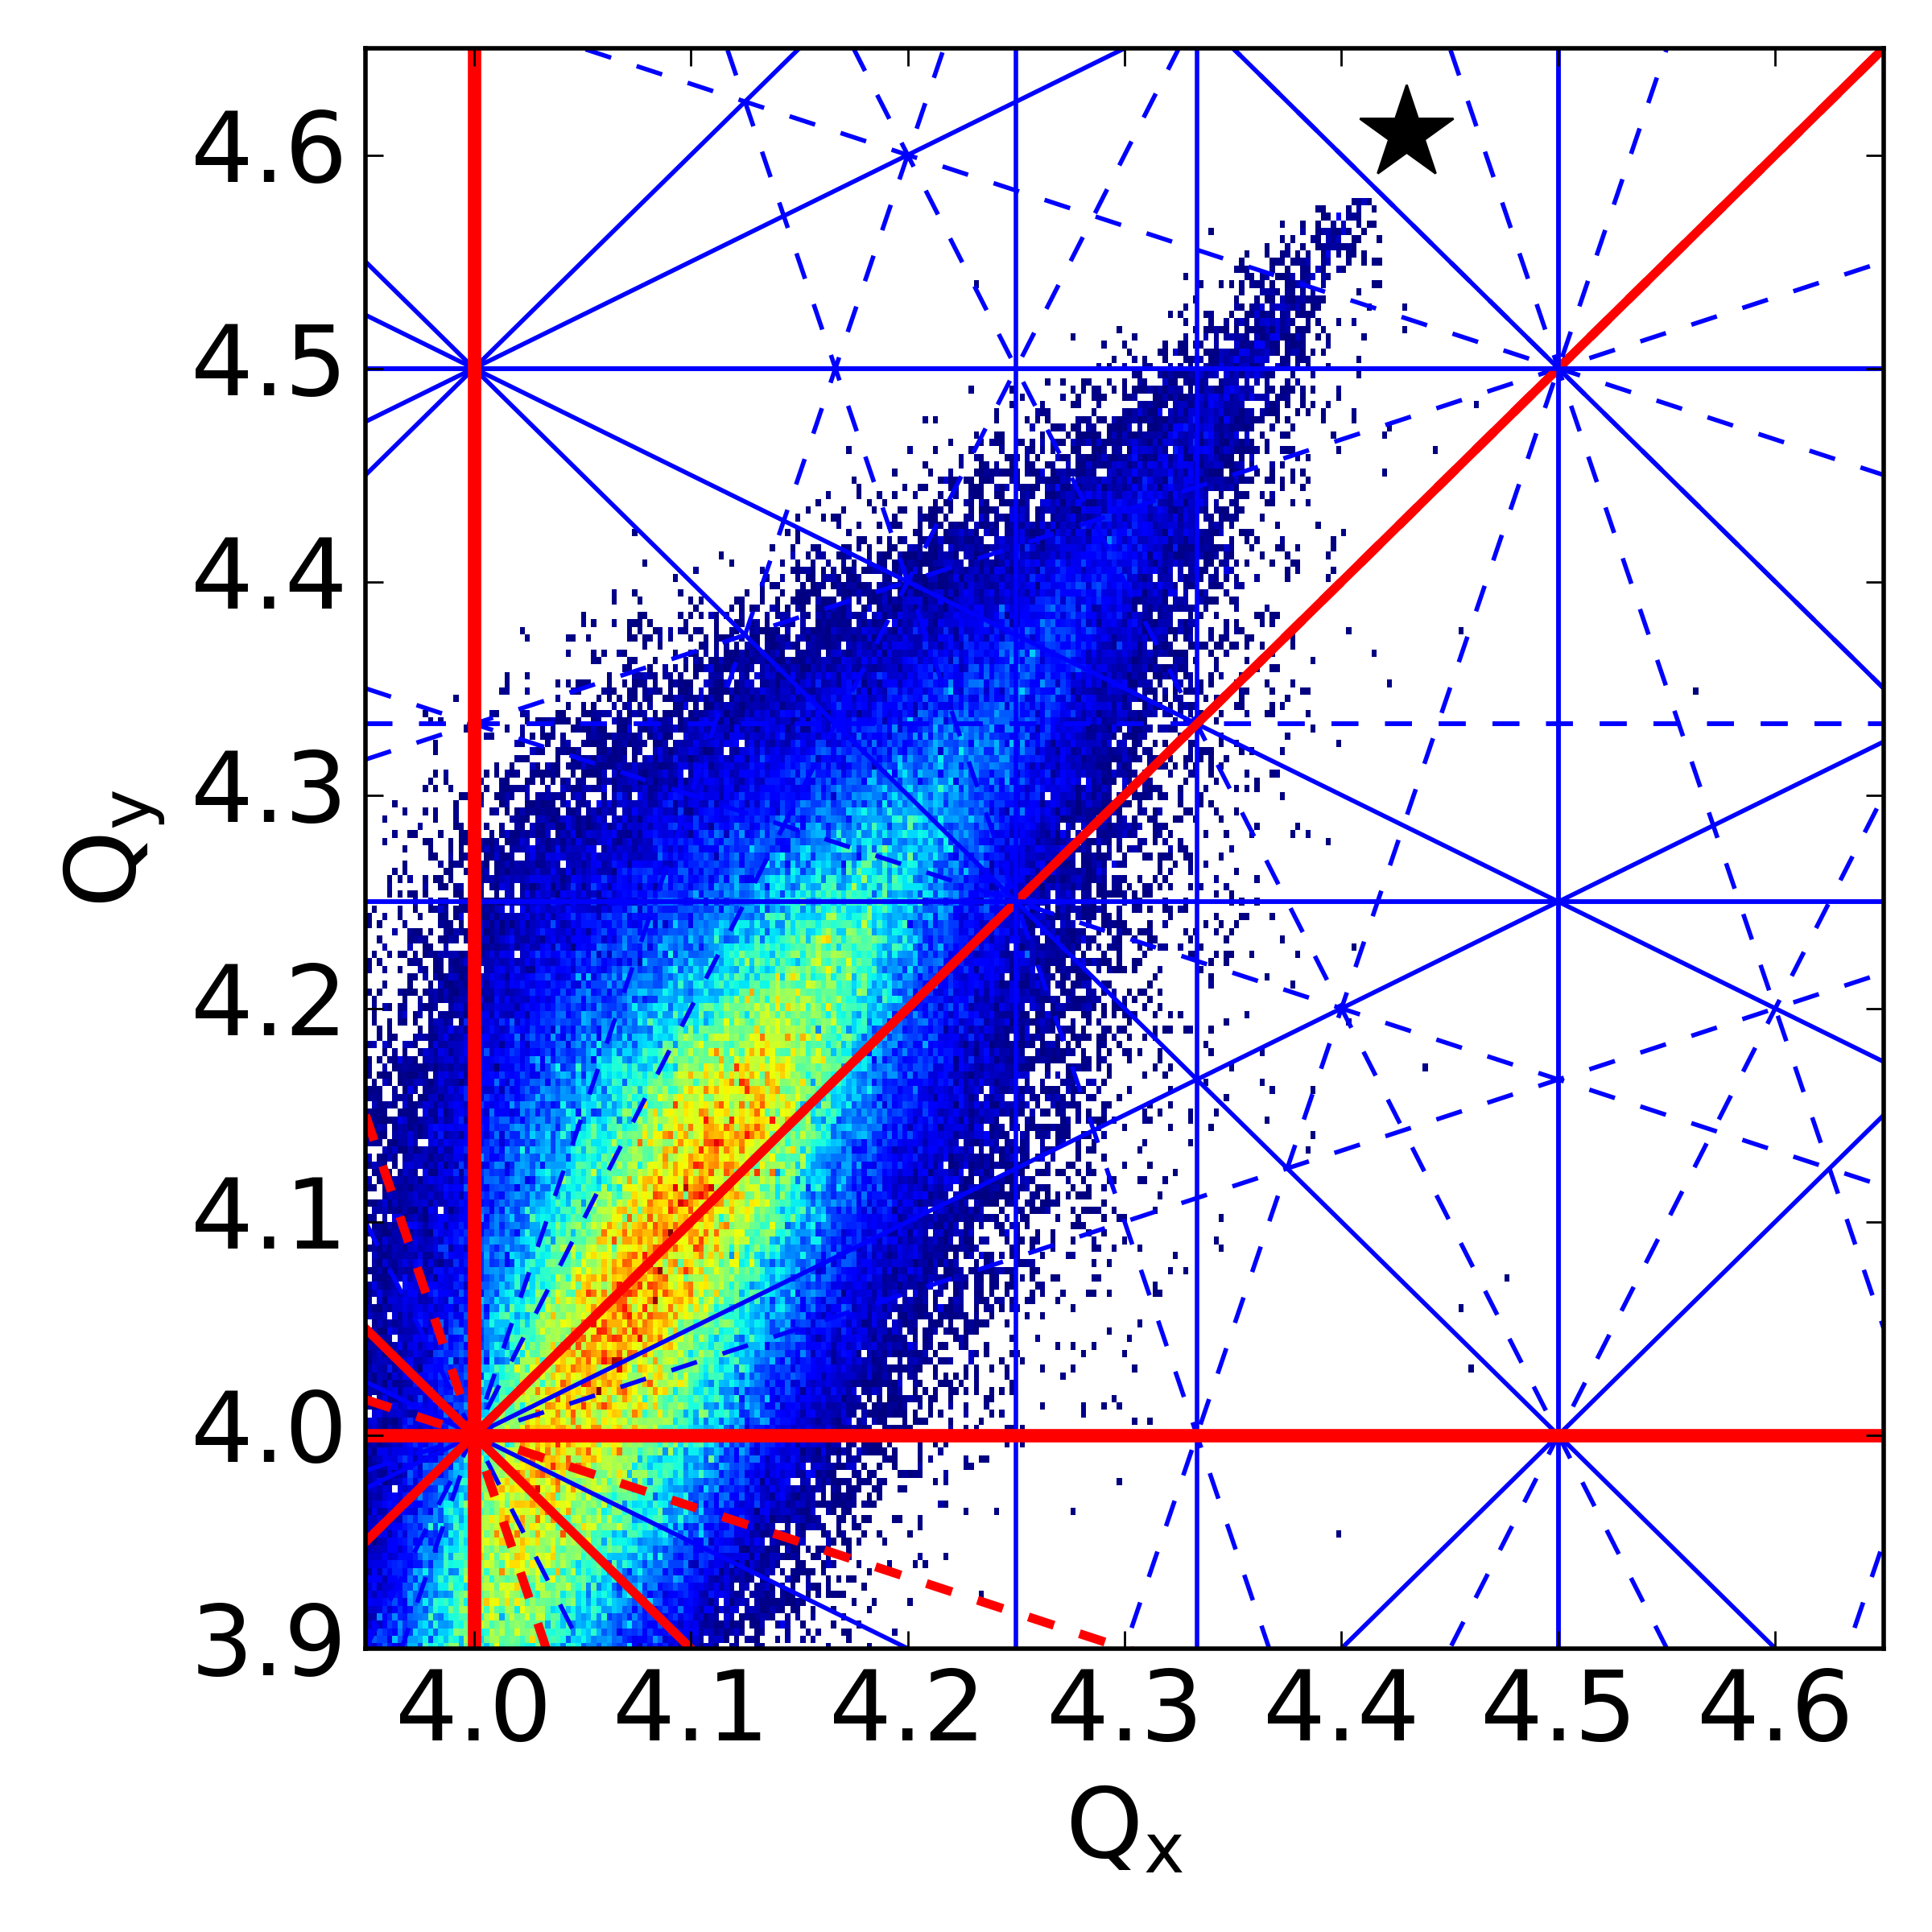
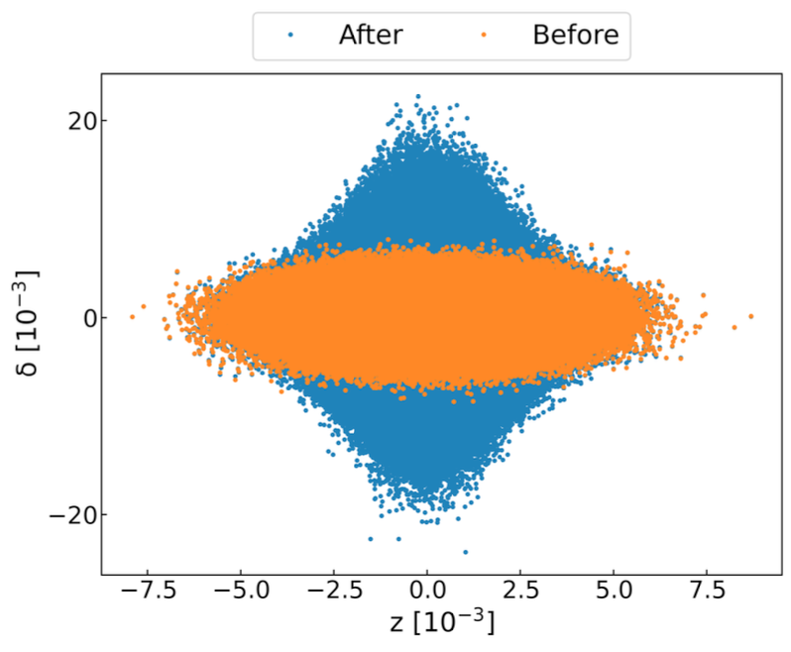
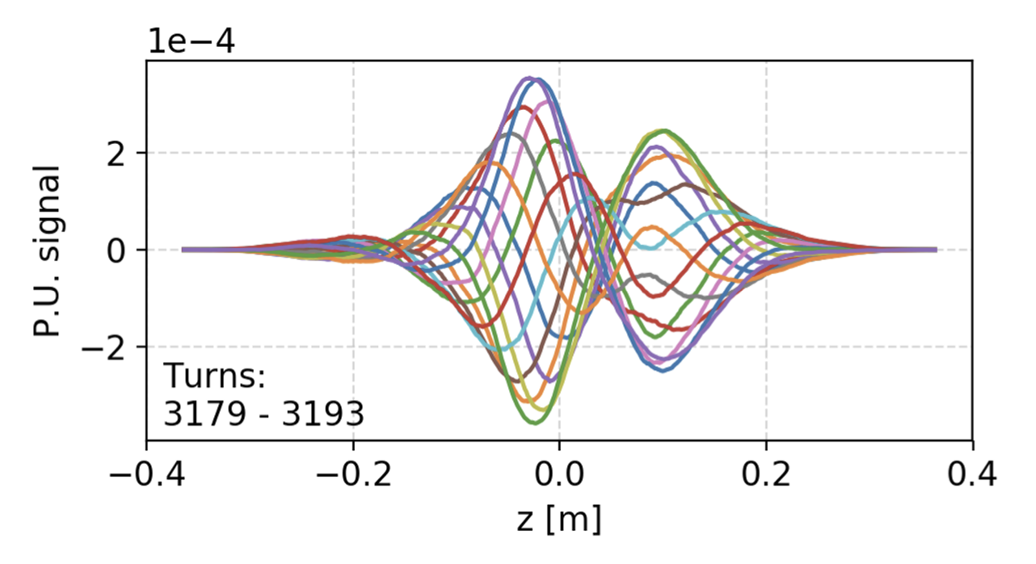
Beam dynamics software landscape at CERN - before
Courtesy S. Łopaciuk et al. – @IPAC2025
CERN has a long history of powerful software tools for beam physics applications, typical examples:
MAD-X (2002)
MAD-X (2002)
SixTrack (1990)
SixTrack (1990)
Lattice Design
Optics (calculation & design)
Tracking (dynamic aperture)
Collimation
pyHEADTAIL (2014)
COMBI (2007)
SixTrack (1990)
pyORBIT (2003)
MAD-X (2002)
Impedances
Beam-Beam Effects
Space Charge
Intra-Beam Scattering

Slide 5

Beam dynamics software landscape at CERN - now
Courtesy S. Łopaciuk et al. – @IPAC2025
Xsuite is now the main production tool, replacing many legacy codes now to be discontinued
Xsuite
Xsuite
Xsuite
Xsuite
Lattice Design
Optics (calculation & design)
Tracking (dynamic aperture)
Collimation
Xsuite
Xsuite
Xsuite
Xsuite
Impedances
Beam-Beam Effects
Space Charge
Intra-Beam Scattering

Slide 6







Xsuite Development Approach
Courtesy S. Łopaciuk et al. – @IPAC2025
For full list of features, see documentation: xsuite.web.cern.ch
Target requirements:
One toolkit from low-energy hadron rings to high-energy lepton colliders
Heterogeneous simulations made natural, as opposed to ad-hoc model translations between tools
Modern user-interface: Python, with its ecosystem of scientific computing tools
GPU support built-in, in addition to single- and multi-threaded CPU
Agile development:
Community effort: users can (and do!) become developers
Fast release cycle: up to a few new versions per month!
The coolest place to simulate cooling!
Xtrack
Single particle
tracking engine
Xpart
Generation of particles distributions
Xfields
Computation of EM fields from particle ensembles
Xdeps
Data flow manager,
deferred expressions
Physics modules
Xcoll
Particle-matter interaction and collimation
Xwakes
Wakefields and impedances
Xobjects
Interface to different computing platforms
(CPUs and GPUs of different vendors)

Slide 7
ELECTRON COOLING

Slide 8
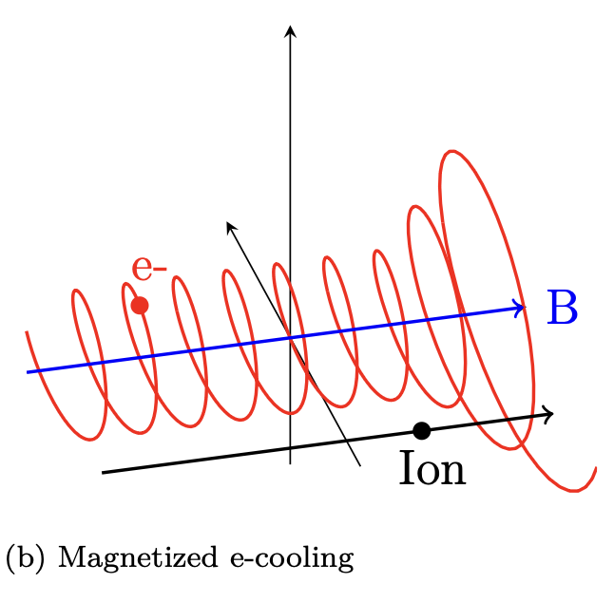
Electron Cooling Model Choice: Parkhomchuk
All CERN e-coolers assumed to work in “magnetized cooling” regime
Relatively low energy (<30 keV) DC e⁻ beams in 100 to 750 Gauss field
Best represented by empiric formula derived from experiments by V. Parkhomchuk:
Still, several parameters not easily accessible (e.g. B field quality, e⁻ temperature and profiles)
Constants
Scaling with e⁻ beam density and ion charge
Electron-ion velocity difference
Include normalisation by “effective e⁻ temperature”
Log of “impact parameters”:
Linked to probability of interaction
Depends on B field, e⁻ temp., …
Typically, ≈ 10

Slide 9
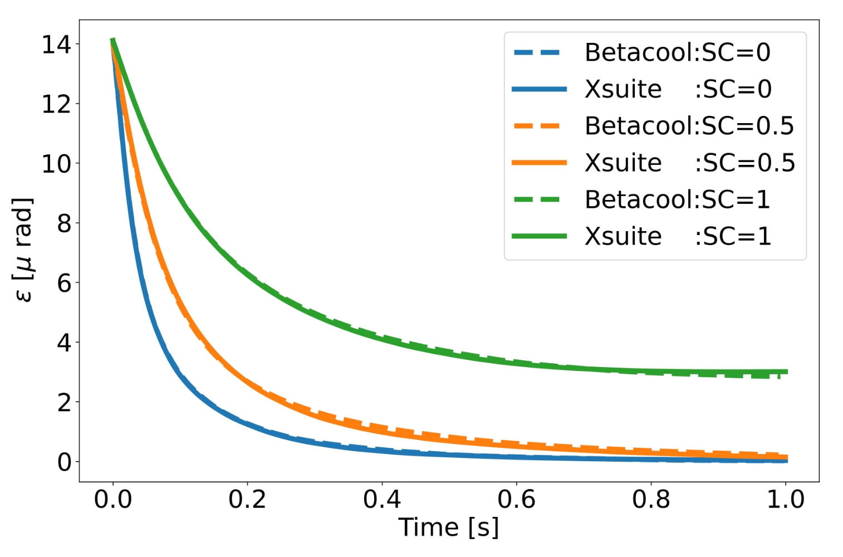
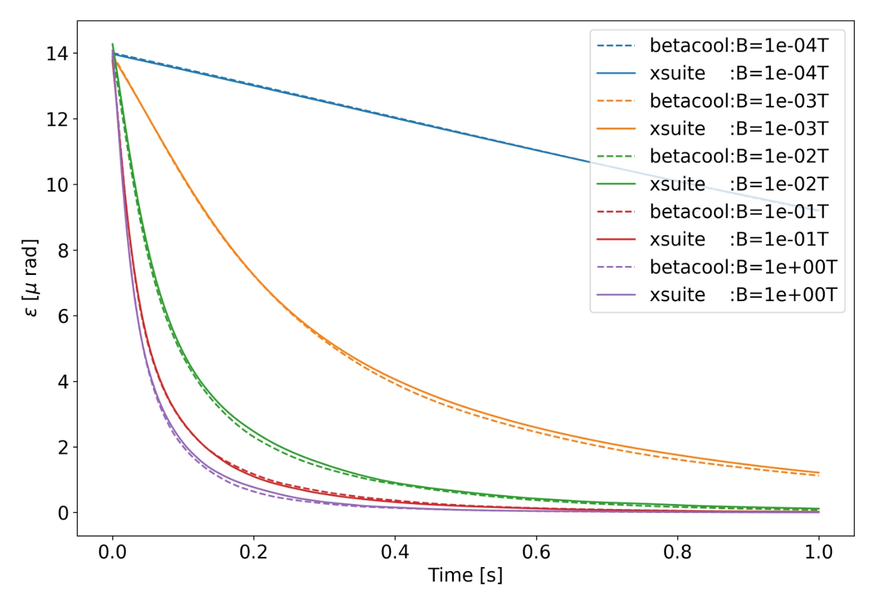
Benchmark with Betacool
Betacool by A. Sidorin is presently not actively maintained (to our knowledge)
JSPEC, PyOrbit, PyHEADTAIL implementations of Parkhomchuk model exist
Implementations derived from Betacool, or similar
Went back to the origin: Betacool
Thorough check of the physics implemented, including minor bug fixes in Betacool:
Improper handling of space-charge neutralisation
Wrong sign used in the rotation of the e⁻ beam
Additional (undocumented) effect of electron beam rotation on transverse e⁻ temperature was not fully understood
This feature was NOT imported in XSuite, as its implementation was not properly validated
Validated and documented e-cooling implementation now available in Xsuite!
LEIR-like study case

Slide 10
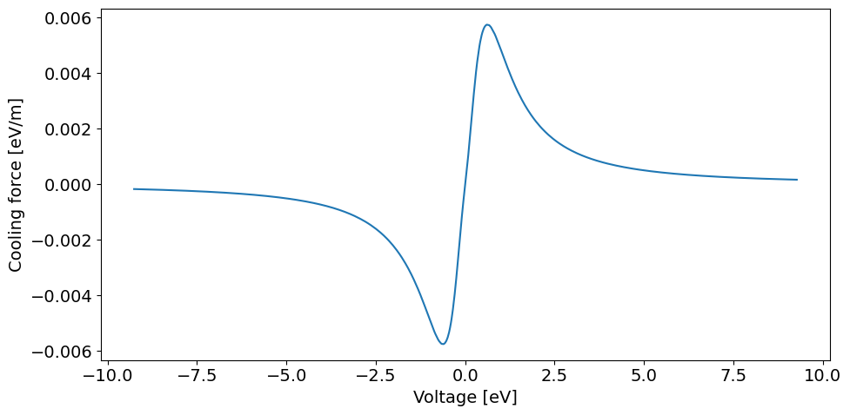
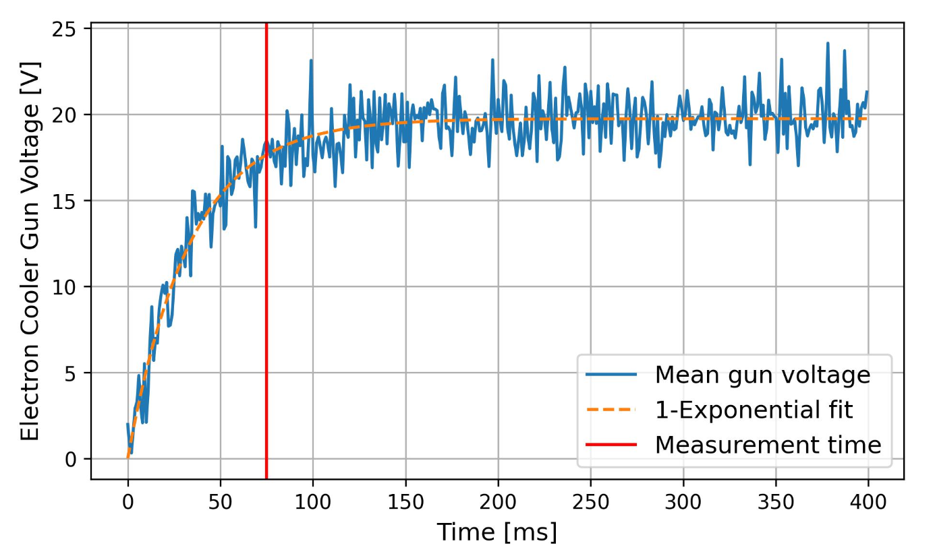
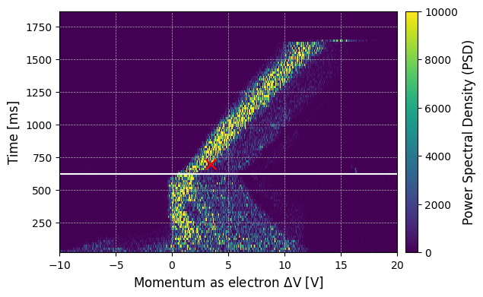
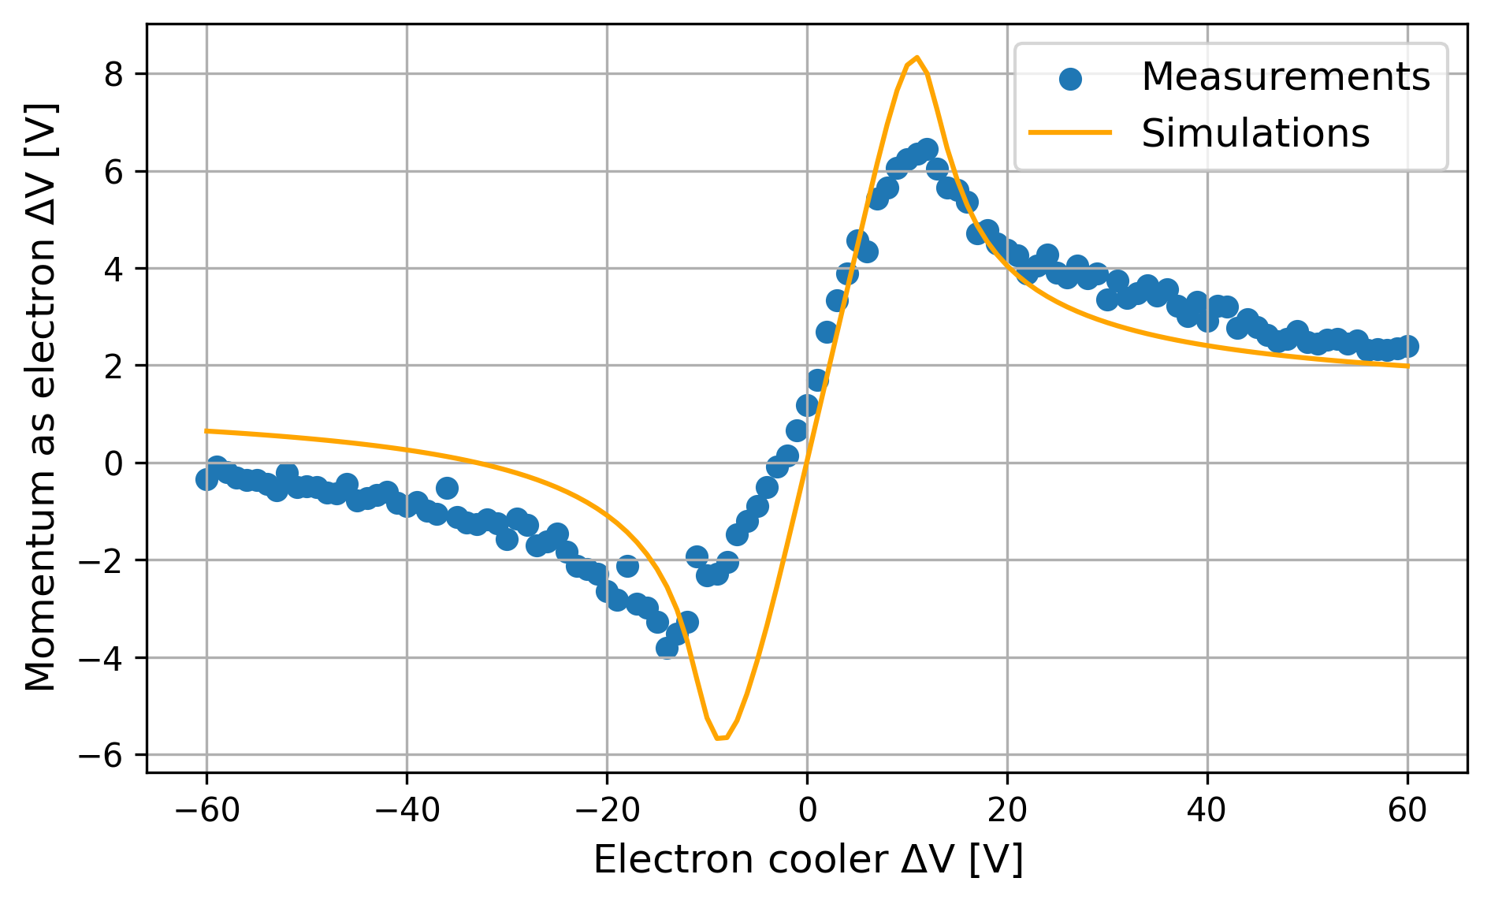
Measurement and Simulation of Cooling Force
Longitudinal Friction Force is the most typically measurement:
Pre-cool the circulating beam
Apply a voltage step on the gun voltage (i.e. e⁻ energy)
First pitfall: actual voltage/e⁻ energy not instantaneous
Measure derivative of ion momentum variation
Second pitfall: Limited measurement resolution
simulate the whole dynamic process (in Xsuite)!
First measurements with Mg⁷⁺ not perfect
No time to measure all beam parameters; not enough pre-cooling; …
Gun Voltage (electron energy)
Time in the cycle

Slide 11
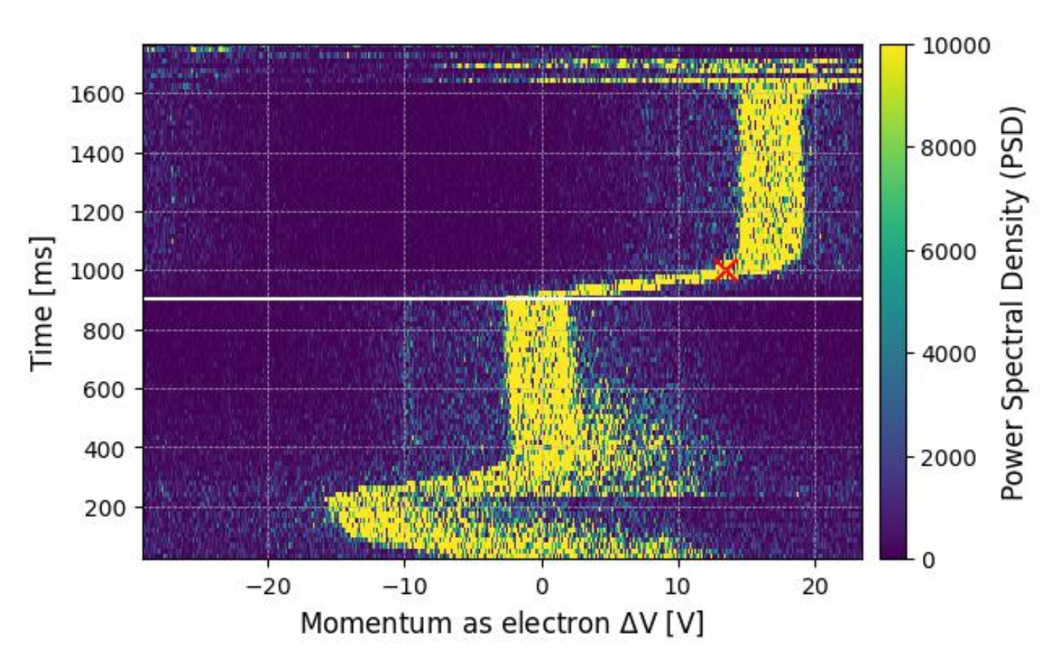
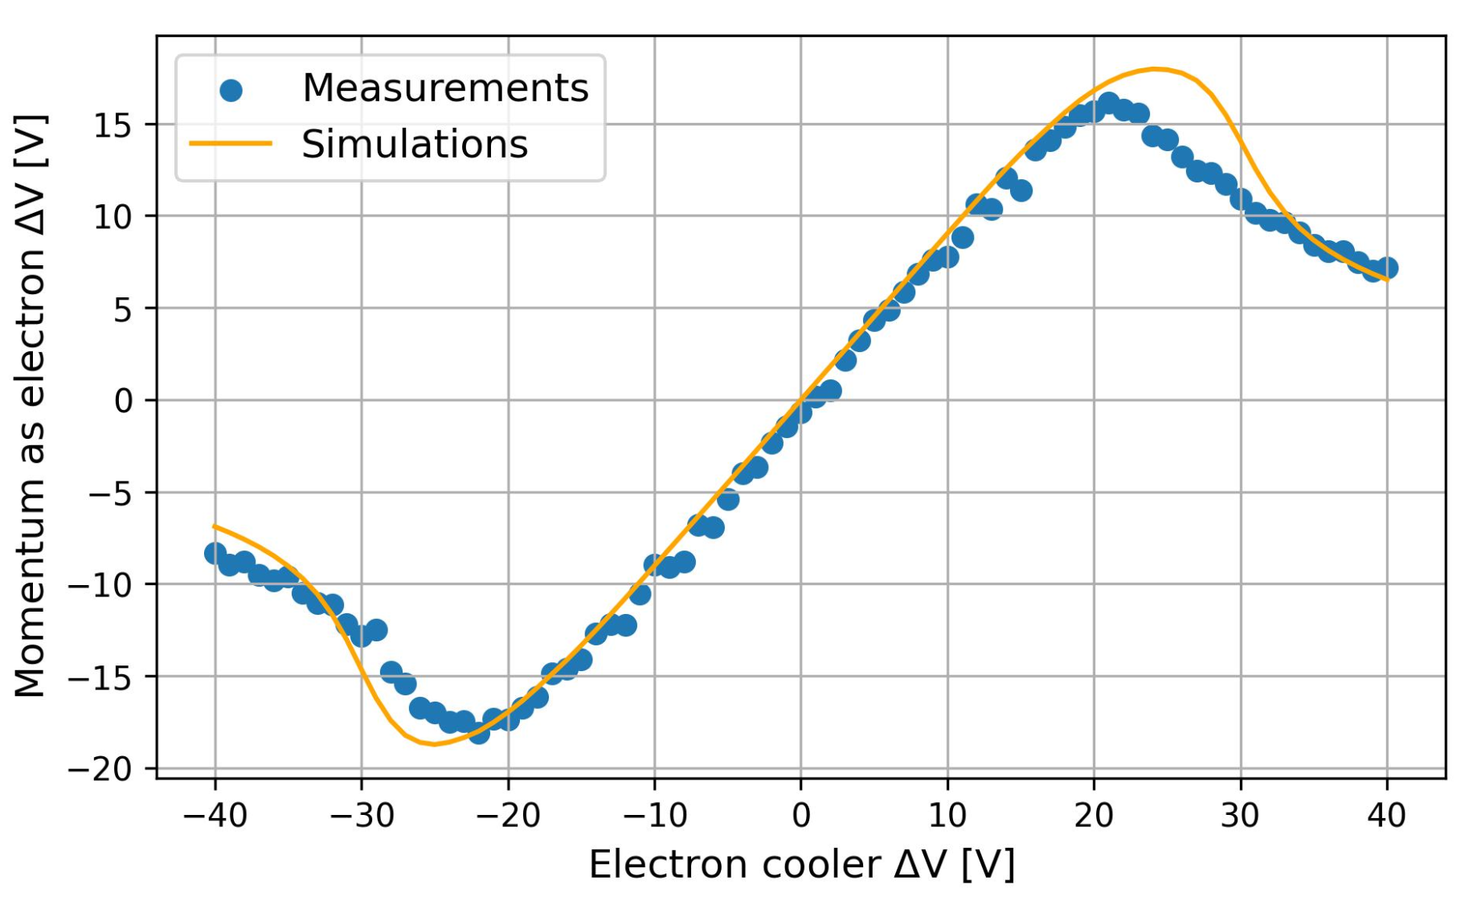
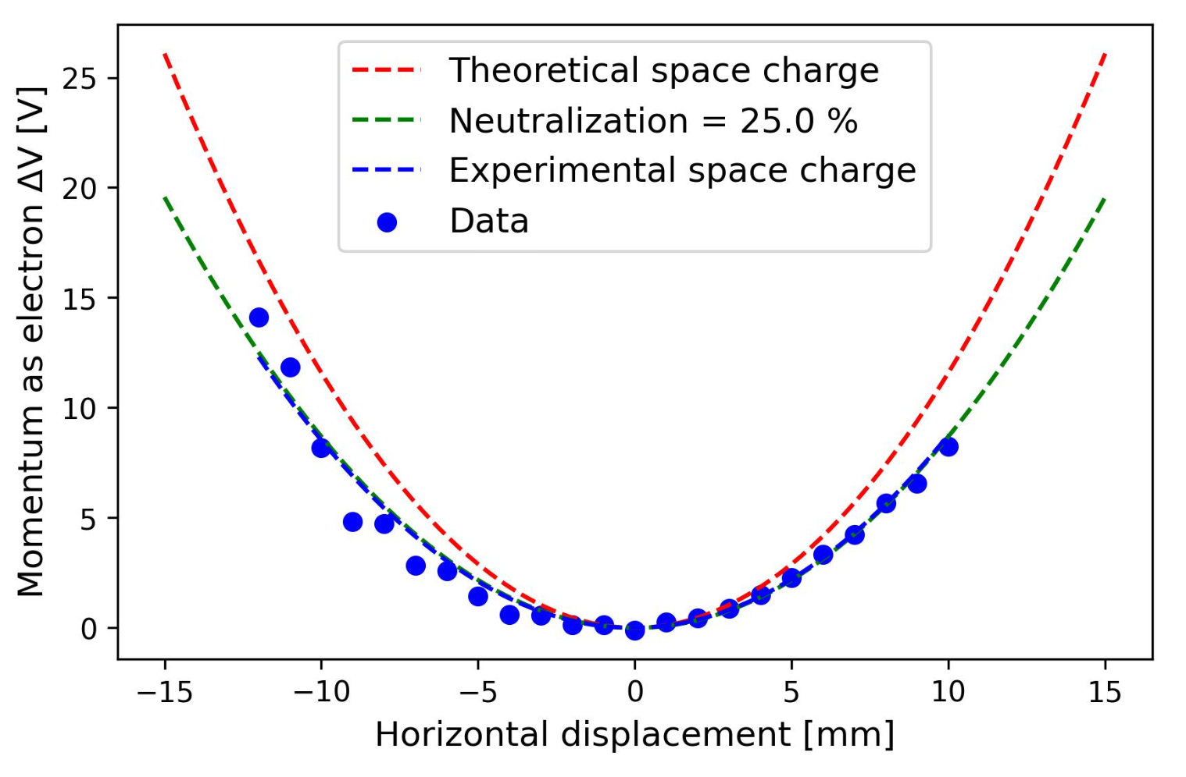
Longitudinal Cooling Force: Pb⁵⁴⁺ case
Much better agreement after constraining beam parameters as much as possible !
E.g. measure effects such as e⁻ beam “neutralisation”
Only e⁻ T (T⟂=100 meV; T‖=1 meV), and profile (flat) still guessed

Slide 12
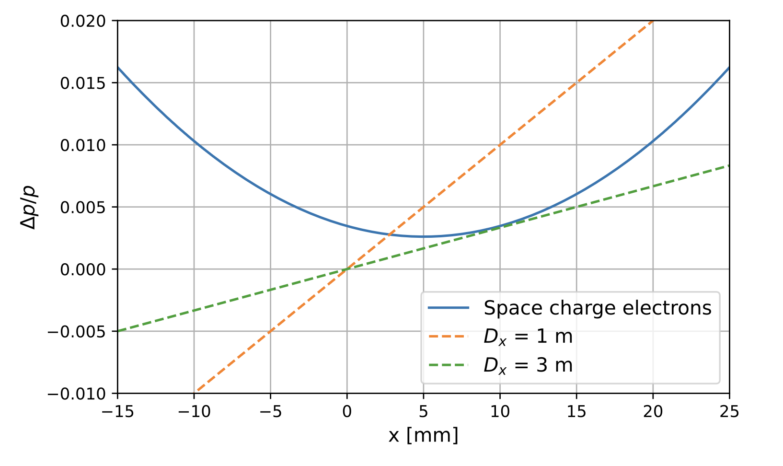
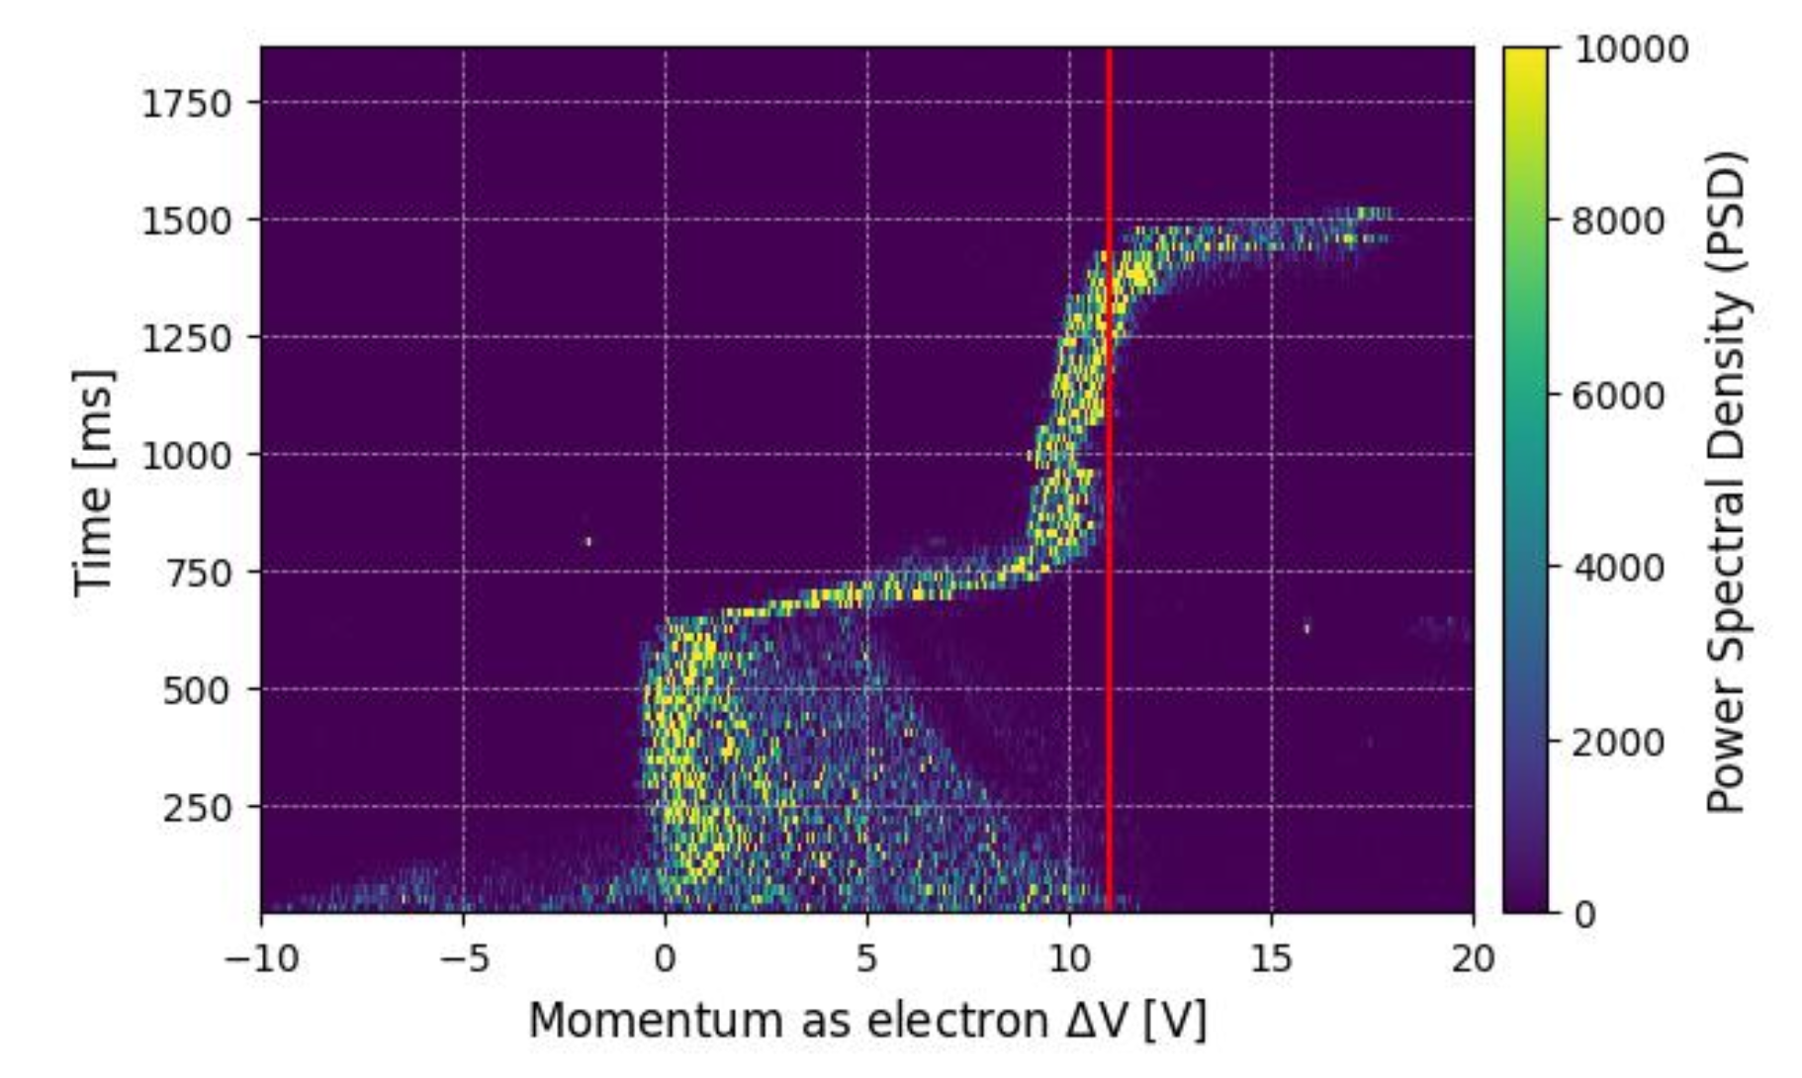
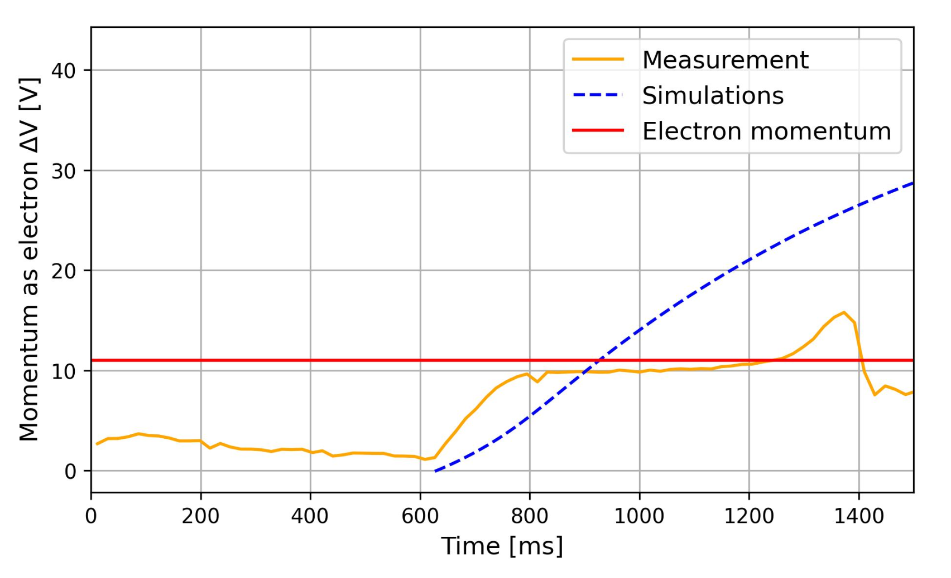
More exotic effects under investigation in LEIR
Fast “run away” observed during Mg⁷⁺ measurements
Not seen with standard Pb⁵⁴⁺ beam
Tried to explain it by interplay between e⁻ space charge + ion-e⁻ offset + transverse heating
Unrealistic dispersion needed, not possible to reproduce
Better machine control or e-cooling models might be needed

Slide 13
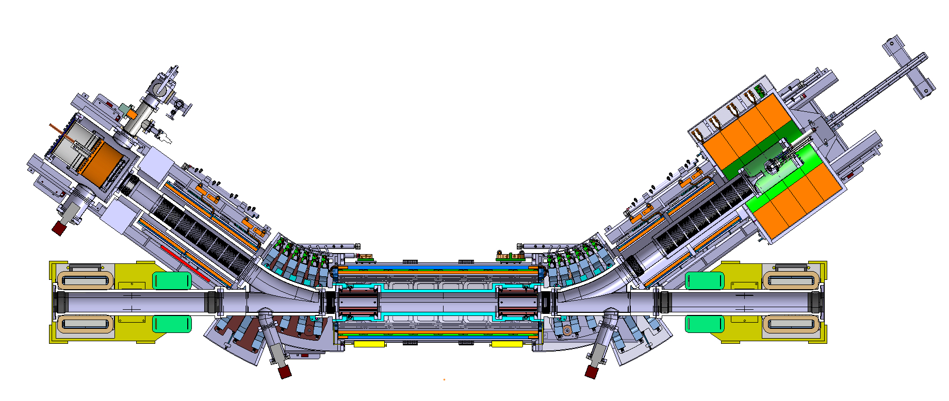
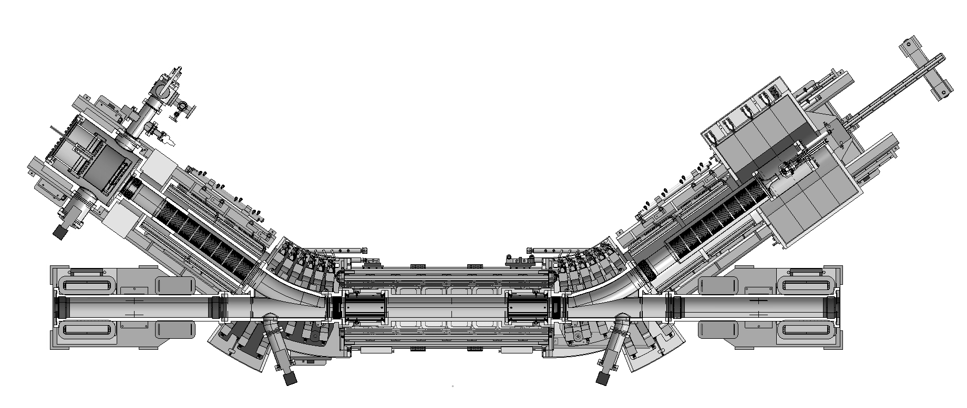
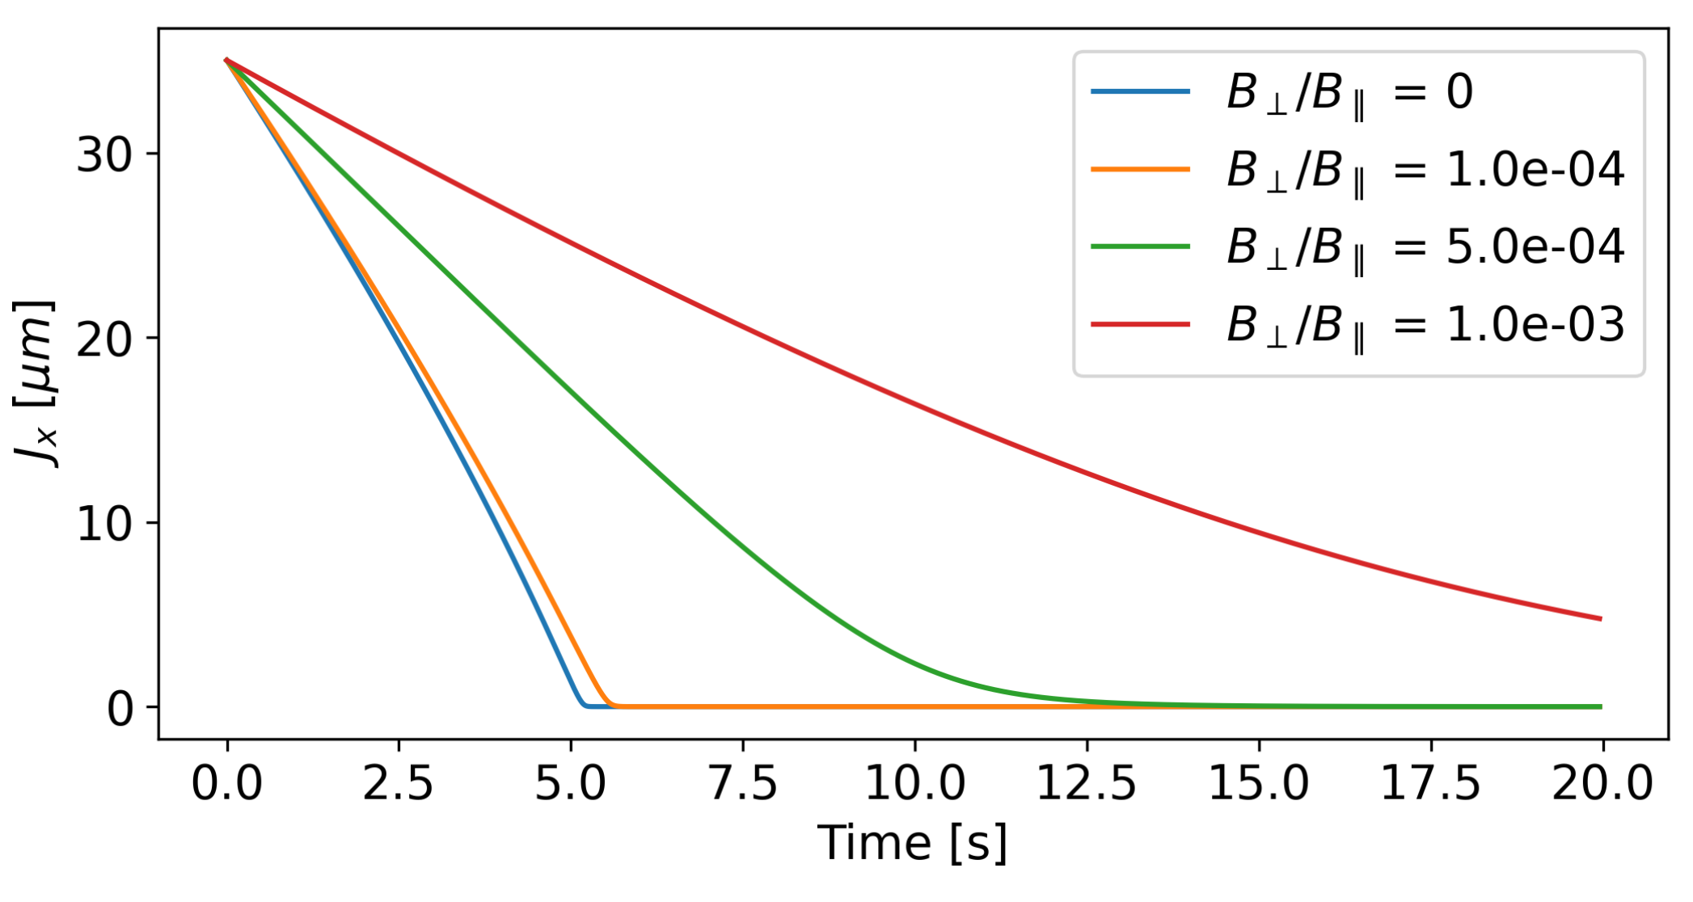
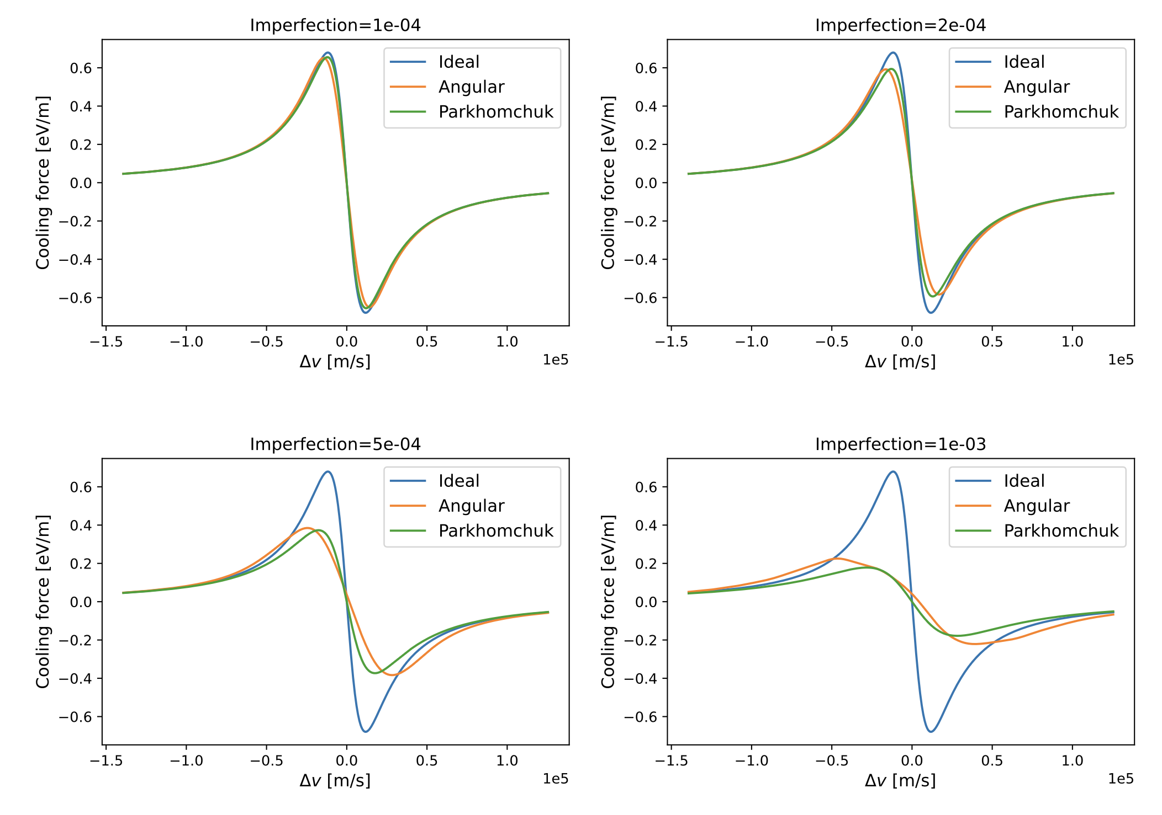
Impact of field quality on new AD e-cooler
New AD e-cooler is being built
See also Laurette’s and Gunn’s presentations
Specification on field quality was required
Ideal problem addressed in Xsuite !
Comparison between Parkhomchuk’s effective temperature approach and sum of shorter coolers with given angular spread
Impact most sever at highest energies (i.e. 300 MeV/c for AD)
Provided specification for magnet design (rms < 1e-4)

Slide 14
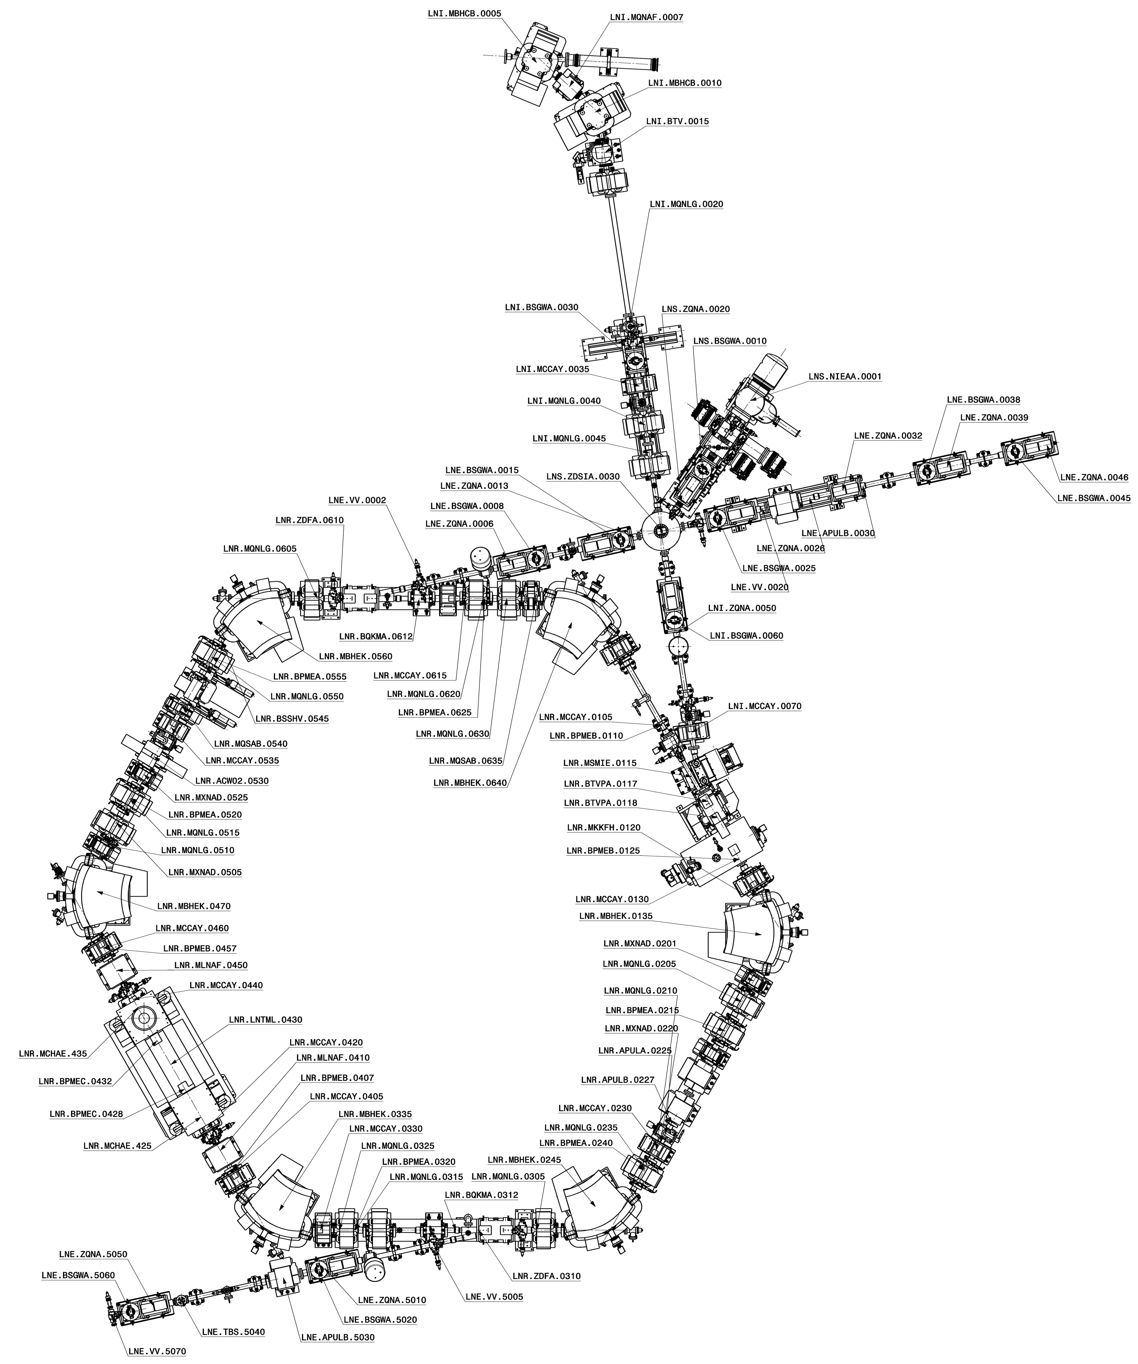
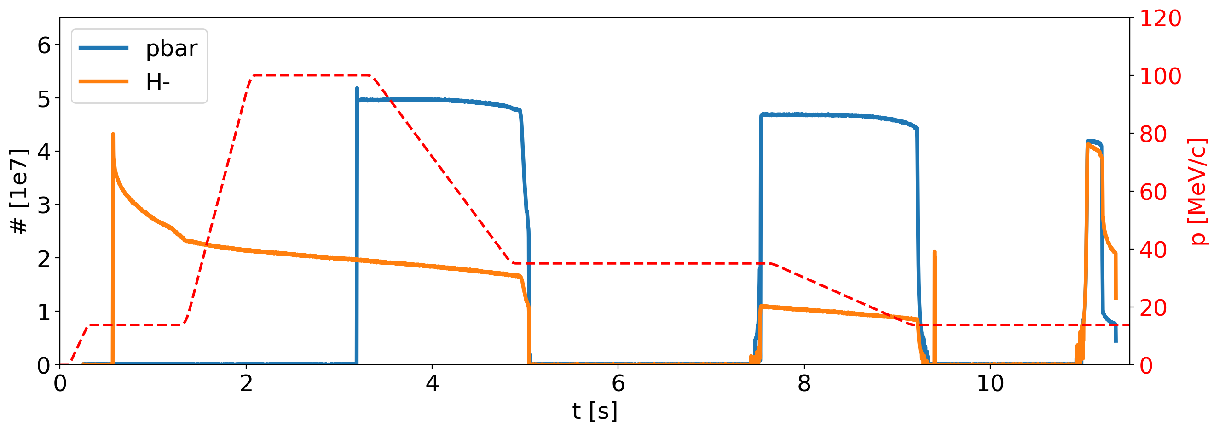
The ELENA cycle
Profile
monitors
From AD
H⁻ source
Running with two (magnetically-equal) ~15-second-long pbar or H⁻ cycles
Second H⁻ injection to increase beam intensity @100 keV before extraction
n bunches extracted on demand by users
Scraper
To experiments
h=1
h=4
H⁰
monitor
h=4
h=1
ELENA
Ring
E-cooling
E-cooling
E-cooling
e-cooler
Pbar repetition rate is very slow for any e-cooling study/setup
Good news: No H- lifetime degradation observed with e-cooling! We can use H⁻ for most studies!
Bad news: H⁻ lifetime strongly affected by vacuum levels in the ring (typically 10⁻¹¹ mbar)
Limited beam instrumentation available in the machine: only scraper measurements for transverse profile
Bad news: typical scraping time > cooling time constant; and poor performance with H⁻ (requires in-vacuum MCPs)
Good news (low energy only): beam can be fast-extracted on transfer line profile monitors
Future? (for H⁻ only): Promising development using neutrals monitors – see Gerard’s presentation

Slide 15
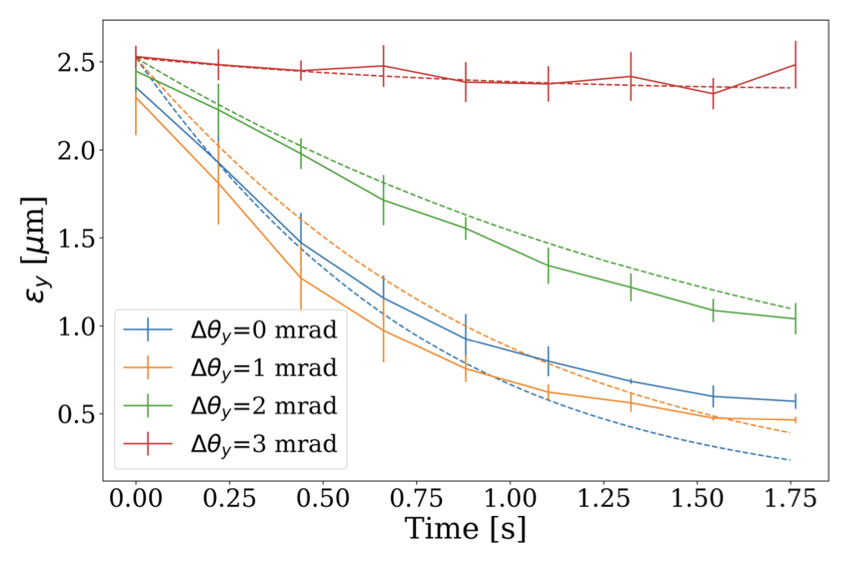
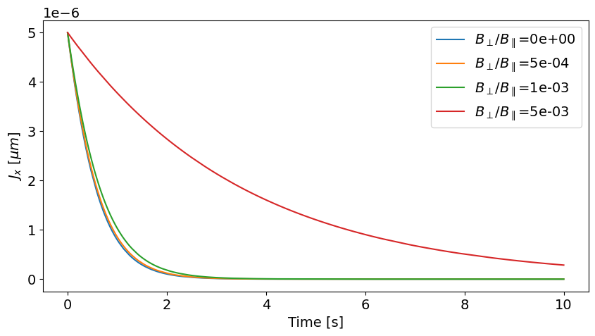
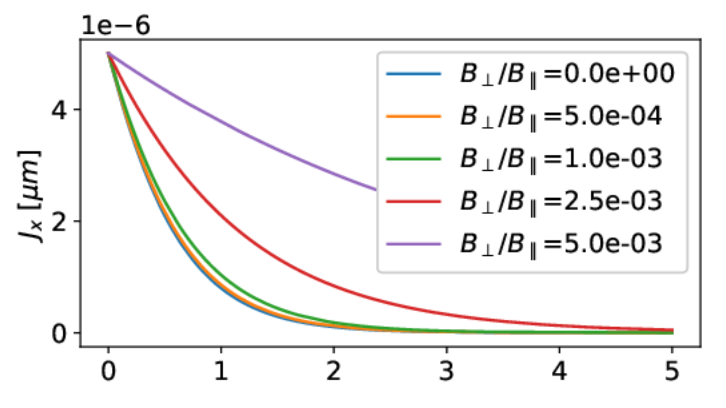
E-cooling studies in ELENA
Transverse cooling measurement extracting beam at different times on a profile monitor
Generally, good agreement between measurements and simulations !
Wish to test impact of field quality (by spoiling it with available correction coils) on cooling efficiency
Better studied at higher energy, where impact is more sizeable but no fast transverse measurement available
Promising results with H⁰ monitor – see Gerard’s presentation
Measurements and simulations at 13.7 MeV/c
Simulations at 35 MeV/c
ELENA magnetic field quality somewhere in this range

Slide 16
LASER COOLING

Slide 17
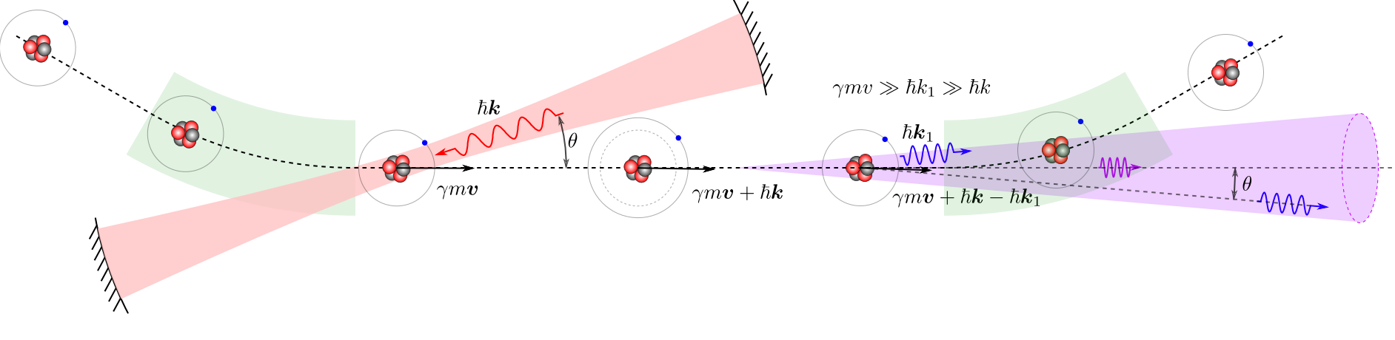
Gamma Factory PoP Experiment in ‘a nutshell’
Strong multidisciplinary interest in producing high-intensity gamma-ray flux
see Aurélien’s presentation
Concept based on partially stripped ions (PSI) excited by a laser
exploiting Doppler shift twice: to excite otherwise inaccessible levels and boost photon energy
Need for a demonstrator, which appears feasible in the SPS
Excellent opportunity to test laser cooling at the highest ion energies ever achieved
SPS Pb ions
3.5 m
Input laser
Fabry-Perot cavity
Gamma rays
Courtesy gamma factory collaboration
E. Granados | SPS MPC meeting | 27.05.25

Slide 18
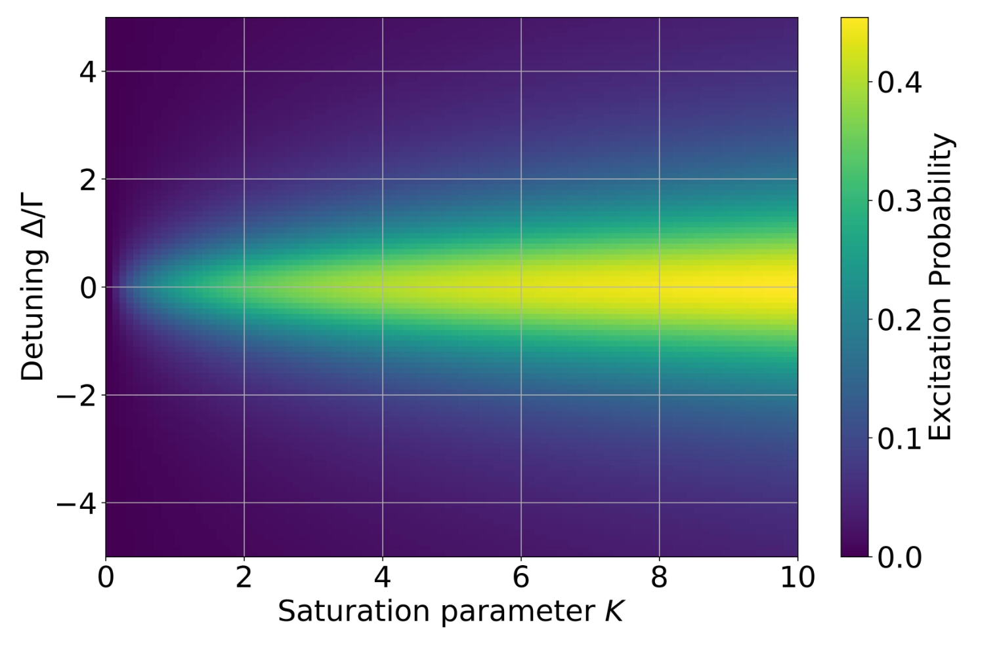
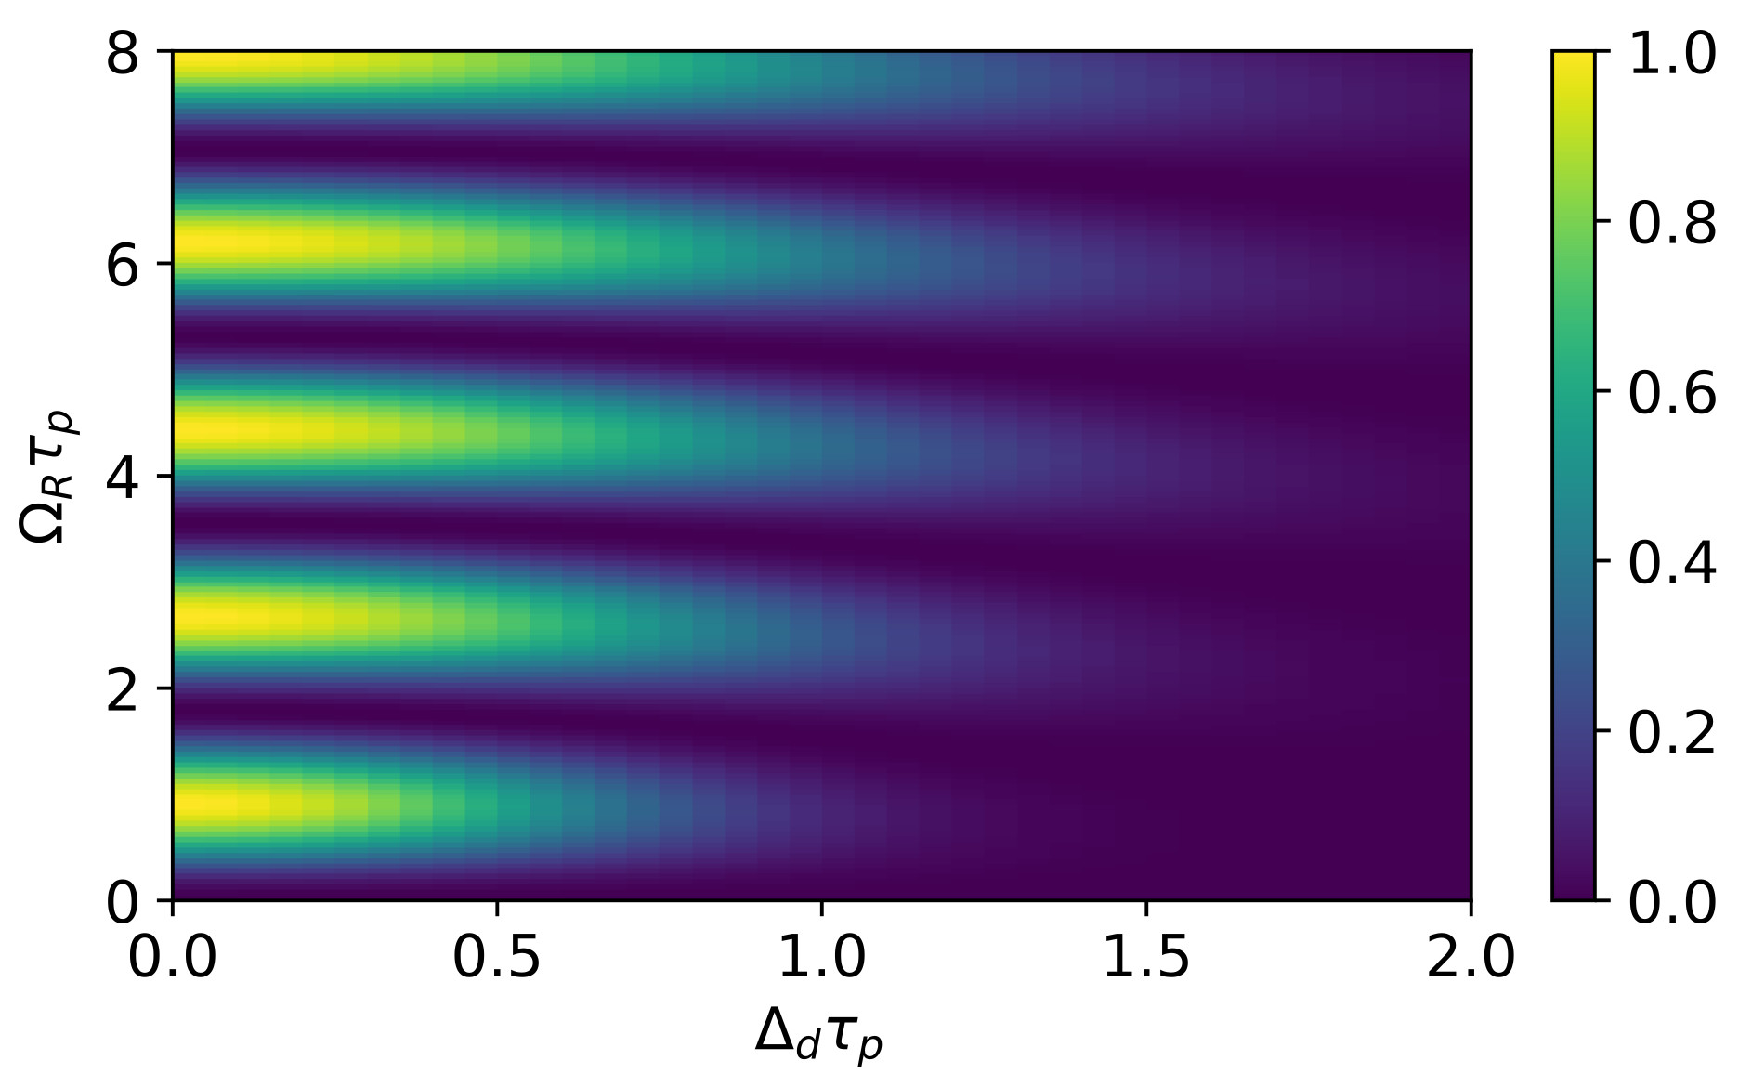
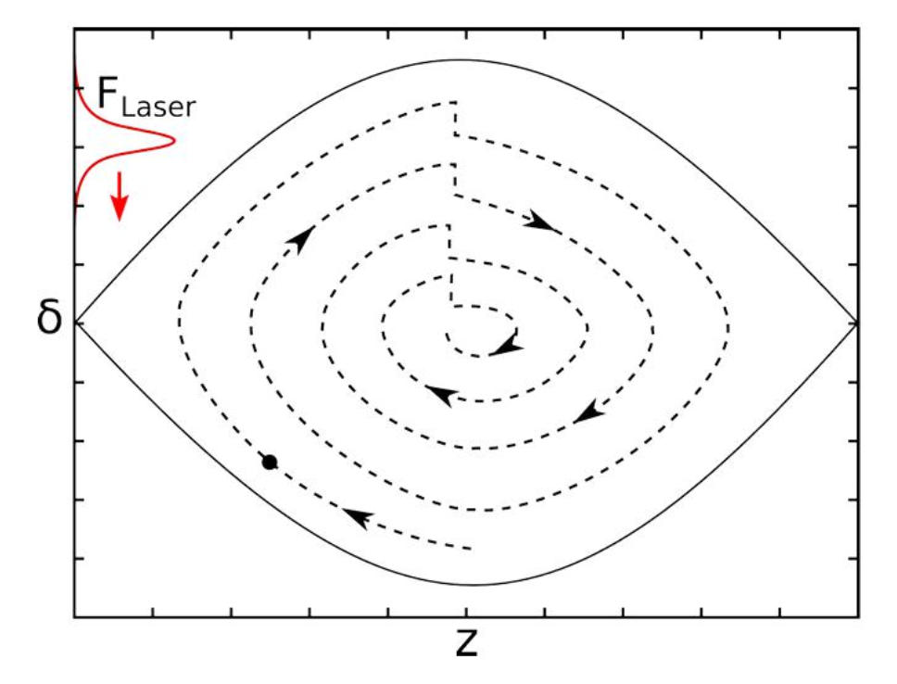
Laser Cooling in Xsuite
Pulsed Laser
Principle: selective particle momentum reduction
First implementation in Xsuite by A. Petrenko
Requires to solve optical Bloch equations
Done for pulsed Fourier-limited and CW lasers
Chirped lasers explored, but not yet implemented
Multi-thread + GPU support essential for long simulations
CW Lasers
From L.Eidam

Slide 19
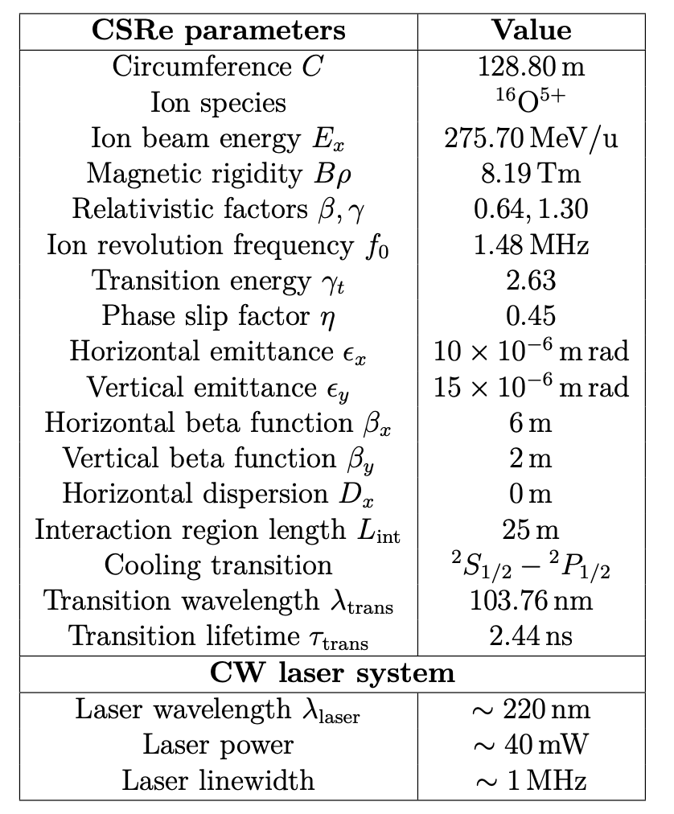
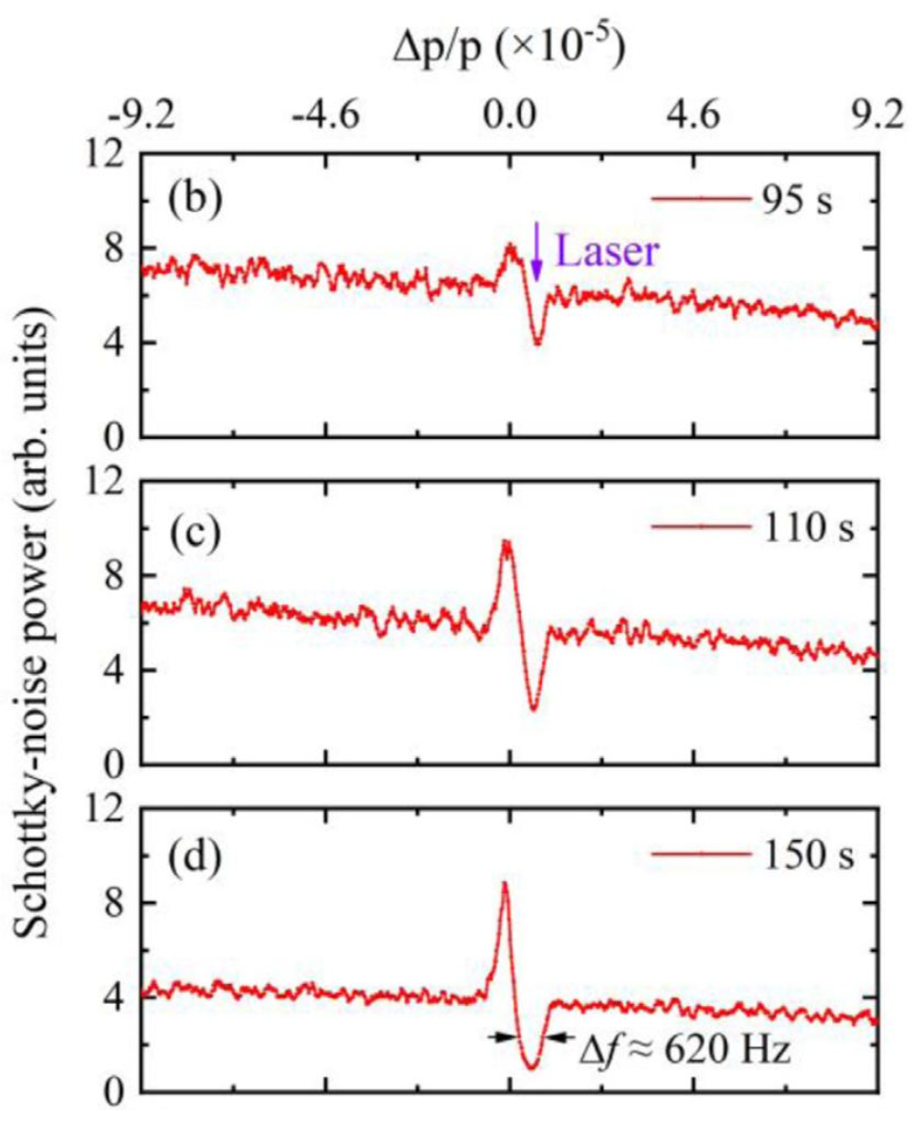
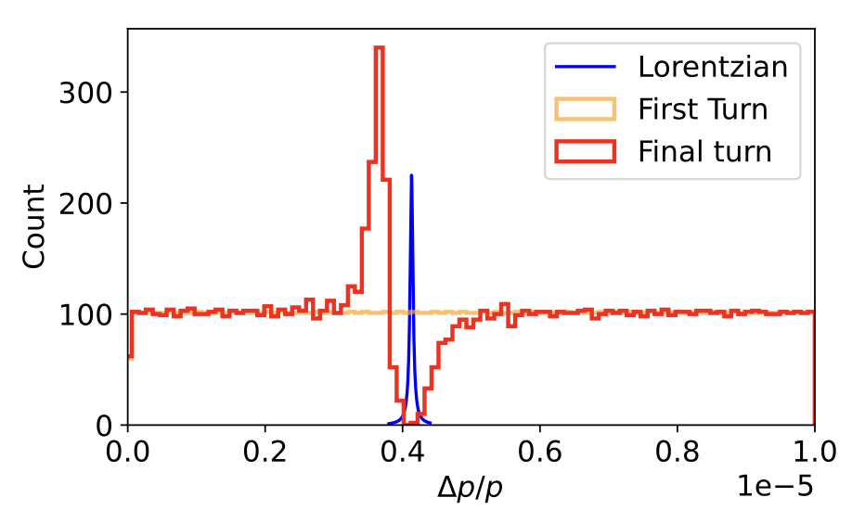
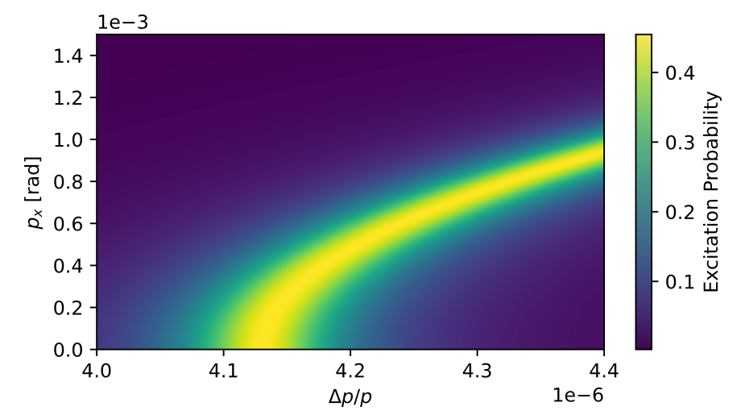
Benchmark with Literature: Lanzhou experiment
Replicating published measurement with CW laser
Requires to account for doppler effect correction due to emittance
Results compatibles with published data
Uncertainty given by varying laser beam size at IP
Measurement in Lanzhou
Effect on zero-emittance beam
Broadening due to emittance
 | Experiment | Original simulation | Xsuite
FWHM dp/p | 5.7e-6 | 5.7e-6 | [2e-6, 7e-6]

Slide 20
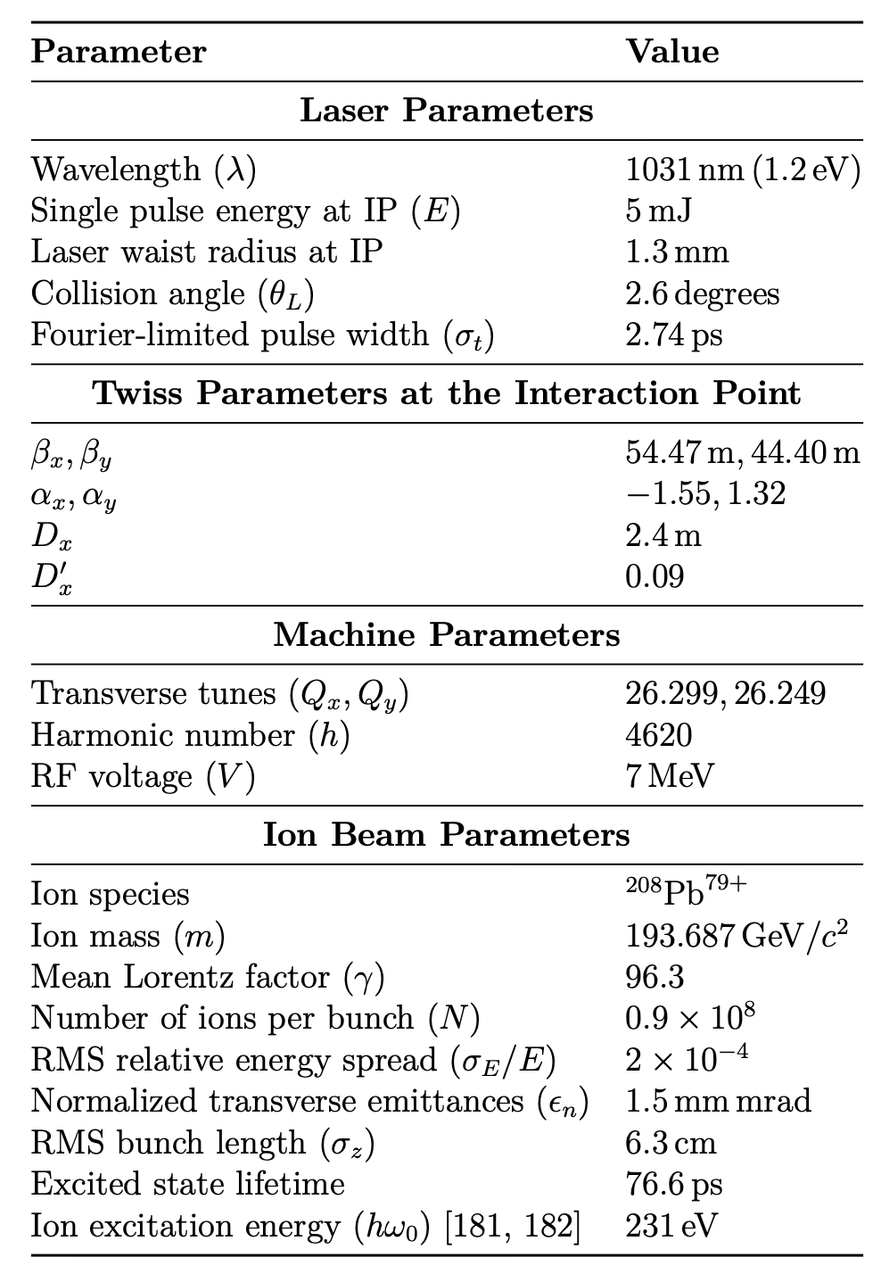
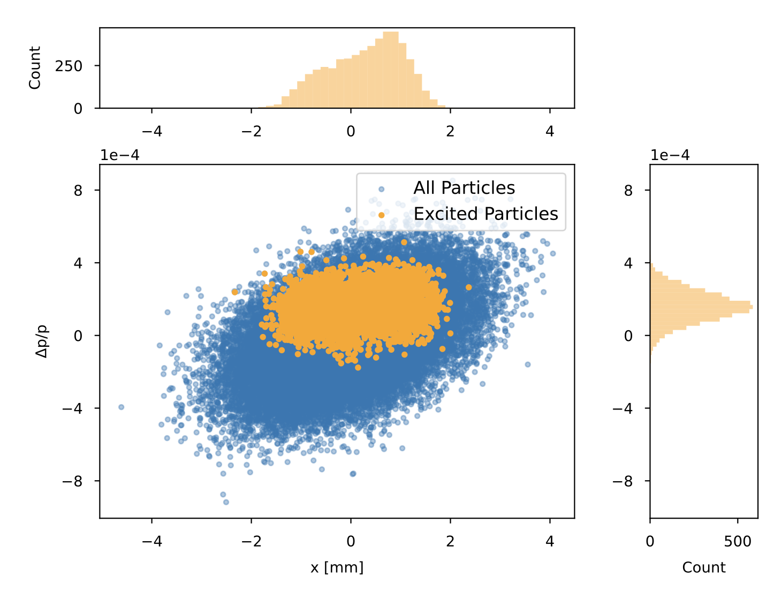
Parameters for PoP experiment
Choice of parameters dependent on:
accessible energy levels
available laser parameters
machine optics and ion beam constrains
Multi-parameter exploration accessible within Xsuite

Slide 21
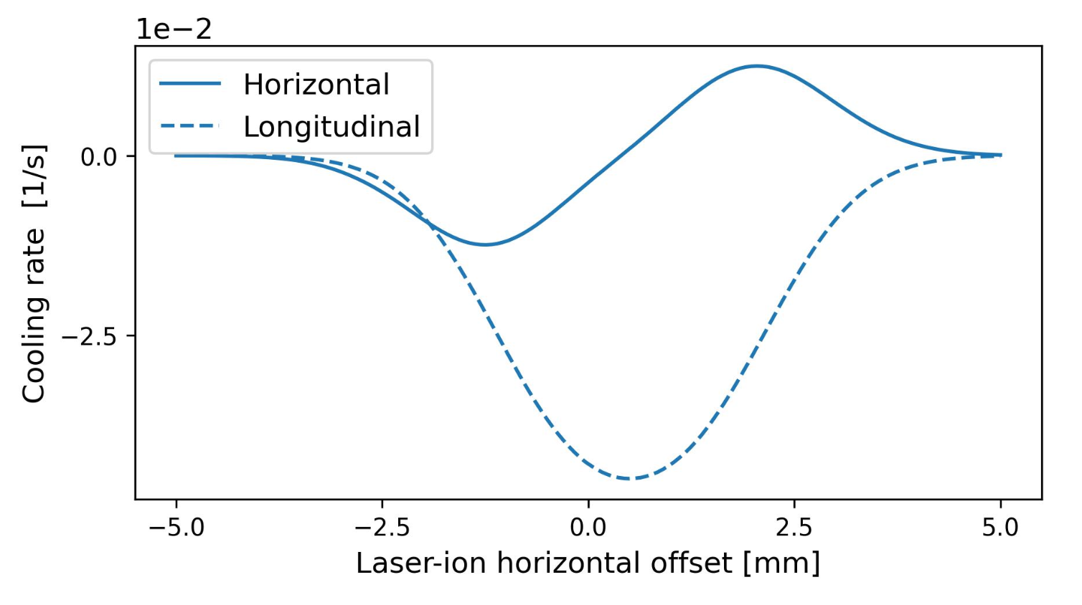
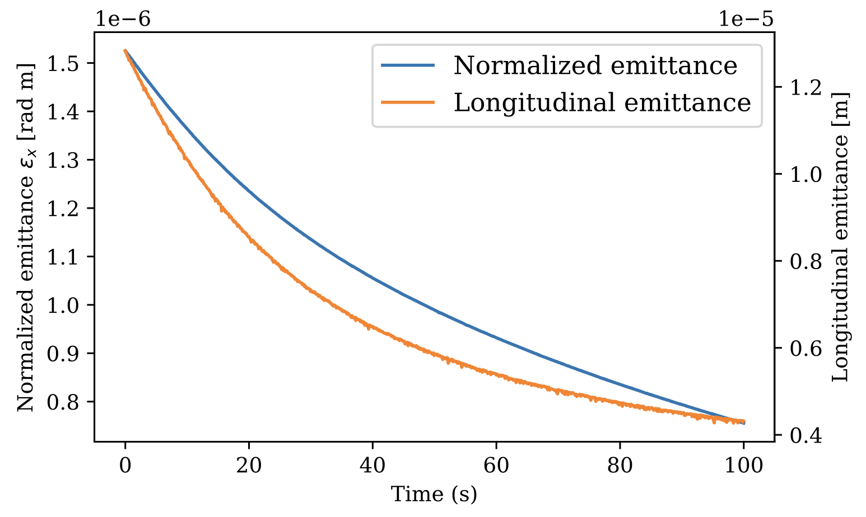
Transverse Cooling Enabled by Dispersion Coupling
Dispersion at the IP converts longitudinal cooling into transverse cooling
Strong transverse cooling reduces longitudinal cooling
Full optimisation possible with Xsuite
Vertical cooling achieved through transverse plane coupling
-1.24 mm

Slide 22
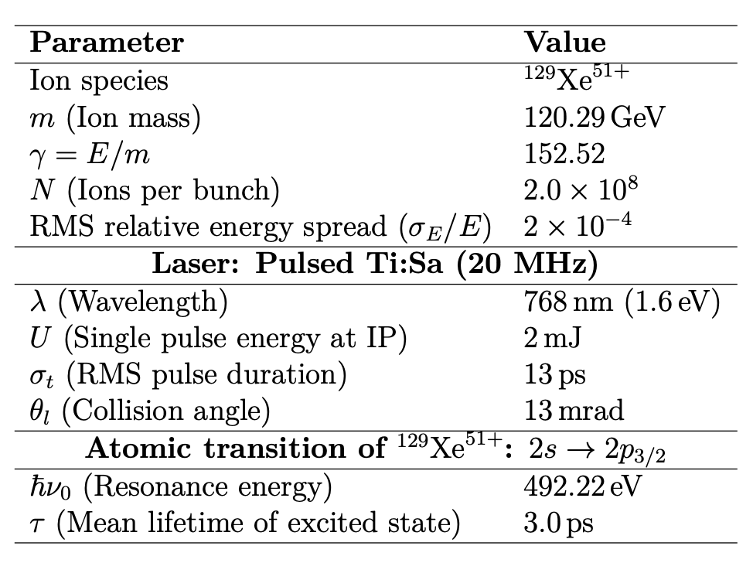
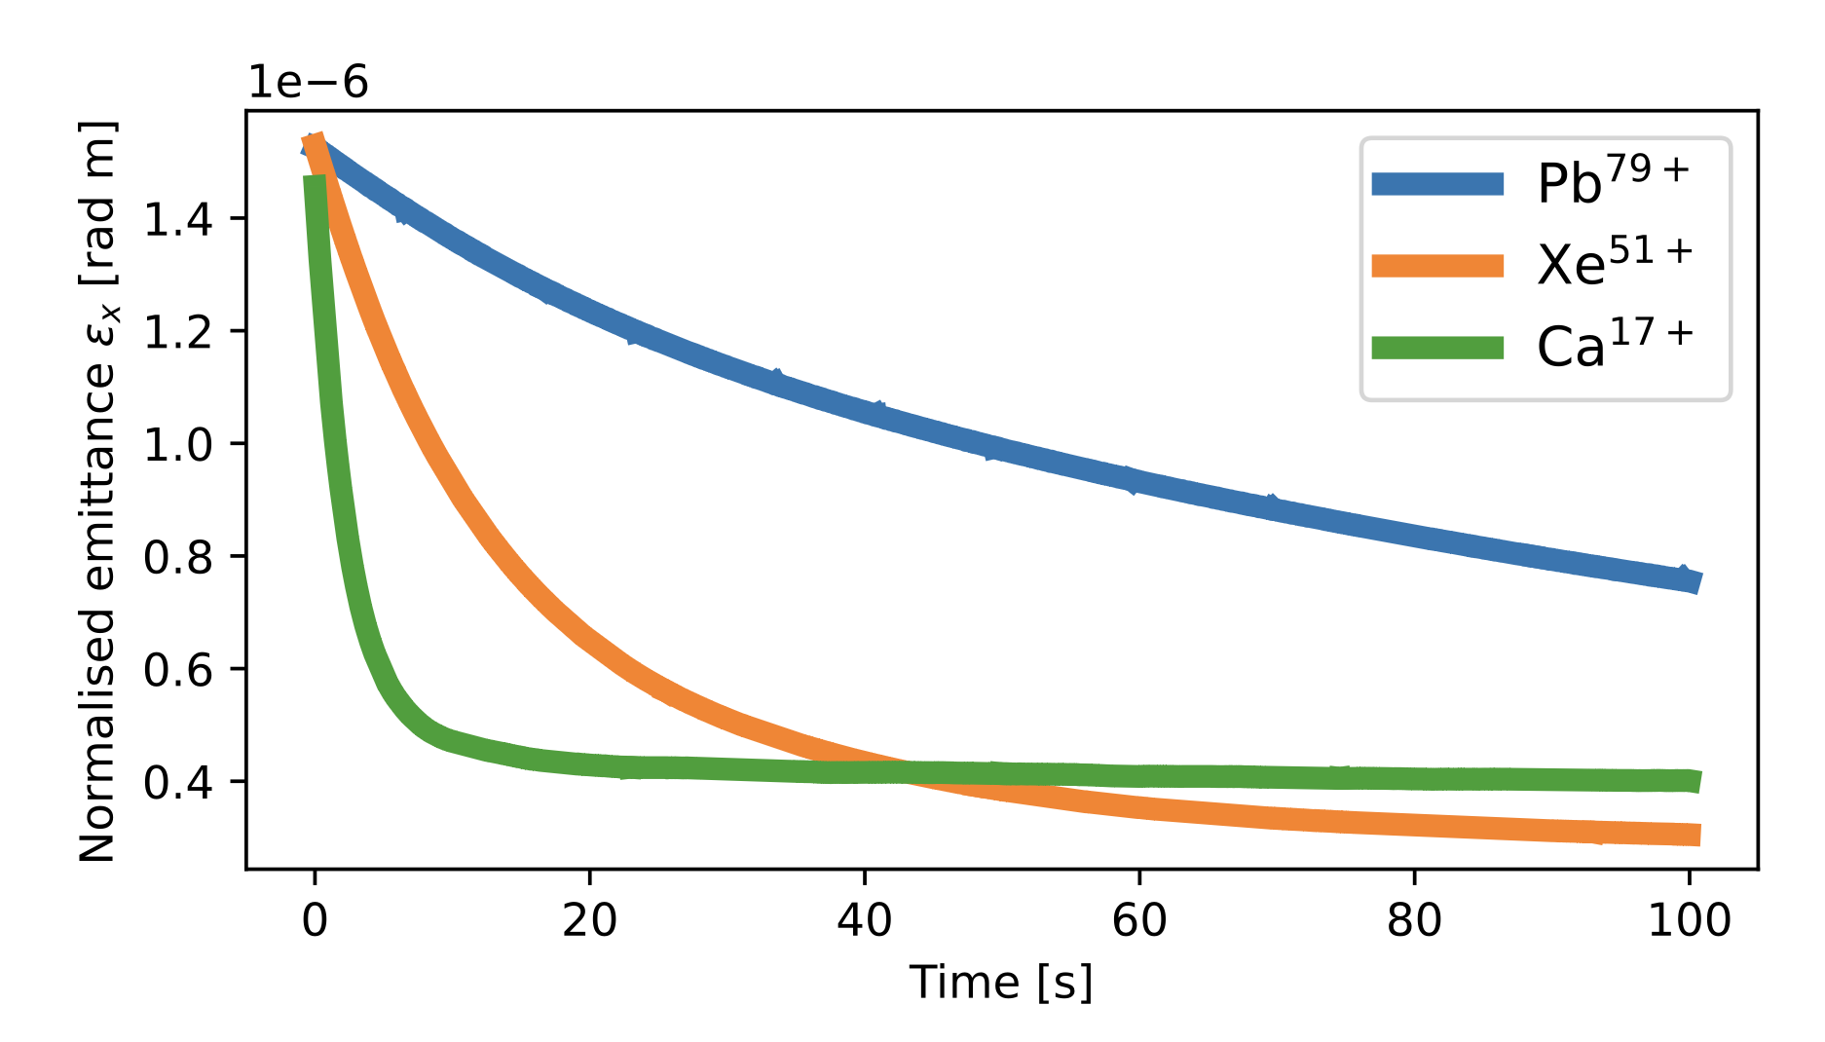
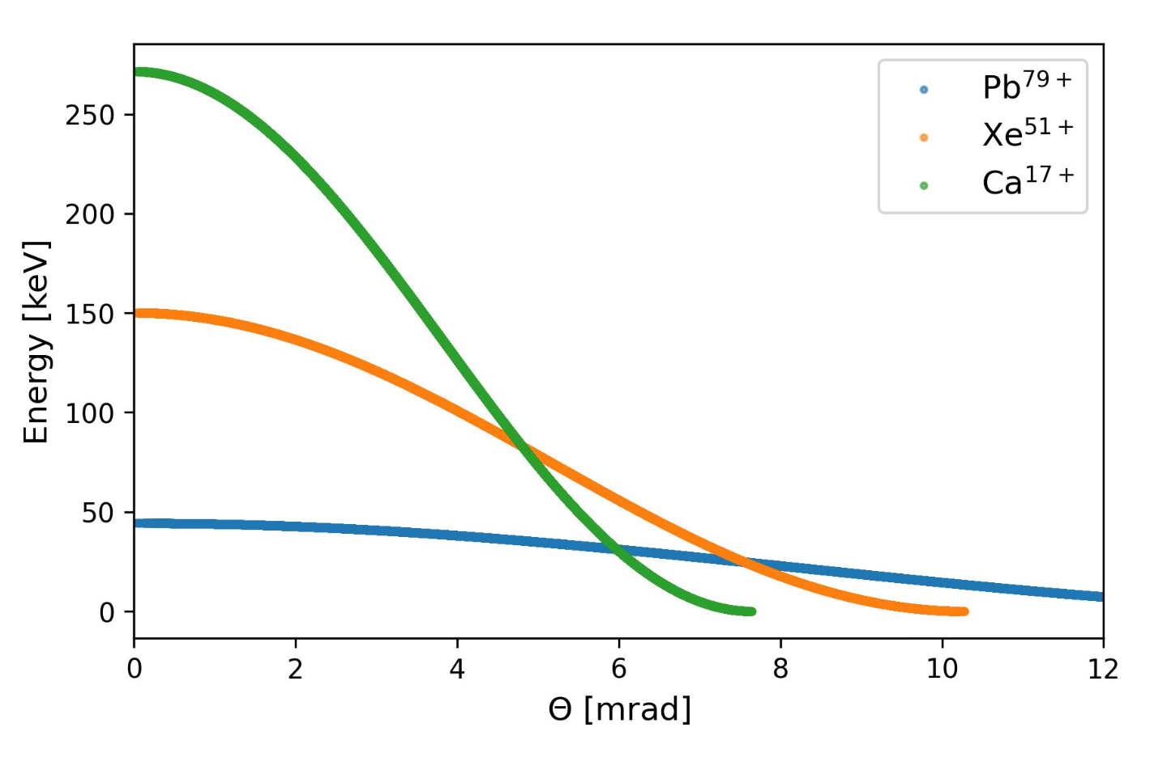
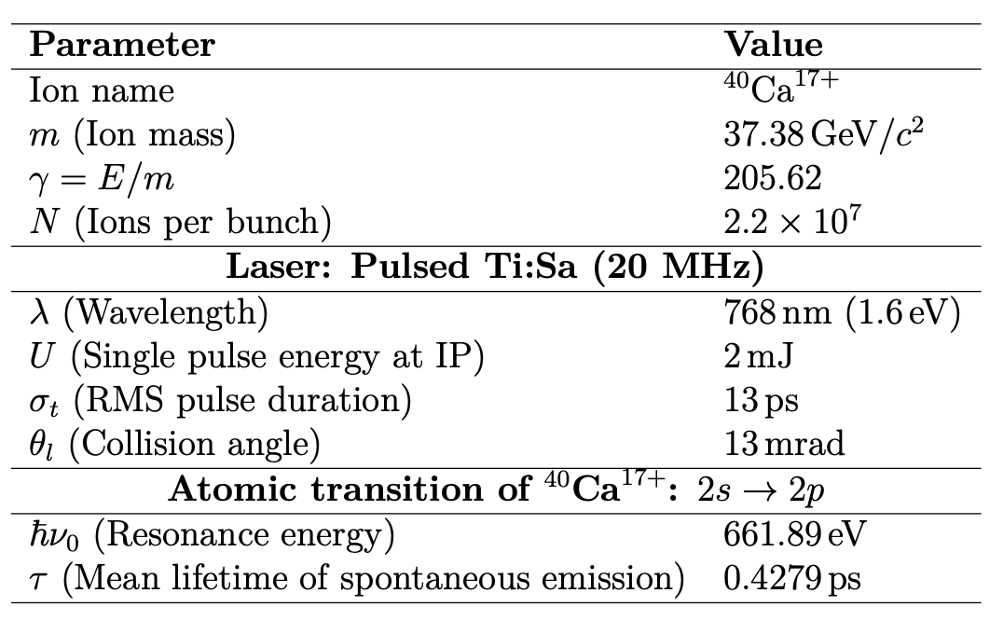
Cooling rates for different ions (without IBS)
Several ions could be potentially injected - and cooled – in the SPS:
Note: much faster cooling for lower-charge and lower-mass ions thanks to larger excitation energy and consequent larger absorption kicks
Xsuite implementation can provide information about energy and distribution of produced photons
Envelope of photon energy and angular distribution

Slide 23
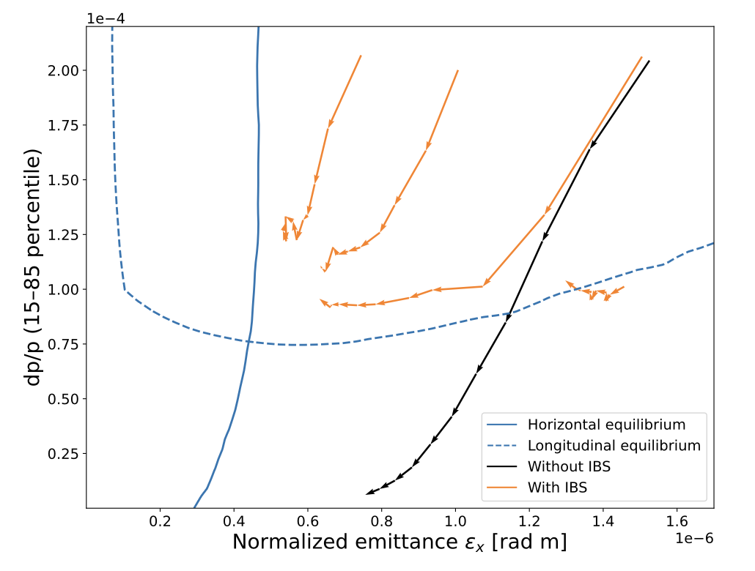
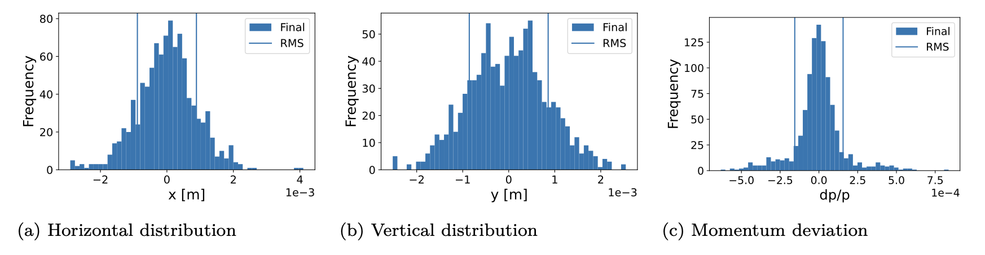
Cooling with IBS Studies
IBS has a two-fold impact:
Slower cooling time
Larger equilibrium emittance
Using 15-85 percentile to better represent non-Gaussian core
Often an issue of IBS computations
Contributes to blurry border definition
Each arrow represents 10s-long step
Area expected to be not accessible
Design starting point

Slide 24






Ongoing Work: Devise Operational Scenario for PoP
Check compatibility of design with nominal SPS beams
Verify beam steering margins, considering corrector strength and aperture
Put everything together: devise start-to-end simulation of the cooling experiment in Xsuite
Check on aperture restrictions (for all other beams)
Beam control at the IP

Slide 25
Summary and Outlook
Parkhomchuk e-cooling model integrated and validated in Xsuite
Measurements in ELENA and LEIR consistent with simulations
e⁻ space-charge effects essential to capture the correct behaviour
Laser-cooling capabilities advancing in Xsuite
CW and pulsed laser-cooling modules nearing completion
Merge request for next Xsuite release in progress
Chirped-laser option under development (lower priority, as not useful for PoP)
Provided first SPS PoP Performance Estimates
Cooling vs heating interplay now accessible within a single, well-supported simulation framework
SPS Proof-of-Principle and new AD e-cooler provide key validation opportunities
“Cool” times ahead of us after CERN Long Shutdown 3
Thanks for your attention and comments !

Slide 26
APPENDIX

Slide 27




Electron Coolers at CERN
Currently we have three electron coolers in operation at CERN (30 keV – 55 eV):
LEIR
AD
ELENA
LEAR
LEIR e-cooler was designed specifically for the LHC ion chain and uses the most advanced technologies at that time (~2004):
Variable density electron gun
Beam expansion
Pancake structure of magnets
Electrostatic bend for improved vacuum
First used in the Initial Cooling Experiment (ICE) in 1977-80, then used in LEAR (1982-97).
Finally moved to the AD (since 1999).
It will “retire” soon with the advent of a new electron cooler specifically designed for AD.
See Gunn’s contribution
The smallest, start operation in 2018 and required challenging manufacturing/optimization of the very low magnetic field (100 Gauss)

Slide 28
CERN Electron Coolers Main Parameters
Each cooler is designed with specific parameters to match the accelerator needs
 | LEIR | AD |  | ELENA
(Main) Ion particle | ²⁰⁸Pb⁵⁴⁺ | pbar | pbar | pbar | pbar
Ion momentum | ~88 MeV/c/u | 300 MeV/c | 100 MeV/c | 35 MeV/c | 13.7 MeV/c
Electron kinetic energy | 2.3 keV (<6.5 keV) | 25.5 keV (<35 keV) | 2.9 keV | 355 eV | 55 eV
Relativistic beta | 0.094 | 0.305 | 0.106 | 0.037 | 0.015
Electron current | 600 mA | 2.5 A | 100 mA | 5 mA | 1 mA
Cooling length | 2.5 m | 1.5 m |  | 1 m
Ring length | 78.54 m | 182.43 m |  | 30.41 m
Gun magnetic field | Up to 2.3 kG | 590 G |  | Up to 1 kG
Drift magnet field | 750 G | 590 G |  | 100 G
Electron beam radius (drift) | 14 - 25 mm | 25 mm |  | 8 to 25 mm
Notes:
For LEIR we typically speak about 4.2 MeV/u kinetic energy

Slide 29
Overview of the new AD cooler magnet system
Courtesy L. von Freeden
ddd
Drift ID fixed by BPMs
Y-chamber in TF region
Space for gun support (cantilever)
Space for vacuum flange

Slide 30


E-cooling Parameters in Simulations

Slide 31
Examples of Previous Laser Cooling Experiments
Facility (ring) | Ion species | Beam energy (typical) | Relativistic β | γ | Notes / references
CSRe (IMP Lanzhou) | O⁵⁺ | 275.7 MeV/u | 0.636 | ≈ 1.295 | Laser cooling of bunched relativistic O⁵⁺; Schottky diagnostics. Currently the highest-β/γ demonstration.
ESR (GSI Darmstadt) | C³⁺ | 122 MeV/u | 0.47 | 1.13 | Multiple campaigns (2004–2013, 2021+): broadband and narrowband cooling; extensive spectroscopy with β≈0.47.
TSR (Heidelberg) | ⁷Li⁺ (and others) | ~7–13 MeV (few MeV/u) | ≈ 0.05 | ≈ 1.001 | First storage-ring laser-cooling demonstrations (longitudinal), ~5% of c.
S-LSR (Kyoto, ICR) | ²⁴Mg⁺ | 35–40 keV | ≈ 9×10⁻³ | ≈ 1.00004 | Low-energy ring; 1D laser cooling and studies of coupling / ordering.

