Slide 1
Versatile Platform for
Relativistic Electron Cooling and other Experiments
Or: From Electron cooling to medical physics….and Back?
Kurt Aulenbacher, Helmholtz Institut Mainz (HIM)
Cool-25, Stony Brook
October, 29, 2025
Presenting work by HIM Section ACID-II
(K.A. T. Beiser, J. Dietrich and W. Klag),

Slide 2
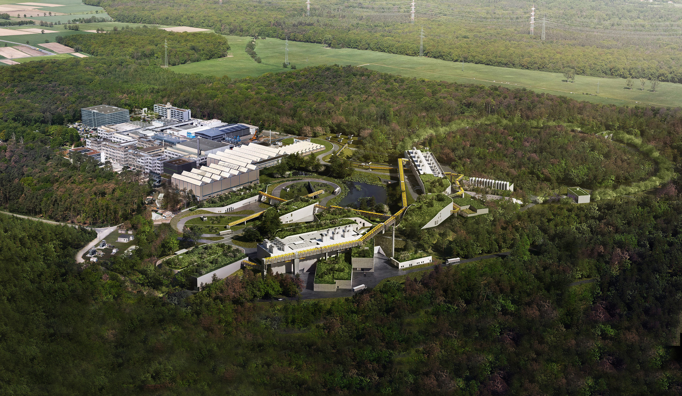
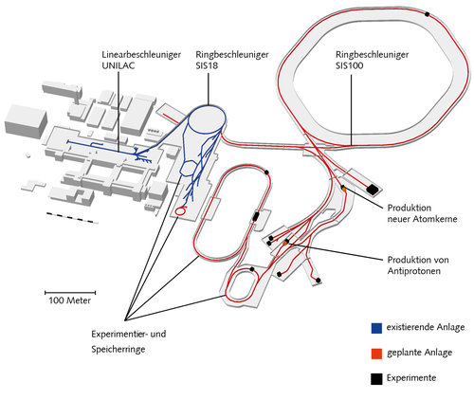
S
Introduction-FAIR
HESR@FAIR
FAIR FACILITY ion accelerator complex under construction in
Darmstadt/Germany (animation: ) https://fair-center.de/

Slide 3
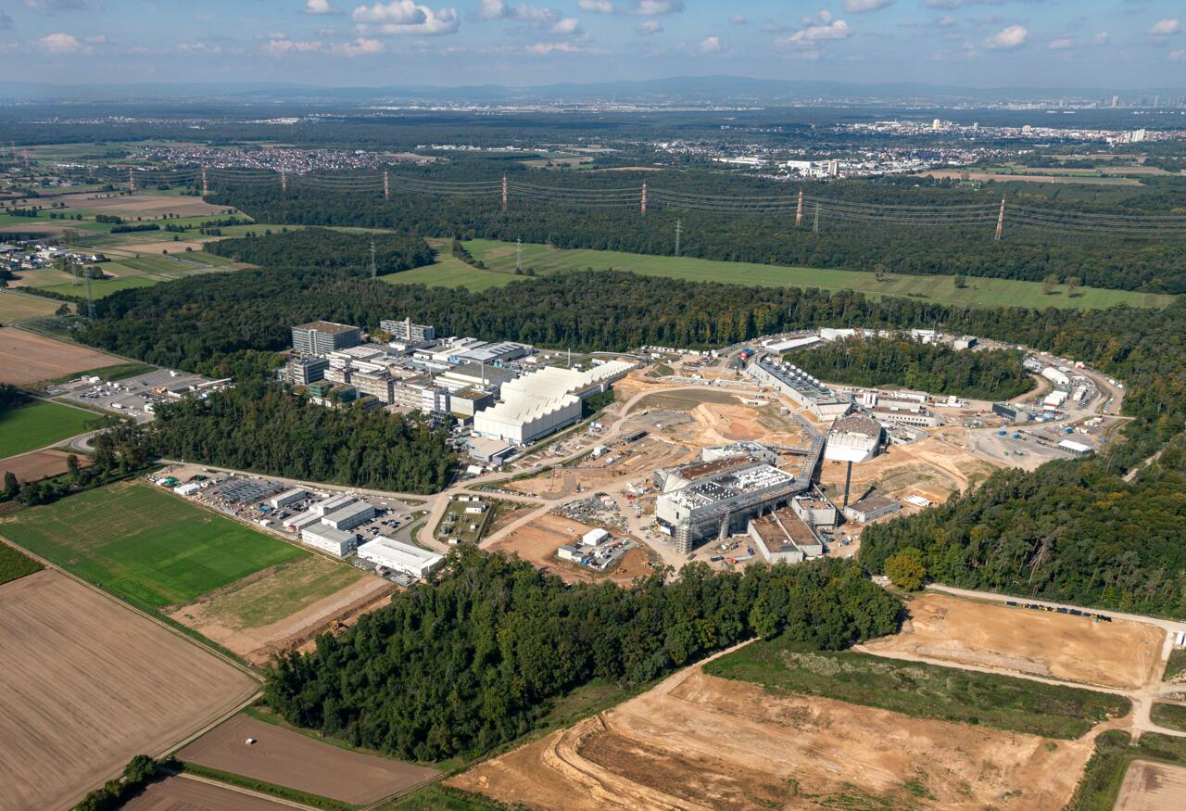
Introduction-FAIR
HESR@FAIR Status and Future
Photo: October 2025 - https://fair-center.de/

Slide 4





FAIR-SCHEDULE
HESR@FAIR COOLER Prototype Status and Future
SIS-100
Operation begins 2028/2029
HESR
Operation 2035+
Antiproton target and collector rings
FAIR FACILITY ion accelerator complex under construction in Darmstadt/Germany

Slide 5
Status Cooler at HIM

Slide 6
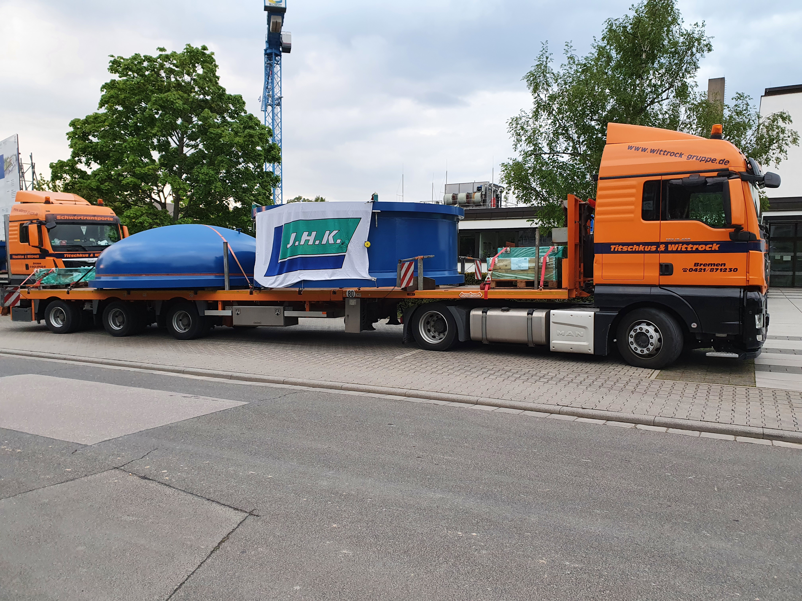
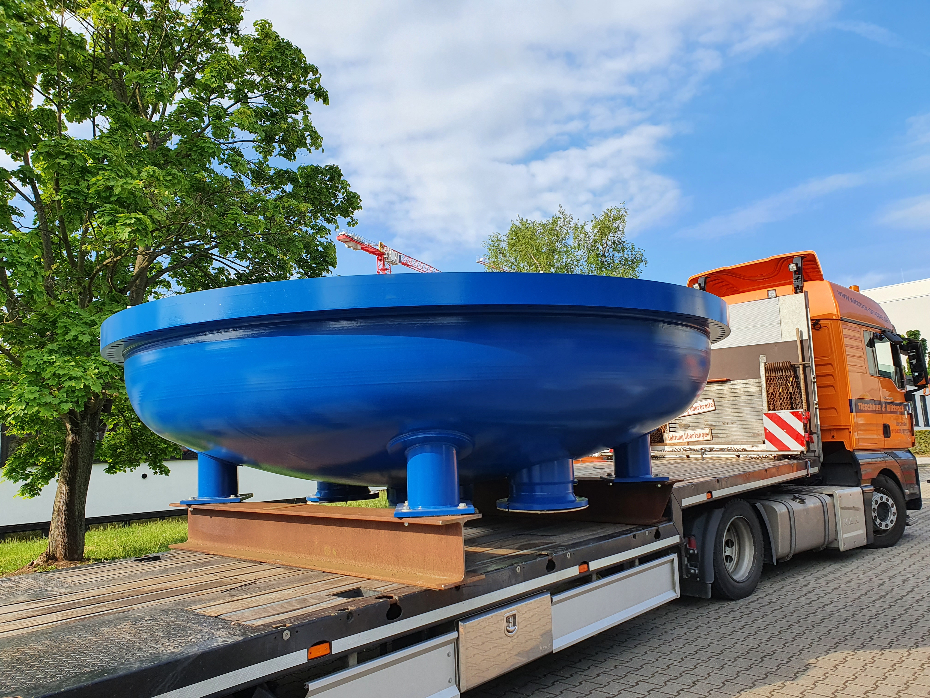
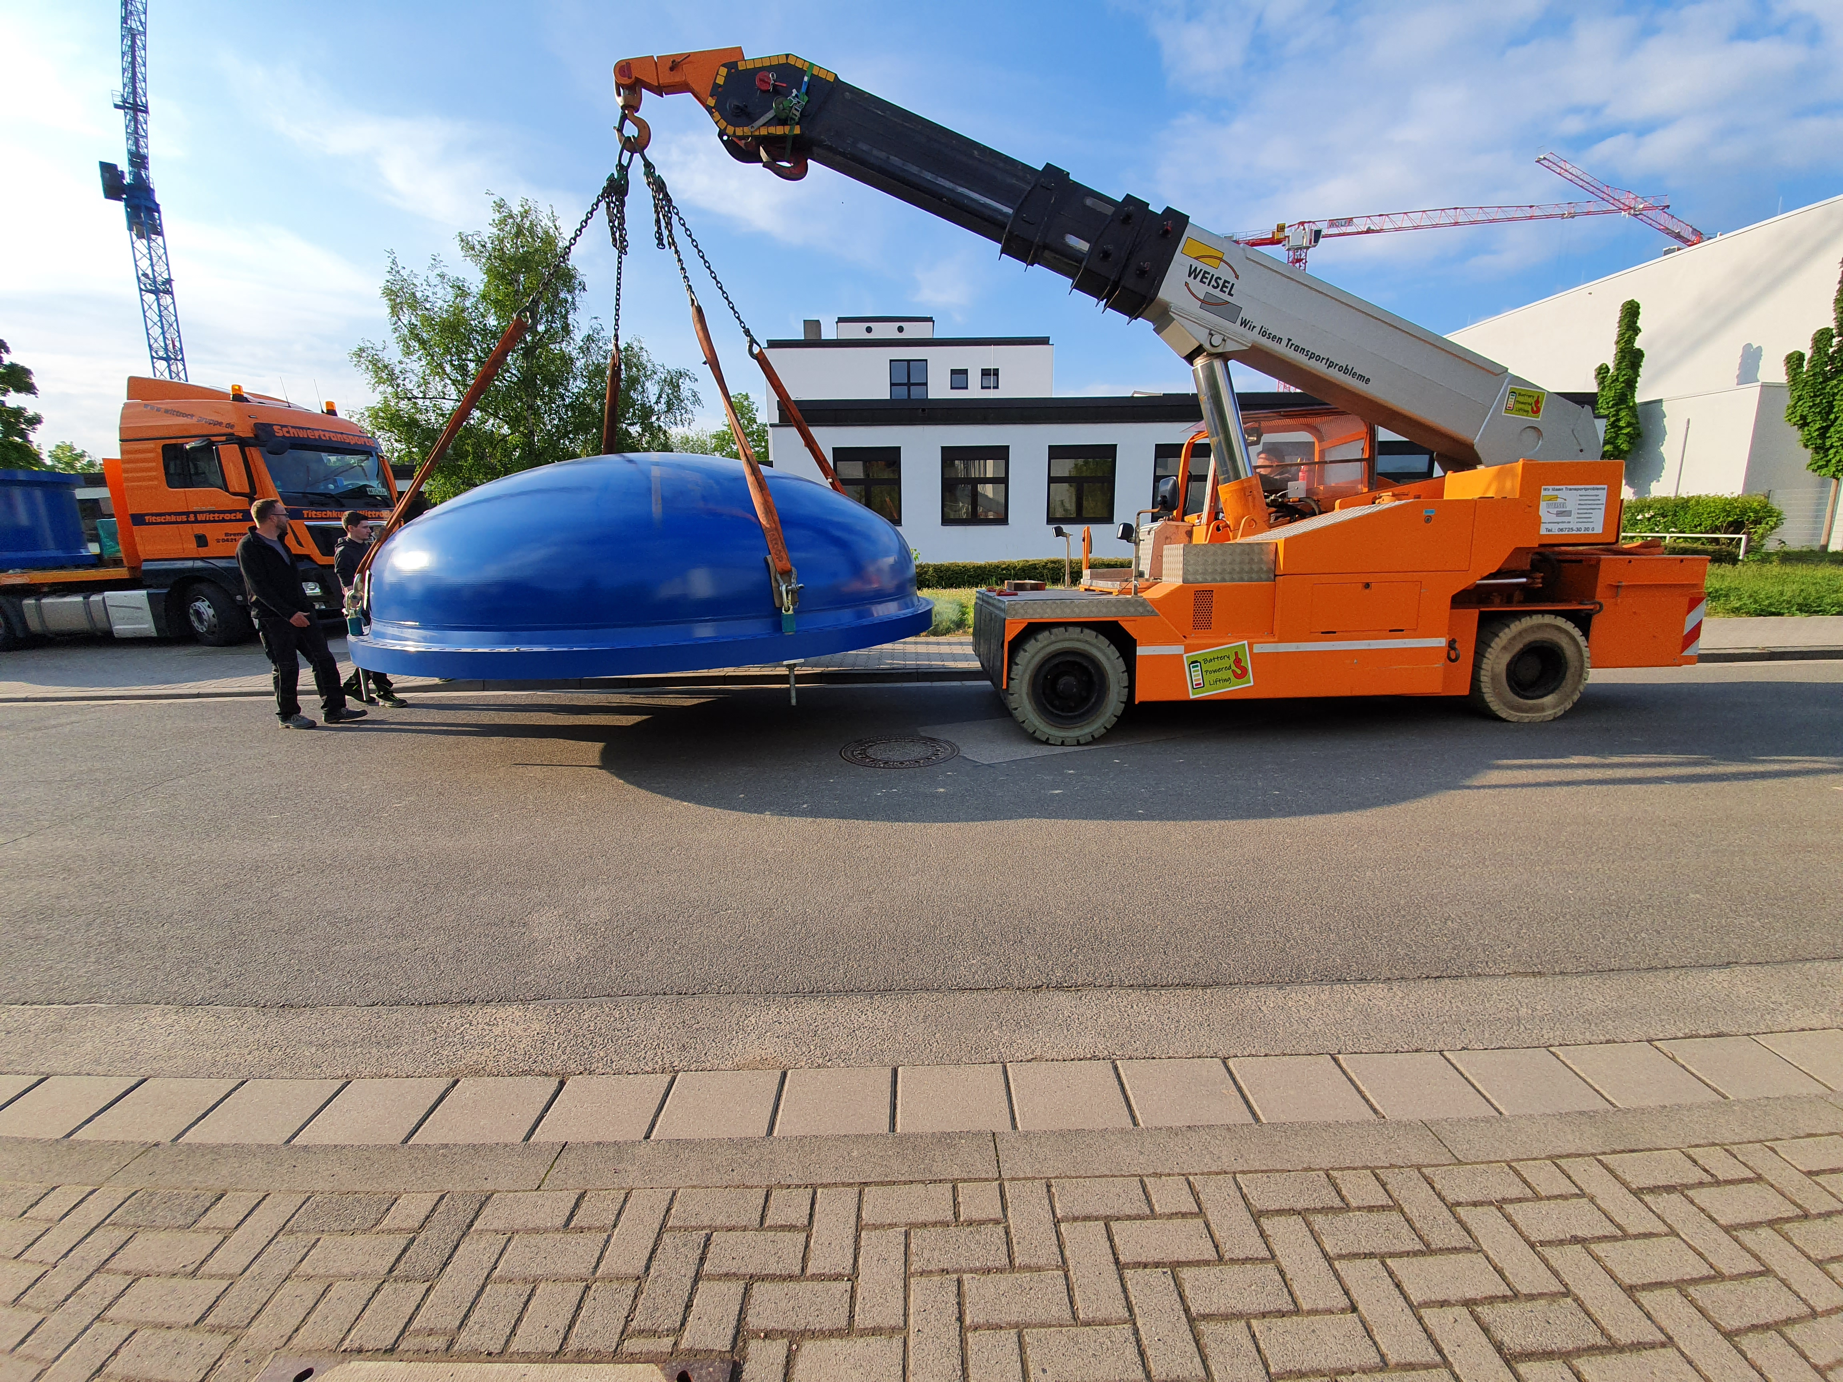
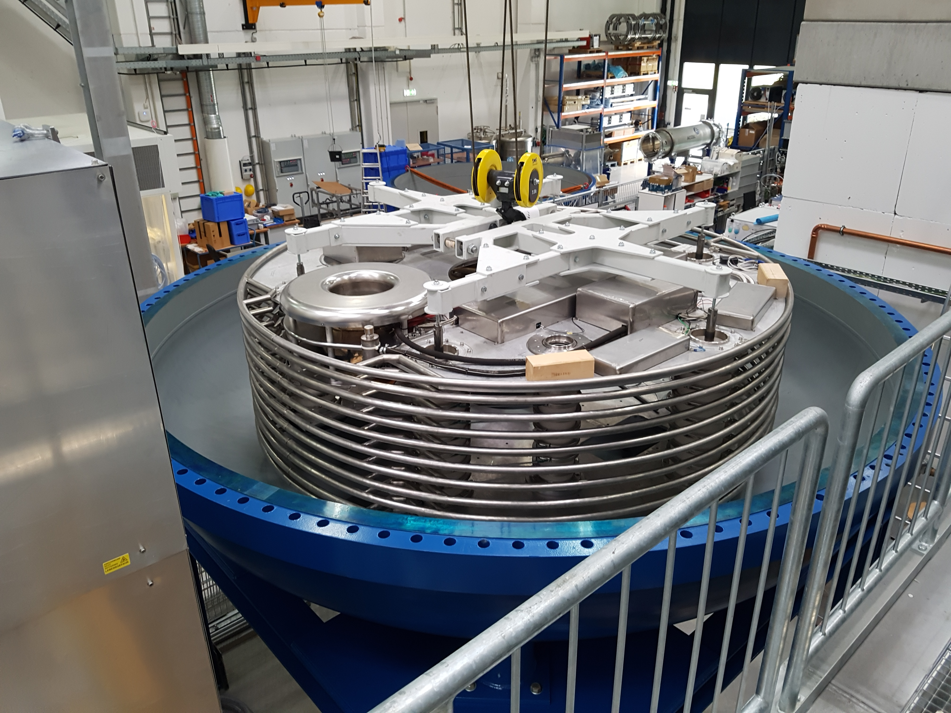
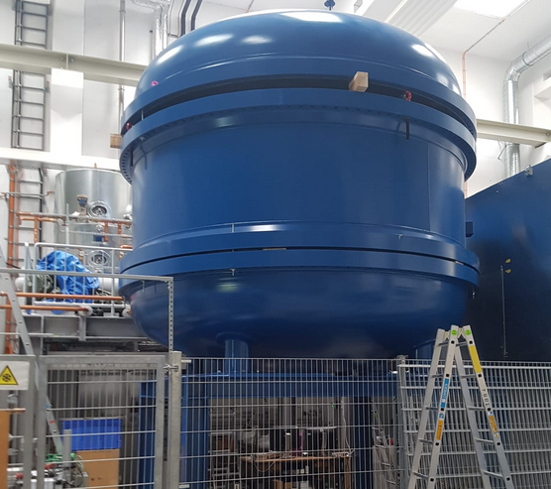
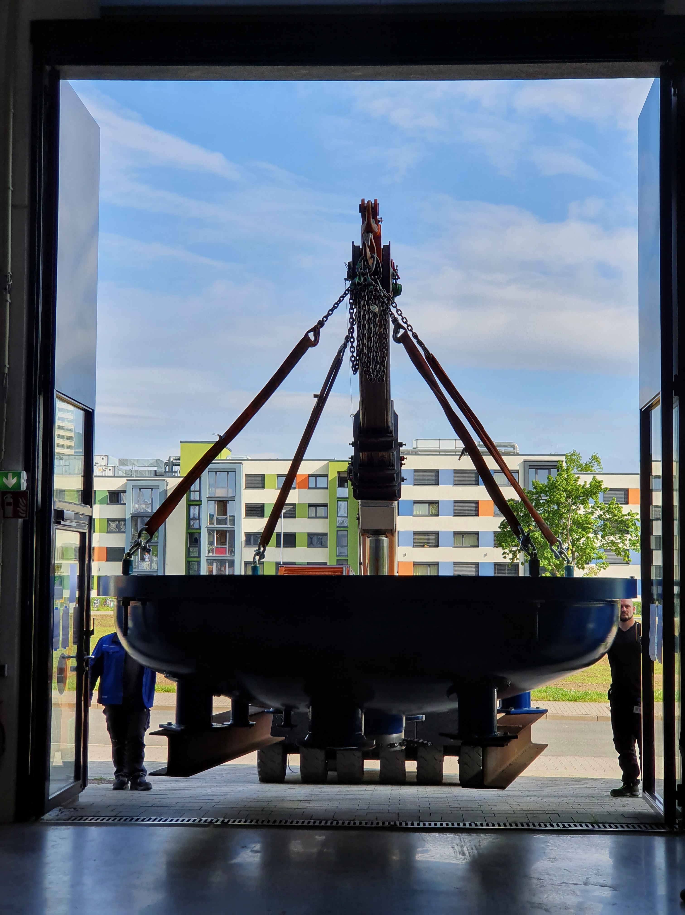
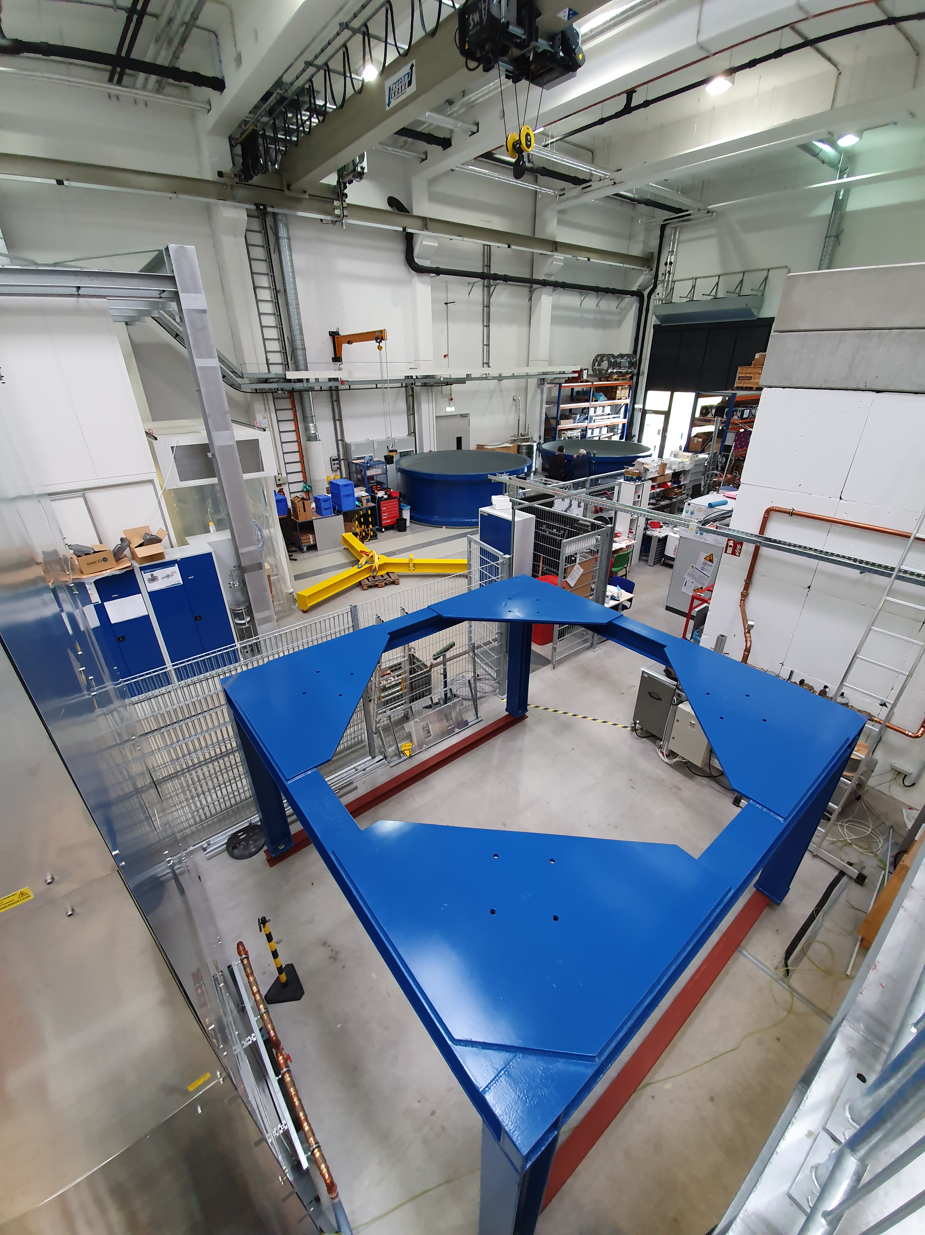
The “BIG Blue Bubble” HV-Tank

Slide 7
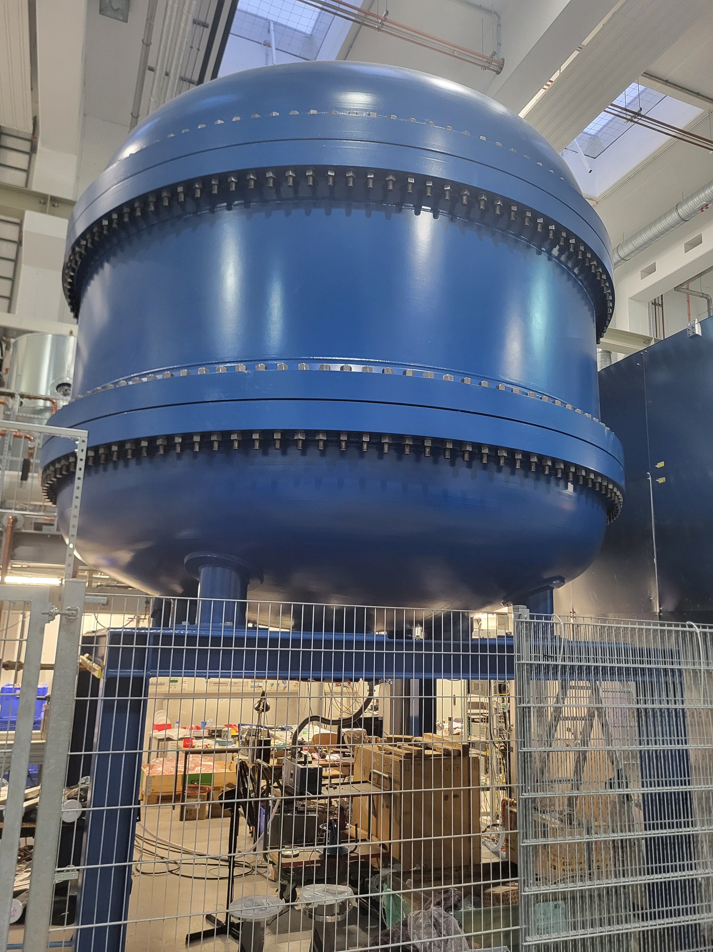
Modular HV-installation
600 kV Modules (first platform build by BINP/Novosibirsk)
Tank during installation of first platdorm
Pressure tank in operation
(Oct. 2025)

Slide 8
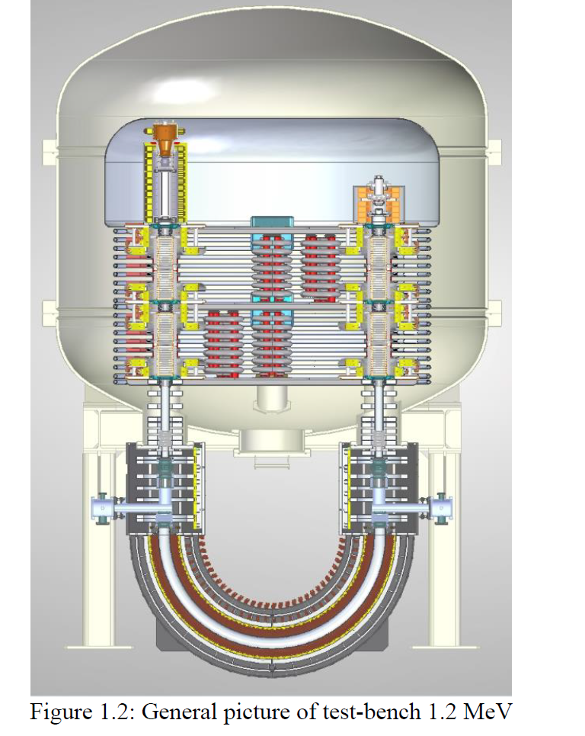
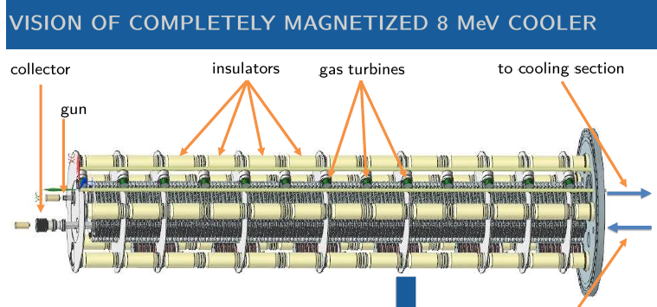
Mission…with obstacles…
The focus was on scalable high voltage platforms (N*600kV) with turbogenerators to power the solenoid channel.
Two obstacles: Cooperation with BINP-Novosibirsk stopped February 2022
moreover: HESR many years in the future!

Slide 9
S
Outline
HESR@FAIR COOLER Prototype Status and Future
“Hibernating” the know how - example: medical spin-off
Hibernating the prototype as versatile platform ? example: EDM-ring

Slide 10
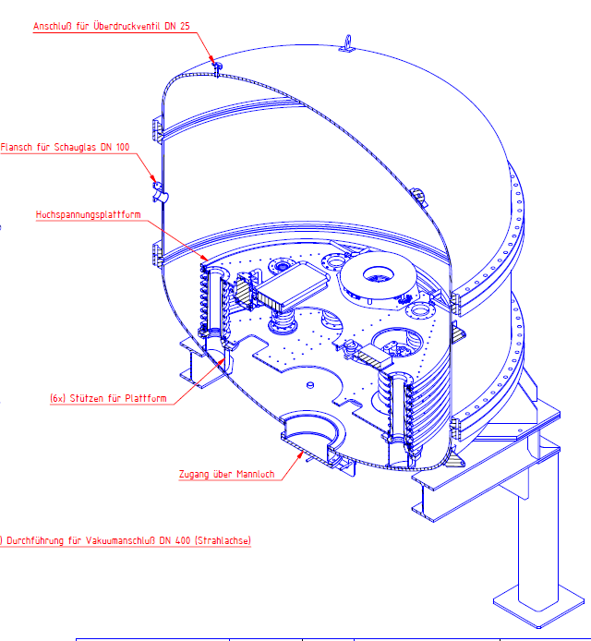
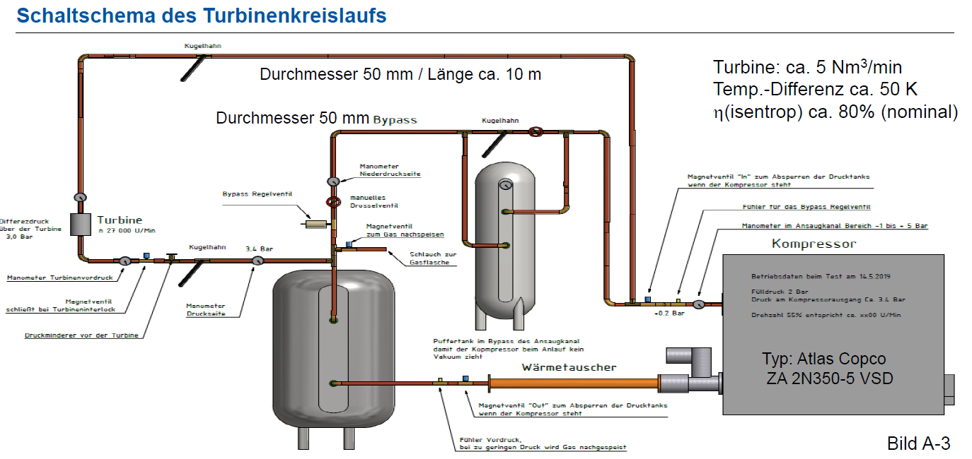
Closed cycle operation
Tank can accommodate two
platforms + gun and collector
operation with Nitrogen in closed
cycle,
Operation turbine circuit designed by
M. Wirsum, Institute for Power plant
technology RWTH Aachen

Slide 11
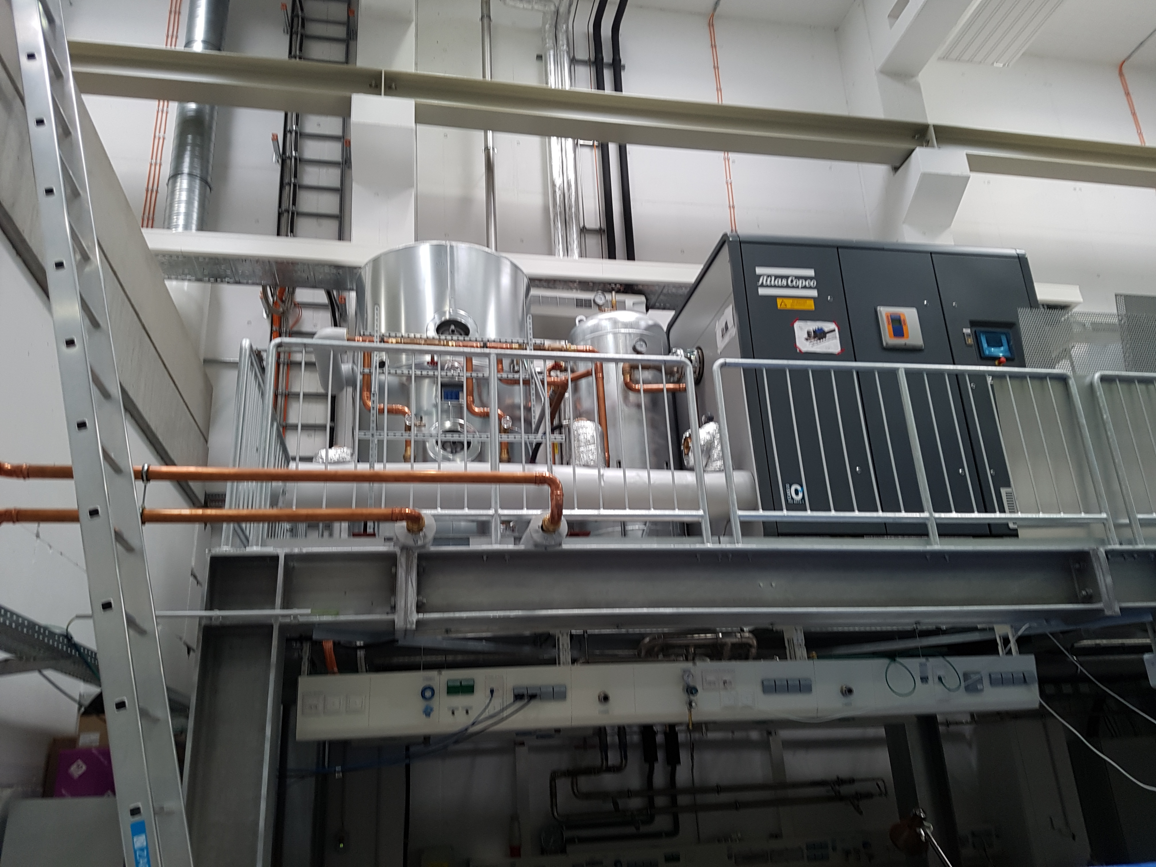
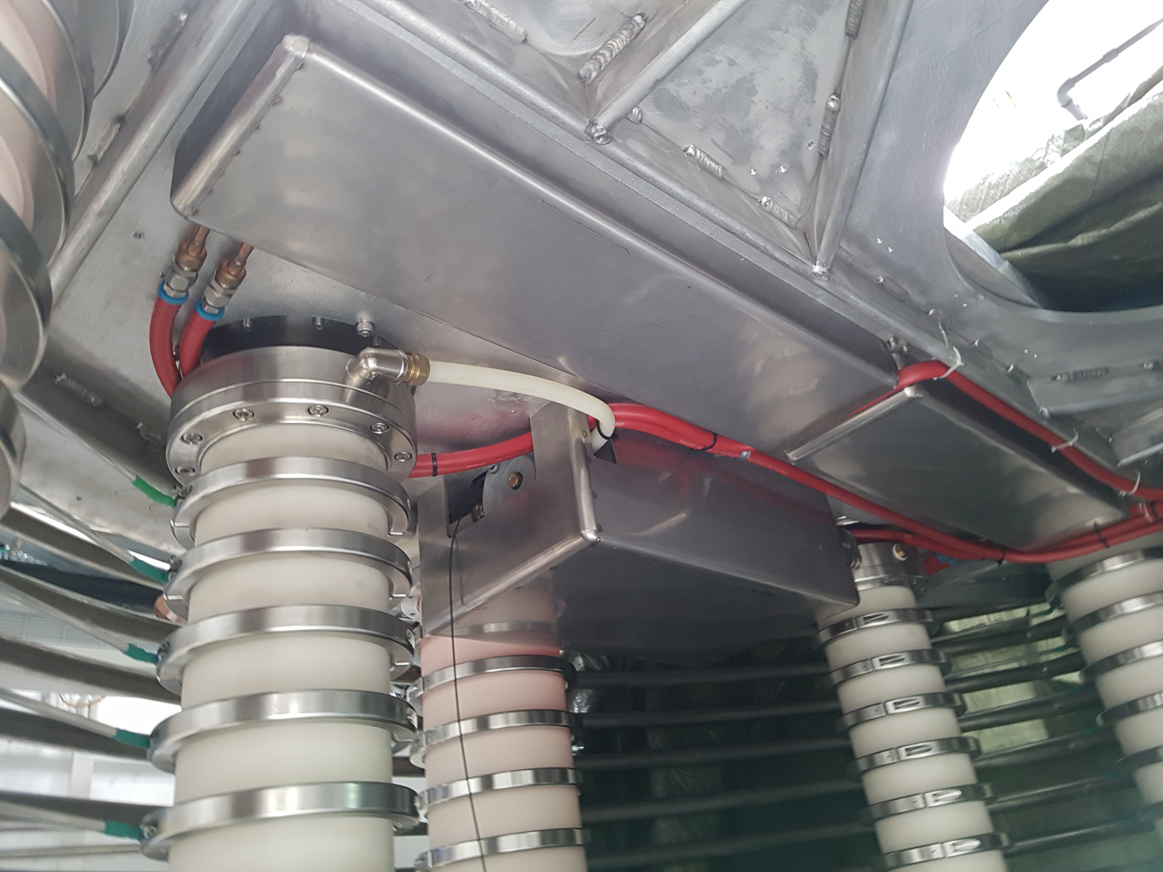
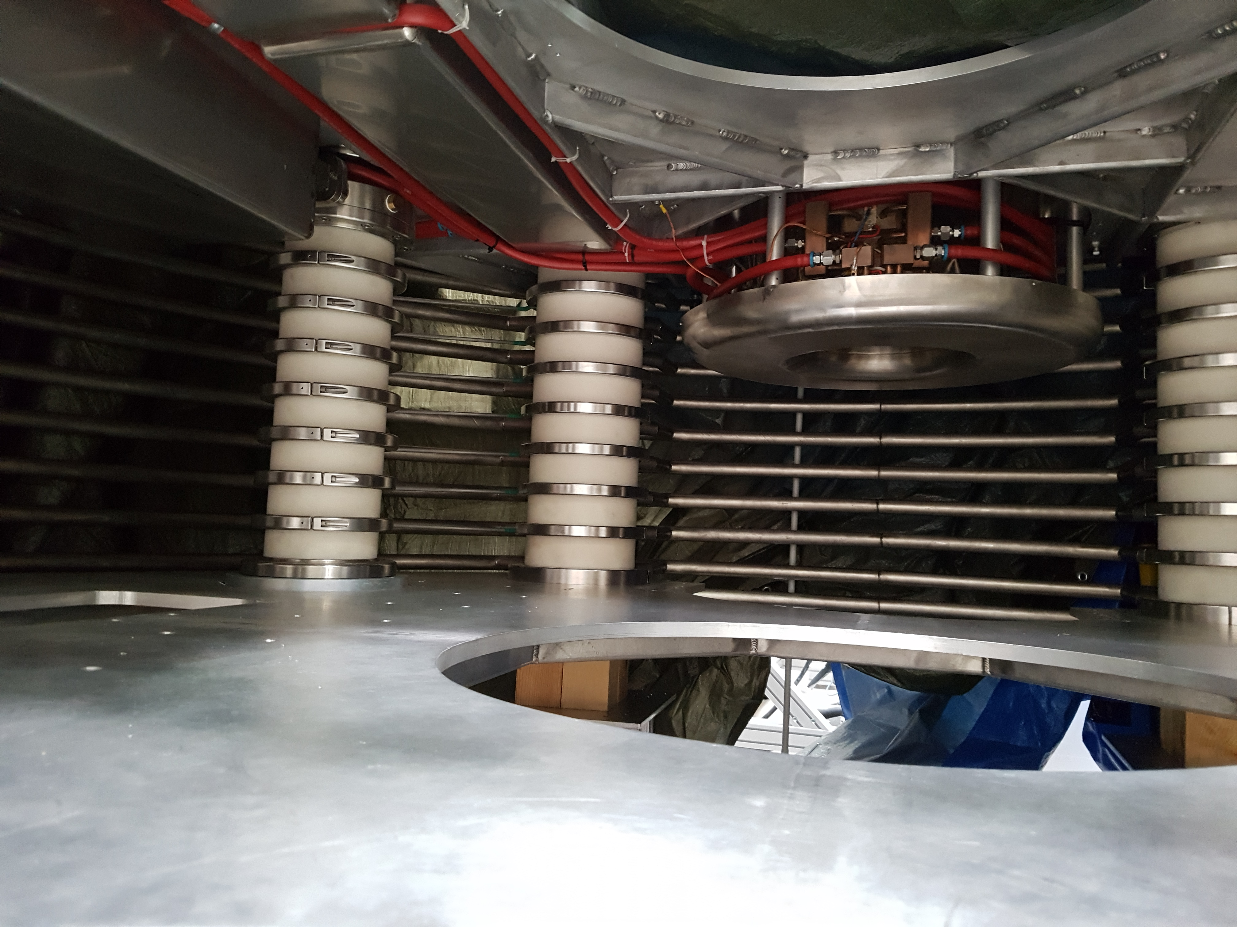
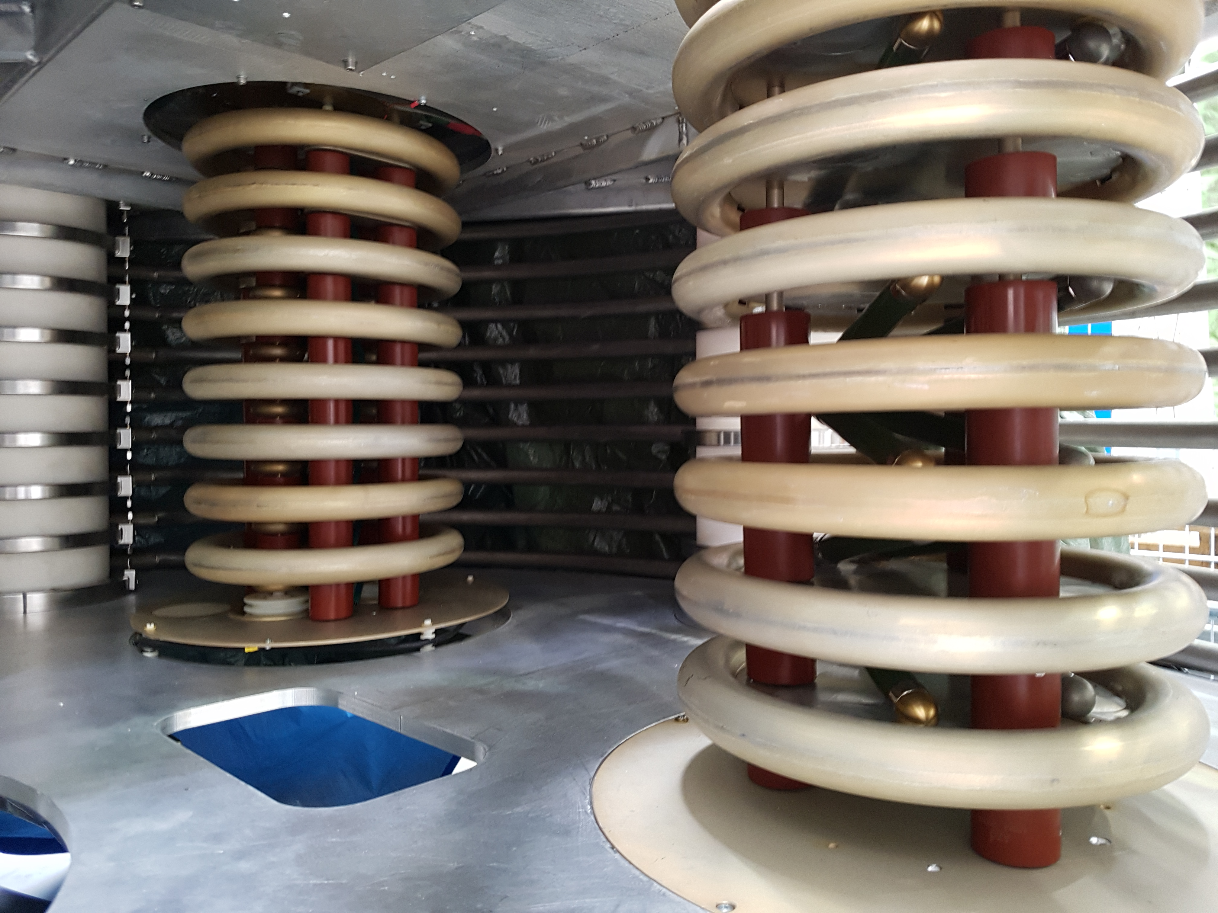
Hardware status
Reverse engineering:
communication with BINP
hardware OK.
Gas tank filled with 3bar
Nitrogen, no leaks.
Turbine supplies Cockkroft
Walton and solenoid
under HV.
HV limited by to 80kV
(internal safety ?
→ reverse engineering)
Compressor station for up to three turbines
Turbine (in box) hanging from HV-deck
Solenoid hanging from HV-deck
HV-generator

Slide 12
Whats next?
“Hibernating” the know how - example: medical spin-off
“Hibernating” the prototype as versatile platform ? example: EDM-ring

Slide 13
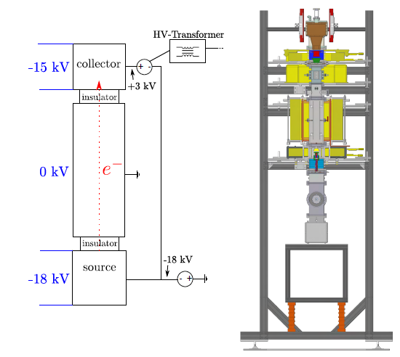
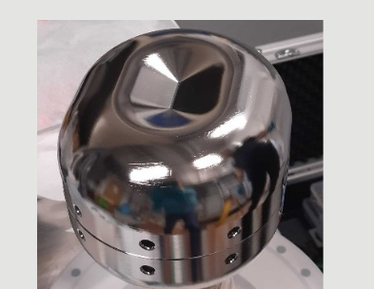
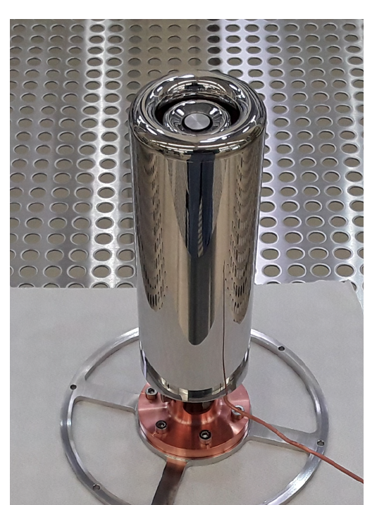
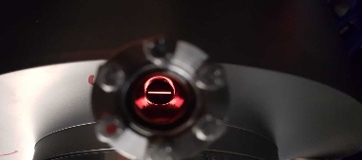
“Hibernating” the know how - example: medical spin-off
Experience with high quality beam from „test cooler“ (1A, 30kV) 300mA 300kV „line focus tube“
Test set-up: 1A electron beam for HESR
Test cooler Egun with
BaO-cathode
Line focus Egun with
BaO-cathode

Slide 14
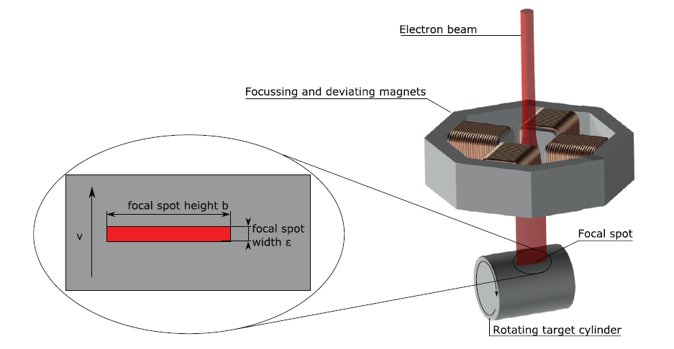
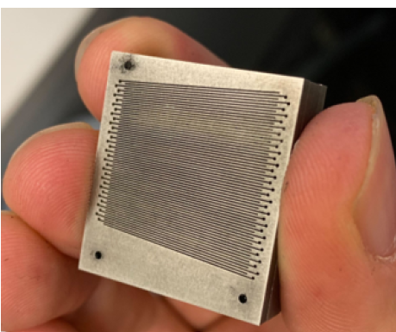
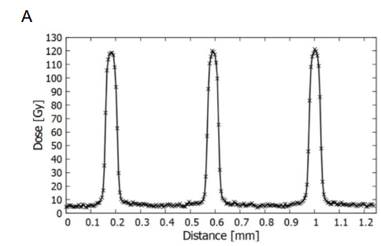
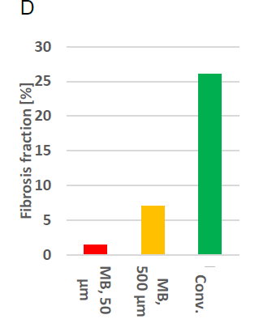
Why X-ray microbeams ?
Bartzsch et al Phys. Med. Biol. 62 8600 (2017)
C. Petrich TUM
Results from ESRF
(1km circumference synchrotron)
Side effects incidence
for same total dose

Slide 15
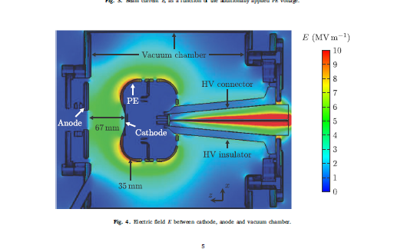
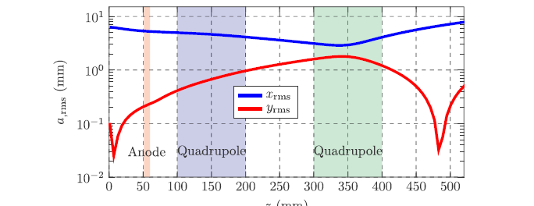
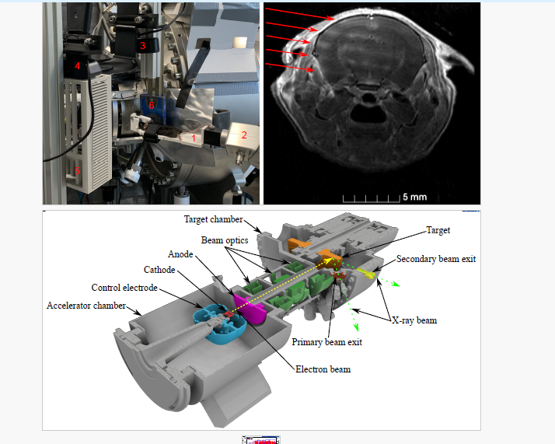
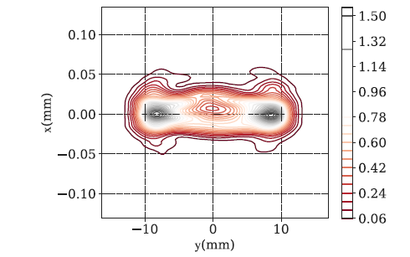
“Hibernating” the know how - example: medical spin-off
Experience with high quality beam from „test cooler“ (1A, 30kV) towards 300mA 300kV „line focus tube“
Ch. Matejcek et al.
Physica Medica 106 (2023) 102532

Slide 16
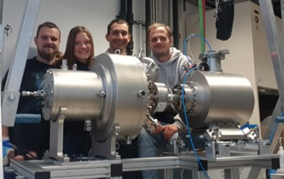
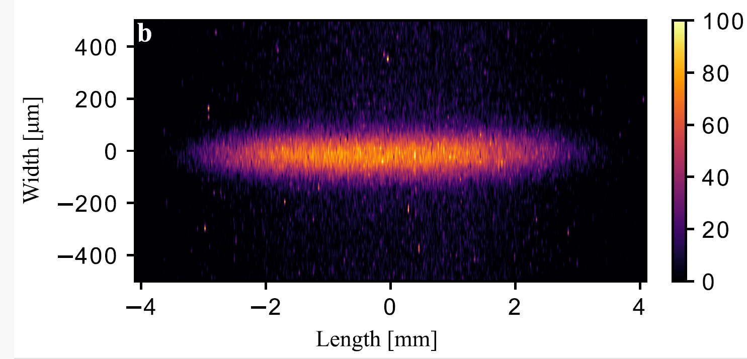
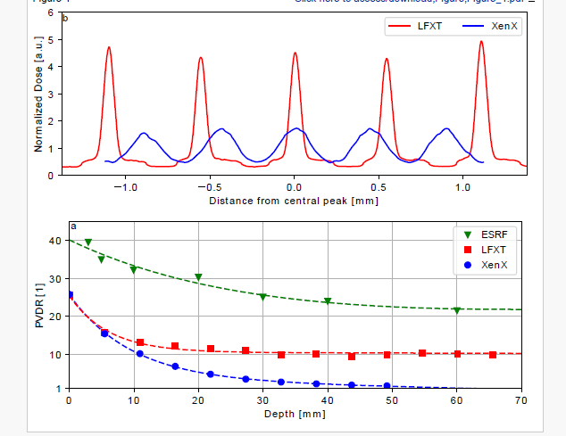
The LFXT-1 Protoype
Electron source design and assembly at HIM/MAINZ
Operating at TU-Munich/Garching
Microbeams with relevant dose rate are now
available on the laboratory/clinical scale
2m
Peak to valley dose distribution (PVDR)
Ch. Matejcek et al. Physica Medica 106 (2023) 102532
C. Petrich et al. Accepted for publication
International Journal of Radiation Oncology
Upper: Xray source distribution
Lower: Mouse brain after irradiation

Slide 17
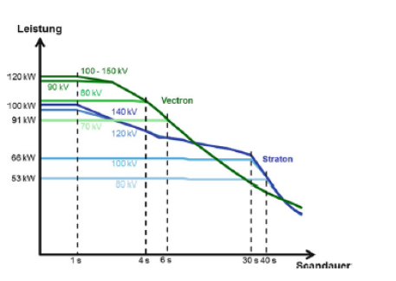
Development path until ~ 2030
Ideal Therapy device („Microflash“)
(600kV, 1MW, 2 s→2MJ heat load)
A lot of engineering work, but first therapy device seems possible
Preclinical device /first therapy
(300kV, 90kW, 20s→ 1,8MJ)
Achieved: 150kV, 1kW, 600s 0.6MJ
W. Schlegel et al. (ed‘s) Medizinphysik , Springer

Slide 18
S
“Hibernating” the prototype as versatile platform ? example: EDM-ring

Slide 19

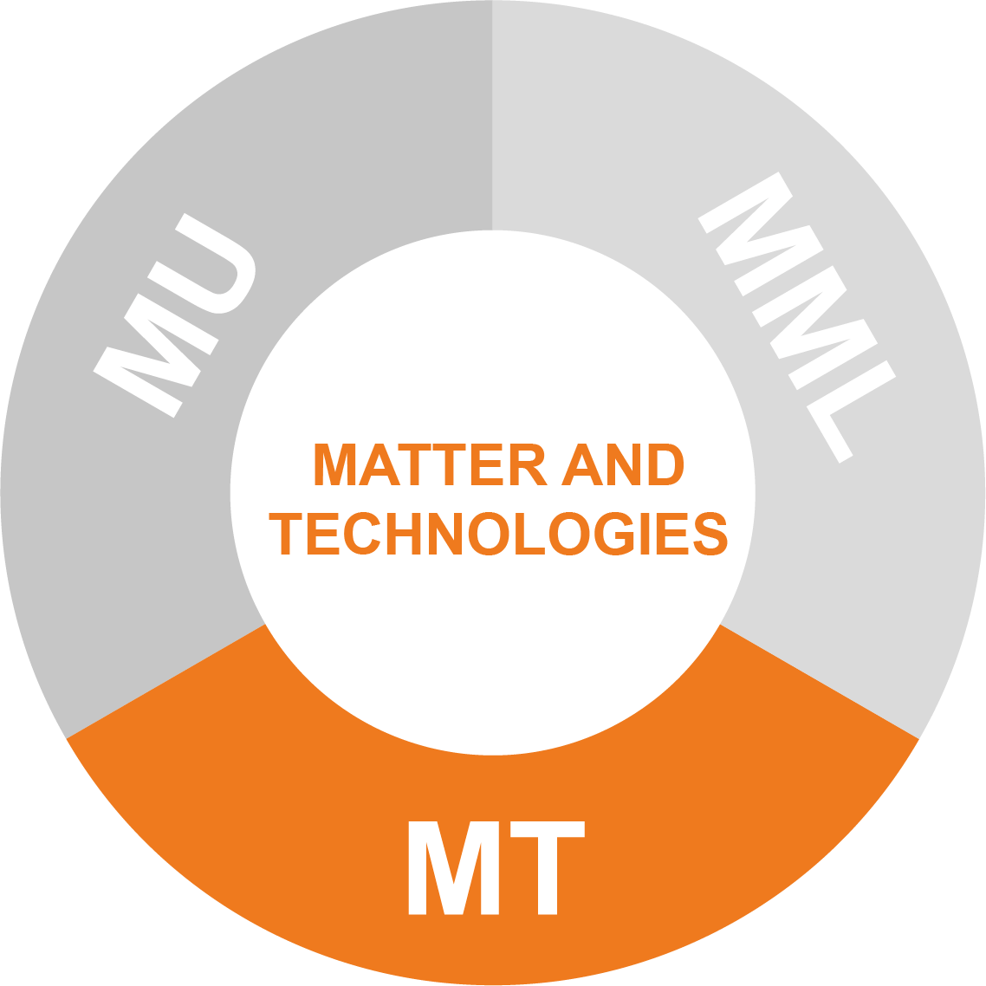

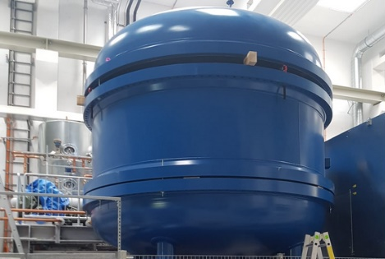
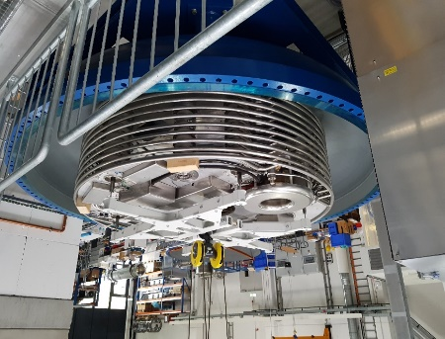
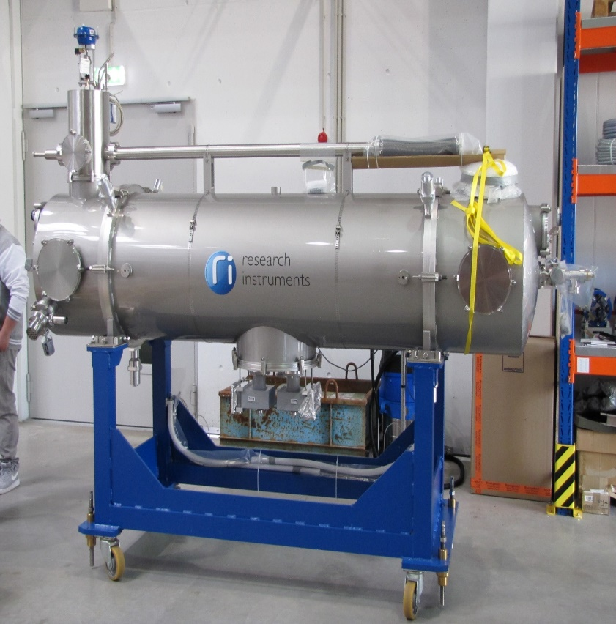
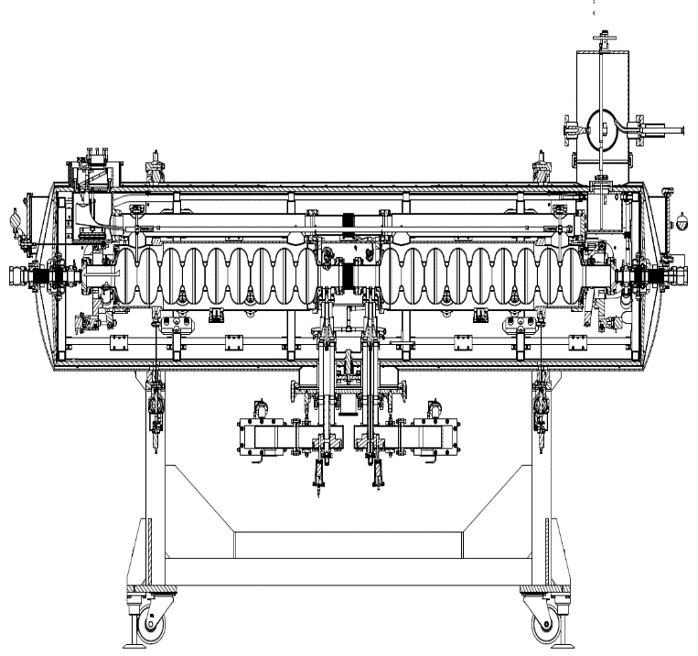
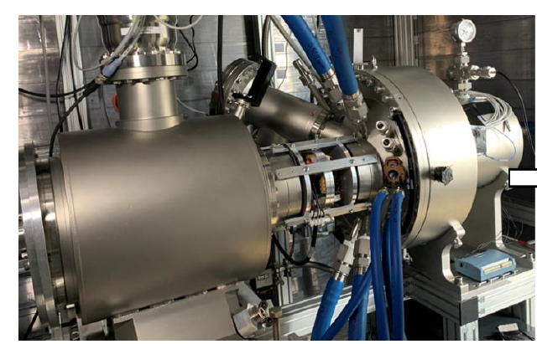
Combine MESA and HESR components ?
ARD
Continue cooler developments - Goal: demonstrate „turbine driven“ 600kV beam until 2026
Accelerator developments for FAIR-Phase 0 at MAMI-C and Helmholtz Excellence network activities at MESA
High power beam competence enables new approach for radiation therapy „Line focus X-ray tube“
1.
Project 1. - Further activities
depend on future
expansion of FAIR
ACID-2‘s 2022 crisis-reaction:
→ „diversify“
1.
Project 2. Accelerator research for Helmholtz Excellence network experiments at MESA
(and FAIR-0 at MAMI-C)
2.
3.
Project 3 – Line focus X-ray tube- Increase of activities & resources because initial successes have already attracted third party funding.
2018
2022
2024
2028
2035

Slide 20
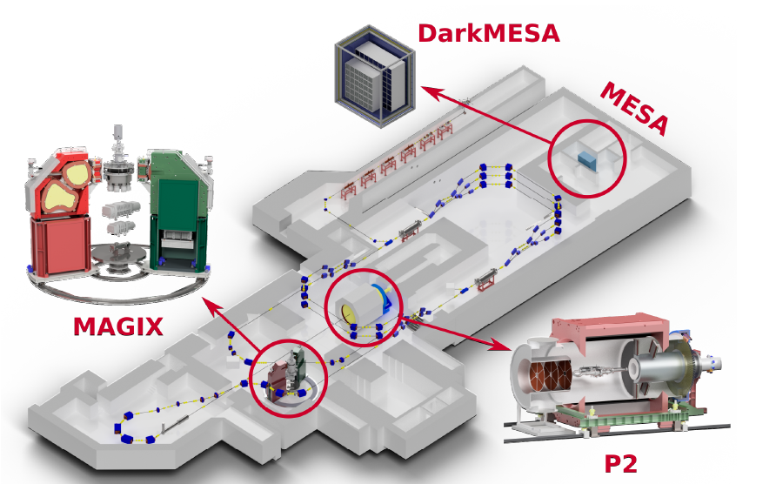
MESA Operational modes & Experiments
Op-mode | Target | Beam power@target
Ext. Beam (polarized) | Solid/ Liquid | 0-25kW
Energy recovery(ERL) | Gas-jet | 0.1-1MW
Dark-MESA

Slide 21
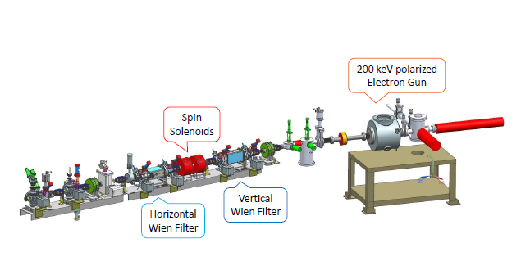
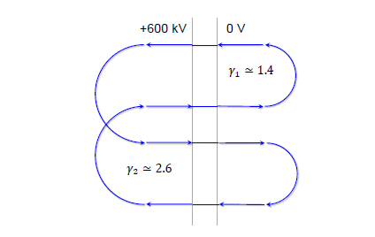
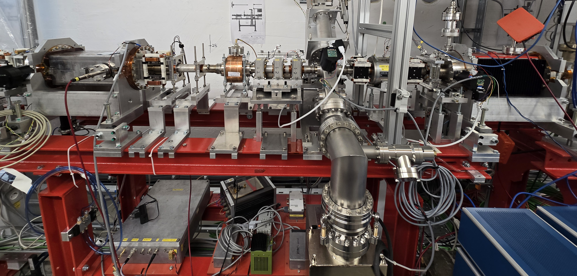
S
Using the tank…?
Hibernating the prototype as versatile platform ? example: All electric EDM-ring
Based on publications by Jefferson LAB (Derbenev et al. arXiv:2105.11575v1 [physics.acc-ph], 24 May 2021):
Combine the components available at MESA and HIM…
200kV bends
800kV bends
2 m
Unique feature: ample power available
on large HV-platform
Operating mode of electrostatic
Figure of 8 EDM Ring proposed
by Derbenev et al.
3d-spin rotator at MESA
(200kV source not shown)

Slide 22
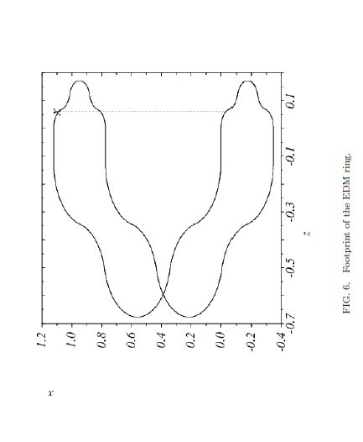
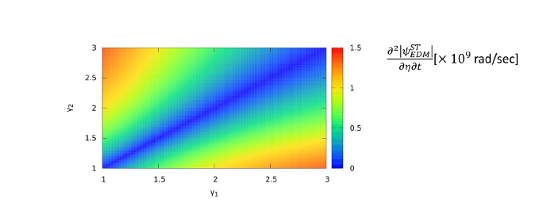
Non-MAGIC EDM ring
The Figure of 8 periodic system cancels the magnetic g-2 precession.
The electric fields bending at different energies would cause an EDM-dependend spin precession.
Electric ring allows clockwise/counterclockwise beams → cancellation of many systematic effects
R. Suleiman, V. Morozov, Y. Derbenev
arXiv:2105.11575v1 [physics.acc-ph] 24 May 2021
Simpler than EDM-ring at
„MAGIC“ energy (14.6 MeV)
200kV
bends
800kV
bends
Orbit layout of „Figure of 8“
Electrostatic storage ring
(units are meters)
EDM Sensitivty of the order <10⁻²⁸ e*cm anticipated!

Slide 23
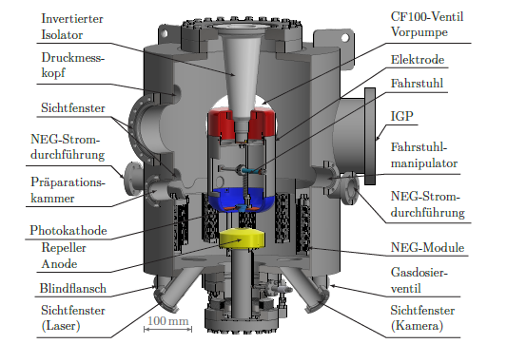
Non-MAGIC EDM ring
The Figure of 8 periodic system cancels the magnetic g-2 precession.
The electric fields bending at different energies would cause an EDM-dependend spin precession,
to be measured with Mott polarimter
2800mm
200keV INjection
R. Suleiman, V. Morozov, Y. Derbenev
arXiv:2105.11575v1 [physics.acc-ph] 24 May 2021
Simpler than EDM-ring at
MAGIC“ energy (14.6 MeV)
200kV
bends
800kV
bends
Orbit layout of „Figure of 8“
Electrostatic storage ring
(units are meters)
MESA
electron source
EDM Sensitivty of the order <10⁻²⁸ e*cm anticipated!

Slide 24
Conclusion
BINP and HIM have produced turbine driven HV-Generator for 600 kV with several kW of floating power on terminal
Ready for installation of electron source, but no immediate project for electron cooling in foreseeable future!
Intermediate project at HIM: Medical Physics, with high power electron beam
Perhaps other applications for existing installation?

Slide 25
Thank you!

