Slide 1

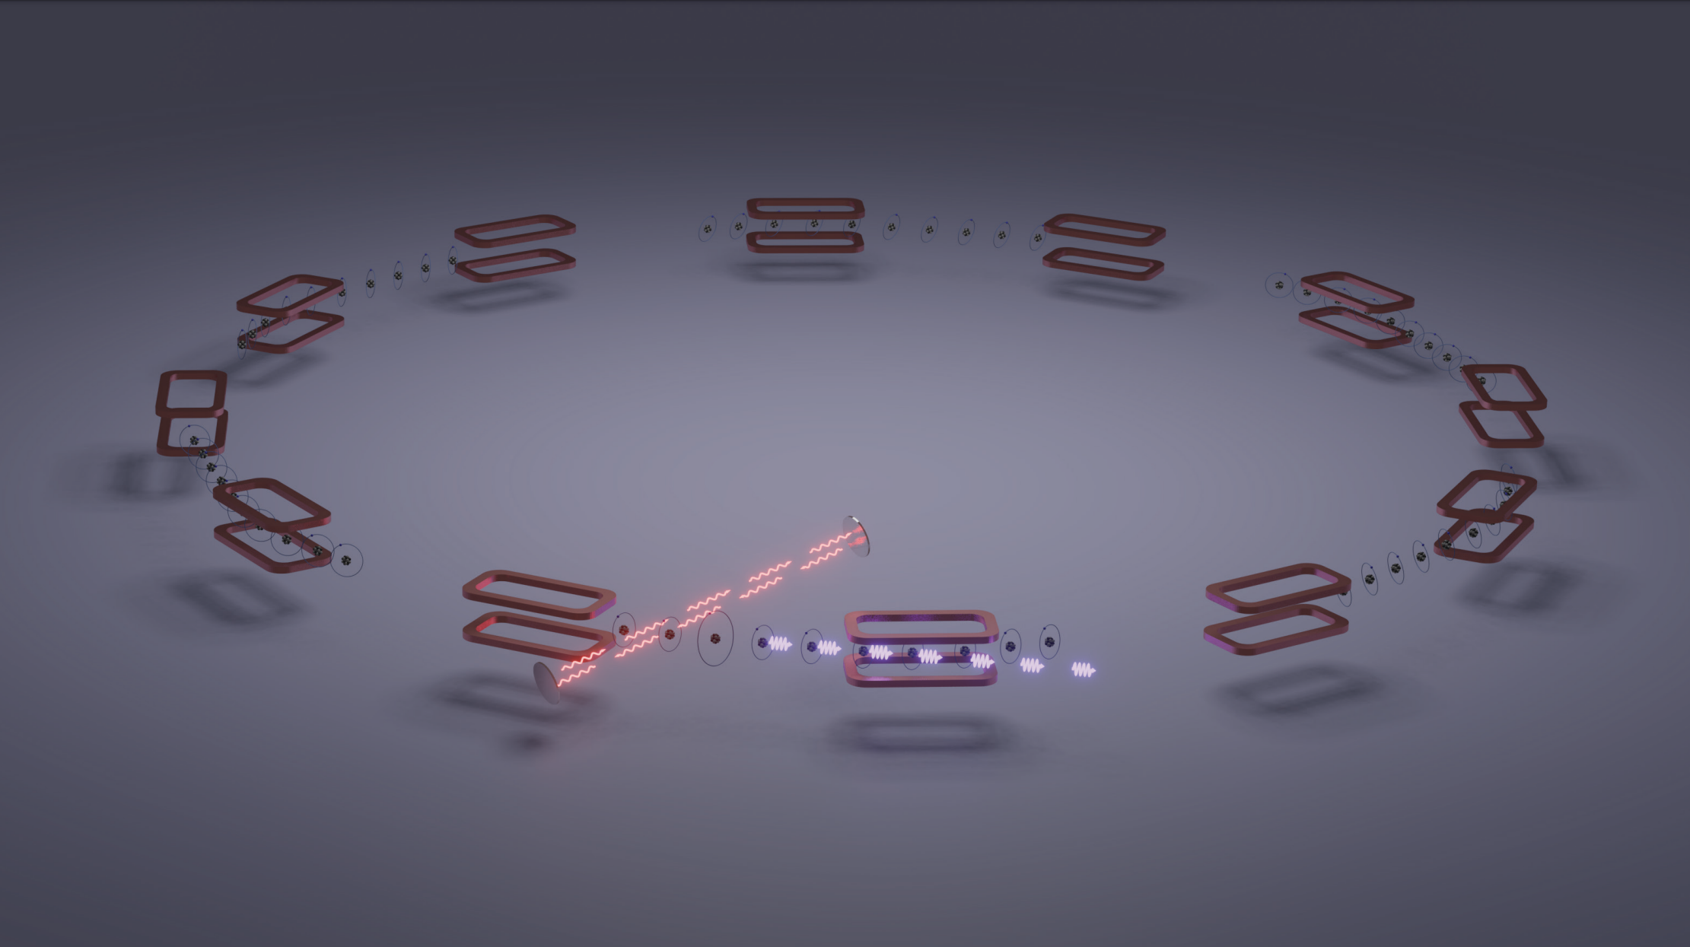




Progress towards the CERN
Gamma Factory Proof of principle experiment
Aurélien MARTENS (IJCLab Orsay) on behalf of
The Gamma Factory study group

Slide 2
Gamma Factory:
Scientific context

Slide 3
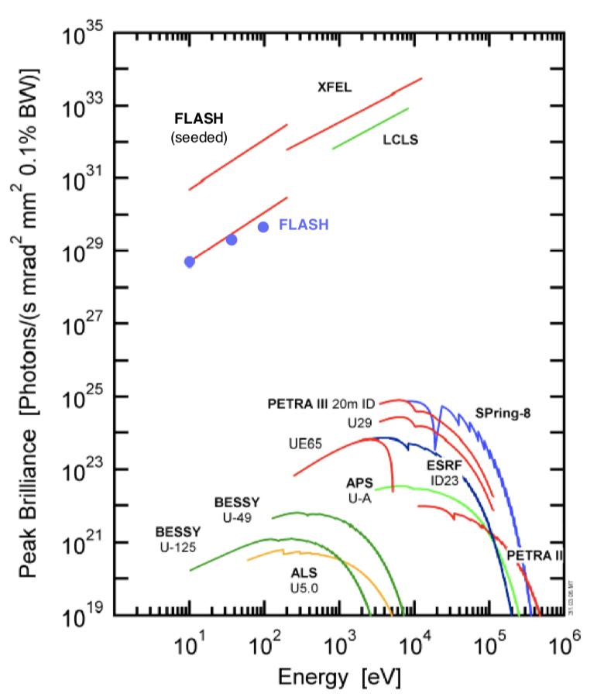
A striking fact
Weise, LINAC 2006 proceedings;
Few 100’s keV at most

Slide 4
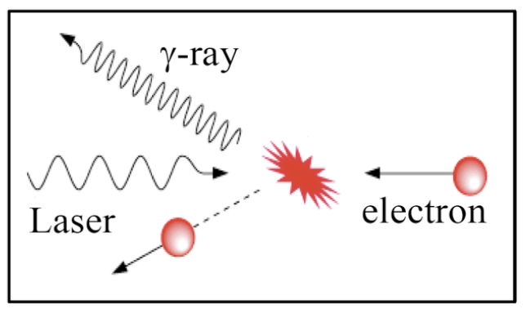
A striking fact
No bright photon source for nuclear and particle physics applications !
FEL and synchrotron impracticable
Weise, LINAC 2006 proceedings;
Inverse Compton scattering ?
Excellent monochromaticity but
O(1barn) cross-section is low !
ICS lie here
10’s keV—100 MeV
Example : HI𝛾S@Duke, 10¹⁰ ph/s, 1-100MeV

Slide 5
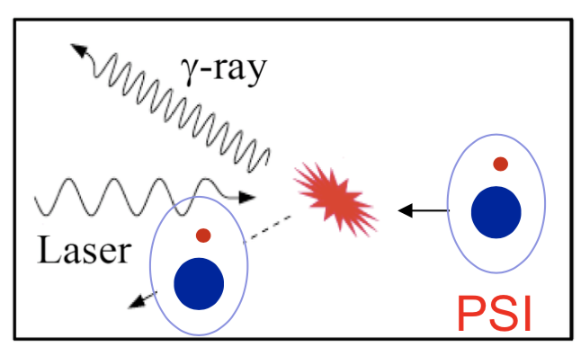
Physics concept
💡: Exploit high cross-section of atomic resonances & existing CERN accelerator complex
E. J. Bessonov & K.J. Kim Phys. Rev. Lett. 76, 431, M.W. Krasny arXiv:1511.07794,
D Winters et al 2015 Phys. Scr. 2015 014048
High-energy
PSI: Partially stripped ions
Very similar with Inverse Compton scattering but O(10⁹) larger cross-section !
For instance
H-like Xenon at LHC (𝛾=3000) → 180 MeV
Energy upshifting by a factor 4𝛾²
Li-like Calcium at SPS (𝛾=130) → 80 keV

Slide 6
Physics concept
💡: Exploit high cross-section of atomic resonances & existing CERN accelerator complex
E. J. Bessonov & K.J. Kim Phys. Rev. Lett. 76, 431, M.W. Krasny arXiv:1511.07794,
D Winters et al 2015 Phys. Scr. 2015 014048
High-energy
PSI: Partially stripped ions
Very similar with Inverse Compton scattering but O(10⁹) larger cross-section !
👍🏻 PSI recycling in ring is very efficient (relative energy loss << beam energy spread)
👍🏻 Energy tunability provided by PSI species choice and ion beam energy (<400MeV w/ LHC)
👎🏻 Laser wavelength must be « tuned » to PSI species and beam energy
👎🏻 Laser must be placed in a harsher environment (compared to e⁻ accelerators)

Slide 7
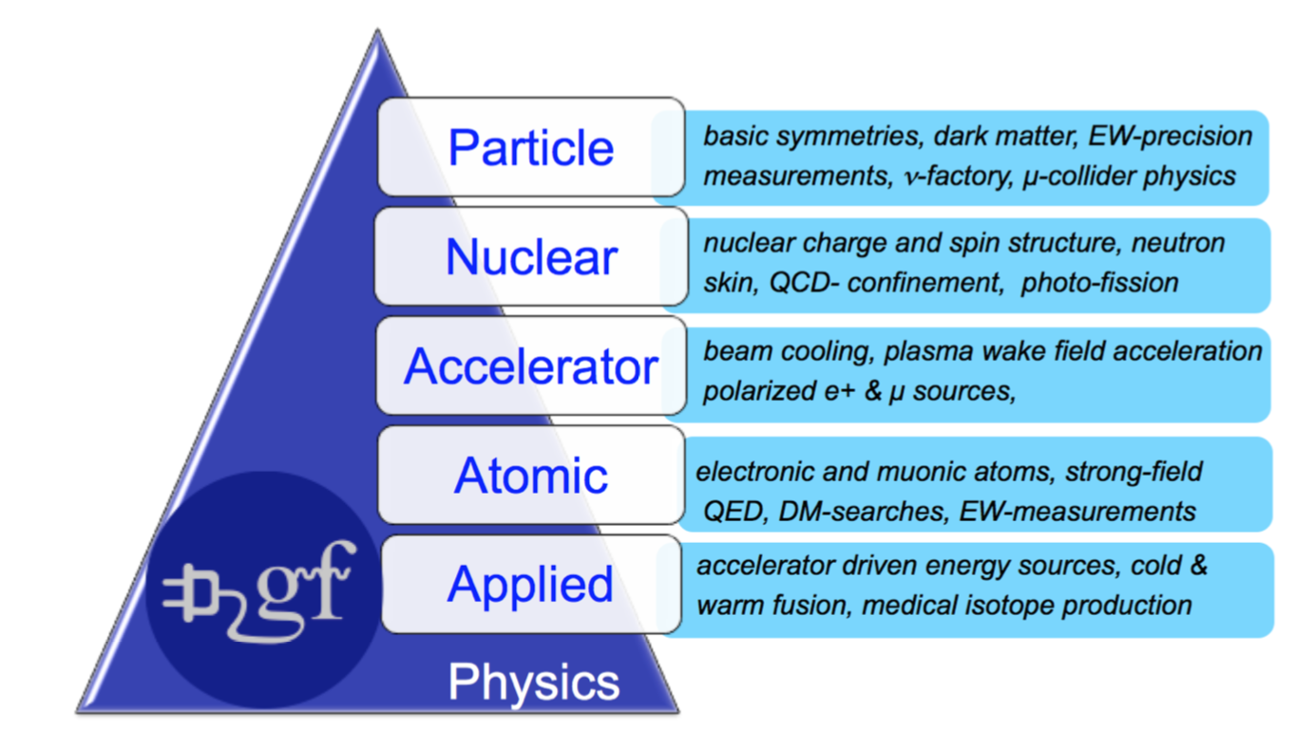
Beyond a bright photon source
High potential to open new opportunities in many branches of physics
M. W. Krasny et al. SPSC-I-253, M.W. Krasny arXiv:1511.07794, https://indico.mitp.uni-mainz.de/event/214/, https://indico.cern.ch/event/1096767
For a recent review, see Krasny, ICHEP 2025
Integrated in Physics Beyond Colliders initiative

Slide 8
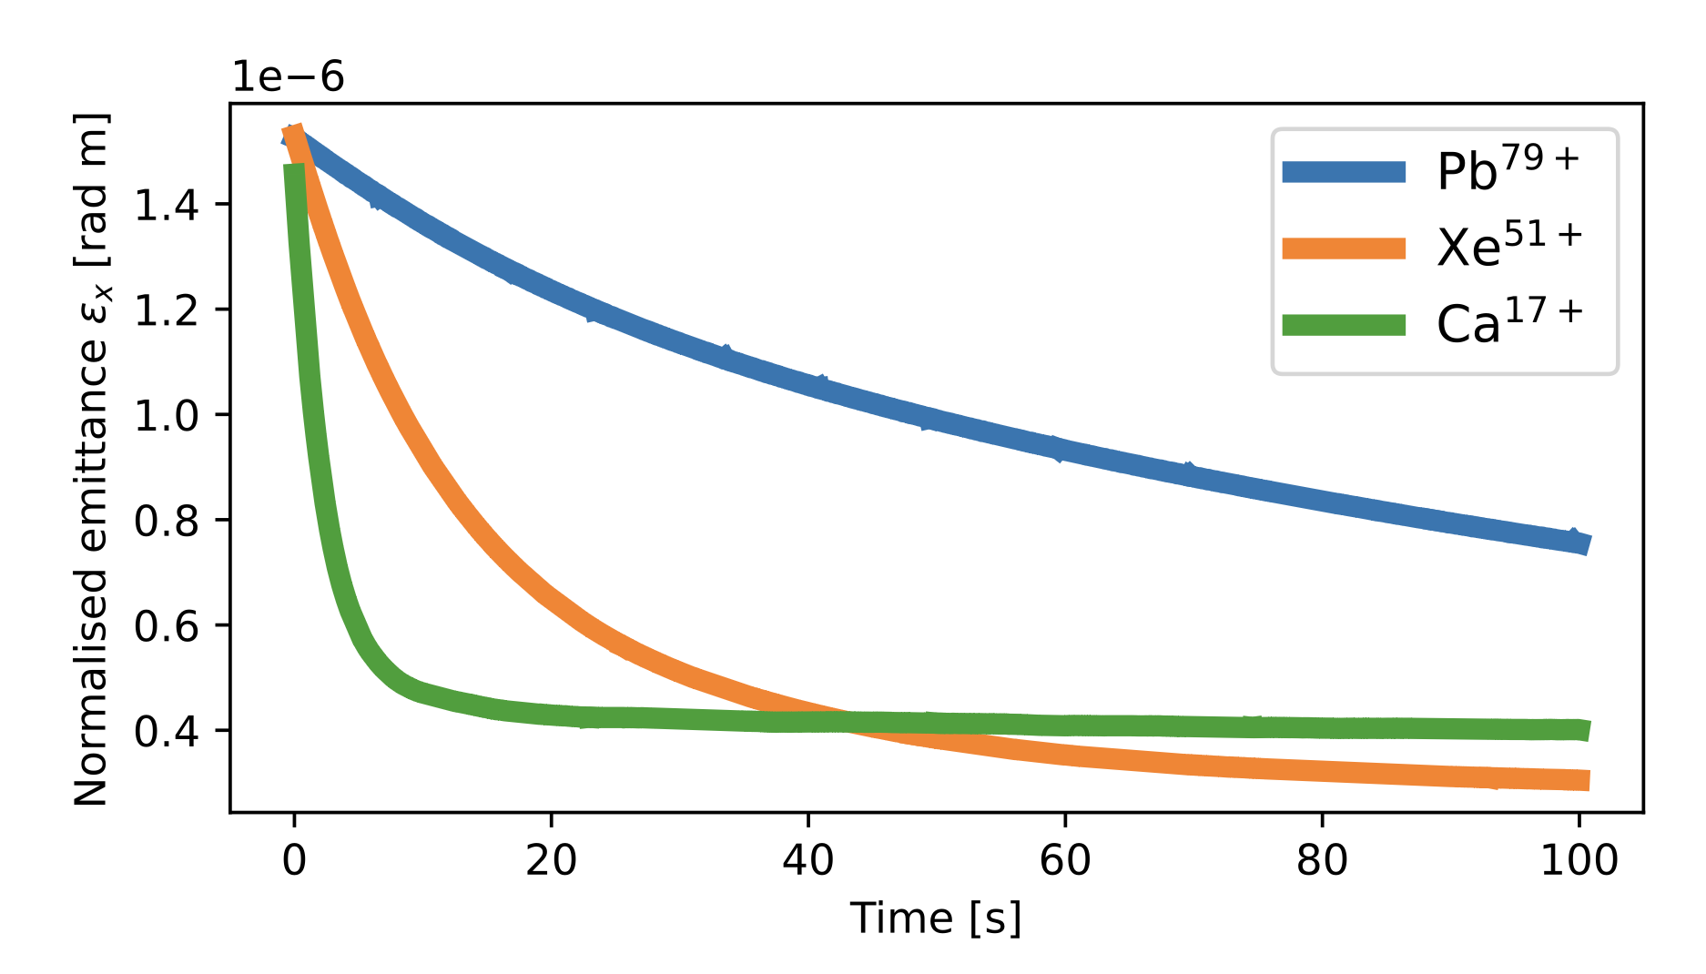
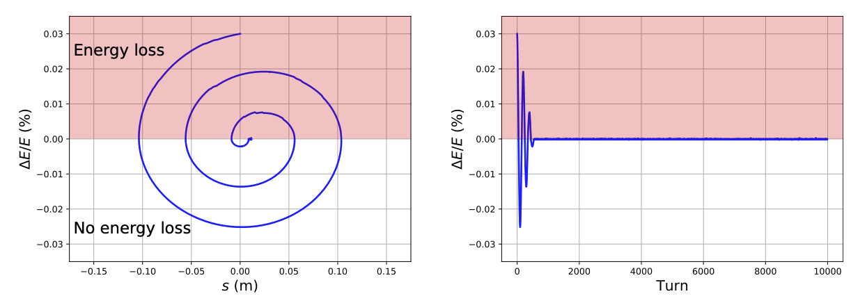
Laser cooling of ion beam
Potential for the first demonstration of laser cooling of relativistic ions (β ≈ 0.99)
Potential to improve beam quality in LHC-like collider conditions.
Simulation studies ongoing
  see D. Gamba’s presentation
Courtesy, P. Kruyt
M. W. Krasny et al. SPSC-I-253
Detuned laser spectrum

Slide 9
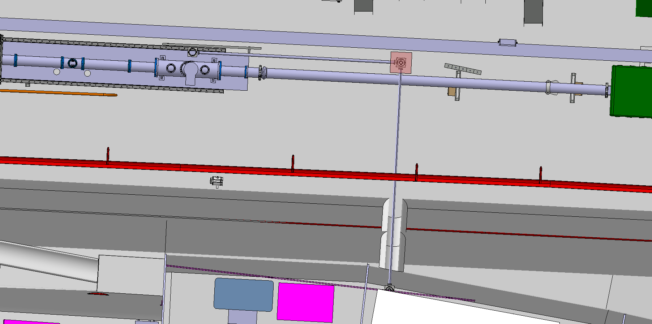
Gamma Factory:
Proof of Principle experiment
@ SPS

Slide 10
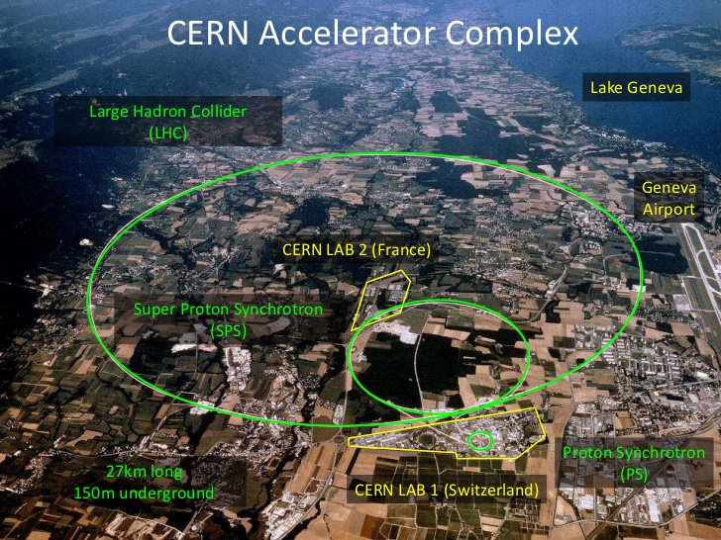
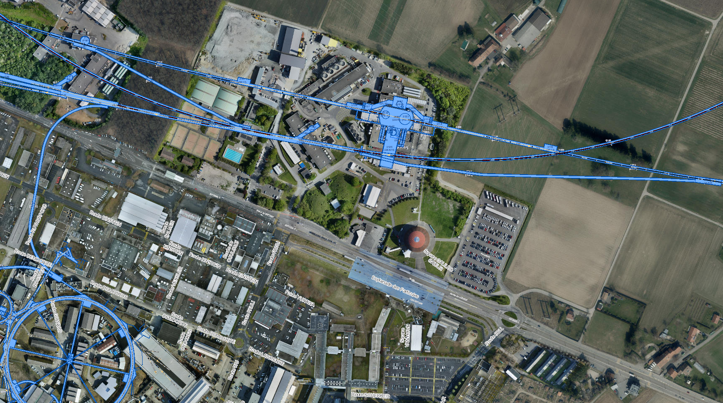


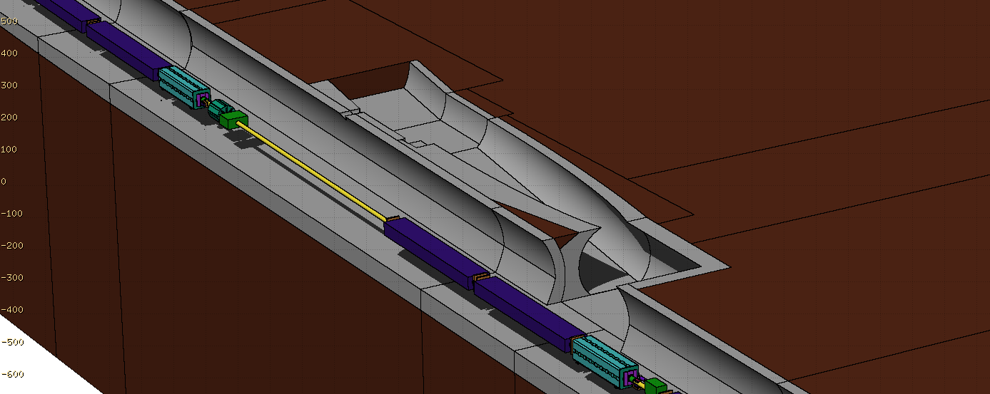
Proof of principle experiment location
LHC
ATLAS
SPS
Gamma Factory PoP
5 m
SPS
Laser room
Interaction region

Slide 11
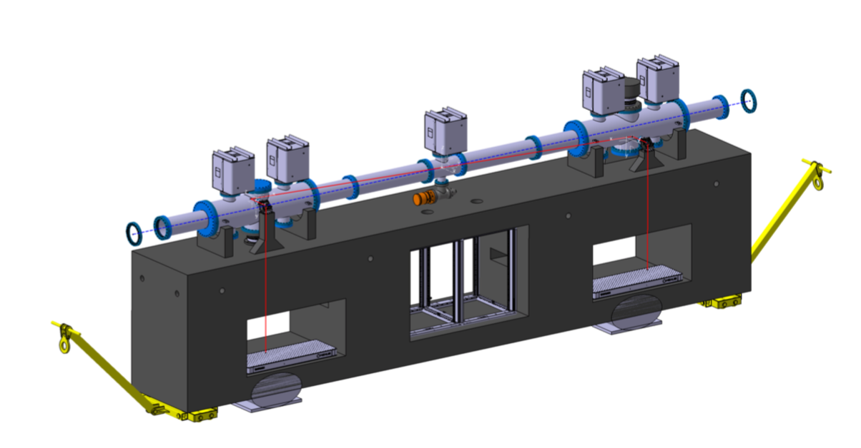
Optical system in SPS tunnel
5mJ 40MHz (200kW) laser system
Challenges:
Laser beam transport
Full remote operation
M. W. Krasny et al. SPSC-I-253
Laser Room

Slide 12
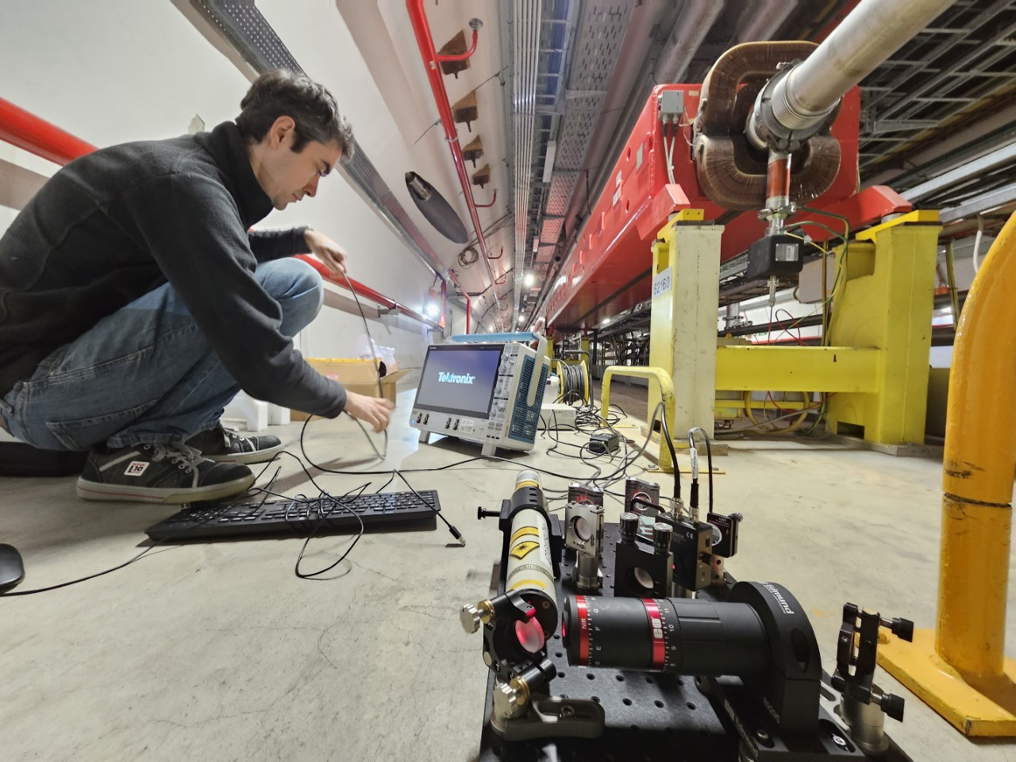
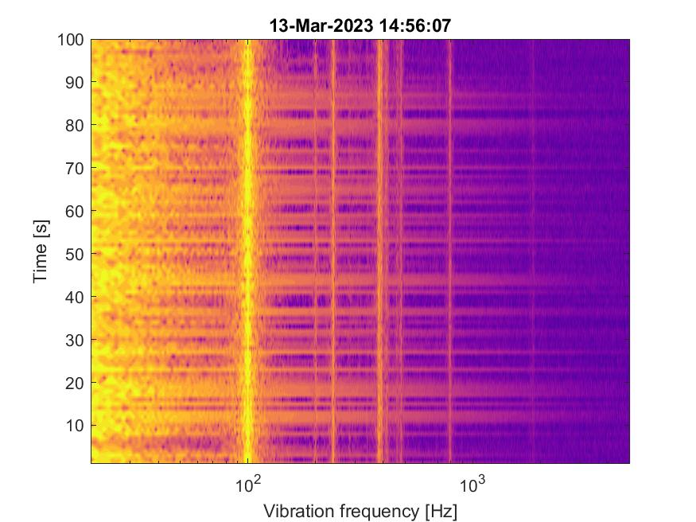
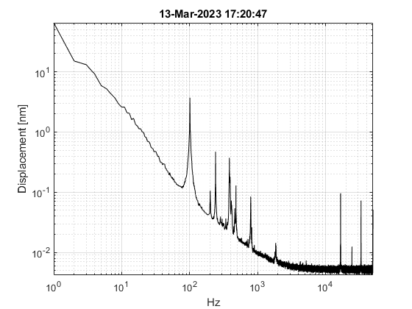
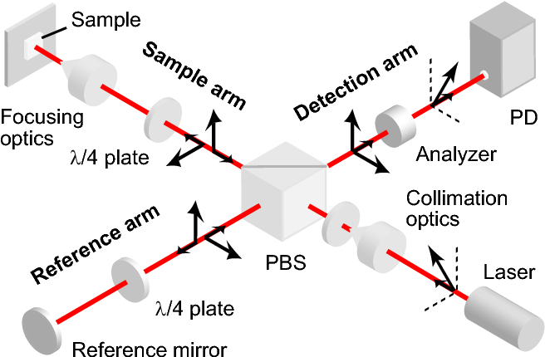
Laser beamline
Supported by Physics Beyond Colliders at CERN
© Yann Dutheil
Measured the vibration spectral content during 6 hours with SPS equipment switched ON.
Accuracy was down to few pm in length and up to 10 kHz in frequency.
Largest contributions are acoustics below 1 kHz, with eventual tones at 2.3 kHz.
Avoid the coupling of vibrations to laser beamline and with a Fabry-Perot cavity resembling the future experiments

Slide 13
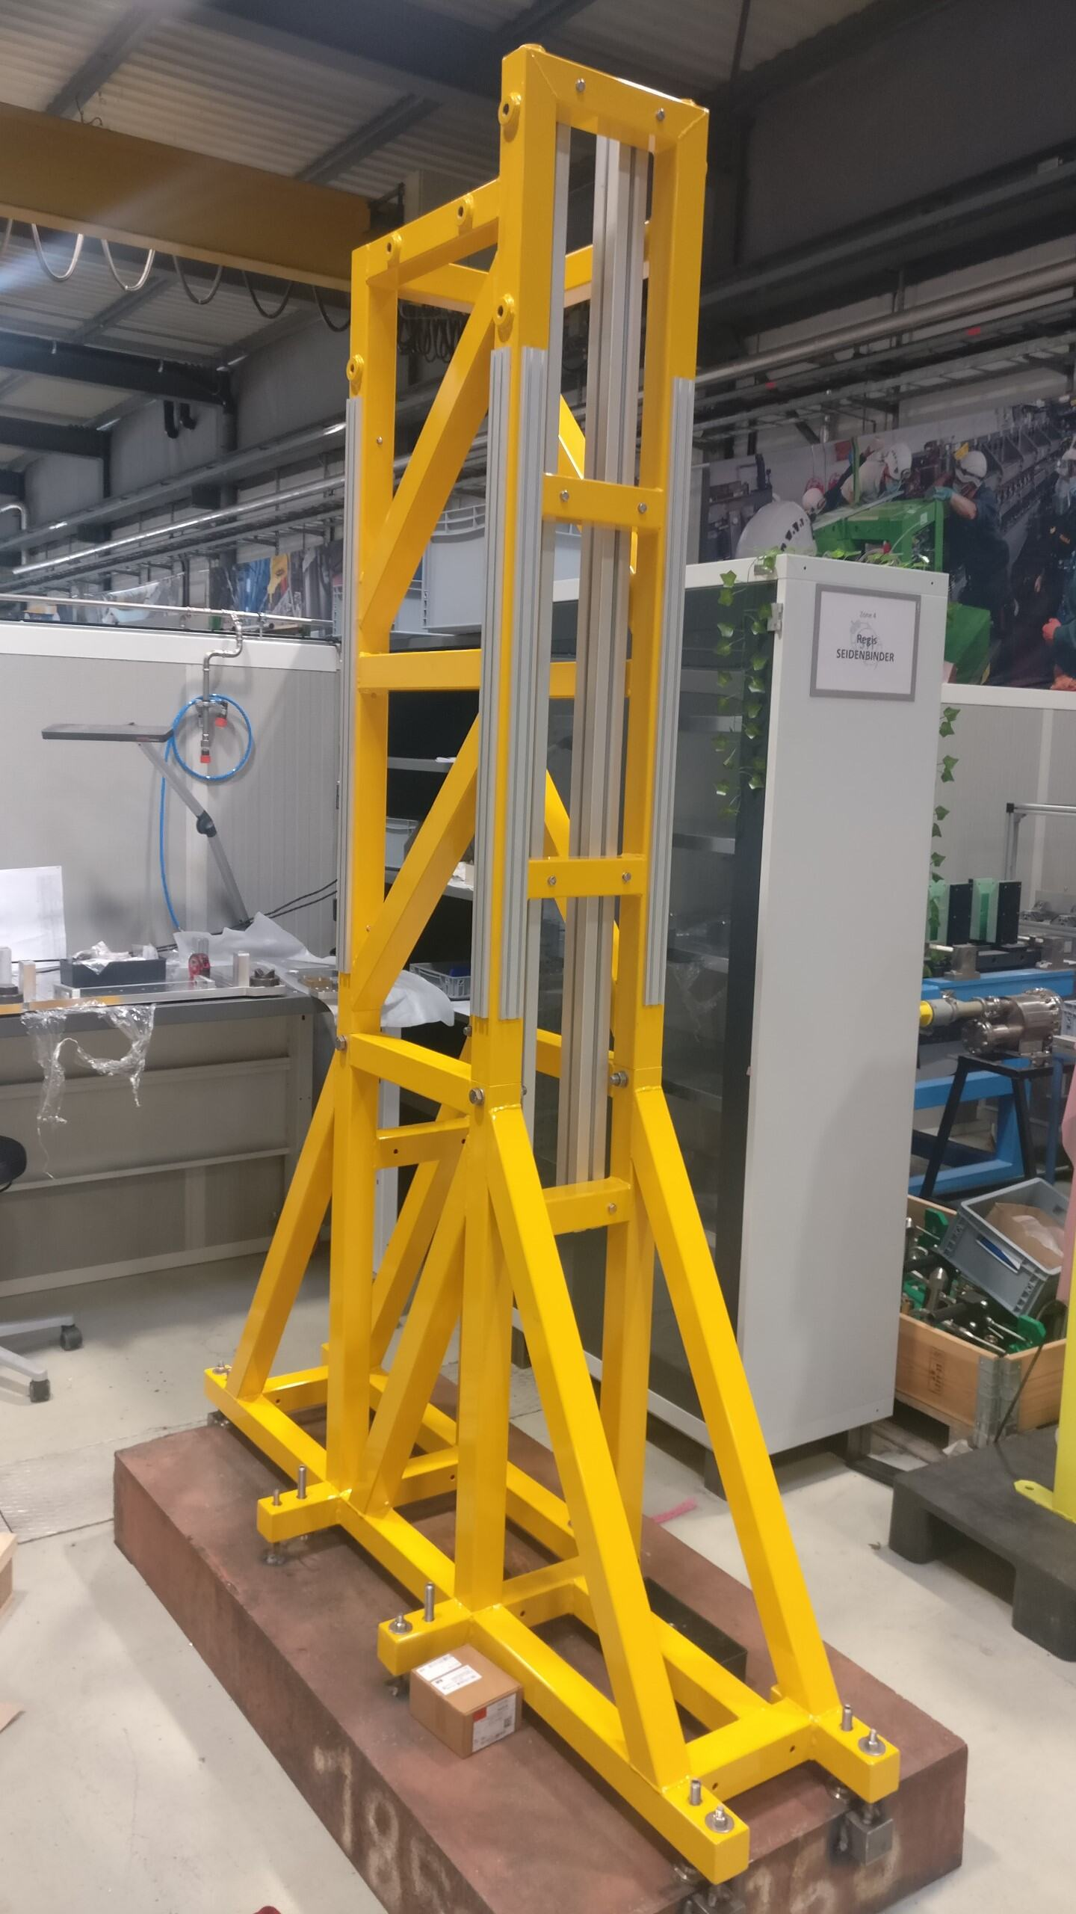
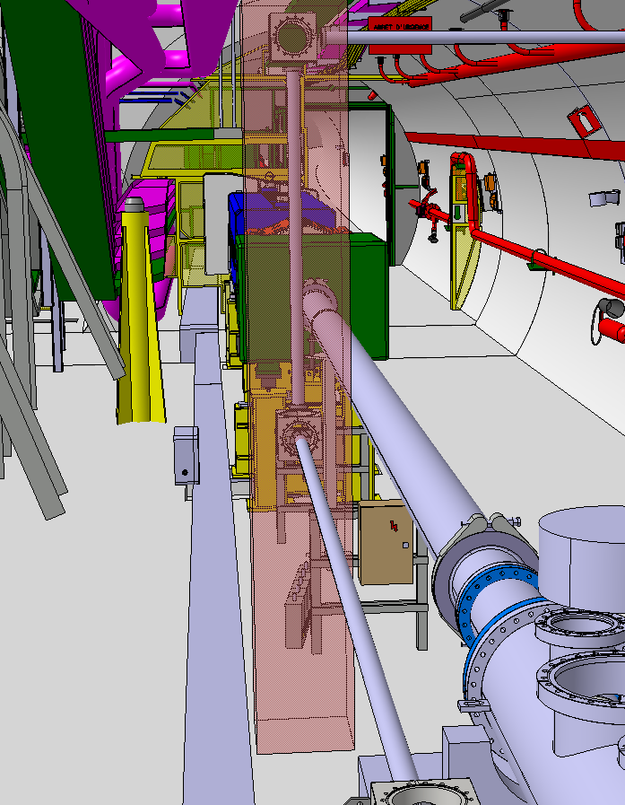
Pillar preparation
Supported by Physics Beyond Colliders at CERN
Pillar
Busbars
GF Cavities
SPS Beam Line
GF Laser
Beam Line
SPS
350 mm
Hole between
SPS and TI 18
350 mm
TI 18

Slide 14
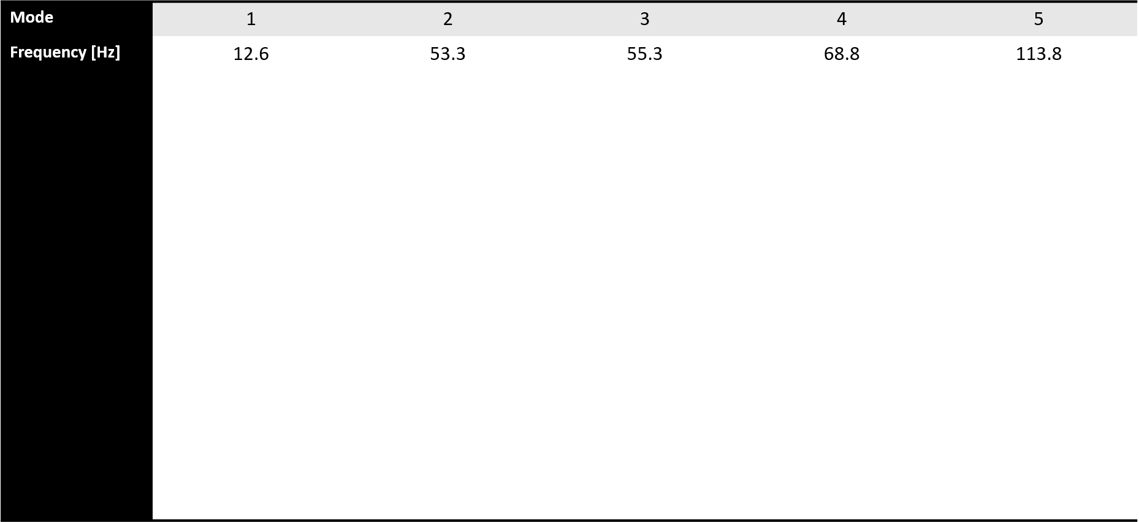
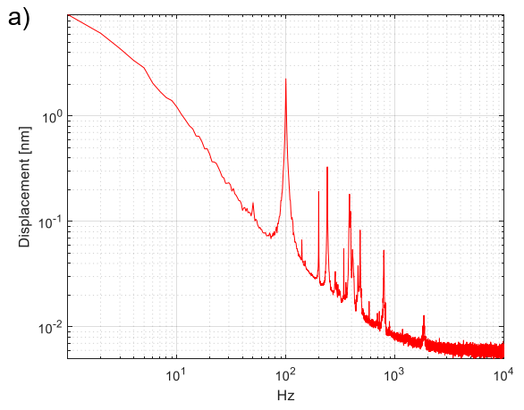
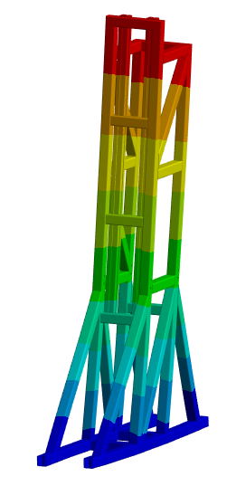
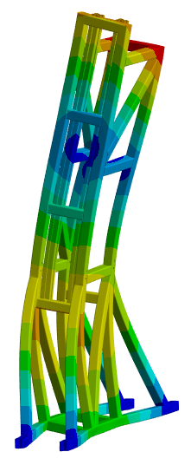
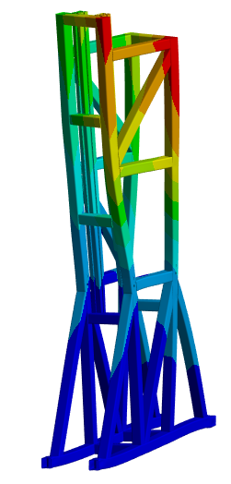
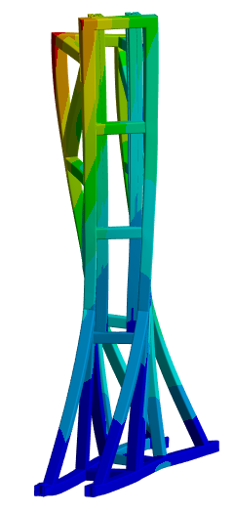
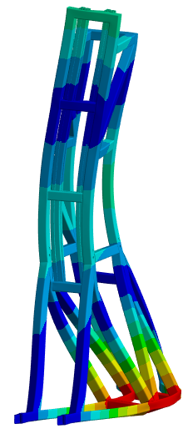
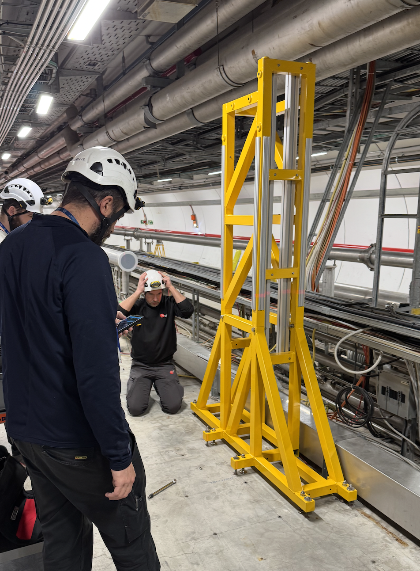
Pillar support simulations
Supported by Physics Beyond Colliders at CERN
Mismatch to SPS vibration spectrum
Fixed supports
Analysis of resonant modes without attachment to ceiling.
All the contacts are bonded. No additional mass on the structure was considered
The modes are mismatched to the existing vibrational modes found in SPS
First element installed in SPS (Jan’25)

Slide 15
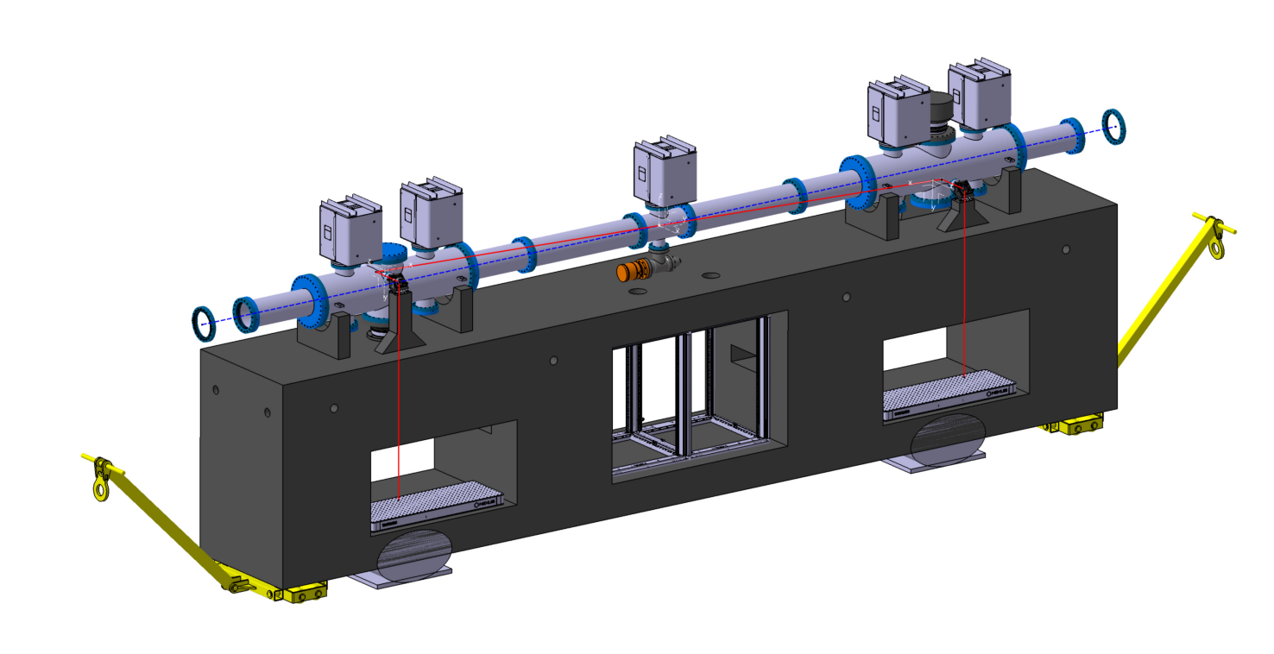
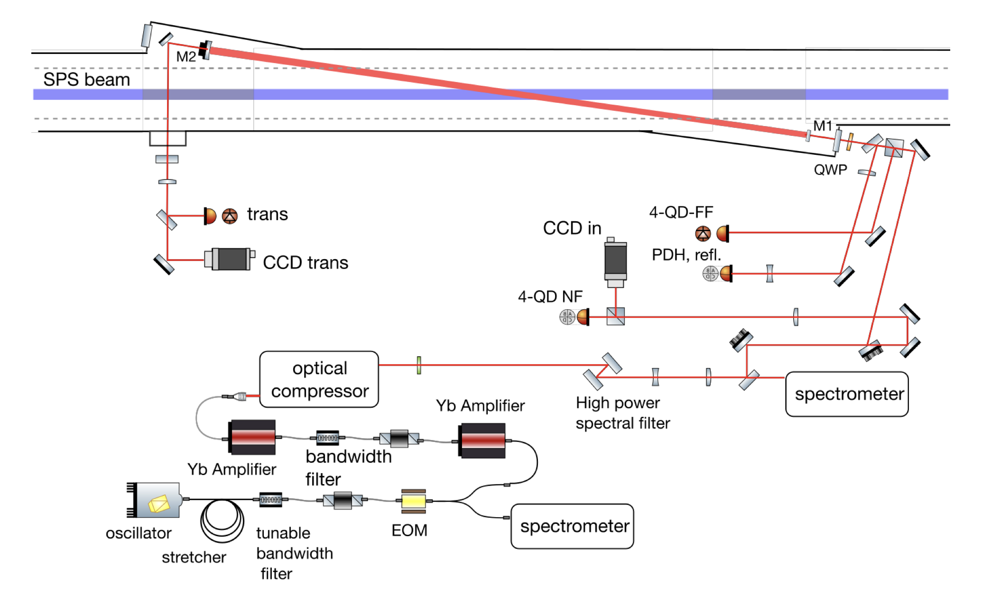
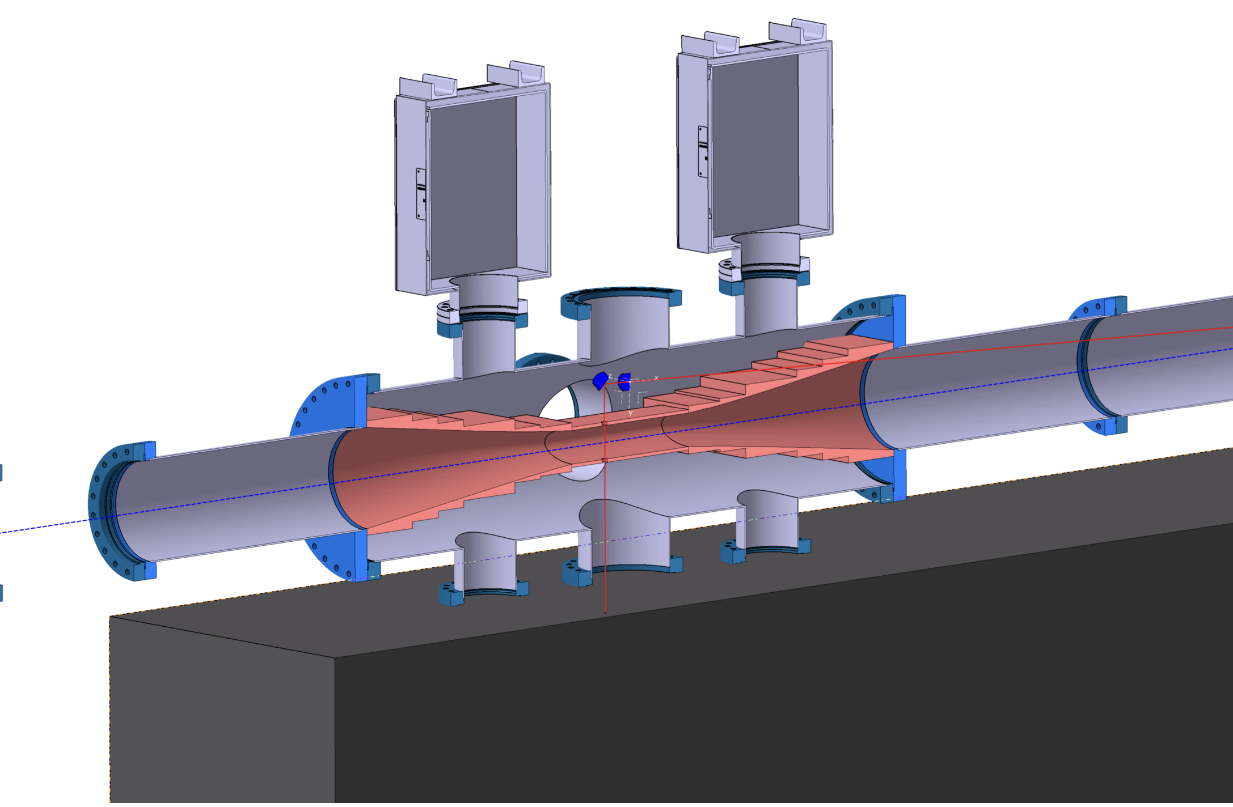
Fabry-Perot preparation
Supported by Physics Beyond Colliders at CERN
Pre-design was done by IJCLab
CERN is preparing the engineering design, possibly ready for procurement in 2026

Slide 16
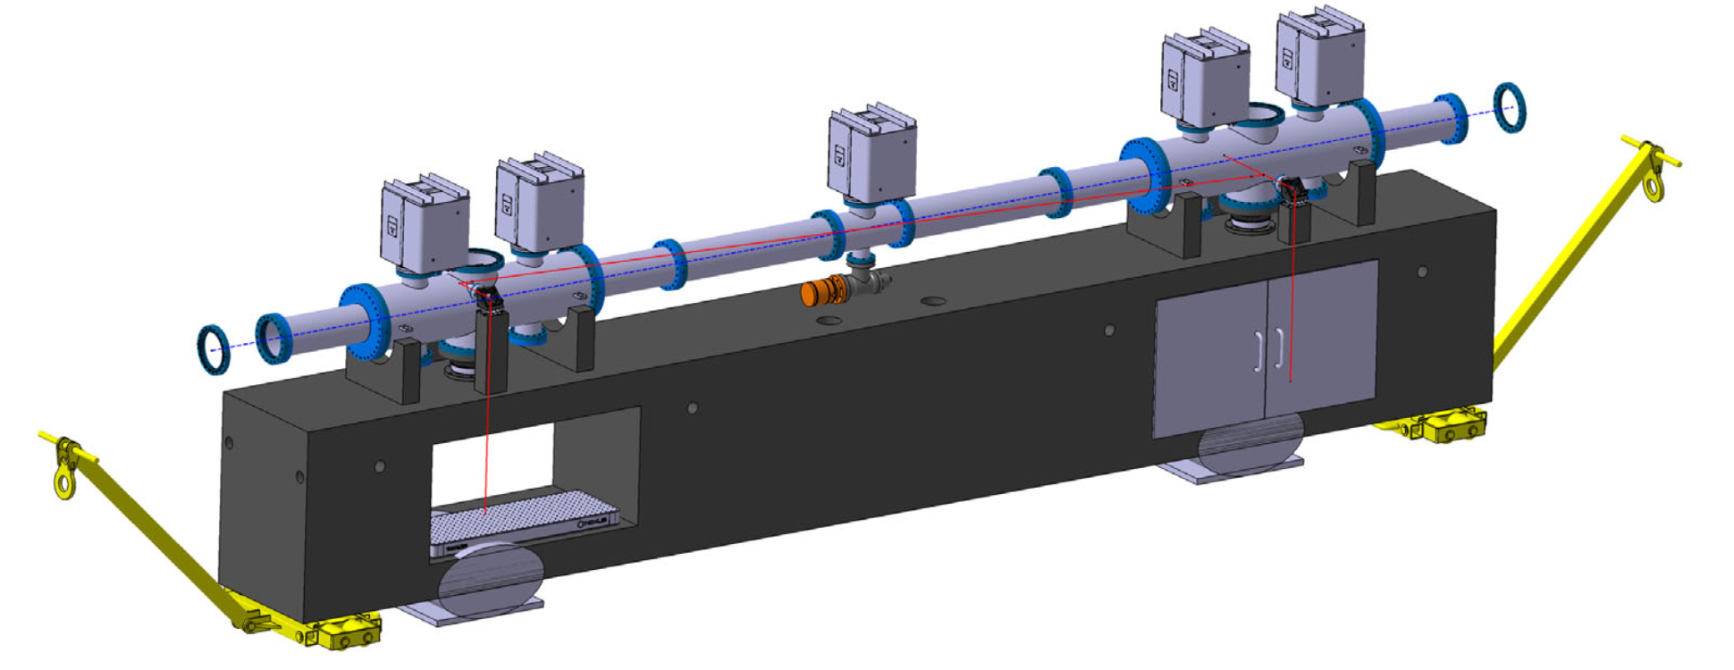
Optical Cavity for Gamma Factory PoP
Optical system scheme: 2-mirror optical cavity coupled to the storage ring
Parameter design :
  FSR = 40 MHz
  Cavity Linewidth = 4 kHz
  Finesse = 10,000
  Gain = 5,000
  Amplified power = 50 W
  Coupling efficiency = 70%
  Circulating power = 180 kW
Fully remote operation is needed
M. W. Krasny et al. SPSC-I-253; A. Martens, et al. PRAB 25.10 (2022): 101601.

Slide 17
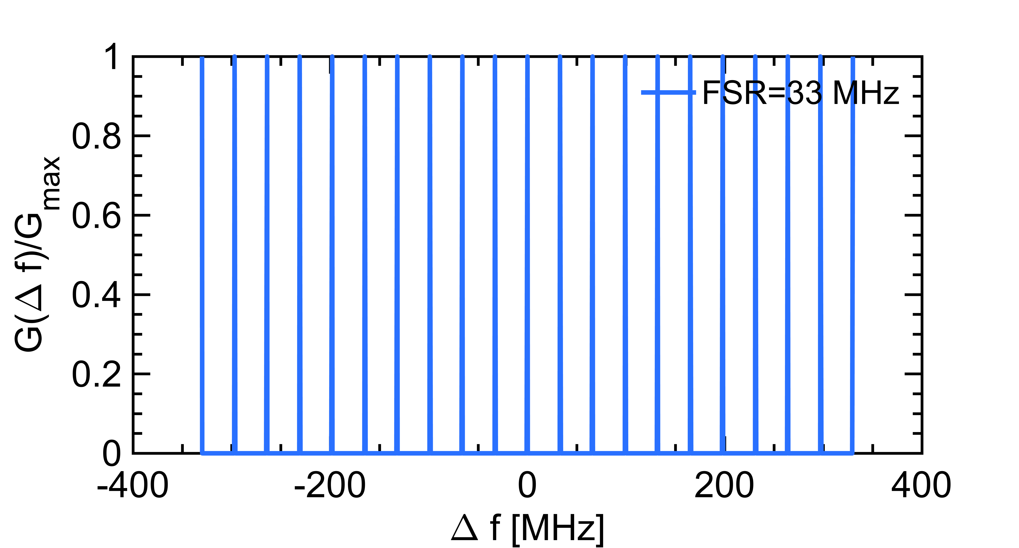
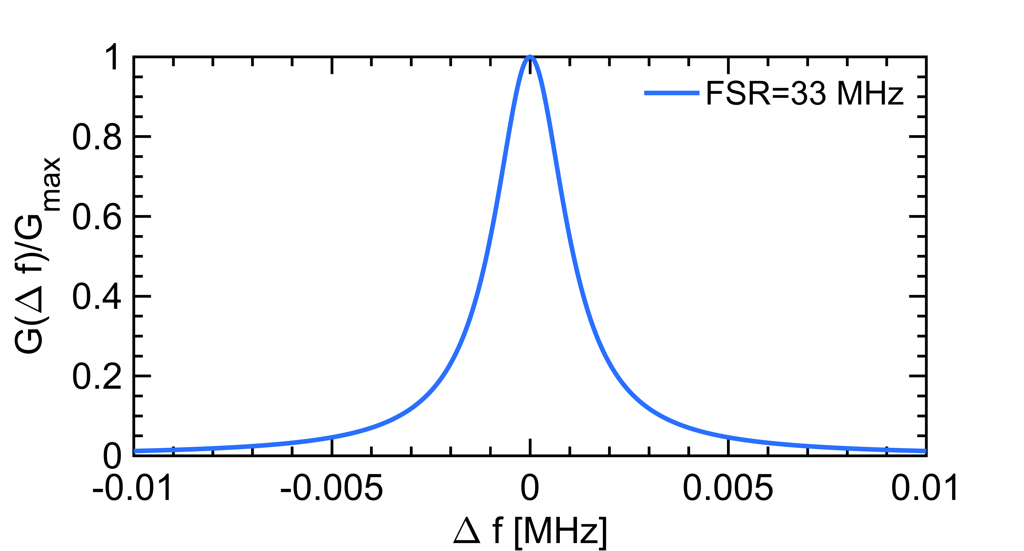

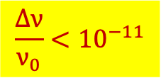

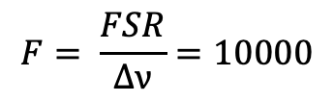
Fabry-Perot interferometric filter
First difficulty
Laser frequency must be precisely tuned
And remain stable !
$$F= \frac{FSR}{∆ν}=10000$$
$$∆ν=4kHz$$
$$for FSR=40MHz$$
A. Martens, et al. PRAB 25.10 (2022): 101601.
E. Roikova et al., APL Photonics 10, 070901 (2025)
NB: Compare with central frequency of $ν_{0}=290THz$
$$\frac{∆ν}{ν_{0}}<{10}^{−11}$$
Metrology-level requirement !
→careful choice of laser provider

Slide 18
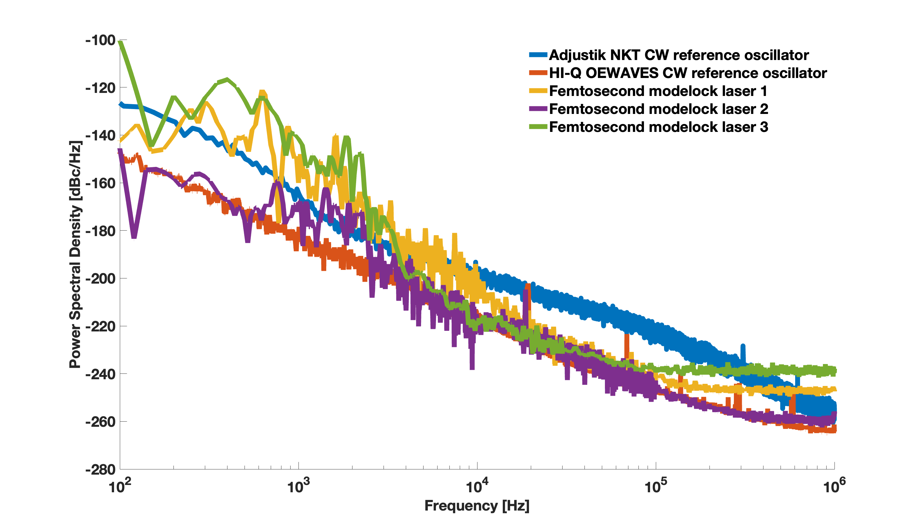
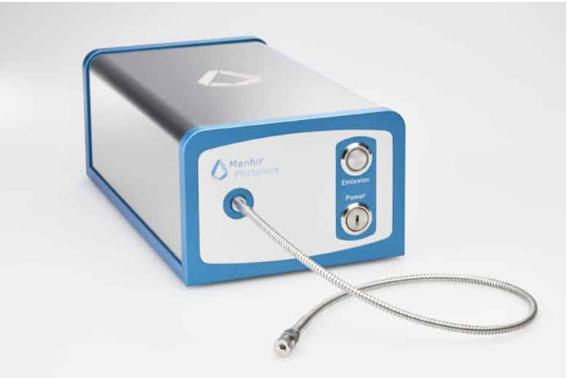
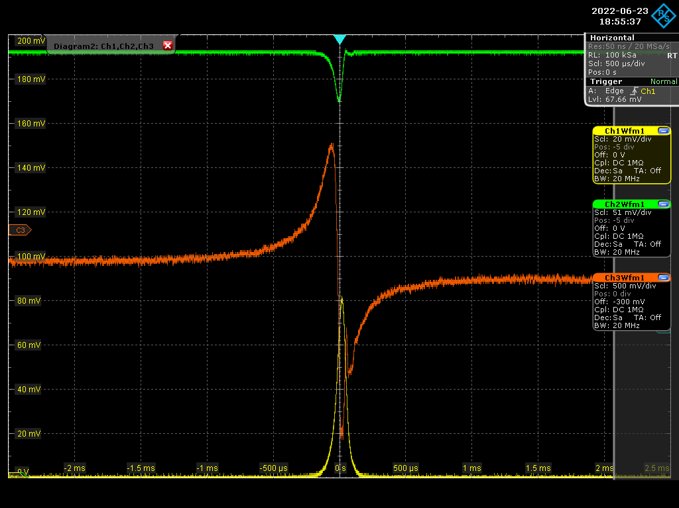
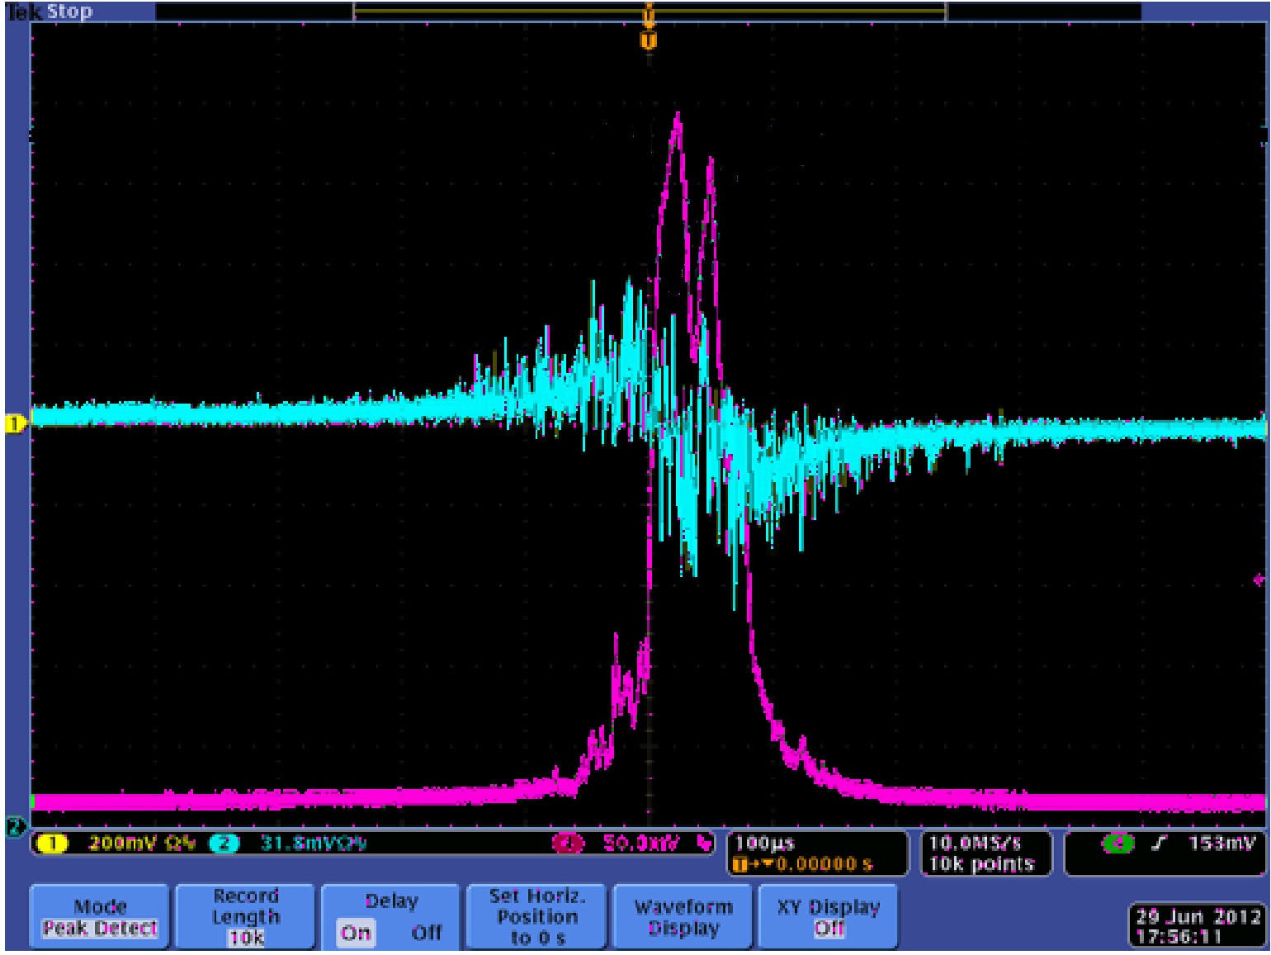
Phase noise: choice of provider
Supported by Physics Beyond Colliders at CERN
Laser provider identified, laser oscillator procured (160MHz)
A. Martens, et al. PRAB 25.10 (2022): 101601.
(Very) good laser
Example of (very) bad laser

Slide 19

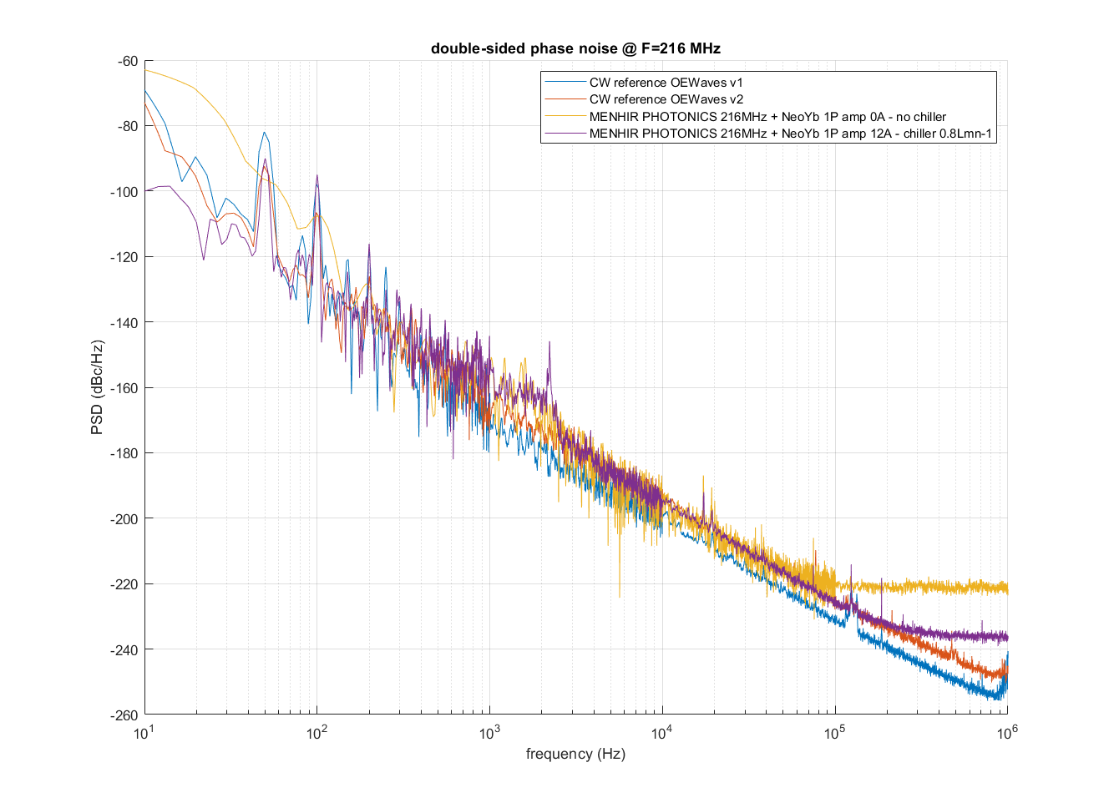
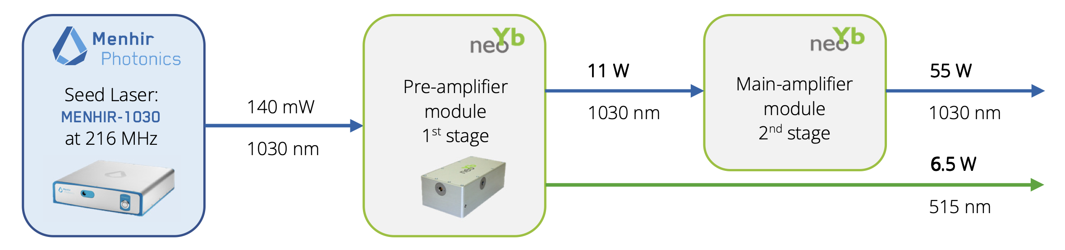
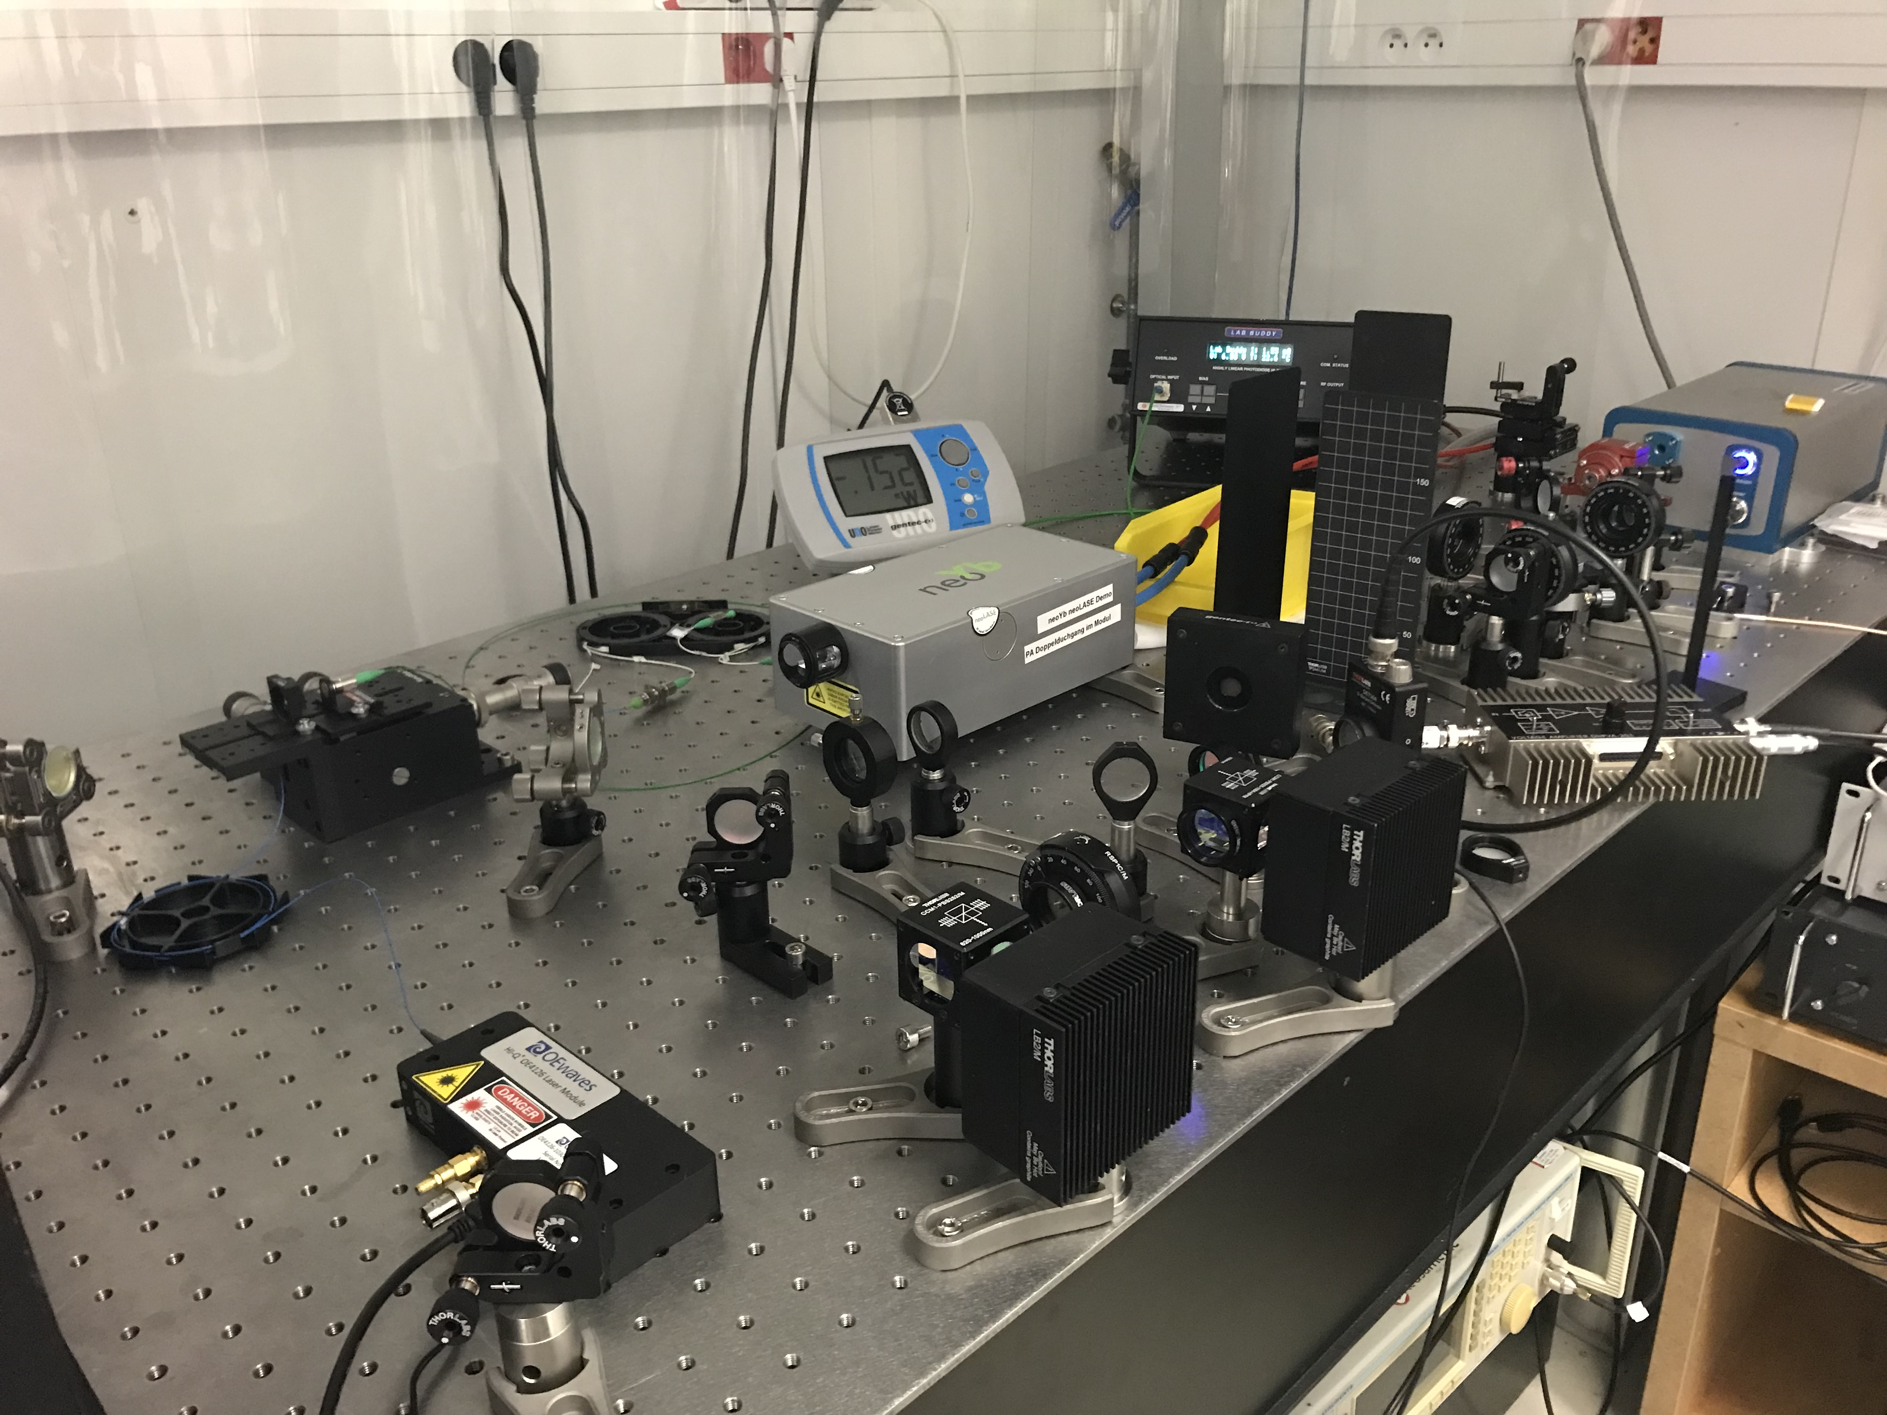
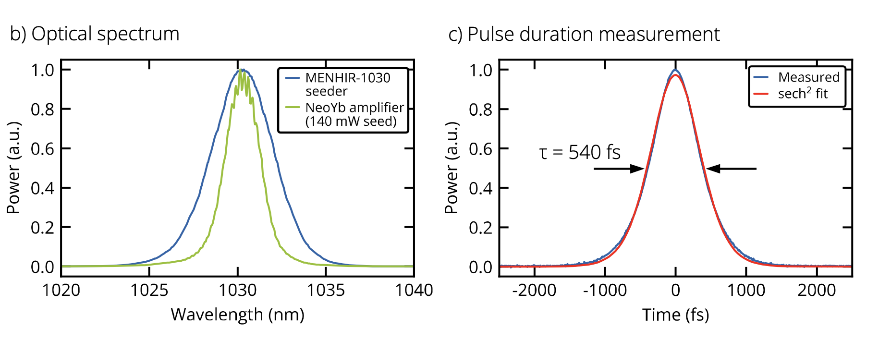
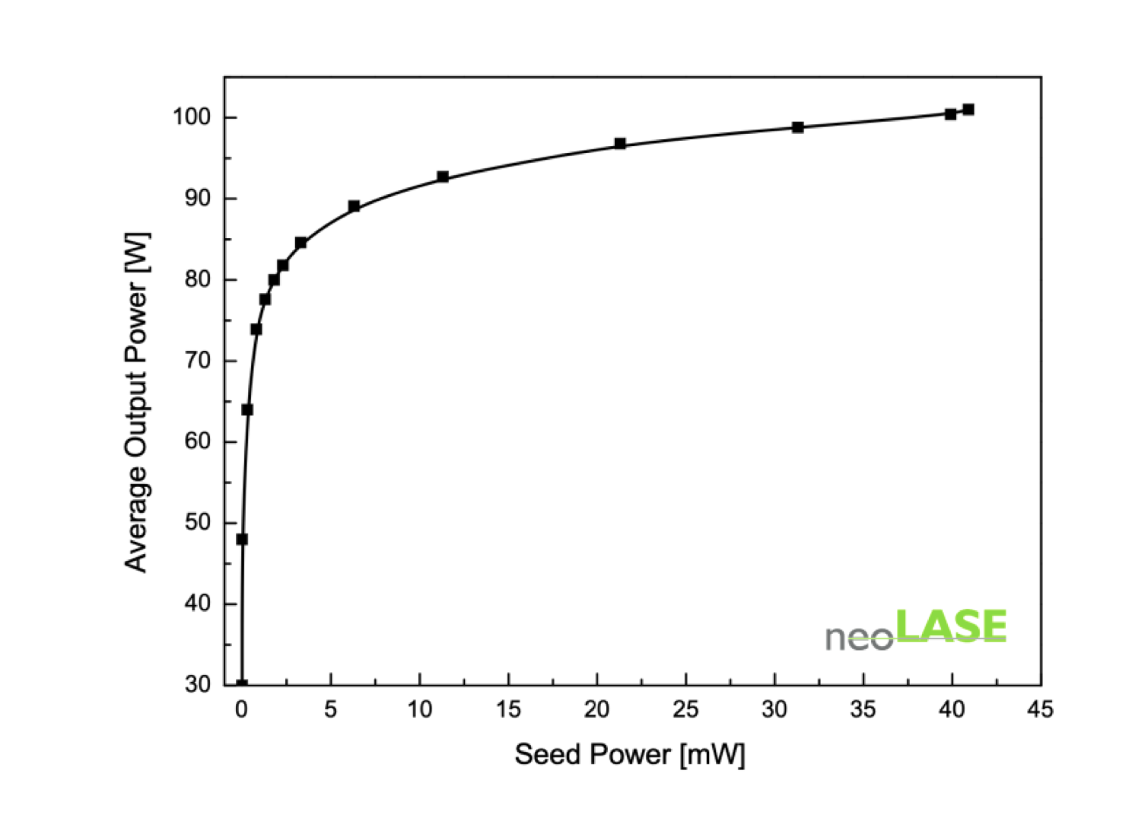
Amplifier choice - neoLase
Supported by Physics Beyond Colliders at CERN
Amplifier procured, delivery end 2025
Requires validation on cavity

Slide 20
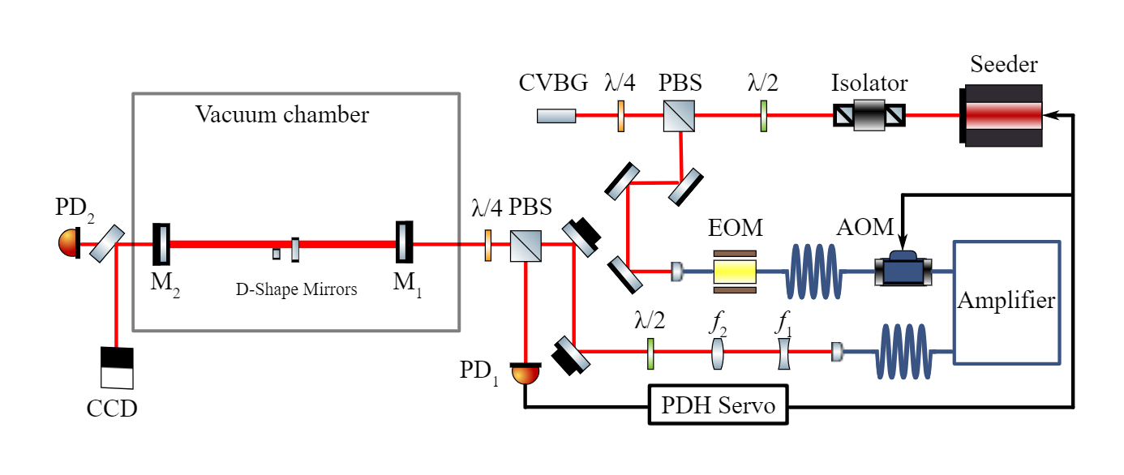
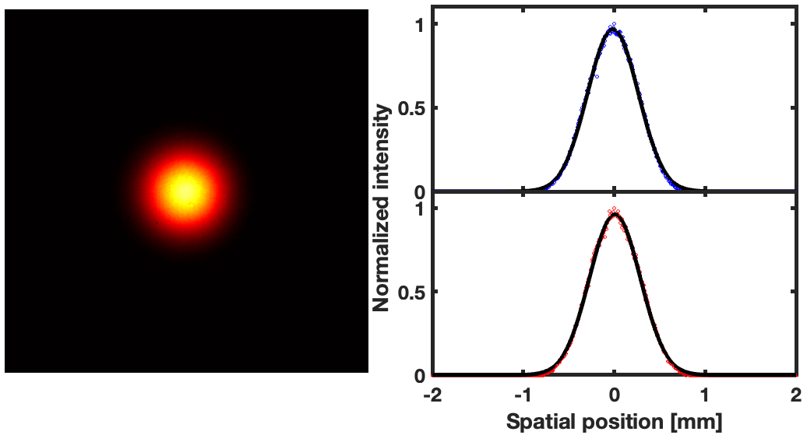
2-mirror cavity demo
in collaboration with Tsinghua University, Dpt of Engineering Physics
NB: amplifier used not that of GF-PoP
Uses GF-Pop seed laser
Amplifier is R&D
216 MHz
X.Y. Lu, et al. Appl. Phys. Lett. 124, 251105 (2024)
X.Y. Lu, et al. Optics Letters 49 (2024) 6884
700 kW
Finesse 45,000
Effective enhancement 18,000

Slide 21
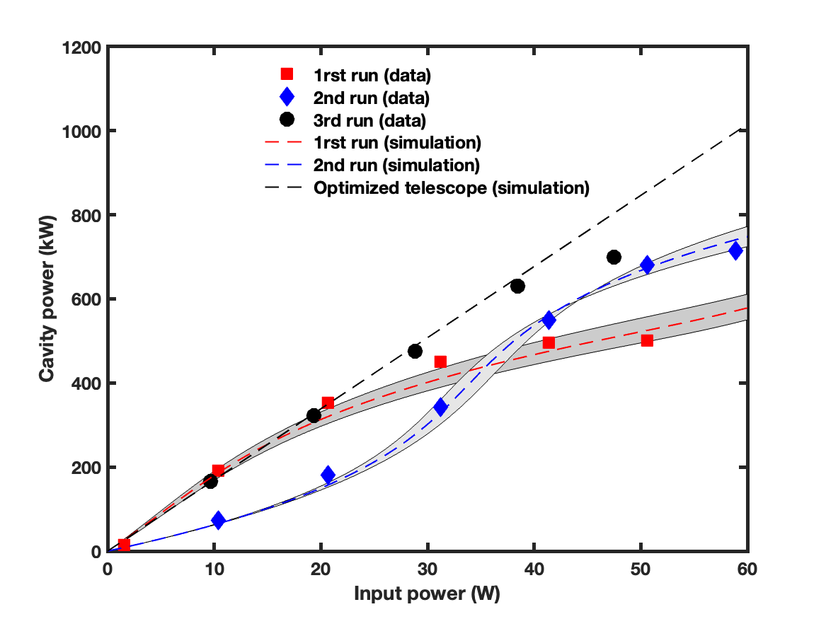
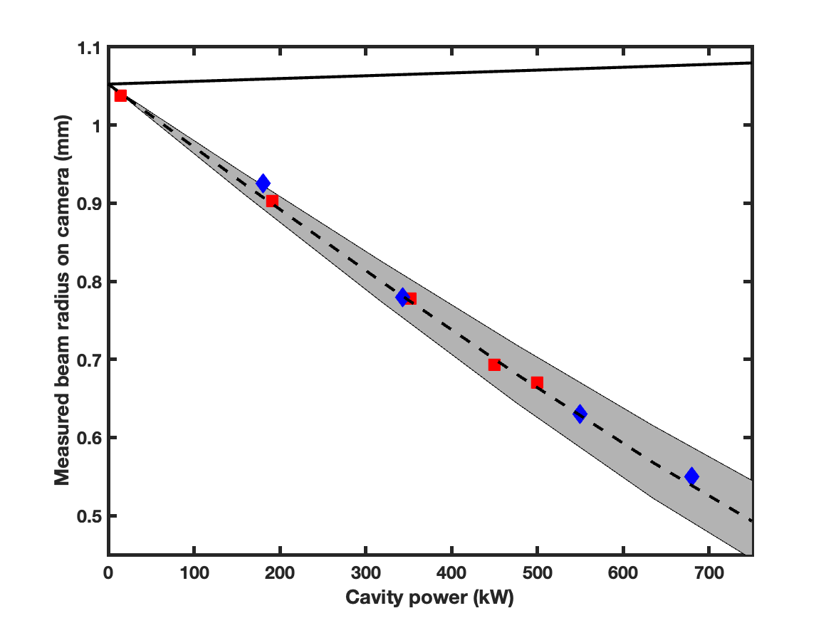
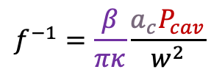
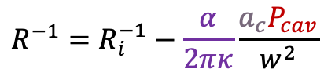
Coupling difficulties
in collaboration with Tsinghua University, Dpt of Engineering Physics
NB: amplifier used not that of GF-PoP
Transmission camera beam size
$$R^{−1}=R_{i}^{−1}−\frac{α}{2πκ}\frac{a_{c}P_{cav}}{w^{2}}$$
X.Y. Lu, et al. Optics Letters 49 (2024) 6884
$$f^{−1}=\frac{β}{πκ}\frac{a_{c}P_{cav}}{w^{2}}$$
Lensing also occurs in input mirror (Suprasil 3001) similarly as in output coupler
Thermo-optic coefficient are similar
Strong mode mismatching at high power
Mode mismatching at low power can improve at high power depending on telescope setting
Expect new results from Tsinghua soon (context of SSMB→DENG X. presentation later this week)

Slide 22
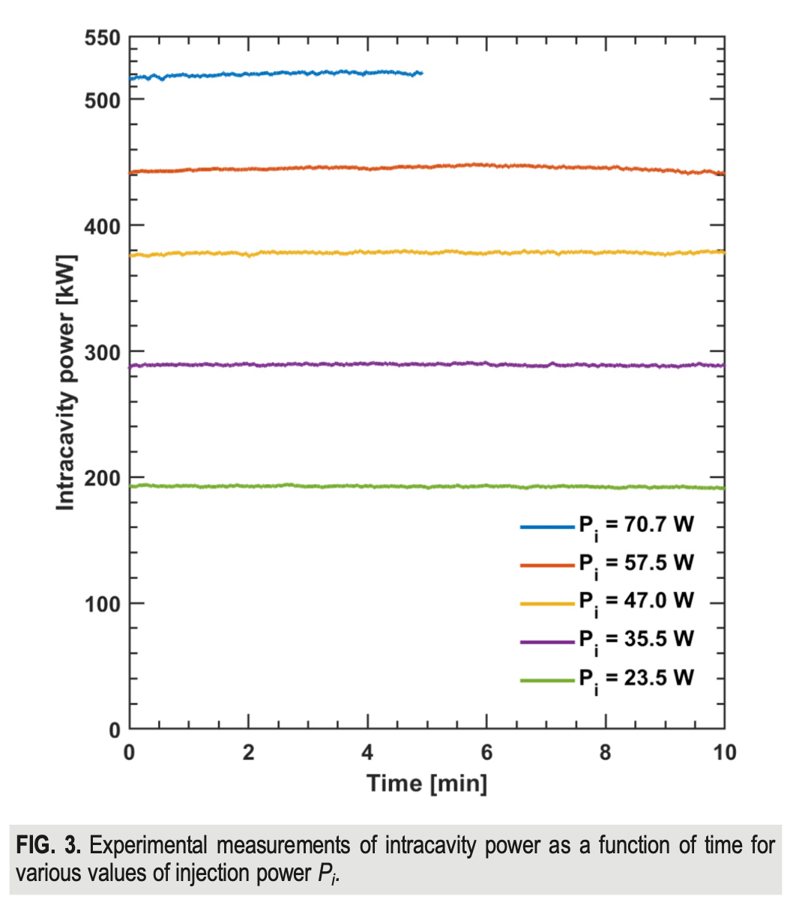

Stability
in collaboration with Tsinghua University, Dpt of Engineering Physics
Excellent overall stability
Limited by amplifier pump diodes temperature rise at high power
Limited by the need to manually tune one laser piezo voltage (can be automatized)
X.Y. Lu, et al. Appl. Phys. Lett. 124, 251105 (2024)

Slide 23
Conclusion/Prospects
The Gamma Factory proof of principle experiment is a laser cooling experiment for the CERN SPS ion beam
Comprehensive physics program beyond the Proof of Principle experiment
Evident progress towards implementation over the past few years
Hardware validation obtained at Orsay with parameters scalable to GF-PoP design
World record in stored laser power in the long term
Expect the laser system to be ready in 2026
Fabry Perot could be procured in 2026
Project on schedule for experiment start in 2028

Slide 24

Beam size in transmission
in collaboration with Tsinghua University, Dpt of Engineering Physics
NB: amplifier used not that of GF-PoP
Transmission camera beam size
Cannot be explained simply with a ROC change !!!
$$R^{−1}=R_{i}^{−1}−\frac{α}{2πκ}\frac{a_{c}P_{cav}}{w^{2}}$$
Lensing in transmission of the the output mirror (ULE) !!!
NB: cavity beam mode nearly unaffected.
w~0.6mm
X.Y. Lu, et al. Optics Letters 49 (2024) 6884
$f^{−1}=\frac{β}{πκ}\frac{a_{c}P_{cav}}{w^{2}}≈2 m^{−1}$ at 700kW
Assuming known material parameters (subject to systematic uncertainties) allows to estimate coating absorption $a_{c}≈0.35$ ppm

Slide 25
Current situation
Parameter | R&D | ThomX | GF-PoP design
Frequency | 160 MHz | 33.3 MHz | 40 MHz
Finesse | 35000 | 30000 | 10000
Linewidth | 4.5kHz | 1.3kHz | 4kHz
Amp. power | 75 W | 16 W* | >50 W
Cavity power | 520 kW | 80 kW | >200 kW
Coupling | 70% | 30 % | 70%
Pulse duration | 160 ps | 5 ps | 1-10 ps
We continue to learn and plan to increase power gradually in 2024-2025. We still learn from operation in accelerator at high power with this 4-mirror geometry:
Drift of cavity length correlated with stacking of pulses in cavity → thermally induced ?
Dynamics is complicated but we manage to preserve lock of laser-cavity-RF by sliding the stepper-motors slowly without loss of lock ! (was not observed at KEK-ATF with 30kW)
It is the main point of attention for GF-PoP (+laser transport)

Slide 26



R&D setup: 4 mirror cavity
in collaboration with Tsinghua University, Dpt of Engineering Physics
NB: amplifier used not that of GF-PoP
Finesse 35,000
Effective enhancement 8,000
ULE mirrors (M234)
Suprasil input mirror (M1)
X.Y. Lu, et al. Appl. Phys. Lett. 124, 251105 (2024)
X.Y. Lu, et al. Appl. Phys. Lett. 124, 251105 (2024)
520 kW

Slide 27

Fabry-Perot resonator
T_{rep}=1/F_{rep}
L
Input laser beam:
Few ps pulse duration
Input laser beam must be matched to the cavity:
Temporal superposition
Transverse mode matching
2L/c=F_{rep}
Resonant at different cavity lengths*
*for a non-degenerate cavity

Slide 28



Back in 2020: modal instabilities
But unstable at high-power
Favier P., Amoudry L. & H. Wang, PhD theses
High-order mode instability
Highly sensitive to cavity topology
Rough understanding from simple simulations
→ HOM damping with additional D-cut mirrors in cavity

Slide 29


Back in 2020: D shape mirrors
But unstable at high-power
Introducing losses to HOM
Favier P., Amoudry L. & H. Wang, PhD theses
High-order mode instability
Highly sensitive to cavity topology
Rough understanding from simple simulations
→ HOM damping with additional D-cut mirrors in cavity

Slide 30
Stability
in collaboration with Tsinghua University, Dpt of Engineering Physics
Excellent overall stability
Limited by amplifier pump diodes temperature rise at high power
Limited by the need to manually tune one laser piezo voltage (can be automatized)
X.Y. Lu, et al. Appl. Phys. Lett. 124, 251105 (2024)

Slide 31







Beam mode
in collaboration with Tsinghua University, Dpt of Engineering Physics
0.85 mm/MW
0.02 mm/MW
Carstens, Optics letters 39.9 (2014): 2595-2598.
Lower mode size increase
(than legacy work from Munich group)
Much smaller coating’s residual absorption
Can be “tuned” by choosing distance between spherical mirrors
X.Y. Lu, et al. Appl. Phys. Lett. 124, 251105 (2024)
Iterative numerical calculation since w depends on ROC R, which depends on $P_{cav}$
$$R^{−1}=R_{i}^{−1}−\frac{α}{2πκ}\frac{a_{c}P_{cav}}{w^{2}}$$
main approximate effect: ROC change

Slide 32

Coupling issues
X.Y. Lu, et al. Optics Letters 49 (2024) 6884
Ideal waist size and position for perfect mode matching strongly evolves with stored power
Acceptable region to obtain small (<10%) residual mode mismatching gets extremely tight at high stored power
→ Adaptative telescope ?

