Slide 1
Collective Effects in Muon Ionization Cooling
FERMILAB-SLIDES-25-0292-AD
October 27, 2025
Katsuya Yonehara
COOL’25, Stony Brook University and Brookhaven National Lab

Slide 2
Contents
Overview of the muon cooling channel for a muon collider
Determine beam parameters to achieve the desired luminosity
Mechanism of beam-induced plasma formation within the absorber material
Estimation of collective electromagnetic fields in ionization cooling
Evaluate focusing strength with collective fields
Effect of plasma on stopping power
Increasing stopping power using plasma
Summary

Slide 3
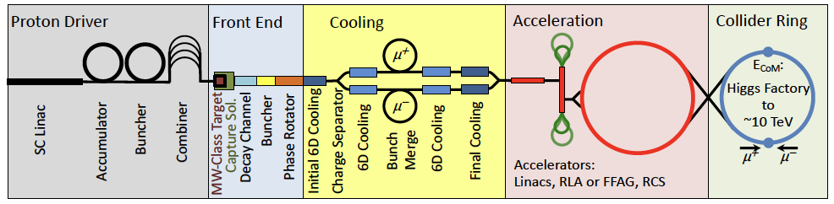
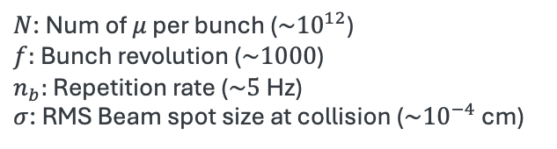
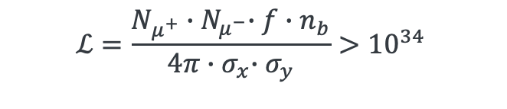
Overview of the Muon Collider Concept
Proton beam-based muon source and cooling chain
Our story starts from luminosity…
Number of particles cross at an Interaction Point (IP) per second
$$ℒ=\frac{N_{μ^{+}}{∙N}_{μ^{−}}∙f∙n_{b}}{4π{∙σ}_{x}∙σ_{y}}>{10}^{34}$$
$N$: Num of $μ$ per bunch ($\sim {10}^{12}$)
$f:$ Bunch revolution ($\sim 1000$)
$n_{b}:$ Repetition rate ($\sim 5$ Hz)
$σ$: RMS Beam spot size at collision ($\sim {10}^{−4}$ cm)
cm⁻² s⁻¹
Beam crossing area at IP

Slide 4
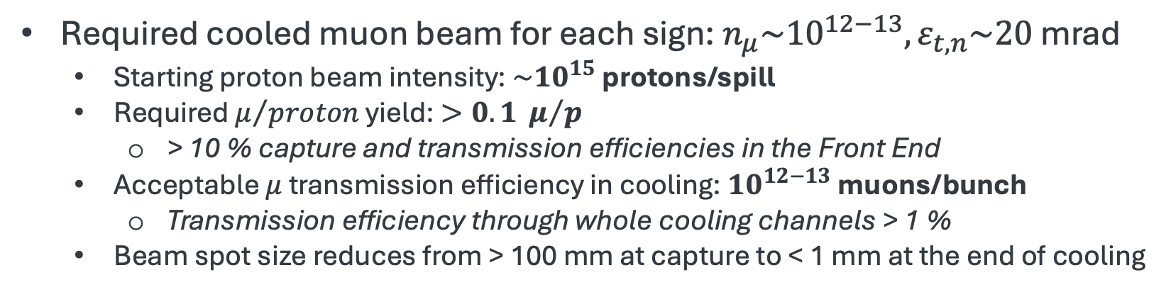
Muon Beam Cooling Requirements
Proton beam-based muon source and cooling chain
Required cooled muon beam for each sign: $n_{μ}\sim {10}^{12−13}, ε_{t,n}\sim 20$ mrad
Starting proton beam intensity: $\sim {10}^{15}$ protons/spill
Required $μ/{proton}$ yield: $>0.1 μ/p$
> 10 % capture and transmission efficiencies in the Front End
Acceptable $μ$ transmission efficiency in cooling: ${10}^{12−13}$ muons/bunch
Transmission efficiency through whole cooling channels > 1 %
Beam spot size reduces from > 100 mm at capture to < 1 mm at the end of cooling

Slide 5
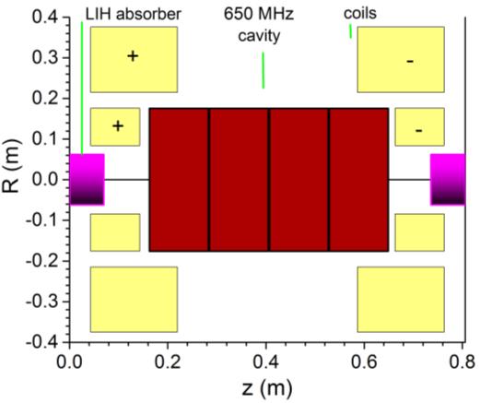
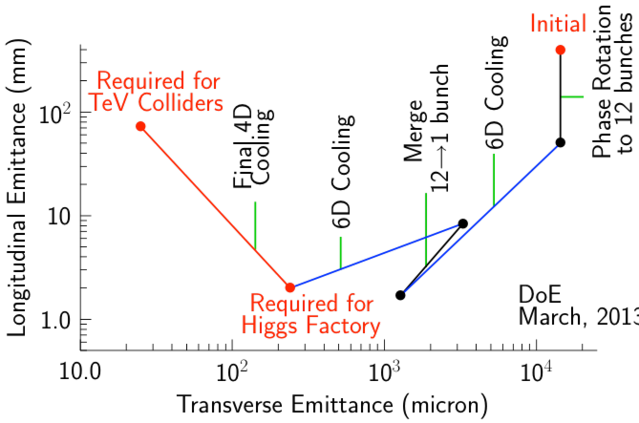

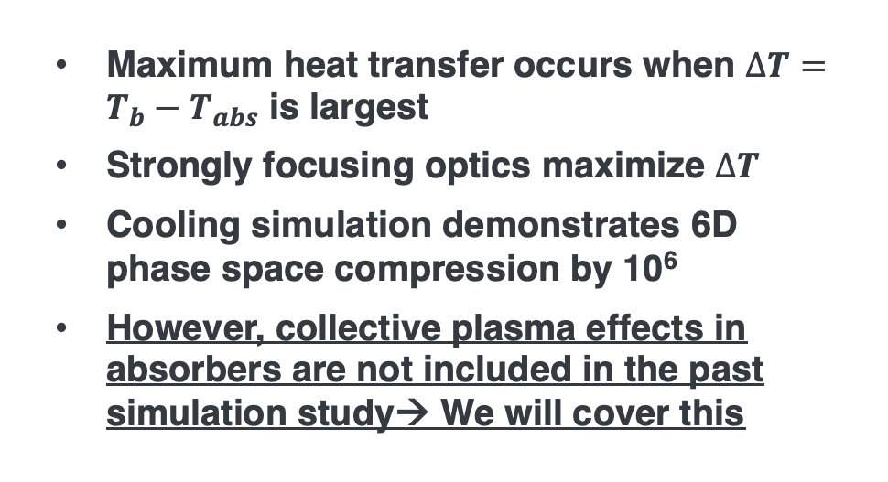


Ionization Cooling and Emittance Evolution
Beam
Absorber
q (momentum)-transfer
via coulomb interaction
$$\frac{∆p_{⊥}^{2}}{m}=kT_{b}$$
$$\frac{3kT_{abs}}{2}$$
Heat flows when
Ionization Cooling Channel
$$T_{b}>T_{abs}$$
D. Stratakis, CERN Workshop 2021
Maximum heat transfer occurs when $∆T=T_{b}−T_{abs}$ is largest
Strongly focusing optics maximize $∆T$
Cooling simulation demonstrates 6D phase space compression by 10⁶
However, collective plasma effects in absorbers are not included in the past simulation study→ We will cover this
D. Stratakis, CERN Workshop 2021

Slide 6
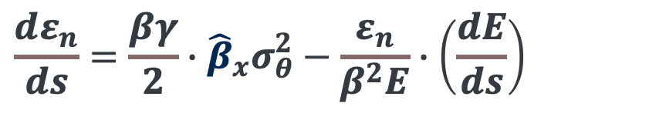
Phase Space Compression
Emittance evolution formula
Betatron function
Stopping Power
$$\frac{dε_{n}}{ds}=\frac{βγ}{2}∙{\hat{β}}_{x}σ_{θ}^{2}−\frac{ε_{n}}{β^{2}E}∙\left(\frac{dE}{ds}\right)$$
Heating term
Cooling term
In this presentation, we will discuss modulation of the stopping power and beam focusing mechanism due to collective effects

Slide 7


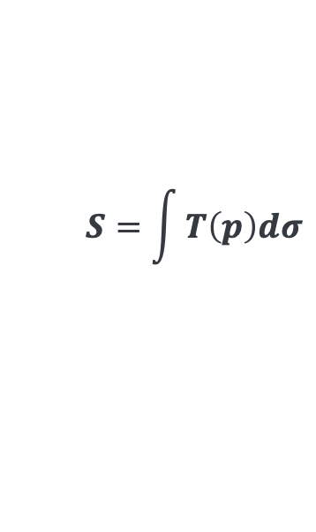
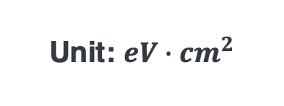

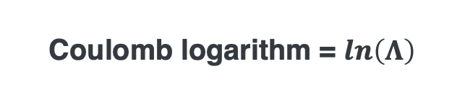

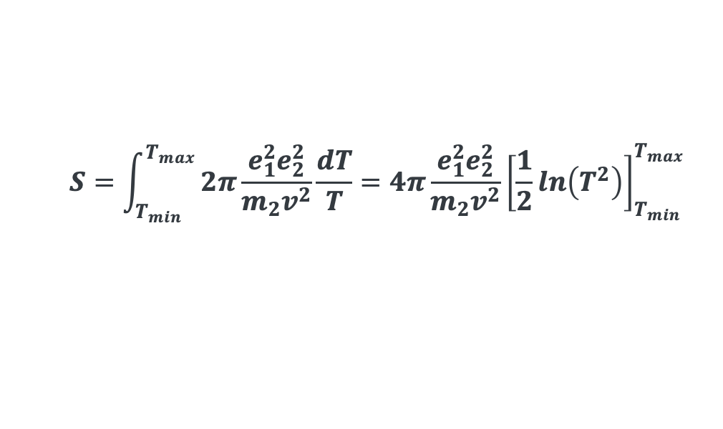

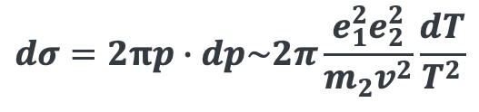
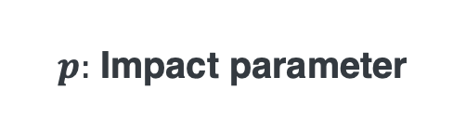

Review of Stopping Power
$$m_{1}, e_{1}$$
Stopping cross section
$$v$$
$$p$$
$p:$ Impact parameter
$$S=\int{T\left(p\right)dσ}$$
$$m_{2}, e_{2}$$
$$T=\frac{q^{2}}{2m_{2}}$$
$$dσ=2πp∙dp\sim 2π\frac{e_{1}^{2}e_{2}^{2}}{m_{2}v^{2}}\frac{dT}{T^{2}}$$
:Differential cross section in Coulomb interaction
$$S=\int_{T_{min}}^{T_{max}}{2π\frac{e_{1}^{2}e_{2}^{2}}{m_{2}v^{2}}\frac{dT}{T}=4π\frac{e_{1}^{2}e_{2}^{2}}{m_{2}v^{2}}}{\left[\frac{1}{2}ln\left(T^{2}\right)\right]}_{T_{min}}^{T_{max}}$$
Unit: $eV∙{cm}^{2}$
Coulomb logarithm = $ln\left(Λ\right)$
Stopping power
Represents the mean energy loss due to Coulomb interaction with target electrons
$$\left\langle −\frac{dE}{dx}\right\rangle =S∙N$$
:The formula is valid for single particle collision process

Slide 8
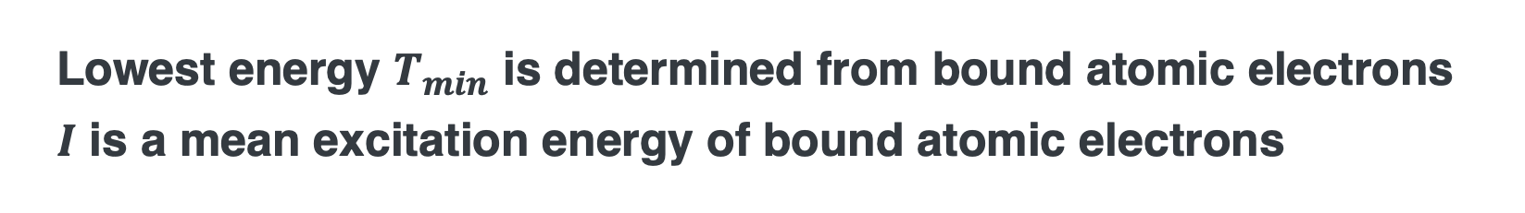

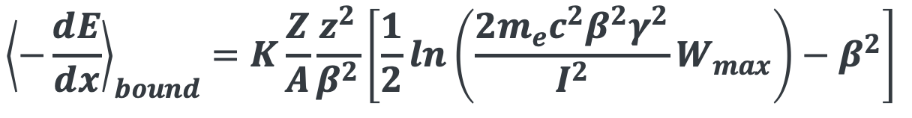
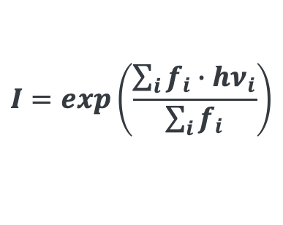
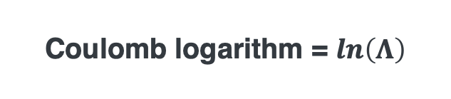
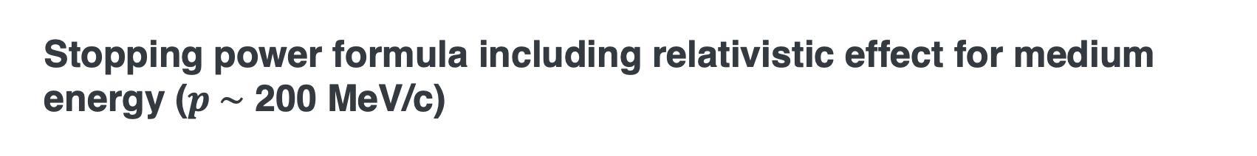
Bethe Equation
Stopping power formula including relativistic effect for medium energy ($p \sim$ 200 MeV/c)
$${\left\langle −\frac{dE}{dx}\right\rangle }_{bound}=K\frac{Z}{A}\frac{z^{2}}{β^{2}}\left[\frac{1}{2}ln\left(\frac{2m_{e}c^{2}β^{2}γ^{2}}{I^{2}}W_{max}\right)−β^{2}\right]$$
Coulomb logarithm = $ln\left(Λ\right)$
Lowest energy $T_{min}$ is determined from bound atomic electrons
$I$ is a mean excitation energy of bound atomic electrons
$$I=exp\left(\frac{\sum_{i}{f_{i}}∙hν_{i}}{\sum_{i}{f_{i}}}\right)$$
$f_{i}:$ Transition probability

Slide 9
Plasma in Ionization Cooling

Slide 10
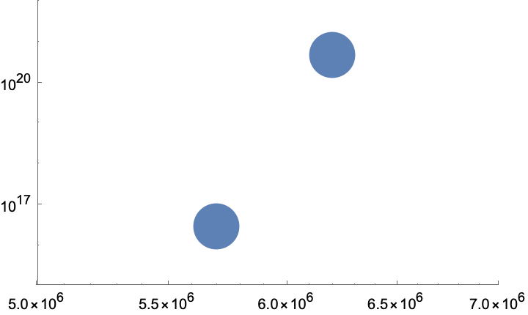
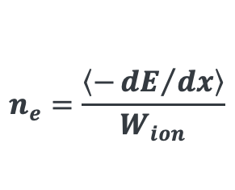
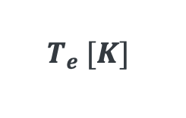
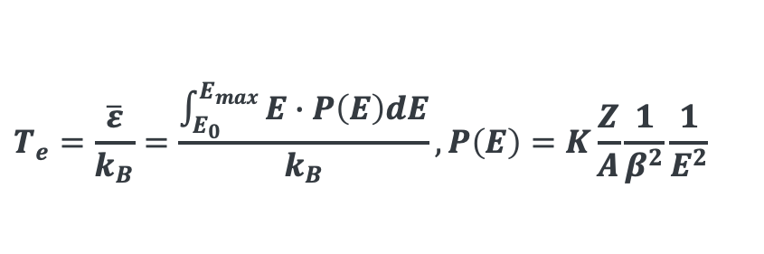
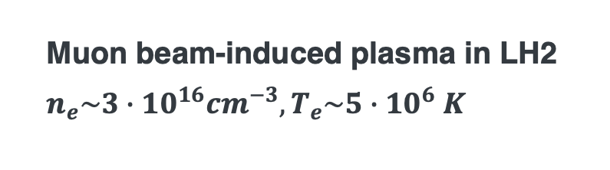

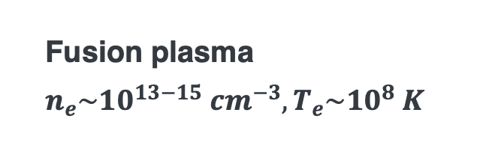
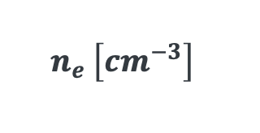
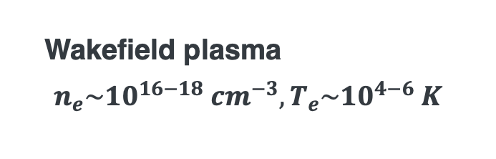
Plasma Parameter of Ionized Electrons in Muon Collider System
$$n_{e} \left[{cm}^{−3}\right]$$
M. Chung et al, PRL111, 184802 (2013)
Proton beam-induced plasma in graphite target
$$n_{e}\sim 5∙{10}^{20}{cm}^{−3}, T_{e}\sim 6∙{10}^{6} K$$
$$n_{e}=\frac{\left\langle −{dE}/{dx}\right\rangle }{W_{ion}}$$
Muon beam-induced plasma in LH2
$$n_{e}\sim 3∙{10}^{16}{cm}^{−3}, T_{e}\sim 5∙{10}^{6} K$$
Fusion plasma
$$n_{e}\sim {10}^{13−15} {cm}^{−3}, T_{e}\sim {10}^{8} K$$
$$T_{e} [K]$$
Wakefield plasma
$$n_{e}\sim {10}^{16−18} {cm}^{−3}, T_{e}\sim {10}^{4−6} K$$
F. Sauli, CERN 77-09 (1977)
$$T_{e}=\frac{\overline{ε}}{k_{B}}=\frac{\int_{E_{0}}^{E_{max}}{E∙P\left(E\right)dE}}{k_{B}},P\left(E\right)=K\frac{Z}{A}\frac{1}{β^{2}}\frac{1}{E^{2}}$$

Slide 11




















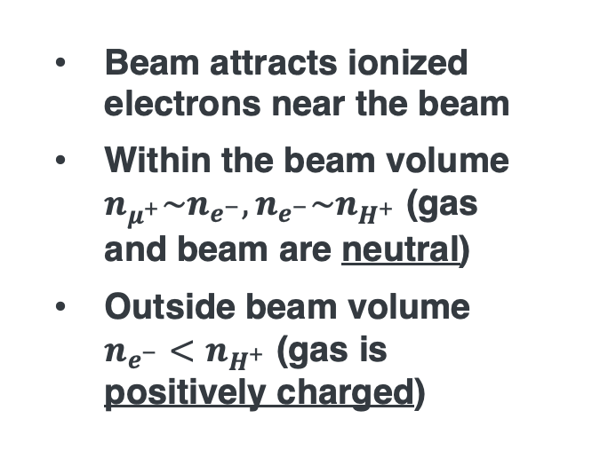

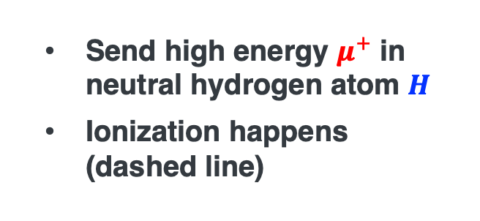







Plasma Sheath Formation
1. Ionization
$$H$$
$$H$$
$$H$$
Send high energy $μ^{+}$ in neutral hydrogen atom $H$
Ionization happens (dashed line)
$$μ^{+}$$
$$μ^{+}$$
$$μ^{+}$$
$$μ^{+}$$
$$μ^{+}$$
$$H$$
$$μ^{+}$$
$$H→H^{+}+e^{−}$$
$$H$$
$$H$$
$$H$$
$$H$$
$$H$$
$$H$$
Beam attracts ionized electrons near the beam
Within the beam volume $n_{μ^{+}}\sim n_{e^{−}}, n_{e^{−}}\sim n_{H^{+}}$ (gas and beam are neutral)
Outside beam volume $n_{e^{−}}<n_{H^{+}}$ (gas is positively charged)
2. Charge neutralization (within ~10 ps)
$$H^{+}$$
$$H$$
$$e^{−}$$
$$H^{+}$$
$$H^{+}$$
$$H$$
$$μ^{+}$$
$$H^{+}$$
$$H^{+}$$
$$μ^{+}$$
$$e^{−}$$
$$e^{−}$$
$$e^{−}$$
$$e^{−}$$
$$μ^{+}$$
$$μ^{+}$$
$$μ^{+}$$
$$H^{+}$$
$$μ^{+}$$
$$e^{−}$$
$$e^{−}$$
$$H$$
$$H^{+}$$
$$H$$
$$H^{+}$$
$$H^{+}$$
$$H$$
$$H$$
$$H$$

Slide 12
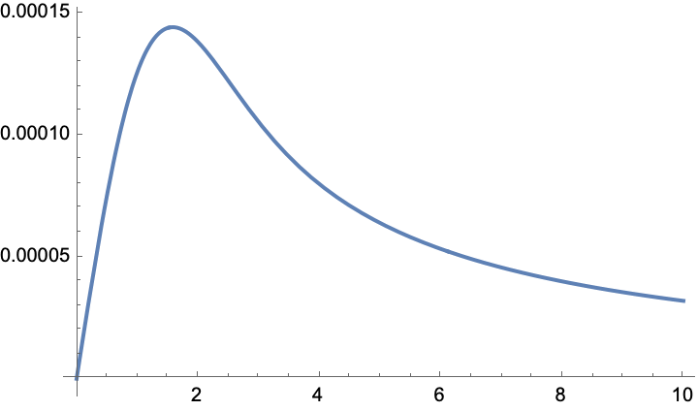


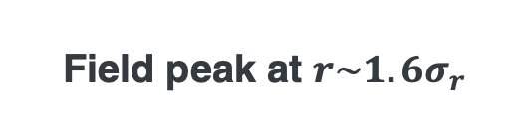


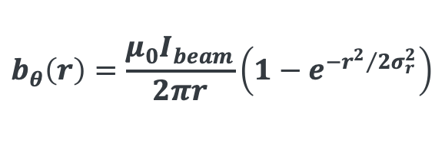

Formulate Azimuthal Magnetic Field from Collective effect
Beam charge is neutralized, but beam current $I_{beam}$still exists
Plasma sheath
$$b_{θ}$$
Charge neutralized beam
$$I_{beam}$$
$$b_{θ} [arb. unit]$$
Field peak at $r\sim 1.6σ_{r}$
Beam induced magnetic field
$$b_{θ}\left(r\right)=\frac{μ_{0}I_{beam}}{2πr}\left(1−e^{−{r^{2}}/{2σ_{r}^{2}}}\right)$$
$$b_{θ}\left(r\right)∝r$$
$$r [σ_{r}]$$

Slide 13
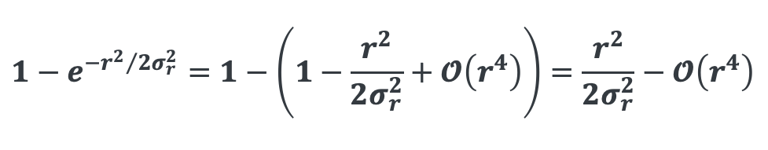
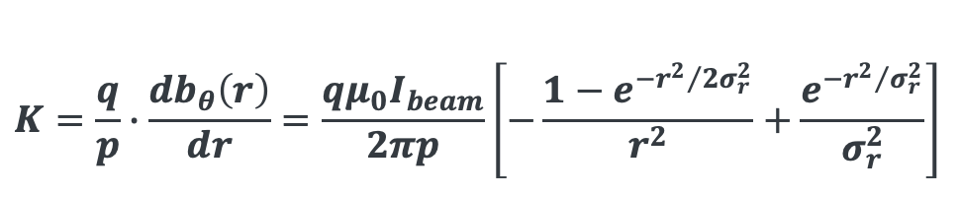
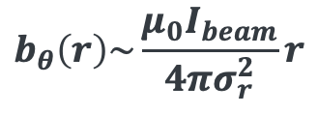
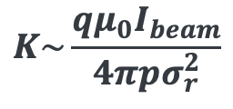

Additional Focusing Strength
Focusing strength
$$K=\frac{q}{p}∙\frac{db_{θ}\left(r\right)}{dr}=\frac{qμ_{0}I_{beam}}{2πp}\left[−\frac{1−e^{{−r^{2}}/{2σ_{r}^{2}}}}{r^{2}}+\frac{e^{{−r^{2}}/{σ_{r}^{2}}}}{σ_{r}^{2}}\right]$$
$$1−e^{{−r^{2}}/{2σ_{r}^{2}}}=1−\left(1−\frac{r^{2}}{2σ_{r}^{2}}+𝓞\left(r^{4}\right)\right)=\frac{r^{2}}{2σ_{r}^{2}}−𝓞\left(r^{4}\right)$$
For near beam axis (up to around $r\sim σ_{r}$),
$$b_{θ}\left(r\right)\sim \frac{μ_{0}I_{beam}}{4πσ_{r}^{2}}r$$
The induced azimuthal field introduces an additional, self-generated focusing force proportional to beam current density – effectively behaving light an embedded plasma quadrupole
We will validate the focusing model in numerical simulation as the future work
$$K\sim \frac{qμ_{0}I_{beam}}{4πpσ_{r}^{2}}$$

Slide 14



Numbers evaluation (I)
In final cooling stage
$n_{μ}={10}^{12}$ /pulse in 0.1 ns
$p=0.2$GeV/c
$σ_{r}=0.001$ m
$$I=1.6∙{10}^{−19}×\frac{{10}^{12}}{{10}^{−10}}=1.6∙{10}^{3}$$
$$K=\frac{0.3∙4π∙{10}^{−7}∙1.6∙{10}^{3}}{4π∙{0.001}^{2}}=240 m^{−2}→{\hat{β}}_{⊥}=\sqrt{\frac{1}{K}}\sim 0.065 m$$
Net betatron function ~ 10-20 % shorter → stronger focusing → increasing cooling rate within $r≤σ_{r}$
However, non-linear Lorentz force for $r>σ_{r}$ can drive envelope oscillations and halo growth
Need numerical simulation study

Slide 15
Modify Stopping Power Formula by including Plasma Polarization

Slide 16




Dielectric term (Free/Collective electrons)
For free electrons (i.e. a plasma), use the dielectric form:
M. D. Barriga-Carrasco
Eur. Phys. J. Plus (2022) 137:375
$$\left\langle −\frac{dE}{dx}\right\rangle =\frac{z^{2}e^{2}}{2πv^{2}}\int_{−∞}^{∞}{\frac{dk}{k}\int_{0}^{kv}{ω∙Im\left[−\frac{1}{ε\left(ω,k\right)}\right]dω}}$$
In the case of collisional plasma, a dielectric term (Drude model):
$$ε\left(ω\right)\sim 1−\frac{ω_{p}^{2}}{ω\left(ω+iν\right)}$$
$$ω_{p}=\sqrt{\frac{n_{e}e^{2}}{ε_{0}m_{e}}}$$
Assume $ω≫ν$ (cold plasma), the lowest energy transfer: $T_{min}\sim ℏω_{p}$

Slide 17











Modified Stopping Formula
Experimentally validate
S. N. Chen, Nature 8:14586
We assume that the total electron density, $n_{e}^{total}$ is the sum of the bound electrons, $n_{e}^{bound}$ and the plasma electrons, $n_{e}^{plasma}$
$$n_{e}^{bound}=\left(1−χ\right)∙n_{e}^{total}$$
$$n_{e}^{plasma}=χ∙n_{e}^{total}$$
$\left\langle −\frac{dE}{dx}\right\rangle$ [MeV/(g/cm²)]
Modified stopping power formula
$$\left\langle −\frac{dE}{dx}\right\rangle =\left(1−χ\right)∙{\left\langle −\frac{dE}{dx}\right\rangle }_{bound}+χ∙{\left\langle −\frac{dE}{dx}\right\rangle }_{plasma}$$
$$χ=0.1$$
$${\left\langle −\frac{dE}{dx}\right\rangle }_{plasma}=−K\frac{Z}{A}\frac{z^{2}}{β^{2}}\left[ln\left(\frac{2m_{e}c^{2}β^{2}γ^{2}}{ℏω_{p}}\right)−β^{2}\right]$$
$$χ=0.01$$
$χ=1$e-7
$E_{μ, Kin}$[MeV]
Nominal plasma density in Liquid H is $χ=1e−7$
$χ$ can be 0.01-0.1 in Gaseous H
Or, use laser or beam to increase plasma density

Slide 18
Summary
We considered the collective effect in ionization cooling
The induced collective fields have the potential to change the cooling performance
Muons near beam axis gain additional focusing force, so that the phase space shrinks more than without the collective effect
However, muons far from the beam axis gain non-linear focusing force, which could be destructive to the phase stability conditions
We propose further simulation study to evaluate the collective field effects
We also propose a new stopping power formula to include plasma polarization in absorbers
This effect is negligible in a nominal cooling beam parameters
On the other hand, this mechanism is useful for enhancing ionization cooling without introducing additional stochastic effects
It is worth considering an increasing in plasma density using laser and/or beam

Slide 19
Extra Slides

Slide 20

Beam-Plasma-Neutral Atom Interaction

Slide 21









Electric force in muon beam in final 6D cooling channel section
Transverse direction
Longitudinal direction (on beam axis)
$$f_{r} \left[eV/m\right]$$
$$f_{z} \left[eV/m\right]$$
$$n_{μ}={10}^{12}$$
$$t_{beam}=0.1 ns$$
$$σ_{r}=0.001 m$$
$$p=200 MeV/c$$
$$b=0.001 m$$
z [m]
r [m]
$$b=0.01 m$$
$$f_{r}=eE_{r}$$
$$\sim \frac{eQ}{2πε_{0}γ^{2}r}\left[1−exp\left(−\frac{r^{2}}{2σ_{r}^{2}}\right)\right]$$
$$f_{z}=eE_{z}$$
$$\sim \frac{eQ}{2πε_{0}γ^{2}}\left[1+2 ln\left(\frac{b}{σ_{r}}\right)\right]\frac{z}{σ_{z}^{2}}exp\left(−\frac{z^{2}}{2σ_{z}^{2}}\right)$$

Slide 22

Additional Considerations and Future Directions
Multiple scattering in plasma material
Plasma screen charge of nuclei
However, a toy model shows that this effect changes only a few percent change (thus not shown in this presentation)
Complicate plasma chemistry is not included in toy model
However, the recombination rate is known to be small because it is a binary process
Electron capture by neutral atoms should be investigated further, because it proceeds via a three-body process
Electron temperature could be quickly thermalized and reach $T_{e}\sim T_{i}$
We are preparing plasma simulation study to include those processes
Production of intense plasma
We are considering either beam and laser to generate intense plasma

