Slide 1
Simulation of Longitudinal Electron Cooling of 20 GeV Proton Beam at EicC
COOL2025， Charles B. Wang Center, Stony Brook University， Oct. 27-31 2025
X. D. Yang
Institute of Modern Physics, CAS
Lanzhou, China

Slide 2
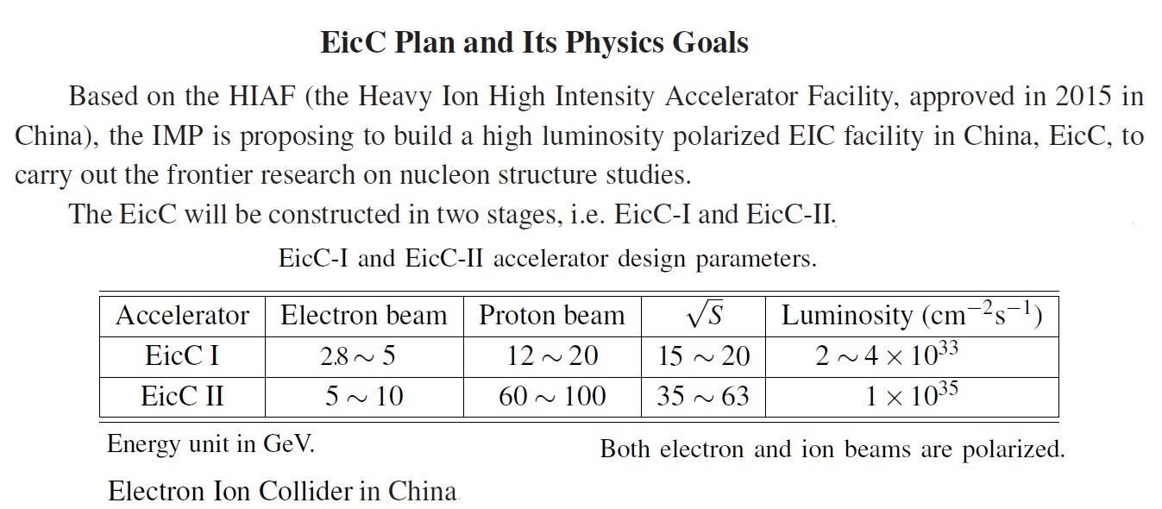

Slide 3
Background
High Brightness
High Quality of proton beam in the storage ring
High Experiments efficiency
Long Lifetime of proton beam in the storage ring

Slide 4
Key parameters affecting cooling time
Storage ring: Betatron function, dispersion
Proton beam: Energy, initial emittance, momentum spread
Electron cooling device: Magnetic field strength, parallelism, cooling length
Electron beam: Radius, density, transverse temperature

Slide 5
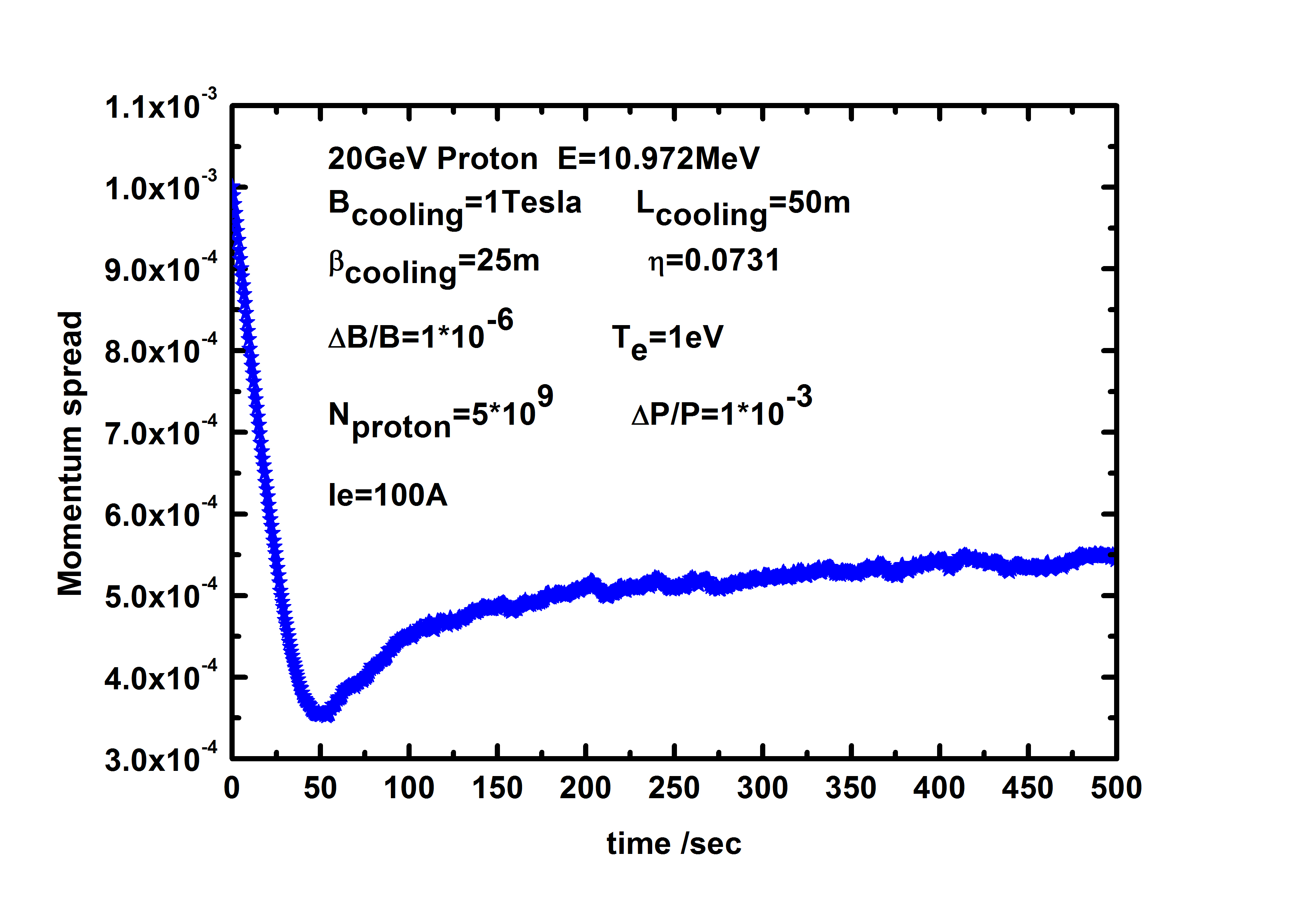
Figure 1: A typical longitudinal cooling process.

Slide 6
Longitudinal cooling
The longitudinal cooling behaviour is different from the transverse one. After the balance is achieved in the transverse direction, the transverse emittance remain unchanged. But the longitudinal momentum spread shrink rapidly at the beginning and then bounces back from the bottom.

Slide 7
Longitudinal cooling time

Slide 8
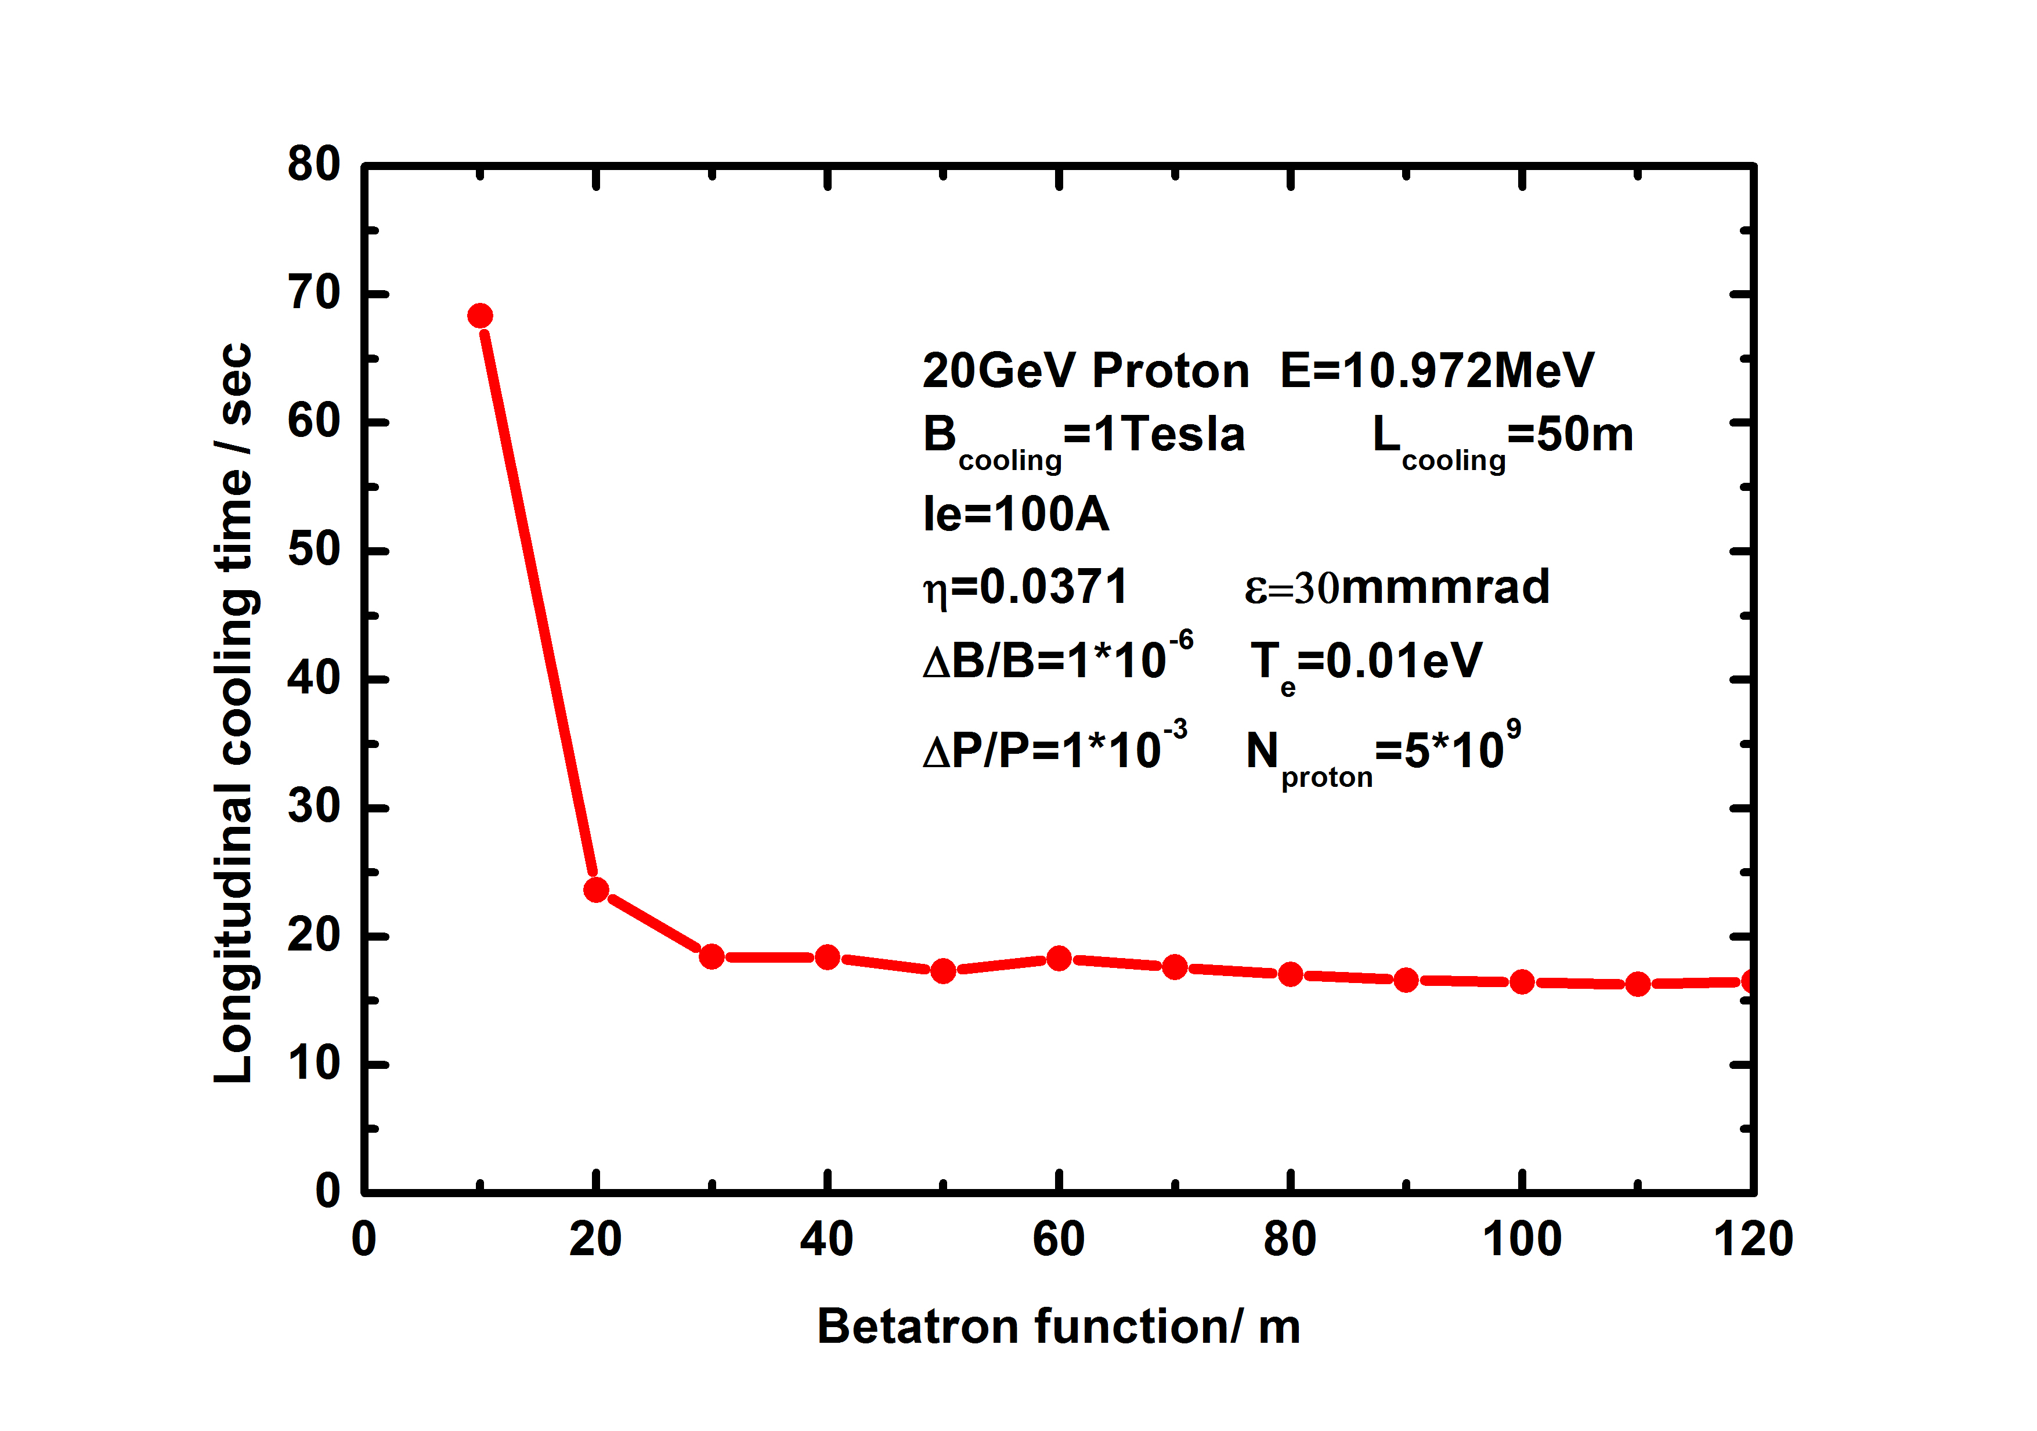
Figure 2: The longitudinal cooling time as a function of the Betatron function in the cooling section.

Slide 9
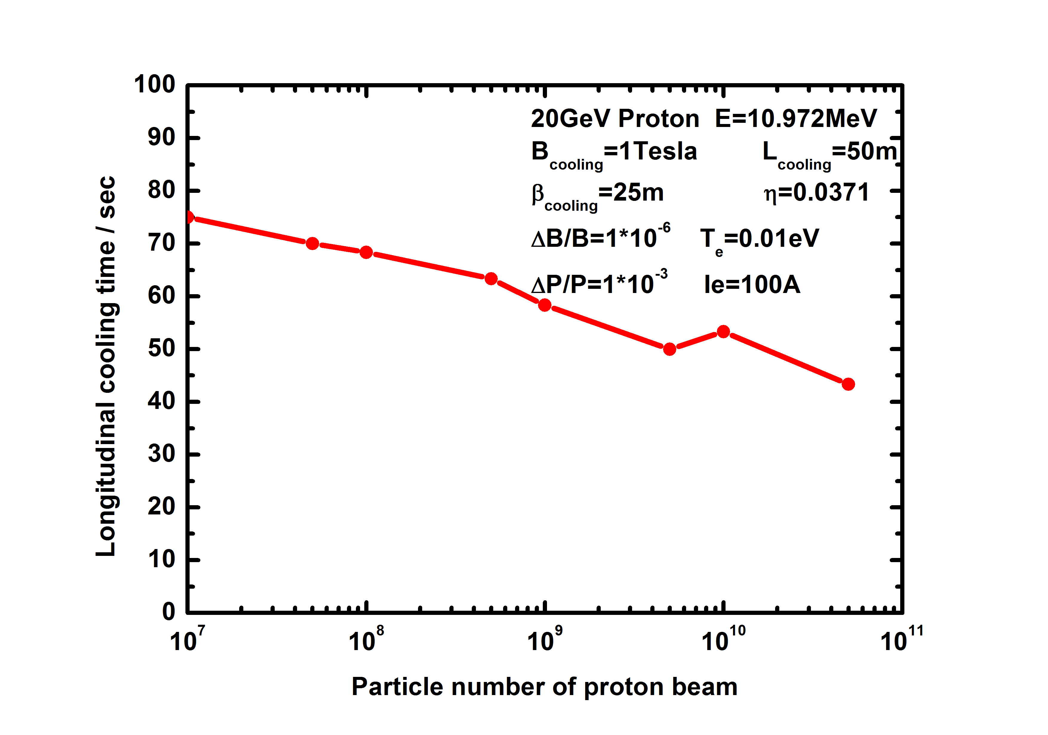
Figure 3: The longitudinal electron cooling time as a function of the particle number in the proton beam.

Slide 10
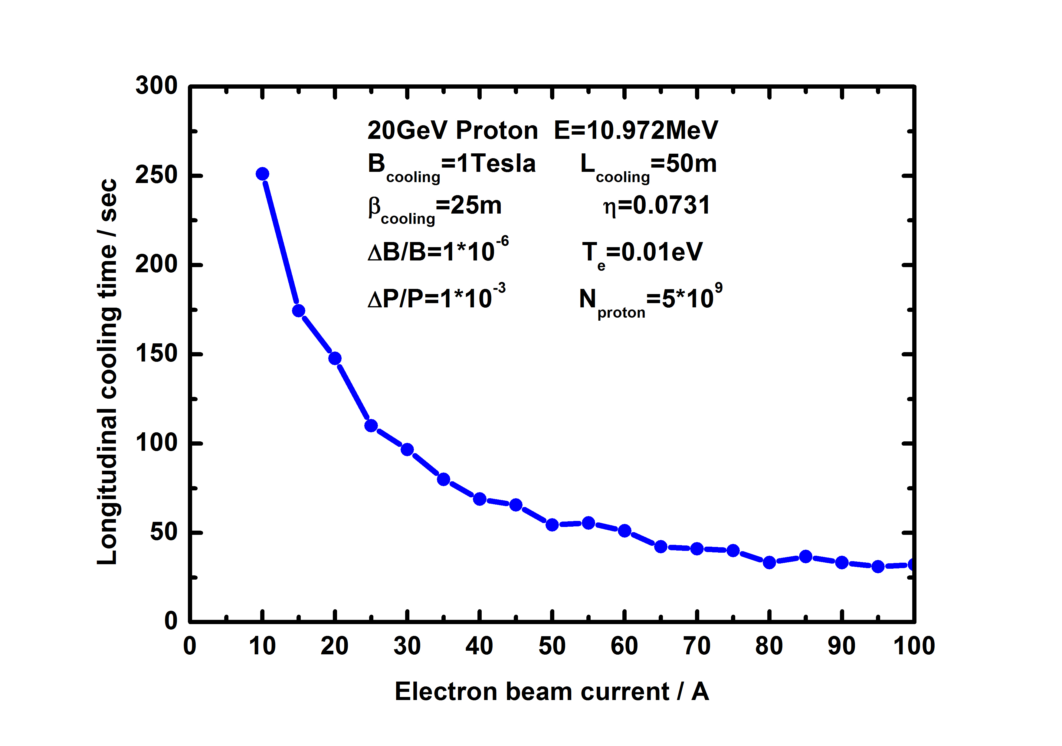
Figure 4: The longitudinal cooling time as a function of the electron beam current.

Slide 11
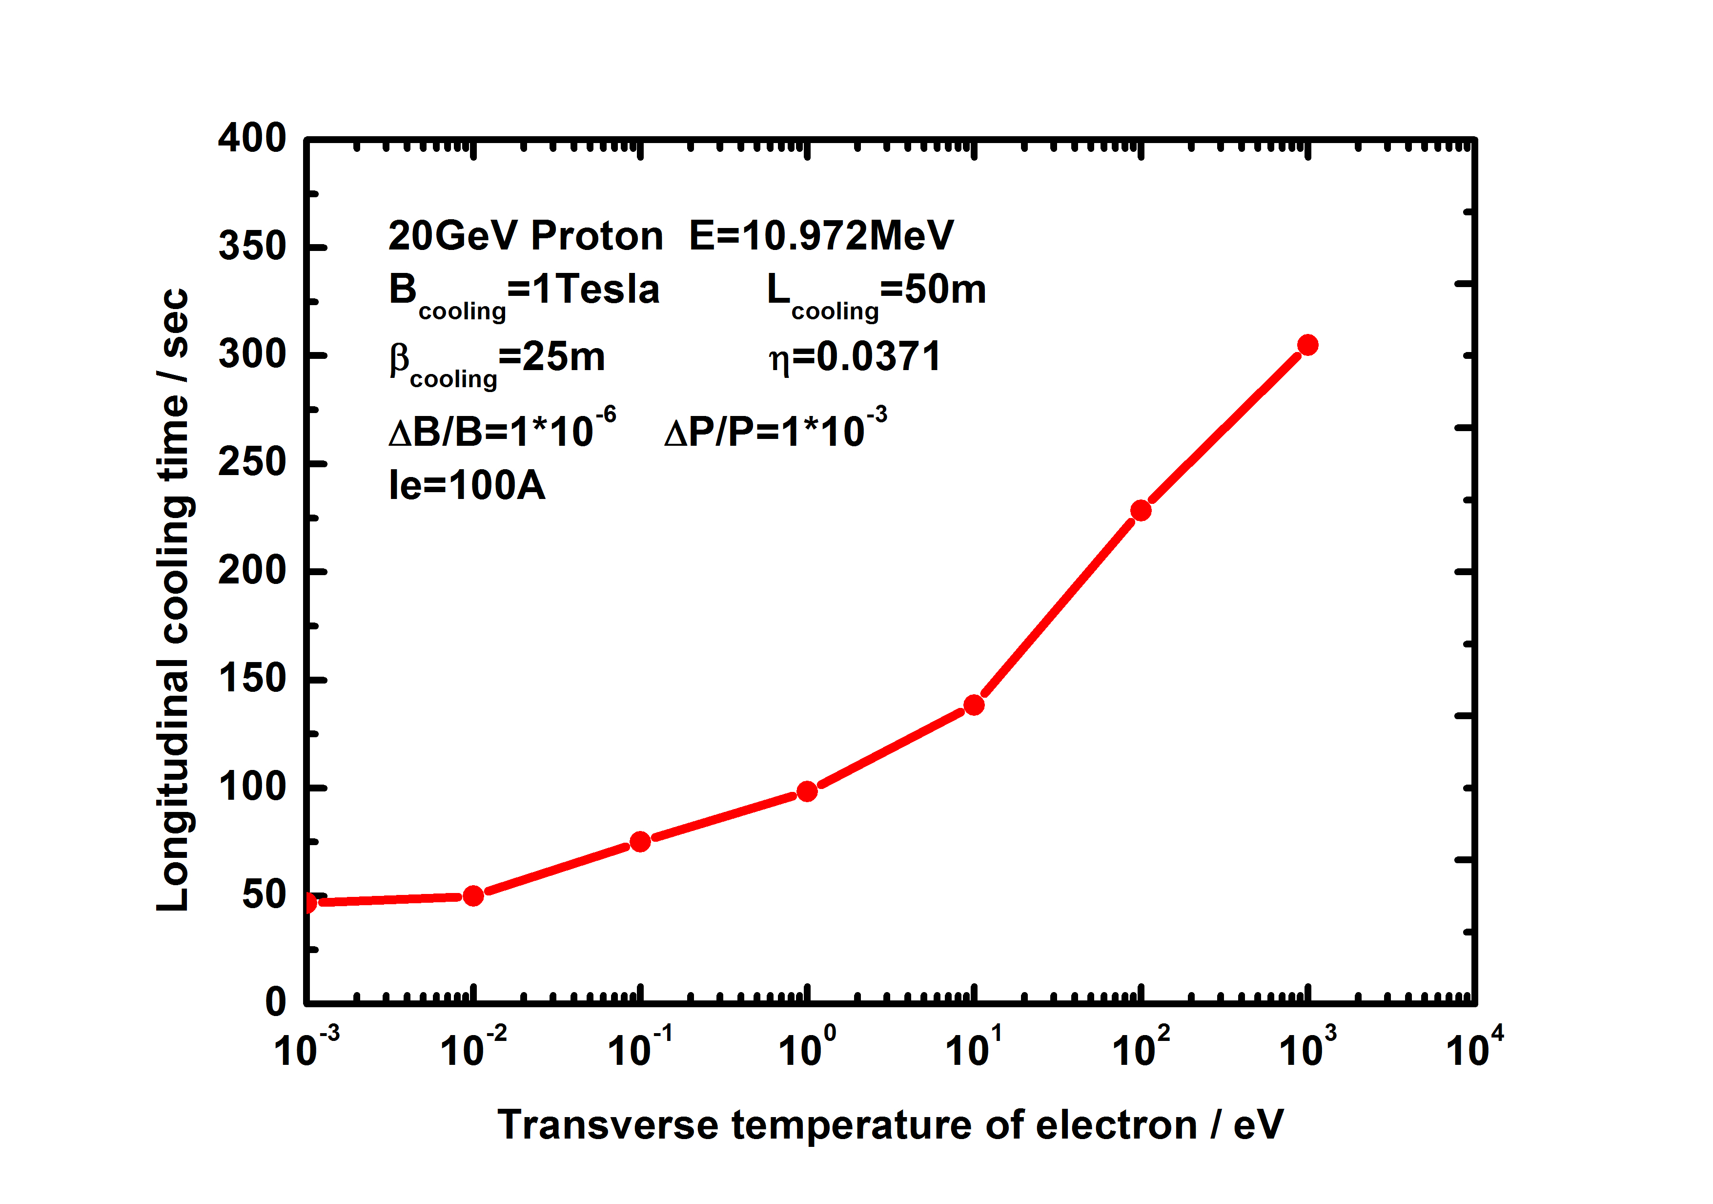
Figure 5: The longitudinal cooling time depends on the transverse temperature of the electron beam.

Slide 12
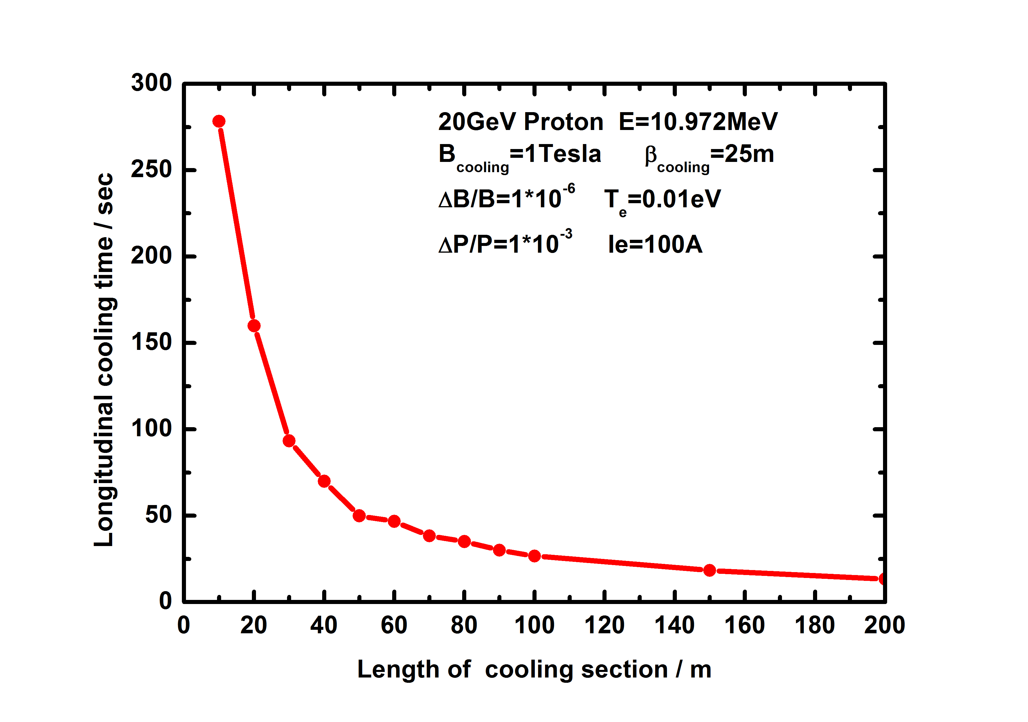
Figure 6: The longitudinal cooling time varies as a function of the length of the cooling section

Slide 13
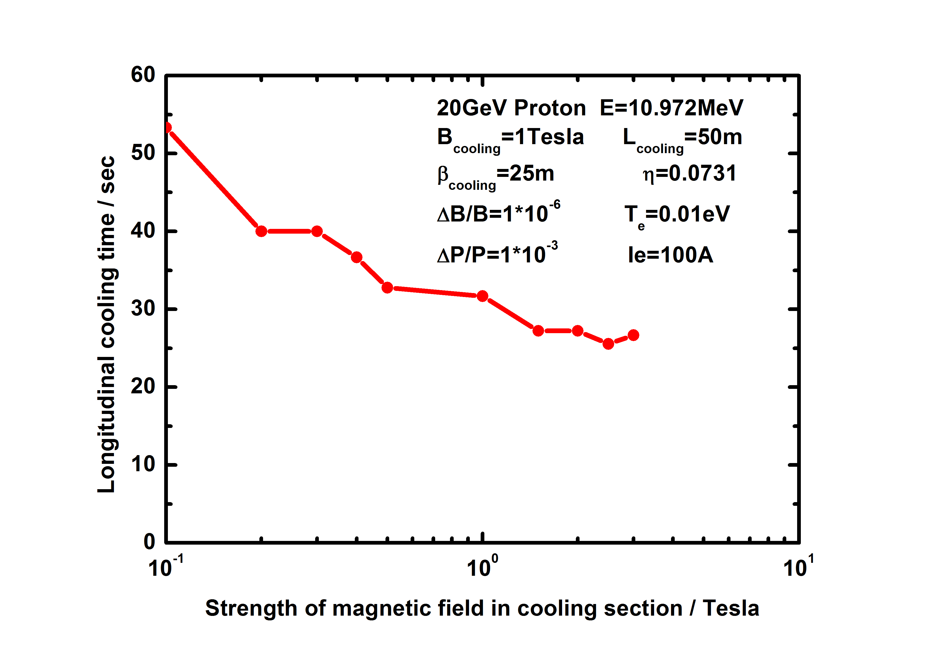
Figure 7: The longitudinal cooling time as a function of the magnetic field strength in the cooling section.

Slide 14
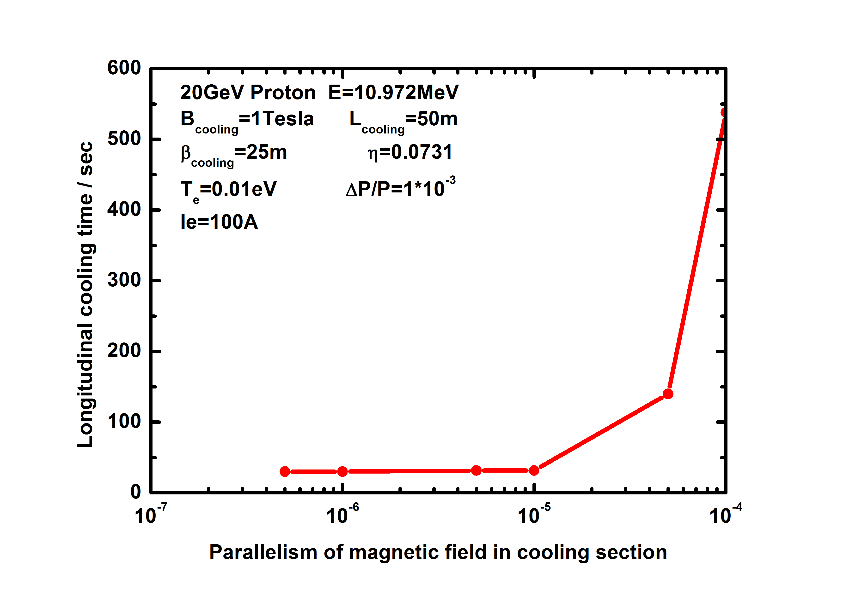
Figure 8: The longitudinal cooling time as a function of the parallelism of the magnetic field in the cooling section.

Slide 15
Possible cause
In the case of high-energy electron cooling, the longitudinal velocity of the electron beam was much greater than the transverse velocity. In the cooling simulation, the same time interval was used for both transverse and longitudinal. Electron beams travelled at different path lengths during the same time interval in the transverse and longitudinal directions. This may be the cause of the unexpected results in the simulations.

Slide 16
Possible cause
Due to longitudinal velocity mismatch or magnetic field parallelism, the projection of longitudinal velocity in the transverse direction will also be much greater than the transverse velocity of the electron beam. Therefore, in the longitudinal direction, the parameter requirements are more precise and the matching degree is high.

Slide 17
Minimum and final momentum spread

Slide 18
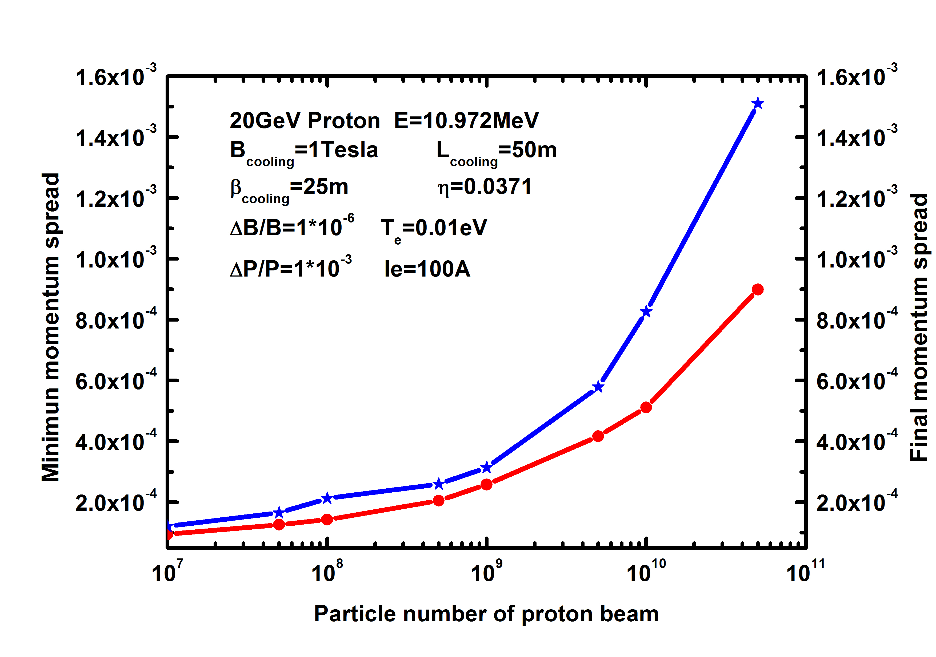
Figure 9: The minimum and final momentum spread as a function of the particle number.

Slide 19
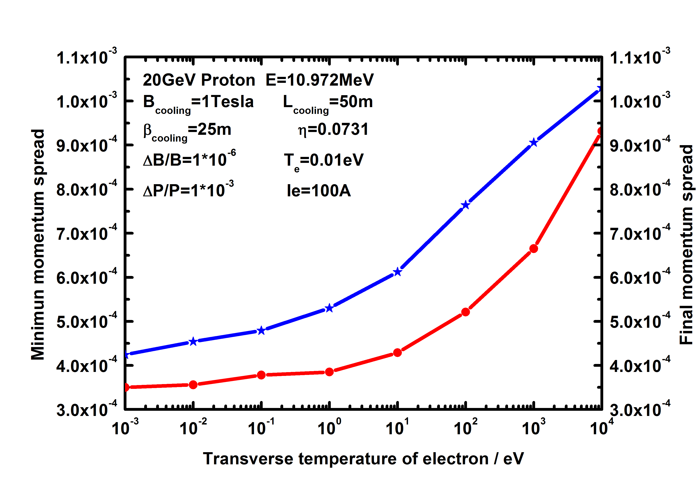
Figure 10: The minimum and final momentum spread as a function of the transverse temperature of the electron.

Slide 20
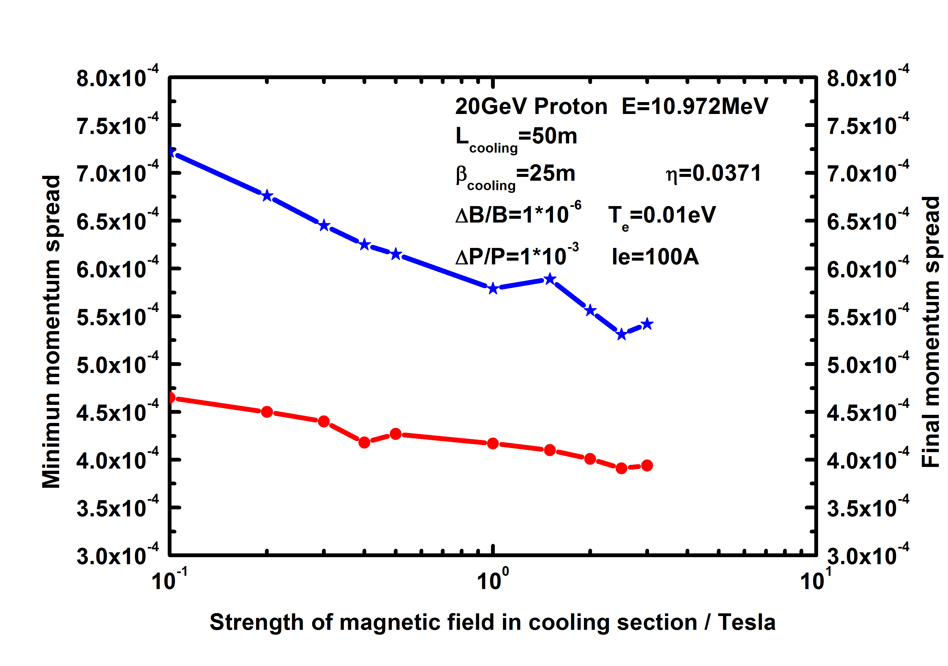
Figure 11: Theminimum and final momentum spread as a function of the magnetic field strength in the cooling section

Slide 21
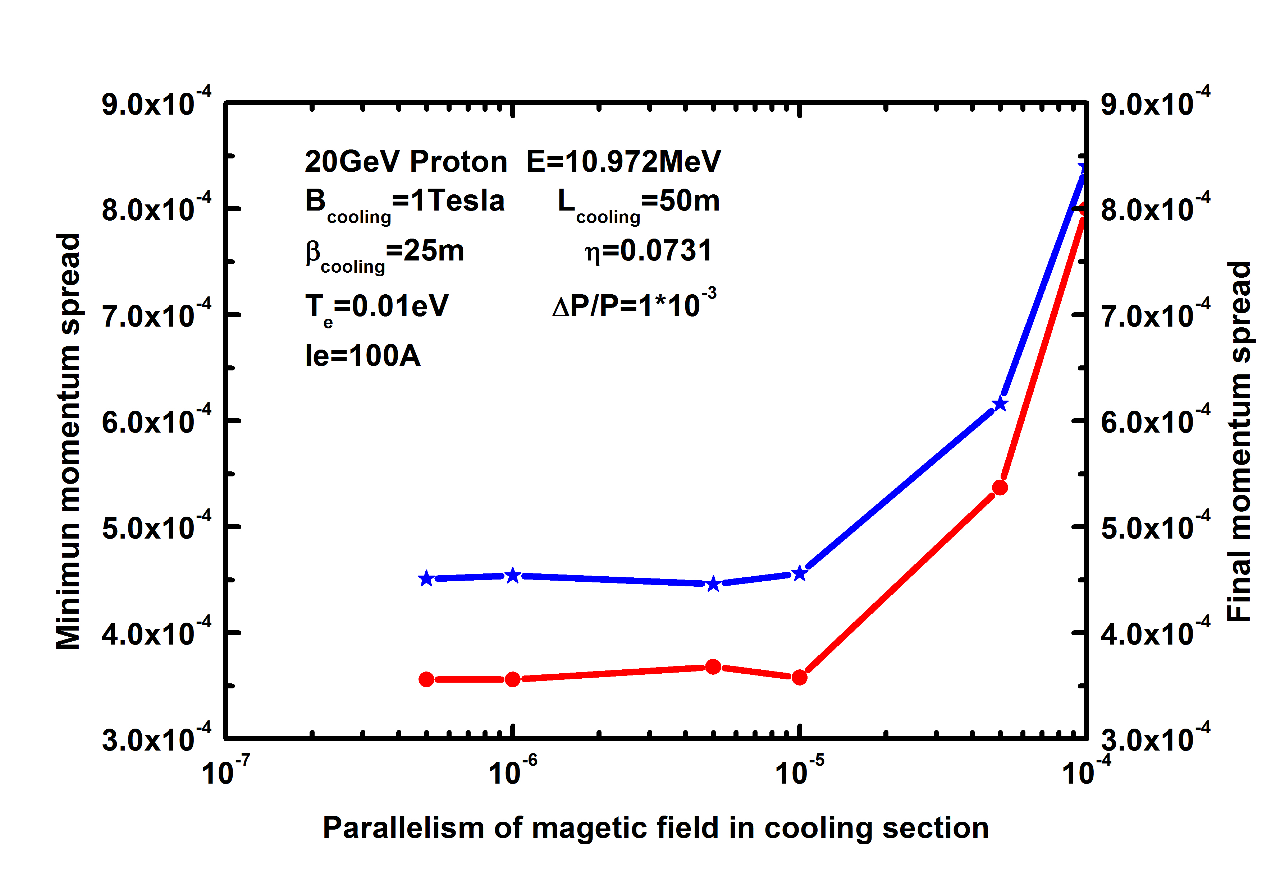
Figure 12: The minimum and final momentum spread as a function of the parallelism of the magnetic field in the cooling section

Slide 22
High energy electron cooling
The longitudinal cooling behavior is different from the transverse one
Optimized carefully and compromise each other
Dispersive cooling
Multi-stage cooling

Slide 23
Summary
The longitudinal cooling time can be shortened with the help of proper configuration of the parameters, such as smaller initial emittance and electron transverse temperature, higher magnetic field strength, parallelism of magnetic field in the cooling section, longer length of electron cooling section, stronger electron beam current, and proper beta function in the cooling section.

Slide 24
Financial Support
This work was supported by National Natural Science Foundation of China, NSFC ( Grant No. 12275325, 12275323, 12205346 )

Slide 25
Thanks for your attention!
yangxd@impcas.ac.cn

