Slide 1

Hadron Beam Cooling Concept and Cooler Design Status for the EIC
Alexei Fedotov
Brookhaven National Laboratory
COOL25 Workshop, Stony Brook
27-31 October 2025

Slide 2
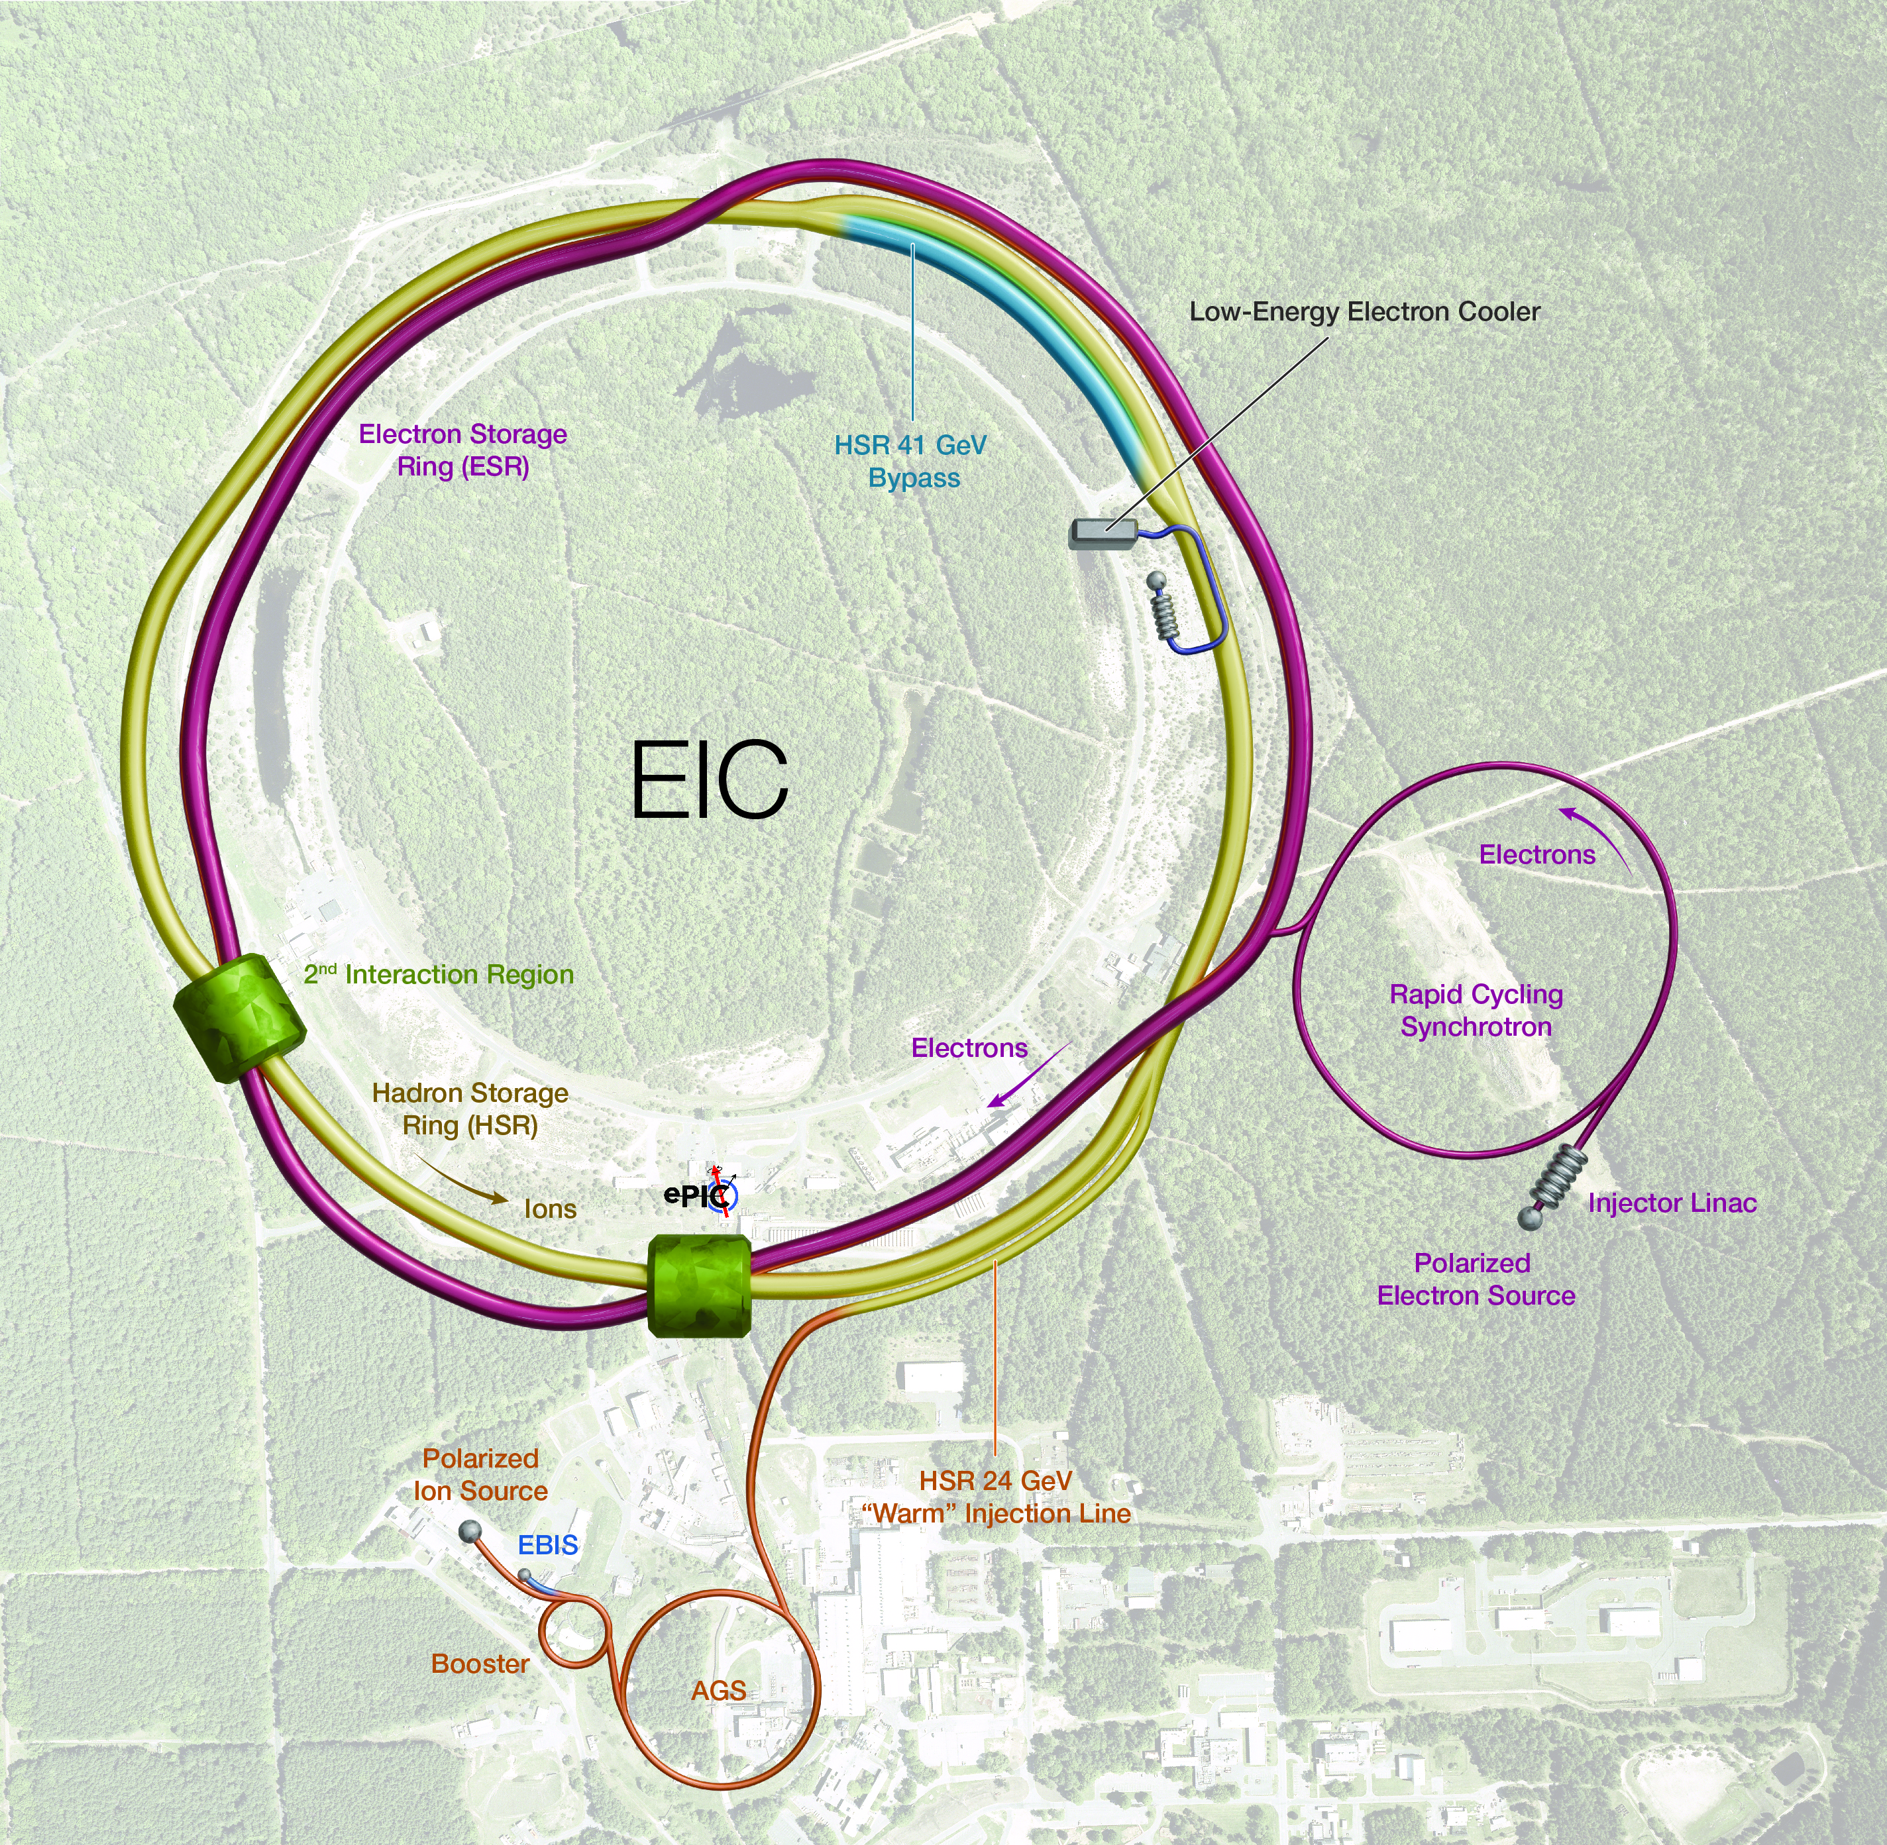
Outline
Hadron Cooling in the EIC
High-energy cooling for the EIC
Low-Energy Cooler (LEC) design status
LEC parameters and performance
Technical challenges
Summary

Slide 3
Hadron Cooling in the EIC
Protons and ions will be precooled at 24 GeV using Electron Cooling.
Heavy ions at collision energies will be cooled using Stochastic Cooling.
Currently, no hadron cooling of proton is implemented at collision energies. However, it may be added in the future to increase the EIC average luminosity during store.

Slide 4
Cooling Requirements for EIC
Low-Energy Cooling (LEC):
The goal of cooling at proton injection energy is to obtain initial proton parameters by cooling the vertical emittance from ~2 um to 0.3 um (rms normalized).
Cooling at injection energy of protons (24 GeV) requires a 13 MeV electron beam.
High-Energy Cooling (HEC) of protons:
High-Energy Cooling (HEC) system capable of fully counteracting emittance growth at collision energies (41, 100, and 275 GeV) would greatly improve luminosity in the EIC.

Slide 5
Cooling techniques for the EIC
Present EIC concept:
Electron Cooling (13MeV electrons):
Cooling of protons at injection energy of 24 GeV, talks by A. Fedotov (TUA1), D. Kayran (THB3)
Stochastic cooling:
Cooling of heavy ions at collision energies, see talk by M. Blaskiewicz (TUB3)
Possible future EIC upgrades:
Coherent electron Cooling (CeC) based schemes (at collision energies) – detailed study for EIC was performed, see talks by E. Wang (TUA2), W. Bergan (TUA3), K. Dietrick (THB1)
Electron Cooling (at collision energies) – under study, see talks by S. Seletskiy (TUB1), D. Kayran (TUB2), J. Kewisch (THB2)

Slide 6
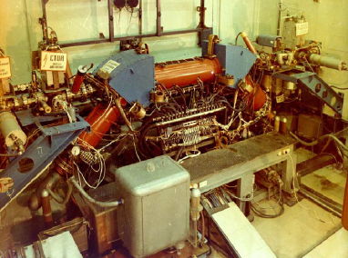
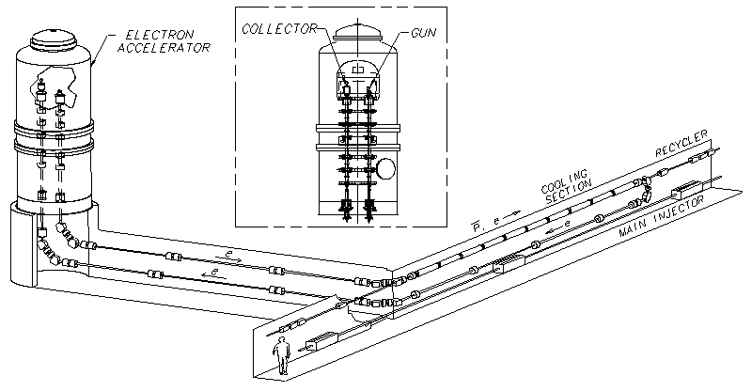
Electron Cooling Technique
S. Nagaitsev, et al. “Experimental Demonstration of Relativistic Electron Cooling”, Phys. Rev. Lett. 96, 044801 (2006)
Experimental
demonstration of electron cooling
at NAP-M
(Novosibirsk, 1974).
Electron Cooling is a well-established technique with 50+ years of experimental experience.
High Voltage DC coolers: (1974-): all DC electrostatic accelerators; all use magnetic field to confine electron beam (magnetized cooling). FNAL cooler (2005-11): Extension to relativistic energies (4MeV electrons), transport of electron beam without continuous magnetic field.
RF acceleration (High Energy approach): BNL LEReC electron cooler (2019-25): First RF-linac based electron cooler (concept directly extendable to higher energies). LEReC does not use any magnetization of electrons. LEReC was successfully used for RHIC operations in 2020-21 to cool ion bunches directly at collision energy.
A. V. Fedotov et al. “Experimental Demonstration of Hadron Beam Cooling Using
Radio-Frequency Accelerated Electron Bunches”, Phys. Rev. Lett. 124, 084801 (2020)

Slide 7
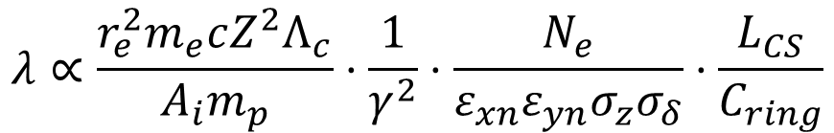
Electron Cooling at high energy
$$λ∝\frac{r_{e}^{2}m_{e}cZ^{2}Λ_{c}}{A_{i}m_{p}}⋅\frac{1}{γ^{2}}⋅\frac{N_{e}}{ε_{xn}ε_{yn}{σ_{z}σ}_{δ}}⋅\frac{L_{CS}}{C_{ring}}$$
Cooling rate
Can one use Electron Cooling technique at very high energies in the EIC?
Reduction in a cooling rate with energy can be compensated by:
  Increasing the 6-D phase space density of the electron bunch
  Increasing the length of the cooling section
  Precooling an ion bunch, because ions with a small velocity spread are cooled faster
As Electron Cooling is a well-established technique, what is needed is to design accelerator which can provide electron beam parameters required for cooling.

Slide 8
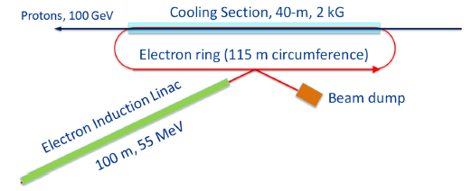
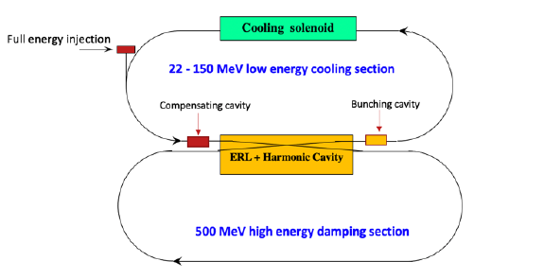
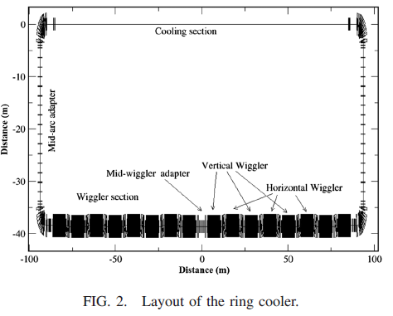
High-energy Electron Cooling for EIC
Several approaches based on conventional Electron Cooling, were considered in the past:
Induction Linac based Ring cooler (FNAL):
V. Lebedev, S. Nagaitsev et al.,”CDR: A ring-based electron cooling for EIC”, JINST 16 T01003 (2021).
2. Dual-ring electron accelerator (JLAB):
B. Dhital et al., “Beam dynamics study in a dual energy storage ring for ion beam cooling”, Proc. IPAC21, TUXA07 (2021).
3. ERL-based Circulator Ring (JLAB):
S. Benson et al., ERL19, LINAC20 presentations
4. Storage Ring electron cooler (BNL):
H. Zhao, J. Kewisch et al., “Ring-based electron cooler for high energy beam cooling”, PRAB 24, 043501 (2021)

Slide 9
High-energy Cooling for future EIC upgrades
Robust High-Energy Cooling (HEC) system capable of fully counteracting emittance growth at collision energies would greatly improve luminosity in the EIC.
Several approaches using well-established technique of Electron Cooling (EC) are presently being explored at BNL CAD for HEC application:
Design of storage Ring Electron Cooler where electron bunches which provide cooling of protons are being cooled themselves via synchrotron radiation in wiggler magnets.
Design of ERL-based Recirculator where electron bunches are supplied by high-brightness electron source.

Slide 10
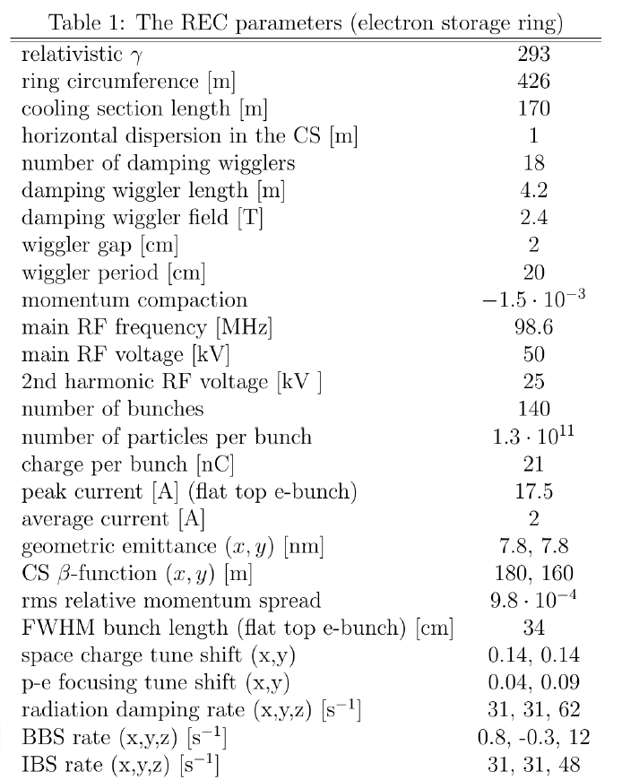
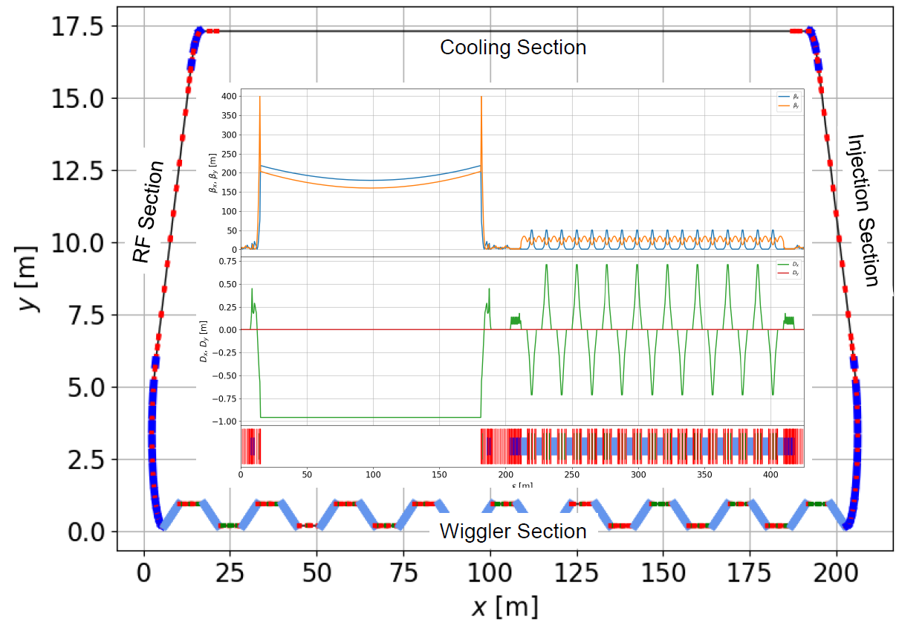
High-energy Ring Electron Cooler
See presentations:
S. Seletskiy (TUB1), J. Kewisch (THB2)
The Ring Electron Cooler (REC) is a non-magnetized, bunched electron cooler based on an electron storage ring, which utilizes damping wigglers to provide radiation damping for the electrons.

Slide 11
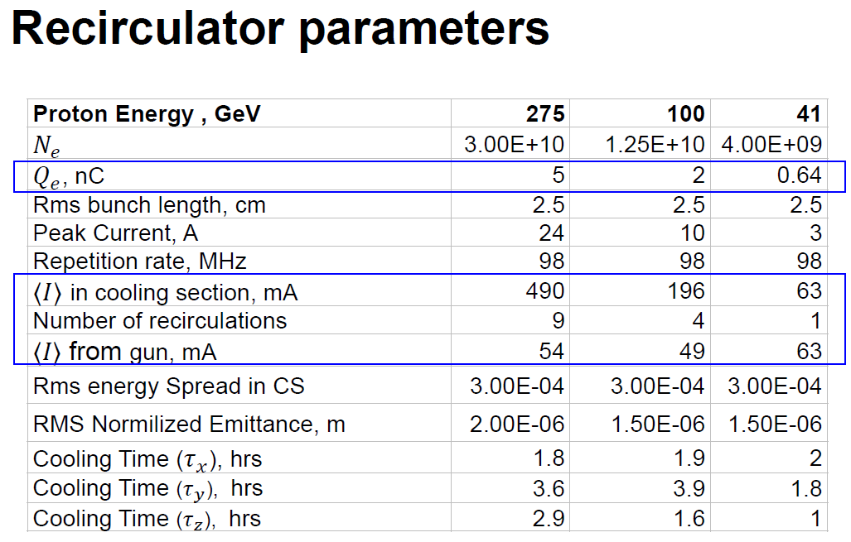
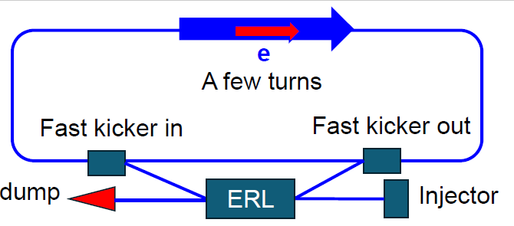
High-energy Recirculator Cooler
See presentation:
D. Kayran (TUB2)
- Electron bunches are accelerated in the ERL
- Recirculated in the ring for just a few turns (1-9)
to reduce current required from injector
- Decelerated and sent to a beam dump
- Non-magnetized electron beam is used

Slide 12
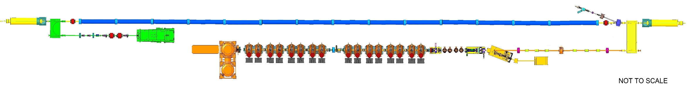
Low-Energy Cooler (LEC) for the EIC
RF diagnostics line with Deflecting cavity
180°Dipole
(U-turn)
LEReC
Cooling Solenoids
180° Dipole
Spectrometer
Mu-metal shielding
Quad
cooling
RF diagnostic
hadron
hadron
hadron
e⁻
HSR
e⁻
HSR
e⁻
extraction
transport
injection
Injector test
SC Quad
PM
Cathode transport
PM
PM
Solenoids
Laser
197 MHz
130 kW Beam Dump
Extraction line
930 kW Beam Dump
4x 591 MHz
NCRF correction Cavities
Not to scale
DC Gun
400kV
Injector/linac
Test line
24MHz
RF cavity
16x 197 MHz
NCRF LINAC
The LEC is scaled up version of LEReC: more RF cavities, longer cooling section, higher beam current.
12

Slide 13
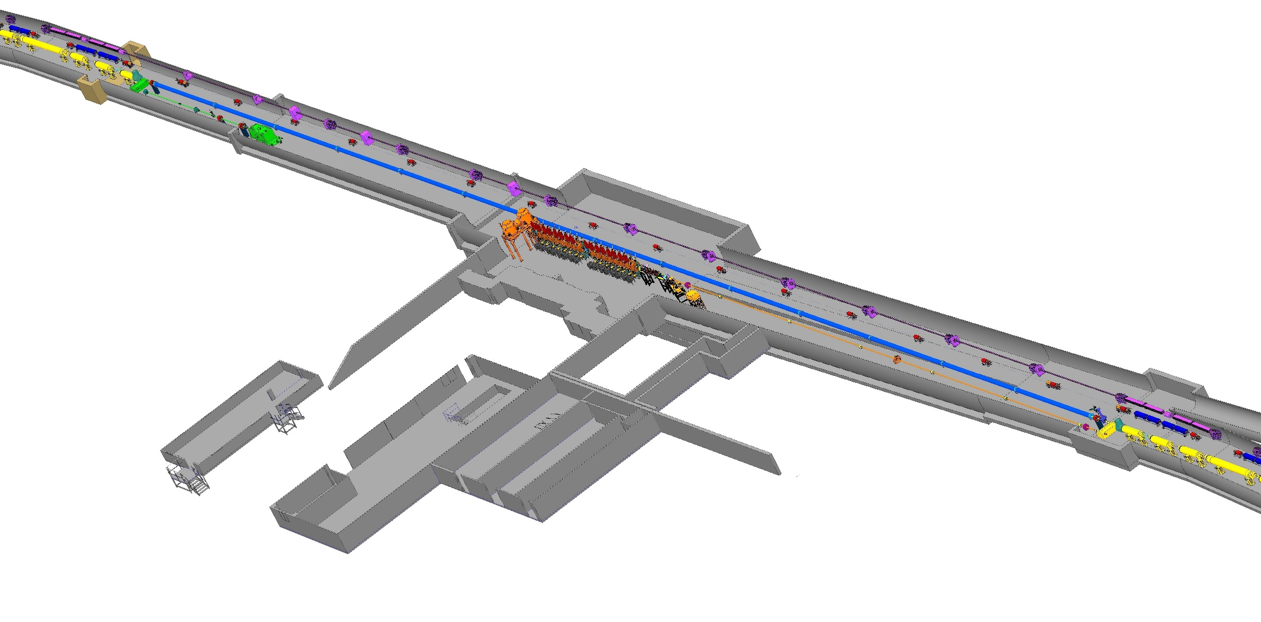
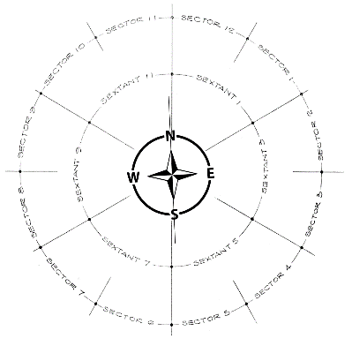
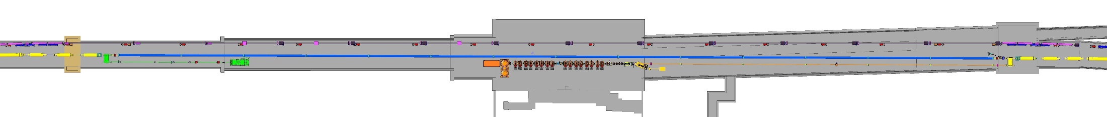
Low-Energy Cooler (LEC) Layout
2 o’clock
SECTOR 1
IP2
SECTOR 2
COOLING ~168 meter

Slide 14
Low Energy Cooler Parameters
LEReC key parameters for reference
 | electrons | protons
gamma | 25.4 | 25.4
RHIC RF frequency, MHz | 197 | 24.6
Cooling section length, m | 168 | 168
Cooling sections beta function, m | 150 | 100-200
Hadrons Dy, Dy’, m, rad |  | <1, <0.02
Total charge per proton bunch, nC | 3 | 45
Electrons kinetic energy, MeV | 12.46
Electron average current, mA | 74
Normalized emittance, rms, um | <1.5 | 2
rms bunch length, cm | 4 | 100
rms dp/p | <5e-4 | 6e-4
Angles in cooling section, urad | 20-30 | 20
electrons
4-5
704 MHz (9 MHz)
20 m
30 m
3 nC
1.6-2 MeV
30 (60 mA in tests)
<2 um
5 cm
<5e-4
<150 urad

Slide 15
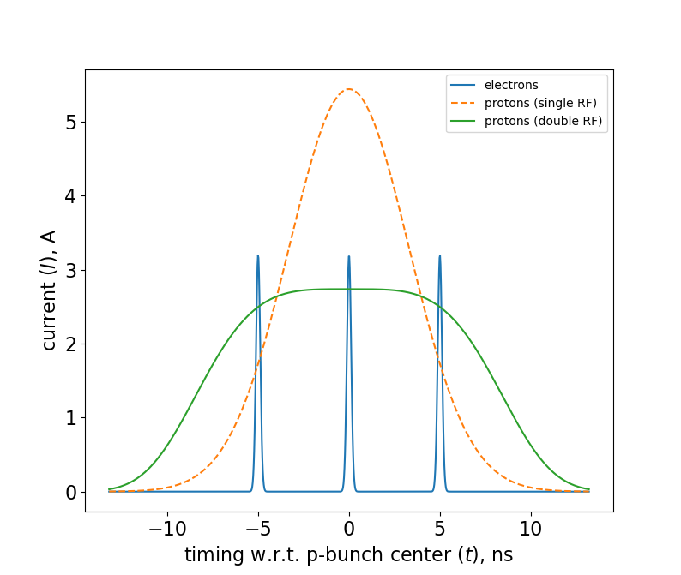
Beam Structure in Cooling Section
Protons bunch structure:
f_rep=24.6 MHz
N_p=2.8e11, I_peak=2.7 A (with 2nd harmonic RF)
Rms length=1m
Electrons bunch structure:
f_RF=197 MHz
Single bunch: Q_e=1 nC
Number of bunches in macro-bunch: 3
Rms length=0.04m
Proton bunches during cooling:
2nd harmonic RF alleviates space-charge effects reducing peak current of protons to about 3A , with the space-charge tune shifts of ΔQ_{sc,x,y}=0.07, 0.13 (with 2nd harmonic RF) at the end of cooling.
RHIC APEX studies, May 8, 2024:
1) Expected proton beam parameters with using quad pumping in AGS were established: peak current of 5.4A with single harmonic 28MHz RF. Double RF system will decrease peak current by about factor of 2.
2) Use of double RF system and making flattened bunch profiles was also demonstrated at proton injection energy in RHIC.
Fig. Three electron bunches (blue color) spaced by 5.1 ns placed on a single proton bunch (orange dashed line: single RF harmonic; green solid line: double RF harmonic).

Slide 16
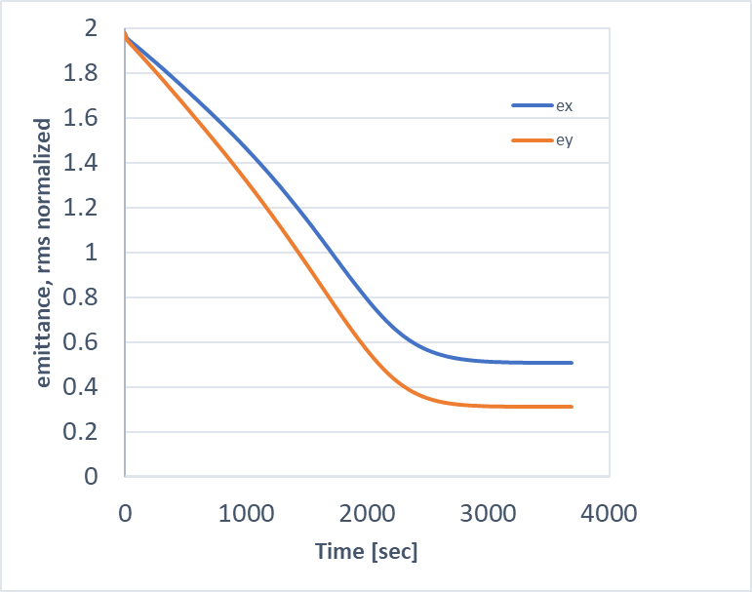

Cooling Performance
Average current of electrons: I_{av}=74mA
Electrons rms angles in the cooling section: 25 urad
Effective cooling section length: 168 meters
Non-magnetized cooling: very strong dependence on relative angles between electrons and ions.
Requirement on electron angles:
for γ=25: σ_{p}<4e-4; θ <25 urad
Contributions to the rms electrons angles budget in the cooling section:
- Electron beam emittance: < 20 urad
- Electron beam space charge: < 10 urad
- Focusing from proton beam: < 10 urad
- Remnant magnetic fields (with shielding) < 7 urad
Total preliminary budget (added in quadrature): 25 urad
Cooling simulations of protons at γ=25, with decoupled transverse motion (IBS+Cooling only, using single harmonic RF).
Longitudinal emittance is kept constant during cooling process.
After cooling, normalized rms emittances of protons ex, ey=0.5,0.3 um
(horizontal emittance can be increased further as needed.)
Note:
For electron beam beta-function of 150m in cooling section,
rms emittance of 1.5 um corresponds to 20urad divergence.
Hence requirement on emittance in cooling section: <1.5um.
𝜃$=\sqrt{\frac{ε_{xn}}{{γβ}_{x}}}$
16

Slide 17
LEReC experience and LEC challenges
LEReC experience:
1) Stable 24/7 running of high-current electron accelerator and stable cooling was provided over many weeks of RHIC collider. 2) Reliable operation was ensured by implementation of laser position feedbacks, intensity feedback, energy feedback, automatic cooling section orbit correction and feedback. 3) Robust photocathodes (K₂CsSb) with initial Quantum Efficiency of around 8%. 4) Pulsed beam diagnostics worked very well; did not find need for high-power beam diagnostics.
The LEC design parameters are challenging with required angular spread of electrons in cooling section about factor of 5 smaller than in LEReC and electron current about factor of 3 larger than used in routine long-term LEReC operations.
Based on LEReC operational experience, the following areas require special attention:
1. Long-term stable Gun operation at required current of 75mA.
2. Achievement and control of electron angles in cooling section at the level of 25 urad.
3. High-power beam dump, 930kW at 12.5MeV
17

Slide 18
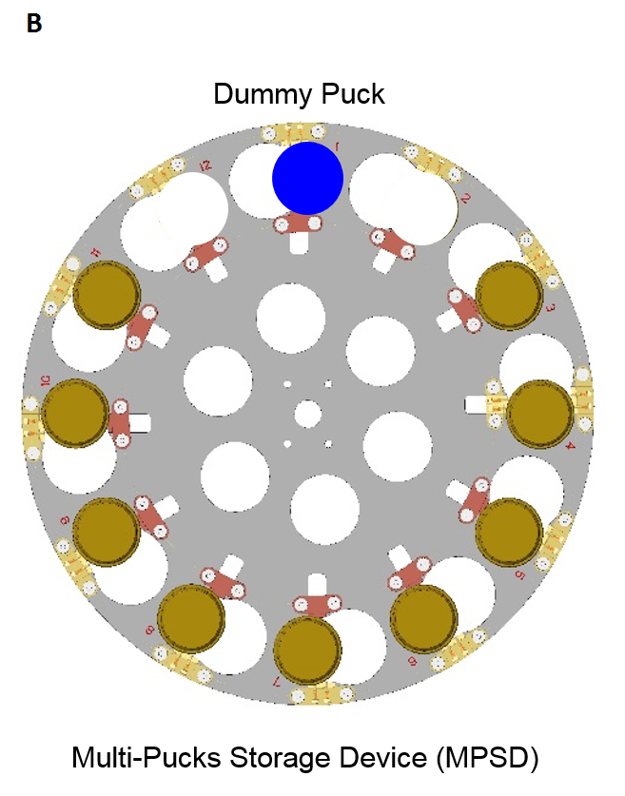
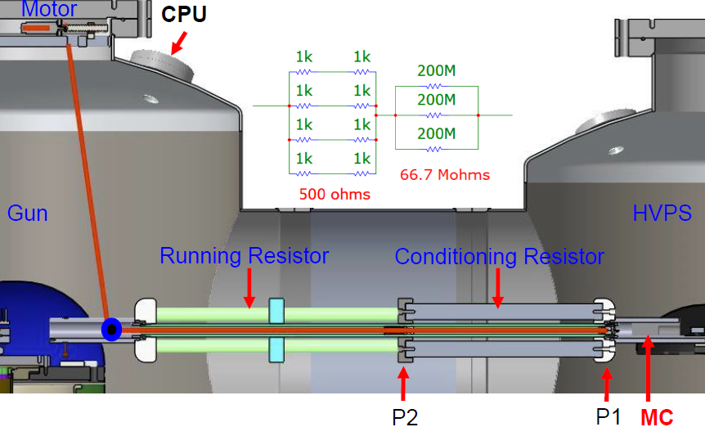
LEC source requirements and LEReC gun experience
LEReC gun was built by Cornell University and upgraded at BNL.
  BNL developed cathode growth, cathode exchange and cathode transfer system.
  Upgraded Gun with conditioning/operation Resistor remote switch to support long term operation.
 | LEReC operation | LEC requirements
Gun Voltage [kV] | 375 | 350-375
Bunch charge [nC] | 36x0.06 | 3 x 1
Macro Bunch Charge [nC] | 2.2 | 3
Rep. rate [MHz] | 9.3 | 24.6
Average current [mA] | 20 | 74
Cathode peak current [A] | 2.5-3 | 2-3
Cathode Laser power [W] | 0.5-5 | 9
Cathode initial QE[%] | 8 | 8
Lifetime [weeks] | >2 | > 2
X. Gu et,al Phys. Rev. Accel. Beams 23, 013401

Slide 19
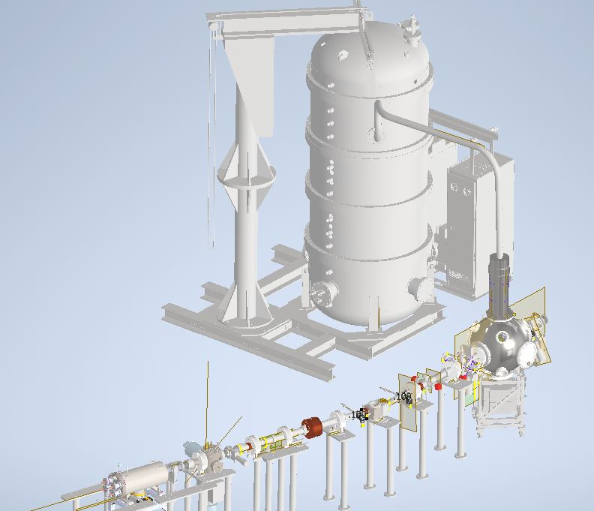
LEC gun choices
LEReC Gun (built by Cornell):
Existing LEReC Gun and HVPS (600kV). Need to demonstrate stable operation at require current (75mA) for the EIC. Present HVPS operation is limited to about 80mA current.
R&D Gun at Stony Brook (under development):
Active cathode cooling. HVPS (600kV) and Gun are designed to operate at 100mA. Tests with beam to start in late 2026.
E. Wang et al., Phys. Rev. Accel. Beams 25, 033401

Slide 20
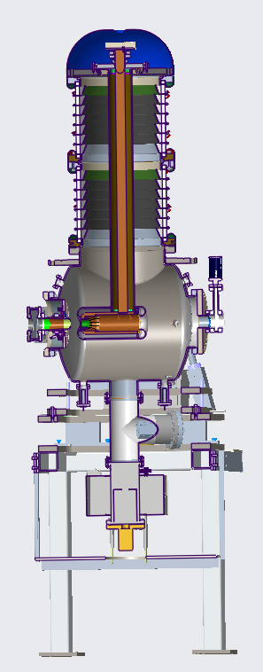
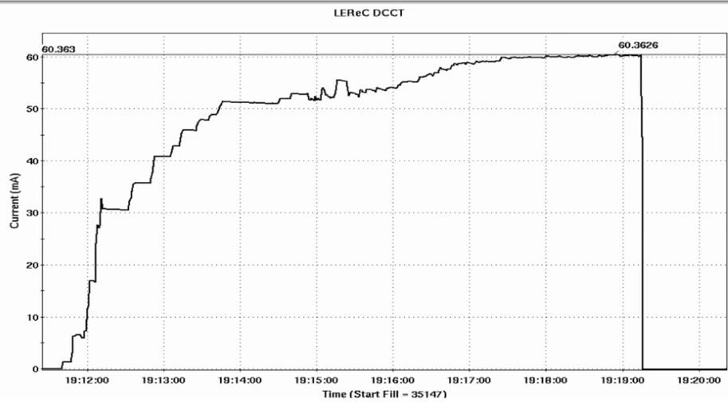
LEReC high-current studies
High current source is required for EIC LEC:
  The LEC requires stable operation at around 75mA current.
High-current source R&D:
  Explore LEReC Gun operation with high-current up to 80mA.
  Explore Gun and HVPS long-term stability at high currents.
  Explore operation with active cathode on center vs cathode off center.
  Explore large cathode area vs small active area.
  Explore cathode QE at various laser powers with and without cathode stalk cooling.
  Test multi-alkali photocathodes using different growth methods.
Stable operation at 50mA in tests (April 2022)
60mA (October 2024):

Slide 21
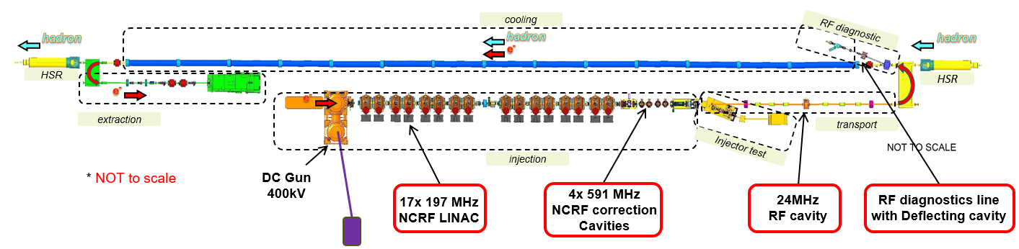
LEC RF systems
 | 197 MHz* | 591 MHz | 24 MHz | 591 Deflecting
Frequency [MHz] | 197.0508 | 591.1524 | 24.6314 | 591.1524
Tuning range [MHz] | ±0.12 | -0.5~+1.0 | ±0.15
Total Voltage [MV] | 13.6 | 1.5 | 0.01 | 0.12
# of Cavities | 17 | 4 | 2 | 1
Voltage per cavity [kV] | 800 | 400 | 5 | 120
R/Q cir. [Ω] | 170 | 96 | 15 | 750
Q0 | 48000 | 34000 | 160 | 13500
FPC Qext | 24000 | 34000 | 160 | 13500

Slide 22
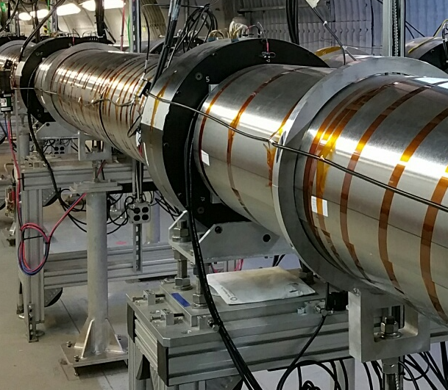

LEC Cooling Sections
Requirements on residual transverse magnetic field between correctors in the cooling region is 1 μT-m, which is similar to LEReC requirements.
Assuming 12 m long sections, the transverse magnetic fields should be shielded to 1 mG level in each section.
Shielding of the residual magnetic field to such level can be achieved using concentric cylindrical layers of high-permeability alloy in the cooling sections, similar to LEReC.
.
mu-shielding
mu-shielding
mu-shielding
mu-shielding
mu-shielding
12 m
12 m
12 m
merging/matching section
merging/matching section
BPMs and correctors
Weak solenoids
22

Slide 23
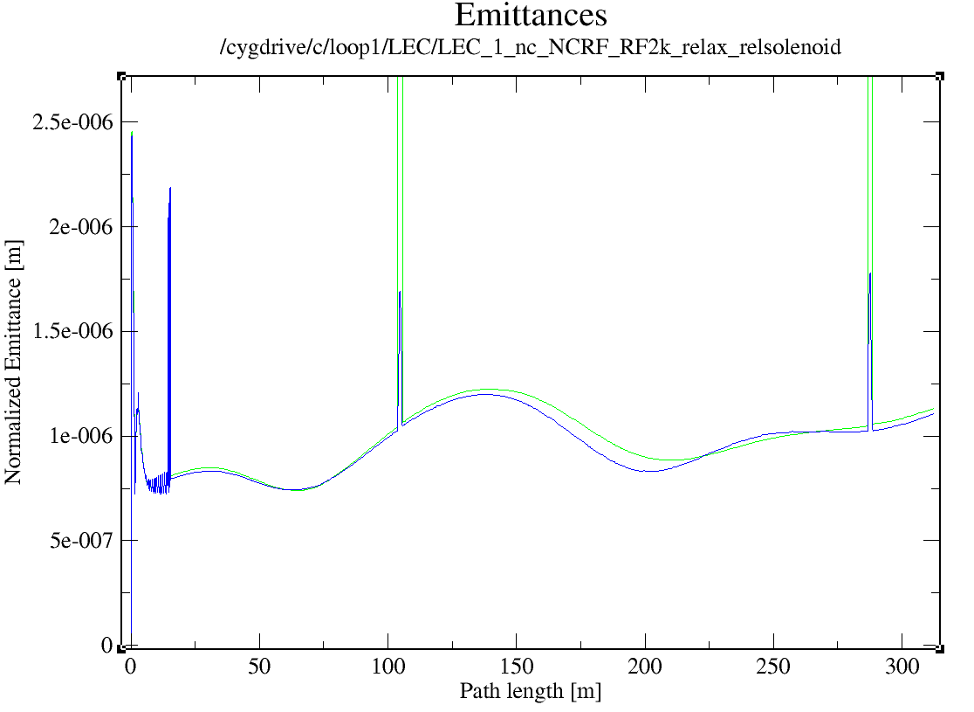
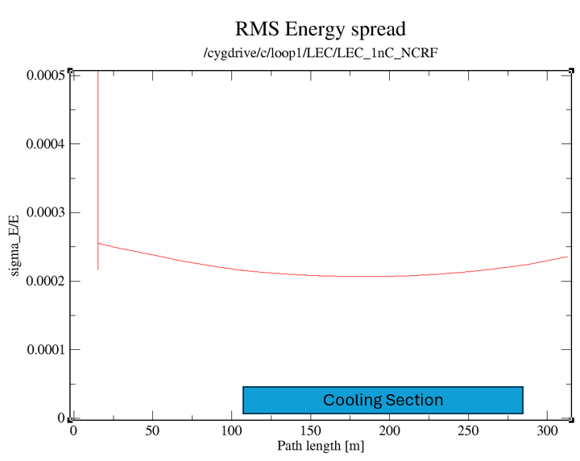
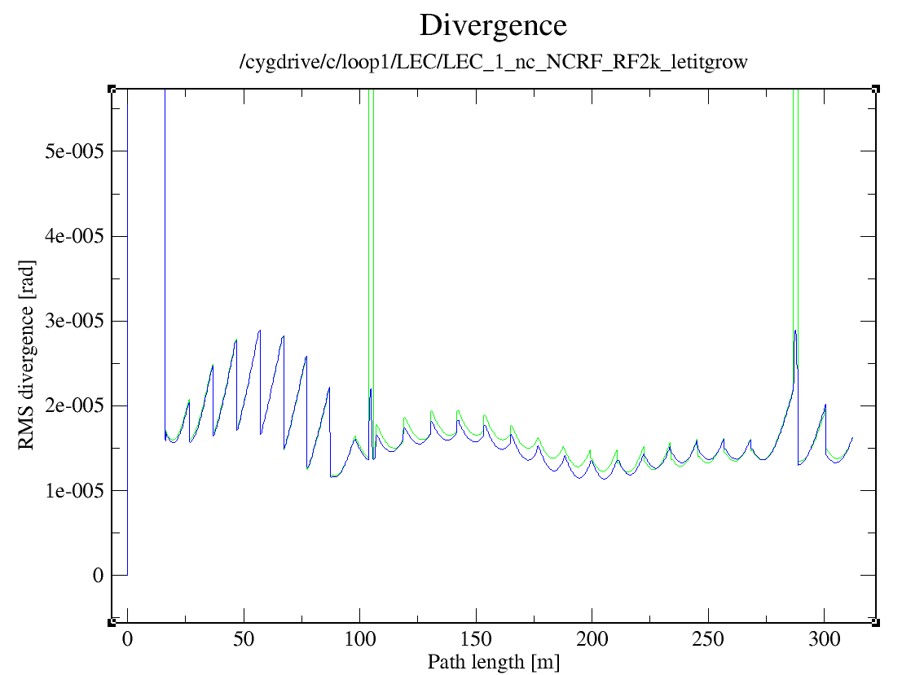
LEC Electron Beam Dynamics
requirements
cooling section
Simulations for 1 nC electron bunch charge:
Results:
Normalized rms emittances <1.5um
RMS energy spread <4e-4
Electron beam divergence in the cooling <20 urad.
cooling section
See D. Kayran presentation (THB3)
23

Slide 24
Summary
Protons and ions will be precooled at 24 GeV using Electron Cooling.
Heavy ions at collision energies will be cooled using Stochastic Cooling.
Low-energy Electron Cooler (LEC) at injection energy of protons at 24 GeV addresses challenges of achieving design luminosity in the EIC and simplifies requirements for potential future high-energy cooling at collisions.
The LEC is RF-based 13MeV electron cooler designed to cool protons and ions at 24GeV.
The LEC design is in progress.
24

