Slide 1


Women in Physics:
The Ambivalence of Success, Forces of Inertia and Pathways to Equity
Beate Ceranski (University of Stuttgart, Germany) and
Ewelina Ciaputa (Jagiellonian University in Krakow, Poland)
17th International Particle Accelerator Conference, Equal Opportunities Session – 20/05/2026

Slide 2
Introduction
Normative concepts of science – and why the meritocracy narrative is so dangerous
The current situation of women in physics and its subdisciplines
Insights from history I: enablers
Barriers in academic careers
Insights from history II: lab cultures
Interplay of factors and the problem of the positive loop feedback
Accelerator physics – a special case?
Best practices

Slide 3
Normative concepts of science – and why the meritocracy narrative is so dangerous
Robert Merton (1910-2003), 1942 (Science and Technology in a Democratic Order)
Common ownership
Universal validity
Disinterestedness
Organized Skepticism
→ privileged epistemological status of science
„A scientist never seeks publicity and expects no reward.
If you are successful you really deserve no great credit.“
(Frieda Robscheit-Robbins, 1935)

Slide 4
Normative concepts of science – and why the meritocracy narrative is so dangerous
Merito-cracy: [scientific] merit → status and position in scientific community
Dangers:
1) Discouragement
2) Dishonesty
3) Disregard

Slide 5
Normative concepts of science – and why the meritocracy narrative is so dangerous
1) Discouragement in view of failure:
„If you didn‘t make it, you‘re not made for it. You‘re just not good enough.“
2) Dishonesty and double standards in view of exceptional merit: Curie effect.
„Of course, a woman scientist will be hired if she‘s as good as Marie Curie.“
3) Disregard of EO commitment and blindness to double standards in view of one‘s own achievement:
Rosalyn Yalow (1921-2011)
1977 Nobel Prize for Medicine/Physiology (radioimmunoassay technique)
1978 president of the Endocrinological Society, presidential address:
→ I believe my ascending to the Presidency of the Endocrine Society is the final step in the general recognition that women have come of age in our Society and now participate with full equality in all its functions. I think it unfortunate that the Women's Caucus of the Society has chosen to remain a special interest group rather than changing its name and function […]

Slide 6
The current situation of women in physics and its subdisciplines

Slide 7
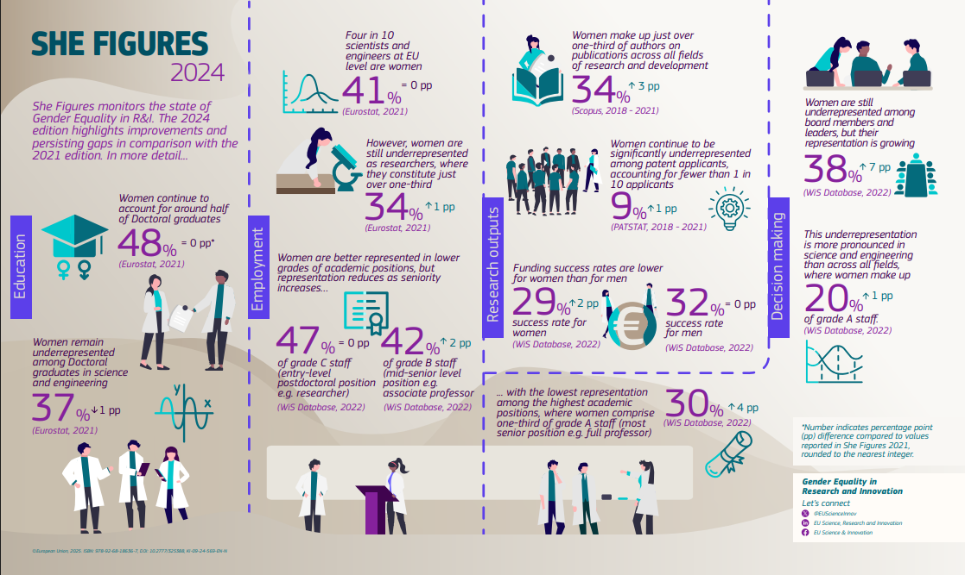
Source: https://european-research-area.ec.europa.eu/sites/default/files/documents/2025-03/she%20figures%202024-KI0924569ENN-infographics.pdf

Slide 8
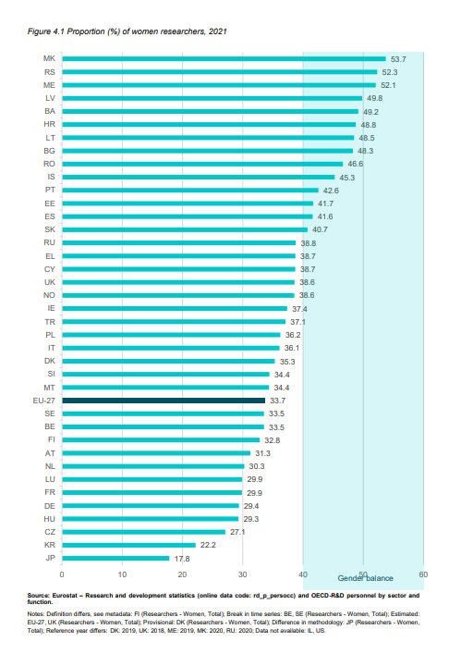
Europe/global snapshot: women are about one third of researchers worldwide

Slide 9
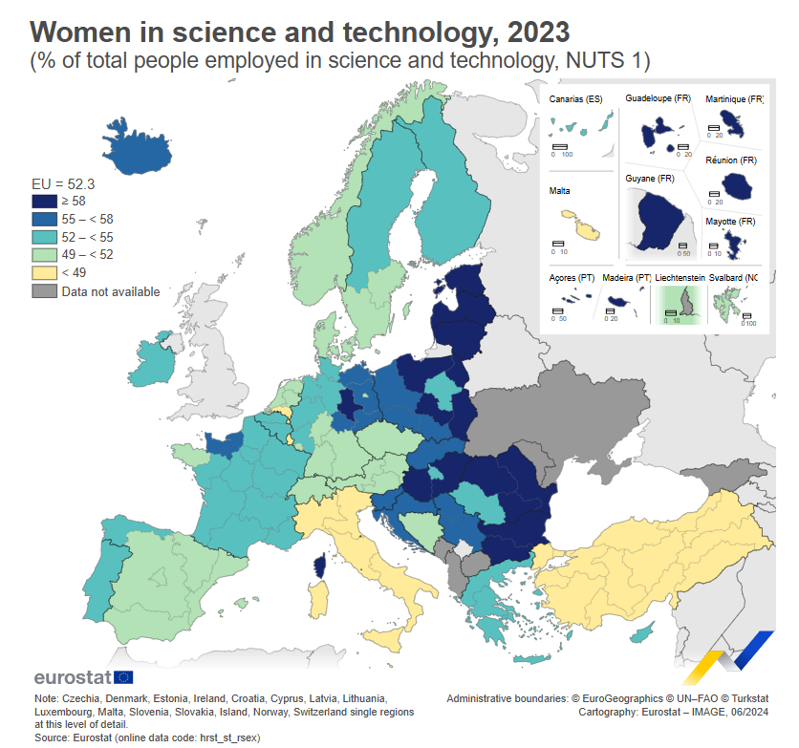
Source: https://ec.europa.eu/eurostat/web/products-eurostat-news/w/ddn-20240613-2

Slide 10
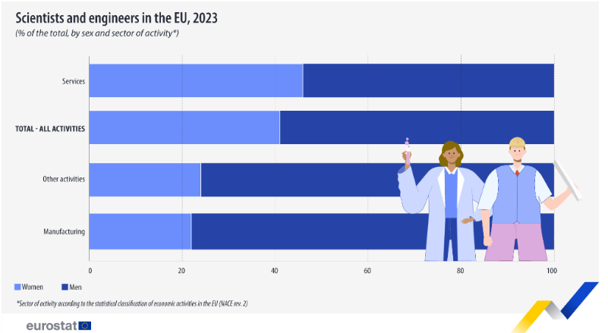
Source: https://ec.europa.eu/eurostat/web/products-eurostat-news/w/edn-20250211-1

Slide 11
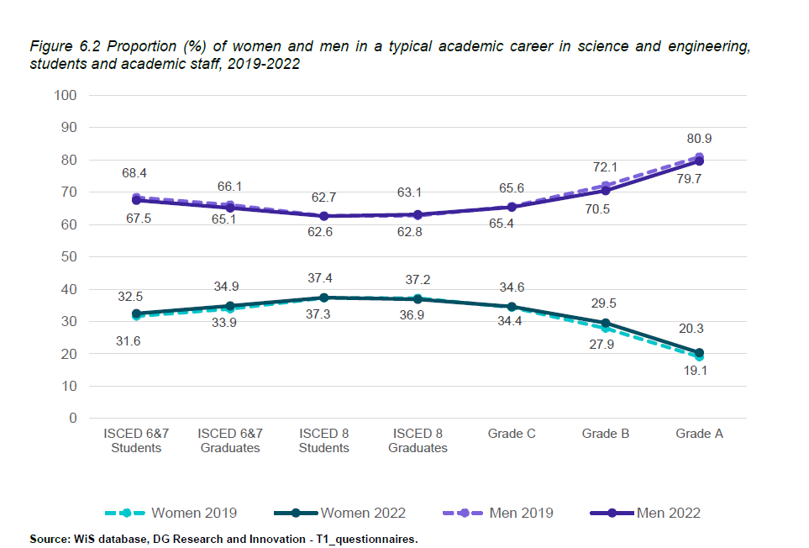
Women shares are lower in STEM fields
In the EU, women are a larger share among researchers than among the most senior academic roles
In STEM, representation drops at each successive career stage; among full professors it is often below 20%

Slide 12
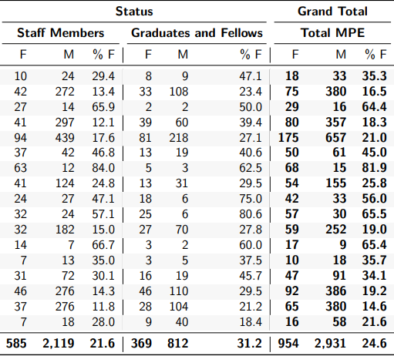
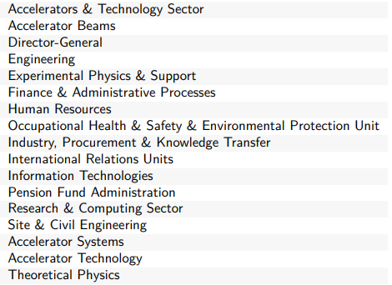
Source: CERN Personnel Statistics 2024

Slide 13
Insights from history I: enablers
1) The confidence of belonging, part I: Earning one‘s living
Lise Meitner to a friend, 1911:
Sometimes I am faint-hearted and my life with the huge uncertainty, the ever recurring worries and the feeling of my exceptional position, of absolute soleness [des absolut Alleinseins] seems hardly tolerable. […] At its best, everything I do is of use only to me, to my ambition […] Somehow our lives should be related to those of the others, should be essential for them. But I am outlawed, because I am of use to nobody.
Lise Meitner to a friend, 1914:
I love physics from all my heart, I can’t imagine my life without physics. It’s a kind of personal love, like love towards a person to whom one is greatly indebted. And although I am so prone to having a guilty conscience I am a physicist without a trace of a bad conscience.

Slide 14
Insights from history I: enablers
2) The confidence of belonging, part II: Excellent relationships
Maria Goeppert Mayer (1906-1972)
1931 PhD in Göttingen with Max Born (quantum theory)
1933ff. Jewish refugees from Germany and Italy (James Franck, Fermi, …)
1941 First paid position: part time teaching at a women‘s college
1942 ff. Manhattan Project (Fermi, Teller, …)
1949 Spin-orbit-coupling in the atomic nucleus → nuclear shell model
1955: Maria Goeppert Mayer and Hans Jensen: Elementary Theory of Nuclear Shell Structure
1960 Full Professor at UC San Diego
1963 (half) Nobel prize in physics together wie Hans Jensen
„I have been very lucky in my career.“

Slide 15
Insights from history I: enablers
3) Practical support
Kaiser-Wilhelm-Institut für Hirnforschung (brain research), Berlin (est. 1914)
Directed by Oskar Vogt (1870-1959) who was married to Cécile Vogt (1875-1962)
Institutional innovation: Hiring personnel for the institute‘s scientists
Scientists included two „scientific couples“ with children and a remarkable percentage of female researchers

Slide 16
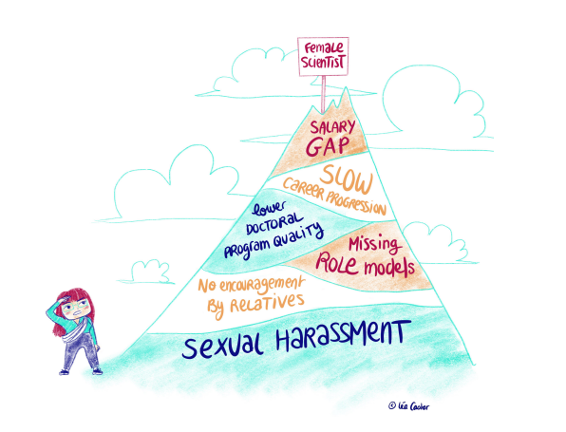
Barriers in academic careers
Underrepresentation is less about individual “leaks” than about career structures, norms, and networks
Formal procedures can appear open, while informal practices shape who is identified, encouraged, nominated, and recognized
Belonging to a network was fundamental for the development of my career in this field. 44_M
You must belong to different research groups, have different professional contacts and collaborate with many people. 24_F
Hiring and promotion often reward an “ideal worker” profile: uninterrupted availability, mobility, constant productivity
I know what I have to do which is working hard and publishing a lot. But other things are not in my hands, such as the number of positions that will be offered in the future. 24_F
Exclusion often happens upstream, before formal decisions, through visibility and nomination dynamics

Slide 17
Barriers in academic careers
Care responsibilities and mobility demands translate into missed opportunities and reduced visibility
Children were influent in the sense that they limited the options I could consider (…) Of course it impacts your career if you get a maternity leave once and again, you travel less, go to few conferences and publish less, just because you are exhausted. 27_F
The most problematic is international mobility, especially when having small children that require constant care and support from other family members. 56_F

Slide 18
Barriers in academic careers
Everyday culture matters: microaggressions and invisibility affect credibility and belonging
We had this experiment and there were very vulnerable electronic modules, they were
very capricious and had to be monitored all the time. It was my experiment, so I asked my male colleagues “If something happens to it, let me know, please?” and then they asked me a question “And what will you do? To which expert we should call? What will you do?” and I said what I would come and repair it because I knew how. But for them it was impossible to imagine that a girl could do such things. Although they are educated men and probably have seen many women doing different things, yet still the environment is strongly dominated by men, and they couldn’t imagine me doing such things. All in all, they are not against women, but they have in their minds these clichés that we [women] don’t do such things. 61_F
Mainly elderly people, (...) older than 50 years, used such sexual overtones or jokes, but it slowly, it somehow slowly changes, however there used to be such distasteful comments 64_F
Yesterday I talked to the other women and then it came out that we are both sort of isolated. So we are not allowed until now, we both do not have a project anymore, so no defined project and they [the men] are getting all the new projects, even though one of them is leaving in two months. 07_F

Slide 19
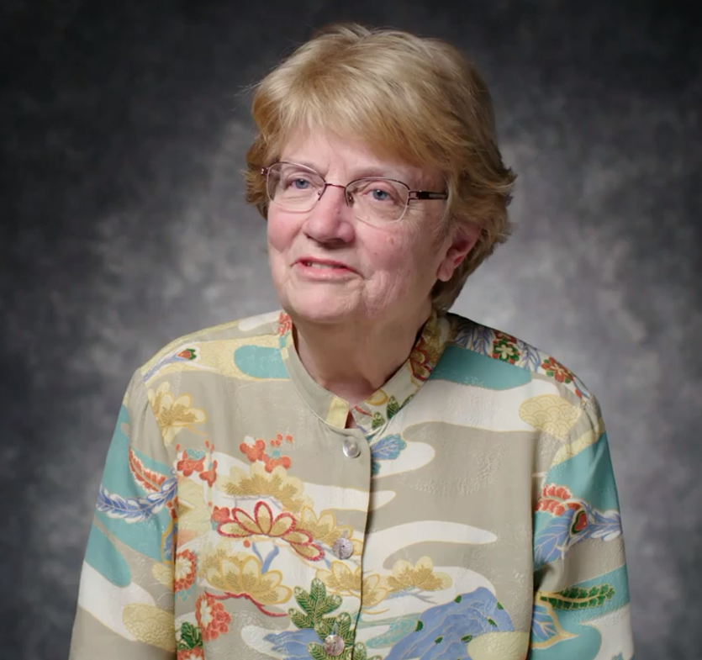
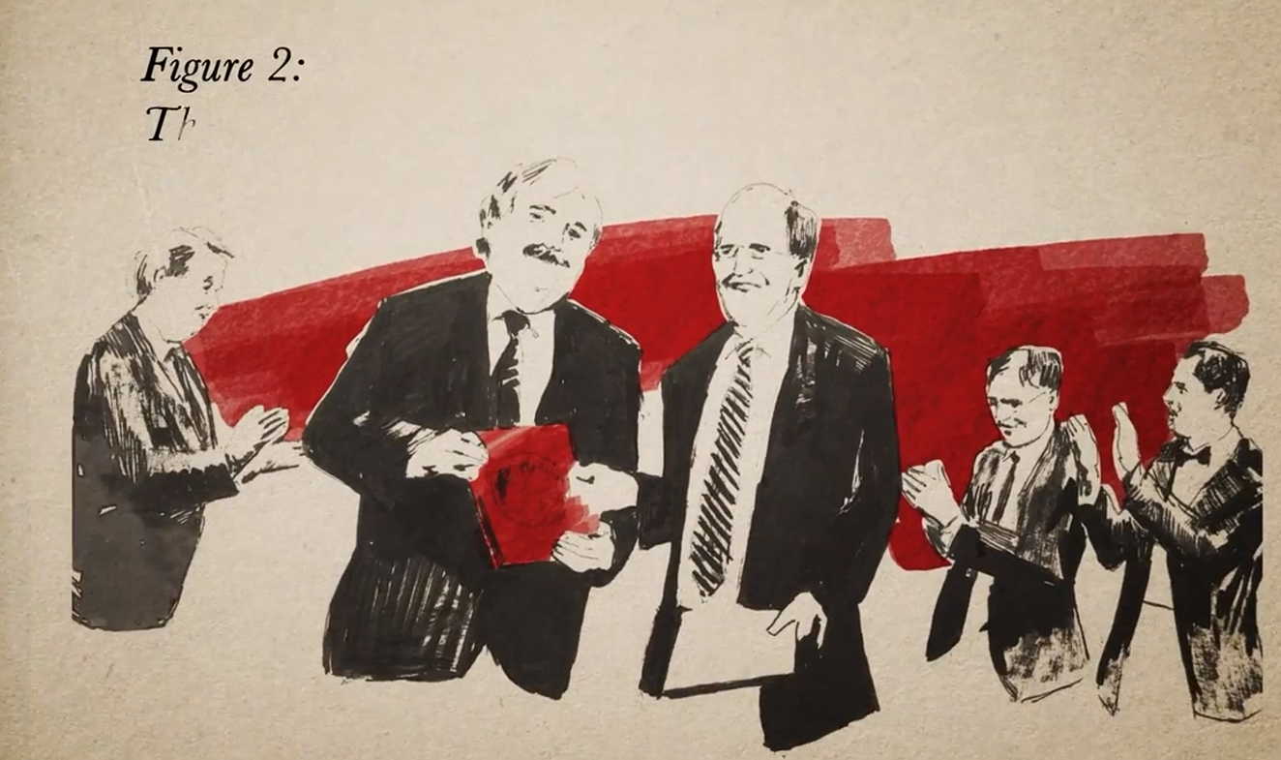
Insights from history II: laboratory cultures
Film tipp: Picture a Scientist
Documentary by
Sharon Shattuck and Ian Cheney, 2020
„Picuture a nation,
where brillant minds can florish.“
Nancy Hopkins, MIT

Slide 20
Insights from history II: laboratory cultures
Harriet Brooks to Ernest Ruthereford,1903:
I am afraid I am a terrible bungler in research work, this is so extremely interesting and I am getting along so slowly and so blunderingly with it. I think I shall have to give it up after this year, there are so many other people who can do so much better and in so much less time than I
that I do not think my small efforts will ever be missed.
funding situation ↔ lab equipment ↔ competition

Slide 21
Insights from history II: laboratory cultures
MacDonald Lab, McGill Univ. Montreal; E.Rutherford 1898-1907
Physics Lab, Manchester; E. Rutherford, 1908-1919
Cavendish Laboratory, Cambridge; J.J. Thomson, from 1919 E. Rutherford
Institut für Radiumforschung, Vienna; F. Exner/St. Meyer, 1910-
Laboratoire Curie, Paris; M. Curie 1907-
Harriet Brooks (1876-1933) research 1900-1907
Ellen Gleditsch (1879-1968) research 1907-1940s
Jadwiga Szmidt (1889-1940) research 1911-1930s
… and many more

Slide 22
Interplay of factors and the problem of the positive loop feedback
Underrepresentation has no “root cause”
Outcomes emerge from interacting structural arrangements, institutional practices, and everyday cultural norms
Policy effects are often non-linear and context-dependent; single interventions rarely map cleanly onto outcomes
Many equality initiatives remain weakly institutionalized: resources, structures, and monitoring are uneven
Under-resourced interventions can create “activity without impact” when implementation and evaluation capacity are missing
Equality work is often displaced onto individuals as undervalued, additional labour, creating potential career penalties
Feedback loops reinforce inequality: low representation sustains norms; performance regimes amplify service-load penalties; limited leadership diversity constrains reform

Slide 23
Accelerator physics – a special case?
1) Big Science – small visibility
Accelerator physics between international (prestige) projects and facility service
2) Theoretical physics – experimental physics – hardware – engineering?
Science, technology, and gender…

Slide 24
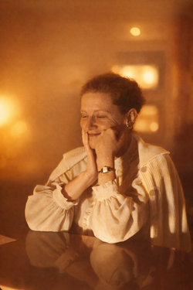
Accelerator physics – a special case?
3) Taking the intersectional challenge
Making visible the joy, excitement and pride of your work!
Hildred Blewett (1911-2004),
„the mid-wife of large accelerators“,
in CERN PS Main Control Room, Nov 24, 1959
https://commons.wikimedia.org/wiki/File:Hildred_Blewett_(colorized_image).png
Courtesy CERN, CC-BY-4.0

Slide 25

Afterthought
EO is not a scientific problem
no technological fix, no formula, no innate progress, no linear progression
EO has societal, institutional, local, disciplinary aspects
EO commitment: manifold, lifelong, ever changing,
strenous, tentative, rewarding
let it (also) be joy!
be honest and be kind to one another!
Nancy Hopkins (*1943),
molecular biologist, MIT
„Study on the Status of
Women Faculty in Science at MIT“,
1995-1999
Nancy Hopkins featuring in the trailer of Picture a Scientist

Slide 26
Best practices
Treat equality of opportunity as governance and working conditions, not a “side project”
Make outcomes visible through annual, disaggregated monitoring of recruitment, promotion, leadership, pay, and participation
Improve recruitment and promotion by using structured criteria, transparent shortlists, diverse panels, and brief de-biasing reminders
Act upstream: strengthen encouragement, nomination practices, and visibility pathways
Treat care-conscious policy as research infrastructure: predictable schedules, leave, tenure-clock adjustments, childcare support
Culture change requires full integration, leadership engagement (including men), and intersectional monitoring

Slide 27
“A truly competitive and innovative Europe is one where every mind, regardless of gender, gets the chance to thrive.”
Ekaterina Zaharieva

Slide 28
Thank you!

