Slide 1


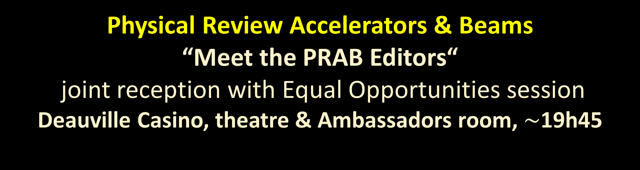
Physical Review Accelerators & Beams
“Meet the PRAB Editors“
joint reception with Equal Opportunities session
Deauville Casino, theatre & Ambassadors room, $\sim$19h45
Frank Zimmermann, CERN, PRAB Chief Editor
joining us at IPAC’26:
Brad Rubin, APS, PRAB Managing Editor
Sara Casalbuoni, EuXFEL, PRAB Associate Editor
Wolfram Fischer, BNL, PRAB Associate Editor

Slide 2

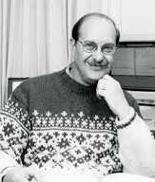
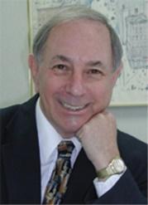
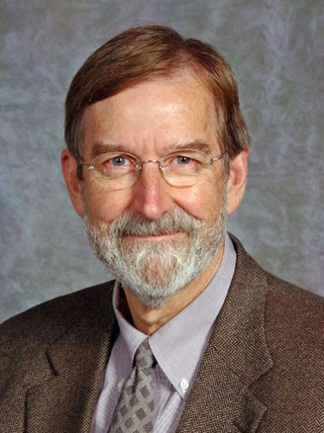

Physical Review Accelerators & Beams, launched by the APS-DPB
Gene D. Sprouse
APS Editor-in-Chief,
2007-2015
Martin Blume
APS Editor-in-Chief, 1997-2007
understood the connection between accelerator science and technology;
departing from Physical Review tradition, willing to champion a journal covering the full spectrum of accelerator science and technology
Michael
Thoennessen
APS Editor-in-Chief,
2017-2022
Robert H. Siemann
Founding Editor of PR(ST-)AB,
1997-2007

Slide 3
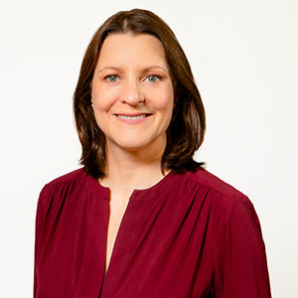
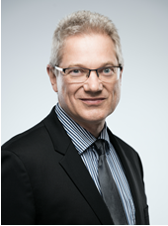


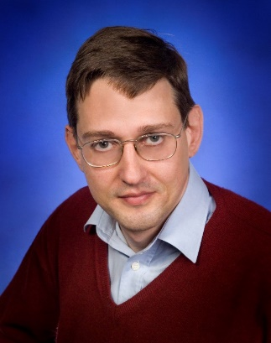


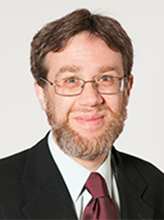
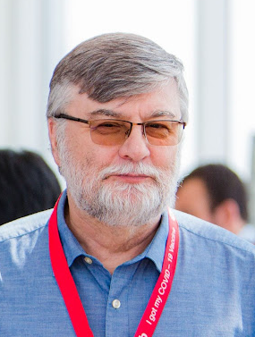

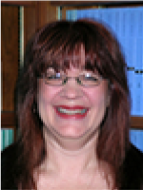
APS/PRAB staff in 2026
APS CPO
Rachel Burley
Chief Editor
Frank Zimmermann,
CERN
APS Executive Editor
Jessica Thomas
Associate Editor
Wolfram Fischer, Brookhaven National Laboratory
Editorial Board (3 year terms, 6 members rotating per year):
David Bruhwiler (RadiaSoft), Iryna Chaikovska (IJCLab), Ping Chou (NSRRC), Moses Chung (PAL/POSTECH), Bruce Dunham (xLight), Mamad Eshraqi (ESS), Alessandro Fabris (ELETTRA), Ralf Gebel (FZJ), Ubaldo Iriso (ALBA), Verena Kain (CERN), Eiji Kako (KEK), Alexei Kanareykin (Euclid Techlabs), Yuhui Li (IHEP/CAS), Michiko Minty (BNL), Andrea Mostacci (Sapienza Rome), Brahim Mustapha (ANL), Carl Schoeder (LBNL), Ben Shepherd (Daresbury)
Associate Editor
Alex Scheinker,
LANL
Assistant
Executive Editor Athanasios Chantis
Managing Editor
Brad Rubin,
APS Editorial Office
Associate Editor
Chao Feng,
SARI Shanghai
Assistant Editor
Maria
Poko
Associate Editor
Sara Casalbuoni,
EuXFEL
Associate Editor
Sergey Belomestnykh,
FNAL

Slide 4
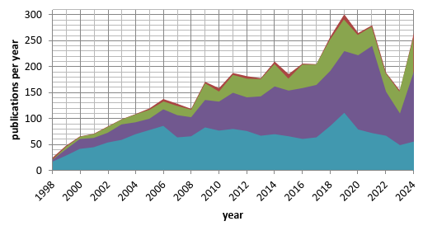
PRAB Evolution & Affiliated Groups
launched by the DPB in 1997 ; for a while the fastest growing APS journal, and ever more international
PRAB is supported by two “Affiliated Professional Groups,” APS-DPB (Chair Mark Palmer, Vice Chair Mark Boland) and EPS-AG (Chair Peter McIntosh), jointly responsible for health and vitality of PRAB
rest of the world
Asia
Europe
US + Canada
PRAB 2024 Impact Factor: 1.8

Slide 5
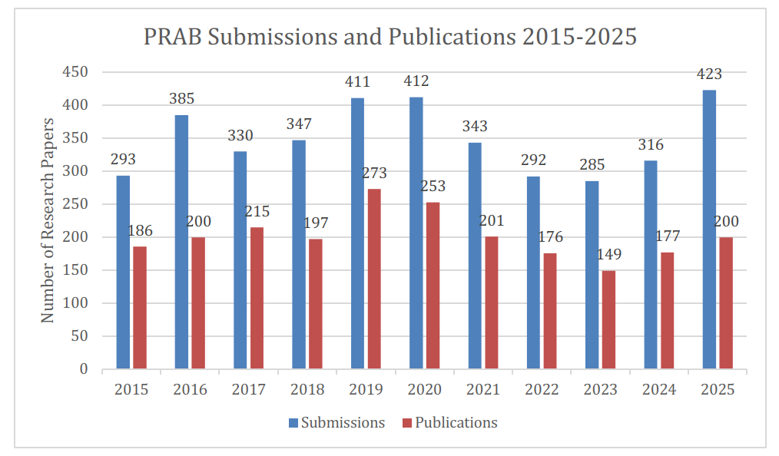
PRAB statistics: submissions & publications
Submissions for the first 3 months of this year similar to last year (106 in 2025, 111 in 2026).

Slide 6












































“Diamond” Open Access thanks to Sponsors
The generous support of sponsors enables PRAB to be provided without charge to both authors and readers.
Any deficit is covered by the APS.
Industrial Sponsors
Tech-X
Institutionial Sponsors
if your institute is not listed and would like to become a sponsor please contact us !
KEK
IHEP
Tsinghua
U Maryland

Slide 7
PRAB as the “Community Organizer” (V. Shiltsev)
“To better serve and nurture the accelerator community, in 1997 the APS Division of Physics of Beams (DPB) recommended establishing a scholarly, peer-reviewed journal devoted to the science and technology of accelerators and beams. It would cover the full breadth of accelerators and beams, publish quickly, circulate widely, and have an international editorial board and pool of referees [R. Siemann].”
“Through special editions, invited contributions, articles related to the APS Robert R. Wilson Prize for Achievement in Accelerator Physics, editorial outreach, tutorials, Editorial Board meetings, and events during the International Particle Accelerator Conferences, PRAB has become an important "Community Organizer," thereby realizing one of the intentions of its founders. For the coming years, PRAB looks forward to further transforming scientific publication in the field of accelerators.”
For more details and references see:
aps.org/archives/publications/apsnews/201804/beams.cfm
https://journals.aps.org/prab/abstract/10.1103/PhysRevSTAB.11.050003

Slide 8
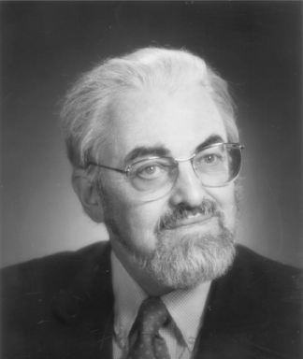
joint APS-DPB/PRAB Ernest Courant Outstanding Paper Recognition
The Courant recognition was established in 2021 by the Division of Physics and Beams (chaired by Sarah Cousineau) in partnership with the Physical Review Accelerators and Beams (PRAB) journal.
Prize recipients:
2022
Carlo Vicario, Simona Bettoni, Alberto Lutman, Andreas Dax, Martin Huppert, and Alexandre Trisorio: “Two-color x-ray free-electron laser by photocathode laser emittance spoiler,” Physical Review Accelerators and Beams 24, 060703 (2021)
2023
Mamdouh Nasr, Emilio Nanni, Martin Breidenbach, Stephen Weathersby, Marco Oriunno, and Sami Tantawi: “Experimental demonstration of particle acceleration with normal conducting accelerating structure at cryogenic temperature,” Physical Review Accelerators and Beams 24, 093201 (2021)
2024
P. Raimondi, S. Liuzzo: “Toward a diffraction limited light source”, Physical Review Accelerators and Beams 26, 021601 (2023)
2025
R.A. Margraf et al., “Microbunch rotation in an x-ray free-electron laser using a first-order achromatic bend”, Physical Review Accelerators and Beams 27, 030702 (2024)

Slide 9
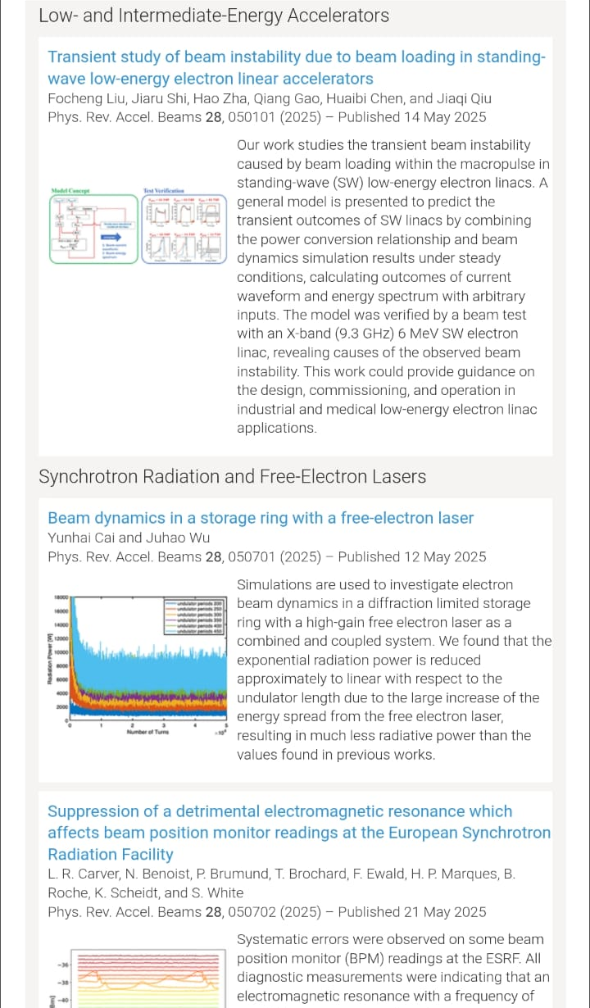
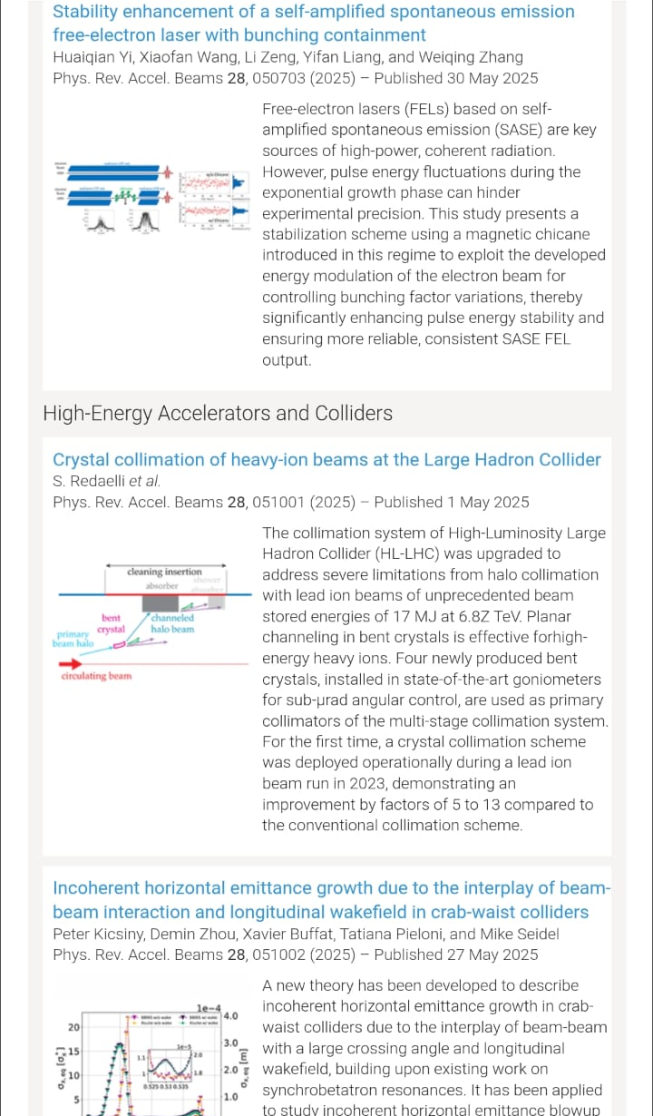
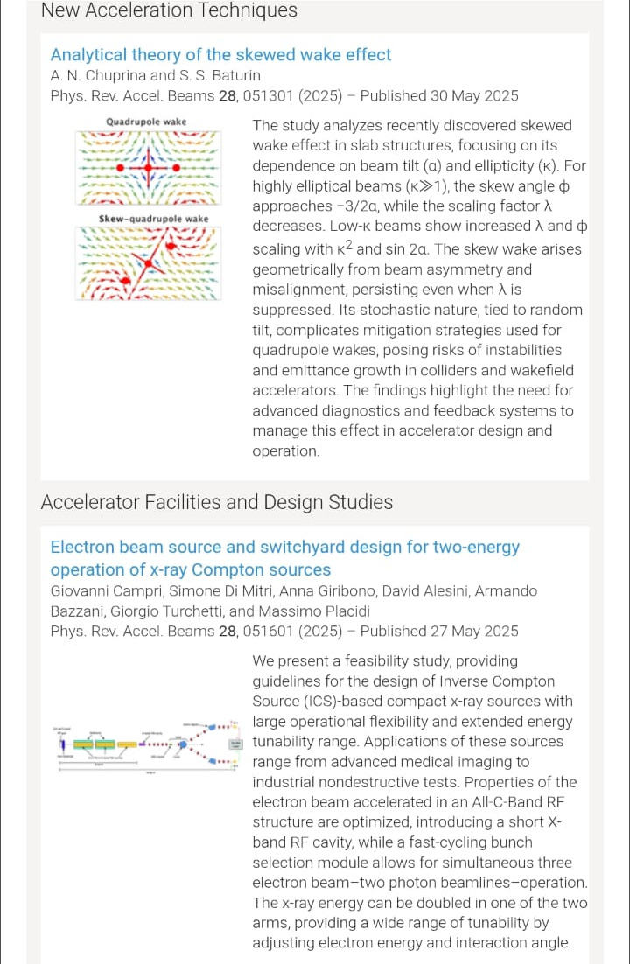
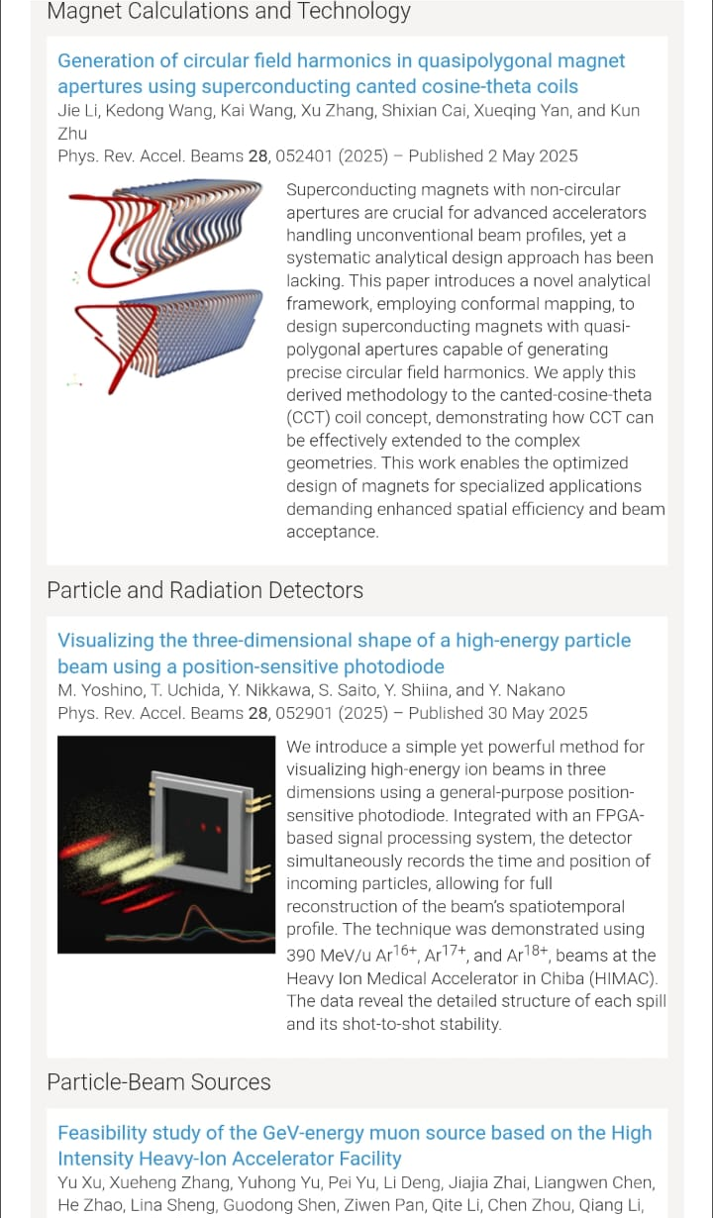
New ! – teasers and key images for all PRAB papers

Slide 10
Also New ! – PRAB Letters
New article type: PRAB Letters, effective May 1, 2025 https://journals.aps.org/prab/edannounce/prab-launches-letters-article-type
rapid publication of concise, high-impact research reports that communicate important new results in accelerator and beam physics
expedited editorial handling to facilitate prompt peer review and publication
like all PRAB articles, fully open access and free of charge to authors

Slide 11
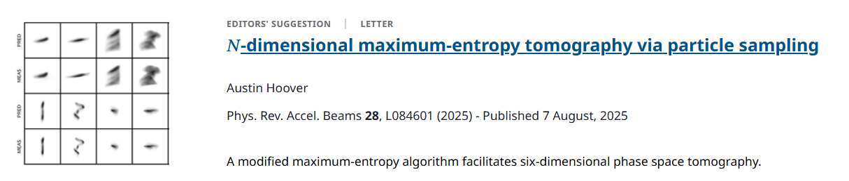
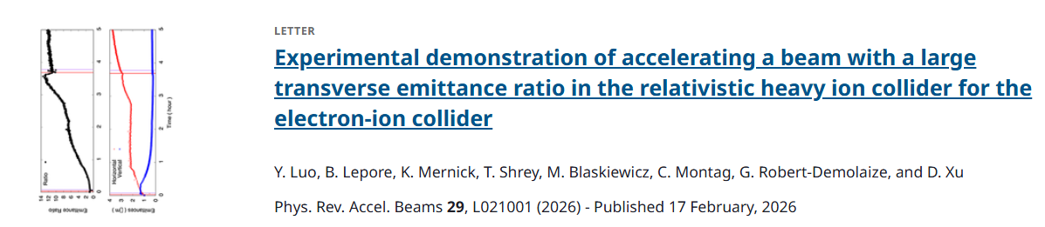
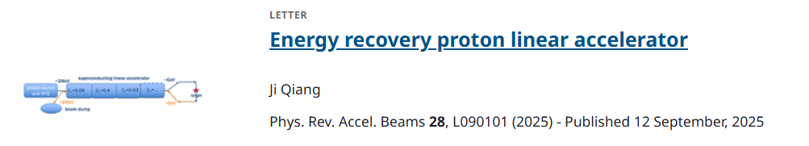
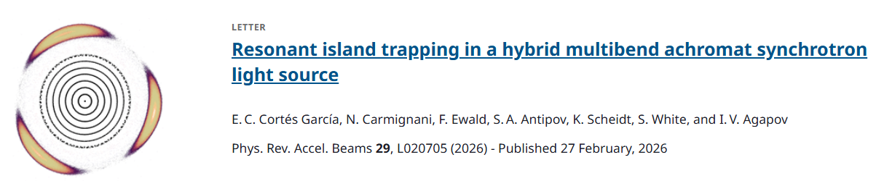
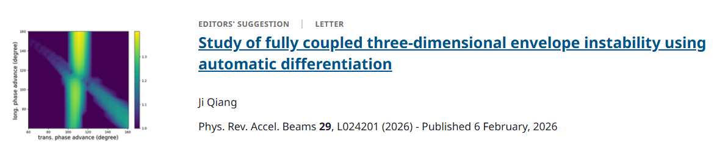
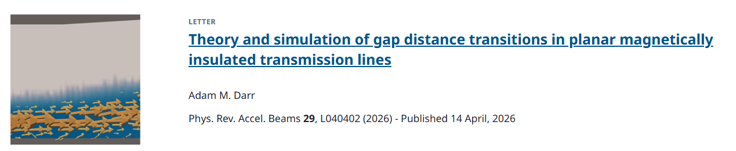
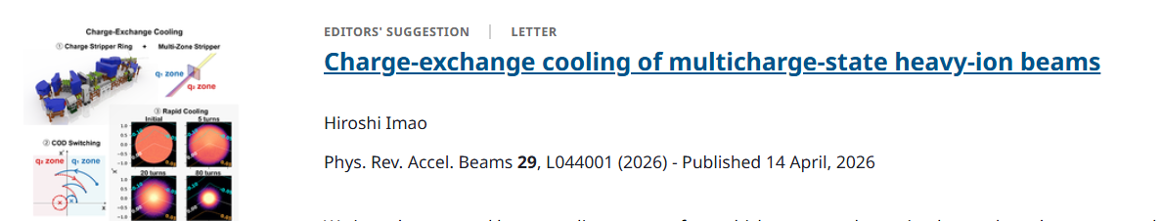
PRAB Letters published so far
7 published (5 PRL transfers),
8 in process
ORNL
BNL
LBNL
CERN, DESY, ESRF
LBNL
Sandia
RIKEN Nishina

Slide 12
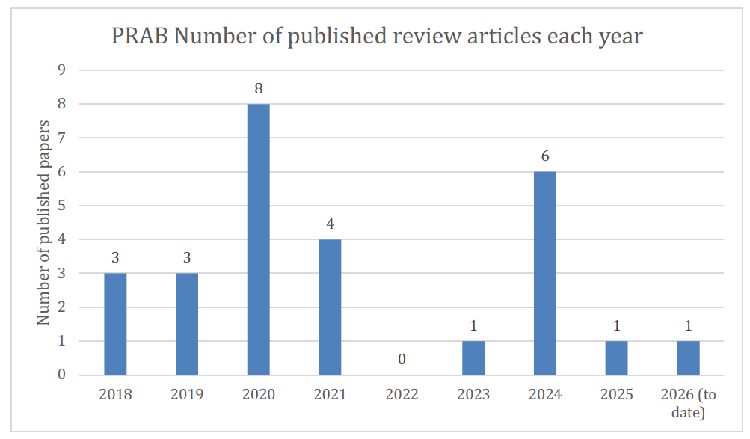
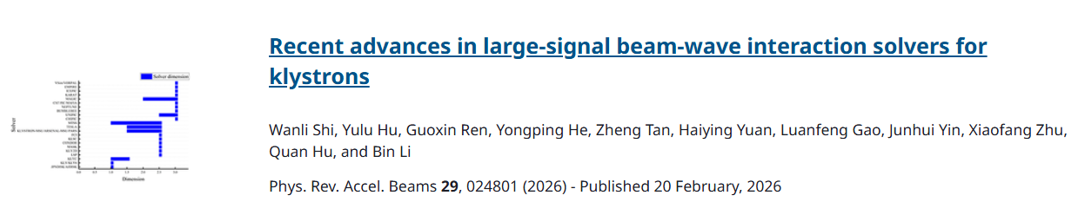
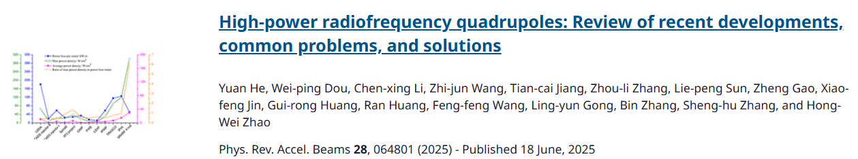
PRAB Review articles
1 published in 2025, 1 to date in 2026, 2 still in process -
High gradient rf testing of x-band structures: A comprehensive review (CERN, PSI etc.)
Resonant isomeric transmutation via coherent gamma-ray Excitation: A theoretical framework for selective proton emission from ¹⁹⁶Hg
(unnafil)
How to get more high-quality PRAB Review articles?
UESTC
IMP

Slide 13
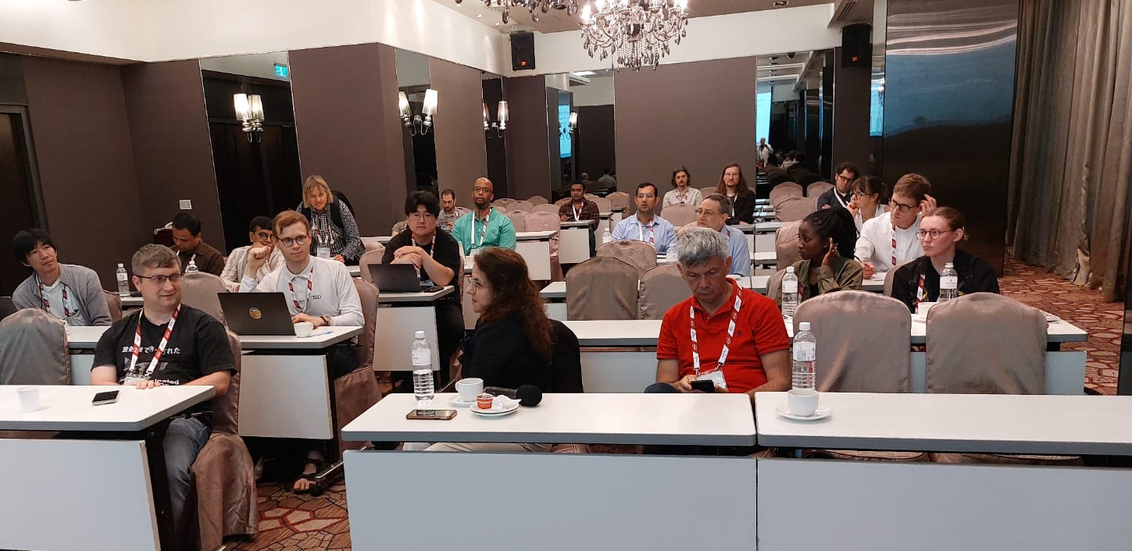
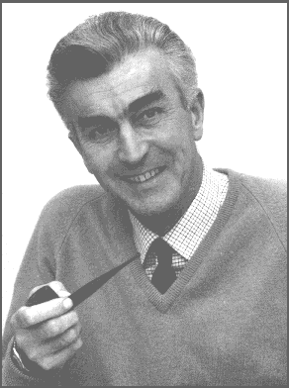
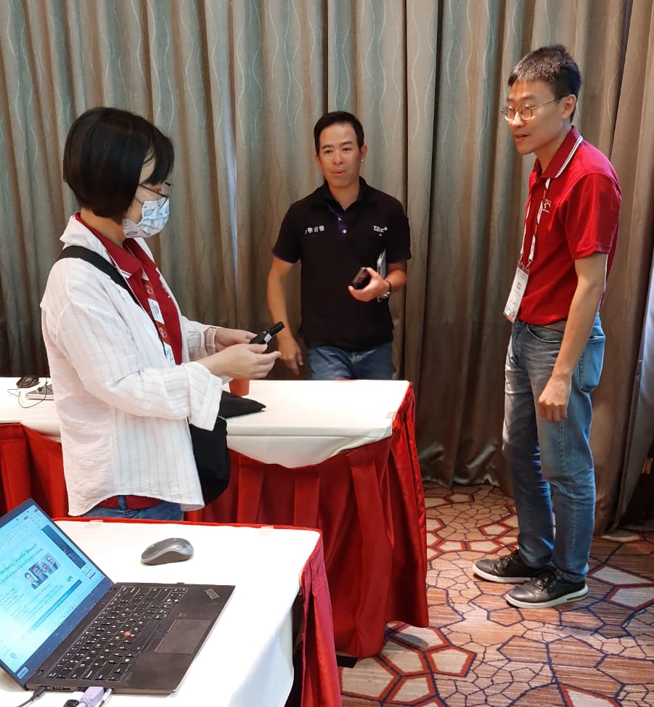
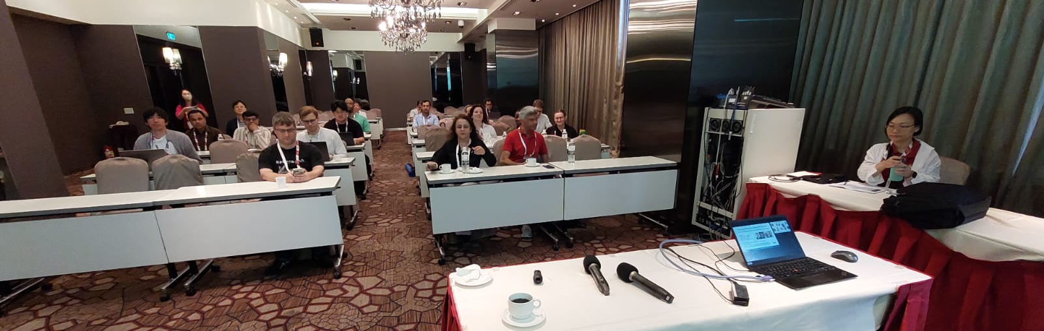
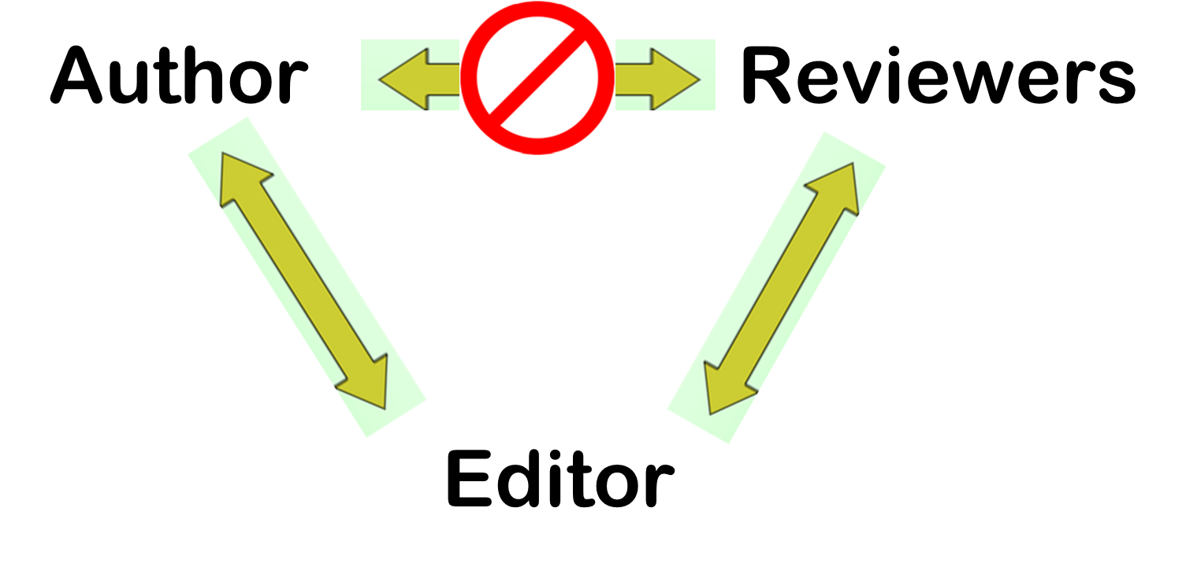

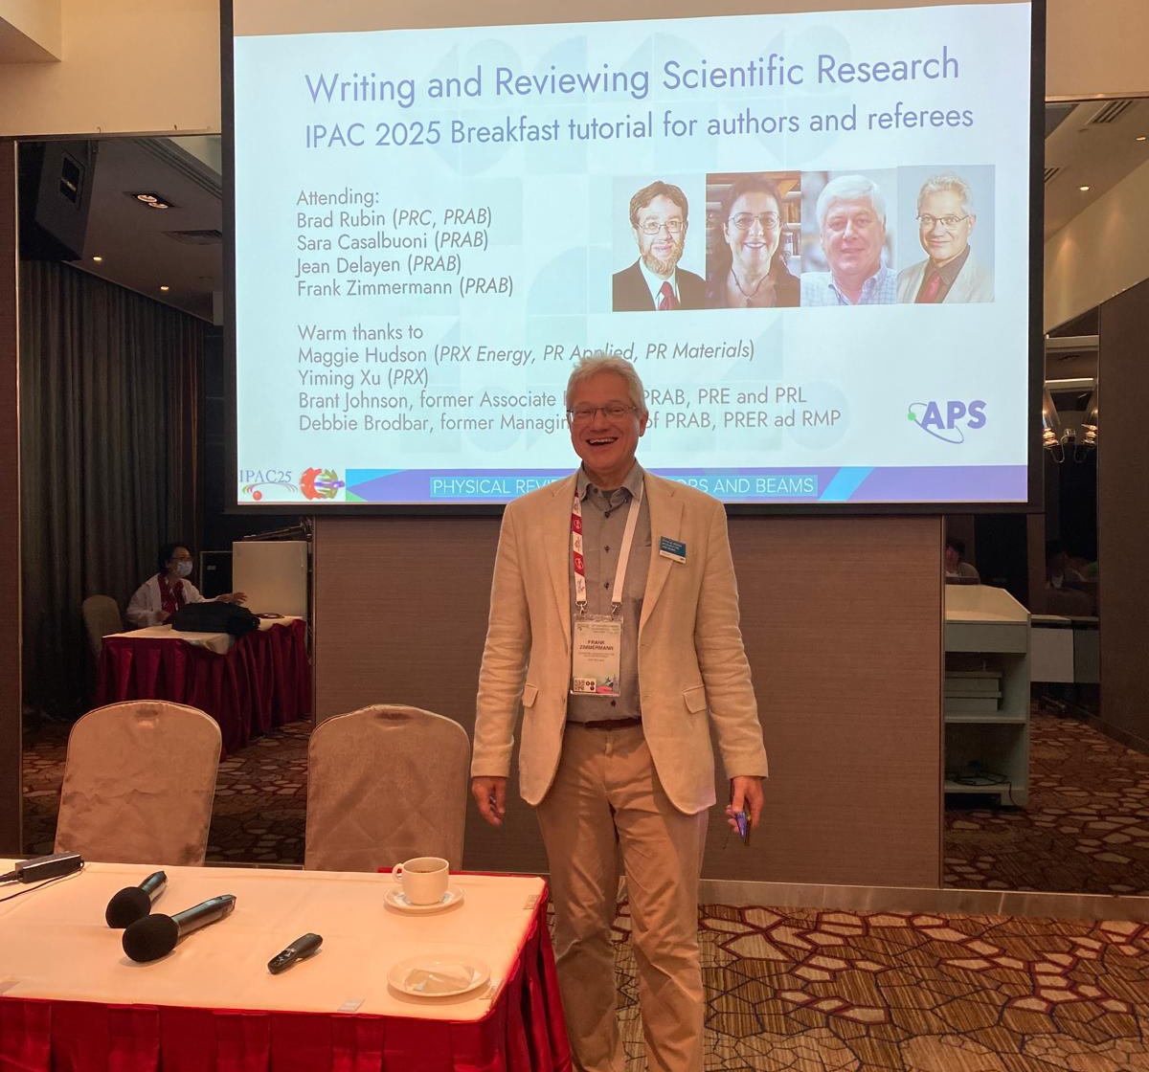

APS / PRAB breakfast/lunch tutorial for authors & referees
great seeing some of you this
morning !
Wednesday, 22 May, 2024, 7:30-10:30 am
Cumberland 1, OMNI Hotel, Nashville
“We publish in concrete and steel.”

Slide 14

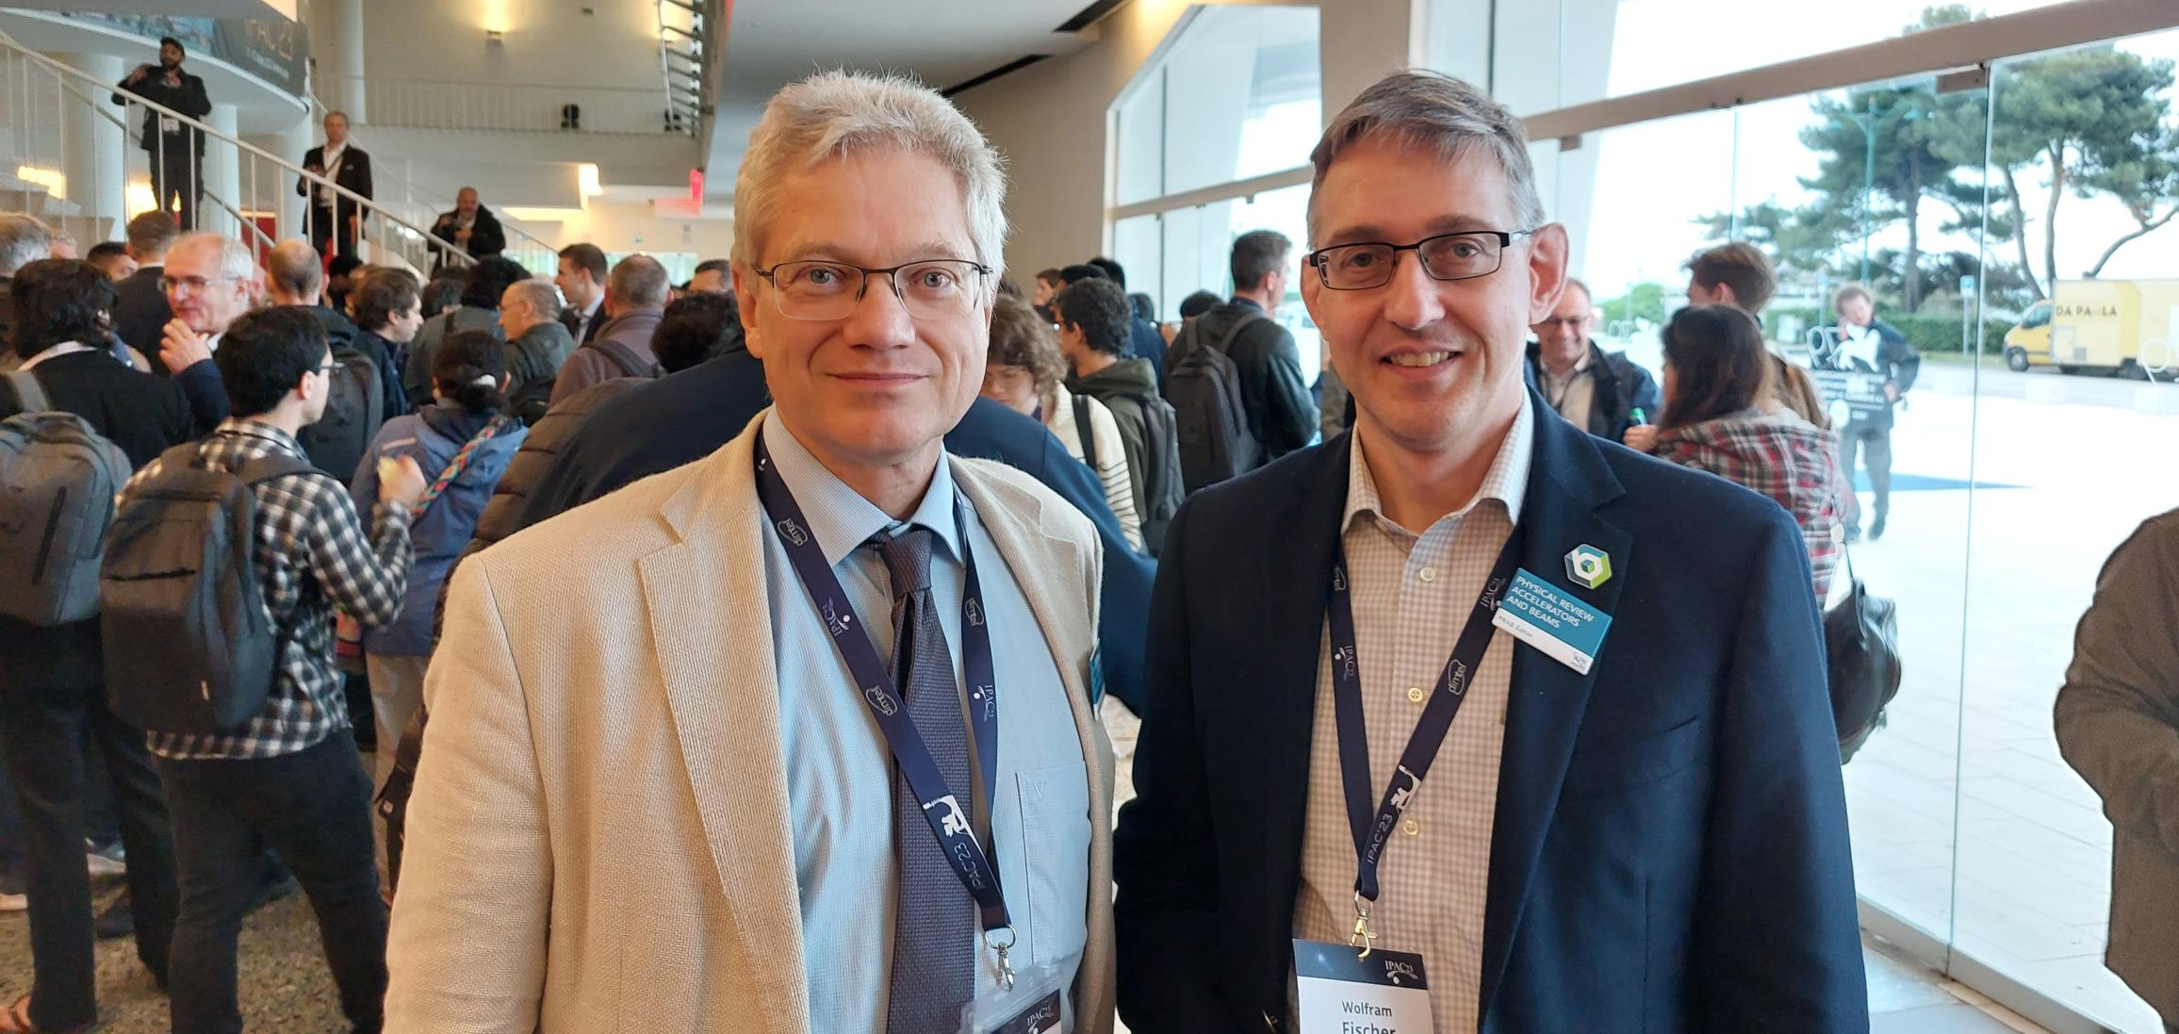
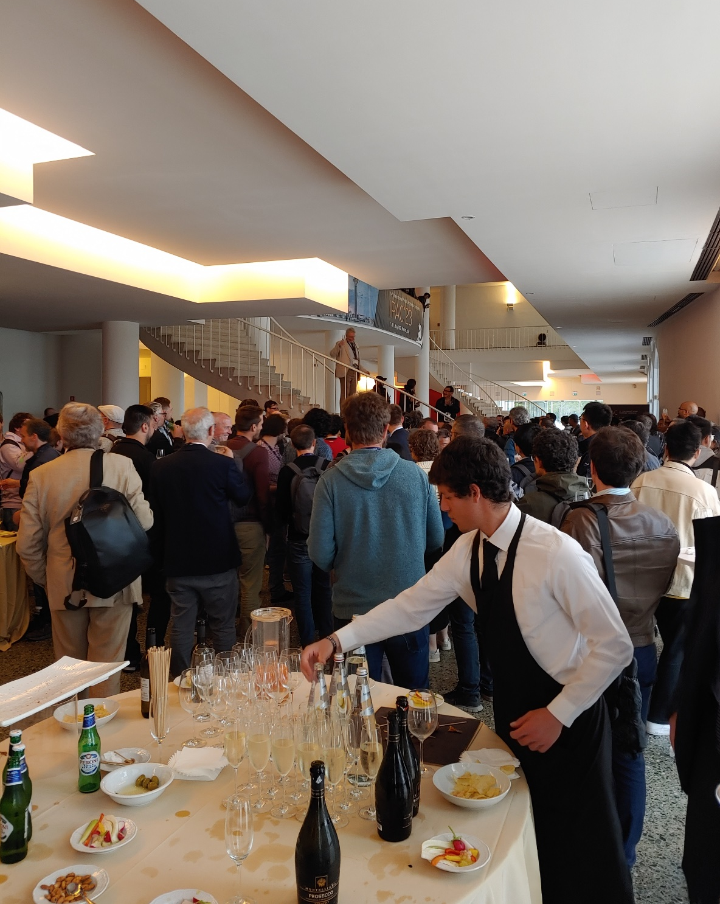
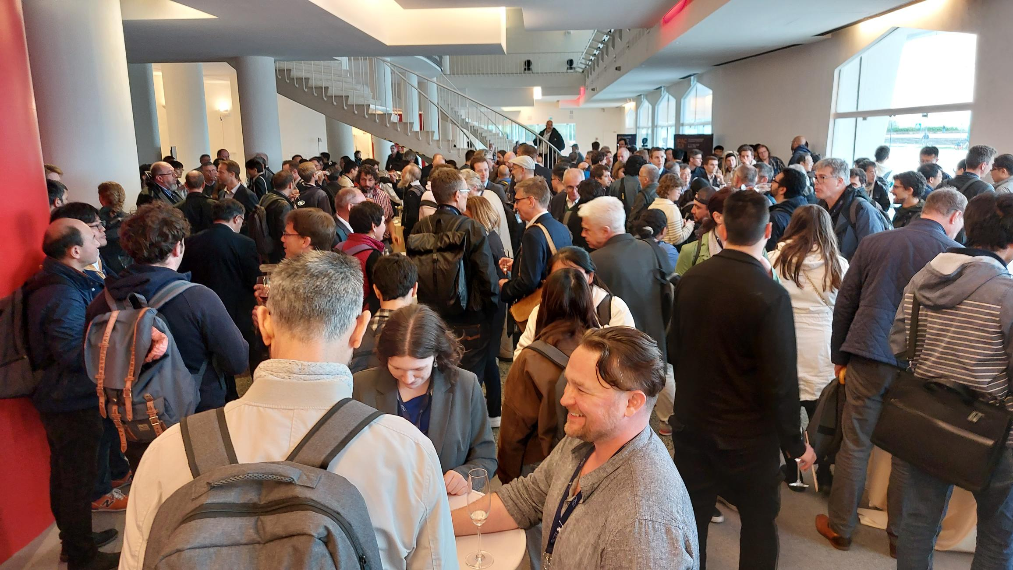
APS/Phys. Review/PRAB reception at IPAC’23

Slide 15
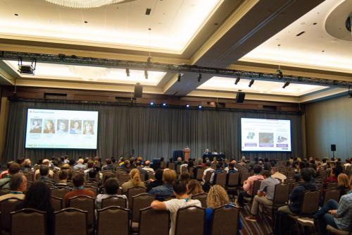
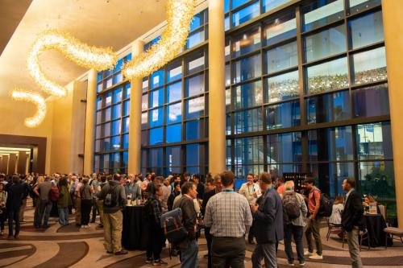
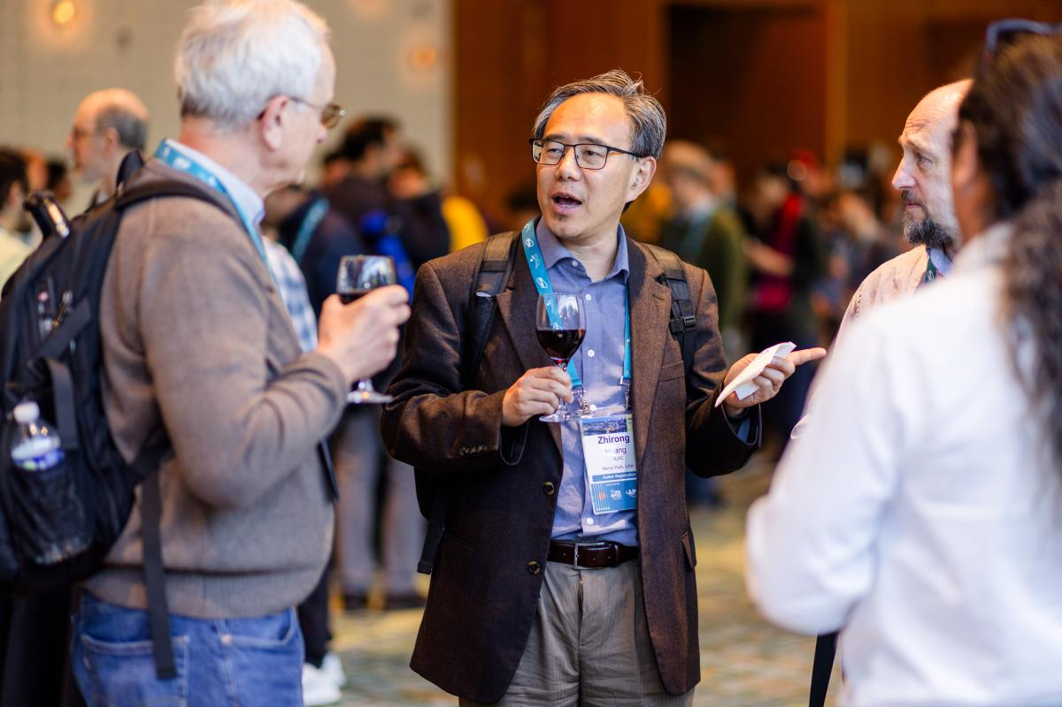
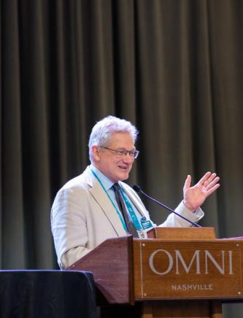
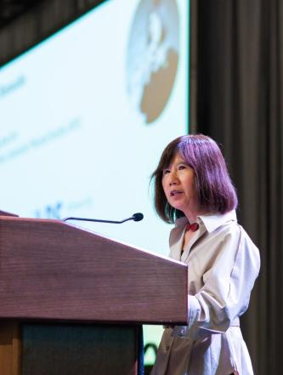
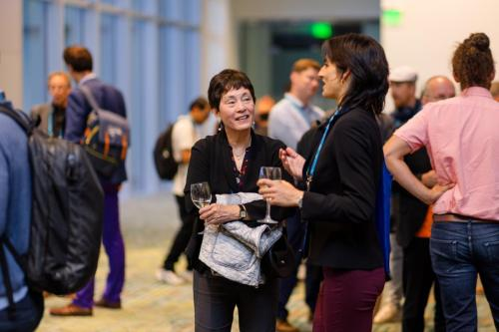
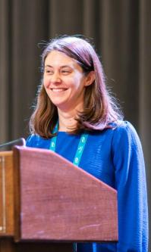
joint WISE & PRAB reception at IPAC’24

Slide 16

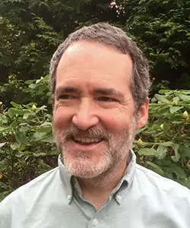

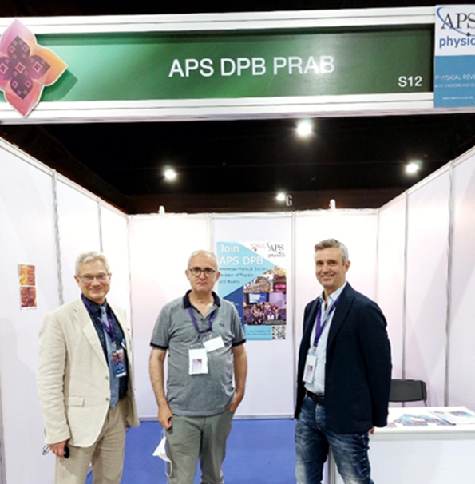
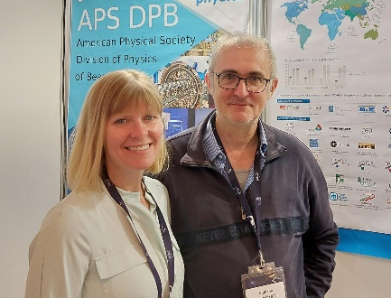
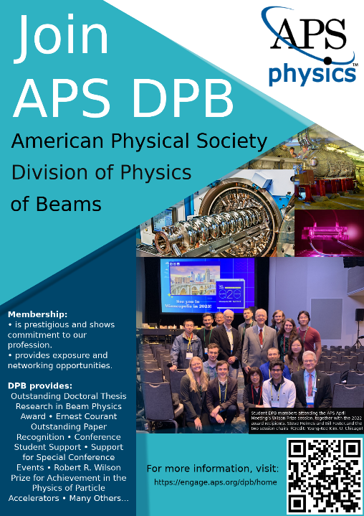
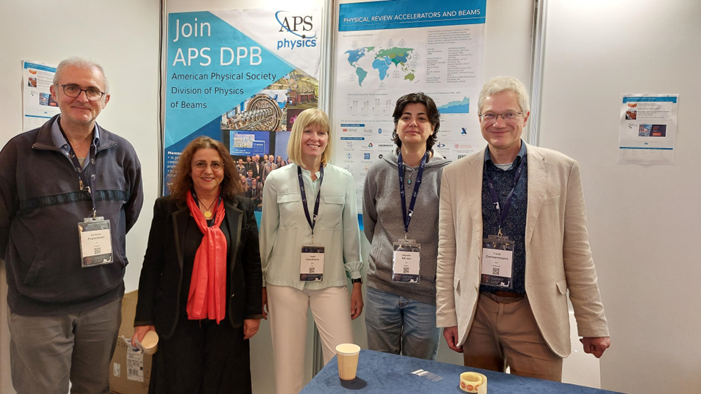
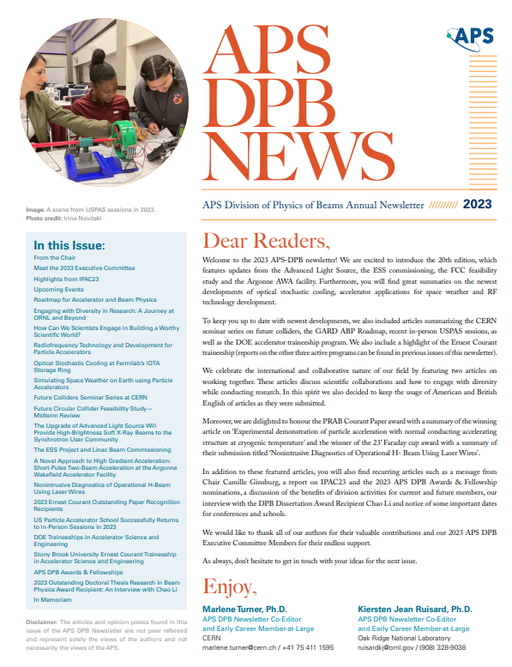
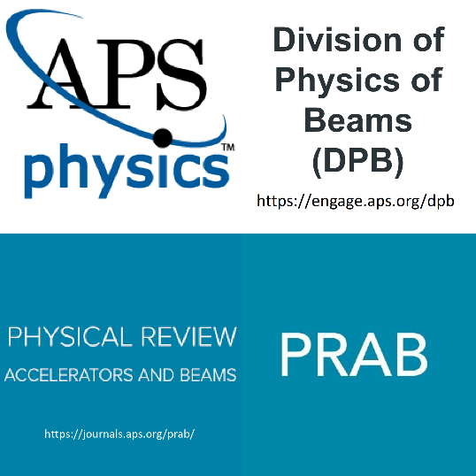
Invitation to join APS & DPB
Division of Physics of Beams
(DPB)
Established in fall 1985, the APS Division of Physics of Beams (DPB) is the oldest and worldwide largest professional group in the accelerator field. Open to all scientists with interest in the application of accelerators, covering wide breadth of sciences and industries.
→ Become an APS member ! Find your professional home in a diverse physics community and actively engage in scientific education, research, and advocacy.
And, especially, join the APS-DPB !!
https://engage.aps.org/dpb (APS student membership is free for the first year).
APS President: Brad Marston (Brown U)
APS-DPB Past Chair: Soren Prestemon

