Slide 1


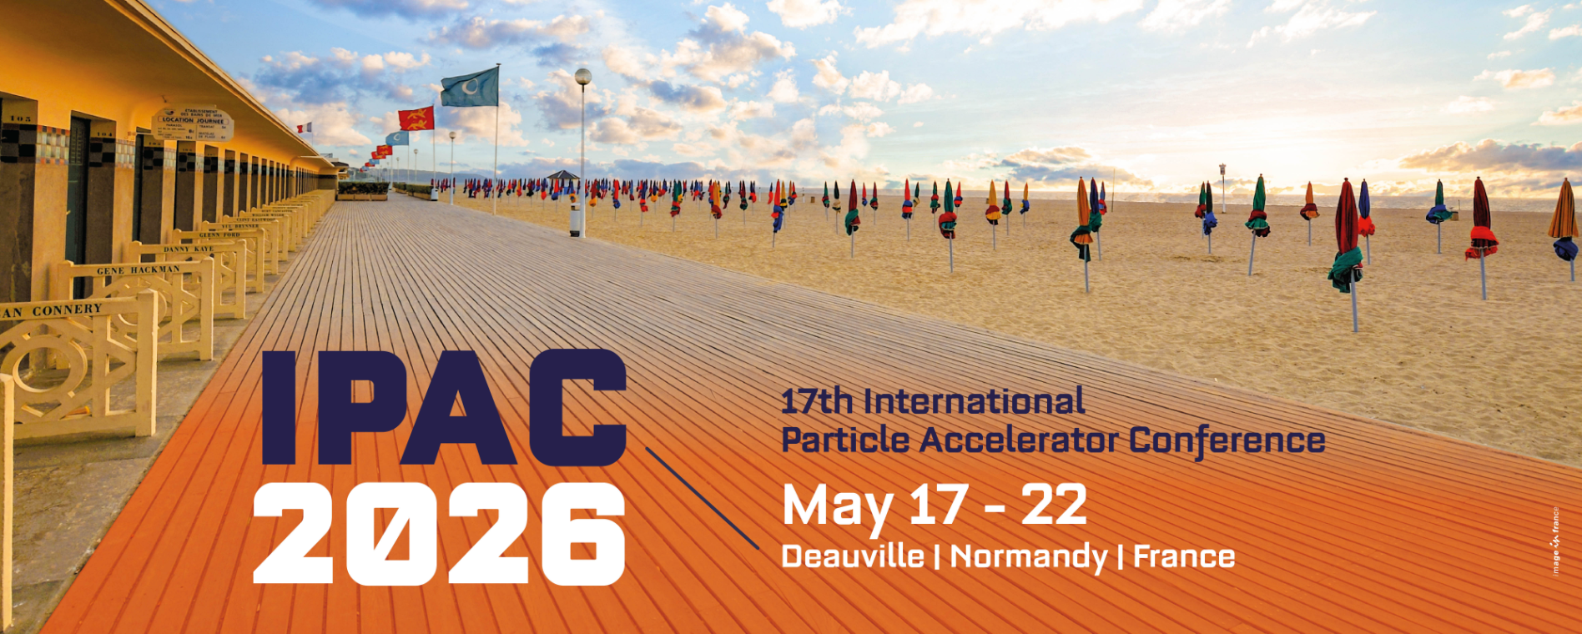
Sustainability into Pre-Procurement and Procurement: CERN’s Recent Journey
Enrico Cennini - CERN/IPT-PI-SE
20.05.2026
EDMS 3449957

Slide 2


Sustainability in Europe
United Nations - 2030 Agenda for Sustainable Development.
« … Building a climate-neutral, green, fair and social Europe – Green Deal …»
UN Sustainable Development Goals.
EU Directives:
  CSRD (Corporate Sustainability Reporting Directive) - Reporting
  CS3D (Corporate Sust. Due Diligence Directive) - Supply Chain Due Diligence
EU Framework : ESPR (Ecodesign for Sustainable Products Regulation).
2030 Agendas in EU in favor of Sustainable Development.
« … to reconcile the economy with the way we consume our planet … »
EDMS 3449957
Notes:
CSRD (Corporate Sustainability Reporting Directive): EU rules requiring companies in scope to report standardized sustainability information, including environmental, social, and governance impacts. CSRD defines what you need to disclose.
CS3D (Corporate Sustainability Due Diligence Directive) sets expectations for how you run due diligence in practice across your value chain. CS3D entered into force in July 2024, and the adopted Omnibus has now settled its final scope and obligations
ESPR (Ecodesign for Sustainable Products Regulation): EU framework to set product requirements so products placed on the EU market are more durable, repairable, circular, and resource-efficient

Slide 3
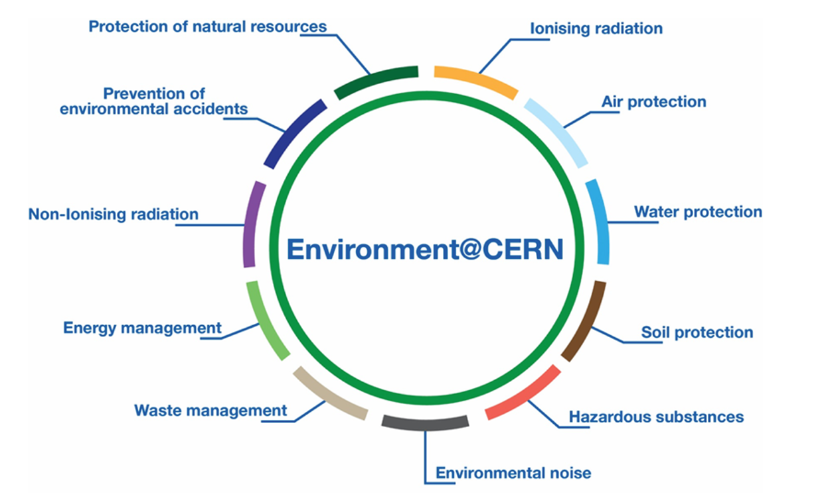








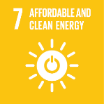

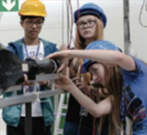
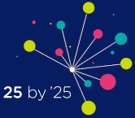
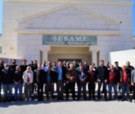

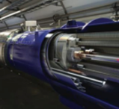



Sustainability at CERN
Education is one of CERN’s core missions
Beam Line for Schools Competition
Diversity is a
core value for CERN
25BY’25 Diversity and Inclusion Initiative
CERN is a model
for collaboration
Synchrotron Light Source (SESAME) in Jordan
Technologies
for health care
Cancer therapy
CERN
Knowledge Transfer
Magnet in the LHC Tunnel
CERN
Energy management
Heating local housing
CERN
Environment Protection
Reports (GRI Standard)
EDMS 3449957

Slide 4
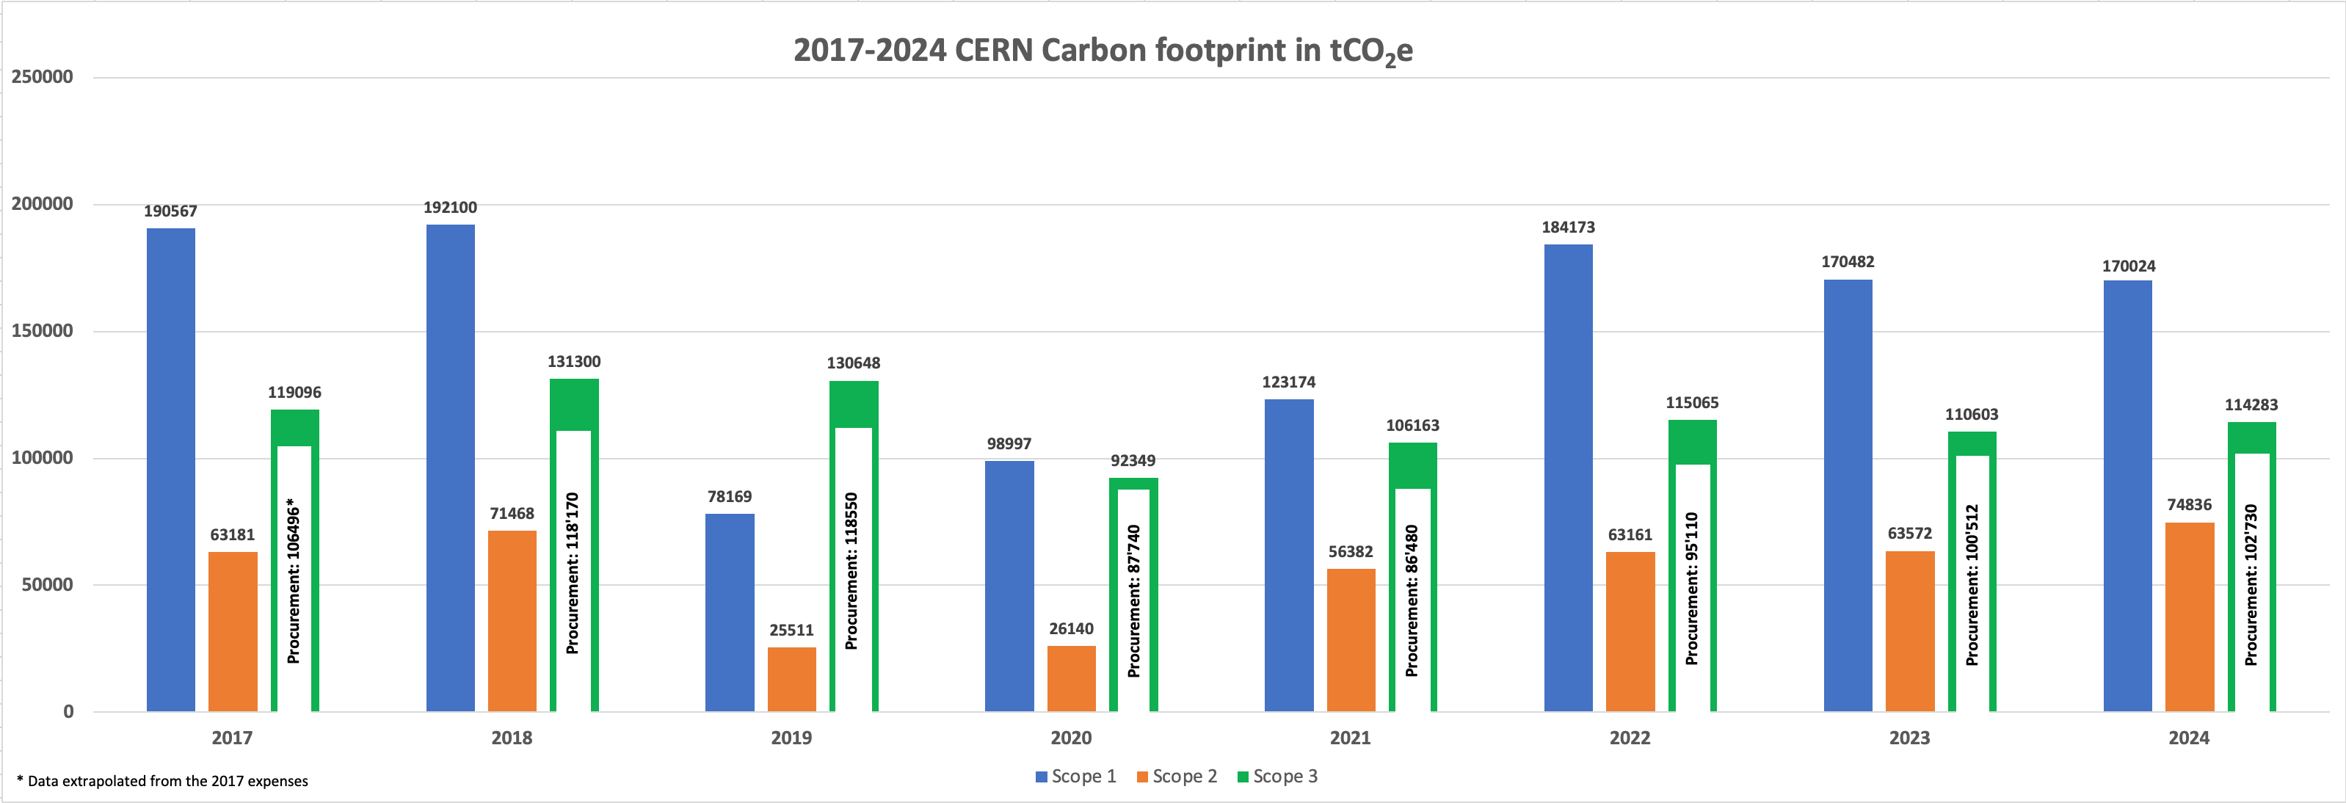




CERN Procurement impact on Emissions, Compliance, and Risk Management
RUN 2
LONG SHUTDOWN 2 (LS2)
RUN 3
LS3
¹
²
²
²
²
¹
²
¹
²
¹
²
¹
¹
¹
¹
¹ Location-based Scope2 estimates
² Spend-based Scope3 procurement estimates (Exiobase)
40% of CERN’s annual funding is spent with its suppliers.
> 90% of CERN’s indirect (Scope 3) emissions resulted from purchases of goods & services.
Increasing Rules/Regulations on Sustainability.
Alignment with CERN sustainability goals.
CERN decision to report (GRI standards)
Mitigate risks of environmental impacts.
Partnership with strategic suppliers to prevent/mitigate supply chain risks.
Enhance responsibility across the supply chain.
35% (RUN) up to 50% (LS) of CERN’s annual carbon footprint is driven by procurement.
EDMS 3449957
Notes:
CERN carbon footprint:
Scope 1 emissions are activity-based
Scope 2 are location-based (provide a general overview of the emissions intensity of the electricity grid in a specific location, while market-based estimates reflect the specific choices and investments of the consumer).
Scope 3 are activity based except for the procurement of goods and services which was estimated on a spend based approach.

Slide 5
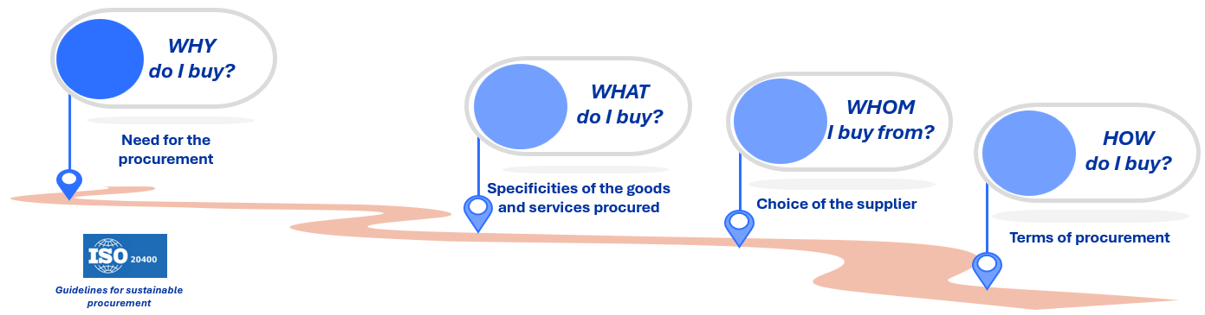
Embedding Sustainability into Pre-Procurement and Procurement Process
Pre-Procurement phase
Procurement Process
Most impactful time to embed sustainability
Set mandatory/desirable sustainability criteria (risk mitigation)
EDMS 3449957

Slide 6
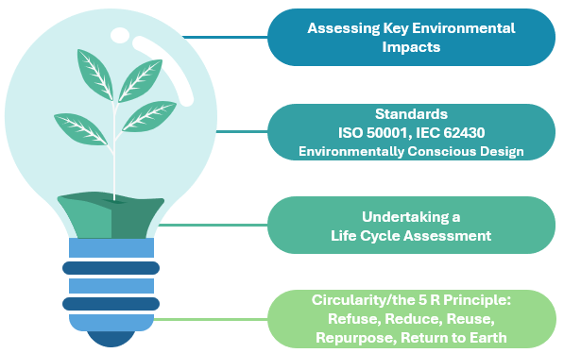

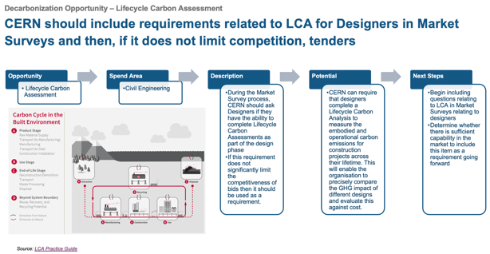
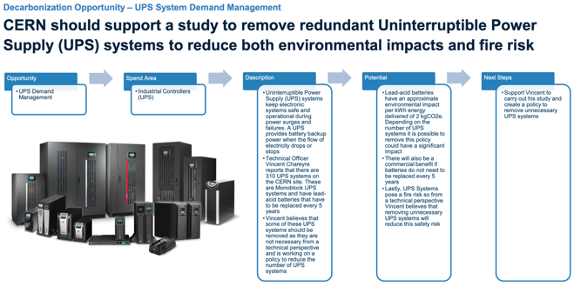
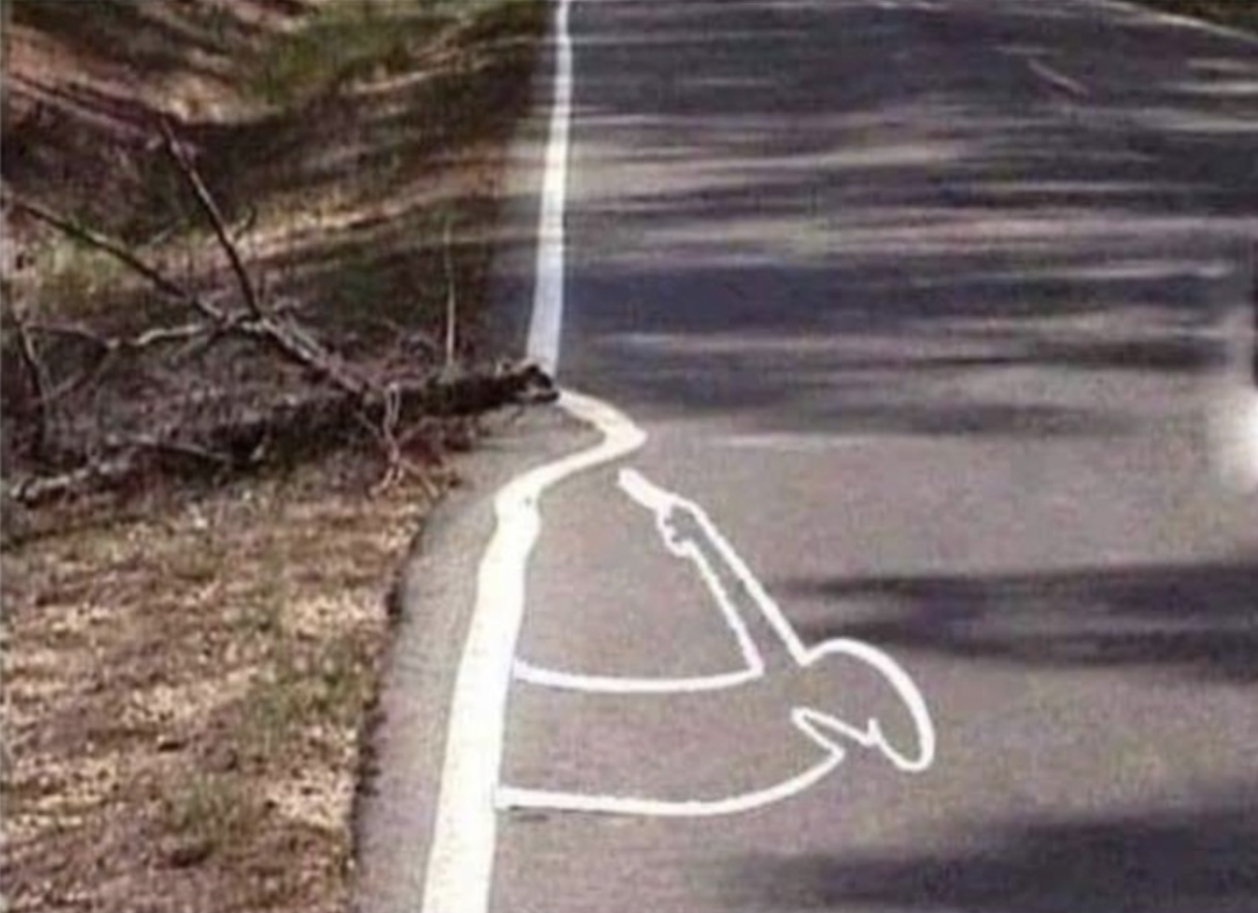
Pre-Procurement phase - Need definition & Life Cycle Assessment (LCA)
Assessments (Need & Lifecycle)
Challenge, Perform!
Start with environment!
Guidelines
Check best practices!
EDMS 3449957

Slide 7
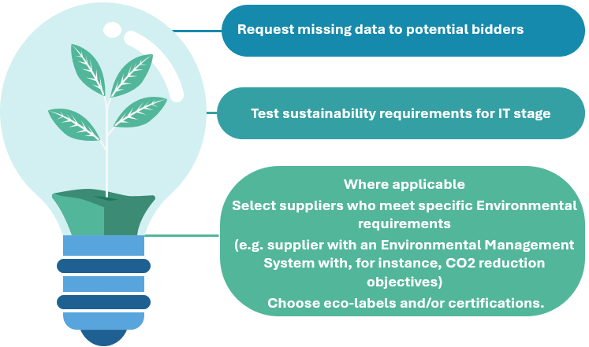
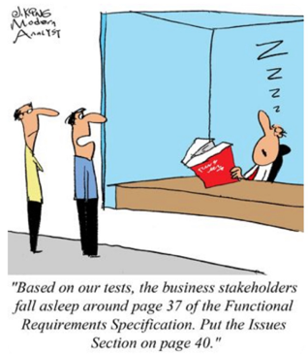
- Market Survey and Tendering
Procurement Process
Investigate
  Collect information, analyse supplier sustainability maturity.
  Evaluate suppliers based on their sustainability performance.
  Communicate
  Communicate Corporate Sustainability mission and goals.
  Engage supplier to discuss Sustainability expectations and capabilities.
Influence specs
  Include mandatory or desirable sustainability requirements.
  Include measurable sustainability requirements.
  Example: Supplier shall take back all packaging, delivery outside peak hours, delivery in bulk quantities…
EDMS 3449957

Slide 8
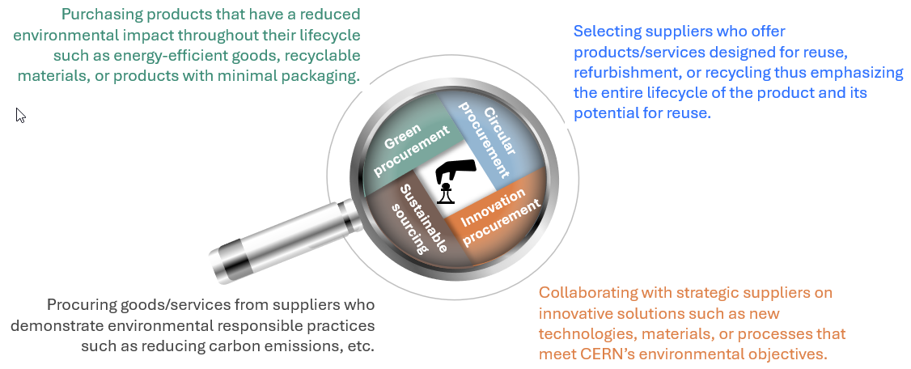
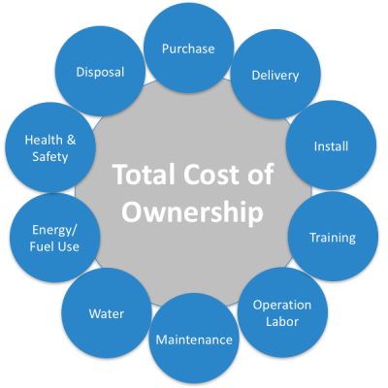
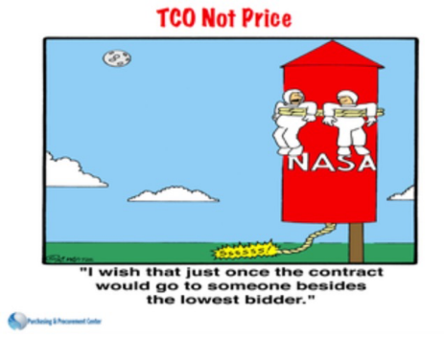
- Procurement Strategy
Procurement Process
Set Sustainability Strategy
Set Targets!
Total Cost of Ownership
Consider!
  Example: For energy at CERN, all costs such as maintenance, repairs, and disposal
  are taken into consideration in the adjudication price (ISO 50001 certification).
EDMS 3449957

Slide 9
Procurement Process
- Adjudication and Contract Management
Lowest Compliant
Evaluation of Suppliers and adjudication
  Lowest Compliant (LC): Environmental aspects are evaluated separately.
  Best Value for Money (BVFM): Bidders’ proposal assessed, scored, and weighted as part of the quality criteria.
→ Yes/No assessment and lowest compliant bidder wins.
Best Value For Money
→ Quality Score+Price Score, Weighting.
Set KPIs and/or SLAs that can be used to measure sustainability performance over the contract
Contract Management
  Monitor the supplier’s adherence to sustainability clauses of the contract.
  Collaborate with suppliers for continuous improvement/new opportunities (e.g. innovation).
EDMS 3449957

Slide 10
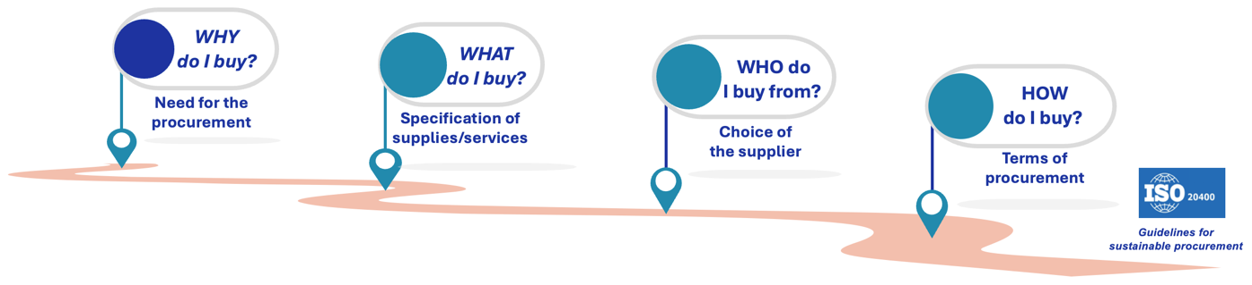
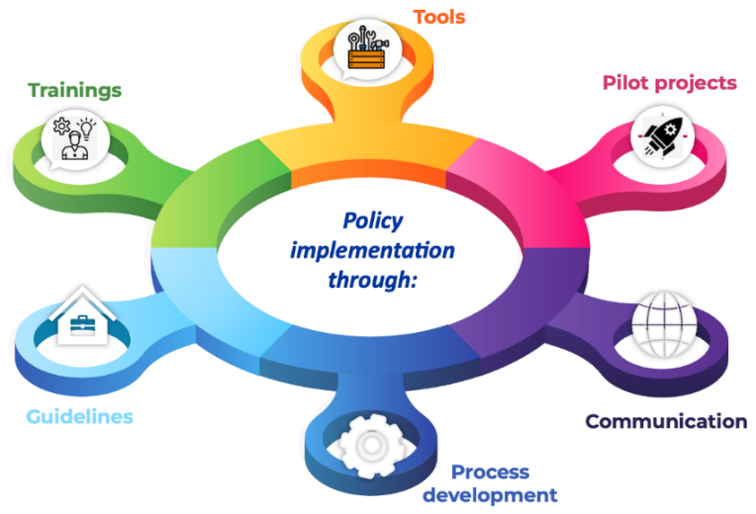

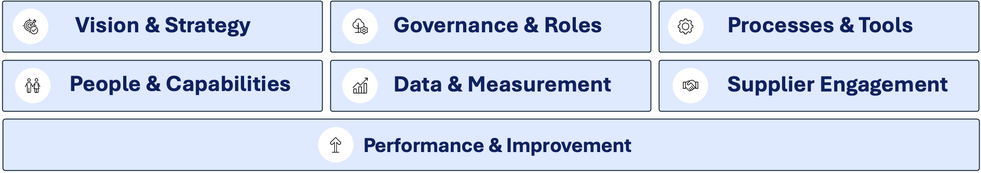

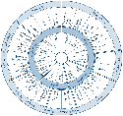

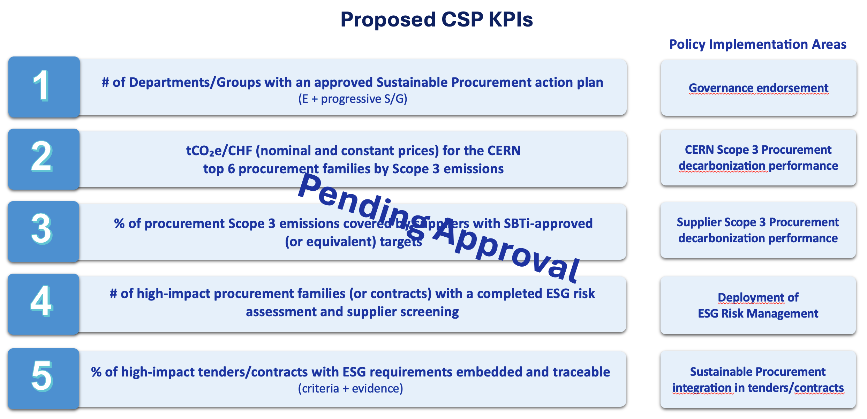
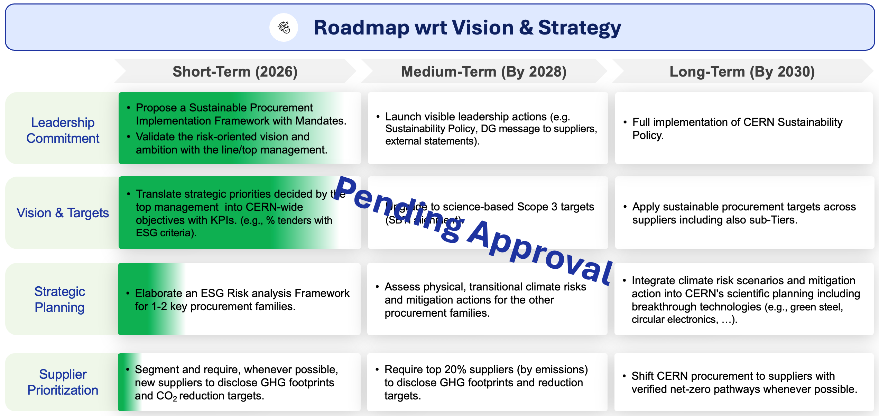
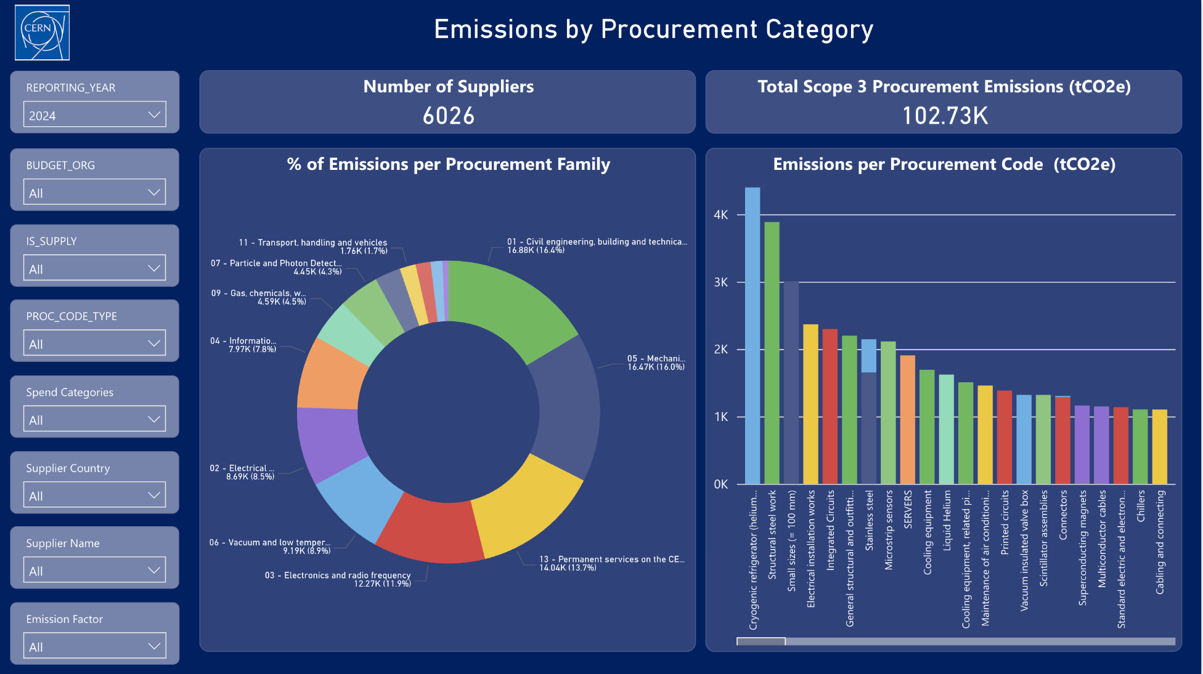
CERN journey from Environmentally Responsible Procurement to Sustainable Procurement
CERN Environmentally Responsible Procurement (CERP) Policy
CERP Policy implementation
Workshops with Departments
Guidelines
Jan 2024
Policy approval
2024 - 2025
Kick off phase
  Development of Trainings
Supplier engagement supported by a due diligence tool
Internal/External communication
Pilot Projects
Gap Analysis
ISO 20400 alignment
Implementation Clusters
Dec 2025
CERP Review
Lessons learnt
Feedback
Proposals
Objectives Setting
Expert benchmarks
Best practitioners’ insights
The CERP Policy Project becomes the CERN Sustainable Procurement (CSP) Project!
Deployment and scaling supported by KPIs (draft), roadmaps (draft), a supplier sustainability due diligence tool, and dashboards.
2026 - 2030
Deploy & Scale
EDMS 3449957

Slide 11
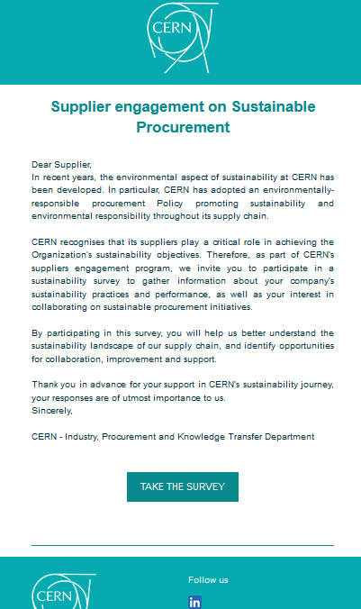

CERN Supplier Engagement - Survey
Scope and data collected
Identify maturity of suppliers on sustainability level
Identify to what degree suppliers are willing to collaborate
WHY
WHO
Sent to +300 suppliers from all procurement code families
Questionnaire with targeted sustainability questions
WHAT
Weekly automated emailing through SpotlerMail+
HOW
Response Rate
87 out of 267 suppliers among 9 procurement code families
= 32.5%
EDMS 3449957

Slide 12












CERN Supplier Engagement - Methodology
Questions were asked to suppliers to assess and score their level of:
Sustainability Maturity
Weight
on score
Engagement Willingness
Weight
on score
Does your company currently have a sustainability/environmental policy or program in place?
10%
Would you be interested in collaborating with CERN to calculate these emissions?
50%
Does your company hold any certifications related to environmental or sustainability practices?
10%
Does your company have initiatives in place to encourage sustainability/environmental practices across its supply chain?
15%
Would your company be open to setting targets for reducing the carbon footprint of its supplies or services provided to CERN?
20%
Does your company measure its carbon footprint?
20%
Does your company publish a report on its carbon footprint?
15%
Is your firm able to provide data on CO2 emissions specifically related to services or products provided to CERN contracts?
10%
Length of relationship with CERN in years
15%
Has your company defined specific sustainability/environmental goals for the next 5 years?
20%
Yearly average contract amount in the last 3 years
15%
EDMS 3449957

Slide 13
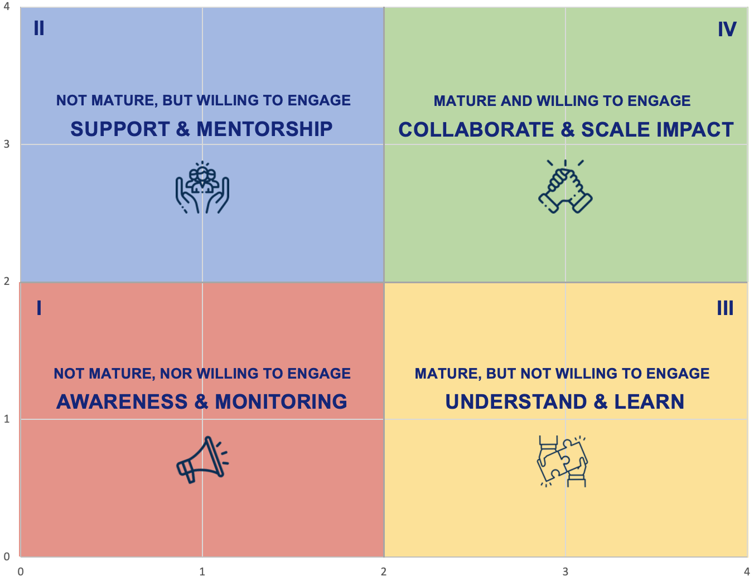
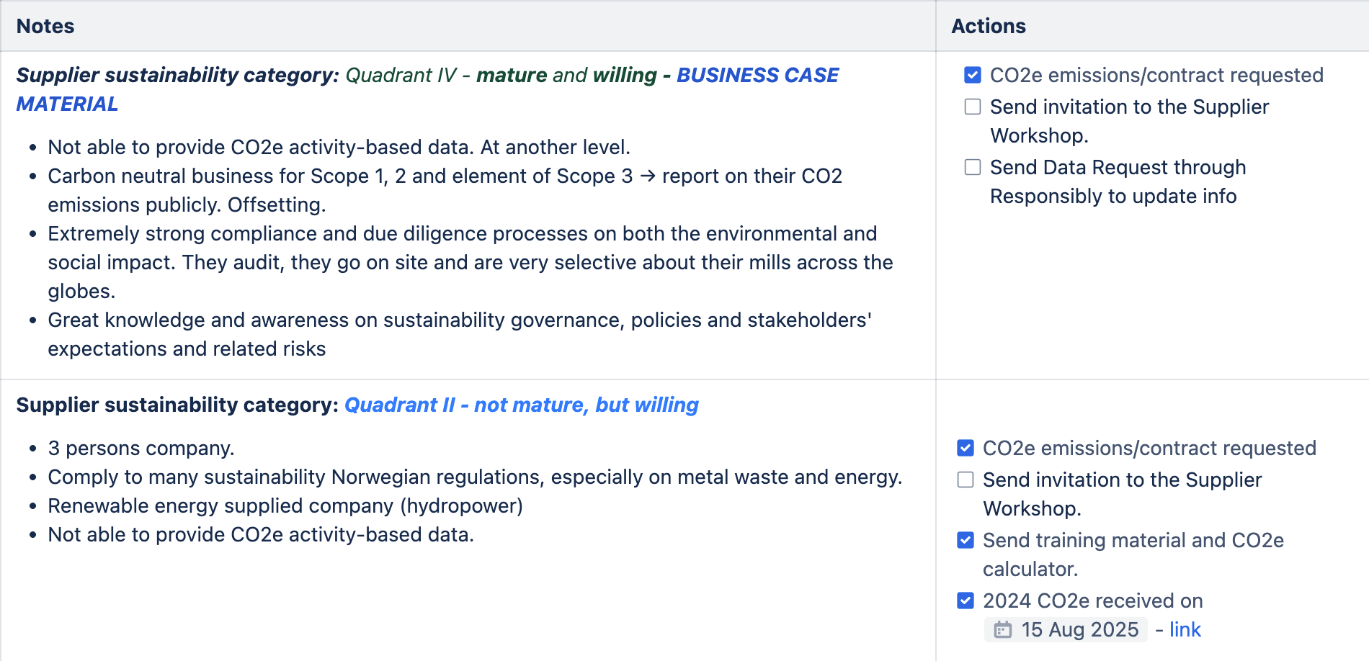
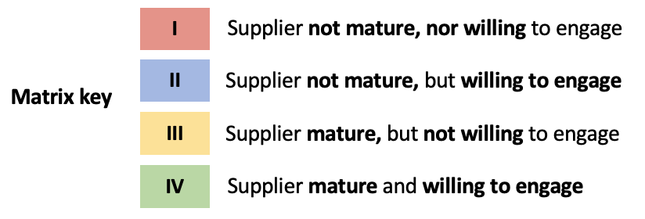

CERN Supplier Engagement - Action Plan
II QUADRANT
IV QUADRANT
Supplier willingness to collaborate around sustainability
I QUADRANT
III QUADRANT
Maturity of the suppliers’ strategy towards sustainability
To develop ad hoc engagement action plans for suppliers per quadrant.
EDMS 3449957

Slide 14


Why an Environmentally Responsible Procurement Policy?
Sustainability
into Pre-Procurement
and Procurement:
CERN’s Recent Journey
01
Procurement impact: 35% (RUN) up to 50% (LS) of CERN’s annual carbon footprint is driven by procurement.
Prevent/mitigate supply chain risks.
Stakeholder expectations: CERN wants to align with internal sustainability objectives and global best practices (e.g. ISO 20400, GRI, SDG reporting).
Embedding Sustainability
02
Ideally at the need definition and design phases.
Set mandatory/desirable sustainability criteria throughout the procurement process.
Engage suppliers on sustainability to learn/spread value in the Supply Chain.
Key takeaways
03
Supplier Engagement - Who’s ready and who needs help?
Tailor engagement per quadrant.
Use surveys, audits, training, and pilot collaboration.
04
The CERP Policy Project becomes the CERN Sustainable Procurement (CSP) Project.
Deployment and scaling in all Departments.
Setting targets and KPIs supported by dashboards.
Launch new supplier engagement rounds.
EDMS 3449957

Slide 15
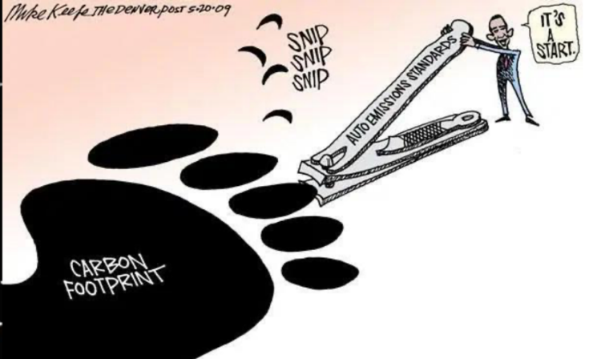

Responsible Procurement
Scope 1
Scope 2
Scope 3
Scope 3
Thank you!
Questions?
EDMS 3449957

Slide 16
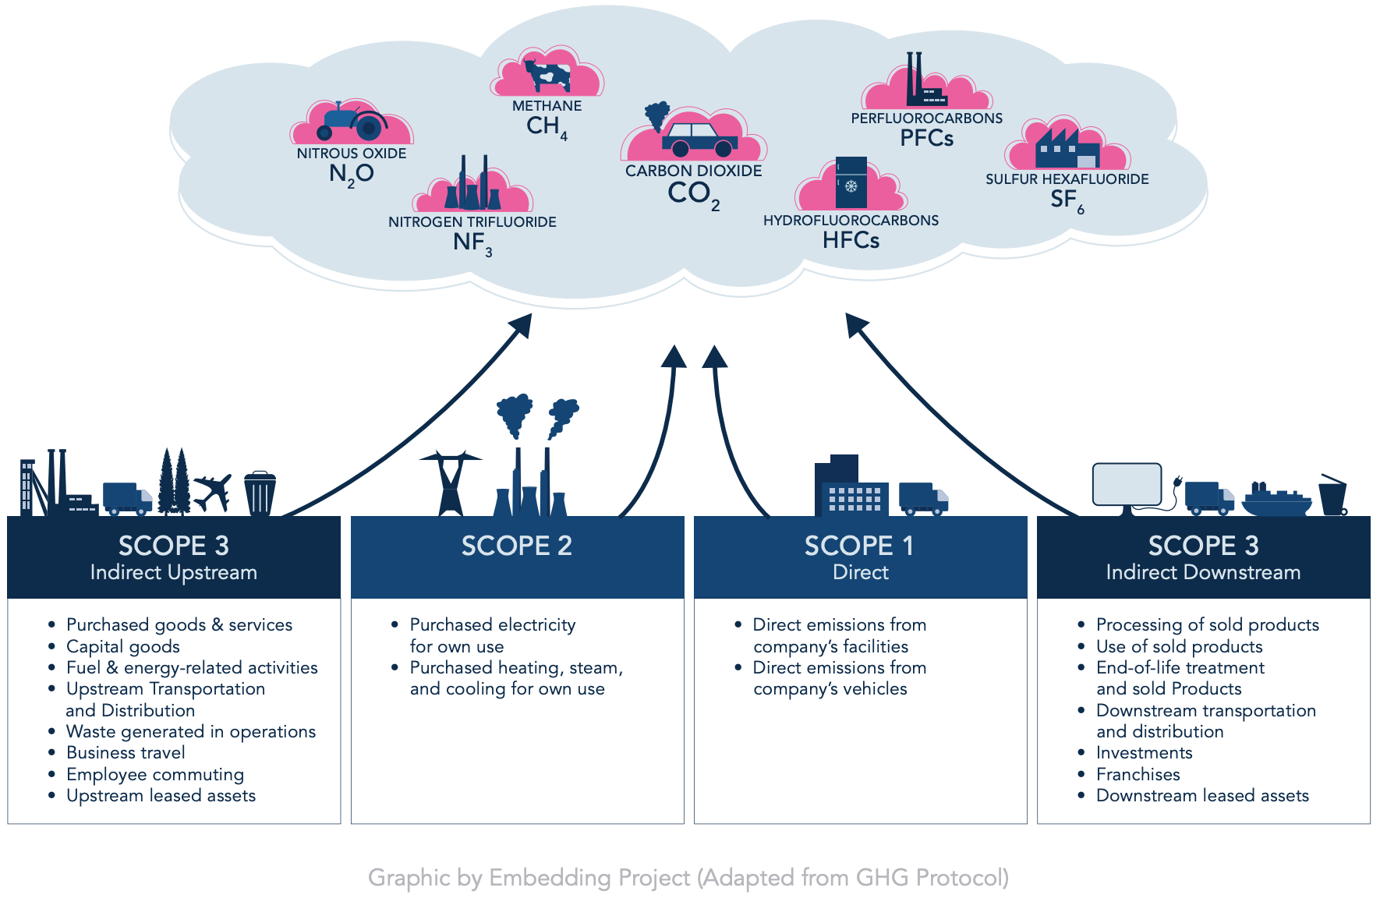
EDMS 3449957

Slide 17
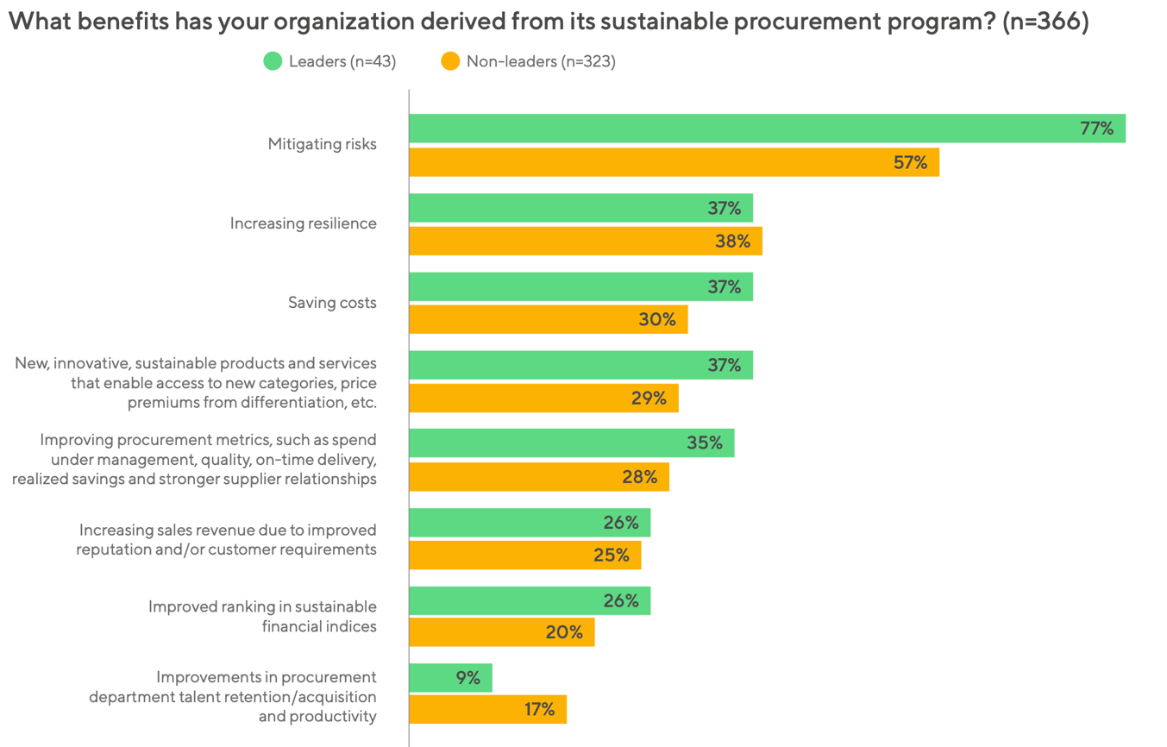
Benefits of Sustainable Procurement
“Sustainable Procurement Barometer 2024,” EcoVadis and Accenture, February 2024. Based on data collected from nearly 600 buyers and more than 1,000 suppliers, worldwide.
EDMS 3449957

Slide 18
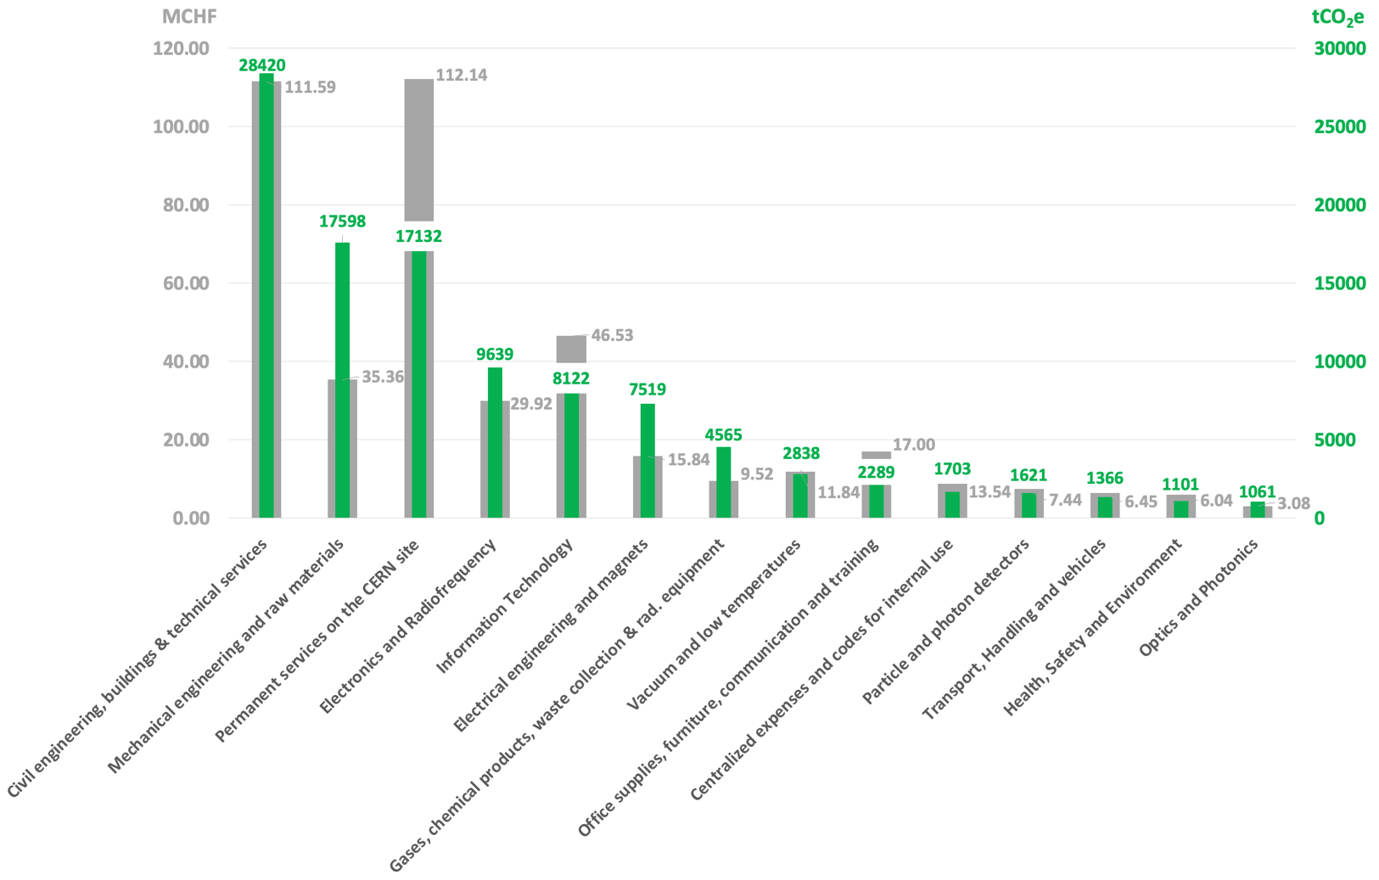
2022 total CERN + TEAMS expenses: ~430 MCHF
(excl. VAT & non procurement related)
2022 total related emissions: 104’974 tCO₂e
Top 6 CO₂ emitting
Procurement families
NB: Estimation following a spend based method (CERN 2022 expenses) using EXIOBASE conversion factors.
EDMS 3449957
Notes:
Regarding CO2 emissions linked to the purchase of goods and services at CERN, the spend-based methodology made it possible to identify the purchasing families with the highest emissions in 2022 beyond the CO2 emissions figure which remains a very rough estimate.
Each year the order changes slightly, however the 6 most emitting families remain the same.

Slide 19
Location-based vs. Market-based Scope 2 estimation
These are two different methods of calculating carbon emissions associated with electricity consumption.
Location-based Scope 2 estimates are based on the average emissions intensity of the electricity grid in a particular location.
  It considers the emissions from all electricity sources in that location, regardless of the contractual agreements or specific electricity purchases made by the consumer.
  This method assumes that consumers are using the average mix of electricity sources in their region.
  Location-based estimates may not accurately reflect the emissions impact of consumers who have made efforts to support renewable energy.
Market-based Scope 2 estimates considerthe specific contractual agreements and electricity purchases made by the consumer.
  It considers the emissions associated with specific renewable energy certificates (RECs) or power purchase agreements (PPAs) that the consumer has invested in.
  This method allows consumers to track the emissions associated with their own electricity choices and helps support the development of renewable energy projects.
  Market-based estimates are more conservative because they provide a more accurate reflection of the emissions impact of individual consumers.
In summary:
Location-based estimates provide a general overview of the emissions intensity of the electricity grid in a specific location, while market-based estimates reflect the specific choices and investments of the consumer.
Market-based estimates can give consumers more accurate information about their own emissions impact and allow them to support renewable energy projects directly.
EDMS 3449957

