Slide 1
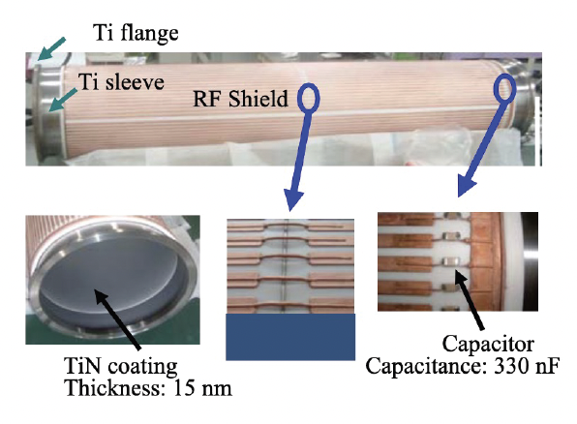
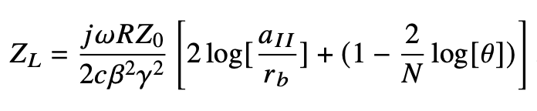
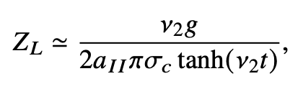
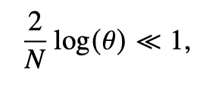
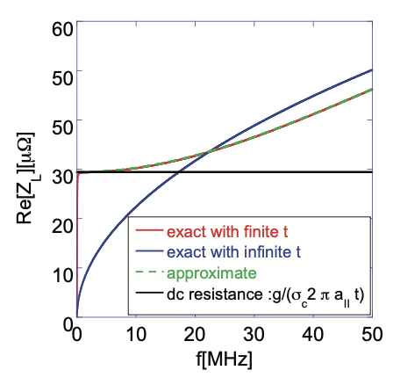
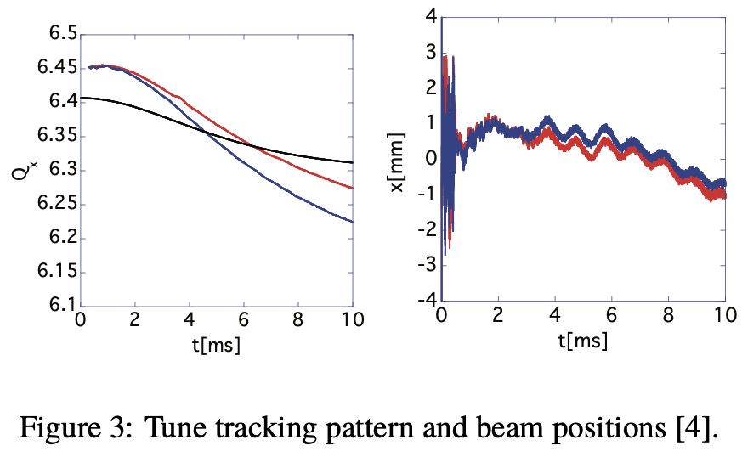
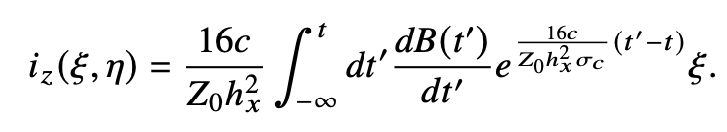
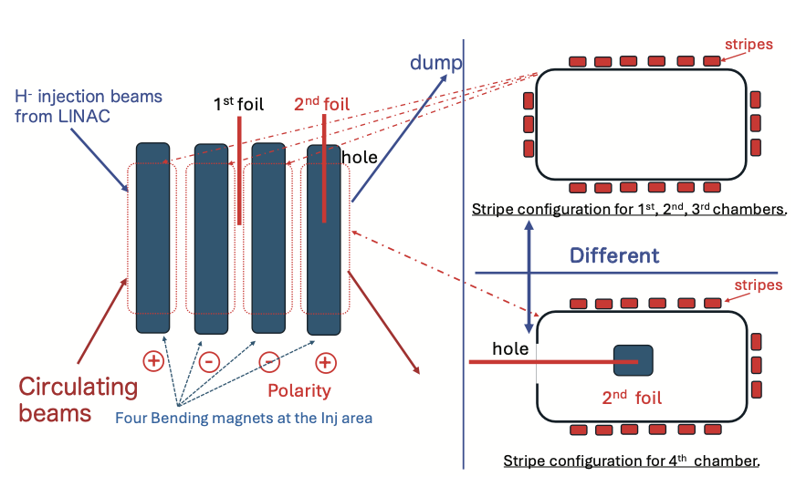
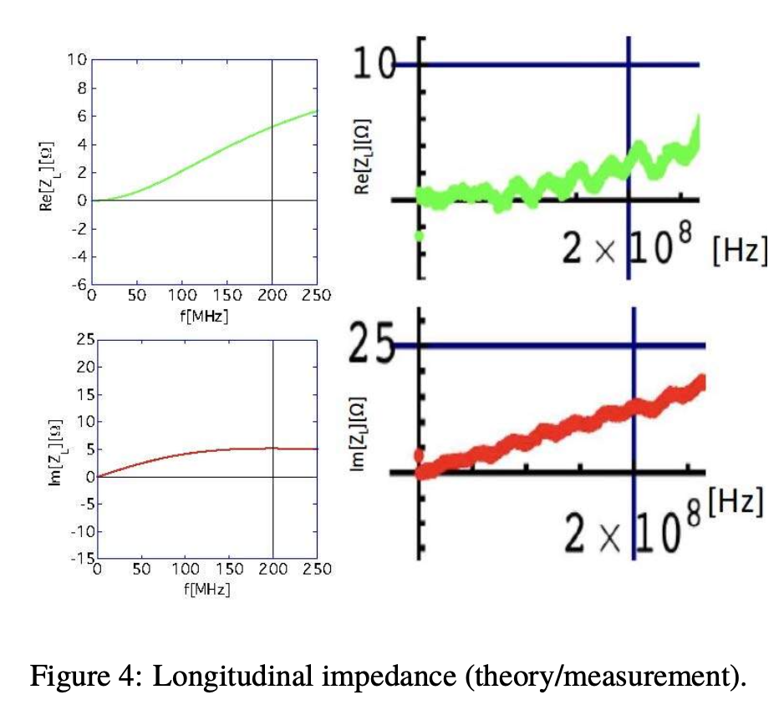
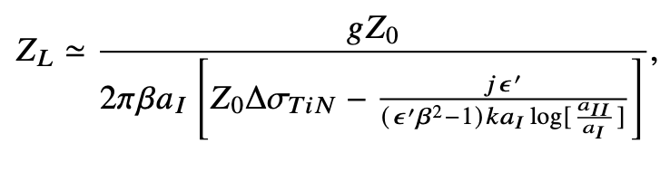
Design Concept of Ceramic Chambers at the J-PARC RCS: An Analytical Perspective
Y. Shobuda, M. Kinsho, T. Toyama (J-PARC)
Abstract:
Ceramic chambers are essential for rapidly accelerating high-intensity beams at the J-PARC RCS, as they mitigate the effects of eddy currents on the chambers. An analytical perspective could provide valuable insight into the design of ceramic chambers, though computer simulations and demanding measurements need to certify the estimates. The identity of bending magnets, including chambers, is a key to reducing beam losses at the injection area of the RCS.
Introduction
The 3-GeV RCS (rapid cycling synchrotron) at J-PARC is a proton accelerator to achieve a 1-MW beam by accelerating two bunches containing N_{b}=4.15 × 10¹³ particles per bunch (ppb) from 400 MeV to 3 GeV in 20 ms with a repetition rate of 25 Hz, without any transverse feedback system (Shobuda et al, PTEP 2017, 013G01, (2017)).
The figure shows a developed ceramic chamber, placed in magnets at the RCS.
The outer surface of the ceramic, with radius a_{II}, is covered with N rectangular copper stripes (RF shields) of horizontal width h_{x} and radial thickness t, each terminated at one end by capacitors. The inner surface, with radius a_{I}, is coated with a titanium nitride (TiN) layer of thickness Δ.
The ceramic chambers with TiN coating are essential for rapidly accelerating high-intensity beams within 20 ms, as they mitigate the effects of eddy currents in the chamber and suppress secondary electron emission when the halo part of the proton beam collides with the chamber surface, avoiding the electron cloud instability (Ohmi et al, PRAB 5, 114402, (2003)).
An analytical analysis could provide valuable insights in designing the ceramic chambers, which may assist the development of ceramic chambers in the next generation, supported by the success of the J-PARC RCS.
(Kinsho et al, Vacuum. 73, 187, 2004).
Design concept in terms of beam impedances and chamber heating
Determination of the capacitance
Determination of the thickness of RF shields
Determination of the area ratio covered by the stripes
Because the capacitance is determined by the impedance becomes low for the circulating beam and high for the induced current with 25 Hz, the capacitance is chosen as 330 nF.
However, the RF shielded ceramic chamber functions as an LCR circuit in combination with both flanges at the ends (The strongest intrinsic frequency is around 250 kHz (Shobuda et al, PRAB 12, 032401, 2009)).
When the sinusoidal external magnetic field B_{ext} is applied, the field modulates as ΔB/B_{ext} < 2× 10⁻⁷ , which is not so significant at the RCS.
Measurements were performed with different tune-tracking patterns (red and blue) for a 1-MW beam (Black is the resonance line originating from 250 kHz).
Though the red and blue lines cross the resonance line at approximately 6 ms and 4.5 ms, respectively, no beam instability or beam loss is observed.
Since the screening effect of the electromagnetic field is important for designing the RF shields, the thickness t of the RF shields is determined by considering the leakage field from the chamber.
Consider a g long cylindrical metal chamber with conductivity σ_{c}, where the inner radius and the thickness are a_{II} and t, respectively.
It is essential to accelerate `non-relativistic' beams at the RCS. As a result, the general form of resistive-wall impedance, except for the space charge impedance, is simplified as
It becomes a dc-resistance when the skin depth is larger than t.
The wall currents can shield the electromagnetic field from the non-relativistic beam with Lorentz-β=0.97 (3-GeV).
The area ratio θ=N h_{x}/2πa_{II} covered by N stripes is determined by referring to the space-charge impedance of a chamber composed of the stripes (T. Wang et al, PRAB 4, 104201, 2001) :
When the condition
is satisfied, Z_{L} reproduces the
space-charge impedance of a cylindrical
chamber with inner radius a_{II}.
We can set θ = 0.5 and N~100 as parameters, once the horizontal width h_{x} is determined by the heating condition due to eddy currents in the stripes.
Determination of the horizontal width
Thanks to the capacitors, the heating contribution of the ceramic chamber from the RLC circuit is negligible.
The contribution from the inner part of the stripe is dominant.
For a 1m long stripe with h_{x}=5 mm and t=0.5 mm, the power consumption is ~0.5 W/stripe under 25 Hz operation.
Determination of the thickness Δ of TiN coating
Mitigation of Resonance Losses Associated with the Injection Scheme
The secondary electron emission yield coefficient δ of the material on the inner surface of the chamber must be below 1.
A significant reduction was observed for a TiN coating of 1-2 nm (Michizono et al, J. Vac. Sci. Technol. A 10, 1180, 1992).
TiN suppresses both the diffusion of adsorbed gases from the ceramic into the chamber and the adsorption of moisture on the chamber surface (Kato et al, Vac. 38, 380, 1995).
The impedance budget needs to be considered to determine Δ (Chin et al, HB’06, 125; Chin et al, HB’08, 40).
By generalizing the model (T. Wang et al, PRAB 4, 104201, 2001), we can calculate the impedances of the ceramic chamber with TiN coating, approximated as a chamber multi-layered with TiN, ceramic, and the conductive pipes (Shobuda et al, PAC’05, 1898).
Δ=15 nm satisfies the impedance budget (Chin et al, HB’06, 125) and suppresses the secondary electron emission.
Thinner TiN is better only from an impedance point of view, because the wall currents flow predominantly on the RF shields as Δ approaches zero.
Comparison to the measurements
Four bending magnets, including the chambers, must be perfectly identical because a trapezoidal magnetic field is excited at the injection period, causing ΔB/B_{ext} > 0.018 for each chamber (Shobuda et al, PRAB 12, 032401, 2009)).
The identity was significantly violated at 181 MeV injection, causing huge beam losses at ν_{x}=ν_{y}=6.2, analytically explained (Shobuda et al, JPS Conf. Proc. 8, 012003, 2015).
After 400 MeV upgrade, beam losses at ν_{x}=6.14 are still observed, explained analytically (Shobuda et al, JPS Conf. Proc. 8, 012003, 2015) because of partial recovery of the identity.
The excellent agreement between the theoretical results and measurements up to at least 100 MHz, sufficient for the RCS.
The heating due to the beam is ~0.5 W/chamber, acceptable.
Summary
An analytical analysis could be a good guideline in designing ceramic chambers to capture some physical perspective, although simulations and measurements need to certify the estimate in the end.

