Slide 1
ON THE OPTIMIZATION OF THE NON-LINEAR PERFORMANCE OF
4th-GENERATION LIGHT SOURCES
B. Kuske, B. Alberdi-Esuain, Helmholtz-Zentrum Berlin
IPAC 2026, Deauville, May 20th, 2026
Cherish efficiency

Slide 2
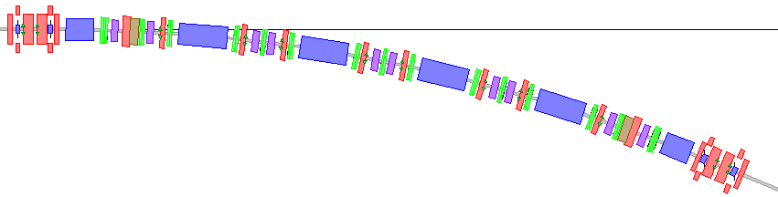
Introduction to the topic
1/16 of the BESSY III lattice
6-bend achromat with distributed sextupoles
4th generation storage ring light sources are usually built as Multi Bend Achromat lattices (MBA)
  MBA-lattices usually have many multipoles!
  proper linear lattice design can ease non-linear behaviour
    (phase matching, reverse bends, low sextupole strength) ¹⁾
  optimization of multipoles not trivial
Need to achieve:
  large momentum acceptance (MA) - long Touschek lifetime
  large dynamic aperture (DA) – large window for injection
1) B. Kuske and P. Goslawski, “Construction of multi-bend achromat lattices based on their substructures,” Phys. Rev. Accel. Beams, 2026, accepted for publication.

Slide 3
Content
2 approaches:
a) Multi-Objective Genetic Algorithms (MOGA) directly on DA and MA
  ‘brut force’ numeric optimization of the physical model (to best knowledge)
b) Driving Term Minimization (DTM)
  Minimization effects of resonances, tune confinement
Decide for the project phase which one to use
Content of presentation:
Brief introduction to driving terms
Sketch of the DTM algorithm
Results of DTM
Results of MOGA calculations
Comparison of both approaches
All calculations are performed for the
BESSY III lattice (current design)
and use pyAT¹⁾.
1): S. White, L. Carver, L. Farvacque, and S. Liuzzo, “Status and recent developments of python Accelerator Toolbox,” JACoW, vol. IPAC2023, WEPL031, 2023. doi:10.18429/JACoW-IPAC2023-WEPL031

Slide 4
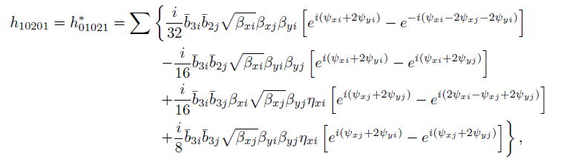
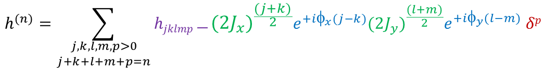

Introduction to driving terms
After demanding mathematical treatment… ¹⁾
The n^{th} order of the Hamiltonian of particle motion in a ring can be expanded as:
(using action angle variables)
$$h^{(n)}=\sum_{\begin{aligned}j,k,l,m,p>0 \\ j+k+l+m+p=n\end{aligned}}{hjklmp}\frac{}{}{(2J_{x})}^{\frac{(j+k)}{2}}e^{+iφ_{x}(j−k)}{(2J_{y})}^{\frac{(l+m)}{2}}e^{+iφ_{y}(l−m)} δp$$
Driving terms
amplitude dependence
phase dependence
energy dependence
$hjklmp$ :
  all DTs are accumulating sums over magnet data
    and linear lattice functions
  expressions can be cumbersome, see ^{1), 2), 3)}
  p = 0 geometric DTs
  p ≠ 0 chromatic DTs
1) J. Bengtsson, “The sextupole scheme for the SLS,” 1997, http://slsbd.psi.ch/pub/slsnotes/sls0997.pdf
2) C.-X. Wang, Phys. Rev. ST Accel. Beams 12, 061001, (2009).
3) M. E. Arlandoo, “Transverse resonance island buckets in advanced light sources,” Ph.D. dissertation, Humboldt-Universität zu Berlin, 2024, doi:https://doi.org/10.18452/29179

Slide 5
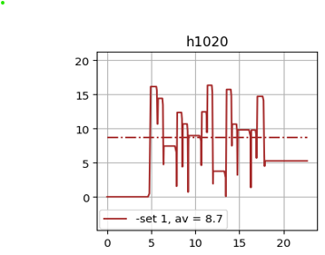
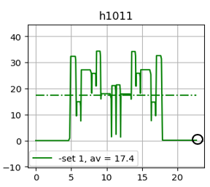
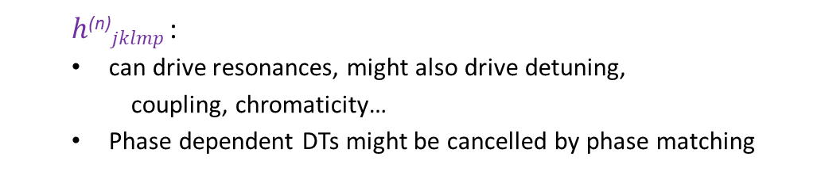
Introduction to Driving Terms
  $h$^{(n)}$jklmp$ :
  can drive resonances, might also drive detuning,
    coupling, chromaticity…
  Phase dependent DTs might be cancelled by phase matching
Driving Term - examples | drives …
h₁₀₀₁₀, h₁₀₁₀₀ | Q_{x} – Q_{y}, Q_{x} + Q_{y}
h₁₁₀₀₁, h₀₀₁₁₁ | natural chromaticity
h₃₀₀₀₀, h₂₁₀₀₀, h₁₀₁₁₀, h₁₀₀₂₀, h⁽²⁾₁₀₂₀₀ | 3rd order resonances
h₂₀₀₀₁, h₀₀₂₀₁, h₁₀₀₀₂ | synchro-betatron resonances
h₂₂₀₀₀, h₀₀₂₂₀, h₁₁₁₁₀ | tune shift with amplitude
h₁₁₀₀₂, h₀₀₁₁₂ | tune shift with momentum
Accumulating sum of h₁₀₁₁₀ and h₁₀₂₀₀ over one arc:
good phase matching
=> cancellation
bad phase matching
=> accumulation over ring

Slide 6
DT minimization 1
Minimization of driving terms: which ones?
Restrict to: 3rd order-resonance DT
detuning terms (TSWA, TSWM)
Group them in 4 ‘classes’ of equal physical impact
Take rms-value of each class
Two weight functions:
Weight function¹⁾ to leverage between class magnitudes
Option for factorial weights (factor) for individual DTs/classes
  Apply to TSWM: W = 1, 50, 100, …, 400 – 9 values
Optimization goal:
Goal: sum of 4 class rms values
DT of “HOA-case”
type | no | impact | rms value | using weight function
geometric | 5 | 3rd order resonances | 3.73 | 0.086
chromatic | 3 | sychro-betatron resonances | 1.18 | 0.257
TSWA | 3 | tune shift with amplitude | 118424.0 | 14.46
TSWM | 2 | tune shift with momentum | 27.26 | 0.324
goal (sum) |  |  |  | 15.13
A. Streun, OPA Documentation: Inside OPA (in-side1.pdf), https://github.com/opa-code/opa4-documentation/blob/main/inside1.pdf, Eq. 71, Accessed:2026-02-28, 2024.

Slide 7
DT minimization 2
Algorithm: COBYLA¹⁾
  Python algorithm, constraints to fix chromaticity
Exploit potential of 8 individual sextupole families
use 6 discrete octupole values
  O = 0, 100, …, 500 m⁻³
start each minimization from ‘HOA-case’:
  2 families of chromatic sextupoles, phase matching, ξ_{x,y}=1
include limit on sextupole strength:
  deviation from HOA-case: 10%-40%
9 weights * 6 octupole strengths * 4 limits
216 cases
parallelisation on HPC
~30 min / case (# minimization steps/lattice size)
M. J. D. Powell, A direct search optimization method that models the objective and constraint functions by linear interpolation, 1994.
(SciPy documentation, https://docs.scipy.org/doc/scipy/index.html, Accessed: May 08, 2025 Version: 1

Slide 8
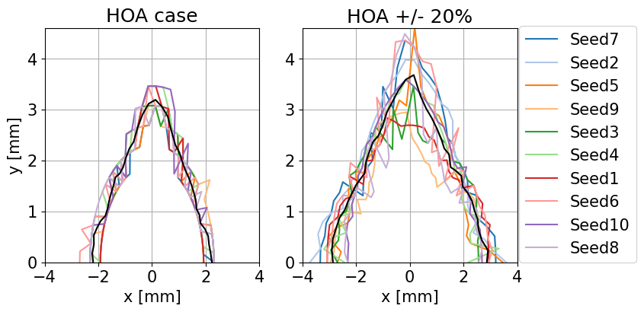
Benefit of The phase matching
Error type | rms value
transverse misalignment (all magnets) | 30 μm
roll (all magnets) | 180 μrad
pitch and yaw - dipoles | 60 μrad
pitch and yaw - other magnets | 400 μrad
calibration | 1e-4
Example 1:
Track HOA-case for 10 sets of magnet tolerances
Apply DTM allowing for 20% deviation in sextupole strength
Dynamic aperture (DA) of the BESSY III lattice for 10 sets of errors
(corrected closed orbit, no beta beat correction).
Seek compromise between robustness
against errors and sufficient DA and MA
HOA-case, insensitive to errors.
DA when allowing for a 20 % deviation of
sextupole strengths during DTs minimization.

Slide 9
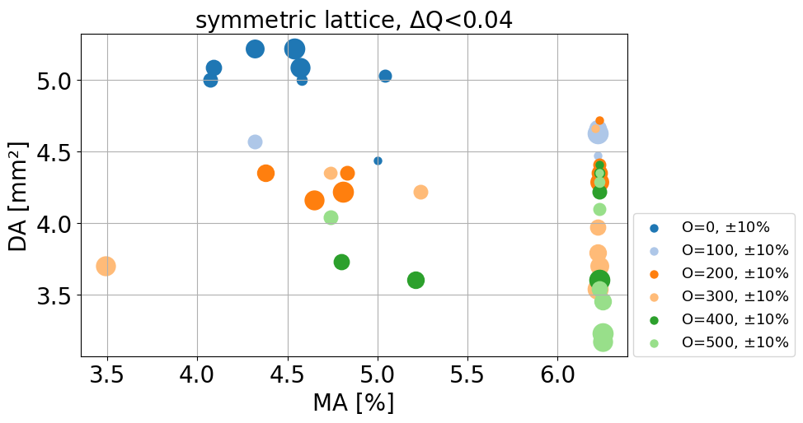
Processing of results
After minimization:
216 sets of 8 sextupole and 1 octupole strengths
calculate DA:
  6D-tracking, DA represented by its area
  1024 turns, no errors
  mimic particle loss by limiting the particles tune shift ΔQ_{x,y}< 0.04
calculate MA
  Local MA in straight section
  apply tune shift criterion ΔQ_{x,y}< 0.04
2. Example: symmetric lattice
  10% deviation from HOA-case allowed for sextupoles
  bullet size marks weights
  colours represent octupole strength
    DA small, decreases with increasing octupole
    MA increases to RF acceptance

Slide 10
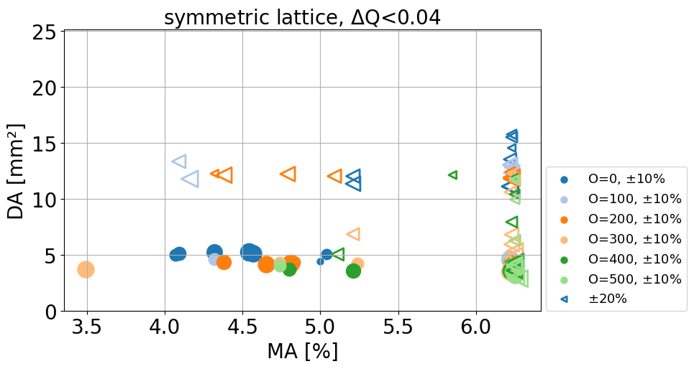
Minimization results
20%

Slide 11
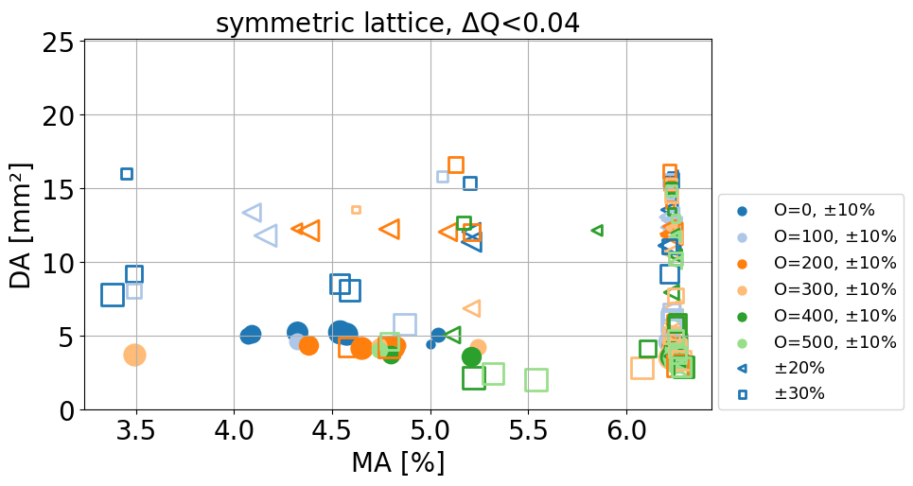
Minimization results
30%

Slide 12
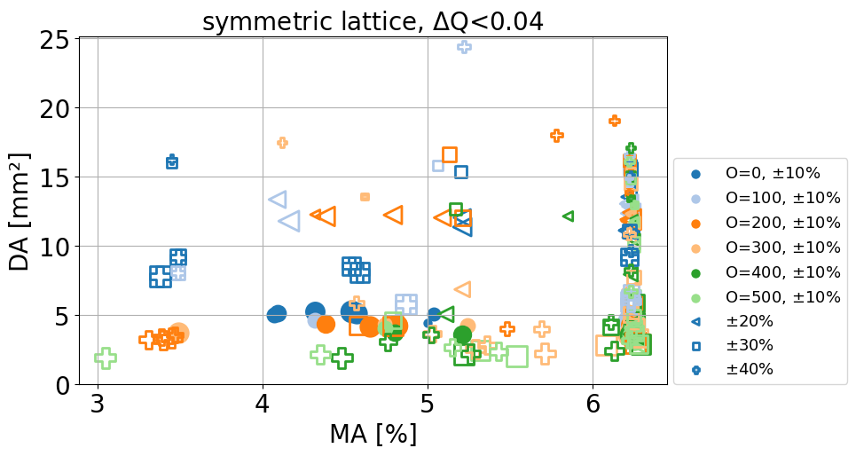
Minimization results
40%

Slide 13


Minimization results
40%
definition of ‘best’ cases (somewhat ‘arbitrary’):
  MA > 6%, 10 largest DAs
Error statistics for symmetric lattice:
Need to assess consistency of results wrt tolerances:
  track with 10 lattices including tolerances (100 cases)
  corrected orbit, no beta beat correction
MA > 5%
DA and x_{min} too tight for injection
 | unit | including tolerances
 |  | mean | std
MA | % | 5.21 | 0.31
DA | mm² | 11.85 | 2.93
x_{min} | mm | -2.62 | 0.49

Slide 14
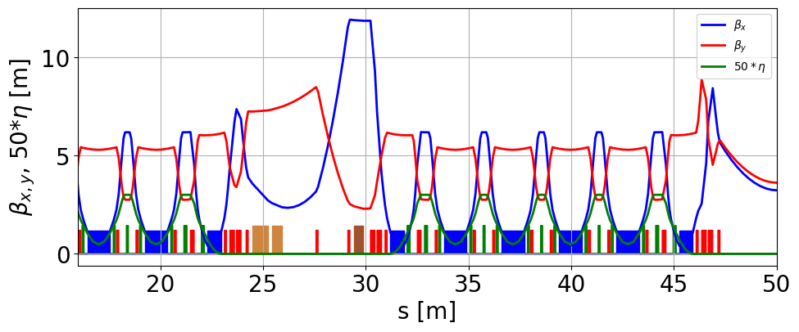
Injection straight
THP2147
"The BESSY III Injection Scheme"
M. Abo-Bakr, T. Atkinson, P. Goslawski, J. Völker
Thick and thin septum
nonlinear kicker, β_{x}=11.9m
Minimal disturbance to lattice symmetry
non-linear kicker (NLK) injection
perturbation confined to straight
keep phase advance over straight
chrom. DTs will change:
DTs include 𝐾, 𝛽_{𝑥,𝑦} or 𝑑𝛽_{𝑥,𝑦}/𝑑s
periodicity = 1
different results in minimization

Slide 15
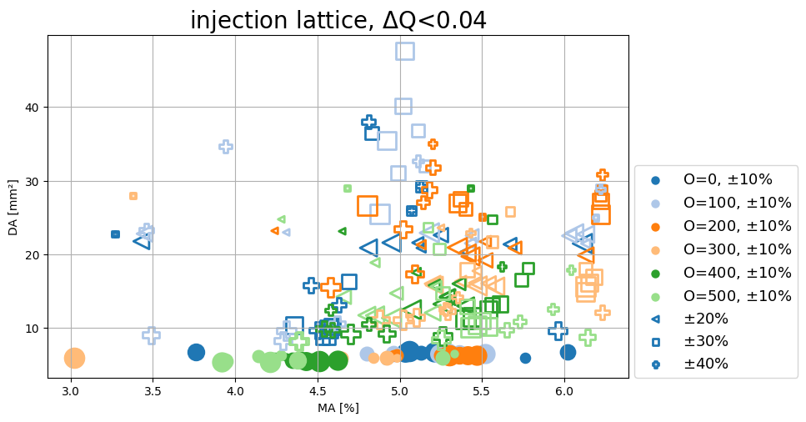
Injection Lattice
definition of ‘best’ cases (somewhat ‘arbitrary’):
  MA > 5.4%, 10 largest DAs
Error statistics for injection lattice:
Need to assess consistency of results wrt tolerances:
  track with 10 lattices including tolerances (100 cases)
  orbit-, beta beat- and coupling correction
  injection lattice: β_{x,y}= 11.9, 2.4m at NLK
 | unit | including tolerances
 |  | mean | std
MA | % | 5.29 | 0.17
DA | mm² | 39.48 | 3.00
x_{min} | mm | -8.60 | 0.66
injection lattice:
MA > 5%
NLK max. kick at -7mm, within DA

Slide 16
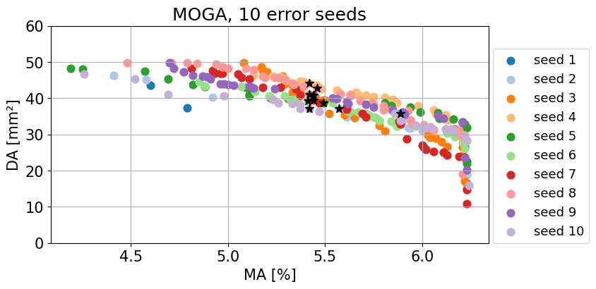
MOGA calculations
MOGA calculations to optimize DA and MA directly
8 symmetric sextupole families and a single octupole
lattice includes tolerances, orbit-, beta beat- and coupling correction
evaluated of MA and DA area at NLK
run takes around 20 hours on 100 CPUs of an HPC
10 best cases (black stars): largest DA for MA > 5.4%
Error statistics:
Each MOGA result is the optimization for a
specific error set – unlikely that of the real machine.
Consistency assessment necessary, also for MOGA.
10 best cases are evaluated for 10 lattices with error sets,
closed orbit-, beta beat- and coupling correction.
 | unit | including tolerances
 |  | mean | std
MA | % | 5.44 | 0.33
DA | mm² | 27.71 | 5.97
x_{min} | mm | -6.48 | 1.04
DA collapses from ~40mm² at Pareto front
to 28mm² with errors

Slide 17
Comparison 1: MOGA – DTM
MOGA:
DTM:
 | unit | including tolerances
 |  | mean | std
MA | % | 5.44 | 0.33
DA | mm² | 27.71 | 5.97
x_{min} | mm | -6.48 | 1.04
 | unit | including tolerances
 |  | mean | std
MA | % | 5.29 | 0.17
DA | mm² | 39.48 | 3.00
x_{min} | mm | -8.60 | 0.66
Comparison of statistical results:
MA results comparable (+3% for MOGA)
DA larger for DTM (+42%)
x_{min} larger for DTM (+32%)
Results depend on the choice of ‘best cases’ !

Slide 18
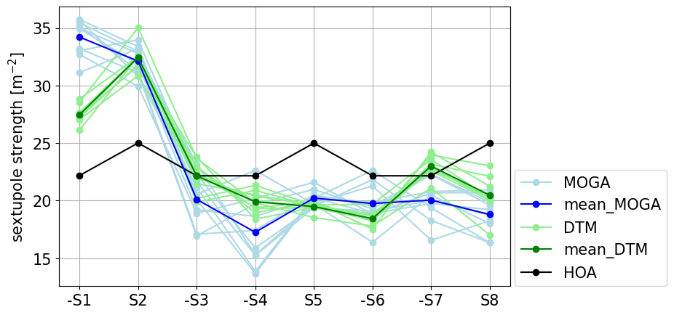
Comparison 2: MOGA - DTM
Sextupole values of ‘best cases’
Simulated commissioning on
averaged DT from DTM:
injection efficiency of 97%
THP2035
“SIMULATED COMMISSIONING AND LATTICE ROBUSTNESS FOR BESSY III”
Benat Alberdi-Esuain, M. Abo-Bakr, P. Goslawski
8 sextupole families
Significant part of sextupole strength shifted to the
  outer S1, S2, in both approaches
Sextupole strength more confined in DTM (std: 3.9 %/ 7.8 %)
Mean S1 is 24% stronger in MOGA (34.2 m⁻²/27.5 m⁻²)
Mean octupole is 10% stronger in MOGA 243 m⁻³/220 m⁻³

Slide 19
conclusion
Conclusion
Strategy to optimize the multipole values of MBA lattices for BESSY III
  4 classes of dominant DT
  Minimizer with constraints for chromaticity
  2 weight functions to leverage between magnitude of the classes
  Scan over weights, octupole, and deviation from HOA-case
Results are show comparable MA and better DA than MOGA
DTM takes less than 10% of computation time
Easy to adapt non-linear configuration to
  different working points
  different chromaticities
  adapt to lattice changes
Thank you for your attention!

Slide 20
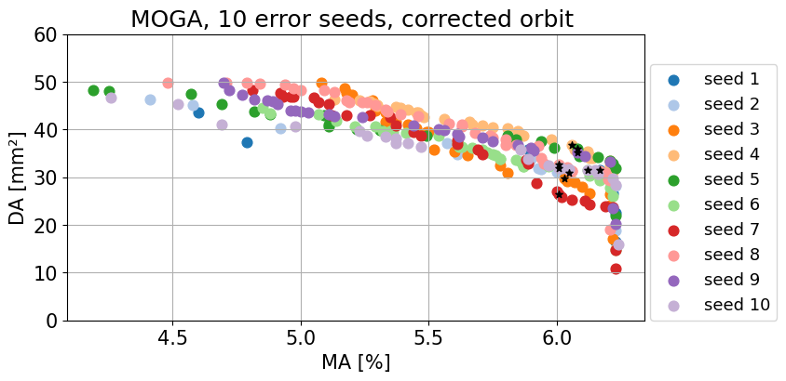
MOGA calculations
10 best cases defined by:
largest DA for MA > 6%
MOGA calculations to optimize DA and MA directly
NSGA-II algorithm of the Python pymoo package
physics covered by pyAT and pySC
runs start from the linear lattice
8 distinct, but symmetric sextupole families and a single octupole
lattice includes tolerances, orbit-, beta beat- and coupling correction
magnet values confined to technical limits
constraint on chromaticity to 𝜉𝑥,𝑦 = 1.
full 6D tracking, 1024 turns
MA and DA at NLK (𝛽_{𝑥} = 11.9 m) defined by particle loss
physical apertures ±9 mm
population of 300 points per generation
100 off-springs and 100 rejected cases per generation
200 generations total
evaluated of MA and DA area at NLK
run takes around 20 hours on 100 CPUs of an HPC
Each MOGA result is the optimization for a
specific error set – unlikely that of the real machine.
Consistency assess necessary, also for MOGA.
10 best cases are evaluated for 10 lattices with error sets,
closed orbit-, beta beat- and coupling correction.

