Slide 1
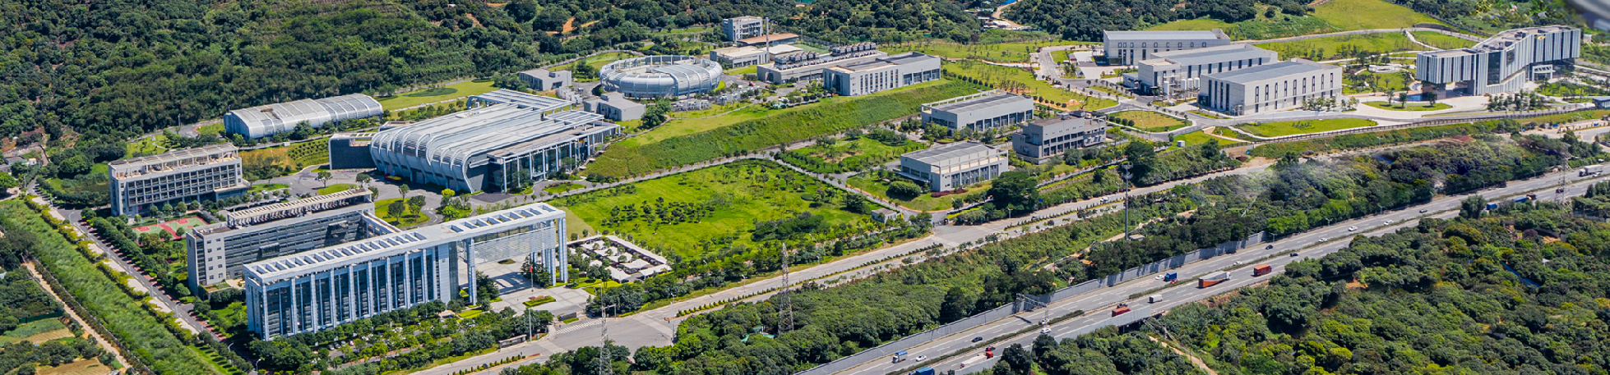



Report of Dongguan Branch
Beam commissioning and upgrade progress for the CSNS-II RCS
Ming-Yang Huang
Institute of High Energy Physics, Chinese Academy of Sciences
2026-05-21
THO4M02

Slide 2

Outline
Introduction
Beam commissioning for the RCS
Upgrade progress for the CSNS-II RCS
Summary

Slide 3
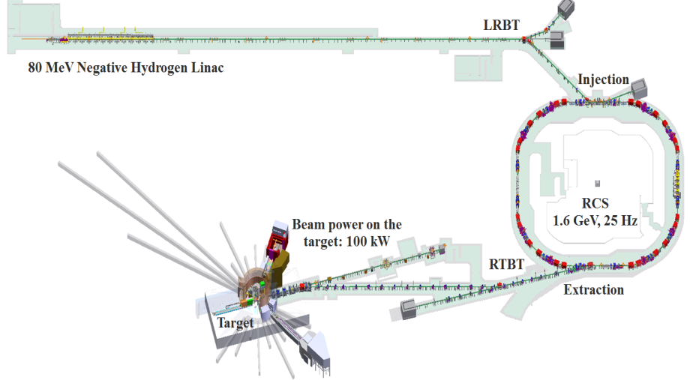
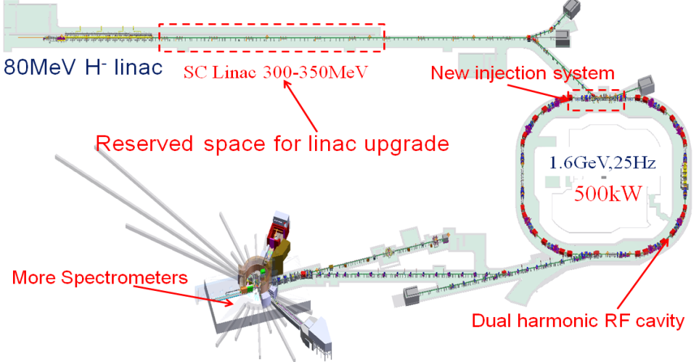
I. Introduction
The CSNS facility consists of an 80 MeV H⁻ Linac, a 1.6 GeV RCS, two beam transport lines, a target station, and several instruments
The design goal of beam power on the target for the CSNS is 100 kW which has been achieved in Feb. 2020
Main goal of CSNS-II: increase the beam power on the target to 500 kW
Main contents of CSNS-II accelerator upgrade: Linac upgrade; injection system upgrade; three dual harmonic cavity would be added to the RCS
CSNS
CSNS-II
3

Slide 4
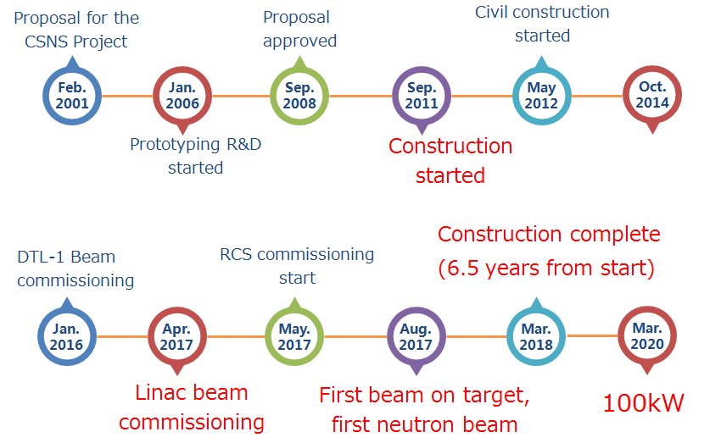
CSNS brief history
4

Slide 5
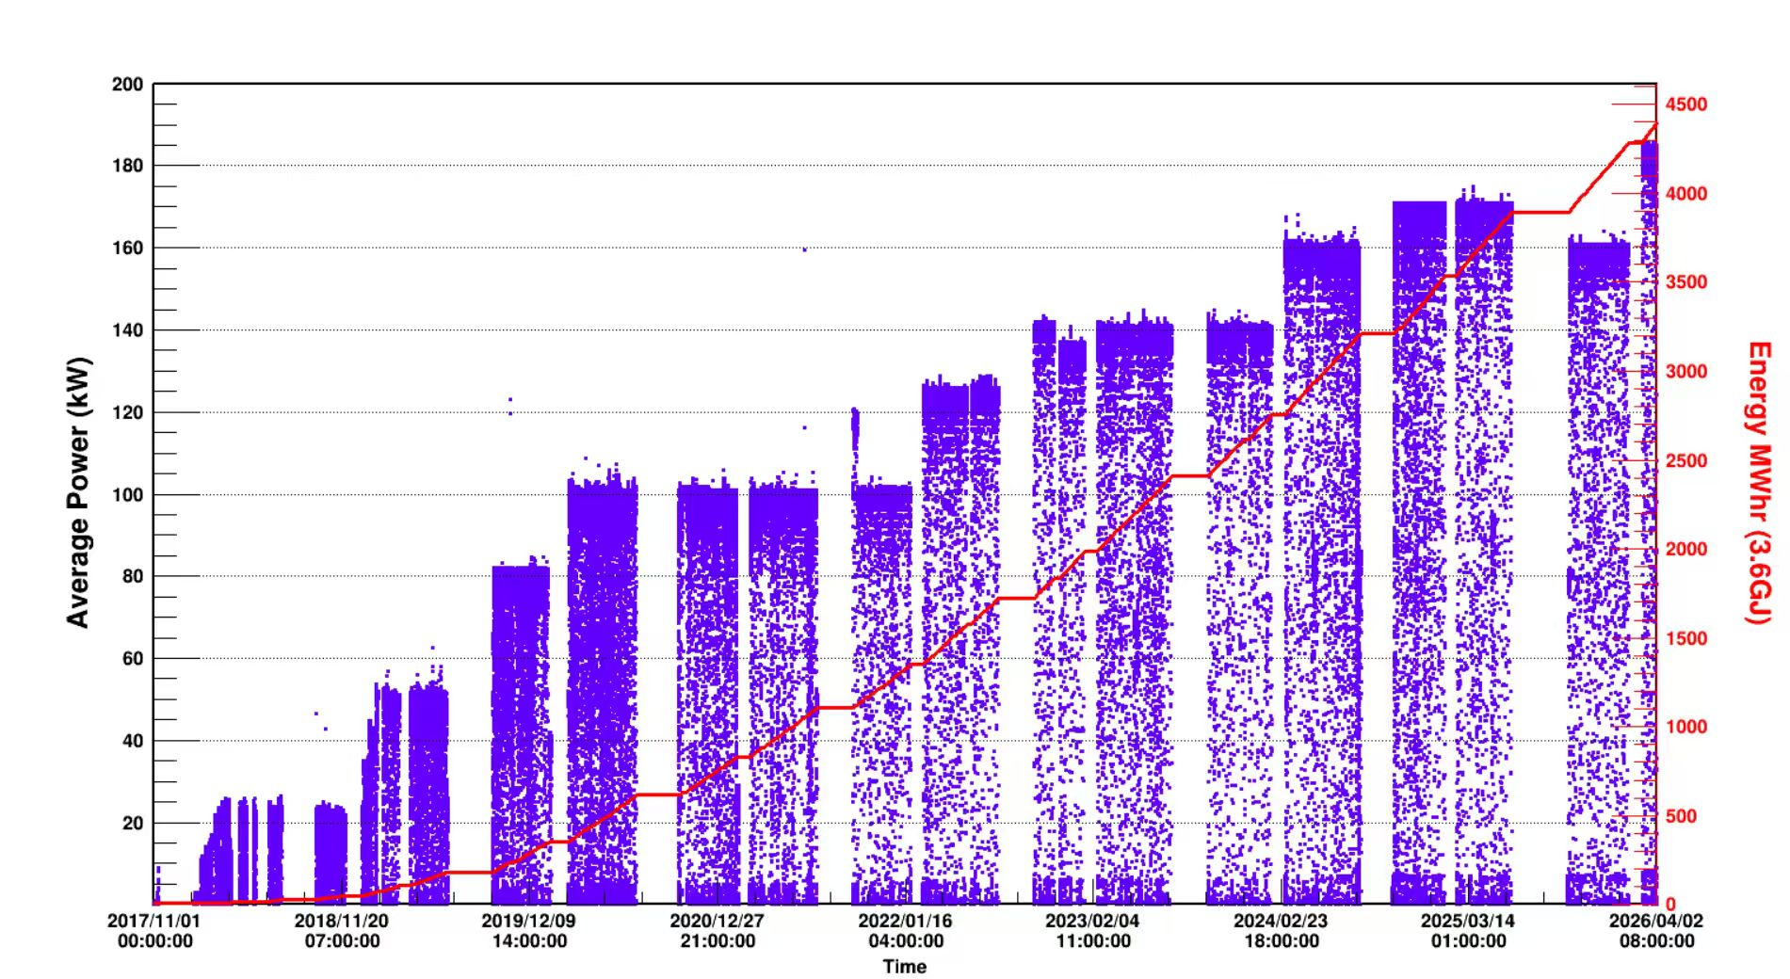
CSNS beam history
Detailed optimizations in many aspects (Mar. 2024)
Optimization of vertical painting area (Oct. 2024)
New injection system and painting method (Mar. 2026)
Installation of a new dual harmonic RF cavity (Oct. 2022)
Slight modification of injection system, installation of new AC trim quadrupoles and AC sextupoles (Feb. 2022)
With the optimization of tune and chromaticity (Feb. 2020)
By switching from anti-correlated to correlated painting (Sep. 2019)
5
5

Slide 6
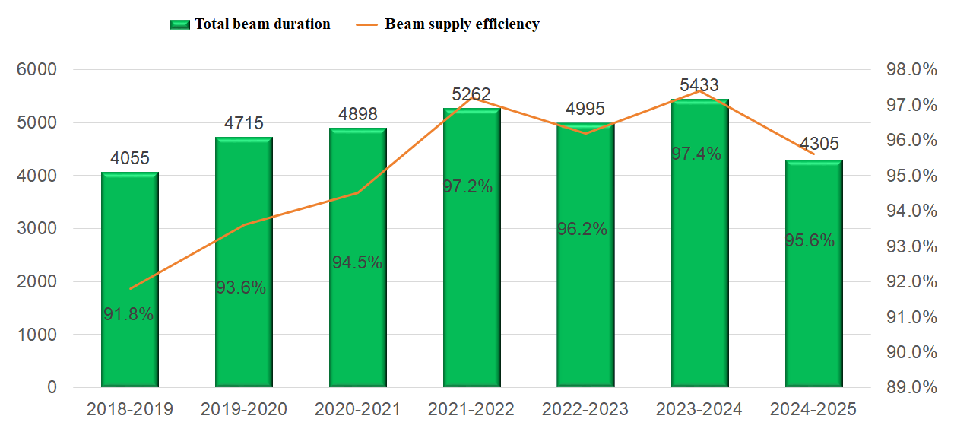
Operation of the CSNS RCS
Comparison of operational indicators across seven operational years since the opening for operation
6

Slide 7
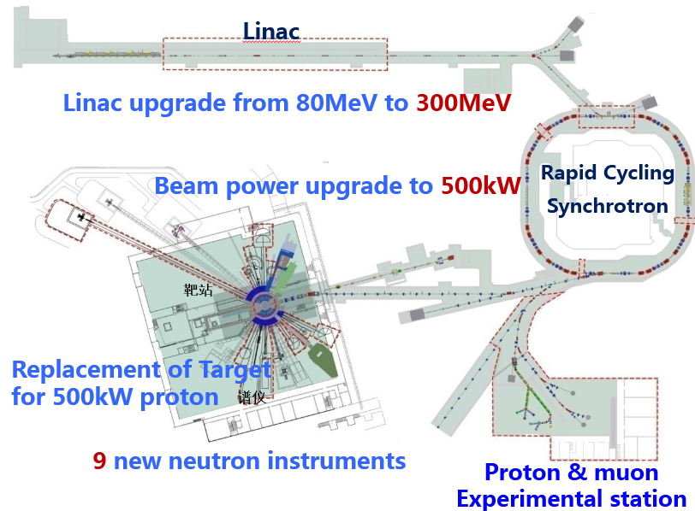
Second phase of the CSNS (CSNS-II)
Linac（80 MeV）+ RCS upgrade 150~200 kW
  New dual harmonic RF system
  AC trim quadrupoles, sextupoles and octupoles
Linac （300 MeV+）+ upgraded RCS 500 kW
  New injection system
  SC Linac to 300 MeV
Project Budget: 2.9 BCNY, Funded by central and Guangdong local government
Construction: 2024.1~2029.9 （5 years and 9 months）
7

Slide 8
CSNS-II Time Schedule
LRBT+RCS injection upgrade
Linac-RFQ+MEBT upgrade
Linac-SC
2024.08
Infrastructure start-up
2026.07 Completion of the Experimental Support Equipment Building
2026.10 Completion of the SC linac Building, the Cryogenic Hall and the High Energy Proton Experiment Hall
2029.10
Project completion
2024
2025
2026
2027
2028
2029
2024.01
Preliminary approval
2026.10 200kW beam commissioning for the accelerator
160kW→185 → 200kW
2027.07-2028.04 Machine shut-down for new cryomodues installation
2029.07
Beam power up to 300kW
2025.08 Accelerator injection upgrade
2029.01
300MeV commissioning
8

Slide 9
II. Beam commissioning for the RCS
1. Low-intensity beam commissioning
2. Intense beam issues
2.1 Space charge effects
(1) Tune pattern optimization
(2) Method to achieve the correlated painting
(3) Super-periodicity restoration
(4) Optimization of the bunching factor
2.2 Beam instability
9

Slide 10
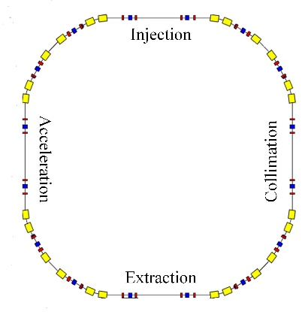
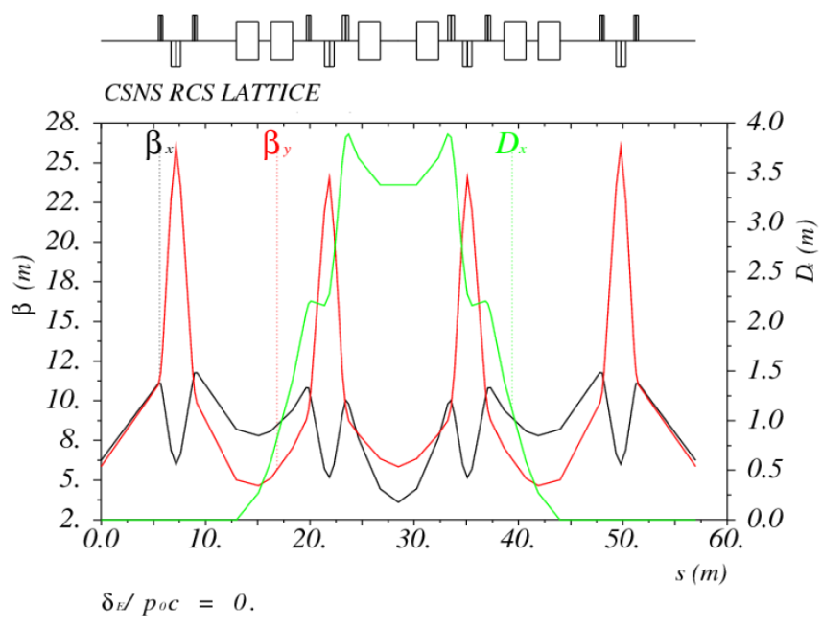
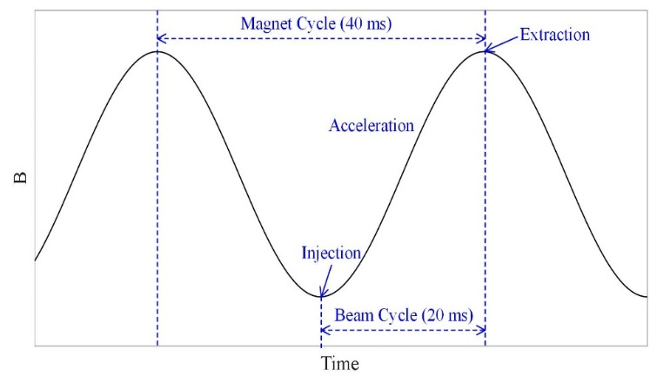
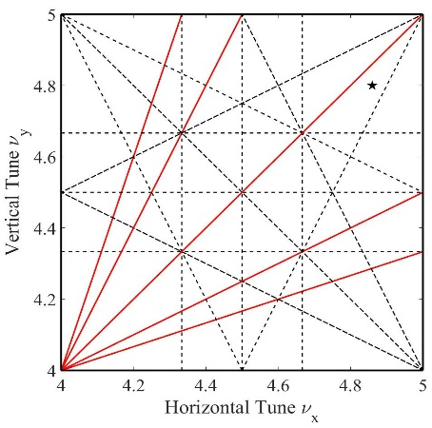
Introduction of the CSNS RCS
Output Beam Power [kW] | 100
Injection Energy [MeV] | 80
Extraction Energy [GeV] | 1.6
Pulse repetition rate [Hz] | 25
Acceleration Time [ms] | 20
Circumference [m] | 227.92
Number of dipoles | 24
Number of quadrupoles | 48
Lattice Structure | Triplet
Nominal Betatron Tune (H/V) | (4.86, 4.78)
Natural Chromaticity | -4.0/-8.2
Ring Acceptance [π‧mm‧mrad] | 540
Harmonic Number | 2
Number of Particles per Pulse | 1.56×10¹³
Space-Chare Tune Shift | -0.28
Layout of the RCS
Optical parameters of a super-periodicity

Slide 11
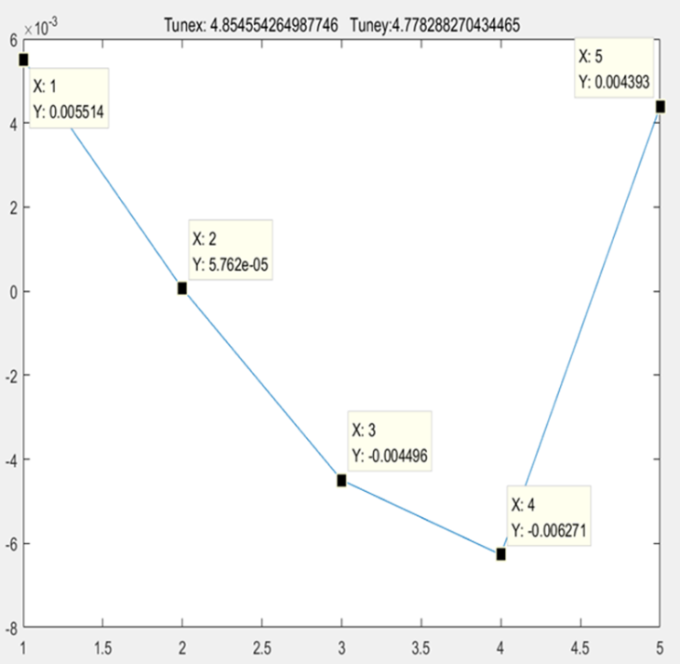
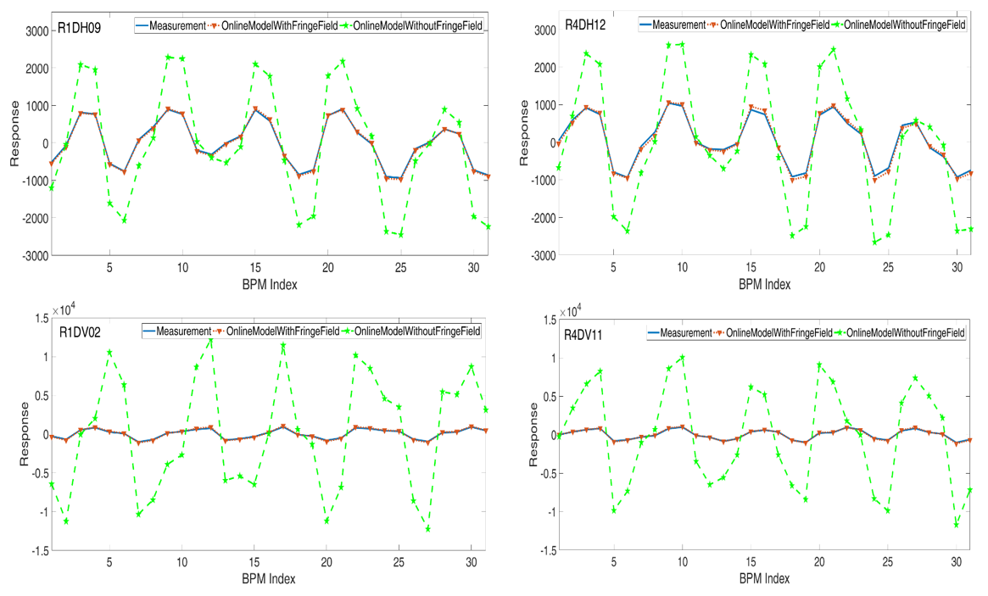
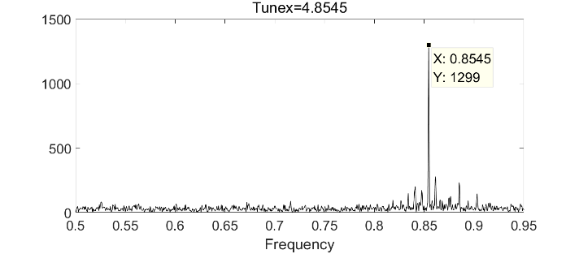
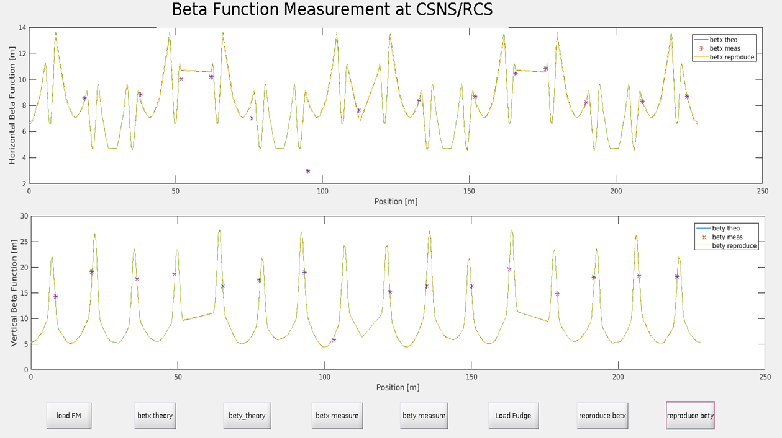
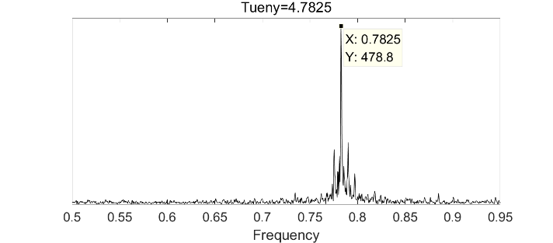
1. Low-intensity beam commissioning
The measured tunes were 4.855/4.783 in the DC mode, which were very close to the nominal value of 4.860/4.780
Fudge Factor
Response matrix
Tune_x
It has been verified that the online model agrees with the theoretical design
The theoretical design and magnetic field measurement results are good
Beta function
Tune_y
11

Slide 12
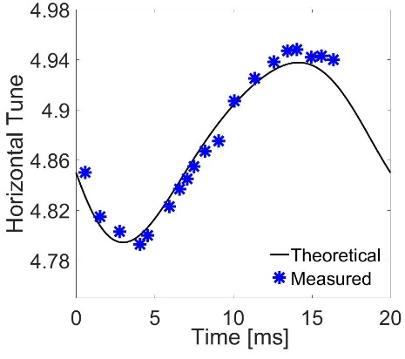
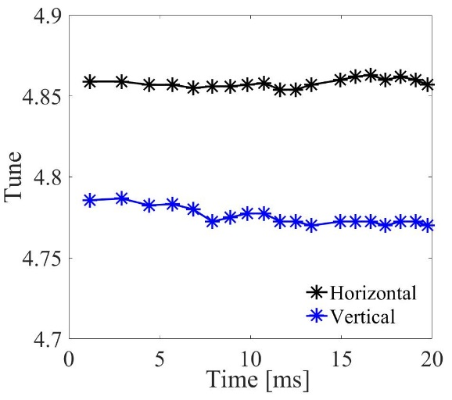
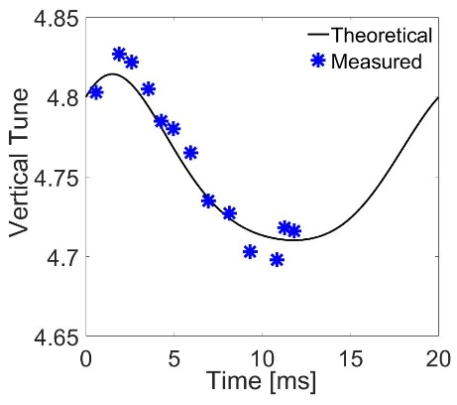
Control of the tune
Harmonic compensation
Harmonic compensation on magnets was used for the tune optimization. The tune variation during the acceleration process was well controlled
The design tune (4.86, 4.78) was adopted at low-intensity beam commissioning
By using the theoretical design (tune, painting method, et al.), the beam power had successfully reached 50 kW
Before harmonic compensation
12

Slide 13
2. Intense beam issues in the beam commissioning
Beam power | Challenges
≤50 kW | Differences between the online model and theoretical design
>50 kW | Space charge effects and beam instability
Space charge effects
Beam instability
Intense beam effects
13

Slide 14
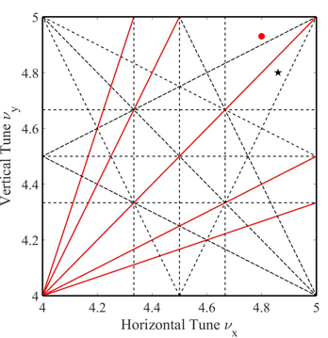
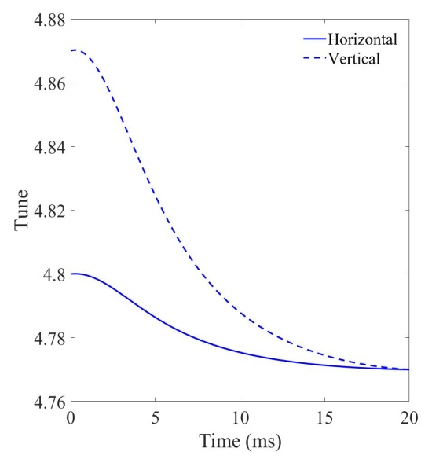
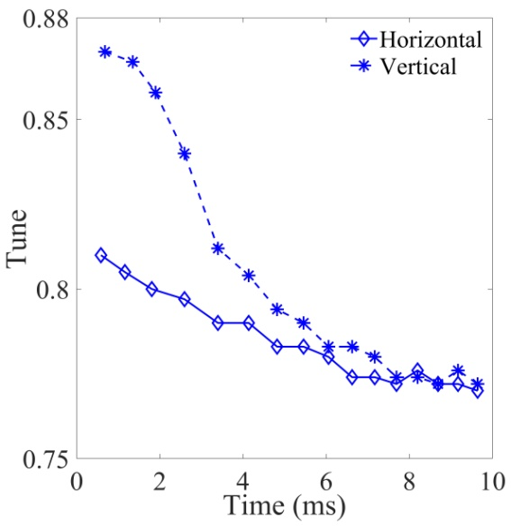
2.1.1 Tune pattern optimization
Tune pattern plays an import role in the control of the intense beam effects
The tunes at injection were set at (4.81, 4.87) to reduce space charge effects induced beam loss (the tunes were moved downward to suppress the beam instability)
Simulation
Measurement
14

Slide 15
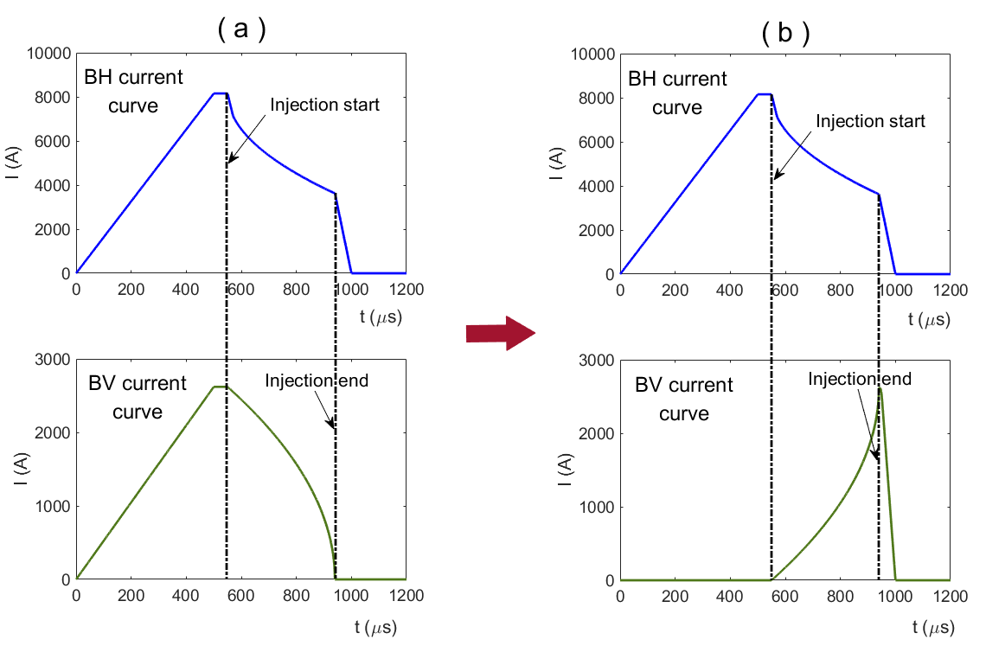
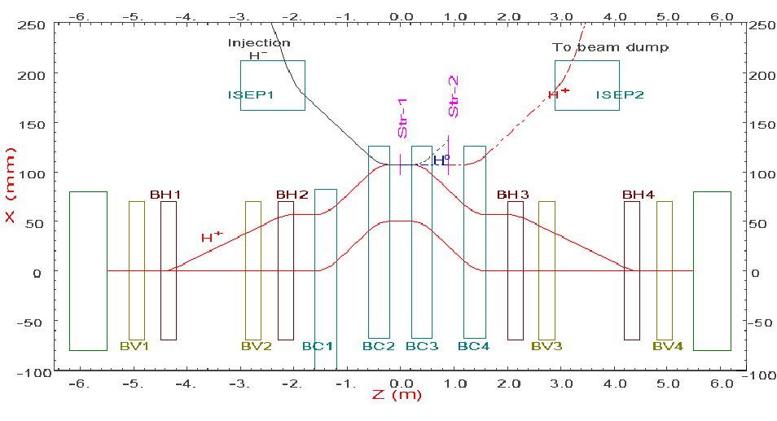
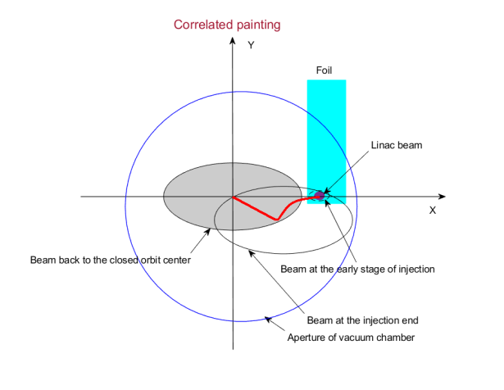
2.1.2 Method to achieve the correlated painting
Challenges: too large beam size after painting, non-uniform beam distribution, large transverse coupling effects resulting in additional beam loss (>50 kW)
Reasons: the actual vertical painting acceptance of the ceramic vacuum chamber is only about 70% of the design value; the transverse coupling effects on the beam distribution are very strong
Method: Based on the mechanical structure of the anti-correlated painting, the rising curve of the pulse power supply current had been used for the vertical painting to achieve the correlated painting

Slide 16
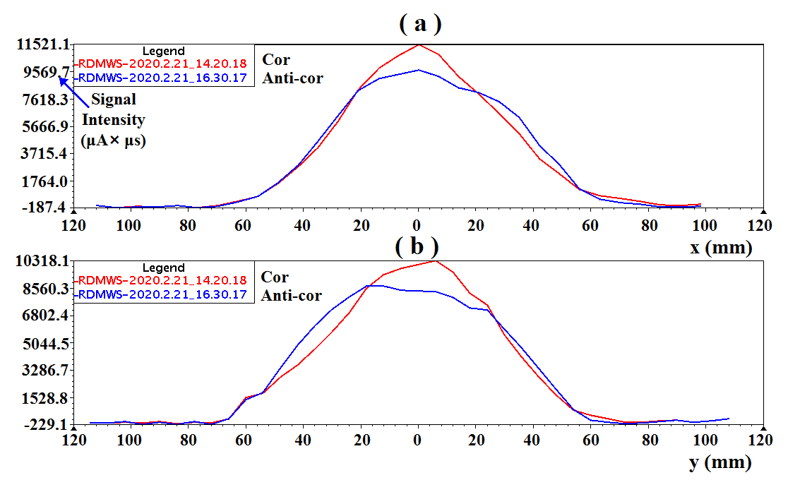
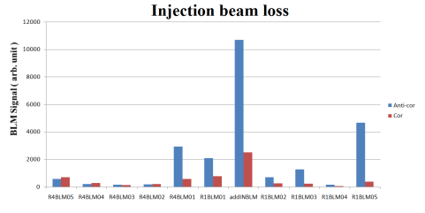
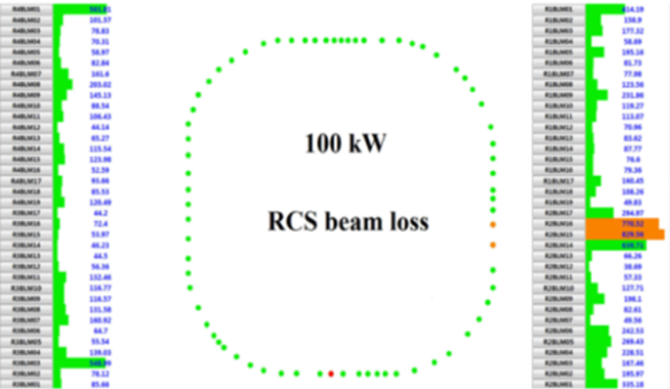
Beam commissioning results
Results：The method unlocks the shackles that restrict the beam power increase of the CSNS accelerator. The beam power had reached 80 kW and 100 kW (design goal) successively
By using the correlated painting:
Beam loss was well controlled
Transverse beam size was largely reduced
Beam distribution was much better
Transverse coupling effects were improved
Experience and lessons：Both correlated and anti-correlated painting need to be performed in the CSNS-II

Slide 17
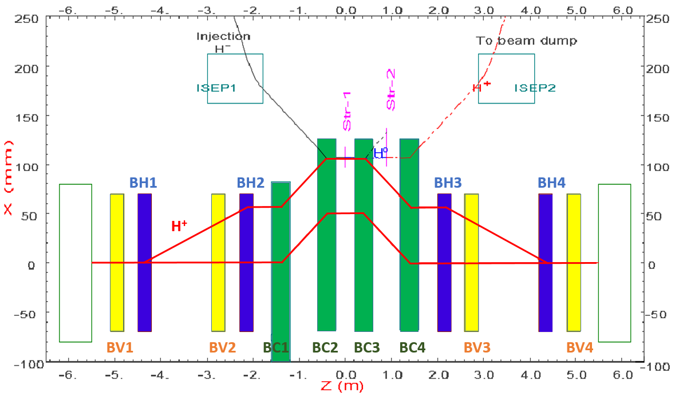
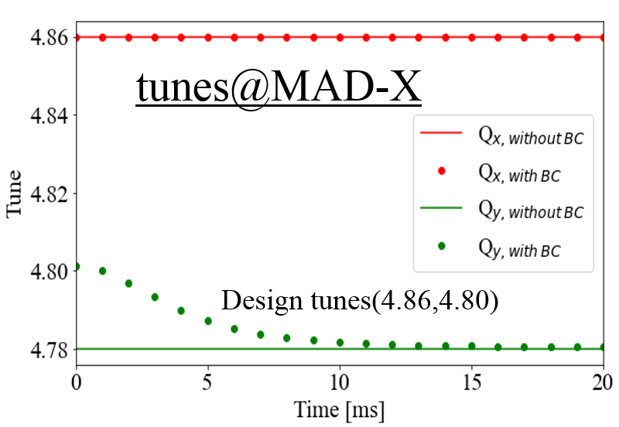
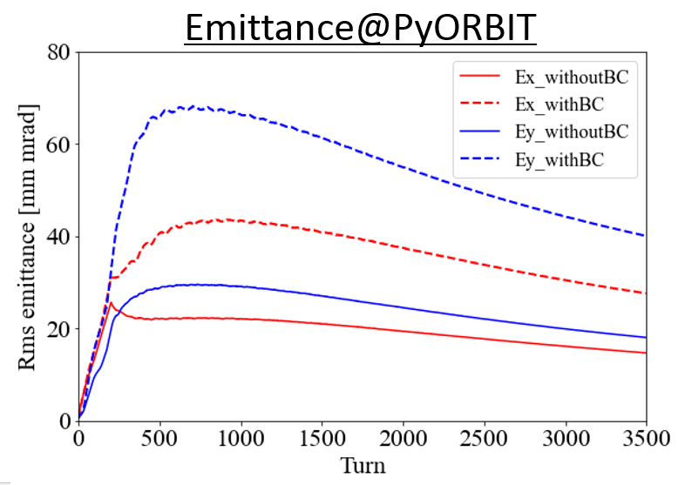
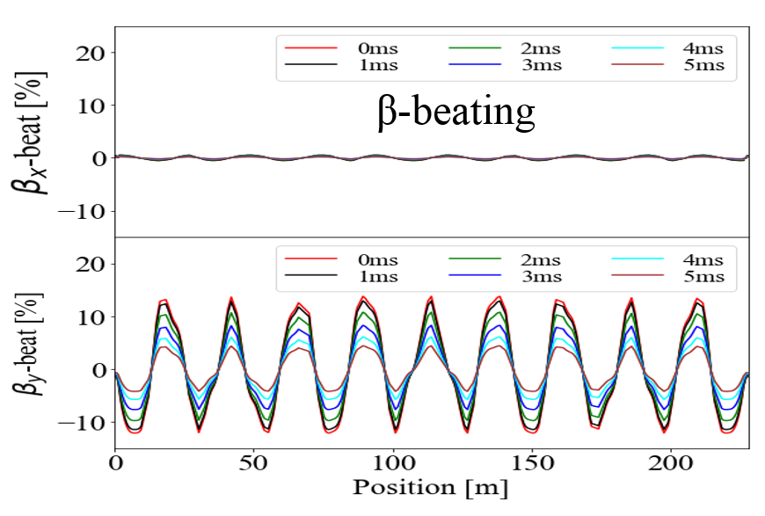
2.1.3 Edge focusing effects of chicane bump magnets
Broken four-fold symmetry :
Tune
Beta-Beating
Emittance
17

Slide 18
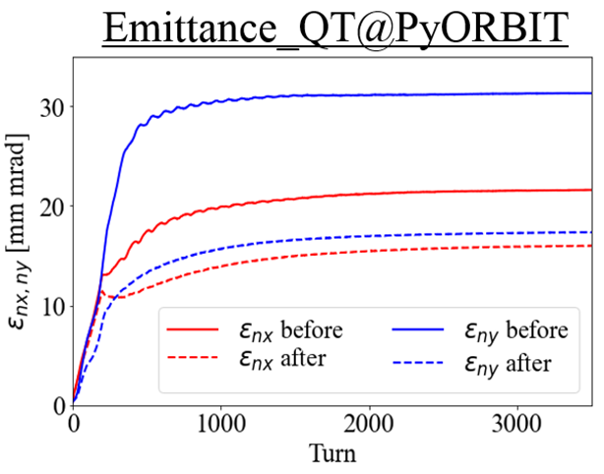
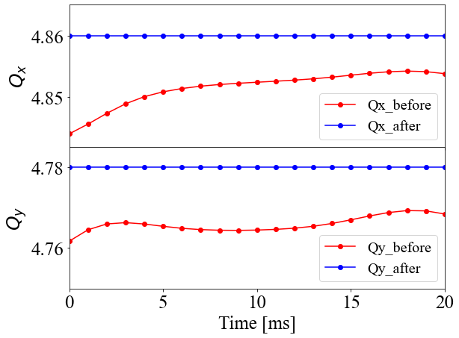
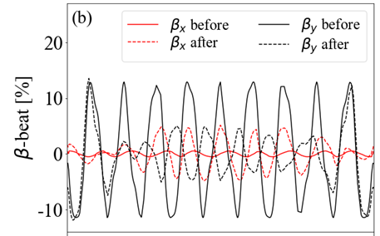
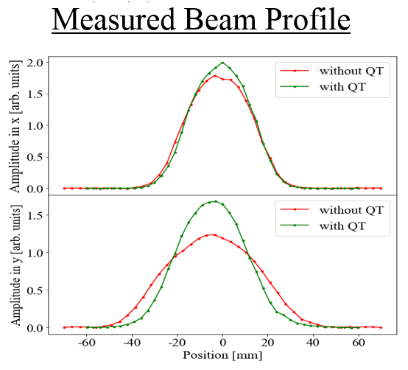
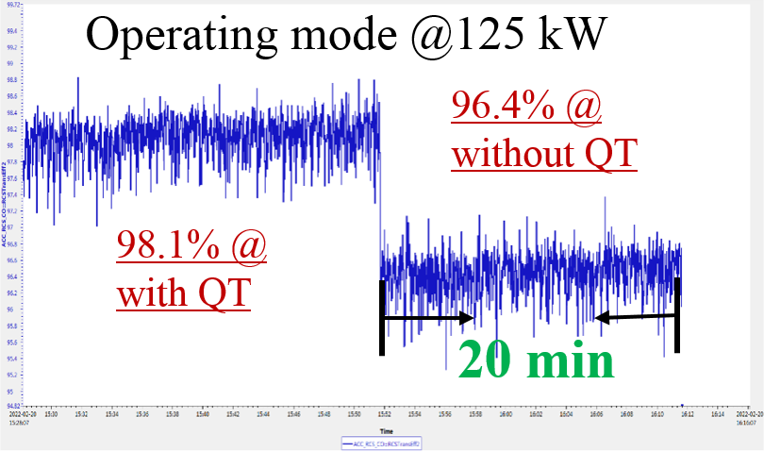
Super-periodicity restoration
Installation of AC trim quadrupoles : correction of the tune and Beta-Beating; restoring the Lattice symmetry to reduce the emittance growth
Solutions in the CSNS-II:
Power supplies of bump magnets will be changed from DC to AC
18

Slide 19
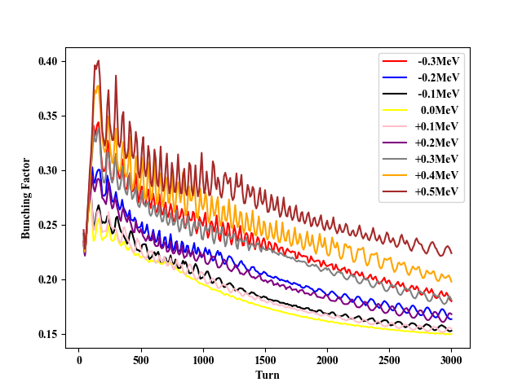
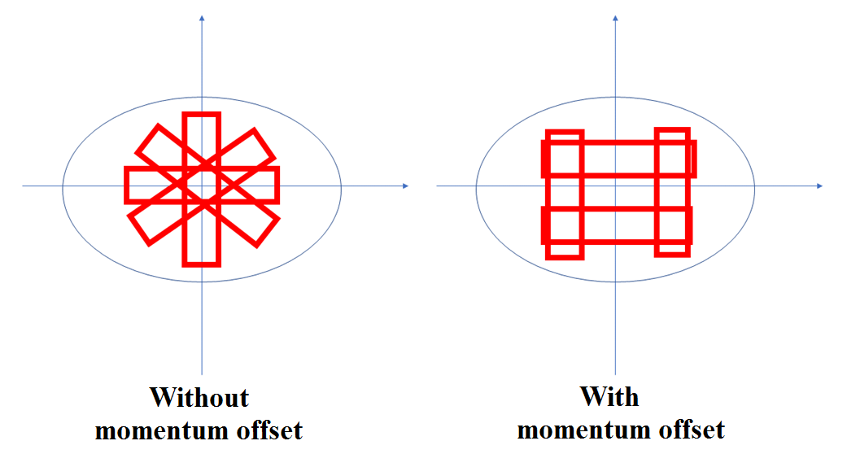
2.1.4 Optimization of the bunching factor
Increase of the bunching factor can reduce space charge effects
By adjusting the energy (momentum) offset during the injection, the bunching factor can be increased
Longitudinal motion for the multi-turn injection process
Measurement Results of Bunching Factor under Different Energy Offsets

Slide 20
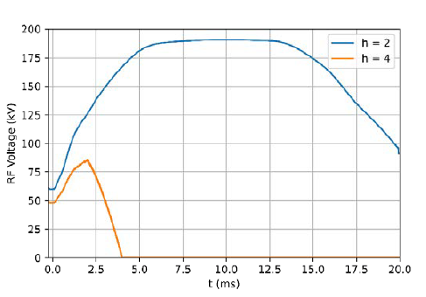
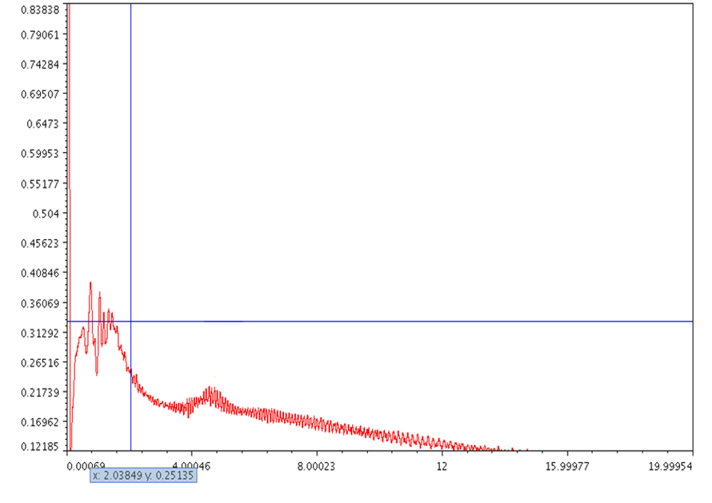
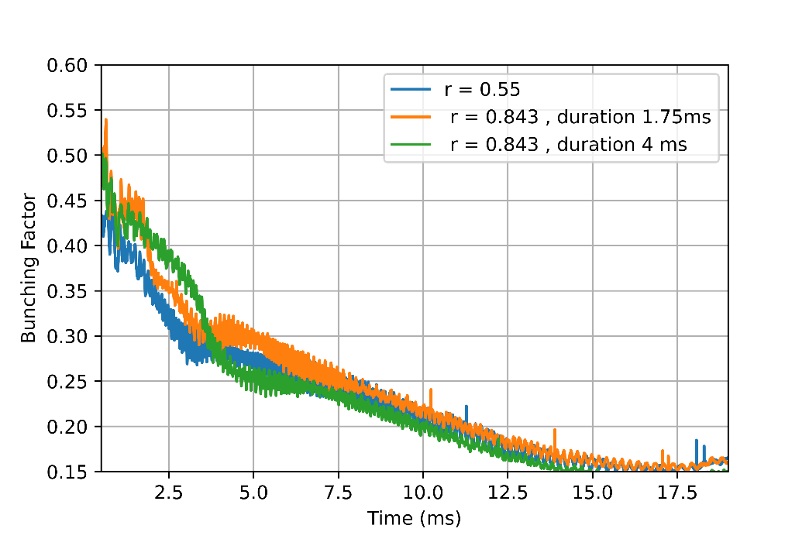
Bunching factor optimization with dual harmonic RF cavity
Using the dual harmonic RF cavity to reduce the space charge effects is one of the main methods of the beam power upgrade
The bunching factor can be increased by optimizing the RF voltage waveform
Optimization of the bunching factor

Slide 21
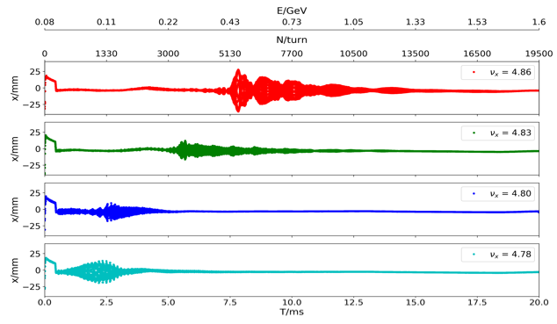
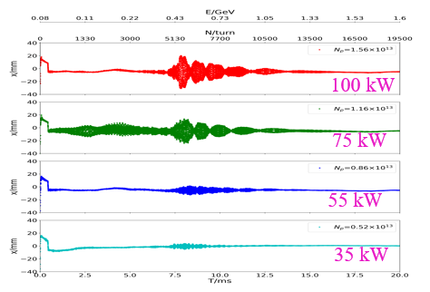
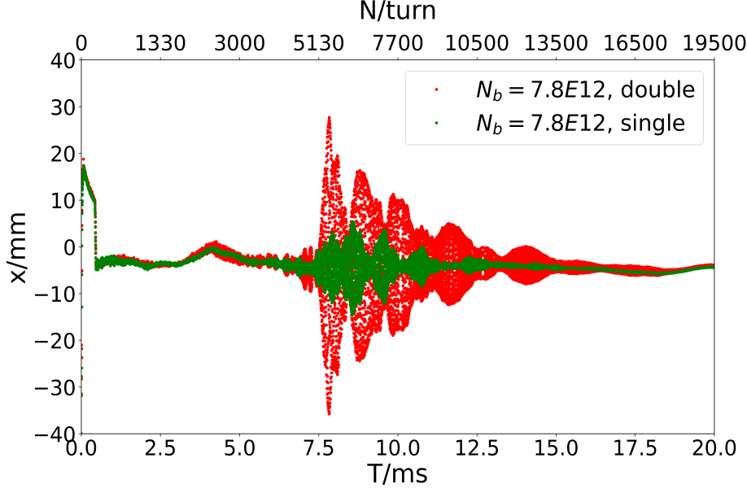
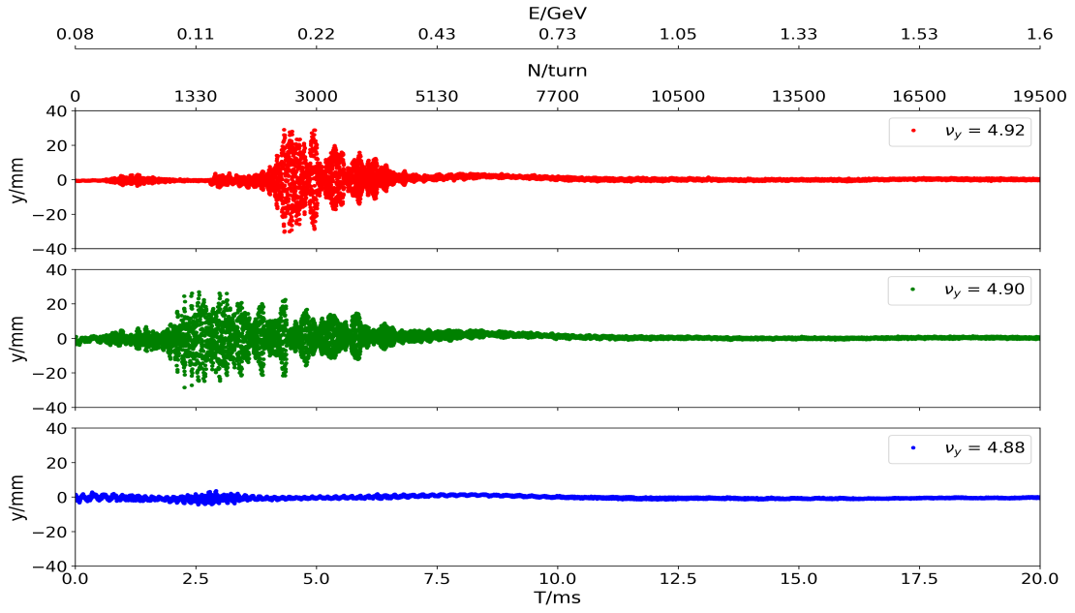
2.2 Beam instability
  With the nominal tune (4.86, 4.78) and nature chromaticity, beam instability was observed when beam power >50 kW
  The growth time is less than 1 ms for 100 kW
  The beam instability depends on the total particles number, double or single bunches, tune, horizontal and vertical, etc
  Base on the characteristic, it was given the name of“Head-tail coupling bunch instability”
Hor. plane
Ver. plane

Slide 22
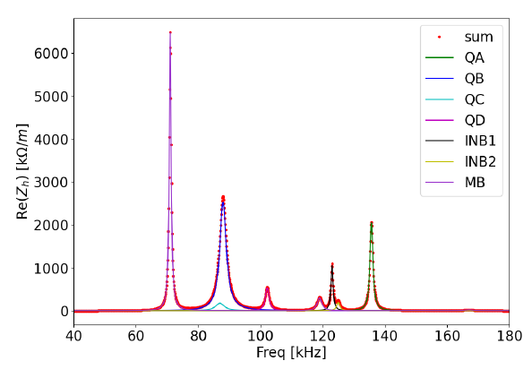
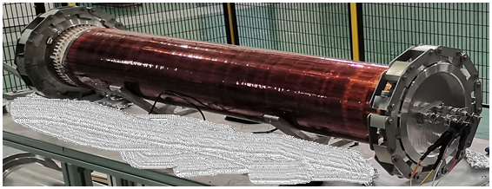
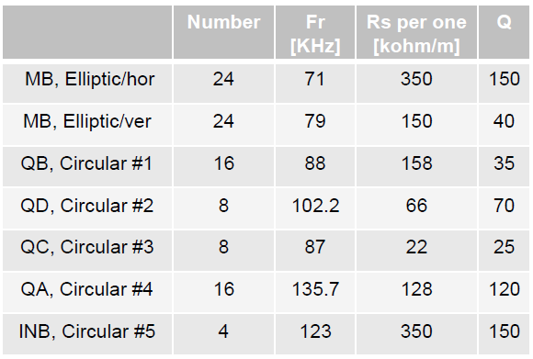
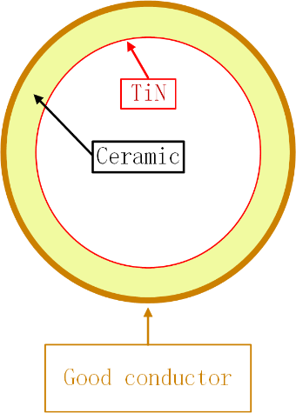


Impedance source of the CSNS RCS
Measurements have confirmed that the RF shield on the ceramic chambers is responsible for the instability. The beam behavior is perfectly consistent with the impedance
The impedance of all the RCS ceramic chambers is much big. It is a “broadband” impedance
9 types of ceramic vacuum chamber:
  QKA is approximately (≈) QA; QKB ≈ QB; INB2 ≈ INB1
  For the ceramic chamber of the diploes, the resonance in horizontal plane is different from that in vertical plane
With RF shield/screen
Without RF shield/screen

Slide 23


Beam instability in the CSNS-II RCS
The new and replaced elements in the RCS have little effect on the change of the impedance
  Bunch lengthening driven by parasitic impedance of the MA cavity is very small
  The head-tail coupling bunch instability remains a key issue in the CSNS-II
    The threshold of beam power is ~ 300 kW
Prediction of the beam instability with 500 kW beam power in the CSNS-II
Bunch length with different number of the MA Cavity
23

Slide 24



Mitigation of the beam instability in the CSNS-II
  Tune curve optimization
  Chromaticity optimization
  Tune below 0.5
  Develop a low-impedance ceramic vacuum chamber
  Develop a feedback system
Bandwidth | 2.5 MHz
Shut impedance | 3 kΩ
Voltage | 5 kV
power | 2.5 kW
Damp time | 0.5 ms
(4.3,5.3), w/o instability
Simulation study by using octupoles

Slide 25

III. Upgrade progress for the CSNS-II RCS
 | CSNS | CSNS-II
Output beam power [kW] | 100 | 500
Injection energy [MeV] | 80 | 300
Extraction energy [GeV] | 1.6 | 1.6
Pulse repetition rate [Hz] | 25 | 25
Acceleration time [ms] | 20 | 20
Extraction average current intensity (uA) | 62.5 | 312.5
Circumference [m] | 227.92 | 227.92
Number of dipoles | 24 | 24
Number of quadrupoles | 48 | 48
Number of trim quadrupoles | 0 | 16
Lattice structure | Triplet | Triplet
Nominal betatron tune (H/V) | (4.86, 4.78) | (4.86, 4.78)
Ring acceptance [πmm-mrad] | 540 | 540
Harmonic number | 2 | 2
Number of particles per pulse | 1.56×10¹³ | 7.8×10¹³
Space-charge tune shift | 0.28 | 0.19
Space-charge induced tune shift
Injection energy | Beam power | ΔQ | Extraction energy
80 MeV (CSNS) | 100 kW | 0.28 | 1.6 GeV (RCS)
300 MeV (CSNS-II) | 500 kW | 0.19 | 1.6 GeV (RCS)
400 MeV (J-PARC) | 1 MW | 0.12 | 3 GeV (RCS)
1 GeV (SNS) | 1 MW | 0.08 | 1 GeV (AR)
70 MeV (ISIS) | 160 kW | 0.4 | 800 MeV (RCS)
The highest beam intensity in the same kind of RCS for the CSNS-II
25

Slide 26





3.1 Challenges for the CSNS-II beam injection
Key issues: (1) The injection energy increases from 80MeV to 300MeV and beam intensity increases 5 times
(2) The peak temperature of the stripping foil is too high (approaches or exceeds its melting point)
(3) The beam dynamics is greatly affected by the edge focusing effect of horizontal chicane bump
(4) The single fixed painting method may not be suitable for the future operational scenarios
T $≈$ 3000 K

Slide 27


New painting injection method
Idea: chicane bump and horizontal painting bump are combined into one bump which make the chicane bump "move“. The horizontal painting is performed by using the position and angle scanning at the same time
Advantages:
Foil peak temperature can be greatly reduced
Both correlated and anti-correlated painting can be performed
The edge focusing effect of bump magnets is greatly reduced
The difficulty of large aperture near the injection point required by angular scanning is solved
It saves a set of bump magnets and is easier to optimize the layout of the injection system
27

Slide 28





Upgrade of the injection system
Jun. 20- Aug.3，2025
CSNS Injection
Dismantling
CSNS-II Injection

Slide 29







Beam commissioning results of new injection system
The feasibility of new injection system design scheme has been verified
The foil peak temperature is significantly reduced, and its lifetime is greatly increased
The injection beam loss and radiation dose are significantly reduced
Before injection system upgrade
After injection system upgrade
Old painting method
New painting method
Stripping foil | Foil lifetime
Before upgrade | ~ 3 weeks
After upgrade | > 4 months
1718K
758K

Slide 30




3.2 Longitudinal dynamics
When the injection energy increases from 80MeV to 300MeV and beam intensity increases 5 times, the longitudinal dynamics need to be optimized
Longitudinal parameter optimization during the beam injection
Optimization during the acceleration and extraction stages
After optimization, most particles are within bucket and the bunch length can be compressed to below 130ns. The RF curves (voltage and phase) have been given below
0.003%

Slide 31



3.3 Simulation of 500kW beam power
Comparison of the simulation results between CSNS and CSNS-II
CSNS
CSNS-II
Tune spread of CSNS-II is far less than that of CSNS
Comparison of the bunching factor between CSNS and CSNS-II
Transverse emittance of CSNS-II is much lower than that of CSNS

Slide 32


3.4 Closed orbit correction
  Method: global closed orbit correction + local closed orbit correction
  The correction of horizontal orbit has always been a challenge for the RCS
  BPM offsets are difficult to measure
  Energy mismatch makes orbit correction in the dispersion region difficult
Physics-constrained neural network
  A neural-network-based orbit correction scheme is being investigated to search for improved correction solutions beyond conventional algorithms
32

Slide 33



3.5 Transverse and momentum collimators
Transverse collimator
Momentum collimator
  Complete the design of transverse collimator system that accommodates both single-stage and two-stage collimation schemes
  The simulated beam collimation efficiency reached 96%
  The momentum collimator has been installed in the tunnel
  The validity of the physics design has been confirmed, and the beam loss in the arc section has been effectively confined to the collimator area

Slide 34


3.6 Magnetic field measurement for main magnets
  Since the injection energy increase from 80 MeV to 300 MeV, the magnetic field measurement of main magnets need to be done
  A detailed and feasible magnet measurement plan has been developed
  All dipole magnets will be measured and sorted based on the measurement results to reduce the initial COD
34

Slide 35


3.7 Application software
  A simulation platform for beam dynamics was developed based on the PyORBIT
  OpenXAL and Pyapas are chosen as the beam commissioning tools
35

Slide 36
IV. Summary
The CSNS beam commissioning has been surpassing the design beam power (185 kW)
Many intense beam issues have been studied in the beam commissioning
The experience and lessons from the CSNS have laid an important foundation for the CSNS-II
For the CSNS-II, the upgrade progress of the RCS have been studied in detail, including the new injection system, longitudinal dynamics, closed orbit correction, collimators, magnetic field measurement for main magnets, application software, etc.
Thank you for your attention!
36

Slide 37
Backup
37

Slide 38
BPM offset measurement
In the RCS, there are 32 BPMs in total
We can measure the offsets of 8 BPMs using the QT
In principle, the offsets of another 10 BPMs could be measured through the quadrupoles sharing a common power supply
However, the remaining 14 BPMs do not meet the conditions for offset measurement
It is challenging to assess the impact of potential BPM offsets on orbit correction
BPM | Num | Quadrupoles Used for Measurement
R*BPM05/R*BPM08 | 8 | R*QT05, R*QT08
R1BPM04 | 1 | Series-Powered Quadrupole R1QF04
R1BPM11 | 1 | Series-Powered Quadrupole R2QD02
R2BPM12 | 1 | Series-Powered Quadrupole R3QF01
R2BPM09 | 1 | Series-Powered Quadrupole R2QF04
R3BPM01 | 1 | Series-Powered Quadrupole R3QF01
R3BPM04 | 1 | Series-Powered Quadrupole R3QF04
R3BPM11 | 1 | Series-Powered Quadrupole R3QD08
R4BPM12 | 1 | Series-Powered Quadrupole R4QF01
R4BPM09 | 1 | Series-Powered Quadrupole R4QF04
R4BPM02 | 1 | Series-Powered Quadrupole R4QD02
38

