Slide 1
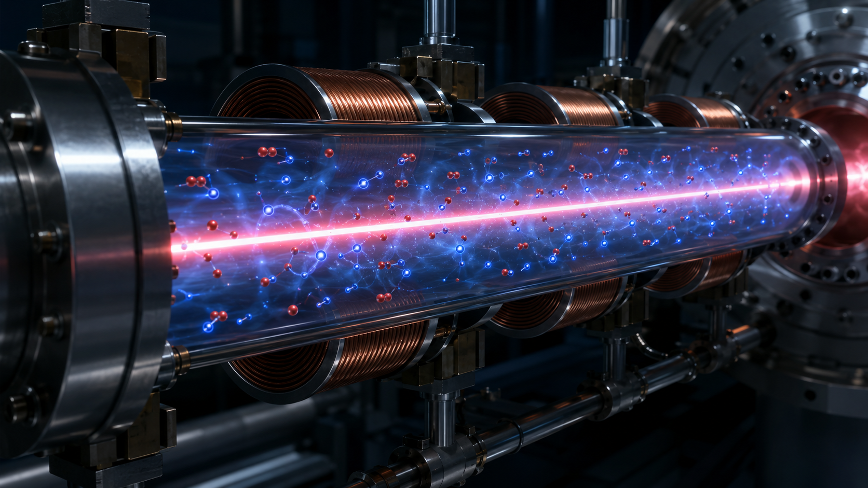
Plasma-Column
Neutralization
in a Cyclotron Injection Line
Motivation • analytical model • WarpX/PIC simulation methods • result comparison plan
Prepared for internal discussion
Plasma-column neutralization in cyclotron injection line
01

Slide 2
Why neutralization matters for cyclotron injection
Low-energy, high-current transport is dominated by space-charge defocusing.
proton beam
proton beam
weak residual gas ionization
electron–ion plasma column
Without sufficient neutralization
With controlled plasma column
Large radial electric field from the beam core
Emittance growth and envelope mismatch
Aperture losses before the cyclotron inflector
Strong sensitivity to pressure, current, and chopping pattern
Electrons partially cancel positive beam charge
Reduced tune depression and envelope growth
More robust matching into injection optics
A measurable path to model validation
Plasma-column neutralization in cyclotron injection line
02

Slide 3
Concept: beam-driven ionization creates a local plasma column
The beam is both the source of space-charge and the source of neutralizing plasma.
proton beam
electron–ion plasma column
Primary beam
Ionization source
Confinement / loss
Neutralized transport
1
2
3
4
H⁺ beam propagates through H₂ background gas.
p + H₂ → p + H₂⁺ + e⁻ creates slow plasma species.
Electrons respond rapidly; ions and walls set the loss time.
Effective beam charge is reduced by fₙ.
Eᵣ,eff ≈ (1 − fₙ) Eᵣ,beam
K_eff = (1 − fₙ) K₀
Plasma-column neutralization in cyclotron injection line
03

Slide 4
Analytical model: neutralized envelope dynamics
Use a reduced model to set scaling laws and sanity checks for PIC results.
Beam envelope with neutralization
Neutralization build-up
R'' + k(s) R − ε²/R³ − K_eff/R = 0
K_eff = (1 − fₙ) K₀
K₀ = 2 I / (I_A β³γ³)
dnₑ/dt = n_b n_g σᵢ(E_b) v_b − nₑ/τ_loss
dfₙ/dt = 1/τᵢ − fₙ/τ_loss
τᵢ = 1 / (n_g σᵢ v_b)
Interpretation
Model limits
Pressure controls ionization time scale through n_g = P/kBT.
Cross-section table determines the absolute plasma source rate.
Loss mechanisms set the steady-state neutralization fₙ,∞.
Envelope data can infer an effective fₙ before full PIC validation.
Assumes quasi-axisymmetric beam/plasma column.
Does not resolve non-neutral sheath, wall losses, or instabilities.
Needs PIC/MCC for transient and kinetic effects.
Plasma-column neutralization in cyclotron injection line
04

Slide 5
Scaling expectation: pressure sets the neutralization time scale
Representative curves based on fₙ(t) = f∞[1 − exp(−t/τeff)]. Replace with measured or simulated rates.
Design implications
Long injection pulses allow plasma to reach quasi-steady neutralization.
Short pulses or chopped beams can operate in a partially neutralized transient regime.
Pressure optimization is a trade-off: better neutralization versus gas load and beam–gas loss.
Diagnostics should resolve both fast build-up and slow recovery.
Replace with WarpX time histories
Plasma-column neutralization in cyclotron injection line
05

Slide 6
Simulation hierarchy: three progressively self-consistent methods
A staged workflow separates fast design scans from full collision-model validation.
1. Seeded neutralization
2. Python callback source
3. C++ BackgroundMCC
Impose initial plasma or effective neutralization factor fₙ for fast optics scans.
Create e⁻/H₂⁺ pairs from local beam density using σᵢ(E) tables.
Production-quality ion-impact ionization process inside WarpX MCC.
Increasing physics fidelity
Use the seeded model to bracket possible neutralization factors and optics sensitivity.
Use the callback source to test rates, particle loading, and transient behavior without recompilation.
Use the C++ MCC model for scalable, reproducible simulation campaigns.
Plasma-column neutralization in cyclotron injection line
06

Slide 7
Method 1 — seeded neutralization model
Fastest route for determining whether neutralization is required and how much is sufficient.
Implementation idea
Initialize electron/ion populations around the beam, or scale the beam self-field by 1 − fₙ.
Scan fₙ = 0, 0.25, 0.5, 0.75, 0.9 to obtain an operating envelope.
No cross-section data are required; therefore this is a calibration and sensitivity model, not a source model.
proton beam
electron–ion plasma column
Outputs
Role in workflow
Envelope suppression versus fₙ
Transmission and aperture loss sensitivity
Back-calculated effective neutralization from measured beam sizes
Defines target neutralization level for source models.
Provides a rapid benchmark for PIC/MCC consistency.
Useful for experiment planning and diagnostics placement.
Plasma-column neutralization in cyclotron injection line
07

Slide 8
Method 2 — Python callback proton-impact source
Self-consistent particle source in WarpX without modifying the core C++ code.
Algorithm loop
ΔN_pairs ≈ n_b n_g σᵢ(E_b) v_b Δt ΔV / w
p + H₂ → p + H₂⁺ + e⁻
1
Deposit beam density n_b(x,y,z)
2
Read gas density n_g and σᵢ(E_b)
Strengths
3
Sample ionization events per cell
Rapid prototyping
Transparent event-rate control
Good bridge between reduced model and compiled MCC
4
Create e⁻ and H₂⁺ macroparticles
5
Advance all species with self-consistent fields
Risks to check
Particle noise from low-rate rare events
Time-step dependence of source sampling
Load balance when plasma becomes localized
Plasma-column neutralization in cyclotron injection line
08

Slide 9
Method 3 — C++ ion-impact ionization BackgroundMCC process
Production implementation for reproducible, scalable simulation campaigns.
Input tables
Collision kernel
PIC advance
H₂ cross section σᵢ(E)
beam ion species and energy
neutral gas density profile
sample collision probability
spawn e⁻ and H₂⁺ products
conserve weights and metadata
deposit current/charge
solve fields
advance beam + plasma species
Validation criteria
C++ MCC and Python callback should agree for the same σᵢ(E), n_g, Δt, and particle weights.
Neutralization inferred from fields, species density, and envelope behavior should be mutually consistent.
Energy conservation and particle accounting should be tested in a fixed-cell benchmark before full beamline runs.
Best for final parameter scans and production runs
Plasma-column neutralization in cyclotron injection line
09

Slide 10
Representative result: neutralization suppresses envelope growth
Illustrative plot for presentation structure — replace with final WarpX/beamline data.
Interpretation
The final RMS size is strongly sensitive to the neutralization fraction.
If measured beam sizes fall between fₙ = 0.5 and 0.9 curves, the effective plasma density is already high enough to matter.
The same plot becomes a practical calibration target for WarpX and diagnostics.
Placeholder result
Plasma-column neutralization in cyclotron injection line
10

Slide 11
Result comparison: what each method should reproduce
Use the seeded model as a reduced benchmark and test source models against density, field, and beam observables.
Observable
Seeded model
Python source
C++ MCC
Neutralization fₙ(t)
prescribed
computed
computed
Plasma density profile
initialized
self-consistent
self-consistent
Beam envelope / centroid
fast scan
PIC response
PIC response
Particle accounting
not applicable
debuggable
production
Computational cost
low
medium
lowest at scale
Primary comparison metrics
Acceptance test
fₙ from charge density: 1 − ⟨nₑ⟩/⟨n_b⟩
fₙ from radial field: 1 − Eᵣ,eff/Eᵣ,beam
beam optics response: rms size, centroid, emittance, loss
Python and C++ source models agree within statistical PIC noise.
Source rates scale linearly with pressure and cross-section table.
Beam transport agrees with seeded model at matching effective fₙ.
Plasma-column neutralization in cyclotron injection line
11

Slide 12
Validation strategy: connect simulation outputs to beamline observables
Neutralization is not directly a single measurement; infer it from a consistent set of diagnostics.
Beam diagnostics
Plasma diagnostics
Simulation probes
profile / wire scanner
slit-scan emittance
current transmission
residual gas pressure
collector / clearing electrode current
time response after beam on/off
species density maps
radial electric field
ionization event rate
Effective neutralization target:
fₙ,beam ≈ fₙ,field ≈ fₙ,density
Plasma-column neutralization in cyclotron injection line
12

Slide 13
Summary and next actions
A staged model hierarchy reduces risk before production-scale WarpX campaigns.
Key messages
Immediate next steps
Plasma-column neutralization can substantially reduce low-energy beam space-charge defocusing in a cyclotron injection line.
The reduced analytical model provides scaling laws for pressure, ionization rate, and envelope response.
Three simulation methods should be compared using the same cross sections, gas density, and beam parameters.
The final result should be validated using both plasma observables and beam transport observables.
1
Finalize H₂ cross-section tables
2
Benchmark single-cell ionization rate
3
Run pressure/current scan in seeded model
4
Compare Python and C++ source rates
5
Replace placeholder plots with simulation outputs
Backup: add detailed WarpX input decks and code snippets
Plasma-column neutralization in cyclotron injection line
13

