Slide 1
Beam Tests of a Permanent Magnet Medical Accelerator Arc from 10-250MeV

Slide 2
Hadron Therapy Accelerator
Dejan Trbojevic proposes to accelerate protons in 10-250MeV range with a rapid cycle (500Hz+) for FLASH hadron therapy
  Many cycles within ~100ms allow many energy (depth) slices to be irradiated as well as being quick enough to trigger the biological FLASH effect
Need a fixed-field (FFA) ring with fixed tunes
  But needs to fit in the hospital, so smaller than a scaling FFA → nonlinear non-scaling FFA

Slide 3
Nonlinear Non-Scaling FFAs
Linear field non-scaling FFAs have cell tunes that vary with momentum
This tune dependence can be flattened by adding non-linear components to the magnet fields (although not necessarily for an unlimited momentum range)
Quadrupole affects tune level, sextupole affects dQ/dp, octupole affects d²Q/dp², etc.

Slide 4
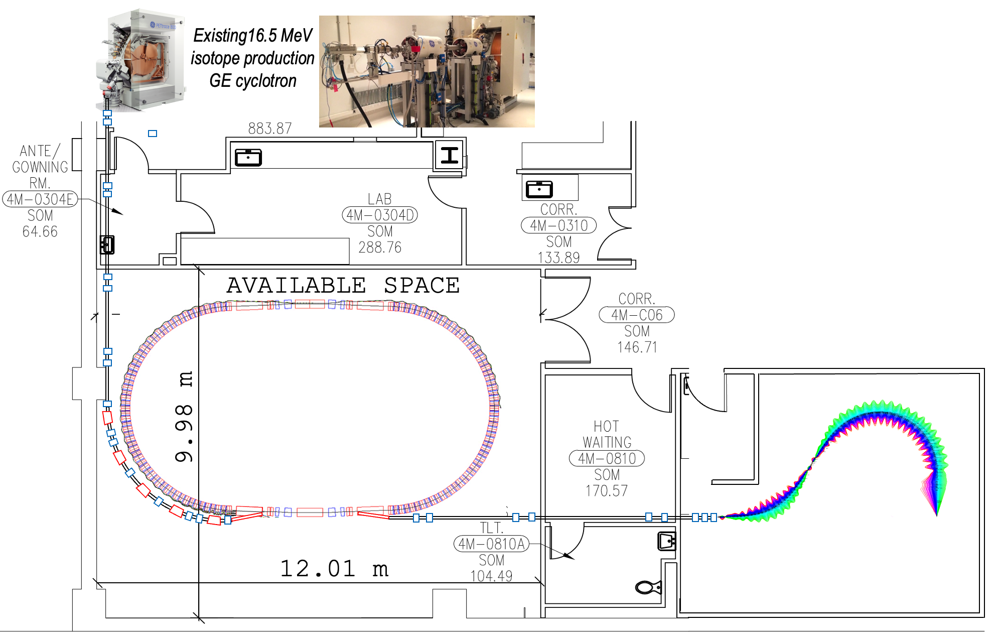
‘FLASH’ Proton Therapy facility:
Stony Brook University Hospital – Radiation Oncology
6. D. Trbojevic, Title: “Non-scaling fixed field alternating gradient permanent magnet cancer therapy accelerator”, patent number: US 9661737 B2, Date of the patent: May 23, 2017 (belongs to the DOE). https://patentimages.storage.googleapis.com/42/5e/92/f7da1cf617d6e3/US9661737.pdf

Slide 5
Facility Parameters
Parameter | Value | Unit
Injection E_{k} | 10-30 | MeV
Extraction E_{k} range | 65-250 | MeV
Arc radius | 3.5 | m
Machine cycle rate | 500-800 | Hz
Energy gain per turn | 30-45 | kV
Treatment charge | 60 | nC
Treatment time | 75-250 | ms

Slide 6
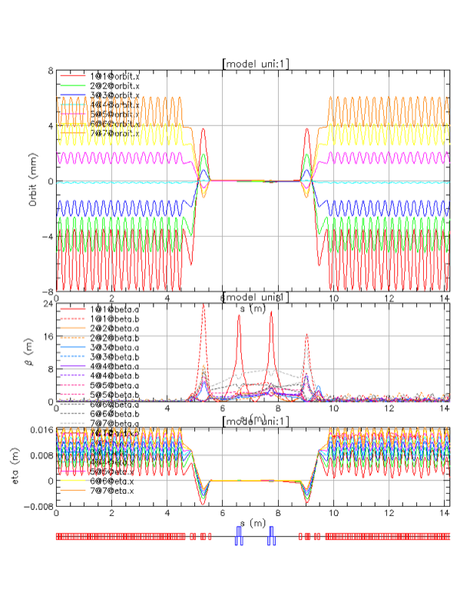
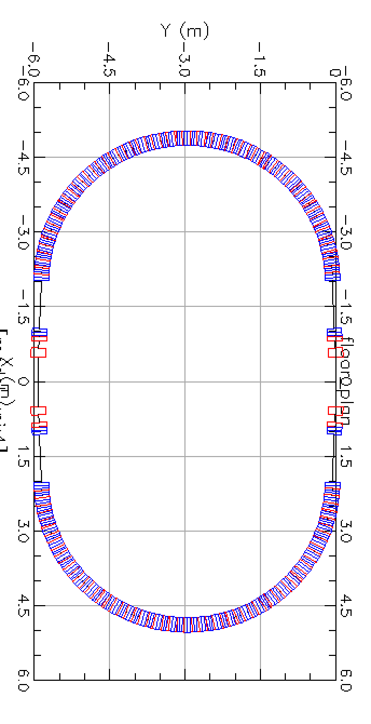
Matching of the Multiple Energy Orbits to the Straight Section
3.5m arc radius in current design

Slide 7
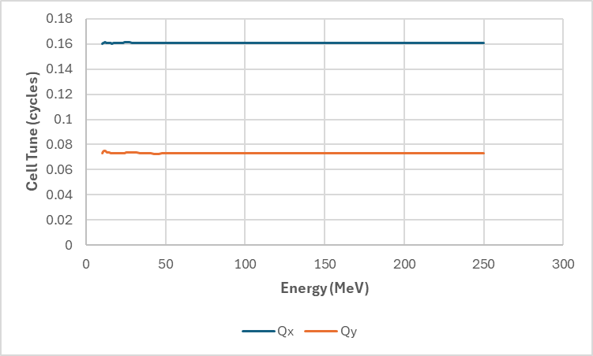
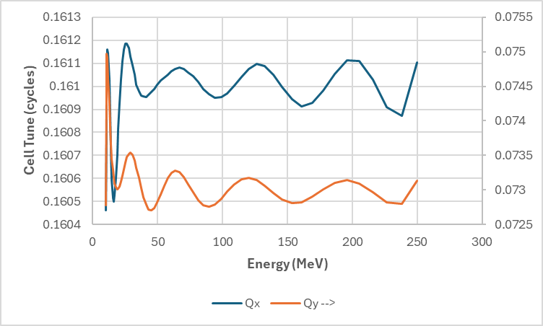
FFA Arc Cell Tunes
After iterative correction in Muon1, starting from an initial BMAD model, tunes are stable from 10MeV – 250MeV and nearly constant.
(Wiggly near low energy end because rigidity changes fast there).
Cell tune ranges:
Qx = 0.1608 ± 0.0004
Qy = 0.0738 ± 0.0011

Slide 8
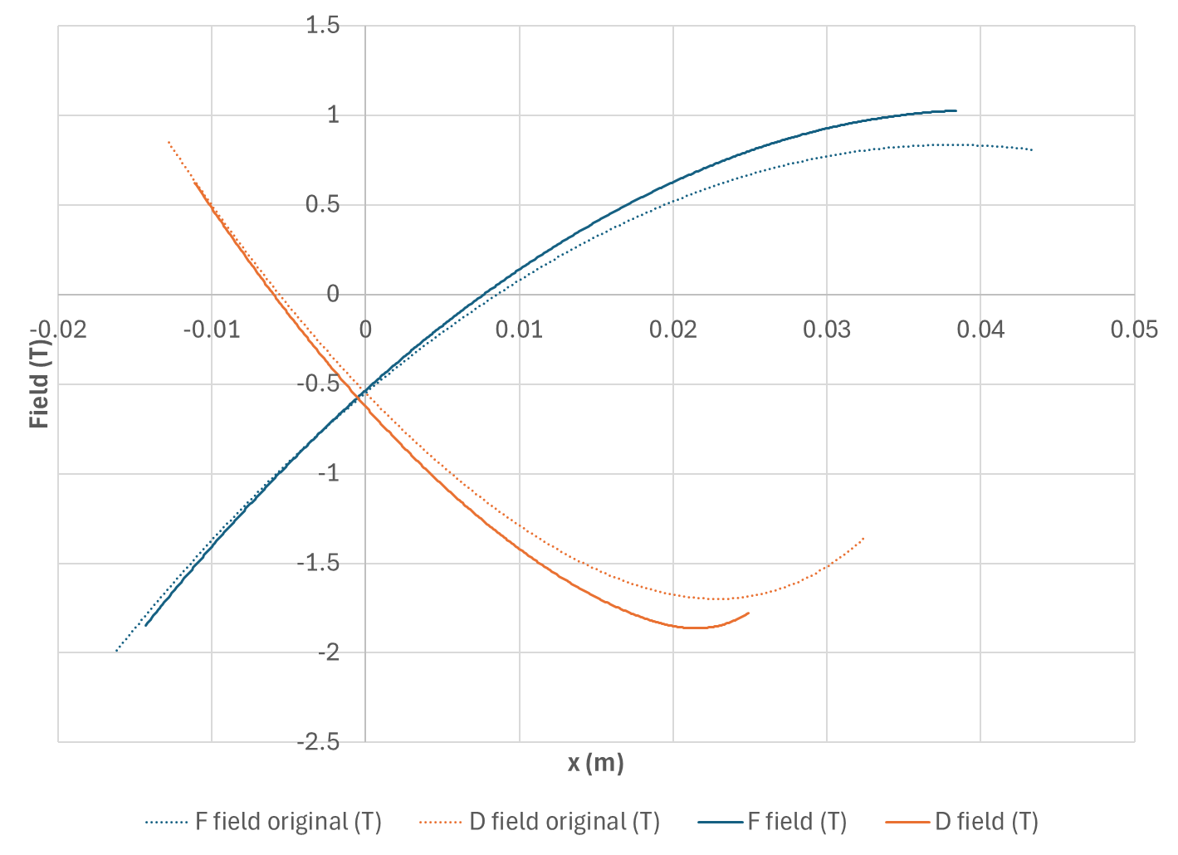
Nonlinear Magnet Field Profiles
Maximum fields equalised at 1.86T rather than 1.99T
“original” = BMAD model

Slide 9
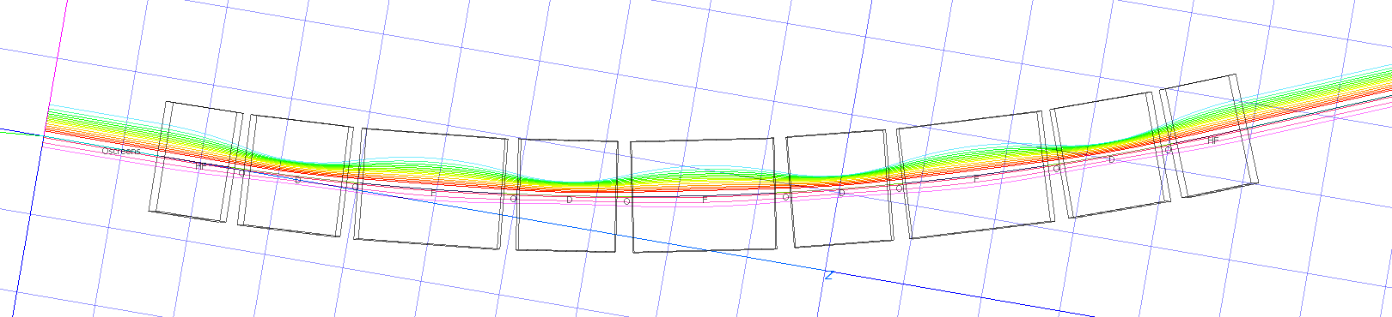
Test Beamline Simulated Orbits
D
HF
10MeV
HF
D
F
D
F
D
F
250MeV
10cm grid
Angle 5.625° per cell, 4 cells total = 22.5° (1/8 of an 180° arc)
Half-F magnets on each end → parallel orbits
Cell length 34.4cm, 4 cells total = 1.374m

Slide 10
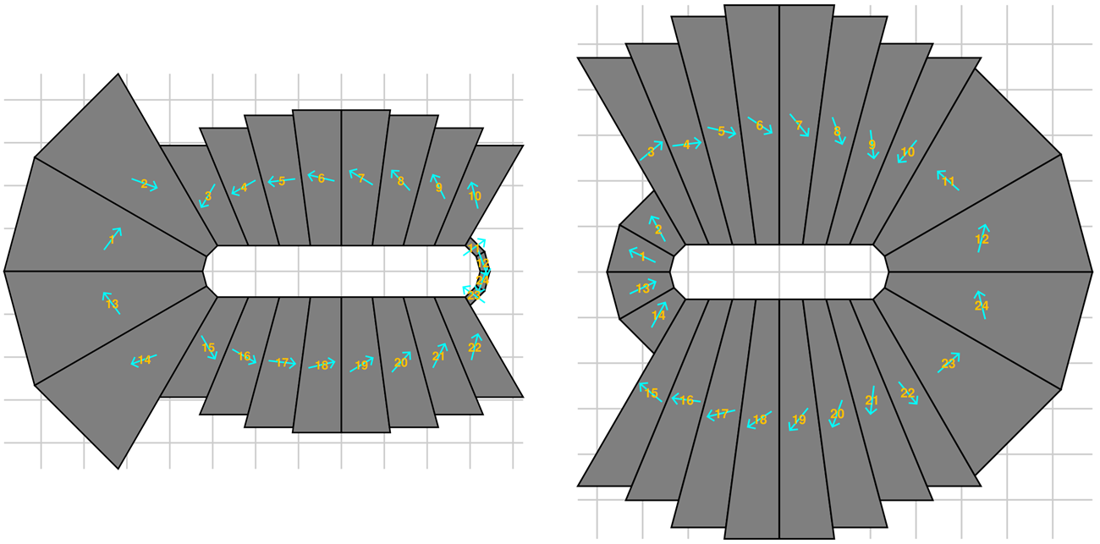
Permanent Magnet Cross-Sections
D
F
1cm grid

Slide 11
Permanent Magnet Parameters
Parameter | F magnet | D magnet | Unit
Material | NdFeB
Grade | N42EH
Remnant field B_{r} | 1.30 |  | T
Area | 69.90 | 93.88 | cm²
Full aperture | 64.7 × 12 | 48.1 × 12 | mm
Good field region x | ±26.3 | ±18.0 | mm
Maximum field | 1.85 | 1.86 | T

Slide 12
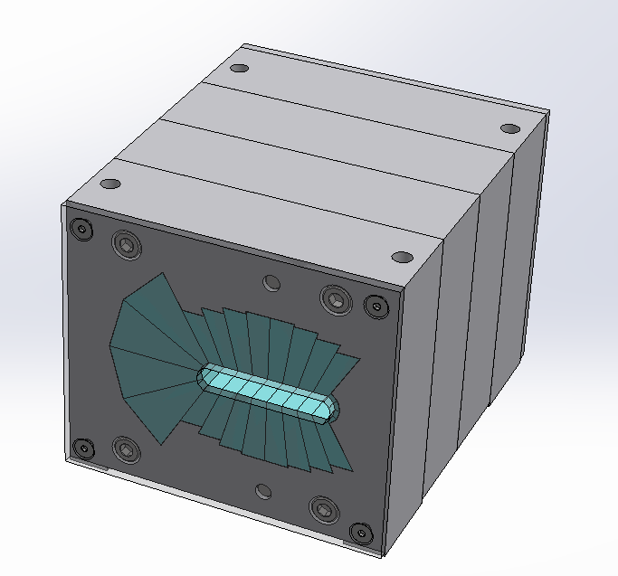
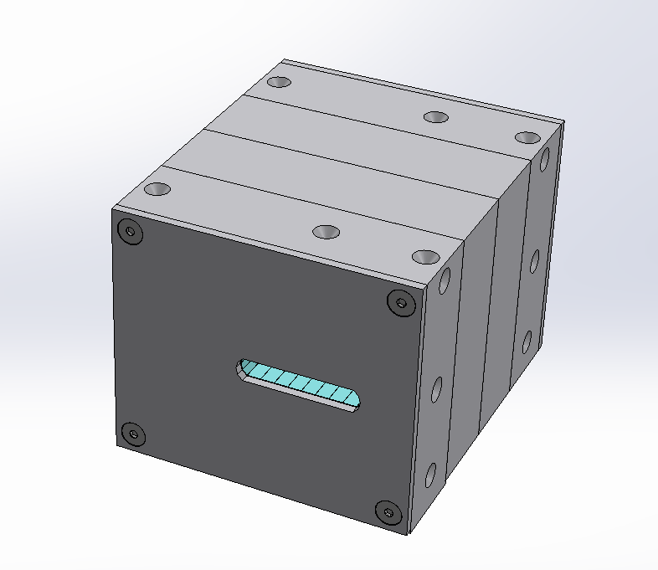
Magnets Ordered from
SABR Enterprises, LLC.

Slide 13
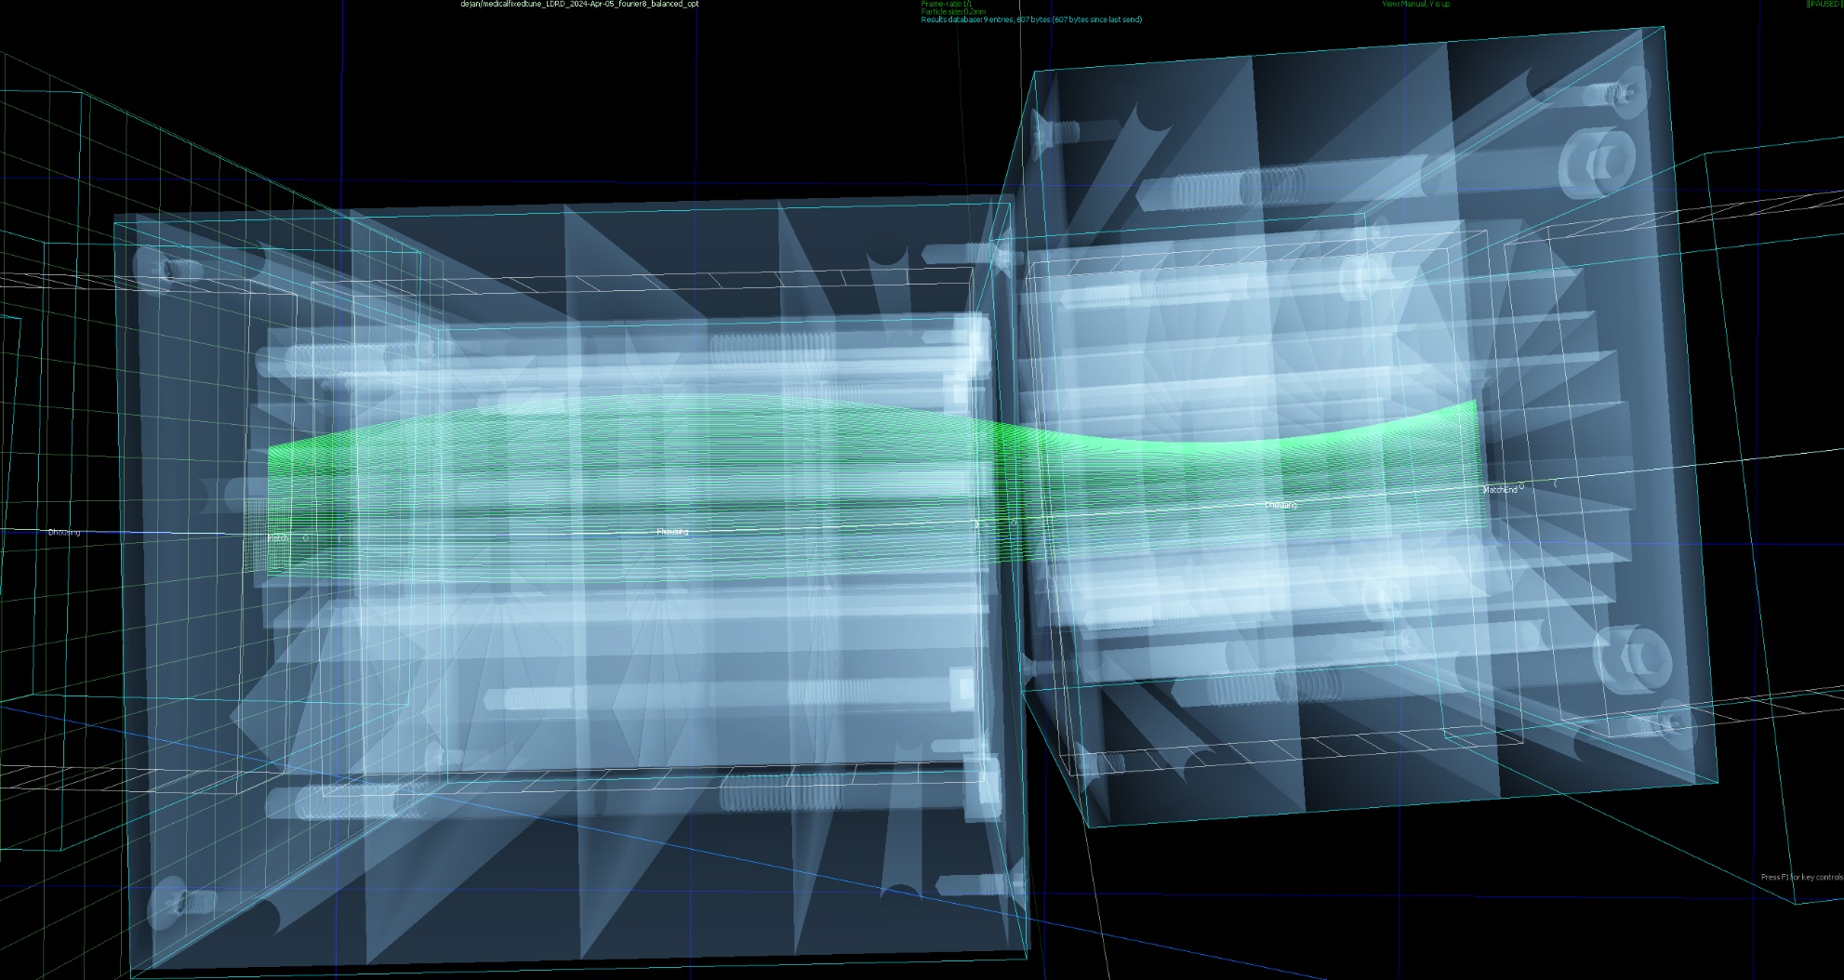
Orbits within Magnet Models

Slide 14
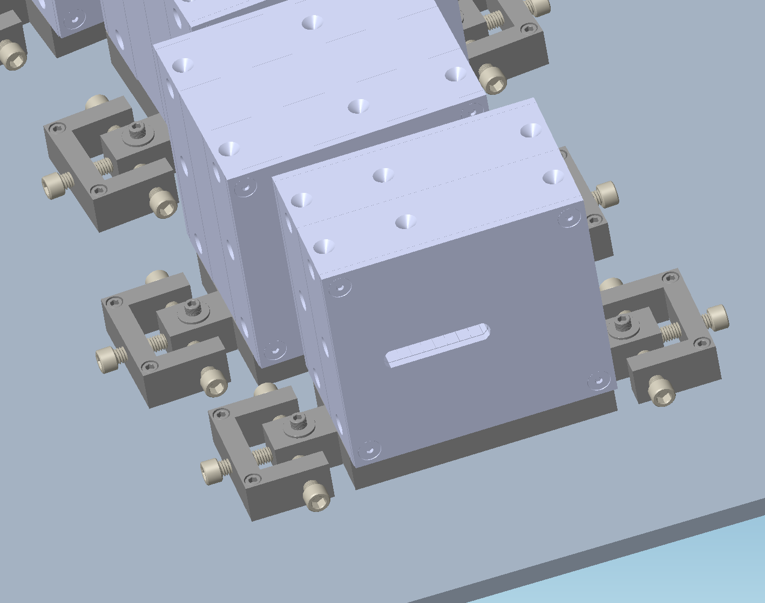
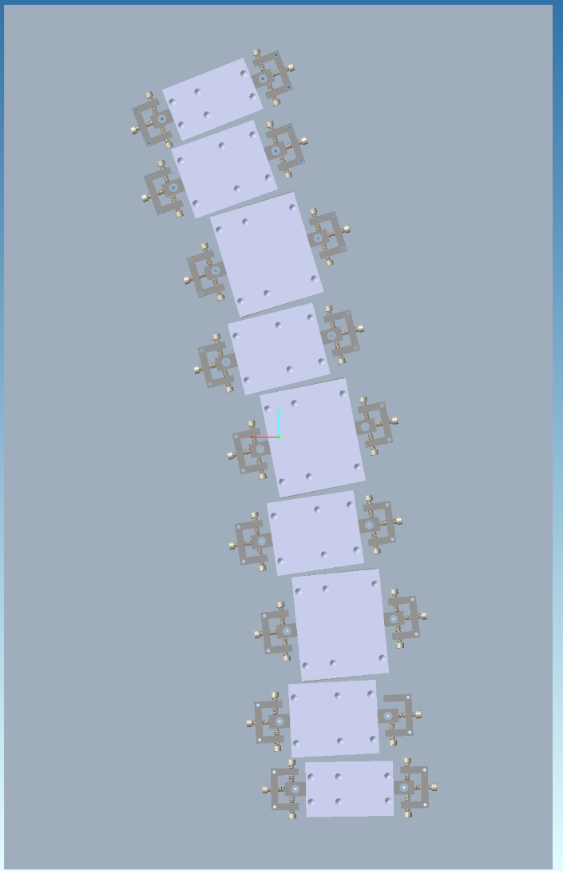
Test Beamline with Mounting

Slide 15
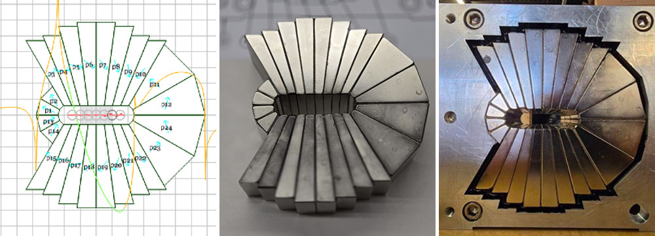
Magnet Construction by Vendor
SABR Enterprises, LLC. in Massachusetts

Slide 16
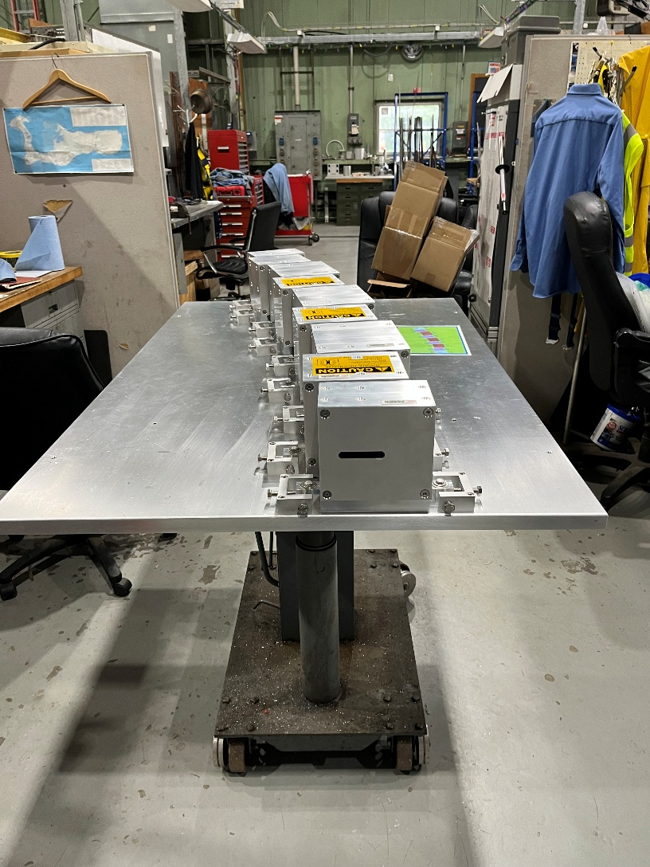
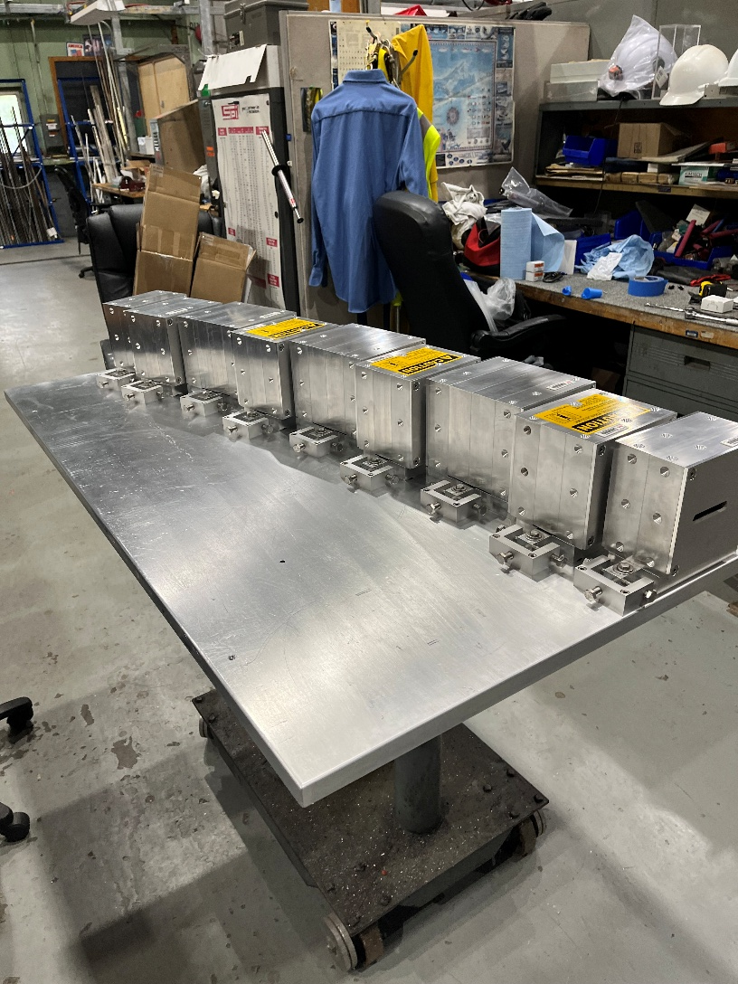
Beamline Assembly

Slide 17
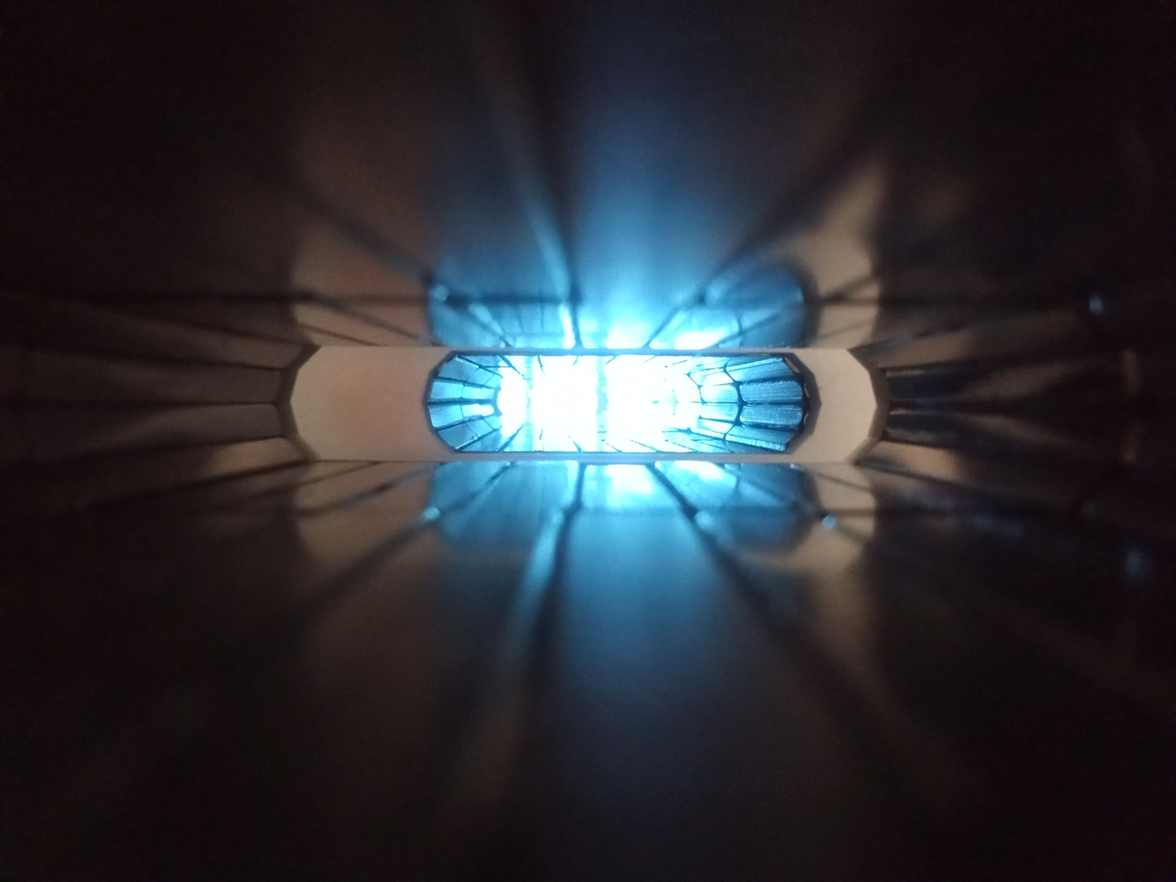
Magnet Apertures

Slide 18
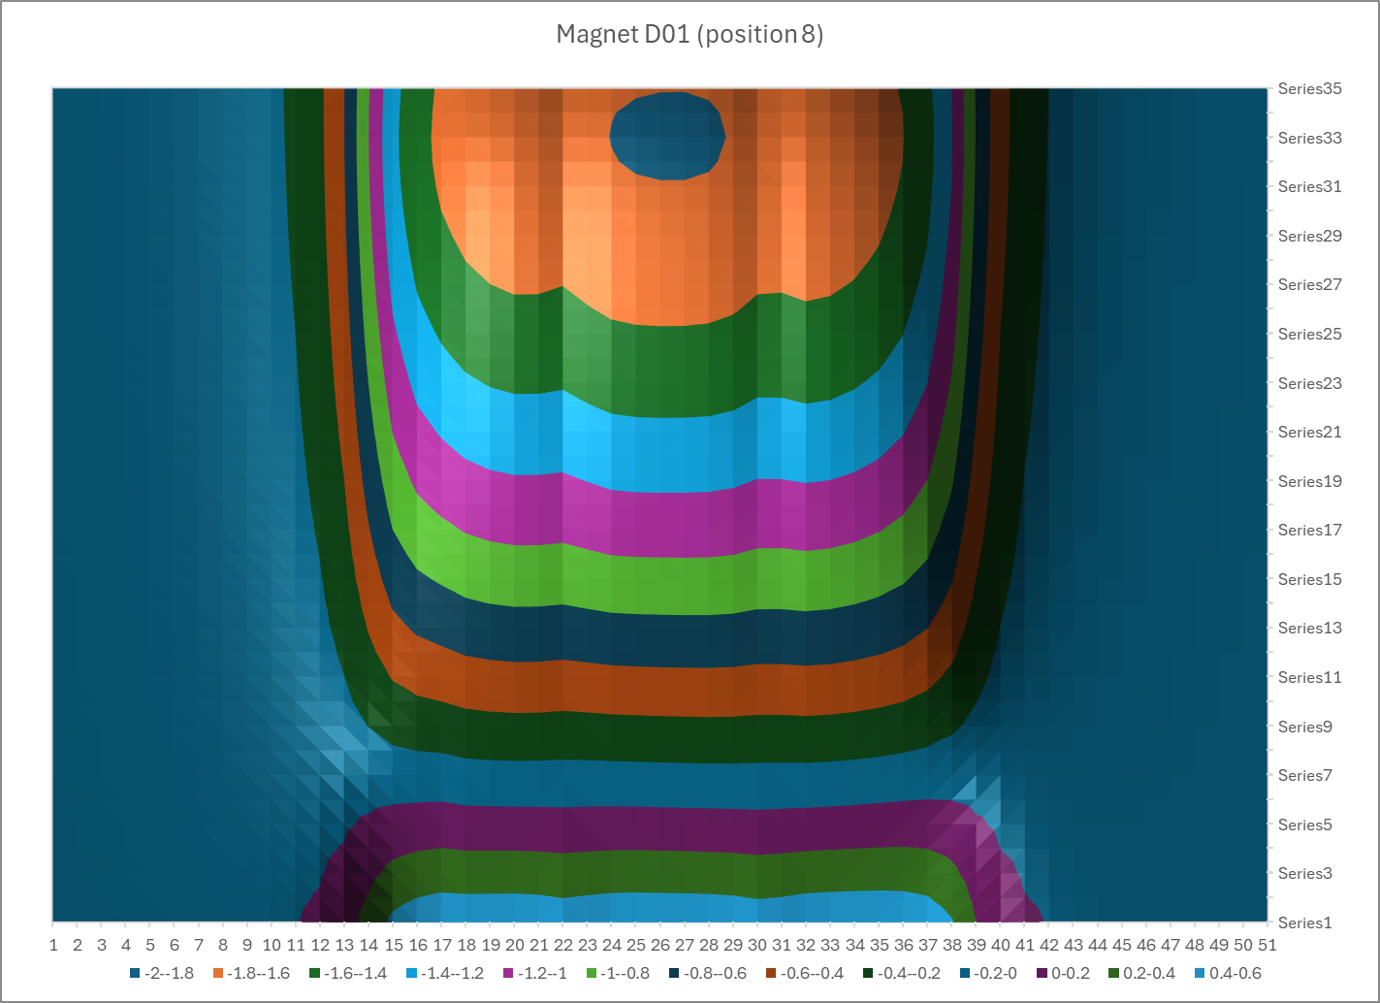
Fieldmap of one magnet

Slide 19
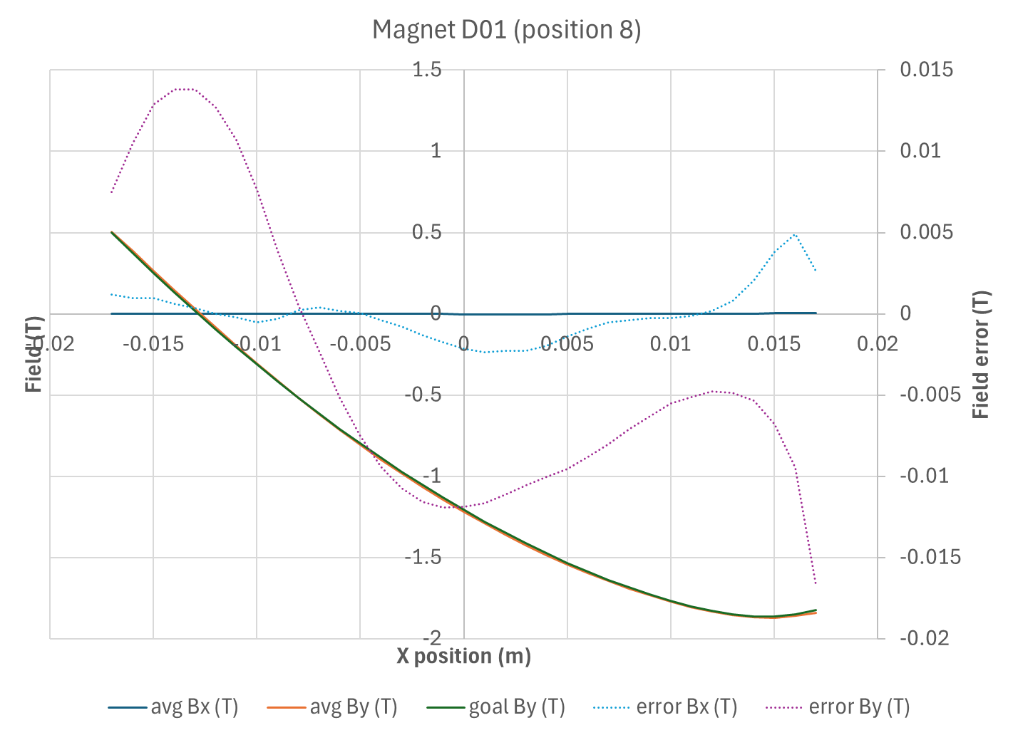
Measured Integrated Field
Corrected via fit for Hall probe displacements and tilt angles, <1% error

Slide 20
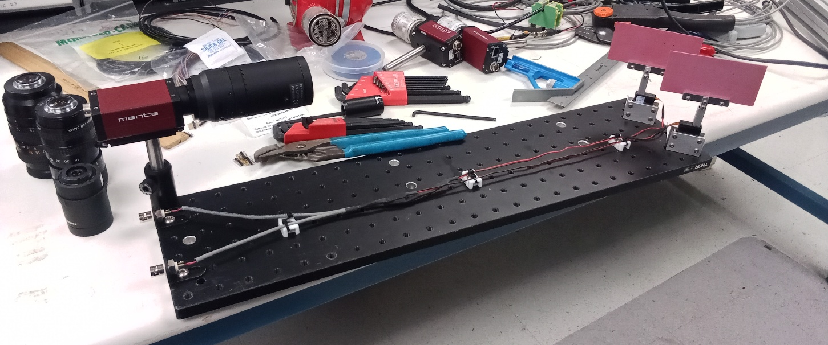
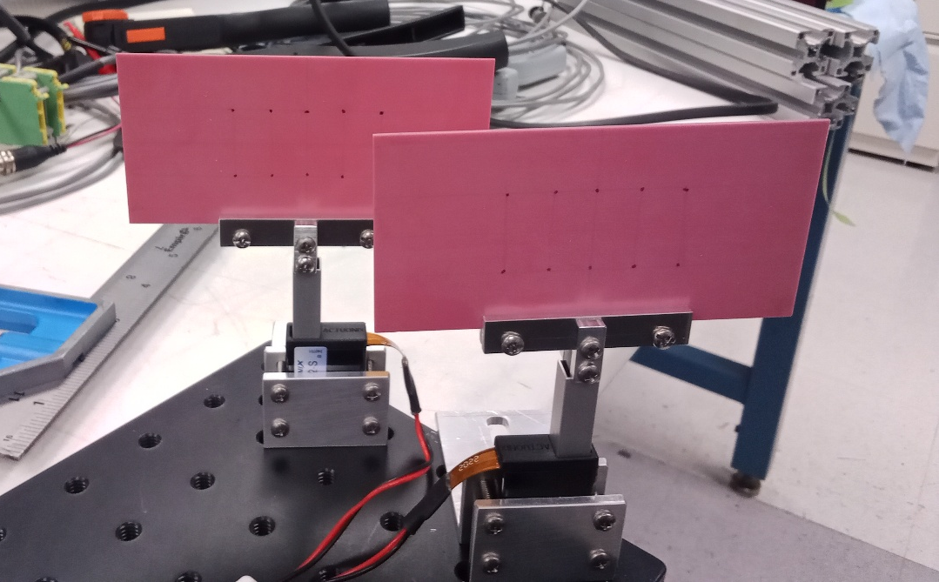
Camera and Beam Screen Plates
These were attached to both ends of the beamline.
4 cameras and 4 screens in total.

Slide 21
Experiment at BNL beamlines
NSRL
  Protons 50-250MeV
  1 day 2 hours
Tandem
  Deuterons 12.9-28MeV
  Equivalent to protons 10-50MeV
    Via rigidity but also window/air energy loss calculation
    Tandem proton max energy is 28.75MeV
  1 day

Slide 22
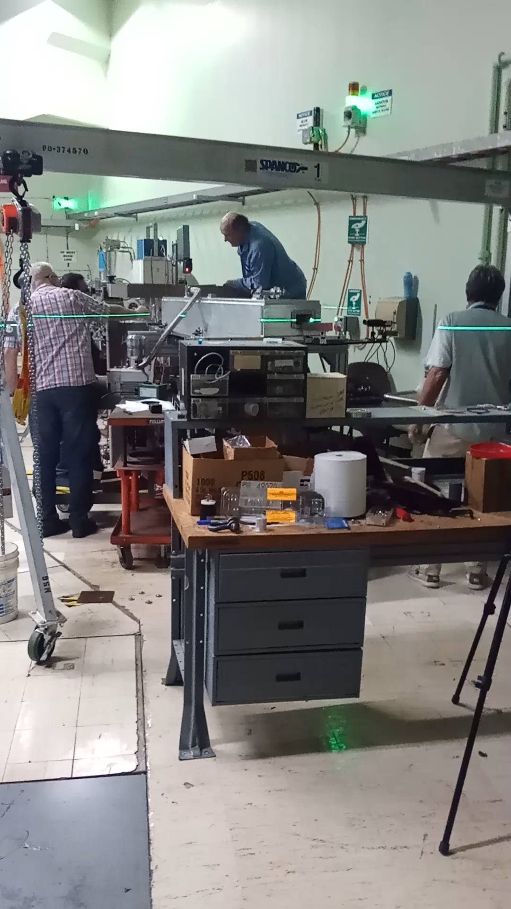
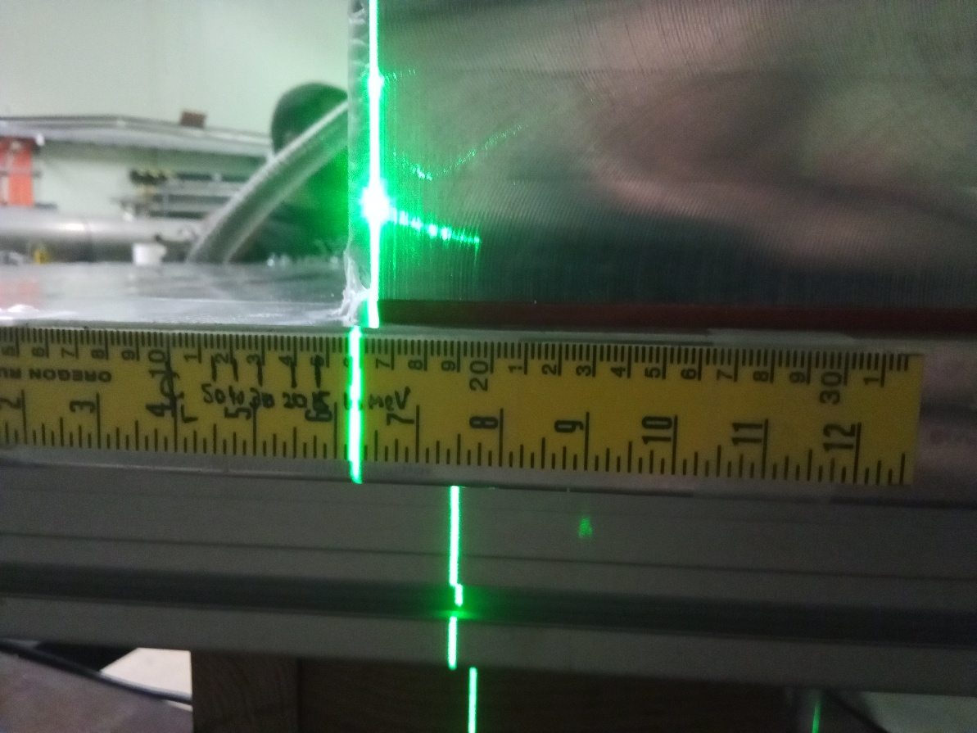
Installation (Tandem)
Different beam energies marked on a ruler for alignment.

Slide 23
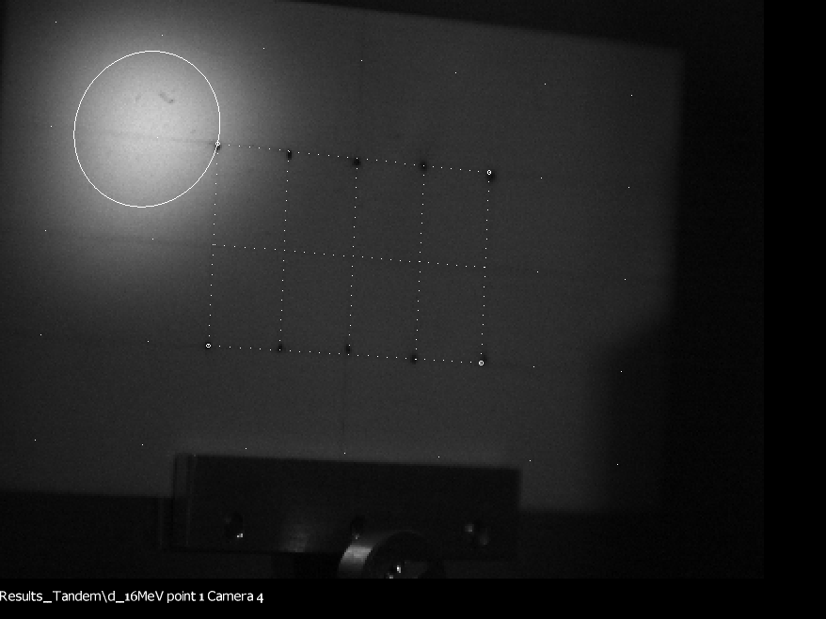
Calibration and 1σ Ellipse Fit

Slide 24
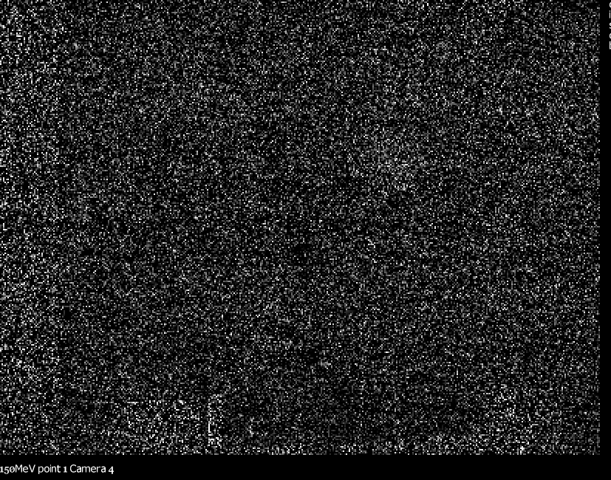
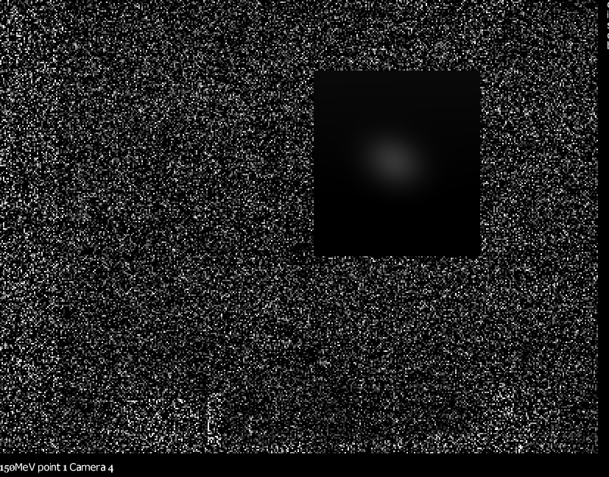
Dimmest Beam Fit
Also background frames were subtracted

Slide 25
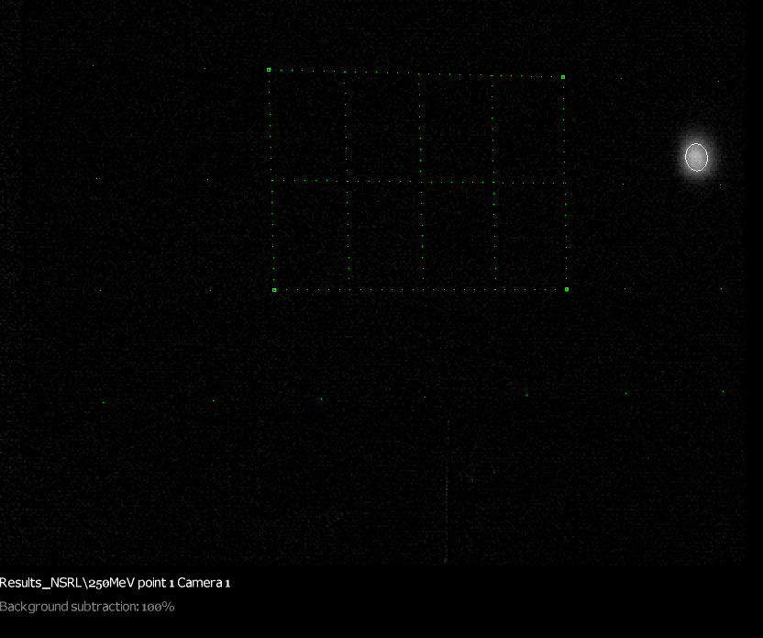
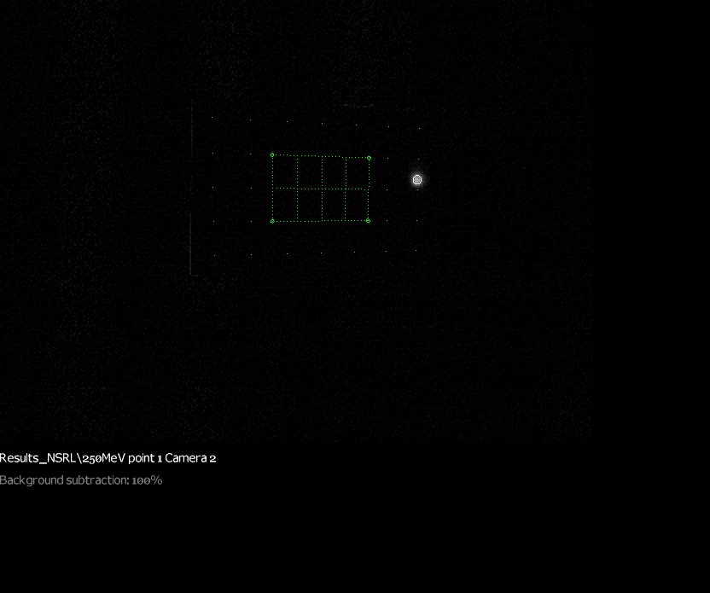
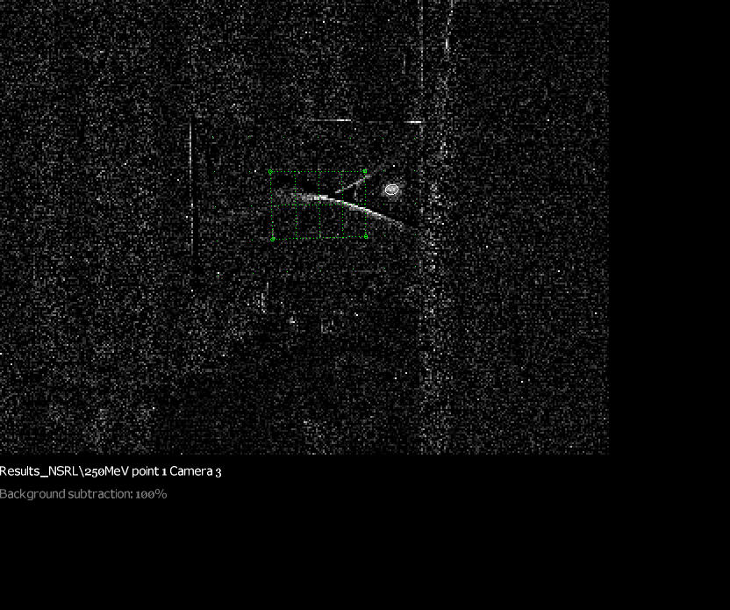
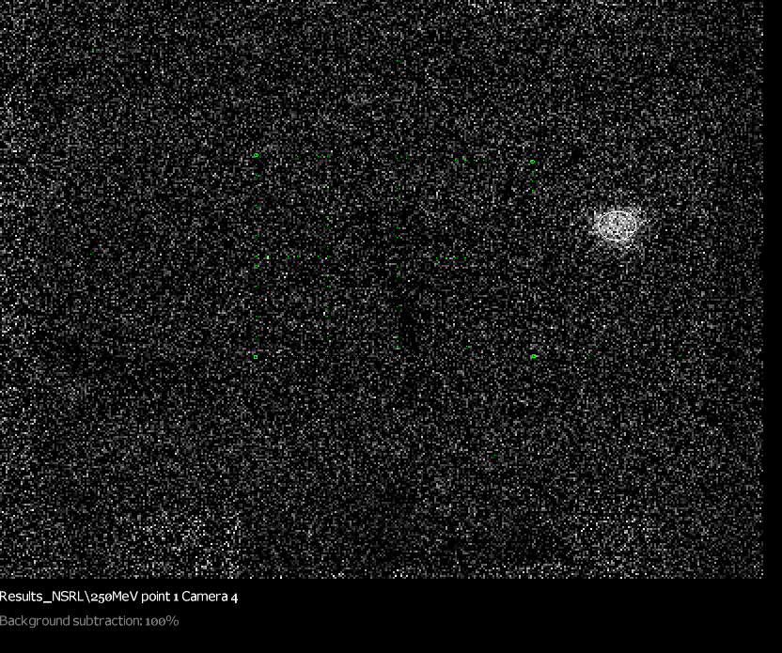
NSRL 250MeV protons
Beam in
Beam out

Slide 26
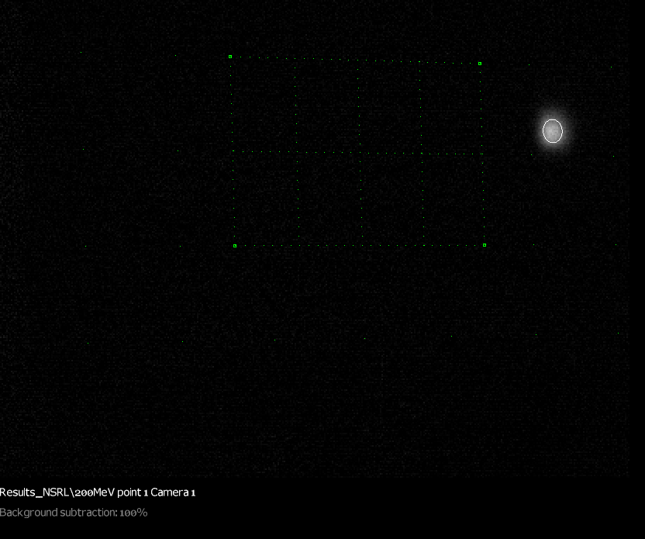
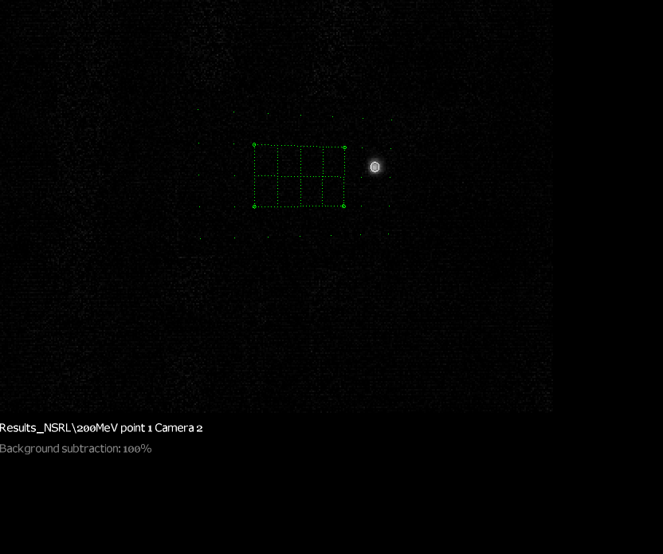
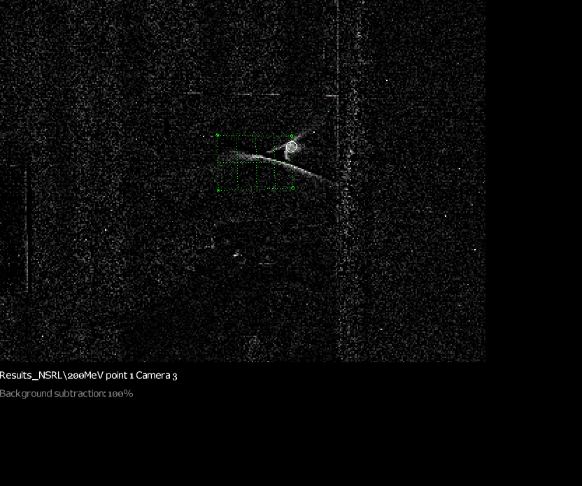
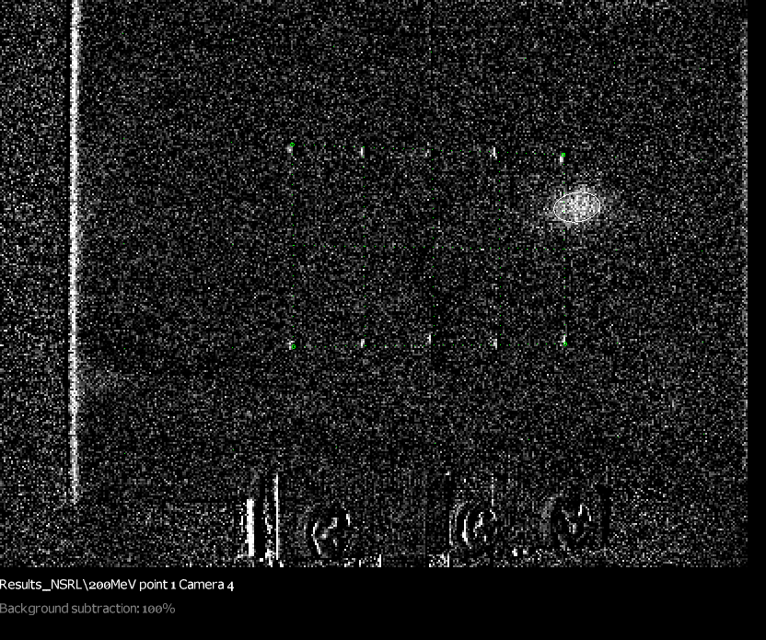
NSRL 200MeV protons
Beam in
Beam out

Slide 27
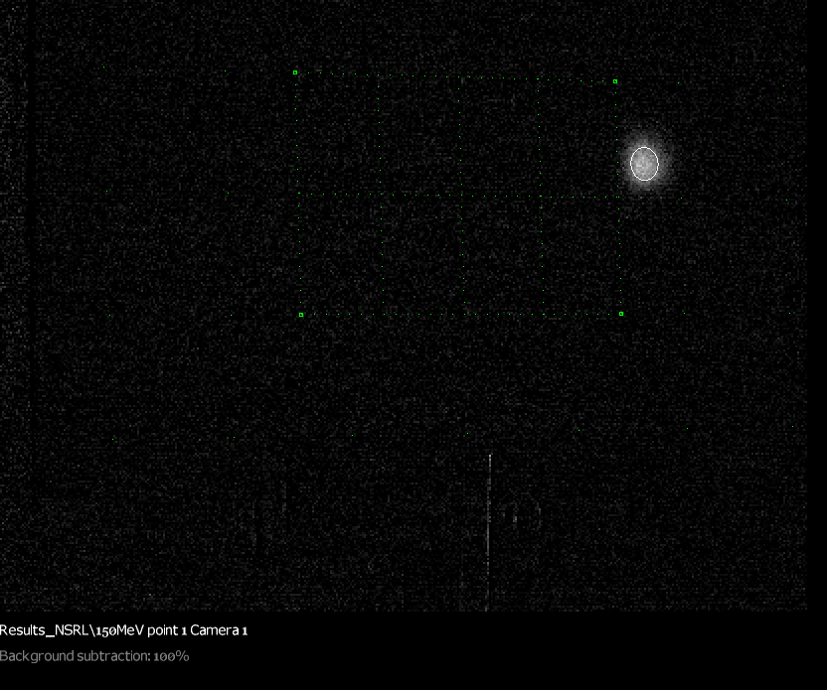
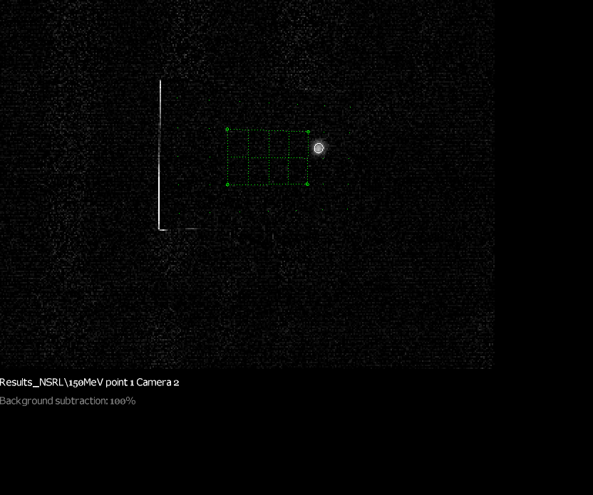
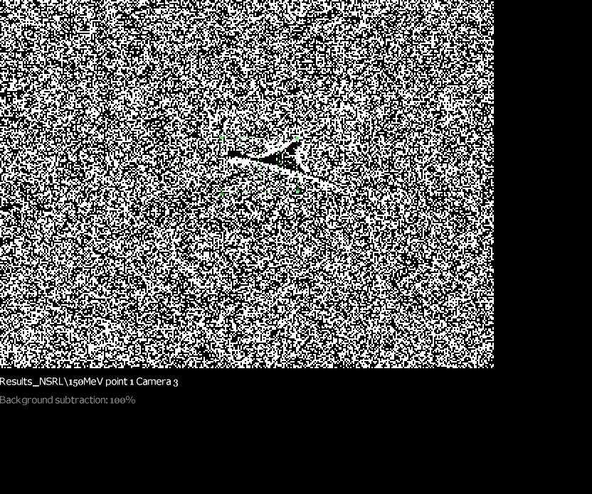
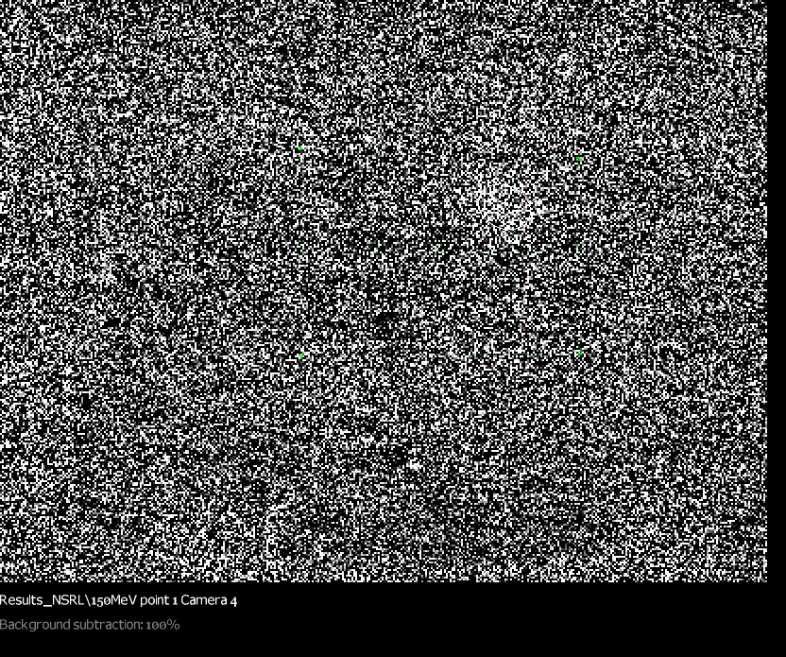
NSRL 150MeV protons
Beam in
Beam out
Obscured by stray light on screen 3

Slide 28
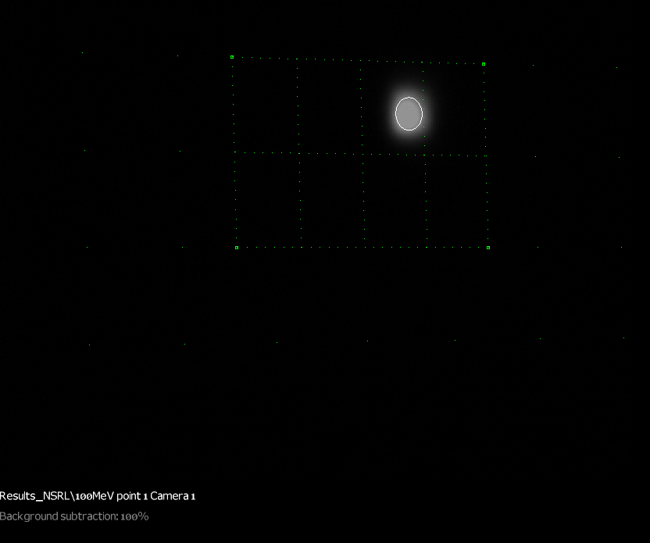
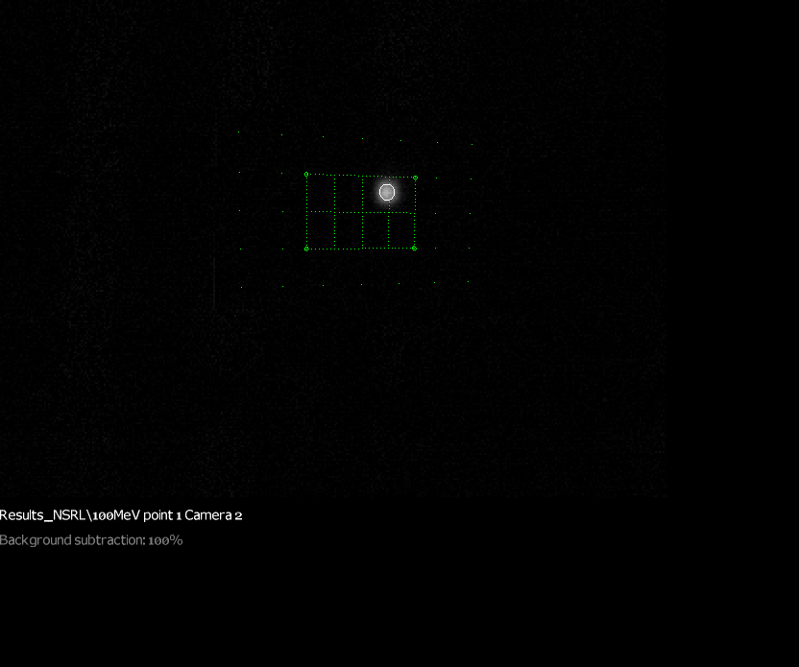
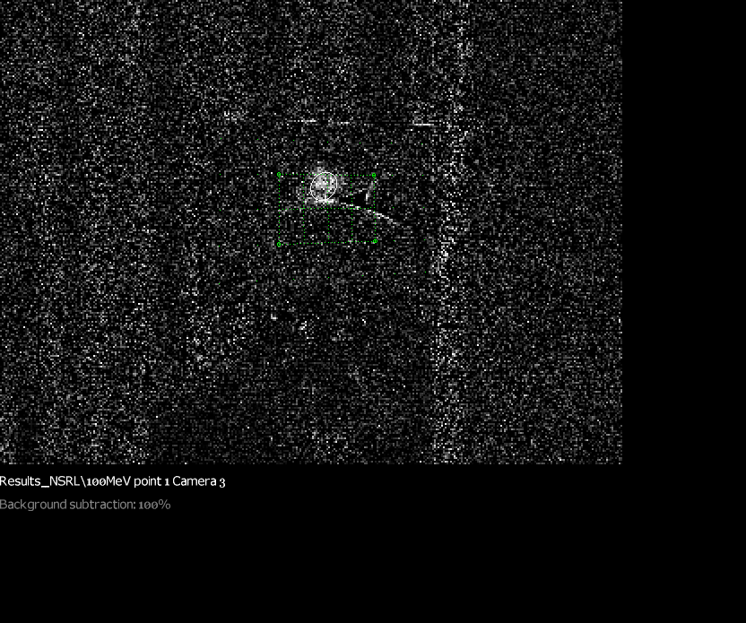
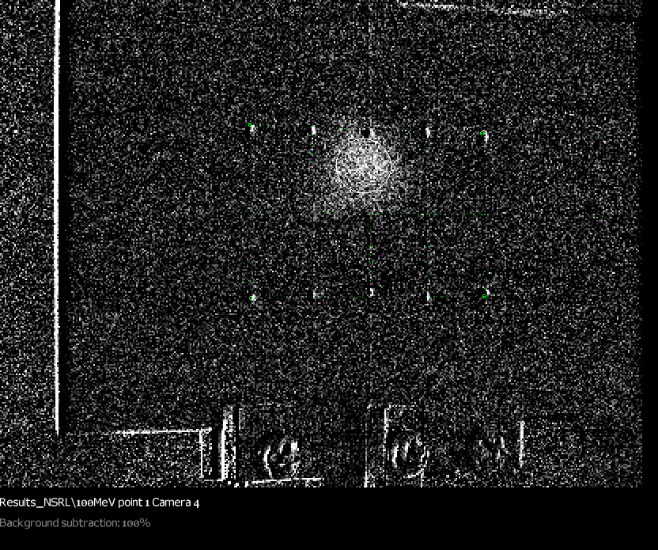
NSRL 100MeV protons
Beam in
Beam out

Slide 29
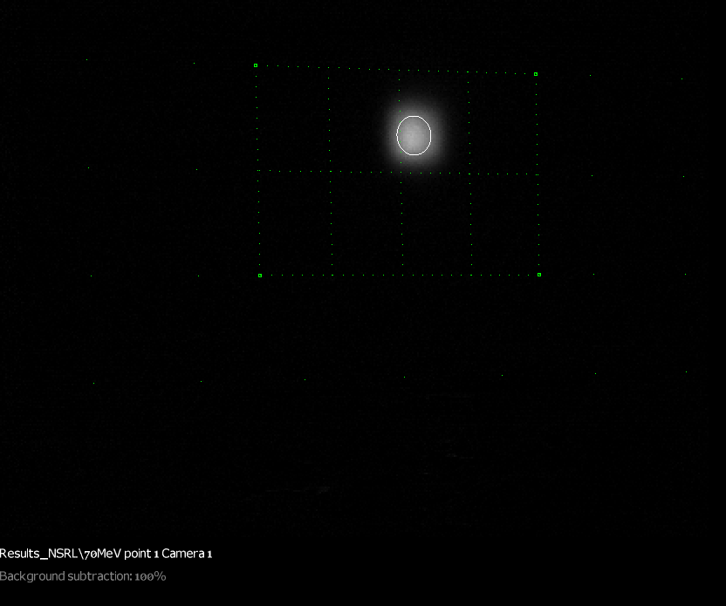
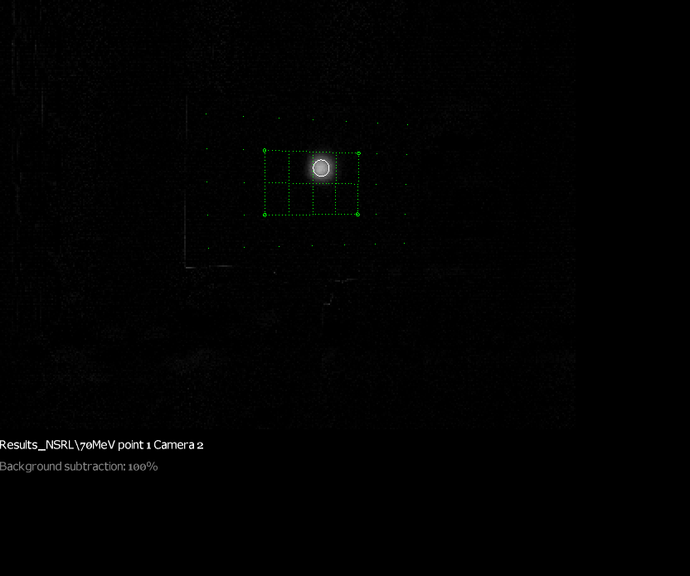
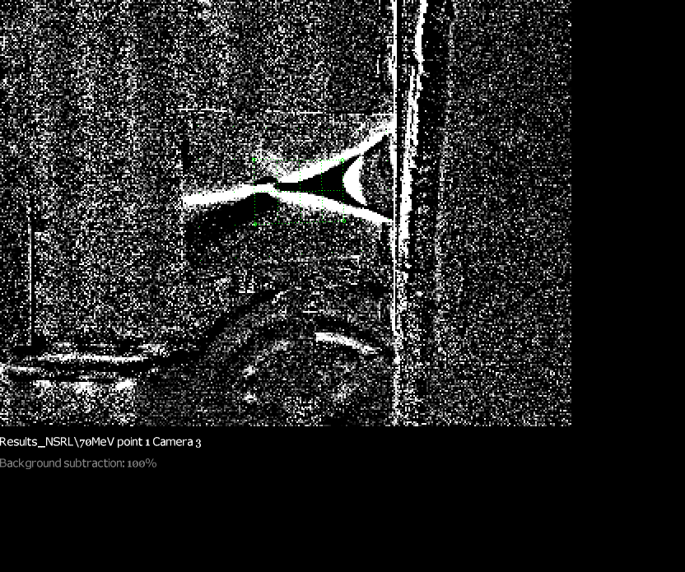
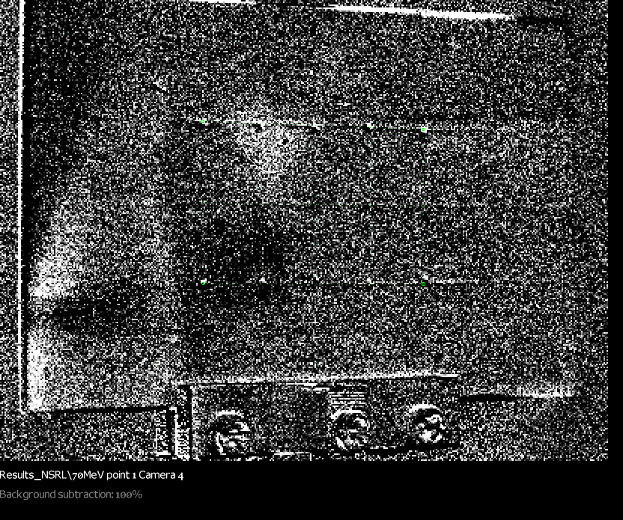
NSRL 70MeV protons
Beam in
Beam out

Slide 30
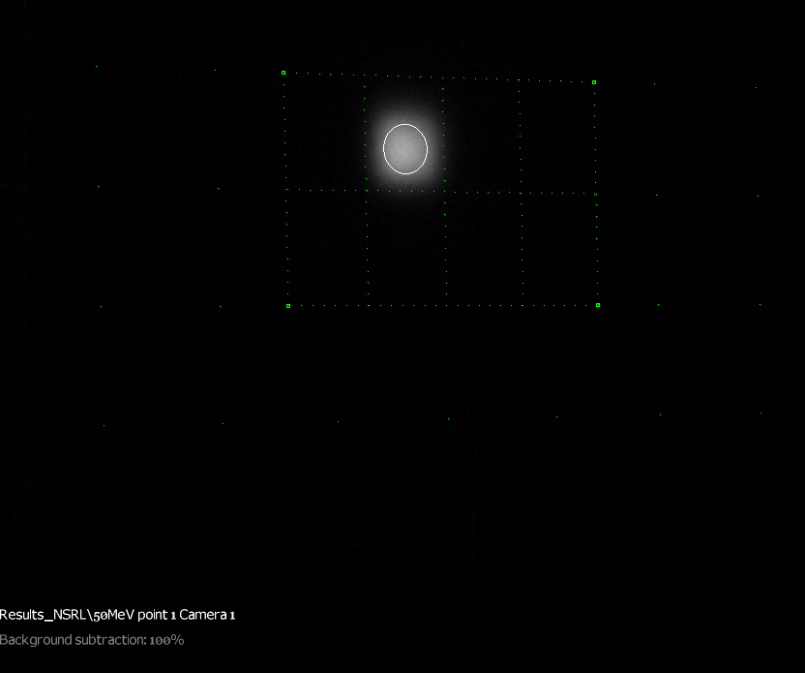
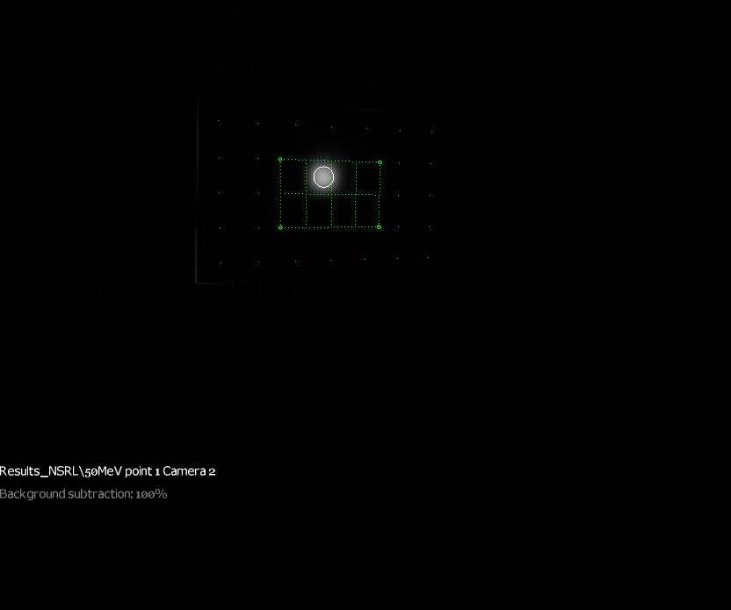
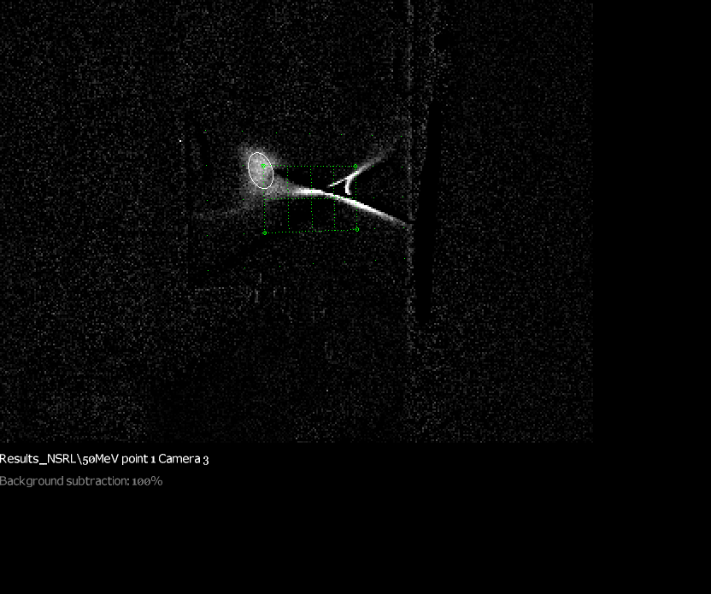
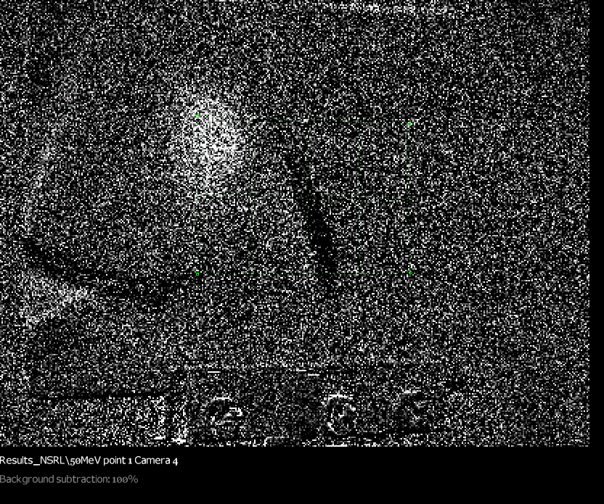
NSRL 50MeV protons
Beam in
Beam out

Slide 31




NSRL All Energies
Beam in
Beam out

Slide 32




Tandem 28MeV d ~ 50MeV p
Beam in
Beam out

Slide 33




Tandem 24.2MeV d ~ 40MeV p
Beam in
Beam out

Slide 34




Tandem 20MeV d ~ 30MeV p
Beam in
Beam out

Slide 35




Tandem 16MeV d ~ 20MeV p
Beam in
Beam out

Slide 36




Tandem 14.3MeV d ~ 15MeV p
Beam in
Beam out

Slide 37




Tandem 12.9MeV d ~ 10MeV p
Beam in
Beam out
Beam may have stopped in air before screen 4

Slide 38




Tandem All Energies
Beam in
Beam out

Slide 39




All 12 Ellipses
Beam in
Beam out

Slide 40


Screen Alignment Errors
This affected the Tandem run, so the screens were resurveyed and the offsets subtracted
Screen 3
Screen 2
Screen 4
Screen 1

Slide 41

Corrected Centroid X Positions
Beam in
Beam out
Location tracks with energy as expected
Alignment was “by hand”: 3-8mm input errors

Slide 42

Filling the Dynamic Aperture?
At lower energies, the output beam gets very large and starts to assume a crescent shape
Simulation
Experiment

Slide 43
Experiment Conclusion
Beams at all energies were transmitted through the 4-cell test girder (22.5° or 1/8 arc)
  Protons at NSRL and deuterons at Tandem
10-250MeV is a factor of 5.3× in momentum
  Very large for a non-scaling FFA, especially one with a flattened tune
  250MeV is highest ever energy in any NS-FFA line
Beam ought to propagate several cells around a ring at the start of commissioning
  (even without magnet shimming/correction here)

Slide 44
BACKUP

Slide 45


Fast Cycling Synchrotron Cycles
Kinetic
Energy
(MeV)
Extraction #2
250
Ex.1
Ex.2
RF manipulation
Ex.3
16.5-30
Injection
Energy
Second synchrotron cycle
t(ms)
Injection
Porch
One synchrotron cycle
Extraction kicker wave forms
0.8ms < τ < 1.85ms
1.3kHz< f < 540 Hz
If the RF kicks are $±$30 kV, during the slip-stacking merge a difference in the time of flight for two 2 energies is 773ps. If the batches are 15 m apart it would take 370 turns to get them aligned. Next step would be to merge into one bucket by snaping the new RF voltage on.
Time of bunch flight 405-550 ns
At the injection porch time of 926 μs there are 1680 turns. 15 turns for 15 Cyclotron bunches and 1650 turns for RF manipulations

Slide 46
Fast Cycling Acceleration with Ferrite cavities
By Stephen Brooks
 | Choices for injector cyclotron |  |  |  | Units
 | ACSI | GE | TR-19 | IBA
Energy of Injector Cyclotron | 14 | 16.5 | 19 | 30 | MeV
Cyclotron current | 400 | 200 | 400 | 1200 | μA
Treatment charge | 60 | 60 | 60 | 60 | nC
Injection turns | 4 | 4 | 4 | 2 | #
RF acceleration per turn | 29.70 | 29.70 | 29.70 | 44.55 | kV
Calculation | Treatments Options
Turn duration | 585.74 | 540.6 | 504.8 | 405.1 | ns
Charge per turn | 0.234 | 0.108 | 0.151 | 0.486 | nC
Charge per injection | 0.937 | 0.432 | 0.606 | 0.972 | nC
Machine cycles | 65 | 139 | 100 | 62 | #
Machine cycle rate | 540 | 540 | 540 | 809.95 | Hz
Outputs
Treatment time | 120 | 257 | 185 | 76.54 | ms

Slide 47

Peak Fields vs. Energy
D
Orange line is field at magnet longitudinal centre, which is different than at exit (orbit in fringe area) for D magnet.

Slide 48

Orbits and Fields in Muon1

Slide 49
Lattice Converted from BMAD
Three cells for field wrap
Multipoles dipole…dodeca
These slides look a lot like last year’s, but Dejan’s multipole numbers have changed!
Angle 5.625° per cell, 64 cells per turn. Cell length 34.4cm, R=3.5m.
This worked well in BMAD, fixed stable tunes from 10MeV – 250MeV

Slide 50
BMAD and Muon1 Magnet Models
BMAD has a zero-length end field model
Muon1 has a Maxwellian fringe field model with finite length (bit more realistic)
  But you have to choose the length yourself!
  Only way to do this sort of field in BMAD is to generate fieldmaps, so there’s a difference
We also changed from sectors to rectangles but that turned out to be a small effect

Slide 51

Field Profiles (BMAD)

Slide 52


BMAD Lattice in Muon1
Vertical tune is unstable at low energies
  On previous lattice version, this was true no matter what Muon1 fringe field length I chose
Cell tune
MeV

Slide 53
This cell can be “easily” fixed using the Algorithm I used before
Runge-Kutta 4th order tracking step
Loop to get trajectory in cell
Finite difference to get transfer matrix
  Also gives tunes if orbit is closed
Iterate (Newton) to find closed orbit
Loop over all FFA energies
Finite difference parameters to get response matrix of tune functions to multipole changes
Iterate (optimiser) to find fixed-tune lattice
Muon1
Muon1 cell optics mode
Muon1 FFA optics mode
Fixed-tune FFA optimiser
(parallel)
Fourier coefficient

Slide 54
Wait, Fourier coefficients?
Representing the transverse midplane field dependence B_{y}(x,0) as a Fourier series made optimisation work better than multipoles
  Suspect this is because sin,cos(nx) are orthogonal whereas polynomials are highly correlated
Used the form
B_{y}(x,0) = c₀ + Σ_{n=1..8} s_{n}sin(nkx) + c_{n}cos(nkx)
…where 2π/k is about twice the orbit excursion

Slide 55


Slide 56

Magnet Sim. Field Error Graph (F)
3.6×10⁻⁴ relative error

Slide 57

Magnet Sim. Field Error Graph (D)
1.6×10⁻⁴ relative error

Slide 58
Permanent Magnet Designs (F)
NdFeB material
N42EH grade
B_{r}=1.3T
69.90cm² area
64.7 x 12mm aperture
Good field X±26.3mm
1.85T max field
cm grid

Slide 59
Permanent Magnet Designs (D)
NdFeB material
N42EH grade
B_{r}=1.3T
93.88cm² area
48.1 x 12mm aperture
Good field X±18.0mm
1.86T max field
cm grid

Slide 60

Magnet Holders Machined

Slide 61


Magnet Holders Machined

Slide 62

End Plates Machined

Slide 63

Raw Integrated Field Data

Slide 64

Measured Gradients

Slide 65




Attempt at Shimming
Shimming is possible in theory but more engineering is needed to keep wires securely in place in aperture, so magnets were not shimmed for this experiment.

Slide 66

Test Beamline, 4 cells
Half-F magnets on each end
Angle 5.625° per cell,
4 cells = 22.5°
(1/8 of an 180° arc)
Cell length 34.4cm,
4 cells = 1.374m

Slide 67




Centroid X Positions
Beam in
Beam out

Slide 68




Corrected Centroid X Positions
Beam in
Beam out

Slide 69




Centroid Y Positions
Known Y shift from reassembly of camera screens between NSRL and Tandem
Beam in
Beam out

Slide 70
Attempt at Transfer Matrix Element
Not much time, but some energies were tried offset horizontally from the nominal entrance position by a few mm
  Often the entrance position of the previous energy was used with the next energy
dx_{out}/dx_{in} ~= (change in average X centroid position on output screens)/(change in average X centroid on input screens)

Slide 71


Transfer Matrix M_{xx} Element
(Kind of surprised we got any valid data for this at all)
4Q_{x,cell} = 0.644 → cos(φ_{x}) = -0.618
Agrees at high energy, changes at low energy
  Could be injecting off the closed orbit → sextupole feed down

Slide 72

Tracking Offset Trajectories
±10mm

Slide 73

Matrix Element from Tracking
Looks sensitive to injection position especially at low energy
±10mm

Slide 74

Transfer Matrix M_{xx} Element Again
With the corrected centroids, use the difference of the beam position to the central orbit (according to survey) to derive a matrix element between input and output
  No longer calculated around an offset orbit!
  Looks more reliably negative, but noisier
  1mm centroid errors make large error bars on this

Slide 75

Magnetic Efficiency
Circumference or field factor of 2.29× relative to ideal synchrotron

Slide 76

Two Stage Machine
Momentum ratio 5.31=3.54*1.40, split at 135MeV k.e.
1.63× relative to ideal synchrotron

Slide 77
Two Stage Machine Conclusion
The two stage machine reduces fields by a factor of 1.4, or same field at lower radius
  One stage FFA: 3.5m radius (7m diameter)
  Two stage FFA: 2.5m radius (5m diameter)
  Ideal synchrotron: 1.53m radius (3.06m diameter)
    But difficult to ramp the magnets at 100s of Hz
Quick design: just cut out pieces of the original machine’s momentum range and scale them!

