Slide 1

WEO3T03 A PORTABLE MUON SOURCE FOR ARTIFICIAL MUON MUOGRAPHY
L. Guo, M. Kuriki∗, Z. Liptak,
Hiroshima University, Hiroshima, Japan

Slide 2
Introduction
A muon is a light particle with a mass of 105.6 MeV/c² (207 times that of an electron).
They are produced by the decay of pions: p → μ + n.
Due to their greater mass, they are less prone to Bremsstrahlung than electrons. Ionization is the primary mechanism.
Consequently, muons travel farther through matter than electrons, making them suitable for imaging large objects.
Muon-induced X-rays are high-energy and easy to detect. Furthermore, since depth can be controlled by energy, it is possible to measure depth-dependent distributions of elements.

Slide 3

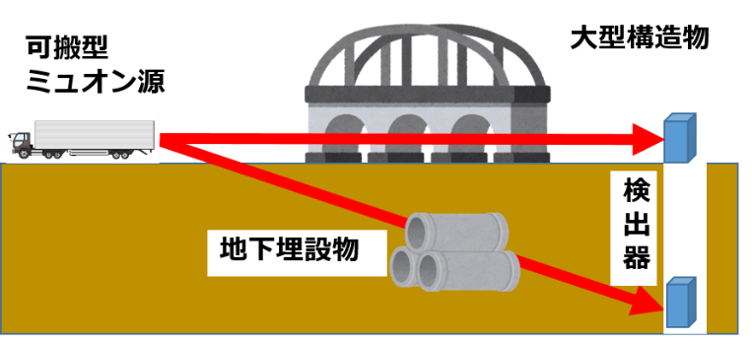
A Portable Muon Source
Currently, research focuses primarily on natural (low rate) and artificially generated muons produced in laboratories (less availability).
Portable muon sources will make it possible to use high-intensity artificial muon beams even outdoors.
Non-destructive inspection: infrastructure, cargo containers, nuclear reactors, and other large structures.
Elemental analysis using muon-induced X-rays: cultural properties, works of art, and historical artifacts.
Large
structure
Muon
Source
Detector
Underground objet

Slide 4
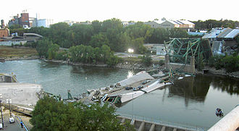
Preventive Maintenance Using Muons
The aging of social infrastructure built worldwide in the 1950s and 1960s is a major challenge.
There is a shortage of the funds, personnel, and materials needed for renewal, making a blanket replacement impossible.
It is essential to assess the condition of infrastructure and carry out efficient maintenance and renewal (preventive maintenance).
The Ministry of Land, Infrastructure, Transport and Tourism estimates that preventive maintenance can reduce maintenance costs by 30% to 50%.
Muon non-destructive inspection, in addition to X-rays and neutrons, contributes to the implementation of preventive maintenance.
Minneapolis Highway Collapse
Opened in 1967, the highway collapsed during the evening rush hour, killing 13 people and injuring 145.

Slide 5
Configuration of a Portable Muon Source
Muon Driver
400 MeV 10μA
Electron Accelerator
Muon Target
ep→Δ →π →μ
Muon Accelerator
400 MeV

Slide 6
Muon Generation
For portable systems, muon production using an electron beam—which is easy to accelerate—is advantageous.
Generally, the number of muons produced increases as energy rises, but efficient muon production is possible by utilizing the Delta resonance (1232 MeV).
The threshold for electron beam energy is ~259 MeV. Efficient muon production occurs around 400 MeV.
A 100 μA, 400 MeV electron beam is assumed.

Slide 7

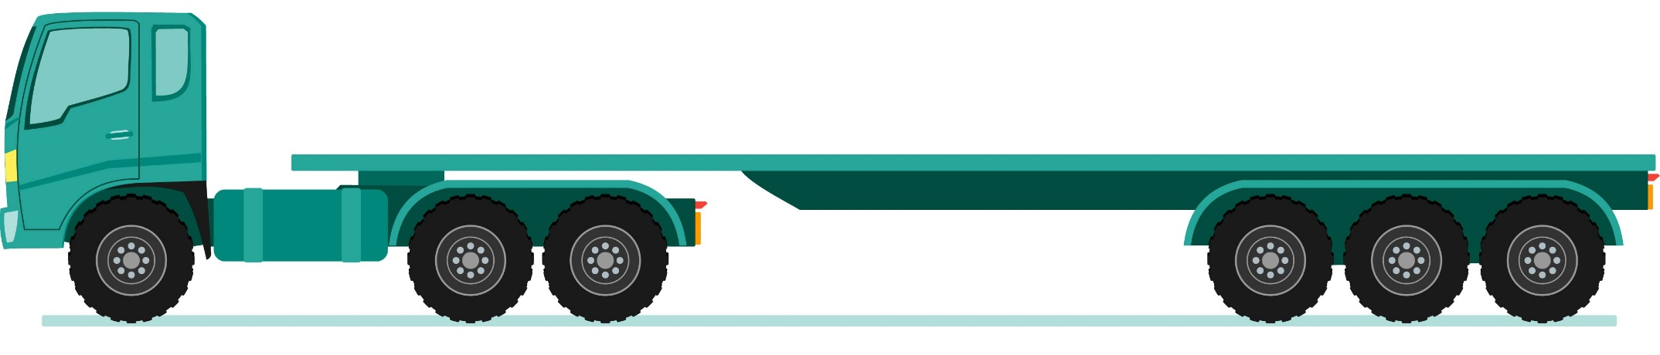

ASLMG Advanced SC Linac Muon Generator
12m
Laser
1m²
RF amp. 2.6m²
He
Vessel
1m²
He liquefier
2m²
2.5m
40kW
Target
20MeV RF Gun
400 MeV Linac
Cathode
prep.
絵に描いた餅
Rice-cake on Canvas
(A pipe dream)
Operating a superconducting accelerator with an effective length of 5 m at 80 MV/m yields 400 MeV.
This high gradient is made possible by a multilayer structure consisting of Nb₃Sn and an insulator.
This technology has not yet been demonstrated.

Slide 8
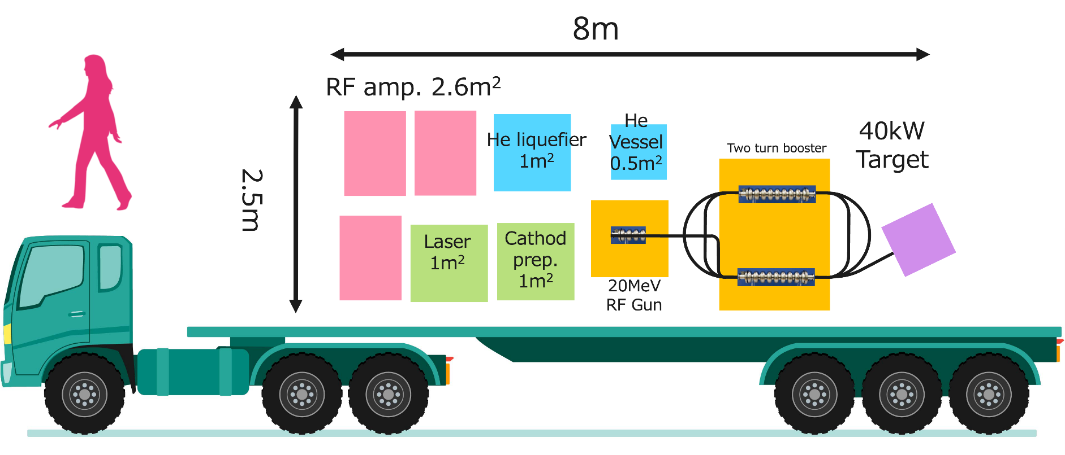
DSMMG Double-Sided Microtron Muon Generator
This method is based on established technology.
It allows for a shorter length than the previous ASLMG.

Slide 9

Single-side bending
Consider a particle entering a dipole magnet at an angle and exiting on the same side.
Regardless of the energy, the angle of incidence equals the angle of reflection. The orbits shift parallel to each other depending on the energy.
By combining four deflection fields that bend the particle by 90° (with an angle of incidence of 45°), a circular orbit can be created. On two sides, all orbits coincide; on the remaining sides, the orbits shift depending on the energy.
θ
θ
$$D=2r\sin{θ}$$

Slide 10
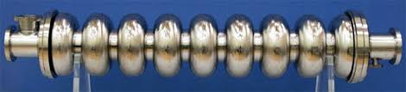
Double-Sided Microtron
Four p/4 single-sided bending magnets form a circular track. Superconducting accelerating cavities are installed in the two straight sections.
An RF electron gun is positioned inside the circular track, with the beam injected from the inside.
This design significantly reduces the mass of the magnets and the volume of the vacuum chamber, making it ideal for portable applications.

Slide 11
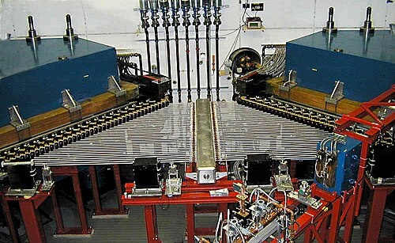
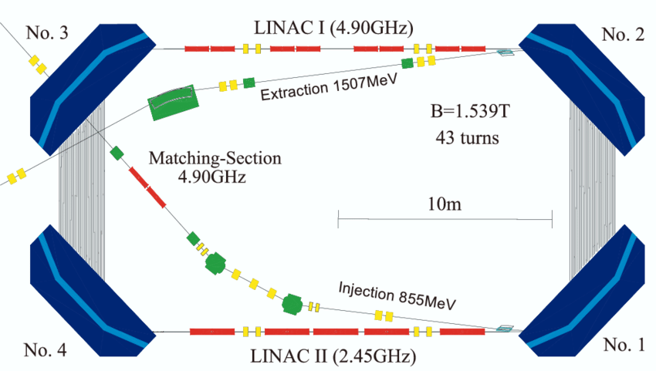
Mainz Double Sided Microtron MAMI C

Slide 12

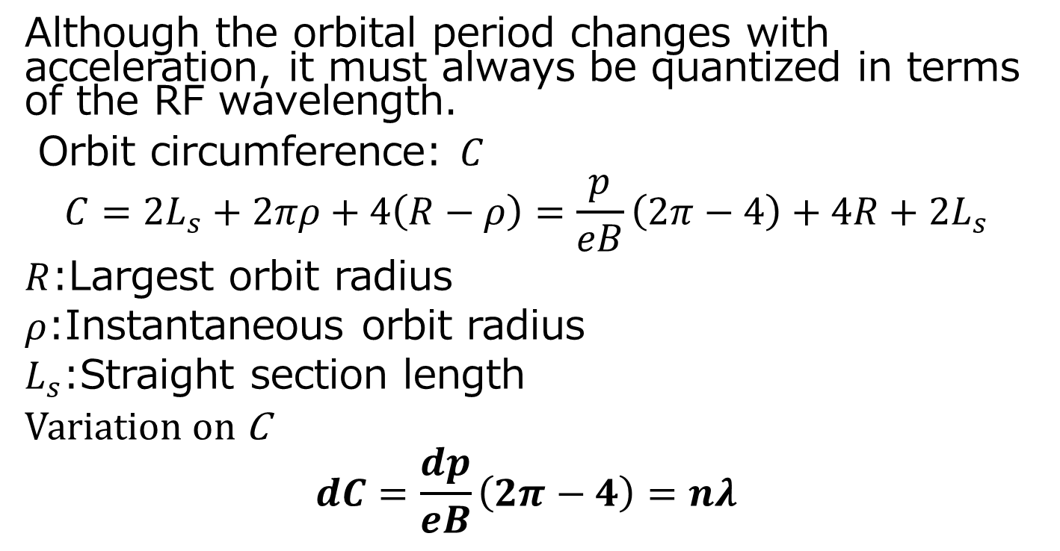

Microtron Condition
Although the orbital period changes with acceleration, it must always be quantized in terms of the RF wavelength.
Orbit circumference: $C$
$$C={2L}_{s}+2πρ+4\left(R−ρ\right)=\frac{p}{eB}\left(2π−4\right)+4R+{2L}_{s}$$
$R$:Largest orbit radius
$ρ$:Instantaneous orbit radius
$L_{s}$:Straight section length
Variation on C
$$dC=\frac{dp}{eB}\left(2π−4\right)=nλ$$
$$L_{s}$$
$$R$$

Slide 13
Numerical Example
Parameter | Number | Unit
B | 1.336 | T
cp (max) | 400 | MeV
R | 1.0 | m
dcp | 41n | MeV
If the particles are accelerated by 𝑑𝑐𝑝 = 41n (MeV) per orbit, the difference in orbital periods will be exactly an integer multiple of the wavelength.
Assuming an acceleration of 41 MeV across the two cavities, the acceleration voltage per cavity can be set to 20.5 MeV.

Slide 14
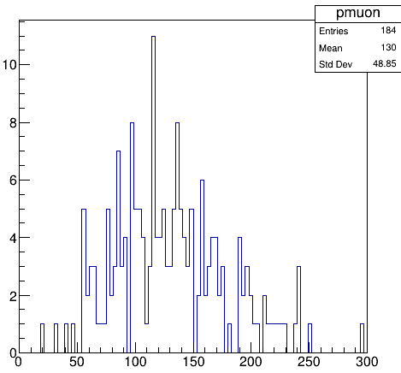
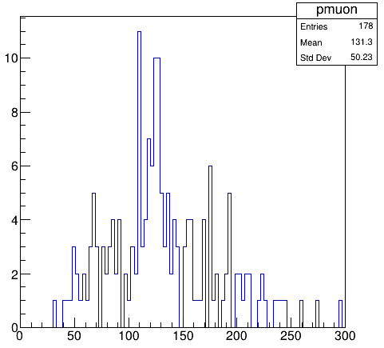
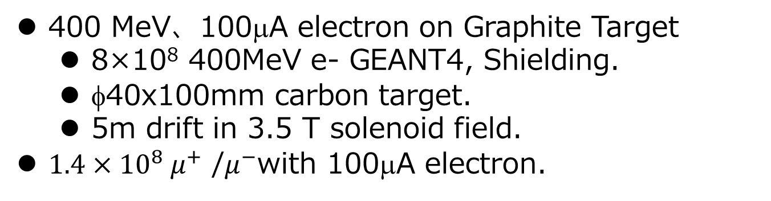
Muon Target
μ+
Solenoid
B=3.5T
μ検出点
at z=5m
e-(400MeV)
Carbon
Target
184個
r
40mm
z
pμ(MeV)
10cm
5m
400 MeV、100μA electron on Graphite Target
8×10⁸ 400MeV e- GEANT4, Shielding.
φ40x100mm carbon target.
5m drift in 3.5 T solenoid field.
$1.4×{10}^{8} μ^{+}$ /$μ^{−}$with 100μA electron.
μ-
at z=5m
178個
pμ(MeV)

Slide 15
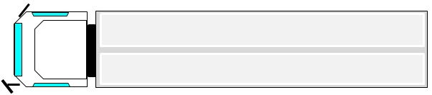


Portable Muon Source
Two TESLA cavities are driven at 20.5 MV/m, and a 100 mA electron beam is accelerated to 414 MeV over 10 revolutions in a double-sided microtron.
The microtron orbit is 2.0 m wide. It can be mounted on a 2.5 m-wide trailer.
RF amp
遮蔽壁
400 MeV DS Micrtron
Operation
area
Control
Refrigrtr
Muon
target

Slide 16
Summary
We investigated portable muon sources.
DSMMG: A compact muon generation system using a vehicle-mounted double-sided microtron.
A graphite target can generate 1.4 × 10⁸ m+m-.
Radiation shielding is the primary challenge for outdoor use.
To re-accelerate muons, an accelerator design for muon capture and re-acceleration is required.

Slide 17
Back Up

Slide 18
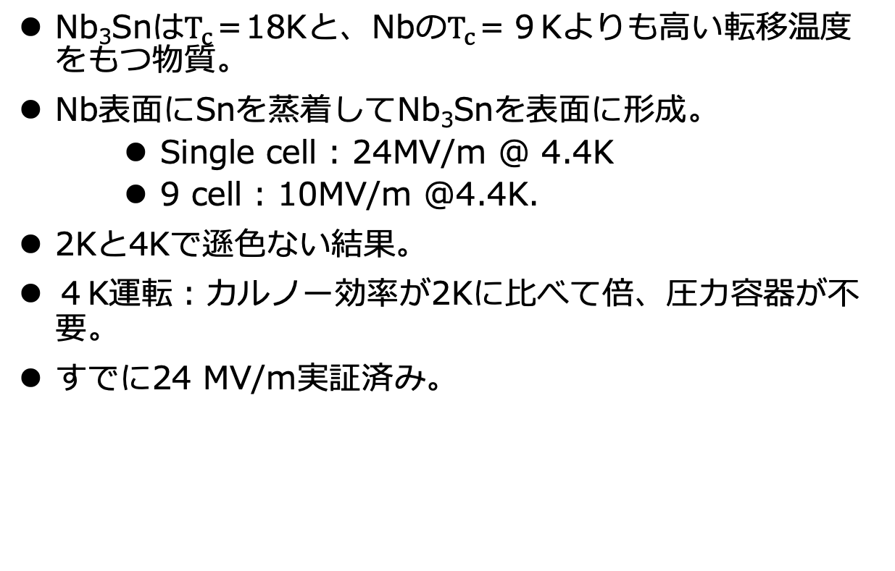
Nb₃Sn Cavity
Nb₃Snは$T_{c}$＝18Kと、Nbの$T_{c}$＝９Kよりも高い転移温度をもつ物質。
Nb表面にSnを蒸着してNb₃Snを表面に形成。
Single cell : 24MV/m @ 4.4K
9 cell : 10MV/m @4.4K.
2Kと4Kで遜色ない結果。
４K運転：カルノー効率が2Kに比べて倍、圧力容器が不要。
すでに24 MV/m実証済み。
S. Posen, et al., 2021 Supercond. Sci. Tech. 34 025007

Slide 19
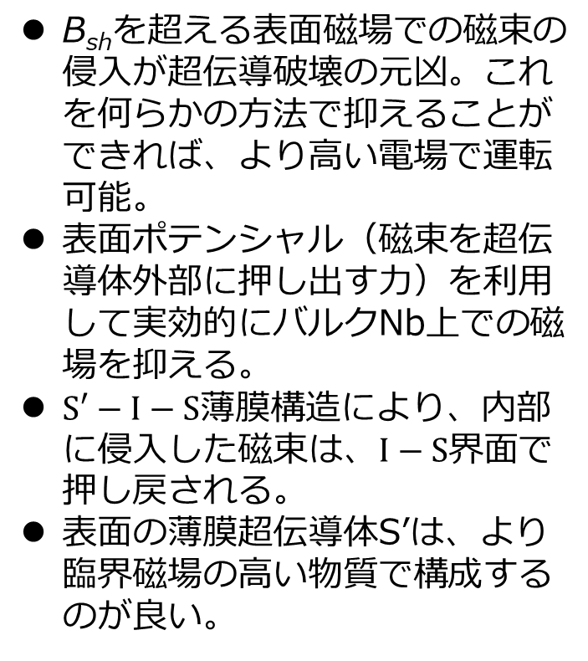
薄膜超伝導体
B_{sh}を超える表面磁場での磁束の侵入が超伝導破壊の元凶。これを何らかの方法で抑えることができれば、より高い電場で運転可能。
表面ポテンシャル（磁束を超伝導体外部に押し出す力）を利用して実効的にバルクNb上での磁場を抑える。
$S′−I−S$薄膜構造により、内部に侵入した磁束は、$I−S$界面で押し戻される。
表面の薄膜超伝導体S’は、より臨界磁場の高い物質で構成するのが良い。
J. Appl. Phys. 130, 050901(2021)

Slide 20
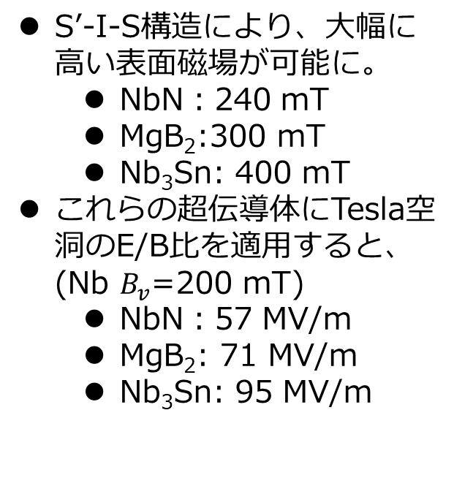
S’-I-S構造の臨界磁場
S’-I-S構造により、大幅に高い表面磁場が可能に。
NbN：240 mT
MgB₂:300 mT
Nb₃Sn: 400 mT
これらの超伝導体にTesla空洞のE/B比を適用すると、 (Nb $B_{v}$=200 mT)
NbN：57 MV/m
MgB₂: 71 MV/m
Nb₃Sn: 95 MV/m
T. Kubo, Y. Iwashita, T. Saeki, APL104,032603(2014)

