Slide 1
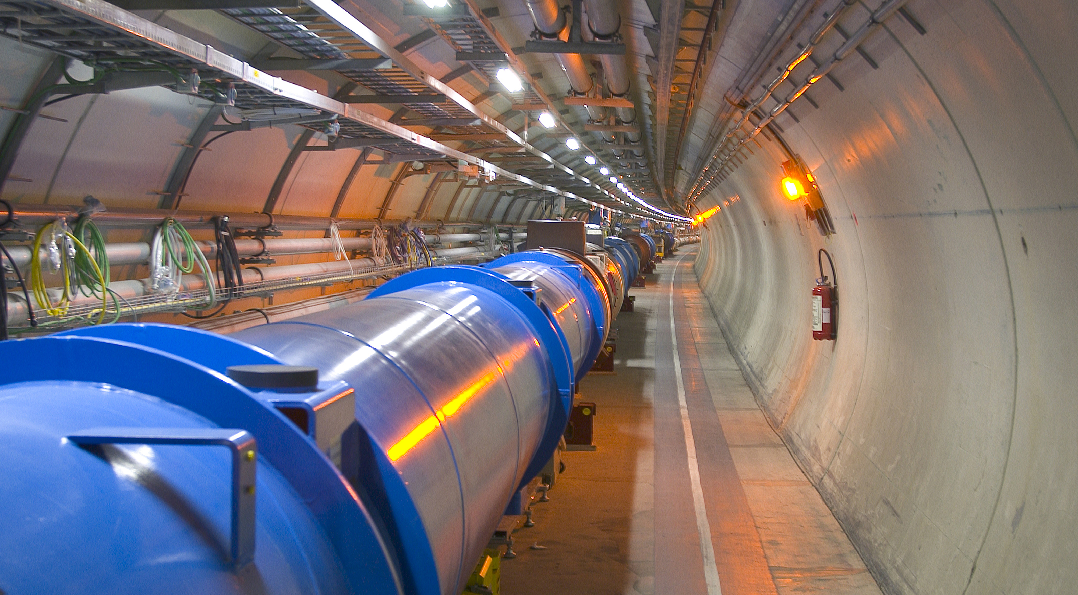

Obtaining a record luminosity production in the Large Hadron Collider in 2025
J. Wenninger / CERN
IPAC 2026
Deauville, France
May 17-22 2026
X. Buffat, A. Calia, J. Esteban Müller,
S. Fartoukh, C. Hernalsteens, M. Hostettler,
D. Jacquet, D. Mirarchi, M. Pojer,
S. Redaelli, B. Salvant, M. Solfaroli,
H. Timko, G. Trad, J.Wanczyk

Slide 2
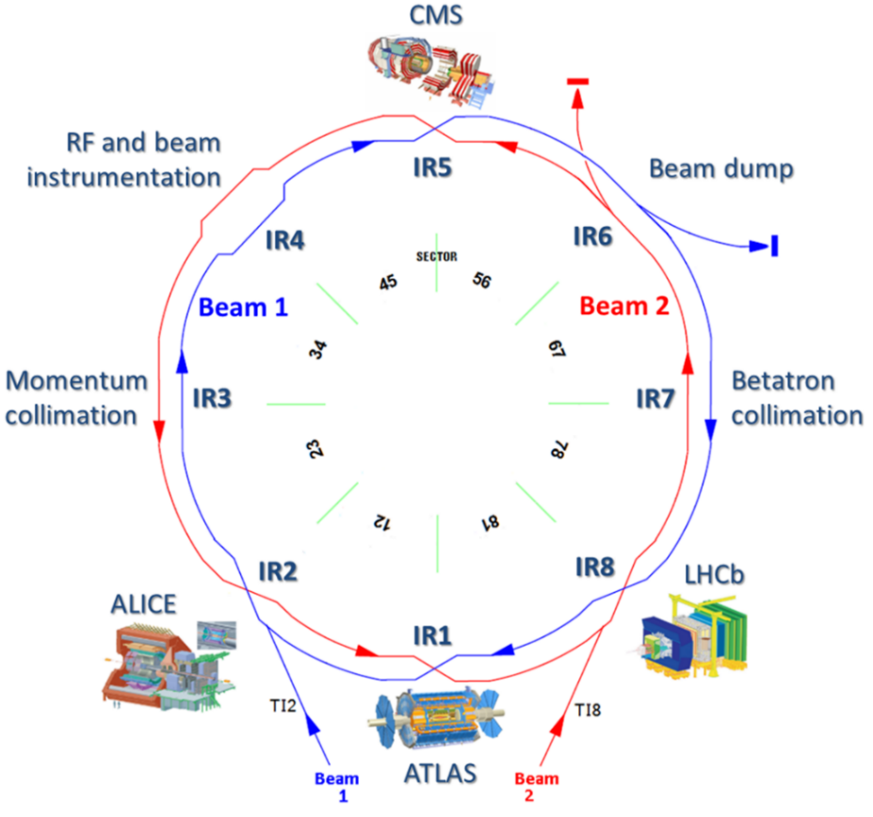






Introduction – LHC
ATLAS & CMS: high luminosity experiments, L ~ 2.2×10³⁴ cm⁻²s⁻¹.
Most performance parameters refer to those experiments.
LHCb: medium luminosity experiment, L ~ 2×10³³ cm⁻²s⁻¹.
ALICE: low luminosity / ion experiment, L ~ 10³¹ cm⁻²s⁻¹.
SND and FASER: Beyond Standard Model and neutrino physics experiments located ~500 m downstream of the ATLAS IP.
LHC is operating the 3rd long run (Run 3) which began in 2022 and which will end in June 2026.
Long shutdown 3 (LS3) will begin in July 2026 and will last 4 years to install the High Luminosity LHC (HL-LHC) upgrade.

Slide 3
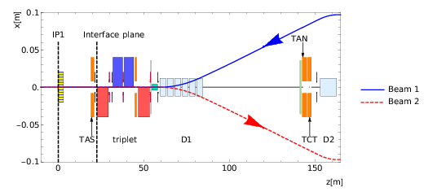
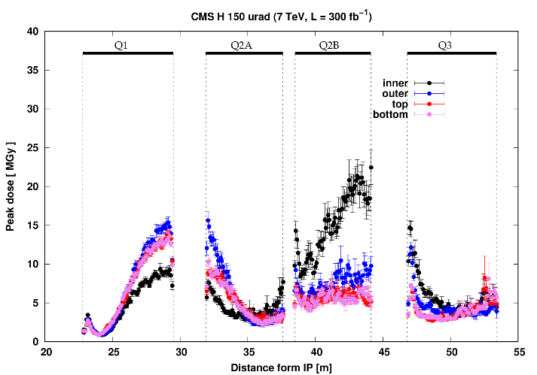
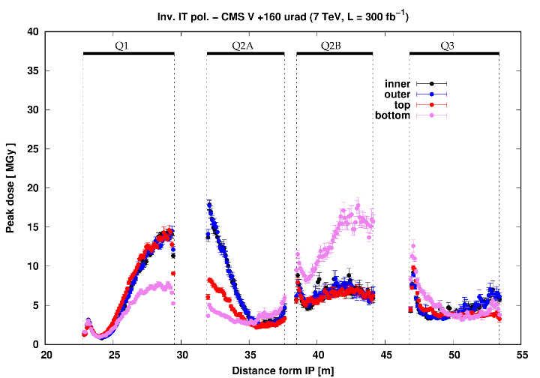
Optics and radiation (1)
Experiment
Q2
separation
recombination dipole
The low-beta (inner triplet) magnets have accumulated high radiation doses due to collision debris (low-angle collisions).
Estimated lower dose limits:
Quadrupoles: 30 MGy
Corrector magnets: 7 MGy
Normal conducting separation dipole: 75 MGy
Peak doses can be mitigated by modifying the distribution in space of the radiation in the magnets.
In some magnets the radiation dose is very localized.
The dose limit is already exceeded in many corrector magnets !
Q1
Q3
CMS – horizontal crossing
CMS – inverted polarity and vertical crossing
Q1
Q2
Q3
Q1
Q2
Q3

Slide 4
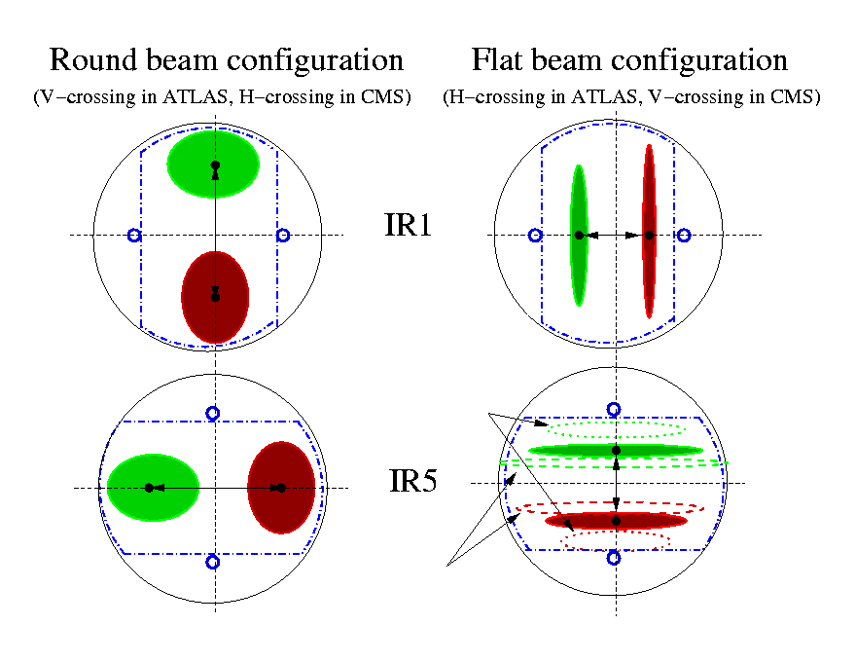
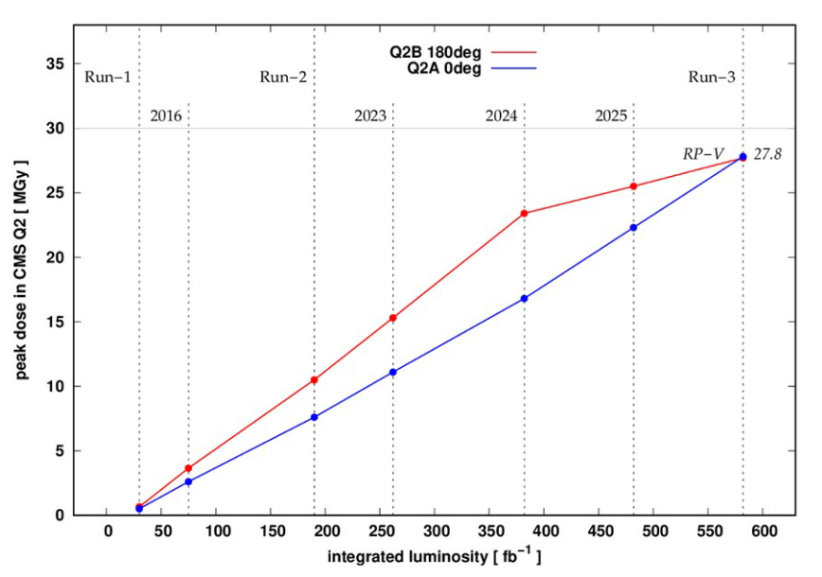
Optics and radiation (2)
Beam profiles in the IT quadrupoles
Peak doses can be mitigated by modifying the distribution in space of the radiation in the magnets:
Modifying the triplet optics by inverting the quadrupole polarities.
Exchanging the beam crossing between vertical and horizontal planes: ATLAS: V → H, CMS : H → V
To switch the beam crossing planes, a flat optics had to be introduced to accommodate the beams in the IT quadrupoles due the shape of the beam screen, with larger β* in the beam crossing plane.
Round optics ≤ 2024: min β∗_{x}/β∗_{y} = 30 cm/30 cm
Flat optics ≥ 2025: min β∗_{x}/β∗_{y} = 60 cm/18 cm
The crossing planes are flipped at high energy during the machine cycle: injection is not possible with flipped planes.
ATLAS
CMS
Radiation dose example CMS Q2
Inverted polarity and crossing plane

Slide 5
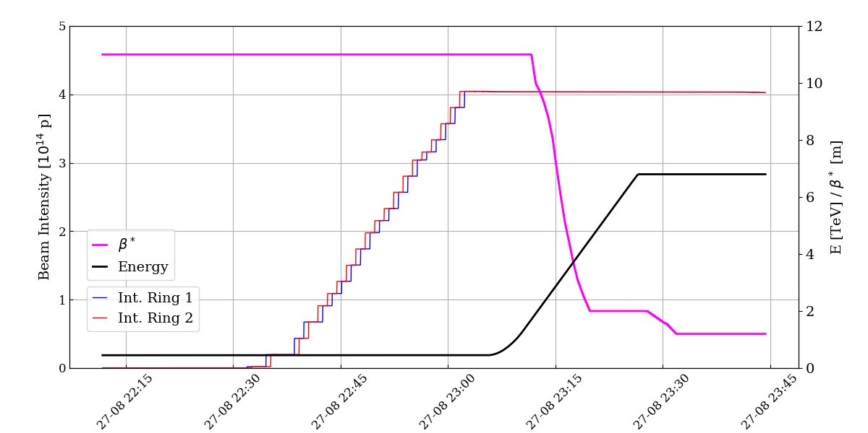
LHC machine cycle
Injection
450 GeV
Combined ramp and β* squeeze
6.8 TeV / β* = 2m
β* squeeze at flat top
β* = 1.2m
IP1/5/8 crossing planes
rotation
Collisions
& data taking
Beam commissioning and machine cycle have been optimized over many years.
β* squeeze partially incorporated into the 20 min long ramp (in 2026: entirely incorporated).
End of β* squeeze and crossing planes rotation on 6.8 TeV flat top.
The minimum time from beam dump to the following start of data taking is 1.8 hours.

Slide 6
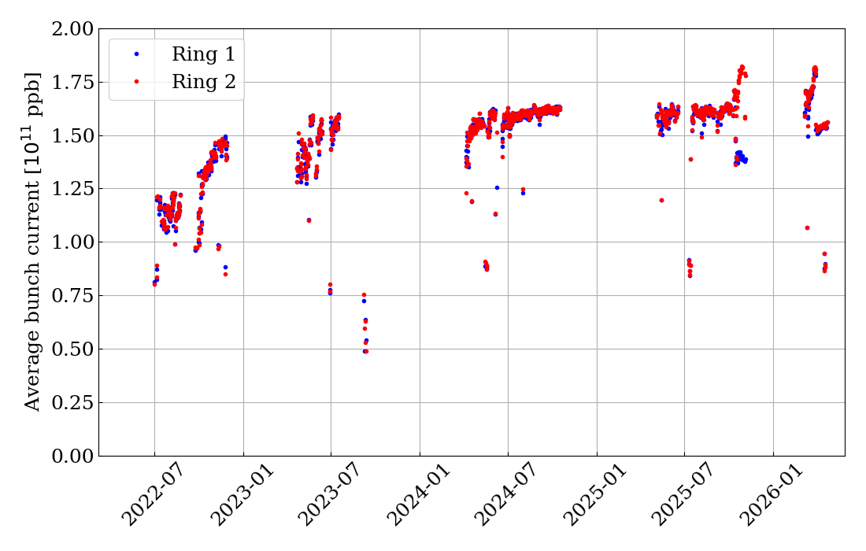
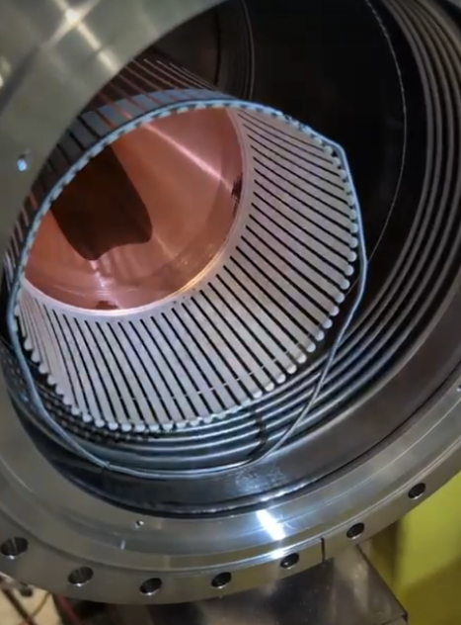
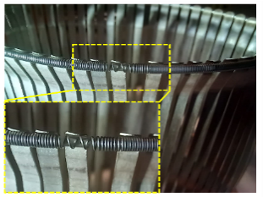
Intensity limitations (1)
The bunch intensity is limited during Run 3 to 1.8×10¹¹ p due to:
Beam dump protection devices damage limits.
Electron cloud heat-load to the cryogenic system.
Following the failure of a vacuum interconnection in 2003, impedance driven beam heating became a new limitation.
Damage to vacuum interconnection modules due to mechanical non-conformities.
The bunch intensity of 1.8×10¹¹ p was finally reached in 2025 for ring 2, for both beams in 2026.
After replacement of ~100 vacuum system components.
Another ring 1 component failure in 2025.
1.8×10¹¹ ppb

Slide 7
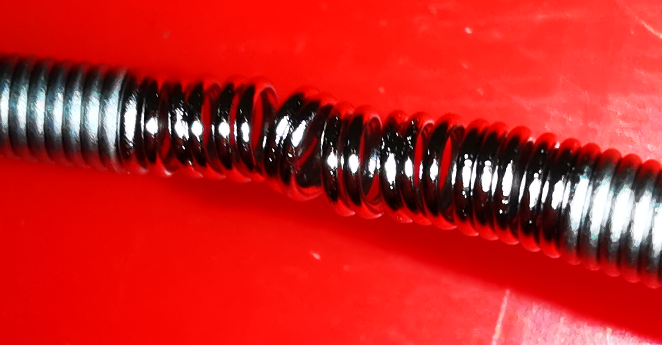
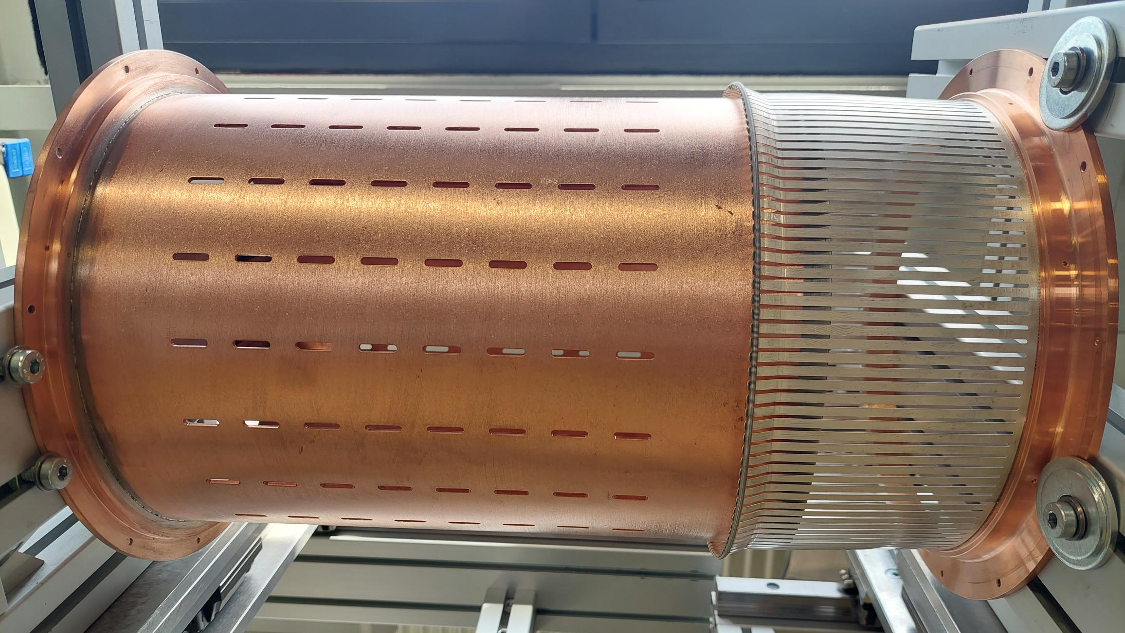
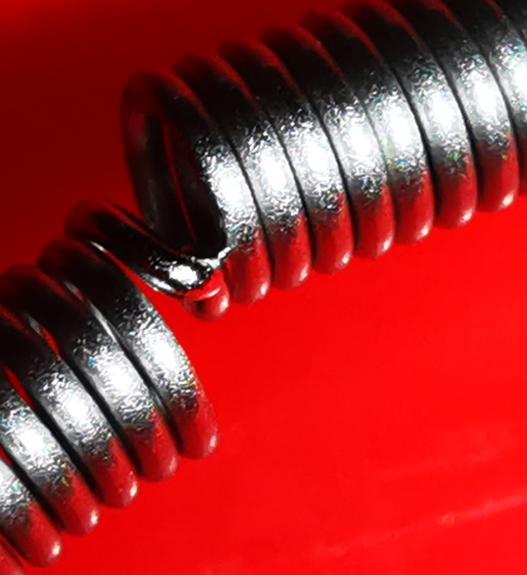
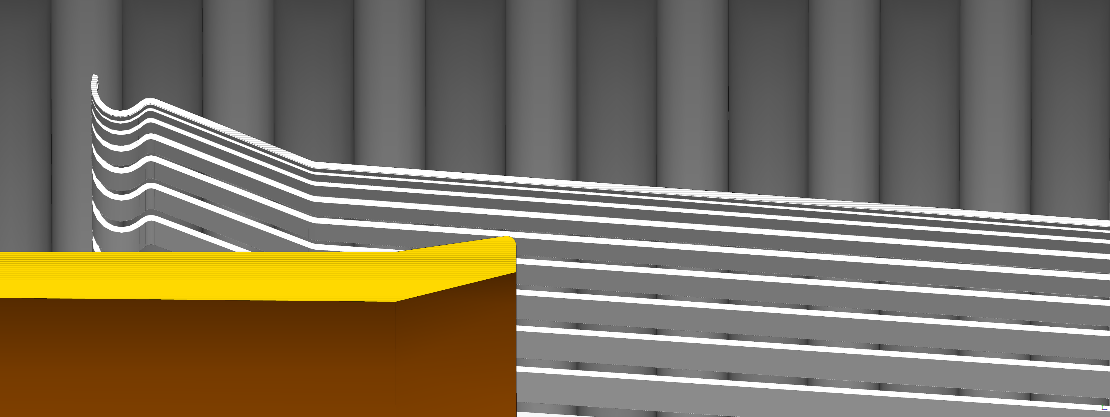
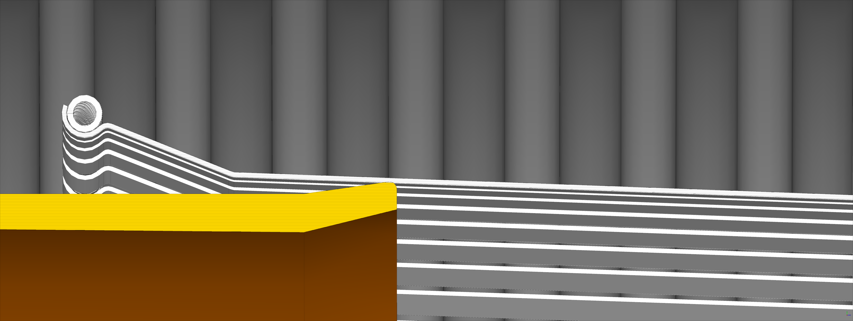
Intensity limitations (2)
2023 issue
The intensity limitations in Run 3 are related to non-conformities of vacuum interconnection modules.
The main limitation – 2023 failure - was related to a 212 mm diameter interconnection module.
Non-conform positioning and holding of ‘RF fingers’ can lead to thermal run-away and damage.
~100 modules were exchanged with a new design between 2023 and 2025 to lift this limitations.
In 2025 a different specialized module installed in the injection region of ring 1 failed.
Again, tension spring issue.
Exchanged during the 2025-2026 winter shutdown with a modified design.
Tension spring
RF fingers
2025 issue
New design
Damaged spring

Slide 8
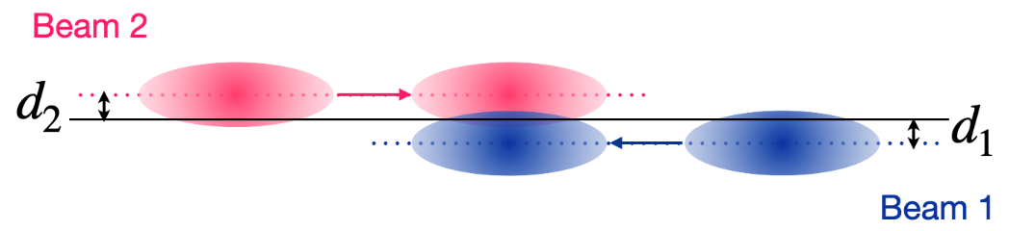
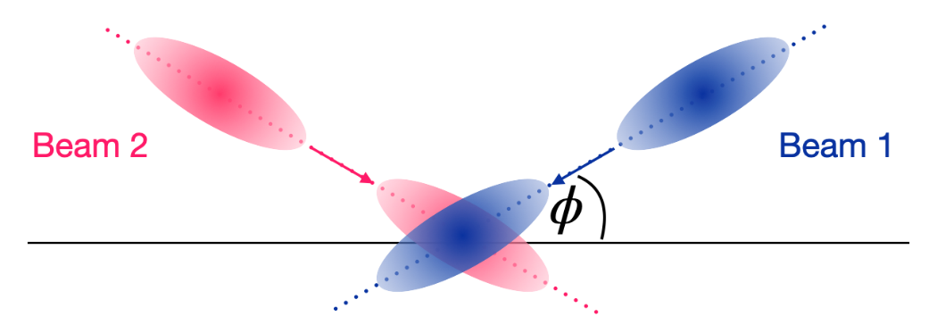
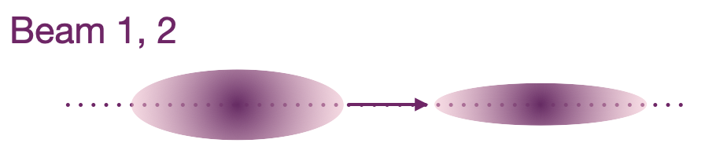
Luminosity levelling
The LHC peak luminosity is limited to L ~ 2.2×10³⁴ cm⁻²s⁻¹ by the local cryogenic cooling capacity.
Luminosity leveling is applied at the LHC for all experiments either due to detector limitations (ALICE, LHCb) or due to the cooling capacity (ATLAS/CMS).
Leveling techniques:
Transverse beam offset
  Very simple, individual to any IP – used for LHCb and ALICE.
  If applied in all IPs bunches may become unstable due to loss of Landau damping.
Crossing angle.
  Limited in range.
Beam size (β* squeeze).
  Beams remain head-on, provides Landau damping from head-on beam-beam tune spread.

Slide 9
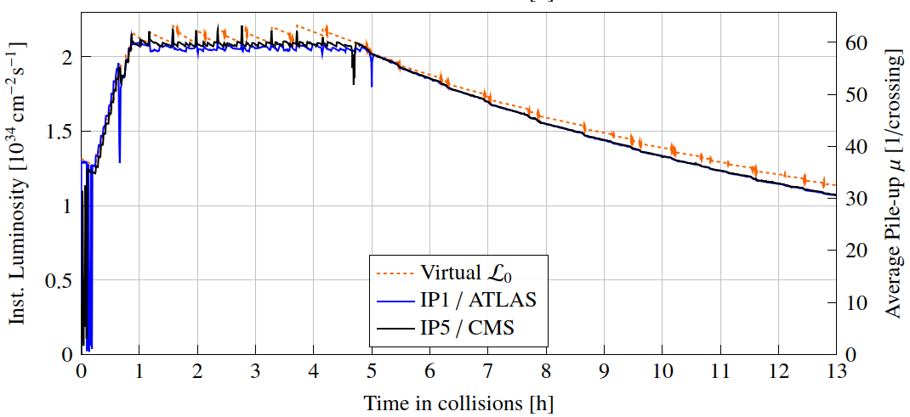
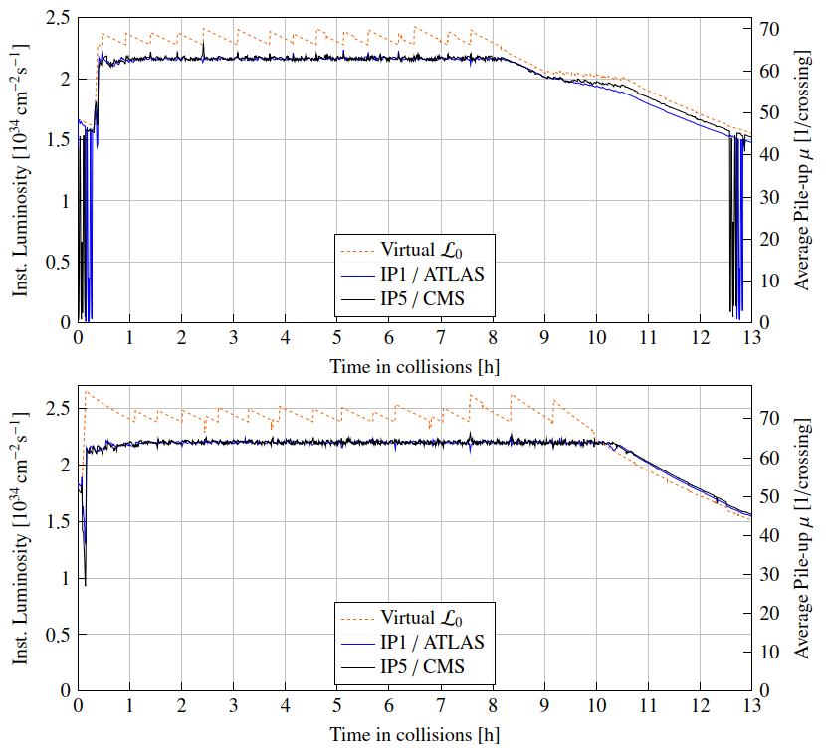
LHC production fills
min β*: 30/30 cm
<I_{b}> ~1.6 10¹¹ p
Once beams collide at 6.8 TeV, β* is squeezed until the target luminosity is reached, followed by a period of levelling at constant luminosity.
Primary levelling for high luminosity experiments by beam size (β* levelling).
Beam separation levelling is added on top to provide a smoother luminosity evolution.
The length of the period at constant peak luminosity was steadily increased with changes to the optics and to the maximum bunch intensities.
2024
min β*: 60/18 cm
<I_{b}> ~1.6 10¹¹ p
2025
min β*: 60/15 cm
<I_{b}> ~1.8 10¹¹ p
2026

Slide 10
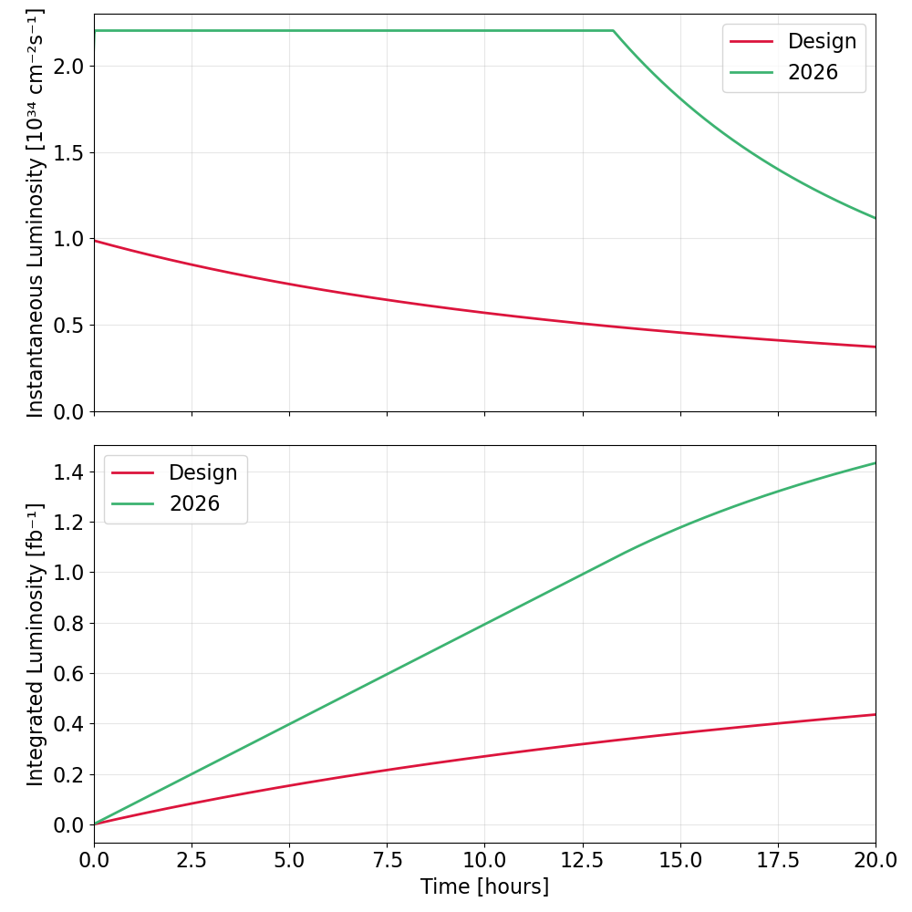
Design versus 2025
A comparison of the luminosity evolution of a LHC design fill with the current performance highlights the important improvements that took place over 3 LHC runs on the LHC and on its injectors.
Reduction in β*.
Higher bunch currents → injectors upgrade
Smaller emittances → injectors upgrade
Parameter | Design | 2025 | 2026
Minimum β* (cm) | 55/55 | 60/18 | 60/15
Bunch current (10¹¹ p) | 1.15 | 1.6-1.8 | 1.8
Norm. emittance (μm) | 3.5 | ~2 | ~2
3x

Slide 11
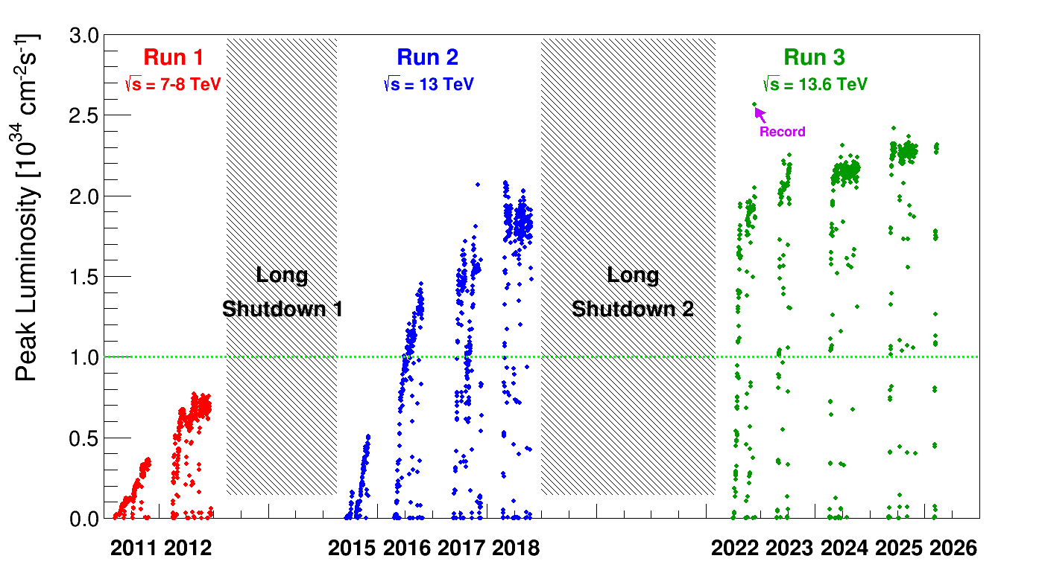
Peak luminosity
The LHC peak luminosity exceeds the LHC design target of 10³⁴ cm⁻²s⁻¹ since 2016.
It has since been pushed up to the limit compatible with the cryogenic cooling capacity of the low-beta quadrupole triplet.

Slide 12
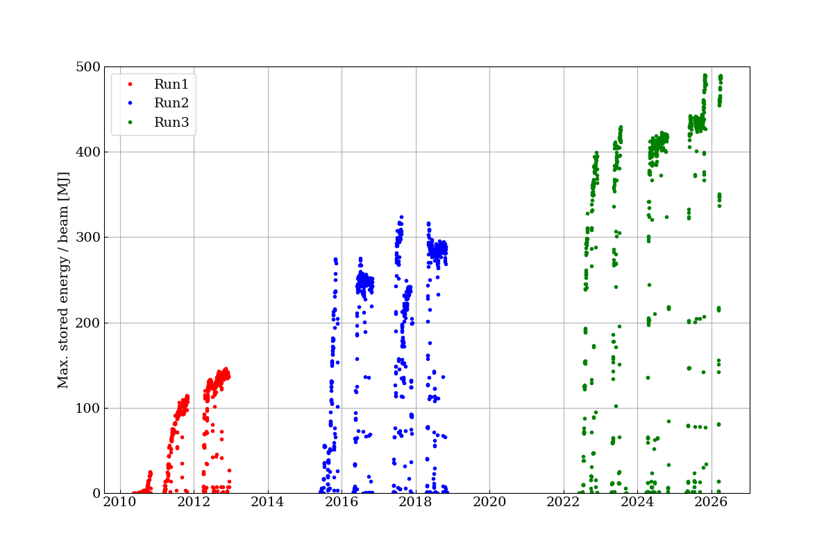
Stored beam energy
In parallel to the peak luminosity, the energy stored also increased over time thanks to the excellent performance of the beam cleaning and machine protection systems.
LHC design 362 MJ @ 7 TeV
Parameter | Design | 2025
No. bunches | 2808 | 2640
Bunch current (10¹¹ p) | 1.15 | 1.8
Beam energy (TeV) | 7 | 6.8
Stored energy (MJ) | 362 | 490

Slide 13
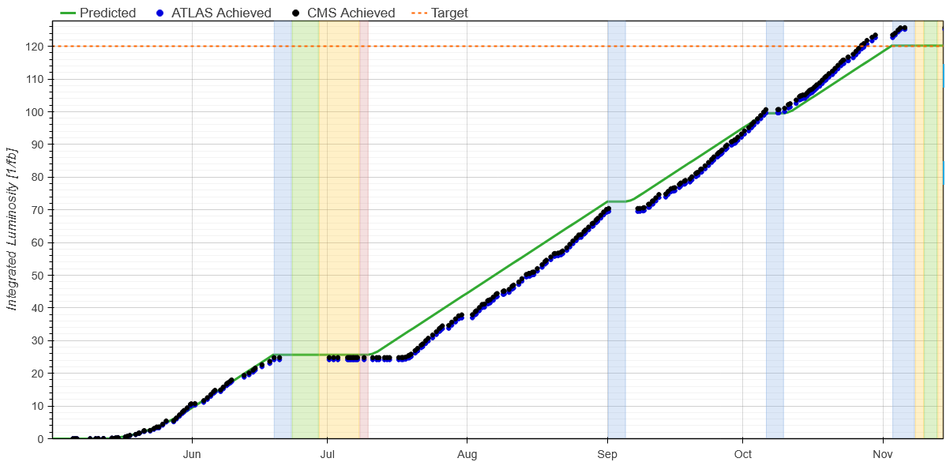
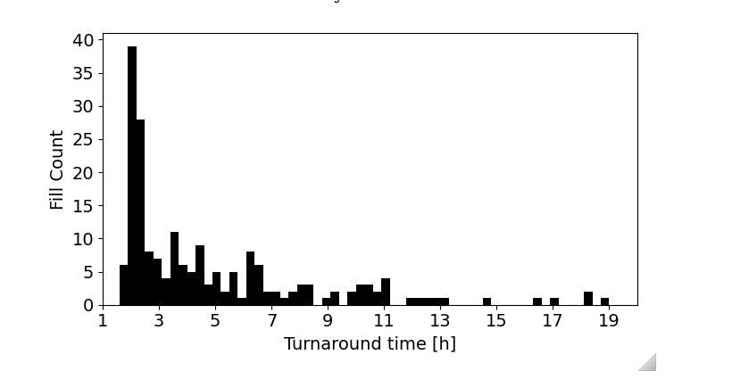
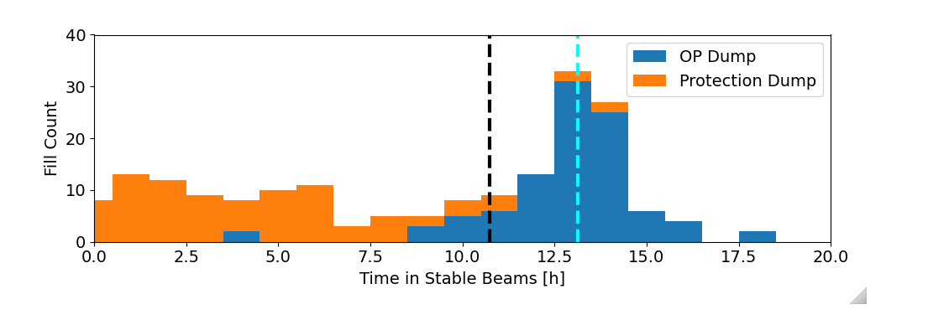
2025 performance
The performance target for 2025 was set to 120 fb⁻¹ delivered to both ATLAS and CMS.
Despite some time lost in the early summer, the target was exceeding, 2025 became the best LHC production year.
Machine availability: 70%
Availability for physics data taking: 54%
125 fb⁻¹
Turn-around time
Fill length (physics)
Programmed dump median: 13h
Median : 3.7h
Minimum : 1.8h
Most likely: 1.9-2.2h
Overall median: 10.7h
Triggered by the machine protection system

Slide 14

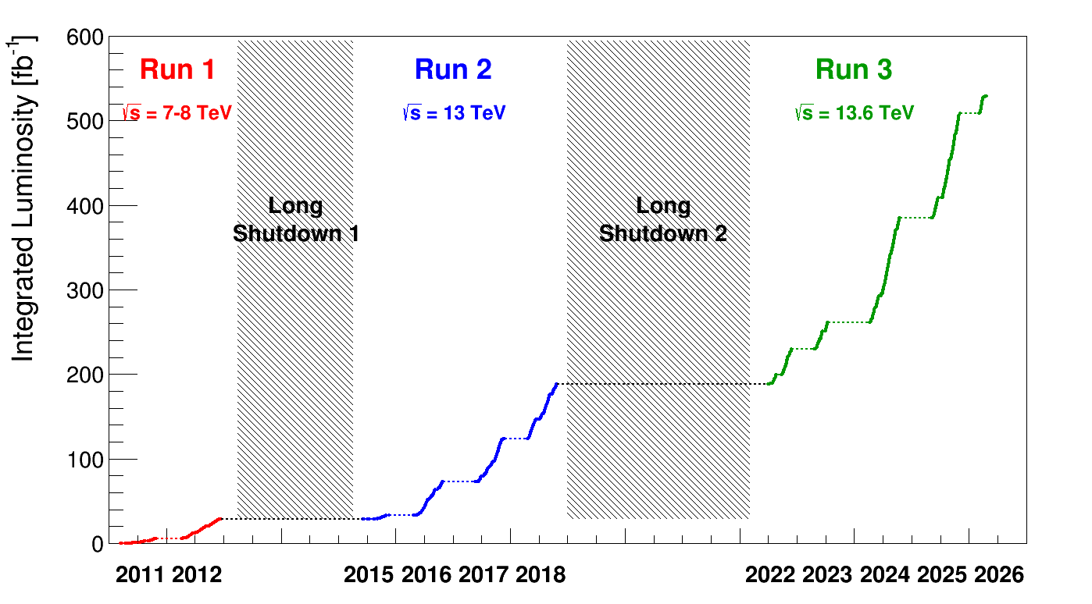

The atto-barn area
LHC delivered more than 1 ab⁻¹ of integrated luminosity to the ATLAS and CMS experiments (combined).
.
ATLAS / CMS
530 fb-1

Slide 15
Summary and outlook
The LHC achieved record performance in 2025, following a long evolution and improvement process:
  Refining beam control and beam commissioning for efficient operation.
  Pushing the beam intensity with the support of excellent injector performances.
  Storing close to 500 MJ of energy per beam in a superconducting machine.
  Mastering luminosity levelling for optimal performance.
LHC operation will end in June 2026, the machine will restart as HL-LHC in 2030 after a 4 year long shutdown.
The beam intensity has reached ~70% of the HL-LHC target.
In June 2026, as last test before the shutdown, we aim to store HL-LHC intensity beams.

Slide 17
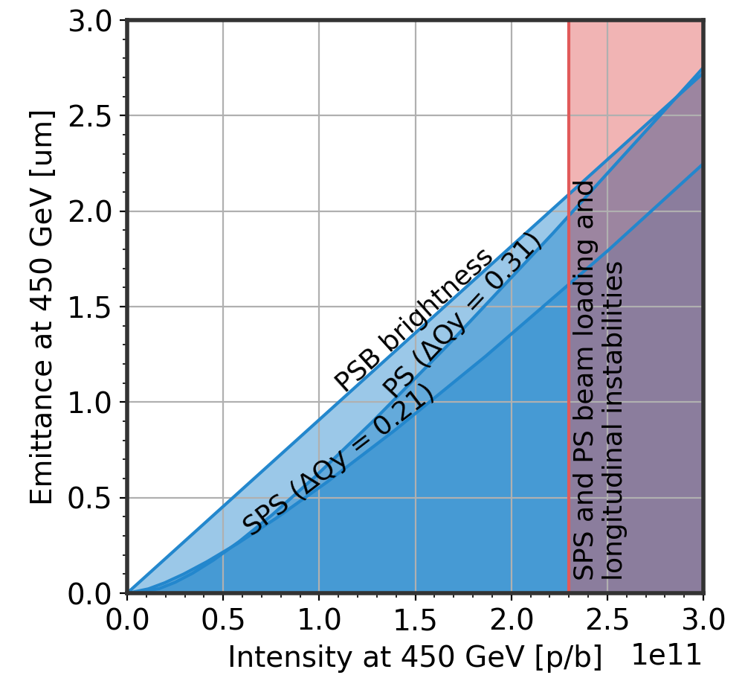
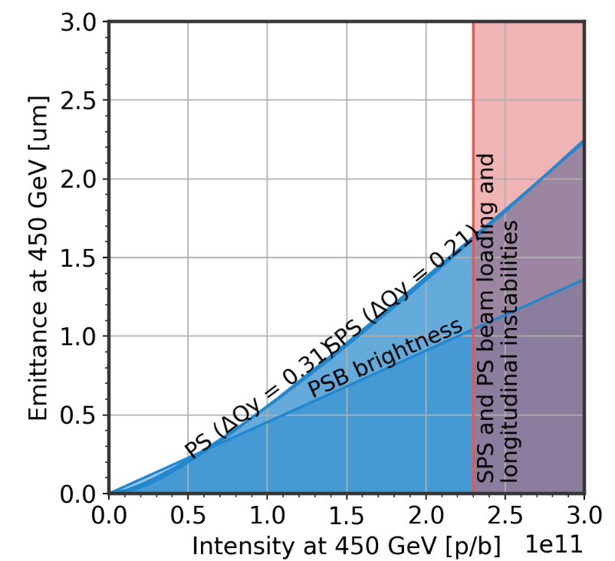
Injector beams
Standard
BCMS
Nominal HL-LHC beam intensities and emittances have been reached in the LHC injectors in 2026.
Bunch intensity: 2.3×10¹¹ proton/bunch.
4 x 72 bunch trains (‘nominal beam’).
5 x 48 bunch trains (‘low emittance beam’).
N = 2.4e11 ppb ε = 2.1 μm
N = 2.33e11 ppb
ε = 1.5 μm
In 2026 the LHC injector chain will perform a ‘reliability run’.
Preparation of the HL-LHC beams for LHC injection will be exercised a few times per week when the LHC is not requesting beam.
Trains: 4x72b
Trains: 5x48b
(low emittance variant)

