Slide 1
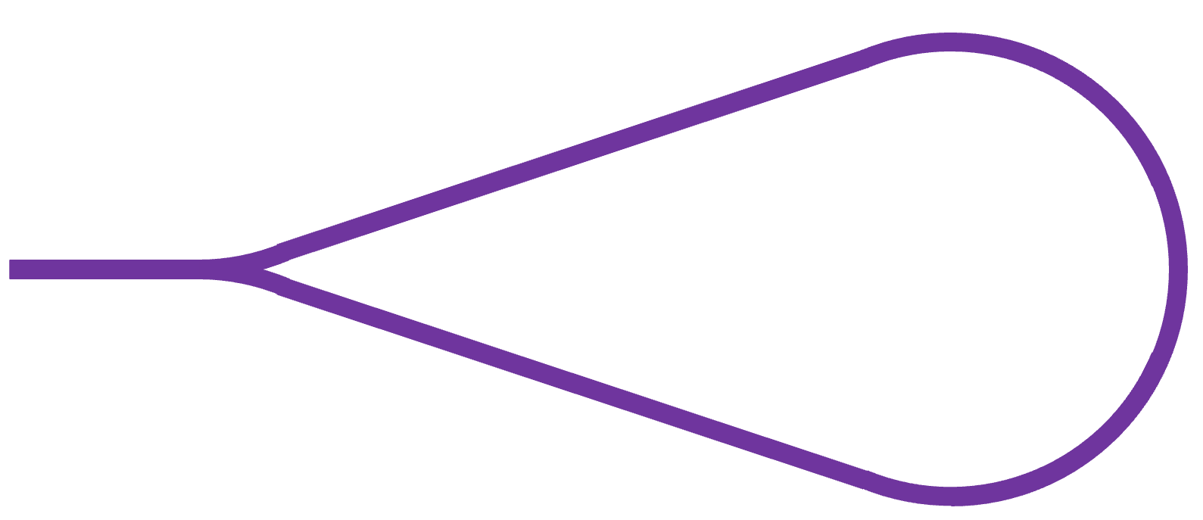

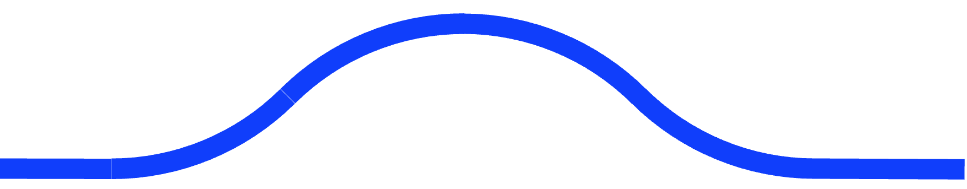

MOO1T02
The Ghost Collider: An innovative Higgs Factory
R. Apsimon
on behalf of the Ghost Collider consortium:
A. Hutton¹, P. Williams^{2,4}, R. Apsimon^{3,4}, B. R. Gamage¹, M. Joshi^{3,4}, K. Yokoya⁵
¹Jefferson Lab, 12000 Jefferson Ave., Newport News, 23693, USA
²STFC, Accelerator Science and Technology Centre (ASTeC), Daresbury, UK
³Lancaster University, Lancaster, LA1 4YW, UK
⁴Cockcroft Institute, Daresbury Laboratory, Daresbury, UK
⁵KEK, Tsukuba, Japan
SRF Linac
Chicanes
SRF Linac
Arc
Arc
IP

Slide 2
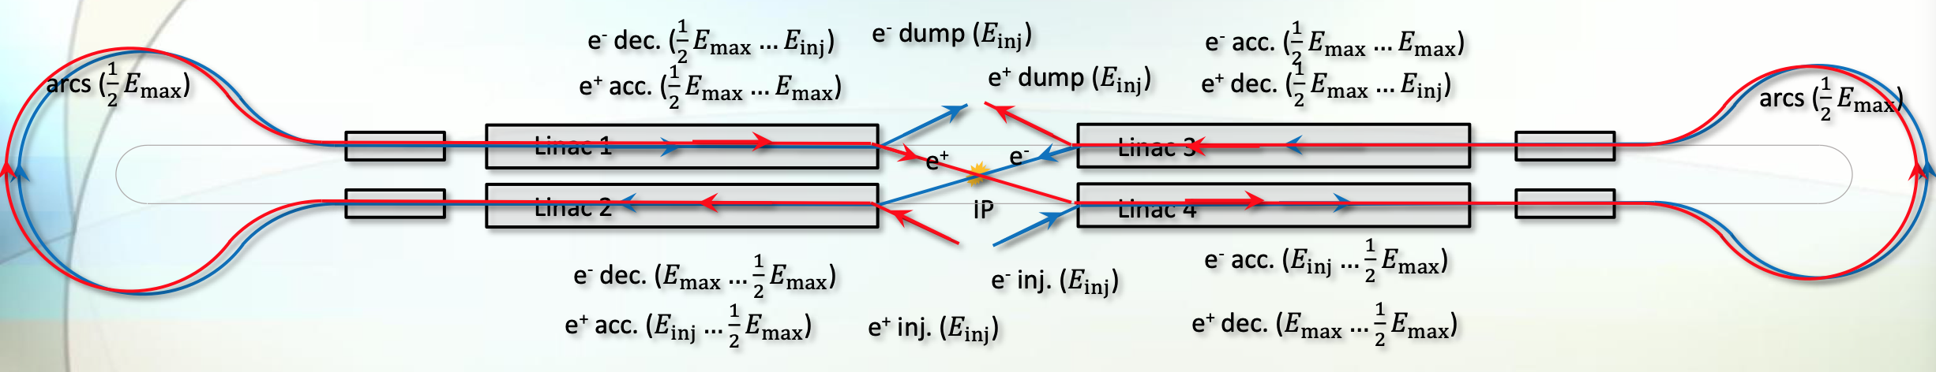
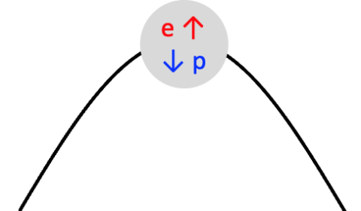
What is the Ghost Collider?
An energy recovery linac where energy exchanged between e⁻ and e⁺ at the same phase
  Energy recovery in conventional ERLs require electron bunches which are 180º out of phase with each other
  The Ghost Collider (GC) is an entirely new class of ERL technology, where energy recover occurs intra-bunch
  All particles recycled, thus e⁺ source requirements similar to storage rings
Bunches in the GC comprised of equal numbers of e⁻ and e⁺, creating electrically neutral bunches
  We refer to these as “ghost bunches”
  No beam loading of the accelerating mode in the linacs
  Conventional ERLs rely on beam loading
Design concept inspired by previous work by Valeri Telnov and Erk Jensen

Slide 3

Interaction region delay concept
Bunches in the linacs have alternating accelerating electrons and positrons
  At the end of the linac, the low energy bunches are extracted and the high energy ones are collided
  We want to create ghost bunches of high energy positrons and electrons
    Need to delay one to overlap with the other before IP, then separate them before passing into the decelerating linac
Let’s say high energy electrons are in one bucket and positrons in the next bucket, separated by $λ_{linac}/2$
  Need to introduce a chicane to delay the electrons by $λ_{linac}/2$
e⁻
e⁺
Linac

Slide 4
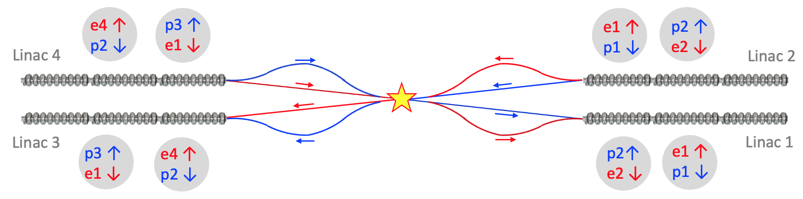

Interaction region delay concept
After the IP, we need another chicane to delay the positrons by $λ_{linac}/2$ to allow for deceleration
  In total, we need four chicanes
  This layout means each electron and positron bunch passes through one chicane
    Restores symmetry to the bunches, balancing chromatic effects

Slide 5
Ghost collisions
A ghost bunch (e⁻ and e⁺ in a single bunch) are brought into collision with another ghost bunch
First tried (unsuccessfully) at Orsay by the DCI Storage Ring Group
  Further theoretical studies concluded that the neutral bunch plasmas were in an unstable equilibrium
All considered moderately high disruption parameters (between 5 and 10)
  Incompatible with storage ring equilibrium
  For GC, bunches are recycled as positron production rates are too low
  High disruption parameters would make it impossible to damp the beam again quickly enough
Theoretical studies indicate that GC would operate in a stable regime
Choose to go for round beams to minimise disruption parameter for a given luminosity
  Neutral bunch collisions eliminate disruption parameter to first order

Slide 6
Single linac
Ghost bunches have much reduced electromagnetic interaction with counter-propagating ghost bunches
  This allows for a major simplification: a single, bi-directional linac on each side of the IP
    There will be head-on collisions in the linac, but the luminosity will be low, as will the disruption parameter
    Electrons and positrons accelerated in both directions in one linac and decelerated in the other linac
Based on ILC technology, each linac would only need to be half the length due to the dual pass scheme.
Counterpropagating ghost bunches have, to first order, no quadrupolar beam-beam focusing
  A second order dipolar charge separation instability exists, which is currently under study
SRF Linac
Chicanes
SRF Linac
Arc
Arc
IP

Slide 7
Turnaround arcs
One technical challenged faced with the Ghost Collider are how to turn around both e⁻ and e⁺
  Both deflected in the opposite direction by any electromagnetic elements
  However, if electrons and positrons pass through a dipole in opposite directions they will follow the same trajectory.
    Now if we join everything together, we have a turnaround arc to accommodate both charge species

Slide 8
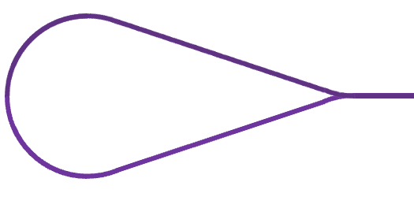
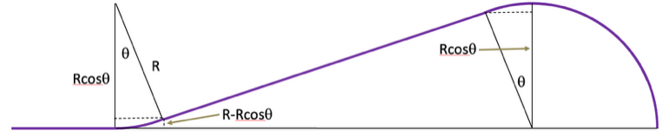





Turnaround arcs
The arcs are a tear-drop shape
  The straight sections avoid the need for additional bending at the expense of additional length
  The total bending angle is $θ_{tot}={180}^{∘}+4θ$
The current design opts for $θ={22.5}^{∘}$ and a bending radius of 3,096 m
  With a filling factor of 88%, this gives an arc radius of 3,500 m, which is the same as LEP
Reduces synchrotron radiation loss by 38% compared to traditional arc shape
$$θ$$
$$R\cos{θ}$$
$$R\cos{θ}$$
$$R$$
$$θ$$
$$R−R\cos{θ}$$

Slide 9
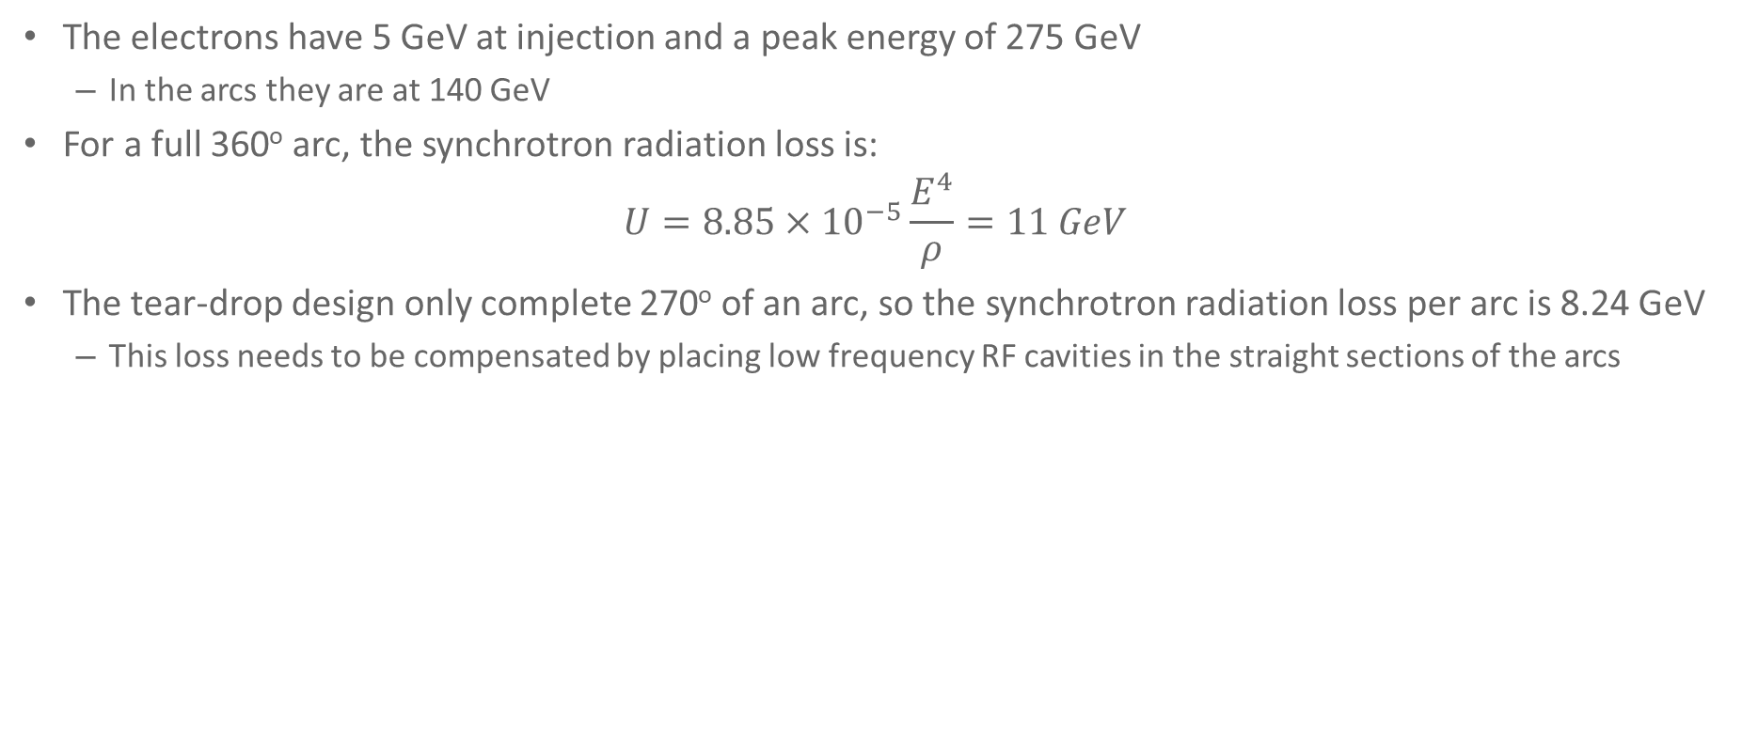
Turnaround arcs
The electrons have 5 GeV at injection and a peak energy of 275 GeV
  In the arcs they are at 140 GeV
For a full 360º arc, the synchrotron radiation loss is:
$U=8.85×{10}^{−5}\frac{E^{4}}{ρ}=11 GeV$
The tear-drop design only complete 270º of an arc, so the synchrotron radiation loss per arc is 8.24 GeV
  This loss needs to be compensated by placing low frequency RF cavities in the straight sections of the arcs
$$θ$$
$$R\cos{θ}$$
$$R\cos{θ}$$
$$R$$
$$θ$$
$$R−R\cos{θ}$$

Slide 10
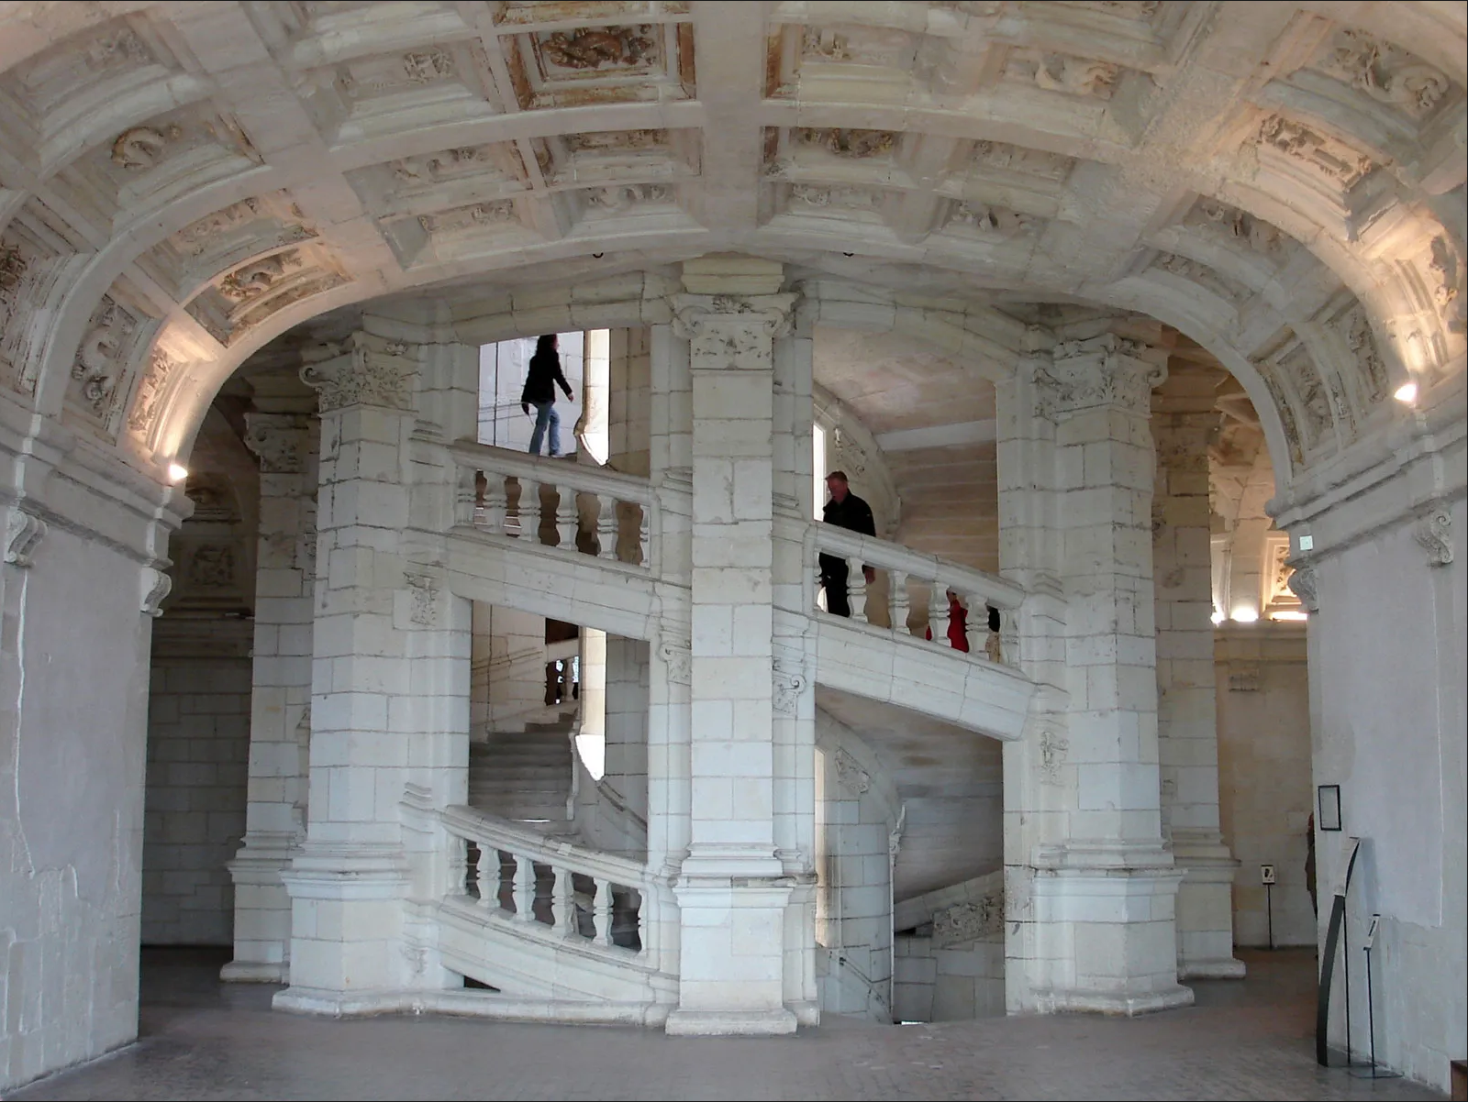
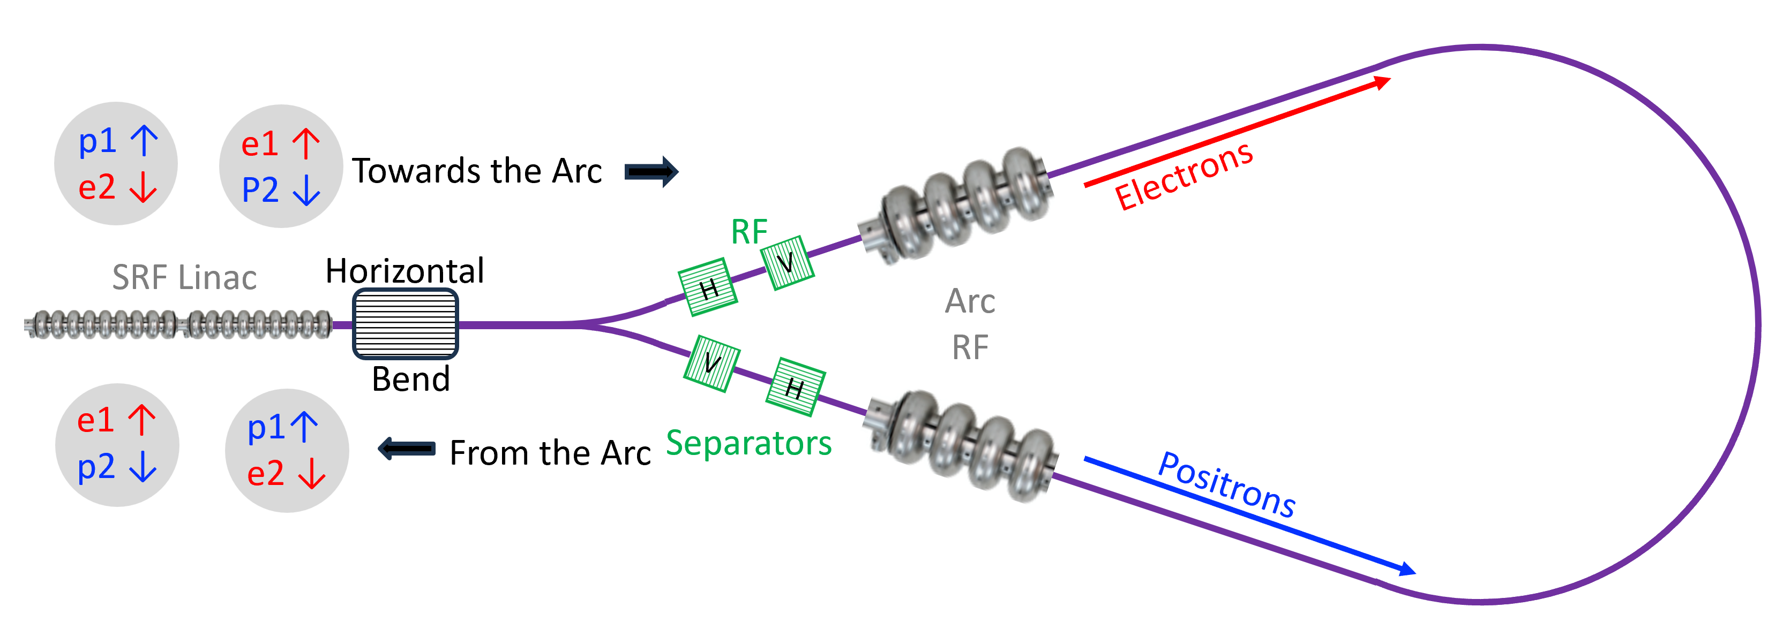
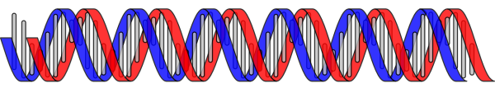
Arc-Linac interface
Electrons and positrons counter-propagating around the arc
  Electromagnetic forces during collisions would severely degrade the beam quality
RF separators used to establish helical paths through the arcs, allowing counter-propagating bunches to avoid each other
  This configuration has been used to great effect at Tevatron
The electron and positron trajectories are like the strands of DNA or the famous double staircase at the Chateau de Chambord in France, designed by Leonardo da Vinci

Slide 11
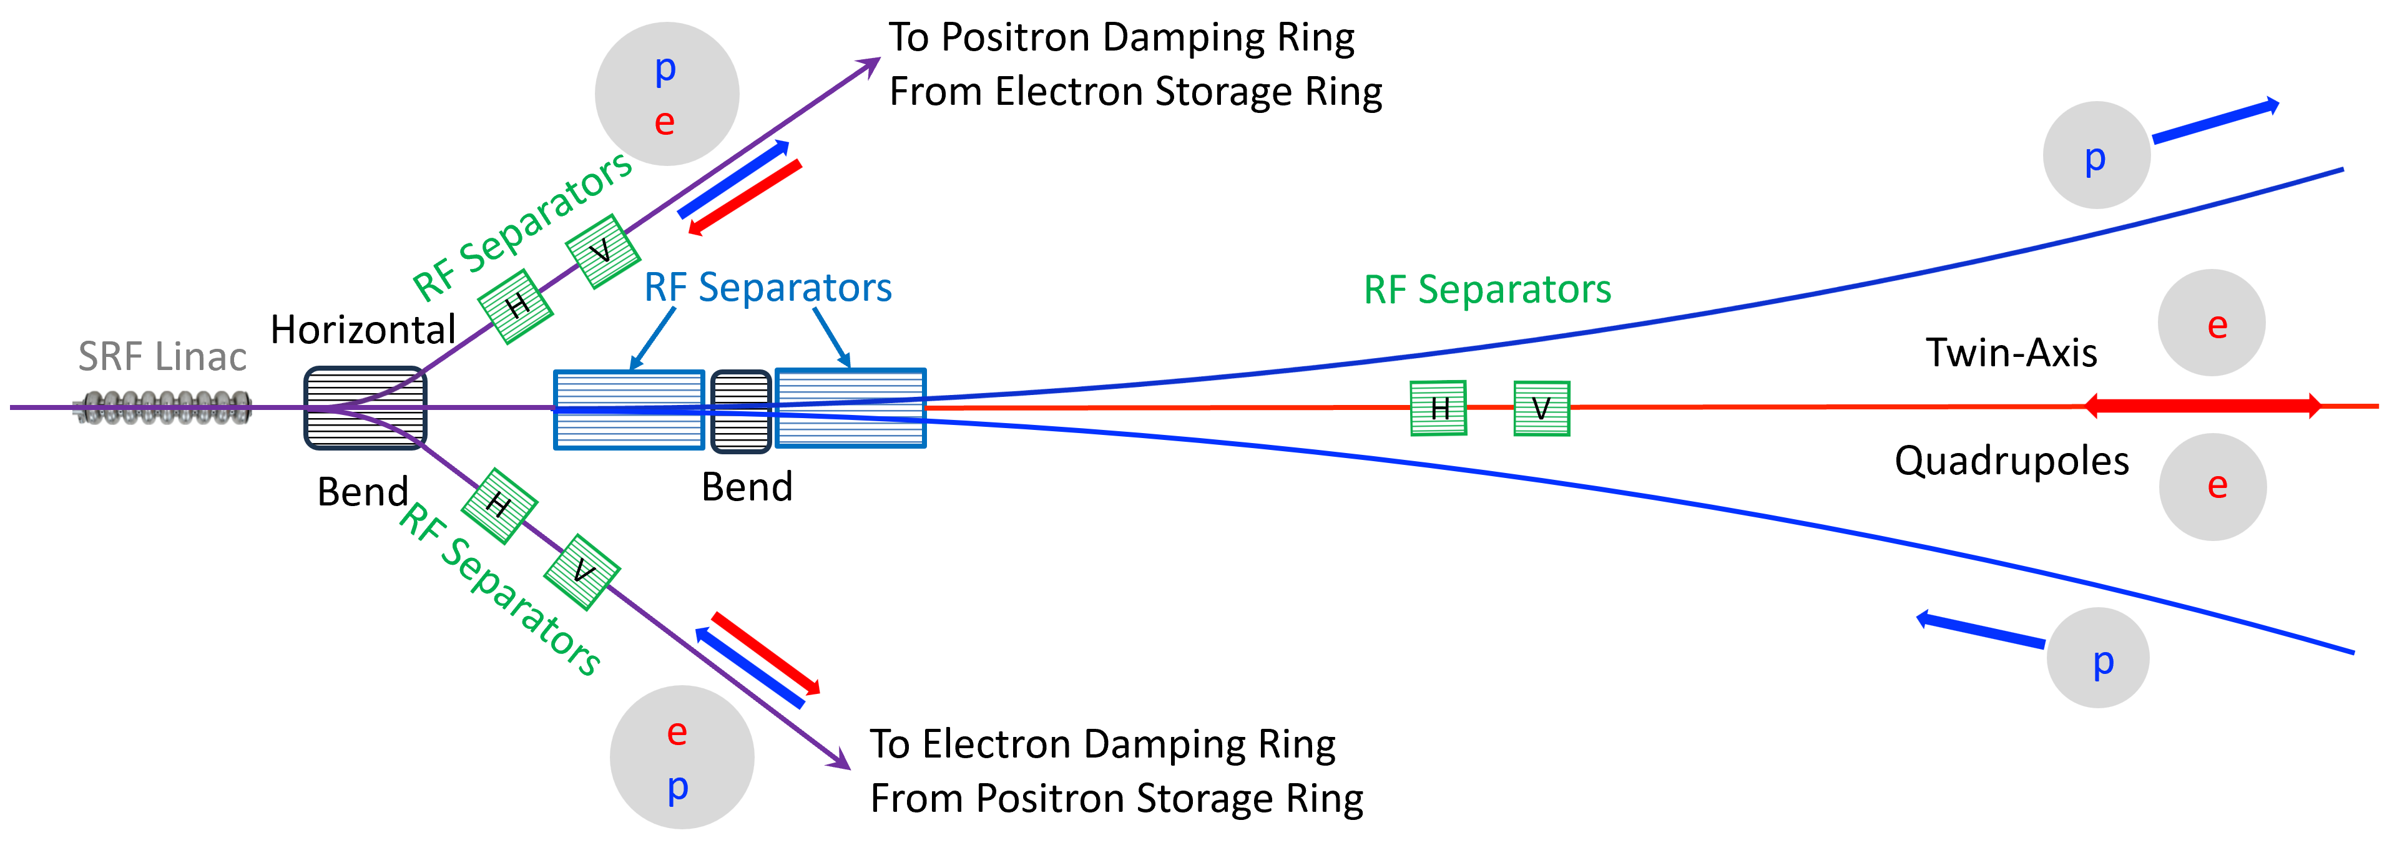
The Linac-Chicane Interface
Bending magnet deflects allows for injection/extraction of low energy electrons and positrons
  Negligible kick to high-energy bunches
RF separators to start or complete the positron chicanes while leaving electrons undeflected
  RF separators for electrons to avoid charged beam collisions
  The other interface deflects electrons in the chicanes rather than positrons

Slide 12
Chicane design
The electrons and positrons need the same energy at the IP, regardless of whether they passed through a chicane or not.
  Need another RF system to replace the energy loss from synchrotron radiation
  Option to partially compensate the energy loss to allow us to distinguish between e⁺e⁻ and e⁺e⁺/e⁻e⁻ collisions
For a bending radius of 12 km, the chicane length is 1.4 km
Synchrotron radiation loss is 1 GeV

Slide 13
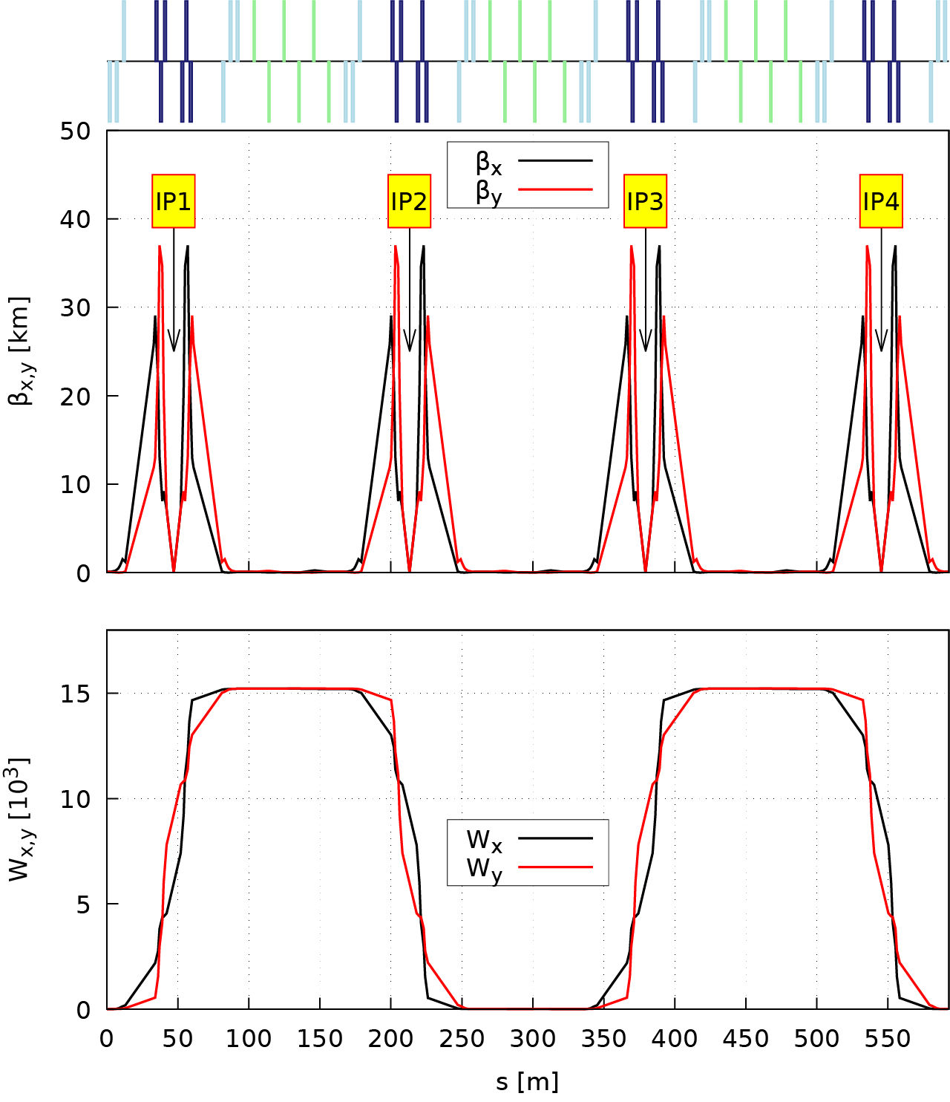
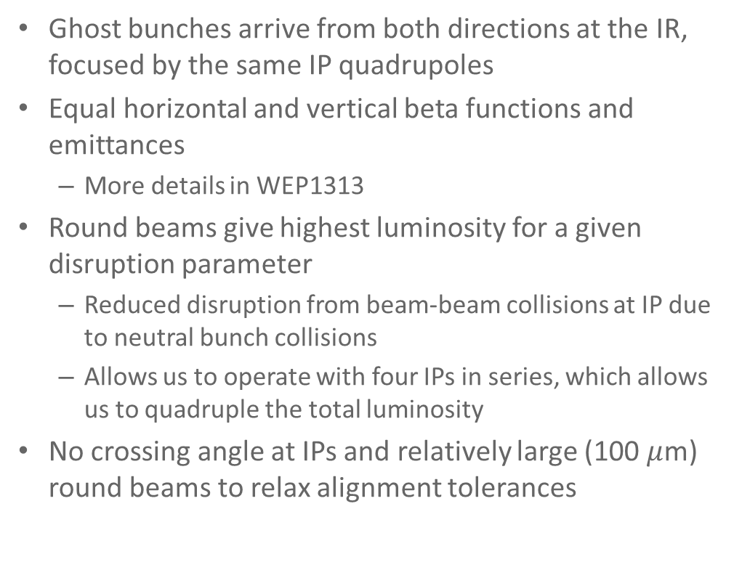
The Interaction Region
Ghost bunches arrive from both directions at the IR, focused by the same IP quadrupoles
Equal horizontal and vertical beta functions and emittances
  More details in WEP1313
Round beams give highest luminosity for a given disruption parameter
  Reduced disruption from beam-beam collisions at IP due to neutral bunch collisions
  Allows us to operate with four IPs in series, which allows us to quadruple the total luminosity
No crossing angle at IPs and relatively large (100 $μ$m) round beams to relax alignment tolerances

Slide 14
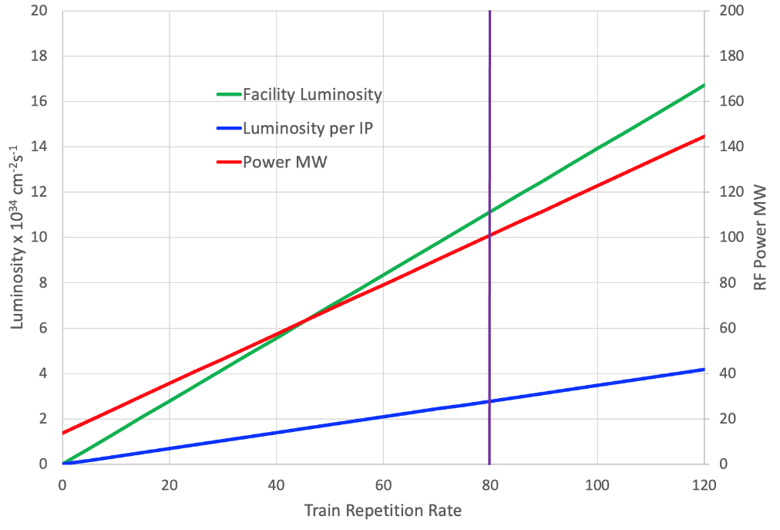
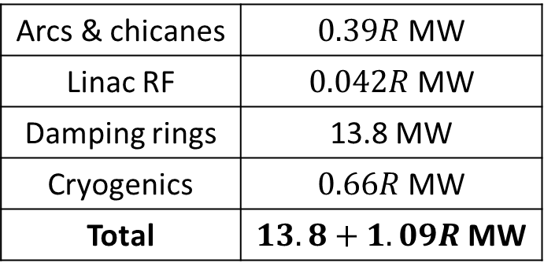
RF power and luminosity
The power required is related to the repetition rate, R
  Train consists of 656 ghost bunches from an ILC-size damping ring
  The RF is pulsed at the same rate with a gradient of 32 MV/m, assuming the use of an FE-FRT to reduce reflected power.
Choose to set luminosity per IP to 1.6x10³⁴ cm⁻²s⁻¹ to limit facility power consumption to 100 MW
  Total facility luminosity is 6.3x10³⁴ cm⁻²s⁻¹
Arcs & chicanes | $0.39R$ MW
Linac RF | $0.042R$ MW
Damping rings | 13.8 MW
Cryogenics | $0.66R$ MW
Total | $13.8+1.09R$ MW

Slide 15
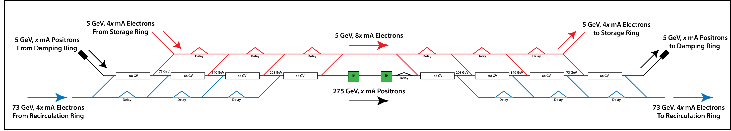
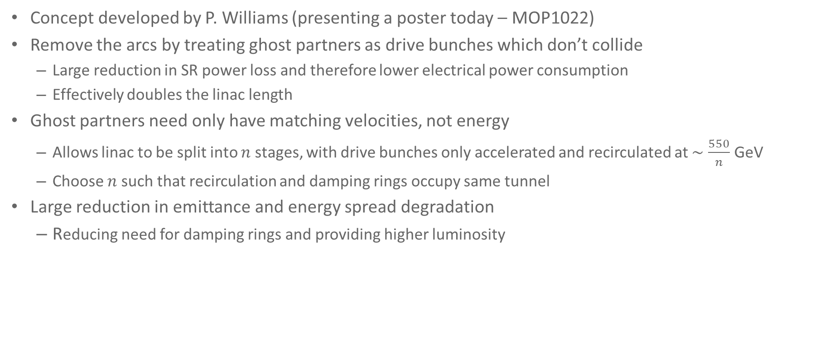
The linear Ghost Collider
Concept developed by P. Williams (presenting a poster today – MOP1022)
Remove the arcs by treating ghost partners as drive bunches which don’t collide
  Large reduction in SR power loss and therefore lower electrical power consumption
  Effectively doubles the linac length
Ghost partners need only have matching velocities, not energy
  Allows linac to be split into $n$ stages, with drive bunches only accelerated and recirculated at $∼\frac{550}{n}$ GeV
  Choose $n$ such that recirculation and damping rings occupy same tunnel
Large reduction in emittance and energy spread degradation
  Reducing need for damping rings and providing higher luminosity

Slide 16
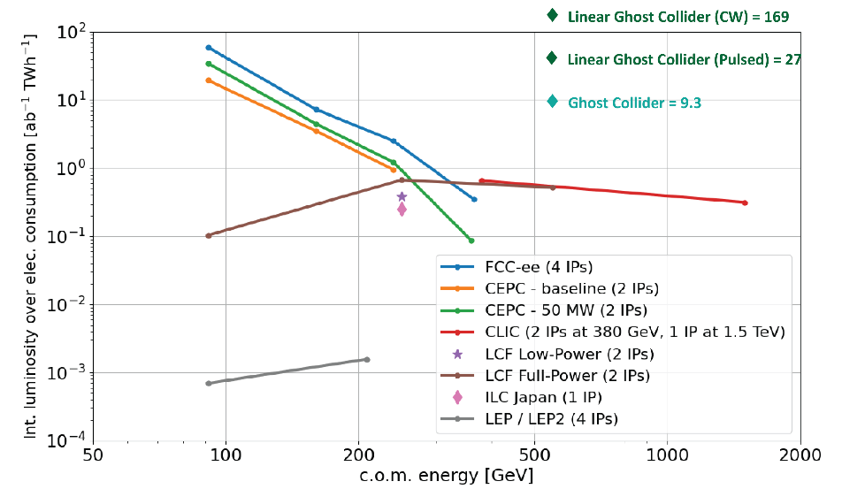
Conclusions
Neutral bunches of electrons and positrons co-propagate in the same RF bucket
  No beam loading and potentially reduced excitation of higher order modes
Single, bidirectional linacs to accelerate/decelerate either side of IR
  Linacs half the length of an equivalent ILC machine
New arc shapes, reducing synchrotron radiation by 38%
Facility luminosity of 6.3x10³⁴ cm⁻²s⁻¹ to limit total power consumption to 100 MW
Please come and visit the poster presentations on Ghost Collider work at IPAC!
  MOP1022 – The Linear Ghost Collider: An Efficient Higgs Factory
  WEP1313 – Chromaticity compensation of a Ghost Collider

Slide 17
Thank you for listening!
Questions?

