Slide 1
Beam Dynamics in the SNS Linac and Beam Test Facility
May 22, 2026 | IPAC’26, Deauville, France
Kiersten Ruisard
Oak Ridge National Laboratory

Slide 2
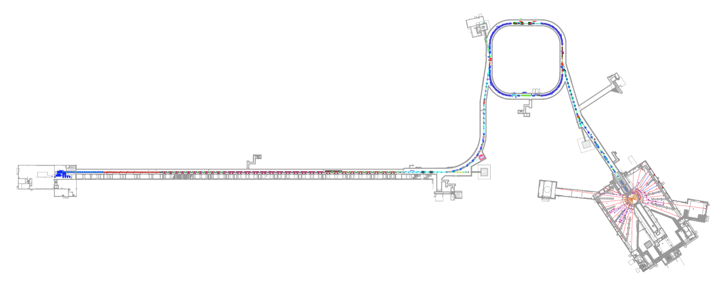
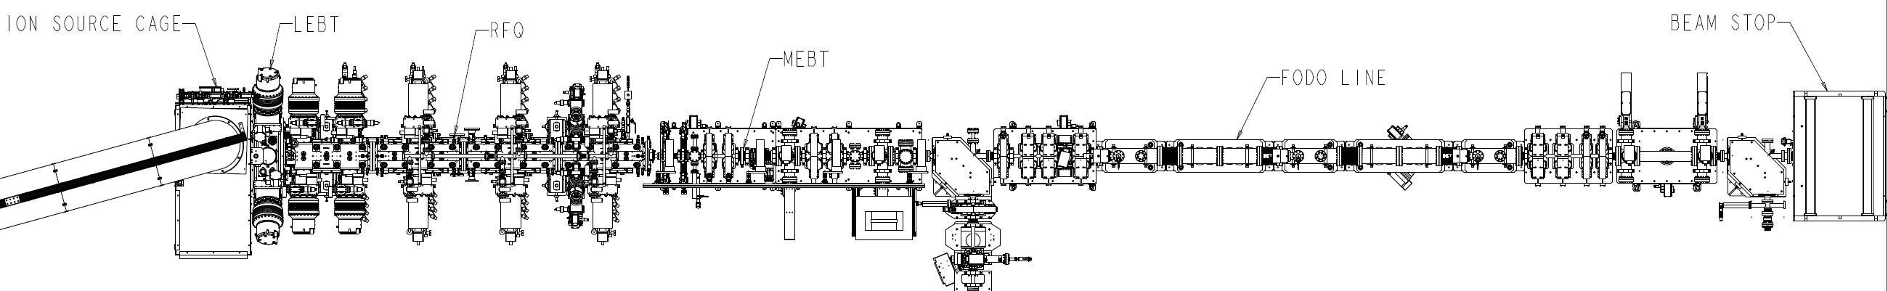
Spallation Neutron Source
320 m, 1.3 GeV H⁻
Beam Test Facility
13 m, 2.5 MeV H⁻
Ion source
LEBT
RFQ
beamstop
MEBT
FODO
Notes:
Dynamics in 2 very different machines…(introduce each)
One operational complexity of the SNS linac is BEAM LOSS
How can beam test facility help? We have time to do needed studies to benchmark (and much simpler beamline), we have diagnostics to detect halo

Slide 3
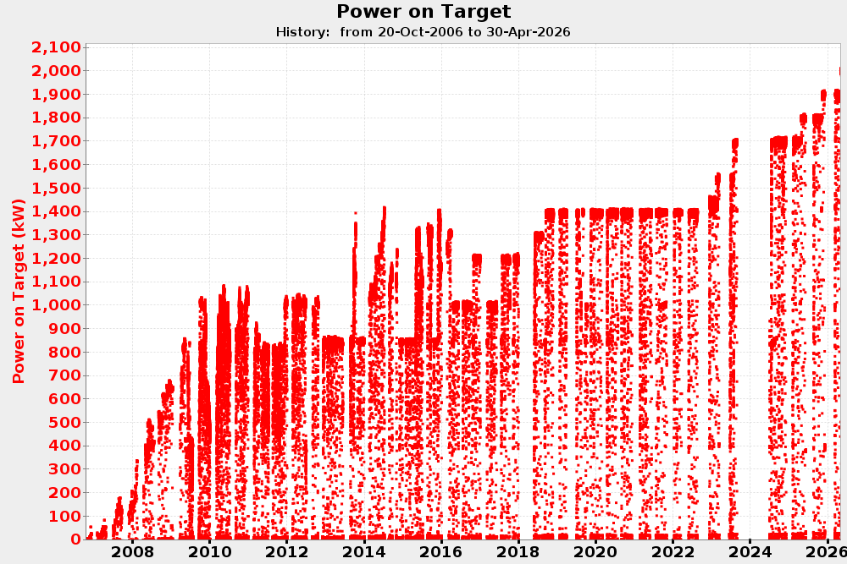
The SNS Linac is currently operating at 2.0 MW
(as of April 23, 2026)
The Proton Power Upgrade increased SNS beam power on target from 1.4 MW to 2.0 MW, mainly through 30% increase in beam energy (1 GeV → 1.3 GeV)
2 MW
Completed PPU installation
20th anniversary of SNS beam on April 28!
1.4 MW baseline design
Notes:
Beam loss outlook: we’re coming up on 2 years (and 3 shutdowns) of PPU beam
How did losses change? Activation levels went up…then down again. Losses are currently in-line with expectations.
ring activation is higher than expected (very localized spot ~1700 mrem/hr at a foot!)
PPU facts:
Commissioned in about 4 weeks in June/July 2024
Over 1 ms, 1000 pulses of negative hydrogen ions, each 700 ns long are accelerated to 1.3 GeV or 0.91c
Accumulated 700 ns long pulse of 1.5 E14 protons is extracted to target 60 times a second – roughly 32 kJ per pulse

Slide 4
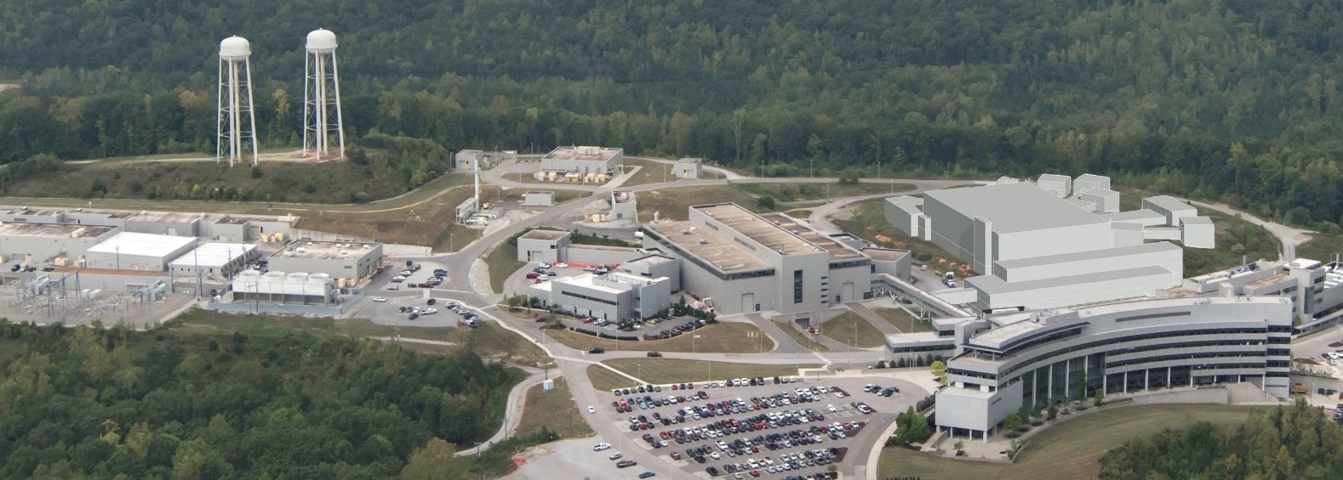
After completion of Second Target Station, SNS will ramp to 2.7 MW
Beam current will increase by 50% from SNS design value
Accumulator Ring
Future Second Target Station
Linac
First Target Station
PPU scope
Notes:
We are currently below 1 W/m goal by factor ~3
We are confident we can keep acceptable losses at 2.8 MW, but it will be more technically challenging, and we will need to keep advancing in the way we operate our accelerator.
We are closing the gap to 2.8 MW. We recently did 2.6 MW demo (reduced rep rate); in a few weeks we'll have a higher number. Only major beam dynamics concern is e-p in ring.
We are confident we can run at 2.8, but we will be running the linac harder (beam loading). Better capabilities for loss control will help us maintain cavity performance over time, and maintain reliability and availability.

Slide 5
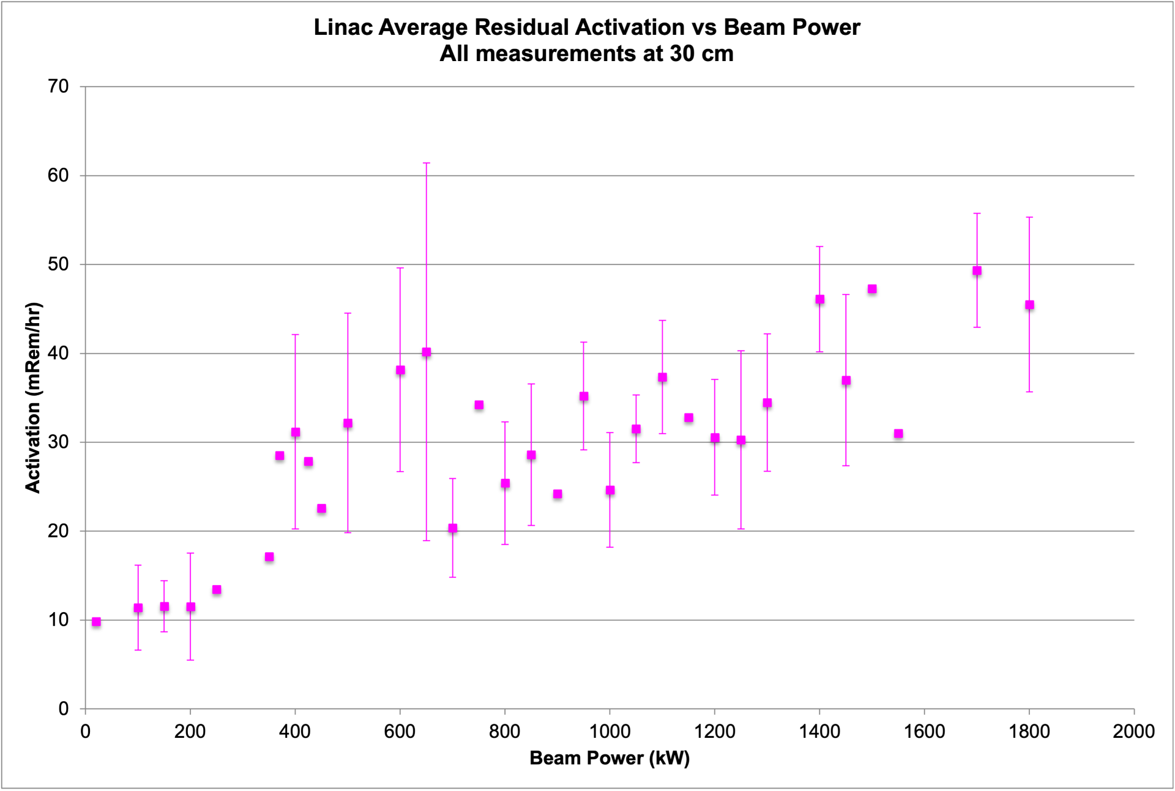
Increased beam loss at 2+ MW brings technical challenges
Notes:
1 W/m ~ (100 mrem/hr at 30 cm after 4 hours)
Bring it back to beam loss…
Beam-loss induced problems in SCL/linac =
Higher activation, wear and tear
Beam-loss-induced degradation events
All components of tunnel suffer faster degradation with higher activation.
In SCL, beam loss could excite gas dynamics and increase the incidence rate of arcing and permanent cavity damage.
In anticipation we’re trying to maintain expertise in cavity refurbishment.
Other beam dynamics issues: (not related dto beam loss)
Beam loading reduces cavity reliability
Higher beam power – more loss when errant beam trips occur
Most likely “catastrophic” dynamics issue is e-p instability in the ring. This has been excluded to 2.6 MW empirically.
Activation plot – we recently changed time until RCT survey from few hours to 1 day. That affects activation plot.

Slide 6
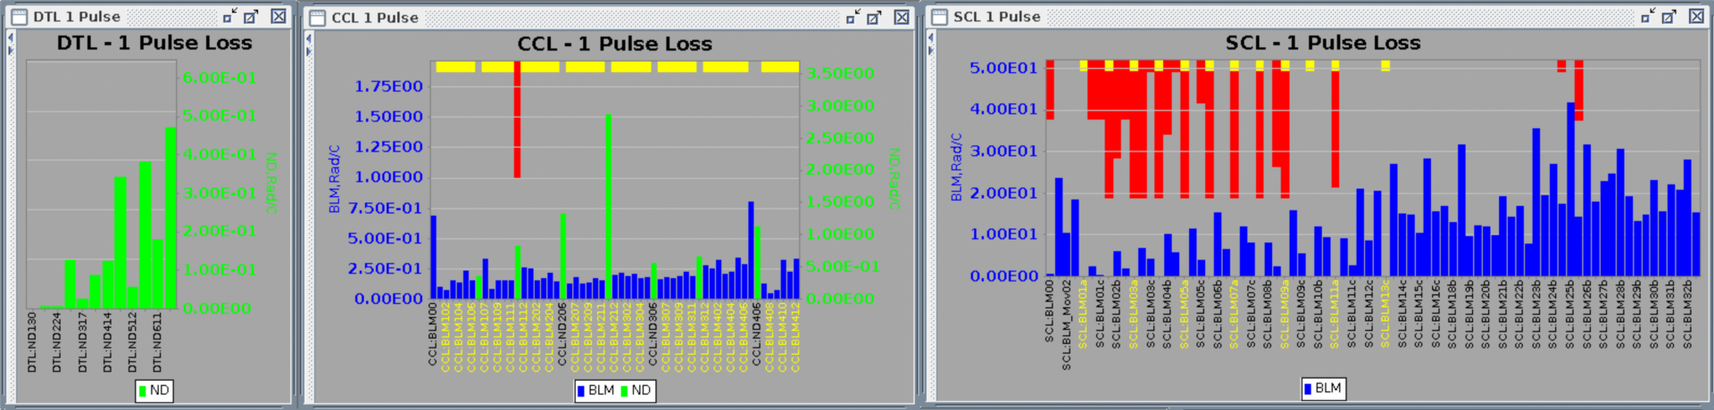
Currently, beam loss control is human-driven and empirical
Automated beam loss tuning is in the near future
✓
Empirical understanding
Physics understanding
Notes:
1 W/m limit (hotspots .2-.3 W/m)
We have 3 beam specialists who can confidently tune losses. Usually ~ half day of loss tuning after startup. This is in addition to linac tuning to set beam energy and longitudinal focusing. (1 hour if everything works)
Requires deep understanding of machine… we measure loss at BLMs, not activation. Example: hot spot at SCL entrance, BLMs are not unusually high
Re-iterate how we do know our machine really well….we just would like a deeper understanding.
Example: Scraping on MEBT choppers reduced losses at SCL entrance. Why? Could it be proton component? Or halo scraping (because temperature sensor near CM2-3 heats up with beam).

Slide 7
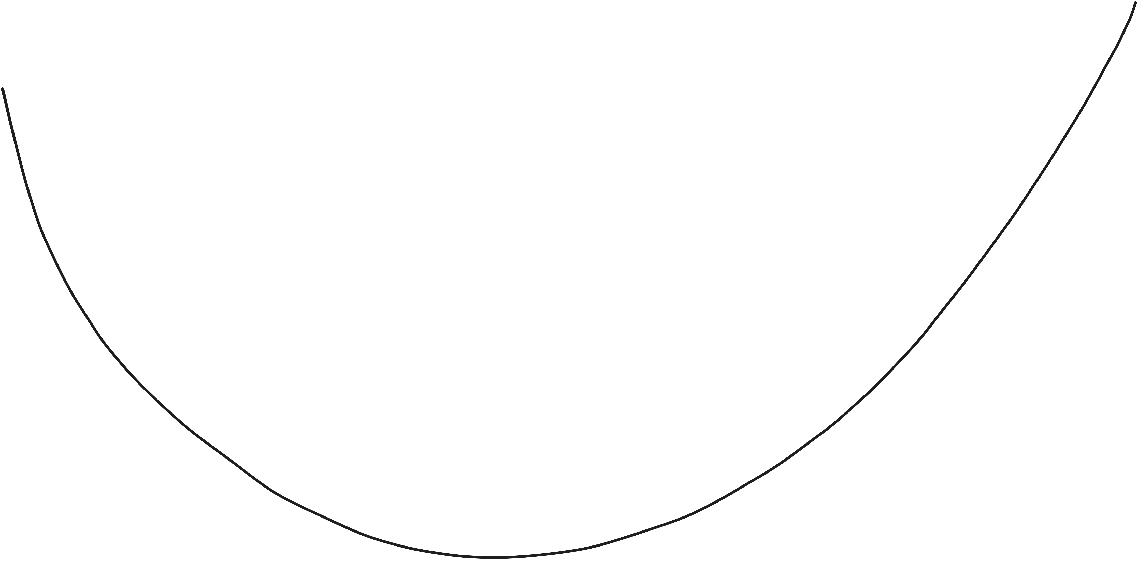
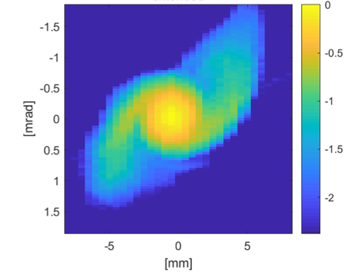





Beam dynamics mechanisms for LINAC beam loss
Dominated by
intrabeam stripping
Dominated by halo
$$H^{−}$$
$$H^{−}$$
Beam loss
$$H^{0}$$
$$H^{−}$$
Model prediction
$$e$$
design
Real operating point
Beam optics (~ bunch size)
Notes:
We’ve semi-empirically found a local minimum and we try to stay close to it.
1 W/meter goal. We are well below this. Highest region ~.2-.3 W/meter
30W total loss in SCL
Design: SNS was designed to be a “no loss” machine
Model: model does not agree that our real operating point is a good one
This is our current understanding! Based on what we’ve learned over the years
Other sources:
- Dark current
- proton component from ion source (easy to fix with dog leg)
dynamic aperture loss?
Plot is from HEBT phase space, at 1.4 MW, 1 GeV, with laser wire emittance scanner

Slide 8
We do use model to understand linac dynamics
Model-based tuning of cavity phases/amplitudes is fast and reproducible
Can be done in 1 hour
Re-scaling around tripped cavity achieves accuracy of 1.5 MeV (0.1%)
Cavity phase/amplitudes known to within 1%
Require only phase scans to fit energy, cavity phase, cavity amplitude
Centroid model is benchmarked for whole linac, model-based orbit correction works (to within 0.1 mm)
Model for rms Twiss is benchmarked in HEBT
RFQ 2.5 MeV
CCL 186 MeV
SCL 387 MeV
DTL 87 MeV
SCL1300 MeV
HEBT
402.5 MHz
805 MHz
But…
We do not rely on transverse model or transverse diagnostics to define operating point
Modeling the operating point predicts large losses. What is wrong with the model?
Notes:
I don’t want you to get the impression we don’t know anything about our machine as well!
Massive efforts in benchmarking the LINAC in 1st decade of operation, but we’ve got better results (for losses) by letting operations take over.
Our strategy is to start each run by restoring last production (low loss solution) rather than design.
Challenge with transverse benchmarking is you need good transverse diagnostics for initial bunch.
LINAC tuning steps (practical)
Perform RF phase & amplitude (or phase only) scan
Figure out how far we are from the design amplitude and phase
Move amplitude and phase to the values from previous production setup
Empirically optimize beam loss and/or set amplitude to reduce RF cavity trip rate
Perform scans and analysis again and save the deviations from the design

Slide 9
Dominated by
intrabeam stripping
Dominated by halo
Beam loss
Beam optics (~ bunch size)
Notes:
We’ve semi-empirically found a local minimum and we try to stay close to it.
1 W/meter goal. We are well below this. Highest region ~.2-.3 W/meter
30W total loss in SCL
Design: SNS was designed to be a “no loss” machine
Model: model does not agree that our real operating point is a good one

Slide 10
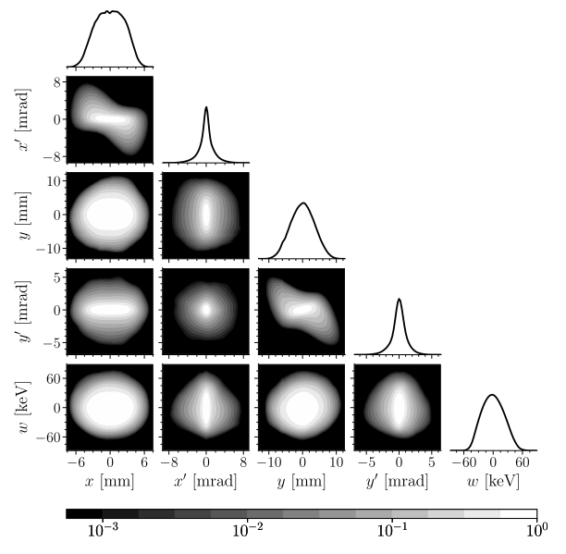
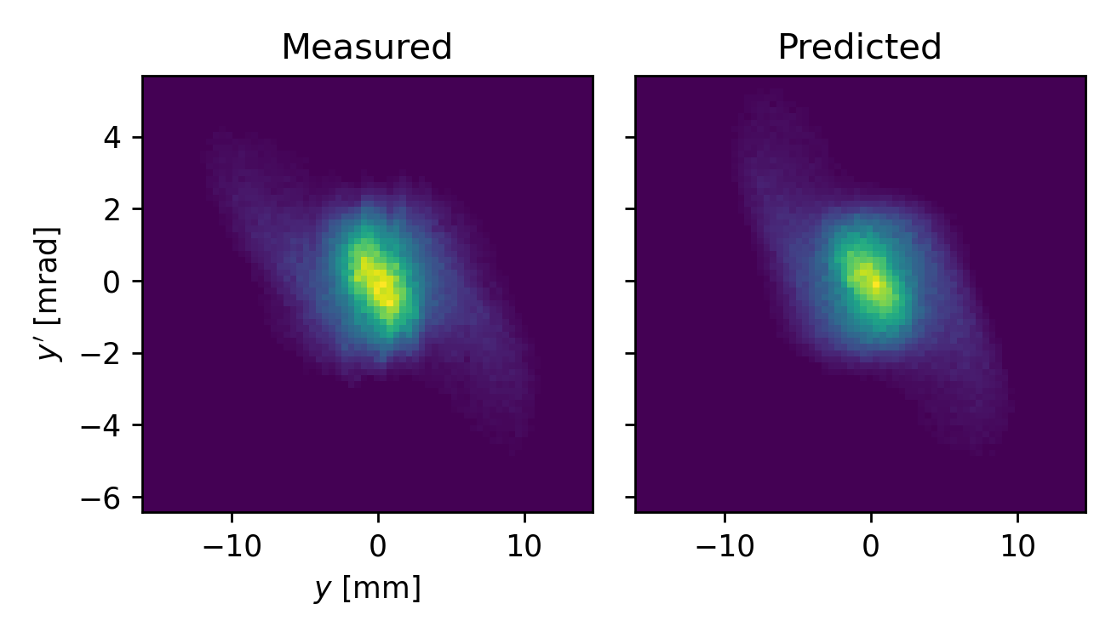
Scope of BTF project is to accurately model halo development over short, 2.5 MeV transport line
“input bunch”
Beam stop
2D high dynamic range
“output bunch”
MEBT
Up to 6D phase space
2D high dynamic range
FODO line
5D measurement of initial bunch
2D phase space measurement
(Linear scale, dynamic range of 10²)
Hoover et. al (2023). PRAB 26, 064202

Slide 11







Scope of BTF project is to accurately model halo development over short, 2.5 MeV transport line
“output bunch”
“input bunch”
2D high dynamic range
2D high dynamic range
Up to 6D phase space
6D measurement of initial bunch
slit 1 $=x$
slit 3 $\sim x′$
slit $2=y$
H⁻ beam
${90}^{∘}$dipole
slit 4 $\sim ΔE$
2D phase space measurement vs model
(Linear scale, dynamic range of 10²)
wire $\sim y′$
RF
secondary e⁻
$f(φ$)

Slide 12


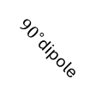
Scope of BTF project is to accurately model halo development over short, 2.5 MeV transport line
“output bunch”
“input bunch”
2D high dynamic range
2D high dynamic range
Up to 6D phase space
slit 1 $=x$
slit 2 $\sim x′$
H⁺
6D measurement of initial bunch
${90}^{∘}$dipole
H⁻ beam
slit 1 $=x$
0.95 m
slit $2=y$
slit 3 $\sim x′$
${90}^{∘}$dipole
2-camera system
H⁻ beam
slit 4 $\sim ΔE$
2D phase space measurement
wire $\sim y′$
RF
secondary e⁻
$f(φ$)

Slide 13
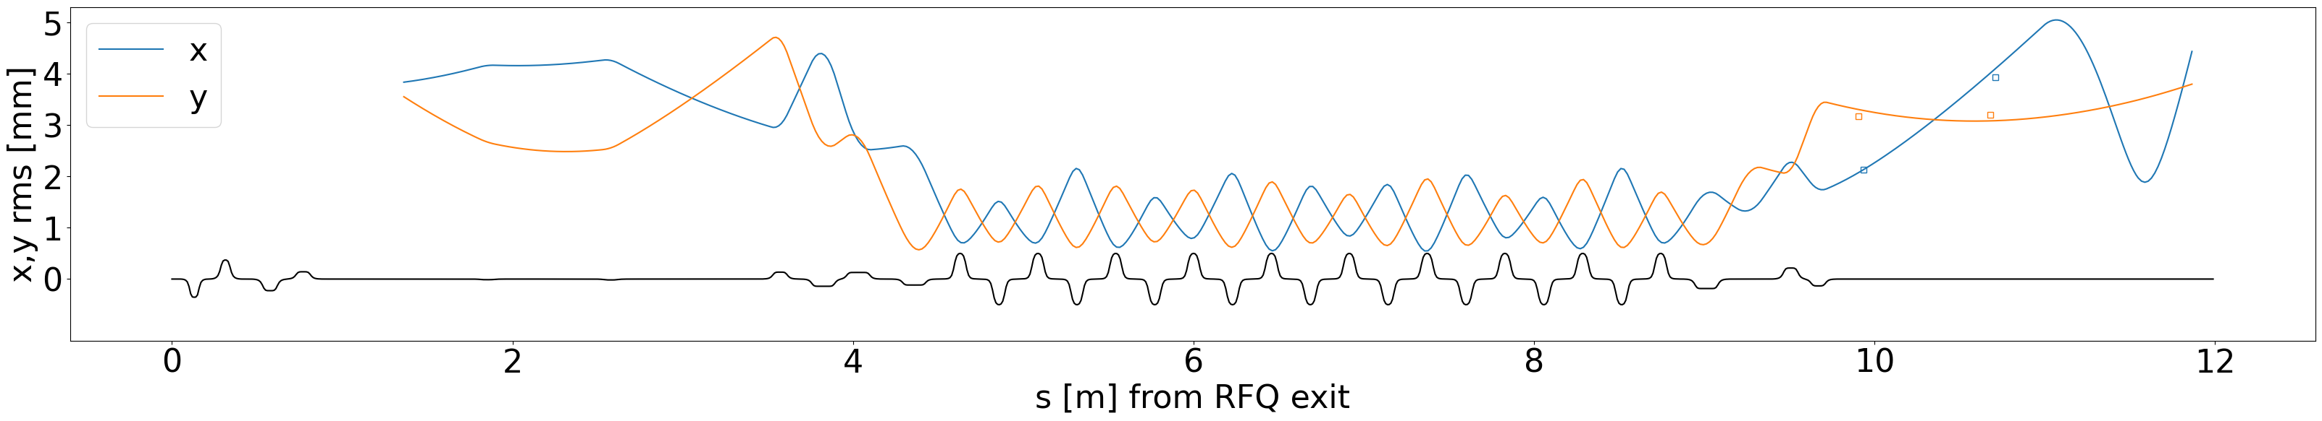
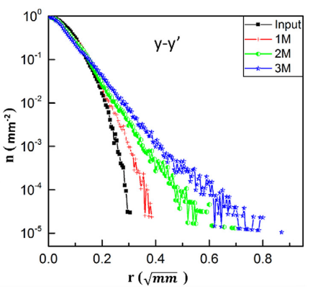
Test beamline is periodic and is long enough to form halo
“input bunch”
“output bunch”
Relatively strong-focusing FODO line:
9.5 cells
105 degrees per cell
Permanent magnet quadrupoles
Zhang, Z., et. al (2020). NIM-A, 949, 162826.
Notes:
Main point:
BTF beamline resembles DTL periodic structure. It’s short but long enough to drive halo, so we have something to study.

Slide 14
2016: First beam in BTF
2017: First full and direct 6D measurement of MEBT distribution
2020: First mapping of 2D phase space projection with 6 orders of dynamic range
2025: First systematic measurement of beam distribution vs. mismatch with 6 orders of dynamic range
Notes:
First beam?

Slide 15
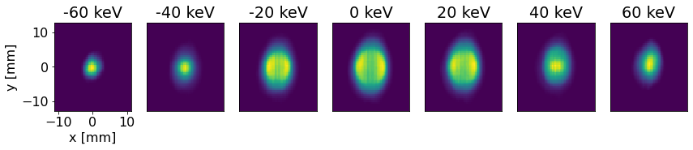

RFQ
MEBT
2016: First beam in BTF
2017: First full and direct 6D measurement of MEBT distribution
6D phase space measurement
2020: First mapping of 2D phase space projection with 6 orders of dynamic range
Slice of distribution, f(x,y) depends on ΔE
2025: First systematic measurement of beam distribution vs. mismatch with 6 orders of dynamic range
y
x
$$ΔE$$
Notes:
Integrated xy spot

Slide 16
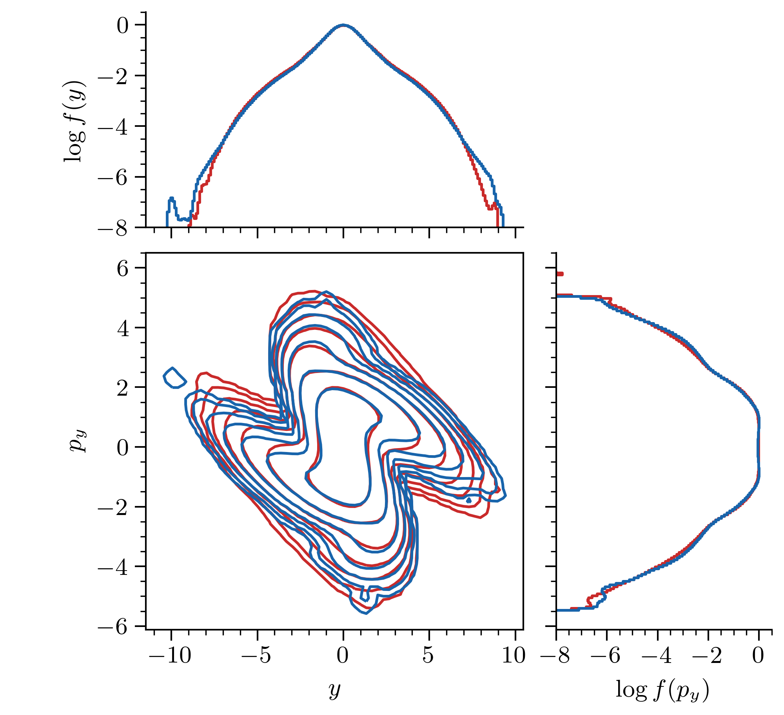
MEBT
2016: First beam in BTF
FODO line
2017: First full and direct 6D measurement of MEBT distribution
6D phase space measurement
2D measurement, high dynamic range
simulate
2020: First mapping of 2D phase space projection with 6 orders of dynamic range
compare
10⁻²
(~99%)
2025: First systematic measurement of beam distribution vs. mismatch with 6 orders of dynamic range
10⁻⁷ (~99.99999%)
Hoover et al, High Brightness Workshop, CERN (Oct 2023)
Notes:
How many particles?

Slide 17
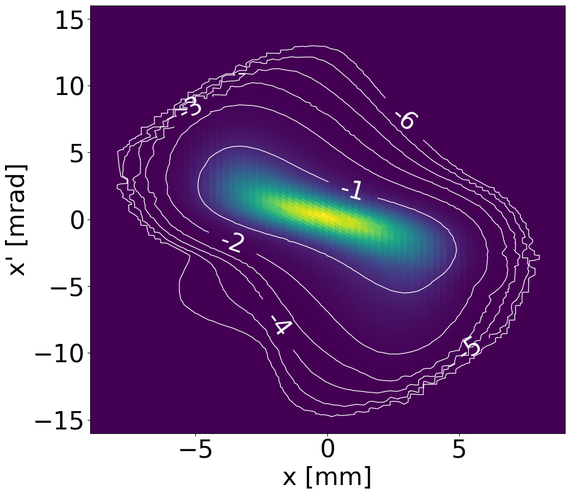
MEBT
2016: First beam in BTF
FODO line
2017: First full and direct 6D measurement of MEBT distribution
2020: First mapping of 2D phase space projection with 6 orders of dynamic range
2D phase space measurement with high dynamic range
2025: First systematic measurement of beam distribution vs. mismatch with 6 orders of dynamic range

Slide 18
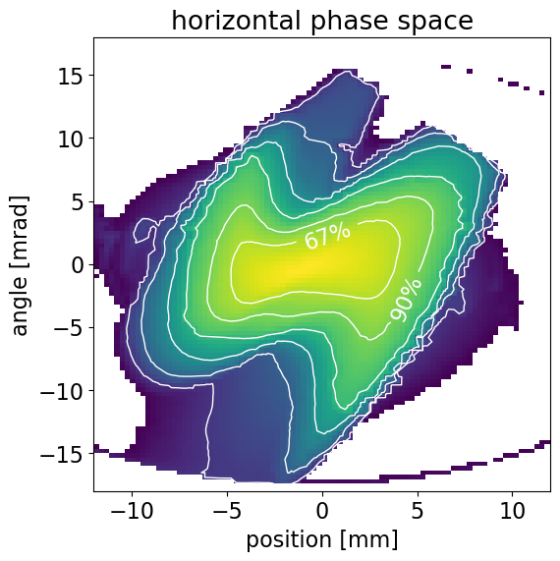
MEBT
2016: First beam in BTF
FODO line
2017: First full and direct 6D measurement of MEBT distribution
2D phase space measurement with high dynamic range
2020: First mapping of 2D phase space projection with 6 orders of dynamic range
2025: First systematic measurement of beam distribution vs. mismatch with 6 orders of dynamic range
99%
99.9%
99.99%
99.999%
Notes:
52 mA beam

Slide 19
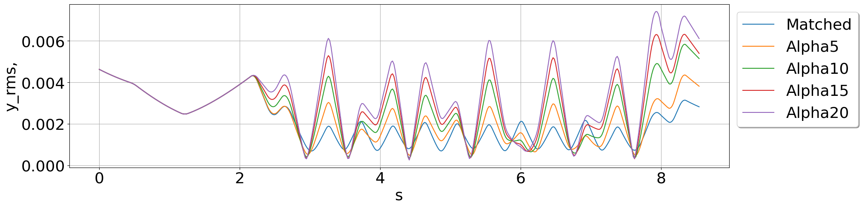
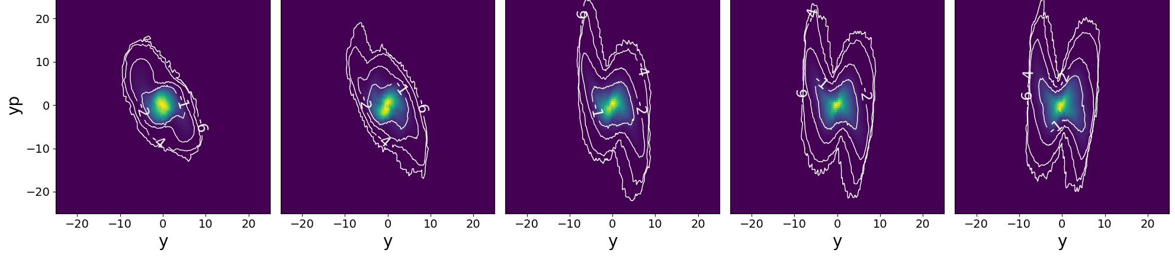
MEBT
2016: First beam in BTF
FODO line
2017: First full and direct 6D measurement of MEBT distribution
Plot shows 5 optics cases with varying level of mismatch:
2020: First mapping of 2D phase space projection with 6 orders of dynamic range
rms y [m]
s [m]
Increasing mismatch parameter
2025: First systematic measurement of beam distribution vs. mismatch with 6 orders of dynamic range
Trent Thompson, Poster THP5349
Notes:
52 mA beam

Slide 20
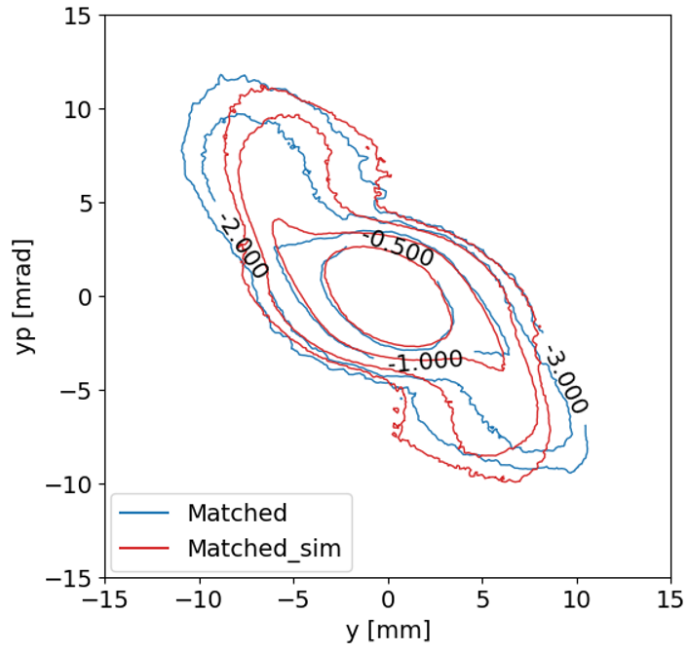
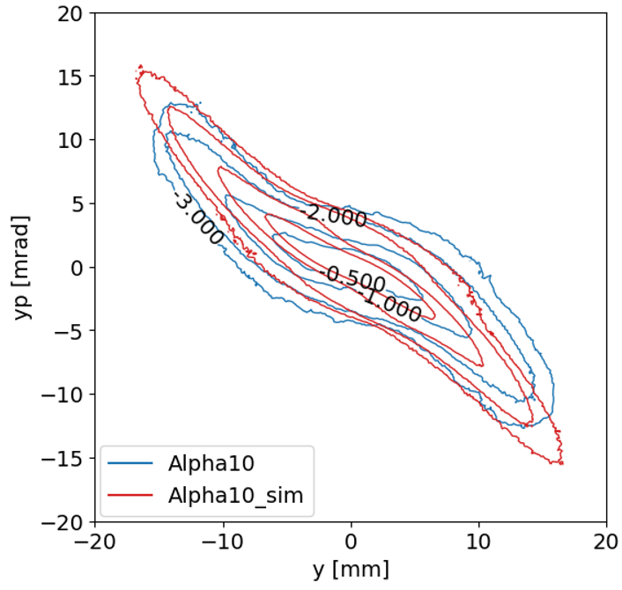
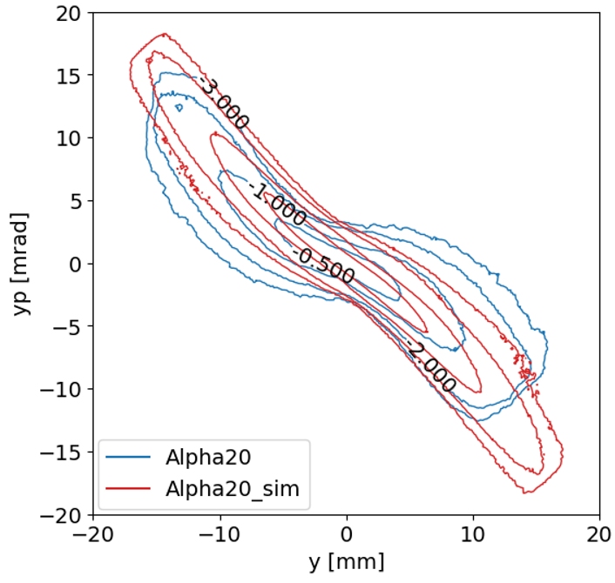






Benchmark of PyORBIT simulation has best agreement for matched case
Increasing mismatch parameter
measured
simulated
$y′$, ±15 mrad
$y′$, ±20 mrad
$y′$, ±20 mrad
Contours are at 31%, 10%, 1%, 0.1% of peak density
$y$, ±15 mm
$y$, ±20 mm
$y$, ±20 mm
PyORBIT PIC simulation uses 100M macroparticles for 40 mA average bunch current

Slide 21
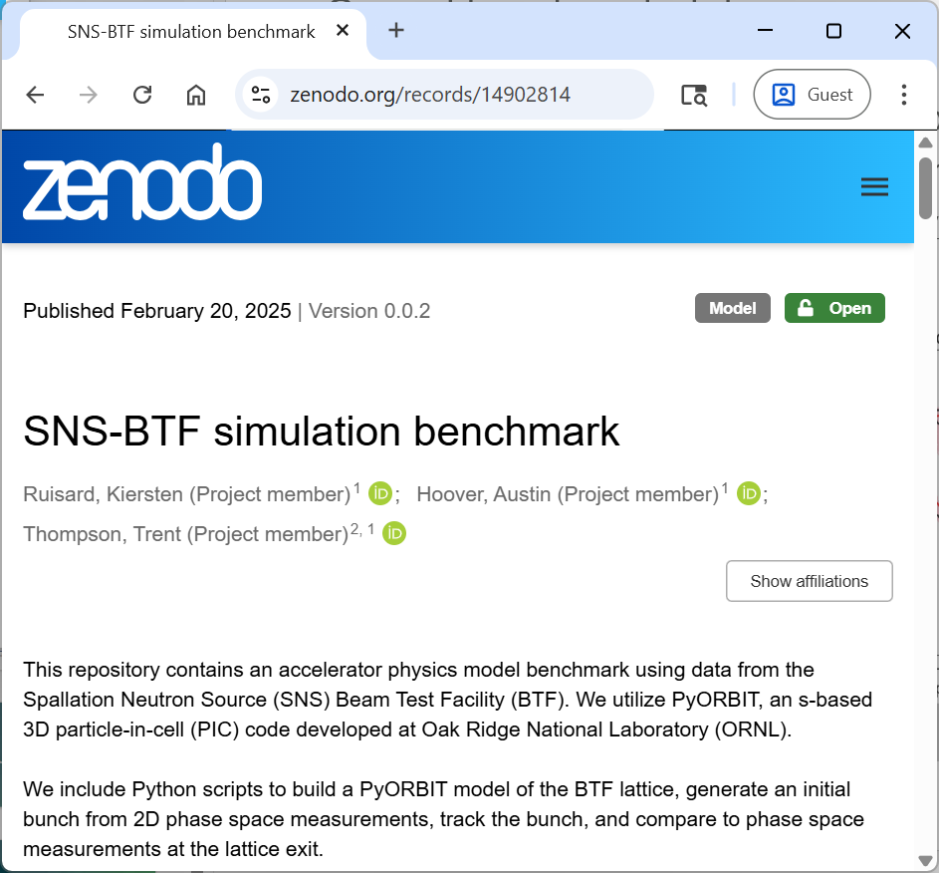
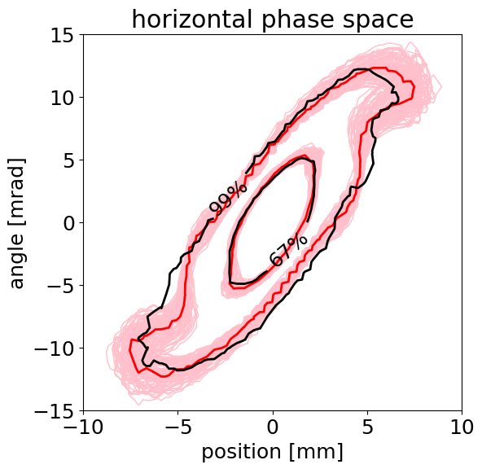
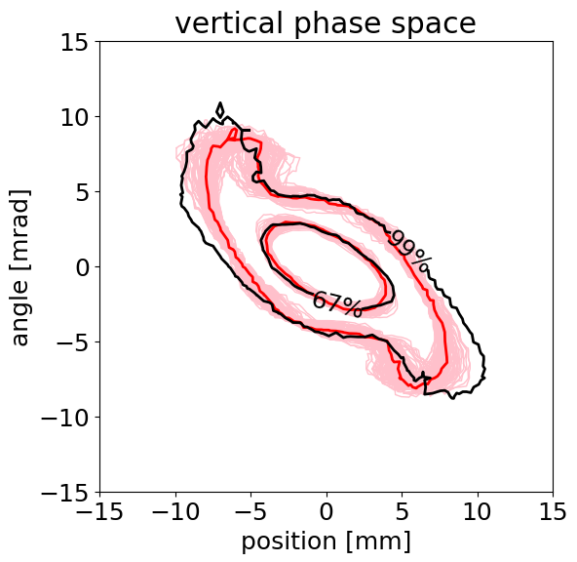
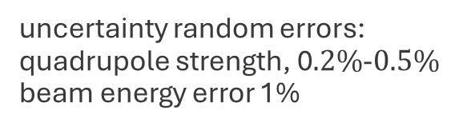
Current benchmark status:
Good agreement for core
Fair agreement to 10⁻² tails (99% of beam)
Larger disagreement for mismatched beams
“Halo benchmark” not achieved yet
Red: simulation model
Black: measurement
Pink: simulation uncertainty
uncertainty random errors:
quadrupole strength, 0$.2\%$-$0.5\%$
beam energy error 1%
Notes:
Larger sensitivity to mismatch: linear focusing error?
Divergence in tails: nonlinear error?

Slide 22
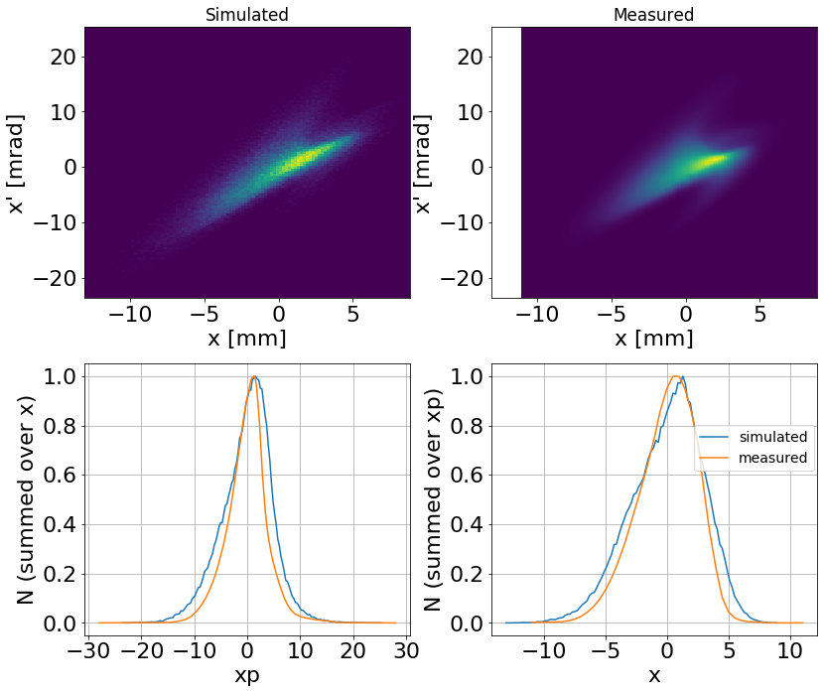
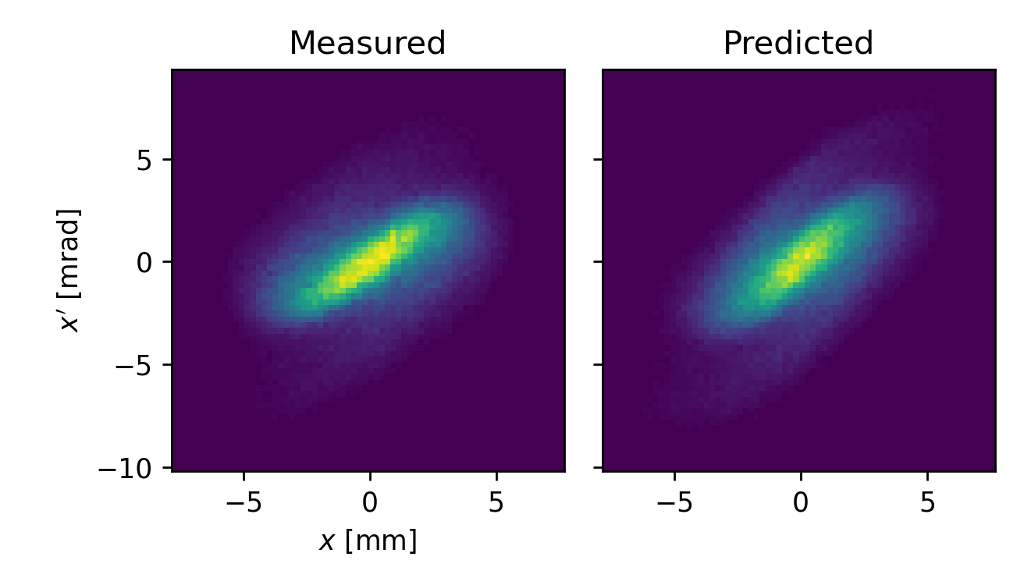
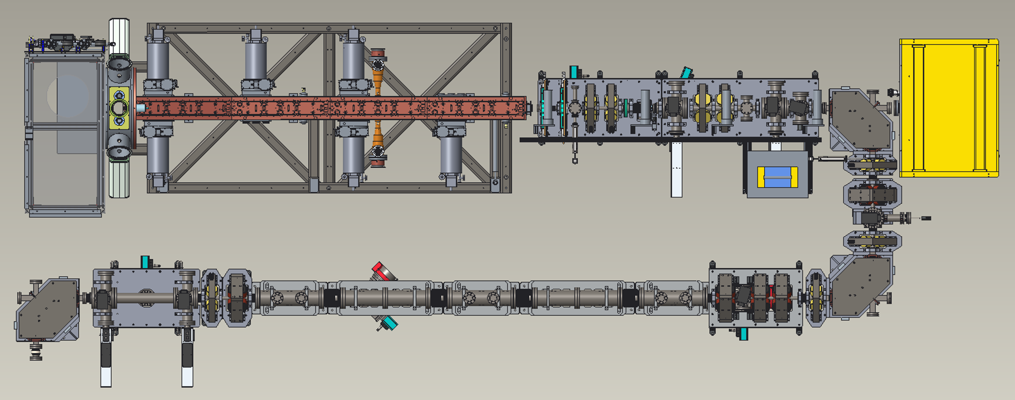
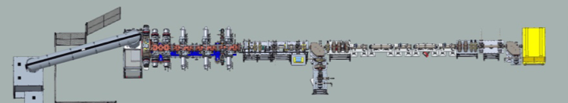
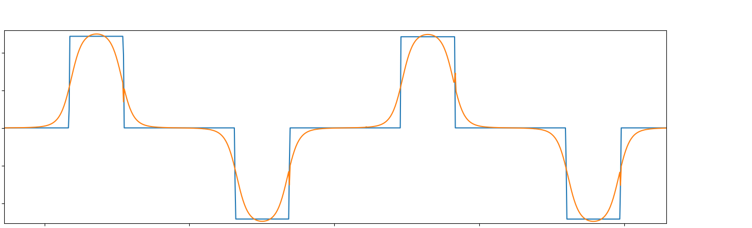





BTF “core” benchmark took years to achieve
measured
simulated
measured
simulated
2018 - 2022
$x′$, ±22 mrad
$x′$, ±10 mrad
January 2024:
$x$, ±10 mm
$x$, ±10 mm
Modeling multi-bunch interaction:
Modeling short FODO quads:
$$l_{s}{>360}^{∘}$$
9 inches

Slide 23
How can we fix this discrepancy to do halo prediction at the test facility?
Nonlinear components of quadrupoles
Improve transmission with added trajectory correctors
Even matched beam has 3% loss
What else?
R&D at Beam Test Facility is in “halo” era – providing a very clear picture of early halo growth
MEBT
FODO
Notes:
We’ve covered low-hanging fruit. What have we not thought about?

Slide 24

Increased “physics intuition” will benefit operations
Dominated by
intrabeam stripping
Dominated by halo scraping
Beam loss
Model prediction
Region of empirical knowledge
Real operating point
Beam optics (~ bunch size)
Notes:
So what?
Bottom line: There are many facets of our machine that we can’t explain with rms model. Design is not good enough. Envelope model is not good enough to explain losses
With better models for beam loss mechanism, we can push
Could a better optics design lower losses?
We’re still not sure if we built what we designed, or how far we are from that.
If we’re actually describing the machine we have, we can start to re-design it for better performance
For example, controlled collimation of halo would allow us to increase beam size and reduce IBS losses
Any knowledge gained has been used to improve operations
This will not be easy! But none of what we have done has been easy…

Slide 25
Thanks for your attention!
This presentation summarizes efforts of many SNS personnel over 2 decades of operations. Similarly, many hands are needed to keep the BTF project moving forwards, too many to list here.
This work is supported by the U.S. Department of Energy, Office of Science,
Office of High Energy Physics and Office of Basic Energy Sciences (DE-AC05-00OR22725).

Slide 27
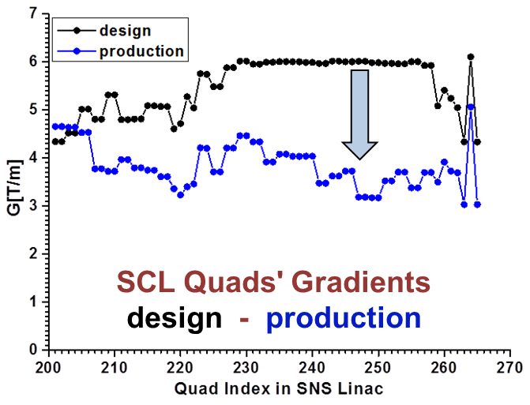

Intrabeam stripping loss was a major hiccup in initial commissioning of SNS to 1.4 MW
$$H^{−}$$
$$H^{−}$$
$$H^{0}$$
$$H^{−}$$
$$e$$
A. Shishlo, J. Galambos, A. Aleksandrov, V. Lebedev, and M. Plum, PRL 108, 1 (2012)
Notes:
We were able to tolerate this because of large aperture in SCL!

Slide 28
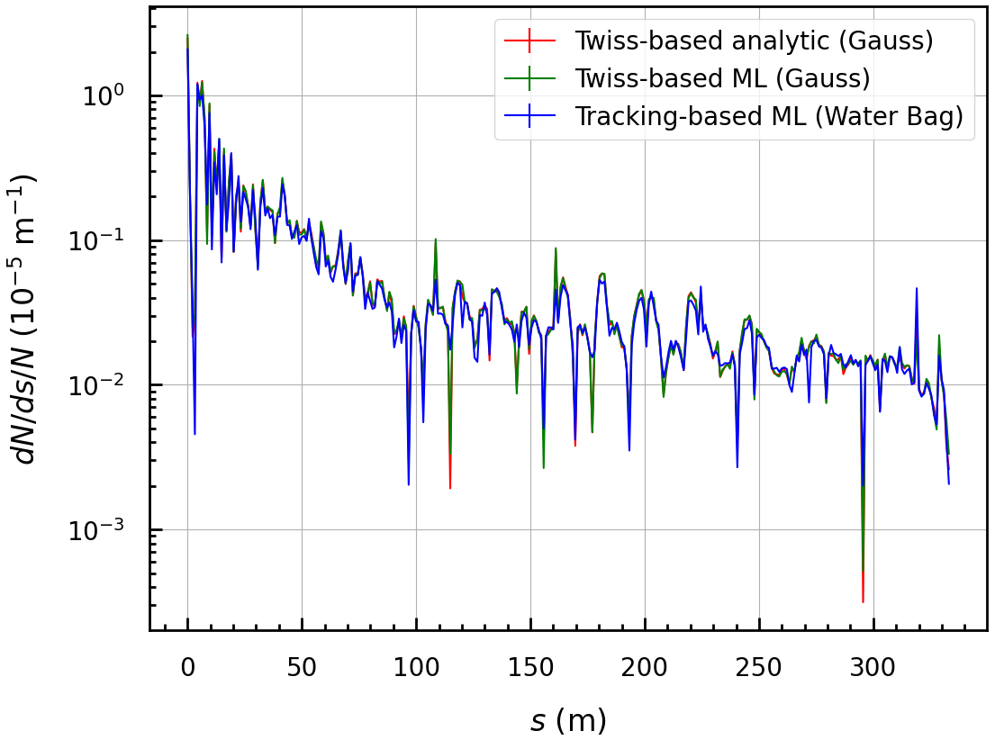
intrabeam stripping loss rate in model tracking
Plot courtesy of Vasiliy Morozov
Notes:
Plot shows default (design) linac optics
We have this fully implemented. Linac model with (100k?) particles runs in ~20 minutes
Now we’re looking for ways to benchmark the IBS model.
It’s complicated…. BLM signal is not one-to-one with losses.

Slide 29
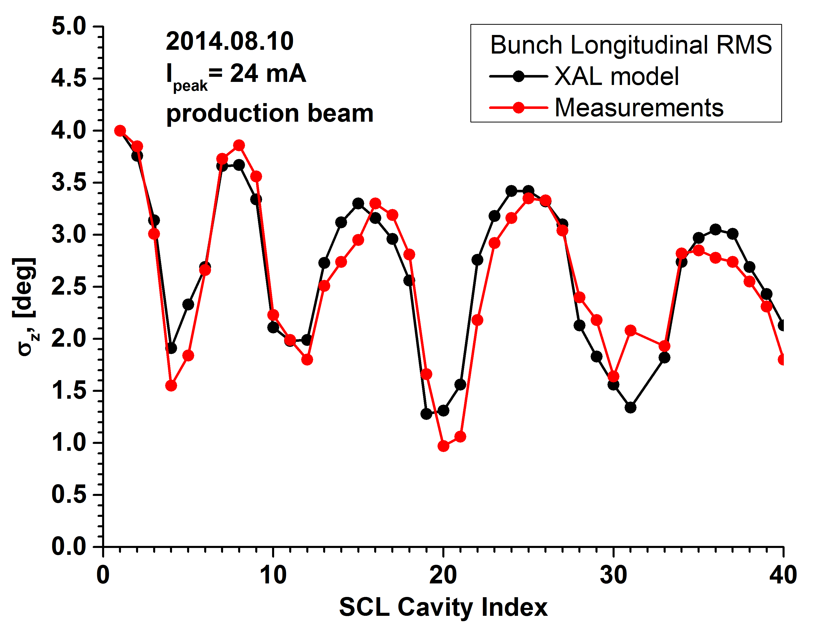
SCL rms benchmark for production (mismatched)
Shishlo, LINAC2014

Slide 30
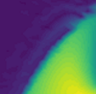
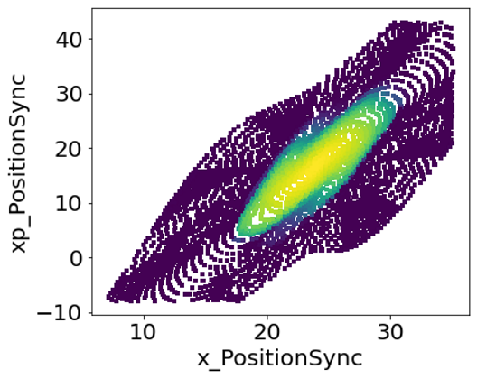



High Dynamic Range (HDR) Phase space measurements
slit 1 $=x$
slit 2 $\sim x′$
H⁺
${90}^{∘}$dipole
H⁻ beam
0.95 m
2-camera system

Slide 31
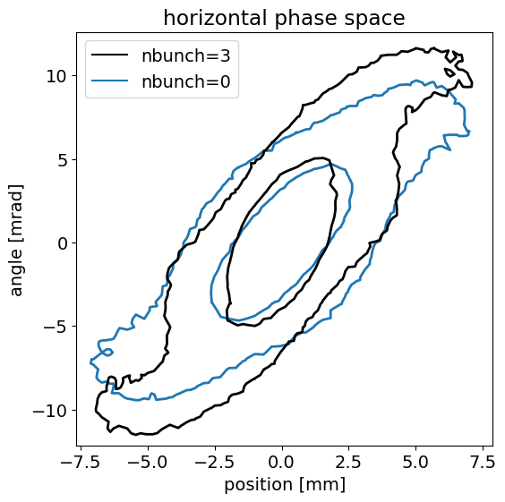
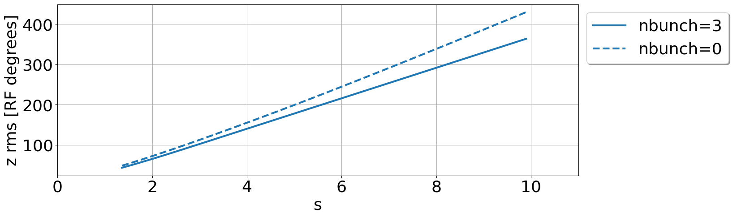

PyORBIT has multi-bunch field solver
$$l_{s}{>360}^{∘}$$
Poisson solver :
3D FFT
nx,ny,nz = 64
n_particles = 200k
stepsize <= 0.01 m
n_bunches = 3
Notes:
This is a limitation for testing codes

Slide 32
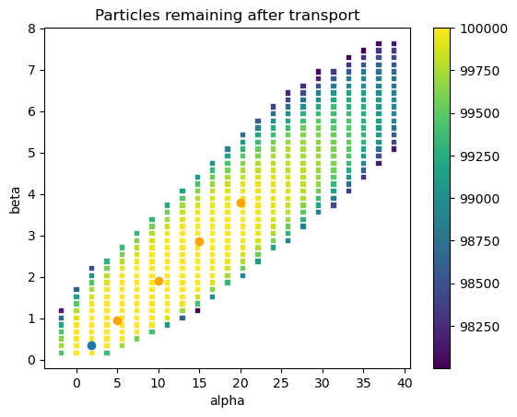
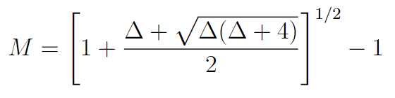

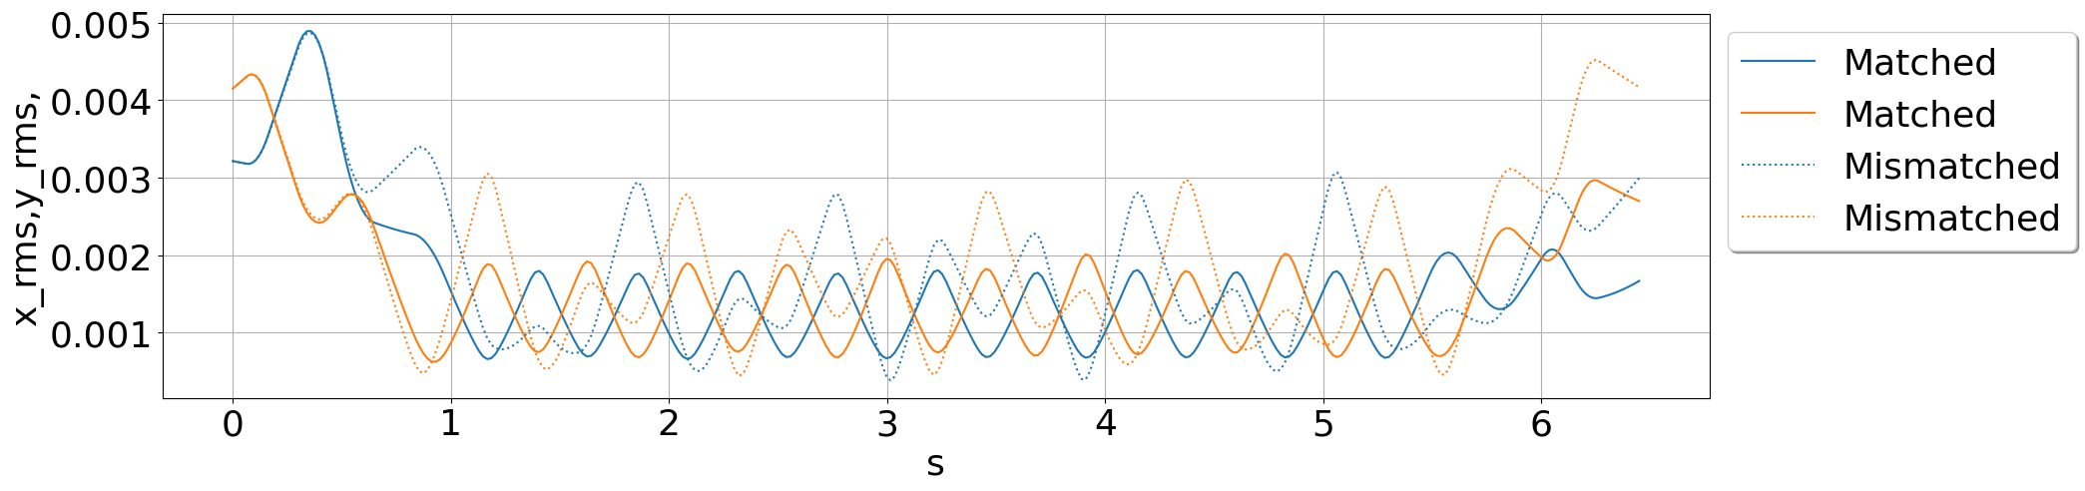
Defining mismatched beams
Alpha | Beta | Mismatch Factor | Transmission
1.84 | 0.34 | 0 | 95%
5 | 0.94 | 0.67 | 94%
10 | 1.90 | 1.36 | 93%
15 | 2.86 | 1.90 | 90%
20 | 3.80 | 2.35 | 86%

Slide 33
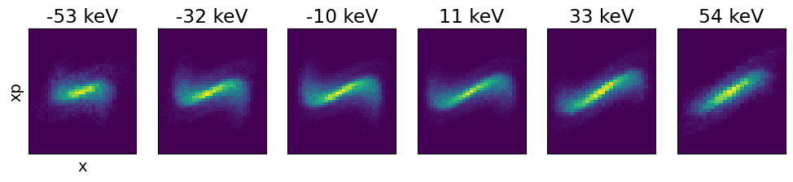
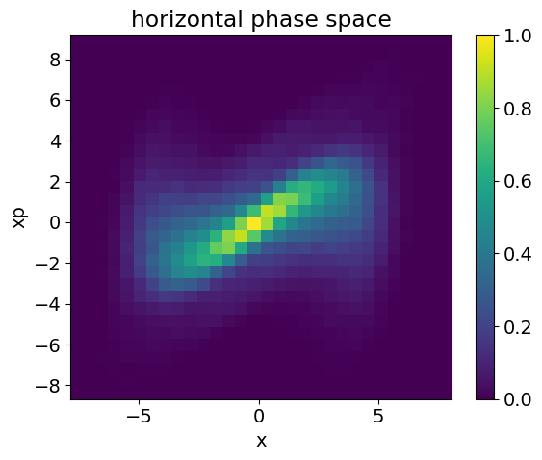
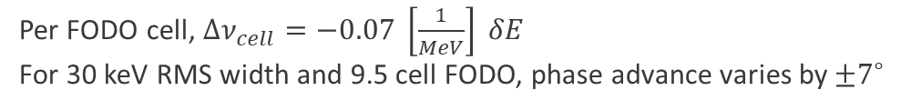
Large energy spread and longitudinal correlation means large chromaticity
Per FODO cell, $Δν_{cell}=−0.07 \left[\frac{1}{MeV}\right] δE$
For 30 keV RMS width and 9.5 cell FODO, phase advance varies by${±7}^{∘}$
Full projection phase spaces:
Phase space for different energy slices:
tail
head
Notes:
This is an effect that is particular to BTF beamline
Two fold effect: energy kick

Slide 34
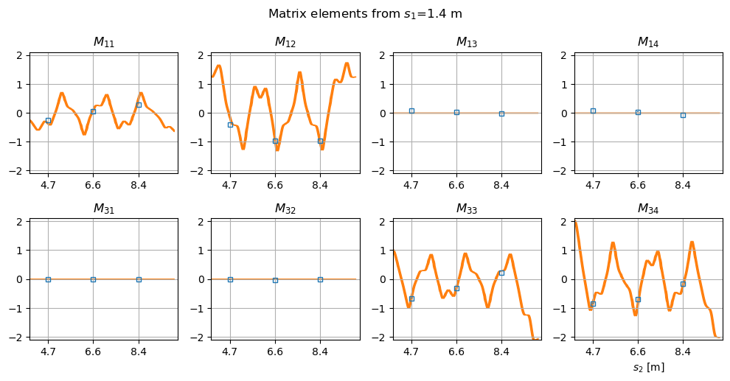
Measured 0-current matrix elements compared to simulation:
s1

Slide 35
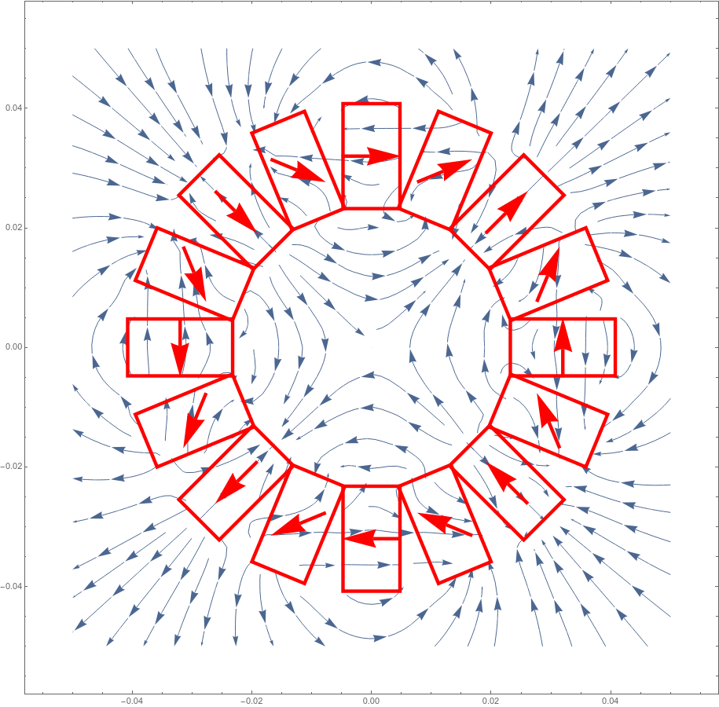
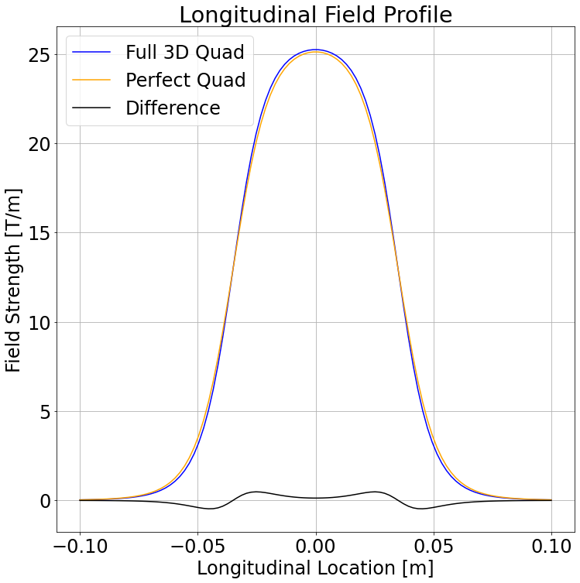
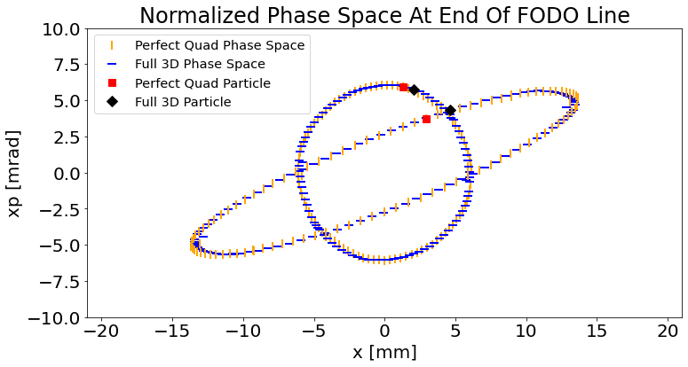
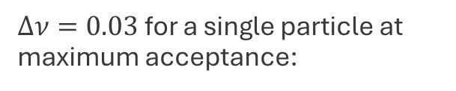
Self consistent model of PMQs has little effect on dynamics
Initial bunch
Quadrupoles
Dynamics
$Δν=0.03$ for a single particle at maximum acceptance:
unnormalized coordinates
normalized coordinates
Thompson, Gorlov, et al, High Brightness Workshop, CERN (Oct 2023)

Slide 36
Large losses and steering kicks
Losing a least 3% of 50 mA beam by end of beamline
Existing correctors
Measure centroid to be as much as 0.5 cm offset in this area
Aperture r=4 cm, x,y rms ~ 0.5 cm
Notes:
What is precision?

