Slide 1

THE TRISTRON, A NEW PARADIGM IN HIGH-EFFICIENCY RF POWER GENERATION
I. Syratchev , N. Catalan Lasheras, R. Gerard, L. Giezendanner, R. Leuxe, C. Marrelli, W.L. Millar, A. Piccini, A. S. Thakur, European Organization for Nuclear Research, Geneva, Switzerland.
G. Burt, Z. Un Nisa, Lancaster University, Lancaster, United Kingdom.

Slide 2
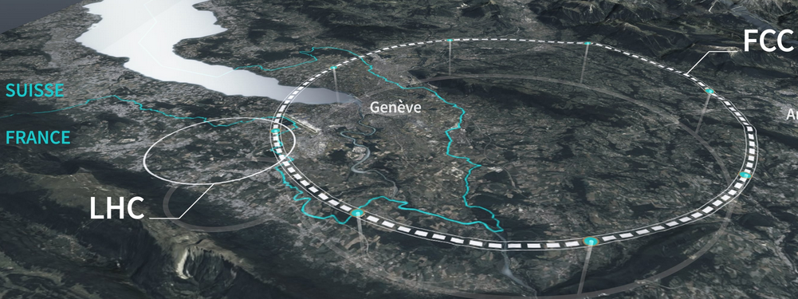
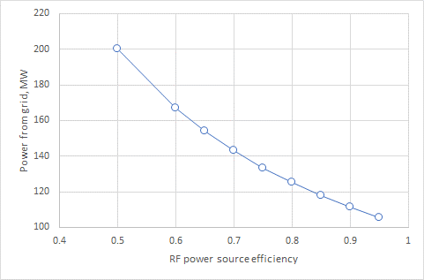
RF power generation in FCC_{ee}.
UHF, 0.3-1MW range, CW klystrons.
Single beam
Multi beam
Multi beam + Depressed Collector
CPI(HERA)
1996
Thales (LHC)
2002
Toshiba(TRISTAN)
1990
CERN/Thales
(HL-LHC)
2023
Philips (LEP)
1993
CEPC
2024
Technology turn over
FCC_{ee} Tristron/ 2024
CEPC targets
2026/27
CERN target
2028
https://fcc.web.cern.ch/overview
CERN TS MBK
2022
FCC_{ee} RF power sources must compensate for the beam synchrotron radiation losses in the collider ring:
Improving RF power sources efficiency will not only reduce considerably electricity power consumption but also will reduce installation and operation cost of power converters and cooling system (environmental impact).
 | Z | W | H | ttbar2 | booster
400MHz | 100MW | 100MW | 100MW | 21MW
800MHz |  |  |  | 79MW | ~1 MW/all poles

Slide 3
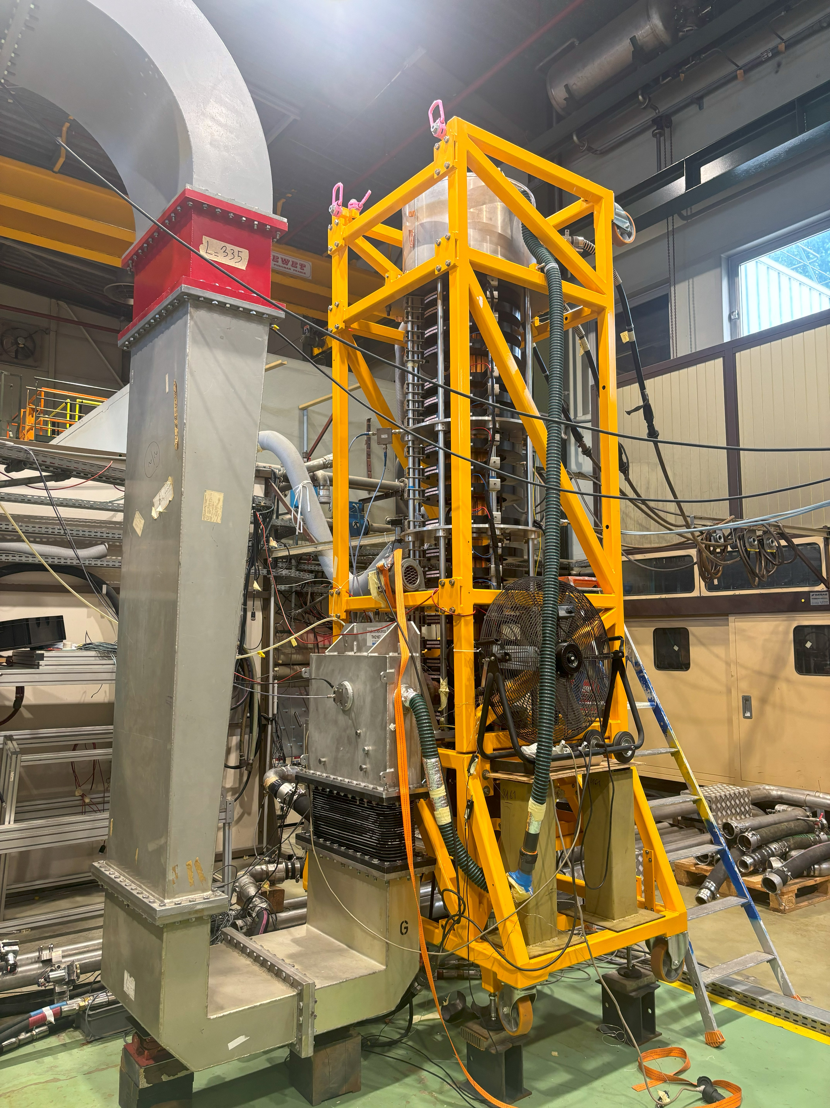
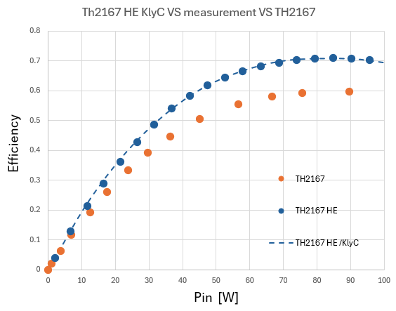
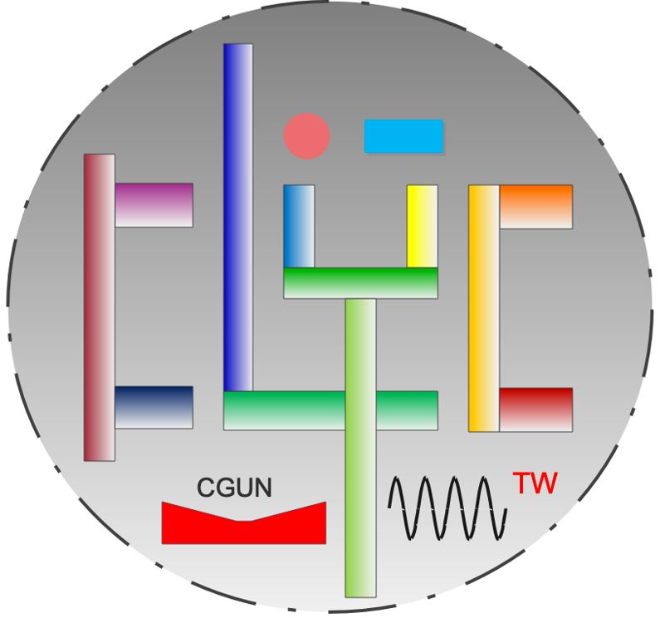


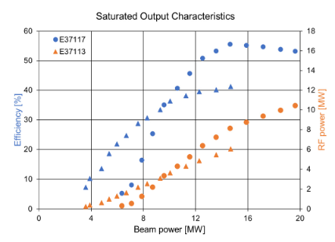

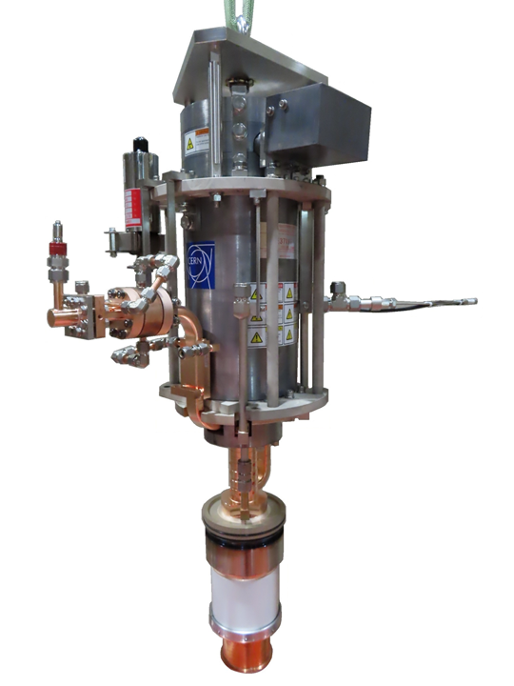

TH2167 HE
High efficiency RF power sources development at CERN.
High Efficiency International Klystron Activity (HEIKA) was initiated at CERN in 2014 ( 9 experts worldwide from Europe, Asia and USA). 15 publications over 3 years.
New electrons bunching methods like COM, COM#2D, BAC and CSM (η> 80%)
CERN home made code KlyC. A fast and accurate tool to simulate linear beam, devices.
HEIKA was converted into CERN HE klystron project in 2021.
Retro-fit efficiency upgrade of existing commercial klystrons:
X-band Canon 6MW, pulsed tube (41%-> 56%) 2022.
X-band CPI 50MW, pulsed tube (39%-> 65%). To be tested at MPP (former CPI) in 2026.
UHF Thales 0.3MW, CW tube (60%->70%) 2024.
New Two-stage Multi-Beam klystron technology (η>85%) 2020. A potential technology of choice for large colliders like CLIC, ILC, FCC_{ee} , MuCol…
RF power upgrade for HL/LHC
CSM
ETD
COM#2D

Slide 4
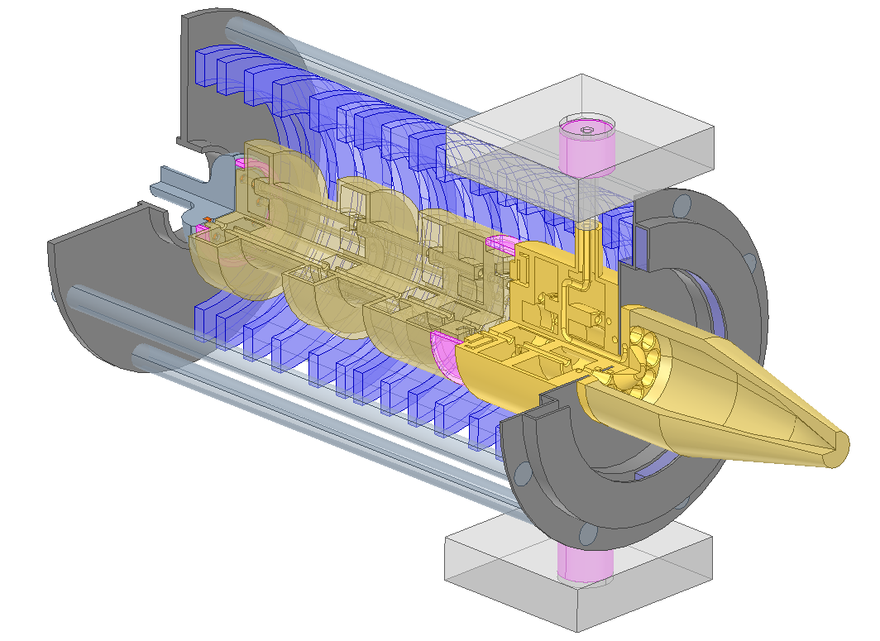
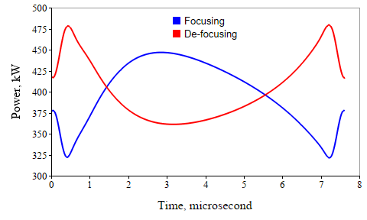
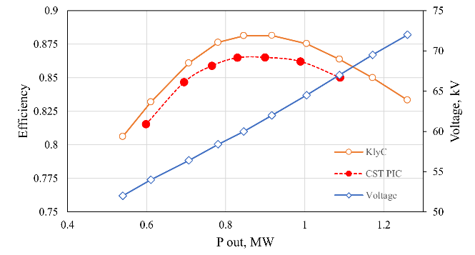
High efficiency RF power source for FCC_{ee}. Challenges.
FCC_{ee} 400MHz, 1.0 MW TS MBK
In the last 5 years the novel concept of the very efficient 1.0MW multi-beam (MB) Two-Stage (TS) klystron was developed at CERN, and it was ready for the industrialization.
Recent (2024) evolution of the FCC_{ee} collider layout reduces the maximum needs RF power from 1MW to below 0.5 MW and suggests operating collider in Reverse Phase Operation regime (RPO) for Z pole.
RPO requires ~25% of RF power transient modulation to compensate for the effect of the beam abort gap in the two families of accelerating cavities:
TS MBK efficiency in saturation
below saturation
at fixed voltage
With such RF power modulation, most of the time klystron will be operated below saturation. Thus, klystron’s operational efficiency will be reduced from 86 % (in saturation) to 67 %.

Slide 5

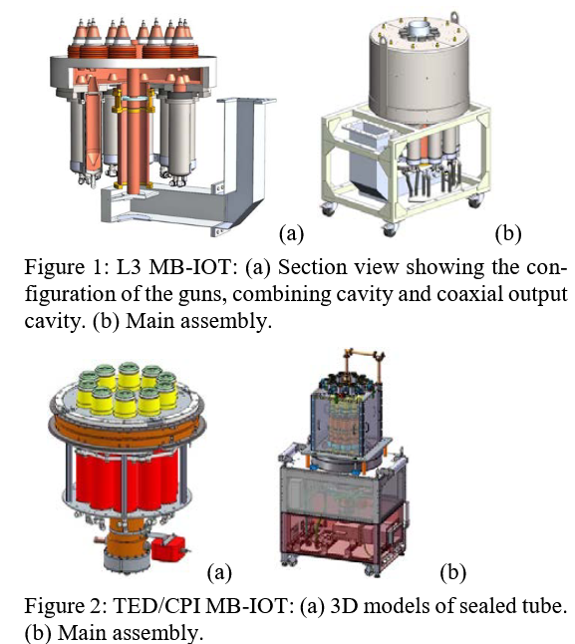
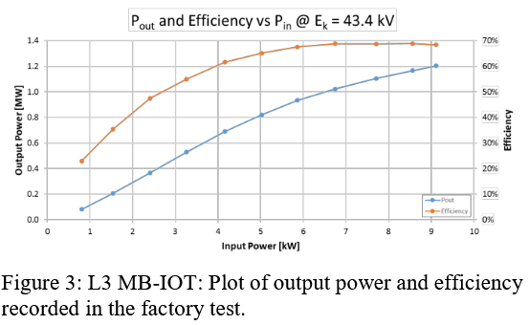

State of the art
ESS 0.7GHz, 1.2MW Mult-Beam IOT
Gridded tubes, like Inductive Output Tubes (IOT), are another class of electrovacuum devices that are renowned for their ability for efficient operation in a wide range of the output power levels when regulated by the input RF signals.
The practical efficiency in industrial prototypes was limited to ~70%.
https://proceedings.jacow.org/ipac2018/papers/wexgbf1.pdf

Slide 6
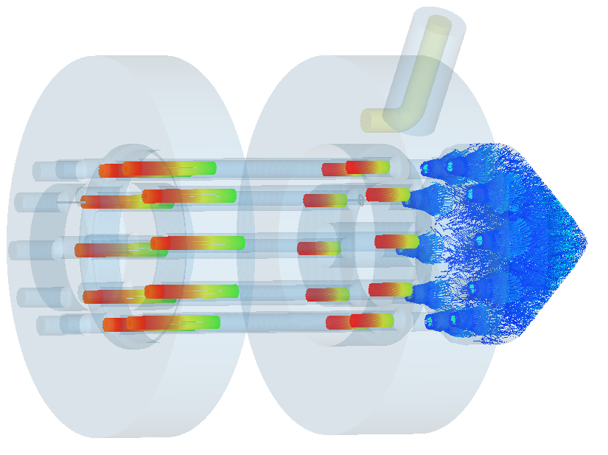
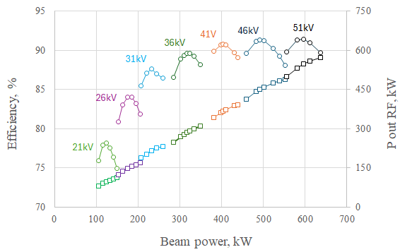
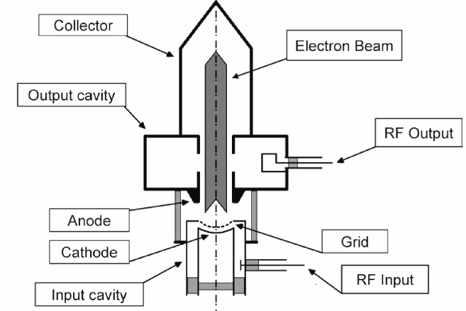
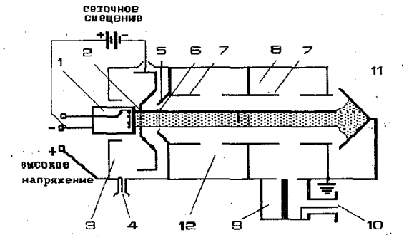
400 MHz FCC_{ee} tristron power/efficiency performance
simulated by CERN’s home-made code KlyC.
MB Tristron RF circuit with beam
Efficiency
RF power
Alike IOT, Tristron (a hybrid between triode and klystron) is a gridded tube with additional penultimate cavity that can boost the RF power production efficiency from 70% to above 90%.
Tristron concept is almost 60 years old, but it was never commercialized.
IOT (A. Haeff, 1939)
Tristron (A.D. Sushkov et. al., 1967)

Slide 7
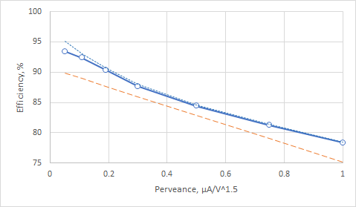
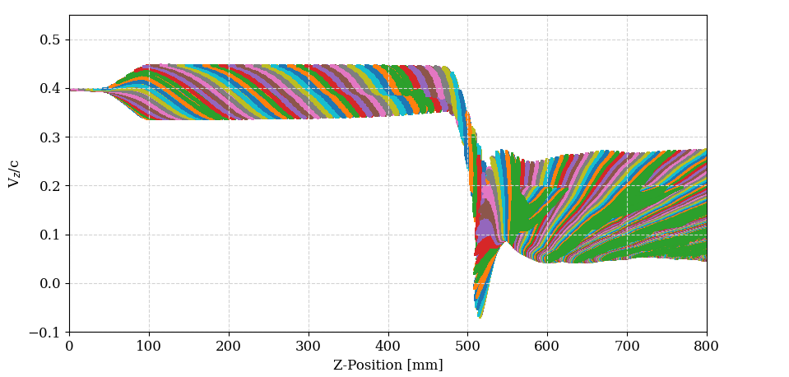
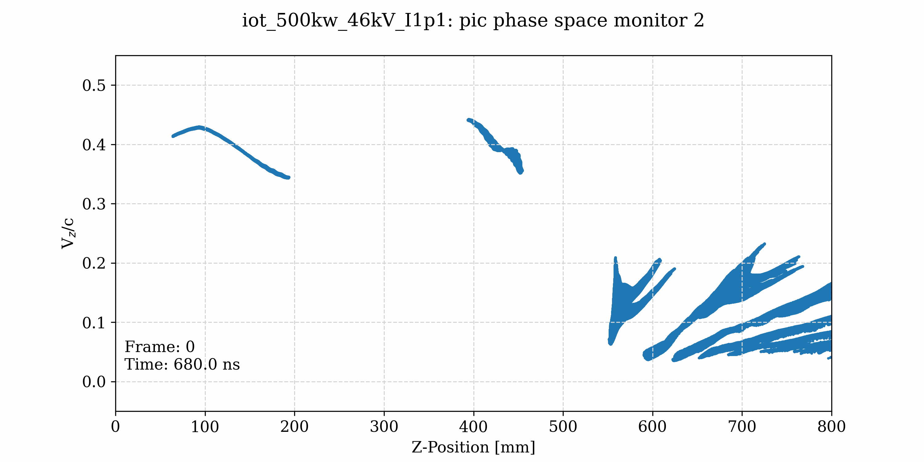
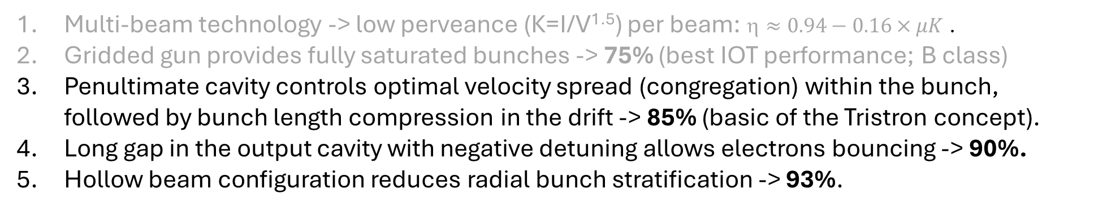
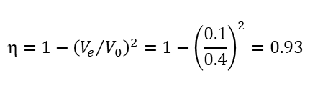
How Tristron can be so efficient?
Multi-beam technology -> low perveance (K=I/V^{1.5}) per beam: $≈0.94−0.16×μK$ .
Gridded gun provides fully saturated bunches -> 75% (best IOT performance; B class)
Penultimate cavity controls optimal velocity spread (congregation) within the bunch, followed by bunch length compression in the drift -> 85% (basic of the Tristron concept).
Long gap in the output cavity with negative detuning allows electrons bouncing -> 90%.
Hollow beam configuration reduces radial bunch stratification -> 93%.
Tubes efficiency vs. perveance
Electron bunches velocity modulation in tristron
Output cavity
Phase space animation
FCC_{ee} MB tristron
Optimal congregation
Drift length provides optimal bunch length compression
Spent beam
Ideal bunch + TS MBK output cavity
FCC_{ee} TS MBK
CEPC CSM klystron
Klystrons theoretical limit
Penultimate cavity
Average velocity (0.1Ve/c)
Bouncing electrons
$$=1−{\left({V_{e}}/{V_{0}}\right)}^{2}=1−{\left(\frac{0.1}{0.4}\right)}^{2}=0.93$$

Slide 8
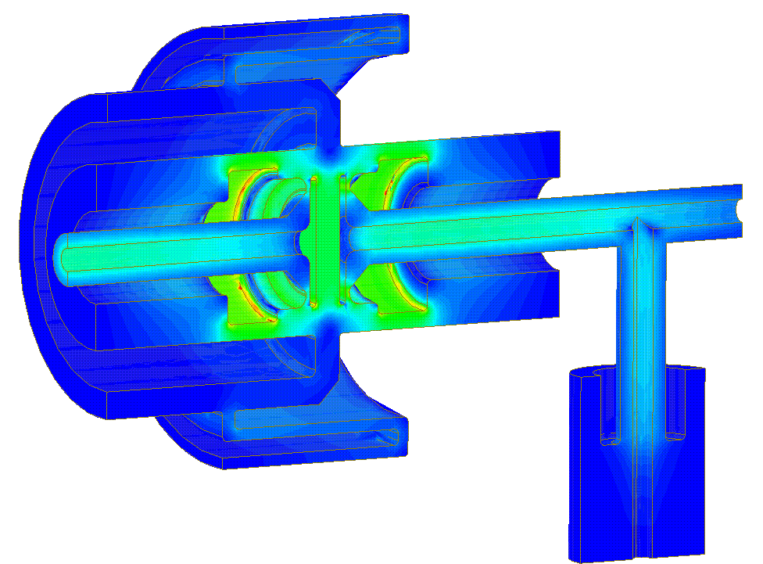


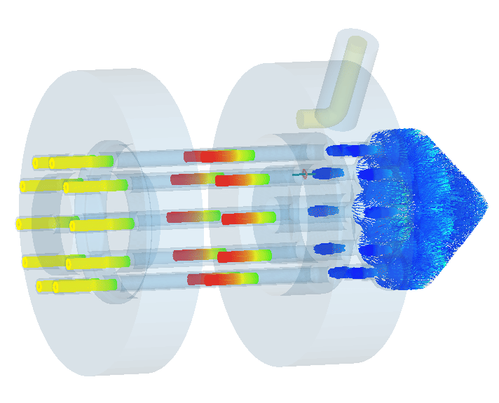
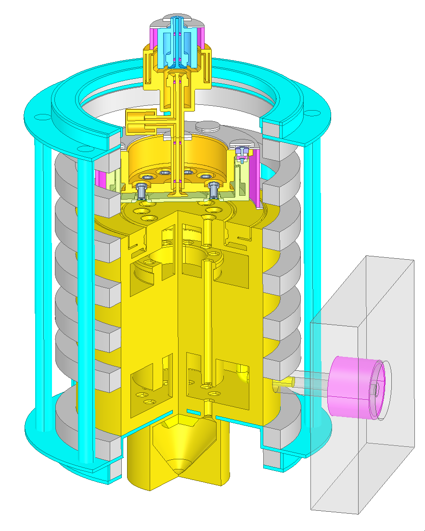
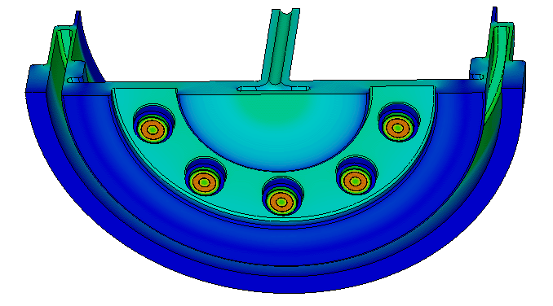
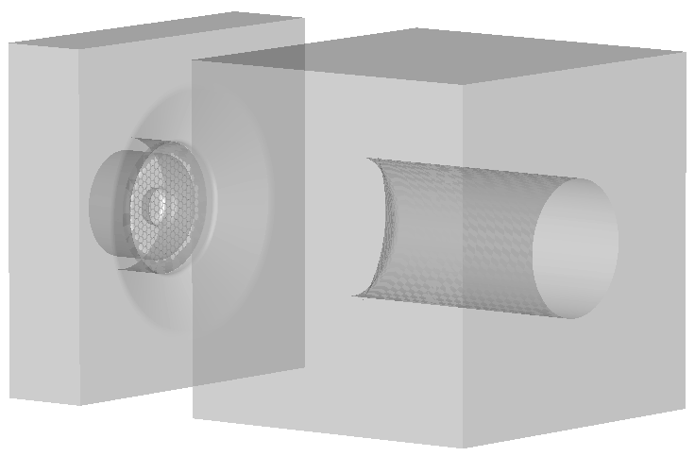
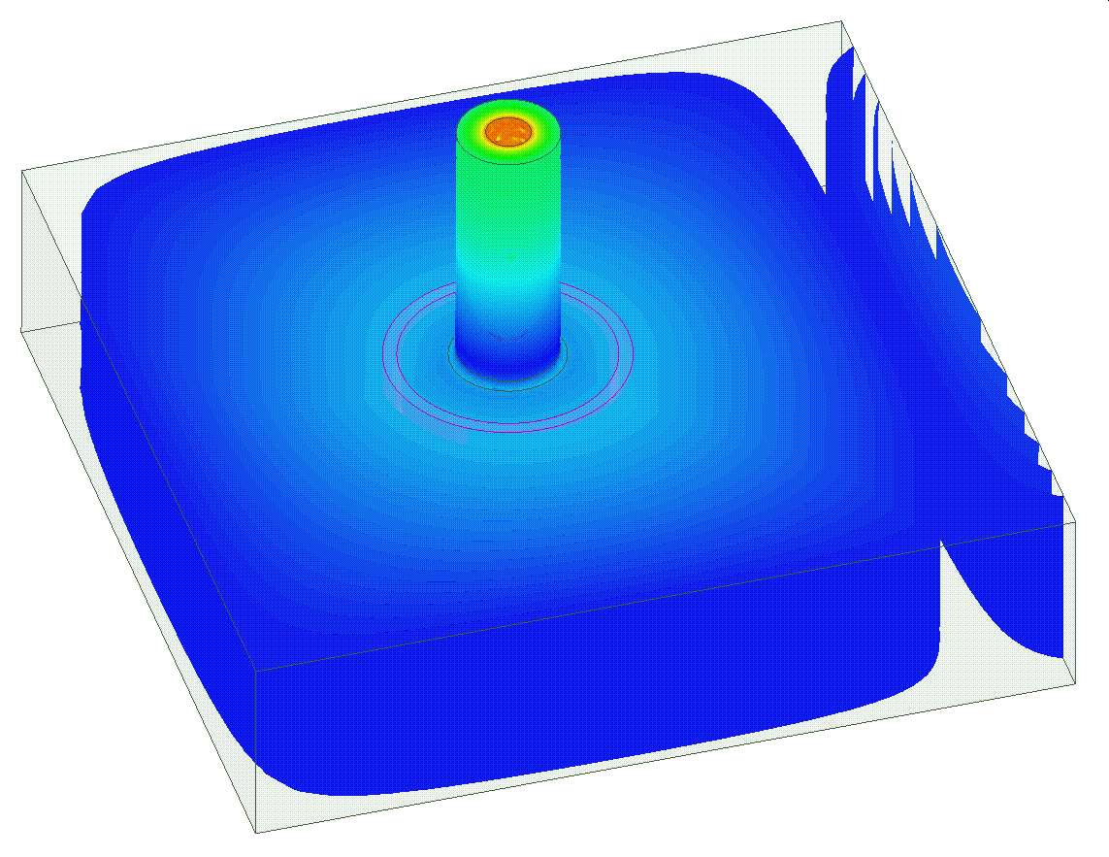
FCC_{ee} 400MHz MB Tristron on one slide
DC breaker
at ground
at HV
RF Circuit
“Open” MB input cavity
Common collector
Gridded gun
Output RF Window
Hollow beam

Slide 9

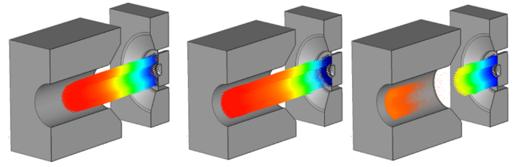
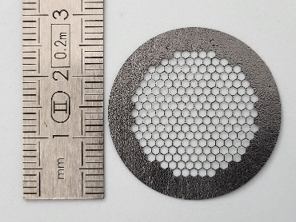
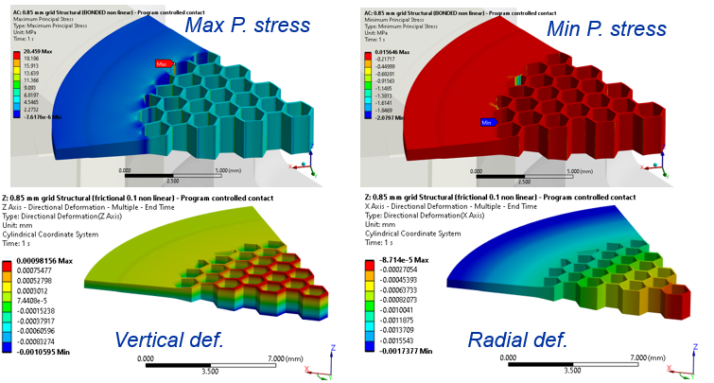
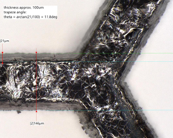
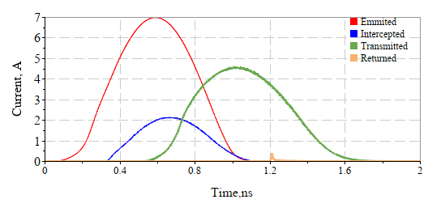
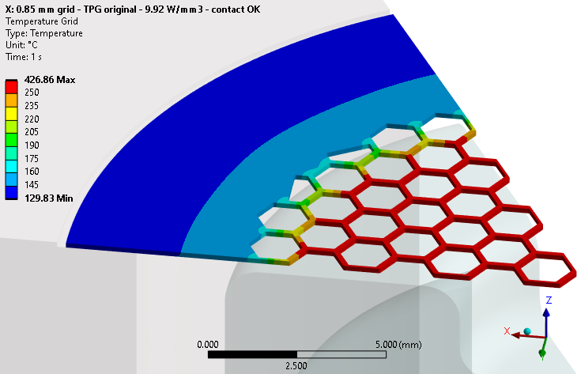
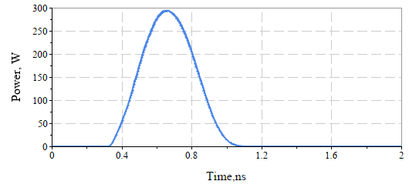
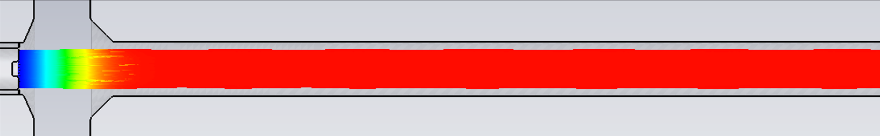
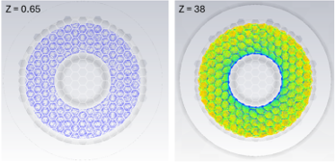
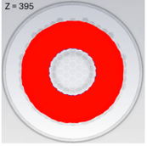
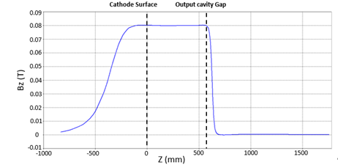
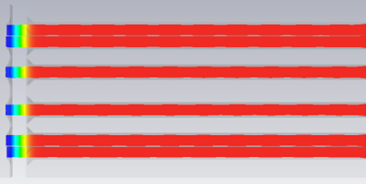
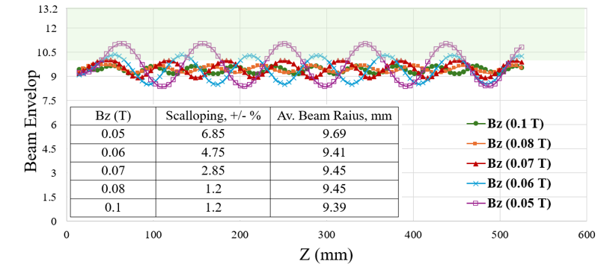
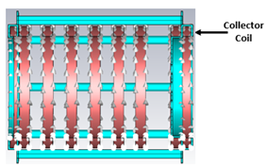
Gridded gun for tristron
Bunch generation in the gridded gun (CST 3D PIC)
Flat HEX grid fabricated at CERN using Laser-cut technology on Pyrolytic Graphite wafer sample with 150 microns thickness.
For the design point of 450kW output RF power:
Maximal temperature reaches 426 C⁰ (T _{cathode} = 1000 C⁰; T _{ambient} =100 C⁰; beam intercepted power 58W).
Grid deformation in ‘Z’ direction is +/-1 micron.
Cathode – grid gap is 0.3mm.
Grid’s wire cross-section 0.15mm x 0.15 mm
Beam power intercepted on the grid
Beam optics
0.08T, 3.5 A DC current
A.S. Thakur poster session MOP7192
Solenoidal field profile

Slide 10
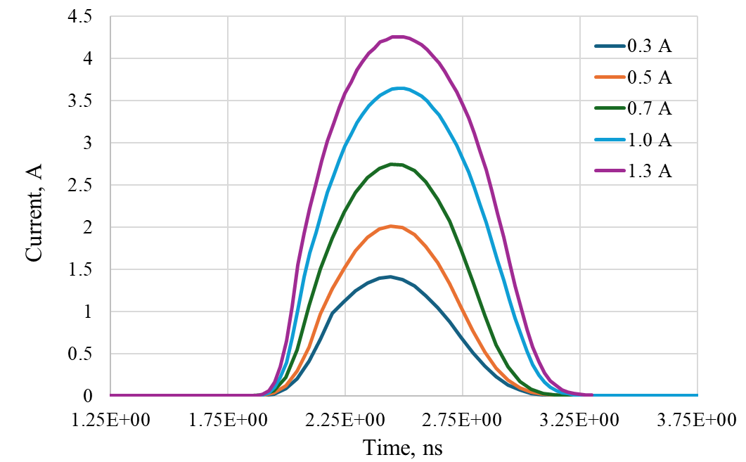
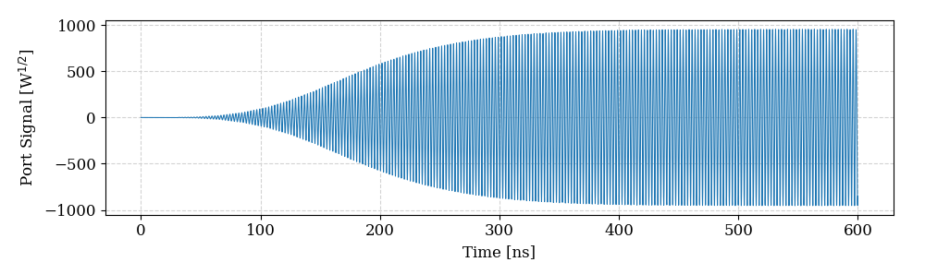
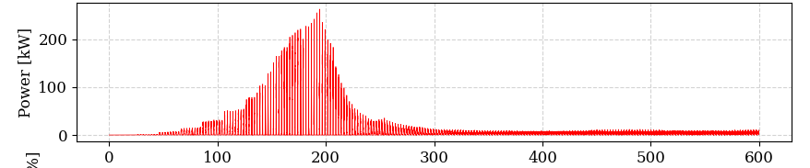
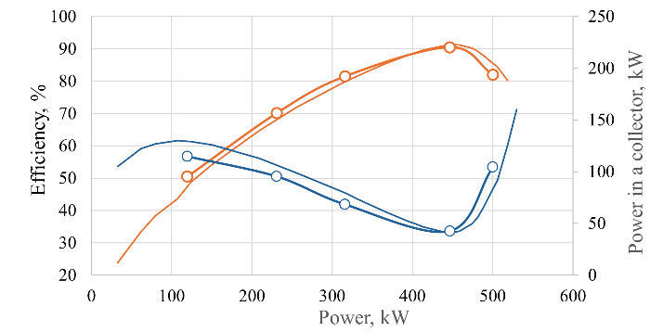
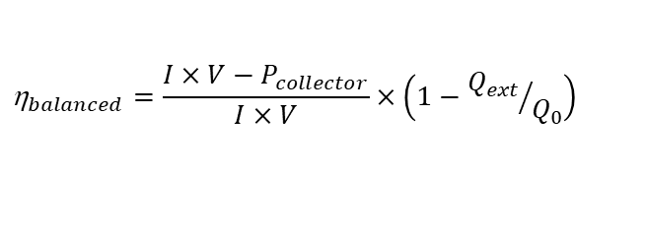

FCC_{ee} 400MHz MB Tristron performance simulated in CST 3D PIC
Calculating efficiency in CST 3D PIC#1 (RF efficiency).
RF power measured at the output coupler port.
Bunches profiles generated in CST 3D PIC gridded gun simulations.
Calculating efficiency in CST 3D PIC#2 (Balanced efficiency).
Spent beam power measured in the collector
Pin=10.7A x 46kV=492kW
MB tristron efficiency and collector beam power vs. output RF power. CST (circles) and KlyC (thin lines) results.
KlyC CST
$${\text{}}_{RF}=\frac{P_{RF}}{I×V}$$
92.66% 93.52%
$${\text{}}_{balanced}=\frac{I×V−P_{collector}}{I×V}×\left(1−{Q_{ext}}/{Q_{0}}\right)$$
91.75% 90.5%
Electronic eff.
Ohmic eff.
“Public” value

Slide 11
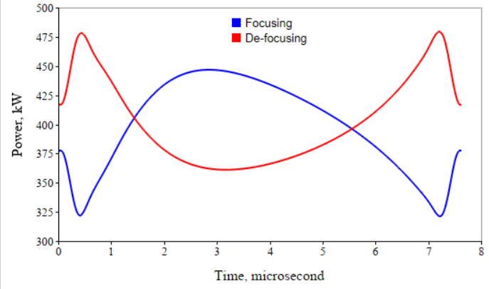
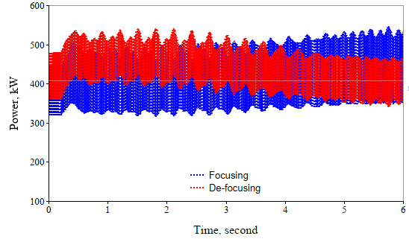
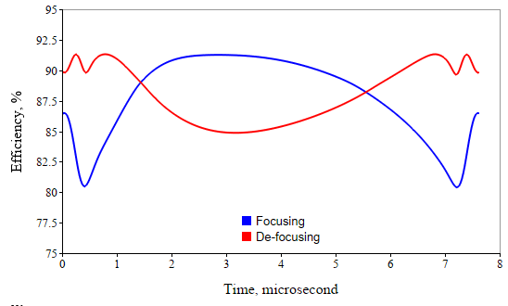
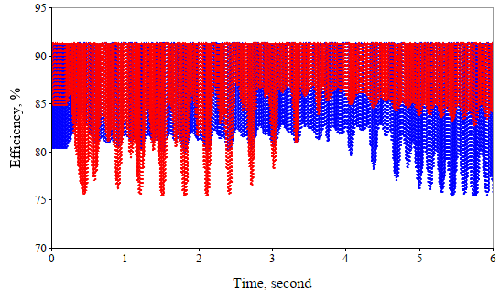
MB tristron operational efficiency. FCC_{ee} Z-pole (RPO).
#1 Nominal operation (46kV)
#2 Single cavity failure mode (46kV)
Accelerating cavities RF power modulation
Accelerating cavities RF power modulation
Cavity failure
Temporal tristron efficiency
Temporal tristron efficiency
η_{avF}=88.3%
η_{avDF}=88.1%
η_{avF}=89.0%
η_{avDF}=87.8%
*By putting two tristrons on a single DC HV power supply, it will see almost constant in time power load.

Slide 12






Tristron technology for FCC_{ee} 800MHz RF power sources
400MHz gridded gun operated at 800MHz.
FCC_{ee} booster (Z,W,H) : 800MHz, 50kW
FCC_{ee} ttbar collider: 800MHz, 220 kW
Peak efficiency/RF power vs. HV
46kV
Efficiency
RF power
800MHz pulses, 1.3A average current. CST 3D PIC results.
88.2%, 56kW (46kV, 1.3A)
Collector
400 MHz gridded gun can be used effectively in the higher frequency devices (up to 1.5 GHz).
For the single beam devices, the gridded gun and input cavity particular layouts are not constrained. Thus, IOT vendors can procced with a retro-fit upgrade of the existing devices to boost the efficiency and RF power.
Due to the high bunch quality, tristron can be designed as an efficient frequency multiplier (x3), brining gridded tubes into S-band with an option of the continues wave operation.
800 MHz, 50kW tristron’s Single Beam RF circuit (0.35m long).

Slide 13
Summary
The MB tristron is selected now as a baseline for 400MHz 0.5MW, CW RF power source for the FCC_{ee}. It provides a high operational efficiency (almost 90%), compact (1.4m high and 1m in diameter) and cost-efficient solution.
Currently the MB tristron is under progressive development as CERN’s internal project, anticipating that the first prototype will be built and tested at CERN in 2028.
FCC_{ee} MB tristron is fully compatible/interchangeable with current LHC klystrons with minor modifications of HV circuit.
Tristron could be a technology of choice to improve overall efficiency of the high intensity and high-power proton SRF Linacs like ESS, MYRRHA and various Energy Recovery Linacs.

