Slide 1
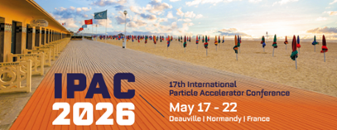
HTS technology development for energy efficient magnets in PSI Large Research Facilities
Stéphane Sanfilippo – Paul Scherrer Institute
Co authors: B. Auchmann, A. Brem, C. Calzolaio, M. Casciello*, M. Duda, Q. Gorit,
G. Montenero, J. Kosse, D. Martins, K. Puthran, R. Riccioli, D. Sotnikov, C. Zoller
All PSI members, M. Casciello belongs to the Polytechnico di Torino
Motivation and context
Projects and R&D programs
Technological bricks and infrastructure
Overview of the on-going R&D PSI activities
IPAC’26 – the 17th International Particle Accelerator Conference

Slide 2
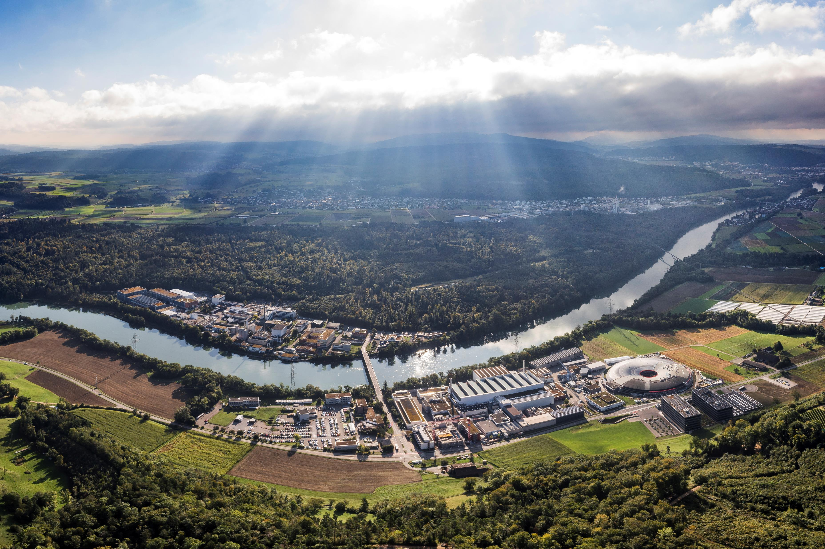
Motivation and context
Notes:
The second aspect concern the development of the superconducting technology related to accelerator magnets

Slide 3

Improved performance and energy transition: a major challenge
The energy transition of key components in large research infrastructure
is essential : Future facilities = high performance, economically viable
and environementally sustainable
Several ambitious programs and events in Europe
Innovation Fostering in Accelerator Science and Technology (I.FAST)
Work Package 11: Sustainable Concepts and Technologies https://www.psi.ch/en/scat
- ESABLiM project, Energy Saving Accelerator and Beam Line Magnets
INFN- LASA (Laboratori Acceleratori e Superconduttività Applicata)- Milano
SuperEML : HTS magnets for very high fields with energy reduction- EU project H2020-INFRADEV-01-2019-2020 with 10 partners, coordinated by the LNCMI.
EPITA (Enabling Partnerships for Innovation & Accelerator Technology advancement) : Enabling + emerging technologies for accelerators including HTS , prototype systems, energy efficiency and sustainability- EU project consortium with 16 countries+ CERN+ESS, 43 beneficiaries.
iRIS (Intelligent Research Infrastructure sustainability ): Sustainability methodology + pilots in Resarch Infrastructure components with AI- HORIZON-INFRA-2025-01-TECH-01 (2026-2029)
ESSRI : Series of workshops for Energy for Sustainable Science at Research Infrastructures workshops

Slide 4
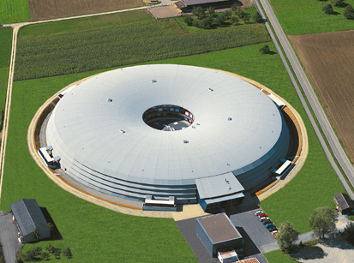
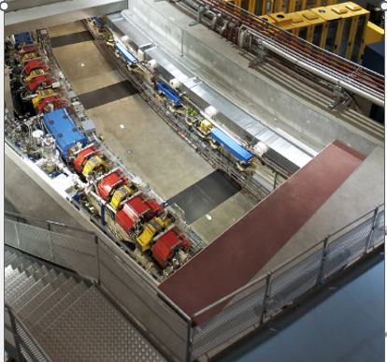
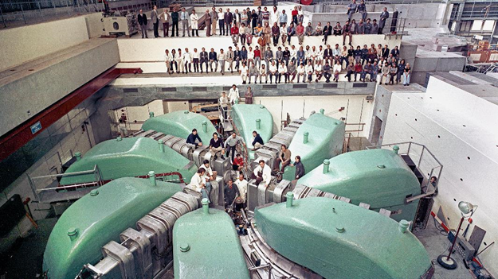
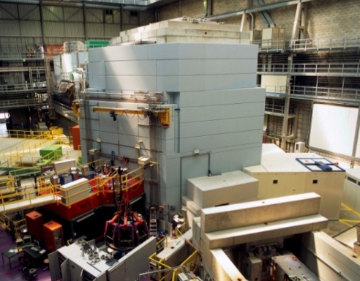
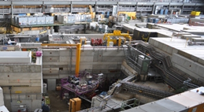
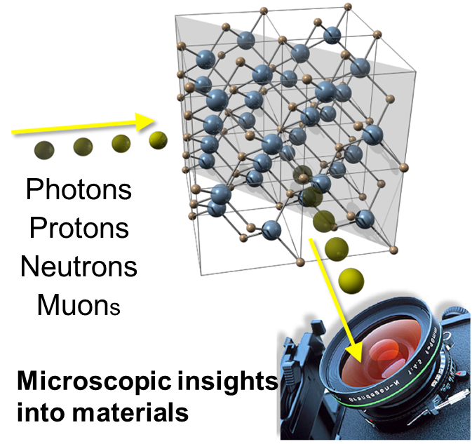
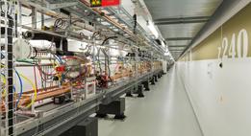
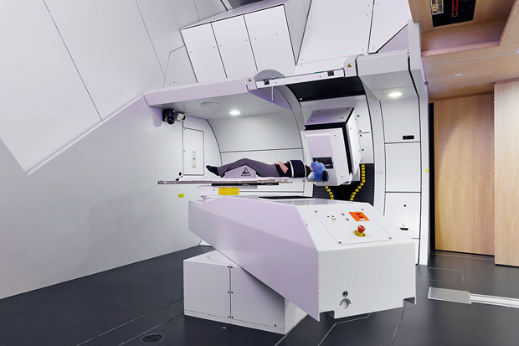
Large Research facilities & CPT at PSI
Engines of discovery= Machine generating “probes” to examine the matter structure
Swiss Light
Source (SLS 2.0)
High Intensity Proton Accelerator Complex
590 MeV Proton
Cyclotron
Spallation Neutron Source (SINQ)
Swiss Muon Source (SµS)
Swiss Free
Electron Laser (SwissFEL)
Protons beam
therapy

Slide 5
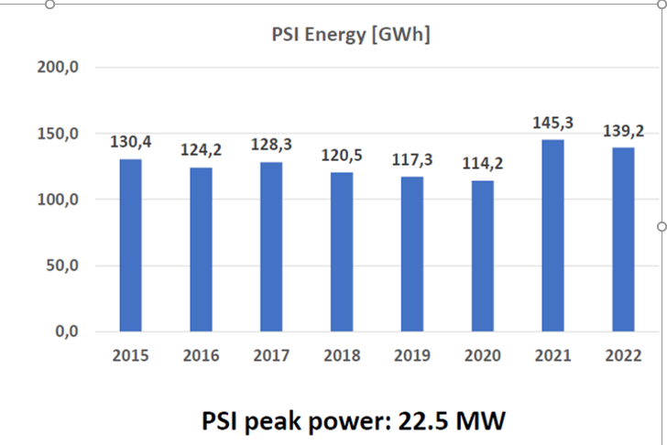
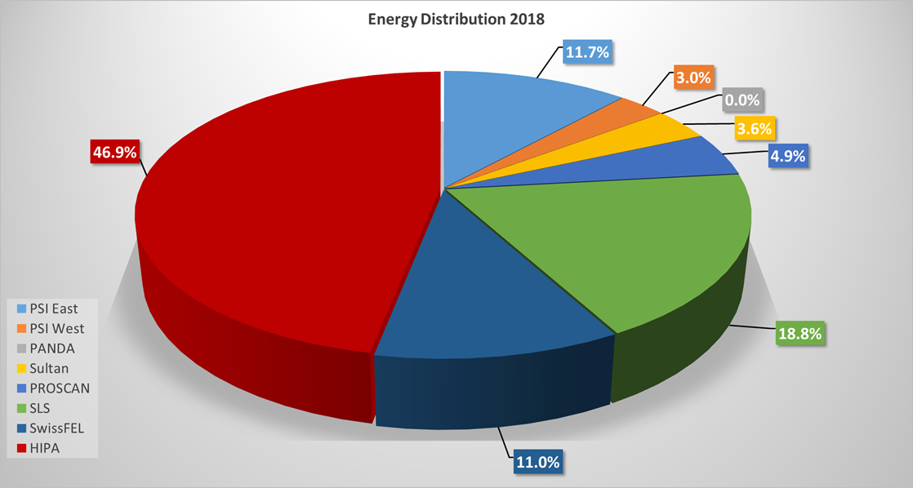
Energy Management in PSI Large Research Facilities – Operation and Upgrade
High Energy Demand of PSI Large Research Facilities:
High Intensity Proton Accelerator (HIPA)
Swiss Free Electron Laser (SwissFEL)
Swiss Light Source (till October 2023)
PROSCAN- Tumor treatment facility
using protons (2 beamlines with gantries)
Strong contribution from resistive magnets to power consumption (HIPA -2.6 MW, 26 %)
Trends
Expected Increase in electricity cost
Growing CO₂ Footprint
PROSCAN
HIPA
SwissFEL
SLS
PSI energy / year ~ 140 GWh

Slide 6
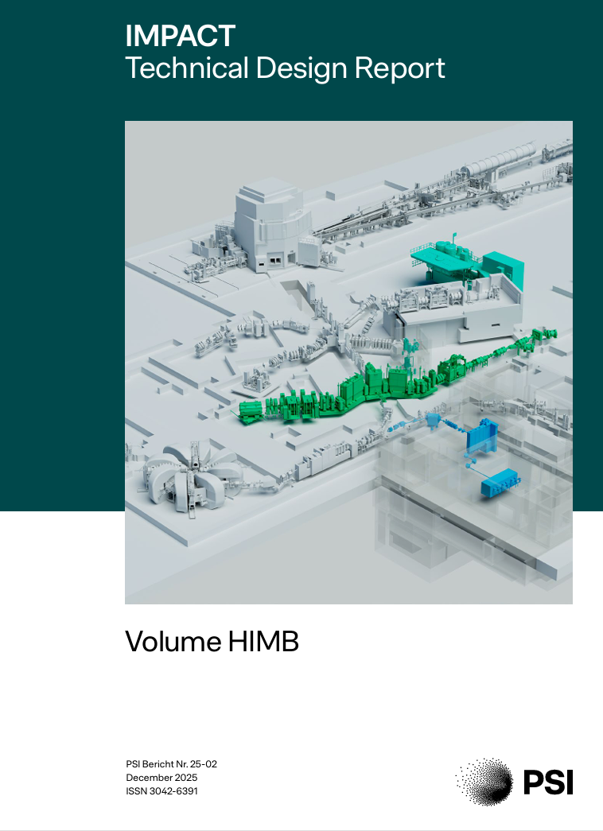
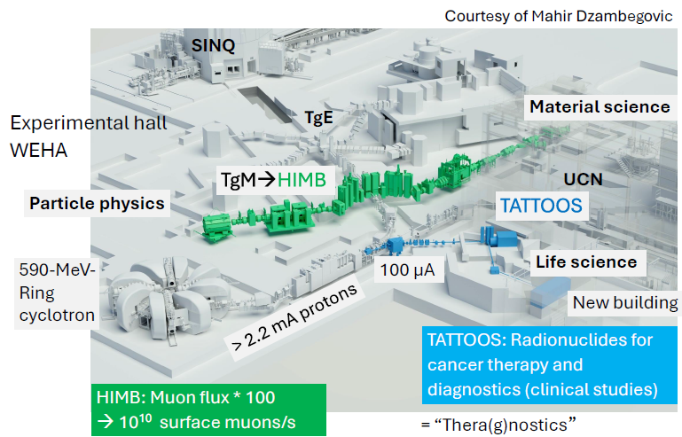
Upcoming upgrade of HIPA Project IMPACT = HIMB + TATTOOS
https://www.dora.lib4ri.ch/psi/dload/psi:78449/PDF/
Aeschbacher-2025-IMPACT_technical_design_report-(published_version).pdf
Timeline of IMPACT: 2027/28 HIMB installation ; 2029/30 TATTOOS installation
New target two new beam Lines at HIPA
to increase the Muon rate production by a factor 100 (HIMB)
create radioisotopes suitable for advanced cancer treatments (TATTOOS)

Slide 7

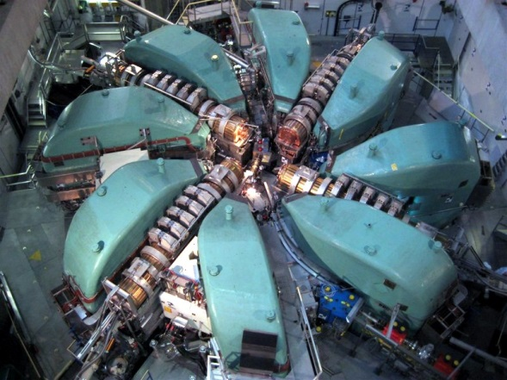
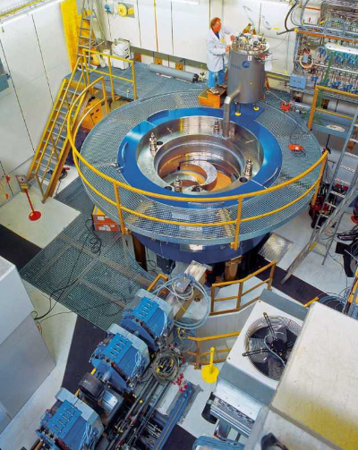
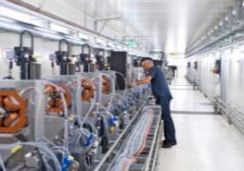
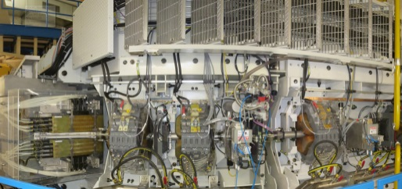
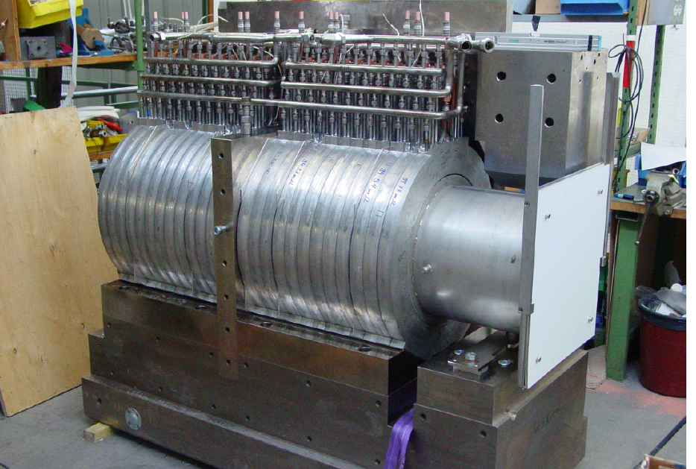
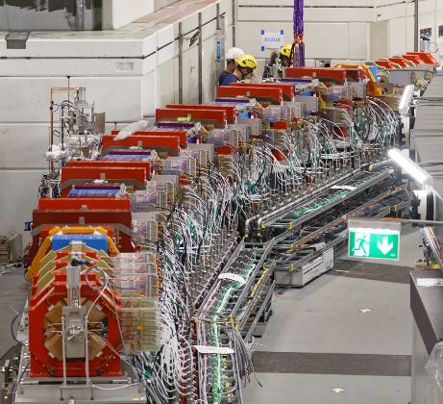
Magnets in operation at PSI end of 2025
Magnets in Operation at PSI
Machine | Magnet number | In operation since
HIPA | 300 | 1974 (Ring) 1984 (Inj. II) 1996 (SINQ)
PROSCAN | 100 | 2004
Gantry 3 | 13 | 2017
SwissFEL | 373 | 2017&2021
SLS2.0 | 1019 | 2025
Total | 1805
HIMB TATTOOS | 34 | 2027 & 2029
Cyclotron
COMET
Gantry 3
SwissFEL
SLS2.0
High Intensity ring cyclotron
80 % are Electromagnets - 385 Permanent Magnets (SLS2.0)+ one superconducting cyclotron
PSI,
PSI,
May 11, 2026
May 11, 2026
Page 7
Notes:
At PSI, nearly 1800 magnets are in operation across the large research facilities. These include dipoles, quadrupoles, sextupoles, correctors, and highly specialized magnets such as the gantry systems for proton therapy.
While there is a wide variety of designs tailored to different machines, it is important to note that the overwhelming majority — more than 85% — are conventional resistive electromagnets.
This dominance highlights both the scale of magnet infrastructure at PSI and the challenge it represents in terms of energy consumption and efficiency.

Slide 8




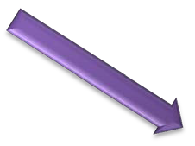



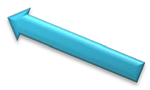


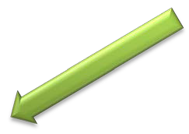
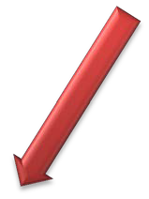


Requirements for Accelerator Magnets in 21st-Century Research Facilities
Performance
↑High field
Field
quality
Compactness
Stability
Robustness
Safety
Sustainability
Magnet
Radiation effects
Operative cost
Manufacturing cost
Operative cost : Electricity and maintenance
Robustness : Manufacturing quality + radiation damage
Notes:
The requirements for accelerator magnets in 21st-century research facilities are becoming increasingly demanding. Beyond traditional needs such as high field performance, field quality, and stability, new priorities now drive magnet development.
Efficiency is essential to reduce electricity consumption and operating costs. Sustainability has become a key factor, meaning magnets must contribute to lowering the CO₂ footprint and be designed with long-term energy management in mind.
Equally, reliability and robustness are crucial, as magnets must maintain performance under radiation exposure and over decades of continuous operation.
In short, the specifications for modern accelerator magnets now combine performance, cost efficiency, sustainability, and long-term reliability, reflecting the broader challenges faced by large research infrastructures today.

Slide 9
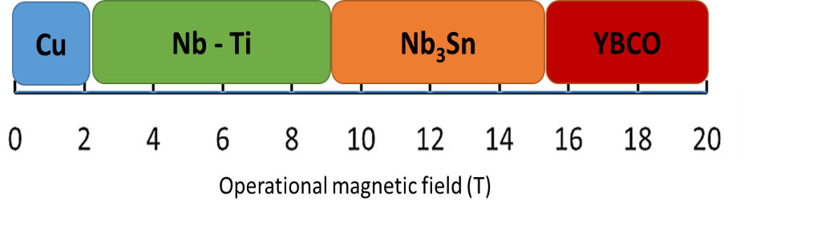

Energie Transition for the PSI accelerator magnets: The proposed strategy
Starting Situation | Proposed Solution
Low field High magnetic density Low radiation (e.g. Light Sources) | Permanent magnets (NdFeB) (applied in SLS2)-PROkW program
Moderate/high field High energy consumption Highly radiation-exposed environment | Superconducting magnets-conduction cooled
Factors:
Operating conditions:
Field strength
Beam energy deposition
Space
2. Economics:
Initial capital cost
Cost saving in electricity
CO₂ emission reduction
3. Radiation damage
Superconductors
Insulation
Copper
LTS
HTS
No ohmic
losses
Reduced cooling costs
Higher magnetic fields

Slide 10
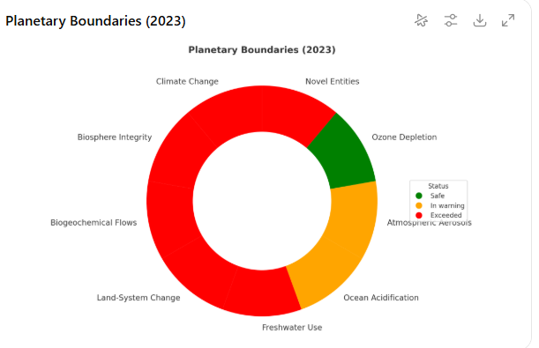
Energy Transition for the PSI accelerator magnets
And …. sustainability?
Factors:
Physics and performance:
Operating conditions (J_{ce}, T_{op})
Field strength beam energy deposition
AC losses &Field Quality
Space
2. Economics & strategic
Conductor cost and availability
lifecycle costs (CAPEX vs OPEX)
long-term compatibility with upgrades.
3. Environmental &Reliability
Radiation dammage
Quench protection
Cooling & powering
4. Sustainability
LCA on raw materials
Process and manufacturing
Recyclability
Reduced waste protocols
6 boundaries exceeded (2023)
Johan Rockström et al, Nature 2009
Production phase→ negative impacts on planetary boundaries (water, materials, extraction pollution….)
Use phase→ positive impacts, energy savings, footprint reduction, supporting medical application
The choice of REBCO tapes, insulation, impregnation, soldering, coatings, copper stabilizers and cryogenic components should also be evaluated through LCA
Notes:
In addition to improving efficiency, we also have to place our work in the broader context of sustainability.
This diagram of planetary boundaries reminds us that technologies, including superconducting magnets, put pressure upstream through resource extraction, water use, and manufacturing.
At the same time, downstream, they bring positive impacts such as energy savings and medical benefits. For PSI, this means that beyond the usual factors—operating conditions, economics, and radiation damage—we now need to consider strong sustainability aspects: raw materials, manufacturing processes, cryogenic operation, life-cycle analysis, and recyclability. This is the additional challenge we are addressing: how to make superconducting magnets not only efficient, but also sustainable in the long term

Slide 11
HTS (conduction cooled) superconducting magnets
Versus resistive and LTS ones
Advantages
Increased performance
Compact design
Saving electric consumption
Reduced cost for power supply
Thermal stability
Large temperature margin
(including beam deposited energy)
Top>20 K
Smaller P_{electric} /P_{cryogenic} ratio
Reduced thermal losses
Drawbacks
Higher capital cost
Cryogenics
Quench detection system
Not multi-filamentary architecture Reduced field quality
AC losses in time varying field
Hysteresis loss
Eddy currents
Coupling currents
Radiation damages
Limits for superconductor operation?
No organic insulation
Resistive magnets
LTS magnets
Notes:
This slide summarizes the main advantages and drawbacks of using HTS conduction-cooled superconducting magnets compared to conventional resistive or LTS magnets. On the positive side, HTS allows for higher performance in a more compact design, with significant savings in electricity and reduced costs for power supplies. The large temperature margin provides strong thermal stability, and operating above 30 K reduces cryogenic requirements and thermal losses. However, there are challenges: the higher capital cost and the need for advanced cryogenics and quench detection systems. HTS tapes also lack a multi-filamentary architecture, which can affect field quality, and they suffer from AC losses in time-varying fields. Finally, radiation damage remains an open issue, especially concerning insulation and long-term operation.
These trade-offs define the research directions for SMILE, where we aim to maximize the benefits while addressing these technical challenges

Slide 12
LTS & HTS technology development : The fundational diagram
Performance & compactness
Energy savings & sustainability (C0₂ reduction)
Cryogen free →Helium free ?
Vision
ReBCo tapes technology &Low loss cables
Radiation hardness & impregnation
Stress management structure
Efficient quench protecion
Cryocoolers +Pulsating Heat Pipes
Cryogenic power supply
Technology
bricks
CHART
SMILE, HTS4SRI
Projects &
Programmes
High field coils & magnets
Radiation hard dipoles
HTS solenoids
Efficient combined function magnets
Low field superferric HTS magnets
Infrastructure (fabrication & tests)
Sub-scale
Prototytpes
Machine
Integration
SLS2.0, IMPACT
PSI beam lines
Inspired from J.F Becquaert
Notes:
In addition to improving efficiency, we also have to place our work in the broader context of sustainability.
This diagram of planetary boundaries reminds us that technologies, including superconducting magnets, put pressure upstream through resource extraction, water use, and manufacturing.
At the same time, downstream, they bring positive impacts such as energy savings and medical benefits. For PSI, this means that beyond the usual factors—operating conditions, economics, and radiation damage—we now need to consider strong sustainability aspects: raw materials, manufacturing processes, cryogenic operation, life-cycle analysis, and recyclability. This is the additional challenge we are addressing: how to make superconducting magnets not only efficient, but also sustainable in the long term

Slide 13
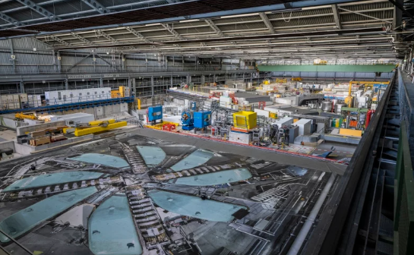
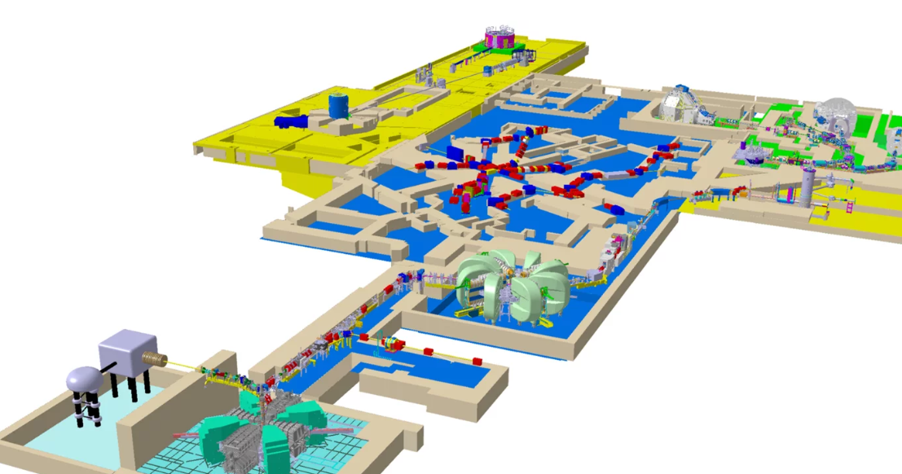
Efficient Magnets in the High Intensity Proton Accelerator
3 Accelerators and 4 Users facilities
Power from the magnets : 2.6 MW- 26 %
Long term plan : Replace progressively high consumption resistive magnets
with HTS magnets
Notes:
This slide summarizes selected resistive magnets that have been in operation for more than 30 years and can potentially be replaced with superconducting magnets.
The table highlights key parameters such as electrical power consumption, magnetic field strength, and magnet dimensions.
The design of the AHO magnet with superconducting coils has already commenced in collaboration with LASA Milan.
We are also seeking support from Politecnico di Torino for simulations assessing the radiation impact on HTS coils, as well as from the CHART program for either in-kind contributions or financial support.
.

Slide 14
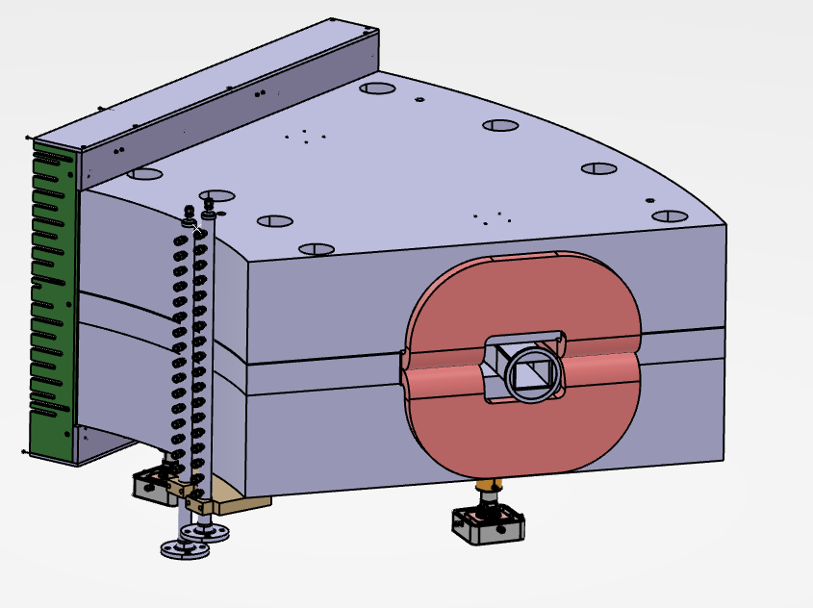
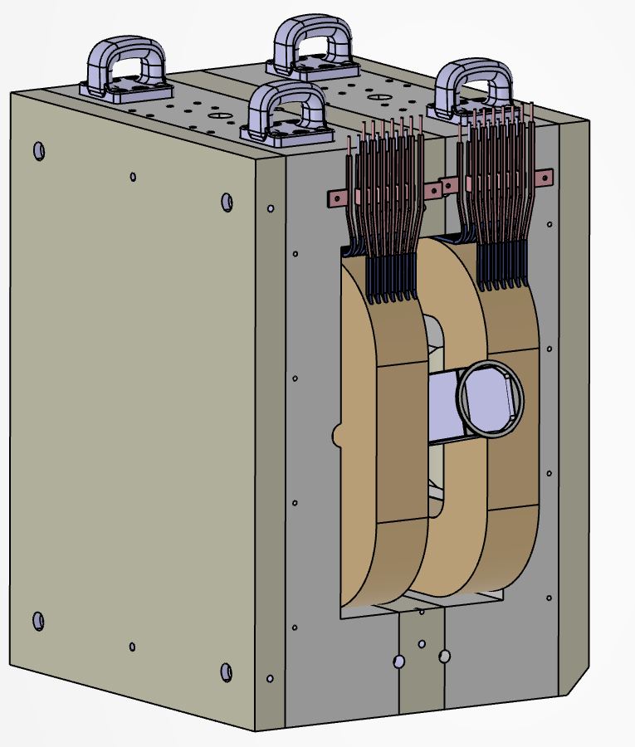
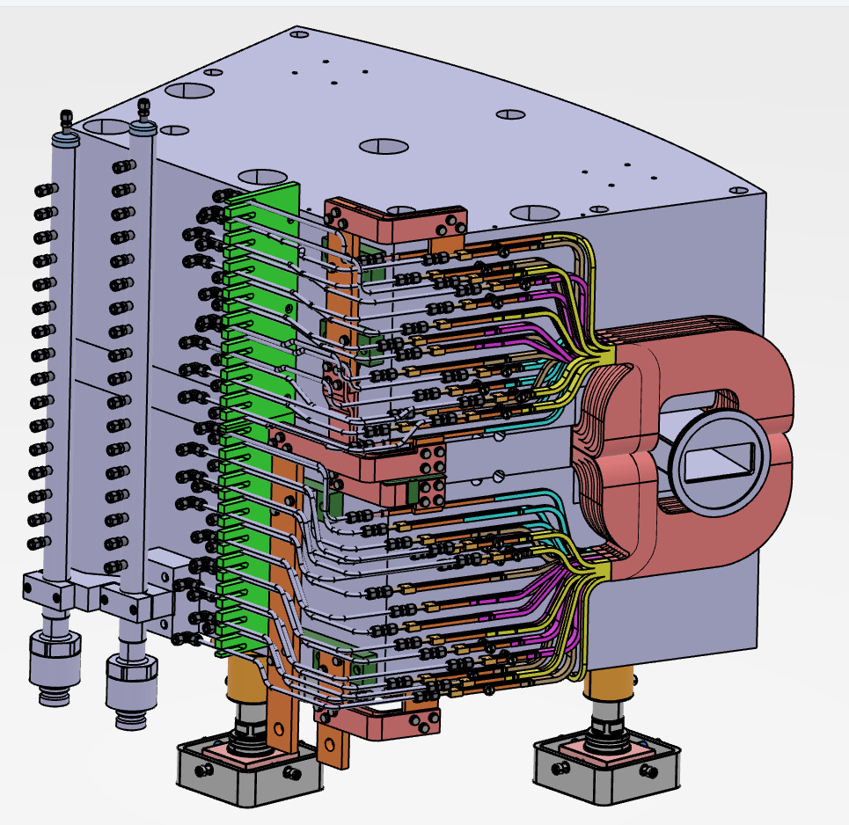
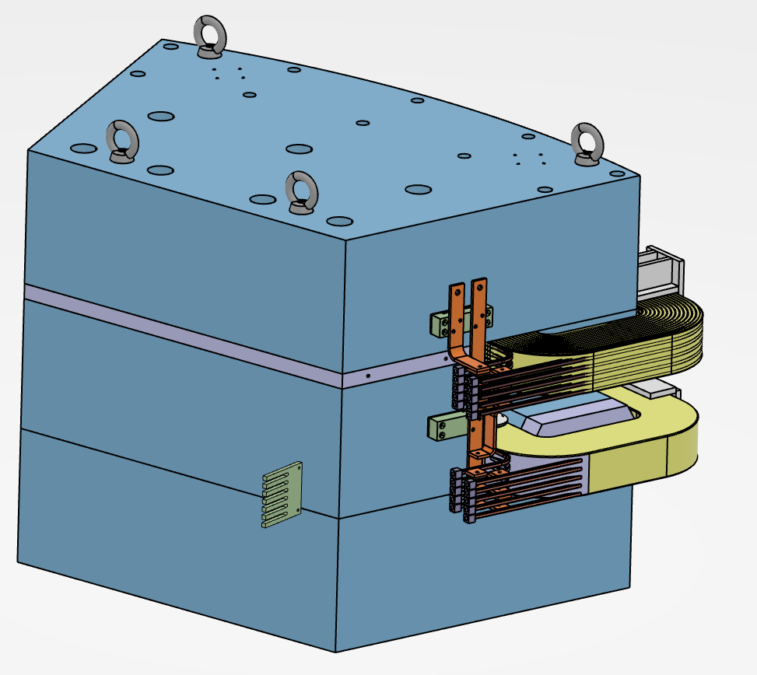
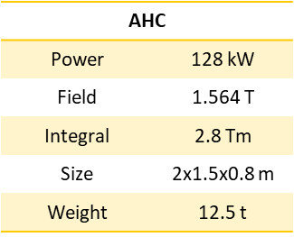
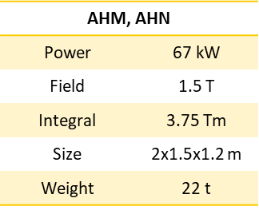
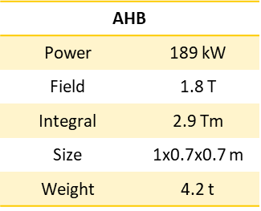
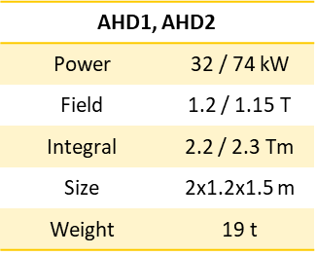
Efficient Superconducting Magnets in the High Intensity Proton Accelerator
Saved Energy (MW/y per magnet)
481MWh
238 MWh
725 MWh
267 MWh
Minimum time of operation: 20 years
Saved energy with one SC magnet from 4.5 GWh (183 Tons CO₂e)
to 14.5 GWh (590 Tons CO₂e) after 20 years of operation
Notes:
This slide summarizes selected resistive magnets that have been in operation for more than 30 years and can potentially be replaced with superconducting magnets.
The table highlights key parameters such as electrical power consumption, magnetic field strength, and magnet dimensions.
The design of the AHO magnet with superconducting coils has already commenced in collaboration with LASA Milan.
We are also seeking support from Politecnico di Torino for simulations assessing the radiation impact on HTS coils, as well as from the CHART program for either in-kind contributions or financial support.
.

Slide 15
Support from projects and programs
Notes:
The second aspect concern the development of the superconducting technology related to accelerator magnets

Slide 16
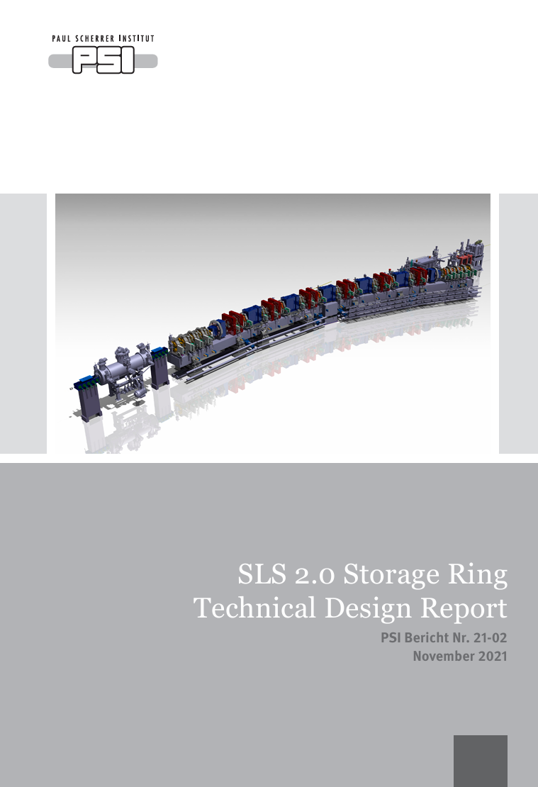

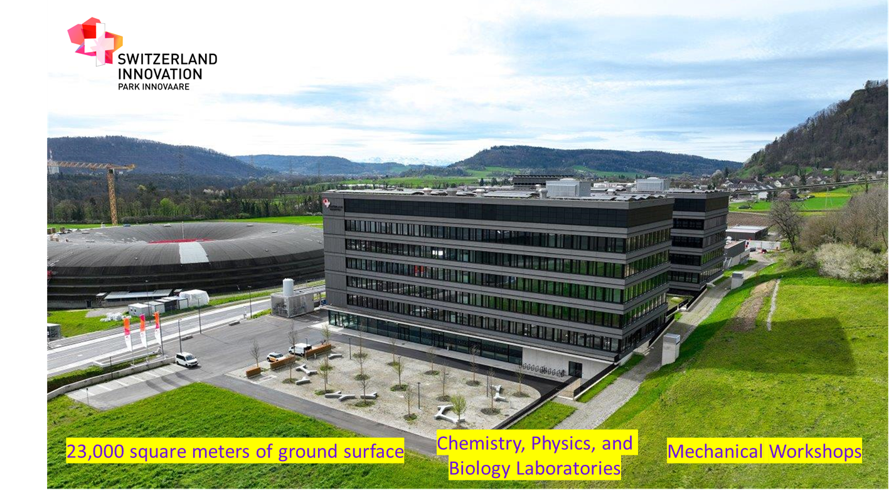
Support for this development
PSI projects and R&D programs
SLS2.0 , IMPACT
Swiss Accelerator Research and Technology (CHART)
Superconducting Magnet to Improve the Efficiency of Large resarch facilities (SMILE)
EU project HTS4SRI (HTS For Sustainable Research Infrastructure)
These activities are complementary and are being developed in a synergistic manner.
2. Infrastructure development and beam line upgrade
Supporting infrastructure, testing, and integration capabilities
PSI Positron Project (P3) (SwissFEL) , Muon beam line, Neutron scattering…
3. International Collaboration and Innovation Ecosystem
Collaborations with CERN, research institutes, and industry partners.
Co-development with the partners of the innovation environment “Park Innovaare”.

Slide 17
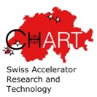


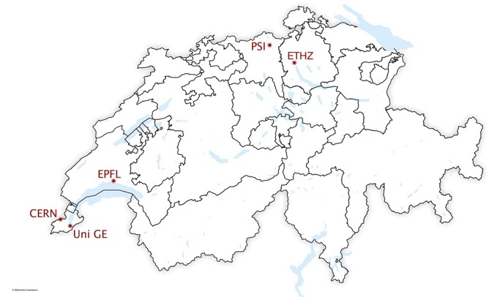












CHART : Swiss Accelerator for Research and Technology
CHART is an umbrella for Swiss contributions to the science and technology of the FCC accelerator, a Swiss national science priority
Initial agreement in October 2015
Co-funded by SERI, ETH-domain and partners CERN, PSI, EPFL, ETHZ, UniGE
Home institute : PSI
> 30 projects
Goals:
development and innovation of future accelerator technologies for the Future Circular Collider;
synergy with synchrotron light sources, medical, industrial, and energy/fusion applications;
emphasis: technologies and demonstrators for high field magnets and FCC-ee injector.
http://chart.ch
PSI MAGDEV program : High field magnet technology, design, manufacturing process & infrastructure for demonstrator construction using LTS and HTS

Slide 18
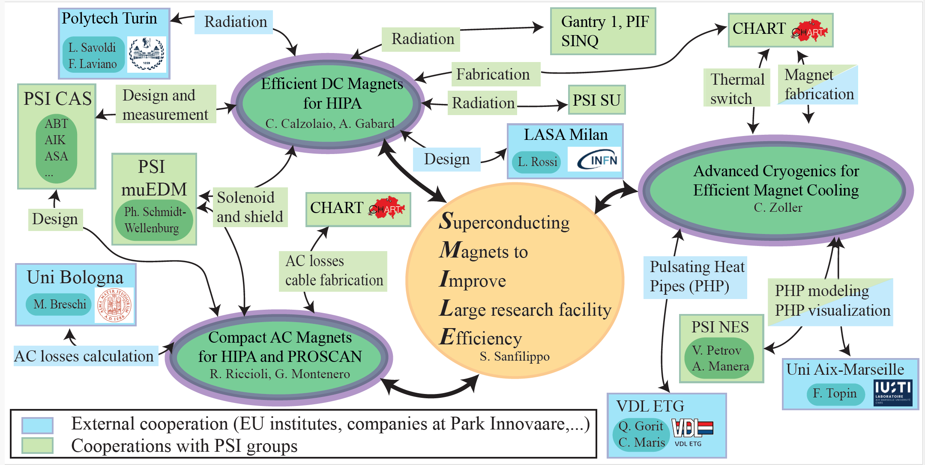





SMILE initiative (2025-2026)
Three poles of activities (partially funded) : DC magnets, AC magnets and Efficient cooling
Pole 1: Irradiation effect on HTS magnet (March 2026)
Pole 2: Numerical and experimental studies of CORC conductors (2026)
Pole 3: Pulsating Heat Pipes with HTS coils
and……. the EU funded project HTS4SRI (2026-2029)

Slide 19
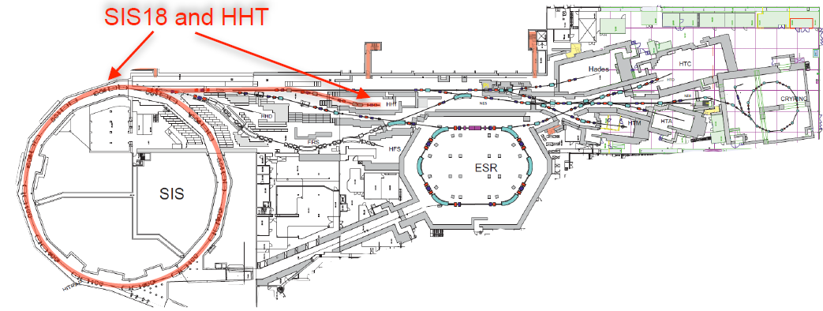
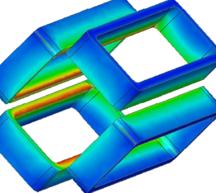
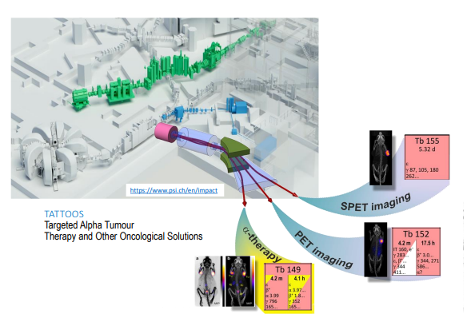
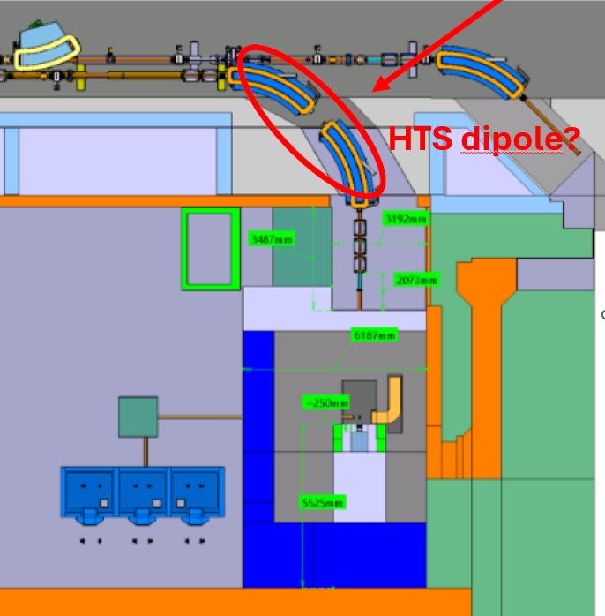
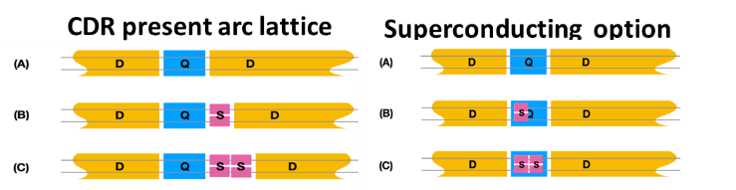
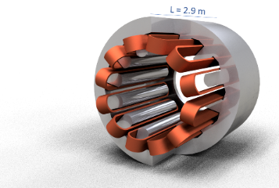
HTS4SRI- 5 MiEuros EU grant HTS coils and demonstrators HORIZON-INFRA-2025-01-TECH-01: New technologies and solutions for reducing the environmental and climate footprint of research infrastructures
Efficient and sustainable HTS accelerator magnets
FFQ coils : HTS Final Focusing Magnet System at GSI heavy ion synchrotron SIS18
FFQ coils
Magnetic Field peak | 4 T
Aperture | 200 mm
Operating Temperature | 20-40 K
Energy Saving | ~ 50 %
normal conducting magnet focusing quad
consuming a lot of energy (~ 60 kW)
→ HTS one
ADHTS : 4 T HTS dipole demonstrator for the TATTOOS beam line
ADHTS dipole
Magnetic Field | 4 T
Bending Angle | 80 °
Gap | 100 mm
Expected Energy Saving / per year | 0.2 GWh (~50 %)
Magnet | Quadrupole–Sextupole Combined Magnet
Design type | Superferric, flat REBCO racetrack coils, dodecapole iron yoke (2T peak field)
Op. Temp | 50–65 K (cryocooler-based refrigeration); extendable to 65 K -77 K (LN₂-derived cooling)
Cooling Approach | Conduction-cooled, distributed cryocoolers (FCCee-CPES compatible)
Manufacturing strategy | Planar coil geometry , robotic winding, AI field quality optimization
Scalability | 20 ‘000 coils for FCC-ee
Energy savings | 0.25 TWh per year
SQCM: HTS sextupole & quadrupole for FCC-ee
(~7,600 NC magnets → ~2,900 combined QSCMs)
Notes:
“

Slide 20
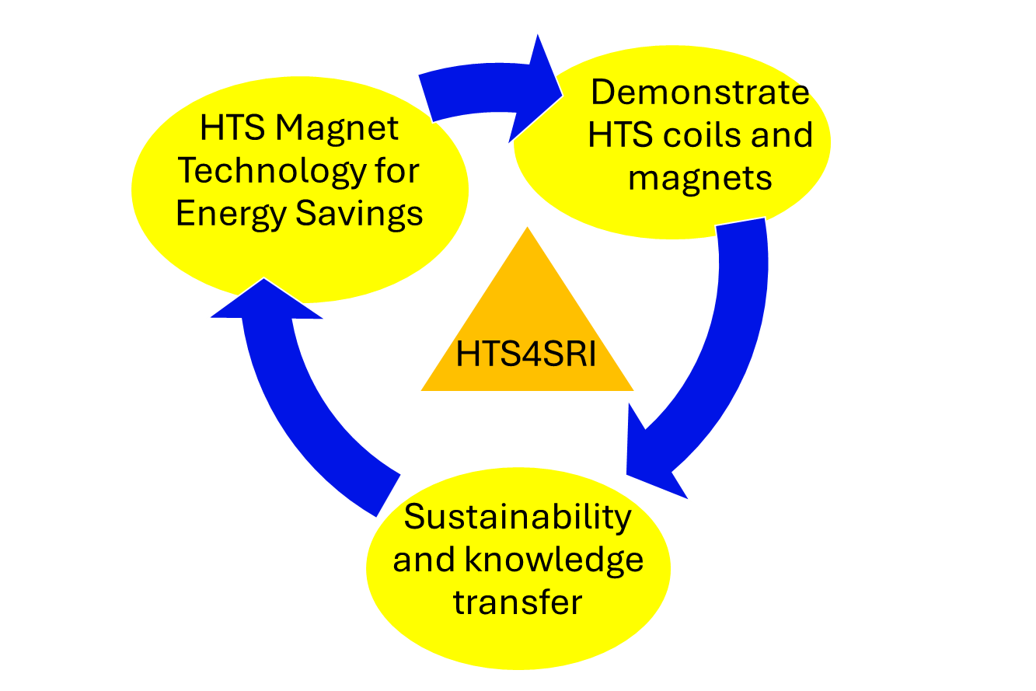
HTS4SRI Identity Kit
📅 Duration: 4 years (2026–2030)
Start : 01 September 2026 👥 Participants: 8 institutions 📊 Budget: 7.57 M€ total – EU contribution 5.0 M€ – In-kind 2.57 M€ (52 % of the EU contribution) 🛠 Work Packages: 6 (WP1–WP6)
WP1: Coordination & dissemination
WP2: LCA & Sustainability
WP3: HTS conductor tests and subscale coils
WP4: Design and Engineering
WP5: Coils & demonstrator manufacturing
WP6: Qualification and testing
Partner | Role / WP leadership
PSI (CH) | Coordinator, WP1 & WP3 lead
Bruker Biospin (CH) | Co-lead WP2
CEA (FR) | Co-lead WP1 & WP5
CIEMAT (ES) | Co-lead WP2
CERN (CH)-Int. Org. | Lead WP6
GSI (DE)-ESFRI | Co-lead WP4
INFN (IT) | Co-lead WP4 & WP5
Univ. Milano UMIL (IT) | Co-lead WP4 & WP5
Kick off meeting: 7-8 October 2026 at PSI

Slide 21
Technological building bricks and infrastructure Conductors and cable Conduction cooling and Pulsating Heat Pipes Laboratories for superconducting magnet development and tests
Notes:
The second aspect concern the development of the superconducting technology related to accelerator magnets

Slide 22

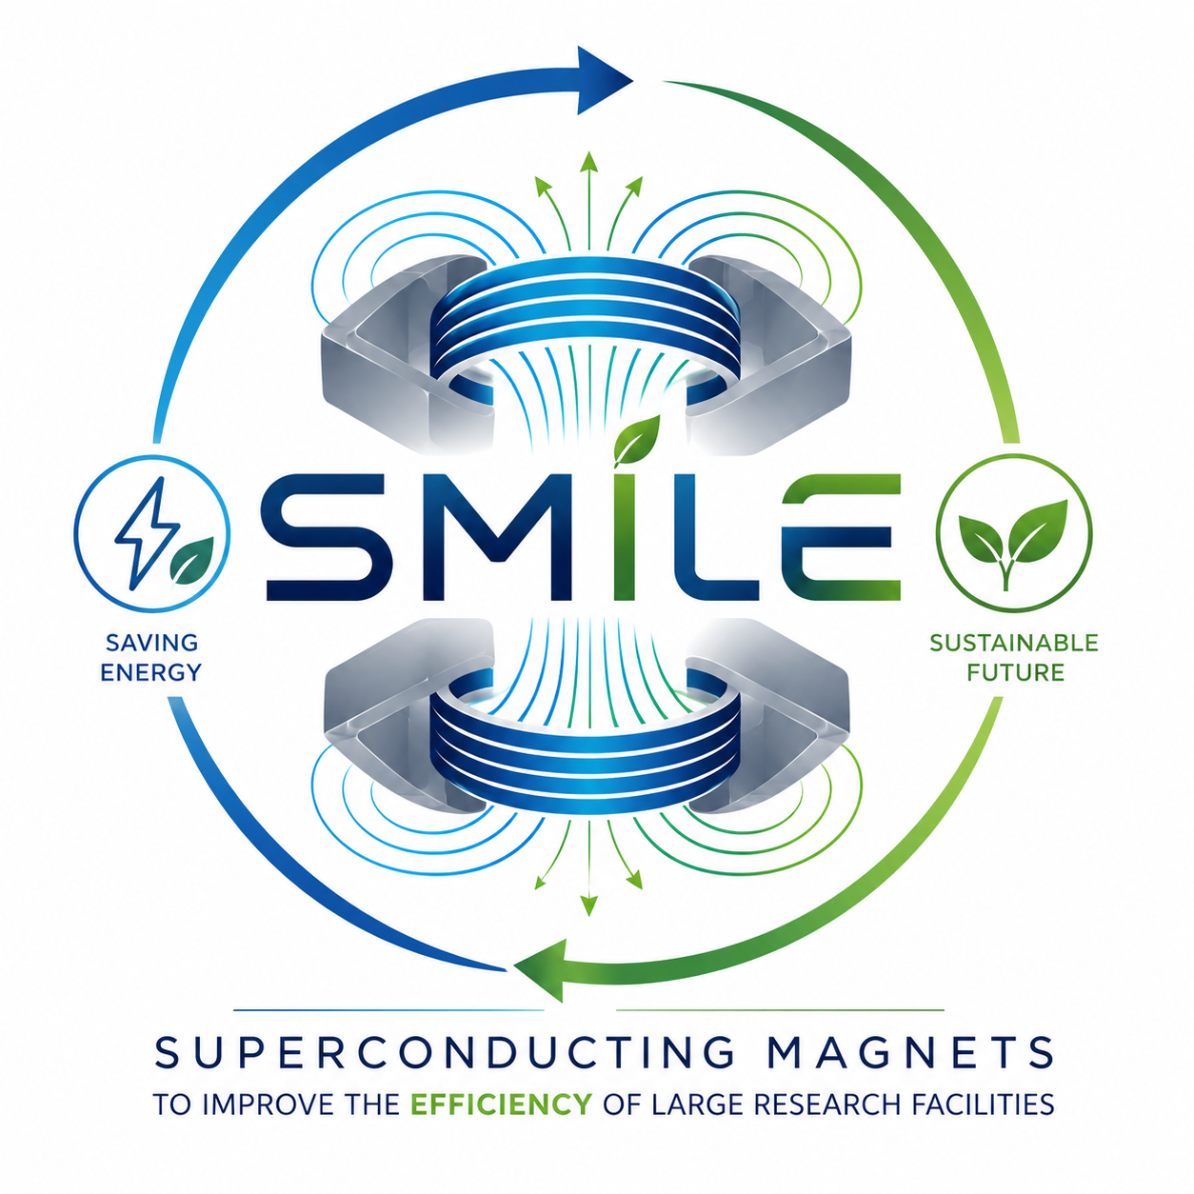
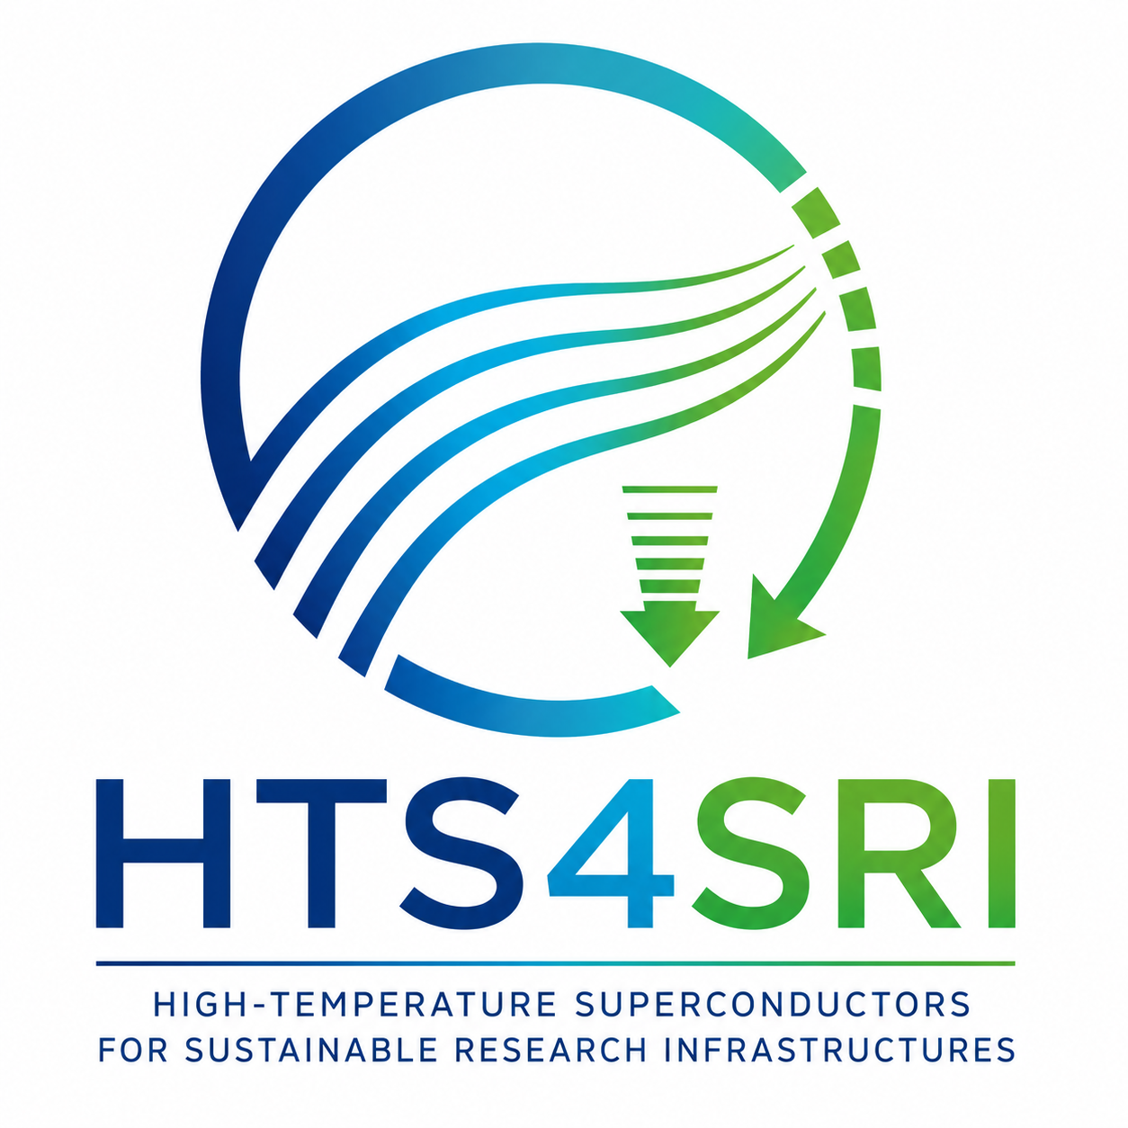

Enabling Efficient HTS Magnets for PSI Large Research Facilities: Technology Pathways
Conductor, cable architectures
REBCO stacked tapes, non-insulated tapes, CORC, CORT, low-loss cable design
Magnet design, manufacturing & assembly processes
Mechanical design & stress management, thermo-mechanical behavior, field quality
Coil winding, soldering, impregnation, mechanical assembly, instrumentation
Cryogenic systems & thermal management
Conduction cooling with cryocoolers+ Pulsating heat Pipes
Reduction of the thermal losses from current leads
Cryogenic power supply (CPES)
Radiation hardness
HTS tapes and full coil test under radiation
Efficient magnet design & integration
Compactness, operating conditions to reduce energy consumption,
full design-to-demonstrator value chain
Quench detection & protection
Adapted to HTS and NI coil behavior
Sustainability
Life cycle assessment of the magnet design and construction
Integrated value -chain approach

Slide 23












Practical superconductors used for PSI magnets
NbTi rutherford cables
ReBCO: Insulated and non insulated tapes
copper
NbTi filaments
strands
Tape and stack of tapes
4 mm width
Non Insulated
ReBCO tape
Coated conductors :
- ReBCO
- HTS film of 1-2 mm thickness deposited on one side of the substrate
- 4 mm width
Rutherford cable
ReBCO cable with CORC(T) or twisted stack of tapes
Nb₃Sn cable
CORC or CORT: Cable On a Round Copper Core (Tube)
Increasing the current;
Allowing current sharing between tapes;
Reducing AC losses;
Improving mechanical properties.
Rutherford cable
(21 high-current-density strands)

Slide 24








One example of synergy: Non insulated HTS technology
for high field magnets in PSI beam lines
Turn
to turn
Insulated coil: R’~∞
Metal-insulated coil: R’>>0
Non-insulated coil: R’~0
+ Very high current density,
→ compact winding, lower cost
→ better mechanical and thermal
conductivity
→ Simpler passive protection
- Slow charging and discharging for large L, 𝜏=𝐿/𝑅
-Need to control turn-to-turn contact resistance
-screening-current effects
4 coils demonstrator
18 T @50 mm cold bore, 10 K
NI HTS technology used for high field solenoids in future PSI beam lines

Slide 25




Conduction cooled magnets (SHI GM cryocoolers)
Choice for single PSI LTS & HTS magnets
Advantages (+) | Disadvantages (−)
No liquid helium plant required | Limited cooling capacity (very low COP)
Compact and modular system | Long cooldown time
Simplified installation | Mechanical vibrations
Small helium consumption | Limured by the thermal contact between the coil, thermal links, and cryocooler cold head.
Lower operational complexity | Failure impacts operation
Ideal for HTS (T>20 K) | Not suited for large heat loads
Improved safety (no liquid helium) | Requires redundancy
Potential cost reduction | Compressor maintenance
RDEK-500B +F70 compressor
Single stage
Power capacity : 45 W @ 20 K (50Hz)
Power consumption :6.6-6.9 kW at 50 Hz
RDE418D4 + E77 compressor- 2 stages
Dual inverter: f ~40-60 Hz
Power capacity :
1st stage : 42 W @ 50 K (50Hz),50W (60Hz)
2nd stage : 1.8 W @ 4.2 K (50Hz), 2W (60Hz)
Power consumption :
6.5 kW at 50 Hz
7.5 kW at 60 Hz
https://shicryogenics.com/product-finder/
Use of dual inverter for energy-saving operation of GM SHI cryocoolers, with regulation frequency of compressor allowing cooling control and reduced electricity consumption.
Notes:
The picture shows how a ReBCo coated conductor looks, with silver, copper stabilizer, and buffer layers surrounding the superconductor.
A Hastelloy layer is added to increase the mechanical properties.
It is clear that the engineering current density is much lower compared to the current passing through the superconductors. For high current applications, cables formed of transposed tapes or tapes wound around a copper round core are used.

Slide 26










Pulsating Heat Pipes for HTS magnet cooling (partnership with VDL ETG-ParkInnovaare)
Context
PSI beam lines: SC magnets cooled with cryocoolers can be installed (space problem)
Challenge: Transport heat efficiently from HTS and LTS coils to cryocooler
Proposed solution: Use Pulsating Heat Pipes (PHP) filled with neon or nitrogen (for HTS) and helium (for LTS)
Principle: 1) Highly efficient passive device transferring latent heat from “warm” evaporator (HT coils) to cold condenser using thermally induced two-phase flow
2) Convection: Oscillation of liquid slugs and vapor bubbles
Test with 2 copper plates
Highlights
Fabrication of PhPs working with Neon and N₂ connected to HTS coils (evaporator) and cryocoolers (condenser)
Experimental campaigns with Ne and LN₂
Successful cooldown and operation of HTS coils with a non-insulated coil (DC operation) and with an insulated coil (AC operation)
$$500 μm$$
Pipe cross-section
Heat transfer improved compared to copper thermal link :
Thermal resistance between the cryocooler and the coil decreased of nearly 80%
Two PHPs in parallel embedded in an insulated HTS coil

Slide 27


















Synergy with CHART : MagDev laboratory for
superconducting magnets (2020-2026)
Douglas Araujo
Engineer LTS
André Brem
Material Scientist
Jaap Kosse
Engineer ReBCO
Anna Stampfli
Technician Processes
1
4
1
6
Dmitry Sotnikovs
Design Engineer ReBCO
Jürgen Schmidt
Technician HTS
1
5
1
Christian Lindner
Technician HTS
3
Inês S. P. Peixoto Magnet Engineer
1
1
Kirtana Puthran
Engineer ReBCO
Colin Müller
Mechanic LTS
1
Nicolas Kehl
Technician LTS
1
2
2
Thomas Michlmayr
CAD, Technical Design
Sascha Röthlisberger
Laboratory technician
Design (1), coil winding (2), heat treatment (3), impregnation (4),
magnet assembly (5) , instrumentation (6)
Alejandro Carlòn Zurita
Technician HTS, CAD
Joep Van den Eijnden
PhD Student
Matteo Crescenti
PhD Student
1
Financed by CHART 2 & 3 program
1
Courtesy Bernhard Auchmann

Slide 28



PSI infrastructure (2) :Test stand for cryogen free superconducting magnets (2019-2026)
1: Cryostat
Thermal radiation shield
Vacuum pumps
Cryocoolers (RDK-415D/418D and RDK-500B)
2: Test setup for superconducting HTS and LTS coils
RRR, T_{C} and th. cond. test
NI HTS coils test (18.2 T)
Versatile infrastructure for tests:
4.5K ≤T ≤65 K (cold heads)
In a 77 K LN₂ bath
3: Electronic rack
vacuum control/monitoring
temperature control/monitoring (16 Cernox/ Pt1000 sensors, PID controller)
voltage signals recording (2 nanovolt/64 high precision/64 fast sampling channels )
quench detection system (CERN uQDS with PSI modification)
4: Test setup for cryogenic pulsating heat pipes (PHP)
10 and 20 tube neon PHP (with VDL ETG)
5: 2 kA $±$ 10V power converter
6: Quench protection
mechanical switch (~4 ms ) with varistor
Magnetic measurement system
3D hall probe

Slide 29
Panel of HTS magnet activities at PSI HTS high field magnet program for FCC-hh Efficient HTS combined function magnet for FCC-ee High field solenoids for PSI beam lines Radiation hardness study
Notes:
The second aspect concern the development of the superconducting technology related to accelerator magnets

Slide 30








Useful experience : Two 5T NbTi Superbends for SLS2.0 (2026)
NbTi coils
2 superconducting Superbend magnets will replace the 3.1 T one of SLS.
2 operating scenarios: 3T and 5T peak field.
Electromagnetic design & magnet qualification at PSI
Cryostat design and magnet manufacturing by the company SIGMAPHI (F)
Power tests and magnetic measurements on-going
Installation foreseen end of 2026
SCA field profile, peak field at 5.4 T
SLS2 vs SLS SB: 170kW x 6800 operating hours ; 0.6 GWh per year
Savings for 15 Years : 9 GWh
Cold test with quadrupole
SCB field profile, peak field at 5.4 T

Slide 31







HTS (ReBCO) magnet development for FCC-hh
MagDev2, MagDev3 (RS1, RS2)
HTS sub-scale RS1 | Magnet Assembly and Tests at PSI (LN₂) and CERN - 2026 (4.5 K and 20 K)
HTS sub-scale RS2 | Conceptual Design Finalization, Coil Manufacturing Development, and LN₂ Testing
REBCO Cable Develop. | Short-Length Sample Production and LN₂ Testing
Prototype
Racetrack winding – cosine θ geometry
with elliptical ends
Race-track coil
Double Racetrack of HTS (ReBCO) insulated (soldered) tape-stack cable tested at PSI
REBCO Subscale magnet 1
REBCO Subscale magnet 2
optimized coil geometry
Stress management of the lorentz forces by the geometry
Assess: engineering current density, AC losses, field quality
Synergies for PSI magnets: coil fabrication, stress management, fast ramping operation

Slide 32







HTS magnet for energy saving : FCCee-HTS4 project (CHART/CERN/PSI)
Replace all arc normal conducting quadrupoles and sextupoles of the FCC-ee arcs (89 MW), with superconducting ones using HTS technology
Design, fabricate and test a cryocooled HTS combined function (quadrupole & sextupole) working at 40 K
for energy saving in FCC-ee short straight section magnets
HTS technology : reduce the consumption by 20 % i.e. 2.9 TWh
Nested geometry : only one type of neighbouring dipoles →increase the packing factor and the luminosity
Sister CHART project : FCC-ee cryogenic power converter (CPES) developed with ETHZ
Two prototyping geometries : Canted Cosine Theta (CERN) and Cosine Theta (PSI)
PSI sextupole (cosine Theta) prototype fabricated and tested
HTS4
Sextupoles made of 6 racetrack HTS coils (coated HTS tapes at PSI)
Cryogenic test of the sextupole at PSI
M. Koratzinos (CERN)
Perspectives 2026 : Fabrication of a full nested magnet and test between 30-70 K
Synergies : conduction cooled HTS magnet construction, field quality, compactness, and reduced power consumption

Slide 33







NI HTS technology for a high field solenoid of the PSI Positron Production (P³) Experiment
P3 final assembly, cryogenic tests up to 1 kA (~10 T,21 K), and installation in the SwissFEL beam line
5x 12 mm wide
Non insulated HTS coils
10.2 T, 21 K
Direct application : HTS solenoid will be installed into an accelerator beam line (2026) !

Slide 34



Split HTS Solenoid for Neutron Scattering experiment in SINQ (CHART-PSI)
17 T @10 K 1700 A ,10 mm split
18 T solenoid
LN2 test
neutrons
10 mm
Split coils with NI HTS double tapes;
Operating temperature: ~12 K;
Cooling provided by a two stages GM cryocooler;
Current leads cooled with liquid nitrogen.
2025: Stack assembled
2025: Initial LN2 tests
2026: Integration in dedicated cryostat

Slide 35




HTS solenoid for the PSI Muon EDM experiment in the μE1 beam line (HIPA)-2030?
https://www.psi.ch/en/ltp/muedm-experiment
Design of a superconducting solenoid for measurement of muons Electric Dipole Moment (muEDM)
Development of a zero-field superconducting injection channel into solenoid→ use of HTS bulk/tape (2024)
High peak field (5 T), large aperture (0.5 m) solenoid for magnetic storage muons trap (highly uniform magnetic field required to control muon spin dynamics)
YBCO tape Helix
Higher field → better signal-to-noise → improved EDM sensitivity
HTS : working above 20 K possible, cost efficiency
Design of a 5T HTS solenoid from mid-2026 to mid-2030: Ph.D. student with SNFS grant

Slide 36





Radiation hardness study (SMILE –pole1)
70 magnets with Mineral Insulated Cables (MIC) (highly radiative environment)
Replacement of high-energy-consumption magnets with LTS and HTS magnets
Cost-effectiveness & performance including thermal stability and radiation effects
Program 2025-2029
Modeling of the radiation effects on HTS tapes & coils
Test of HTS samples in PSI facilities (Gantry 1, PIF, NIS…)
Produce am HTS coil without organic insulation
Build an HTS magnet demonstrator to test the changes in superconducting properties under radiation exposure online in HIPA → 2026
Validation numerical model on experimental data on HTS irradiated samples and coils
Pilot Magnet design and assembly to be installed in a PSI beam line?
Activity linked with EU HTS4SRI project
AHL with MIC coils
copper sheath
PIF
Irradiation (n, p) of HTS tapes and coils
Proton Irradiation Facility

Slide 37








Irradiation effect on HTS magnet demonstrator
Experiment set-up:
Cryocooler head
Aluminum Cryostat
The cooling system is based on a RDK-415D2 cryocooler, which provides about 1.5 W at 4 K
The cryostat features inner and outer aluminum shields
HTS Coil on a copper support
The HTS coil consists of 150 turns of 4 mm Faraday Factory tape, in dry-wound configuration.
Dose rate: ~5e-4 Gy/s
Neutron fluence after 4000 h: 10¹⁸ n/m²
The final demonstrator will be installed in the cryostat near the cyclotron and operated between 10 K and 40 K to monitor its critical parameters.
Neutron flux will be measured using activation foils and beam loss monitors to correlate radiation exposure with coil performance and assess its long-term reliability.
Perspectives 2026 : Installation of the HTS demonstrator close to the PSI ring.
Monitoring of the irradiation effect on superconducting properties.
Information for the possible replacement of the AHC magnet in the PSI ring

Slide 38


Conclusions
The increasing energy demand of more powerful accelerators requires a more efficient and sustainable approach to magnet technologies.
PSI benefits from a strong ecosystem of ambitious strategic projects, of an FCC-oriented R&D program (CHART) and innovative industrial environment , creating a unique opportunity to drive the energy transition through HTS magnet technology.
SMILE and HTS4SRI are developing key technological building blocks for cryocooled HTS magnets tailored to the needs of current and future PSI large research facilities.
The future use of HTS magnets—combining high performance, energy savings, reduced operational costs, and lower environmental impact—is progressively gaining momentum.
Join us in shaping the future of efficient and sustainable HTS magnet technologies

Slide 39


George Bernard Shaw (1856–1950)
Irish playwright, critic, dramatist and polemist
Nobel Prize in Literature in 1925
Thank you
for your attention

