Slide 1
Realization of High-Intensity Beams with Smaller Emittance Without a Transverse Feedback System
Yoshihiro Shobuda (J-PARC/JAEA),
Pranab Kumar Saha, Ippei Yamada (J-PARC/JAEA)
Takeshi Toyama (J-PARC/KEK)
Nobuyuki Yoshimura (Toshiba)
Outline
Introduction
J-PARC RCS kicker (merits and demerits)
Beam instabilities observed at the RCS (discrepancy from classical theory)
Theoretical explanation (role of space charge effects)
Kicker impedance suppression (how to retain the merit of the kicker)
Performance of the impedance measure (consistent with theory)
Summary

Slide 2
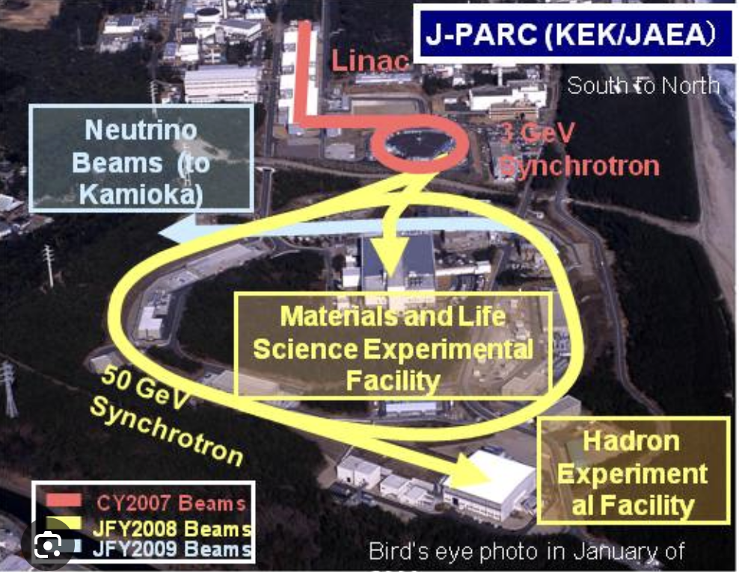
Introduction
Overview of the J-PARC
3-GeV RCS delivers 1-MW beam without transverse feedback system
despite exceeding the classical impedance budget.
Key to this success.
Indirect space-charge effects
Difficulty arises for small-emittance beams
due to mitigation of these effects.

Slide 3
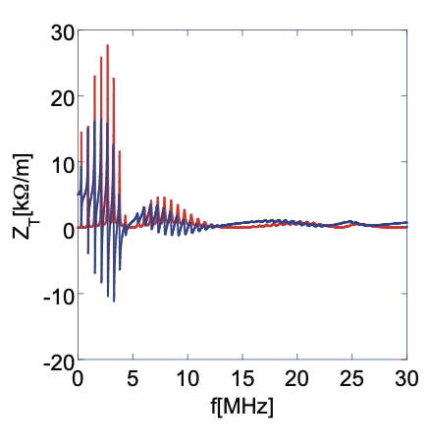
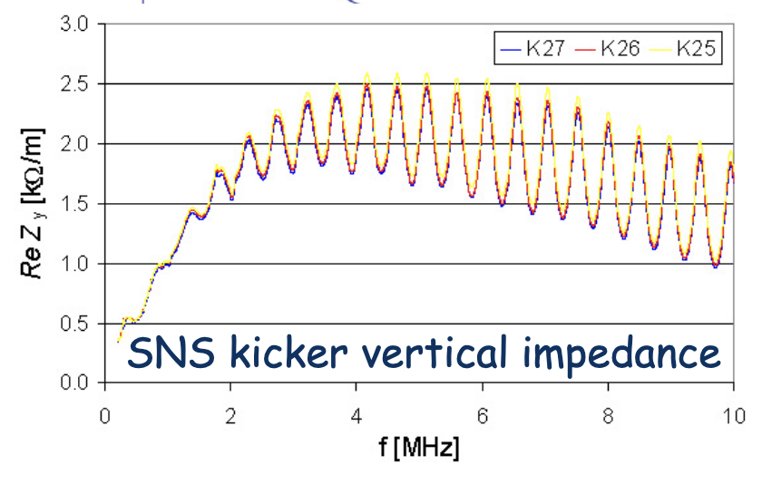
RCS kicker impedance is the main source of beam instability
Kicker impedance
about 10 times higher than the SNS kickers’.
Spike structure
J-PARC RCS kicker
Nevertheless,
eight kickers were installed.

Slide 4
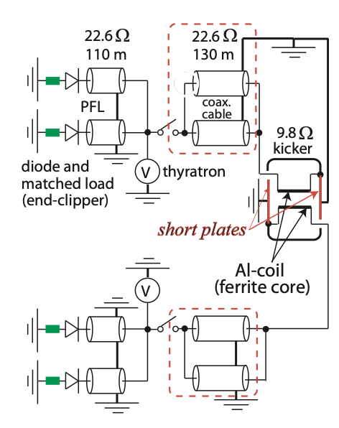
RCS kicker has merits
Kicker is a transmission-line type
with two ferrites and coils.
Kicker has four terminals:
two connect to Power Supply
through 130-m coaxial cables
two, grounded
Shorted plates save power, by doubling excitation current for beam extractions.
Structure increases beam impedance,
during acceleration.
because beam induces current on kicker coil,
trapped in 130-m cables with open ends.

Slide 5
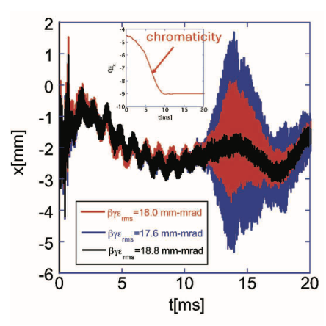
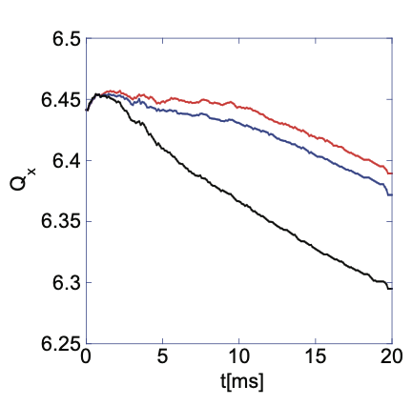
(0.76-MW beam)
Beam instabilities observed at RCS
(discrepancy from classical theory)
Tune dependence
following tune trackings in lower panel.
Sextupole magnet, turned off
after 10 ms at higher energy.
Beam instability, observed at higher energy
despite under natural chromaticity.
Tune dependence exists, suggesting
resonances in kicker impedance drive beam instability.

Slide 6
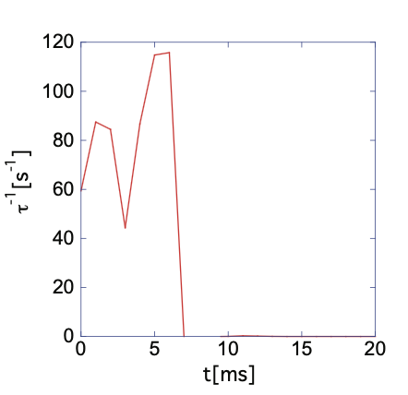
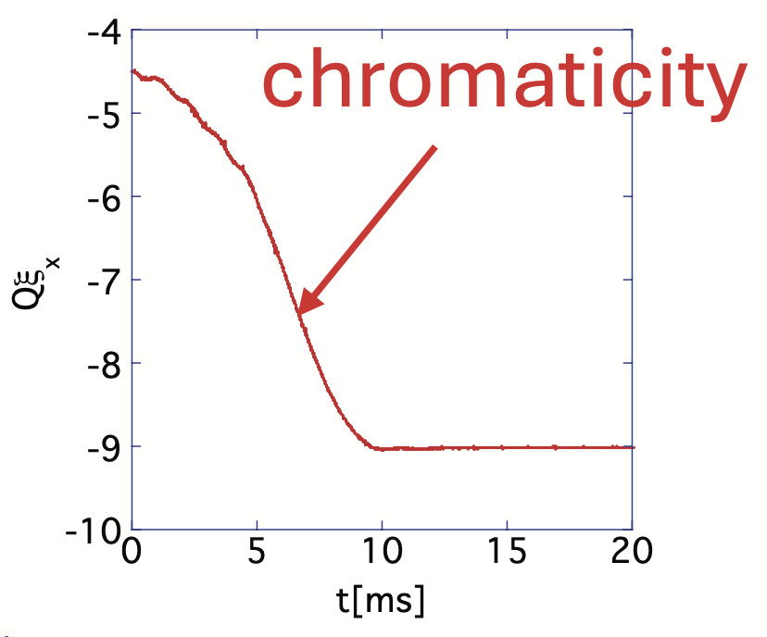
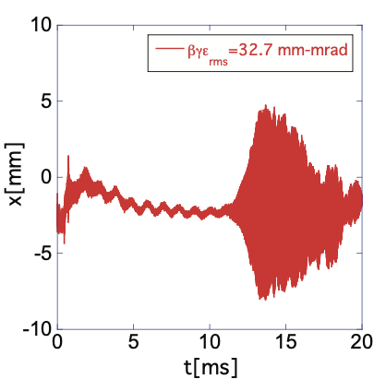
Classical theory vs. measurements (1-MW)
Sextupole magnet, turned off after 10 ms.
Theory neglects space charge.
Instability, excited at low energies: Theory (Sacherer's formula).
Instability, observed at higher energies: Measurements.
A discrepancy exists, suggesting
space charge affects beam instability.

Slide 7
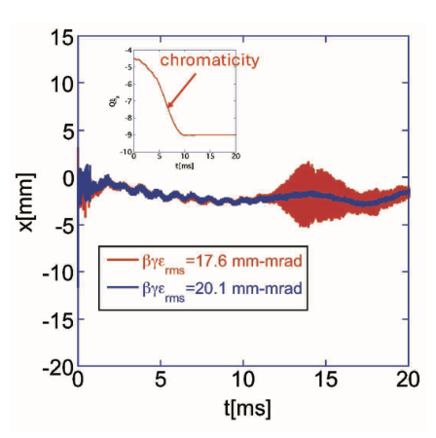
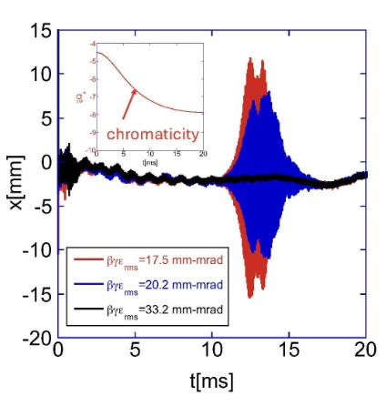
Emittance dependence (0.76 MW beam) for different sextupole settings
Right panel : Sextupole magnet corrects half of chromaticity at injection using DC power supply.
Left panel: Sextupole magnet turned off after 10 ms.
Emittance Variation:
Black/Blue : Results for larger emittance.
Red: Results for smaller emittance.
Key Observation:
Beams with smaller emittance excite instability.

Slide 8
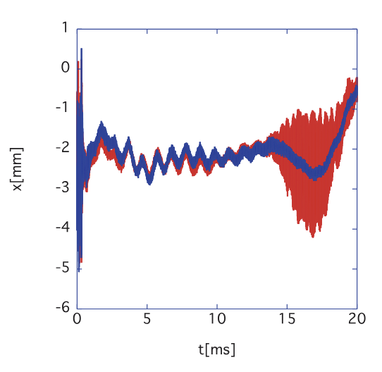
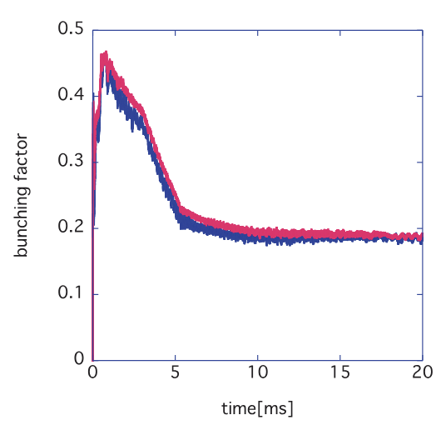
Bunching factor dependence (0.76 MW beam)
B_{f}, average current /peak current
Beam positions
Bunching factor
Blue: results for higher peak current.
Red: results for lower peak current.
Beam is not always stable for lower peak current.
This contradicts the prediction of classical theory,
neglecting space charge effects.

Slide 9
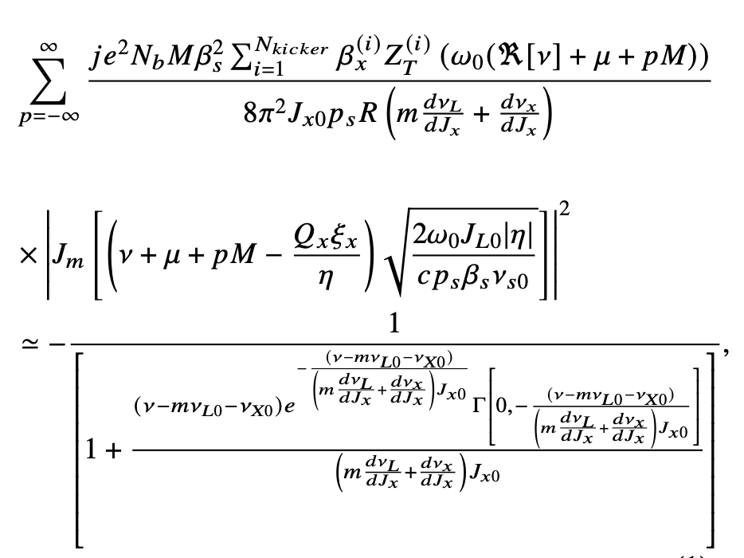
Theoretical explanation (role of space charge effects)
Beam growth rate is evaluated by solving the dispersion relation for ν.
The original formula in (Shobuda et al, PTEP, 013G01, 2017) is extended
to include β^{(i)}_{x} dependence for i-th kicker (i runs 1 to 8).

Slide 10
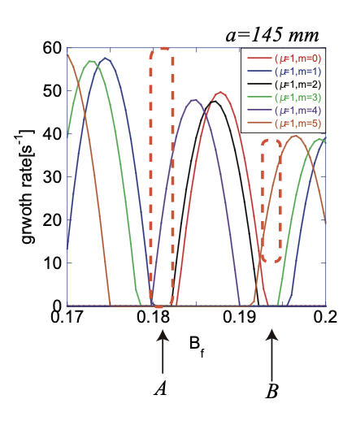
Beam growth rate critically depends on B_{f}.
B_{f}-dependence of beam growth rate @ 15 ms.
Around regions A and B, beam growth rate becomes higher as B_{f} gets larger.
Measurements (0.76 MW)
Theoretically, region A corresponds to measured case.
Theory predicts increasing the peak current can stabilize the beam,
due to space charge effects.

Slide 11
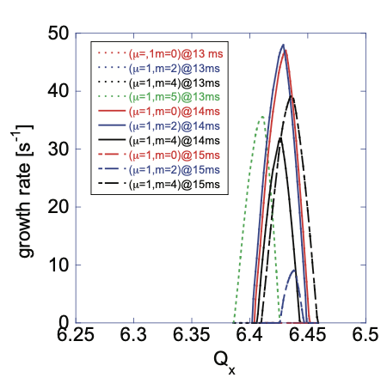
Tune-dependence of beam growth rate (Theory).
Measurements (0.76 MW beam)
unstable
Stable: black
Unstable: red, blue
Measurements align with theoretical prediction.
Kicker impedance drives beam instability at high energy,
Instability begins at 13 ms if tune stays around 6.4–6.45.
due to reduction of space-charge effects,
with tune crossing around 6.4-6.45

Slide 12
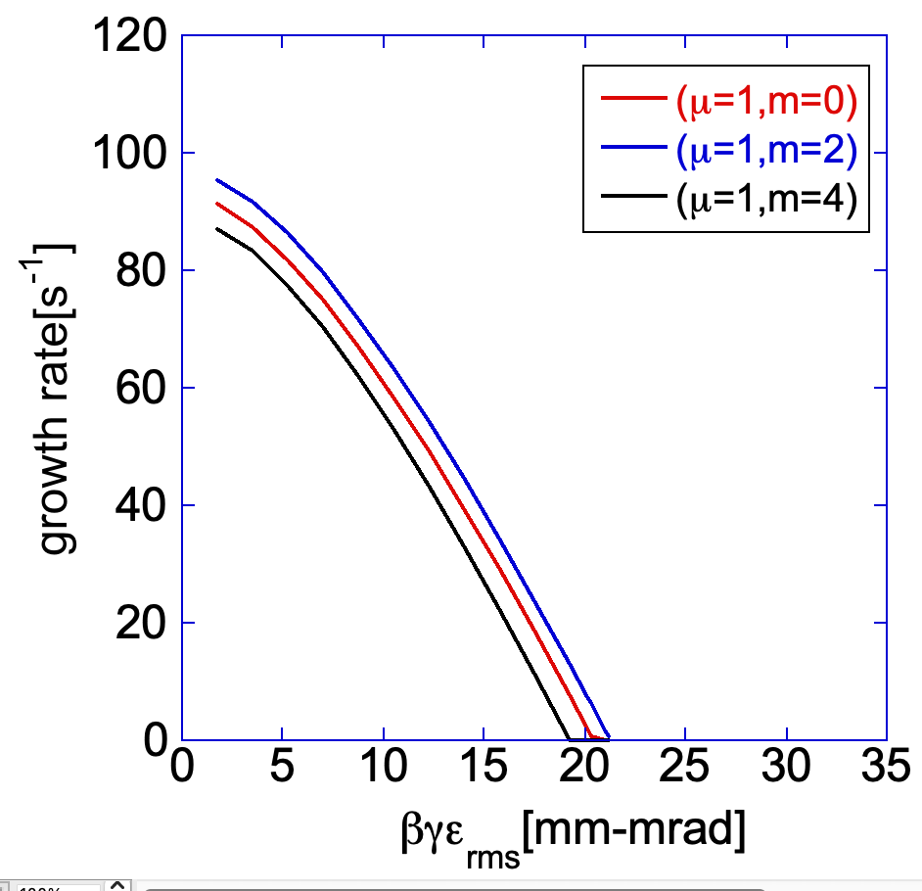
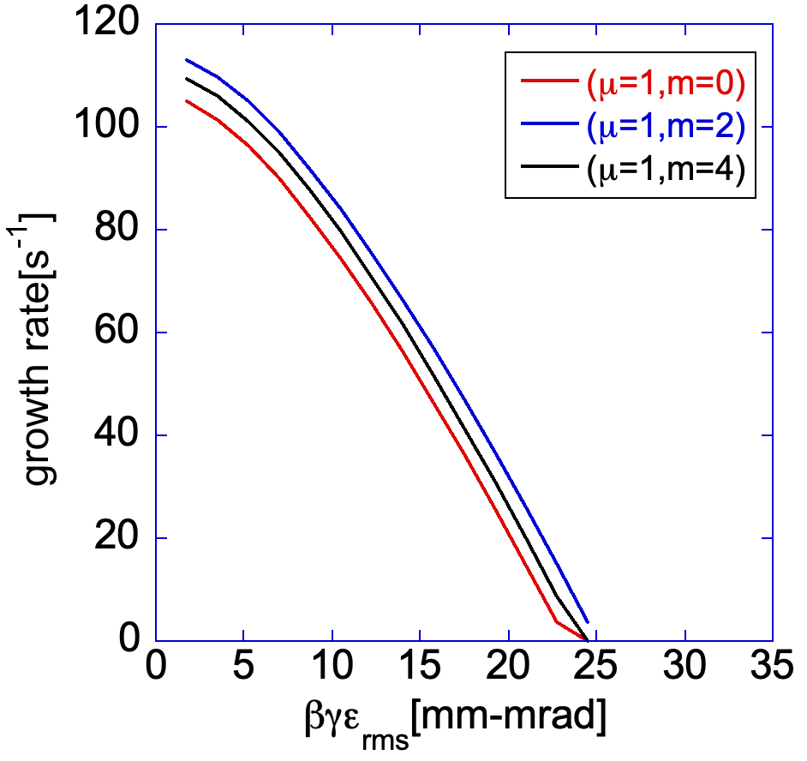
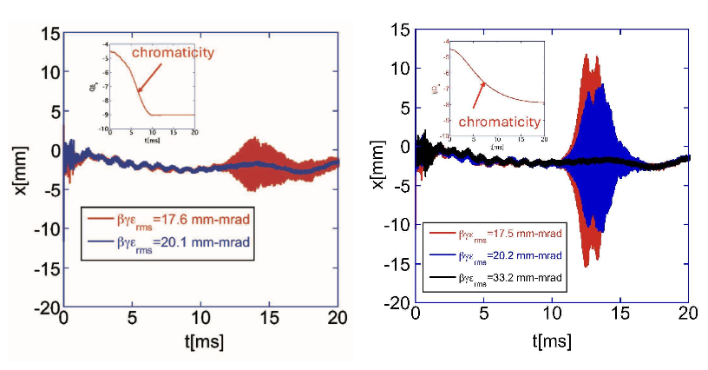
Chromaticity effects
Beam growth rate @14 ms
OFF
DC
Right: chromaticity is -7.5.
Left: chromaticity is -9.
Theory: increase in chromaticity in negative direction realizes
smaller emittance beams.
Measurements (0.76 MW) for different sextupole settings:
Right: chromaticity, partially corrected.
Left : chromaticity, uncorrected.
Blue demonstrates
effectiveness of measure.

Slide 13
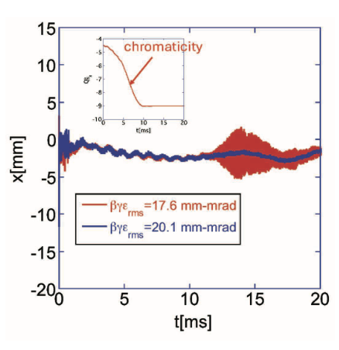
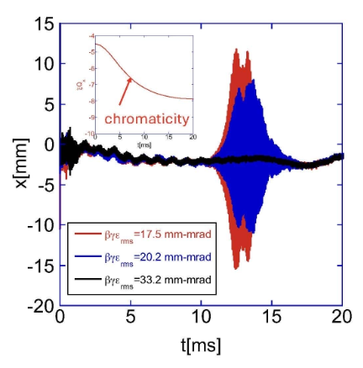
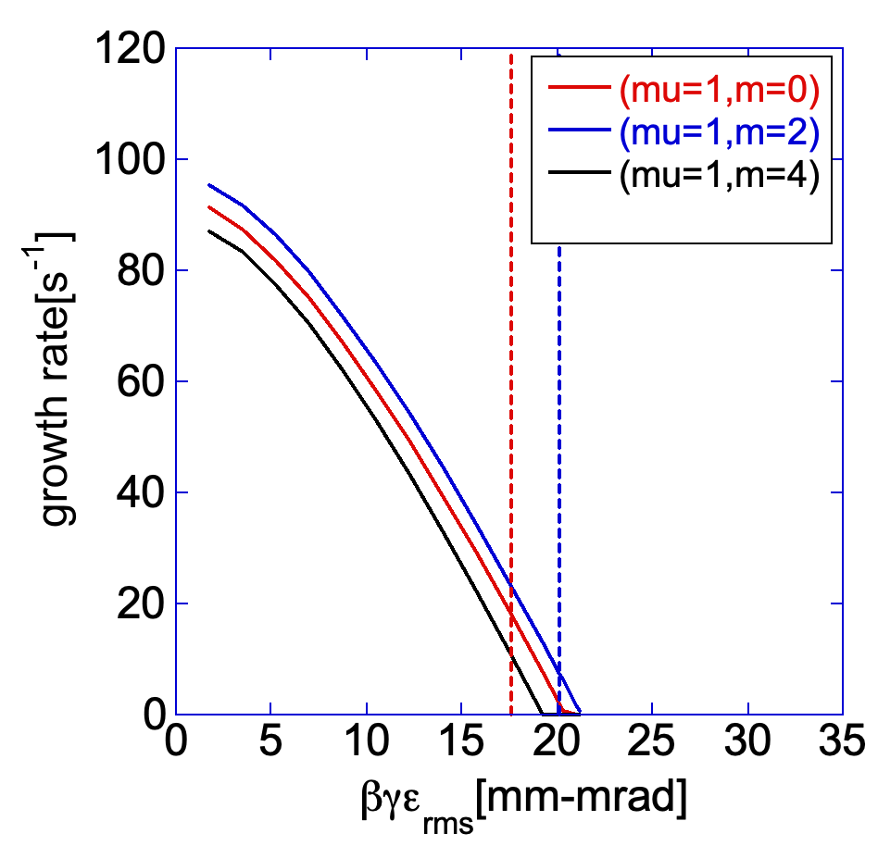
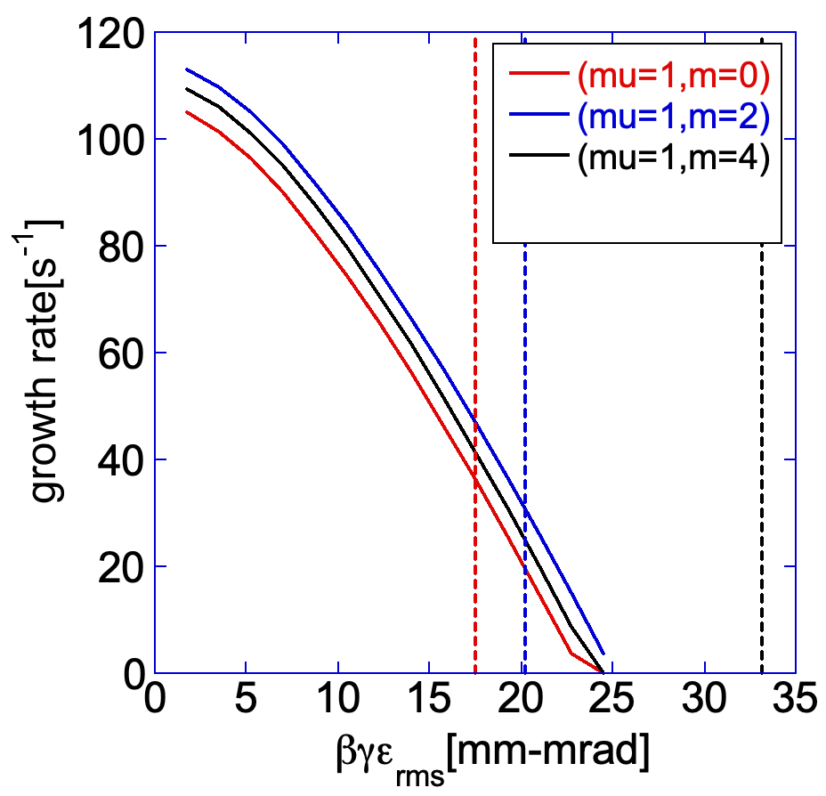
βγε_{rms}-dependence for different setupole settings
Right : Chromaticity, half-corrected using DC power supply.
OFF
DC
Measurements(0.76 MW)
Left : Sextupole, switched OFF after 10 ms.
Emittance:
Red : 17.6mm-mrad
Blue: 20. mm-mrad
Black : 33. mm-mrad
Beam growth rate @14 ms
Black, stabilized thanks to the largest emittance.
20 mm·mrad beam, stabilized simply by turning off sextupole.
Smallest emittance beams excite beam instability, even when sextupole is turned off.
Theory well describes measurements.
Emittance dependence suggests
indirect space-charge effects suppress beam instability.

Slide 14
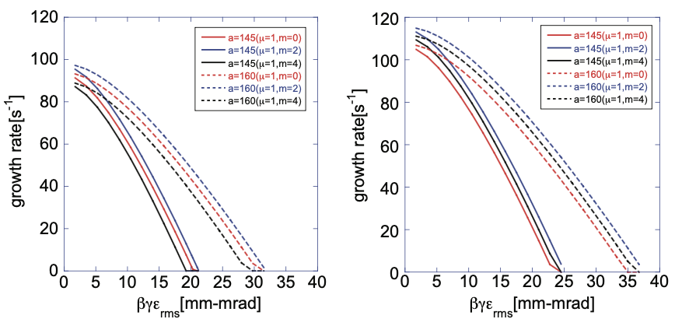
Indirect space charge effects for different sextupole settings
Chromaticity, -9
Chromaticity, -7.5
Solid Line: Chamber radius, 145 mm.
Dashed Line: Chamber radius, 160 mm.
Increasing chamber radius a, enhances beam growth rate.
Indirect space-charge effects are essential:
stabilize large-emittance beams at low energy,
destabilize small-emittance beams at high energy.

Slide 15
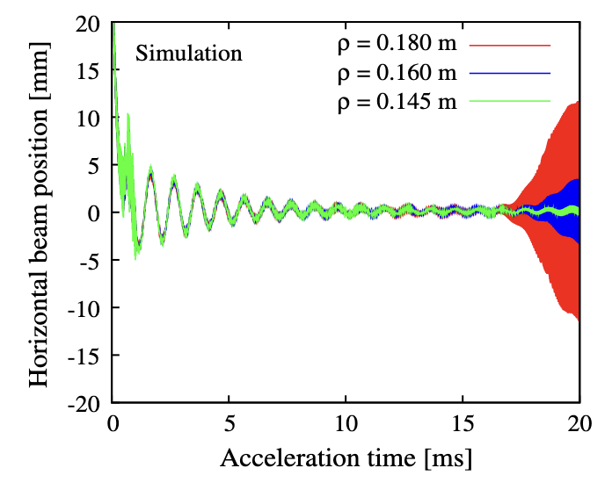
Simulation supports (Saha et al, PRAB21, 024203, 2018)
Chamber Radius Parameter: ρ
Theoretical predictions were supported by simulations with ORBIT (SNS).
Increase in chamber radius ρ leads to enhancement of beam growth rate.

Slide 16
Discrepancy with Alternative Theoretical Model
Simulations differ from those of another theoretical model.
Burov model (PRAB22, 034202, 2019) that accounts for direct space charge predicts
Kicker impedance specific to RCS, might stabilize beams unexpectedly ?
stronger instabilities than in the case where only wake fields are considered.

Slide 17
A resolution [Yoshimura, Toyama, and Shobuda (PRAB22, 034202, 2025, selected as editors’ suggestion)]
Linear model of space-charge in the J-PARC MR under 3-GeV storage mode,
with resistive-wall impedances,
highlights effects of chamber wall on beam instabilities.
The time dependence of the beam distribution is taken into account.
Linear model is justified, transverse beam size is much smaller than chamber radius.

Slide 18
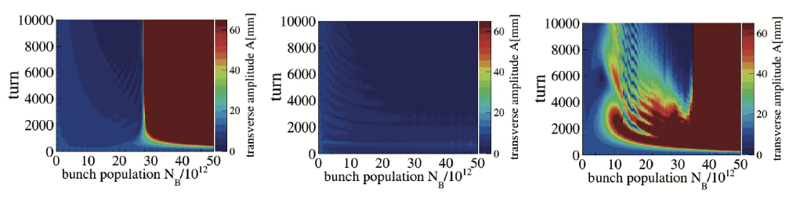
N_{B} dependence of amplitude growth (simulations)
Wake+all space charge
Indirect space charge neglected
Wake-only
The space charge effect is obvious
Blue: stable
Including all space charge effects suppresses beam growth rate (Middle) .
Red :unstable
Ignoring indirect space charge effects increases beam growth rate (Right).
Two different predictions are reconciled.

Slide 19
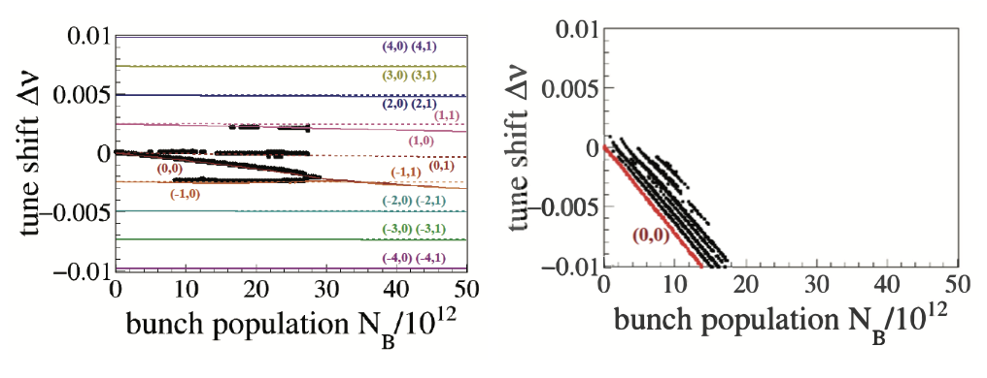
Mode excitation analysis along N_{B} (simulations)
Wake-only
Wake+all space charge
TMCI
Bullets show simulations (head-tail mode, radial mode).
In the wake-only case (left), simulation reproduces conventional theory by DELPHI (CERN).
Transverse mode coupling instability (TMCI) is source of beam instabilities.
Right: space-charge suppresses negative head-tail, higher radial modes,
resolving TMCI.
This is mechanism,
by which space charges suppress beam instabilities.

Slide 20
Findings
Indirect space charge effect suppresses beam instability
for a wider range of impedances (including resistive-wall impedance),
which highlights
difficulty of accelerating high-intensity, low-emittance beams.
Reducing kicker impedance is inevitable.

Slide 21
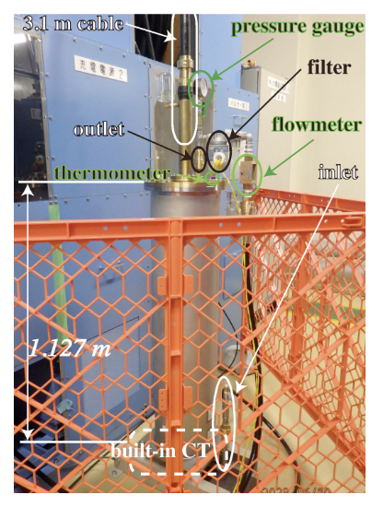
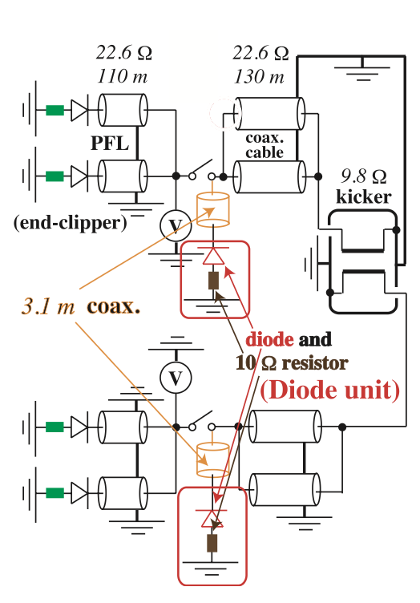
Kicker impedance suppression
Goal: retain power-saving advantage of original kicker design.
Special diodes and matched resistors are inserted at upstream of thyratron switch (Shobuda et al, PRAB26, 053501, 2023, selected as editors’ suggestion).
This scheme secures doubled excitation currents,
by blocking currents from Pulse Forming Line (PFL) from flowing into resistors.

Slide 22
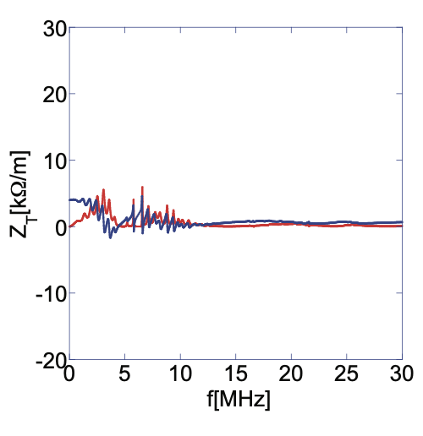
Kicker impedance, suppressed
Diodes act as capacitors and rectifiers for high-frequency beam-induced currents,
A diode unit was installed in July 2021.
Diode units have been installed into four out of eight kickers,
with RCS delivering high intensity beams under routine operation.
which passes into resistors.

Slide 23
Performance of the impedance measure
Eight kickers, numbered as Kicker 1, Kicker 2, etc,
Diode units, systematically attached to respective kickers.

Slide 24

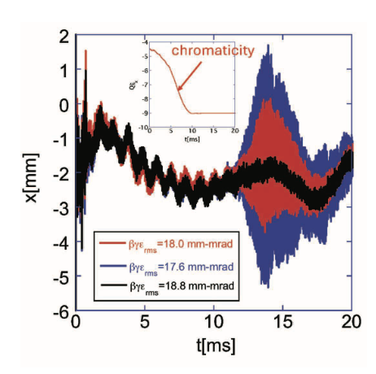
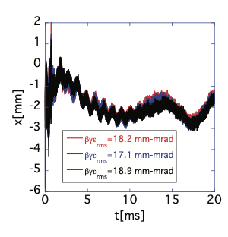
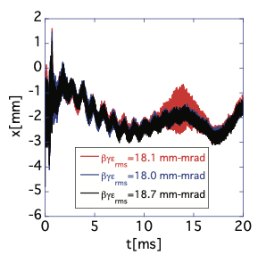
Evaluate Two diode units’ impact on tune dependence
(0.76 MW).
Sextupoles, turned off after 10 ms.
Before the measure
Kicker 8 attached
Kicker 5 & 8 attached
Two Diode units eliminate tune dependence even for 17mm-mrad beams.

Slide 25
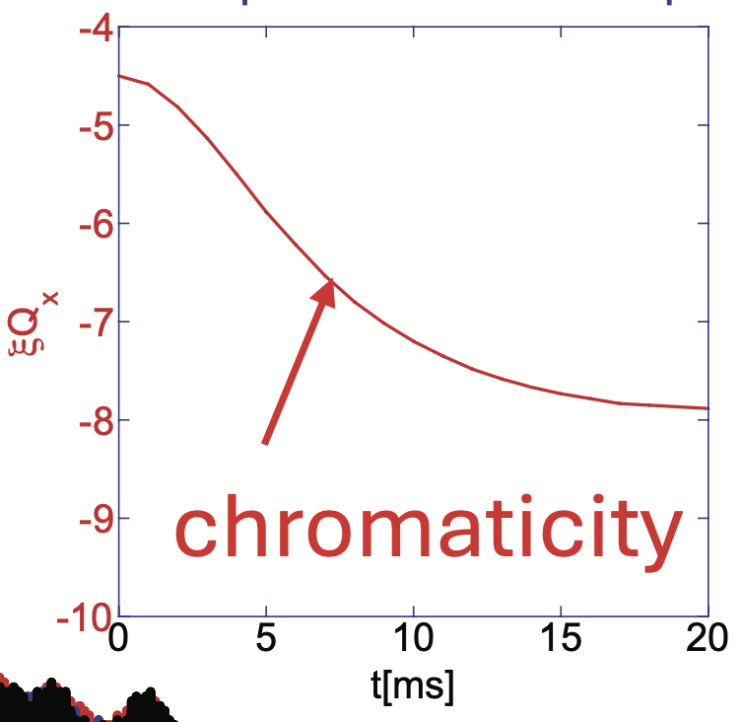
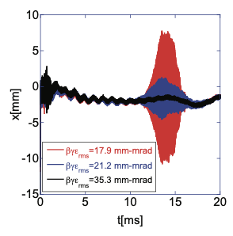
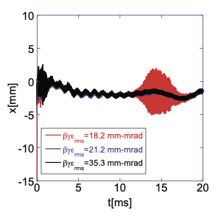
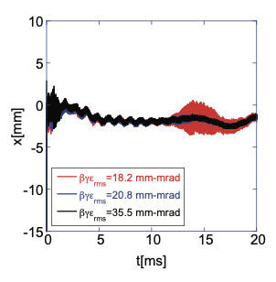
Emittance dependence (0.76 MW),
Sextupoles, activated by DC power supply
Kicker 8 attached
Kicker 5 attached
Kicker 5 & 8 attached
Emittances:
Red :18 mm-mrad
Blue : 21 mm-mrad
Black: 35 mm-mrad
Damping effects by diodes become more evident.
Kicker-position dependence of damping effect comes from
kicker-position’s beta (β⁽⁵⁾_{x}=18.1 m, β⁽⁸⁾_{x}=10.4 m).
Damping effect by indirect space-charge, independent of wake forms.
Regardless of which kickers carry diode units,
smaller emittance beams experience stronger beam instability.

Slide 26
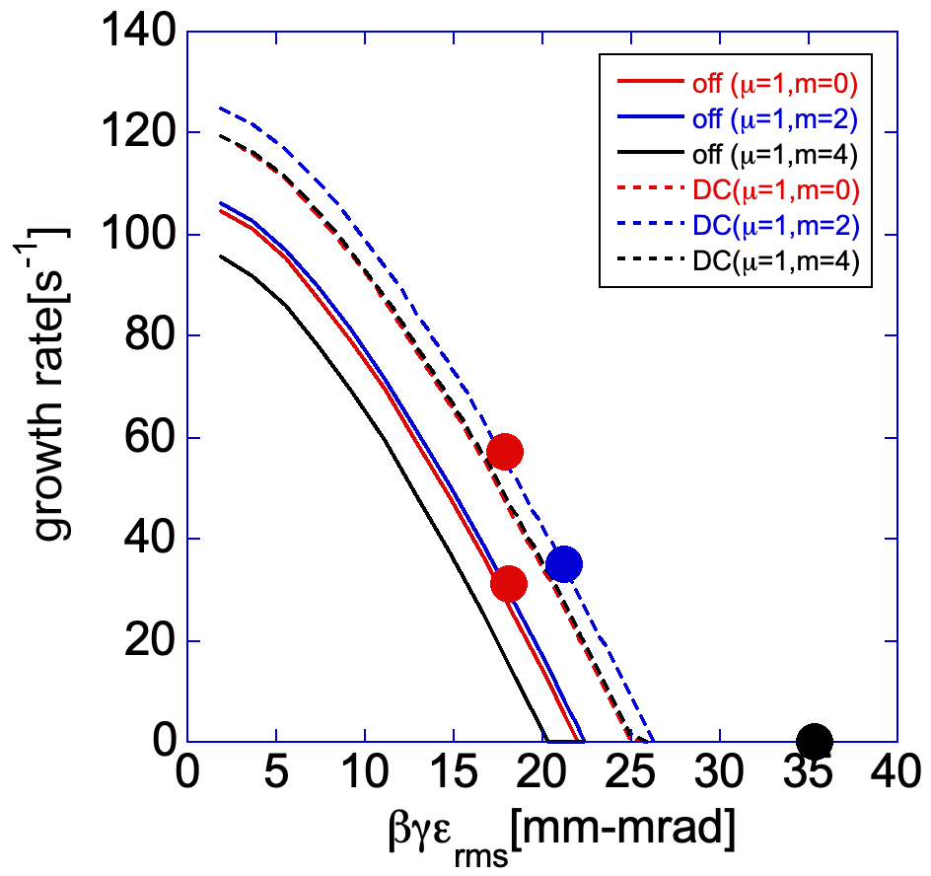
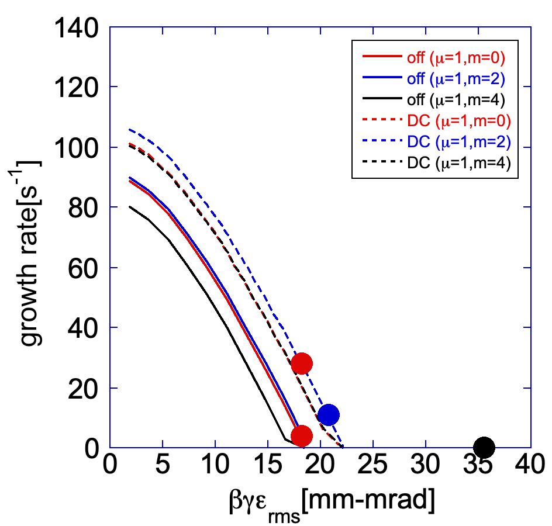
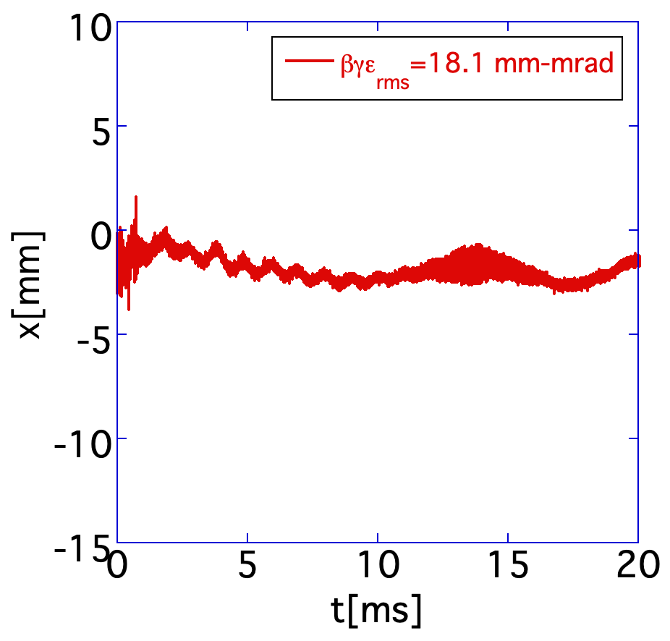
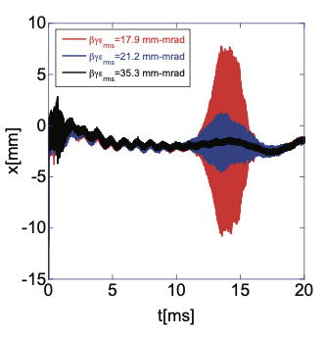
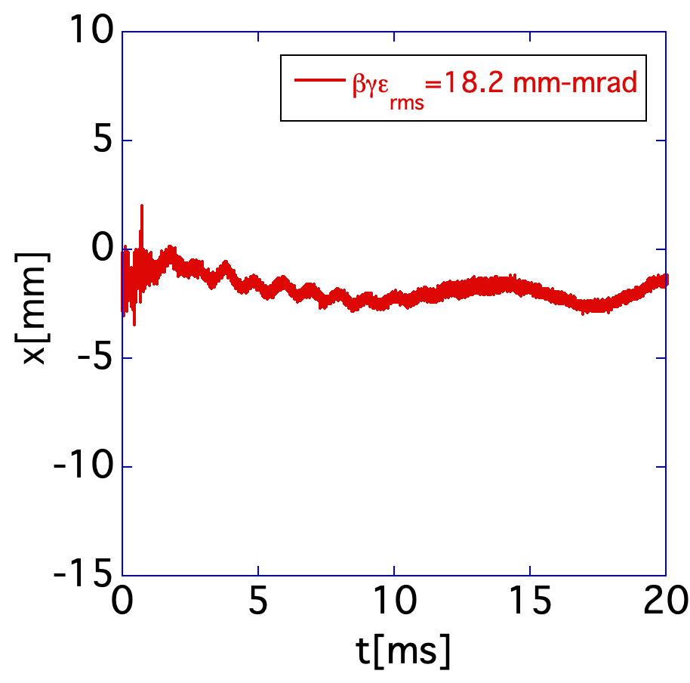
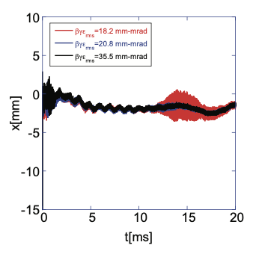
Comparison with the theory for different diode settings (0.76 MW)
Kicker 8 attached @14ms
Kicker 5 & 8 attached @14ms
DC
turned off
Emittances:
Red :18 mm-mrad
Blue : 21 mm-mrad
turned off
DC
turned off
DC
Black: 35 mm-mrad
Theory explains measurements.
Critical emittances,
below which beam instability must occur.

Slide 27
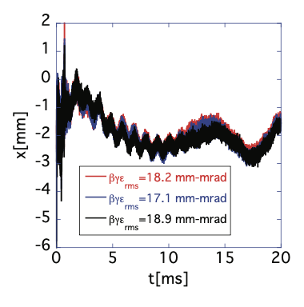
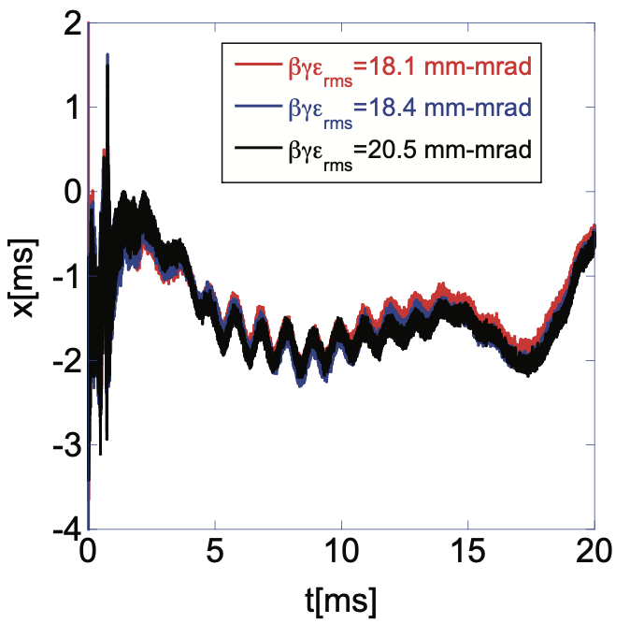
Damping Effect
with Four Diode Units (0.76 MW)
tune dependence
No diode attached
Two diodes attached
Four diodes attached
Condition changed
Two diodes eliminate tune dependence.
Four diodes suppress instabilities,
even for corrected chromaticity cases.
Installing four diode units widens the beam's operational tunability.

Slide 28
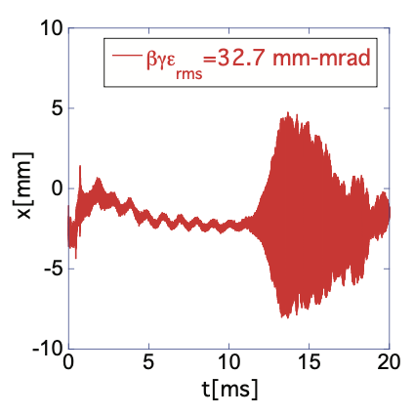
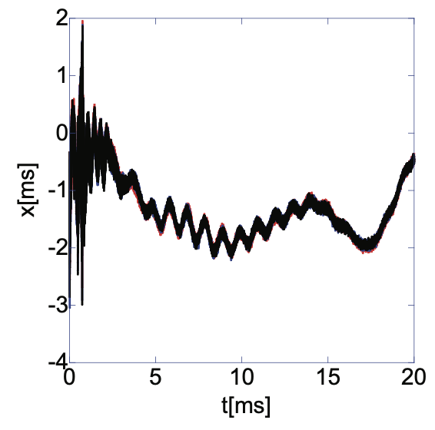
Beam instability
for 1-MW beam
Unstable:
No diode attached
Stable:
Four diodes attached
broader emittance
smaller emittance
βγε_{rms}=26 mm-mrad
natural chromaticity
corrected chromaticity
Three successive shots, overlaid.
Four diode units suppress beam instability with corrected chromaticity,
for 1MW smaller emittance beams.

Slide 29
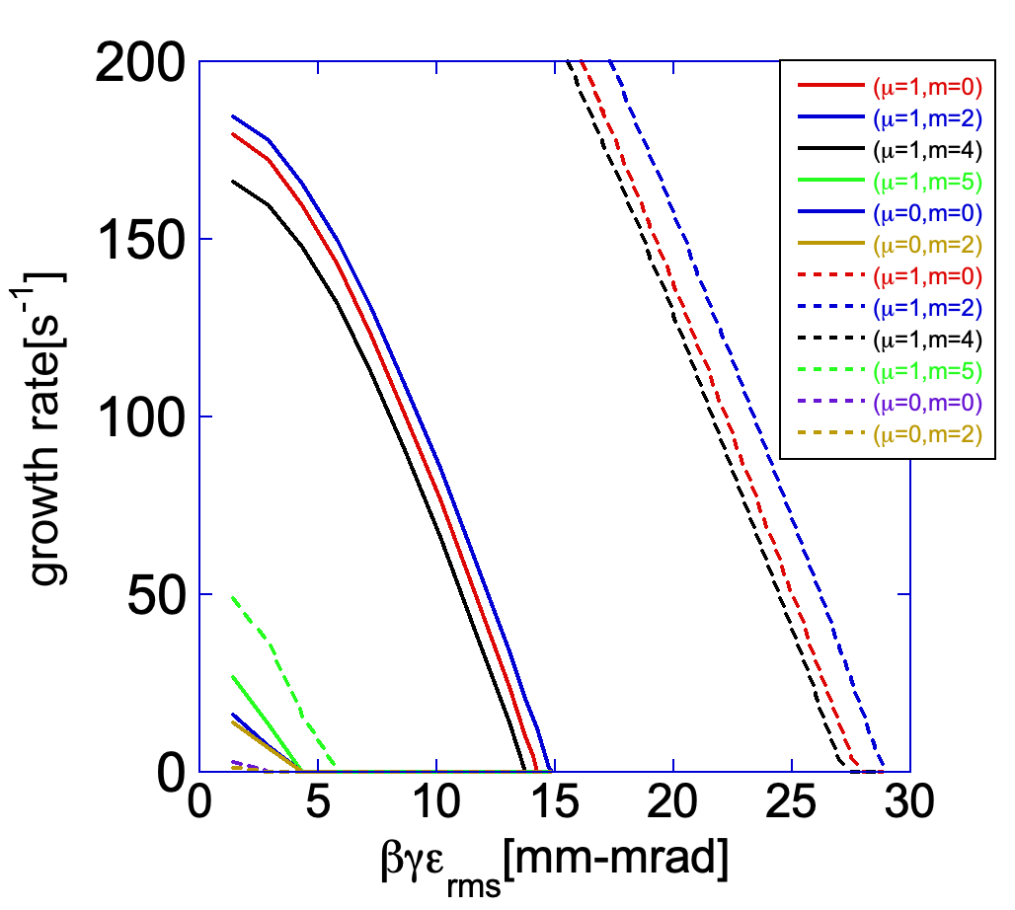
2 MW Beam Growth Rate Estimation
Beam growth rate @ 14 ms (Q_{x}=6.434 and 14 ms)
Sextupole setting
Four diode attached
No diode attached
Four diode units reduce critical emittance from 30 mm-mrad to 15 mm-mrad.
Diode units and space charge expand possibility of achieving 2 MW beam
without transverse feedback.

Slide 30
Summary
Space Charge is Key:
Indirect space charge enables high-intensity beams,
with reduced feedback necessity.
Diode Unit Enhances Performance:
Diode unit expands operational parameters,
maintaining grounded kicker benefits.
Proven Reliability:
Diode unit sustainability is being demonstrated through routine operation.

