Slide 1

Commissioning and current status of High Energy Photon Source
Yuhui DONG
On behalf of the HEPS team
May, 2026

Slide 2
Outline
HEPS Introduction
Commissioning
Operation
Summary

Slide 3
HEPS Introduction

Slide 4
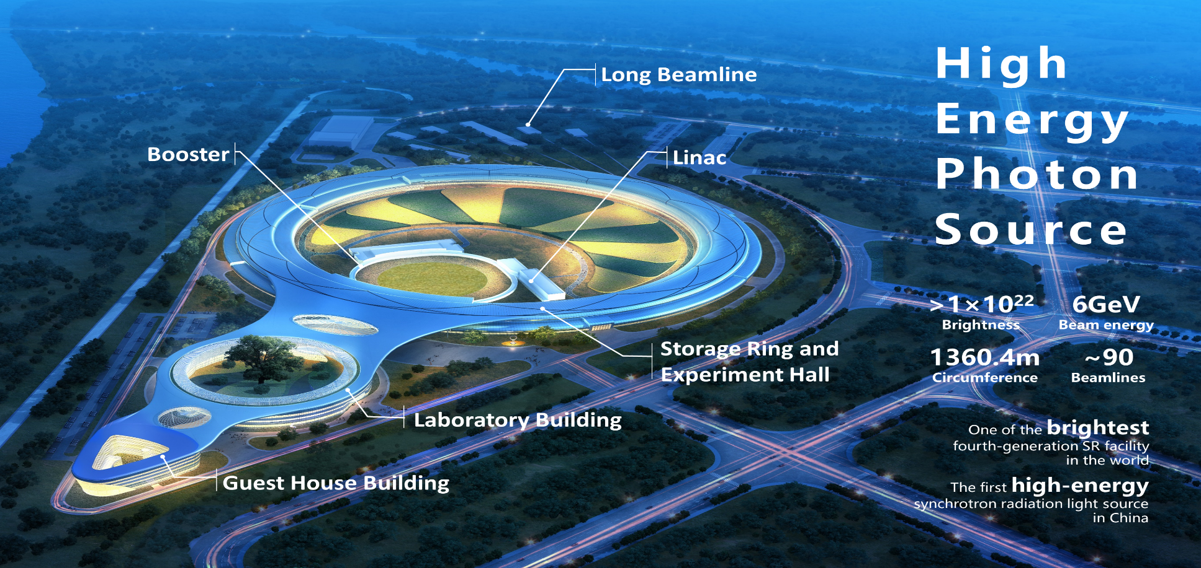
Overview of HEPS

Slide 5
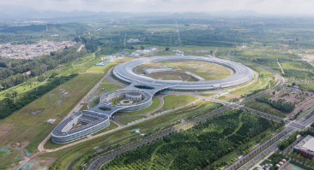
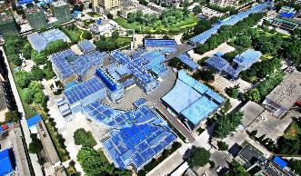
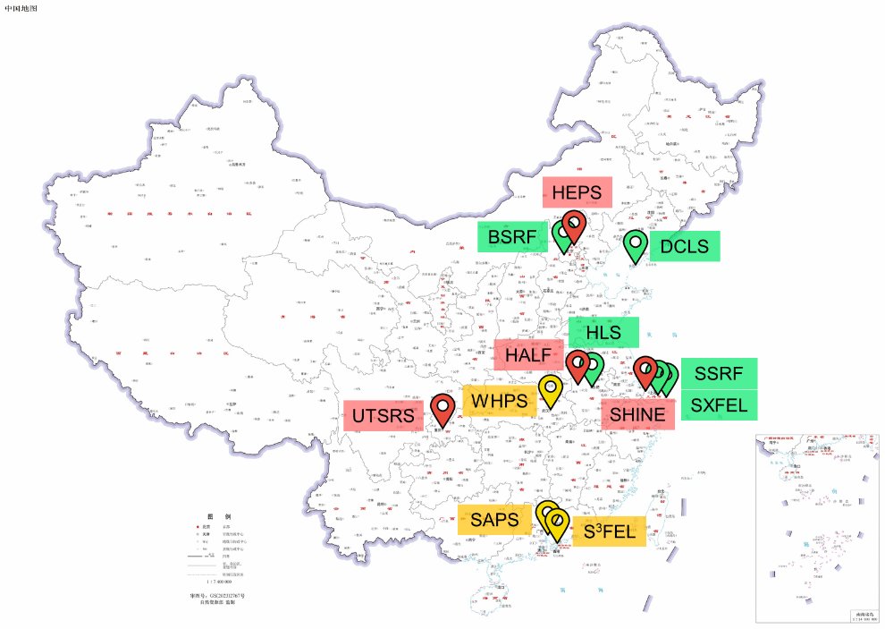
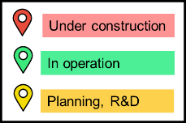
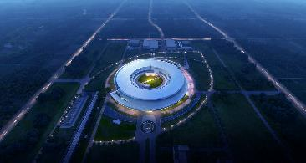
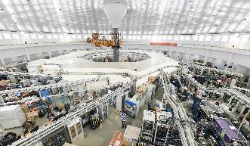
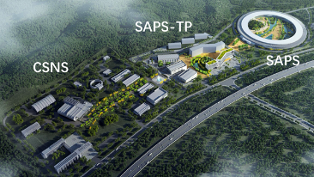
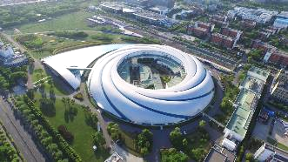
HEPS: 1st High-energy SR source in China
Beijing Synchrotron Radiation Facility (1st-gen)
In operation: 5 light sources (3 SRs + 2 Linacs)
Under constr.: 4 light sources (3 SRs + 1 Linac)
Planning, R&D: 4 light sources (3 SRs + 1 Linac)
High Energy Photon Source
Hefei Light Source
(2nd-gen)
Hefei Advanced Light Facility
Shanghai Synchrotron Radiation Facility (3rd-gen)
Southern Adv. Photon Source

Slide 6
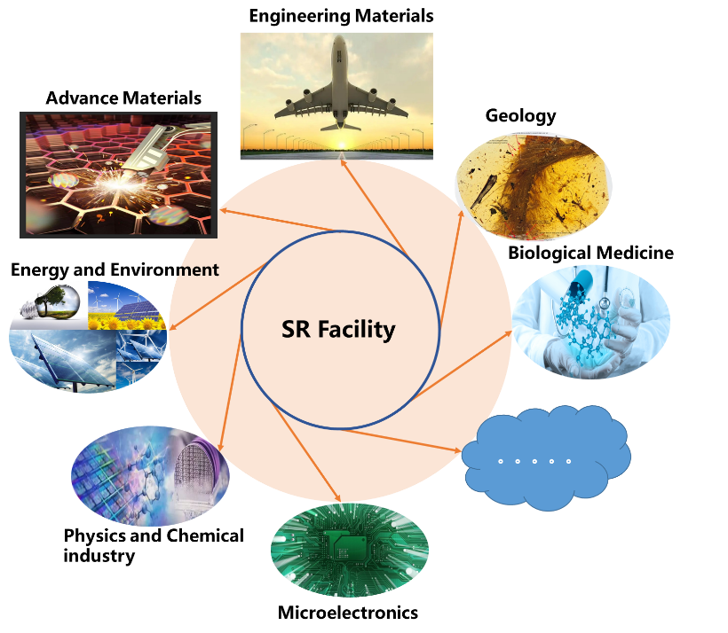
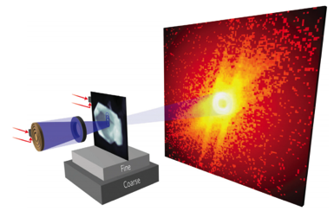
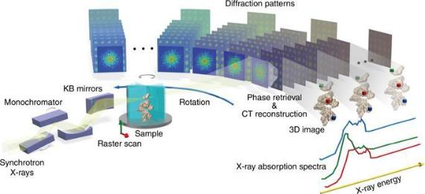
Powerful light sources
required with widely tunable frequency range from Infrared to X-rays !
HEPS will provide high-energy, high-brilliance, high-coherence synchrotron light with energies up to 300 keV and more, with the capability for nm spatial resolution, ps time resolution, and meV energy resolution.
While providing conventional technical support for the general users, HEPS will operate as a platform to analyze the structures, as well as the evolution of structures of engineering materials in the whole process, by in-situ, multi-dimensional and real-time observation.

Slide 7
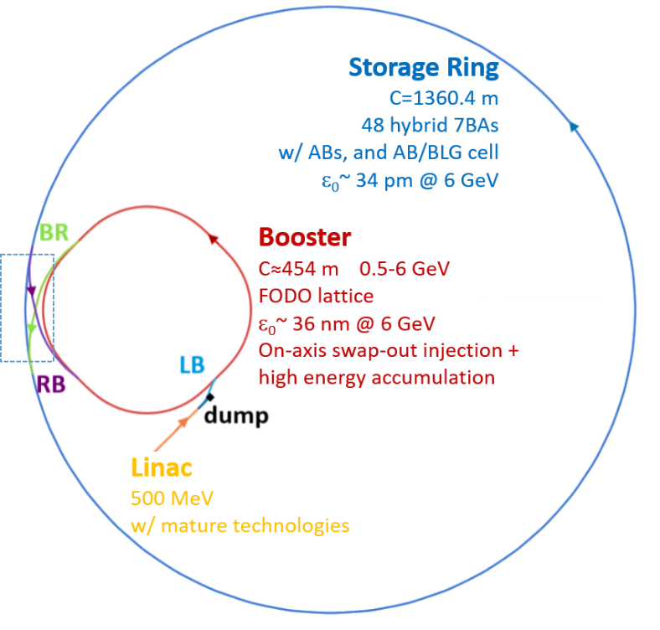
Main parameters: Accelerator
Accelerator complex
- Linac (500 MeV)
- Booster (500 MeV to 6 GeV, 1 Hz)
- Storage ring (6 GeV, top-up)
Parameter | Value | Unit
Beam energy | 6 | GeV
Circumference | 1360.4 | m
Lattice type | Hybrid 7BA
Hori. Natural emittance | <60 | pm∙rad
Brightness | >1×10²² | *
Beam current | 200 | mA
Injection mode | Top-up | -
[1] Y. Jiao et al., J. Synchrotron Rad. 25, 1611–1618 (2018).
[2] Y. Jiao, RDTM 4, 399 (2020).
[3] H. Xu et al., RDTM 7, 279–287 (2023).
*: phs/s/mm²/mrad²/0.1%BW

Slide 8
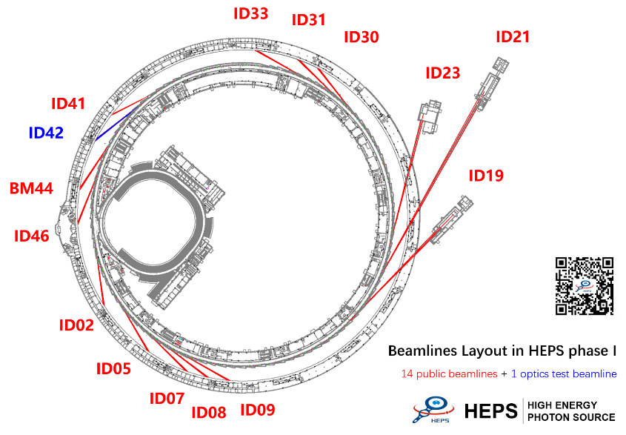
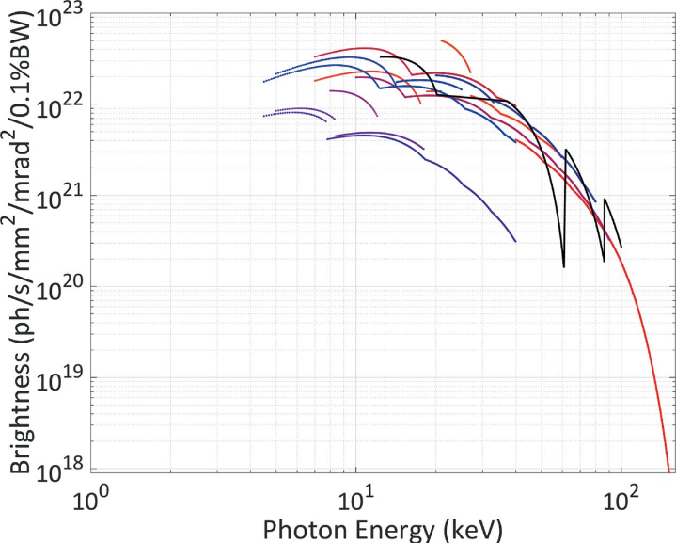
Main parameters: Beamlines
Brightness of 5×10²² phs/s/mm²/mrad²/0.1%BW at the photon energy of 21 keV, can provide X-ray with energy up to 300 keV
14 user beamlines + 1 test BL in Phase 1, HEPS can accommodate up to 90 BLs
3 long BLs
350m longest
19 IDs 6 types
Y. Jiao et al., J. Synchrotron Rad. 25, 1611–1618 (2018).

Slide 9
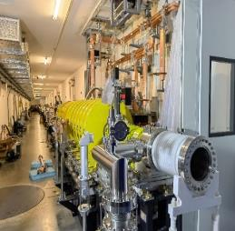

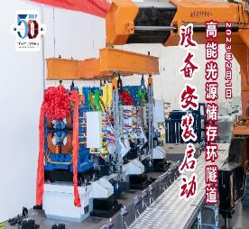
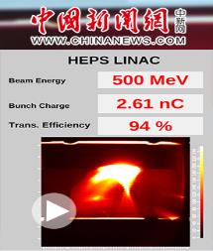
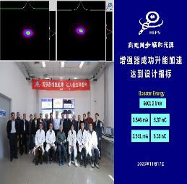
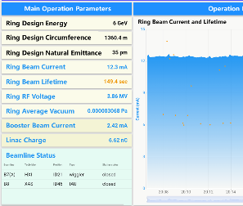
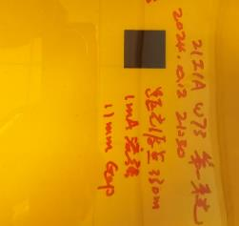
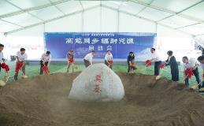
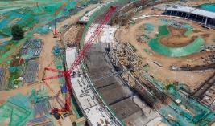
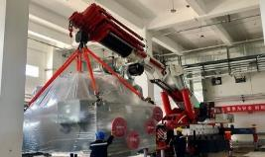
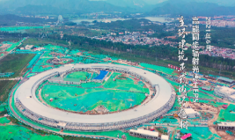
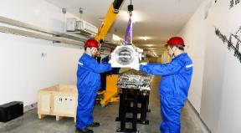
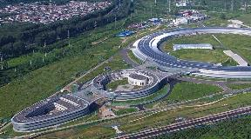
Multi-Milestones Achieved from mid-2019
Mar. 14, 2023
The first electron beam
Nov. 17, 2023
Electron Beam Ramped Up to 6 GeV
Aug. 18, 2024
Electron beams with currents higher than 10mA were successfully stored.
Jan. 13, 2023
The Booster Vacuum-sealing in the tunnel completed
Oct. 12, 2024
the SR X-ray emitted from the R21 wiggler was successfully transmitted to the end station.
Feb. 1,2023
The first girder was installed in the storage ring tunnel
May 12, 2022
The Linac Vacuum-sealing in the tunnel completed
June 29, 2019
Groundbreaking ceremony
June 28, 2021
HEPS Installs First Piece of Accelerator Equipment in Linac Tunnel.
July 1, 2020
The first steel beam was installed
Apr. 13, 2021
Utility installation in NO.2 Hall commenced
June 27, 2021
Roof-sealing work for the main ring building completed
Nov. 3, 2023
Civil Construction for ancillary buildings completed
Notes:
After more than ten years’ R&D, including the HEPS test facility project (2016-2018), the HEPS project started construction in mid-2019 [3] and has achieved multiple significant milestones [4]. In July 2022, the main civil construction was essentially completed; in 2023, beam commissioning of the Linac and booster was completed; in 2024, storage ring main equipment fabrication and tunnel installation were finished (with the exception of some devices whose fabrication and installation were delayed) and initial beam commissioning were complet-ed; in March 2025 joint commissioning of the accelera-tor and beamlines was launched, and in May 2025 a few pilot experiments were performed. Right now, the last round of equipment installation is under way.

Slide 10
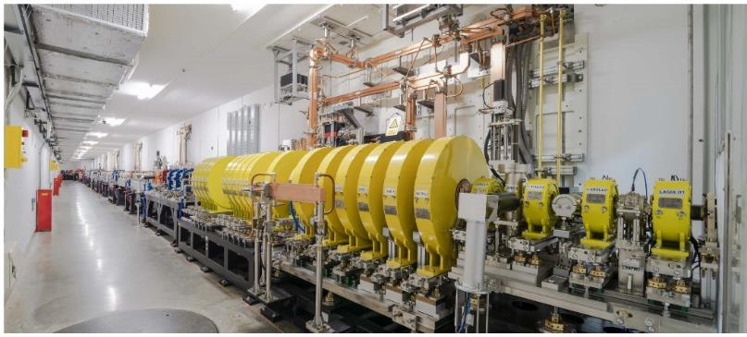
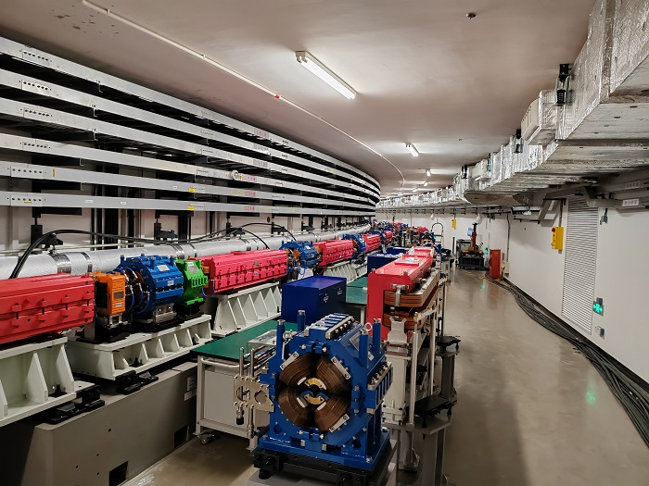
Injector
Linac (high bunch charge 7 nC)
a total length of about 49 m, 500MeV
an s-band normal conducting electron linear accelerator
high bunch charge and large bunch charge range
an electron gun, a bunching system, and S-band accelerating structure system.
Booster (high bunch charge 5 nC)
454 meters in circumference 500MeV -> 6GeV
a four-fold symmetrical FODO structure, with each super-period consisting of 14 standard FODO cells, two matching sections, and an 8.8-meter-long dispersion-free straight section.

Slide 11
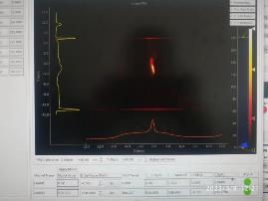
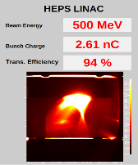
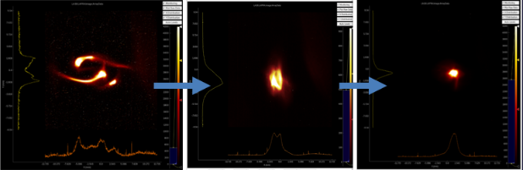
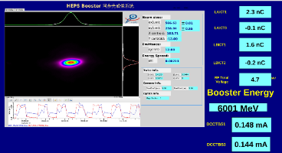
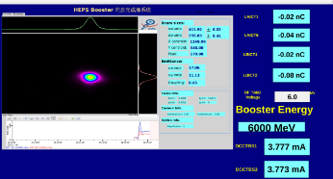
Injector commissioning completed
500 MeV, ~2.5 nC
500 MeV, max bunch charge > 7 nC
Ramped to 6 GeV
>5 nC of single bunch charge
1st electron beam
LINAC passed SAT
1st electron beam in Booster
Booster passed SAT
3.9
3.14
6.5
7.25
8.9
11.17
LINAC CX started
Booster CX started
2023
On-site testing of LINAC in May, 2023, the macro-pulse charge reached 7.29 nC, and beam energy stability was 0.014%.
The electron beam achieved more than 5 nC of bunch charge at 6 GeV via the booster on Nov. 17, 2023.

Slide 12
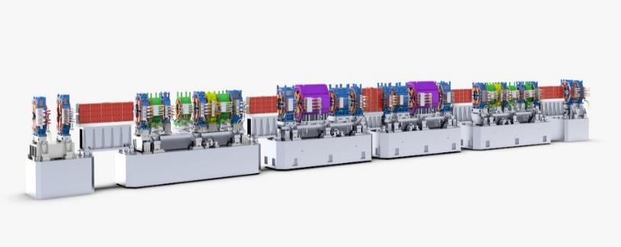
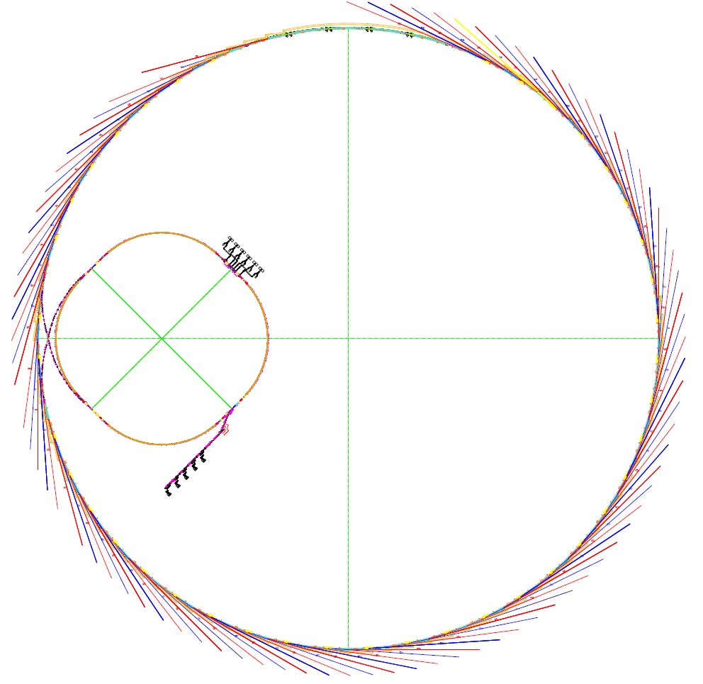
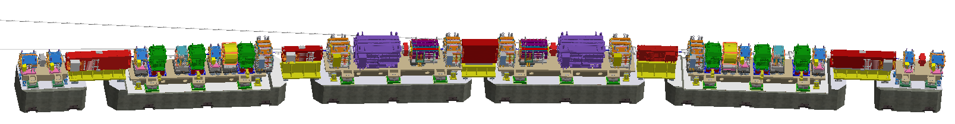
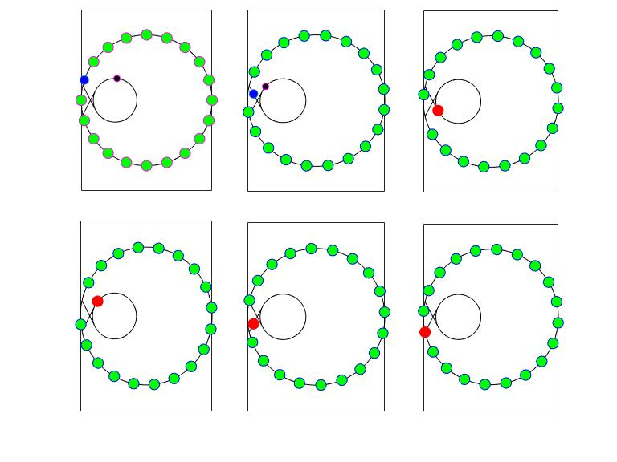
Storage Ring
the main component of the HEPS accelerator complex
Hybrid 7BA with unit cell comprises dipoles of reverse bending angle and longitudinal gradient
19 IDs
1700⁺ Magnets
Bending magnet radiation source
booster
~1300 vacuum chambers
500⁺ BPMs
288 Girders
Linac
a circumference of 1360.4 meters
48 seven-bend achromats, meticulously designed to achieve a horizontal natural emittance of ~35 pm·rad at a beam energy of 6 GeV.
High energy accumulation:
effectively reduced single bunch charge requirement for injector
Storage ring

Slide 13
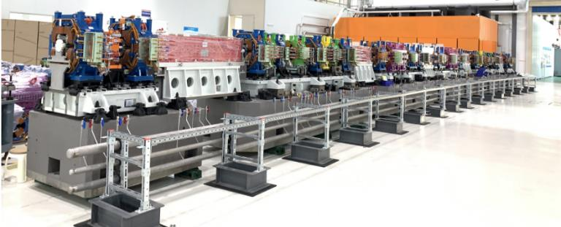
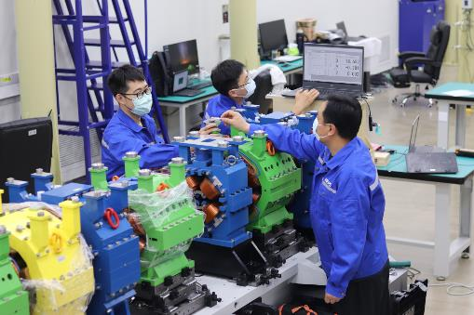
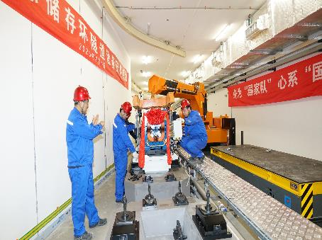
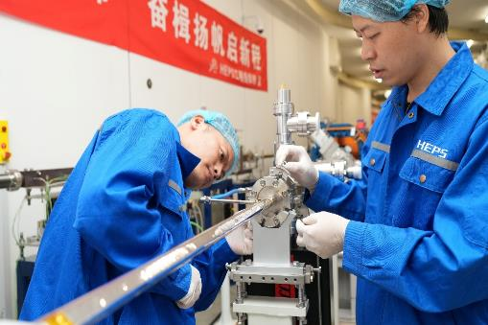
Storage Ring Installation
Process Experiment for Storage Ring Installation
Aim to verify the feasibility of the magnet, vacuum chamber, BPM, etc. installation procedure
The operation space and interfaces have been checked, and pre-alignment scheme, transport scheme and other critical problems have been thoroughly tested
April 2022
July 2022
The pre-alignment began.
30µm for pre-aligned girders
Feb. 2023
The installation began
50µm for alignment in tunnel
July 1, 2024
Vacuum sealing completed.

Slide 14
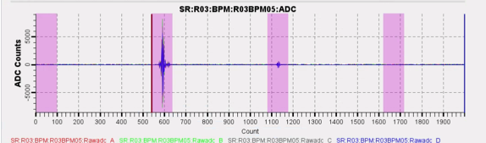
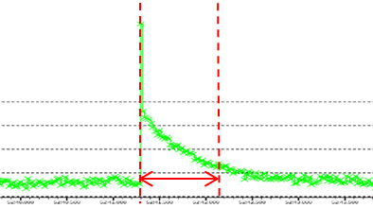
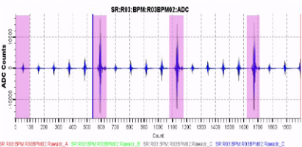
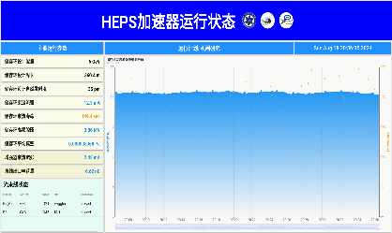
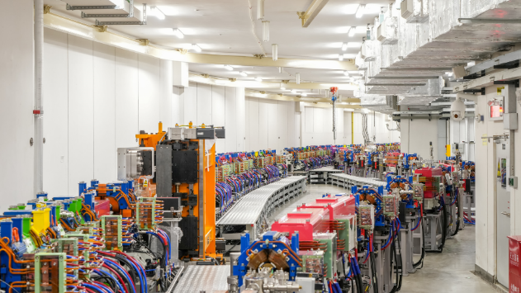
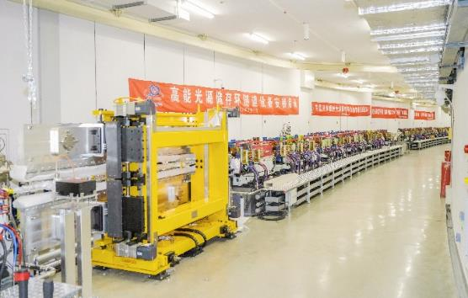
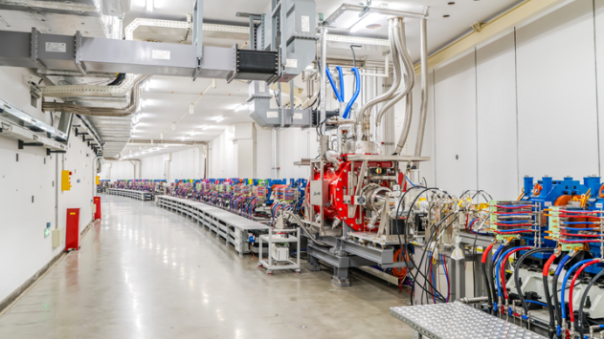
Storage ring commissioning milestones
~1.3 s
Signal of 2nd turn
First turn
One bunch stored
Current: ~0.4 mA, Life time: ~1 min
Current: ~12 mA, Life time: ~2 min
Multi-bunch stored
12 mA stored
Comm.
Started
7.23
7.29
8.4
8.6
8.8
8.15
8.18
First light
in Oct. 2024
10 turns
1000 turns
7 mA, 2 min

Slide 15
Commissioning

Slide 16
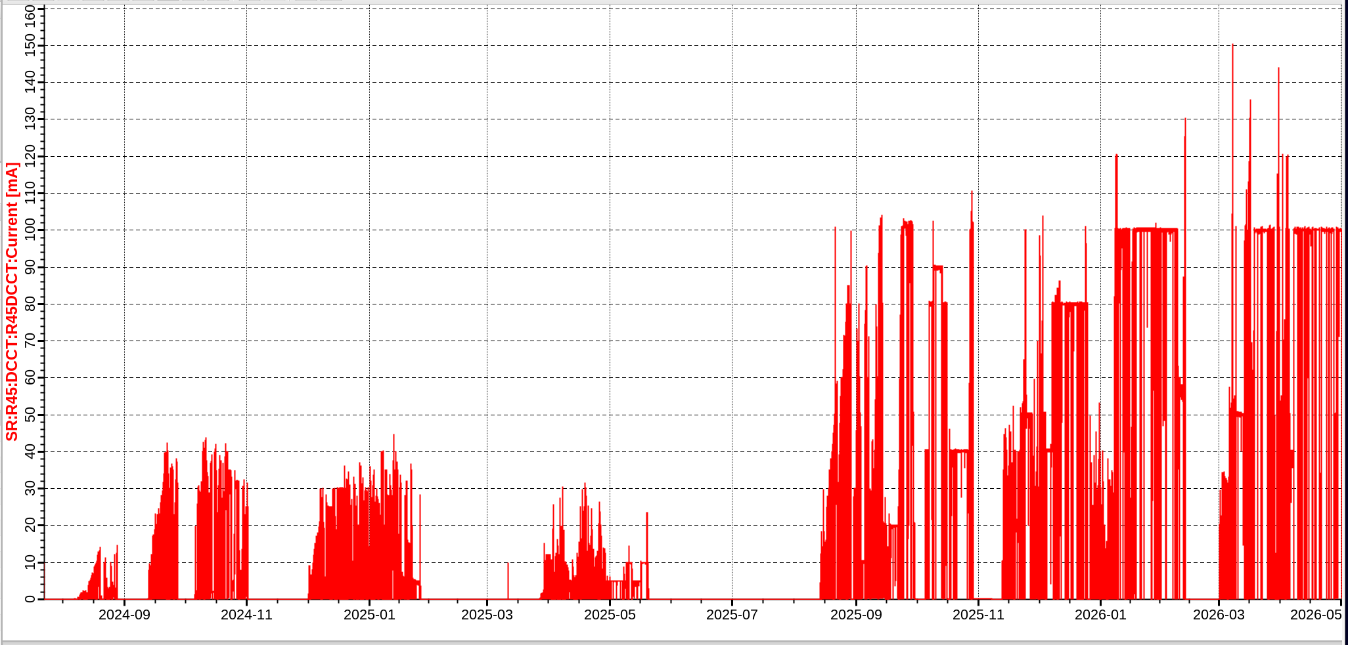
HEPS storage ring commissioning
1.5 years from beginning, 8 rounds, Beam current 150 mA, Emittance < 60 pm.rad
1st, 2nd& 3rd round
4th round
5th round
6th round
7th round
8th round
Commenced on July 23, 2024
Installation of nearly all accelerator and beamline equipment completed
SD#1
SD#2
SD#3
SD#4
SD#5
SD#6
SD#7
Notes:
Now, about one and a half years later, installation of nearly all accelerator and beamline equipment has been completed. We have conducted eight rounds of accelerator commissioning, supporting beamline commissioning and initial user experiments.

Slide 17

Equipment installation and conditioning
Not all hardware systems were fully ready on Day One of the ring commissioning.
Adopted a pattern of commissioning periods interspersed with shutdowns for equipment installation and conditioning.
Two major shutdowns took place in 2025 (totally about 130 days):
SD#4 (Feb 5- Mar 22)：
1，install most IDs；
2，fine global alignment；
3，install beam dump kicker；
SD#5 (May 20- Aug 9)：
1，install 166MHz & 500MHz SCCs；
2，install 4th collimator；
3，fine alignment of booster；
4，install remaining IDs
SD#6：
1，install 6th booster Cavity；
2，Power Supply, Injection& Extraction, Vacuum, ID, Cryogenic System Maintenance
SD#7：
1, Chinese New Year holiday
Notes:
Two major shutdowns took place in 2025, totally about 130 days. The first shutdown, from February 5 to March 22, focused on installing most insertion devices, performing fine global alignment, and installing the beam dump kicker. The second shutdown, from May 20 to August 9, focused on installing the 166 MHz and 500 MHz superconducting RF cavities, installing the fourth collimator, performing fine alignment of the booster, and installing the remaining insertion devices.

Slide 18




Insertion devices
During the first long shutdown in 2025 (SD#4), within a 40‑day period, we completed the in‑tunnel installation and conditioning of 11 insertion devices (including 1 IAU, 4 IVUs, 5 CPMUs, and 1 AK).
  This included ID alignment, vacuum connection, vacuum baking, water and liquid‑nitrogen line connection, post‑baking alignment recheck, testing of feed‑forward coils and long coils, and commissioning of the motion control system.
Notes:
During the same first long shutdown, within a 40‑day period, we completed the in‑tunnel installation and conditioning of 11 insertion devices, including one IAU, four IVUs, five CPMUs, and one AK. This involved alignment, vacuum connection, vacuum baking, water and liquid‑nitrogen line connection, post‑baking alignment recheck, testing of feed‑forward coils and long coils, and commissioning of the motion control system.

Slide 19




Insertion devices
During the first long shutdown in 2025 (SD#4), within a 40‑day period, we completed the in‑tunnel installation and conditioning of 11 insertion devices (including 1 IAU, 4 IVUs, 5 CPMUs, and 1 AK).
During the second long shutdown (SD#5), we completed the installation and conditioning of the remaining 2 insertion devices (one additional CPMU and one Mango wiggler).
In addition, during this shutdown, CPMU22.8 was removed from the tunnel, returned to the laboratory for modification (increasing the maximum gap by 10 mm) and re-test, then re-installed in the tunnel and re-conditioned.
Modification of the CPMU22.8
Test results after modification
Notes:
During the second long shutdown, we installed and conditioned the remaining two insertion devices—one additional CPMU and one Mango wiggler. Notably, during this shutdown, we also removed CPMU22.8 from the tunnel, returned it to the laboratory for modification to increase the maximum gap by 10 mm, retested it, reinstalled it in the tunnel.

Slide 20



166.6 MHz SRF cavities for storage ring
All five 166.6MHz SRF cavities assembled and passed horizontal tests in Jun 2025
Excellent performance in vertical tests nicely preserved in horizontal tests of the module
HOM impedance measurement in line with design (heavy damping)
Total heat load per module: 39~43W (dynamic: 5~7W)
Max Vc: >1.6MV (administration limit),
Q0@1.2MV: 1.5e9~2.1e9, Rad. < 0.1mSv/h
Notes:
Laboratory testing and installation of RF cavities were a major focus in 2025. All five 166 MHz SRF cavities were assembled and passed horizontal tests by June 2025. The excellent performance observed during vertical tests was well preserved in the horizontal tests. HOM impedance measurements were in line with design expectations, demonstrating heavy damping.

Slide 21



RF installation and conditioning
During the second long shutdown (SD#5), six SRF cavities installation and conditions completed
  - an integrated schedule developed, monitored and updated on a daily basis: May 20, 2025 ~ Aug 8, 2025 (81 days)
- Removal of 2 NC cavities, transport & installation of 6 SRF cavities (5×166MHz & 1×500MHz)
- First cooldown of all 7 SRF cavities: Jul 22 – Aug 1, 2025 (11 days)
- RF conditioning & performance check of all 7 cavities: Aug 2 – Aug 5, 2025 (3 days)
Now, BST and SR RF system in nominal setup and fully operational
166MHz SRF
500MHz SRF
High-power RF & LLRF
Notes:
During the second long shutdown, we completed installation and conditioning of the six SRF cavities. An integrated schedule was developed, monitored, and updated on a daily basis over 81 days. This included removal of the two normal‑conducting cavities, transport and installation of the six SRF cavities, first cooldown of all seven SRF cavities over 11 days, and RF conditioning and performance checks over three days. Currently, both the booster and storage ring RF systems are in their nominal setup and fully operational.

Slide 22


Smooth vacuum conditioning
Accumulated dose has exceeded 200 A·h.
Accompanied by a gradual reduction in vacuum pressure.
The normalized beam lifetime increased by 3 orders of magnitudes.
归一化束流寿命
Normalized total beam lifetime
Iτ(mA*h)
平均动态压强
Normalized average pressure rise（Pa/mA）
Notes:
The accumulated dose has exceeded 200 A·h, accompanied by steady progress in vacuum conditioning. The normalized total beam lifetime has improved by three orders of magnitude.

Slide 23



Beam motion of 0.1 μm level reached
Interference between the tuning of different beamlines largely mitigated.
1/0: FOFB on/off
1
Update SC power supply, w/o FOFB
w/ FOFB
Notes:
By the end of 2025, the fast orbit feedback system was commissioned and put into operation. Beam motion has been reduced to 0.1 um level, below 10% of the beam size, and with FOFB on, interference between the tuning of different beamlines has been largely mitigated.

Slide 24


Accelerator KPPs achieved by Sep 2025
Passed accelerator performance tests on Sep 26-29, six key performance parameters met the acceptance criteria.
Passed HEPS performance acceptance review on Oct 29, after passing beamline performance tests.
Parameter | Design | KPP# | Measurement | Unit
Beam energy | 6 | 6 | 6.01 | GeV
Beam current | 200 | 100 | 100.5 | mA
Natural emittance | 34.8 | 100 | 56.8$ | pm·rad
Beam stability | 10% | 20% | < 19.8% | fraction of rms beam size & divergence
Brightness | >1×10²² | 2×10²¹ | 4.00×10²¹ | phs/s/mm²/mrad²/0.1%BW
Capability of providing X-ray photons of 300 keV | 0.1-300 |  | 349.57 | keV
# Key performance parameters for national acceptance test
$ Measured horizontal + vertical emittance @ 100 mA, with grating interferometry
Notes:
In September 2025, we successfully passed the accelerator performance tests from September 26 to 29. All six key performance parameters met or exceeded the acceptance criteria. The measured emittance at 100 mA was below 60 pm·rad. Following this, we passed the overall HEPS performance acceptance review on October 29, after beamline performance tests were completed.

Slide 25





~ half a month to get first beam storage
12th turn beam signal
~1.3秒
第11圈束流信号
Commissioning start
Circulation of 11 turns
First beam storage
08.04
08.06
07.23
07.29
First turn around
Circulation of 1000 turns
Lifetime ~ 1 min
Current~ 60 uA
Life time~ 1min
Signal of 2nd turn
>1000 turns

Slide 26

First-turn circulation
First-turn circulation is achieved within one day
  By using both the tools for automatically tuning (previously validated on the booster) and manual knobbing of the beam trajectories.
  Also thanks to rigorous joint-debugging before the com-missioning that verified the polarity across all magnets (more than 1000).
BPM sum signal

Slide 27

Multi-turn circulation
Great challenges were faced to achieve multi-turn circulation,
  Primarily due to the physical-aperture limitation, i.e., two 1.6-meter ±2.5mm vertical apertures at the injection and extraction Lambertson magnets.
We established 11-turn circulation mainly by implementing multi-corrector strength scans and working point adjustment.
Lambertson:
H：+/-5.25 mm
V: +/-2.5 mm
12th turn signal

Slide 28


Turn on RF and sextupoles & first storage
RF turned on, and sextupole strengths increased to 90-100% of the design values; it took about 1 week to get the first beam storage.
Critical:
RF frequency shift by~200 Hz
Circulation turns
RF/sextupole off
RF on ramp up sextupole/octupole
Notes:
a critical measure is to knob the RF frequency to match the beam path length.

Slide 29



Beam stability
Prior to June 2025, both accelerator and beamline commissioning were affected by low‑frequency (2-3 Hz) beam fluctuations. A comprehensive investigation identified the power supplies for the slow correctors as the main source. After this issue was resolved, beam motion was reduced to below 20 % of the beam size.
Shifting PWM frequency of slow corrector power supplies
optimized
Notes:
Beam Stability is a fundamental topic for the light source.
Prior to June 2025, both accelerator and beamline commissioning were affected by low‑frequency beam fluctuations around 2–3 Hz. A comprehensive investigation identified the power supplies for the slow correctors as the main source. After resolving this issue, beam motion was reduced to below 20% of the beam size.

Slide 30




Beam stability
Prior to June 2025, both accelerator and beamline commissioning were affected by low‑frequency (2-3 Hz) beam fluctuations. A comprehensive investigation identified the power supplies for the slow correctors as the main source. After this issue was resolved, beam motion was reduced to below 20 % of the beam size.
In Dec 2025, start put FOFB into operation, further reducing the beam fluctuation amplitude to below 10% of the beam size at IDs.
Parameter | Feedback design
Algorithm implementation | Fast + RF feedback
BPM sampling rate | 22 kHz (FA)
FC sampling rate | 22 kHz
Signal processors (16 stations) | FPGA (Virtex-7)
Num. BPMs /plane | 192 (4 per cell)
FC /plane | 192 (4 per cell)
FC PS bandwidth | 10 kHz
FC latency | < 25 μs
FOFB closed-loop bandwidth | >500 Hz
Notes:
In December 2025, we began operating the fast orbit feedback system. With FOFB on, the beam fluctuation amplitude was further reduced to below 10% of the beam size at the ID locations.

Slide 31



Beam‑based alignment (BBA)
Multiple rounds of beam‑based alignment (BBA) carried out, meeting the precision requirement for orbit correction and lattice calibration.
Orbit stability plays a critical role in ensuring the reproducibility of BBA measurement results. In August 2025, after the low‑frequency (2–3 Hz) beam fluctuations resolved, the proportion of BPMs achieving reproducibility of better than 30 μm increased from less than 40 % to over 80 %.
Reproducibility of BBA Results Before and After the corrector PWM optimization
Notes:
Multiple rounds of BBA were carried out, meeting the precision requirements for orbit correction and lattice calibration. Orbit stability plays a critical role in ensuring the reproducibility of BBA measurement results. After the low‑frequency beam fluctuations were resolved in August 2025, the proportion of BPMs achieving reproducibility of better than 30 μm increased from less than 40% to over 80%.

Slide 32

Closed orbit correction
Orbit correction iterated with BBA, results in reduced rms closed orbit.
Notes:
With BBA iterated, we achieved reduced RMS closed orbit.

Slide 33

Closed orbit correction
Current rms closed orbit is 70-80 μm, all BPM readings within +/-0.4 mm except two locations where orbit bumps are intentionally applied for beam loss control and lifetime optimization.
Injection region
R18 local bump
Notes:
Currently, the RMS closed orbit is 70–80 μm, with all BPM readings within ±0.4 mm except at two locations where orbit bumps are intentionally applied for beam loss control and lifetime optimization.

Slide 34




Optics correction
From Mar 2025 to now, 5 rounds of orbit and optics correction iterations performed, based on response matrix and LOCO.
Besides the parameter setting optimization, updated AT lattice model (better reflect the cross-talk effect) and sextupole movers were used to improve the correction results.
Beam parameters after correction(20260318)
Beta beating(LOCO) (%) X&Y | 1.28 | 1.41
Δdispersion (mm) X&Y | 1.29 | 1.25
RM Skew/normal(%) HV/HH&VH/VV | 3.19 | 3.74
Beta beating
Sextupole displacement w/ mover
X
Dispersion deviation
Y
Notes:
From March 2025 to the present, we have performed five rounds of orbit and optics correction iterations based on response matrix measurements and LOCO analysis. Beyond optimizing parameter settings, we introduced an updated AT lattice model that better captures cross‑talk effects, and we used sextupole movers to enhance correction outcomes. As a result, we achieved an RMS beta beating of less than 2% and an RMS dispersion deviation of below 2 mm.

Slide 35



Progress of High-Current Commissioning
Commissioning with 500 MHz cavities only
(2 NC 7-cell cavities + 1 SC cavity)
Constraints: limited RF power, short bunch, etc.
Commissioning with active dual-RF system
(5 SC 166.6MHz cavities + 2 SC 499.8 MHz cavities)
First 150 mA
March 7, 2026
There are two stages of the commissioning from the beam current point of view.
First 100 mA
Sep. 12, 2025
Ring Commissioning Start
July 23, 2024
Notes:
The beam current commissioning progressed in two stages. Initially, we operated with 500 MHz cavities only—two normal‑conducting seven‑cell cavities and one superconducting cavity—which faced constraints in RF power and bunch length. When the double-frequency RF system became available, a short time later, we reached the first 100 mA on September 12, 2025, and the first 150 mA on March 7, 2026.

Slide 36


Bunch lengthening commissioning
Manage to reach nearly ideally flat bunch distribution at arbitrary beam current.
  Dec.29 and Dec.31, 2025, try ‘ideal lengthening’（~1.2 nC / bunch）
Notes:
The double-frequency RF system allows us to achieve nearly ideal flat bunch distribution at arbitrary beam current.

Slide 37


Beam lifetime & DA
After more than 200 Ah of vacuum conditioning, currently beam lifetime is ~1 hr@ 100 mA, primarily limited by Touschek effects.
Beam lifetime effectively improved w/ harmonic cavity and a local bump in R18 arc region.
ML-based optimization of sextupole strengths are under way.
Lifetime vs. local bump at R18BPM08
Notes:
After more than 200 A·h of vacuum conditioning, the beam lifetime is now about one hour at 100 mA, primarily limited by Touschek effects. Beam lifetime has been effectively improved using the harmonic cavity and a local bump in the R18 arc region.

Slide 38




Beam lifetime & DA
After more than 200 Ah of vacuum conditioning, currently beam lifetime is ~1 hr@ 100 mA, primarily limited by Touschek effects.
Beam lifetime effectively improved w/ harmonic cavity and a local bump in R18 arc region.
ML-based optimization of sextupole strengths are under way.
DA measured with pre-dump kickers (4.5us pulse, all bunches) or injection/extraction/pre-extraction kickers (4ns/10ns pulse, single bunch) and BBB or TBT data acquisition.
A long-standing issue that has troubled us, “smaller orbit, smaller DA”, solved recently with a local bump in R18 arc region.
Smaller rms orbit
Injection beam loss greatly reduced w/ local bump at R18
Pre-dump kicker + BBB
Notes:
A long-standing issue that has troubled us, “smaller orbit, smaller DA”, was recently resolved with the local bump in R18. This local bump also greatly reduced injection beam loss. Dynamic aperture is measured using pre‑dump kickers with a 4.5 μs pulse or injection/extraction kickers with 4 ns or 10 ns pulses, combined with bunch‑by‑bunch or turn‑by‑turn data acquisition.

Slide 39



Injection commissioning
Swap-out injection based on high-energy accumulation in booster is adopted.
The bottleneck of the whole injection process is the beam transmission efficiency from the booster to the storage ring. This efficiency gradually increased to ~90%, especially after applying a local bump in R18 arc region.
For the timing mode (63 bunches uniformly filled), max. beam current of ~100 mA achieved (7.3nC/bunch).
Effiency~90%
Notes:
The swap‑out injection scheme based on high‑energy accumulation in the booster has been adopted. The bottleneck of the whole injection process is the beam transmission efficiency from the booster to the storage ring. This efficiency gradually increased to about 90%, especially after applying the local bump in the R18 arc region. For the timing mode with 63 bunches uniformly filled in the ring, a maximum beam current of about 100 mA has been achieved.

Slide 40




ID commissioning
ID orbit feed-forward systems are operating stably, effectively compensating for changes in global closed orbit caused by ID gap variations for all IDs.
In-vacuum ID magnetic alignment performed, w/ local bump at ID or ID girder alignment.
A U0 feed-forward system is under development to control significant changes in beam synchronous phase and bunch lengthening induced by U0 (energy loss per turn) variations from insertion device gap changes.
ID orbit feed‑forward system
Beam position variation control w/ FF system
Gap variation
Angle fluctuations < 0.5 urad
magnetic alignment w/ local bump
ID42CPMU 5th harmonic redshift ring distribution
Notes:
All ID orbit feed‑forward systems are operating stably, effectively compensating for changes in global closed orbit caused by ID gap variations. In‑vacuum ID magnetic alignment has been performed using either local bumps at the ID location or ID girder alignment. A U₀ feed‑forward system is under development, to control significant changes in beam synchronous phase and bunch lengthening induced by U₀ variations from ID gap changes.

Slide 41

Storage ring commissioning milestones
Commissioning started from July 23, 2024, and passed the accelerator KPP test on Sep. 29, 2025.
Total time of 14 months including shutdowns for equipment installation in between.
Notes:
Here shows the key milestones of the HEPS storage ring commissioning. The ring commissioning began on July 23, 2024, and we passed the accelerator performance test on September 29, 2025—a total time of 14 months, including shutdowns for equipment installation in between.

Slide 42
Operation

Slide 43

Machine operation
Since passing the acceptance review (Oct 29, 2025), we have delivered photon beams to beamlines for a total of about 70 days, supporting both beamline optimization and initial user experiments (Dec 4–24, 2025, Jan 19–Feb 11, 2026, and Apr 7-May 1, 2026).

Slide 44

Orbit stability during user time
Combination of FOFB and RF frequency feedback contributed significantly to suppressed beam fluctuations and long‑term orbit drifts. Interference between the ID tuning activities of different beamlines was markedly reduced.

Slide 45


Orbit stability during user time
Short‑term orbit stability: beam position fluctuations < 10 % beam size at the ID light source point .
Long‑term orbit stability (>10h): position drift < 10 nm, and angular drift < 3 nrad at the ID light source point.

Slide 46

Statistical Analysis of Faults During Beamline time
We defined that if the beam trip or top-up current is below 98mA, it will be recorded as a fault.
No. | Subsystem | Count | Duration
1 | Power Supply | 11 | 676
2 | Beam Instrumentation | 17 | 669
3 | Injection and Extraction | 4 | 415
4 | Unknown Causes | 19 | 505
5 | Insertion Device | 1 | 482
6 | Timing | 3 | 436
7 | Beam Physics Tuning | 7 | 250
8 | Radio Frequency | 15 | 264
9 | Beamline | 1 | 266
10 | Earthquake | 2 | 46
11 | Fast Orbit Feedback | 2 | 46
12 | Untility | 1 | 35
13 | Vacuum | 1 | 33
14 | Cryogenics | 1 | 26
18 | Total | 85 | 4149

Slide 47



Measures to address beam loss/trip
To address beam loss/trip caused by various factors during operation, we focus on:
  Developing diagnostic tools for rapid fault source identification（bunch-by-bunch BPM & RF signals）.
  Enhancing hardware stability to reduce failure rates, and maintaining sufficient spare components for quick equipment replacement.
Integrated display of fault information for critical systems
Beam loss diagnosis based on bunch-by-bunch BPM data
Beam loss diagnosis based on RF singals

Slide 48

2nd user time period, faults statistics & analysis
Machine development
(accelerator)
Prepare (beamline)
Prepare (beamline)
Shutdown
Warmup
user
Maintenance 1
user
Maintenance 2
user
Shutdown
T_operation（Run 1)
T_shutdown
T_warmup
T_MD
T_prepare1
T_user1
T_M1
T_user2
T_M2
T_prepare2
T_user3
T_shutdown
T_user_nobeam
T_user_with_beam
Scheduled beamline time
26/1/18-2/8 | Statistics
T_user | 465h50min
Number of downtimes | 21
Total downtime | 23h44min
A_user(Availability) | 94.91%
MTBF* | 21.05h
MTTR$ | 1.18h
Availability for user：
A_user$=\frac{T_user_with_beam}{T_user}$=94.91%
MTBF*: mean time between failure
MTTR$: mean time to repair

Slide 49

3rd user time period, faults statistics & analysis
Machine development
(accelerator)
Prepare (beamline)
Prepare (beamline)
Shutdown
Warmup
user
Maintenance 1
user
Maintenance 2
user
Shutdown
T_operation（Run 1)
T_shutdown
T_warmup
T_MD
T_prepare1
T_user1
T_M1
T_user2
T_M2
T_prepare2
T_user3
T_shutdown
T_user_nobeam
T_user_with_beam
Scheduled beamline time
26/4/7-5/1 | Statistics
T_user | 498h7min
Number of downtimes | 26
Total downtime | 19h42min
A_user(Availability) | 96.05%
MTBF* | 18.4h
MTTR$ | 0.76h
Availability for user：
A_user$=\frac{T_user_with_beam}{T_user}$=96.05%
MTBF*: mean time between failure
MTTR$: mean time to repair

Slide 50



Injector status
The injector primarily operates in a 2.5 nC bunch charge mode with a repetition period of about 2 seconds, and overall operation remains stable.
Operation Mode
  Charge: 2.5 nC
  Repetition period: ~2 s
Extracted orbit shows diurnal variation
  Peak–peak: ~80 µm (H) / ~40 µm (V)
Beam availability: >99%
MTTR* = $\frac{Total downtime}{Num of failure}$ < 50min
Top failure sources:
  Power Supplies
  Kicker
  Timing
**Statistical results are derived from data points within 1.21 – 2.8, 2026
*MTTR: mean time to repair

Slide 51


Pilot Proposals
1st round
2025.12.3-2025.12.25
11 BLs, 60 proposals, 1718.5 hours, 210 users, 35 institutions
  2nd round
  2026.1.16-2026.2.11
  12 BLs, 162 proposals, 3132 hours, 498 users, 80 institutions
2 Rounds 13BLs involved
222 proposals conducted
4850.5 Beamtime/hours
708 visiting users 91 institutions
  452 TB Raw & processed data
  60575 datasets
Data collected from Initial commissioning phase

Slide 52






Highlighted Applications
XPCS
High Energy XRD
Mouse kidney unstained
CoNi @HEPS
TC4 @HEPS
3D-RSM on the HfO2 system
BCDI/Ptycho | | X-ray Raman | Nuclear Resonance | Phase-contrast imaging | High speed Imaging | RIXS | PDF | nano-XANES | HERFD | Nano-ARPES

Slide 53
HEPS
Summary

Slide 54
Summary
As a green-field fourth-generation synchrotron radiation light source, HEPS’s construction and commissioning faced various challenges, but have been progressing basically on schedule (2019-2025).
HEPS has successfully passed the performance acceptance review, and now pilot user experiments are underway.
HEPS is planned to be open to users globally in mid-2026.

Slide 55

Summary
Thanks for your attention！

Slide 57


Currently max. beam current ~ 40 mA
Right after the beam storage, we met a great vacuum bottleneck.
  Beam experiments and tunnel inspections revealed that a silicone rubber ring was left in the extraction light pipe of the R20 vacuum chamber, which caused extraordinary outgassing when synchrotron light is hitting on it.
Now the current limitation is from RF power and voltage
  In May to July of 2025, full installation of harmonic cavities (499.8 MHz) and fundamental cavities (166.6 MHz) is underway, which will enable substantial current enhancement

Slide 58

Acc. time
user time
Acc. time
user time
Acc. time
user time
Shut down
Shut down

