Slide 1

The European Research Roadmap on Concepts and Technologies for Accelerators
Mike Seidel, PSI / EPFL, chair LDG
International Particle Accelerator Conference, Deauville, May 2026

Slide 2
European Strategy for Particle Physics:
Motivation for LDG Roadmap and
High Level R&D Goals for Accelerators / Colliders

Slide 3
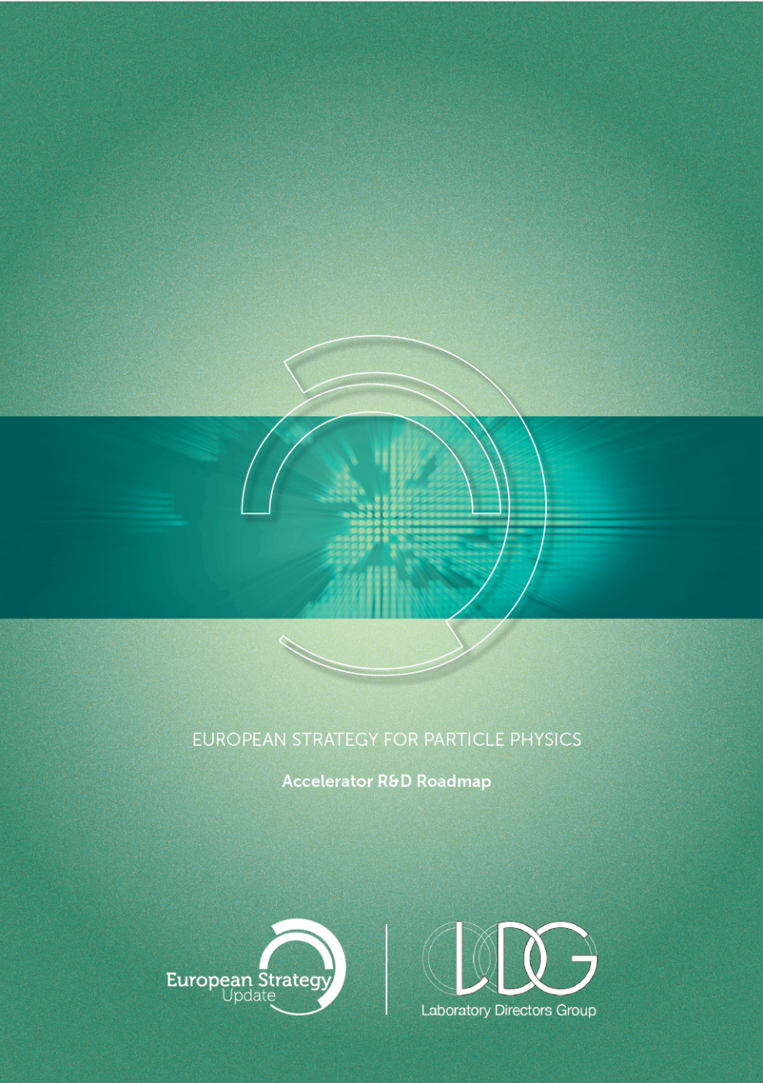
Accelerator Roadmap
Large Laboratory Directors Group (LDG): https://ldg.web.cern.ch/
LDG Roadmap for accelerator R&D: http://arxiv.org/abs/2201.07895 ,
approved by CERN council 03/2022
Technologies and Concepts:
  1) High Field Magnets
  2) High Gradient RF Structures and Systems
  3) High Gradient Plasma and Laser Acceleration
  4) Bright Muon Beams and Muon Colliders
  5) Energy-Recovery Linacs
  6) Sustainability
mid 2026: Update of European Strategy for Particle Physics by CERN Council
Recommendation Document (16p) published December 2025
Deliberation Document published April 2026, and large-scale project report
2022 Accelerator Roadmap

Slide 4
ESPPU Recommendation on Next Collider
The electron–positron Future Circular Collider (FCC-ee) is recommended as the preferred option for the next flagship collider at CERN.
→ the world’s broadest high-precision particle physics programme, with an outstanding discovery potential through the Higgs, electroweak, flavour and top-quark sectors…
→ paves the way towards a hadron collider reusing the tunnel and much of the infrastructure, providing direct discovery reach well beyond the 10 TeV parton energy scale, in line with the community’s ambition for exploration at the highest achievable energy.
→ accelerator technology R&D for FCC ee and hh should receive priority

Slide 5
ESPPU Recommendation on Accelerator R&D
1) … the highest priority must be the development and industrialisation of key technologies:
accelerator-quality magnets in the 14–20 T range, including those based on high-temperature superconductors.
advanced superconducting and normal-conducting RF structures
efficient RF power sources
2) demonstration of high-current multi-turn energy recovery in linacs constitutes an important step towards power-efficient lepton accelerators.
3) the longer-term development of advanced technologies at an appropriate level:
high-gradient wakefield acceleration
technologies underpinning bright muon beams, exploiting synergies with the US initiative on muon collider R&D

Slide 6



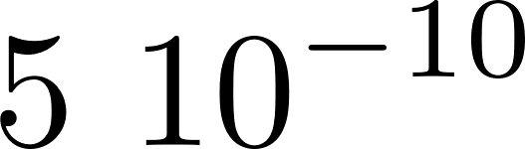

Collider Concept Choices
radiation power relative to electrons
synchrotron radiation (SR) power differs by large factors for the particles under consideration
electron ring collider (FCC-ee): ESPPU recommended, very high luminosity through recirculation → but energy limited by SR, powerful RF*required
electron linear collider: no SR, but beam dumped immediately, RF*
energy recovery linac*: energy recirculated, not beam
plasma acceleration*: high gradient, small footprint, intensity challenge
muon collider*: SR & beamstrahlung suppressed, high energy for leptons
hadron ring collider (FCC-hh): highest parton collision energies, experience from LHC to analyse complex collisions, high field magnets* needed
* accelerator roadmap activities
e
1 MeV
10 MeV
100 MeV
μ
p
1000 MeV

Slide 7















The Importance of Design Tools: Xsuite
  Numerical modelling is key for the design, commissioning and operation of next-generation facilities.
  Increasing need for integrated, multi-physics studies: Optics and lattice design, single-particle dynamics, machine imperfections, collective effects, beam–matter interaction, radiation and damping, spin dynamics, polarization
  Investment over the last years → Xsuite project:
  Open-source and open to feedback and contribution from the community
  Python-based → seamless integration with controls, optimization, AI workflows
  Modular → composable model, plug-in extensions
  High performance & GPU acceleration
More info at https://xsuite.web.cern.ch/
Xtrack
Tracking and optics engine
Xpart
Generation of particles distributions
Xfields
Computation of EM fields from particle ensembles
Xdeps
Data flow manager,
deferred expressions
Physics modules
Xcoll
Particle-matter interaction and collimation
Xwakes
Wakefields and impedances
Xobjects
Interface to different computing platforms
(CPUs and GPUs of different vendors)
CPU GPU
Support and contributions from:

Slide 8
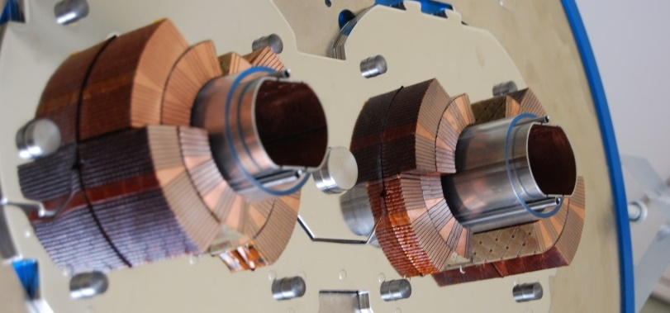
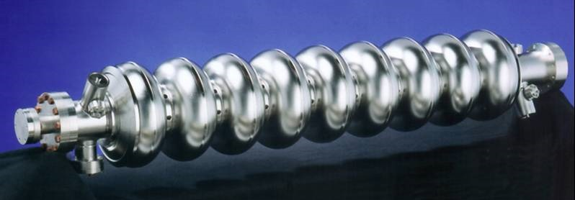
Developing Technology: Superconductivity in Accelerators
the main concepts in accelerators: bending of trajectories and energy gain by RF fields, profit from energy efficient and high performance superconducting technology
Magnets
RF Resonators
highest fields attainable
DC field: cooper pairs move frictionless
zero losses
highest power transfer attainable
RF field: cooper pairs carry mass, causing imperfect RF field shielding
→ very small but non-zero losses

Slide 9
1) Technologies
High Field Magnets,
panel chairs: E.Todesco (CERN), B.Auchmann (PSI)
High Gradient RF Structures and Systems,
panel chairs: G.Bisoffi (INFN LNS), P.McIntosh (STFC)

Slide 10
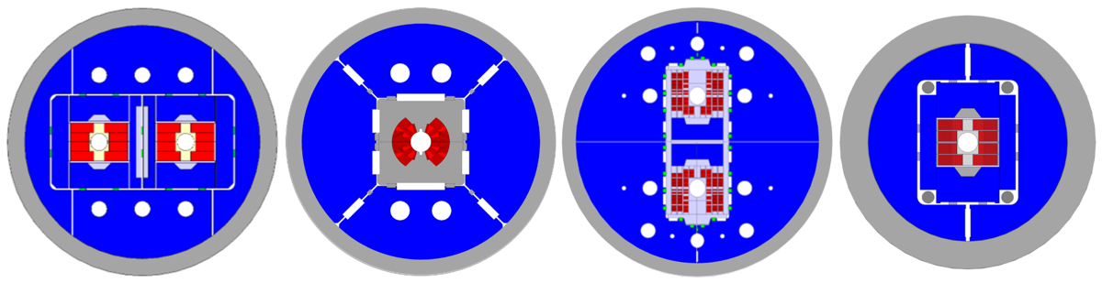
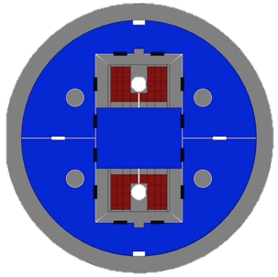





HFM: FCC-hh 2025 Updated Baseline Parameters
 |  | CDR 2019 | 2024-Nb₃Sn
Dipole field | (T) | 16.0 | 14.0
Dipole aperture | (mm) | 50 | 50
Magnetic length | (m) | 14.3 | 14.3
Operational temp | (K) | 1.9 | 1.9
Tunnel length | (km) | 100 | 90.7
Arc length | (km) | 82.0 | 76.9
Arc filling factor | (1) | 0.80 | 0.83
Energy c.o.m. | (TeV) | 50+50 | 42.5+42.5
Loadline fraction | (1) | 0.86 | 0.80
J_{c} at 16 T and 4.2 K | (A/mm²) | 1500 | 1200
# dipoles | (1) | 4587 | 4463
# quadrupoles | (1) | 760 | 520
options (E.Todesco):
Operation at 4.5 K with the same magnet, significant reduction of power consumption of cryogenics
[580MW(16T)→ 430MW(14T)→ ca 330MW(4.5K)]
Hybrid Nb₃Sn/Nb-Ti (large reduction in the mass of Nb₃Sn conductor, even more at 12 T, significant cost reduction)
20-m-long magnets (instead 15m, 25% less magnets to produce, plus a few more TeV or a bit more margin, an a bit cheaper magnet)
short model tests in 2026/27, then downselection

Slide 11

Timeline for LTS
Select the design by 2028/29 (first indications from HFM tests in 2026-2027)
Short model program to verify reproducibility and optimize manufacturing processes: in 2029-2031
Scaling in length in two steps: TRL 7 achieved between 2032 and 2040
Industrialization for final magnets, with pre-series
9 years of production, installation and commissioning in parallel
First selection
of design
5-m-long prototypes
(>5 each type)
Industrialization (pre-series magnets)
ACCELERATED TIMELINE:
Industry is heavily engaged in length scale-up.
Short model program on two selected designs
(>5 each type)
15 m long prototypes with industry (>5)
Production and test
Feedback
HL-LHC operation
Ongoing
12 T and 14 T short models
Selection of final design
to start long magnets
Tender
for the series
Installation and commissioning
`25
`26
`27
`28
`29
`30
`31
`32
`33
`34
`35
`36
`37
`38
`39
`40
`41
`42
`43
`44
`45
`46
`47
`48
`49
`50
`51
`52
`53
`54
RunIII
HL-LHC RunIV
HL-LHC RunV
Nb₃Sn timeline for FCC-hh

Slide 12
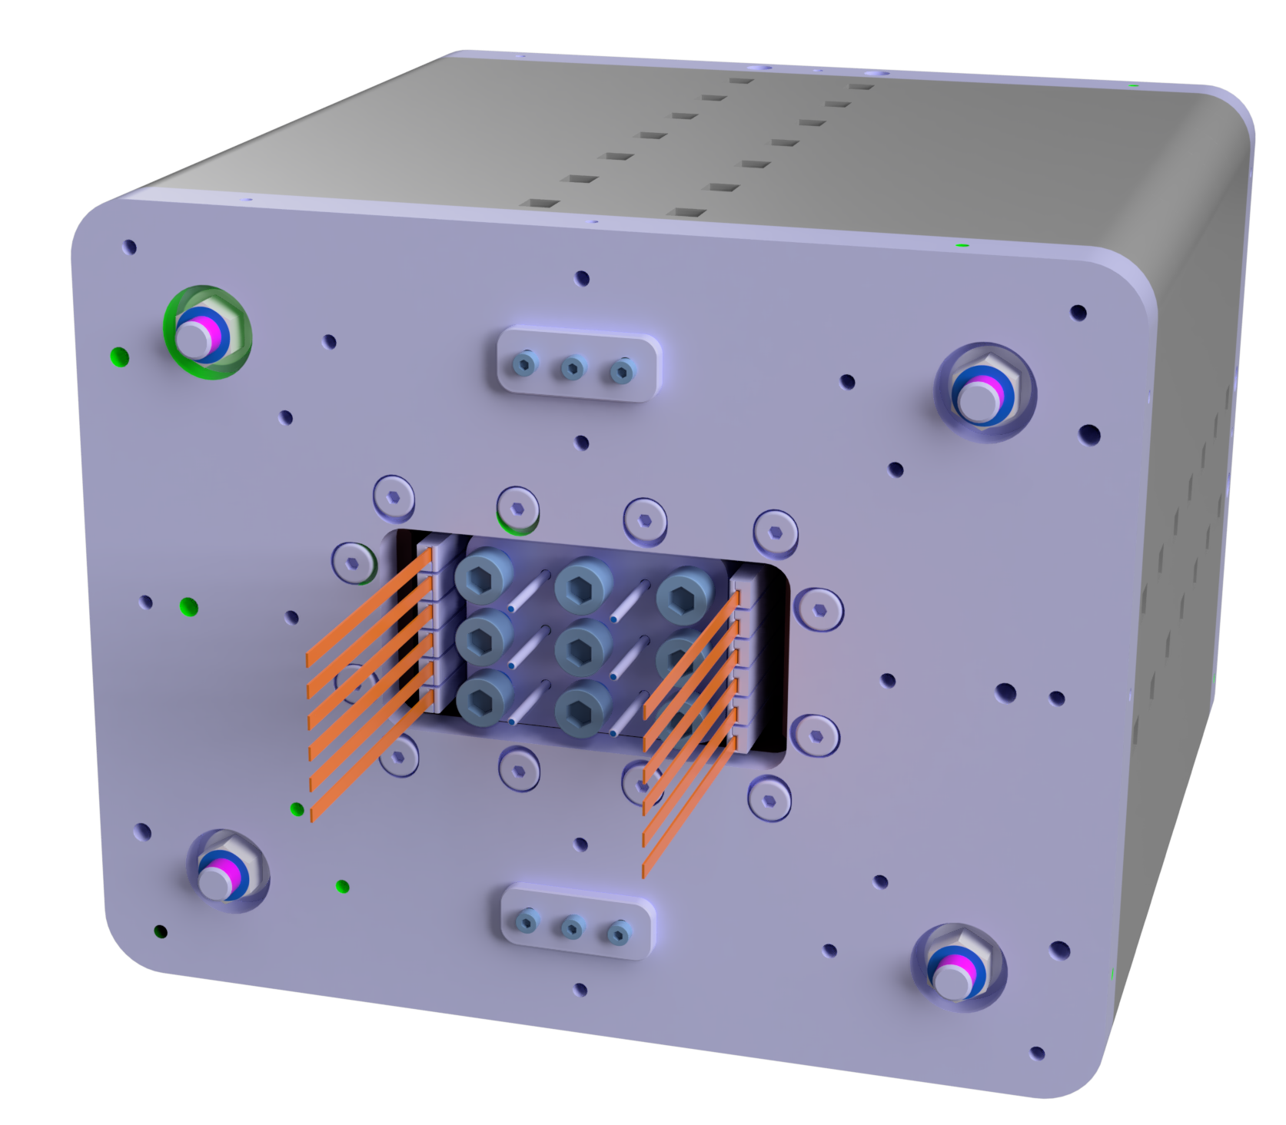
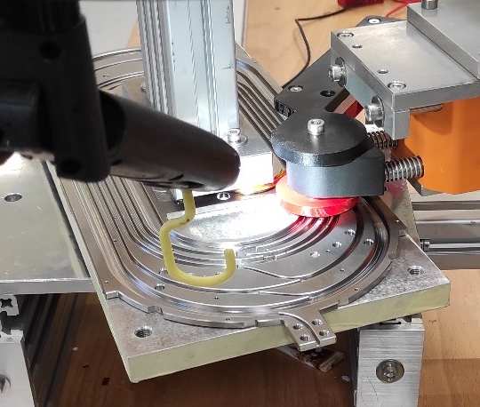
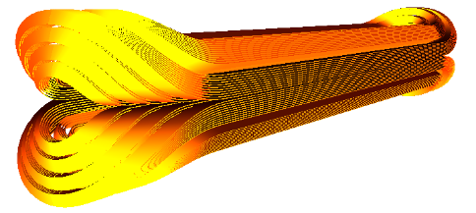
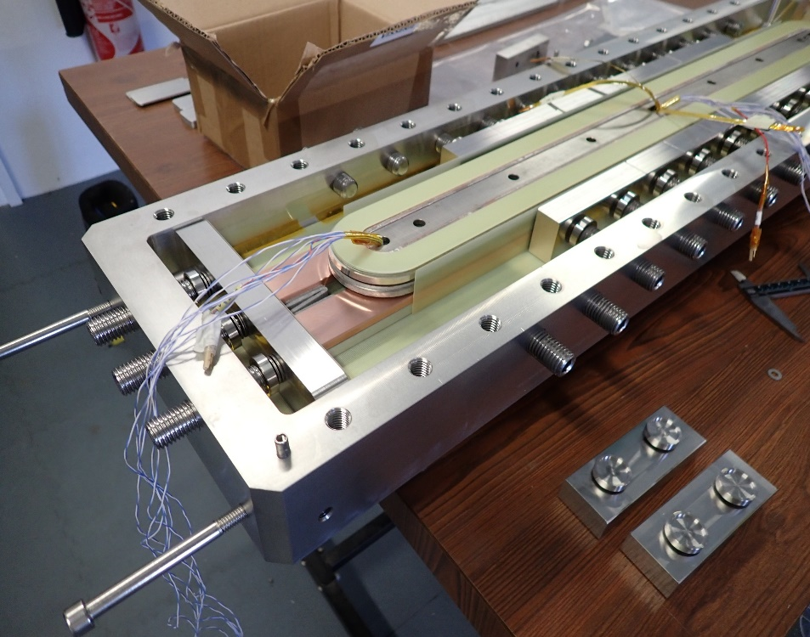

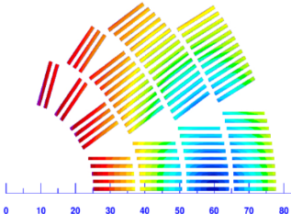
under development: HTS demonstrators
INFN activities: studies on ReBCO demonstrator
  10 T field at 20 K, design to be selected bwteeen three variants
  In synergy with other activities in INFN (ESMA, 10 T split racetrack)
CEA activities: metal insulated racetrack
  5 T achieved without aperture
CERN activities: dieletrc insulated racetracks with stack of 4 tapes
  5 T achieved with 20 mm aperture
PSI activities: racetracks in a stress managed structure
  First tests in July 2026
FLARE demonstrator [A. Baskys, A. Ballarino et al.]
NARSIL stack in the structure
Winding of HTS racetrack in a former [D. Araujo, et al.]
One of the options for 10 T, 20 K dipole [M. Statera, et al.]
Narsil MI coil [T. Lecrevisse et al.]

Slide 13
High Field Magnets R&D Topics
generic - LTS
fast development cycles for test models, sub-scale tests
price reduction of high performance Nb₃Sn wire
ultimate performance of Nb₃Sn wire
design/mechanical concepts that scale to field > 14 T or large apertures (>100 mm)
protection concepts
FCC-hh specific
optimize for 14 T double aperture magnets → best compromise grid power / energy reach / cost
study hybrid Nb₃Sn / NbTi coil configurations (cost)
system integration → field quality/ramping; SR power extraction; vacuum; e-cloud; dust particles; reliability of ca 5000 magnets
length scaling of initial prototypes to 15-20m
magnet cost and industrial supply
determine target specs for HTS FCC magnets
generic - HTS
identifying the most suitable HTS cables for magnets and coil technology for high current density magnets
ramp losses and field quality with tape cables
profiting from operation at higher temperature; cryogenic systems for >=10K operation
protection concepts
input Europen Strategy: https://indico.cern.ch/event/1439855/contributions/6461640/

Slide 14
RFCP Roadmap and RF Priorities Within the LDG Framework
LDG - RF Panel |  | G. Bisoffi INFN, P. McIntosh STFC
WG1 | Bulk Nb | M. Baylac CNRS, C. Madec CEA, L. Monaco INFN
WG2 | Thin films | O. Malyshev STFC, T. Proslier CEA (C. Antoine CEA)
WG3 | Couplers | F. Gerigk CERN, A. Neumann HZB (E. Montesinos CERN)
WG4 | NC High gradient | W. Wünsch CERN, D. Alesini INFN
WG5 | RF Power sources | I. Syratchev CERN, G. Burt STFC, M. Jensen ESS
WG6 | LLRF, AI, ML | W. Cichalewski U-Lodz (Z. Geng PSI)
Following an LDG Review in 2025 and ESG recommendations, the RFCP was asked to focus on a limited set of high-impact and cross-cutting technologies aligned with realistic resources and collider timelines:
– advanced SC/NC RF structures
– high-efficiency RF power sources
– high-current ERLs
– in a longer-term: wakefield acceleration and MC technologies.
The RFCP then carried out a systematic analysis of RF priorities for the main collider options (FCC-ee/hh, LCF, LEP3, LHeC, Muon Collider, HALHF), using TRL6 by 2031 as the common reference target, evaluating:
  Performance gaps
  Remaining challenges, with emphasis on synergies, reliability and energy efficiency.
  Required infrastructures and resource needs
  Laboratory engagement
Bulk Nb cavities
Thin film cavities
High-η RF sources
RF Coordination Panel (RFCP) was established in 2022 to support implementation of the ESPP-U 2020 roadmap, coordinating RF R&D activities across CERN and LDG laboratories and identifying common priorities.

Slide 15
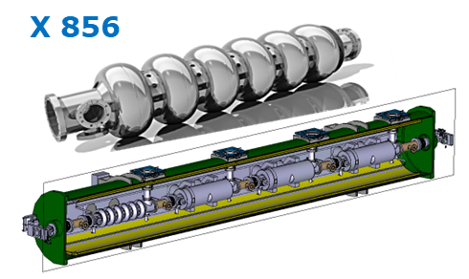
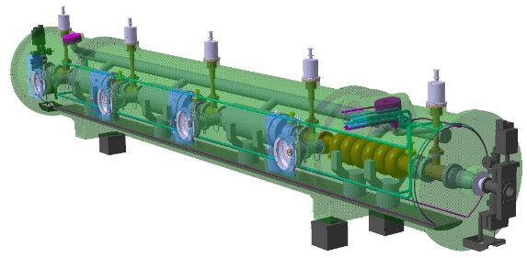
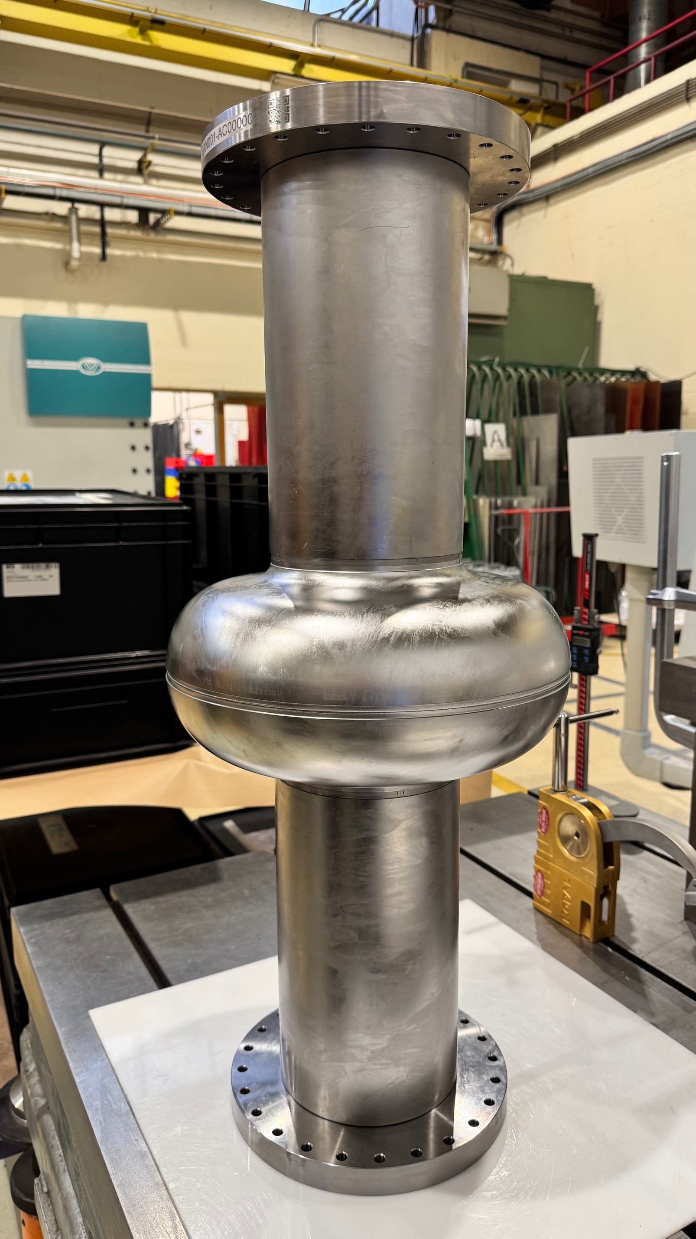
Bulk nb cavities
Applied in many collider schemes
Roots: exceptional expertise made on 1.3 GHz (800 cavities pulsed on Eu-XFEL, 400 cavities CW on LCLS-II-HE, 600 cavities CW on SHINE, Shangai), and the ILC/ITN multi-decade developments.
LCF: higher Q (by improved surface/thermal treatments), tests planned at KEK in 2026-2027
FCCee: transfer of LCF expertise at 800 MHz (mid-T baking, f-depenence and flux trapping to be investigated)
LHeC: targets and R&D path similar to FCCee at 800 MHz (and to PERLE in France)
LEP3 would also require bulk-Nb 1-cell, 4-cell, 6-cell cavities, at 800 MHz and 500 kW (higher than state-of-the-art), requiring effort on FP-couplers/RF sources
Labs with TRL6* (and European with TRL7 *) expertise: CEA, CERN, CNRS/IJCLab, DESY, ESS, HZB, INFN, STFC, UHH, Uppsala/FREIA, et al. (Eu),
FNAL, JLAB, SLAC, et al. (Am),
KEK, IHEP, SHINE, Korea Univ. Et al. (Asia)
iSAS European Project: rationalising R&D on 800 MHz; joint experiments on 1.3 GHz
FCCee - 800 MHz, full Nb, @2 K (2x LCLS-II Q₀)
CURRENT STATE OF THE ART:
5-cell prototype w/o ports, built by JLAB: 3 x 10¹⁰, ~30 MV/m in VT (Vertical Test)
CERN-now: 1-cell cavities under fabrication (deep-drawing and EBW), collab with FNAL, IJCLab, Cornell U and others.
Short-term goal: recipes for needed Q₀ factor at high gradient. Final goal: 6-cell cavity, at TRL7 (test in CM) 3x10¹⁰, 20.25 MV/m

Slide 16
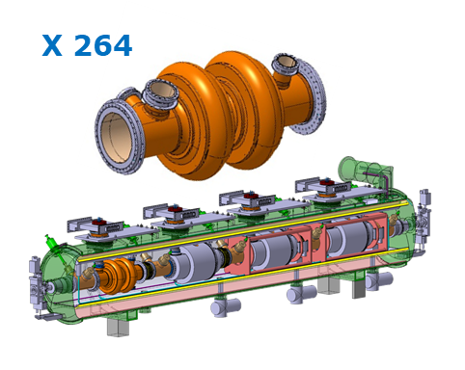
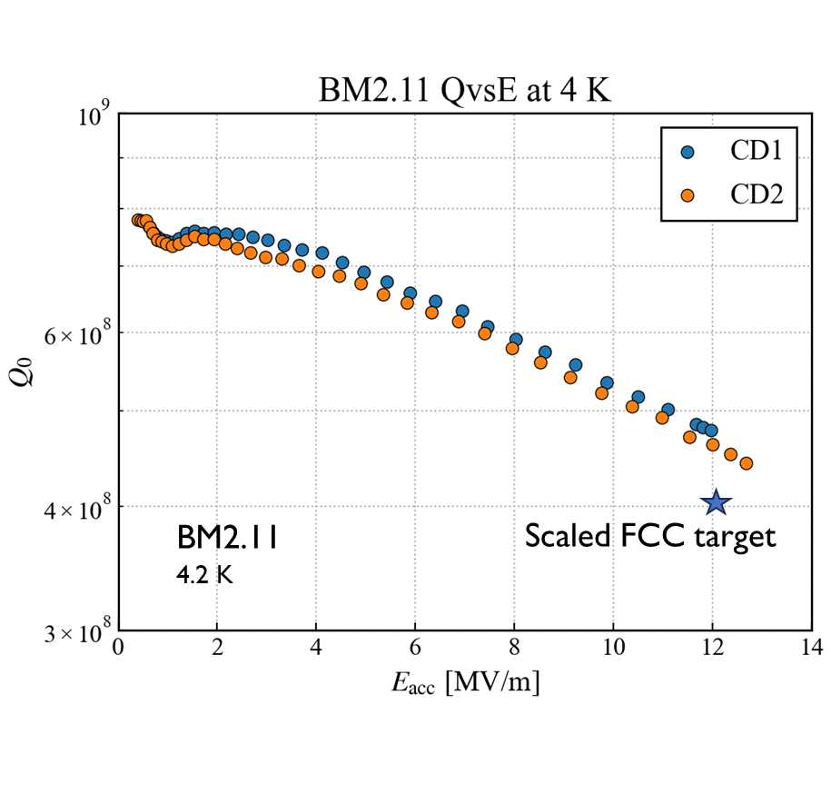
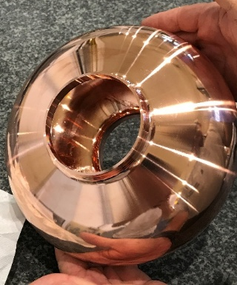
Thin film cavities
FCC_{ee}
Nb/Cu
FCCee to implement Nb/Cu (an ameliorated LEP tech) on 2–cell 400 MHz cavities (lower material impact, same energy).
MC may adopt Nb/Cu cavities with 2x E_{a} (very ambitious for now).
It may be the long-term goal for the LHeC collider option.
Lower R at 4K versus Nb → higher operating T → smaller energy quest.
Nb₃Sn the most mature: promising Nb3Sn/Nb (good for energy saving not for material saving);
Nb3Sn/Cu real goal (material and energy saving).
Other thin-film options are farther from the goal
The production of high-quality Cu bases is paramount (and critical).
TF-collaboration very well integrated, little resources.
IFAST, iSAS and EPITA Projects nicely complementary, fostering infrastructures with standardized equipment and processes.
400 MHz, Nb/Cu thin film, @ 4.5 K (2x LHC E_{a} and Q₀)
Higher T_{c} materials
From the old LEP2 expertise:
Scaled (1.3 GHz) FCC targets for E_{a} and Q₀ have been reached on bulk-machined seamless Cu bases, with a good reproducibility
Chemical electropolishing; Nb coating with High Power Impulse Magnetron Sputtering (HiPIMS).
Promising preliminary results obtained recently on hydroformed cavities within the CERN-KEK collaboration.

Slide 17
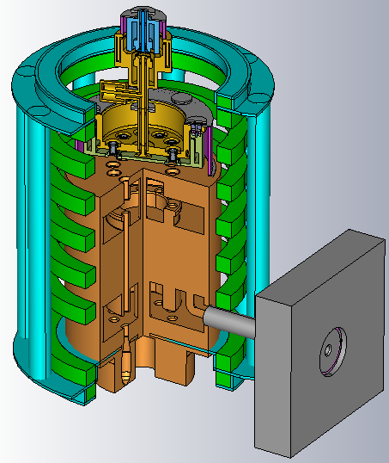

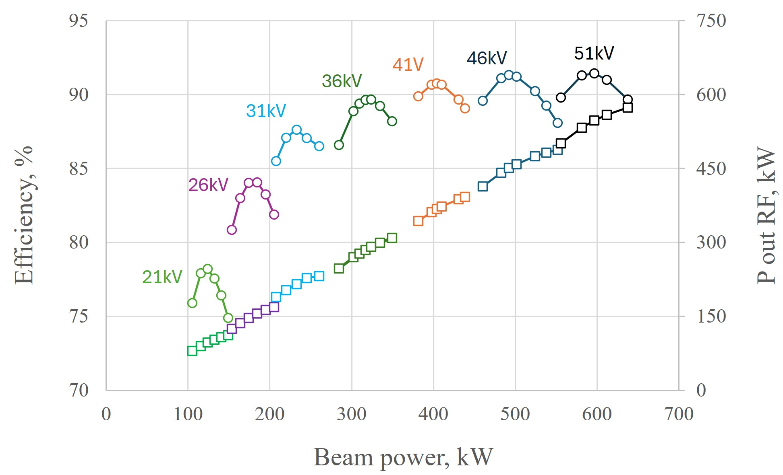
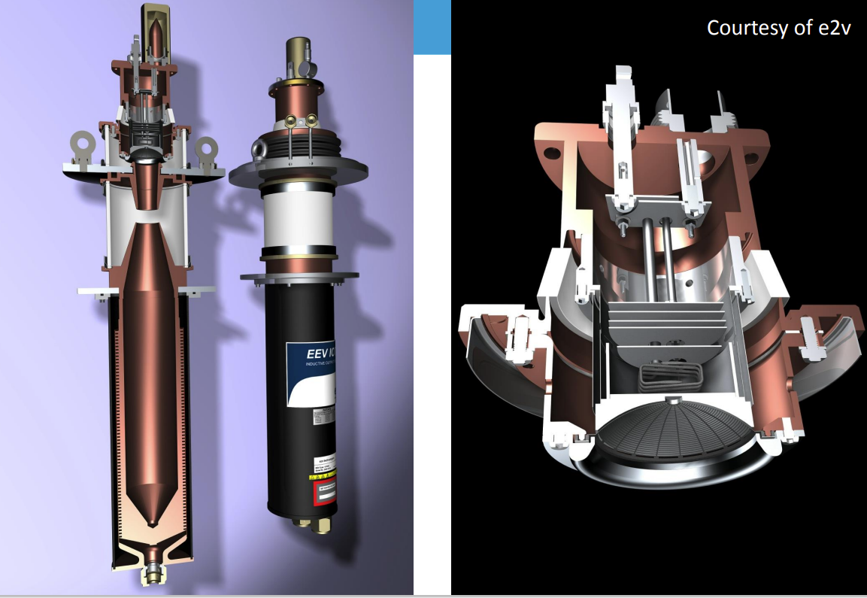
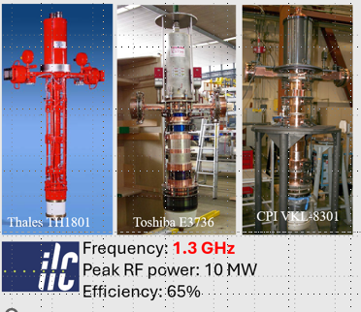
High Efficiency Amplifiers
FCC klystron efficiency gain from 70% to 90% can save > 1 TWh in 10-years
RFCP-WG5 supported/promoted development of high efficiency RF power sources for future large-scale particle accelerators.
Intense collaboration with industry to ensure long-term industrial support for decades to come.
For all collider schemes: some adaptations required, power goals within reach.
All are aiming at ~ 90% efficiency, from present ~ 70%.
MB Tristron prototyped internally at CERN, all resources and competences allocated.
Fabrication and testing will be the next step.
FCC_{ee} x 264 400MHz, 0.5MW, CW MB Tristrons, η=90%, OPEX !!
FCC_{ee} 800 MHz, 50-250 kW CW, Tristron or high-η IOT
LCF - η=80% power sources, reachable with dedicated R&D

Slide 18
2) Advanced Collider Concepts
High Gradient Plasma and Laser Accelerators,
panel chairs: W.Leemans (DESY), R. Patathill (STFC)
Bright Muon Beams and Muon Colliders,
panel chairs: D.Schulte, S.Stapnes (CERN)
Energy Recovery Linacs,
panel chairs: J.D’Hondt (NIKHEF), A.Stocchi (IJCLab)

Slide 19
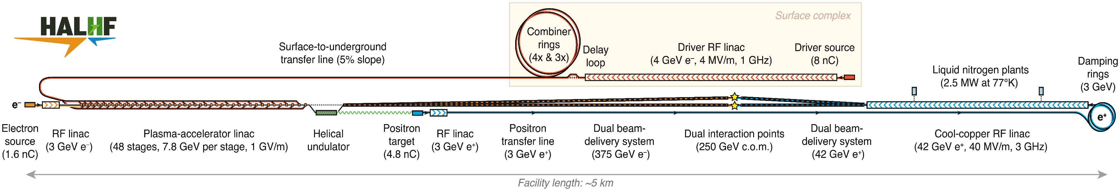
HALHF: A hybrid, asymmetric, linear Higgs factory
  Provides a concept that can fit in many major particle physics labs
Foster et al., Phys. Open 23, 100261 (2025)
e-
e+
e+ BDS
e- BDS
Exploit high gradient of e⁻ acceleration in PWFA and avoid
difficulty of e⁺ acceleration by using conventional RF linac, reducing cost by low E(e⁺) (42 GeV)=> high E(e⁻) (375 GeV), boost γ ~ 1.7 => E_{CM} ~ 250 GeV.
Reduce running costs by increasing current I(e⁺) and reducing I(e⁻); this & asymmetric emittance (increased for e⁻) ease PWFA requirements.
PWFA stage length ~ 1100m ( PWFA gradient~ 1 GV/m;
gradient >~ 0.33GV/m) => facility length ~ 5 km
Cost ~ 68% of CLIC - 4.9BCHF
Current luminosity/power & luminosity/cost estimates for
HALHF compared to CLIC: 21% & 29%*
Still not too big to fit in major particle physics labs
Detailed parameter set is being worked out, based on integrated simulations of the main linac.
Parameters will also be studied for a 550 GeV machine (or other desired energies) – straight forward scaling.

Slide 20

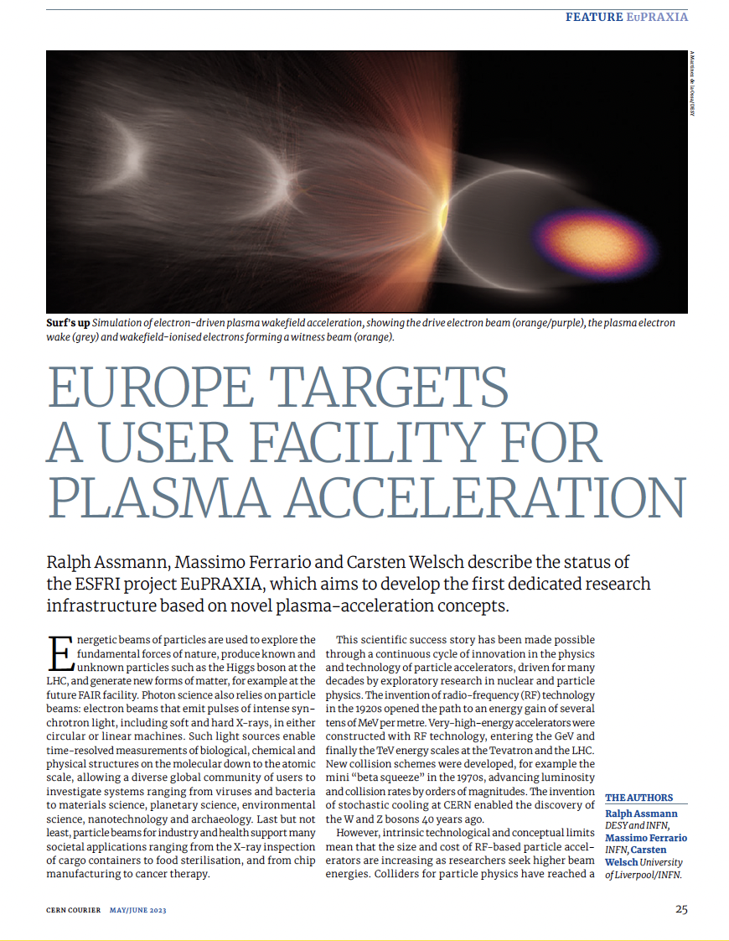
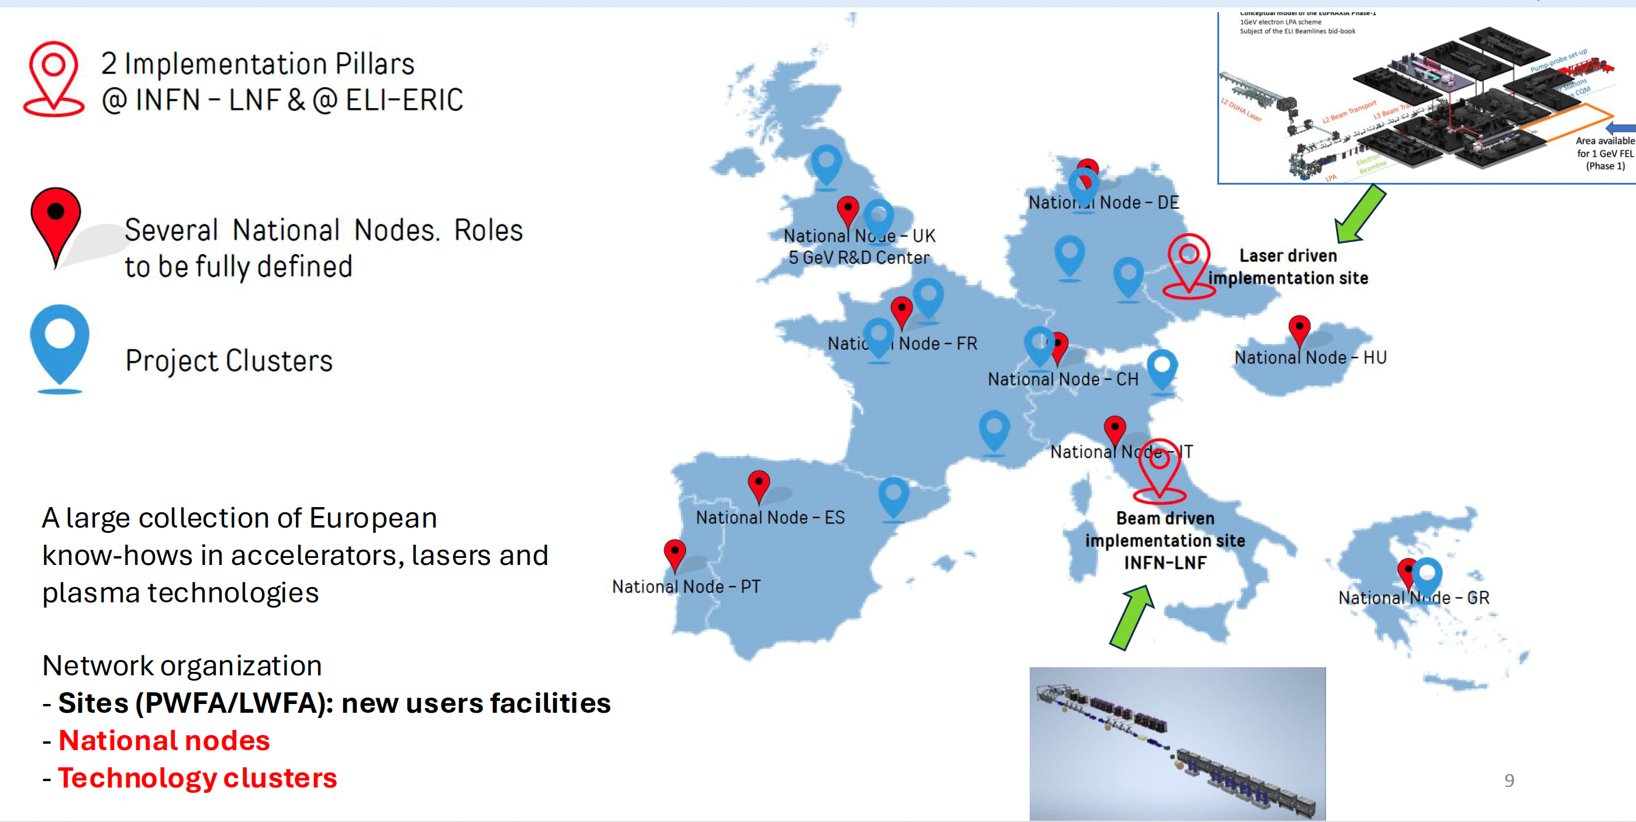
provides complementarity
Beam-driven : INFN, Frascati, Laser-driven : ELI-BL, Prague
addressing key challenges, e.g. low emittance beams, stable & reliable operation
https://www.eupraxia-facility.org/

Slide 21
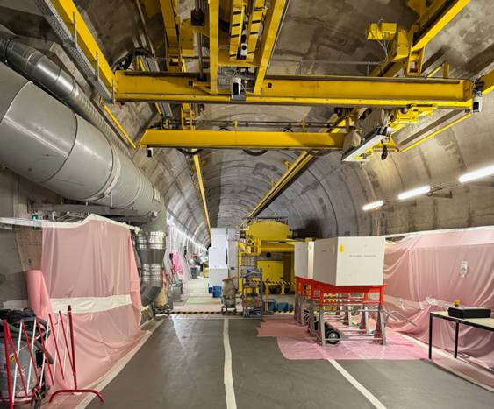
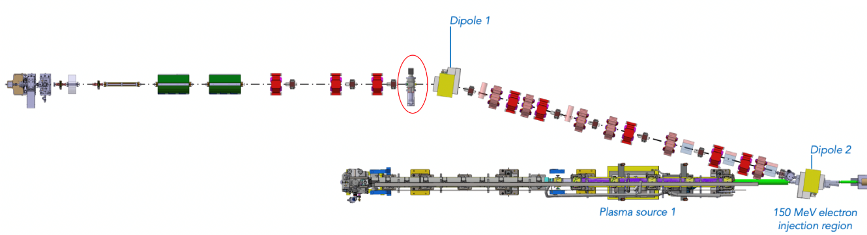
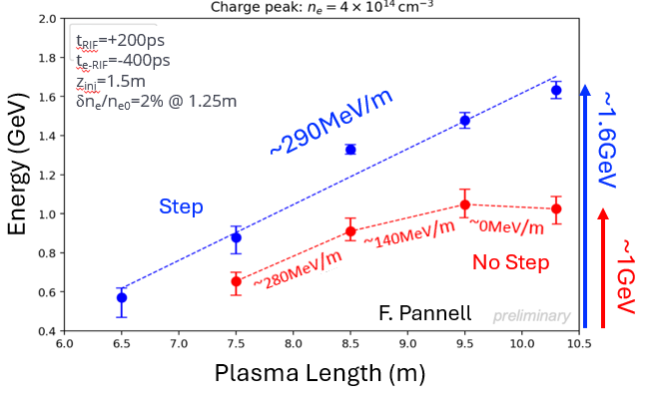

AWAKE made huge progress since Roadmap report
WP3.2: Proton-beam-driven experiments (Edda Gschwendtner, Patric Muggli)
Achieved results:
Demonstration of increased electron energy gain using a density step in the self-modulator plasma source.
Area extension (plus 100 m):
Design of the AWAKE Experimental upgrade:
New witness electron beam system: 150 MeV, 200 fs, 100 pC, σ = 5.75 µm
→ External injection!
View into the 100m long CNGS target area, which will completely dismantled in 2026 to install the upgraded AWAKE experiment. The current AWAKE experiment has already been removed.
Accelerated electron energy at different plasma lengths
10 m long discharge plasma source
Scalable plasma source development (discharge and helicon plasma sources)
→ Expect 10 publications, 5 PhDs

Slide 22
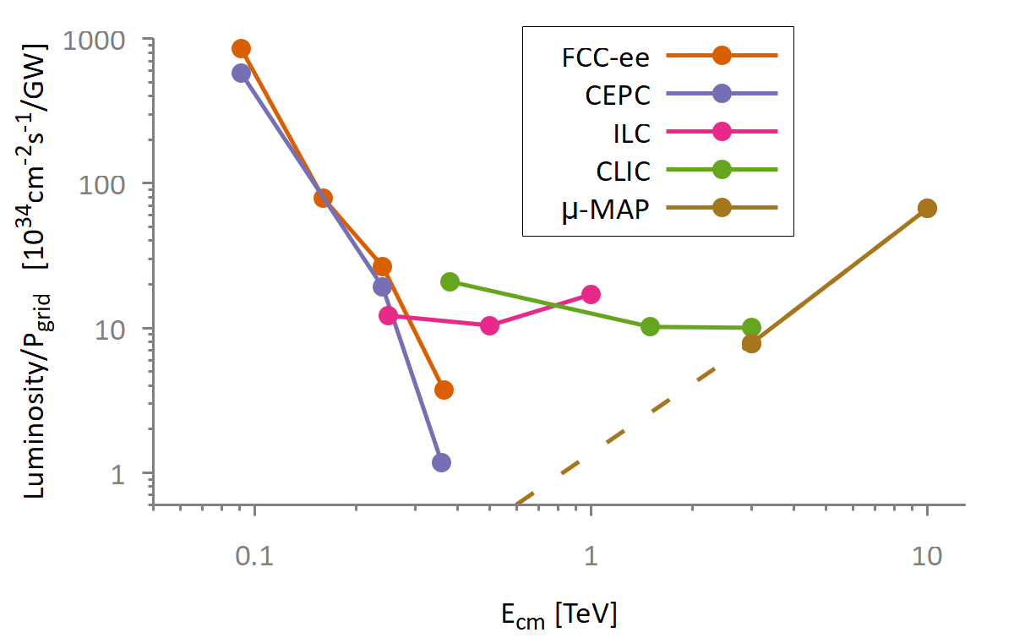
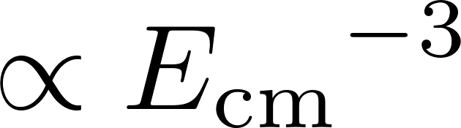



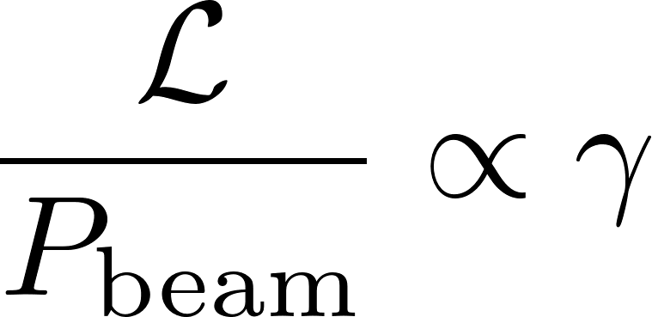
Muon Collider – Efficient at Highest Energies
Muon: E₀ = 106 MeV (200x e-), τ_{μ} = 2.2 μs
low SR, low beamstrahlung during collisions!
stronger focusing with higher E is possible, thus L/P is increasing with energy
Beamstrahlung suppressed for muons!
Lepton collisions at 3 or 10 TeV CM are in reach.
Muon collider:

Slide 23
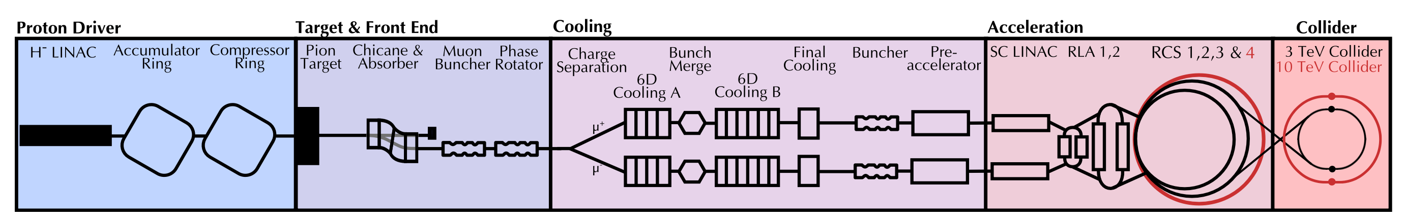
Muon Collider Focus
Protons produce pions which decay into muons which are captured
Short, intense proton bunch
Ionisation cooling of muon in matter
Acceleration to collision energy
Collision
- Proton driver
bunch compression
- Graphite target
- Target solenoid
- Muon cooling design
- 6D cooling solenoids
- 6D cooling RF cavities
- Final cooling solenoids
- Pulsed magnets and
power converters
- RCS RF system
Identified and prioritized with community
Critical lattice challenges
Critical Technology Elements (CTEs)
- Collider ring dipoles
- Final focus quadrupoles
- Machine-detector interface
23

Slide 24
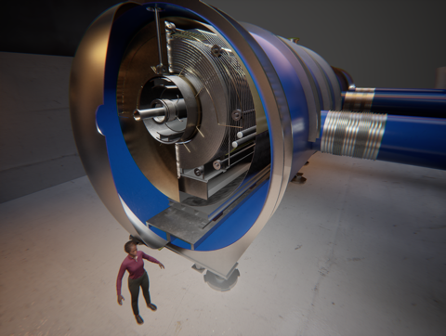
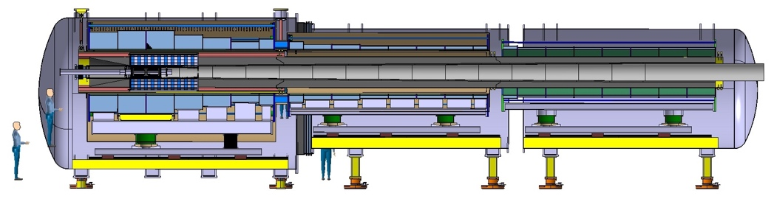
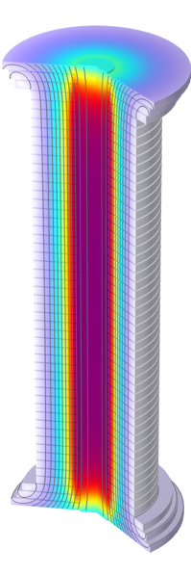
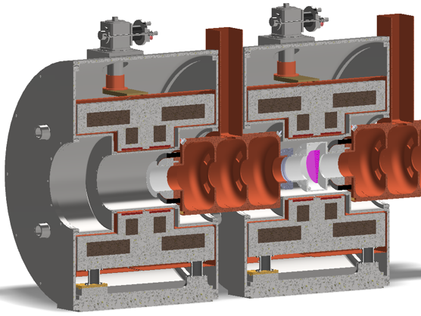
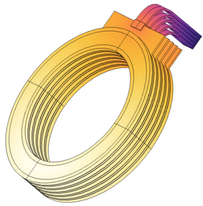
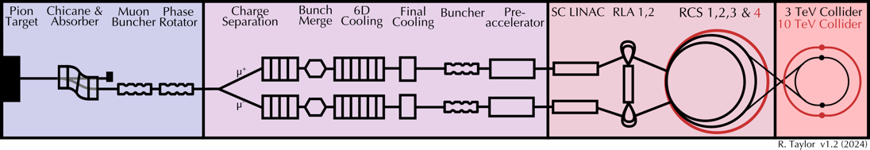
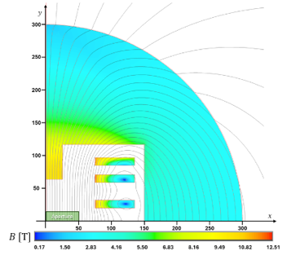
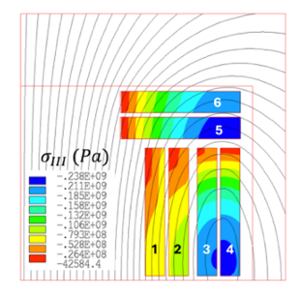
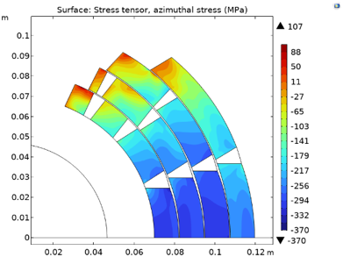
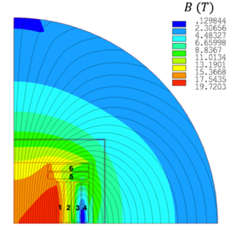
Target and capture solenoid
23 solenoids: 20 T, 1.4 m bore
3000 solenoids: 2 to 14 T, 90 mm to 1.5 m bore
Muon beam cooling solenoids
17 solenoids: 40 T, 60 mm bore
Accelerator and collider magnets
5 km: 10 T, 30(V) x 100 mm (H) dipoles
10 km 14 T, 140 mm bore dipoles
From L.Bottura, HFM meeting 10-12.2.2025

Slide 25


ERL vs Ring or Linear Collider
Ring
beam circulates
ERL
power circulates
Linear Collider
high quality beam
acceleration
I
P
P
I
deceleration
beam (and energy) reused
synchrotron radiation dominated
equilibrium beamsize → collision parameters limited
power recirculated, beam recirc. at low E
benefit from better collision parameters
high L per grid power, but higher investments & complexity
main study today e-LHC, but also e+/e- possible
beam used only once
no synchrotron radiation
ambitious collision parameters possible (no ring dynamics)

Slide 26
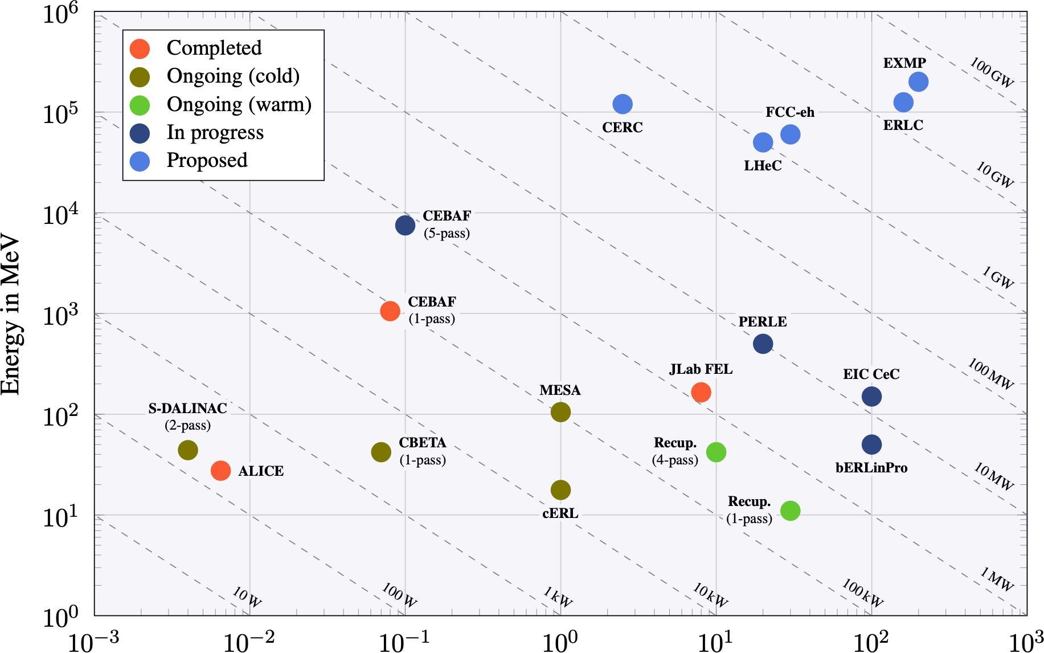
DOI: https://doi.org/10.23731/CYRM-2022-001
ERL to enable high-power beams that would otherwise require one or more nuclear power plants
Future ERL-based Colliders
H, HH, ep/eA, muons, …
nuclear power plant
R&D Roadmap
ERL-based
bERLinPro & PERLE
essential accelerator R&D labs with ambitions overlapping with those of the particle physics community
HEP colliders
Power = Energy x Current
planned
scaling
previous
towards high energy & high power
&
current
Energy Recovery demonstrated
great achievements on all aspects and large research infrastructures based on Energy Recovery systems have been operated successfully
technology
Energy Recovery Linacs (ERL): reaching higher luminosities with less power requirements
J.D’Hondt, A.Stocchi et al
26

Slide 27
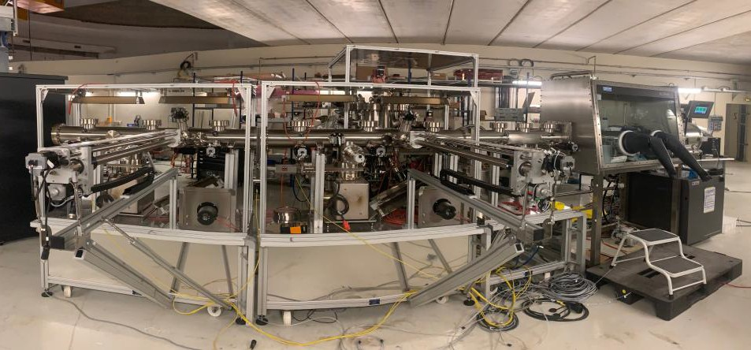
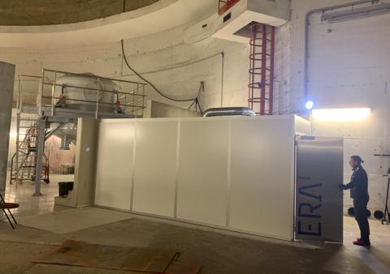
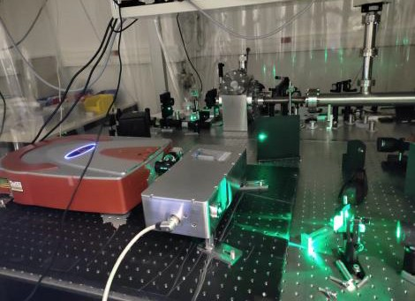
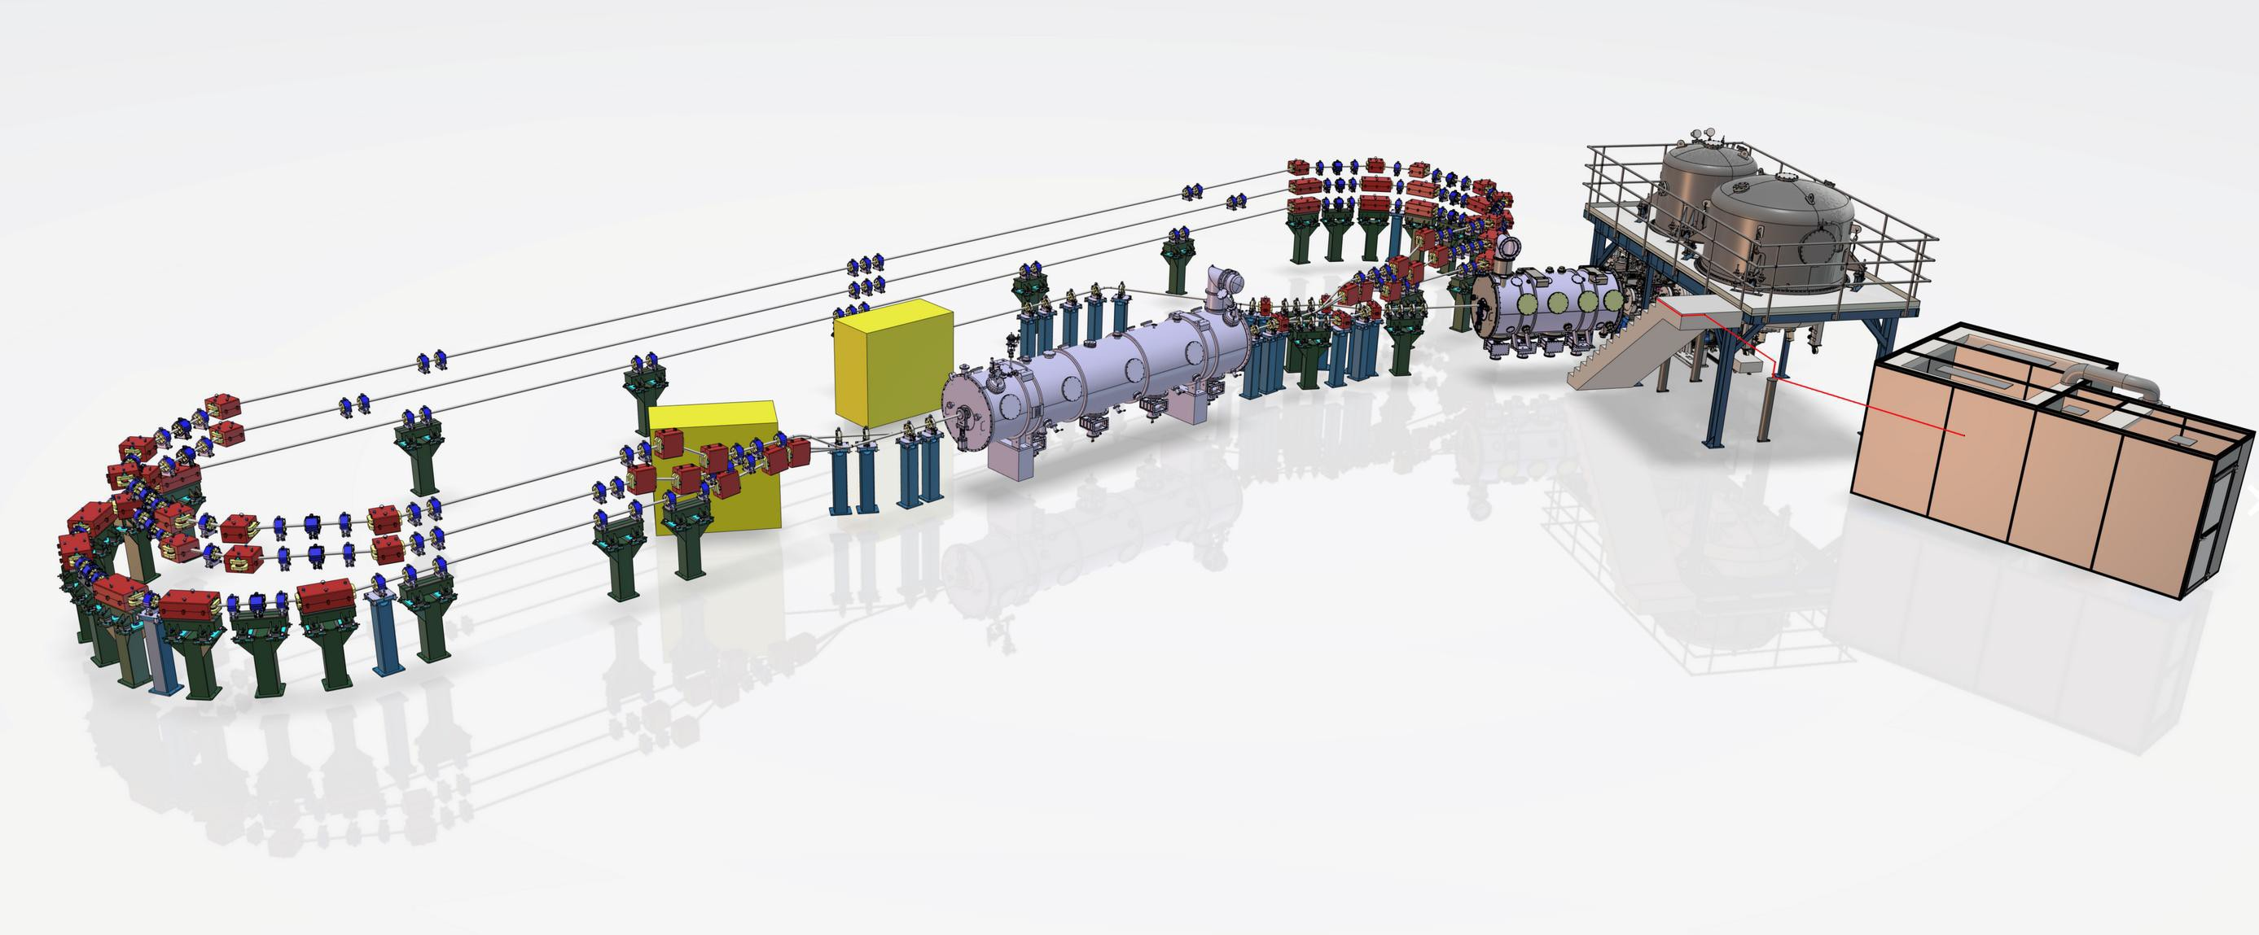
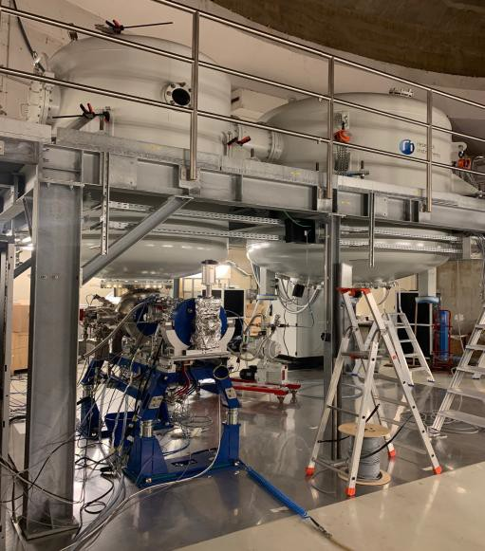
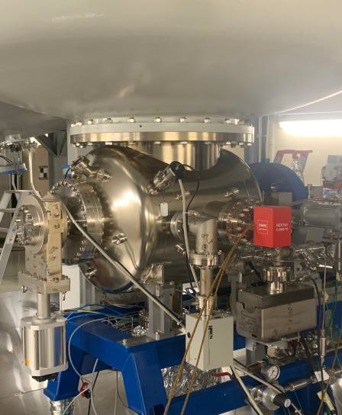
PERLE
Photocathode Laser room
Laser system
Photocathodes Production Facility (PPF)
PERLE: multi-turn ERL based on SRF technology (3-turns)
PERLE @ DIS2026 - Bologna Mai-2026
A.Stocchi et al
PERLE – Powerful Energy Recovery Linac for Experiments [CDR: J.Phys.G 45 (2018) 6, 065003]
DC Gun & HV system
DC Gun
12

Slide 28
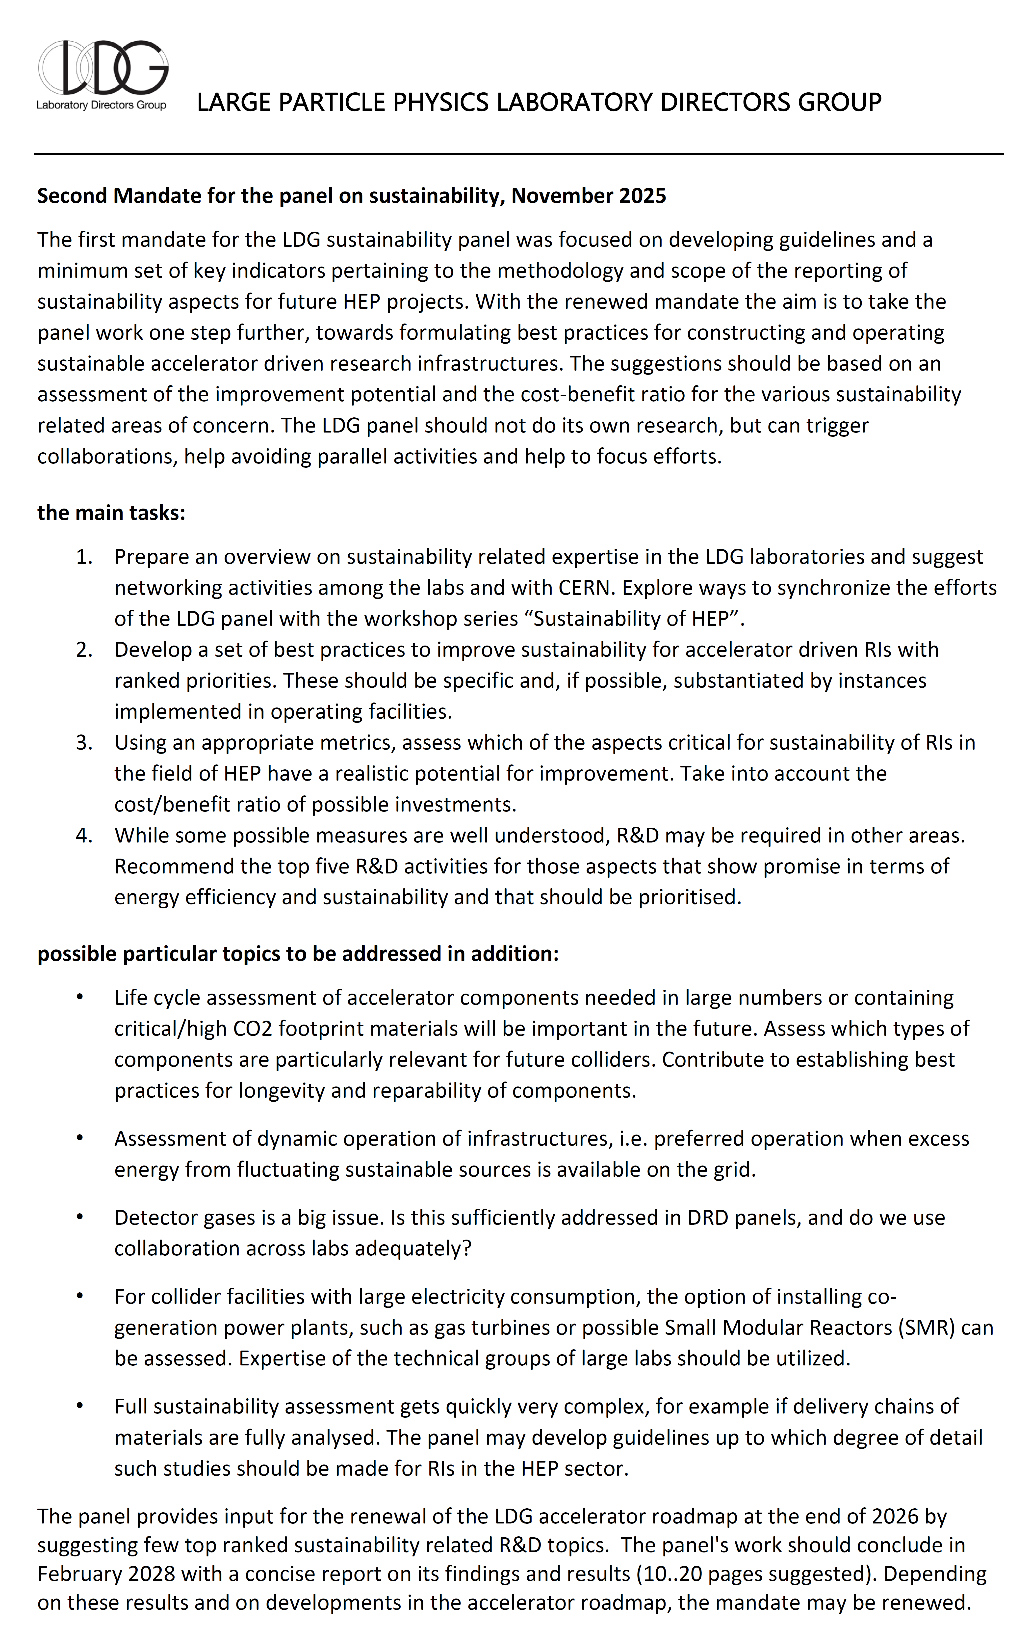
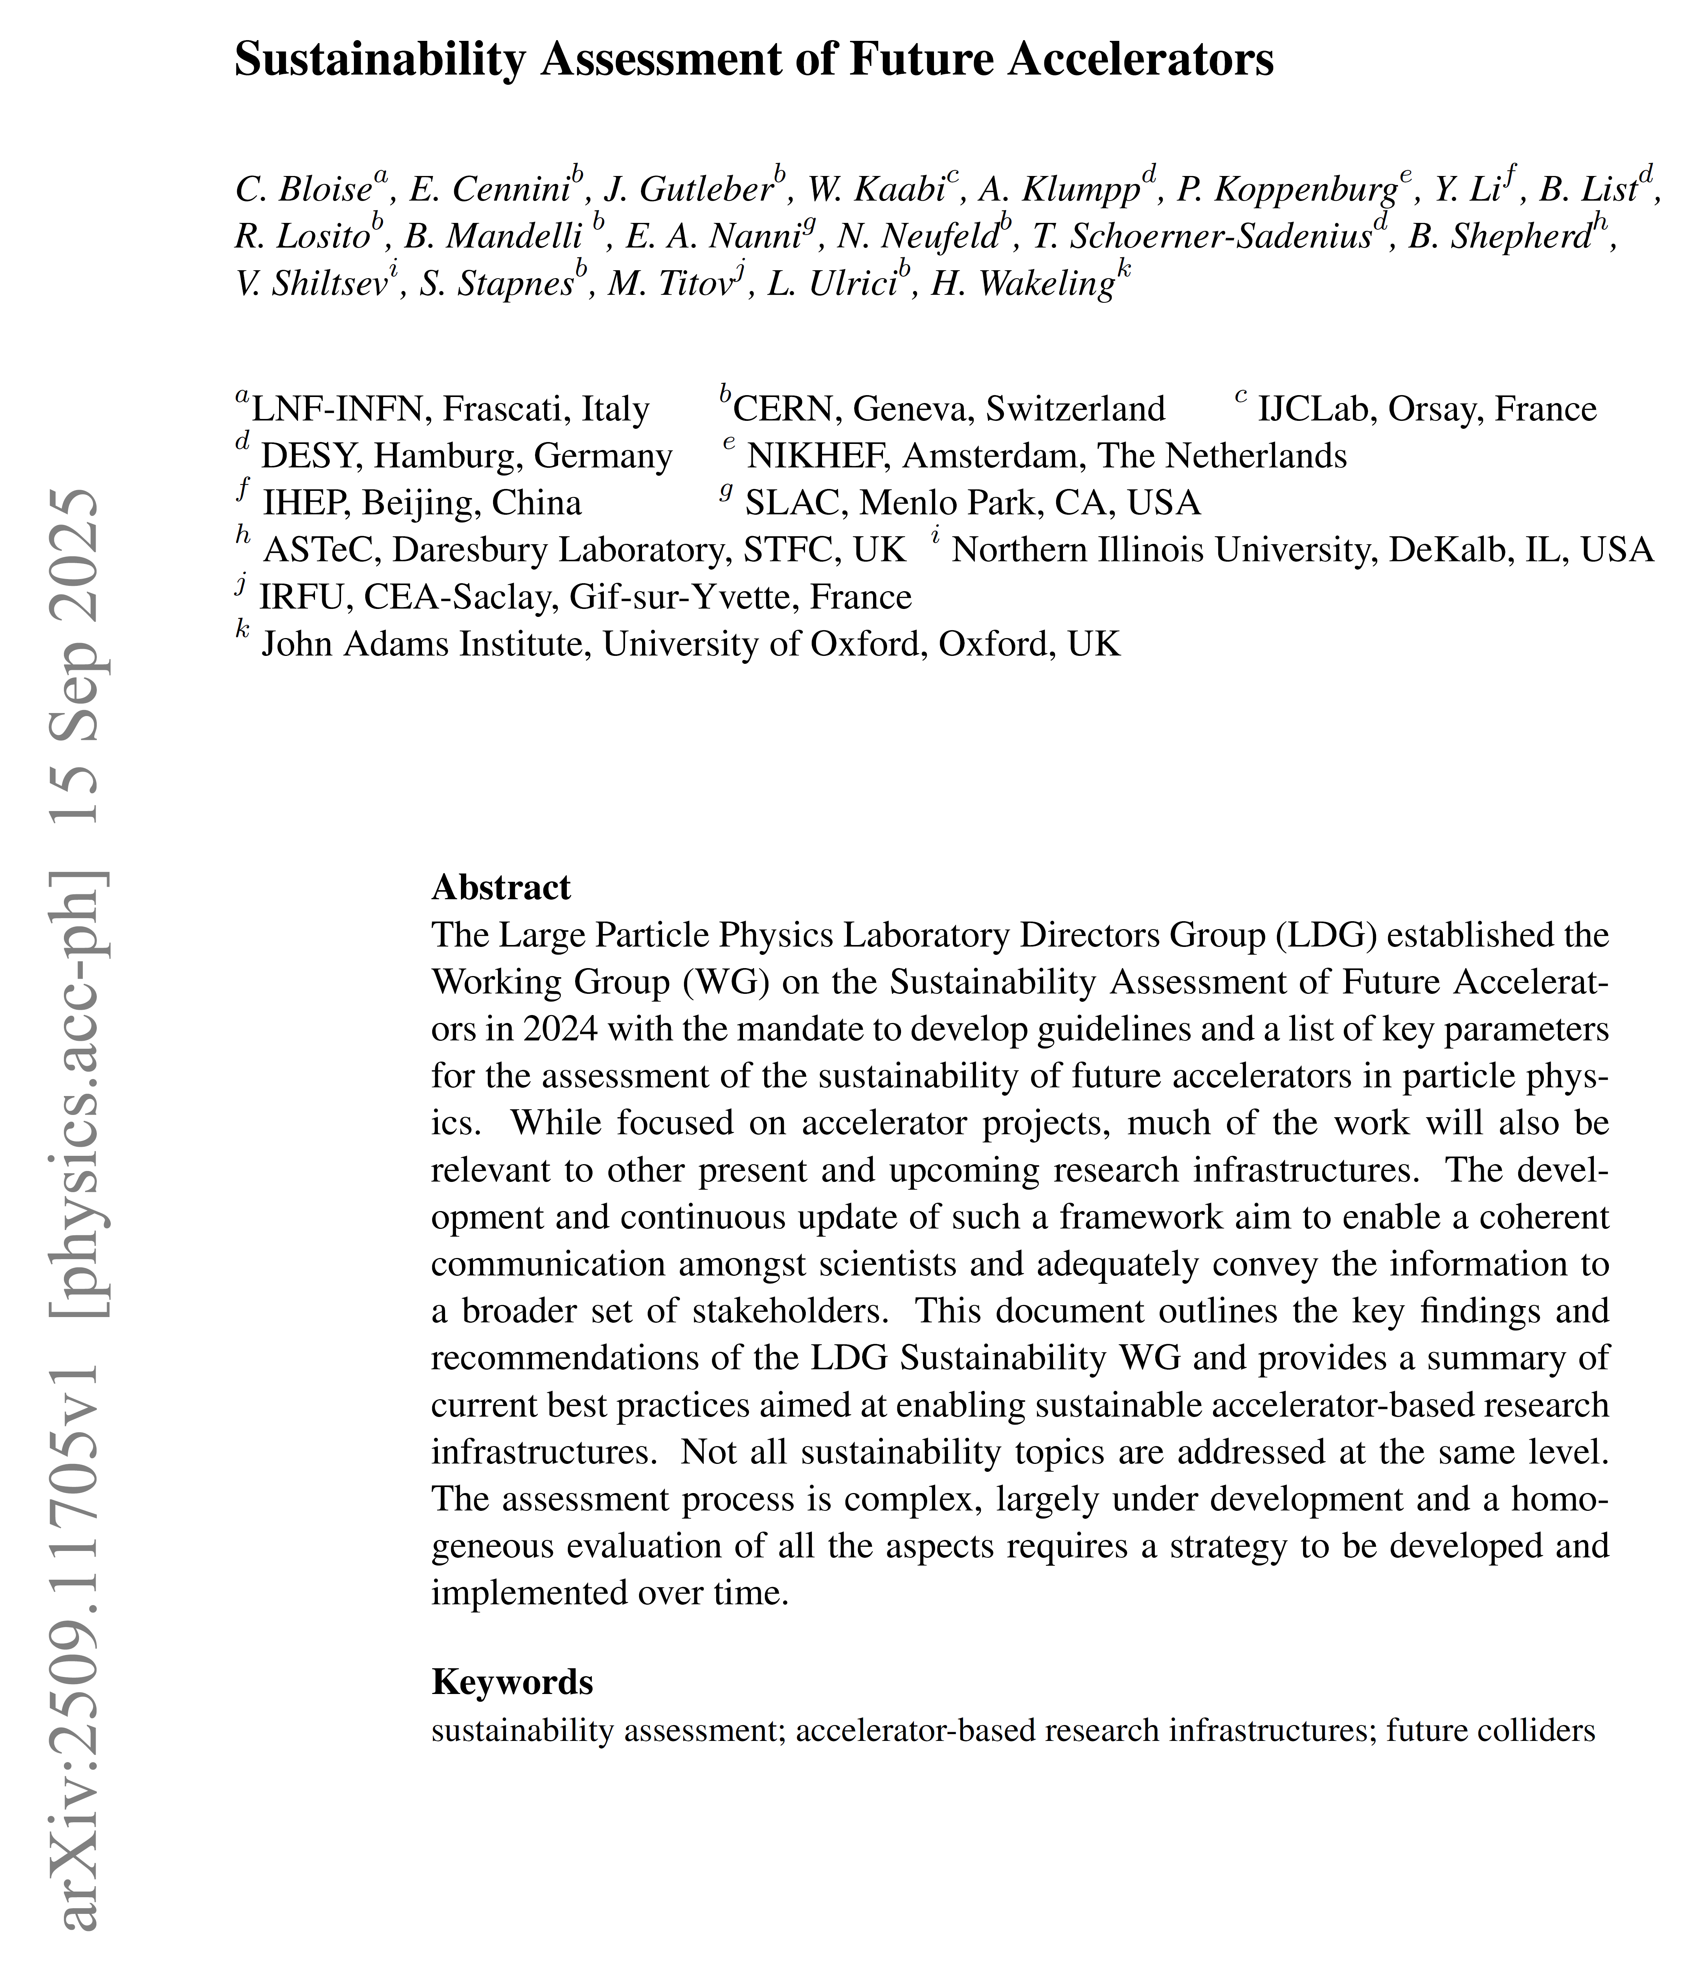
LDG Sustainability Working Group, C.Bloise (INFN), M.Titov (IRFU)
From Executive Summary: The LDG Sustainability WG report outlines the reference framework of best practices & standards for assessing and guiding a sustainable development of large-scale facilities for future accelerators:
renewed mandat 2025:
Landscape of comprehensive sustainability analysis (best practices adopted by RI’s)
Basis of LCA - Status & recommendations for developing analysis for accelerator infrastructures, components and systems
Environmental impact of Large RI’s during construction, operation & decommissioning phases
Mitigation and Compensation Measures
- Targets future accelerators & particle physics
projects, relevant for other research infrastructures
- Promotes transparent, open discussions within
research communities, to adequately convey
the information to a broader set of stakeholders
- Establishing “Guidelines” is the responsibility of
each RI, based on national & local legislations
Approved by LDG in Sep. 2024:
http://arxiv.org/abs/2509.11705
Shorter report version in new Springer EPJ Research Infrastructures

Slide 29
Accelerator R&D - Conclusions
High Field Magnets and RF Systems form the building blocks for future facilities and technology R&D is focused on those, in particular on superconducting technologies.
advanced concepts are promising for long term collider development:
  plasma acceleration → small footprint
  muon collider → highest lepton energies
  energy recovery linacs → most energy efficient
energy efficiency and sustainability are key and have a high relevance for public acceptance of particle physics RIs
significant research is needed → the LDG accelerator roadmap will be updated in 2026 and aligned with the priorities set by ESPPU´26

