Slide 1

CERN: Future Vision and Priorities
Mark Thomson
CERN
IPAC 26
Deauville

Slide 2
Today’s presentation
1) Status of the LHC Run 3 and the preparations for HL-LHC
2) A few words on the North Area consolidation project
3) FCC
4) The European Strategy for Particle Physics – the home straight
5) Some of the challenges for CERN in the coming years
6) CERN’s scientific strategy and priorities
  HL-LHC
  FCC-ee
  A roadmap for non-collider physics at CERN
7) Concluding remarks

Slide 3
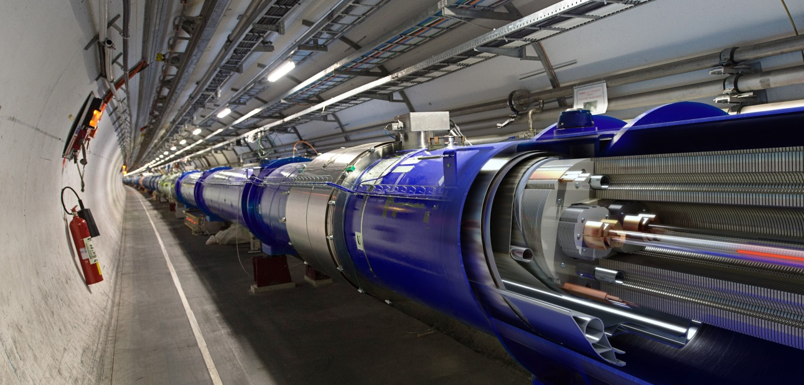
1) Status of the LHC and HL-LHC

Slide 4
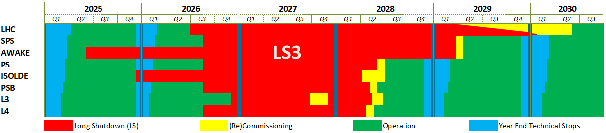
Long Shutdown 3 is coming…
We are here
+ 4 years
LS 3 start
AWAKE: 02.06.2025
ISOLDE: 08.12.2025
LHC: 29.06.2026
Injectors: 31.08.2026
L3: 30.11.2026
Inj. Operation restart
L4 : May 2028
PSB : May 2028
PS : July 2028 (*)
SPS : April/May 2029 (*)
(*) To be optimised
LHC restart
1st sectors cooldown : Early 2029
Final HW Com (P1&5) : January 2030
Caverns closure : Mid-May 2030
Beam vac valves op : End-May 2030

Slide 5
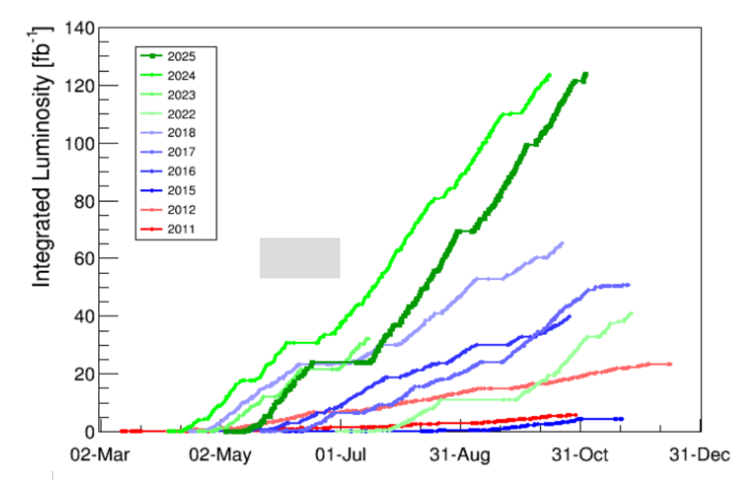
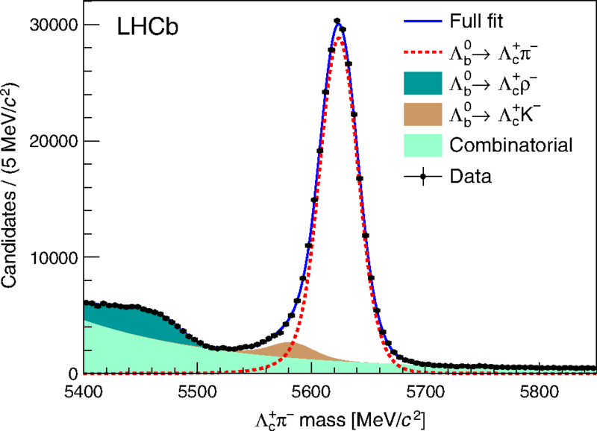
The LHC remains a beautiful machine
2025 was a record-breaking year: delivered over 125 fb⁻¹ to ATLAS/CMS
2026: a shorter run before start of Long-shutdown 3
By the end of 2025:
ATLAS/CMS had each
accumulated ~520 fb⁻¹

Slide 6
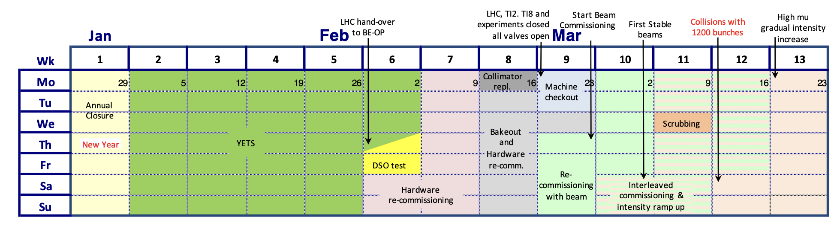
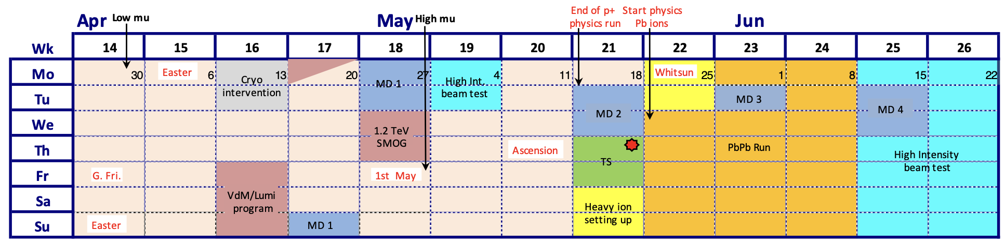
2026 LHC Schedule
Collimator vacuum leak: delay ~5 days
Highly compressed startup
<11 weeks beam-to-beam YETS
< 2 weeks for powering tests
9 days of beam commissioning
Diverse programme:
  Intensity ramp up and high-μ run
  Low-μ run
  VdM
  LHCb “1 TeV” run
  MDs
  High intensity tests
  Pb-Pb ion run
Last proton-proton run scheduled for today
High μ
Low 𝛍
High 𝛍
Warm Compressor exchange: delay 2 days

Slide 7
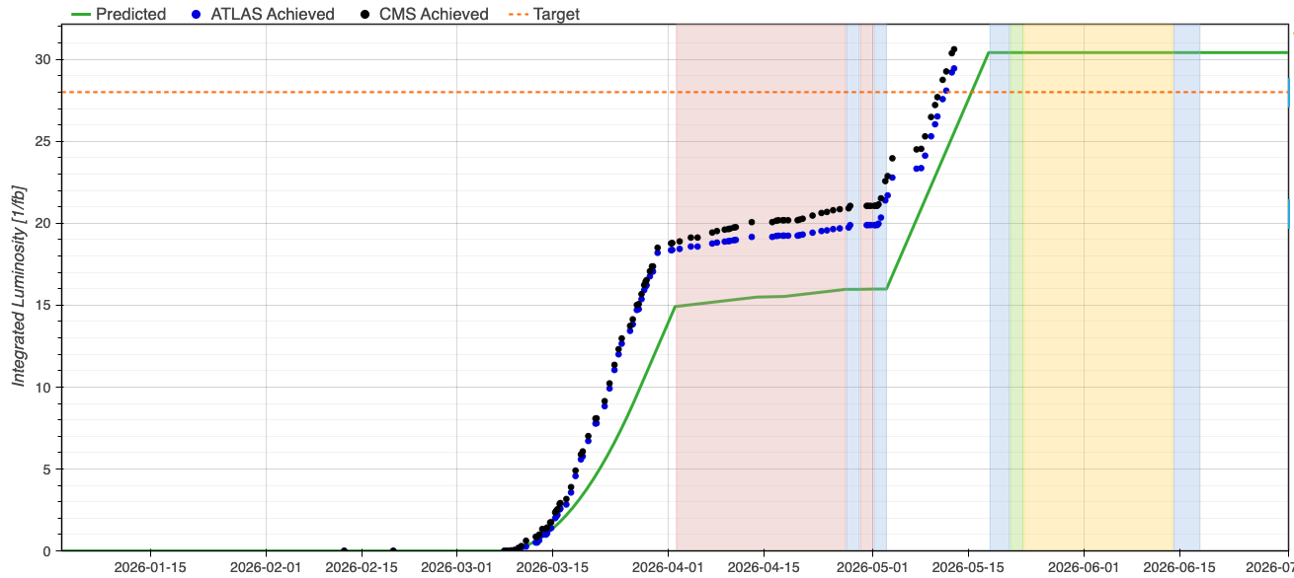
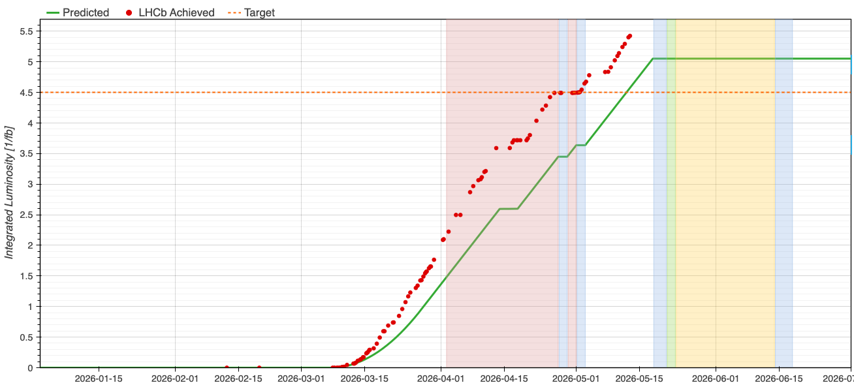
2026: the machine is running beautifully again
Low pile-up runs for ATLAS (μ=3) and CMS (μ=5) are ahead of schedule – will benefit the precise measurement of W mass
And very long fills are good news for LHCb
Performance targets (p-p) exceeded:
p-p target Pb-Pb target
ATLAS/CMS: 28 fb⁻¹
LHCb: 4.5 fb⁻¹
ALICE: 28 nb⁻¹
ATLAS/CMS: 1.8 nb⁻¹
LHCb: 0.6 nb⁻¹
ALICE: 1.3 nb⁻¹
ATLAS/CMS
LHCb
Thanks to my CERN colleagues for this spectacular achievement – this doesn’t happen by chance

Slide 8
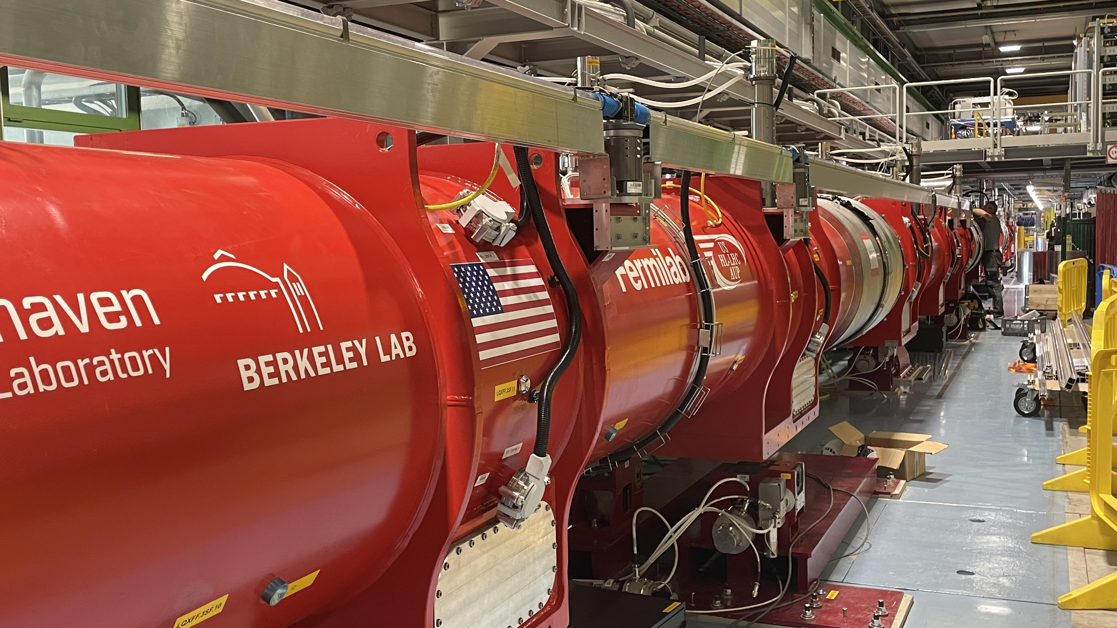
What Next for CERN? HiLumi-LHC (HL-LHC)
The High-Luminosity LHC
major “upgrade” of the LHC, starting operations ~2030 and running until 2041
based on cutting-edge Nb₃Sn technology that didn’t exist when the LHC was built
With ~10 times increased luminosity compared to the LHC
in many ways, we are just at the start of the LHC/HL-LHC journey
Meanwhile the detectors and triggers will become ever more capable
the upgrades of ATLAS and CMS are central to the HL-LHC programme
And never forget the people
Brilliant young researchers, aided by AI tools, will give ever greater power
The HL-LHC is an incredible scientific opportunity
- a lot more data, even better detectors, new techniques
- real discovery potential!

Slide 9
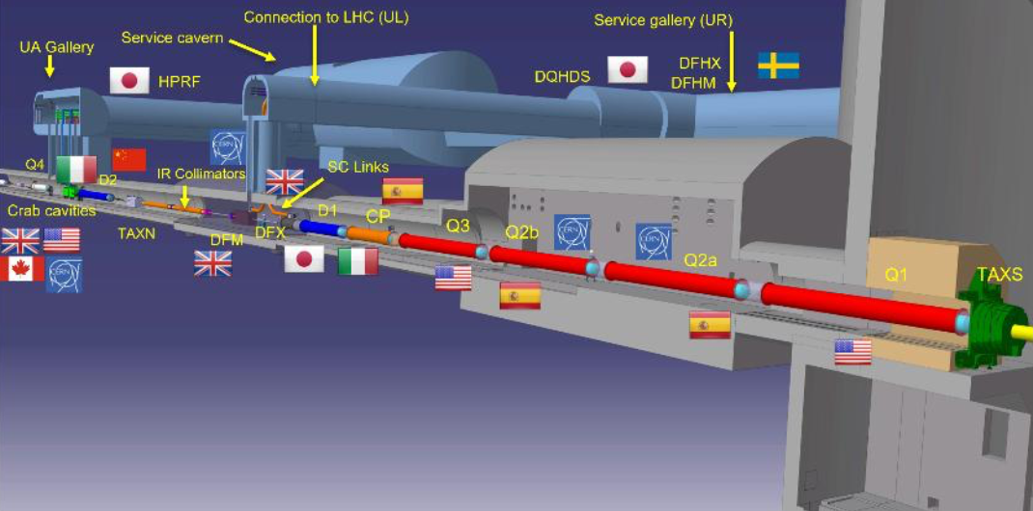
It is also a major international collaboration

Slide 10
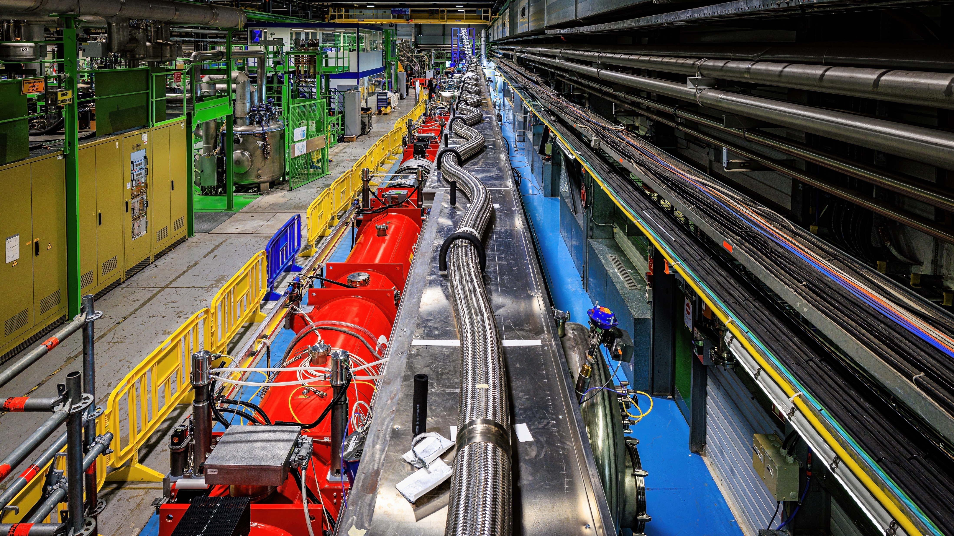
HL-LHC today in SM18: the Inner Triplet String

Slide 11
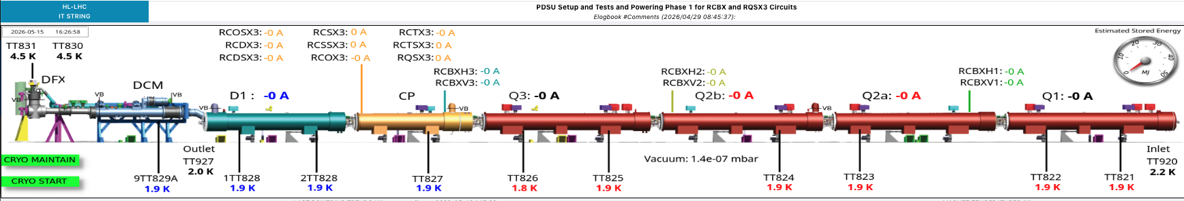
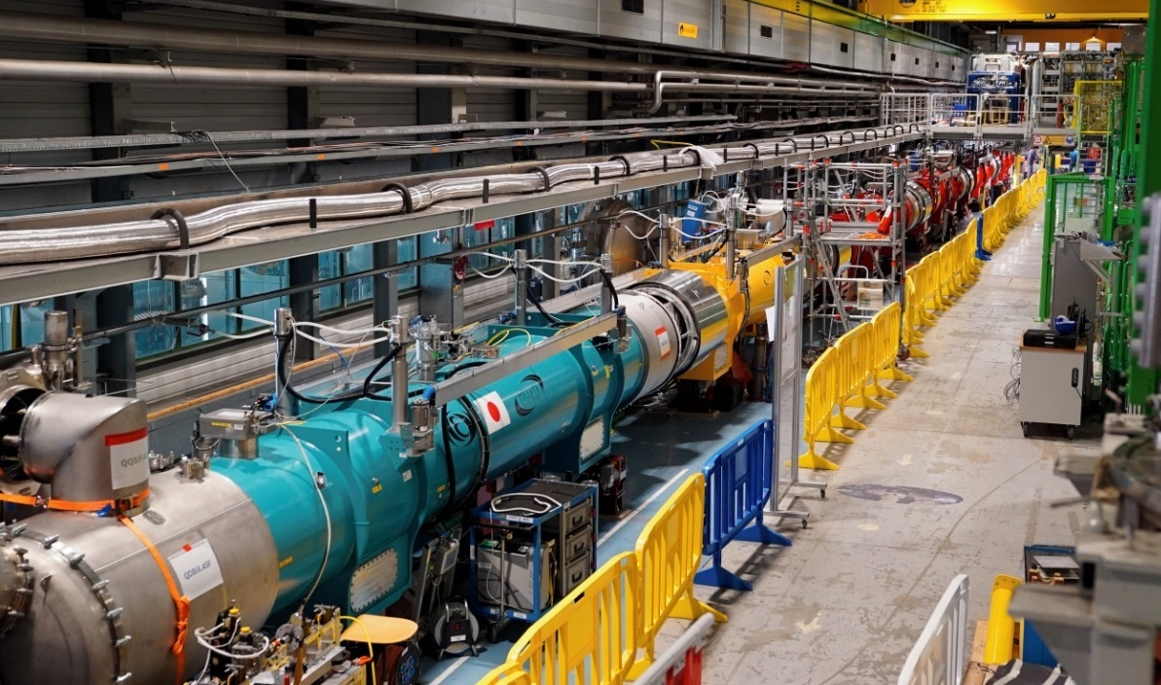
Making great progress with the Inner Triplet String
IT-String Reached 1.9K on March 17th
Corrector magnet powering tests complete
Main circuit powering tests in progress
All powering tests will be complete by the end of Summer 2026
Run 2 of Inner Triplet String in 2027

Slide 12
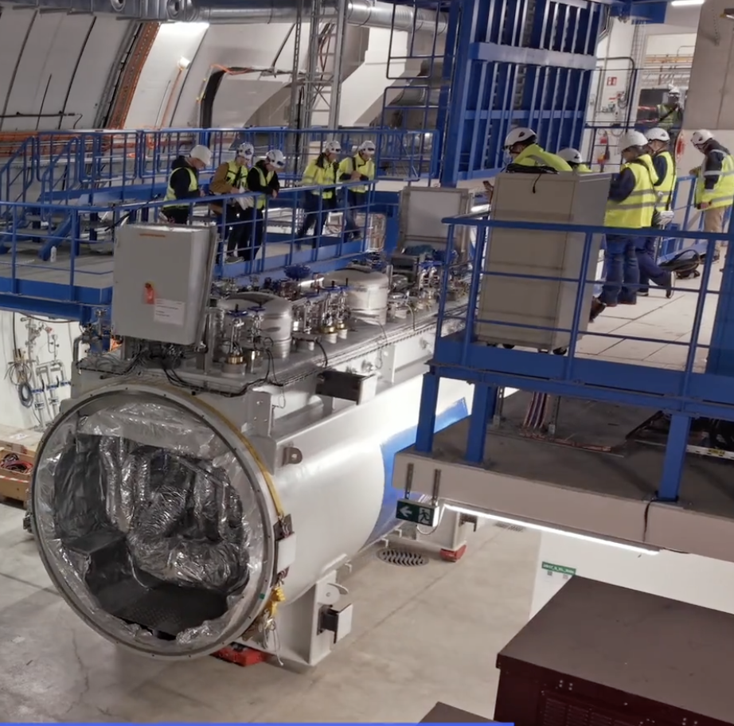
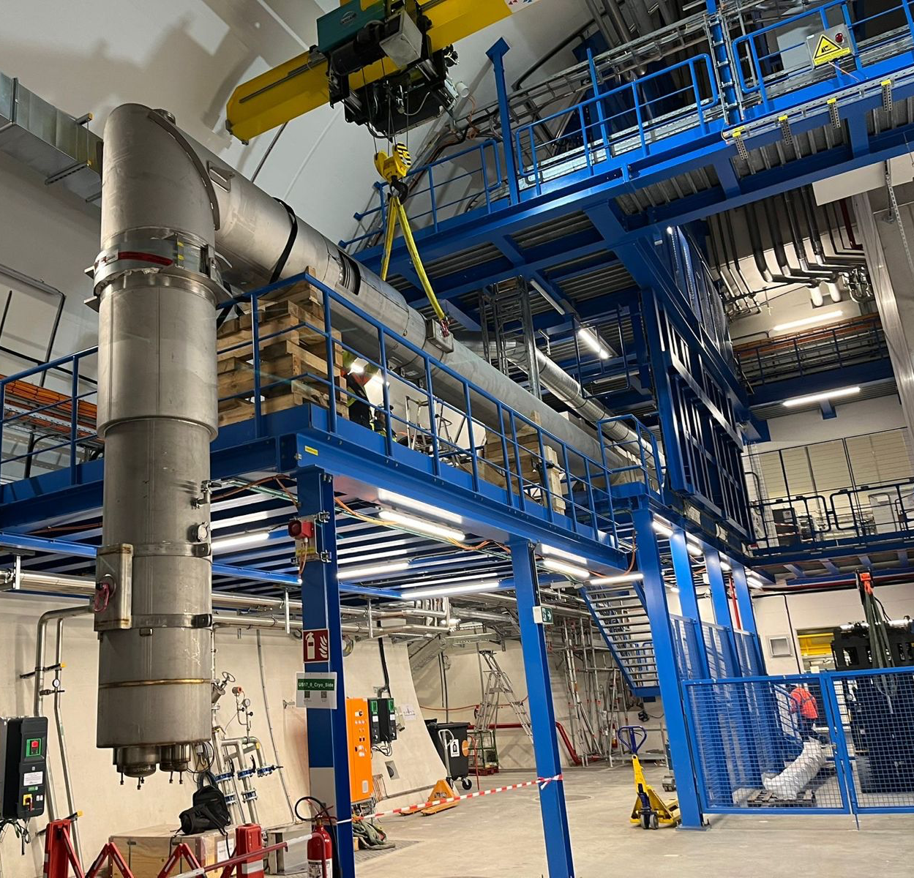
HL-LHC: progress with cryogenic infrastructure
Cold Box (QURCG) handling and installation completed in Point 5
Lowering and temporary storage of first spools for connection to QPLG in Pt5

Slide 13
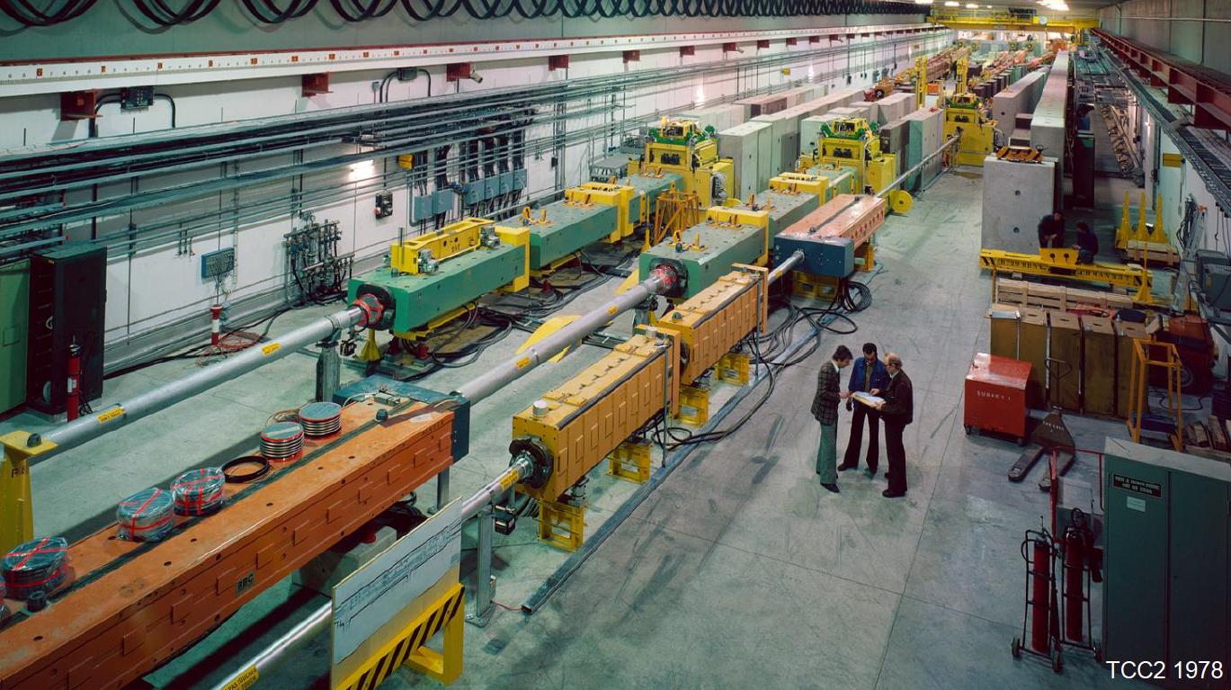
2) North Area consolidation (NA-CONS)

Slide 14
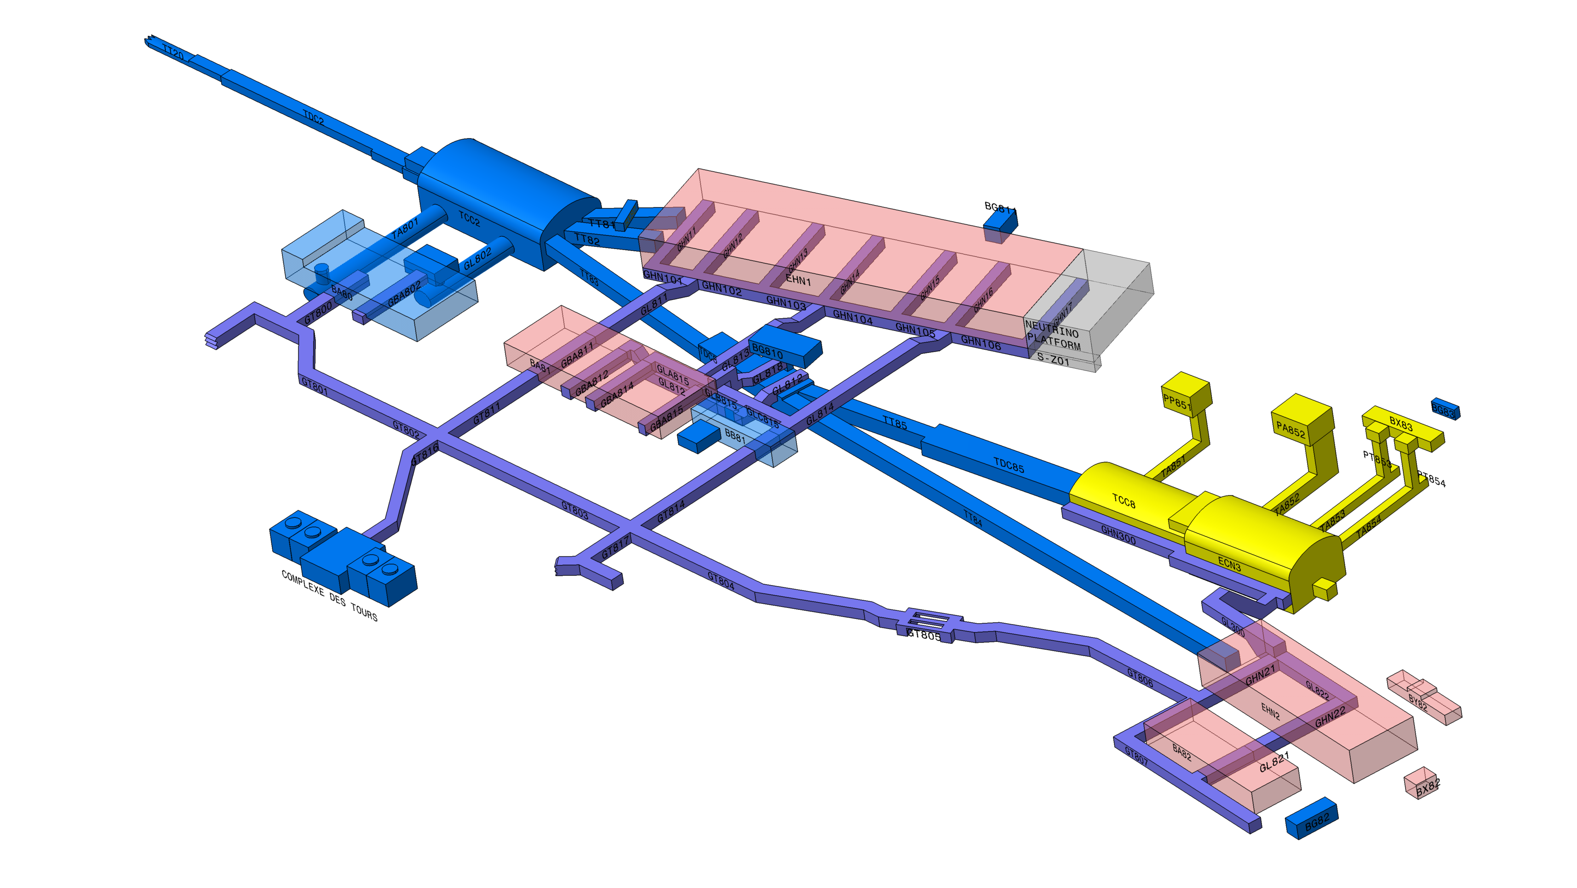
NA-CONS
Renovation of the Fixed Target Experimental Area site after 47 years
  This is a major and necessary project
    Recover the availability and reliability
    Correct safety concerns and non-conformities
    Ready for new experiments/test beam
HI-ECN3 Project
2017
2019
06/2021
06/2024
06/2025
09/2026
06/2029
12/2033
06/2035
NA-CONS Study
NA-CONS Project Phase 1
NA-CONS Project Phase 2
RUN 2
LS 2
RUN 3
LS 3
RUN 4
LS 4
NA-CONS is a necessary high-priority project for CERN
- the main challenge is the significant resource required
NA-CONS Study approved
General Safety Review
NA-CONS Ph. 1 approved
NA-CONS Ph. 2 approved
TCC2 Renovation approved
Start LS3
NA Restart for RUN4
Start LS4
NA Restart for RUN5
HI-ECN3 Project approved

Slide 15

3) The Future Circular Collider

Slide 16
Why the FCC?
The Higgs Boson is a genuinely new and unique type of matter
It is also very “strange” – and may well provide a new window for discovery
A strong scientific case for a new “Higgs Factory” machine to study it in fine detail
The “Future Circular Collider” (FCC)
A new 91km ring
First stage collides electrons & positrons: FCC-ee
An ambitious and exciting scientific programme
  Higgs and much more (Z, flavour, …)
Targeting start of operations in ~2045-2048
Total cost over ~15 years of about 15 BCHF…
It is incredibly exciting and is a suitably ambitious next project for CERN
Scientific case studied by European Strategy Group (ESG)

Slide 17
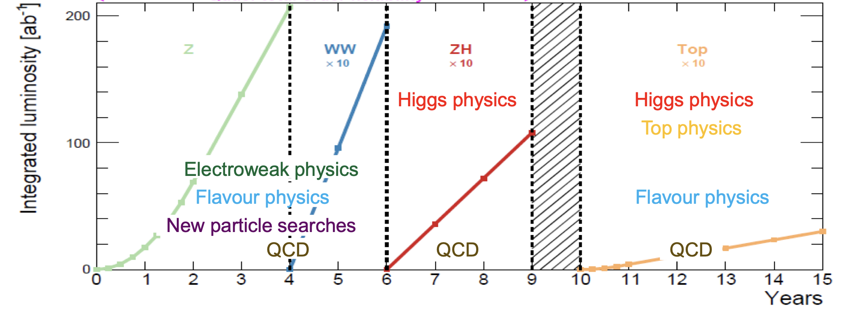
FCC-ee Physics
Flexible exploration of the Higgs and the wider electro-weak sector
Flexibility to run at Z, WW and ZH and subsequently top-pair production
Huge event samples for incredible precision – e.g. 10¹² Z bosons = 1,000,000 x LEP

Slide 18
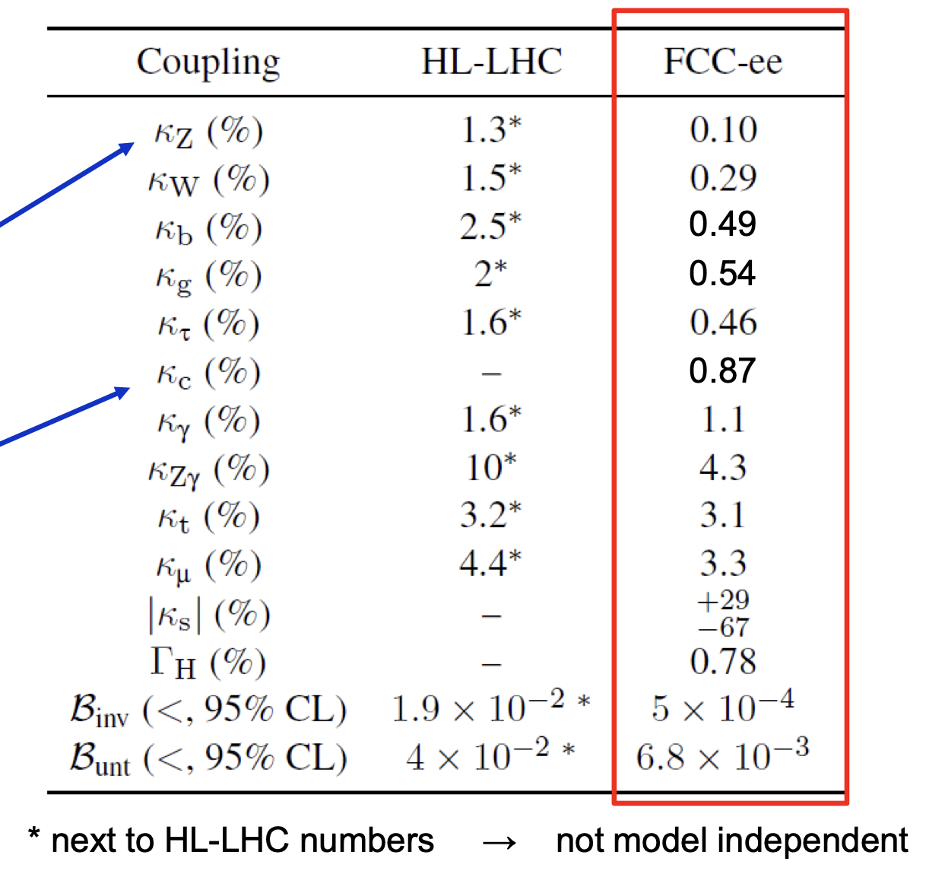
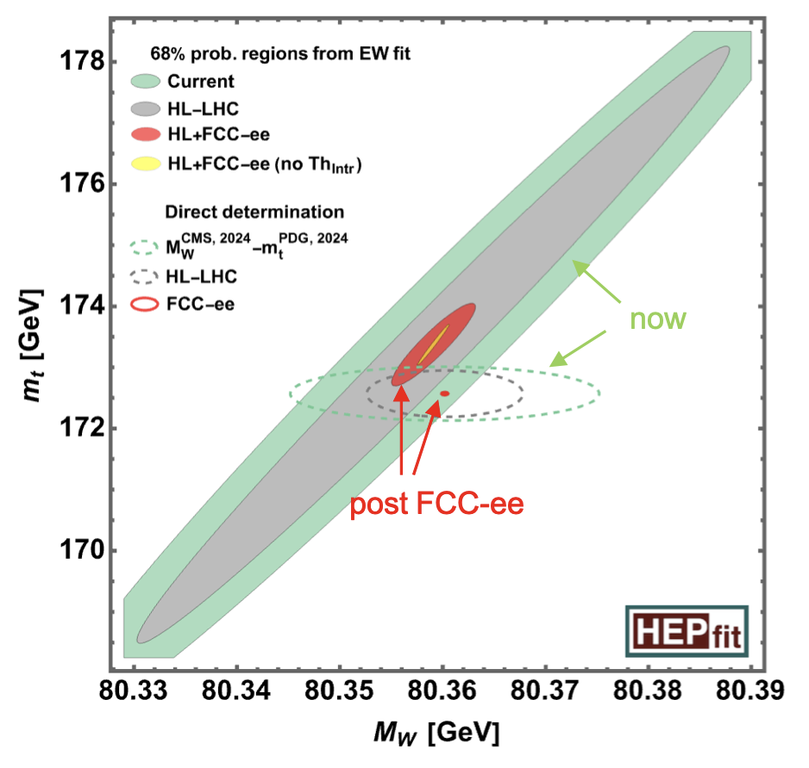
FCC-ee Physics
Step-change in precision!
e.g. Model-independent Higgs couplings at the sub-1% level
e.g. Three-orders of magnitude improvement c.f. LEP – this is a paradigm change

Slide 19

4) The European Strategy for Particle Physics: the home straight
We are coming to the end of a roughly 18-month process:
Hope that the European Strategy for Particle Physics will be updated on 22nd May at a dedicated Council meeting in Budapest later this week

Slide 20
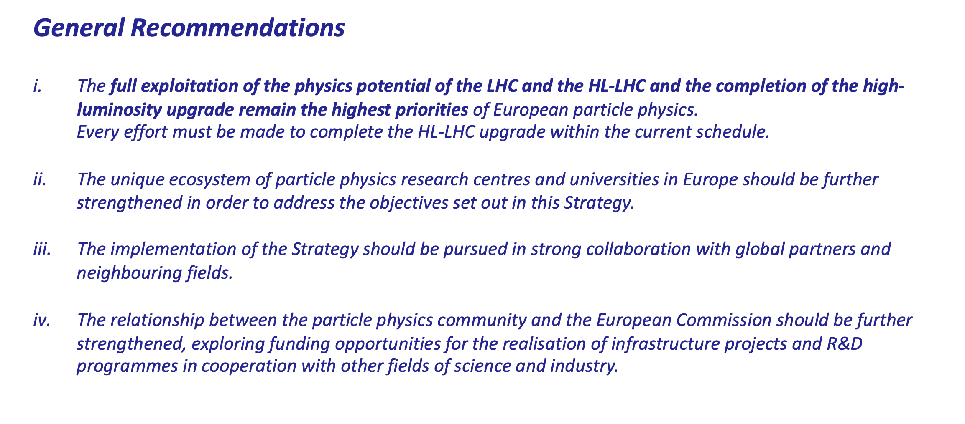
ESG Main Recommendations
CERN’s future vision and strategy is completely aligned with this recommendation:
  HL-LHC machine and detectors are CERN’s highest priorities
  Full exploitation of HL-LHC including LHCb and ALICE upgrades
  Importance of maintaining the current schedule

Slide 21
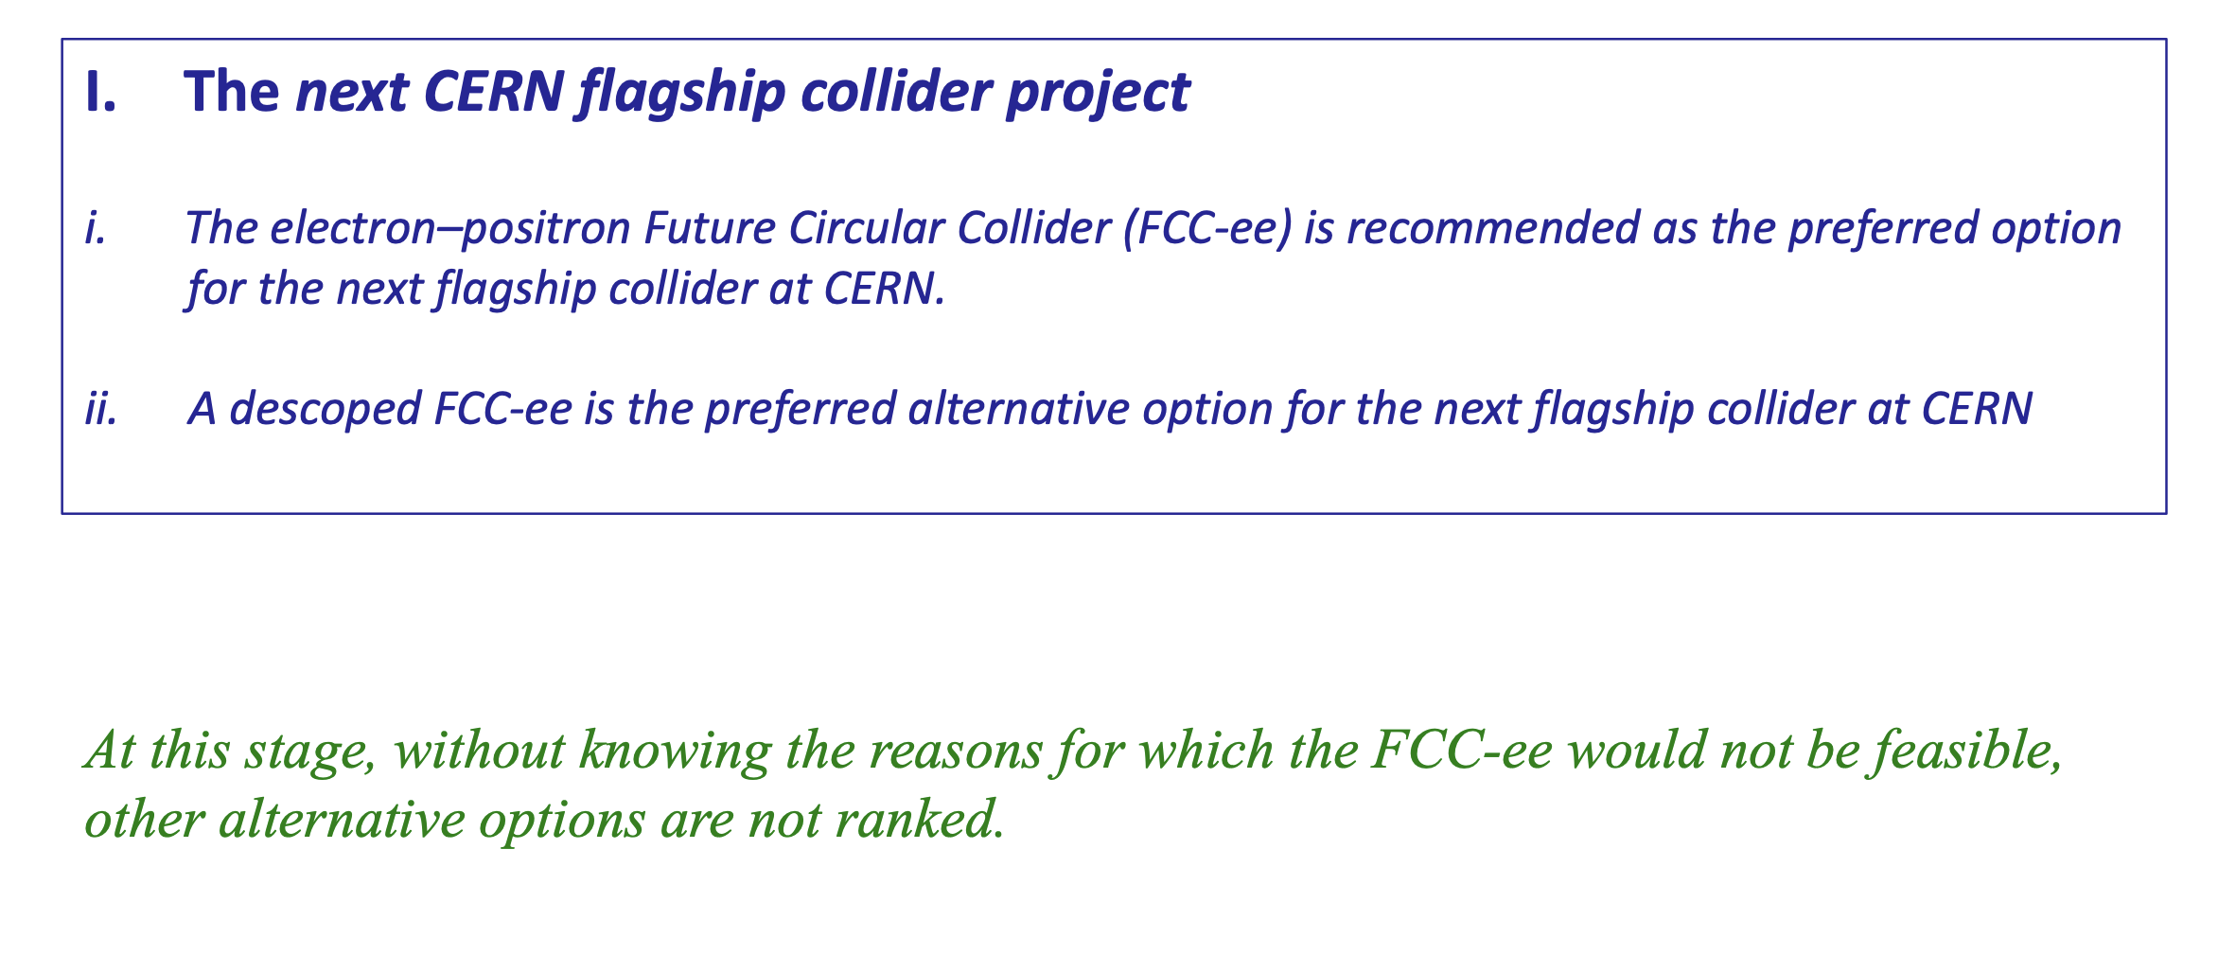
Recommendations on the next collider at CERN

Slide 22
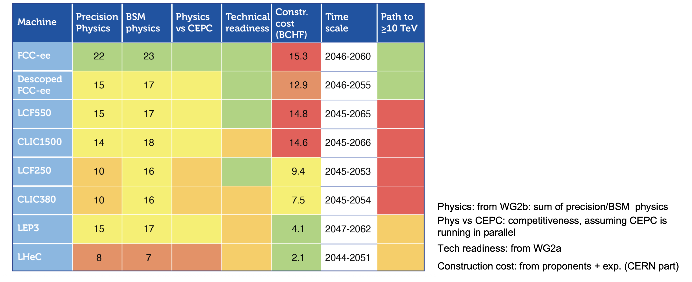
Very clear preference with respect to other options
The strong preference for FCC-ee with respect to other collider options considered is based on the detailed scientific assessment of the ESG
A simple summary below (there is a lot more in the ESG deliberation documents)

Slide 23
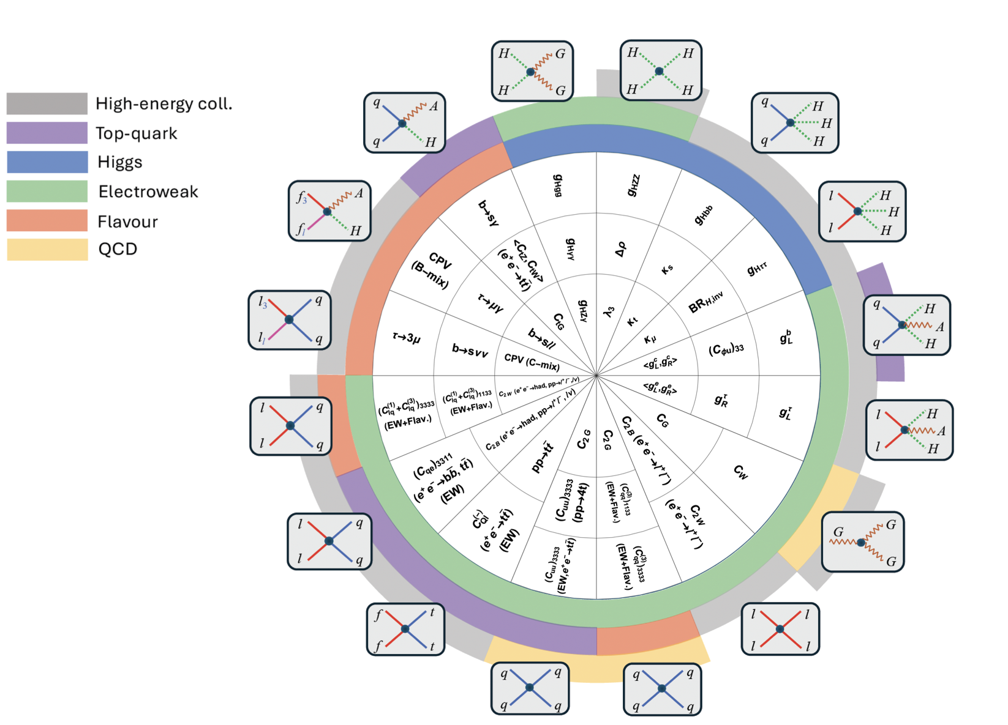
Coverage of the physics landscape
This is a very nice study from ESG WG 2b:
  map improvements in effective couplings relative to HL-LHC
  logarithmic scale 1 – 5
  colour-coded:
    black = 1
    white = 5

Slide 24
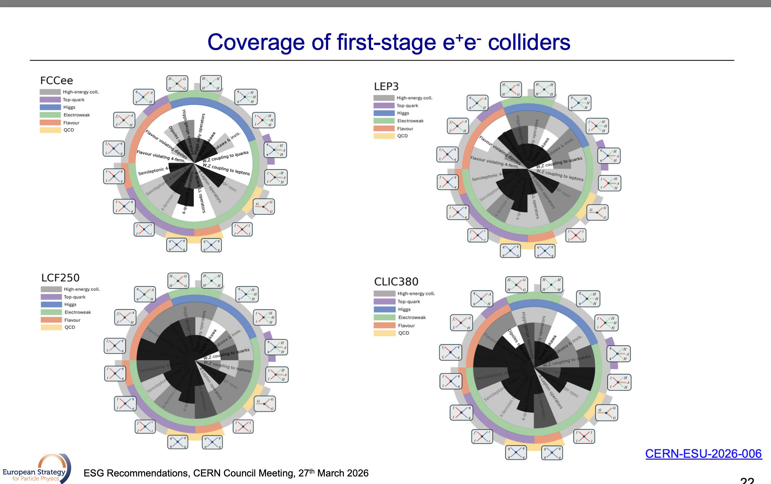
Coverage of FCC-ee with first stage e⁺e⁻ colliders

Slide 25
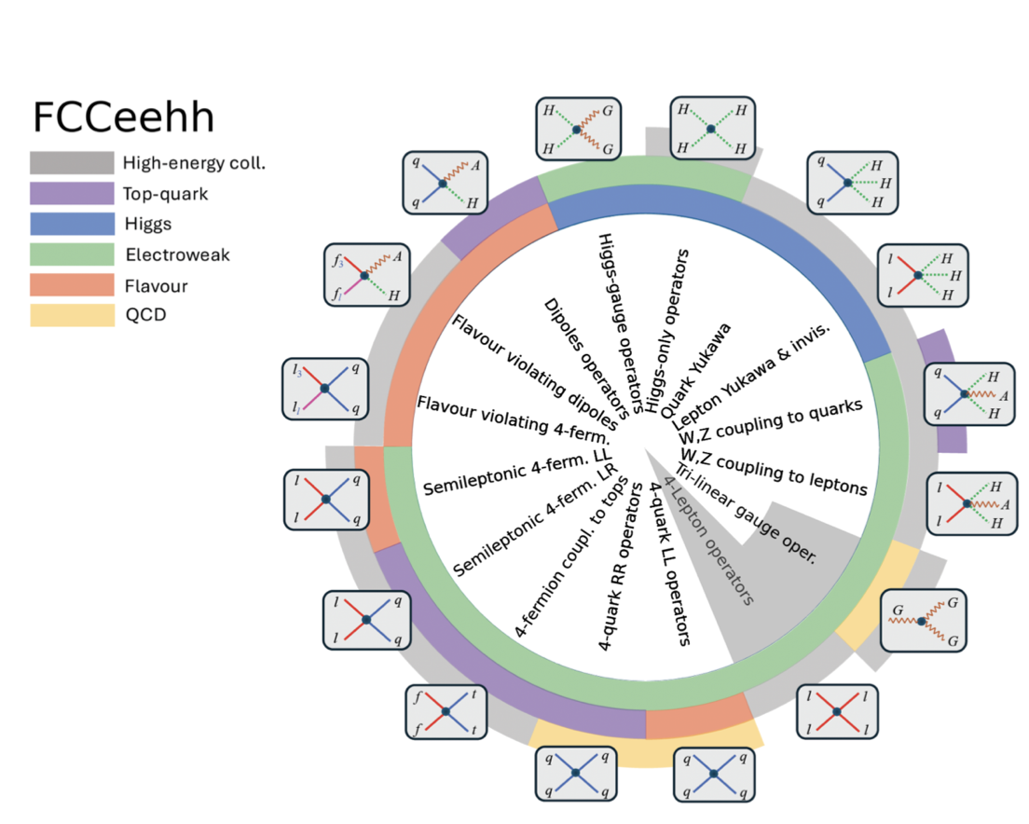
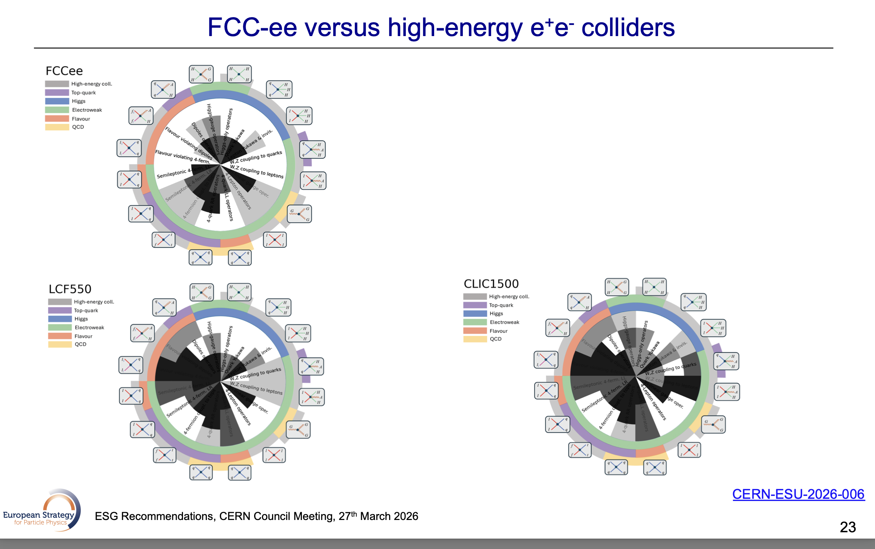
FCC-ee vs. second stage colliders

Slide 26
What does all this mean for CERN?
The key points from the European Strategy Group (ESG) report regarding FCC:
Strong endorsement of the physics and strategic case for FCC-ee as the next flagship collider at CERN
  Near consensus within the particle physics communities in CERN’s Member States
A descoped/staged FCC is preferred to other options as the alternative
No explicit prioritization of LEP 3, LHeC, LCF, CLiC. Concluded that FCC is far ahead
Assuming this update of the ESPP, FCC-ee is CERN’s vision for the future:
Our clear aim is to be ready for a decision on FCC-ee in 2028
CERN’s highest long-term objective is to be in a position in 2028 to propose to Council FCC-ee as CERN’s next flagship collider
  Seeking a go/no-go decision
We will make the case based on FCC-ee alone
  noting that it provides a potential future pathway to a very-high energy hadron collider
Progressing FCC-ee to a decision point is CERN highest long-term scientific priority

Slide 27
The European Strategy underpins CERN’s strategy
Top Priority – full exploitation of the LHC and HL-LHC
HL-LHC and ATLAS and CMS upgrades are CERN’s top priority
Full exploitation of HL-LHC includes the ALICE and LHCb upgrades during LS4
Highest long-term priority – FCC-ee as CERN’s next flagship collider
Our aim is to be in the position for CERN Council to be able to take a decision on FCC-ee from June 2028 onwards
Non-collider physics at CERN will remains an important part of the programme
Our aim is to develop a new roadmap for the future of the non-collider physics programme at CERN by early 2027
Accelerator R&D – top priorities as recommended by the ESG:
Advanced superconducting and normal-conducting Radio Frequency (RF) technology
Efficient RF power supplies
Accelerator quality magnets (14-20T), including High-Temperature Super-conductors (HTS)

Slide 28
The Importance of HL-LHC
The construction of the HL-LHC and the ATLAS/CMS upgrades will dominate the next four years at CERN
Long Shutdown 3 (LS3) for the LHC commences on 29 June 2026
The plan and clear intent is to be commissioning the machine and detectors in 2030
This is a major task
The HL-LHC installation will be the largest project undertaken by CERN in around 20 years
The Phase 2 detector upgrades, are the largest projects undertaken by ATLAS and CMS since the construction of the original detectors
The HL-LHC and the detector upgrades represent by far the highest priority for CERN in the coming years
Meeting the current schedule, which is our intention, will require laser focus
Accordingly, CERN is prioritising resources to during LS3 maximize the likelihood of success
HL-LHC and the Phase 2 upgrades are CERN’s highest priorities

Slide 29
5) The challenges for CERN in the coming years

Slide 30
Challenges in the coming years
The HL-LHC programme (machine and detectors) and LS3 consolidation
Represent a major shift from operation to construction
The work involved is exciting and also extremely technically and logistically challenging
At CERN
There are also other major activities during for LS3, including consolidation of the North Area
Resources (people) are stretched with many activities running in parallel
In the wider scientific community
Resources (people) are already stretched
And today, the economic situation across Europe is not easy – stiff competition for funding
Geopolitically
We live in interesting times. There is increased risk of supply chain disruption and inflation
We can succeed, but it will require real focus at CERN and in the wider community
  this means being willing to delay/pause other activities to free up resources

Slide 31
6) CERN’s Scientific Strategy and Priorities

Slide 32
Accelerator programme
Main priorities
Completion of the HL-LHC with commissioning in 2030
  This is the top priority by far and this degree of priority is being reflected in our financial and personnel planning
  Colleagues in ATS are developing a globally resource-loaded plan for all activities within LS3, with break points for non-HL-LHC activities that could be delayed to maintain the HL-LHC schedule
Bringing the FCC-ee to a decision point in 2028
  FCC-ee is the highest long-term priority
  If the “answer” is “no”, then foresee a likely new targeted European Strategy update
Consolidation of CERN’s injector complex
  With a view to the long-term PS and SPS based non-collider physics programmes, e.g. NA-CONS, HI-ECN3 and ongoing consolidation of the PS and SPS

Slide 33
Scientific research
Main priorities
Completion of the ATLAS and CMS upgrades by 2030
  Alongside the HL-LHC, this is the top priority
  CERN will strengthen the host-laboratory programme to maximise the likelihood of success
Fully exploit the HL-LHC
  Progress the TDRs of the LS4 ALICE and LHCb upgrades and associated funding model
  Need a plan compatible with the current LS4 schedule (2034-2035) and available funding
  CERN has committed to investing in the Phase 2b ALICE and LHCb upgrades
Evolve the computing for the HL-LHC operation
  Working with the LHC collaborations and the WLCG to evolve the computing model for HL-LHC operation within the likely available resources

Slide 34
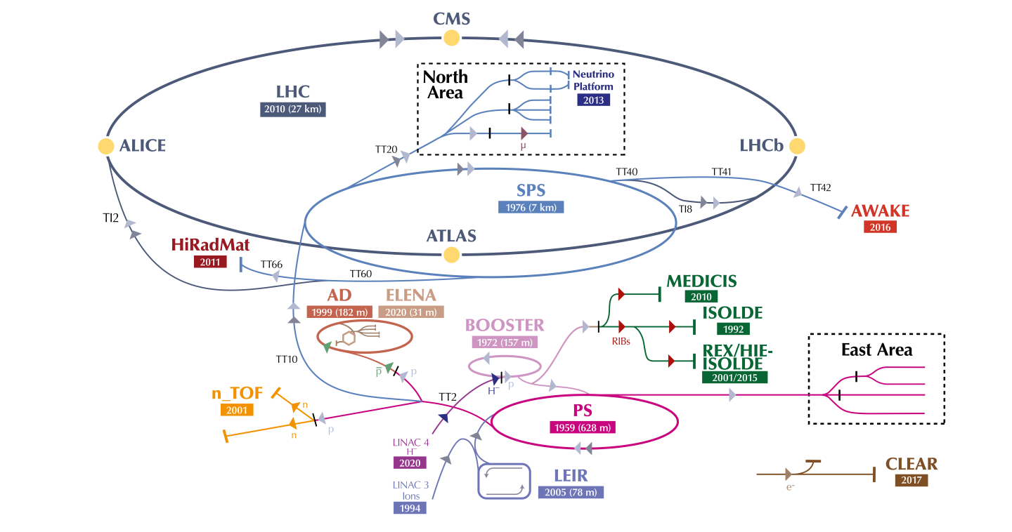
Non-Collider Physics at CERN
There’s more to CERN than the LHC…

Slide 35
Non-Collider Physics at CERN
The non-collider physics programme at CERN
An essential part of the attractiveness of the laboratory and its scientific output
Supports a large scientific user community of ~3,000 users
The Physics Beyond Colliders programme has developed ideas for options for new projects, using CERN’s unique infrastructure
And potential future developments elsewhere: ISOLDE, AD/ELENA, AICE, …
Main priorities for non-collider physics at CERN
Develop a long-term roadmap for non-collider physics at CERN
  Embed a long-term investment line in CERN’s financial planning
  Prioritise potential new experimental activities taking a holistic view
    this work has already started
  SHiP remains a scientific priority, but we still need to have clarity on the scope, schedule and funding model

Slide 36
Concluding Remarks

Slide 37
Concluding remarks
Our mission and our challenge
The next five years will be a critical period for CERN
  We are moving from a period dominated by operations of the LHC, to the HL-LHC machine and detector construction, both of which are at the scale not seen at CERN for the last 20 years
  At the same time, we are aiming to progress FCC-ee, as CERN’s next flagship project after HL-LHC, to approval and then to project implementation
  An amazing and incredibly exciting opportunity, but it will not be easy – far from it…
    HL-LHC construction, detector upgrades, LS3 consolidation and FCC-ee development all running in parallel
  And all in the context of an ever more uncertain economic and geopolitical background
I am confident that we can succeed, but during LS3 we will need to focus on these very top priorities for the future of CERN

Slide 38
Thank you

Slide 39
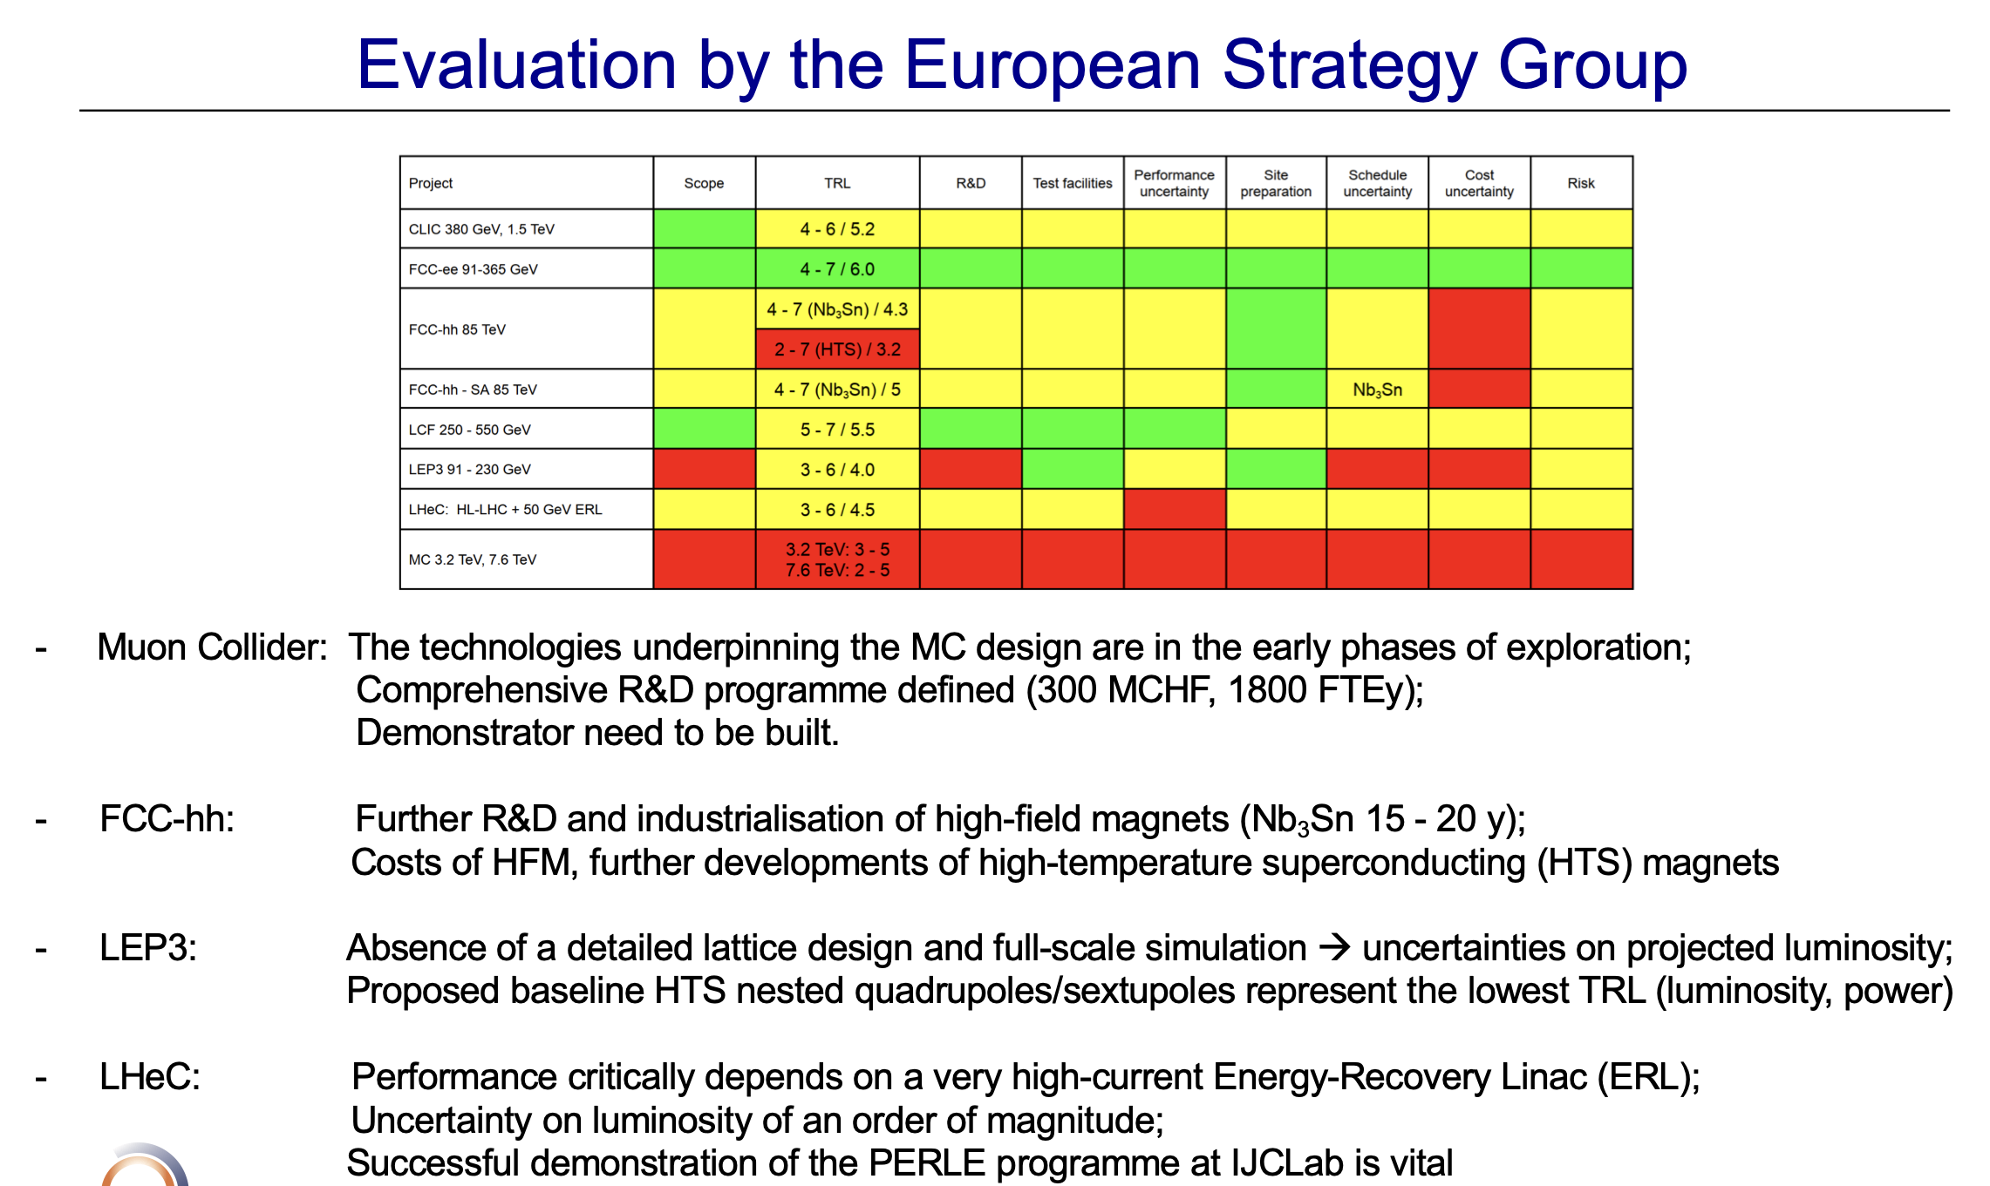
Final Words

