Slide 1



GANIL-SPIRAL2 facility - recent achievements and upgrades
Deauville
Robin FERDINAND for the GANIL teams
1 – Introduction to GANIL
2 – SPIRAL2 commissioning
3 – SPIRAL2 feedback and operation
4 – Futur of GANIL
5 - Conclusion

Slide 2
Grand Accélérateur National d’ions Lourds
1

Slide 3
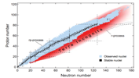
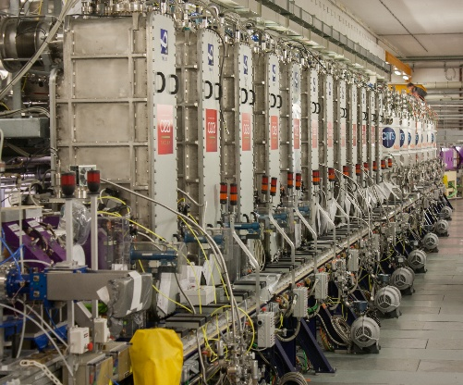

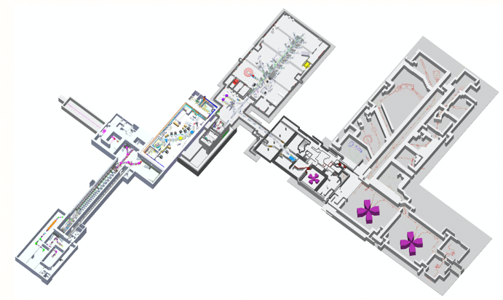
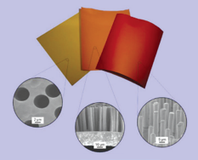
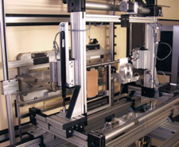


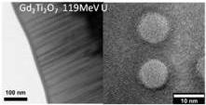

Grand Accélérateur National d’Ions Lourds
GANIL research activities theoretical and experimental aim to respond to:
  How was matter created in the universe?
  How do neutrons and protons interact, making up the nucleus of the atom?
  What are the limits to the existence of matter?
  What are the rules governing the so-called magic nuclei?
Nuclear Physics
Astrochemistry
Materials under irradiation
Nanostructure
Radiobiology
Industrial applications
Detectors and accelerators R&D
Nuclear Astrophysics

Slide 4
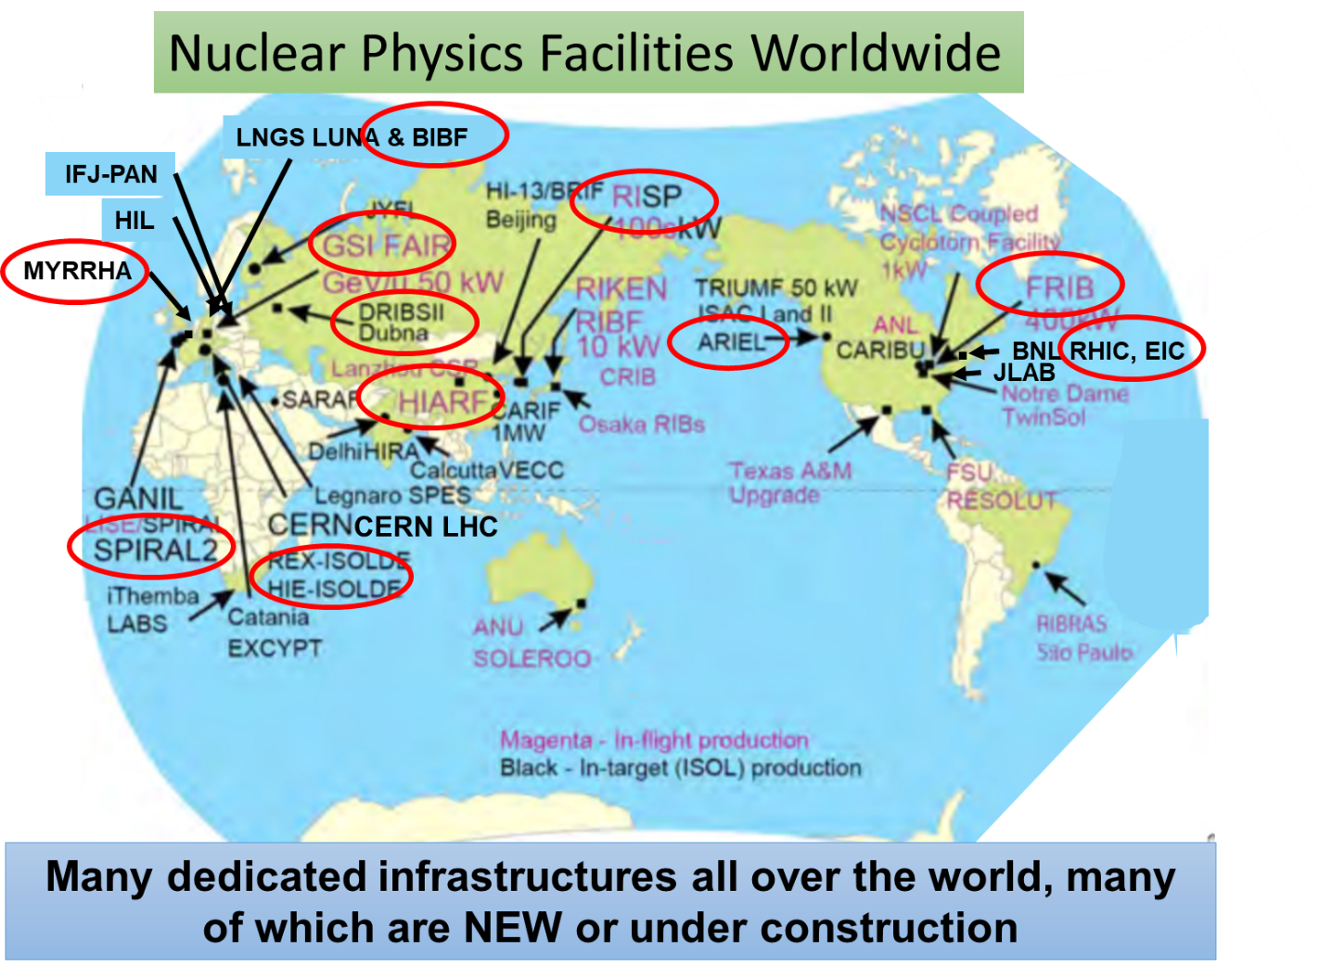
European Landscape of Nuclear Physics Infrastructures
ESFRI Landmarks :
  FAIR in Darmstadt, Germany
  SPIRAL2 at GANIL, Caen, France
  (ELI-NP in Magurele, Romania, under negociation)
  Related to nuclear physics research ESFRI project IFMIF-DONES, Spain
Taking data > 30
Under construction or upgrade ≥ 9
All infrastructures are multidisciplinary !
From NuPECC LRP 2024
@M. Lewitowicz

Slide 5
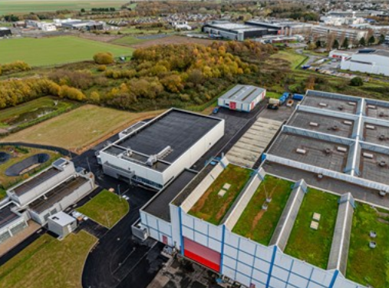
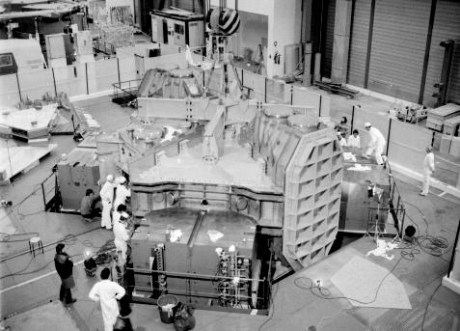
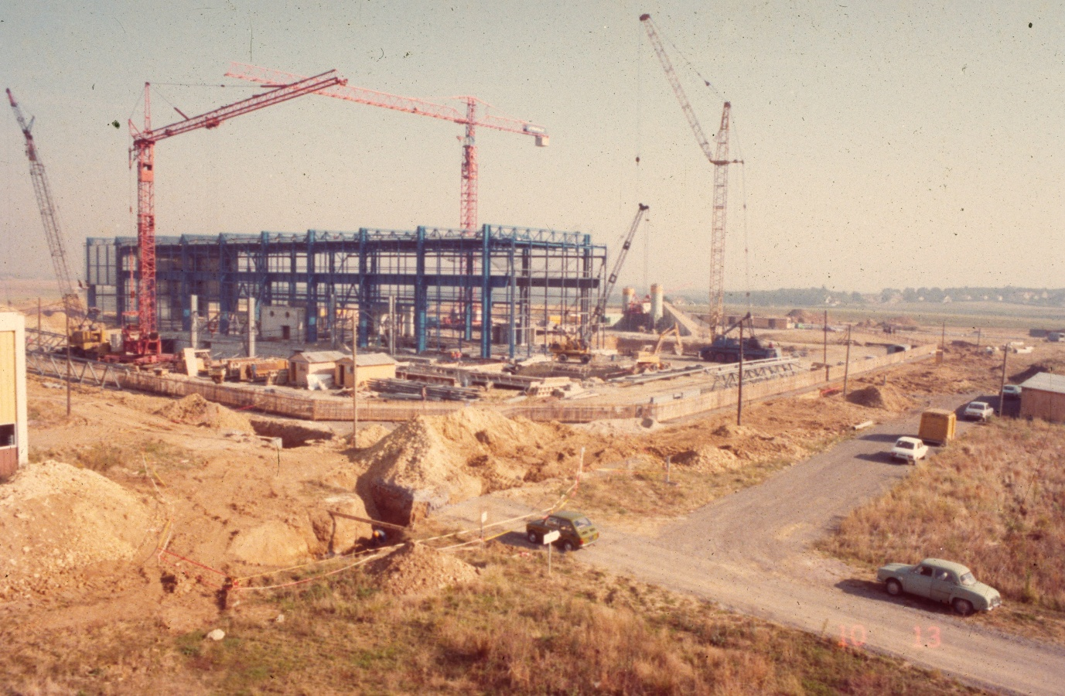
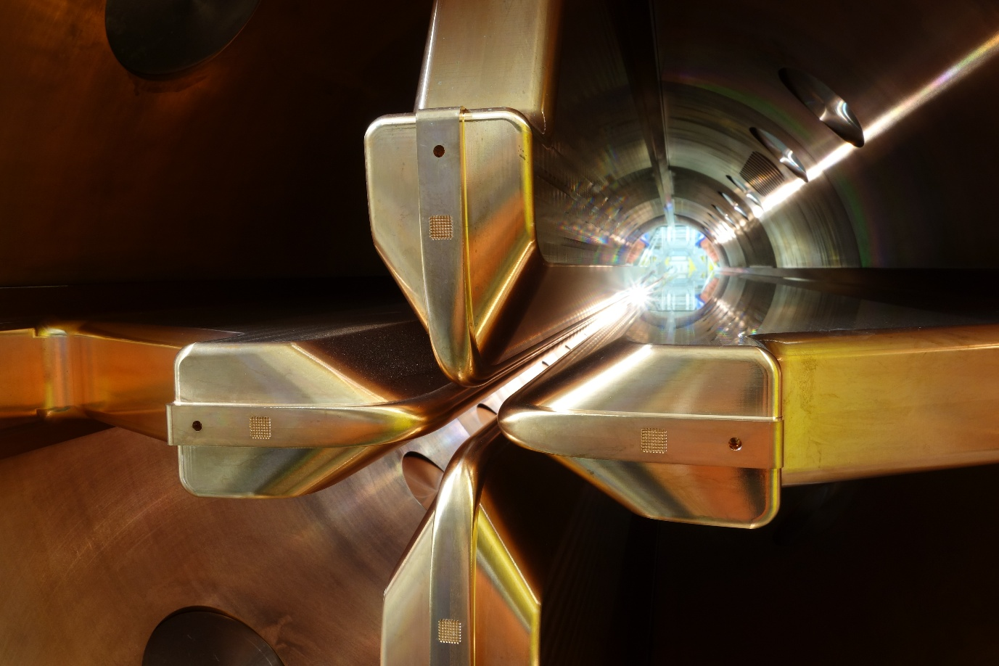
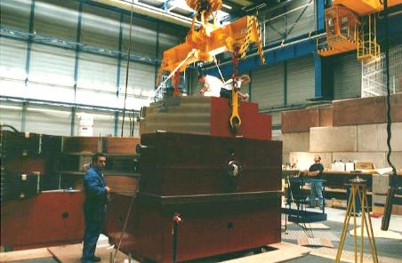
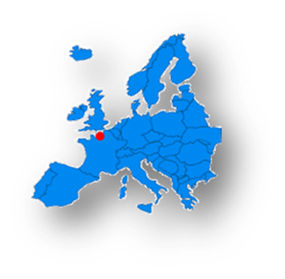


Grand Accélérateur National d’Ions Lourds
GANIL is one of the major laboratories specialized in nuclear research
Established by two French research organizations, each contributing equally to its construction and operation:
  The CEA and the CNRS.
INB (Basic Nuclear Facility) / ZRR (Restricted Area)
Host laboratory: researchers, industry, students.
1972
Start of GANIL Project
1982
CCS2 beam
2001
SPIRAL1 radioactive beam
2019
SPIRAL2 LINAC beam
2005
Start of SPIRAL2
project
2022
SPIRAL2 experiment
2025
DESIR Building
2027 ?
First S3 experiment
2030 ?
NEWGAIN commissioning

Slide 6


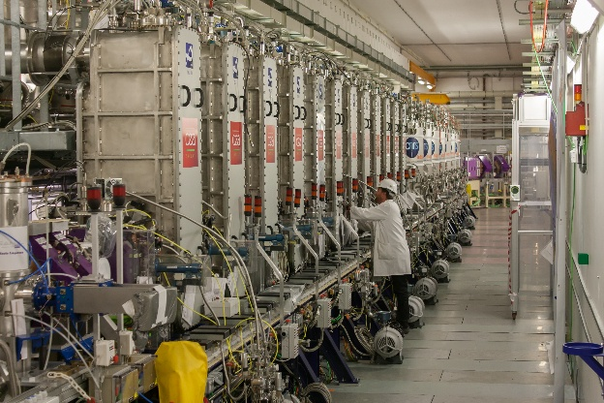
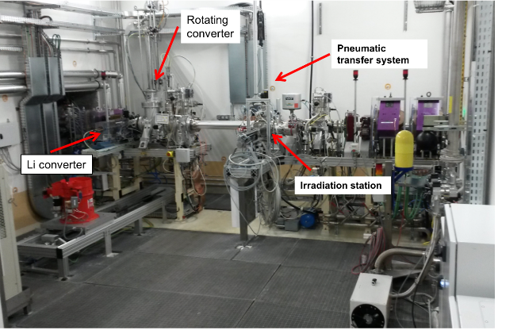
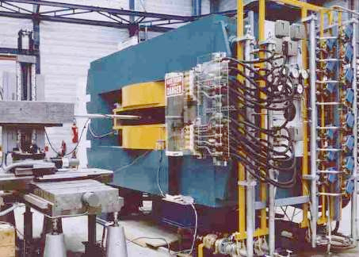
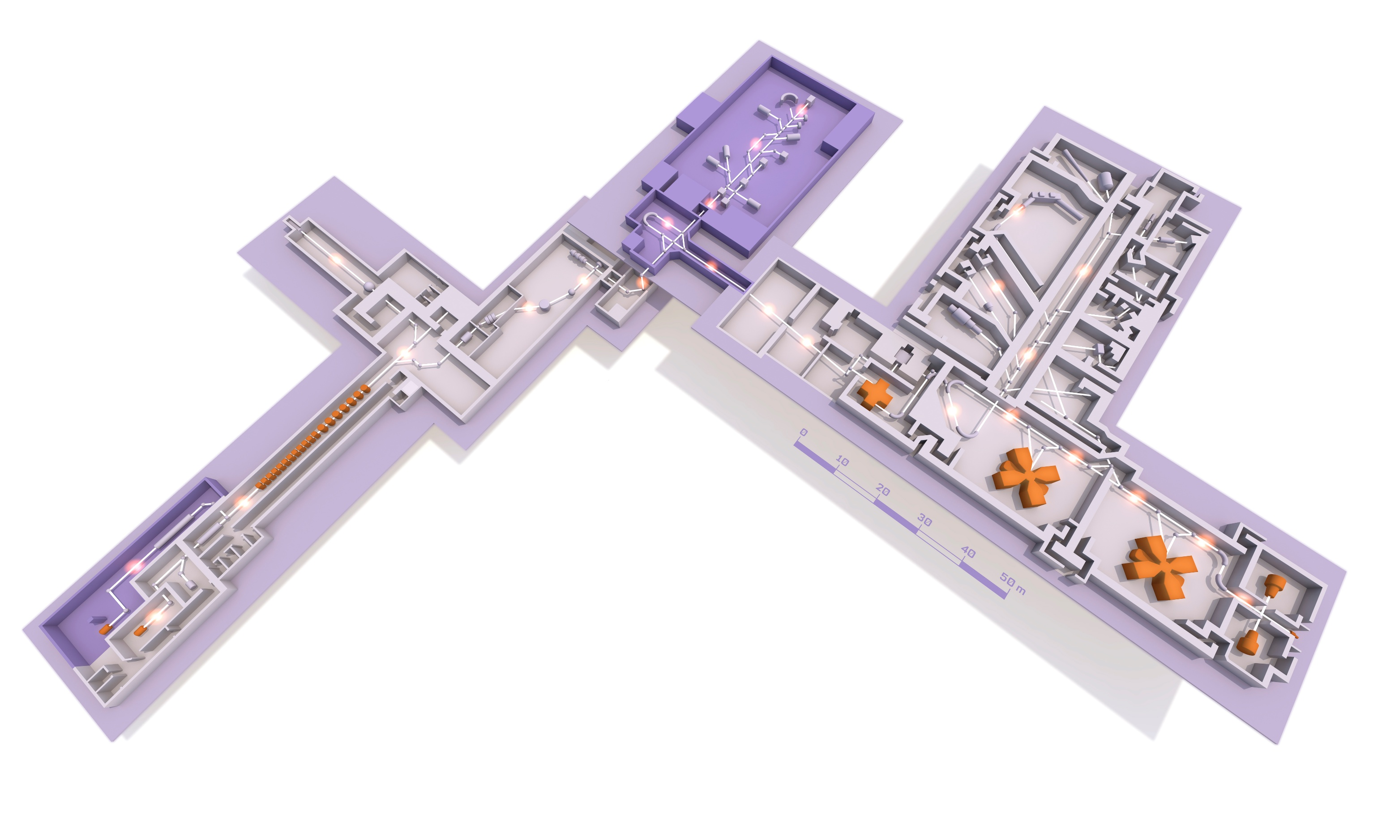
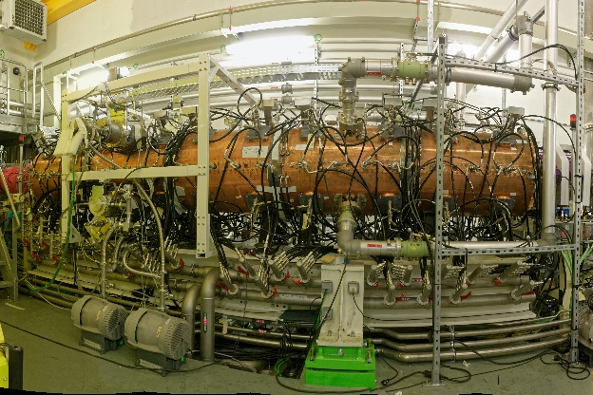
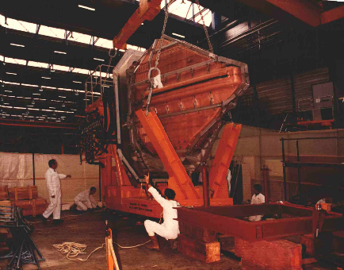
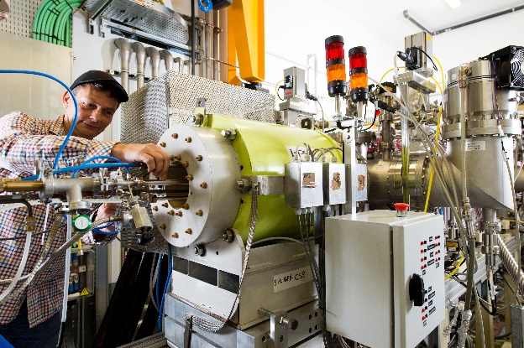

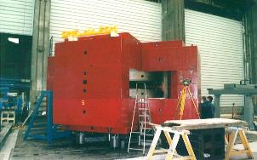
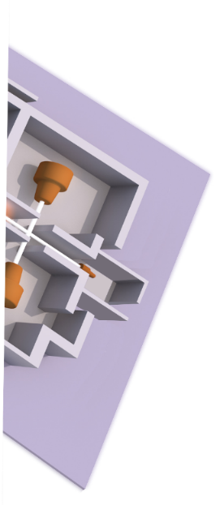
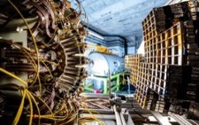
Grand Accélérateur National d’Ions Lourds
NFS
DESIR
Decay Excitation and
Storage of Radioactive Ions
SC LINAC
0
10
20
30
40
50 m
NFS
Neutron For Science
Experimental Halls
C0 cyclotron
RFQ
S³
Super
Separator
Spectrometer
CSS2 cavity
NEWGAIN
7 A.MeV HI (0.3mA - A/Q=7)
Ion source
A/Q=3
Cyclotrons
CIME 25 A.MeV, CSS2 95 A.MeV, CSS1 13.7 A.MeV, C0&C1, C to U 10¹²pps
SPIRAL2 Superconducting LINAC
33 MeV p, 40 MeV d (5mA), 14.5A.MeV HI (1mA – A/Q=3)
SPIRAL1
A multidisciplinary,
multi-users laboratory with up to 6 simultaneous beam production
IRSSUD
0.1-1 A.MeV
INDRA + FAZIA

Slide 7
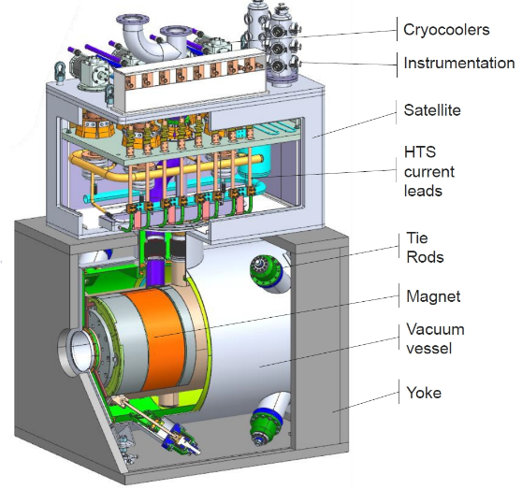
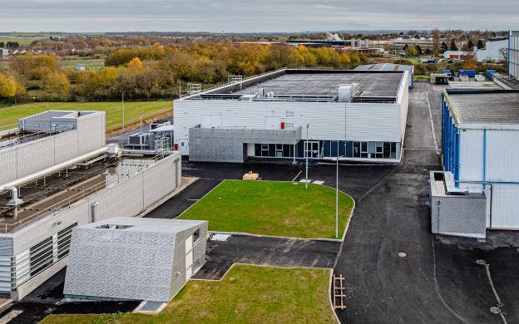
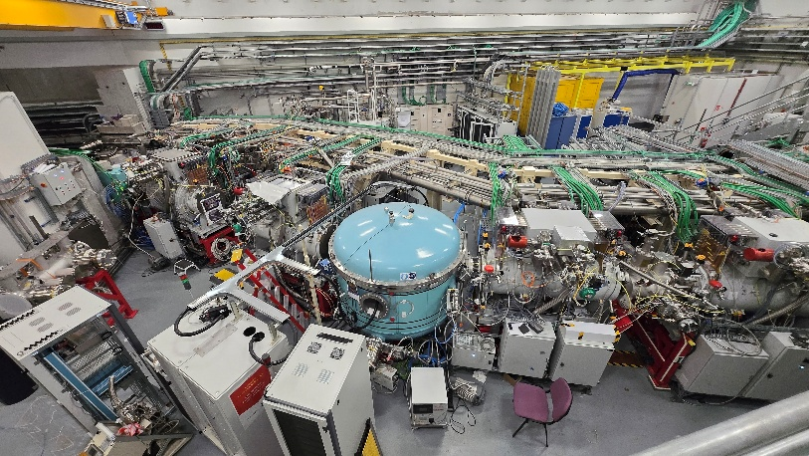
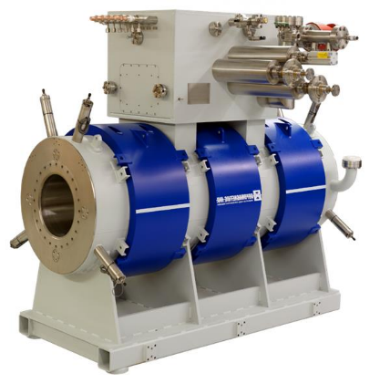
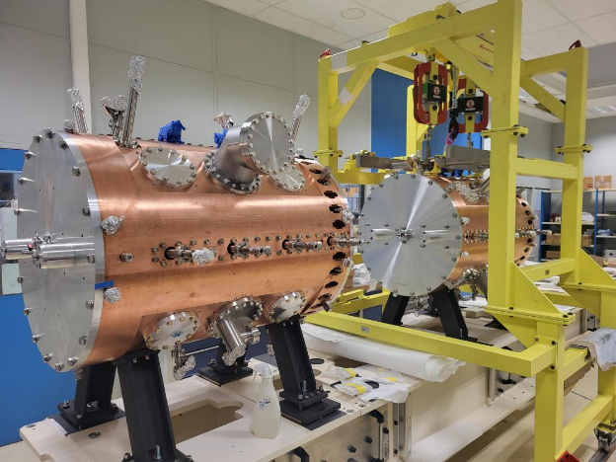
Grand Accélérateur National d’Ions Lourds
DESIR
DESIR
Decay Excitation and
Storage of Radioactive Ions
0
10
20
30
40
50 m
NFS
Neutron For Science
Experimental Halls
Ion source A/Q=7
ASTERICS
S³
S³
Super
Separator
Spectrometer
S³ SMT
Superconducting Multipole Triplet
New RFQ A/Q=7
NEWGAIN
7 A.MeV HI (0.3mA - A/Q=7)
Cyclotrons
CIME 25 A.MeV, CSS2 95 A.MeV, CSS1 13.7 A.MeV, C0&C1, C to U 10¹²pps
SPIRAL2 Superconducting LINAC
33 MeV p, 40 MeV d (5mA), 14.5A.MeV HI (1mA – A/Q=3)
A multidisciplinary,
multi-users laboratory with up to 6 simultaneous beam production
IRSSUD
0.1-1 A.MeV

Slide 8

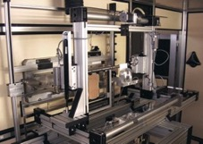
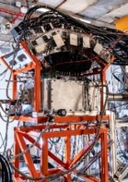
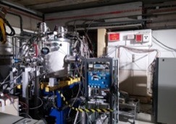
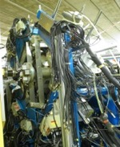
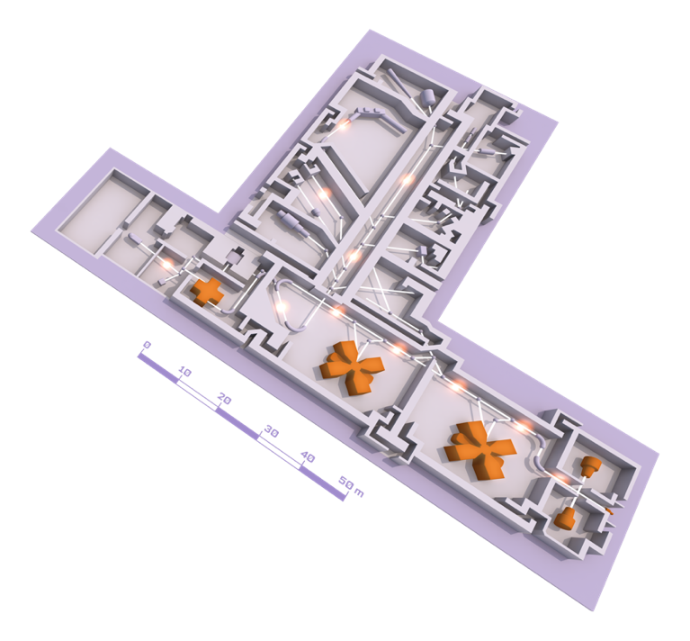
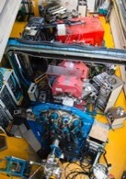
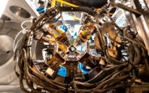
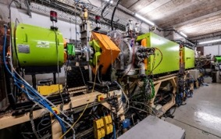
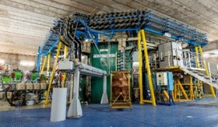
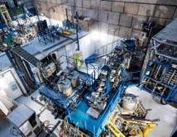
GANIL cyclotrons and experimental rooms
EXOGAM
ACTAR TPC
Industrial irradiation
MUGAST
Experimental rooms
AGATA
LISE SPECTROMETER
VAMOS
5 cyclotrons
Stable beams: ¹²C à U
Energy : from <1 MeV/u up to 95MeV/u
SPIRAL1 radioactive ion beams
Up to 4 experiments in parallel
GANIL CYCLOTRONS
INDRA + FAZIA
CYCLOTRON
SOURCES

Slide 9
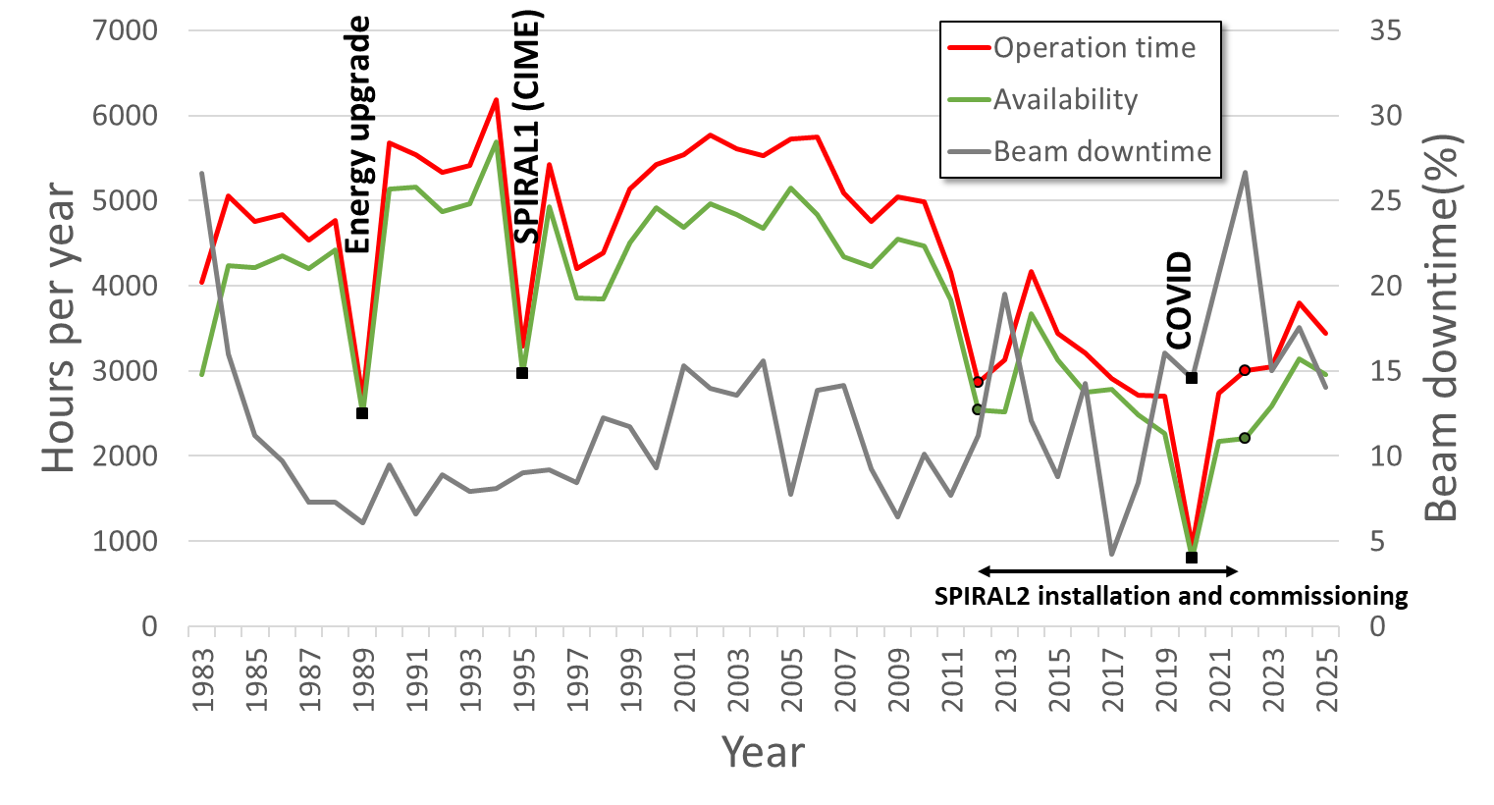
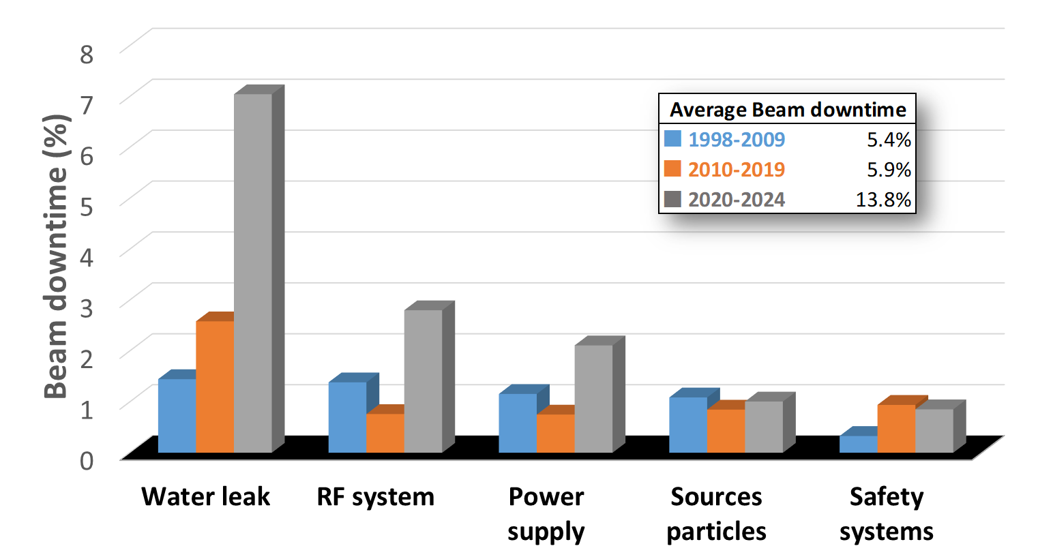
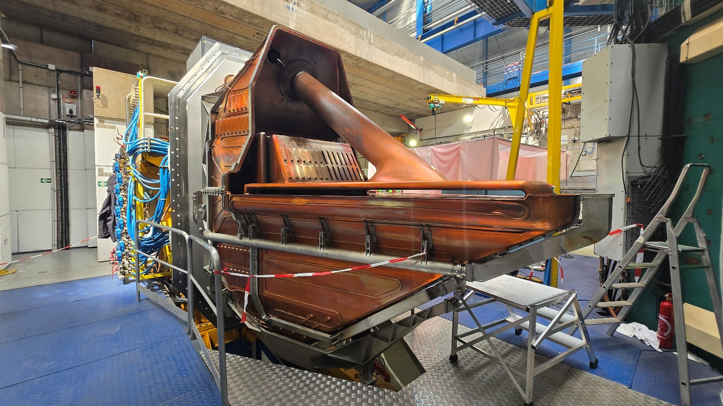
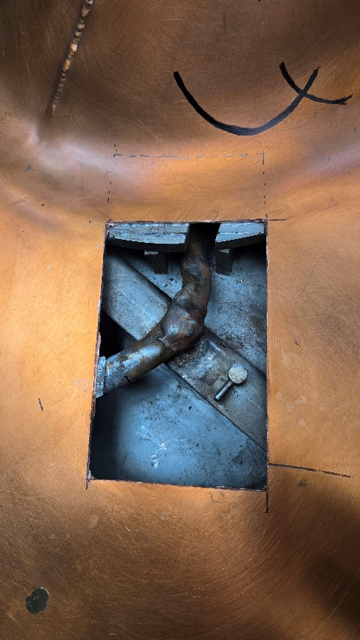
Cyclotrons operational experience
GANIL typically delivered ≈4000 hours of beam per year
Maintenance reduced during SPIRAL2
installation and commissioning
Aging of the cyclotron systems
  In particular, water leaks
  CSS coil short circuit
  Most of the equipment's
⇒ Renovation program “CYREN”
Downtime becoming significant
MOP7142 : P. Anger
CSS2 Cavity opened : last water leak
Notes:
The project encompasses the modernization of the cyclotrons complex, with special emphasis on water leaks in various equipment such as the RF cavities, improvements of the associated beam lines and experimental hall, as well as building infrastructure, technical utilities, and safety, security, and radiation-protection systems. Addressing these problems will require partial disassembly of the cavities and beam lines including modification of controls, requiring a careful planning of maintenance in order to minimize the impact on the physics programs.

Slide 10
SPIRAL2 commissioning
2

Slide 11
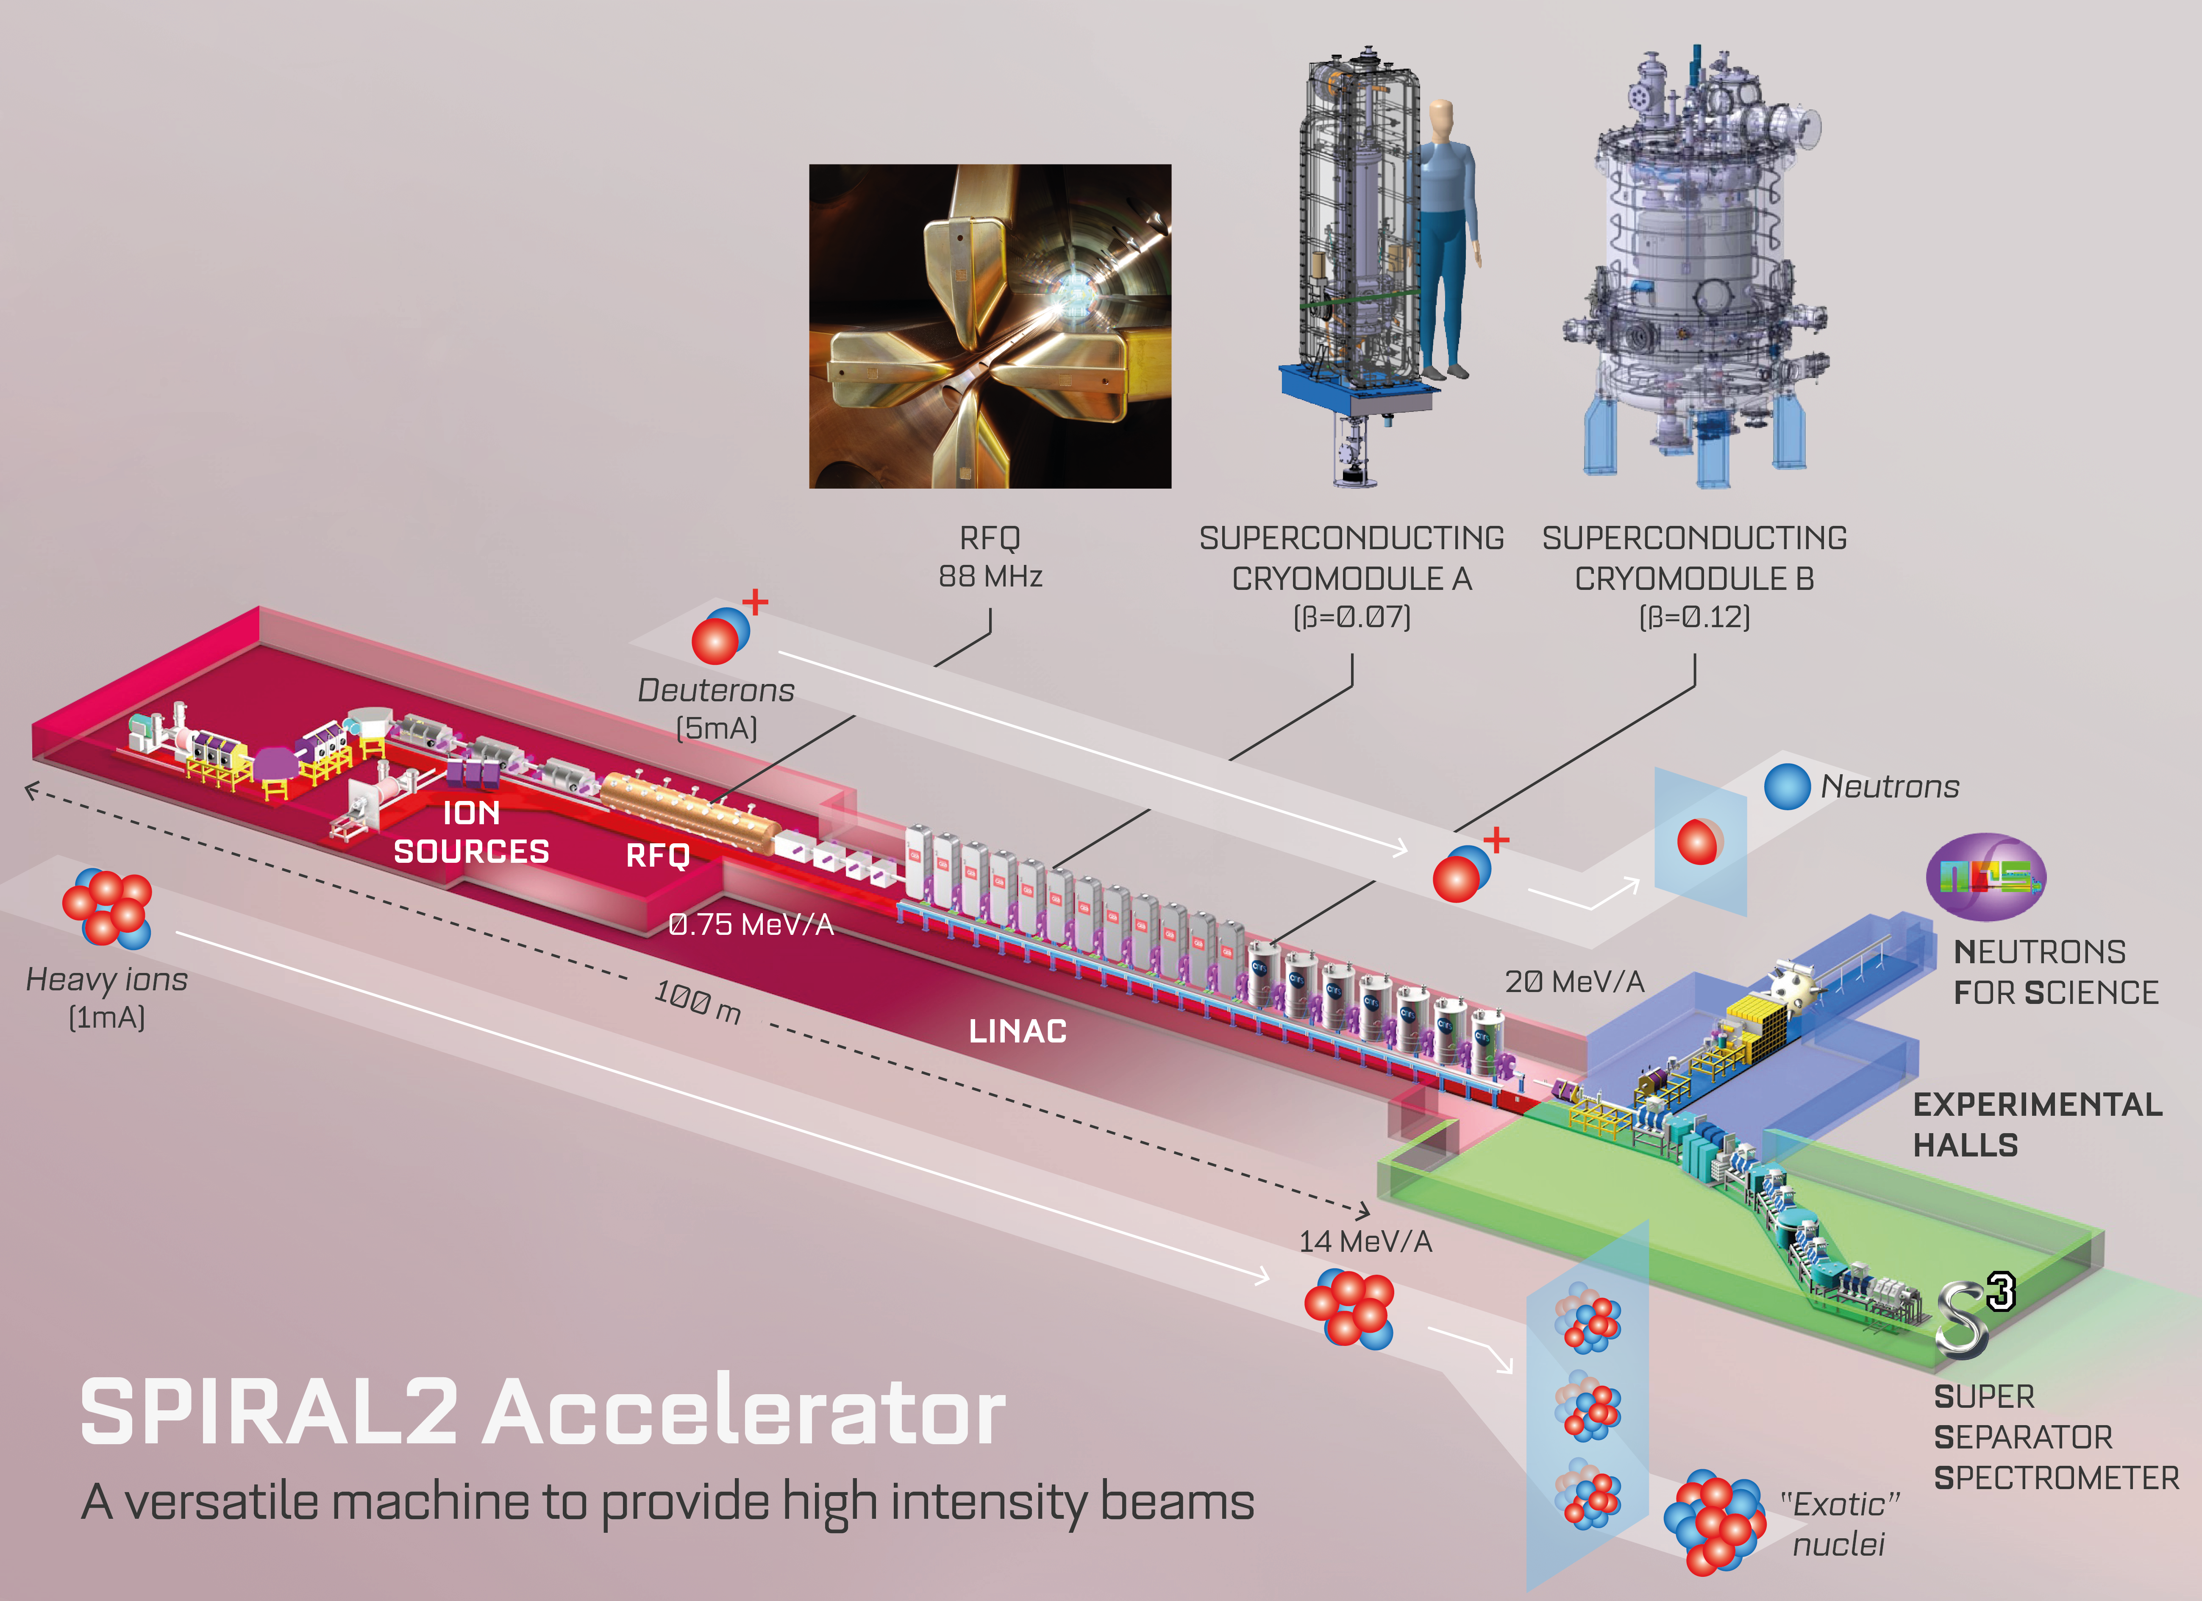
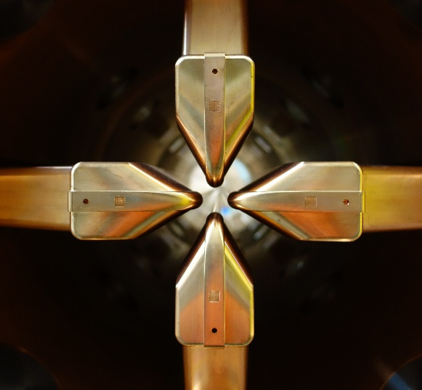
Particles | H⁺ | D⁺ | ions | NewGAIN
A/Q | 1 | 2 | 3 | 7
Max I (mA) | 5 | 5 | 1 | 1
Max energy (MeV/u) | 33 | 20 | 14 | 7
Max beam power (kW) | 165 | 200 | 44 | 16
Built by many French Labs
Collaboration with international labs
Detail study 2006-2008
Process construction and validation in partners lab 2006-2012
SC linac beam commissioning up to the main beam dump
Authorization to operate SPIRAL2, Jul 8th, 2019
1st beam in the linac, Oct. 28th
1st beam in NFS, Dec. 11th 2019 Characterization and first experiments in the NFS room
33MeV H⁺ (2019)
40 MeV ⁴He²⁺, D⁺ (2020)
50 µA D⁺ NFS (2021)
Available for physics research, June 2022

Slide 12


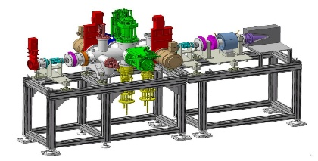
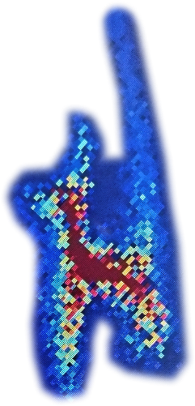
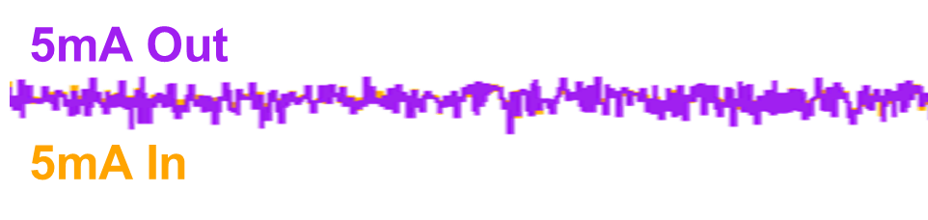
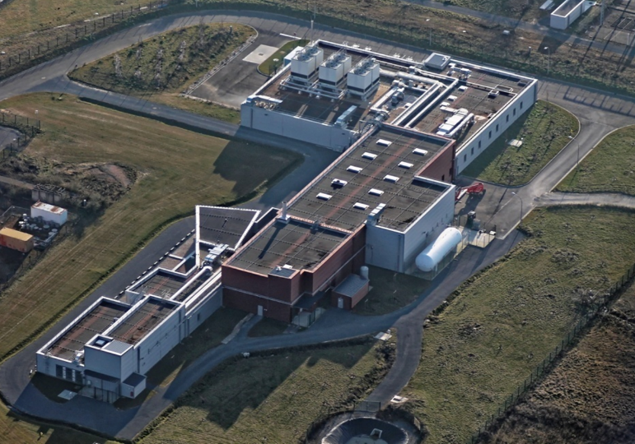
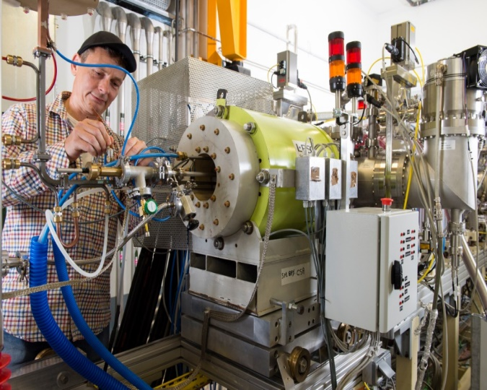
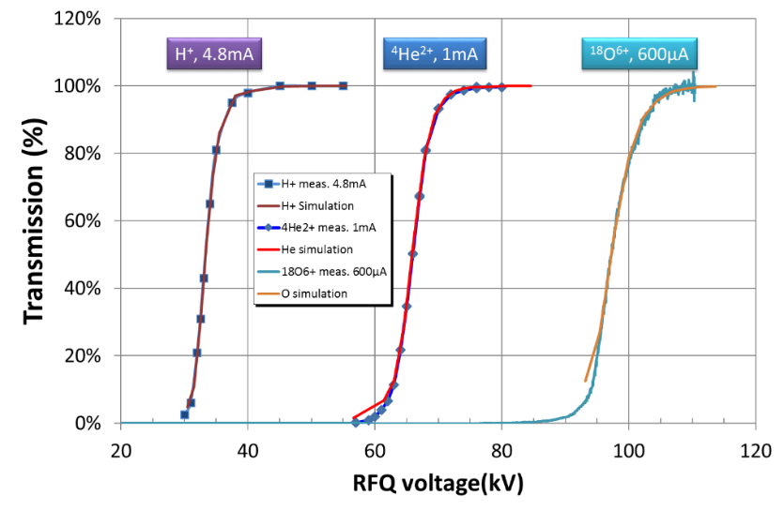


Beam Commissioning Time Line
ECRIS
A/Q=3
1mA
ECRIS
H⁺, d⁺
5 mA
D-plate
LINAC
Beam Dump
RFQ
MEBT
LEBT
NFS
S³
Qualification of the ion sources and LEBT
Initial Proton emittance
Qualification of the injector on a Diagnostic Plate (GANIL)
RFQ performance
2014 1st H⁺ beam @2 mA H/D (Dec)
2015 1st Ar⁹⁺ beam @ 230 µA HI source (Jul) / 1st RFQ H⁺ (Dec)
2018 Diagnostic plate removed in 2018
SC linac beam commissioning up to the main beam dump
Sept. 2019 : All CM @ 6.5MV/m (8MV/m)
November 27th 2019 - 0:33 h LINAC tuned reaching the design value of 33 MeV (with 250µA 1ms/s at 5.4 ms/sec)
The icing on the cake 12/12/2019 test experiment with protons in NFS
16 kW proton beam : Oct. 2020
10 kW deuteron beam : Nov. 2021
First year of SPIRAL2 operation in NFS room
50% time for physics
Pre-commissioning for S³
7 MeV/A ¹⁸O⁶⁺, ¹⁸O⁷⁺, ⁴⁰Ar¹⁴⁺
0.73 MeV/A ¹⁸O⁶⁺, ¹⁸O⁷⁺, ⁴⁰Ar¹⁴⁺
14.5 MeV/A ¹⁸O⁶⁺ 2 kW (2023)
Notes:
Discuss rebunchers, SDP, and the alignment of the last two quadrupoles.Add measurements and label the section as “low beta, high beta.”
16kW : operation equivalent and validation of the designed power of 165 kW (the operation at 16 kW was limited only by the safety rules of GANIL related to the allowed activation of the beam dump).

Slide 13




Beam commissioning main results
H⁺, D⁺ and ⁴He²⁺ were accelerated to their nominal values.
  A 24h run showed a perfect stability of the Linac energy
The beam power ramp up on main beam dump with H⁺ and D⁺ beams demonstrate the reliability of the linac.
  H⁺, 16 kW, 12 ms, 1 Hz, 12% DC. Oct. 2020
  D⁺, 10 kW, 1 ms, 10 Hz, 5% DC.
  Nov. 2021
  Both at nominal pic beam current

Slide 14



Heavy ions beam commissioning
HEAVY-ION ACCELERATION
  In 2023 a 50 µA ¹⁸O⁶⁺ beam was tuned up to the nominal ions energy of 14.5 MeV/u.
  A power ramp-up to 2 kW with a ¹⁸O⁶⁺ beam at
  14.5 MeV/u was performed to qualify the tuning.
  Maximum energy required by S³ → 7 MeV/u.
First milestone of S³
  Nov. 2024 : A first high intensity beam of ⁴⁰Ar¹⁴⁺ accelerated at an energy of 5 MeV/A was sent to the Faraday cup upstream the S³ target
  Beam spot optimization on the target
  LINAC beam synchronization/target wheel
  5 MeV/u, 80 µAe (5.7 pμA, 3.6.10¹³ pps, 1.14 kW)
Peak current in S³ (red), average current in S³ (green)
Beam in line with project expectations

Slide 15
SPIRAL2 feedback for the community and operation
3

Slide 16




SPIRAL2 feedback for the community (1/3)
Design with two dedicated sources
  It is the good choice, good investment
  Allow optimization in source preparation, maintenance, upgrade
4 vanes RFQ design
  Design of the cavity reveal to be adapted in beam dynamics, RF solutions, Mechanics
    Transmission better than 99% ⇒ low losses, therefore low activation and low degradation
    Design made with Tracewin and Toutatis, with perfect accordance between simulation and measurement
    RF cavity design for a 1.65 Kilpatrick. Just right with no margin for a CW machine (RF is on all the time)
    Assembled RFQ, 4 vanes, simple to machined and simple to operate. Ideal for a reliable cavity.
    4 separate amplifiers : deuteron production ok with 3 amplifiers
Use of a “Single Bunch Selector” (SBS)
  SPIRAL2 can operate from 1 bunch every 1000 bunches to CW mode
  Versatile operation in ions, energies, duty cycle
  A good solution for physics requirements
  Usable for light ions only
  Loss of 99% of the particles
  SPIRAL2 MEBT works : After some efforts, takes into account the associated losses (ghost beam, electrons)
Phoenix v3 Heavy ion ECR source
Light ions ECR source
RFQ1 Q/A=1/3 88MHz
Single Bunch Selector
M. Di Giacomo et al., In Proc. IPAC23
doi:10.18429/JACoW-IPAC2023-THPA190

Slide 17
Tuning time ⇒ tuning methods (2/3)
Continuous improvements required for low energy beams
29 cavities to tune
  3 rebunchers, 12 low beta cavities, 14 high beta cavities.
  From β = 0.04 to β = 0.3
Three improved tuning methods
  The signature matching method does not work for low energy part of the linac with partly debunched beam
“Advanced” method (1-2 days) - voltage and phase calibrations unknown
  Phase and voltage tuning. Validation of the input and output energies.
  Phase scan and localized phase scans for improved phase measurement accuracy
  (Low energy beam ⇒ non-linear effects deforming the bunch shape).
  Two cavities detuned, 3 pick-up
“Simplified” method (JML code)
  Use of 1 PU after the cavity, phase scan.
  No cavity detuned
  Only phase and voltage tuning, no energy control
“With reference” method (<60 min) - Using voltage and phase calibration from a previous reference tuning.
  No phase scan, no detuning.
  Phase tuning, assuming known voltage and input energy
  → Phase measurement at PU0 + simulation + verification with phase measurement at the PU1.
  Sensitive to phase measurements accuracy.
Detuned cavity
PU2
BPM
Reference phases
  2022 – 2023: loss of the reference phases every year.
    The phase calibration required yearly adjustment
    (> 2 days).
  2024/2025: the reference phases finally stables
    1 hour for a new linac tuning
M. Di. Giacomo et al., in Proc. 32nd LINAC2024.
DOI:10.18429/JACoW-LINAC2024-TUPB025.
G. Normand, et l., in Proc. 14th. IPAC’23. DOI:10.18429/JACoW-IPAC2023-TUPA192.

Slide 18


SPIRAL2 feedback for the community (3/3)
Small cryomodules design with warm section
  Working solution, probably more expensive
  Positive experience, missing cryomodule ok
  No difficulties with magnetic field from solenoid
  Vacuum in the warm section : very effective tool against losses (for CW beams).
  Cavity pollution does not impact operation (two cavities O shows small limitation linked to cavity pollution - No evolution since 2022)
Linac design tunable event if a cavity is missing
4K operation works well
  Lhe pressure stability good with unclassical regulation
BPM – position, ellipticity (σ_{x}² - σ_{y}²), phase and energies
  From 1µA to 5mA, from β = 0.04 to β = 0.3, 1Hz to 1kHz
  Continuously takes into account the RF perturbation
  Bunch length measurement under demonstration
Linac tuning with missing cavity
https://theses.hal.science/tel-02390264/file/sygal_fusion_28256-vassal-adrien.pdf
P. Salou, et l., in Proc. IBIC 2025. DOI:10.18429/JACoW-IBIC2025-WEPMO12
BPM : ellipticity measurement
Notes:
Dev of hellium processing, in collaboration with IJCLab and Plasma experts – dev independent from other lab devlopment

Slide 19
SPIRAL2 operation feed back
Ready for all type of ions, intensities and energies:
  maximum energy has been reached for each species / minimum energy: 0.73 MeV
Beam currents used in experiments by now:
  from 20 nA up to 5 mA peak
  Up to 10 energy changes per experiment
    Reference phases:
      Since 2024 → 1 hour for a new linac tuning
      Improve maintenance by minimizing detuning requirements, both in terms of frequency and excursion amplitude
X-ray emissions in 2 cavities. Maximum voltage was reduced of around 8% to avoid this problem and compensated by increase the field in other cavities (8 MV/m max available for some cavities vs 6.5 MV/m nominal). Ongoing study in Plasma Processing of Cavities at IJCLab.
  22/28 cavities can operate at field above design value (6.5MV/m → up to 8MV/m)
Cavity 11 degradation – Teething problems associated with the prototype coupler, cavity and cryomodule
  RF losses increased significantly, making it impossible to achieve the nominal field strength of 6.5 MV/m.
  RF losses deteriorate irreversibly when attempts are made to push the cavity's accelerating field beyond 5 MV/m.
Linac works straightforward – no limitation

Slide 20


LINAC in operation since 2022
Four years of operational experience
Availability impact :
  2023
    loss of the reference phase
    Malfunction of NFS rotating converter
  2025
    Faulty safety power inverter
    One rebuncher tuner
    Damaged SBS
  Amplified by the limited LINAC operating time
    ≈ 3 months of operation, max (and only 1.5 month in 2025)
Simultaneous operation of the cyclotrons and the linac remains complicated
  Two types of machine with different interfaces
  Same operators, still in training
  Working on improving parallel processing
Beam ON

Slide 21
Futur of GANIL
4

Slide 22









Super Separator Spectrometer
LINAC
S³
Nuclear spectroscopy of heavy and et super heavy nuclei
MOV7001 : MH. Stodel
Beam
7 SMT
LHE-S3N
Achromatic point
Accelerator & beam line tuning up to the target
Mass separator
Target position
Done in Nov 2024
Primary beam dump
Spectrometer optical commissioning with direct beam : 2027-2028
Momentum achromat
Final focal plane
S³LEB
Scientific commissioning, reactions at the target
Measure/optimize the rejection (case by case)
Detection systems : LEB / SIRIUS
2028
Secondary beam dump
large-acceptance magnetic separator
High selectivity > 10¹³ - High efficiency 50 % - In flight mass separation = 500
Notes:
study nuclei produced by fusion-evaporation reactions with extremely small cross sections using the high-intensity heavy-ion beams. Its primary goal is the nuclear structure study of superheavy nuclei and neutron-deficient isotopes near the proton drip line, using a various techniques ranging from laser spectroscopy and mass measurement to decay spectroscopy

Slide 23








DESIR (Decay, Excitation and Storage of Radioactive Ions)
S3 production
  Dedicated to precision studies of exotic nuclei
  Main asset : high purity and optical quality
  Receive beam from S³ and SPIRAL1
Operation will start in 2028
  100 m of junction beam lines
  1⁺ ions, < 60 keV,
  < 80 π.mm.mrad
  fully electrostatic
Nov. 2025
  Building delivered on October 31, 2025
M/ΔM =20 000 @ 3π mm.mrad / 30keV
SPIRAL1 production
Experimental hall
Mass precision 10⁻⁸ – 10⁻⁹
S3 production
SPIRAL1
transfer line
SPIRAL1 production
HRS test in Bordeaux
First users start thinking about their setup experiment
$$\frac{M_{0}}{ΔM}=\sim 200 000$$

Slide 24




NEWGAIN
SPIRAL2 second injector, A/Q ≤ 7 up to Uranium
Emergency Exit
New
A/Q=7
injector
Future Low Energy Physics Cave
  ASTERICS : 28 GHz ECRIS for M>100
Existing
A/Q=3
injector
Reference ions | Beam current | n. RMS Emit.
²³⁸U³⁴⁺ (A/q=7) | 340 µA (10 pµA) | 0.15 π mm.mrad
⁴⁸Ca¹¹⁺ (A/q=4.36) | 165 µA (15 pµA) | 0.2 π mm.mrad
  2 first RFQ2 sections on Saclay test bench
  Mechanics : RFQ1 type
In construction phase

Slide 25







SAGA Project
Funded by:
Space Applications at Ganil Accelerators: upgrade of existing, and creation of new irradiation facilities
  Increasing need of European space industry for local irradiation facilities dedicated to space electronics
  Development of GANIL partnerships with industry ⇒ increased incomes ⇒ beneficial for science @ GANIL
G4x: new high energy beam lines
New facility, 50-100 MeV/u
G41 renovation
Existing irradiation facility
50-100 MeV/u
Industry
Science - other
Science - nuclear physics
NFS upgrade
Existing neutrons facility
D1 upgrades
Existing facility
3.5-95 MeV/u
Heavy ions
SIMS project
Proposed facility for protons, ions and/or neutrons
CIME 0°: new medium energy beam line
New facility, 16.5 MeV/u
GANIL beam application projection

Slide 26
Conclusion
5

Slide 27
Conclusion
GANIL with the SPIRAL2 facility :
  Demonstrated beam delivery over a wide range of particles, energies and intensities.
  Operational experience has highlighted the strong performance of the superconducting LINAC
    Significant progress has been achieved in LINAC tuning strategies, beam reproducibility, and reliability, while ongoing efforts address remaining limitations.
  Challenges associated with system complexity and aging cyclotron infrastructure.
Major upgrade projects will considerably extend the scientific reach and operational capabilities of the GANIL facility.
  S³, DESIR, NEWGAIN, and CYREN
  The SAGA project further strengthens this evolution by promoting diversification toward industrial applications.
Together, these developments position GANIL as a unique multi-beam facility,
  fundamental nuclear physics
  broad spectrum of emerging scientific and industrial applications in the coming decade.

Slide 28
IPAC26 contributions relevant to GANIL
An exceptional opportunity to witness all the good job done for GANIL
MOP7073 Repair and improvement of the superconducting magnets of the S³ spectrometer at GANIL – A. Wagret-Quatromme et al.
MOP7142 The CYREN project : refurbishment of the GANIL cyclotrons facility – P. Anger et al.
MOP7168 High Voltage Electric dipole conditioning for the Super spectrometer separator at GANIL – F. Esnault et al.
MOV7001 Qualification and commissioning of superconducting magnets for the S³ spectrometer at GANIL – M-H. Stodel
THP3001 A Versatile Beam Splitting System for Simultaneous Delivery of Three Beams to Industrial Applications at the GANIL Accelerator – M. Lalande et al.
THP4019 Towards Automated Cavity Failure Compensation in the SPIRAL2 SC Linac – A. Plaçais et al.
THP4062 Commissioning of the S³ Spectrometer : advances, challenges and outlook – F. Lutton et al.
THP4063 Update of the beam lines conception of the SPIRAL2-DESIR Project at GANIL Caen France – L. Perrot et al.
TUP3022 NEWGAIN project at GANIL: Construction of the new heavy ion injector for SPIRAL2 – F. Chautard et al.
TUP3023 Exotic beam production at GANIL facility – O. Kamalou
TUP3024 Innovative Radioactive Ion Beam Production for MORA at GANIL – P. Jardin et al.
WEO4M03 GANIL-SPIRAL2 4 years in operation – O. Kamalou et al.
WEP5001 In Trap Polarisation of Radioactive Ion Beams with the MORA Experiment – P. Delahaye
WEP5005 Cavity Failure Compensation Study in Spiral 2 LINAC: Simulation and Experimentation – A. Leduc et al.
WEP6032 Study of ion sources using optical emission spectroscopy for beam monitoring – A. Ribet
Poster
Invited poster
Contributed oral
SPIRAL2
S³
DESIR
NEWGAIN
SAGA
GANIL

Slide 29


Thank you for your attention
Thank you for your attention
Thanks to GANIL teams for their valuable work and their contribution to the preparation of this presentation

