Slide 1
Comparison of magnetic field simulation programs for superconducting insertion devices
REPM 2025
Toshi Tanabe (NSLS-II Insertion Devices Group Leader), Marco Musardo, Brian Eipper, Thomas and Patrick N’Gotta
Not Export Controlled
May 31st , 2025

Slide 2
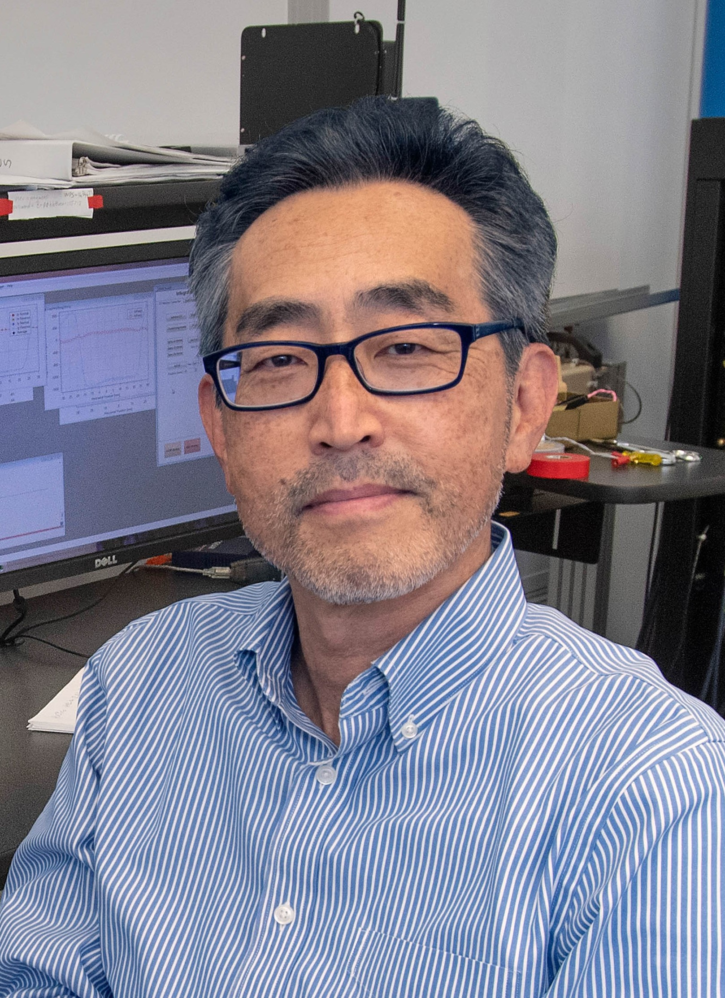
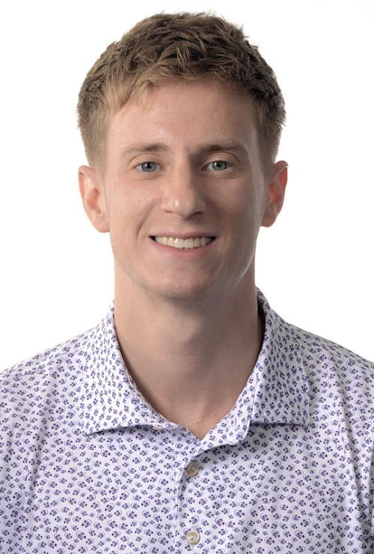
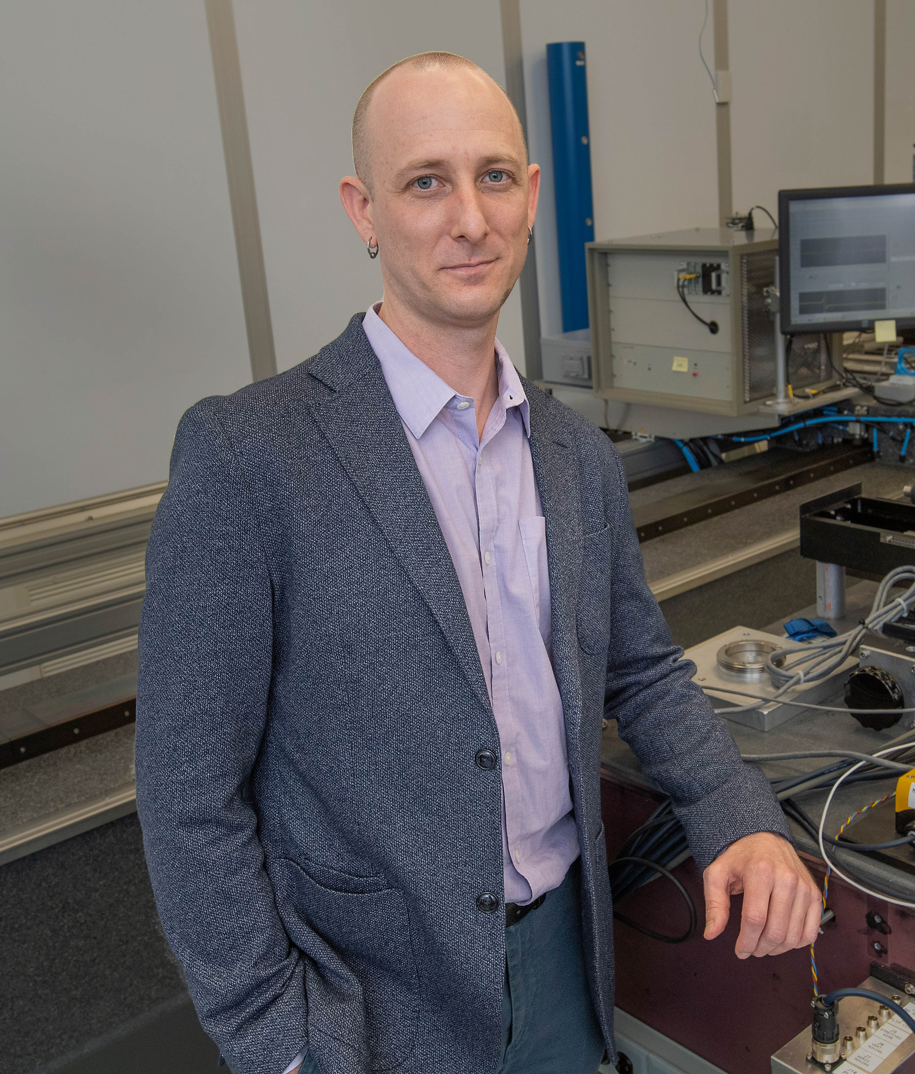

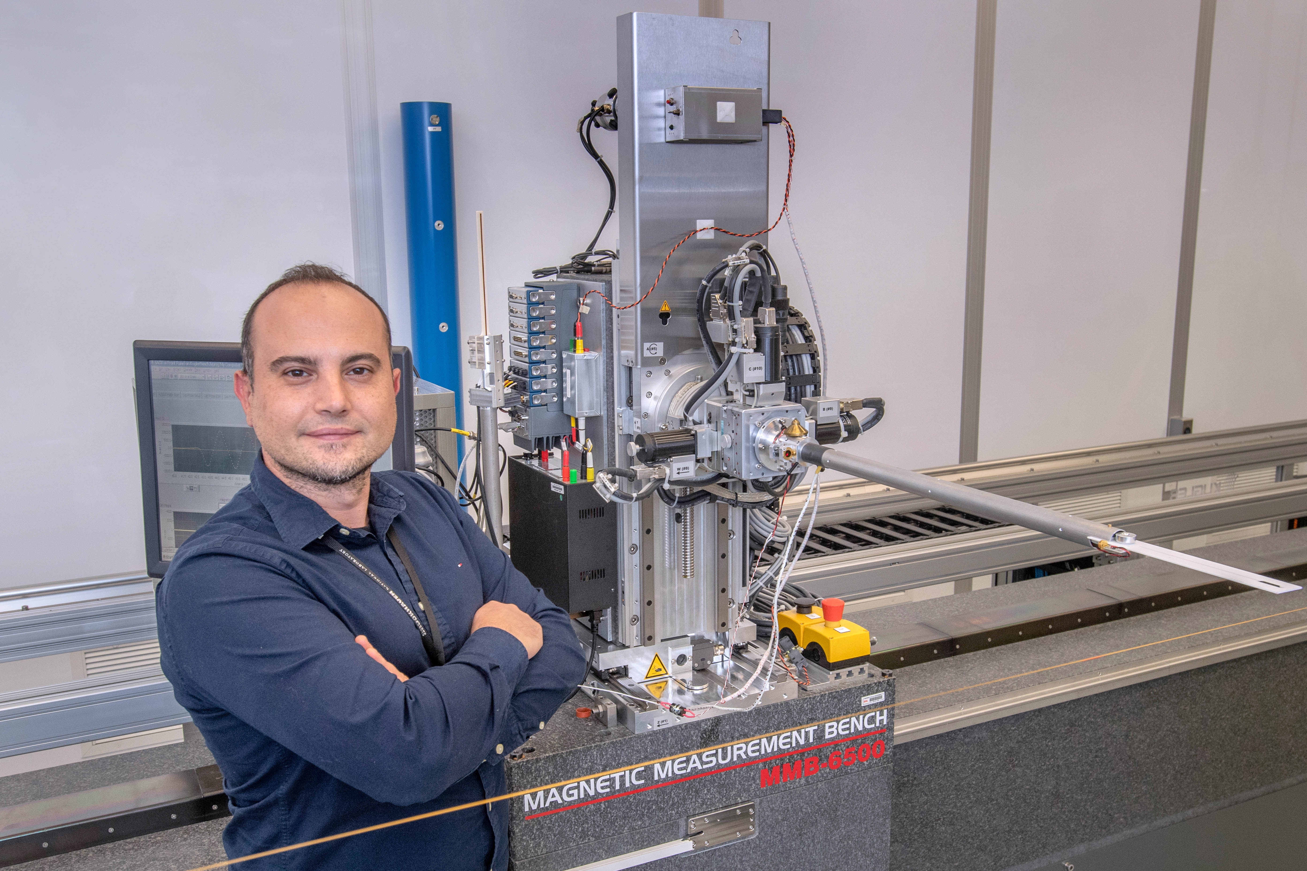
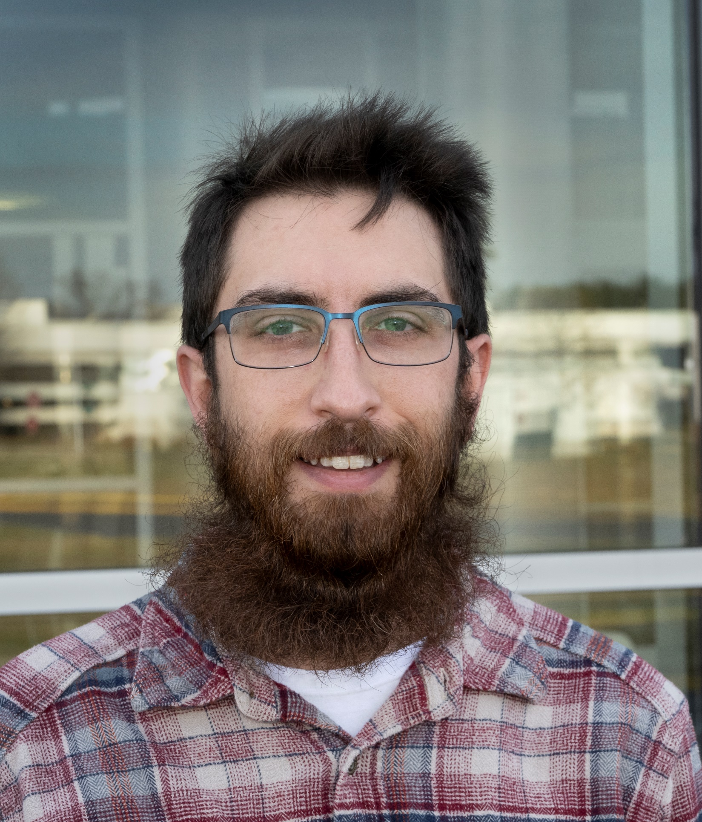
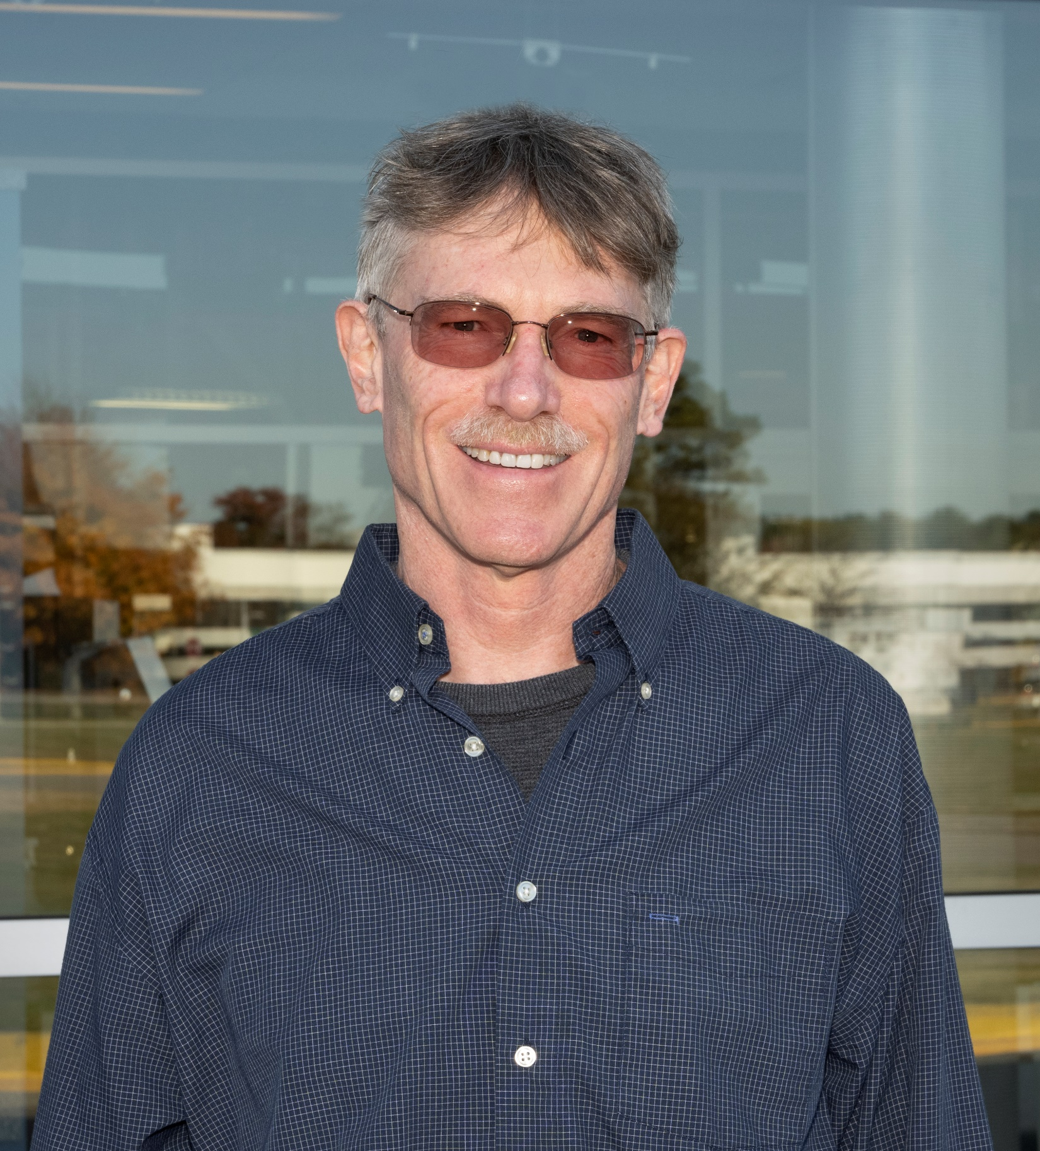
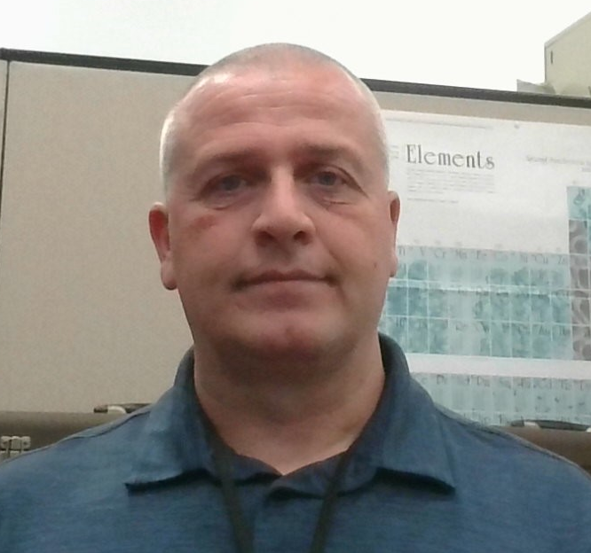

ID Group Staff
  Mechanical Engineer
    Thomas Brookbank
  Electrical Engineer
    Brian Eipper
  Electro-mechanical Technician
    Dan Migliorino
  Electro-mechanical Technician
    Bryan Holland
  Sr. Physicist (Group Leader)
    Toshi Tanabe Ph.D.
  Sr. Physicist (Deputy)
    Dean Hidas Ph.D.
    (Spectral calc., Controls)
    Tech Rep CDI IVU
  Physicist
    Marco Musardo (Mag. Meas)
    Tech Rep ARI/SXN EPUs
  Mechanical Engineer
    James Rank (Ring WCC, LOTO, Maintenance)
4
Patrick N’Gotta

Slide 3
Outline
5
  3D Magnetostatic Simulation Program
  Radia: Developed at ESRF, the main author is Oleg Chuber (currently at NSLS-II)
  CST Studio: Now contains Opera 3D, BNL has only Opera 23 (currently ver. 25)
  ANSYS: Very popular for structural and thermal analysis in mechanical engineering. Contains MAXWELL which can conduct magnetic analysis both in static and dynamic problems
  COMSOL: Multiphysics software (NOT USED FOR THIS TIME)
  The High energy Engineering X-ray (HEX) Diffraction beamline
  -Super Conducting Wiggler (SCW) Simulation and Field Measurement
  1.2 m-long 4.3 T superconducting wiggler (Period Length=70 mm, Pole Gap = 12 mm)
  Radia and Opera23 compared in the same PC (Intel Xeon w7-2495X, 2.5 GHz, 128 GB RAM, 24 cores)
  ANSYS runs limited by license and runs in another PC (Intel Xenon W-2295, 3.0GHz 64 GB RAM, 18 cores)

Slide 4
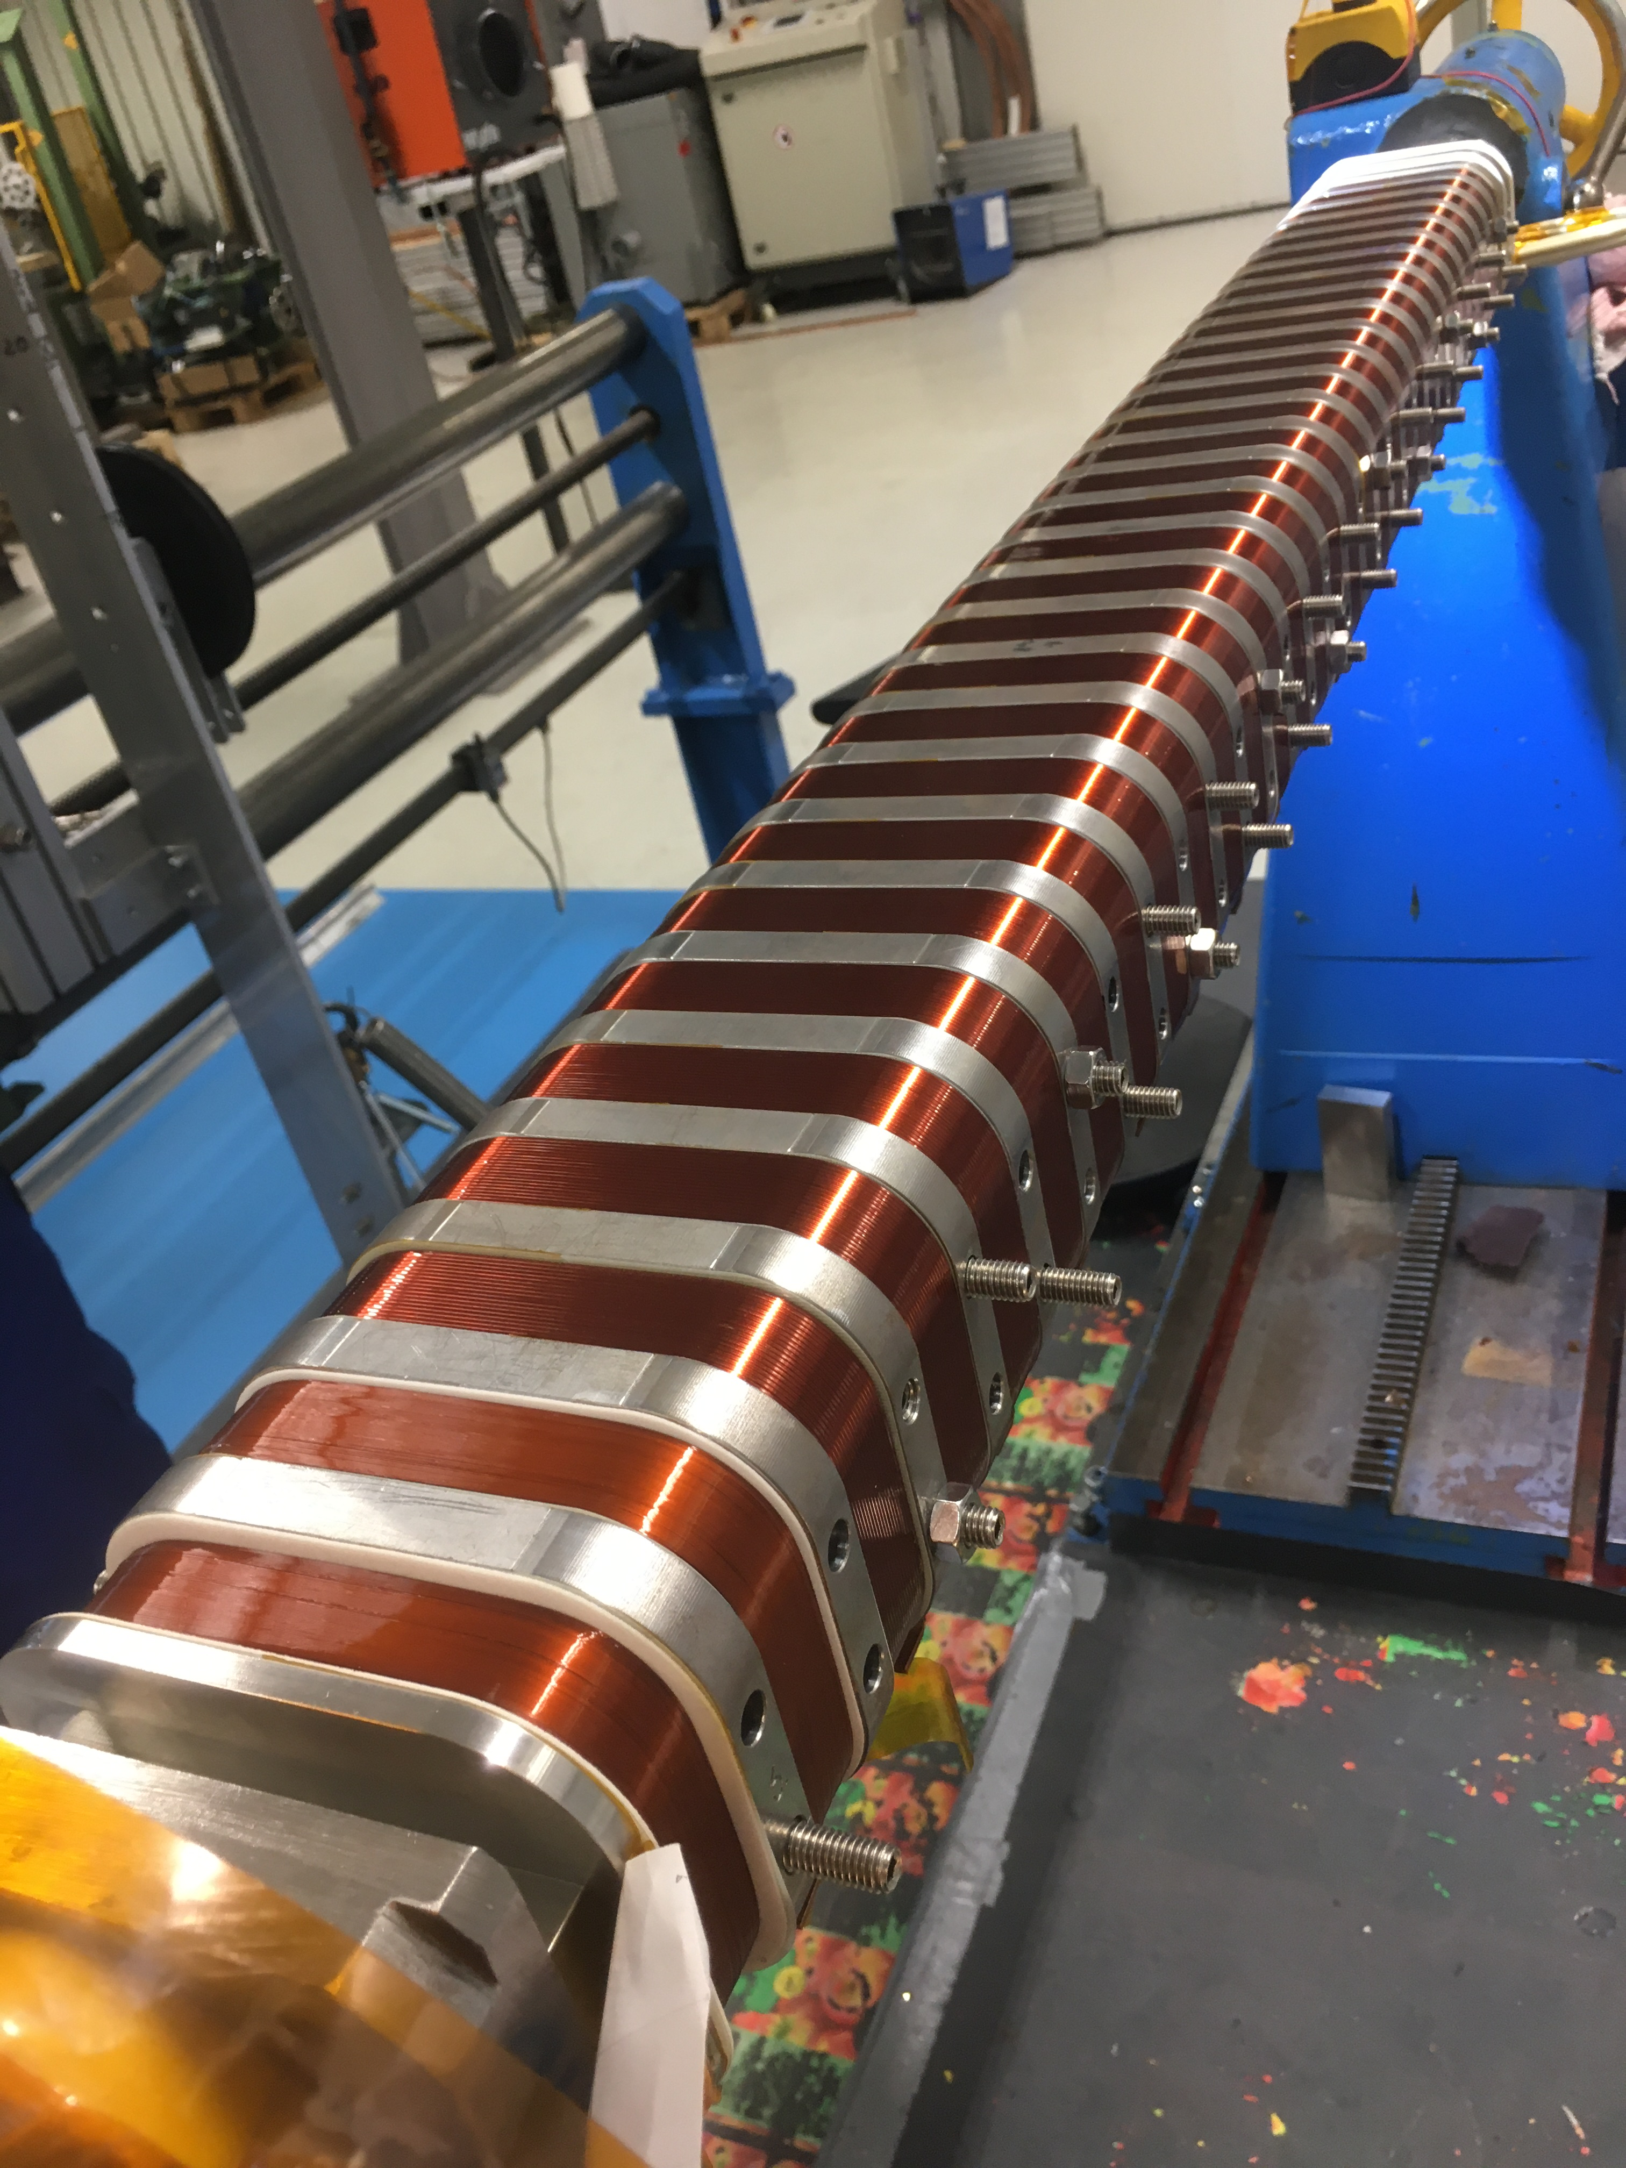
HEX-SCW
Vertically wound coils (1.2m long)
Conduction cooled (4 coolers)
Max field: 4.3T with 440 A of current
Vacuum Aperture: 8mm (Pole Gap=12mm)
Ref: T. Tanabe, D. A. Hidas, M. Musardo, J. Rank, R. Todd, M. Seegitz, M. Breitenbach, A. Hobl, and H. Wu, IEEE Transactions on Applied Superconductivity 32 (2022).

Slide 5
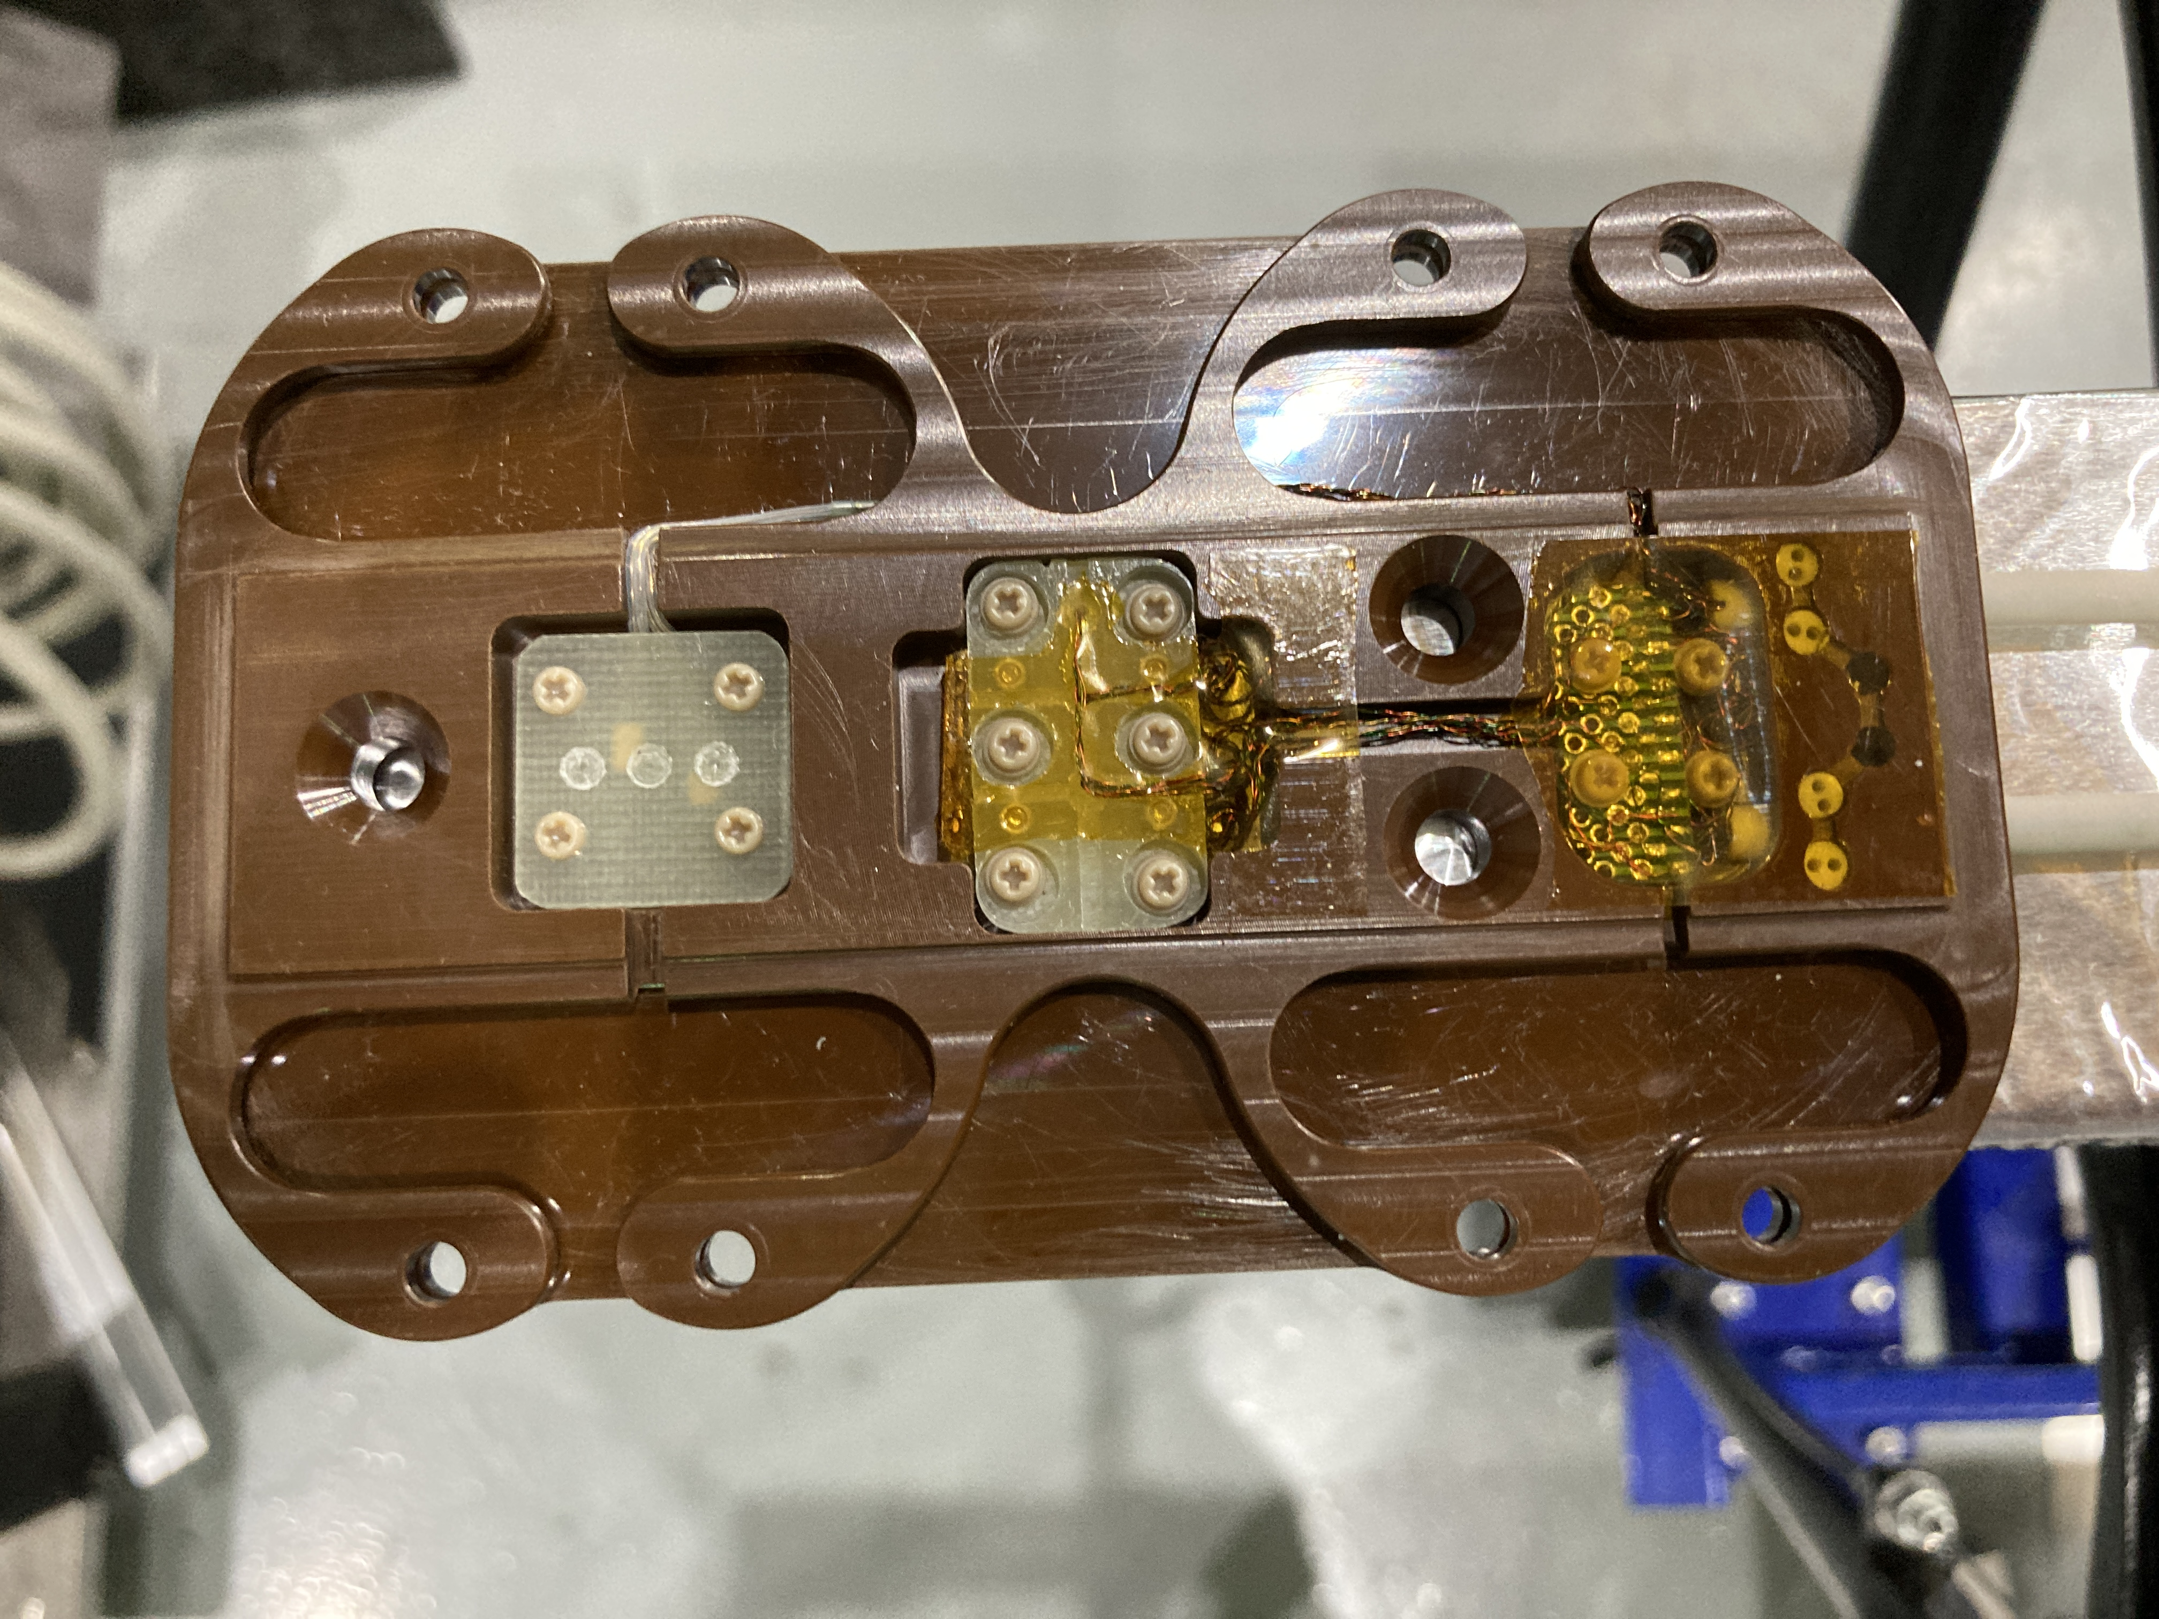
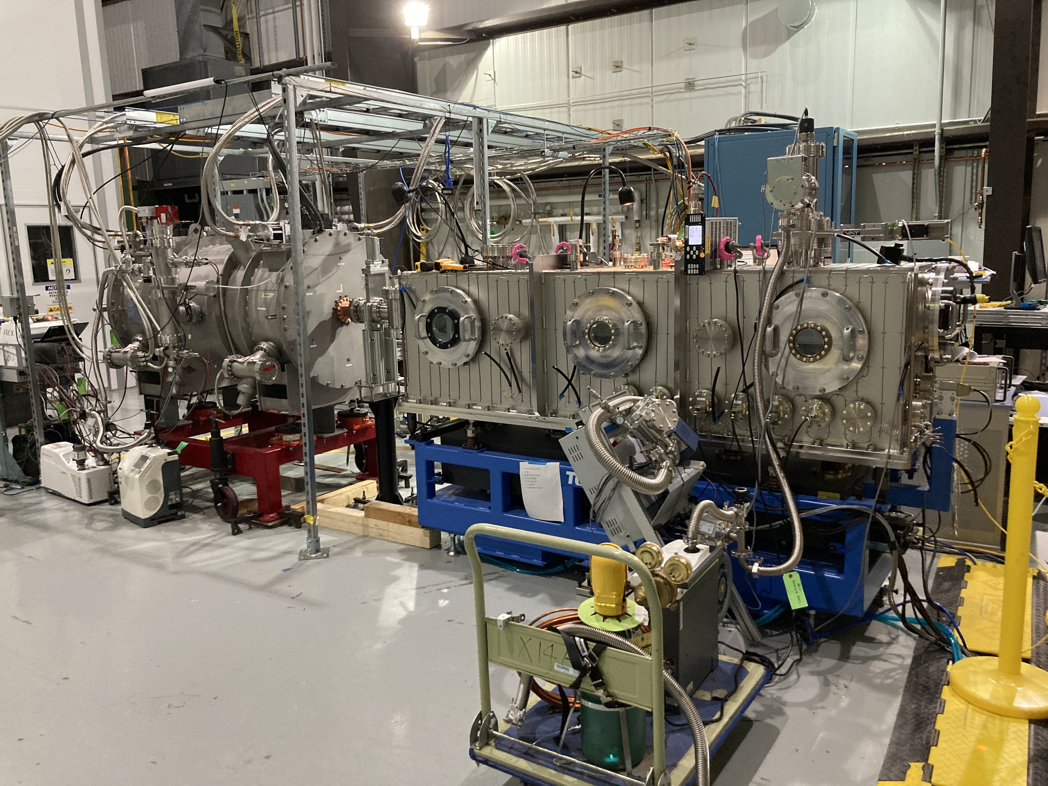
HEX-SCW Mag. Meas. by In-Vacuum Hall Probe Bench
T. Tanabe, et. al.,”Development of the high energy engineering X-ray (HEX) superconducting wiggler, magnetic measurement, installation, and commissioning”, Review of Scientific Instruments 94, (2023): https://doi.org/10.1063/5.0146964

Slide 6
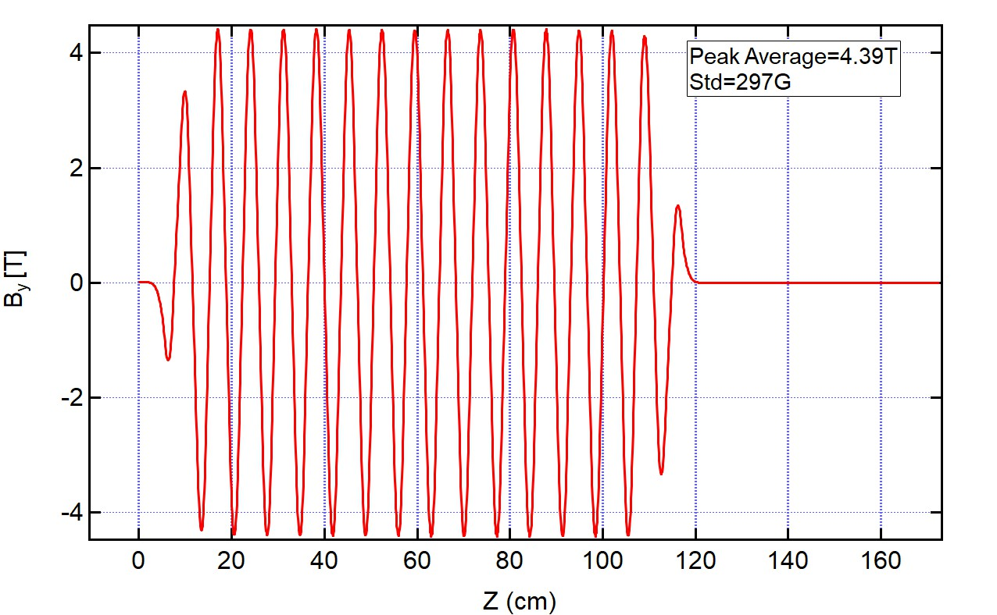
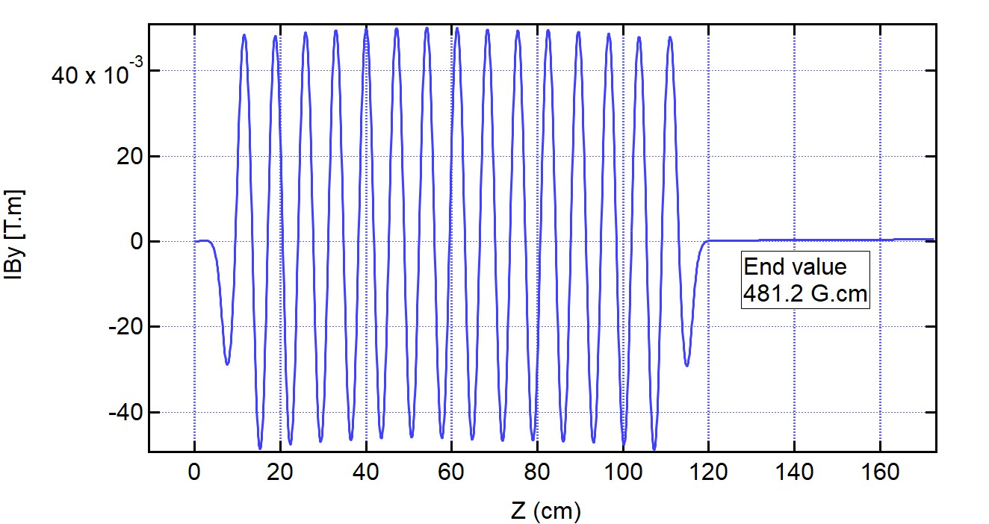
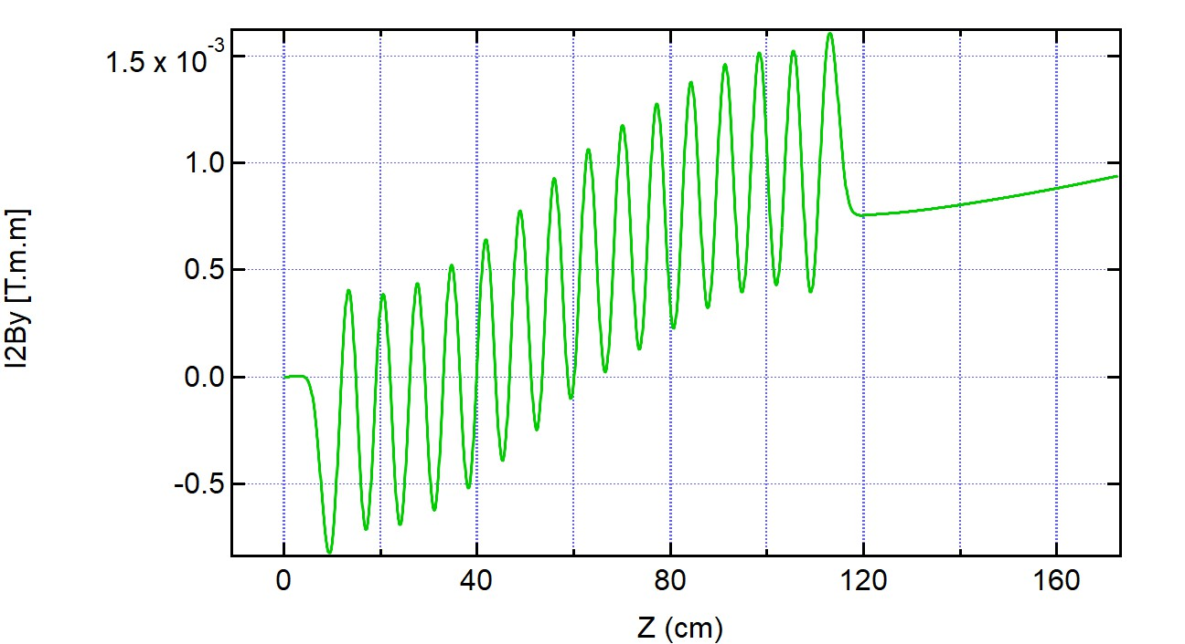
Measurement Results
Note: The second integral includes effect of Helmholz coils which are not included in the simulation

Slide 7
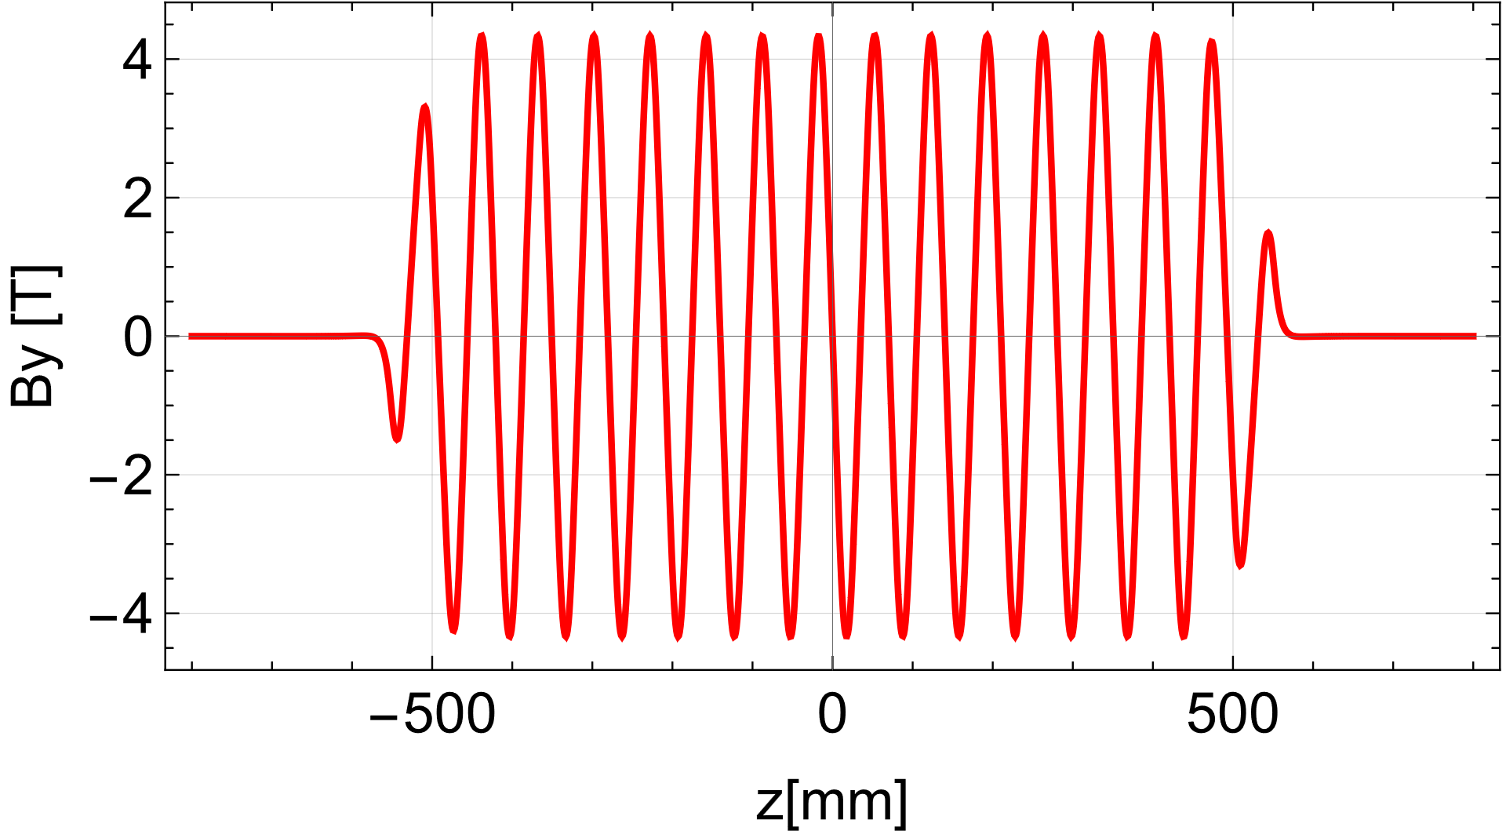
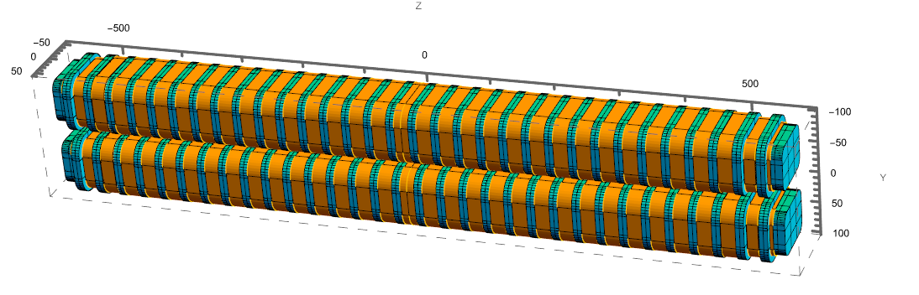
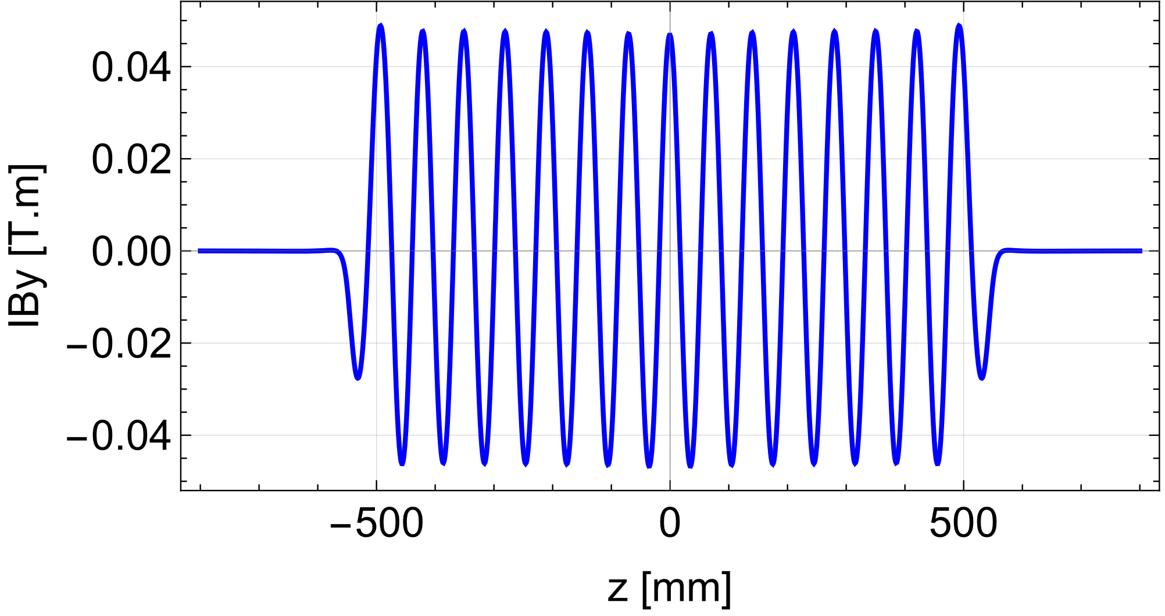
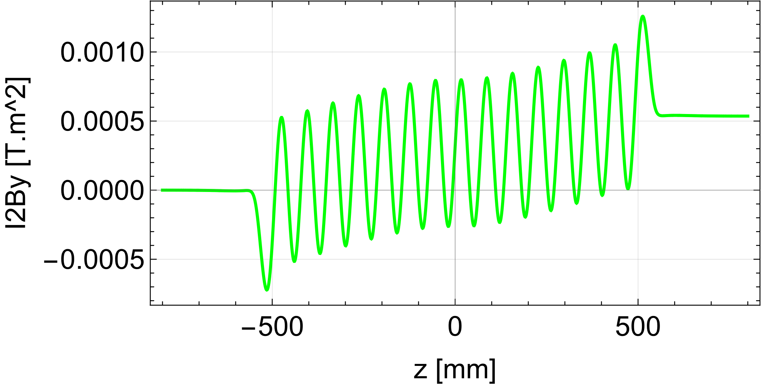
Magnetic Field Comparison (1)
Peak By=4.34 T
  Radia: Solved in 219 seconds using 8th fold symmetry consuming ~3 GB of RAM
  1006 Steel (RadMatXc06[];)

Slide 8
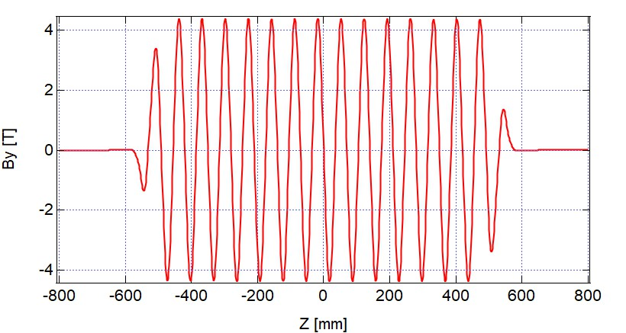
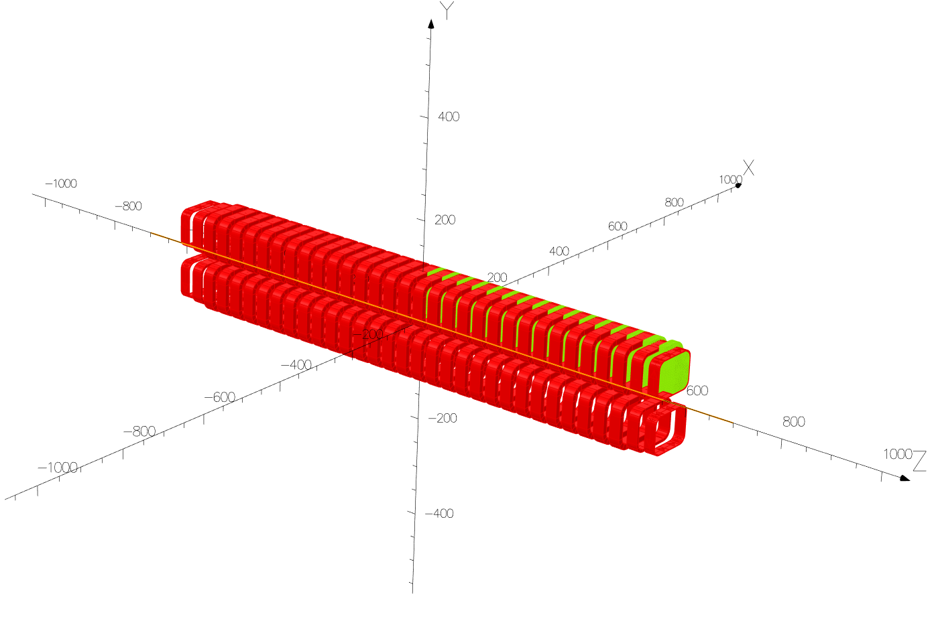
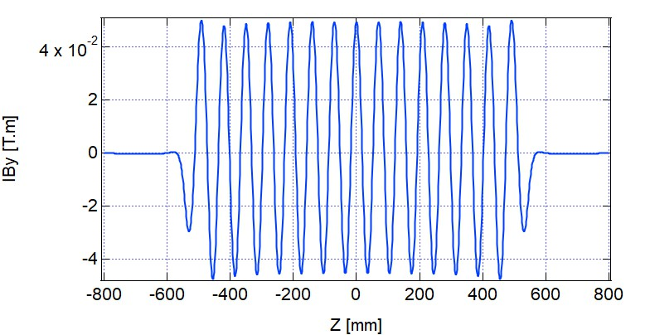
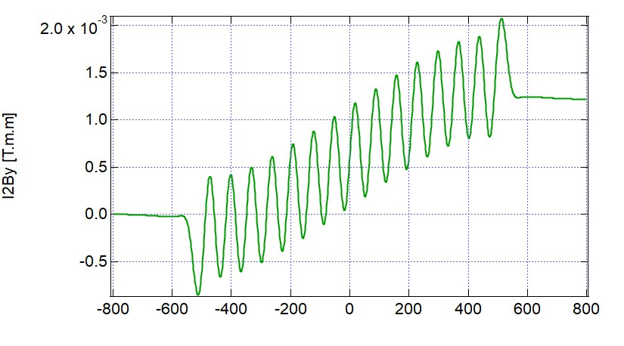
Magnetic Field Comparison (2)
  Opera23: Max surface mesh=10mm,1006 Steel Tolerance=10E-6, consuming 2 GB, Solved in 1560 seconds
Peak By=4.37 T

Slide 9
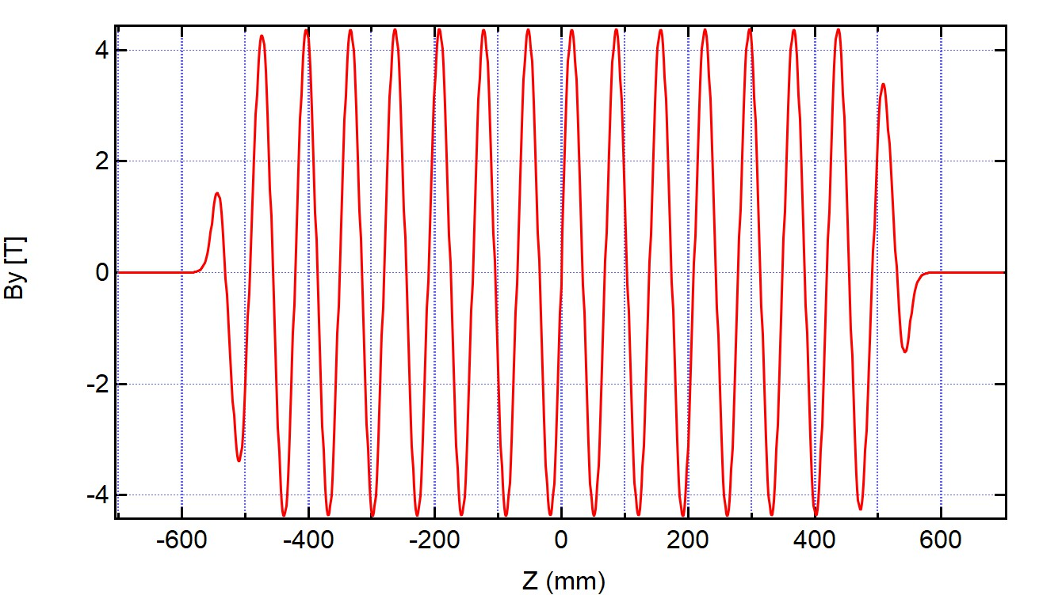
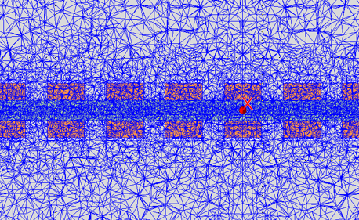
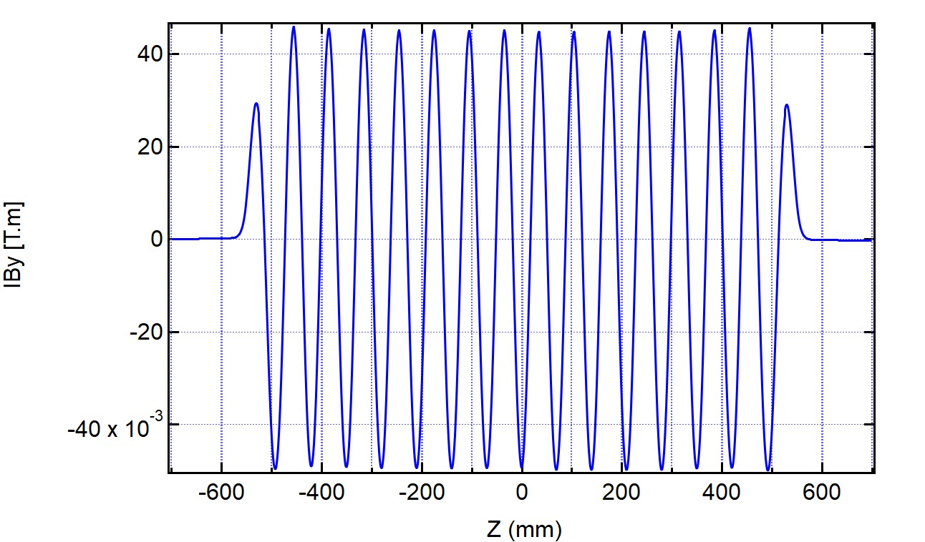
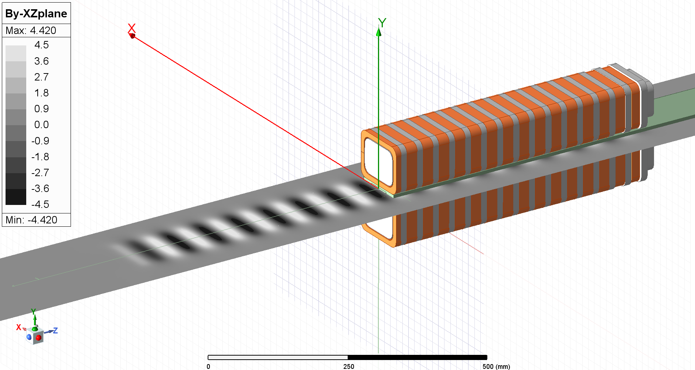
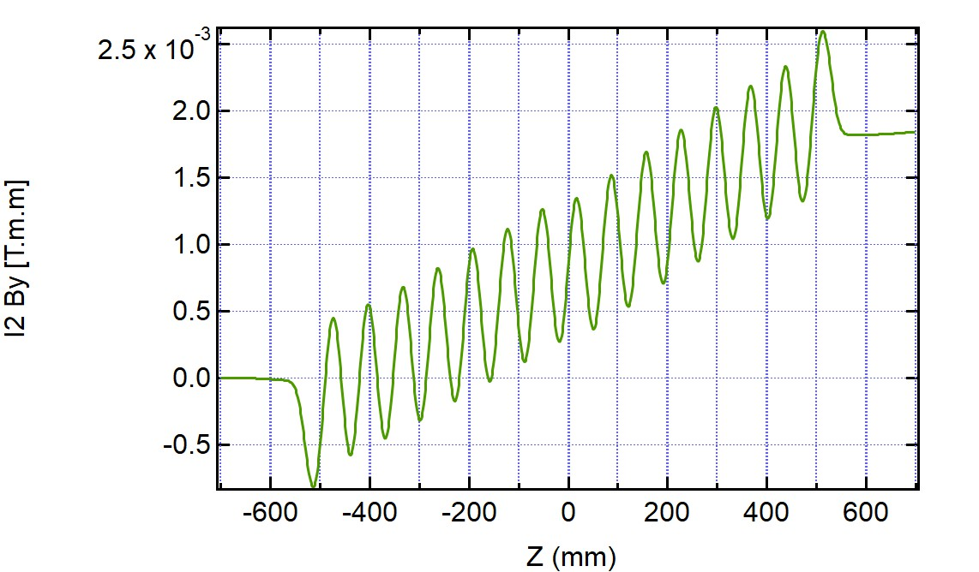
Magnetic Field Comparison (3)
  Maxwell: All coils (meshed) and yokes are made from a 3D-CAD file.
  2h to finish using 12.9 GB
Peak By=4.38 T
Coils are meshed!

Slide 10
Attractive Force Calculation
  Radia: 287 kN, Solved in 8997 seconds
  Opera23: 273 kN (Vendor model), 283 kN (BNL model), Solved only a few minutes after completing calculation
  Maxwell:274 kN, solves as part of the main solution
Stored Energy
  Radia: 114 kJ (Solve in 500 seconds w/o segmentation, 5000 seconds with {8,8,8} segmentation)
  Opera23: 42.3 kJ(Vendor model), 43.6 kJ (BNL model), Solved only a few minutes after completing calculation
  Maxwell:40.4 kJ, solves as part of the main solution

Slide 11
Radia Update (Parallel Processing)
  Python version now has parallel processing capability
  Call to: rank = rad.UtiMPI('on’) to turn it on, and at the end:rad.UtiMPI('off’) to turn it off.
  Unfortunately force calculation is not parallelized yet.
1 core:
Interaction Matrix was set up in 869.71 s
Relaxation took 25.4 s
Relaxation Results: [6.378355928585586e-05, 1.2647994068388093, 1.1830286610524638, 2.0]
Force calculated in 585.45 s
Force [-1.0910383707596338e-05, -14000.493286432204, -0.0004182081170256424]
10 cores:
Interaction Matrix was set up in 91.25 s
Relaxation took 36.61 s
Relaxation Results: [6.378355928585586e-05, 1.2647994068388093, 1.1830286610524638, 2.0]
Force calculated in 584.78 s
Force [-1.0910383707596338e-05, -14000.493286432204, -0.0004182081170256424]

Slide 12
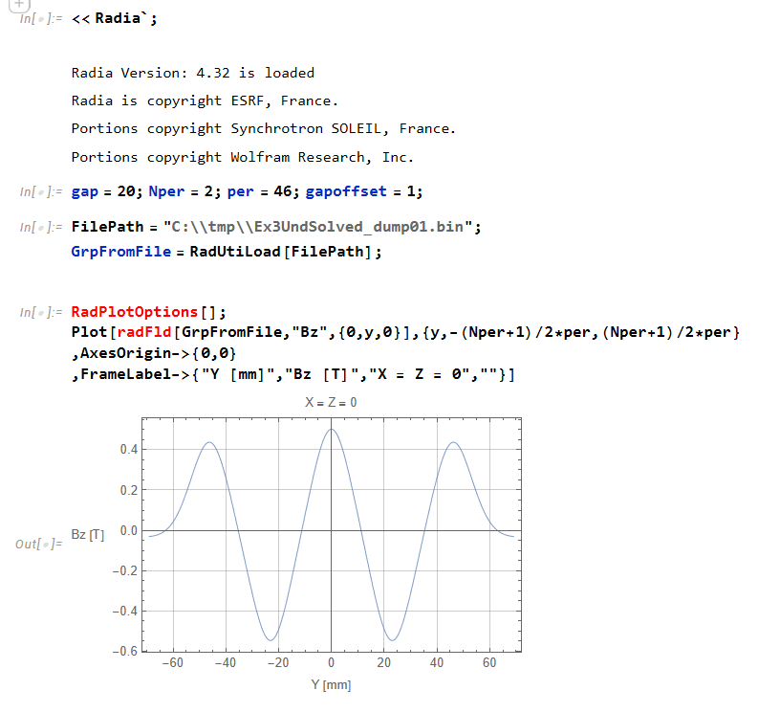
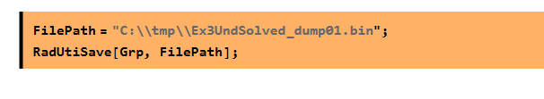
Radia Update (Persistent Object)
  Recent version has persistent object capability
  FilePath = "C:\\UndSolved_dump01.bin";
  RadUtiSave[Obj, FilePath];
  ObjFromFile = RadUtiLoad[FilePath]
In another notebook, you can reuse the calculation result of Example 3
At the end of “Example 3”

Slide 13
Summary
  Once the model is built, magnetic flux density calculation is straightforward for all three programs.
    Radia needs manual model building
    Opera can import a CAD file for yoke, but not coils
    Maxwell can use both yoke and coil from a CAD file → Best candidate for complicated coil structure
  Force Calculation
    Radia requires fair amount of calculation time if the model has fine segments
    Opera and Maxwell require relatively short time after all model calculations were done
  Stored Energy Calculation
    Radia’s built-in routine appears to be inaccurate
    Discrepancy between Opera and Maxwell is small but still non-negligible→ require further investigation
  Radia’s New Features
    Parallel Processing for Python Version (force calculation is not implemented yet)
    Persistent Object → One can reuse calculated results

