Slide 1
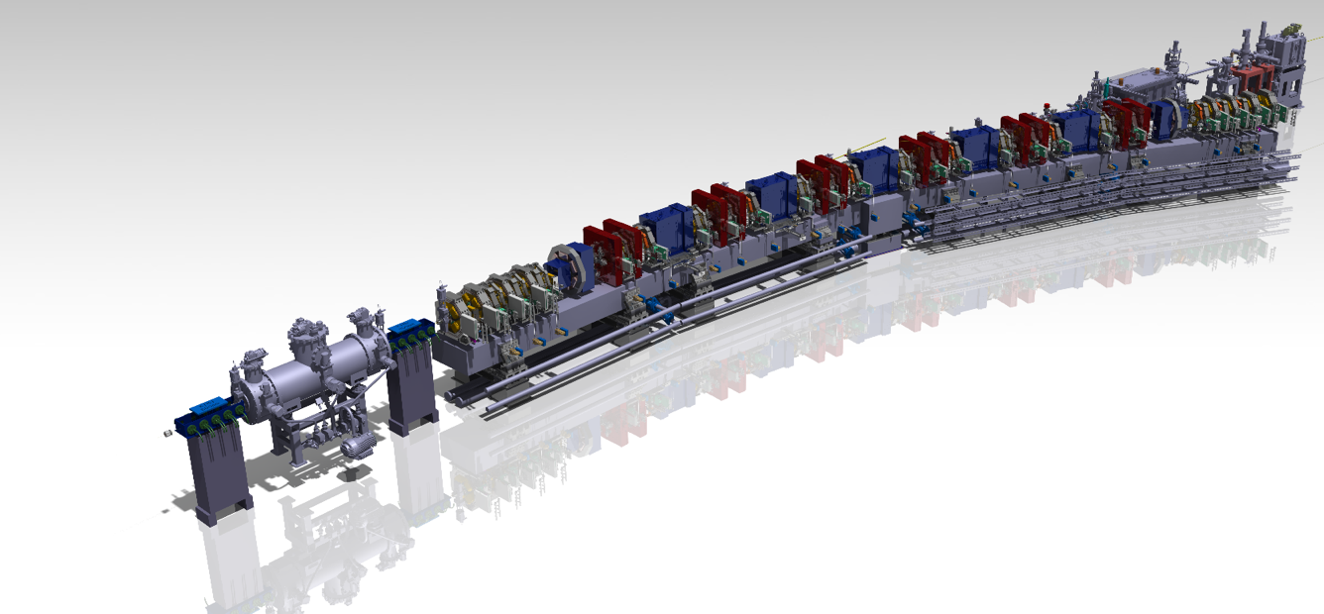
A REBCO Bulk
Superconducting
Undulator for the Microscopic
Tomography Beamline at SLS 2.0
Marco Calvi
Insertion Devices for Future Light Sources Workshop (ID25)
31 May 2025 to 1 June 2025 - Taipei World Trade Center

Slide 2
Overview
Introduction
Results of the short sample experimental campaign:
  Sample preparation
  Magnetic measurements:
  Field optimisation, CoFe versus Ho poles,
  FCM Reproducibility, Charging time,
  Flux creep & flux freezing
The meter-long prototype
  Design
  Status of the production
Conclusions

Slide 3
The bulk High Temperature Superconducting undulator
Example of field cooling magnetisation
time
T. Kii, et al.: Proc. FEL2006 (2006) p. 653.

Slide 4
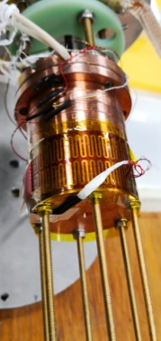
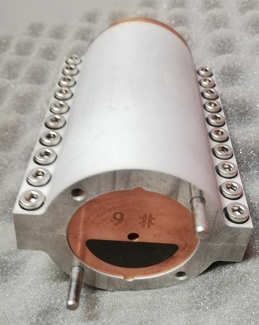
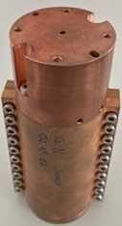
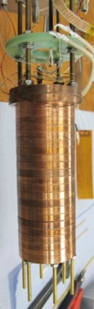
Samples Overview
1st Bulk Sample
2nd Bulk Sample
Bulk Industrial Sample
Bulk Simplified Sample
The baseline Sample
4mm gap
6mm gap
4mm gap
4mm gap
4mm gap
2019
2021
2023

Slide 5
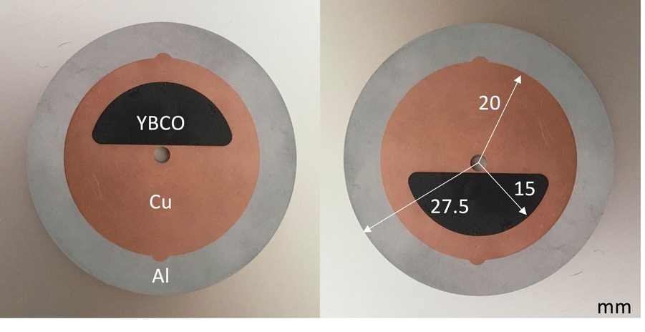
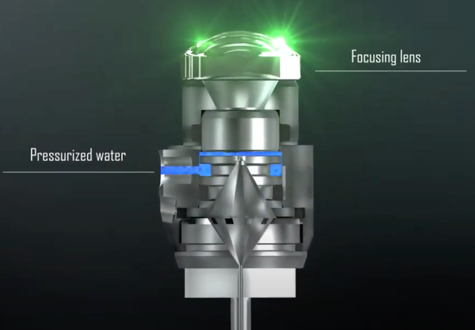
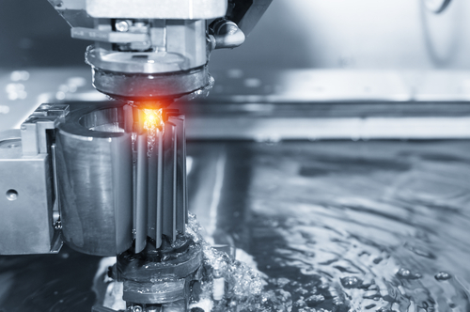
Industrial Sample
Laser Micro Jet
SYNOVA
CH
The HTS crystals are embedded (schrink-fit) into a copper matrix with micro-meter accuracy, to be mechanical and thermally stabilised. An additional Aluminium shrinking cylinder is used to precisely assemble the undulator array
(in the picture only a cross section)
EDM Wire Erosion

Slide 6

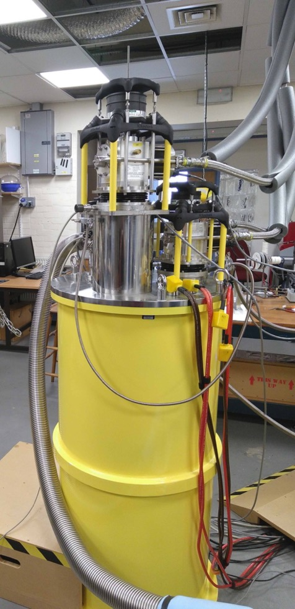
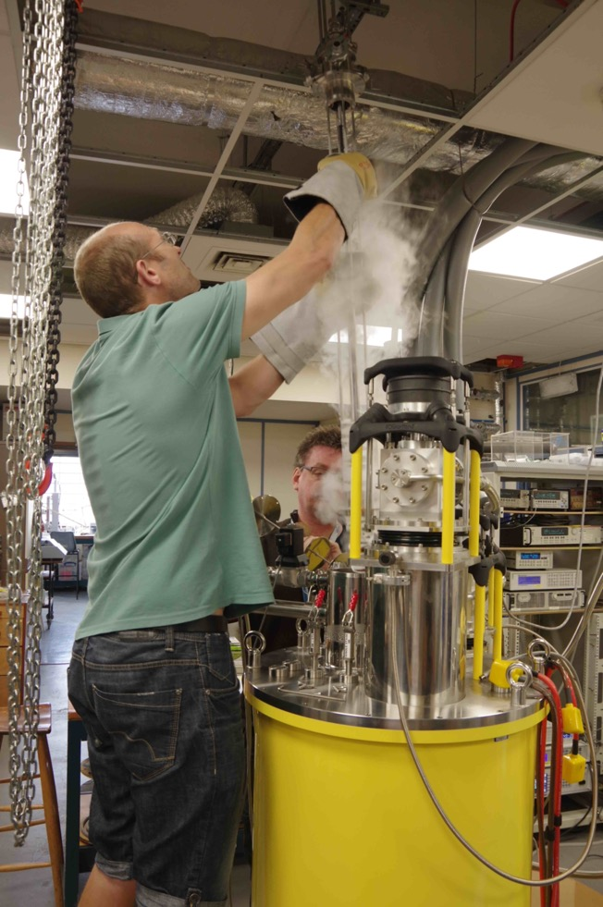
The facility
±12T
the solenoid
6

Slide 7
Cryogenic probe with 5 Hall elements

Slide 8
Staggered Array With CoFe Poles
4mm gap
10 mm period
With additional ferromagnetic poles

Slide 10
Experimental results - YBCO from ATZ

Slide 11
Experimental results - YBCO from ATZ

Slide 12
Experimental results - YBCO from ATZ
⅓

Slide 13
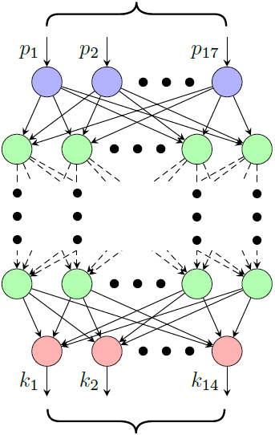
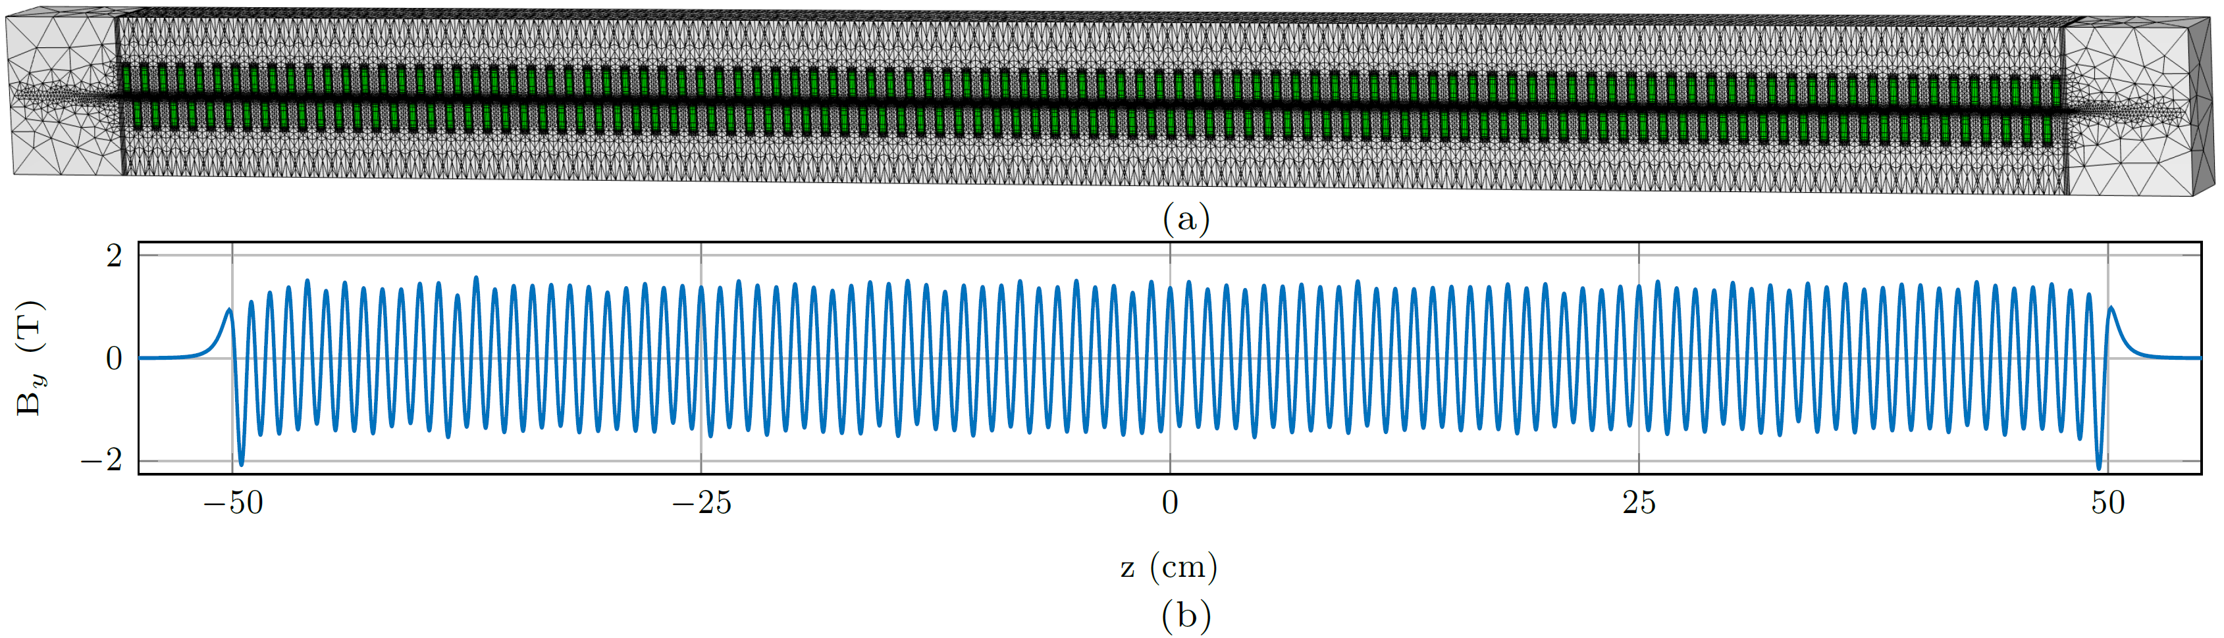
200 bulk simulations
this takes ~0.2 ms
Simulating 200 bulks in 3D requires ~6 hours on a powerful workstation
On the new Merlin7 HPC cluster, this takes ~3 hours

Slide 14
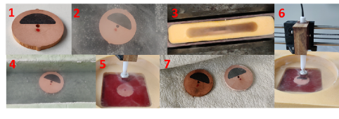
Single Disk characterisation
The Cu-REBCO disks were individually cooled in 1T magnetic field from room temperature down to LN2 and 2D field mapped, on both sides
¹the disk ²pre-cooling ³field Cooling ⁴flux creep ⁵disk support ⁶2D field map ⁷drying

Slide 15
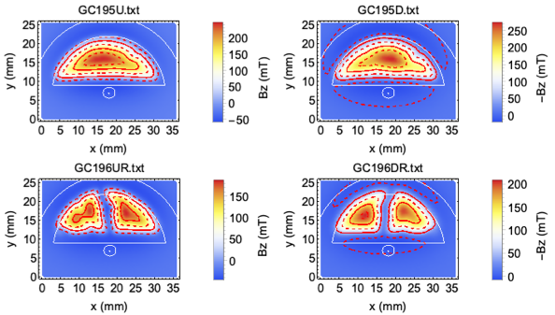
2D Field map

Slide 16
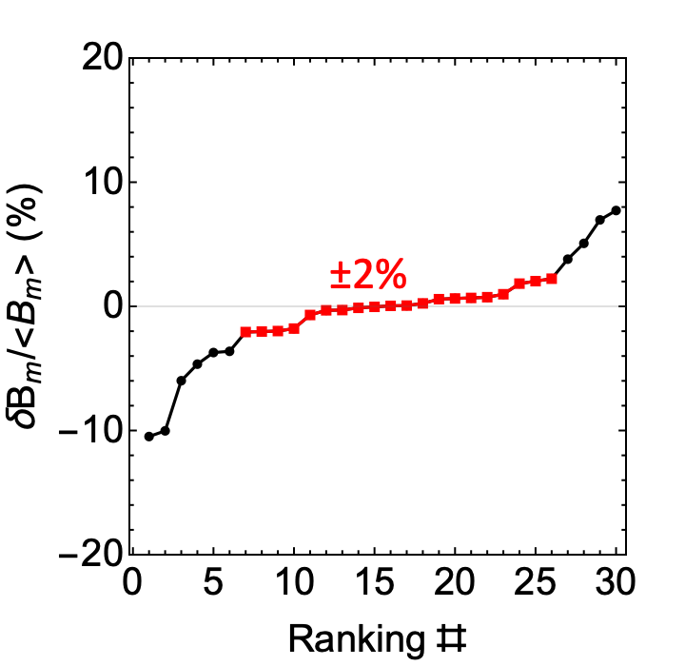
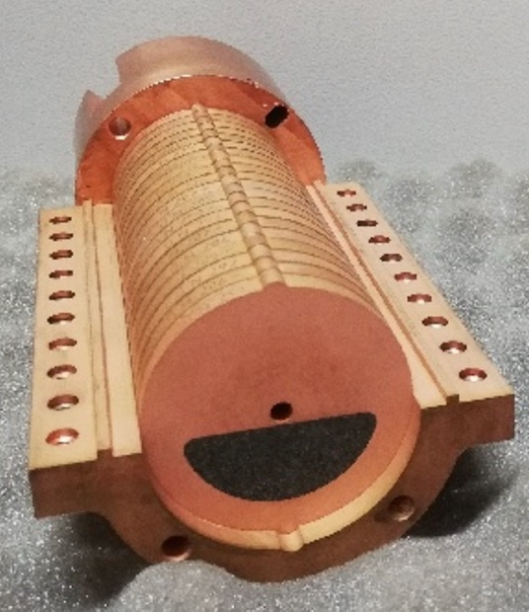
Planar Hybrid: Nippon Steel

Slide 17
Planar Hybrid: Nippon Steel

Slide 18
Planar Hybrid: Nippon Steel
gap = 4mm
18

Slide 19
Impact of the poles

Slide 20
FCM reproducibility study

Slide 21
Towards a quasi-optimum charging time
-4T/h
-3T/h
-1T/h

Slide 22
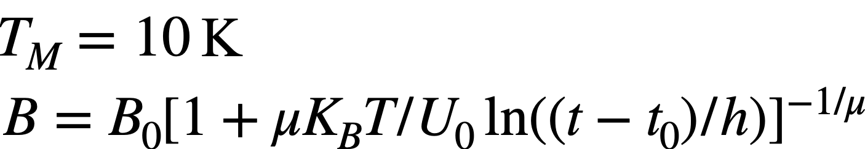
Flux creep and flux freezing
Notes:
The time dependence of the persistent current in the collective creep model is given by the so-called “interpolation formula”

Slide 23
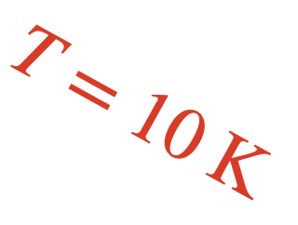
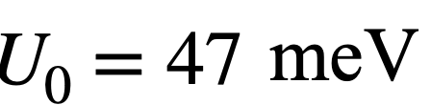
Flux creep and flux freezing
µ = 1.1
Notes:
The time dependence of the persistent current in the collective creep model is given by the so-called “interpolation formula”

Slide 24
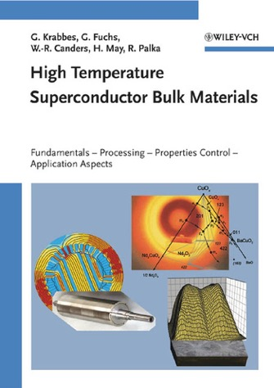
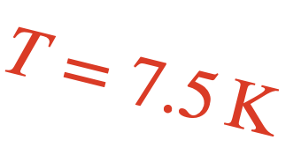
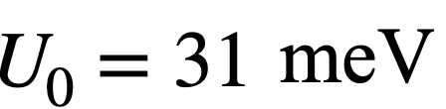
Flux creep and flux freezing
µ = 6.3
Extrapolate to 1 year the field would be around 1.82T
NB: Experiment in preparation to actively stabilise the field amplitude introducing an “acceptable” solenoidal field component.
µ = 1.1
Notes:
The time dependence of the persistent current in the collective creep model is given by the so-called “interpolation formula”

Slide 25
Summary of the planar staggered array with: 𝜆_{u}=10mm & gap=4.0mm
Company | RE | type | Undulator field, B (T) |  |  | 𝜎/B
 |  |  | with different pole's material
 |  |  | w/o | FeCo | Ho
ATZ | YBCO | TSMG | 1.67* | 1.90 | - | 23%
Nippon | GdBCO | TSMG | - | 2.10 | - | 3%
CAN | GdBCO | TSMG | - | 2.02 | - | 7%
CAN | EuBCO | TSMG | - | 1.90 | - | 6%
CAN | GdBCO | SDMG | 1.69 | 1.89 | 2.01 | 5%
THEVA | GdBCO | tape | 0.78 | 0.88 | - | 8%
SuperOx | YBCO | tape | 0.74 | - | - | 8%
*The two ATZ samples are not the same thus the one with and the one w/o poles are not directly comparable

Slide 26
Summary of the planar staggered array with: 𝜆_{u}=10mm & gap=4.0mm
Company | RE | type | Undulator field, B (T) |  |  | 𝜎/B
 |  |  | with different pole's material
 |  |  | w/o | FeCo | Ho
ATZ | YBCO | TSMG | 1.67* | 1.90 | - | 23%
Nippon | GdBCO | TSMG | - | 2.10 | - | 3%
CAN | GdBCO | TSMG | - | 2.02 | - | 7%
CAN | EuBCO | TSMG | - | 1.90 | - | 6%
CAN | GdBCO | SDMG | 1.69 | 1.89 | 2.01 | 5%
THEVA | GdBCO | tape | 0.78 | 0.88 | - | 8%
SuperOx | YBCO | tape | 0.74 | - | - | 8%
*The two ATZ samples are not the same thus the one with and the one w/o poles are not directly comparable

Slide 27
Summary of the planar staggered array with: 𝜆_{u}=10mm & gap=4.0mm
Company | RE | type | Undulator field, B (T) |  |  | 𝜎/B
 |  |  | with different pole's material
 |  |  | w/o | FeCo | Ho
ATZ | YBCO | TSMG | 1.67* | 1.90 | - | 23%
Nippon | GdBCO | TSMG | - | 2.10 | - | 3%
CAN | GdBCO | TSMG | - | 2.02 | - | 7%
CAN | EuBCO | TSMG | - | 1.90 | - | 6%
CAN | GdBCO | SDMG | 1.69 | 1.89 | 2.01 | 5%
THEVA | GdBCO | tape | 0.78 | 0.88 | - | 8%
SuperOx | YBCO | tape | 0.74 | - | - | 8%
*The two ATZ samples are not the same thus the one with and the one w/o poles are not directly comparable

Slide 28
Summary of the planar staggered array with: 𝜆_{u}=10mm & gap=4.0mm
Company | RE | type | Undulator field, B (T) |  |  | 𝜎/B
 |  |  | with different pole's material
 |  |  | w/o | FeCo | Ho
ATZ | YBCO | TSMG | 1.67* | 1.90 | - | 23%
Nippon | GdBCO | TSMG | - | 2.10 | 2.20† | 3%
CAN | GdBCO | TSMG | - | 2.02 | 2.12† | 7%
CAN | EuBCO | TSMG | - | 1.90 | 2.00† | 6%
CAN | GdBCO | SDMG | 1.69 | 1.89 | 2.01 | 5%
THEVA | GdBCO | tape | 0.78 | 0.88 | - | 8%
SuperOx | YBCO | tape | 0.74 | - | - | 8%
*The two ATZ samples are not the same thus the one with and the one w/o poles are not directly comparable
†Those are not measurements but just extrapolations

Slide 29
Overview
Introduction
Results of the short sample experimental campaign:
  Sample preparation
  Magnetic measurements:
  Field optimisation, CoFe versus Ho poles,
  FCM Reproducibility, Charging time,
  Flux creep & flux freezing
The meter-long prototype
  Design
  Status of the production
Conclusions

Slide 30
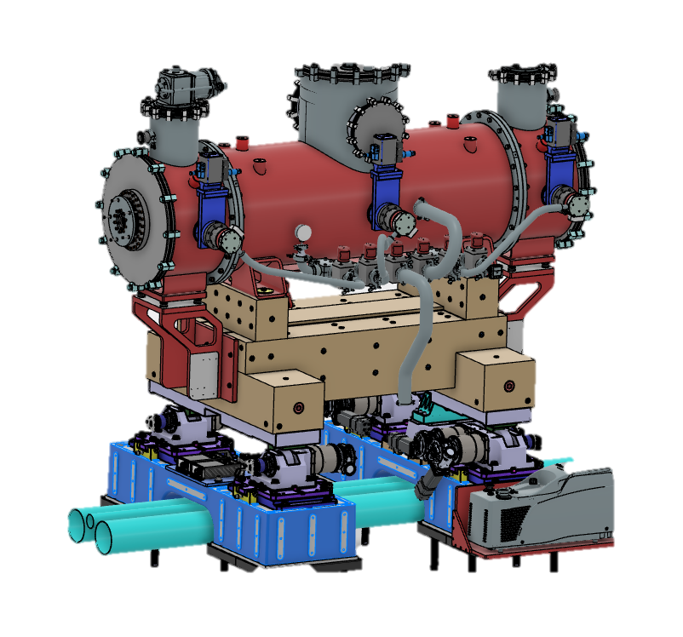
Specifications:
active length = 1.0 m
period length = 10.5 mm
total length < 2.0m
period length = 10.5mm
magnetic gap : 4.5mm
B₀ ∼ 1.8 T
Cryocoolers
HTS temp 10K
LTS temp 4.0K
Meter long HTS Insert

Slide 31
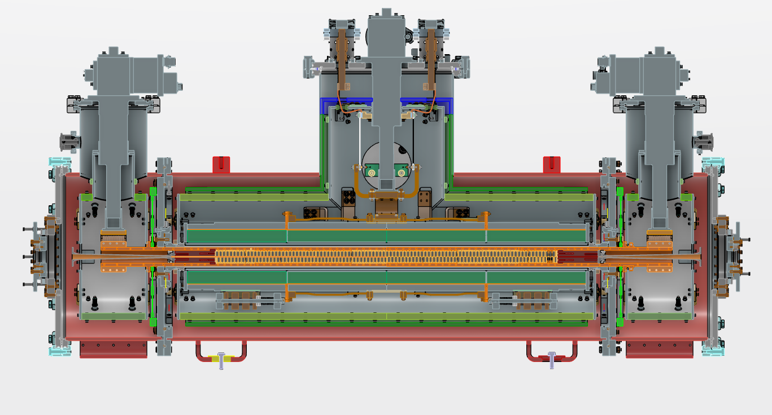
Cryo 1
Cryo 2a
Current leads
Current leads
Cryo 2b
12T Solenoid
Meter long HTS Insert
1
2
3
4
HTS Insert

Slide 32
Cryo 1
Cryo 2a
Current leads
Current leads
Cryo 2b
12T Solenoid
Meter long HTS Insert
1
2
3
4
HTS Insert

Slide 33
Cryo 1
Cryo 2a
Current leads
Current leads
Cryo 2b
12T Solenoid
Meter long HTS Insert
1
2
3
4
HTS Insert

Slide 34
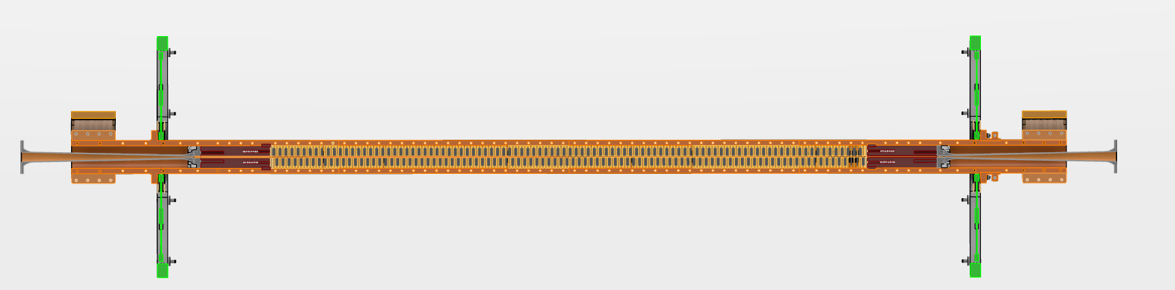
Cu-Cooling strap
GdBCO-Cu disks (190 pieces)
Ho-Cu disks (187 pieces)
Meter long HTS Insert
Flexor support
Flexor support
Designed by Mike Giger

Slide 35
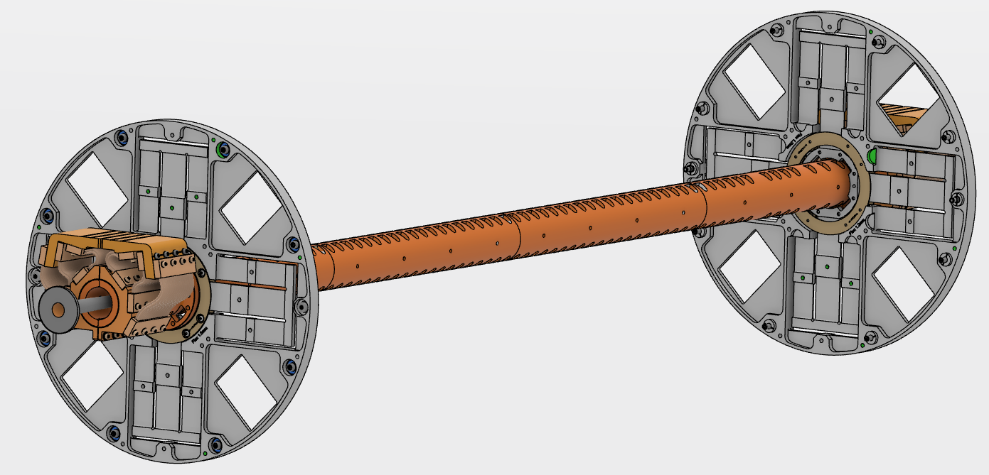
Flexor support
Cu-Cooling strap
Meter long HTS Insert
Bulk structure
Designed by Mike Giger

Slide 36
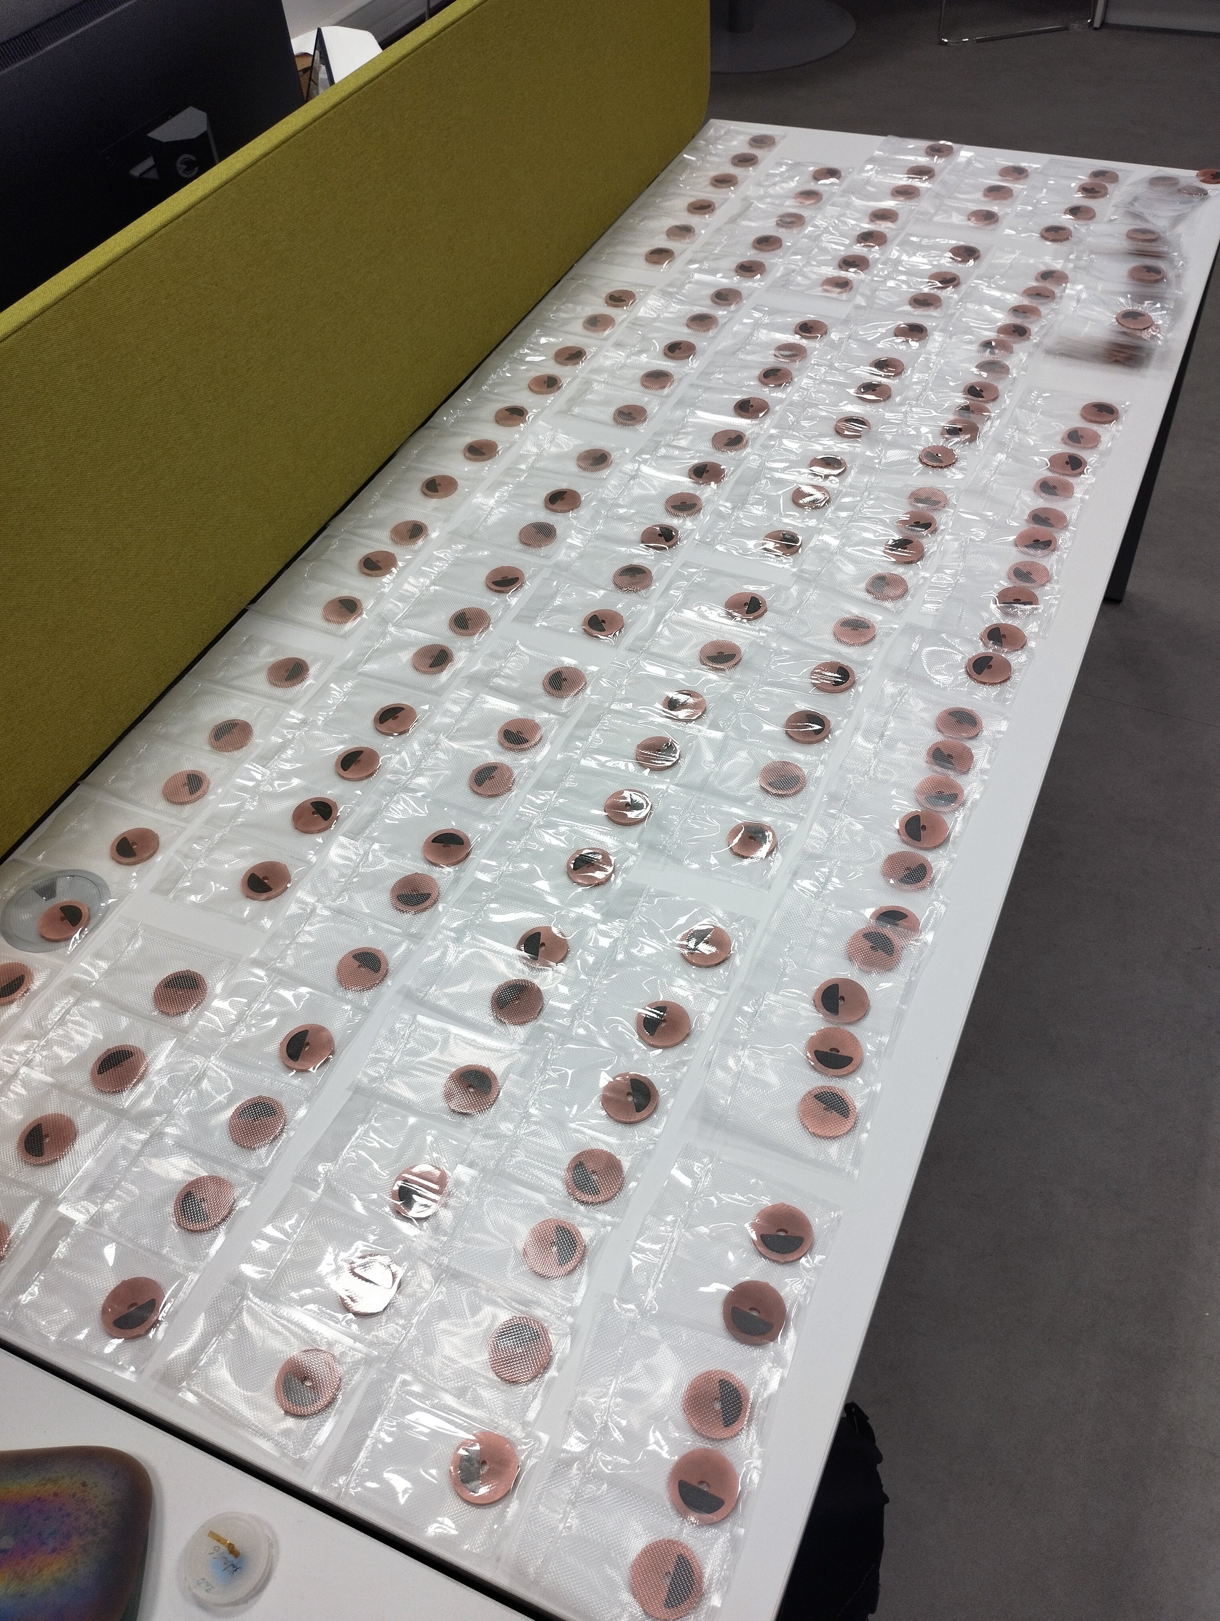
Meter long HTS Insert

Slide 37
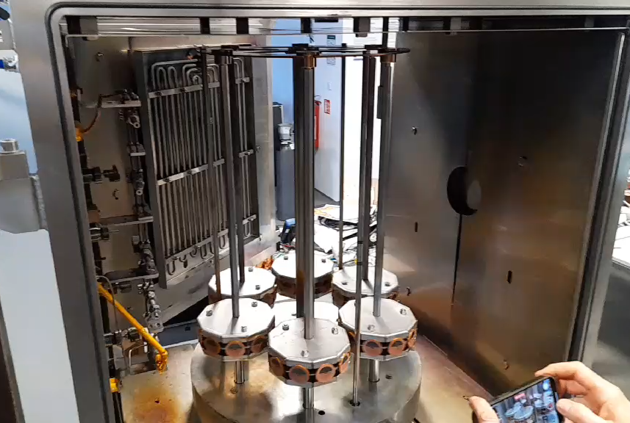
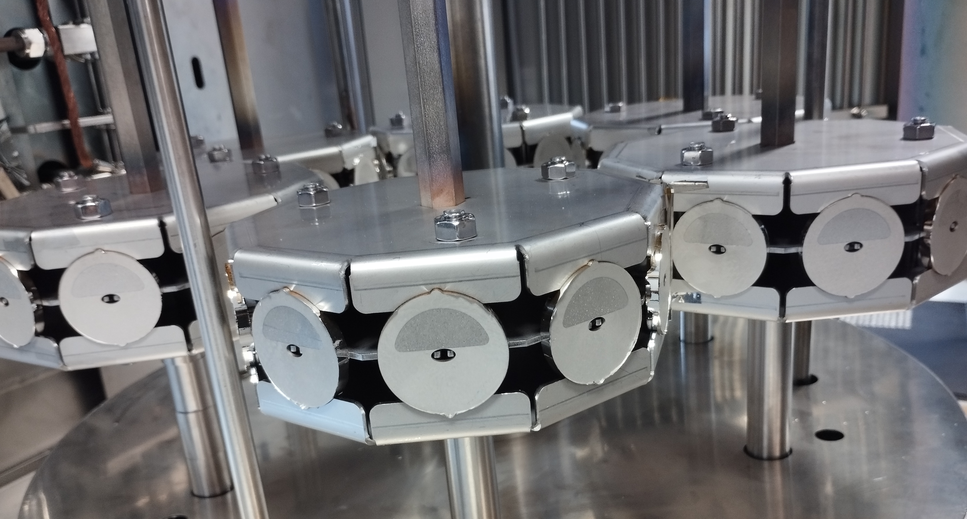
Meter long HTS Insert

Slide 38
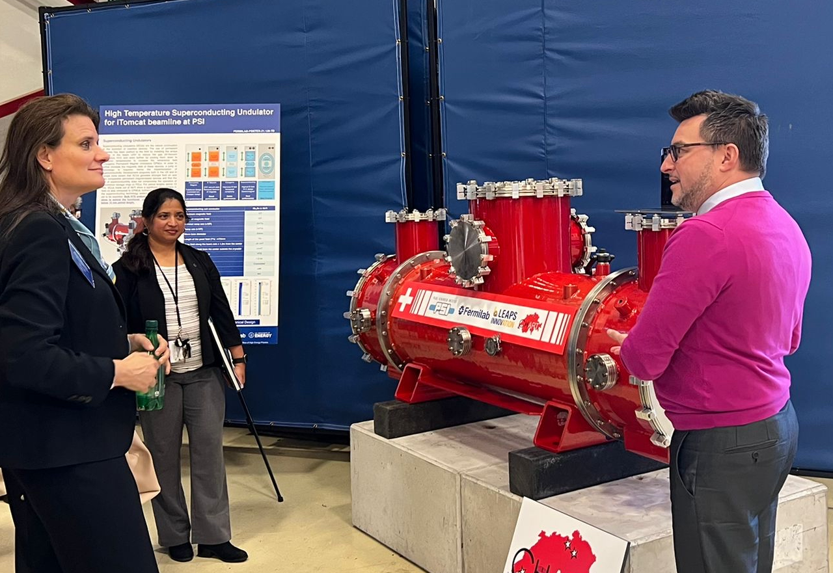
Batavia, October 18th 2022

Slide 39
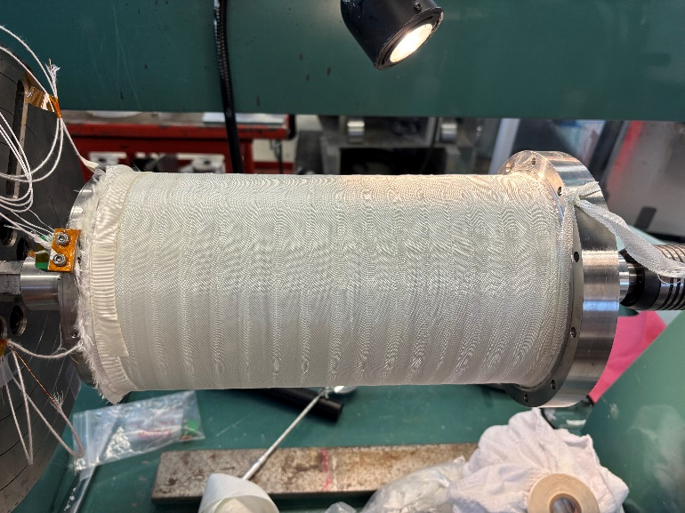
12T Nb₃Sn Solenoid

Slide 40
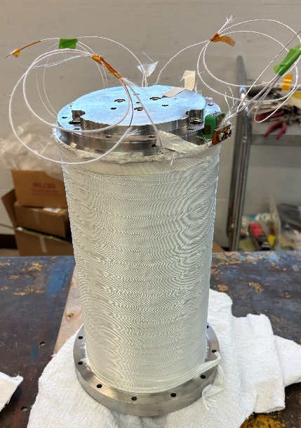
12T Nb₃Sn Solenoid

Slide 41
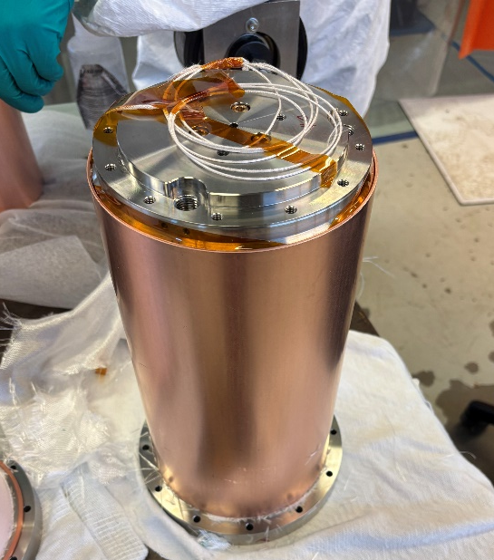
12T Nb₃Sn Solenoid

Slide 42
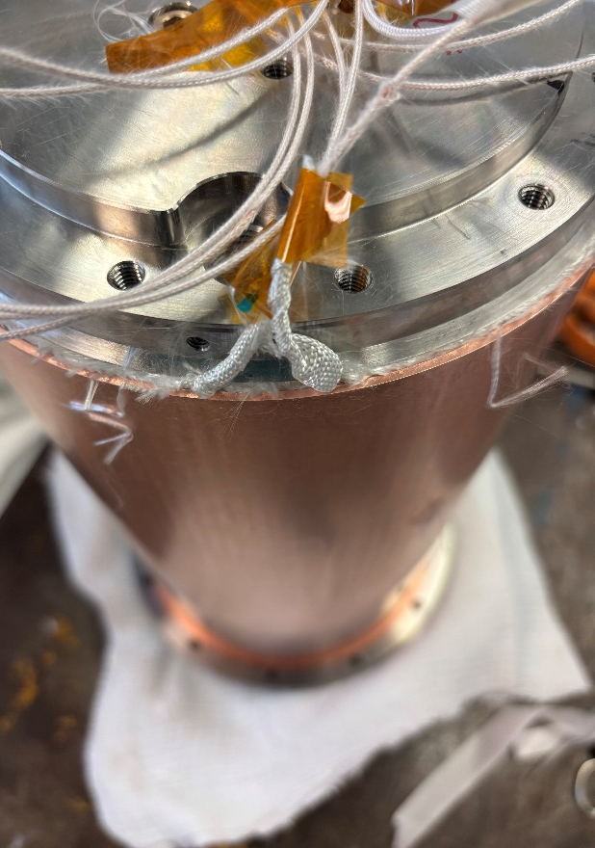
12T Nb₃Sn Solenoid

Slide 43
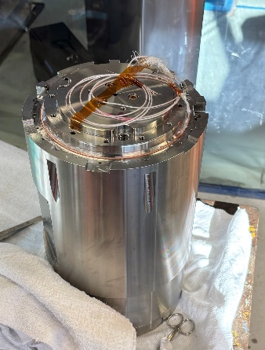
12T Nb₃Sn Solenoid

Slide 44
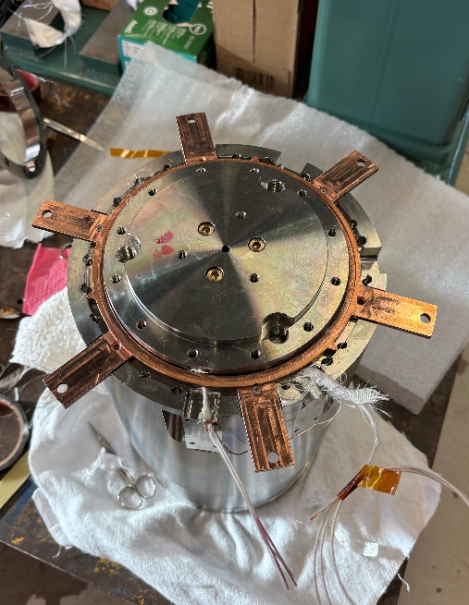
12T Nb₃Sn Solenoid

Slide 45
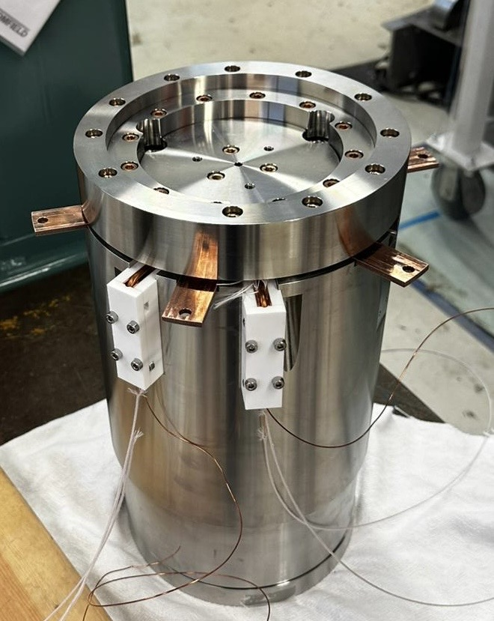
12T Nb₃Sn Solenoid

Slide 46
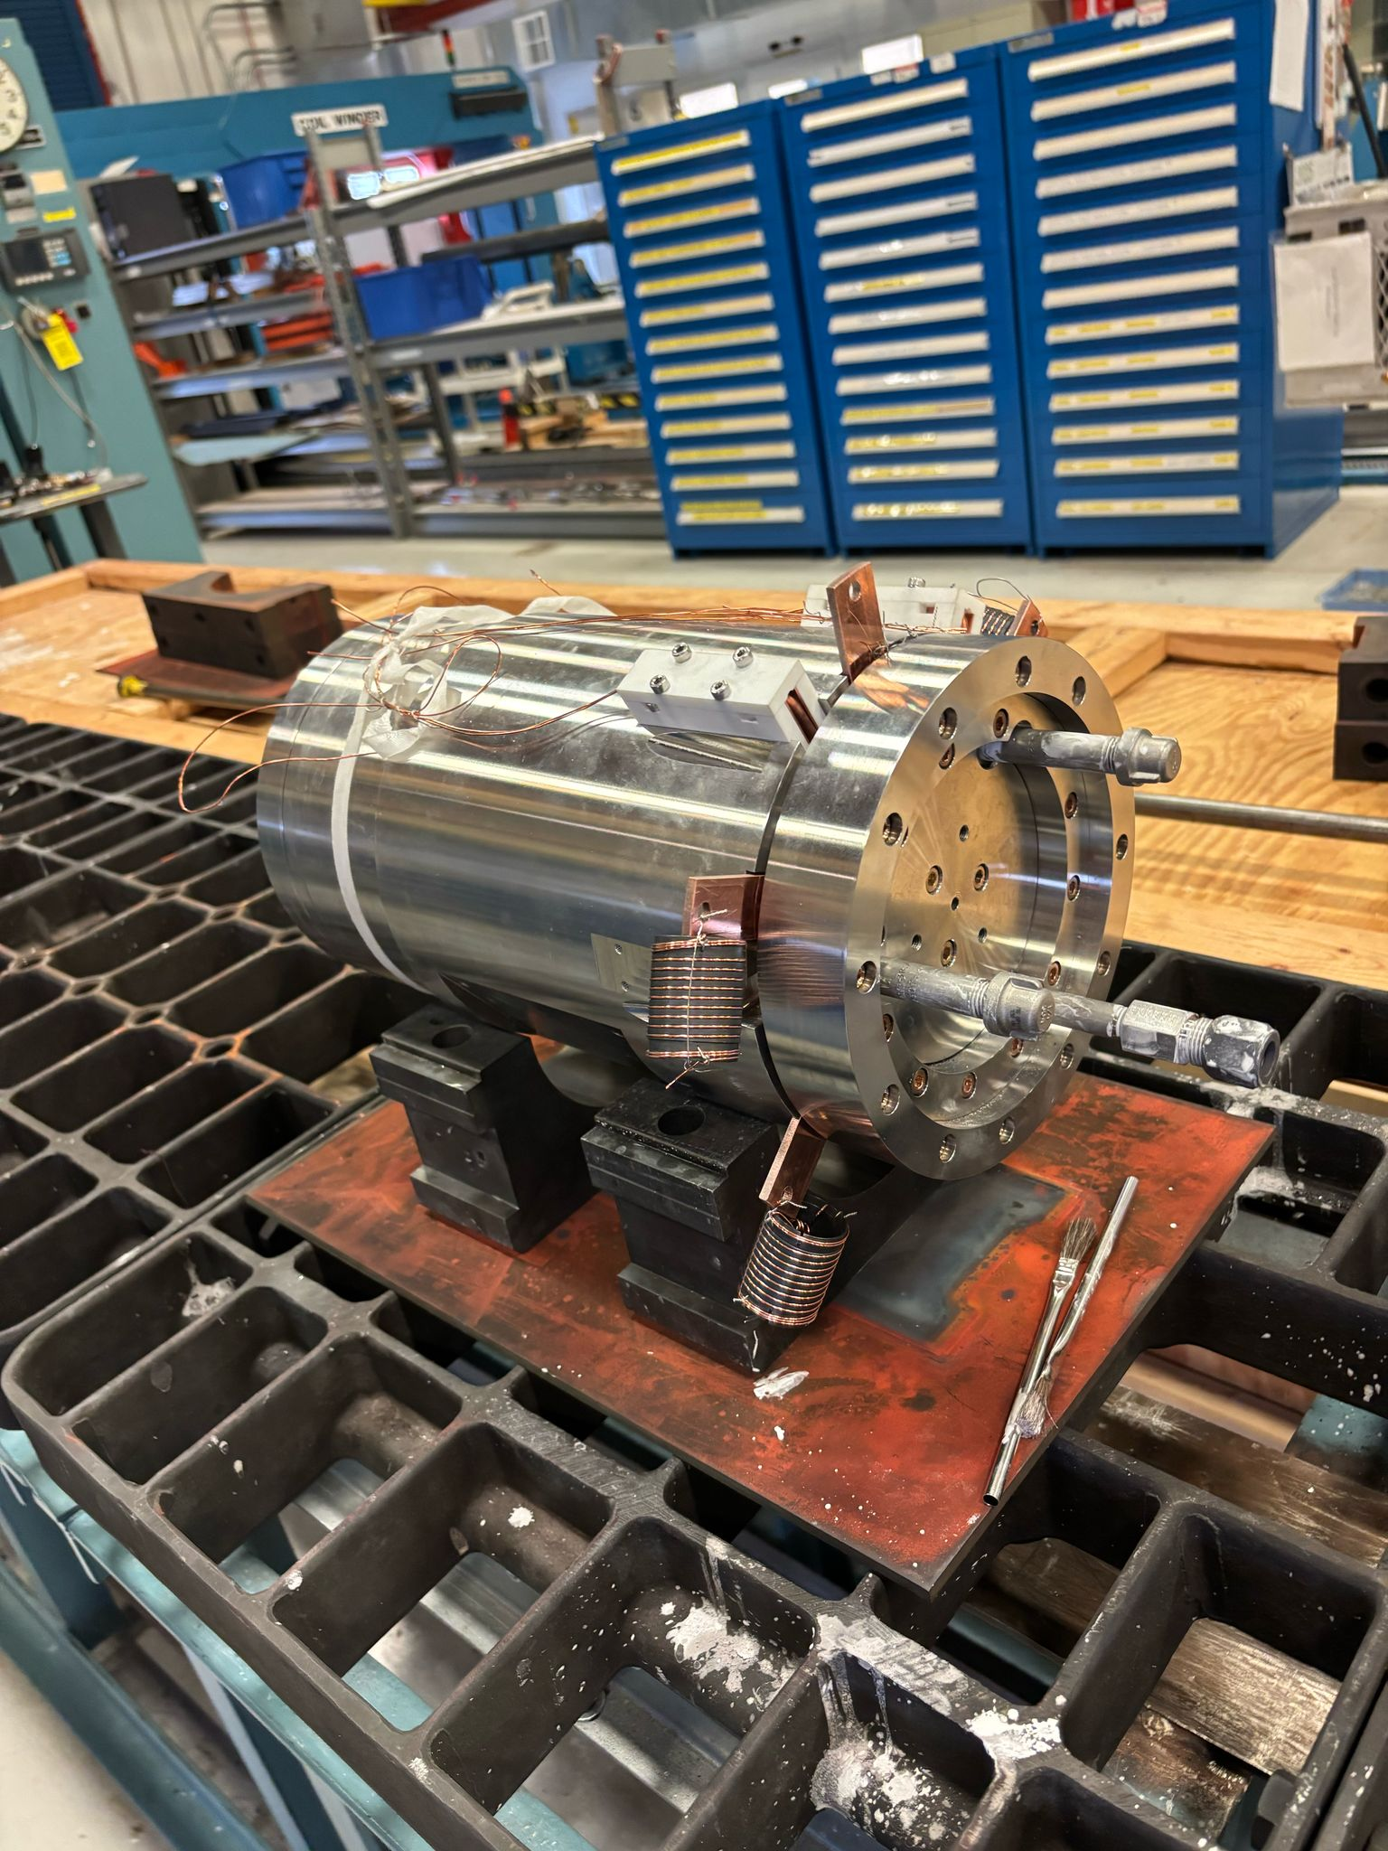
12T Nb₃Sn Solenoid

Slide 47
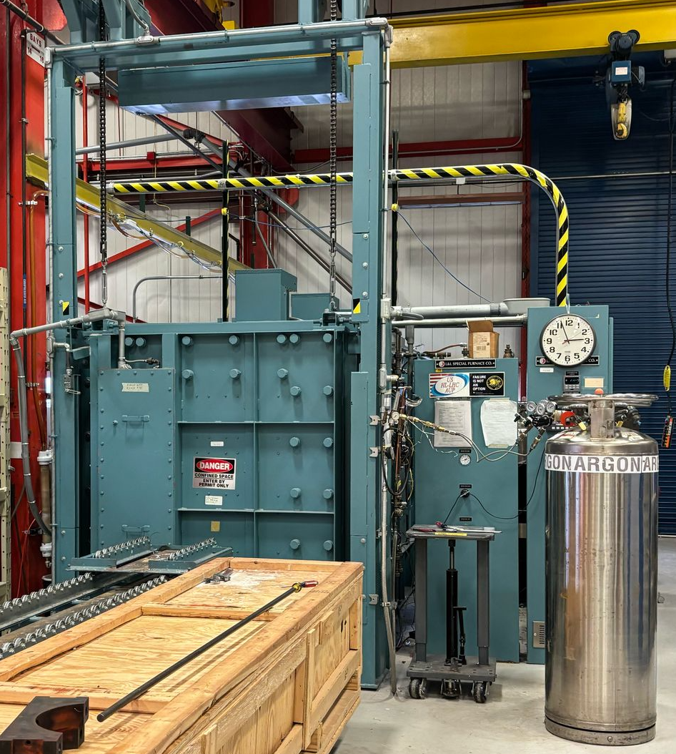
12T Nb₃Sn Solenoid
The thermal treatment of two out of four coils has been completed.

Slide 48
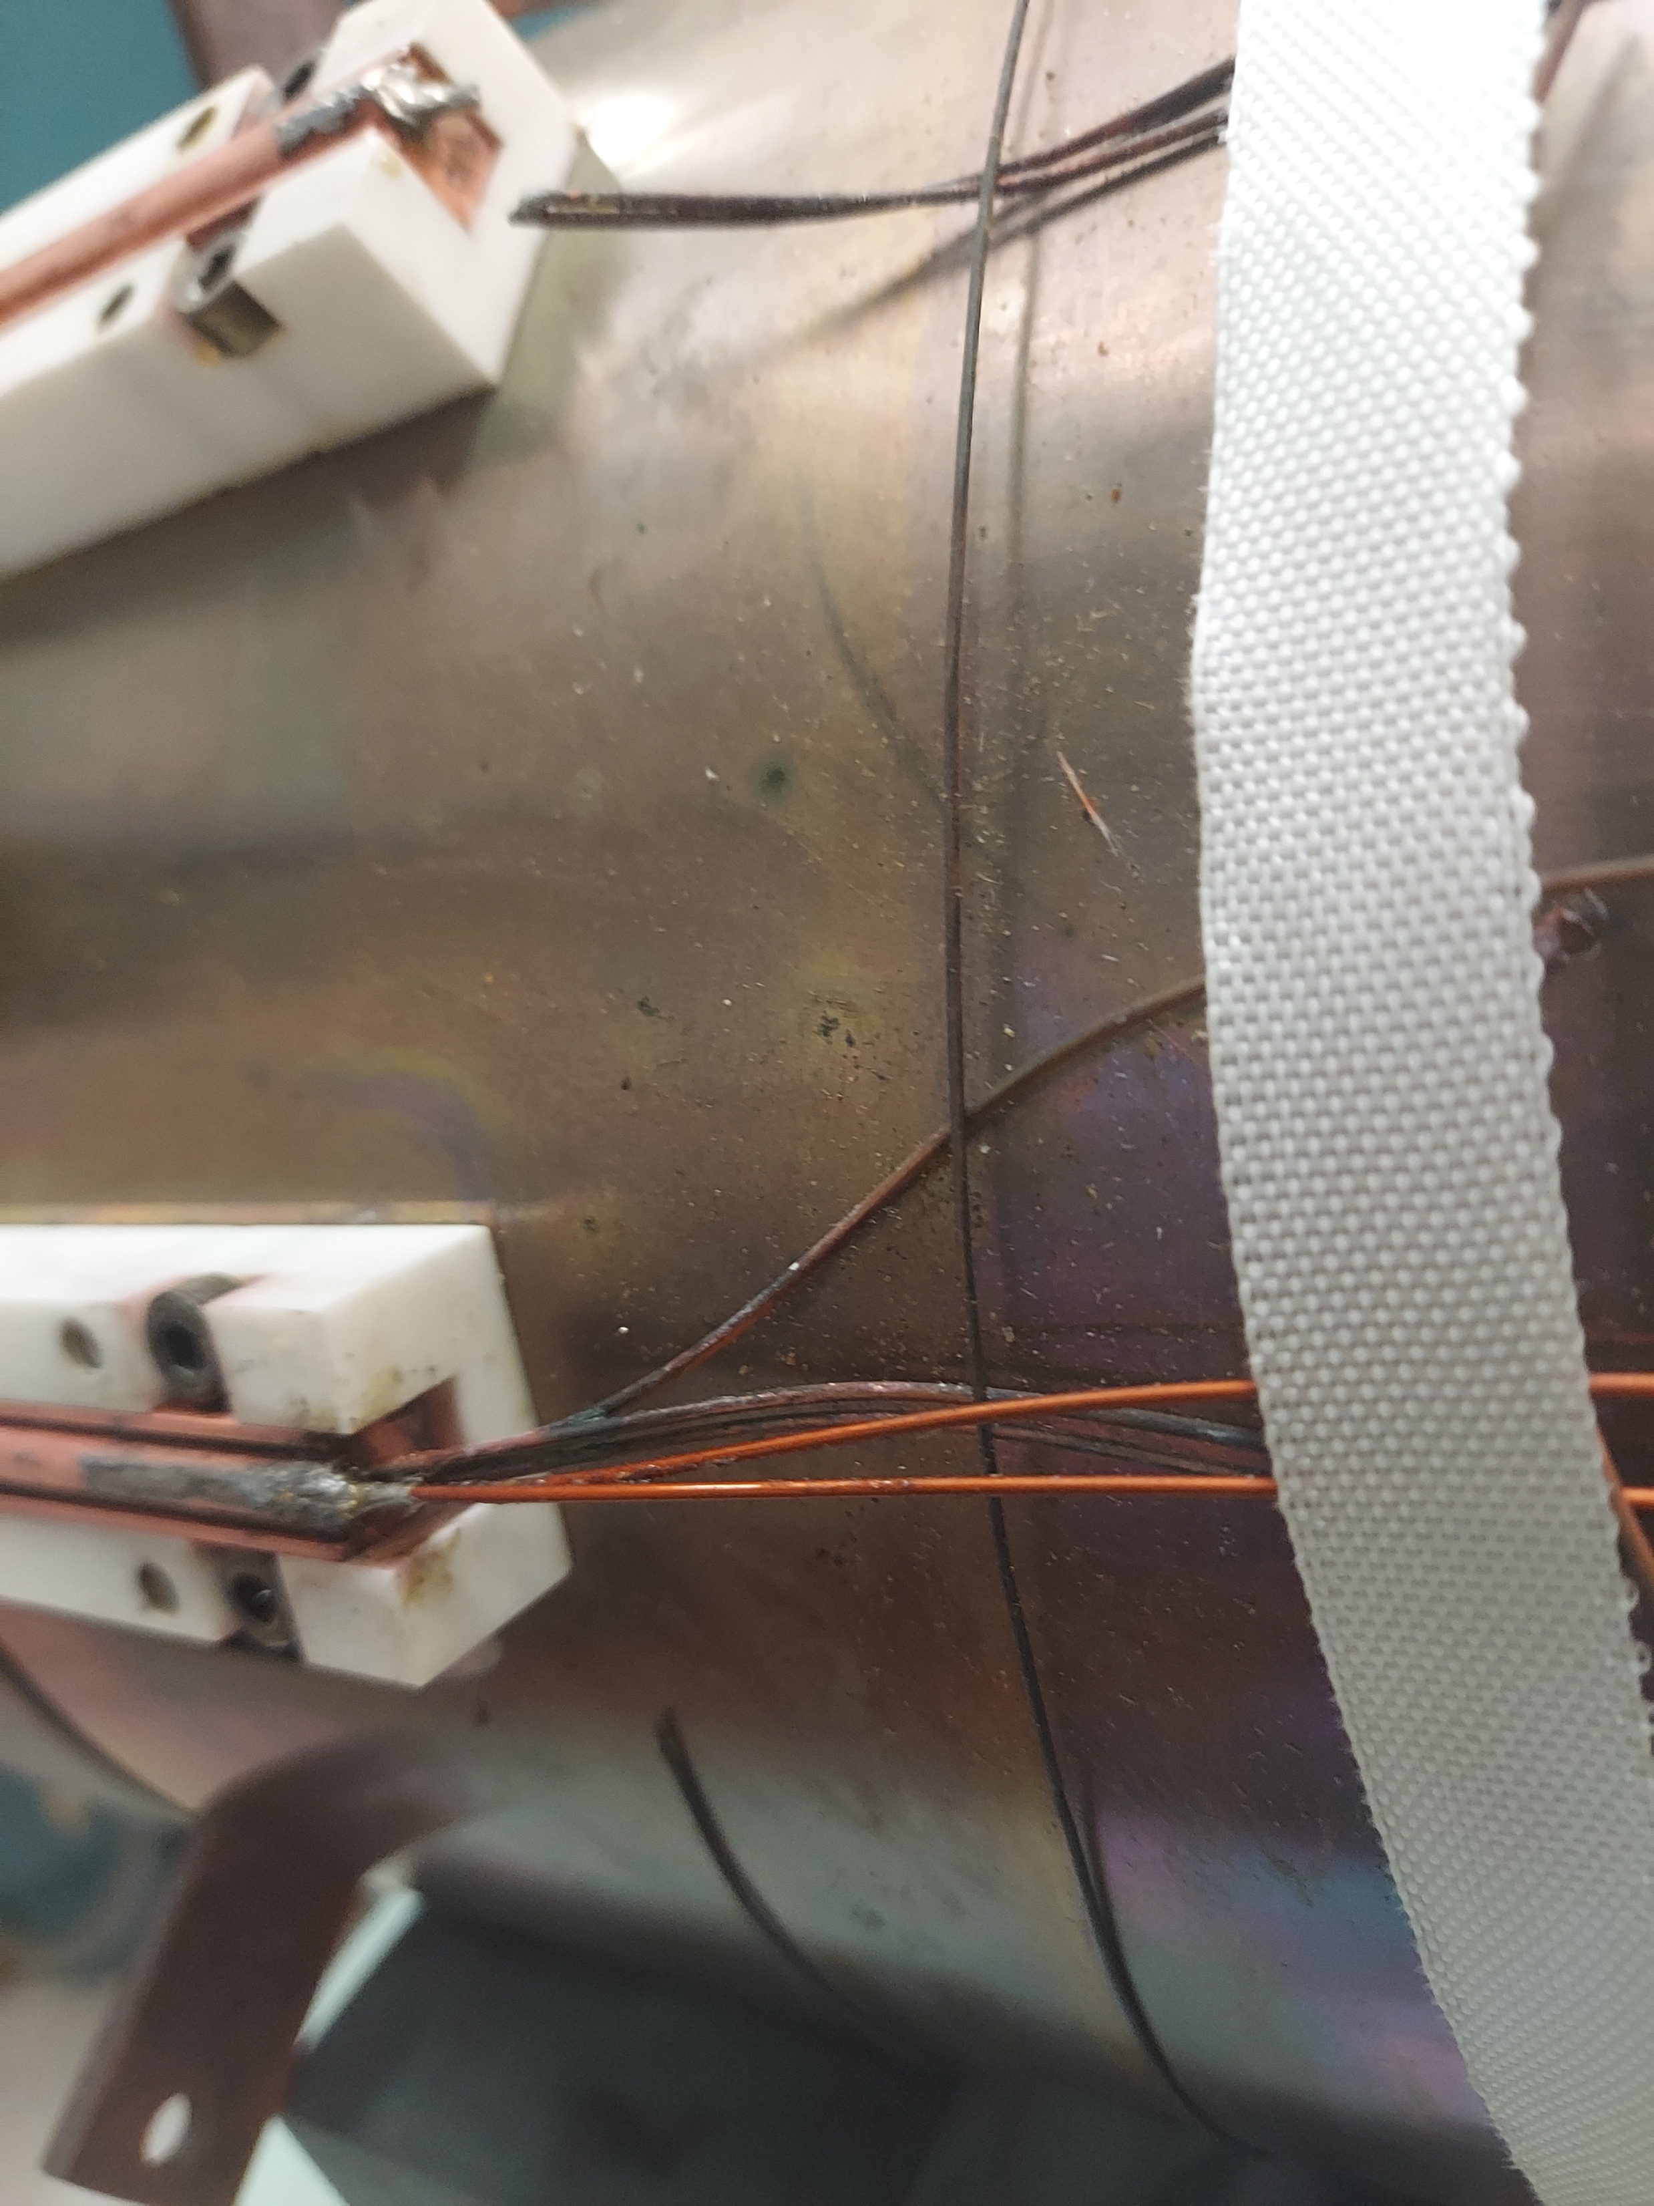
12T Nb₃Sn Solenoid

Slide 49
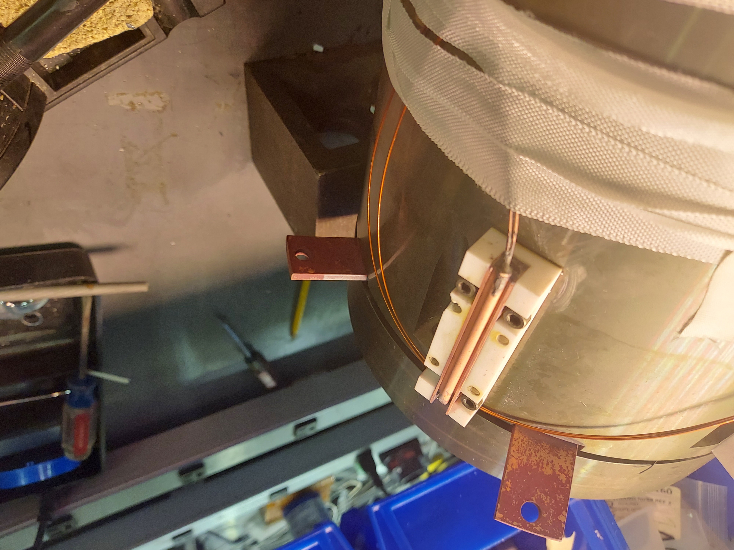
12T Nb₃Sn Solenoid

Slide 50
Conclusions & Outlooks
We demonstrated high magnetic fields (2T) and algorithms for the optimisation.
Holmium poles deliver higher fields than FeCo even if they are not single crystals.
The reproducibility of the Field Cooling Magnetisation is within our measurement accuracy (0.1%)
A preliminary optimisation of the magnet charging process has reduced the required time from 10 hours to 4 hours.
Flux freezing helps to significantly reduce magnetic creep, although it does not eliminate it completely.
Delivery of the “Cryo-Solenoid” to PSI is expected in Q1 2026, after an intensive measurement campaign will follow, aiming to demonstrate phase errors as low as a few degrees and the device is planned for installation in SLS2.0 in early 2027.

Slide 51
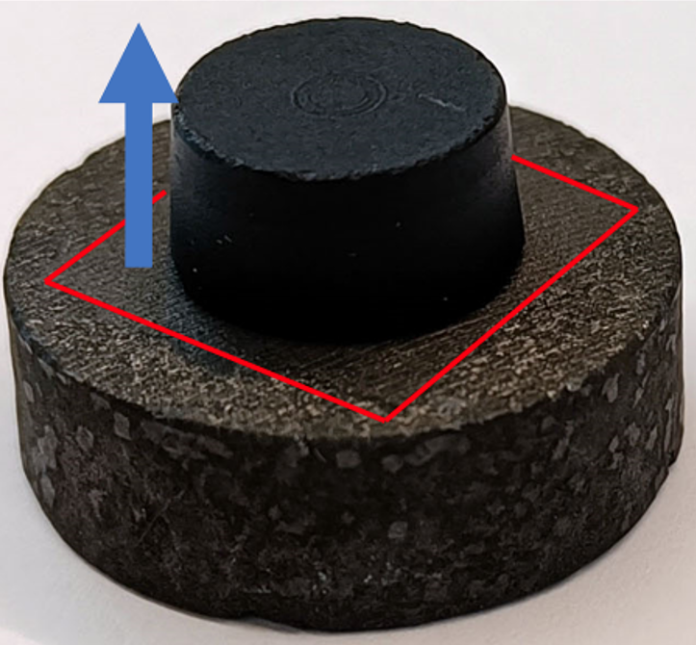
CAN-SUPERCONDUCTOR: SDMG
Single-direction Melt Growth (SDMG) is a novel approach for REBCO single-domain bulk growth, where a grown bulk from a REBCO system with higher peritectic temperature is used to seed the grown bulk (instead of a NdBCO thin-film seed, which is used for both TSMG and TSIG). The main advantage of this approach is that the bulk is composed exclusively of the c-growth region, unlike TSMG-grown bulks. Therefore, the expected homogeneity is significantly higher in SDMG-grown bulks, as no growth interfaces are present in the bulks.
Courtesy of Dr Tomáš Hlásek (CAN)

Slide 52
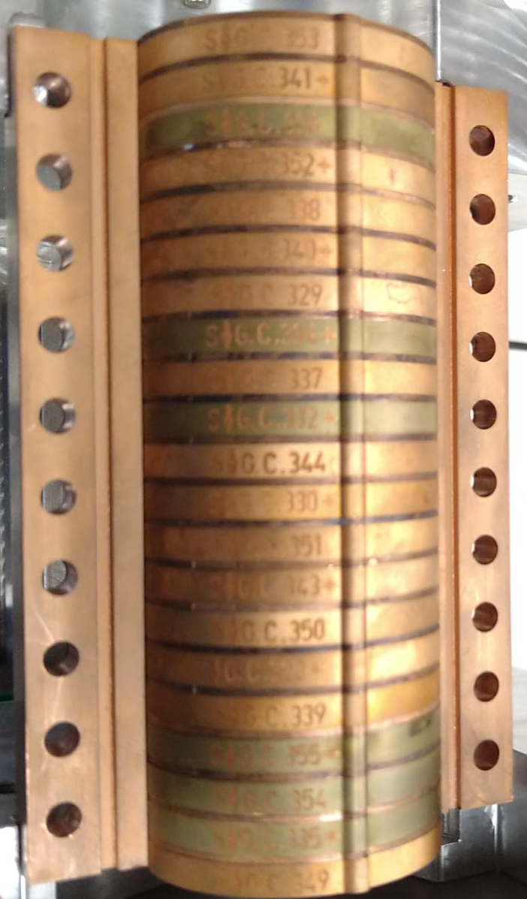
CAN / SDMG + Ho poles

