Slide 1

The Helical Superconducting Undulator (HSCU) Project at STFC
Alex Hinton, Magnetics and Radiation Sources Group, ASTeC, STFC Daresbury Laboratory, on behalf of the HSCU collaboration
Insertion Devices for Future Light Sources Workshop (ID25)
Taipei, Taiwan
31 May – 1 June 2025

Slide 2
The HSCU collaboration
Sam Allum^{[1]}, Josef Boehm^{[2],} Peter Brixey^{[1]}, Simon Canfer^{[3]}, Liam Cooper^{[4]},
Ben Green^{[2]}, Tim Hayler^{[4]}, Chris Herbert^{[1]}, Joel Hodder^{[3]}, Muhammad Imam^{[4]}, Phillip Jeffery^{[4]}, Craig Macwaters^{[5]}, Barnaby Matthews^{[4]}, Stephen Milward^{[6]}, Zsuzsanna Mozsary^{[3]}, Harry Plaisted^{[1]}, Richard Smith^{[1]}, Richard Wadiun^{[1]}, Dave Wilsher^{[1]}.
STFC, Rutherford Appleton Laboratory (RAL), Harwell Science and Innovation Campus, OX11 0QX
[1] TECH/ASD/TD Manufacturing Facilities
[2] TECH/ASD/TD Cryogenics
[3] TECH/ASD/TD Composites and Materials Testing
[4] TECH/ASD/TD Projects and Mechanical Engineering
[5] TECH/DED/TD Electronic Systems Support
[6] Diamond Light Source (DLS) (Head of insertion devices)
Jim Clarke (Director of ASTeC & Project Sponsor), Alex Hinton^{[7]}, Kiril Marinov^{[7]}, Ben Shepherd^{[7]}, Neil Thompson^{[7]}.
STFC, Daresbury Laboratory (DL), Daresbury Science and Innovation Campus, WA4 4AD
[7] Accelerator Science and Technology Centre (ASTeC) - Magnetics and Radiation Sources (MaRS) Group
Image © STFC John Dawson

Slide 3
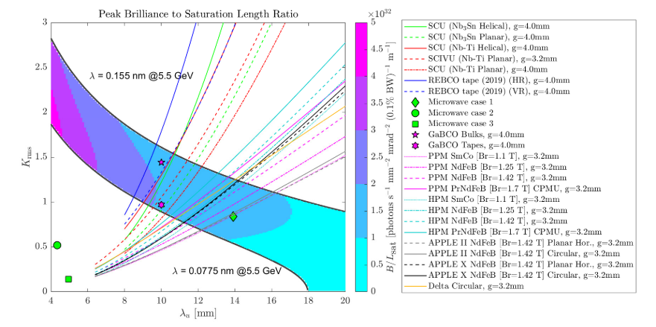
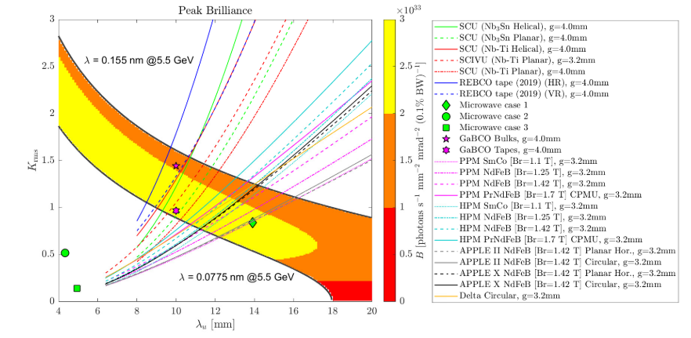

CompactLight
Design study for a Free Electron Laser (FEL) facility aimed at producing higher energy photons from lower electron beam energies than possible with current machines.
SCUs produce higher magnetic fields than permanent magnet undulators at short periods.
Higher peak FEL brilliance and greater range of available photon wavelengths at given beam energy.
Helical undulators have more efficient FEL coupling between electron beam and radiation field.
This results in a reduction of FEL saturation length and can lead to decreases in undulator length.
Image © STFC John Dawson

Slide 4

Helical Superconducting Undulator (HSCU) Project
Parameter | Value | Units
Period Length | 13 | mm
Inner Winding Diameter | 5 | mm
Beam Pipe Inner Diameter | 4 | mm
Photon Energy Range | 8-16 | keV
Deflection Parameter K (8 keV) | 1.33
Deflection Parameter K (16 keV) | 0.62
Peak Field on Axis | 1.09 | T
Electron Beam Energy | 5.5 | GeV
Undulator length | 1.1 | m
Total number of modules | 16
Project to develop a short period, small bore helical superconducting bifilar undulator (HSCU).
Work includes design of undulator and supporting cryogenic and vacuum systems required for operation.
Design parameters based on CompactLight study.
Design targeted to meet the requirements of future x-ray light sources e.g. UK-XFEL.
Image © STFC John Dawson

Slide 5
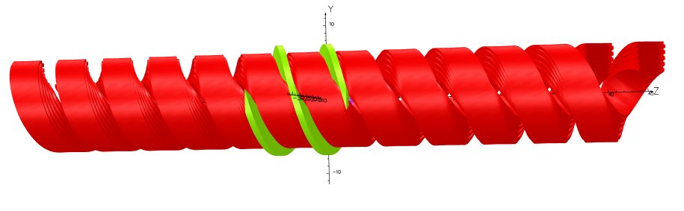
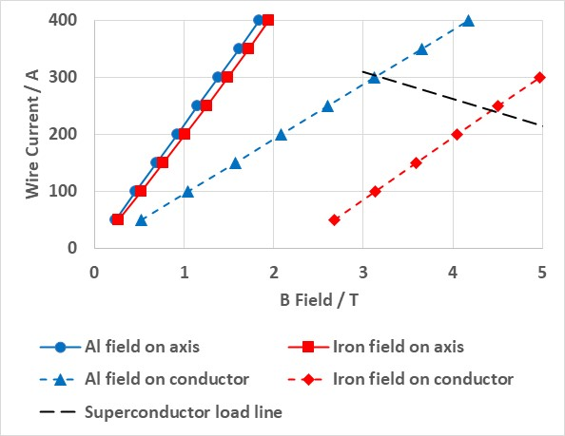
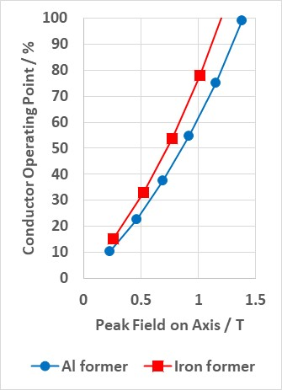
Magnetic Design
Two wire stacks, offset by half period.
One period of iron pole modelled.
Choice of superconducting wire – 0.44 mm insulated diameter VSF-642 very small filament niobium titanium (NbTi) wire from Supercon Inc.
Load lines for different wire stack configurations evaluated at 4.2 K.
Target peak field of 1.09 T could be achieved at lower operating point without iron poles.
Final design used aluminium former - eased mechanical and cryogenic design as well as superconductor load lines.
Target field achieved at 79% of critical current for stack configuration of 10 layers alternating 9 and 8 turns per coil.
Image © STFC John Dawson

Slide 6
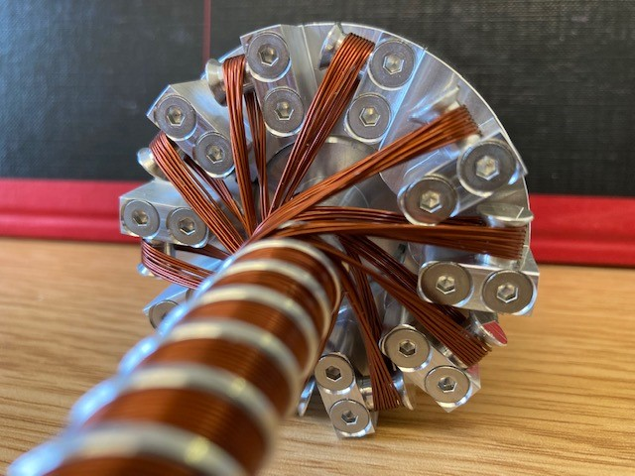
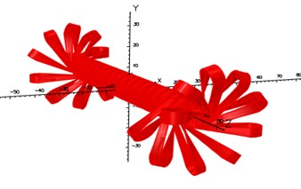
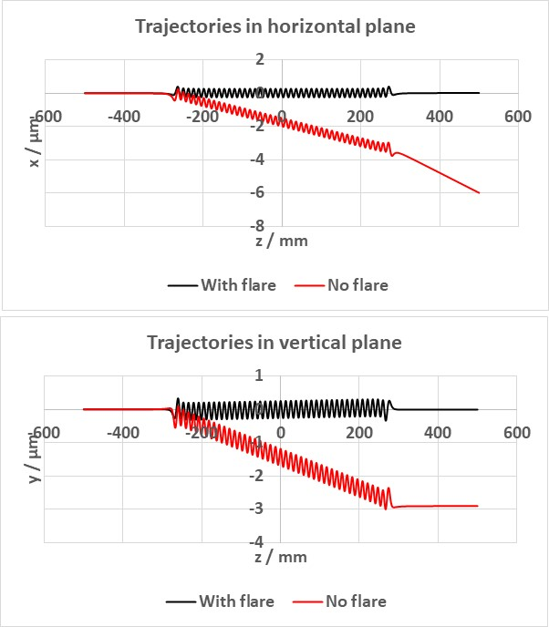
Turnaround Design
Turnaround scheme developed to wind the undulator from a continuous length of superconducting wire.
No resistive joints – removes potential heat source in the cryostat.
Winding radius flared out over final winding period.
Field from turnarounds gives undesired kick to electron beam at either end.
Design must include dipole corrector coils to minimise beam trajectory wander.
Maximum predicted integral correction = 0.25 T.mm.

Slide 7
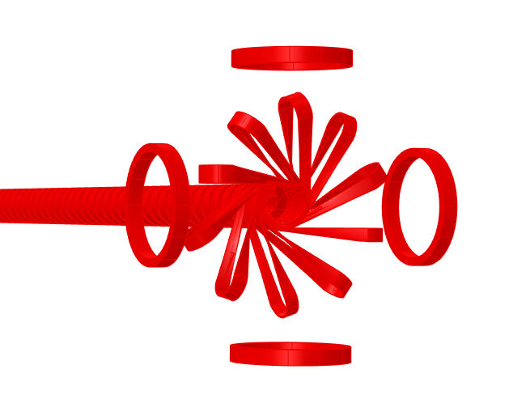
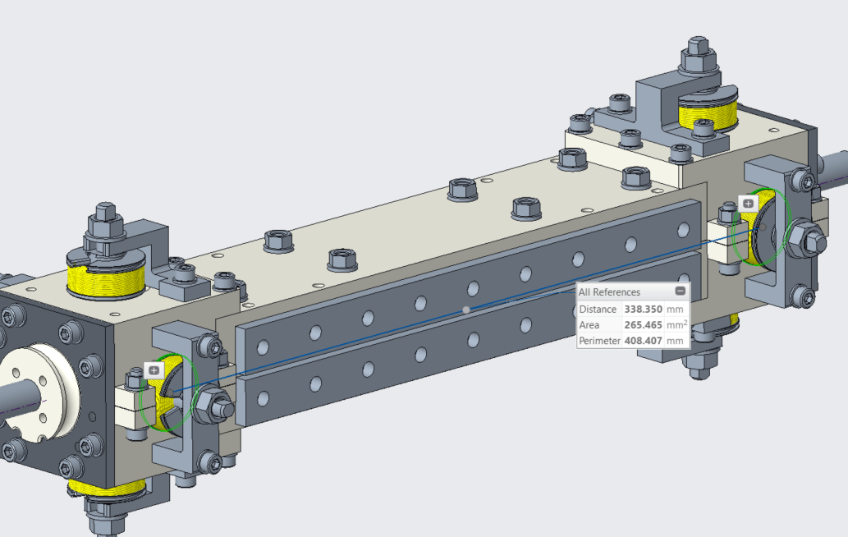
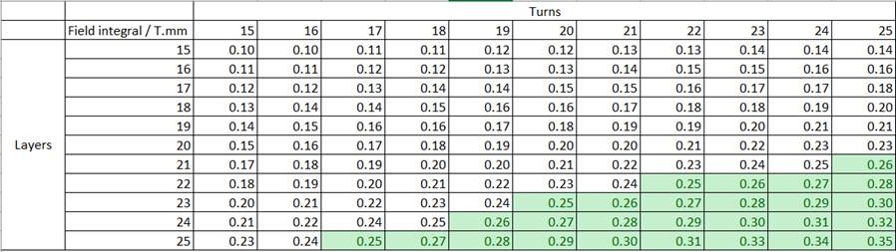
Integrated Corrector Coil Design
Design must include dipole corrector coils to minimise beam trajectory wander.
4 pairs of coils wound from 0.44 mm diameter NbTi superconducting wire for correction of first and second field integrals in horizontal and vertical planes.
Required first integral < 18x10⁻³ T.mm
Required second integral < 9 T.mm²
Predicted maximum integral correction = 0.25 T.mm.

Slide 8
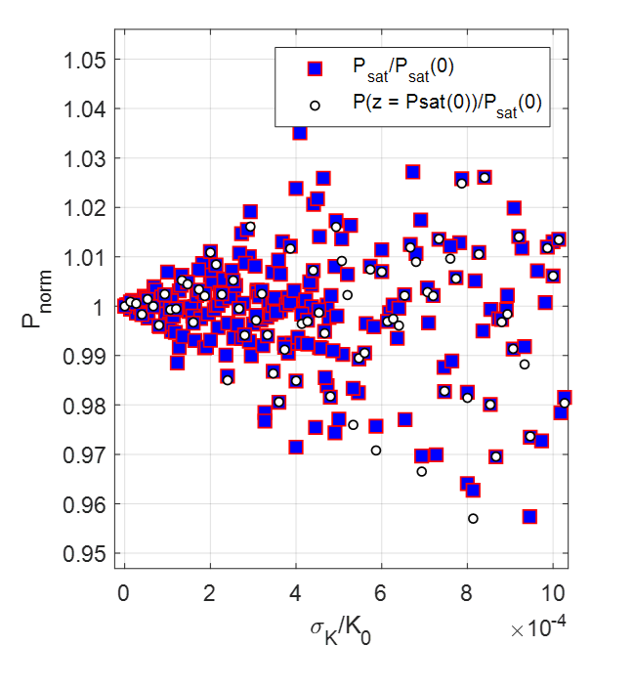
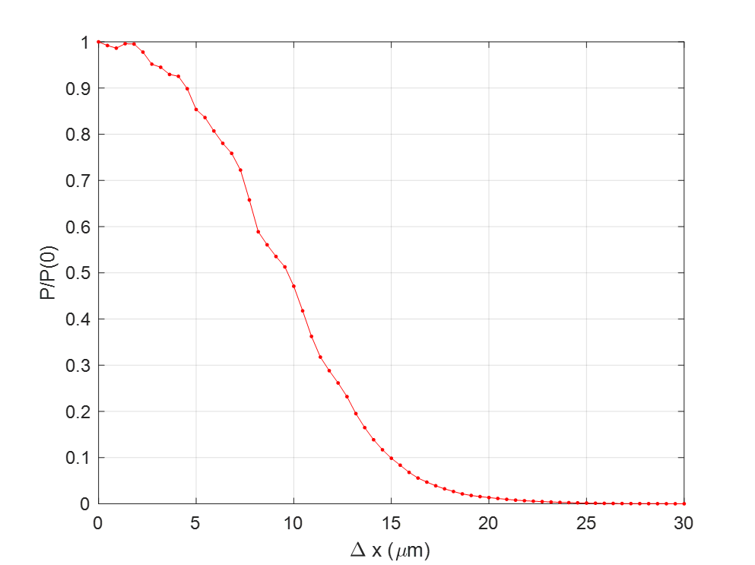
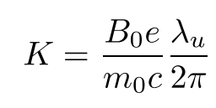
Tolerances
Tight manufacturing tolerances are required to achieve good field quality and optimal light production.
Normalised peak field errors < 1E-3 to avoid 5% change in output power.
Trajectory wander must be < 5 μm to avoid 10% degradation in output power.
^{Ɨ} Figures courtesy Neil Thompson

Slide 9
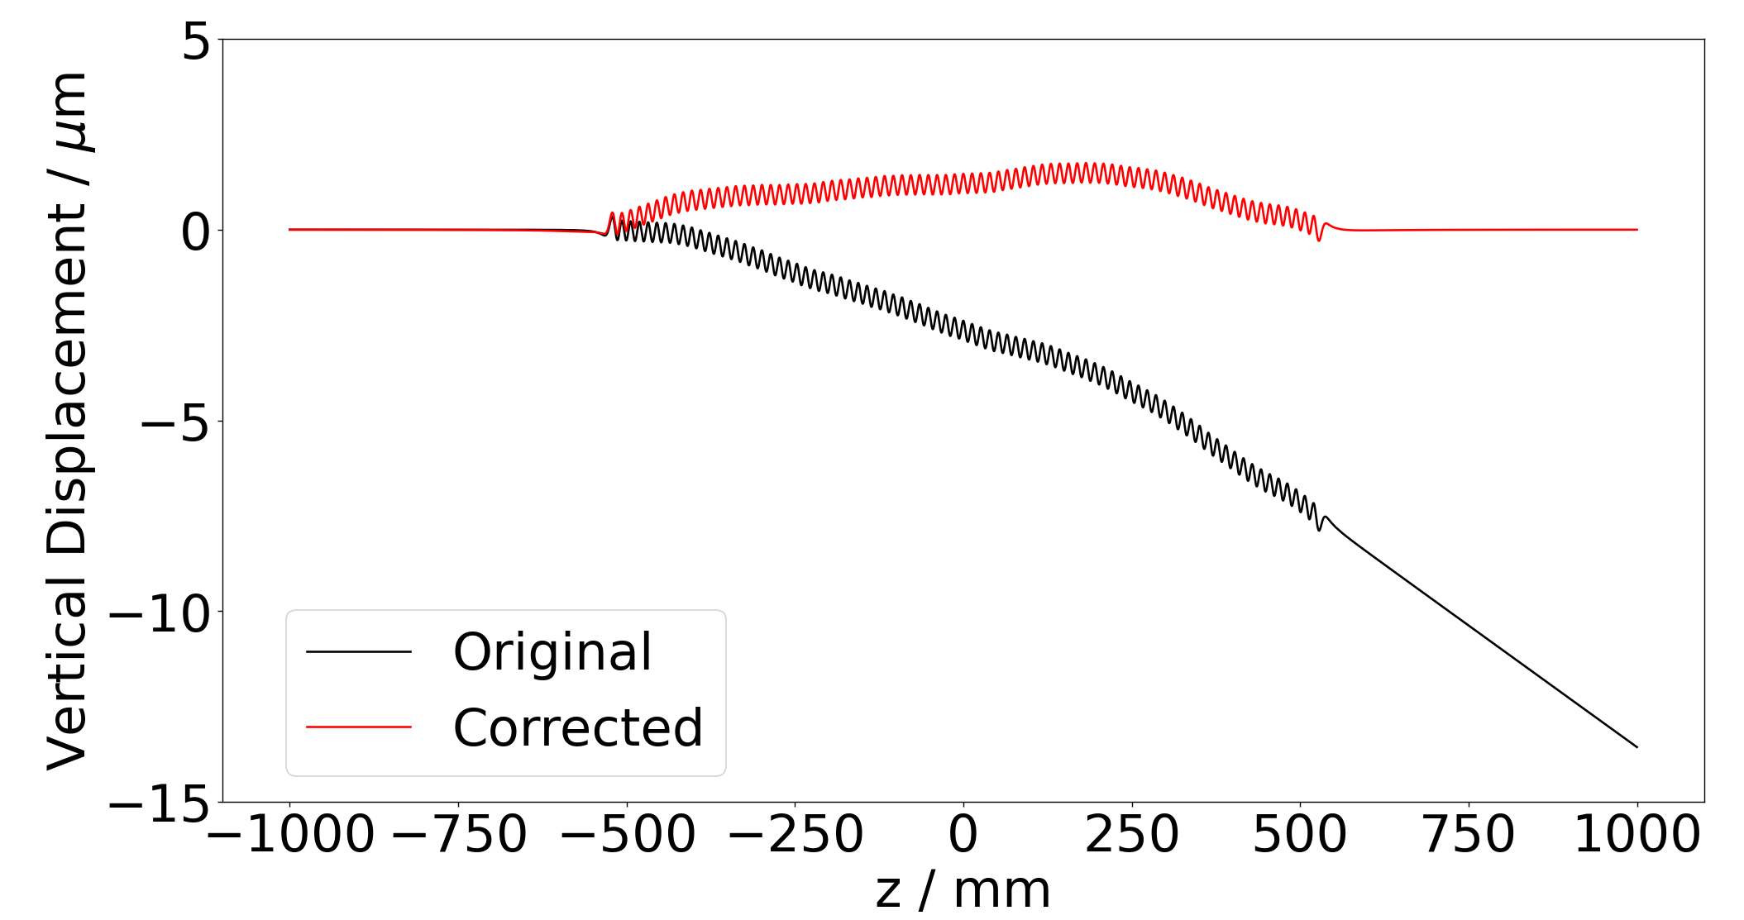
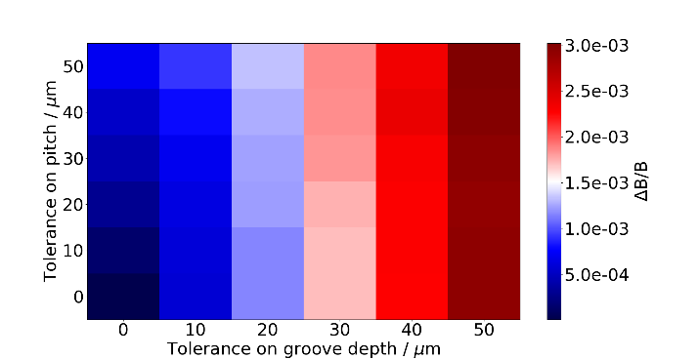
Tolerance Studies
Tight manufacturing tolerances are required to achieve good field quality and optimal light production.
Normalised peak field errors < 1E-3 to avoid 5% change in output power.
Trajectory wander must be < 5 μm to avoid 10% degradation in output power.
Machining and winding tolerances simulated in Opera 3D models.
Correction coils can be used to correct trajectory errors.
Electron trajectory through an example model with ±50 μm manufacturing tolerances and corresponding corrected trajectory.
Measured pitches on a 1.1 m long former are within a tolerance of ±10 μm. The corresponding allowable tolerance on the groove depth is ±15 μm, which is greater than the design tolerance of ±10 μm.
Image © STFC John Dawson

Slide 10
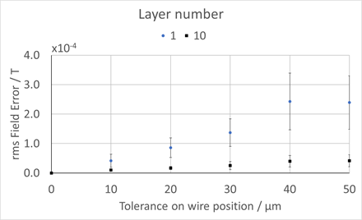
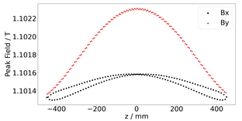
Tolerance Studies
Positioning of individual wire turns within the former grooves impacts the field quality.
Wires wound closer to the HSCU axis need to be wound with greater precision.
Winding tolerance on layer 1 < 20 μm.
Winding tolerance on layer 10 < 90 μm.
Sag of the HSCU former under gravity will lead to a spread in the peak field values on axis.
Sag < 100 μm over 1 m required to keep spread below 1E-3.
Image © STFC John Dawson

Slide 11
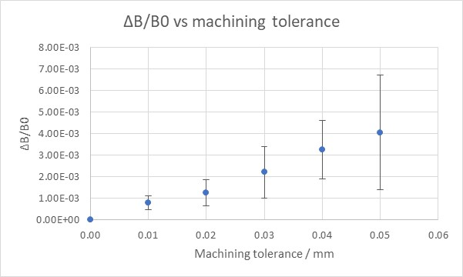
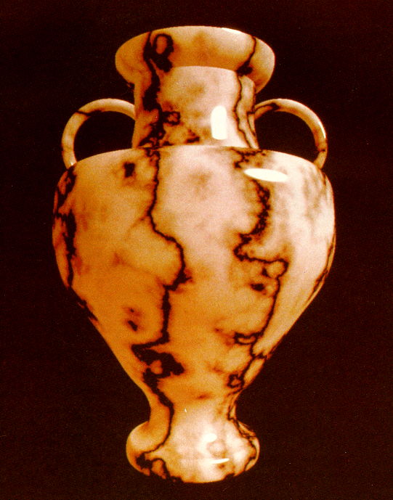
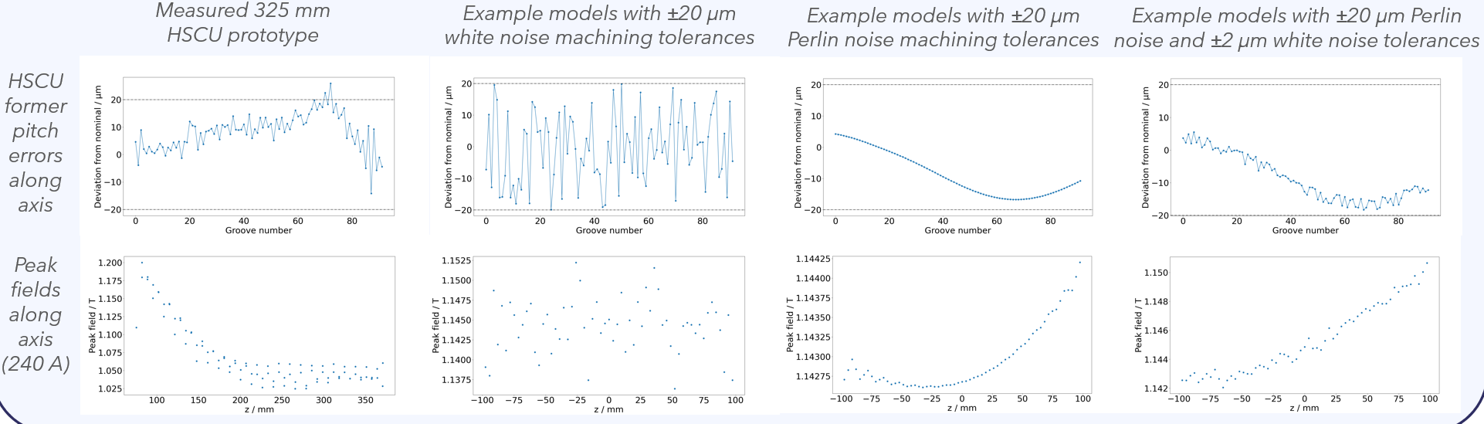
Perlin Tolerances
Perlin noise is used to model realistic textures in computer graphics.
Smoother tolerances modelled using Perlin (gradient) noise.
Is this a more realistic model for machining tolerances?
Mixing Perlin and white noise gives best visually representative results.
Image © STFC John Dawson

Slide 12
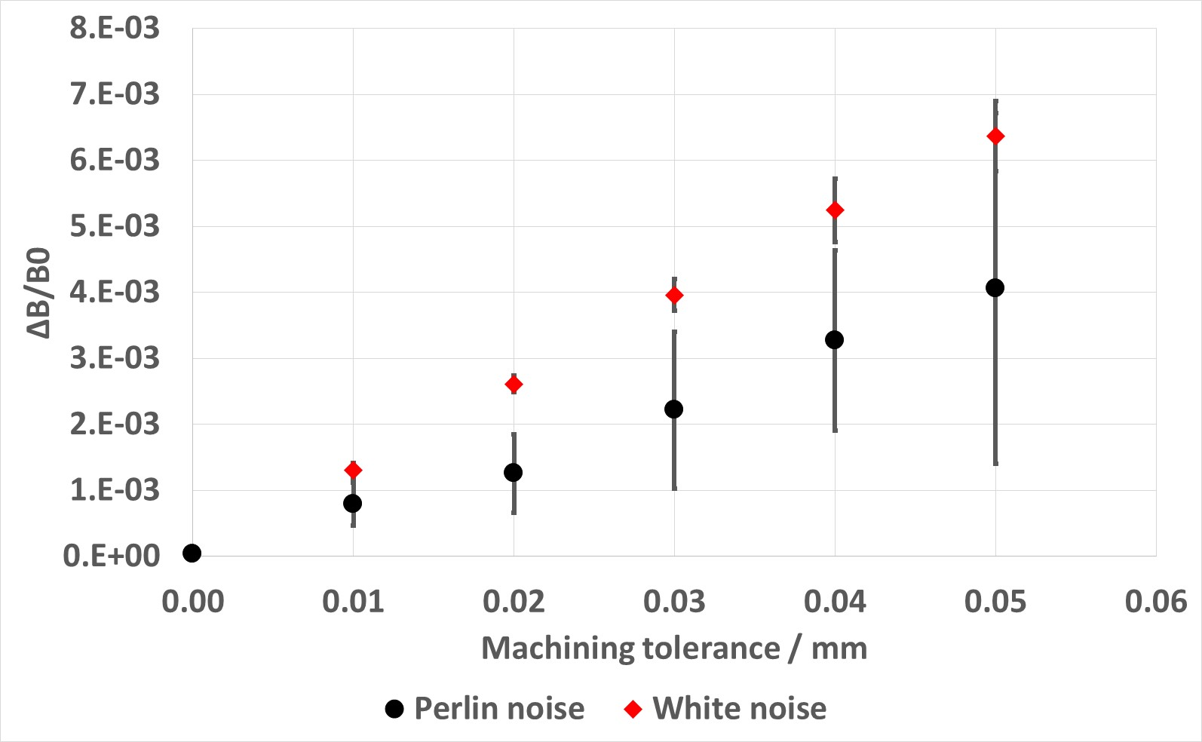
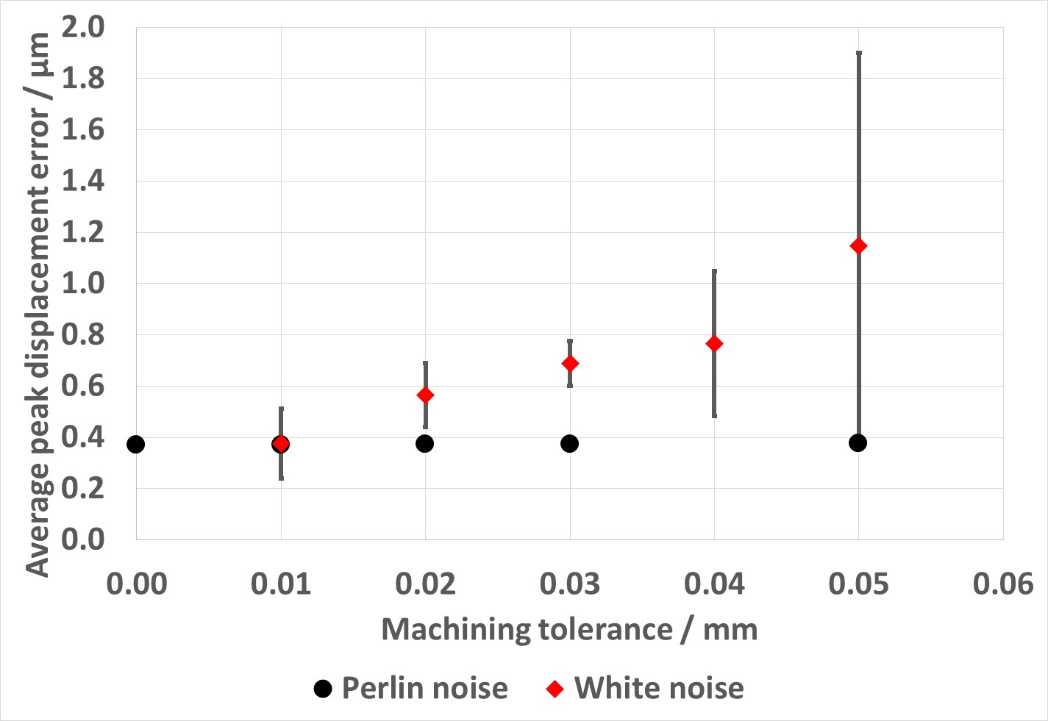
Perlin vs White Noise
Predicted machining tolerances calculated using Perlin and white noise models compared.
For given machining tolerances (on former pitch and inner winding diameter), Perlin noise predicts lower rms peak field errors.
Uncertainty on peak field error is larger with Perlin noise.
Perlin noise predicts lower peak trajectory displacement errors than models using white noise.
Perlin noise models can be used to define smoother varying machining tolerances along the HSCU length.
Smoother deviations give rise to less conservative predictions for required machining tolerances.
Image © STFC John Dawson

Slide 13
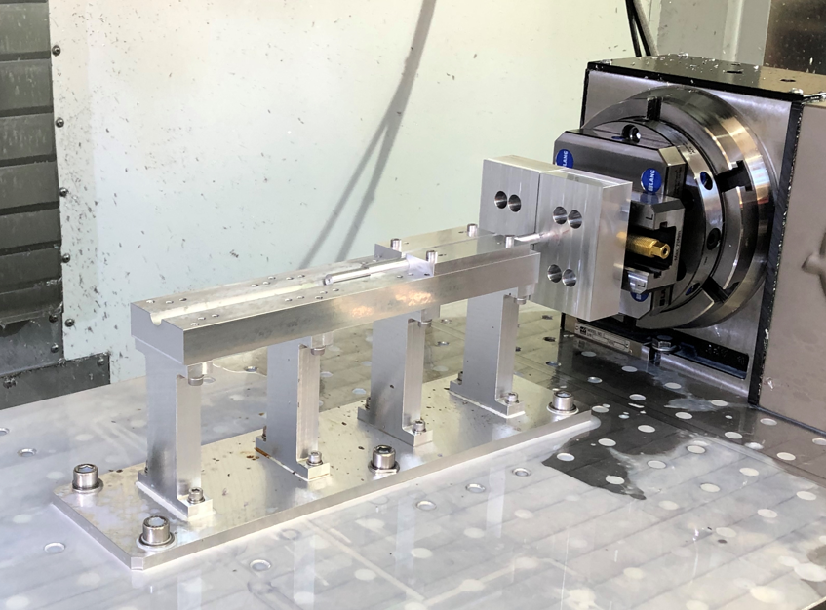
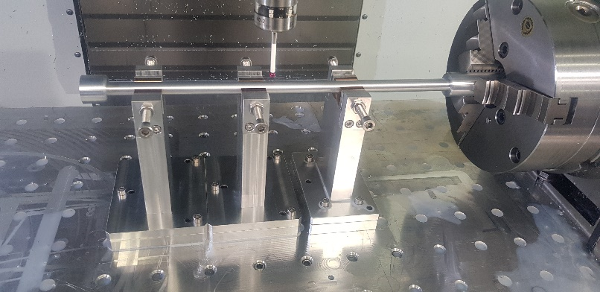
Prototype Former Manufacture
Prototype aluminium formers have been machined.
Short 325 mm prototypes and full length 1 m formers.
Image © STFC John Dawson

Slide 14
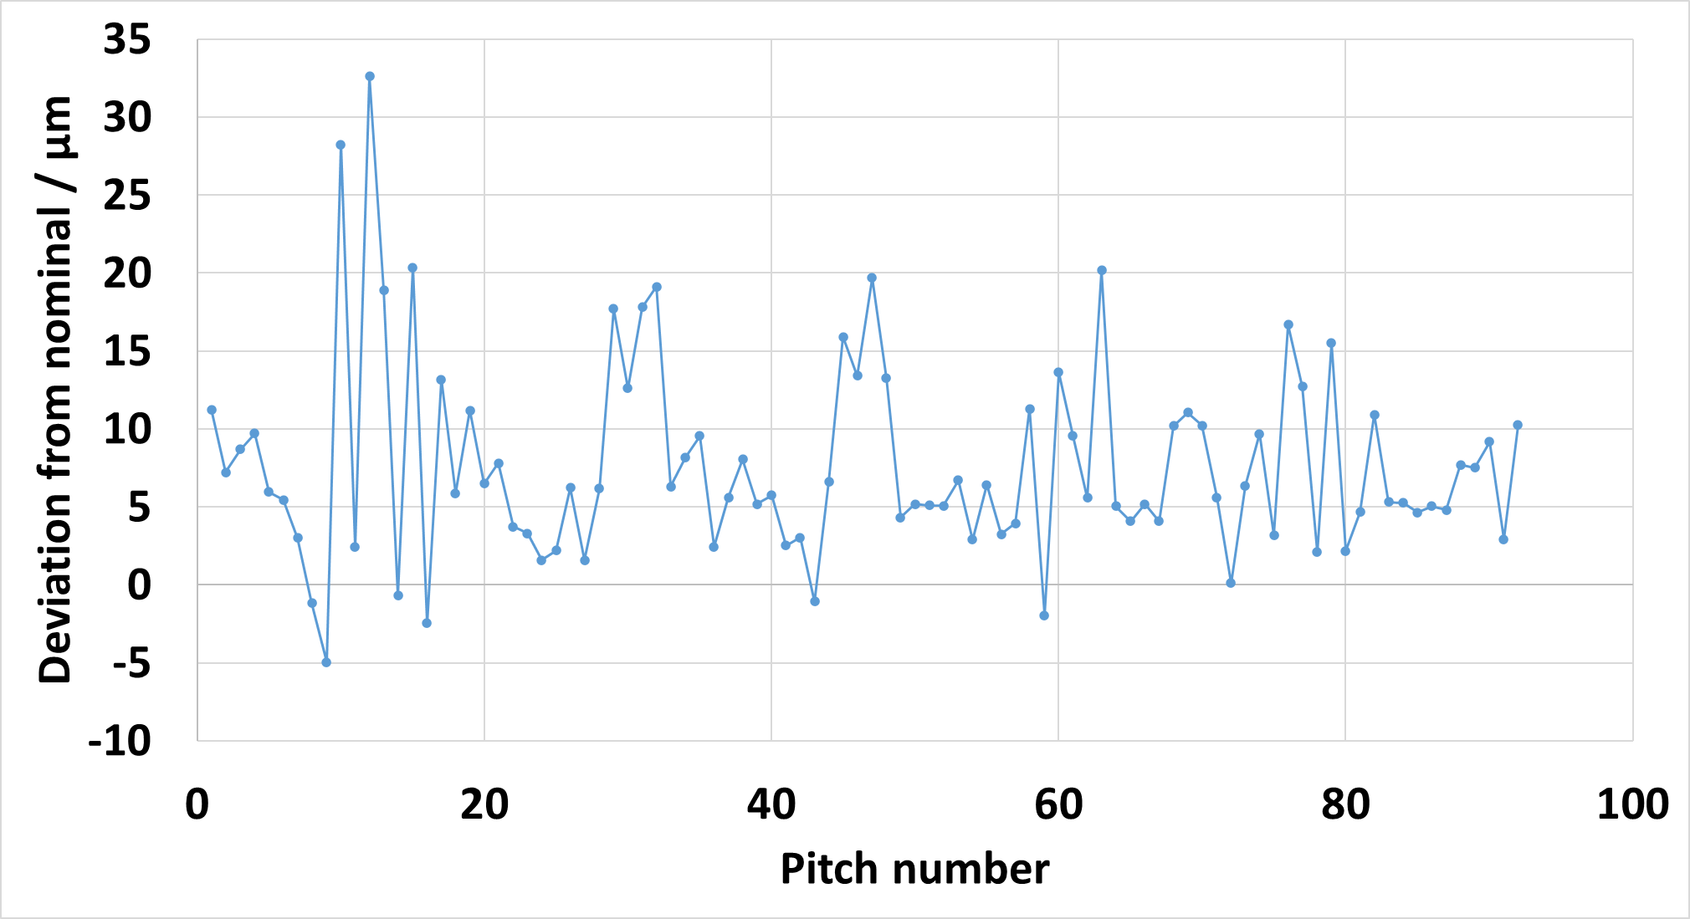
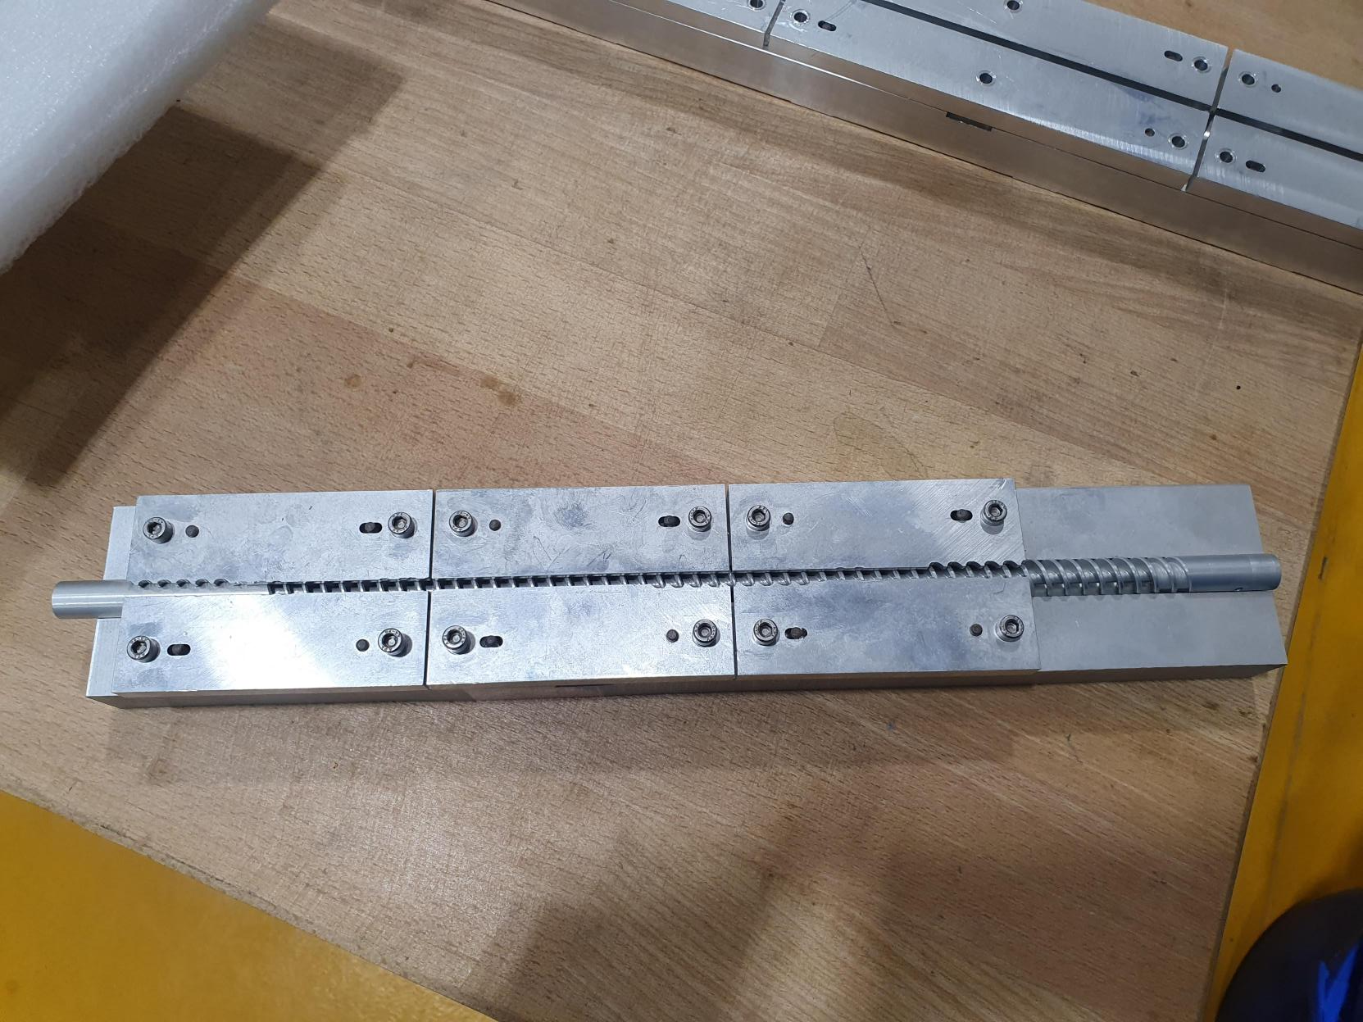
Prototype Former Manufacture
Metrology report on pitches from latest former.
Rms difference from nominal = 10 µm.
Rms spread = 6 µm.
Image © STFC John Dawson

Slide 15
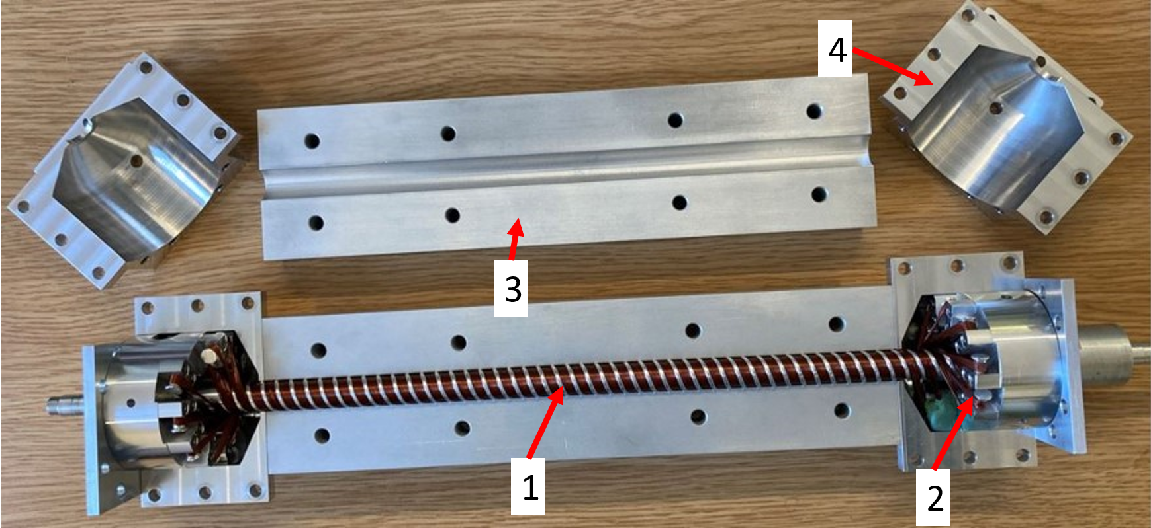
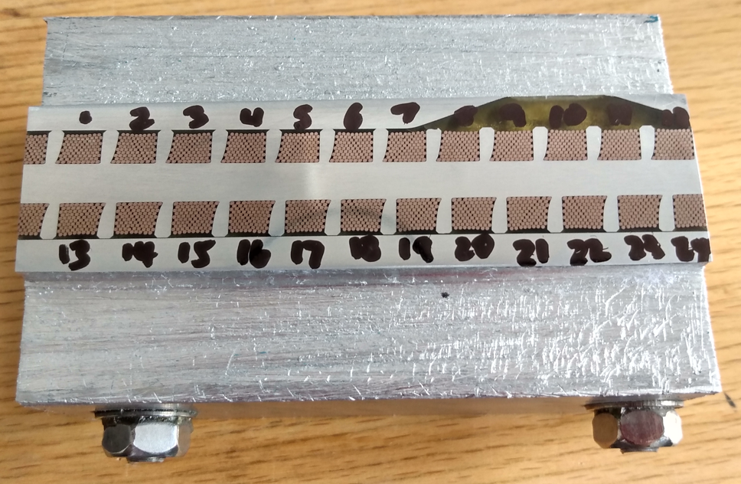
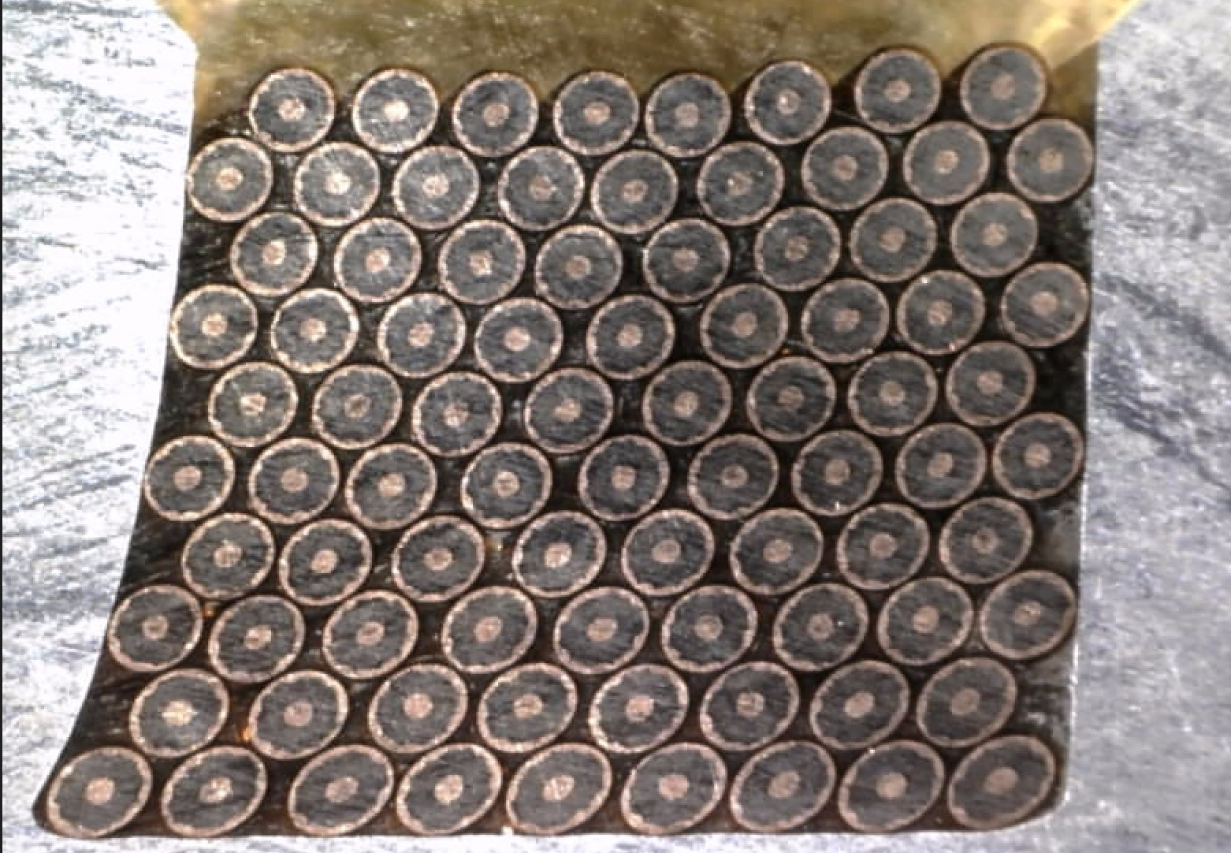
Winding Trials
Winding trials have been ongoing to improve the process of winding the undulator and to optimise the turnaround design and former groove widths.
Accurately winding the wire is key to maintaining good field quality.
Wires potted in epoxy resin for better thermal contact with cooled former.
Strong back provides increased mechanical stability and minimises sag.
Wound formers sectioned with wire cutter to show internal wire stack.
Wound 325 mm HSCU in strong back; 1- Wound HSCU former, 2- Turnaround pins, 3-Potting jig strong back, 4- Potting jig turnaround section.
Image © STFC John Dawson

Slide 16
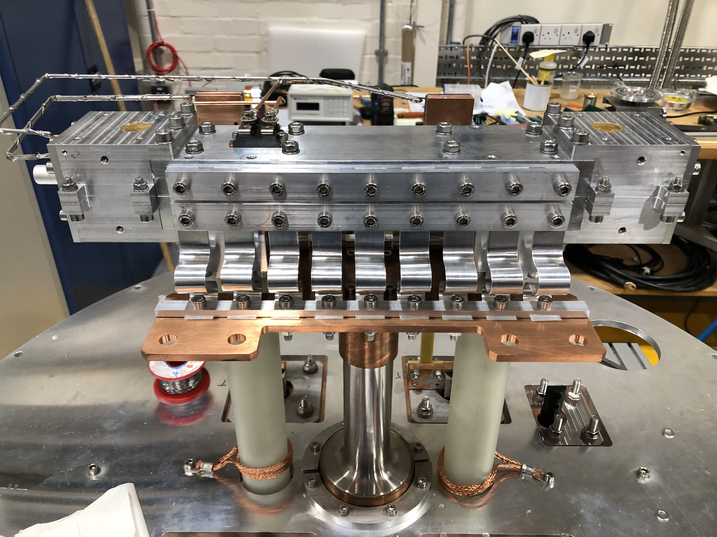
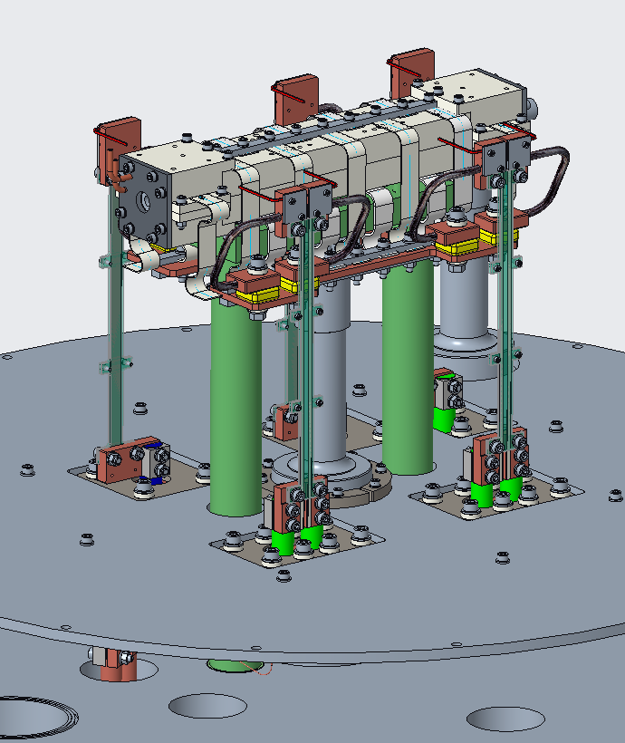
Test Cryostat
A test cryostat has been designed to cool prototype 325 mm HSCUs to < 4 K over 48 hours.
The measured prototype has been successfully cooled in the cryostat.
The HSCU was powered to the design current of 250 A and performed stably for several hours.

Slide 17
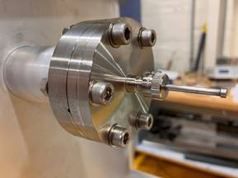
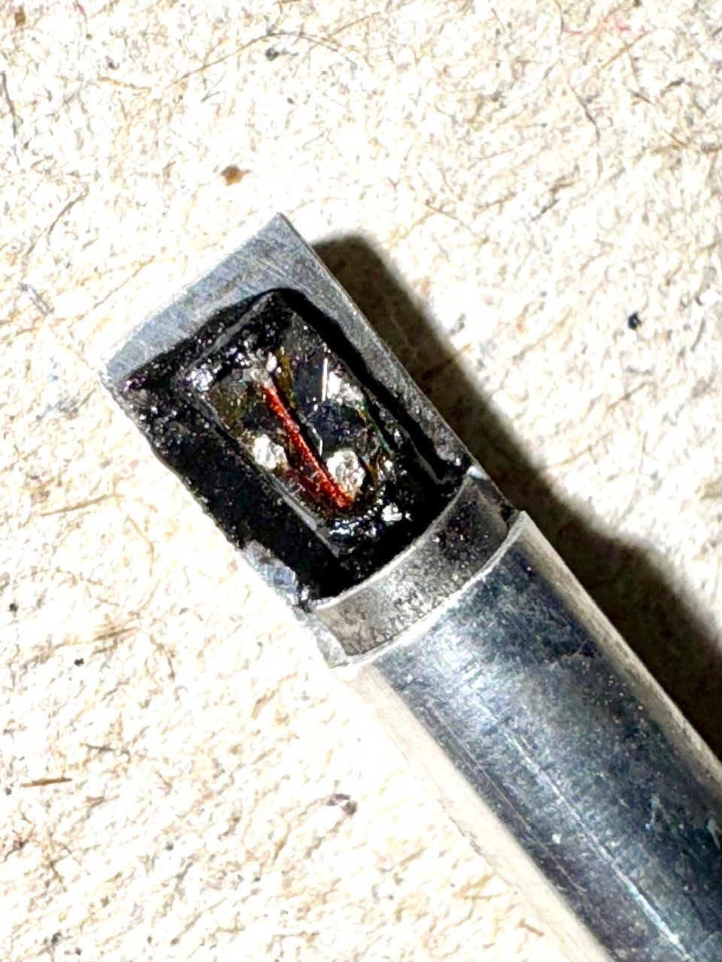
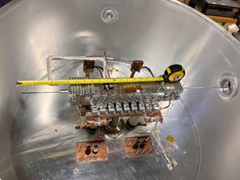
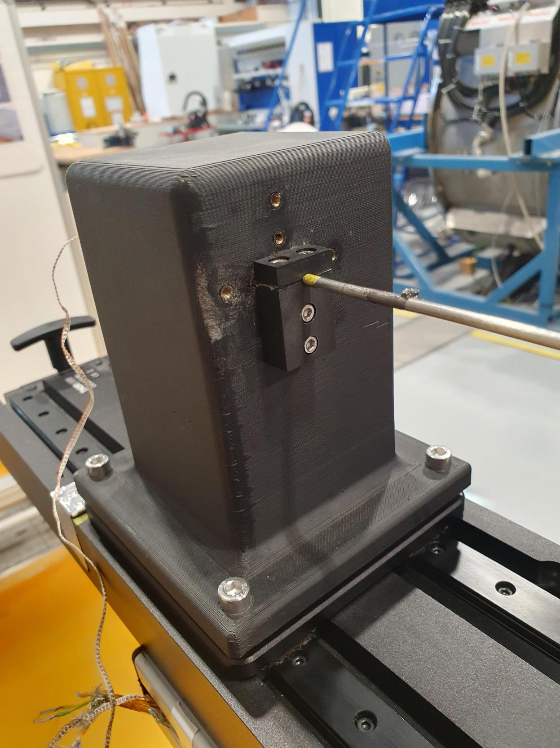
Cryogenic Testing
Field measurements must be taken of the SCU at full current at cryogenic temperatures.
Field profiles measured to quantify field quality and trajectory errors.
Arepoc HHP-VU cryogenic Hall sensor mounted to stainless steel tube.
Probe actuated through length of undulator by motion stage.
Clamped holder allows probe to be rotated in 90 degree steps to measure transverse field components.
Field profiles measured at different combinations of HSCU current, corrector currents, probe orientations.

Slide 18
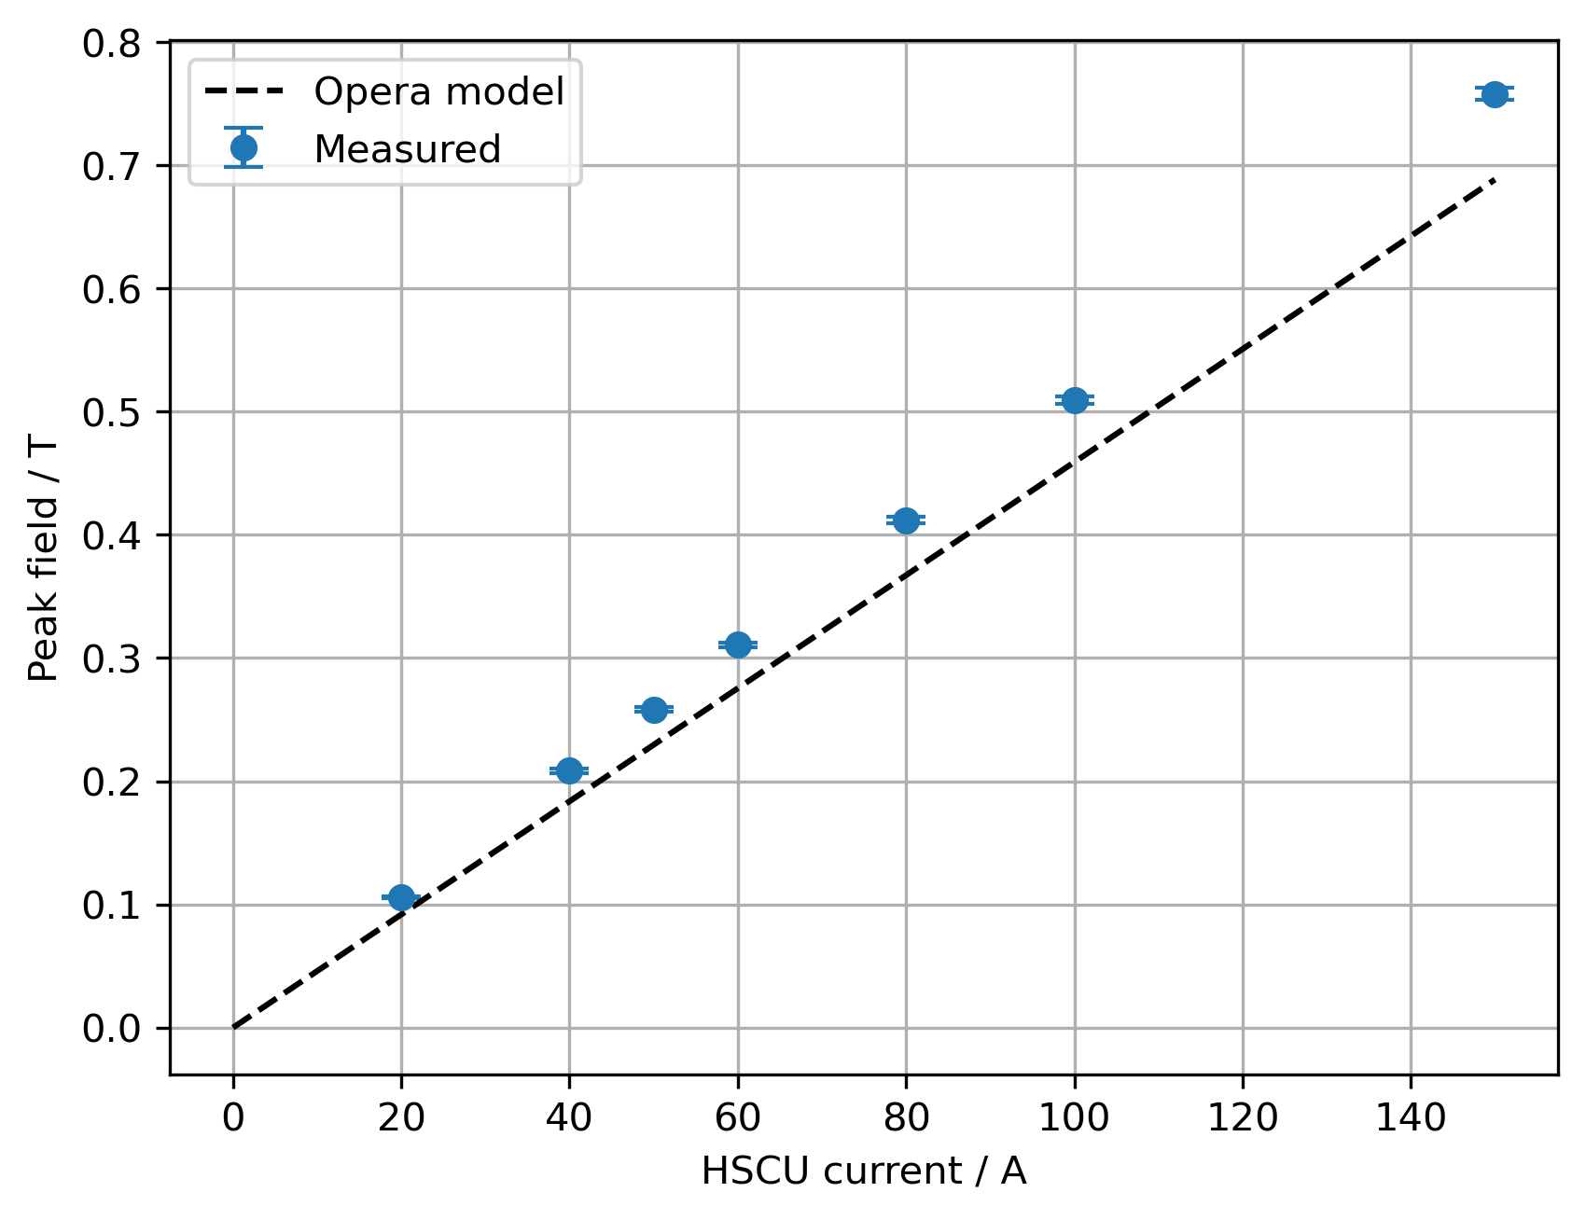
Peak Fields
Peak fields increase linearly with current.
Measured peak fields are ~11% larger than Opera model prediction.

Slide 19
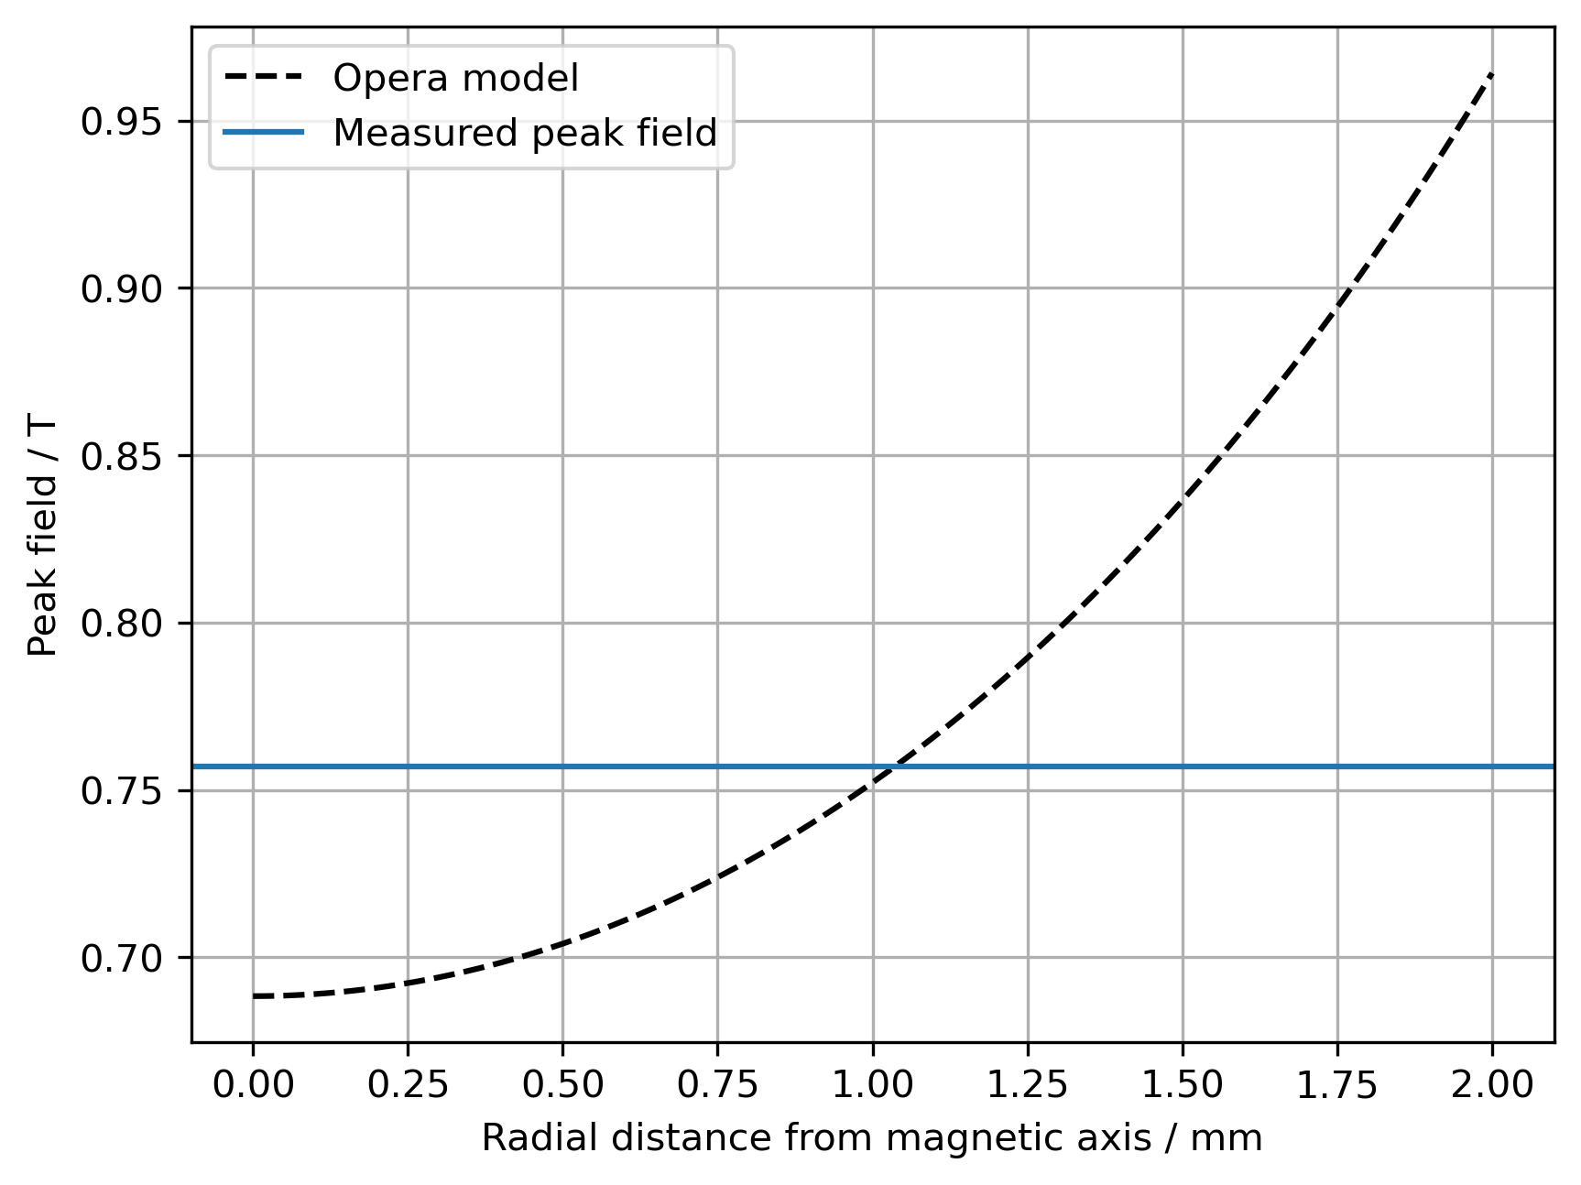
Peak Fields
Could be partially explained by probe radial offset from magnetic axis.
Machining and winding tolerances?
Hall probe calibration?

Slide 20
Peak Fields
Could be partially explained by probe radial offset from magnetic axis.
Machining and winding tolerances?
Hall probe calibration?

Slide 21
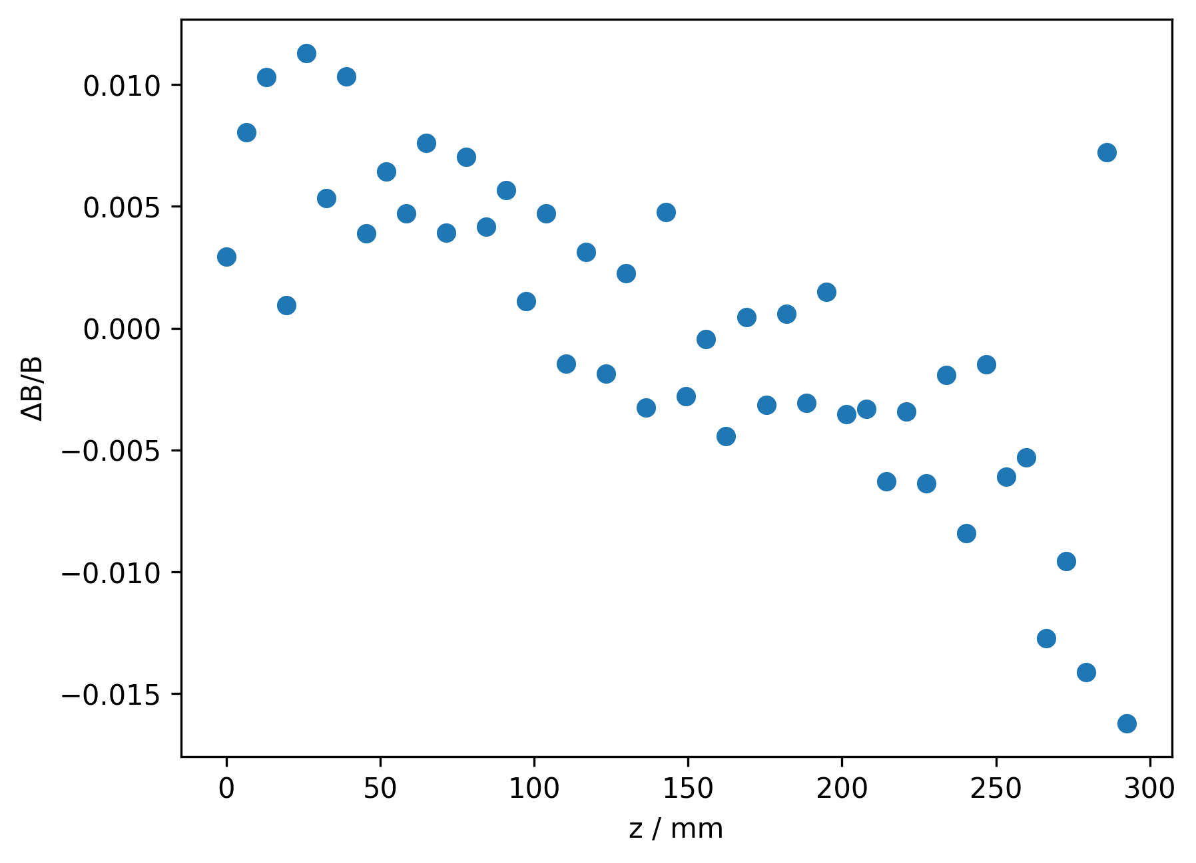
Peak Quality
Field errors result in a degradation of the FEL power produced by an undulator.
Target ΔB/B < 10⁻³ to keep the FEL power produced within 5% of nominal.
Measured ΔB/B = (6.67 ± 0.06) x 10⁻³.

Slide 22
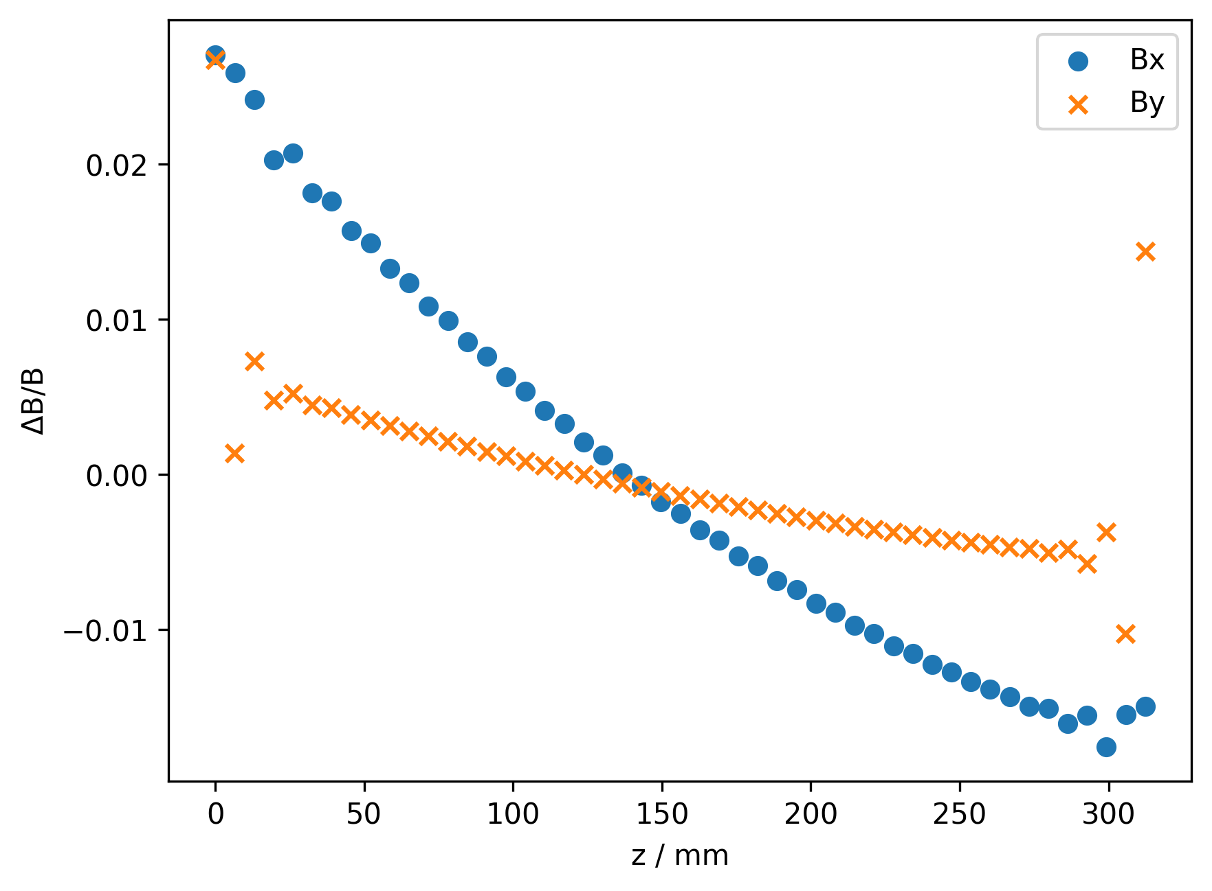
Angled Measurements
Opera models indicate that a slope in the peak fields is observed if measurements are taken along a line at an angle to the magnetic axis.
Plot shows Bx and By field peaks for measurements along line with 0.1° angle relative to magnetic axis in xz plane.

Slide 23
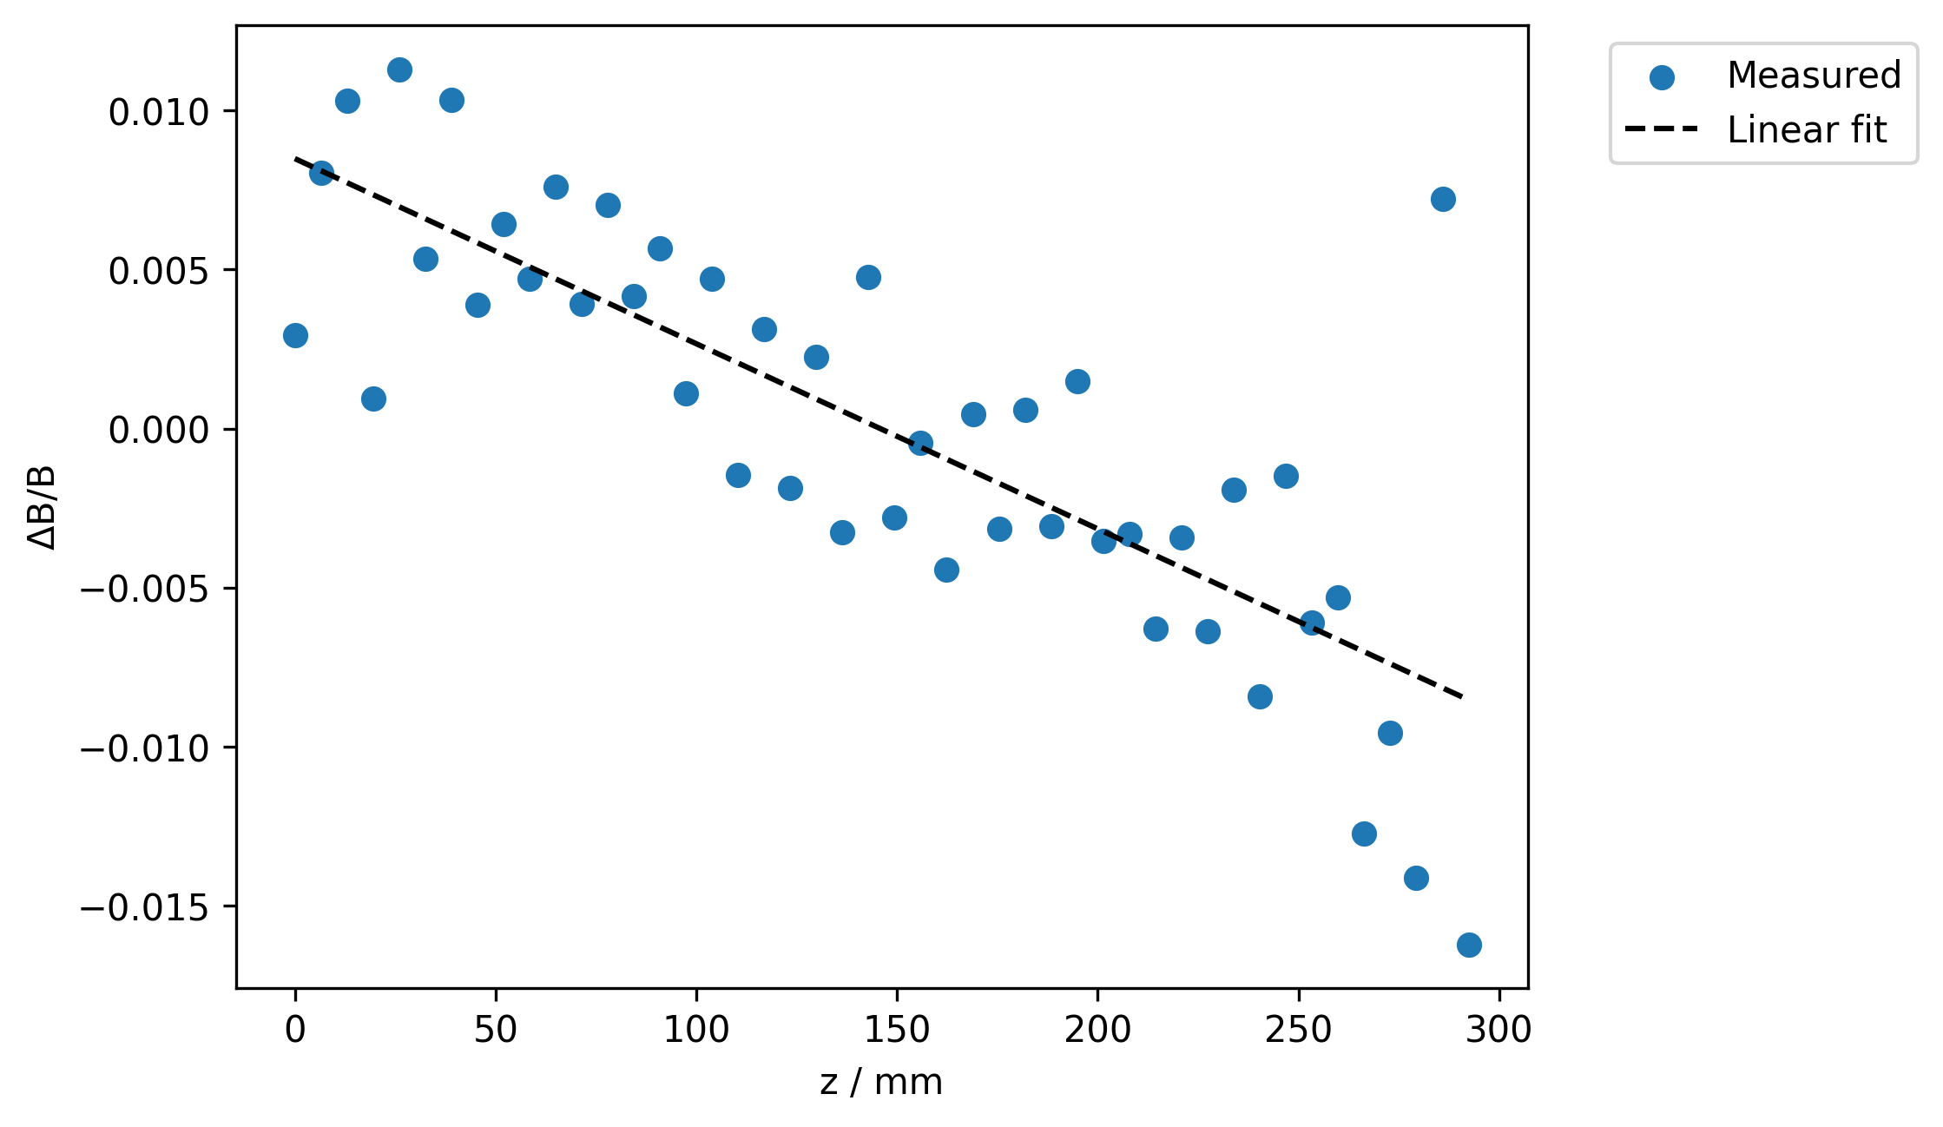
Linear Fit
Can fit a linear slope to the peak to peak field distribution.
Is the slope of the line dependent on the field component measured?

Slide 24
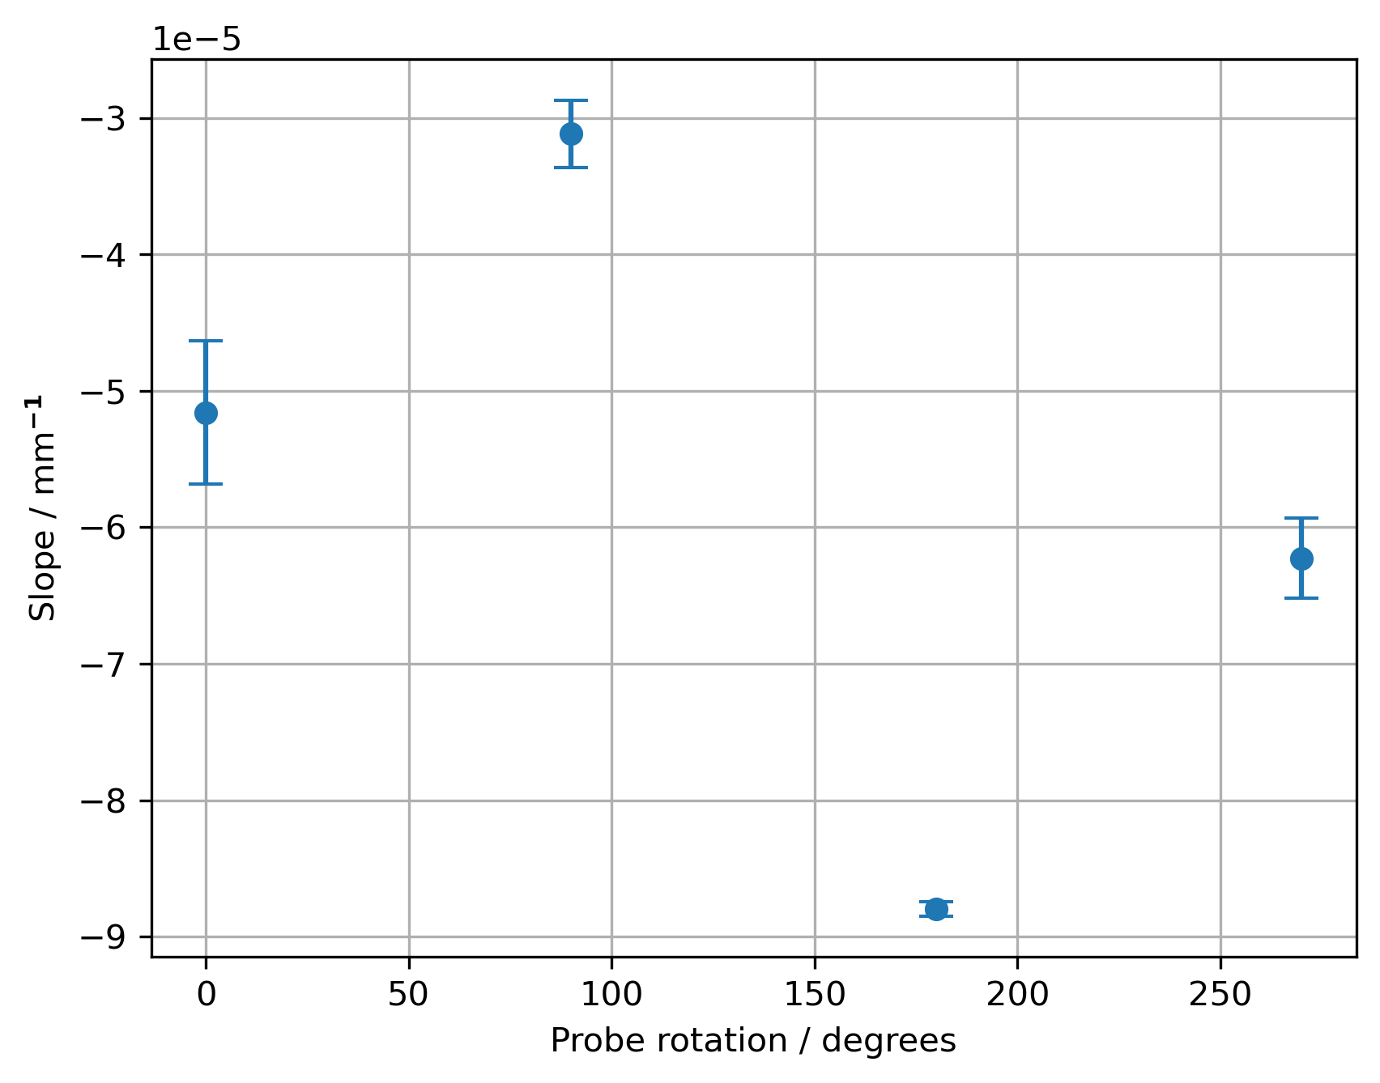
Measured Slope
Slope in peak to peak field deviation measured for different probe orientations i.e. different field components.
Slope dependent on orientation.
Suggests some angle between mechanical bore and magnetic axis.

Slide 25
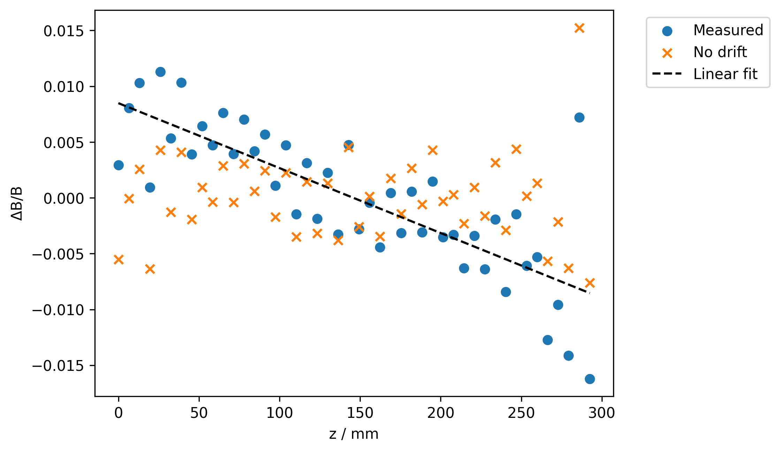
Linear Fit Removed
Slope subtracted from peak to peak field distribution.
ΔB/B with slope =
(6.67 ± 0.06) x 10⁻³.
ΔB/B without slope =
(4.2 ± 0.9) x 10⁻³.

Slide 26
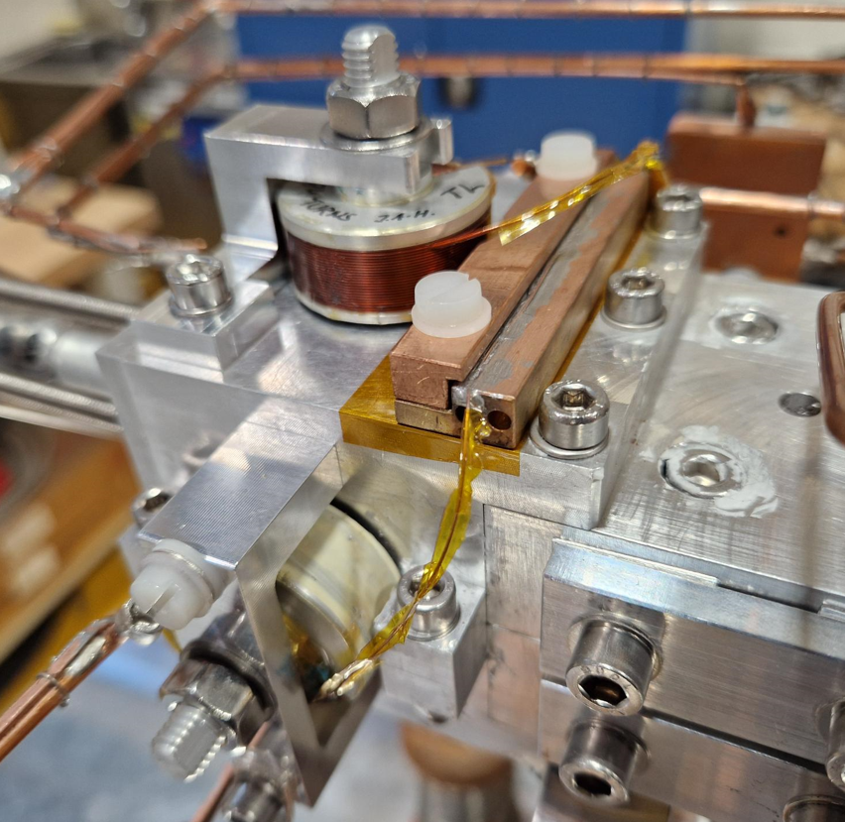
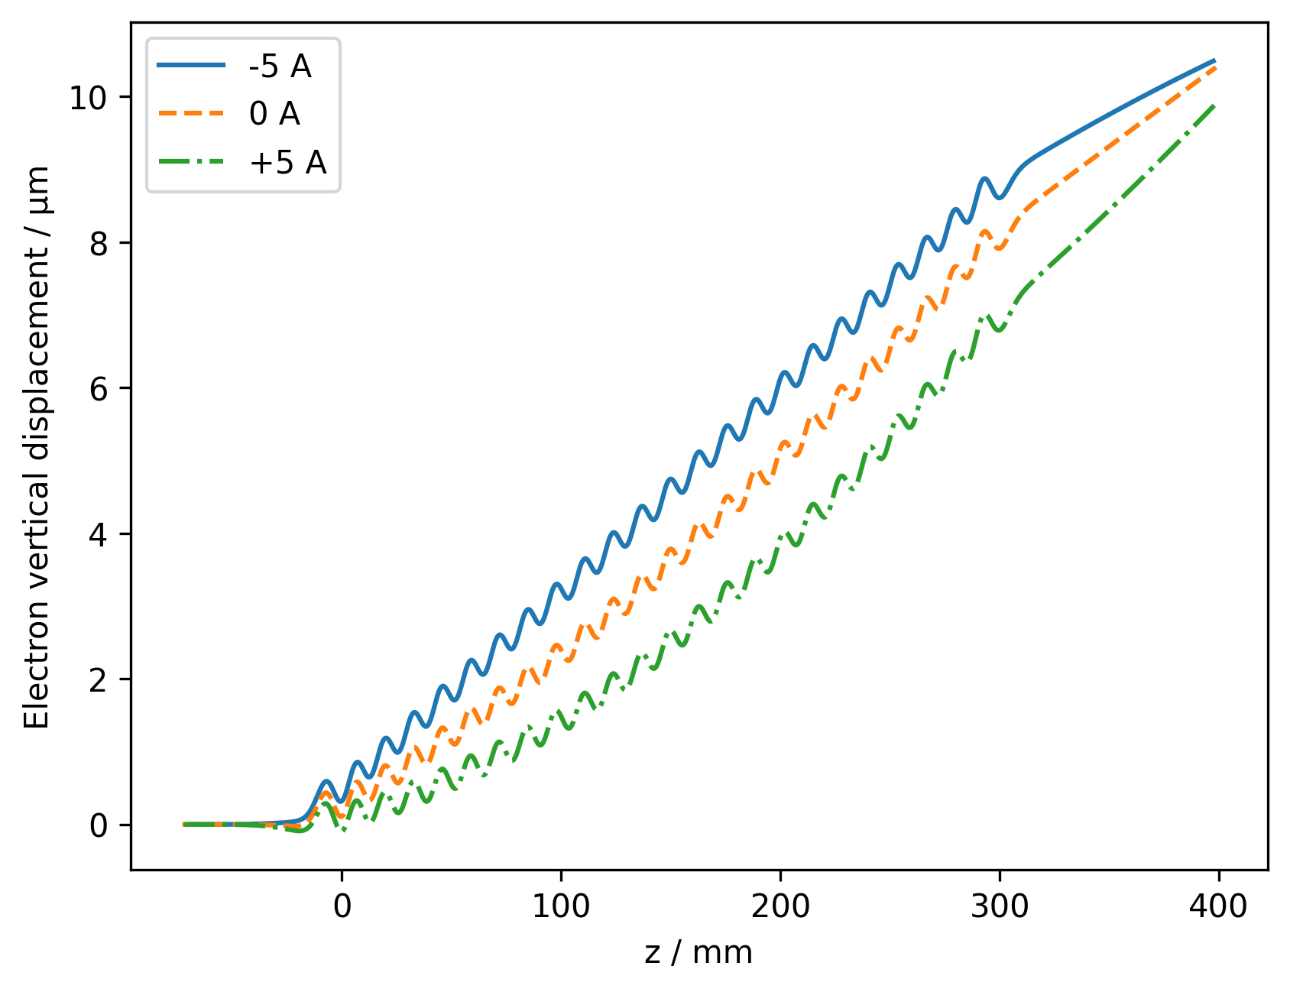
Trajectory wander
Trajectories of 5.5 GeV electron calculated from 2nd field integrals.
Target trajectory wander < 5 µm.

Slide 27
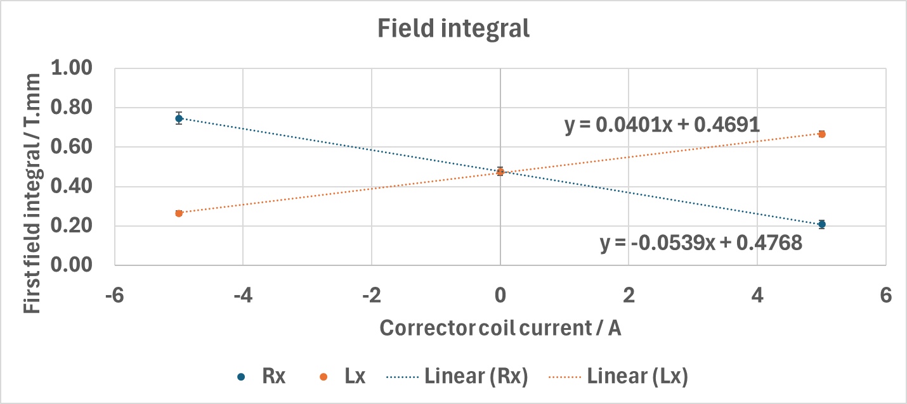
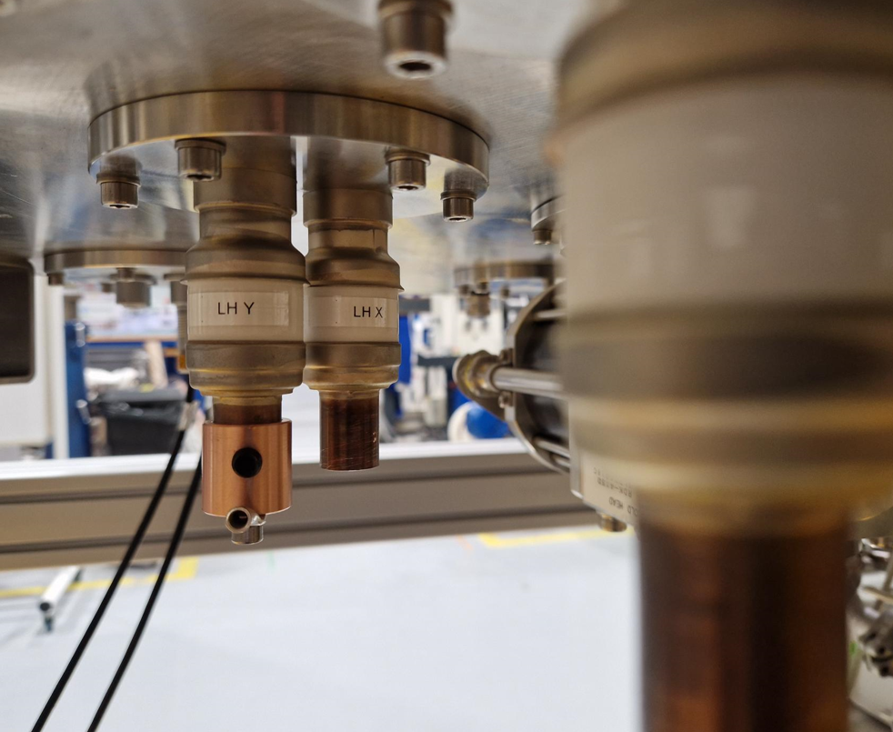
Measured field integrals
Measured integrals as function of corrector coil currents @ 150 A SCU current.
Can use linear simultaneous equations to predict currents for 0 first and second field integrals.
At 150 A SCU, predicted corrector currents:
  Lx = 50 A
  Rx = 50 A
  Ly = -12 A
  Ry = -30 A
Much larger than
initial spec of ±5A.

Slide 28
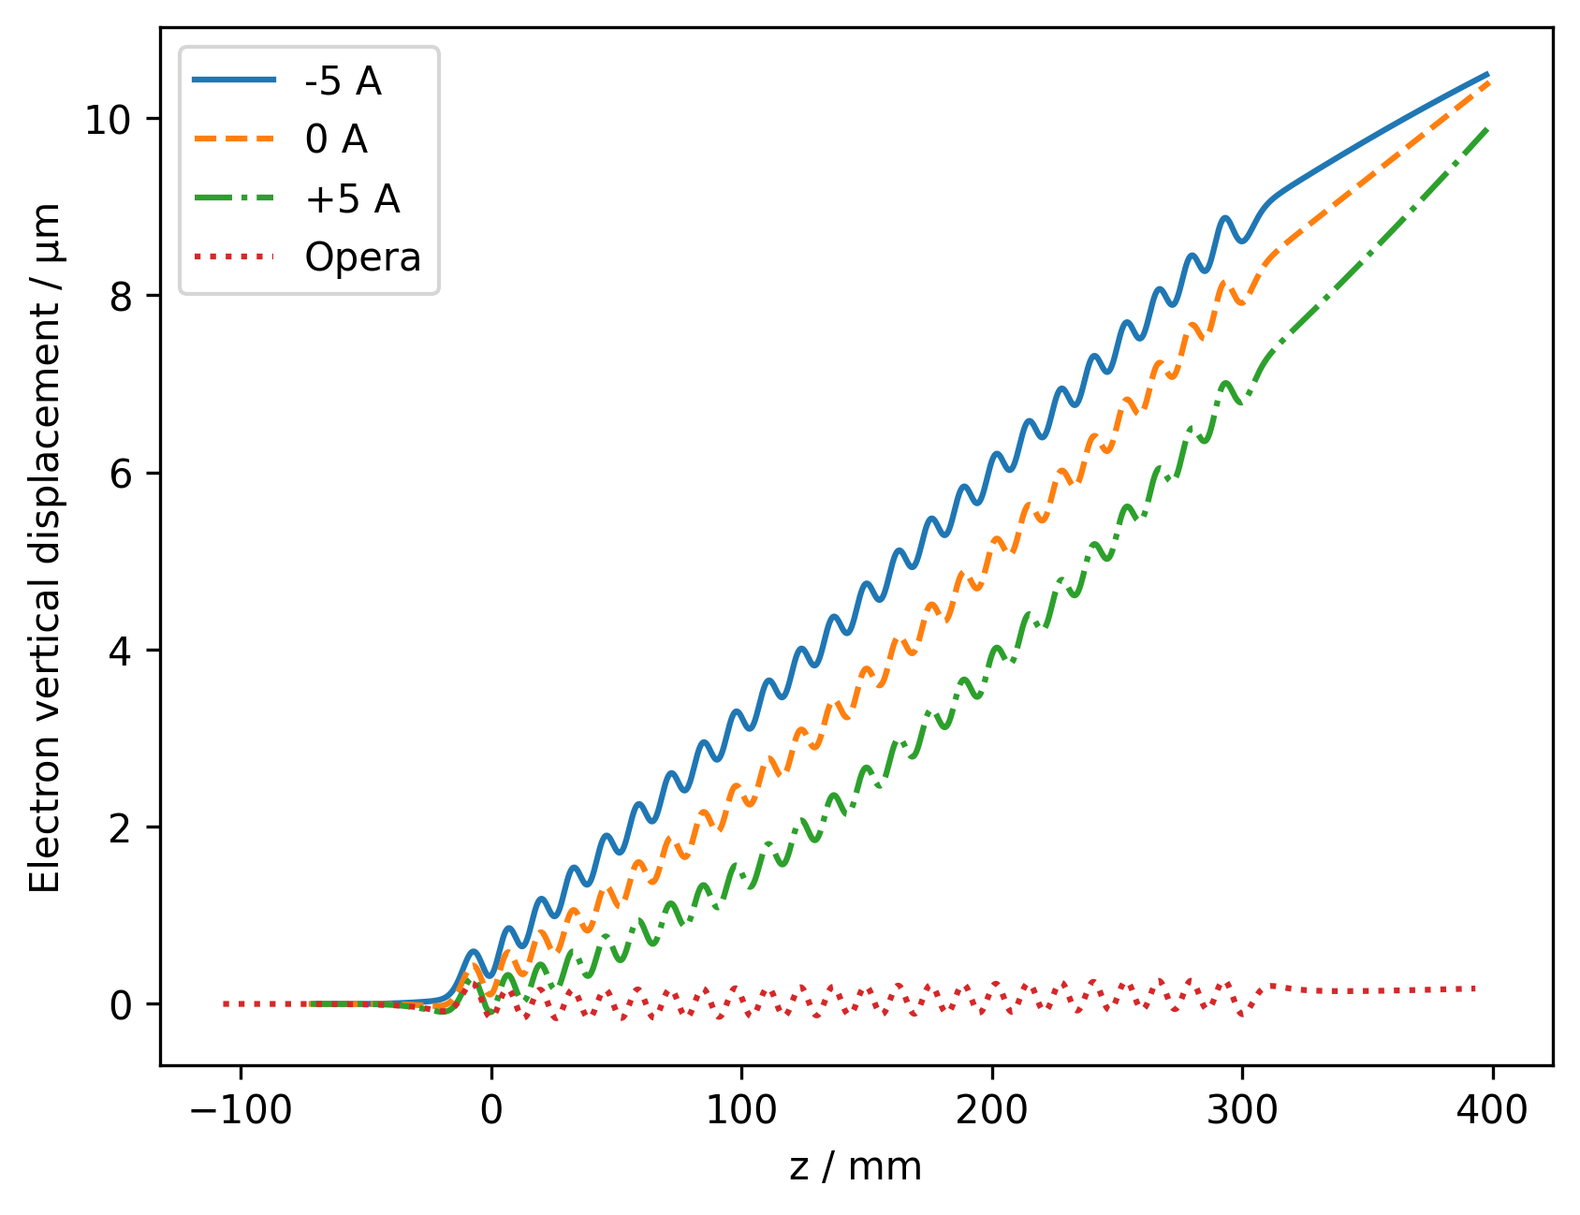
Trajectory wander
Measured kick to beam upon entering device is much larger than that predicted from Opera model.

Slide 29
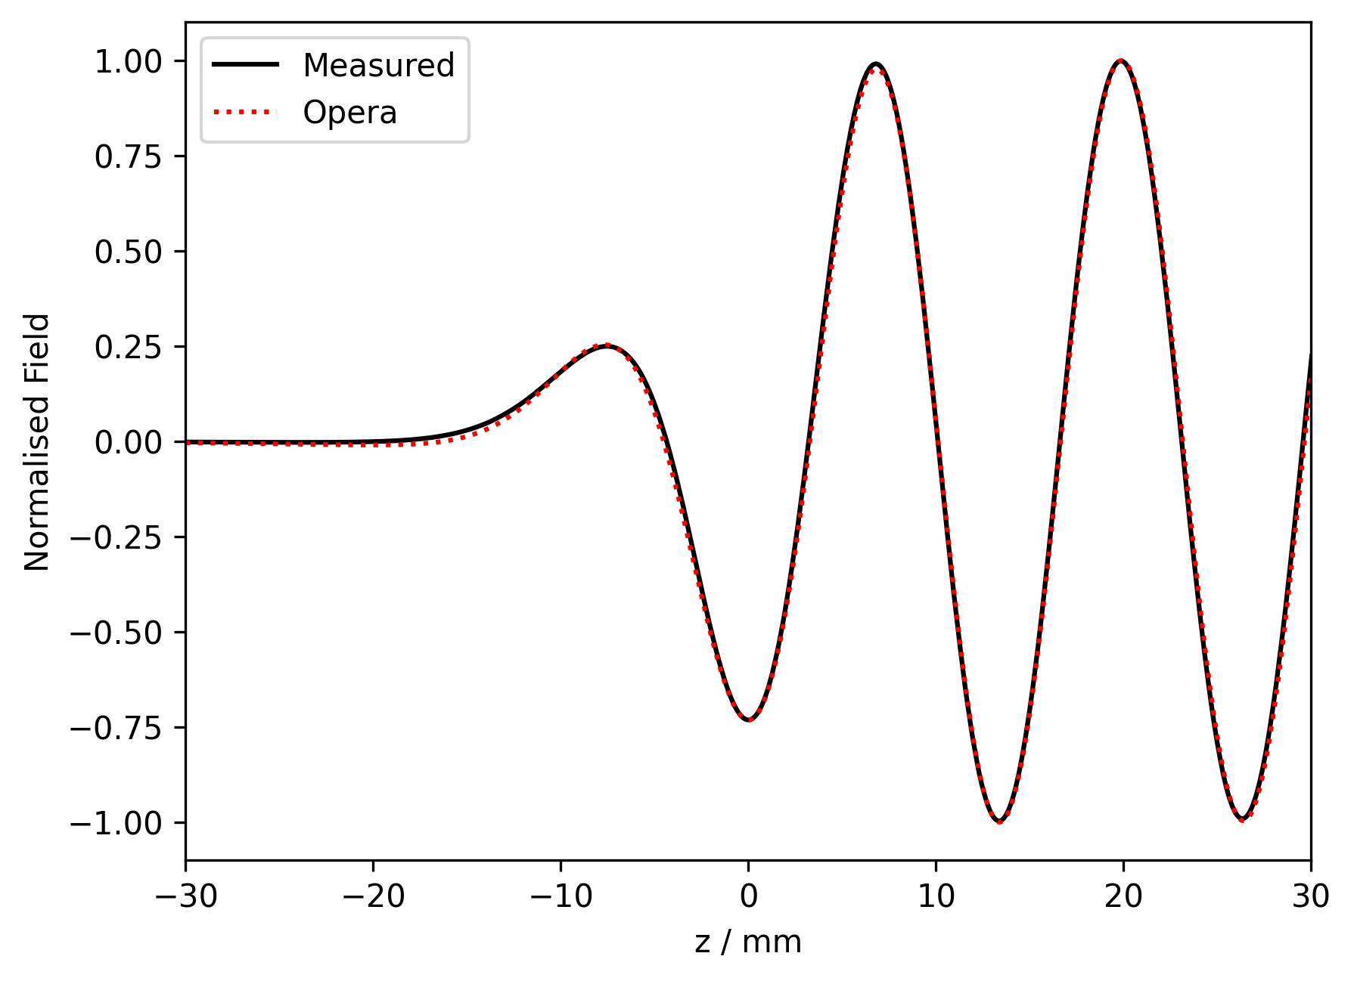
End fields
Measured and Opera model fields normalised.
Small differences in field profiles at ends of device.

Slide 30
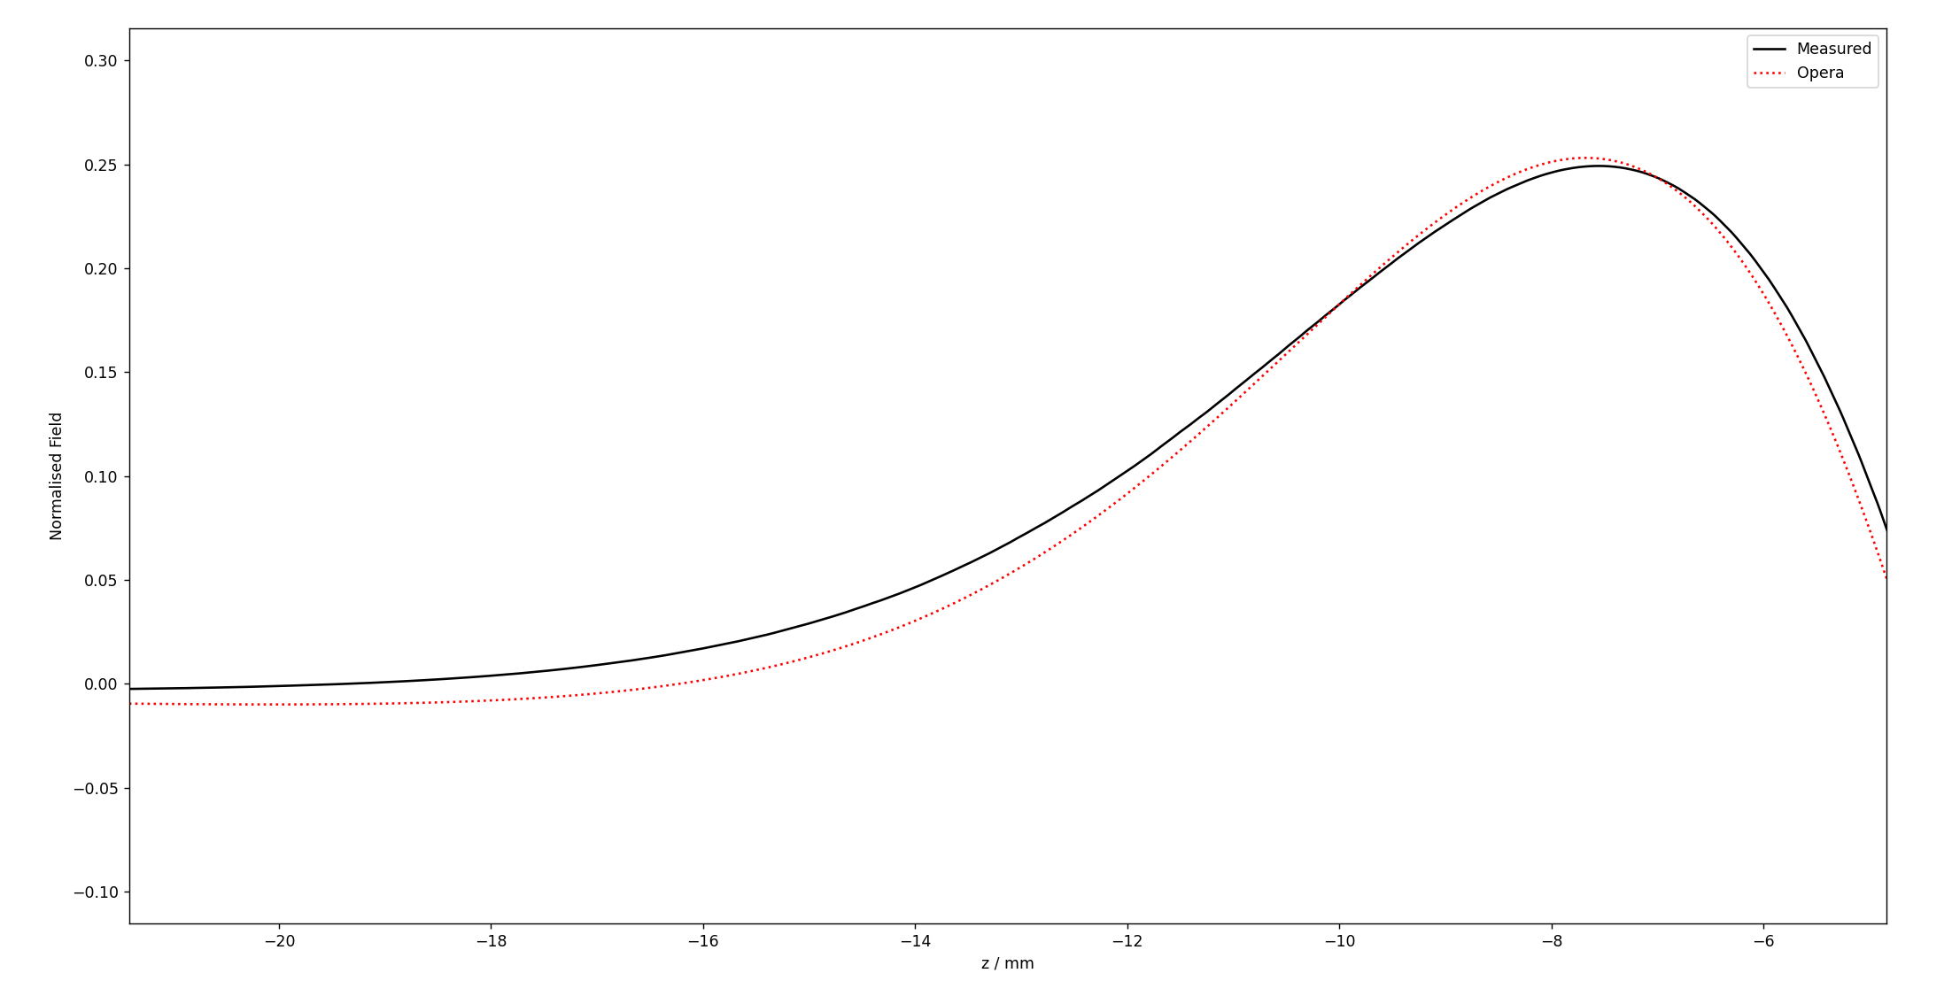
End fields
Measured and Opera model fields normalised.
Small differences in field profiles at ends of device.

Slide 31

End field integrals
Profile of integrals of measured fields different at entrance to device.
Measured integrals are not centred about zero – accounts for kick to trajectory.
Stronger corrector coils required.

Slide 32

Manufacturing the 1.1m long magnet former
Image © STFC John Dawson

Slide 33

Manufacturing the 1.1m long magnet former
Image © STFC John Dawson

Slide 34

Winding the 1.1m long magnet former
Image © STFC John Dawson

Slide 35

Winding the 1.1m long magnet former
Image © STFC John Dawson

Slide 36

Winding the 1.1m long magnet former
Image © STFC John Dawson

Slide 37

Outer Vacuum Chamber Design
Mechanical design for the general arrangement model of a 1.1 m long HSCU is ongoing.
Lessons learned from 325 mm prototypes implemented.

Slide 38
Helical SCU Summary
A 13 mm period helical SCU has been designed as a technology demonstrator for future light sources.
Techniques to machine formers and wind coils are constantly being improved by an iterative R&D process.
A prototype former has reached the full operational current of 250 A in the test cryostat.
A Hall sensor has been used to map the fields of a prototype HSCU.
Difficulties with knowing the position of the probe in the former make interpretation of results difficult.
Experience manufacturing and testing 325 mm formers will be applied to 1 m long formers which will need to be tested.
Ultimate goal of the project is to develop full SCU units which could be used in an undulator line on an XFEL facility.

Slide 39
Thank you
Facebook: Science and Technology Facilities Council
Twitter:@STFC_matters
YouTube: Science and Technology Facilities Council

