Slide 1
Undulators Development for Synchrotron Light Sources and Free Electron Lasers
Wei Zhang
On Behalf of SSRF ID Team
2025.05.31

Slide 2
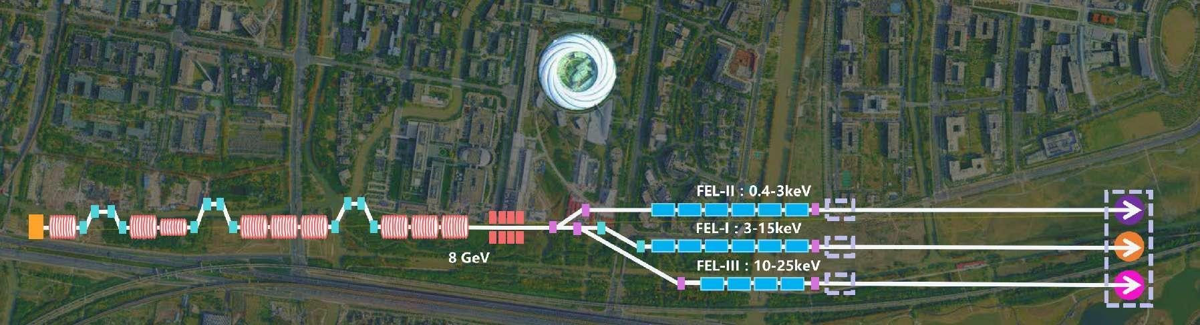
Content
Undulators in SSRF and SSRF-II
Undulators in SXFEL
SHINE undulator project
Undulators for other units
Summary
SXFEL
SSRF
SHINE

Slide 3
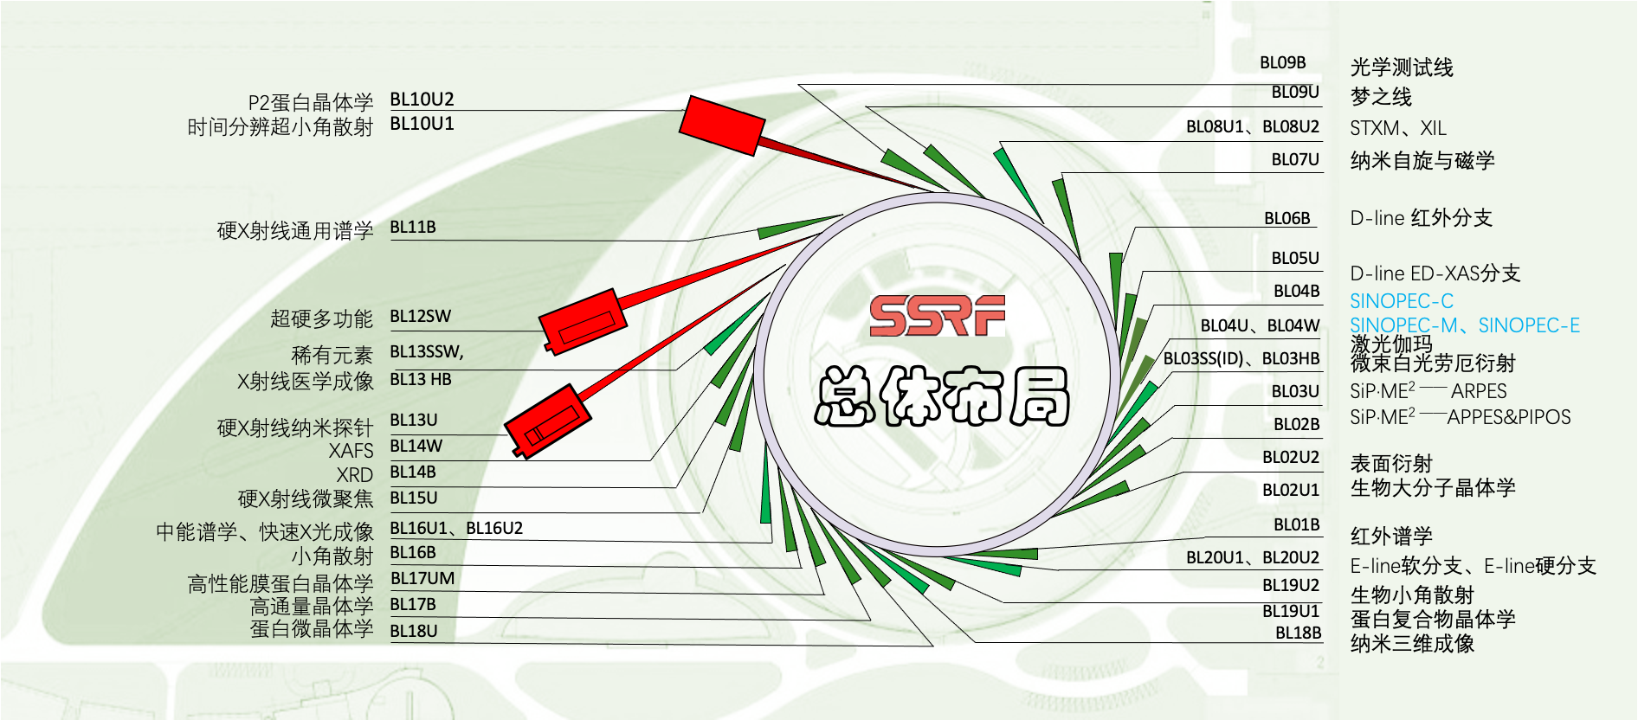

Beamlines and Undulator at SSRF
ID type | Number
IVU | 12
CPMU | 4
Wiggler | 3
EPU | 4 (+2)
AppleKnot EPU | 1
SCW | 1
Dual-Canted | 5+2

Slide 4
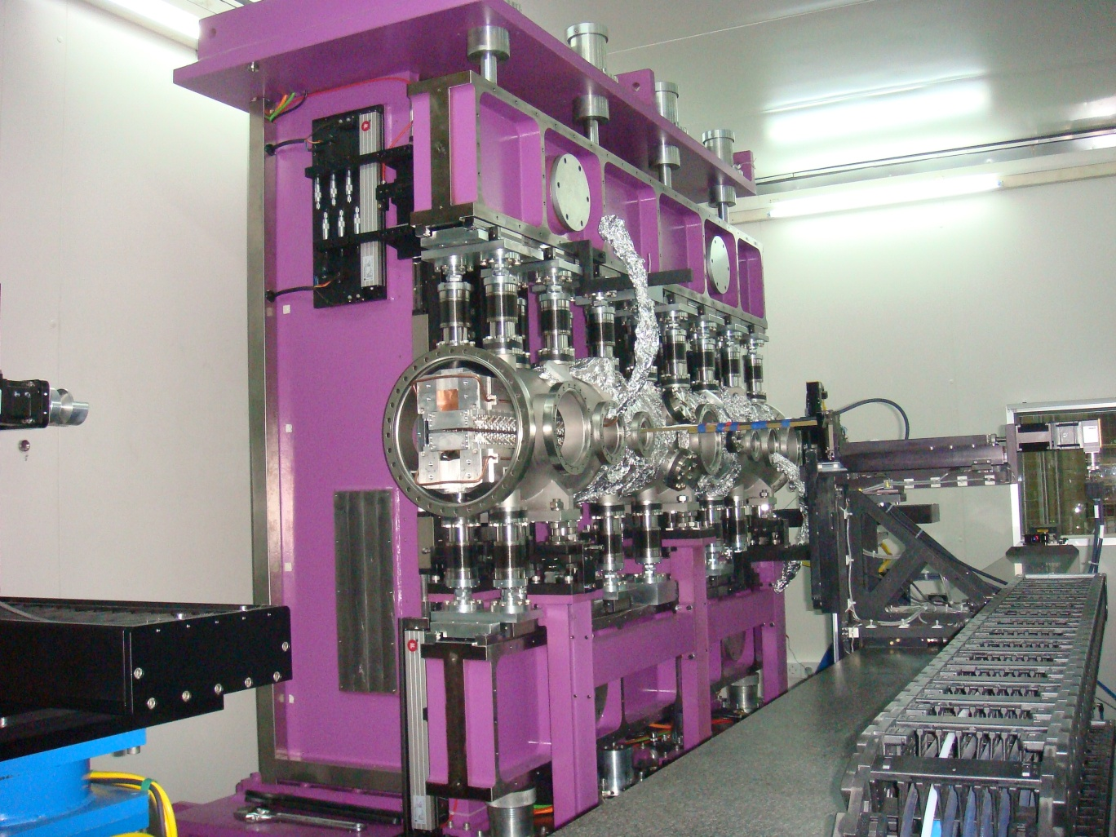
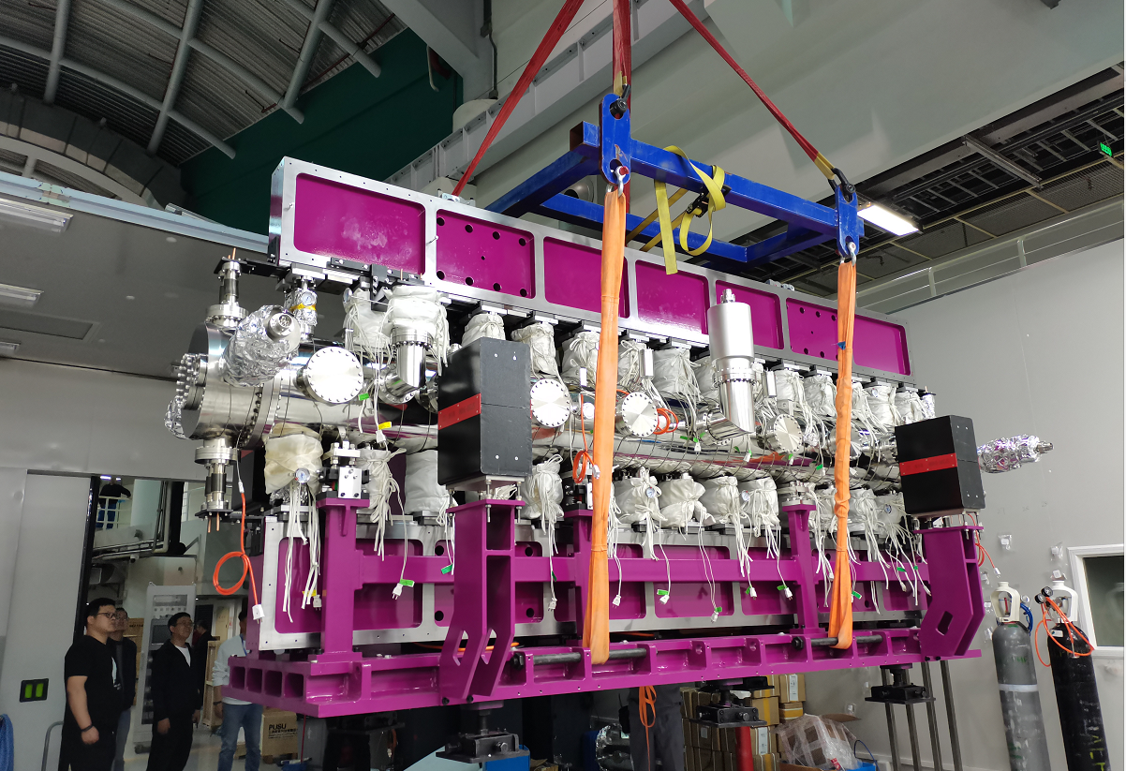
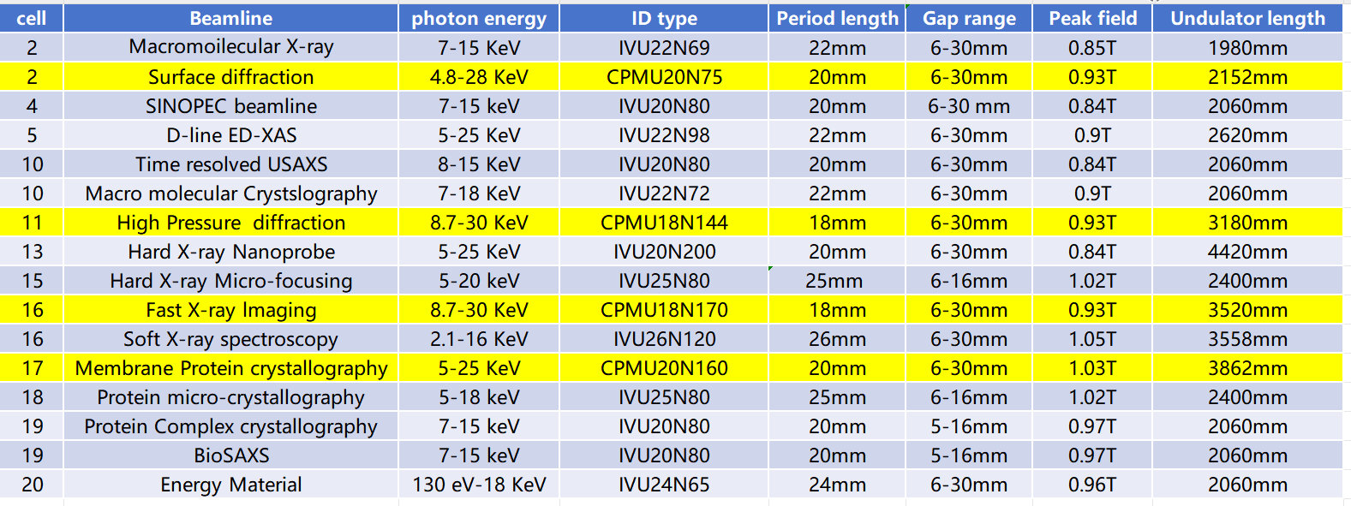
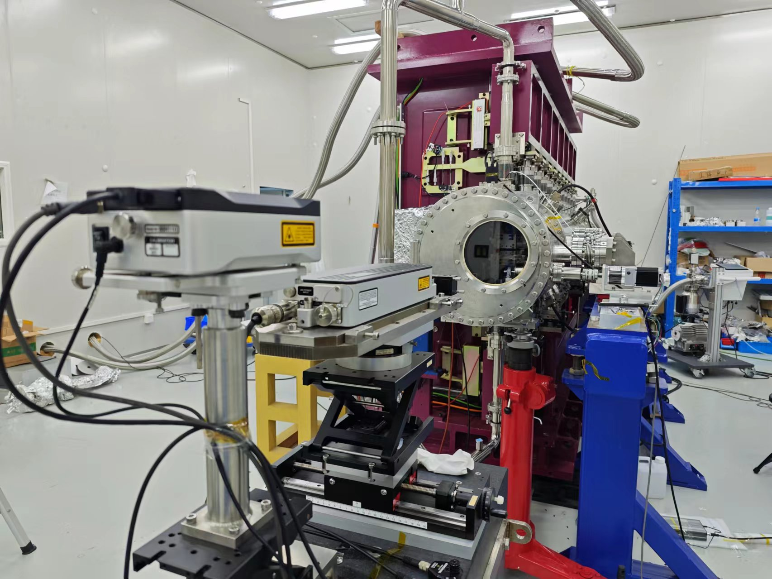
IVUs and CPMUs（2016-2021.04）
Histroy
2009. First IVU developed at SSRF 1.5 m long, 25mm period, minimum gap 6mm
2021.04 The last 4 m IVU (gap 6-12mm, period 20mm) installed into SSRF-II tunnel
Technical progress
period length: 25mm to 18mm
Multipole reduction：100Gs.cm to 50Gs.cm for x: -12mm≤x≤12mm
phase error: 5 degree to less than 4 for 200 periods for gap: 6-20mm
2008-2009 first IVU
last 4m IVU
last 3.2m CPMU in MMS

Slide 5
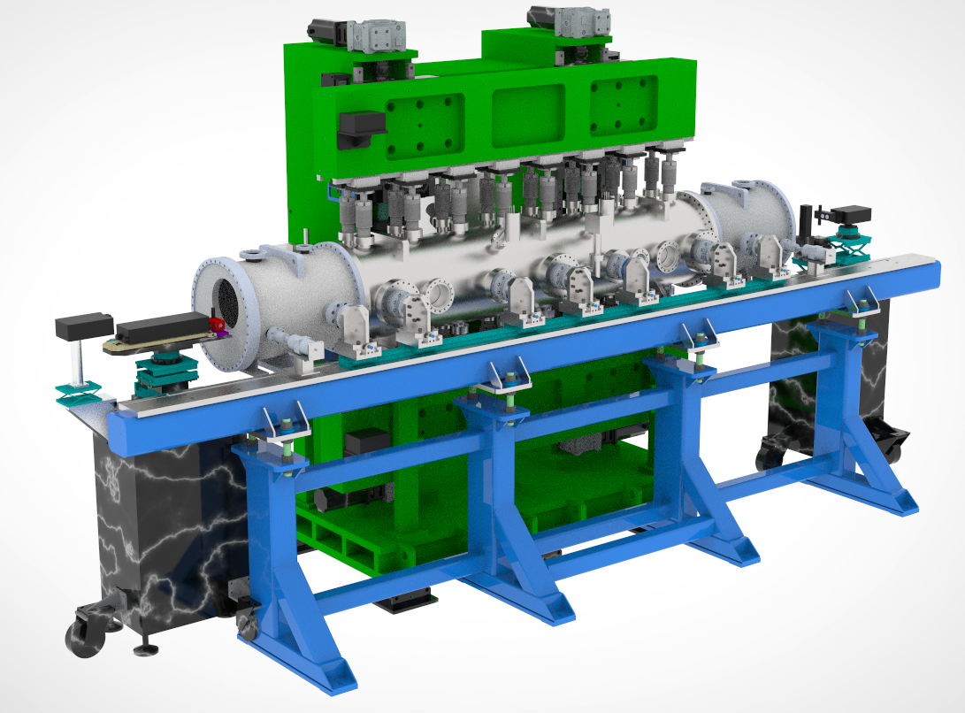
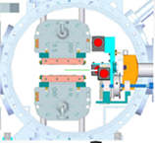
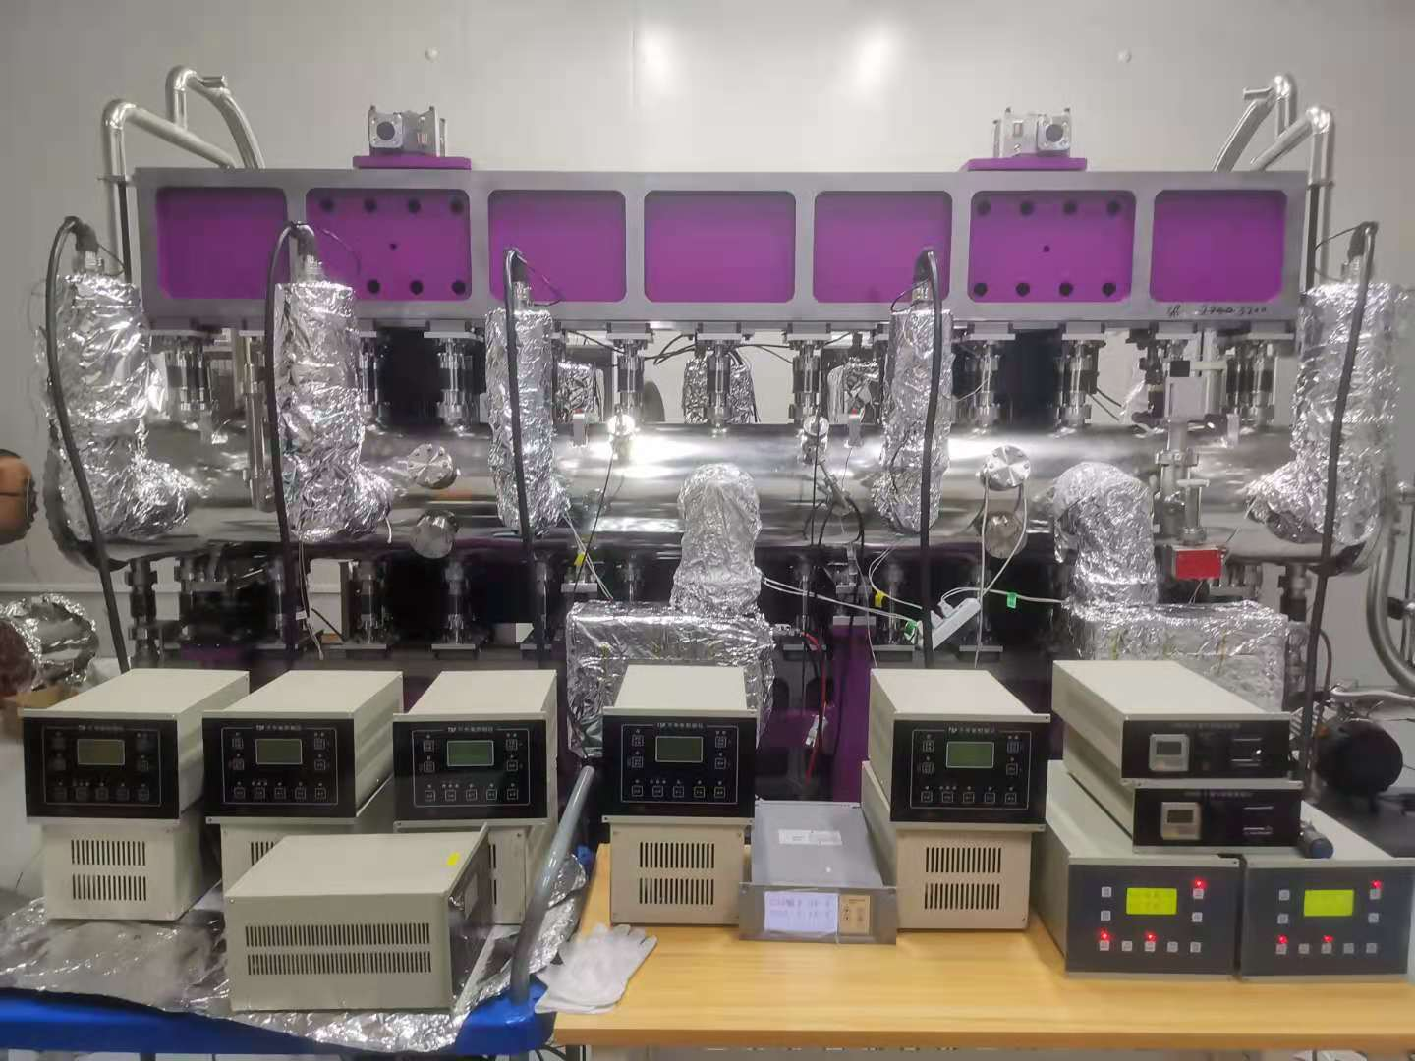
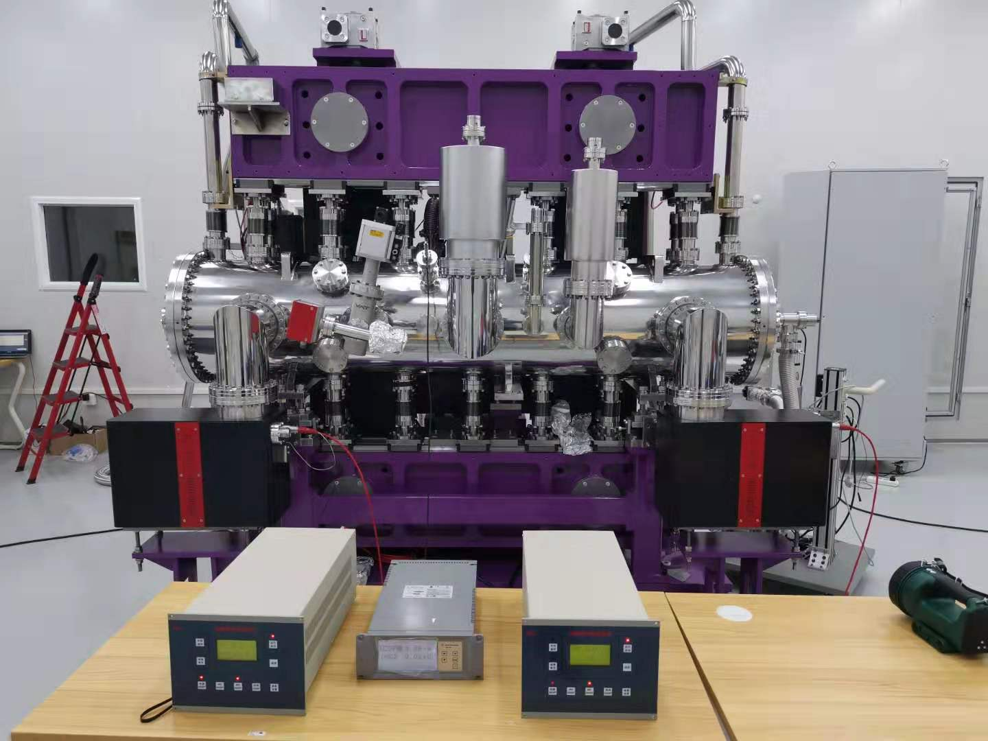
CPMUs developed for SSRF_II
 | BL16U2 | BL02U2 | BL02U1 | sino-pec
Magnet material | PrFeB / P46H
Operating temperature | ~80K
numbers | 170 | 75 | 160 | 144
period (mm) | 18 | 20 | 20 | 18
peak field (T) | 1.02 | 1.09 | 1.09 | 1.02
rms phase error | <3.5 | <3.0 | <3.5 | <4.5
Four PrFeB CPMUs were built for SSRF-II.
The magnet works in the liquid nitrogen temperature zone, which can improve the peak magnetic field of the undulators.
From 2016-2021
Layout of CPMU and MMS
BL02u2-CPMU20
BL02u1-CPMU20

Slide 6
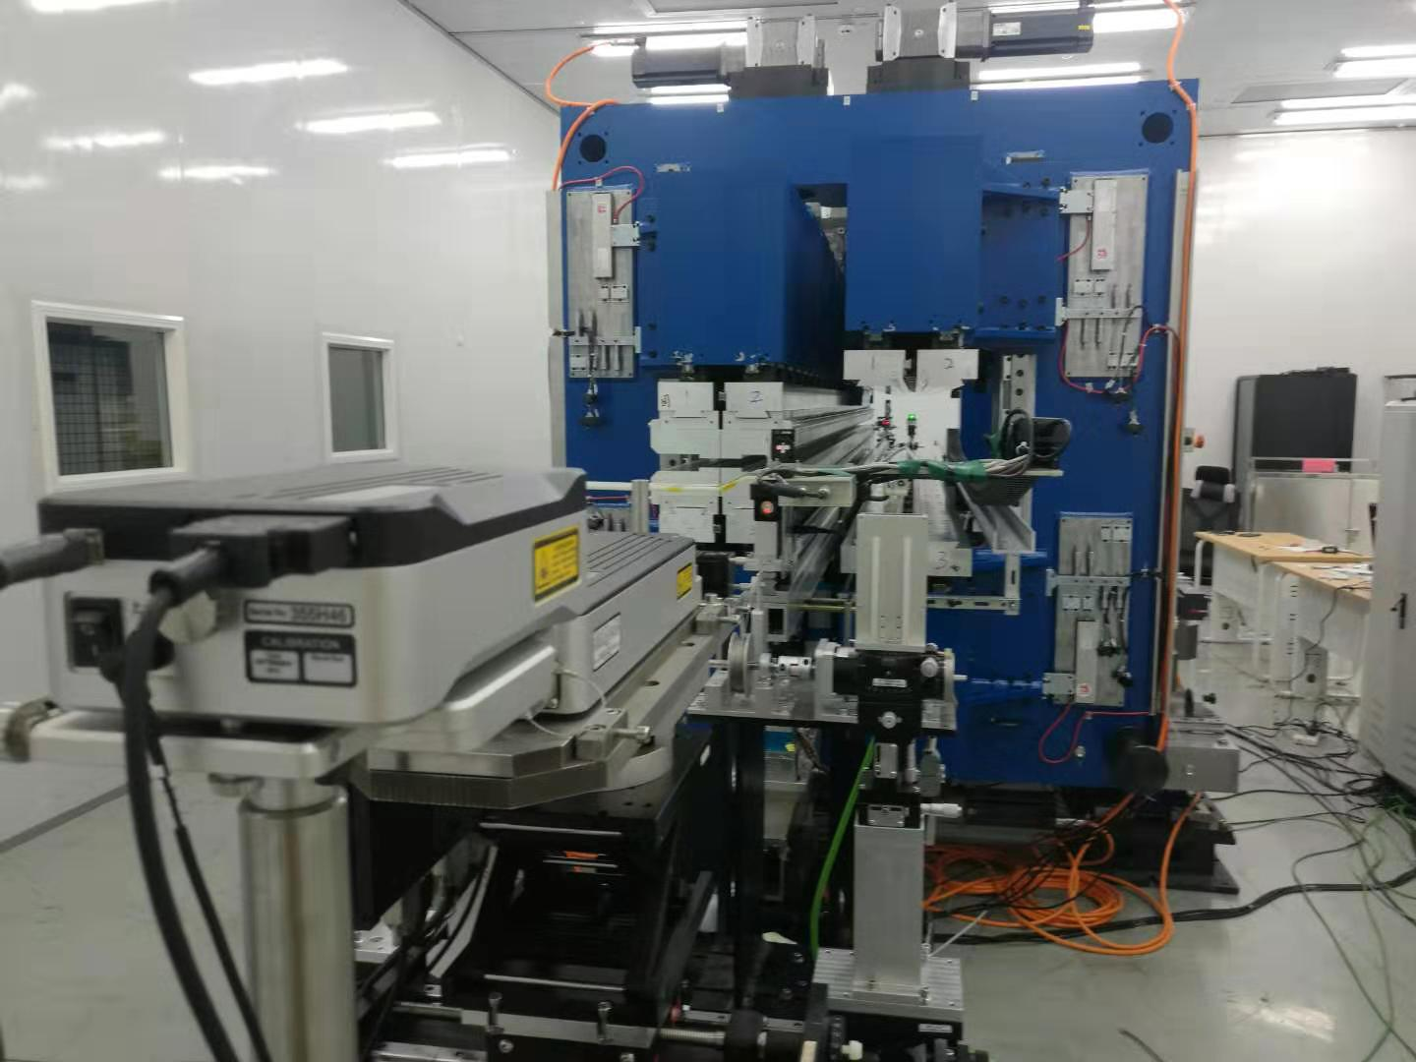
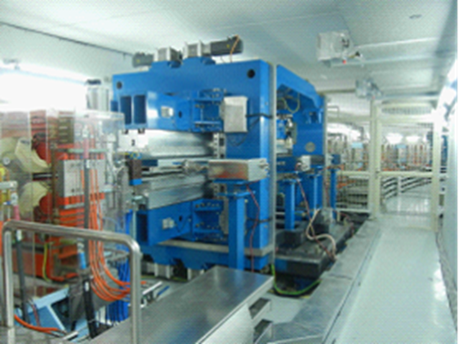
New Double-period EPU for SSRF-II
In 2013, the first DEPU was developed at SSRF
20-200eV EPU148 quasi-periodic
200-2000eV EPU58
2019 SSRF-II DEPU58&90
2013.2 Dream line DEPU
LEID period from 148--90mm
more robust for magnetic force Fz
PSD to measure lateral position
The DEPU consists of two APPLE-II variable elliptically polarized undulators LEID and HEID, which have roughly the same total length and different period length.
The two undulators are placed side by side and share an H-frame, which can be moved laterally to switch between the two undulators.
The low energy undulator LEID uses a quasi-periodic magnet arrangement to effectively suppress higher harmonics.
13 servo motors are used to independently control the air gap, phase shift and switching of the two undulators.

Slide 7
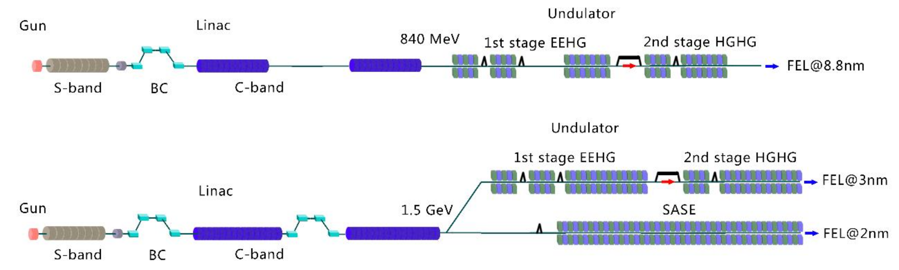
SXFEL Undulator Project
East
West

Slide 8
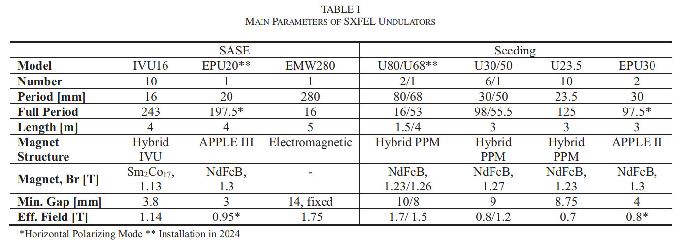
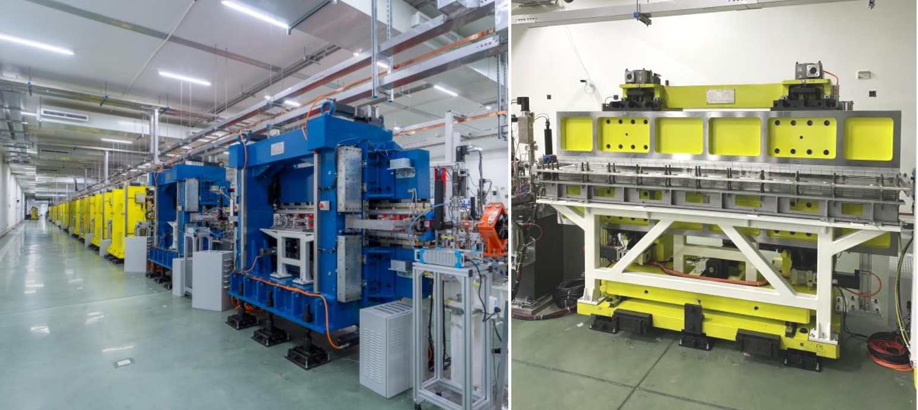
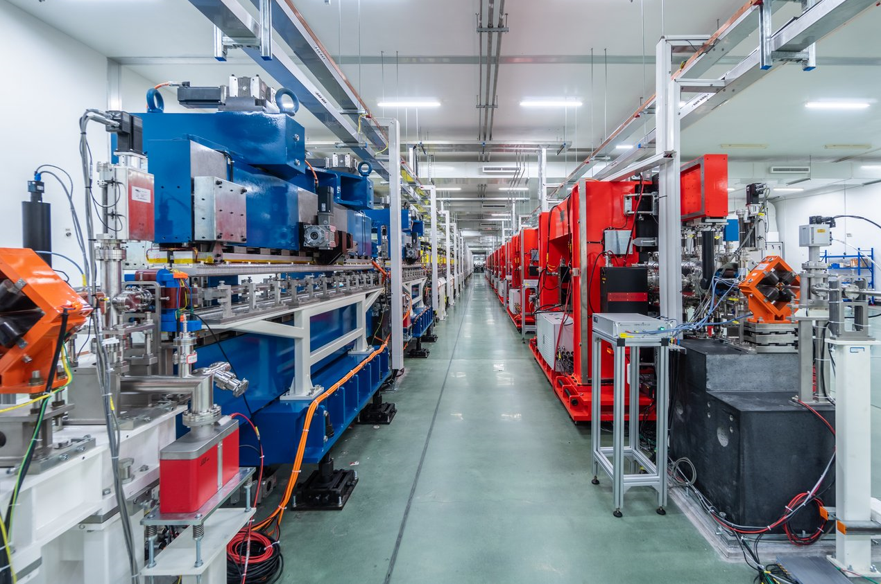
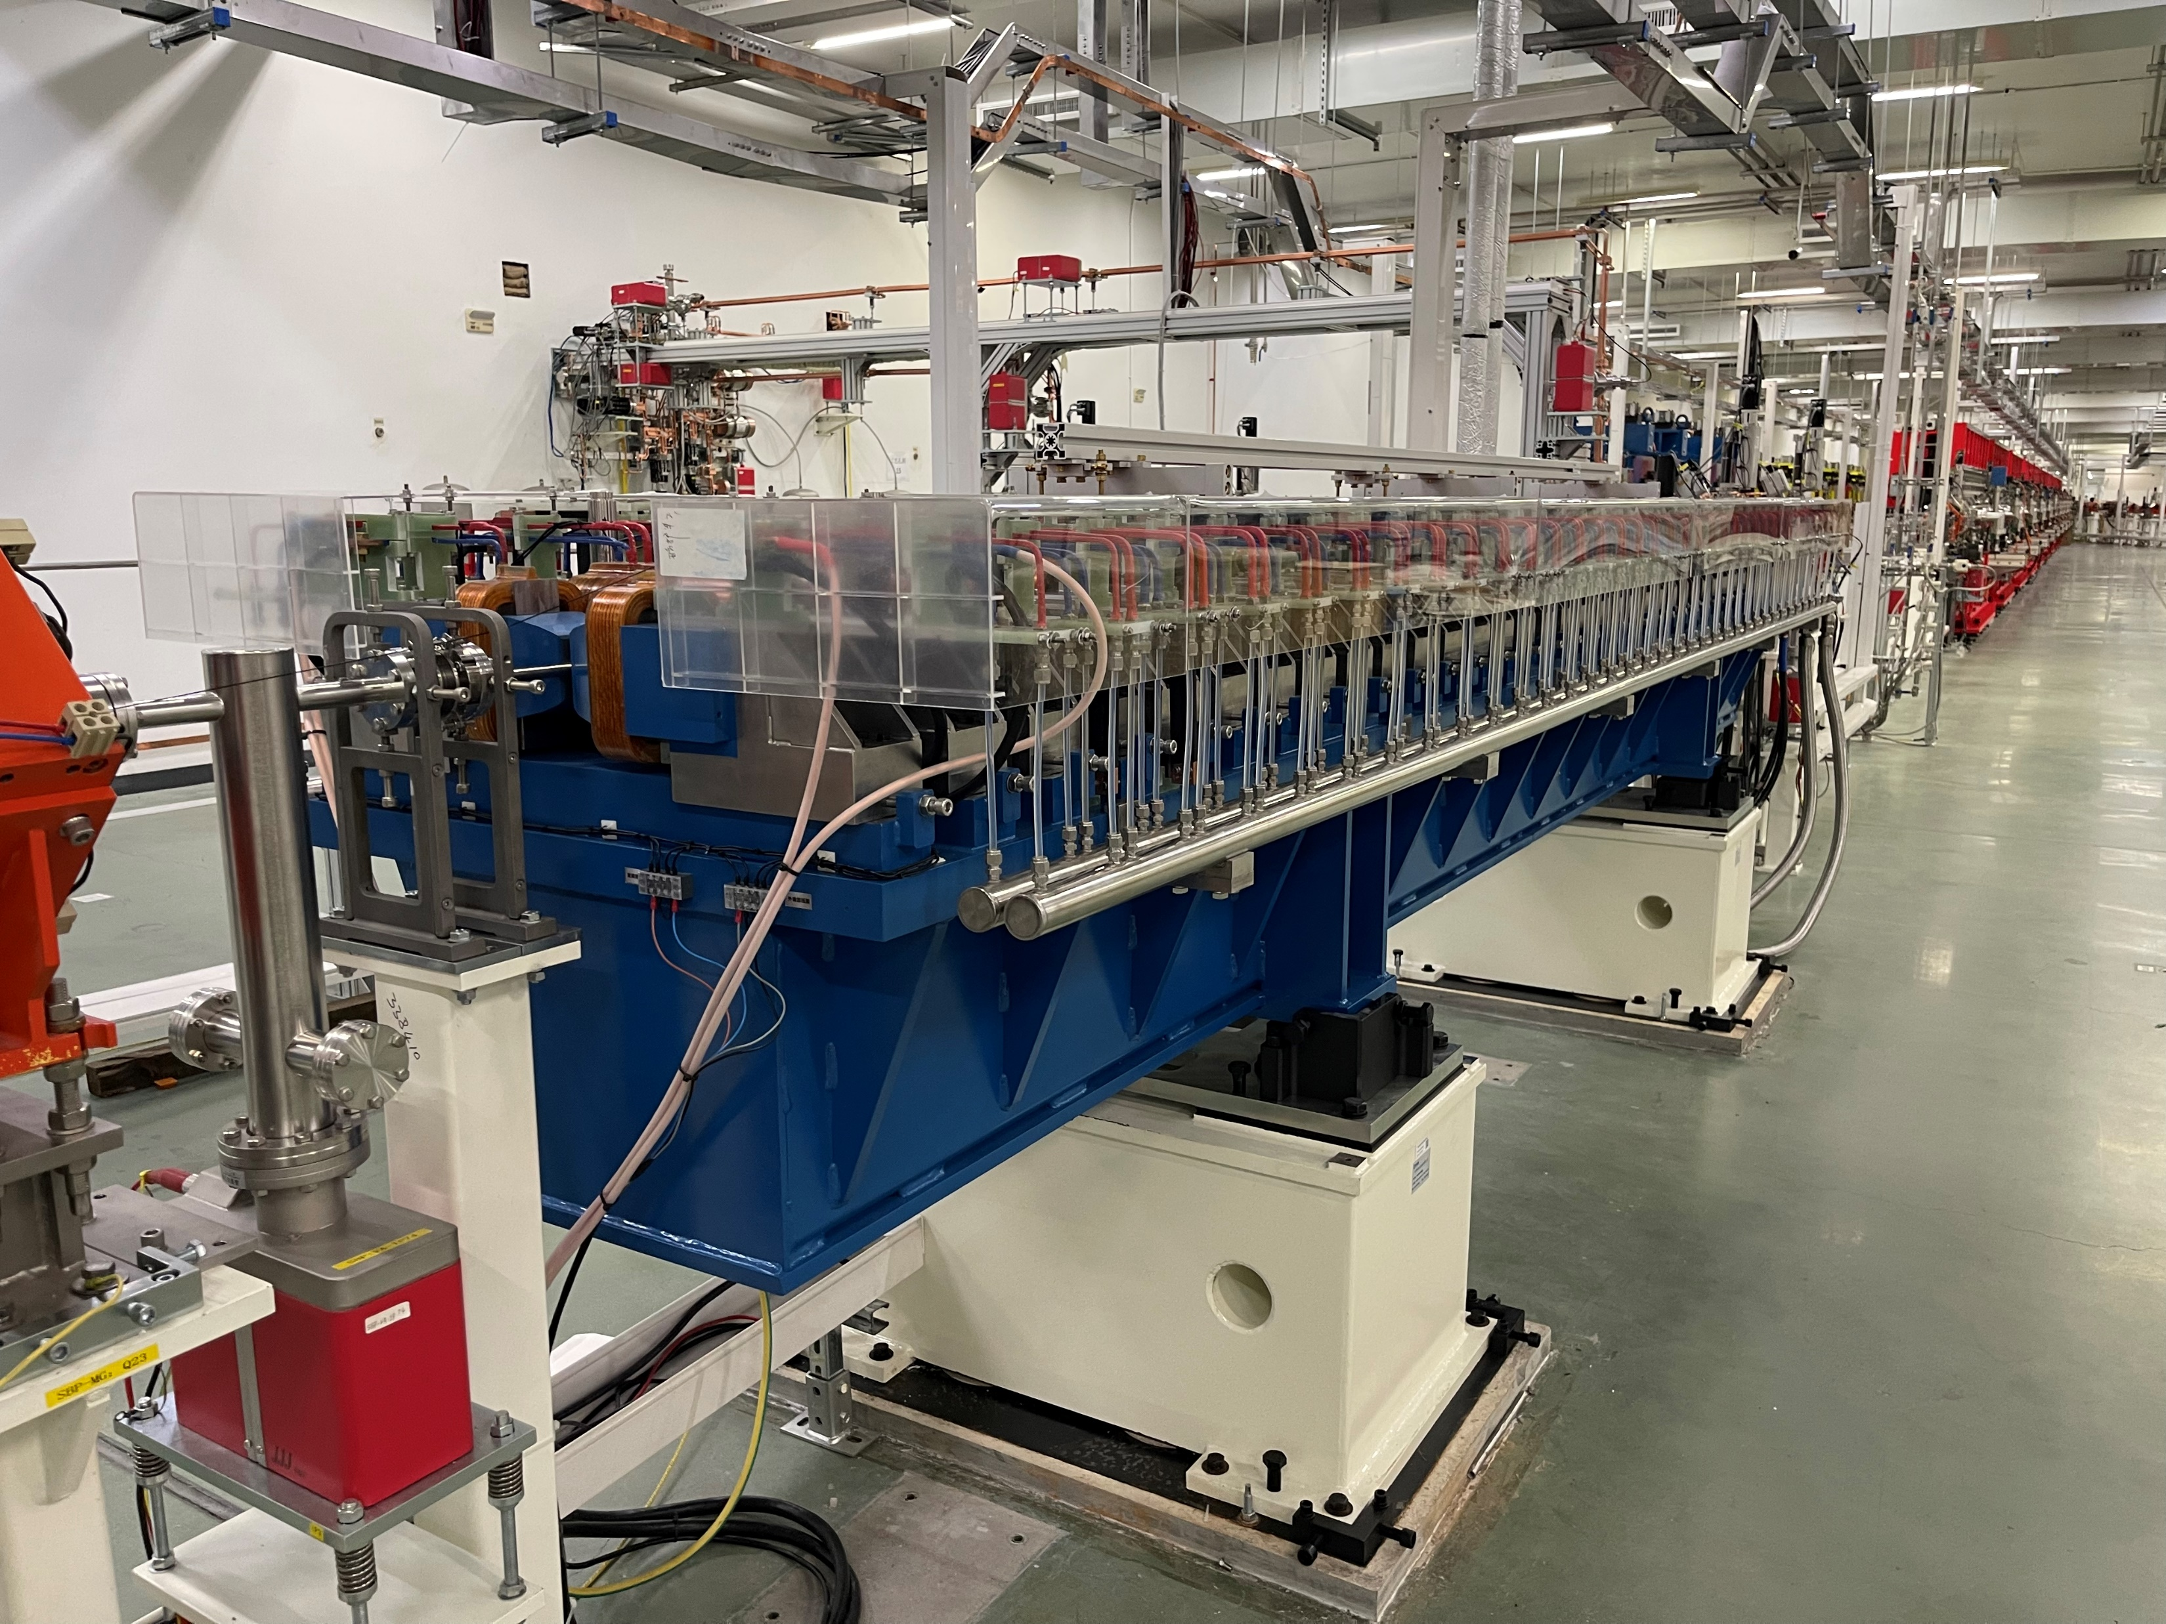
SXFEL-undulators（2016-2022）
undulator in tunnel

Slide 9
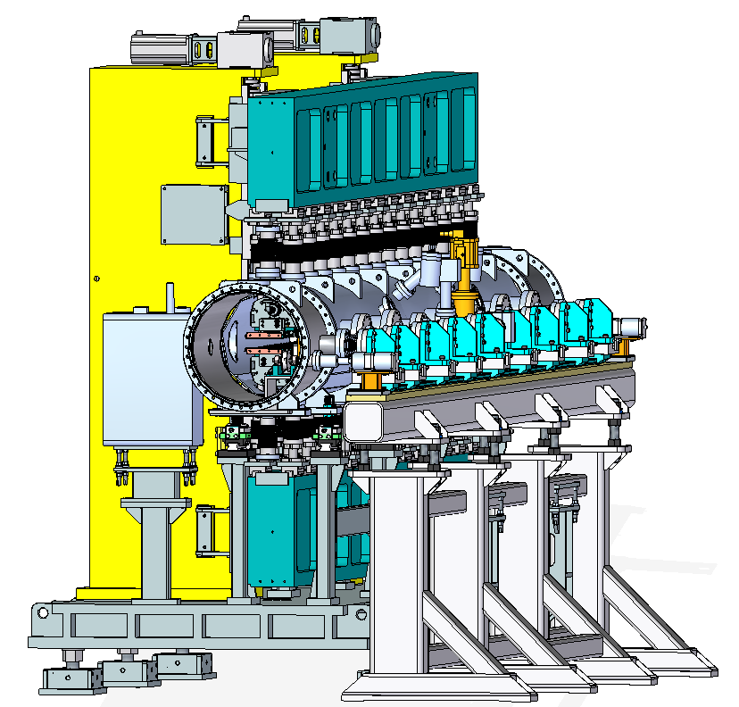
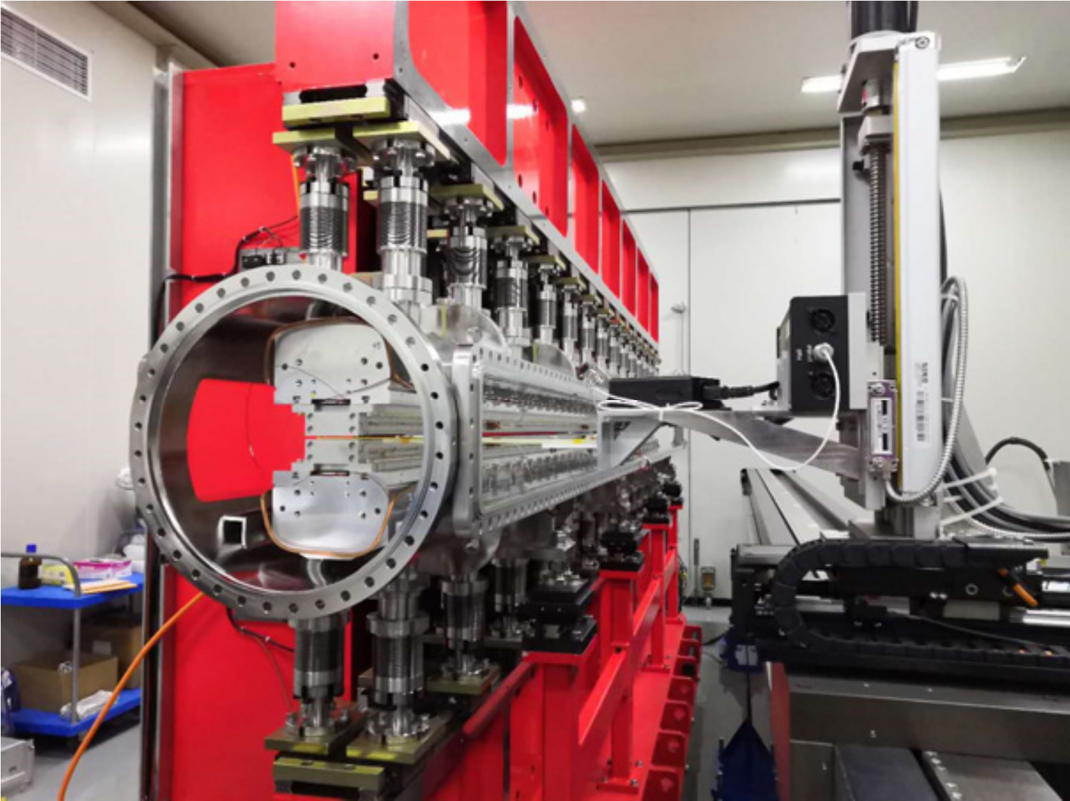
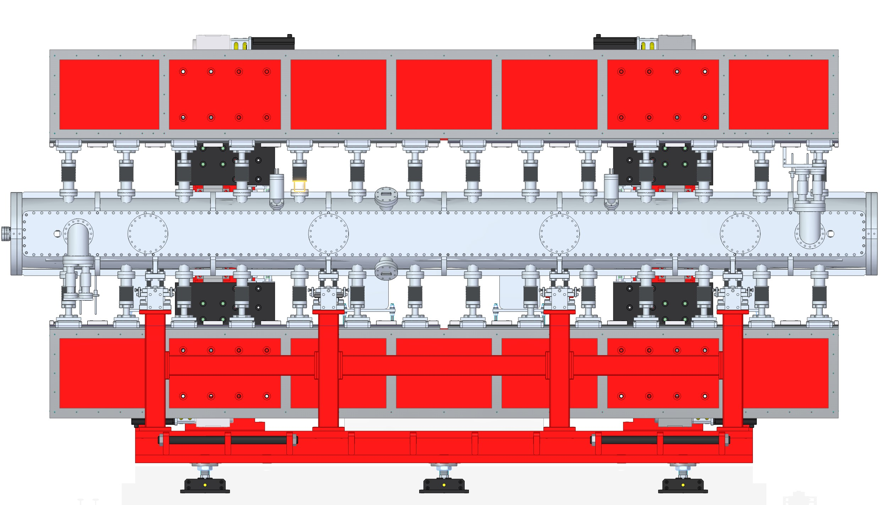
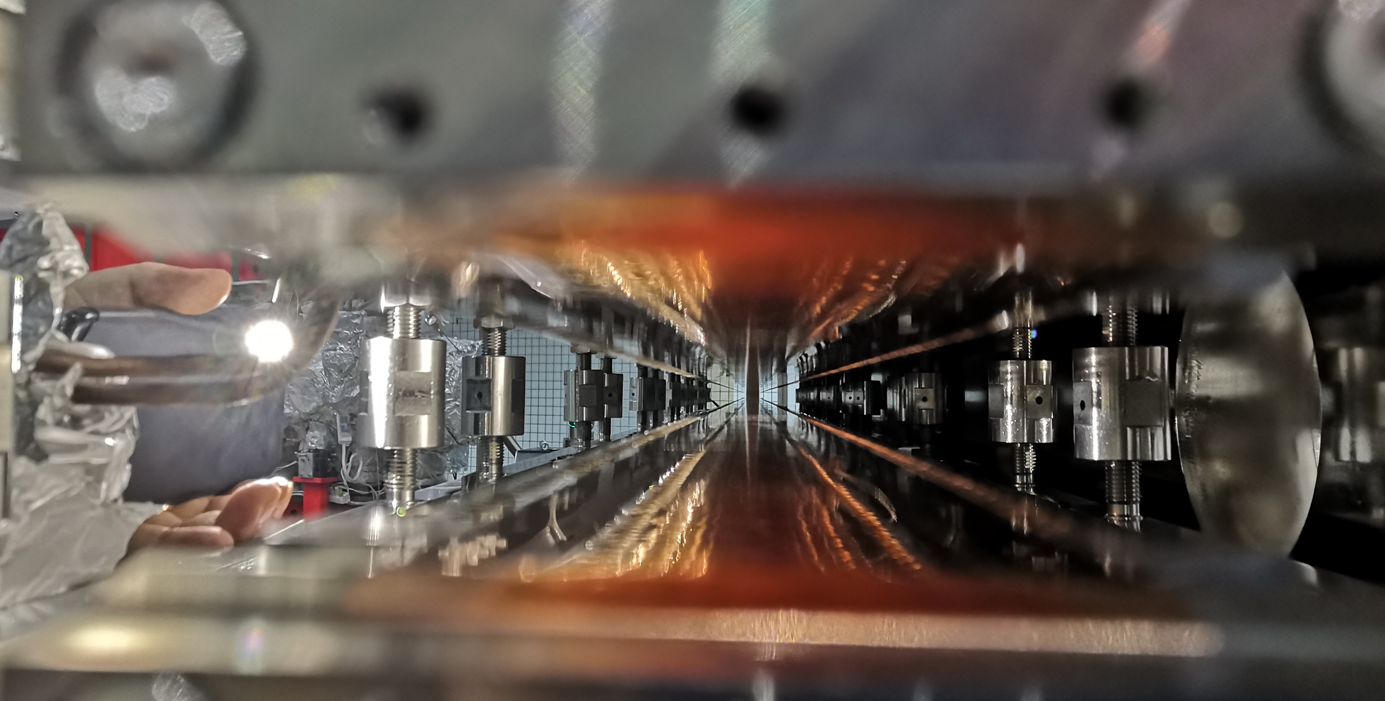
4m long & 3.6mm gap IVUs (2018-2019)
4m long with minimum gap 3.6mm, near 250 periods
Side open cavity design, integration test to improve efficiency,easy to measure and shimming;
10 IVUs : from Augest to December by two sets MMS
Facility | 日本 SACLA | 瑞士 Swiss-FEL | 上海 SXFEL-SBP
length（m） | 5 | 4 | 4
period （mm） | 18 | 15 | 16
number | 277 | 266 | 243
gap（mm） | 3.5 | 3.2 | 3.6
peak field（T） | 1.57 | 1.27 | 1.22
Magnet | NdFeB | NdFeB+Dy | SmCo
IVU16 测试现场
Direct measurement and shimming
Integration testing efficiency improvement
CuNi

Slide 10
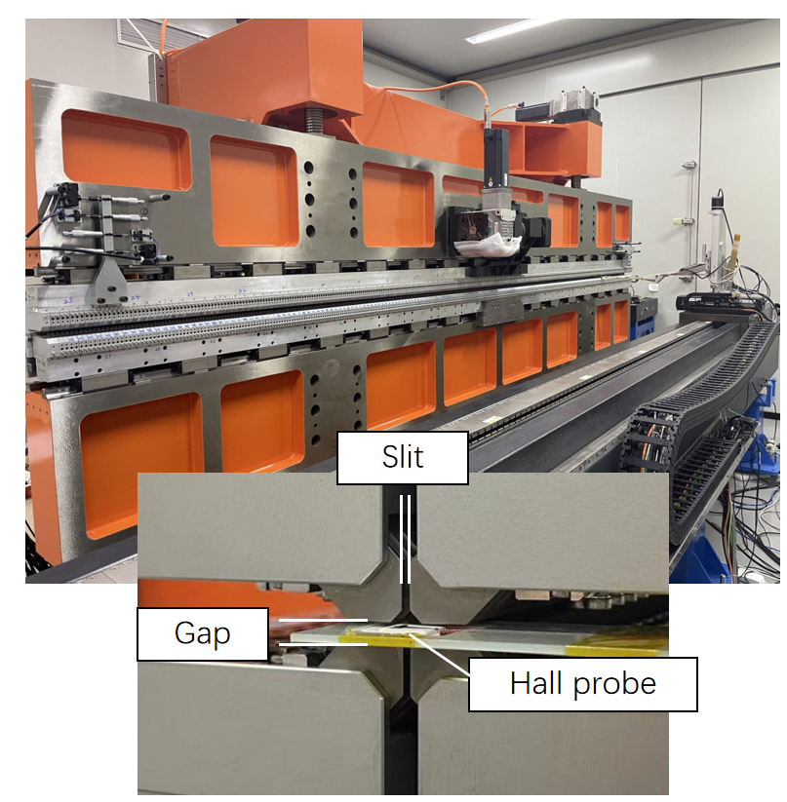
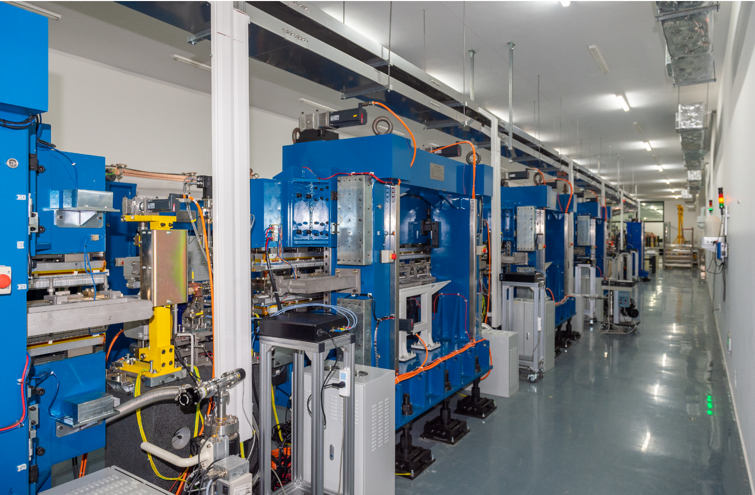
Small bore EPU
2018 first vertical gap 4mm, vacuum bore 8mm， APPLE-II EPU30
2020, four EPU30 were installed into DCLS tunnel
2021, two EPU30 were installed into SXFEl tunnel
2024, APPLE-III EPU20 was installed into SXFEL tunnel at Aug
2024.07
From EPU30 to EPU20
length: form 3m to 4m
vertical gap: 4mm to 3mm
period length: from 30mm to 20mm
APPLE-II to APPLE-III
2021.07, EPU30 in DCLS tunnel
2mm thickness Hall sennor is travelling in EPU20

Slide 11
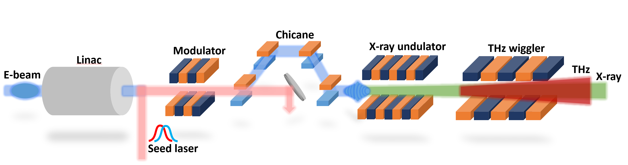
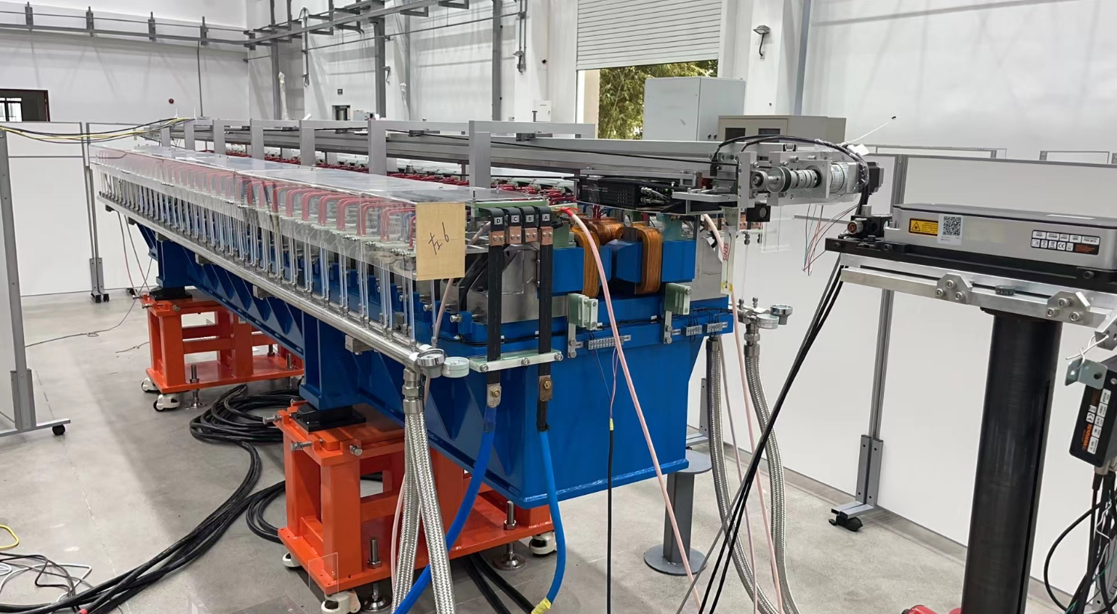
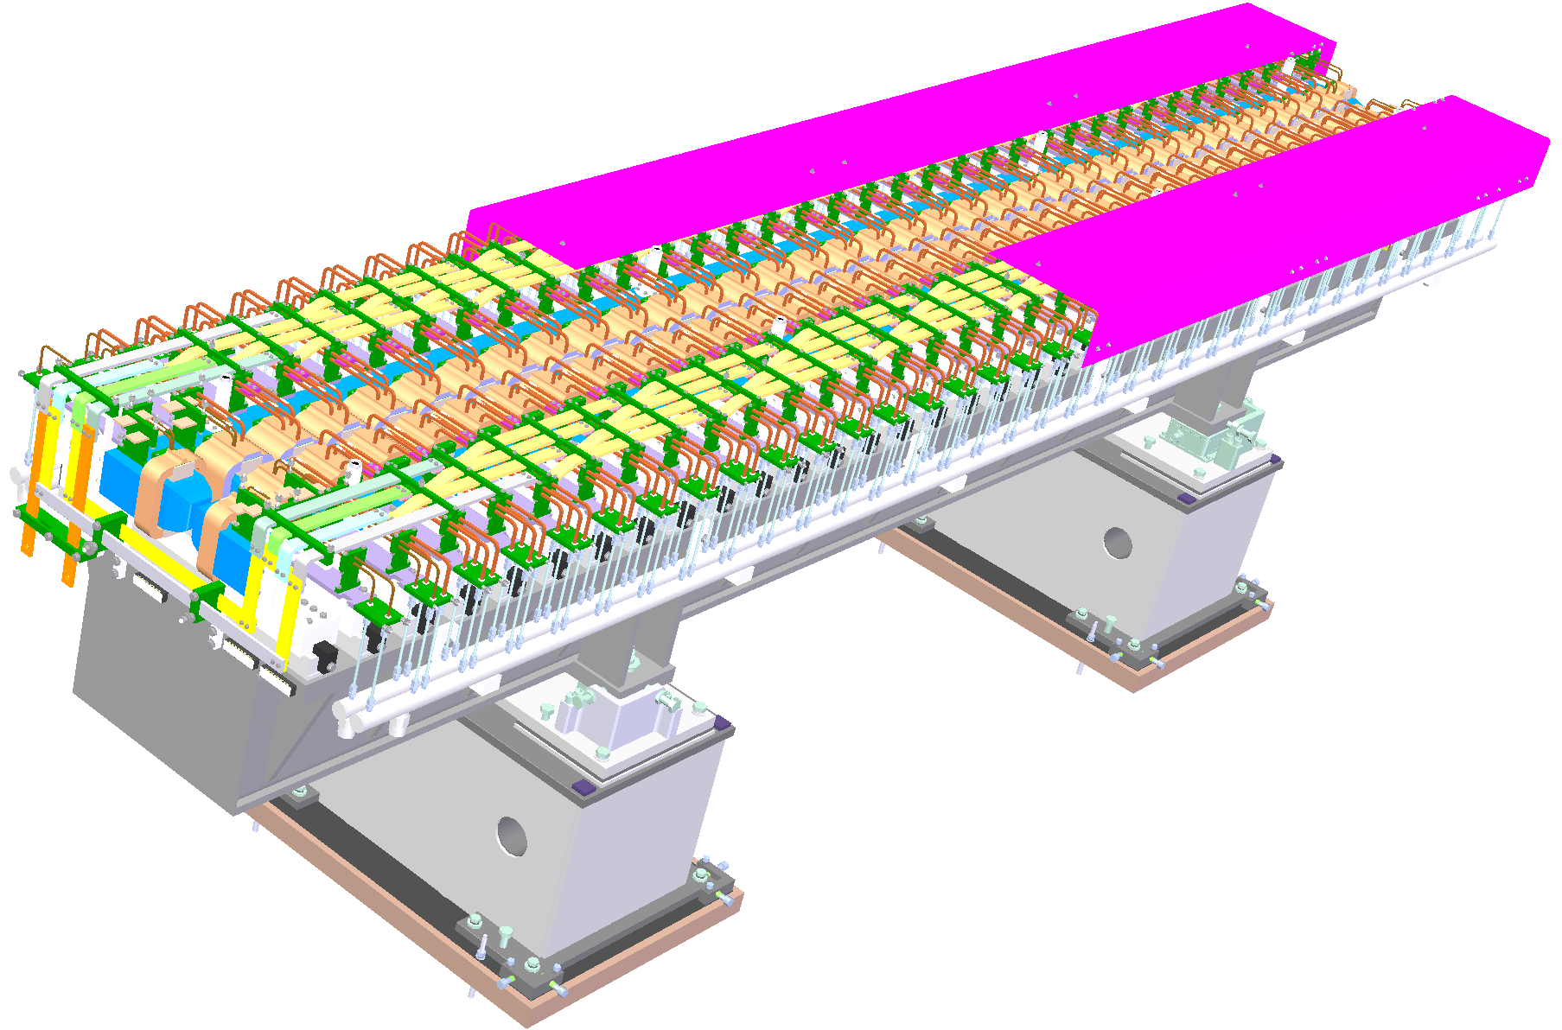
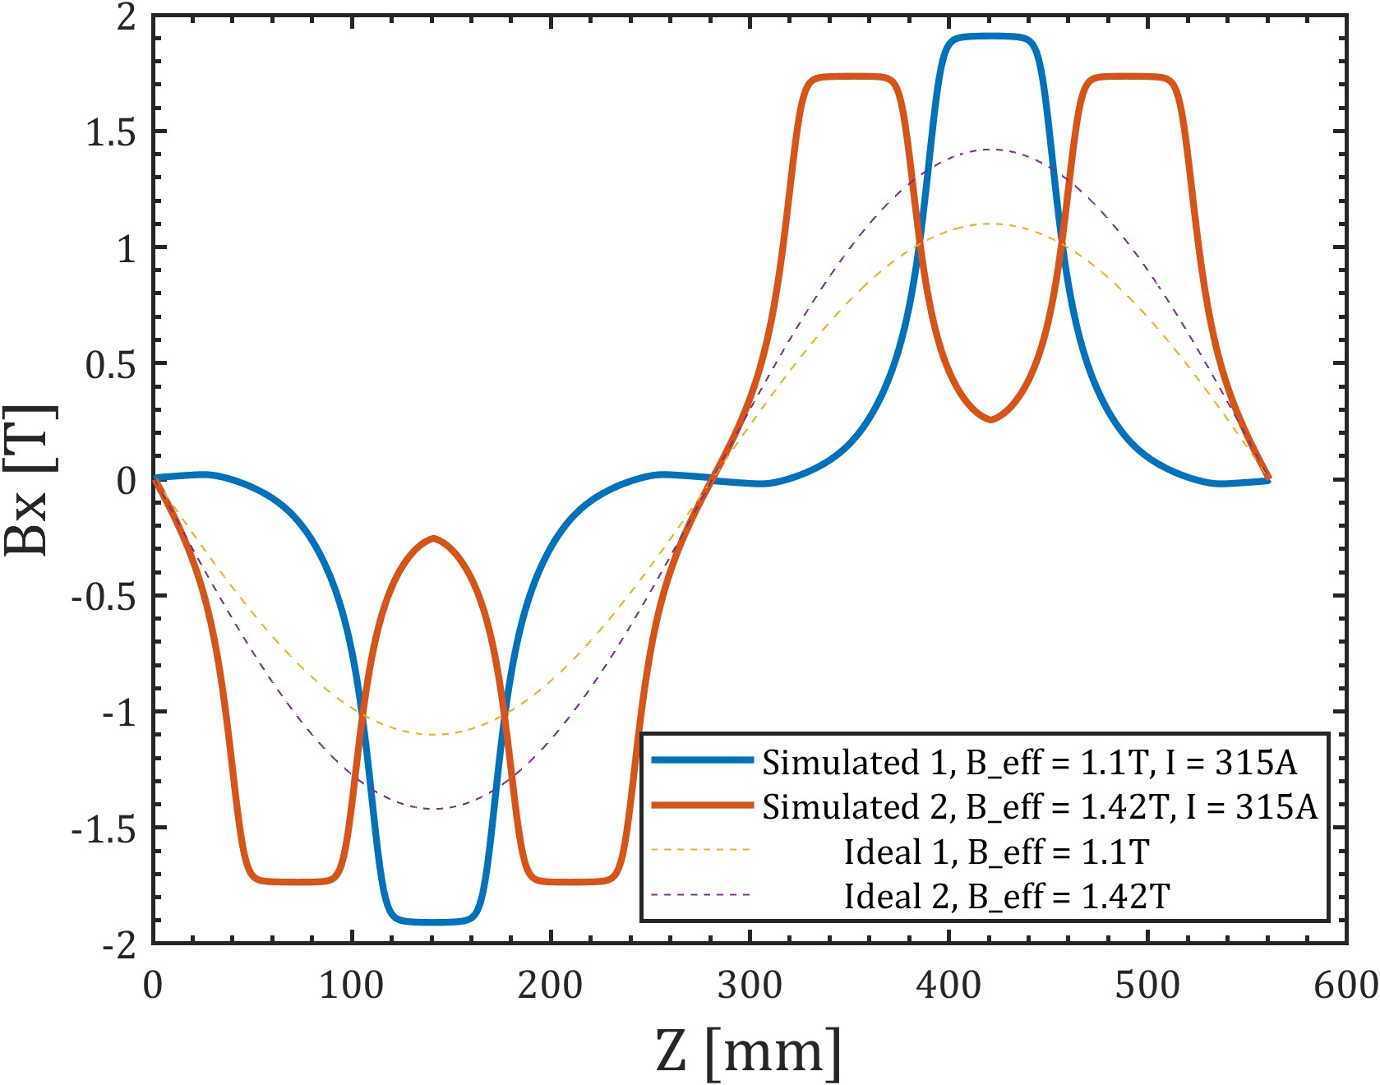
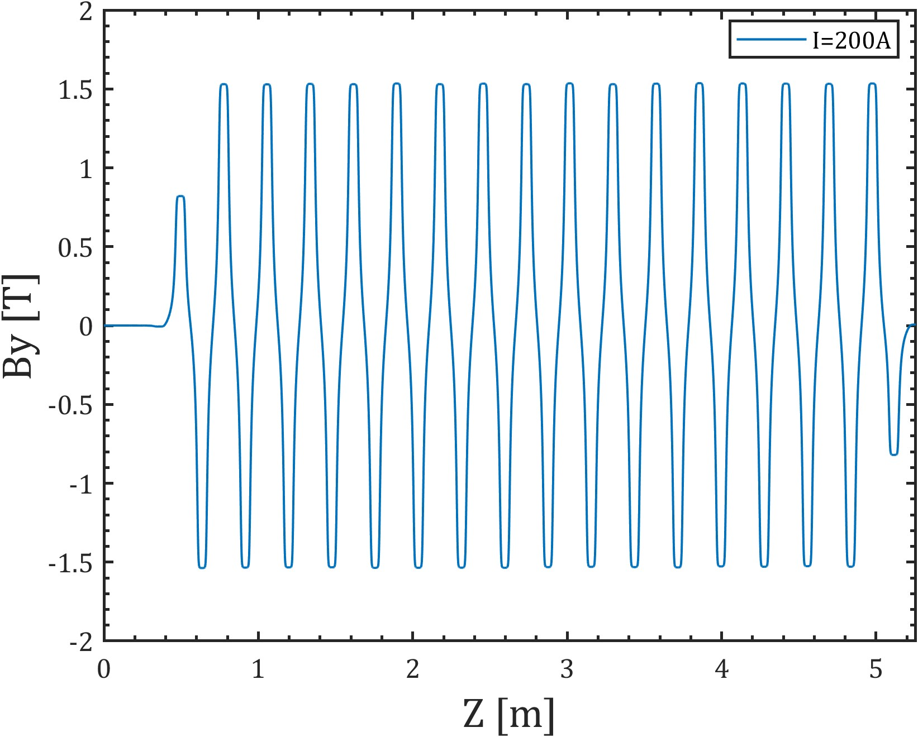
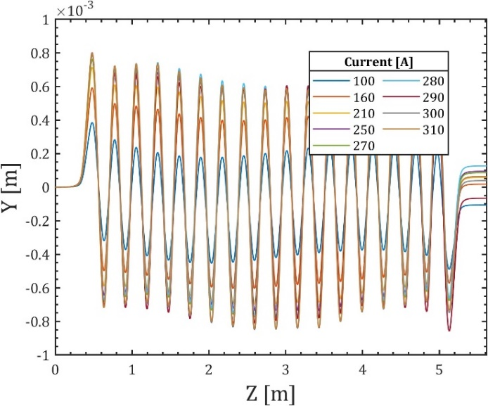
THz wiggler EMW280 for SXFEL
N
S
N
S
N
S
N
S
N
S
N
S
N
N
N
S
S
N
electromagnetic wiggler
vertical polarization：5m long
period：280mm/560mm
hori. gap：14mm
peak field：>1.75T
Frequency switching
S
N
S
S
S
N
N
S
2023.08
开路方案两倍周期
反接方案两倍周期

Slide 12
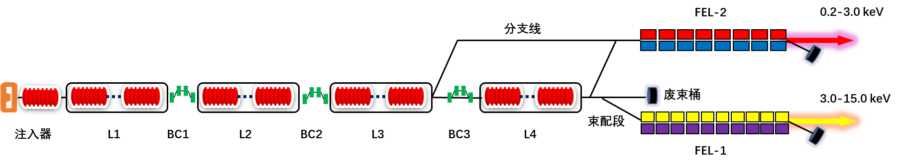
SHINE Undulator Project
East tunnel for future
West tunnel for FEL-III

Slide 13
Overview of FEL Design and Requirements
Nominal beam parameters
  8GeV，1MHz，1.5kA，100pC，0.45mm-mrad，0.01% sliced energy spread
FEL design requirements
  Three undulator lines for the FEL realization from 0.4 to 25keV
SXFEL
SSRF
SHINE

Slide 14
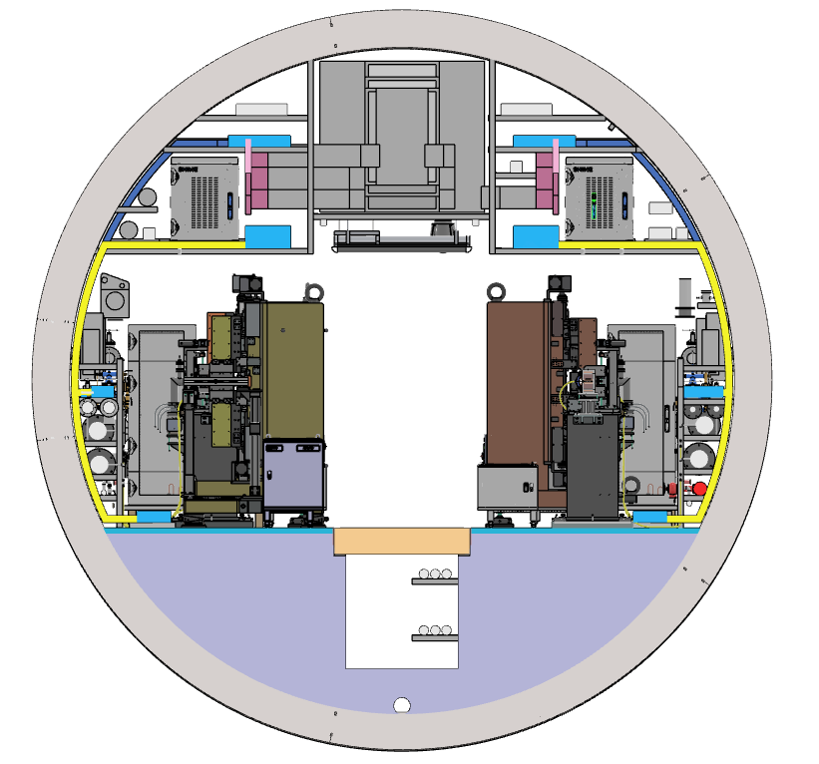
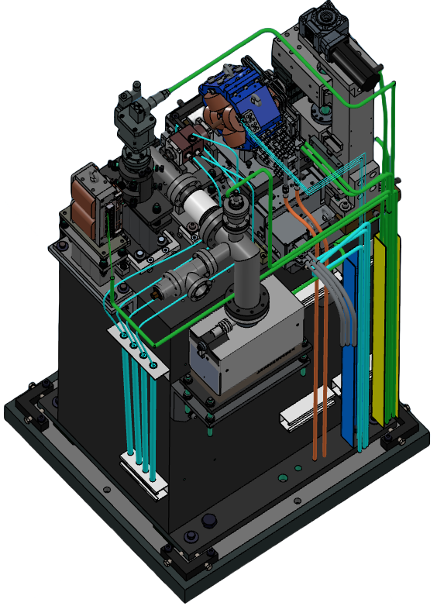
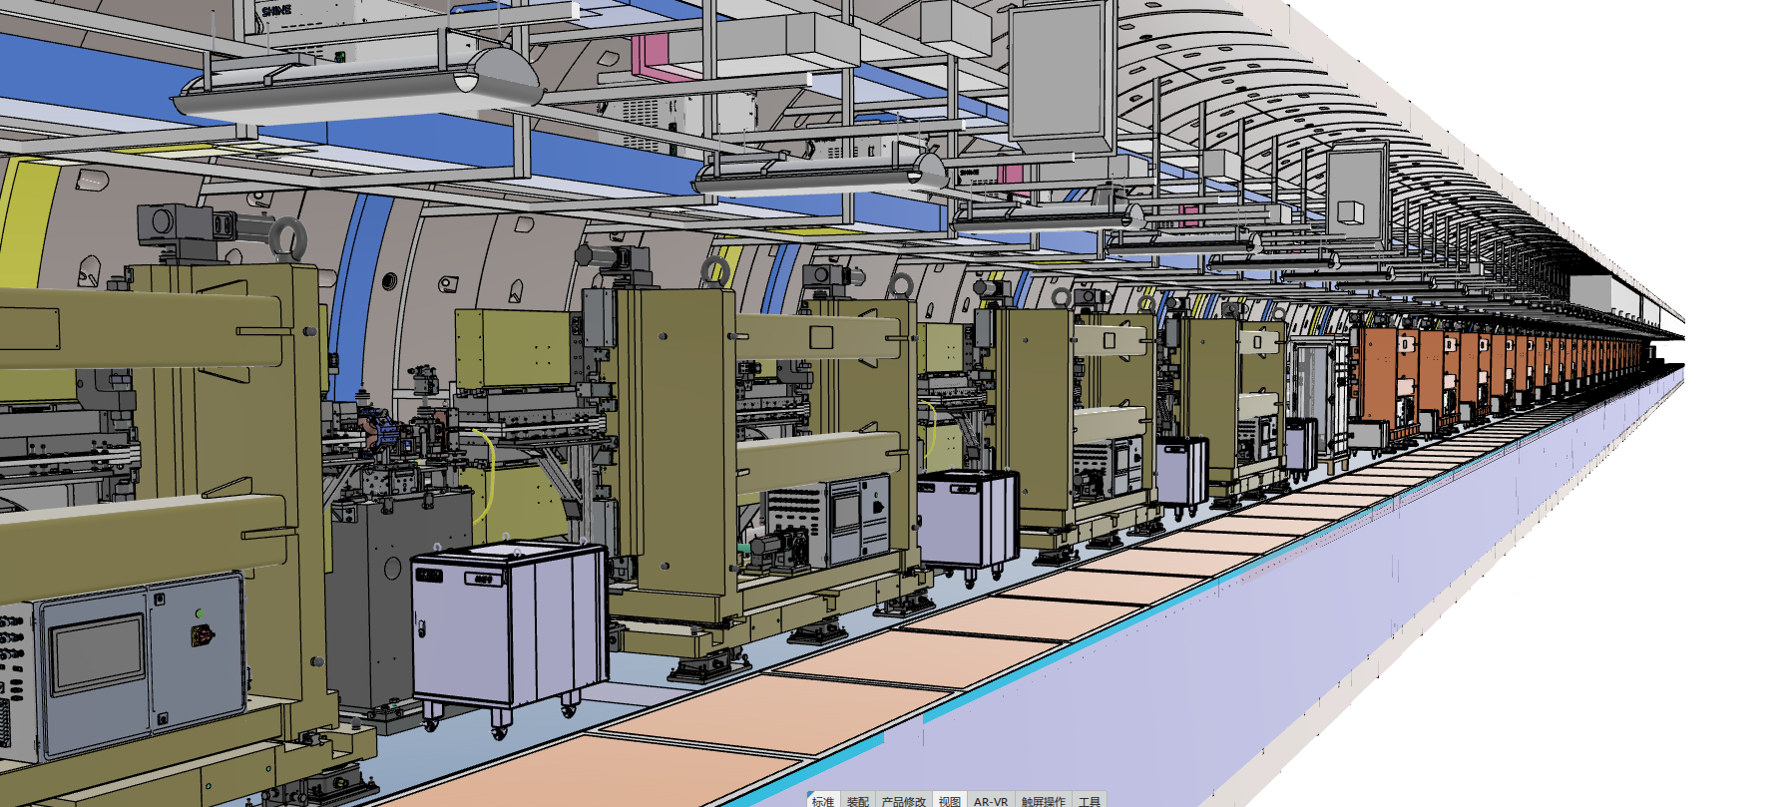
Undulator layout in SHINE middle tunnel
  A unique design scheme of two beamlines for one tunnel was created.
  Complete the simulation installation of the sample section and form the optimized process layout.
FEL-I
FEL-II
insertsection
undulator arrays
Notes:
The SHINE timing system needs to realize two important functions: beam-synchronous trigger signal distribution and random-event trigger signal distribution.
According to the priority from highest to lowest, becasue SHINE requires precise distribution and synchronization of the 1.003086MHz (1300/1296) timing signals over a long distance of about 3.1 km. Therefore, the beam- synchronous trigger signal distribution is the basic and priority function.
For Random-event trigger signal distribution, it is the extension function of the timing system for the distribution of various event signals, such as beam loss, machine snapshot, and so on.

Slide 15
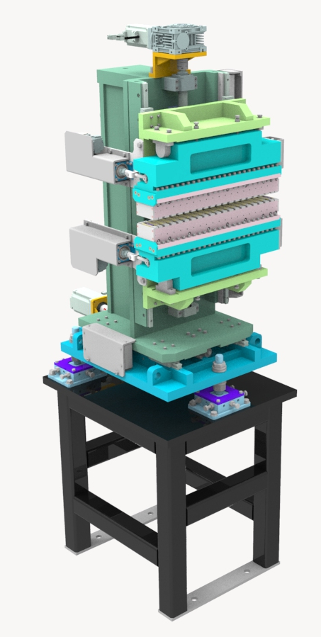
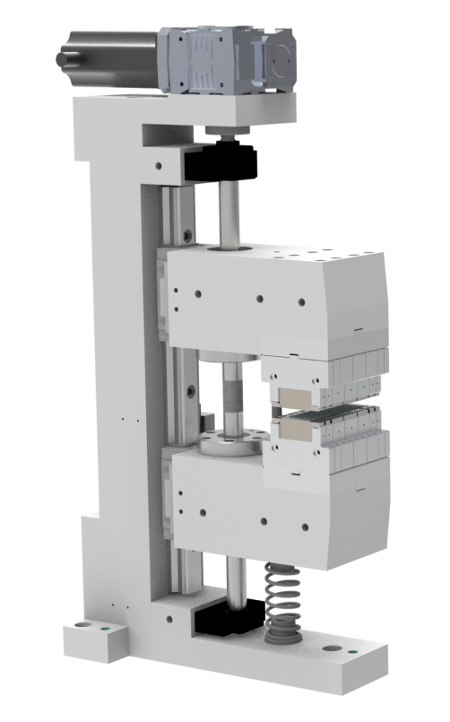
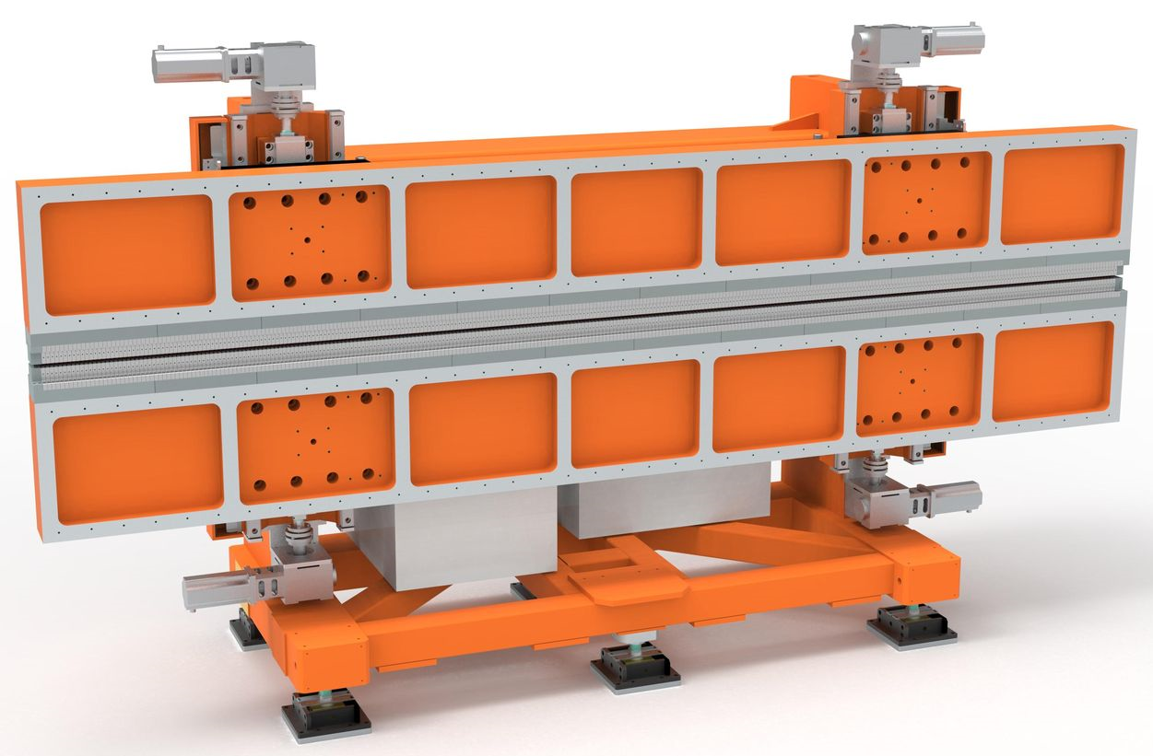
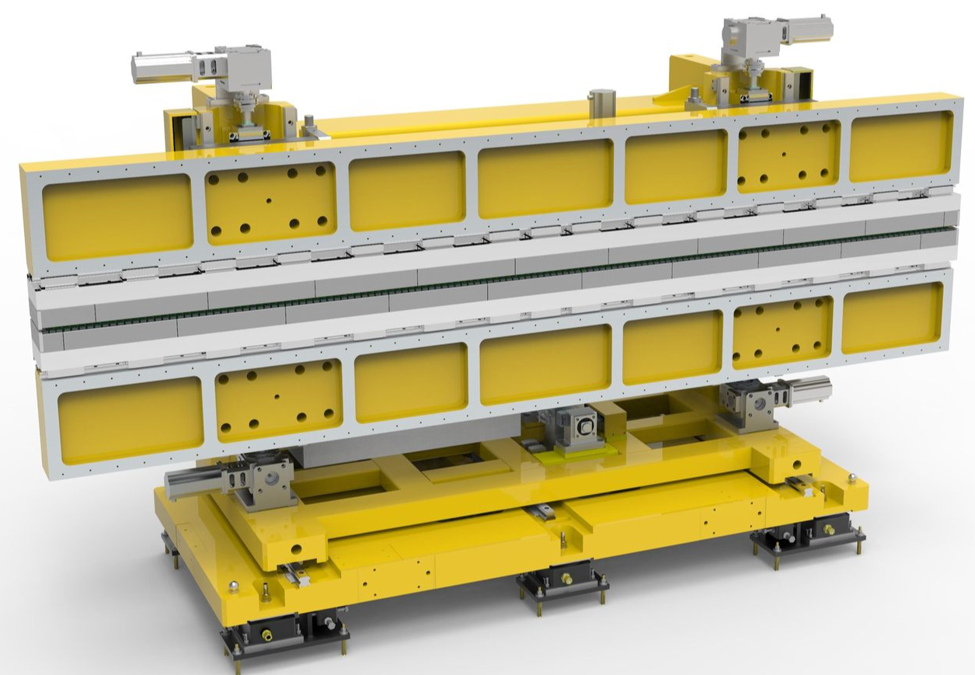
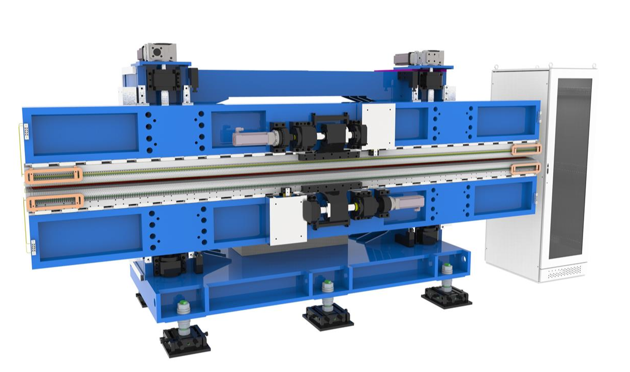
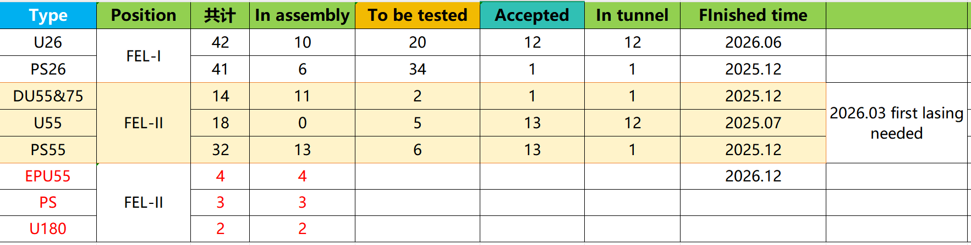
Overview of SHINE FEL-I&II undulators
Time line
11/2023 starts production plan U26 and U55
12/2023 parts procurement
06/2024 first set delivery
12/2024 15+ U55 installation finished
12/2025 FEL-II undualtors finished without EPUs
03/2026 First lasing @ 400eV (SASE)
06/2026 FEL-I undualtors installation finished
real-time status

Slide 16
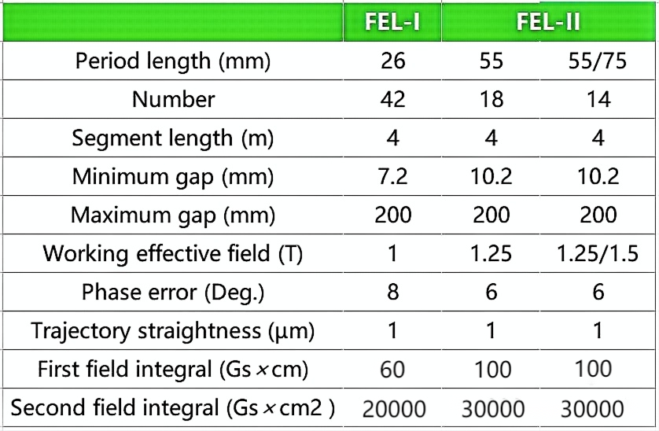
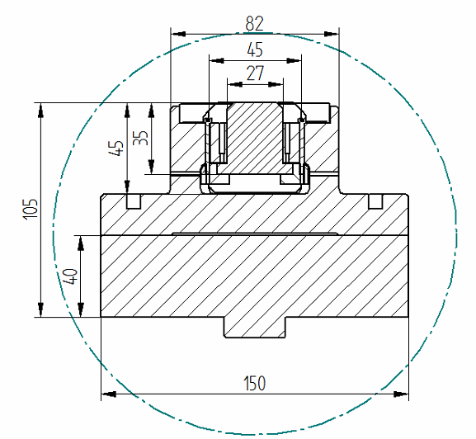
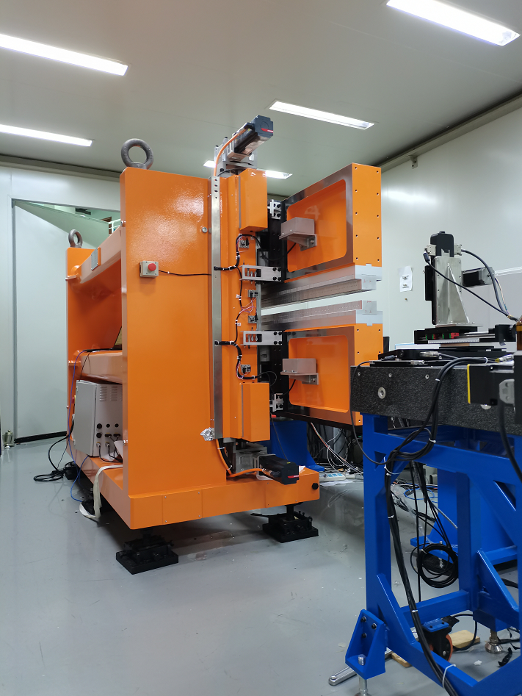
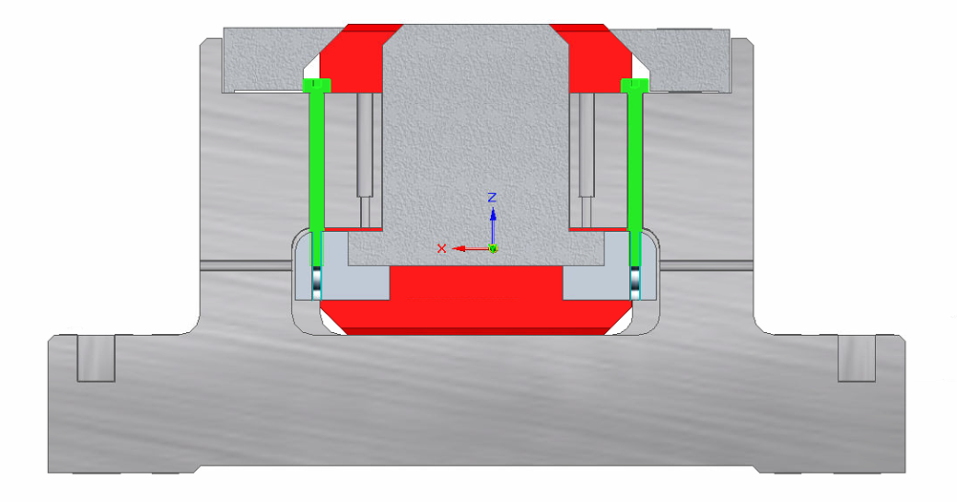
General Undulators for SHINE
Magntic structure: NdFeB+cobalt vanadium iron(CoVFe)
Strongback: Material 42CrMo
Same mechanical structure for U26 and U55
Four Motors, electronic gears
Magnetic measurement: Hall probe+flipping coil
Transfer magnetic axis to undulator frame
Precision measurement of gap / Motor feedback to ±0.5µm
Screw to Change Pole Height
U26 prototype in MMS lab

Slide 17
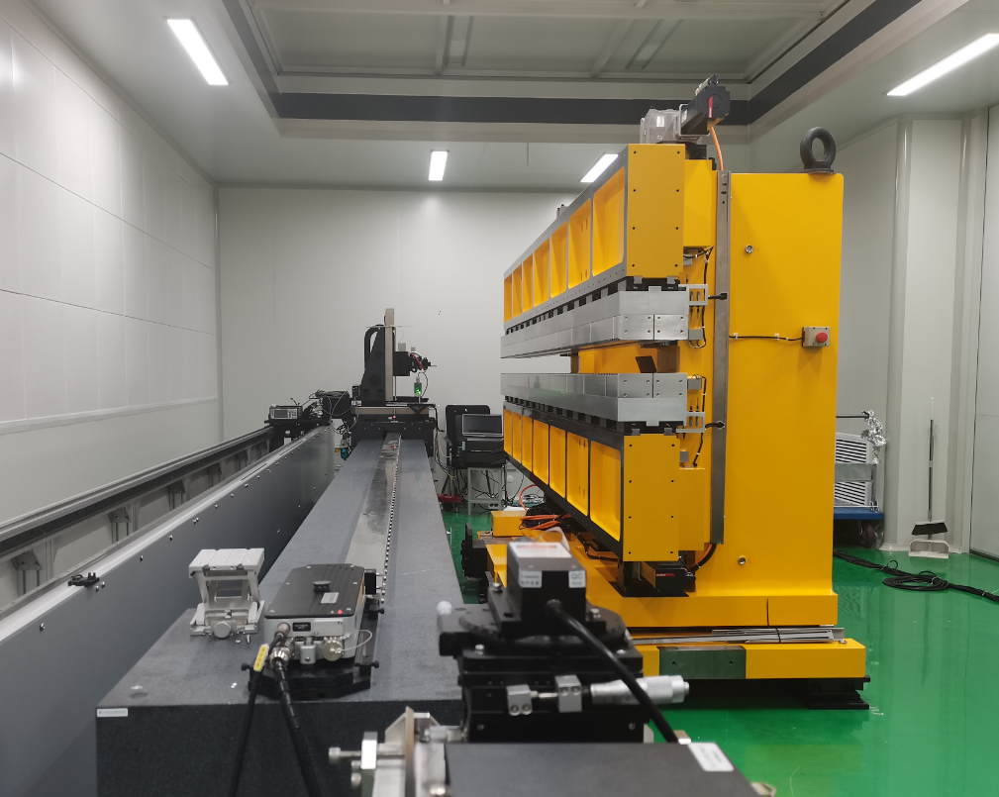
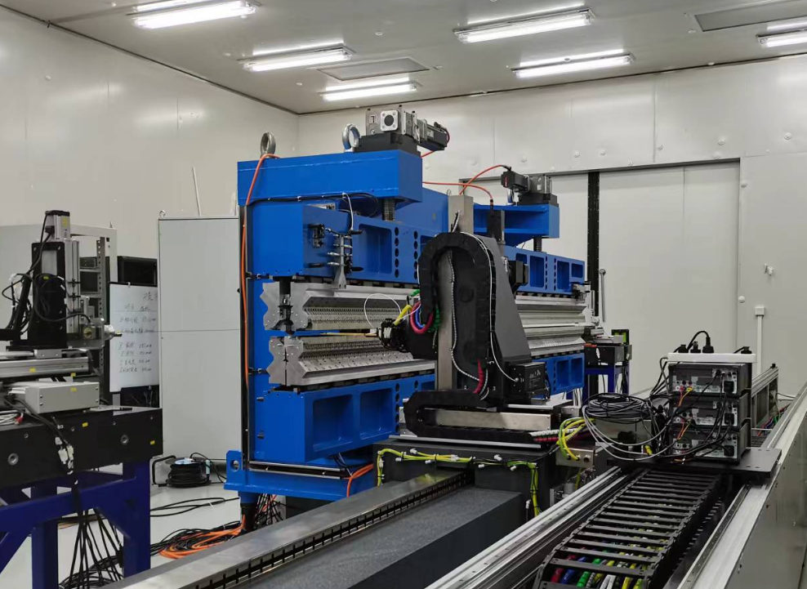
Permanent Undulator Prototypes
FEL-I,2023
FEL-II,2023
FEL-II,2022
Double period Undulator
Elliptical Polar. Undulator Prototype
Conventional planar undulator
Length：4 m
Period: 26mm
Peak field：1.0T
Gap range：7.2--200mm
rms Phase error: <6 deg
Field integral <50 Gs.cm
Length：4 m
Double Period: 55mm and 75mm
Peak field：1.25T&1.5T
Gap range：10.4--200mm
rms Phase error: <6 deg
Field integral <100 Gs.cm
Length：4 m
Period: 68mm
Peak field：1.5T
Vertical Gap range：3.2--150mm
rms Phase error: <12 deg
New EPU55 in technical design

Slide 18
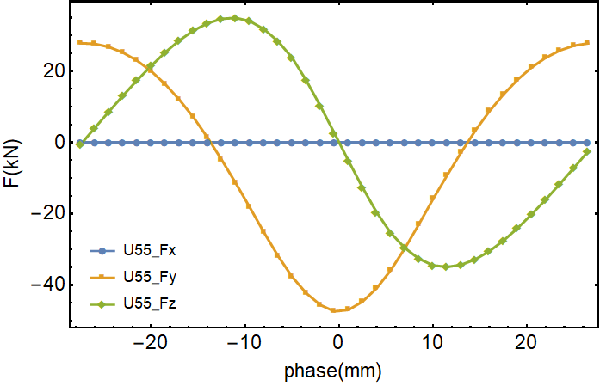
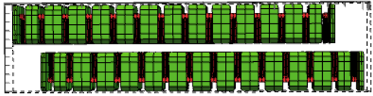
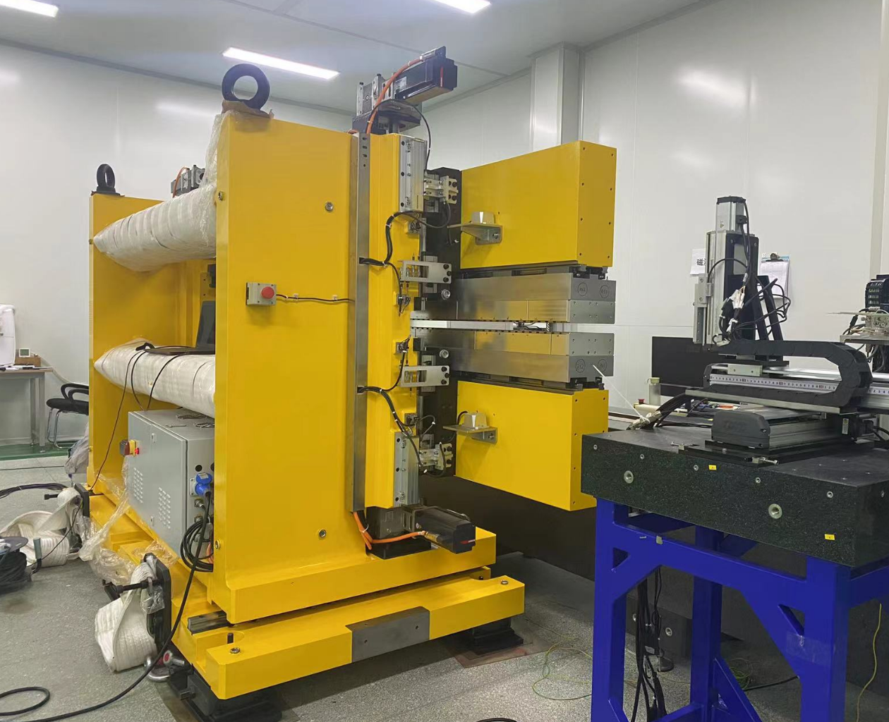
Double-Period Undulator U55/75 Prototype
  Double-period planner undulator
two undulator fix on same girder
U55 switch horizontall to U75
The longitudinal motors produce phase change
compact mechanical structure
When the phase between up arrays and down arrays changes, the magnitude and direction of the magnetic force will also change
magnetic force
compensation technique
2019, The first double-period planner undualtor developed at SXFEL
Prototype in MML.

Slide 19
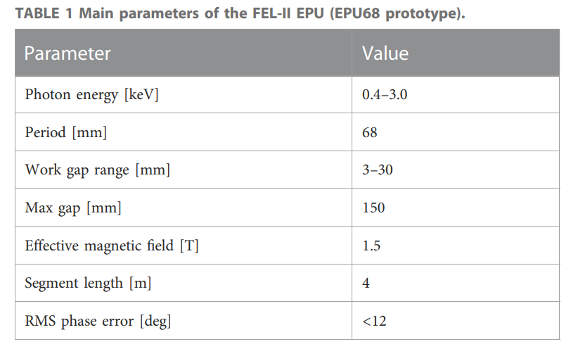
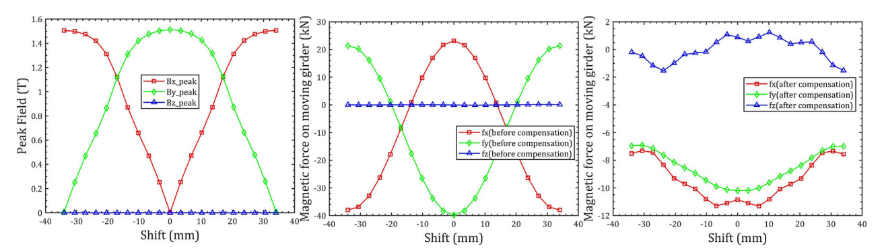





APPLE III undulator prototype (2022)
Max magnetic field 1.5T in L.P and 1.06T in C.P
Vertical and Horizontal gap 3mm
Full force compensation:
magnetic force reduction from 60kN to 12kN for each girder
Phase error less than 12 degree
magnet design
EPU in MMS lab
The landmark
flipping coil
SHINE FEL-I&II tunnel

Slide 20




Measurement facilities for Undulator project
1、Hall probe system (4×6.5m)
probe：SENIS H3A，Resolution 0.02GS
granite scan range in z 6500/5000mm, 300mm in x /y
Field strengh/ phase error/ trajectory
2、Flipping coil (3×)
coil length：Max 5m，coil width 2.8mm，repeatability 3Gs.cm
First and second field integral, kick value for undulator
3、Capacitance sensor
can be integrated in the Hall probe scan system
precision：~5μm
Measured magnetic gap
4、Optical displacement meter (3×)
can be integrated in the Hall probe scan system
precision：~1μm
Measured girder deformation
Hall ptobe scan system
flipping coil system
Capacitance sensor
Optical displacement meter

Slide 21


Magnetic Measurement Lab Location
MML #1-#3 located in SSRF campus, #3 used for CPMUs measurement
One MML at SHINE shaft #3
Two satellite MMLs in the suburbs of Shanghai
SHINE tunnel

Slide 22




Lifting and Transportation Test

Slide 23

Mass production strategy
Design
Company assistance.
Technology design
Interface validation
Mechanical component manufacted
Control electrical integration
Delivery to next step
Manufactured
Assembly
MMS bench
Program
Technical guidance
Provide space and manpower
FAT on Mechanical and control
Execute on measurement and shimming
Test reports
Magnetic measurement
Shimming
Acceptance delivery

Slide 24



Statas of Undulators Mass production
FEL-I SASE-Line>
Magnet, mechanics and control integration of 36 sets of FEL-U26 have been completed
12 sets of U26 finished their magnetic measurements and are installed in the tunnel
FEL-Il Seeding-Line
Magnet, mechanics and control integration of total 18 sets of FEL-U55 has been completed
12 sets of U55 finished their magnetic measurements and are installed in the tunnel
One double-period U55/75 has been installed in the tunnel and 13 sets are in integration
undulators waiting to test
FEL-I&II phase shifters
FEL-I&II in tunnel.2025.05

Slide 25







Cooperation with Sirius on IVUs
2024.06, shanghai
2024.09, Campinas
Comparison of Magnetic Field Properties Before and After Baking

Slide 26






HALF undulators- Work in progress
4.2m EPU 3D Figure
2025.05 First 4.2m EPU42 in MML

Slide 27
Problem: radiation damage in SXFEL seeding line
Debugging initial stage 2018-2020
Several undulators have been detected with severe magnet demagnetization, including U30 and U23.5.
The most significant contributing factor is the profiles during the operational debugging.
The most severe case occurred at the entrance of the first radiation undulator, resulting in radiation damage.
Strategy in SHINE
CBPMs
Collimator

Slide 28

Summary
There are 25 insertion devices in operation in SSRF,still one short straight section not being in use.
The new design IVU16s with long side flange and small core EPUs have been successfully developed and operated well in SXFEL tunnel.
SHINE unulator project is a huge work will be finished in next year
Other next work
Undulators for HALF
Technical Research on Radiation Damage and Online Magnetic Measurement
Compact Structure Undulator：EPU、Doulbe-period IVU
SHINE

Slide 29
Thank You for Your Attention！
谢谢!

