Slide 1

Commissioning of the APPLE-X afterburner at the European XFEL
Suren Karabekyan (Eu.XFEL) and Evgeny Schneidmiller (DESY)
on behalf of the SASE3 variable polarization project team
Insertion Devices for Future Light Sources Workshop
Taipei, 31 May 2025

Slide 2
Overview
Helical afterburner: Concept, implementation, parameters
Installation campaniges of APPLE-X undulators
Commissioning and optimization strategy
Common operation modes

Slide 3
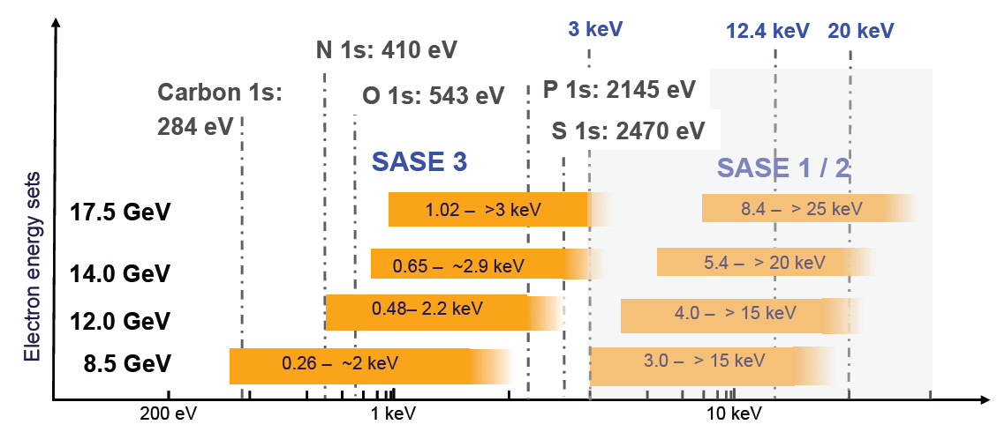
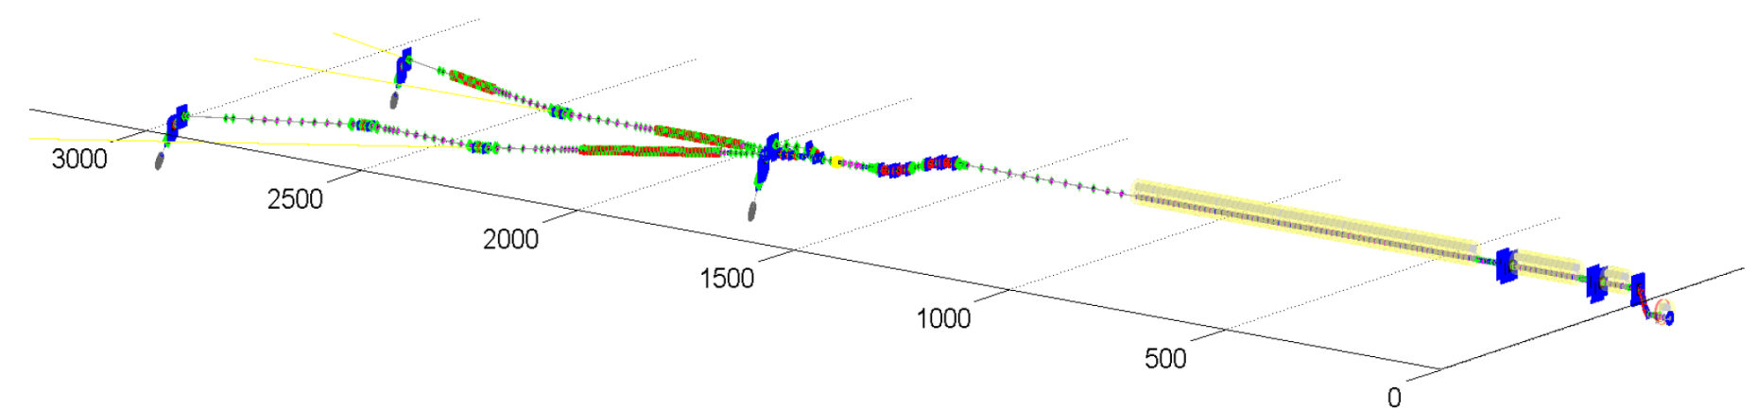
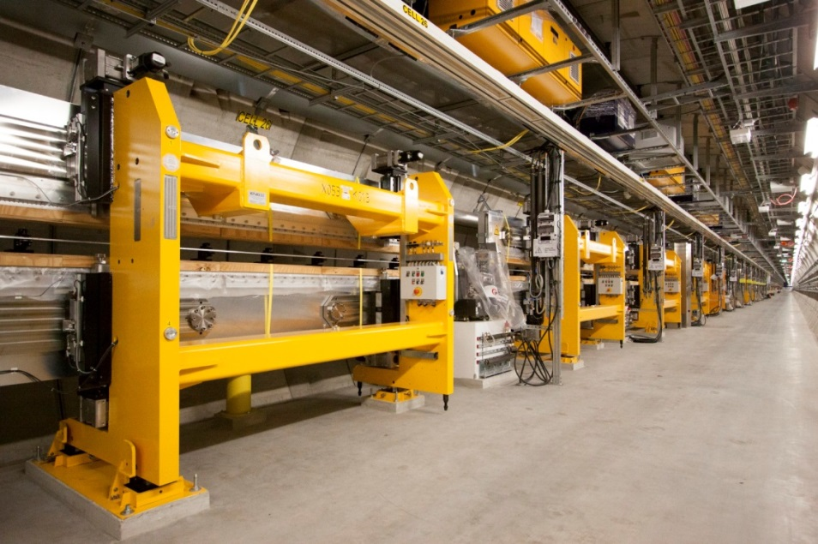
Undulator Systems
One of the requirements of the soft X-ray user community is the possibility to obtain variable polarization modes.
As a result, it was decided to build a helical afterburner in collaboration with Paul Scherrer Institute (PSI), using APPLE-X undulators
Photon Energy Range
Dumps
SASE 3
SASE 1
Switchyard
SASE 2
SC Accelerator
Dogleg
Injector
At the beginning the SASE1, SASE2 and SASE3 undulator systems were equipped with planar undulators that deliver a linearly polarized photon beam.

Slide 4
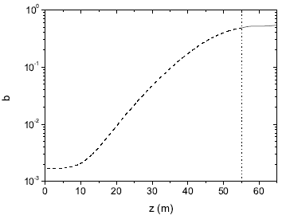
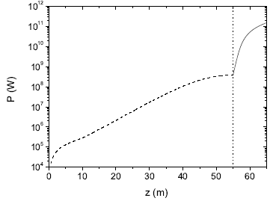
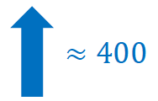
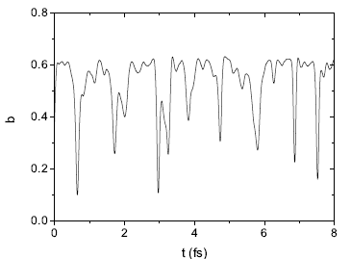
The method: reverse tapering of SASE3 planar undulators
Helical Undulators
Planar Undulators
Use the planar undulators in the reverse tapering mode to produce micro bunching but maximally suppress linearly polarized radiation power at the exit of the planar undulators
Once the micro bunching is saturated the beam radiates at full power in the helical afterburner tuned to the resonance
(E. A. Schneidmiller and M. V. Yurkov, Phys. Rev. ST+AB 2013, 16: 110702)
Evolution of the radiation power from reverse taper and afterburner.
FEL simulations - E. Schneidmiller and M. Yurkov, 2013.
Evolution of the micro bunching. Saturation length is ~55 - 60 m, i.e. 11 - 12 segments
Tao Wei, Peng Li, Yuhui Li, Joachim Pflueger, Proc. of SPIE Vol. 10237 102370J-1

Slide 5
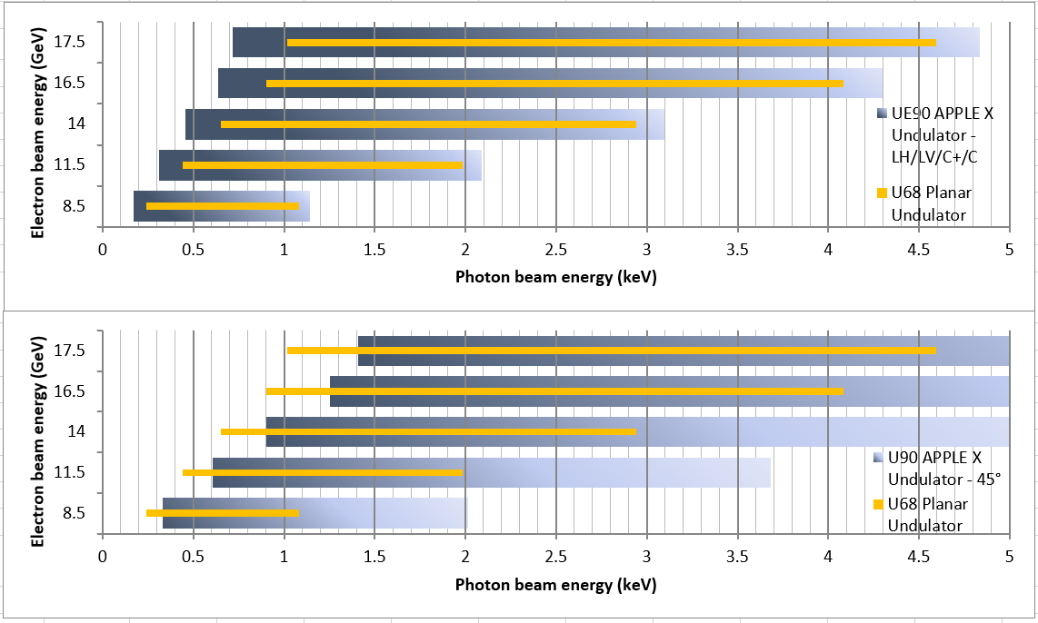
Photon beam parameters generated by the UE90 undulator
Polarization mode | LH/LV/C+/C- | Linear 45°/135°
K-Range | 9.40 − 3.37 | 6.62 − 2.36
Photon Energy Range [keV]
@8.5 GeV | 0.169 − 1.141 | 0.332 − 2.012
@11.5 GeV | 0.309 − 2.088 | 0.608 − 3.684
@14 GeV | 0.457 − 3.095 | 0.902 − 5.459
@16.5 GeV | 0.635 − 4.299 | 1.252 − 7.583
@17.5 GeV | 0.715 − 4.835 | 1.409 − 8.530
Calculated parameters based on measured K values.
Divergence of the radiation is about 4.7μrad
The radiation beam size is about 30μm
The source point is shifted downstream relative to the last SASE3 planar undulator by 14.8 m
Photon energies generated by helical UE90 and planar U68 undulators (gap variation only). The upper figure shows the case of vertically and horizontally as well as circularly polarized modes. The lower figure illustrates the case with linear polarization at an angle of 45°.

Slide 6
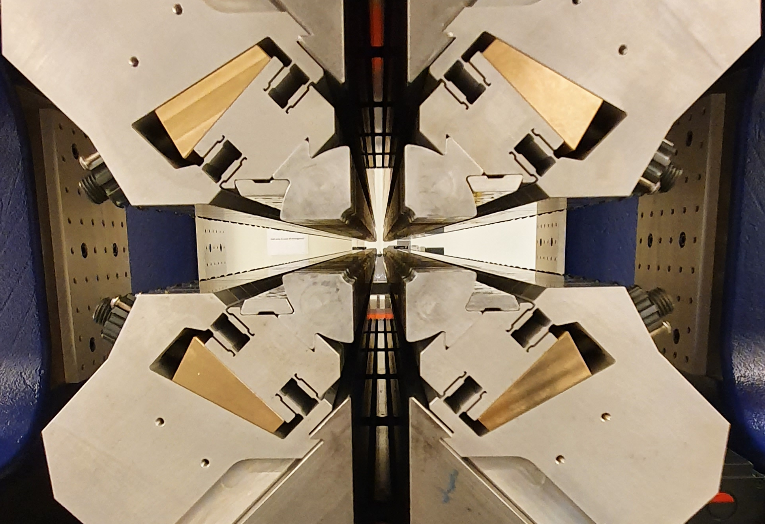
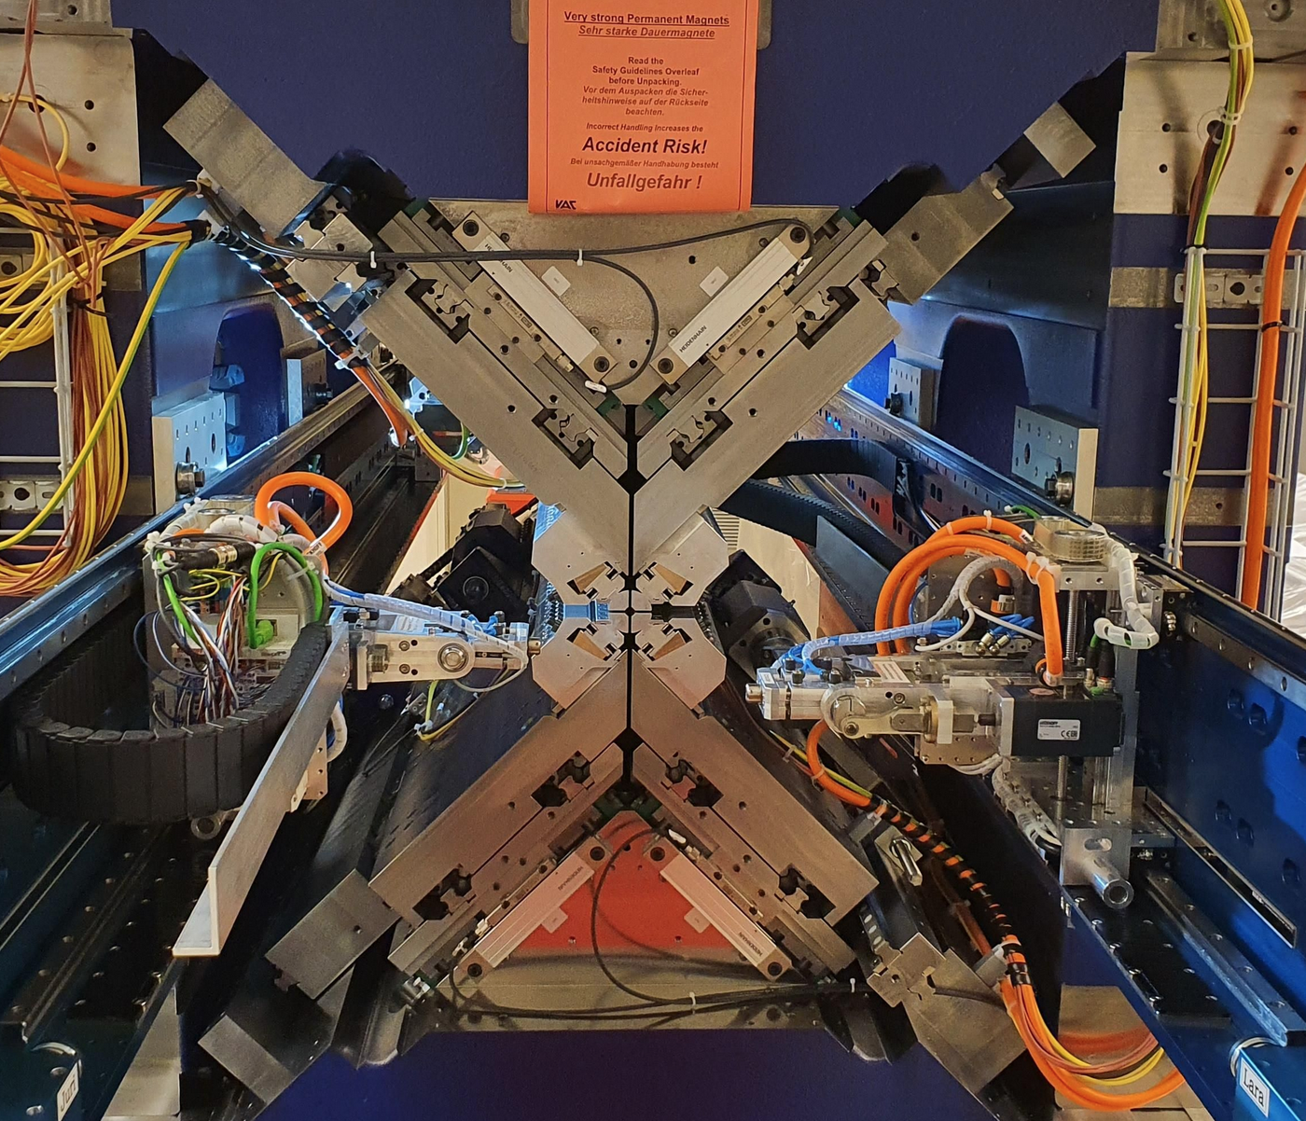
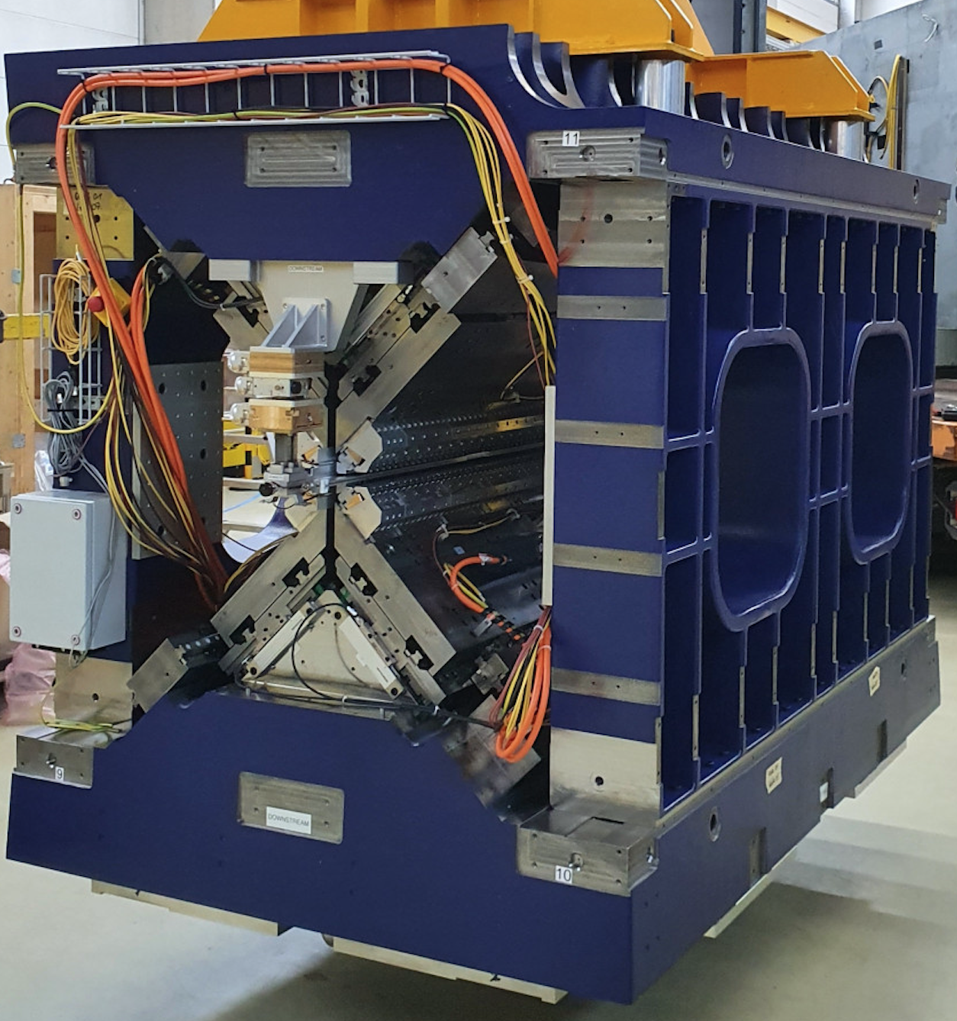
Mechanical and magnetic parameters of the EuXFEL APPLE-X (UE90) undulator
Undulator period length λ_{u} (mm) | 90
Undulator magnetic length (mm) | 1957.5
Full periods per undulator | 20
Gap variation range g (mm) | 12.5 − 31.6
Shift range of each quarter (mm) | ±45
PM material | NdFeB
PM remanent field B_{r} (T) | 1.26
Inner radius for beam pipe R_{in} (mm) | 5.25
Outer radius R_{out} (mm) | 23.5
Minimum slit L_{slit} (mm) | 4.4
Undulator parameter K_{eff} for circular mode (Gap variation only) | 3.38 − 9.59
Undulator parameter K_{eff} for linear horizontal/vertical mode (Either amplitude shift or gap variation) | 0 − 9.59
Undulator parameter K_{eff} for linear45° mode (Either amplitude shift or gap variation) | 0 − 6.76
Good field region (µm) | ±300
R_{in}
R_{out}
L_{slit}
g

Slide 7
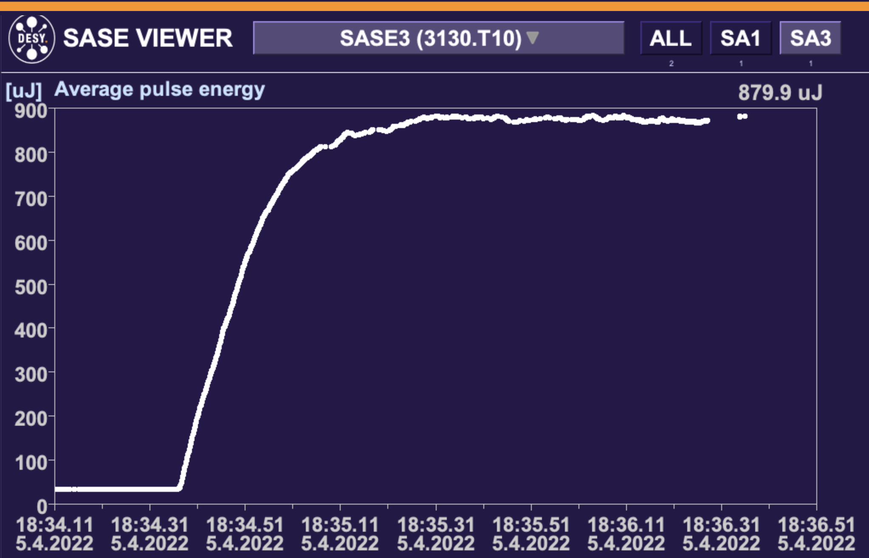
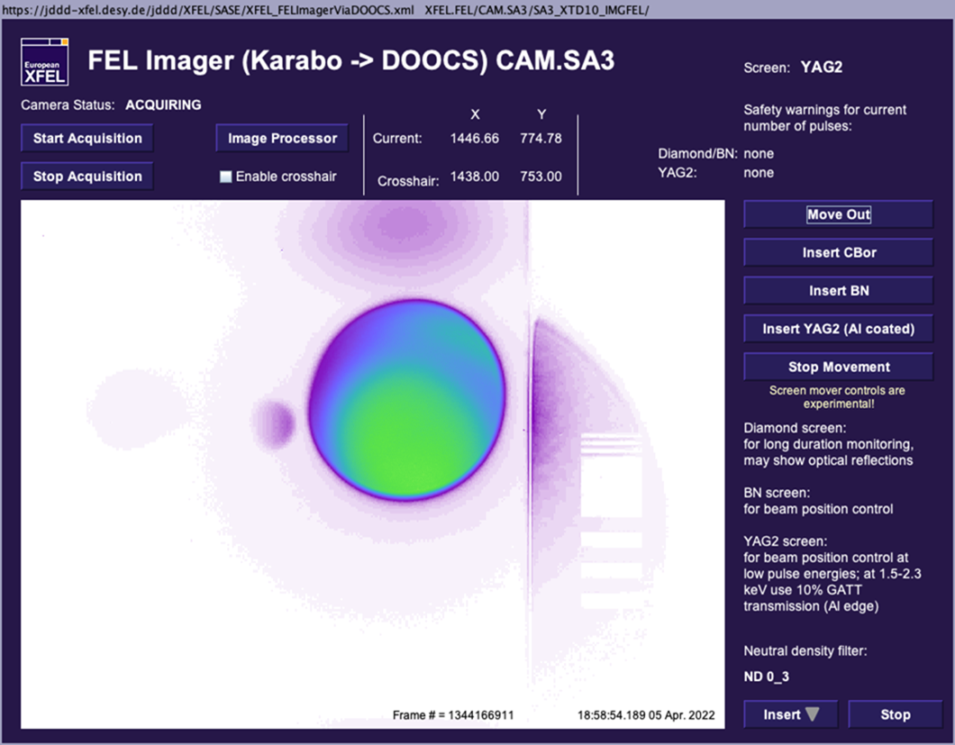
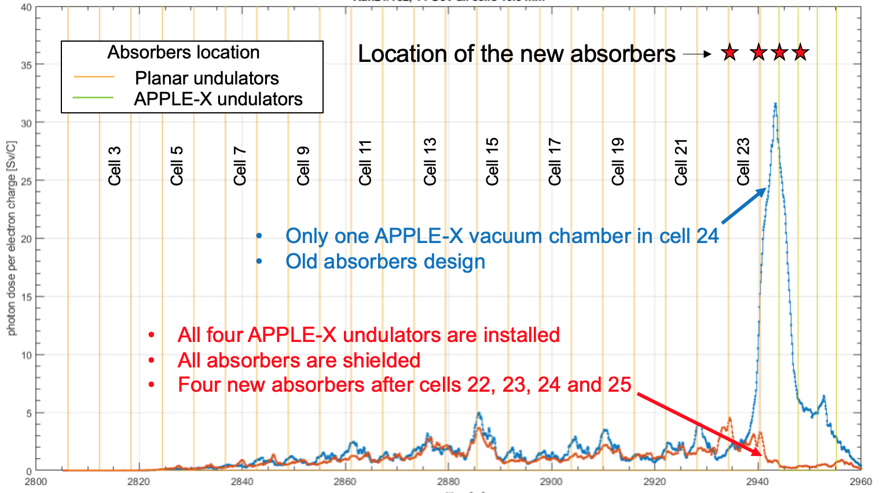
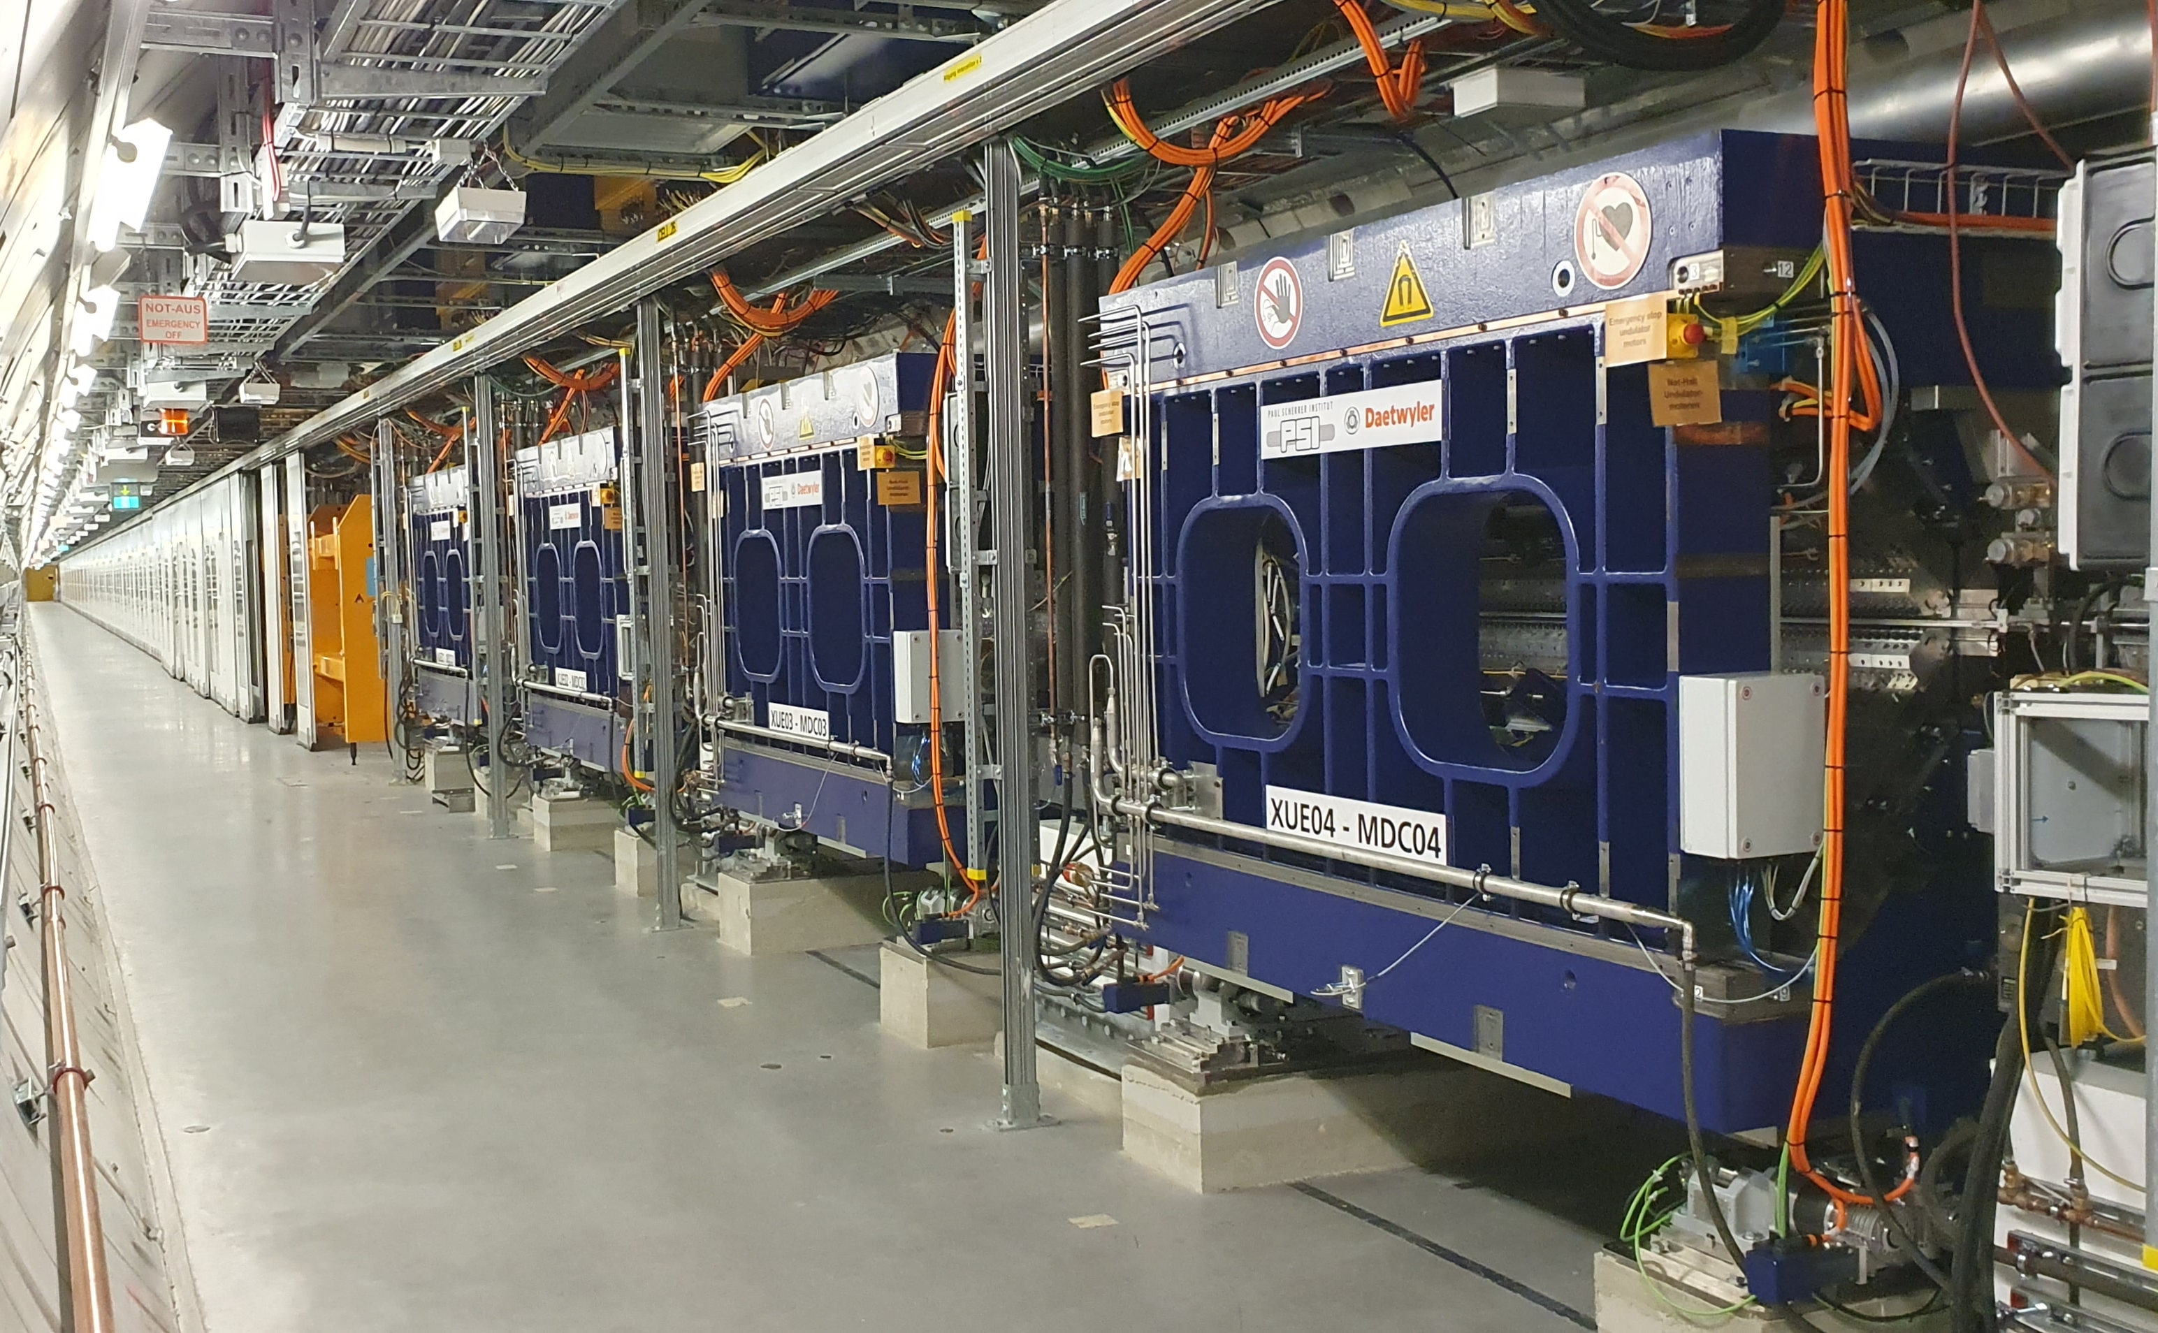
Apple-X undulator installation campaigns
First installation in winter shutdown 21/22 and lasing in April 5th
Radiation damages of the control components – spring 2022
Removing from the tunnel – summer 2022
Repair, investigation of the damage reasons – 2022-2023
  Reason – high-energy Compton scattering from the smaller diameter vacuum chamber of the APPLE-X undulator.
  Solution – a new absorber design
Re-installation in the tunnel – 23/24
Commissioning – 2024

Slide 8
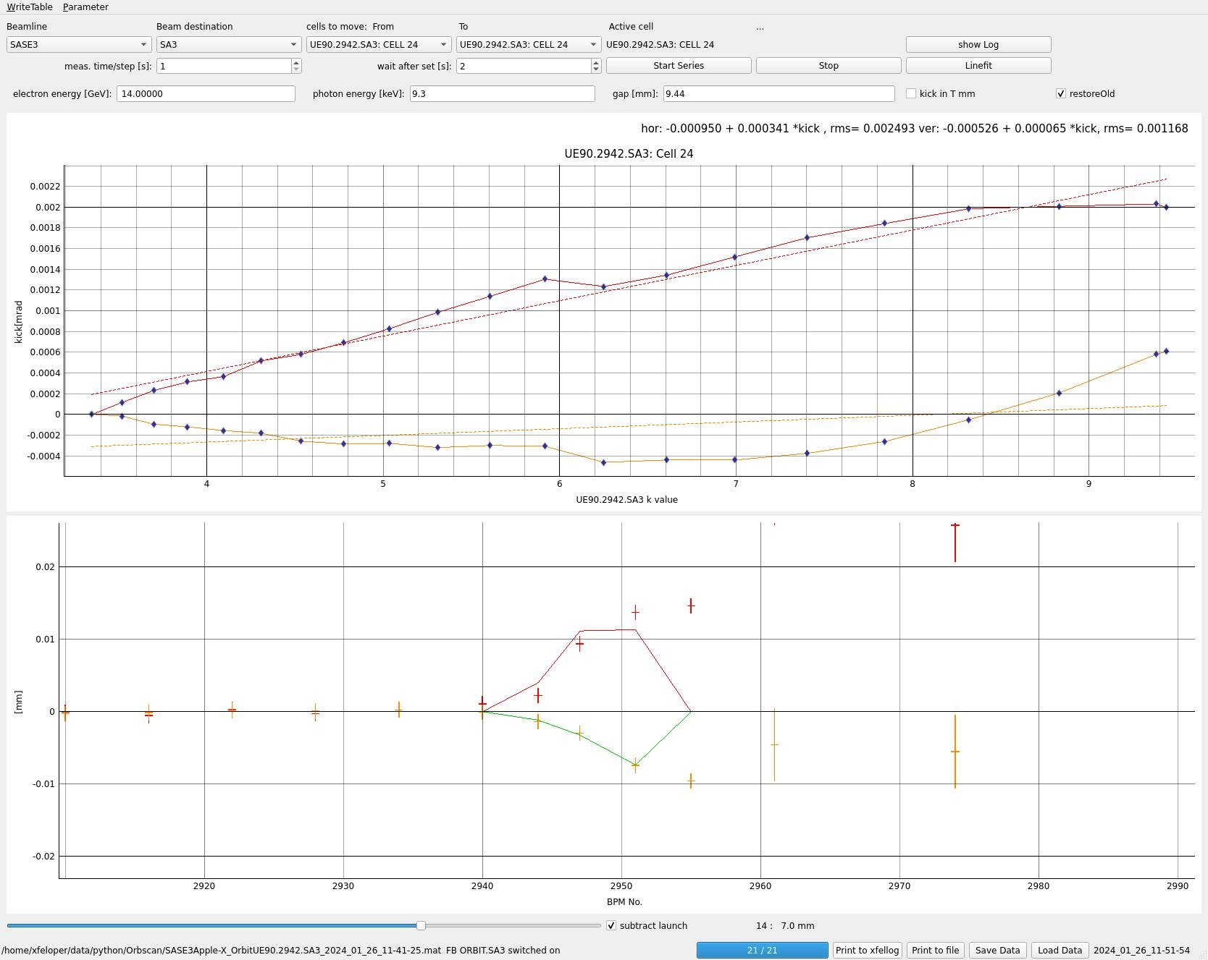
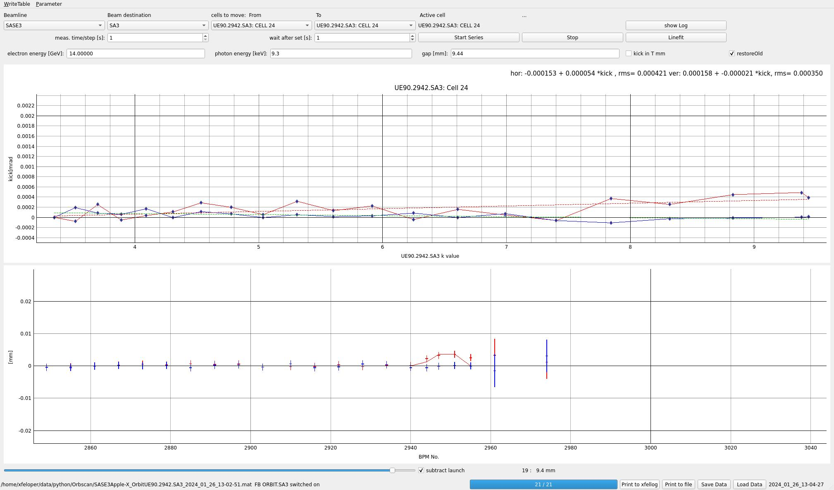
Commissioning of the kicks corrections using electron beam and based on the magnetic measurement results
Horizontal kick without auto corrections
Kick [mrad]
Horizontal kick with auto corrections
K value
Vertical kick without auto corrections
Vertical kick with auto corrections
Automatic kick correction by means of the correction coils keeps the beam within a solid angle of 1µrad, thus within the undulator good field region.

Slide 9
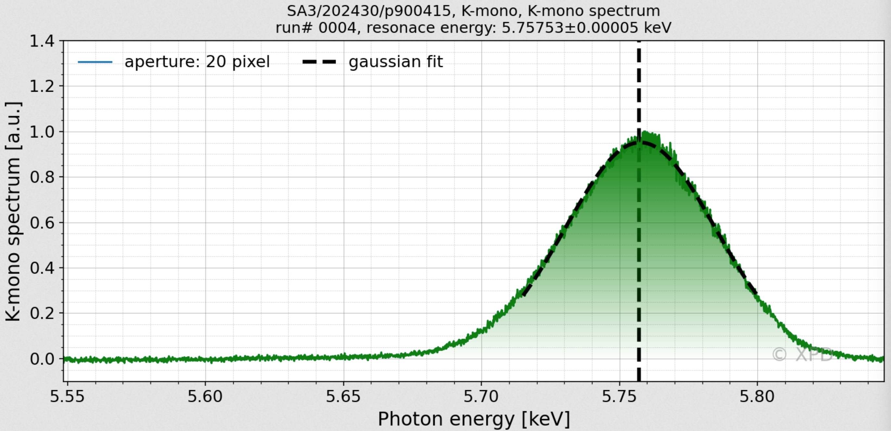
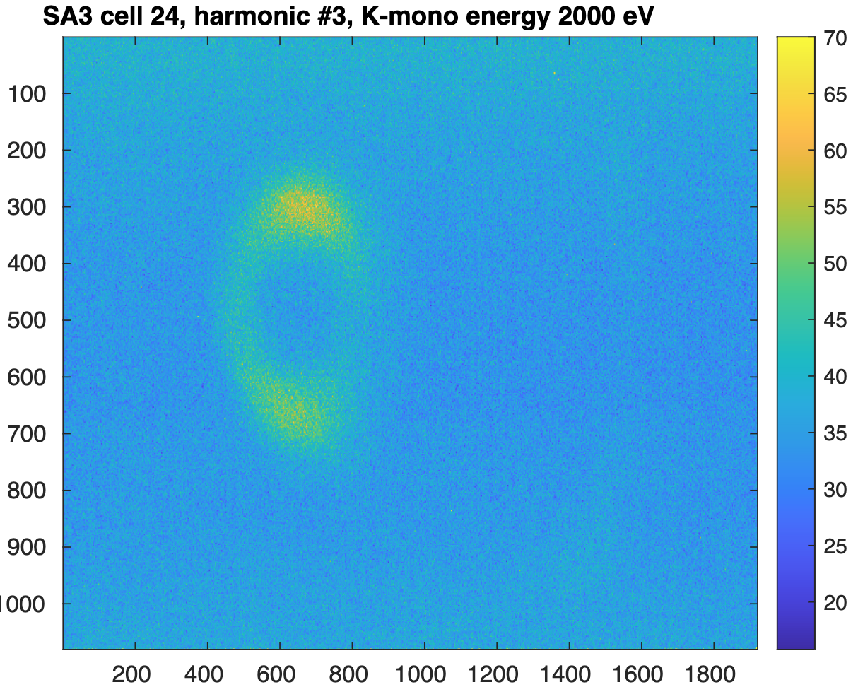
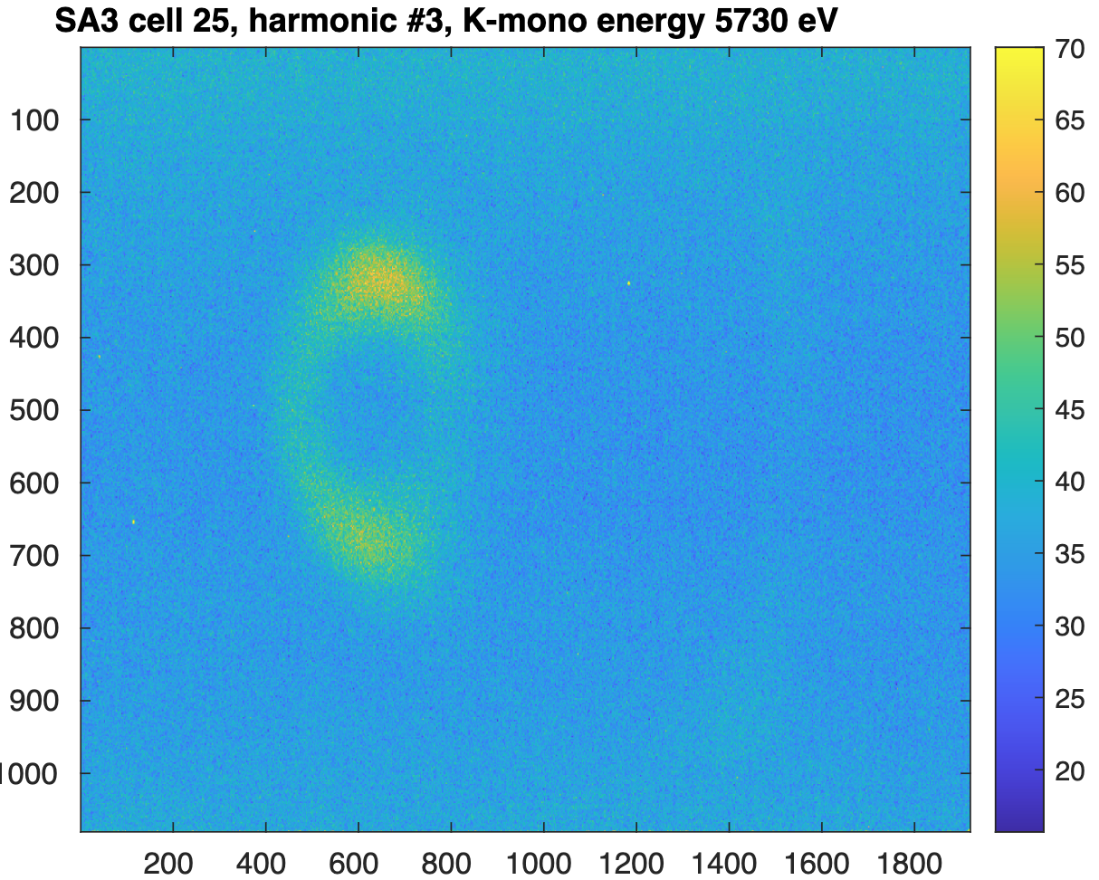
K-mono measurements of the neighbouring undulators
K values were measured using a K-monochromator.
The deviation of the resonance energy for two neighbouring undulators results in the calculated ΔK/K value of 6.15x10⁻⁵
Similar results are obtained for the other undulators
Cell 24
Cell 25

Slide 10
Afterburner optimization goals
The most important property is polarization purity, which is defined by contrast
Contrast is the ratio of the pulse energy when APPLE-X undulators are brought into or out of resonance
Pulse energy from SASE3 planar undulators must be minimized
Pulse energy from APPLE-X as high as possible
Good transverse shape and pointing of the photon beam

Slide 11
Tuning strategy
Coarse tuning of SASE3 planar undulators:
  The main goal is to establish proper suppression of SASE3 intensity keeping bunching preservation
  APPLE-X in “no light” mode or far from resonance
Coarse tuning of APPLE-X: optimize orbit and K-value
Fine tuning of SASE3 planar undulators: optimize reverse taper strength and number of segments
Fine tuning of APPLE-X undulators: further orbit improvement, phase shifters optimization, vary positive linear or quadratic taper

Slide 12
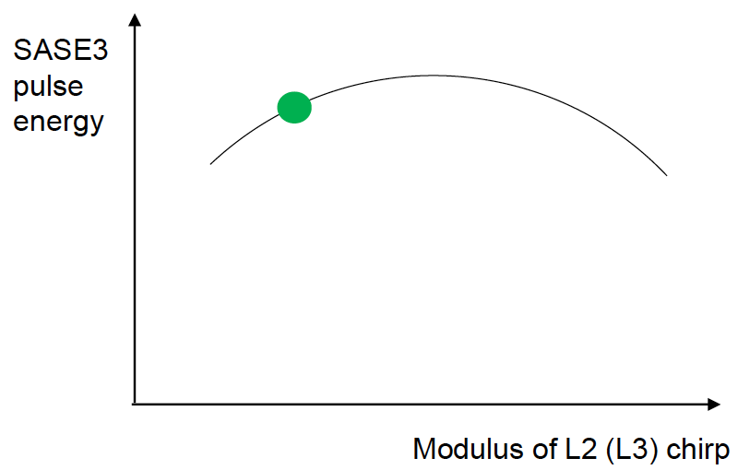
Coarse tuning of SASE3 planar undulators
Start with normal SASE tuning without APPLE-X undulators.
Vary number of segments to be roughly at saturation aim at
~2 mJ (typically 9 – 12 segments);
The beam compression must be relaxed. This can be achieved by reducing the energy chirp in Linac 1 or Linac 2 from the optimum SASE settings (it usually reduses the puls energy by up to 10%;
Make sure that the beam is not far from the center on FEL imager;
Apply reverse linear taper (can vary from -150x10⁻⁵ to
-240x10⁻⁵ in terms of ΔK/K per cell). The pulse energy should be ~ a couple of tens µJ.

Slide 13
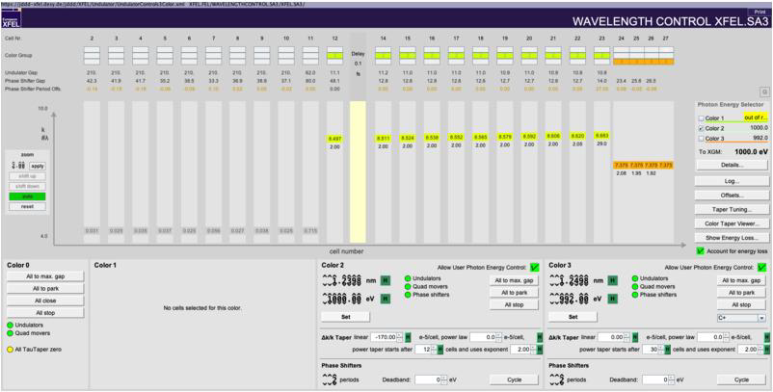
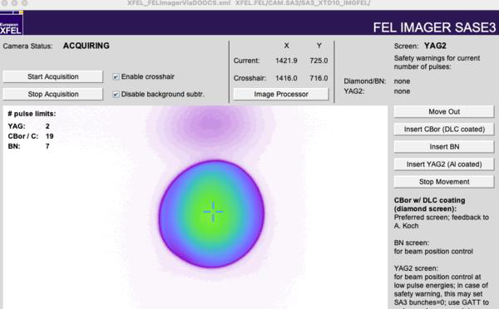
Coarse tuning of APPLE-X: optimize orbit and K-value
Put in the resonance all 4 segments in C+ (or C-) mode and optimize photon energy (the optimal photon energy value is usually lower than planar undulators by roughly 10 eV)
Close APPLE-X segments one by one and optimize steerers in front of the each segment using correction coils and quadrupoles if needed.
Watch FEL imager to get a homogeneous and symmetric central spot

Slide 14
Fine tuning
SASE3 planar undulators:
  Optimize both the contrast and the pulse energy from APPLE-X
  Vary two main parameters: number of segments and linear or quadratic negative taper strength
  As a refinement, play with phase shifter in front of the last planar segment, and with K-offset of this segment
APPLE-X undulators:
  Perform the phase shifter scan in the afterburner area
  Vary linear or quadratic positive taper
  Do fine adjustment of orbit and photon energy

Slide 15
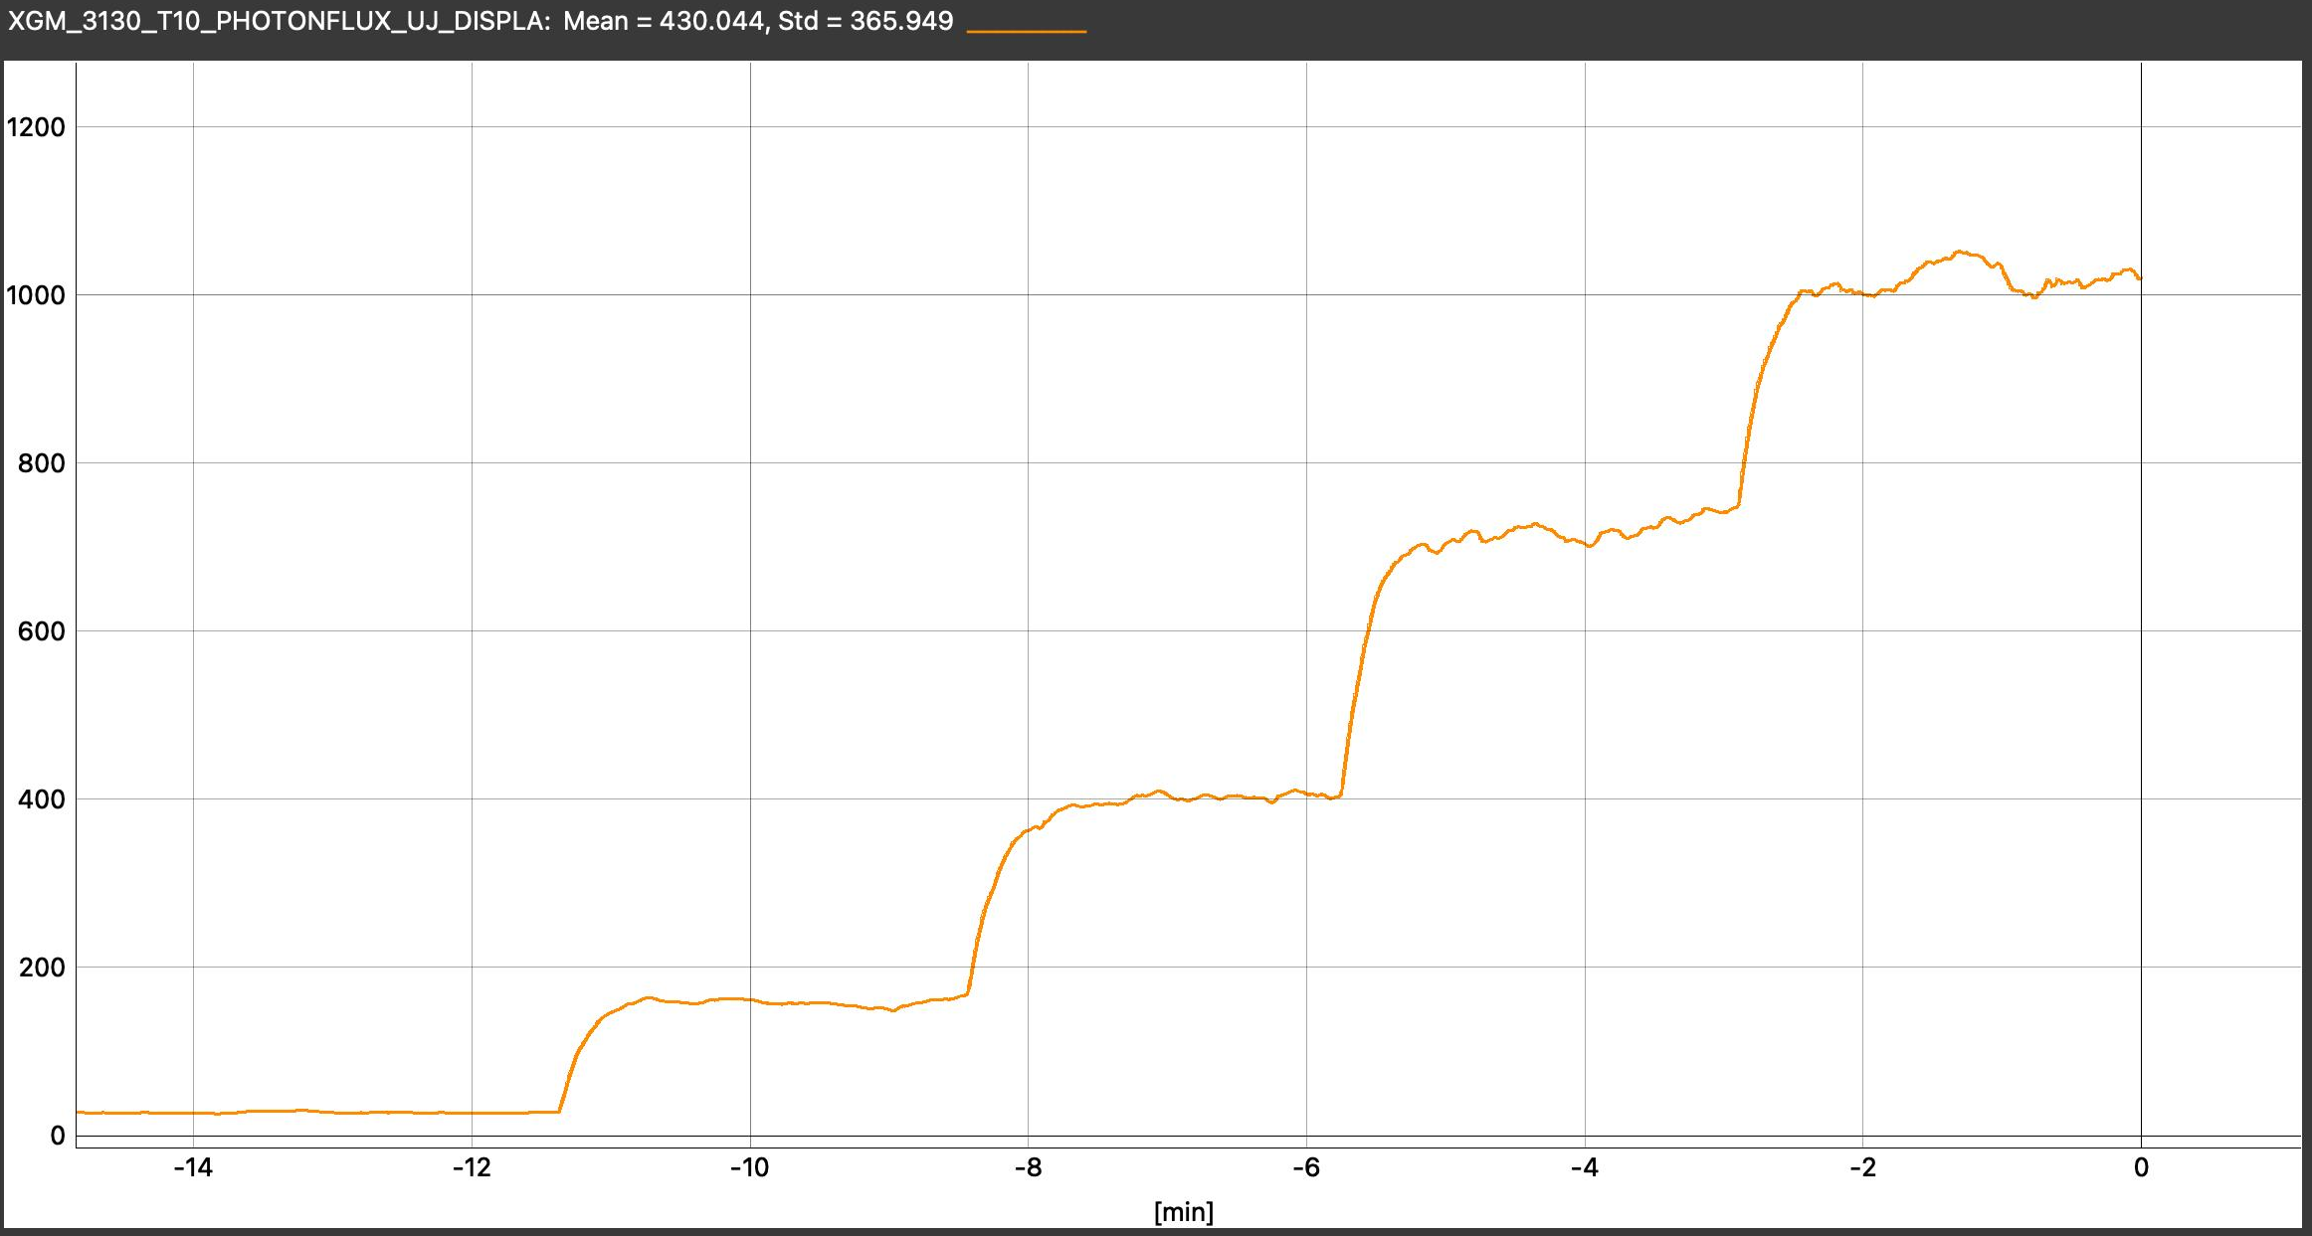
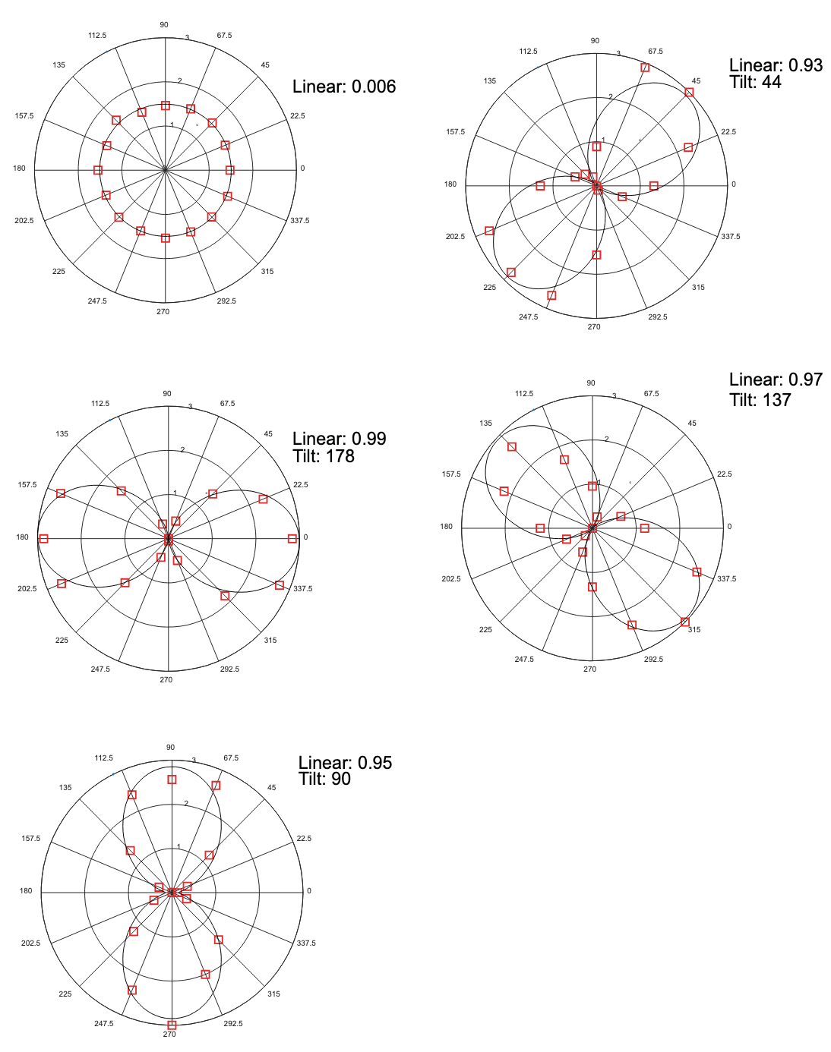
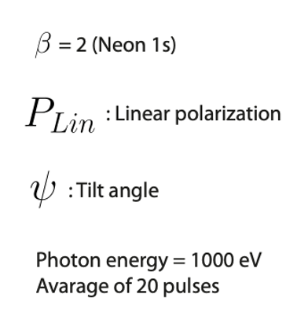
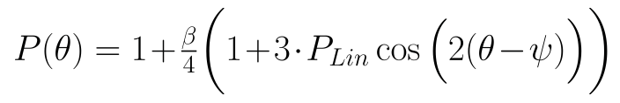
Achieved performance
Number of segments and reverse taper strength are close to simulations from 2013;
Usual achieved pulse energy
@1 keV is 1 – 1.5 mJ. Reliable contrast between linear and circular polarization is ~ 100
Presently, the best contrast is 160 @ 1keV in C+ mode. Puls energy 700µJ with quadratic reverse taper
APPLE-X 4
in resonance
APPLE-X 3
in resonance
Last 12 planar undulators
in reverse taper mode
APPLE-X 2
in resonance
APPLE-X 1
in resonance
The purity of the different polarization modes is controled (LH, C+, -45°, LV, C-, +45°) using pulse-resolved polarization detector

Slide 16
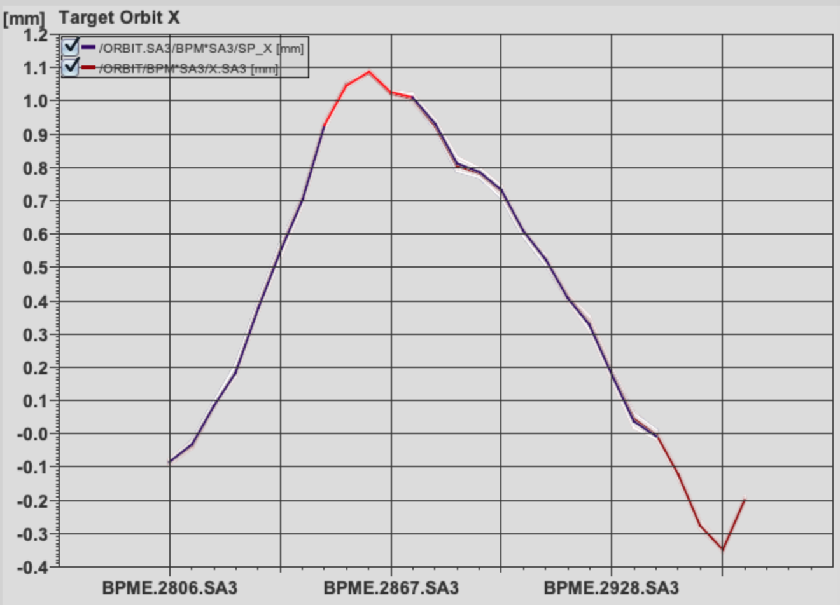
Attempt to implement a microbunch rotation
Apple-X
undulators
Quadrupole
SRA Slits
To increase the contrast, the micro-bunch rotation experiment* was reproduced
  The e-beam orbit is set to a triangular form with a peak of ~1.4 mm in the centre of the SASE3
  Only the second half is in resonance
  Quadrupole is used to deflect the beam back and direct it to the APPLE-X undulators
  Spontaneous Radiation Aperture (SRA) slits are used to shield the radiation from the planar undulators
SASE3 planar undulators
e-beam
FEL imager
Out of resonance
In resonance
1.4 mm
*Lutman, A., MacArthur, J., Ilchen, M. et al. Polarization control in an X-ray free-electron laser. Nature Photon 10, 468–472 (2016).

Slide 17
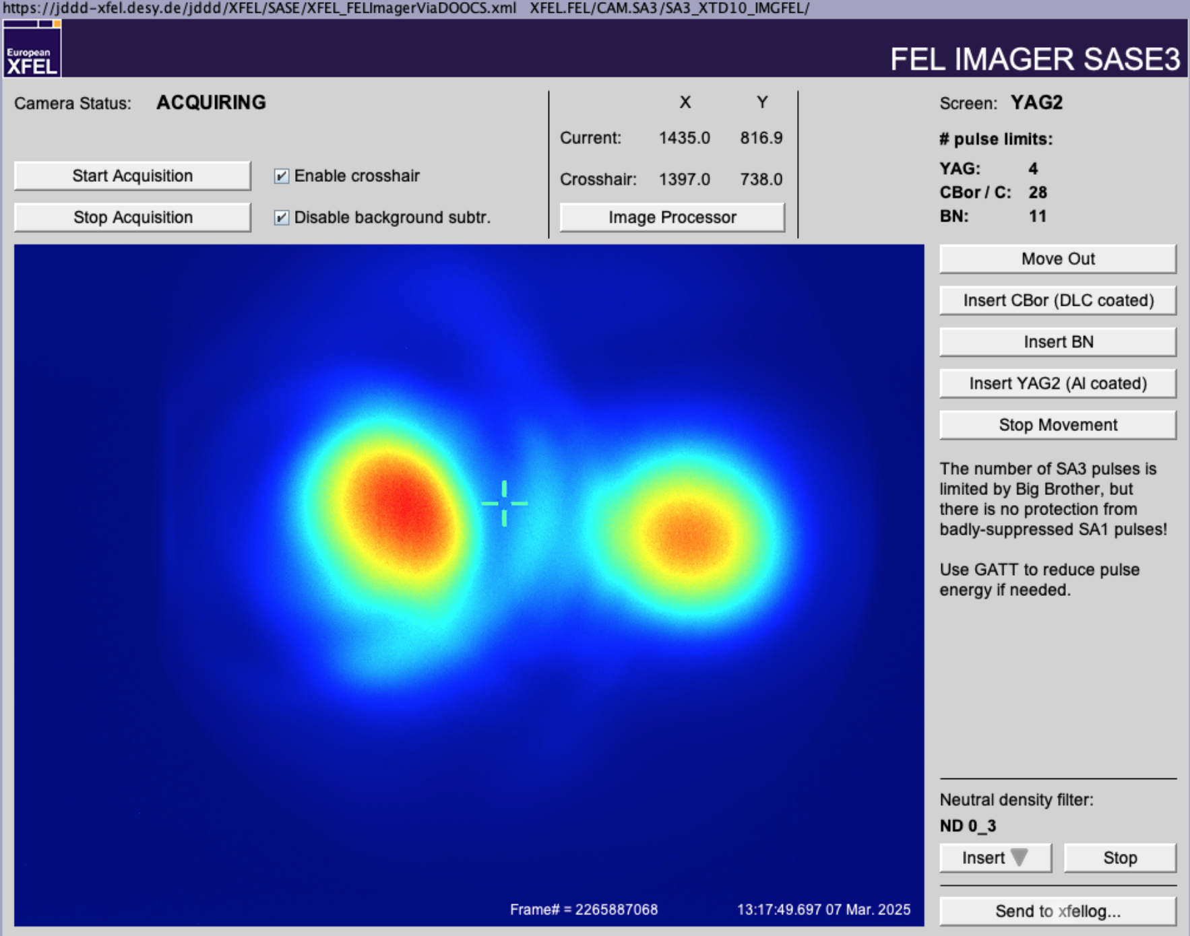
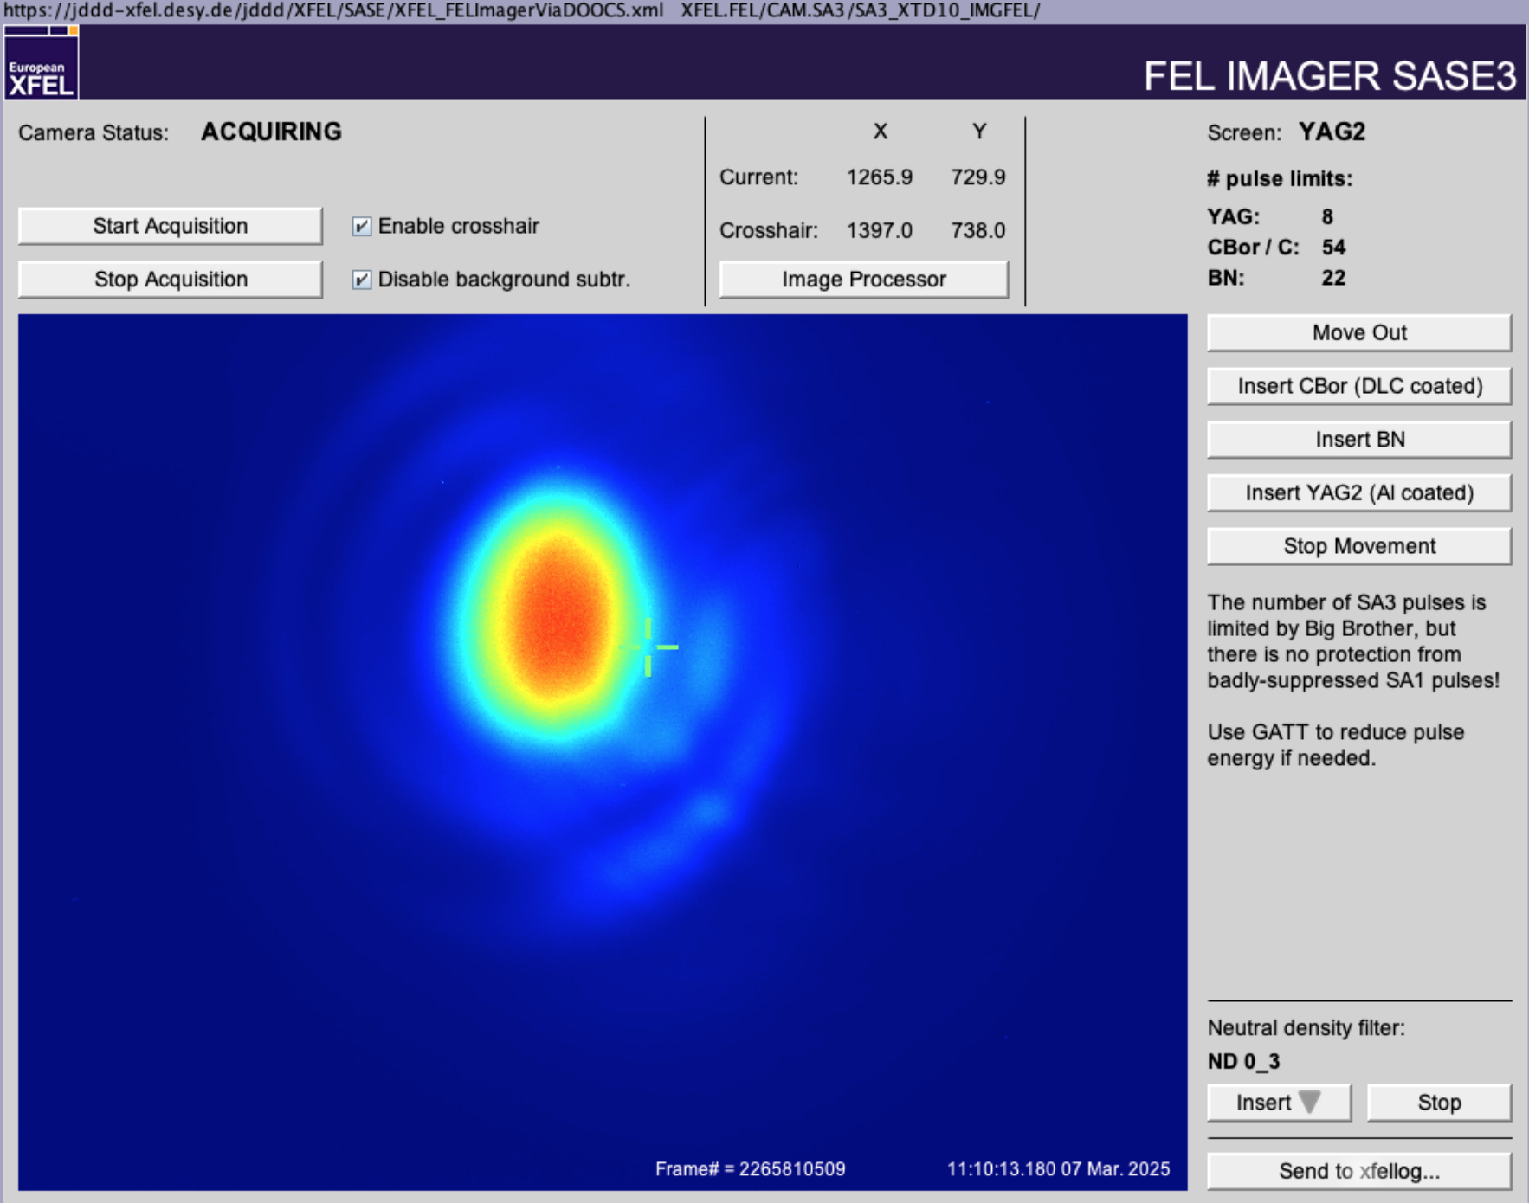
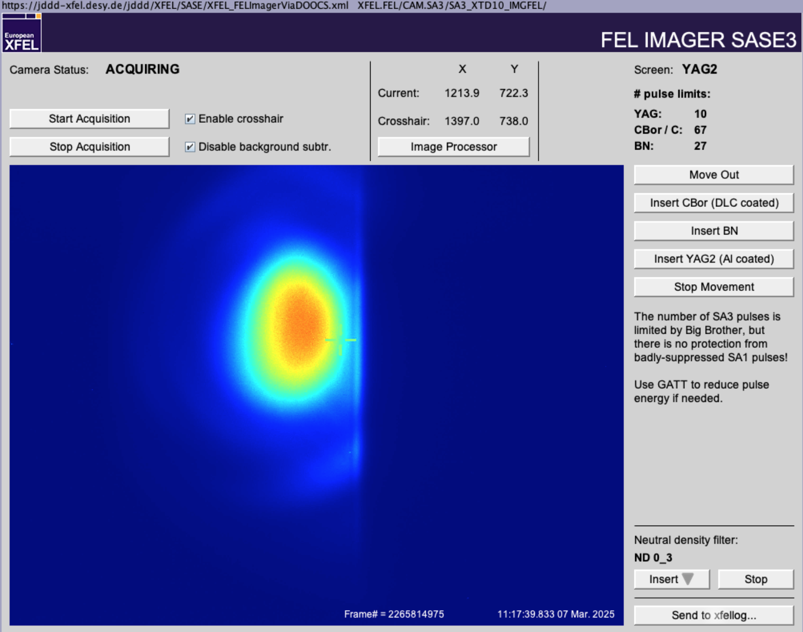
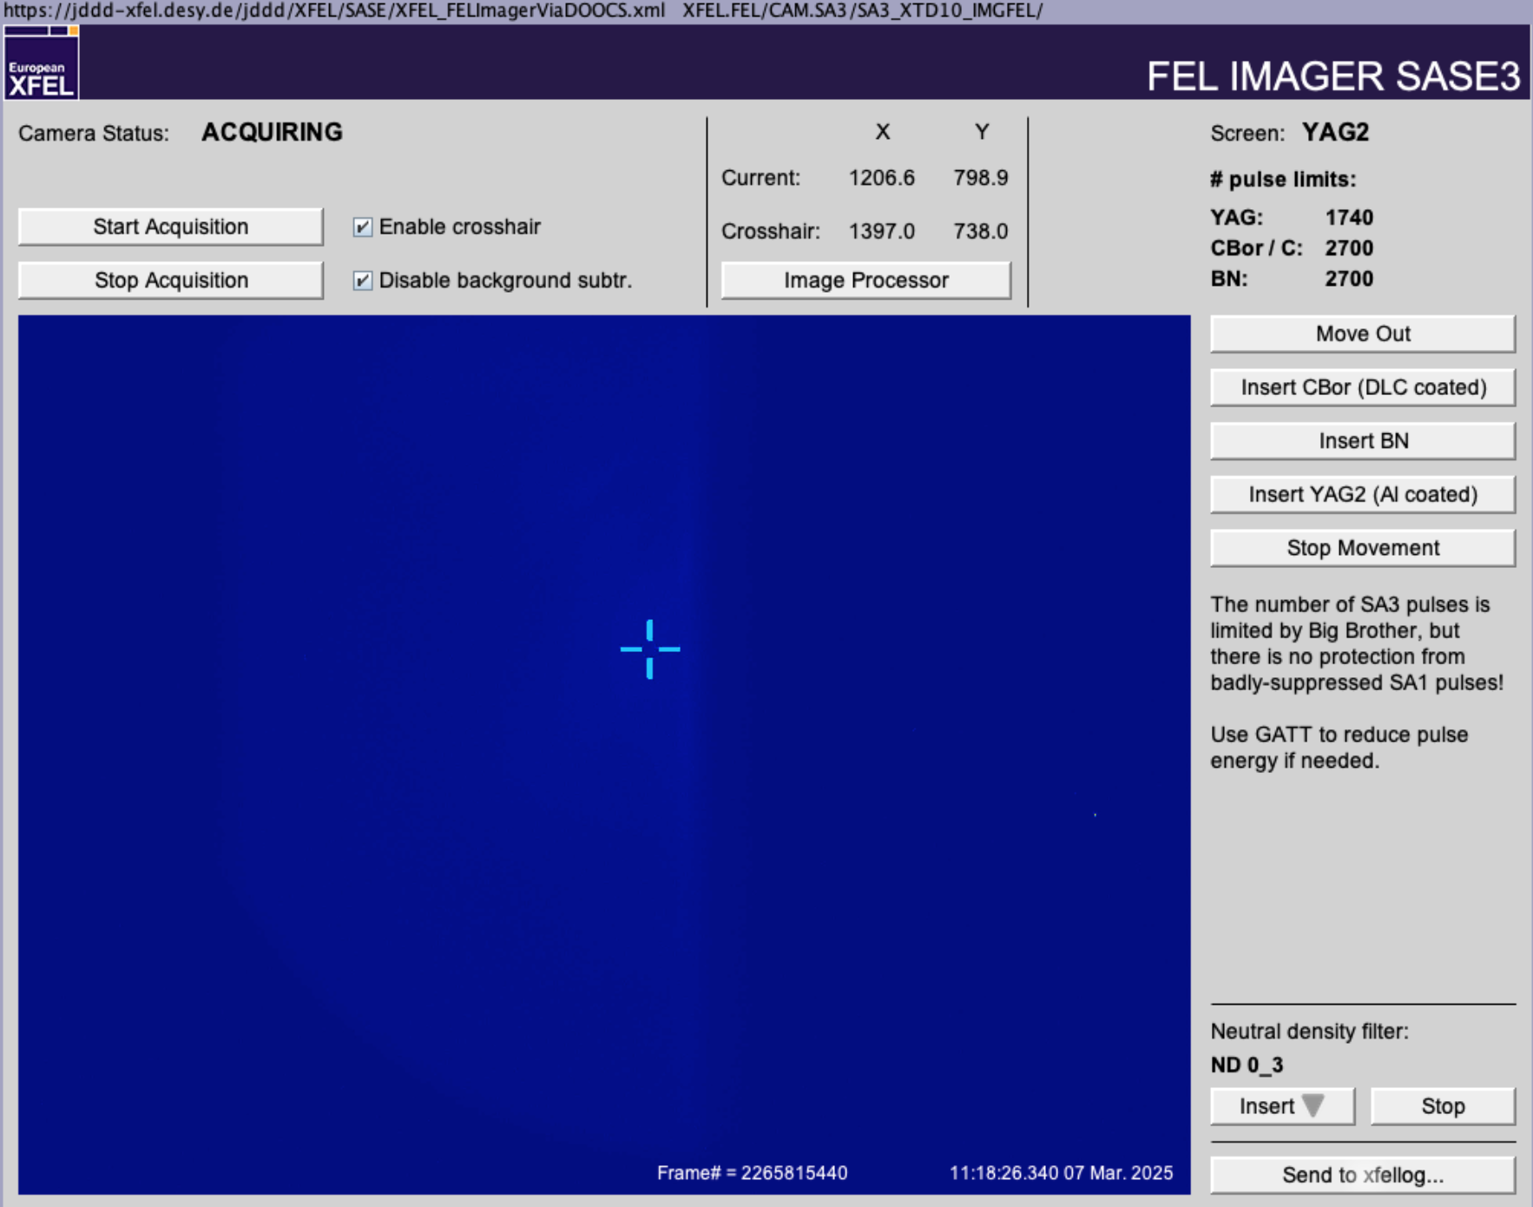
Attempt to implement microbunch rotation mode
The circularly polarized photon beam was separated from the linearly polarized.
The linear polarization was suppressed by a reverse taper
The right-hand blade of SRA slits was used to shield the spot area of the linearly polarized light
The contrast is measured by setting APPLE-X in or out of resonance.
Presently, the best contrast is 170 @ 1keV in C+ mode. Puls energy 700 µJ

Slide 18
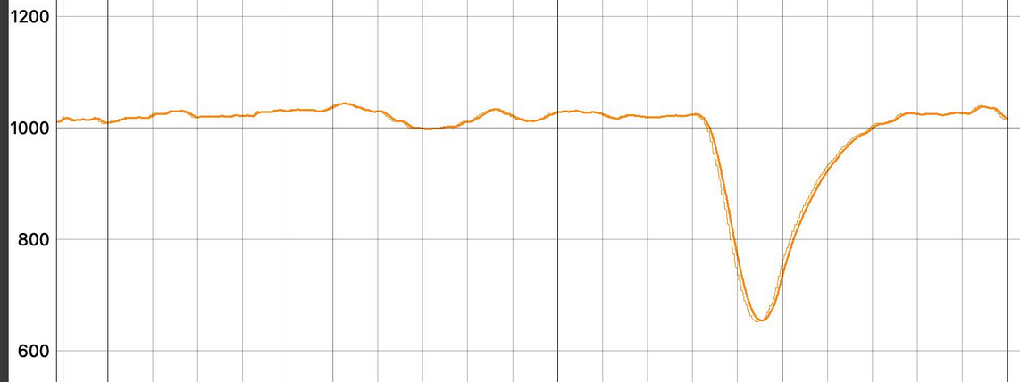
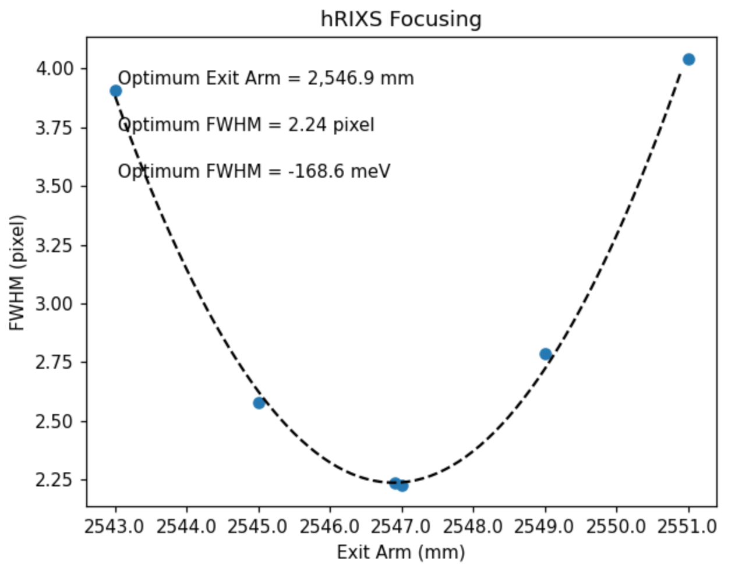
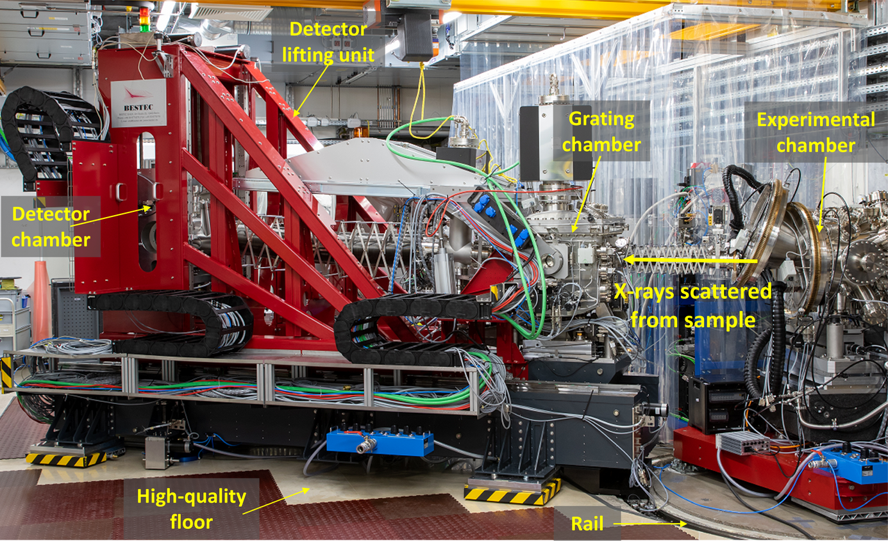
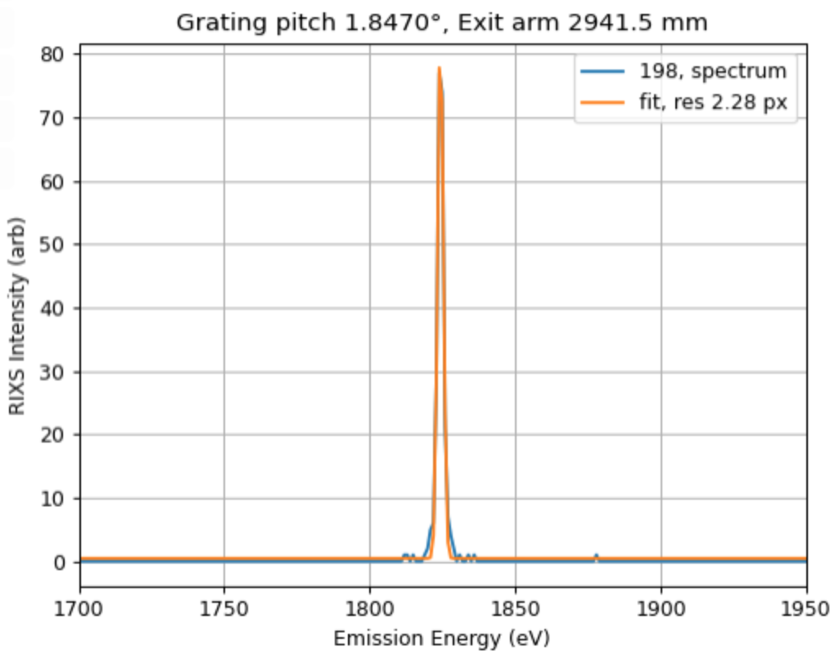
Typical operation modes
25 sec
Most common operation mode is circularly polarized mode (C+ or C-)
Switching from C+ to C-, which normally takes a few seconds.
  Automatic kicks compensation is necessary and very effective
C+ mode
C- mode
Linear Vertical (LV) mode for optimization of Resonant Inelastic X-ray Scattering (RIXS) spectrometer
  LV polarization is used to obtain a strong elastic line ➝ best S/N ratio
min.
  Fine optimization must be carried out for each energy and each scattering angel before the experiment starts.

Slide 19
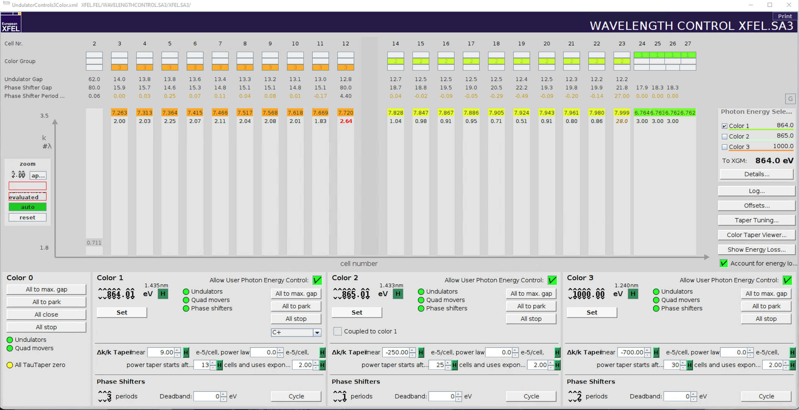
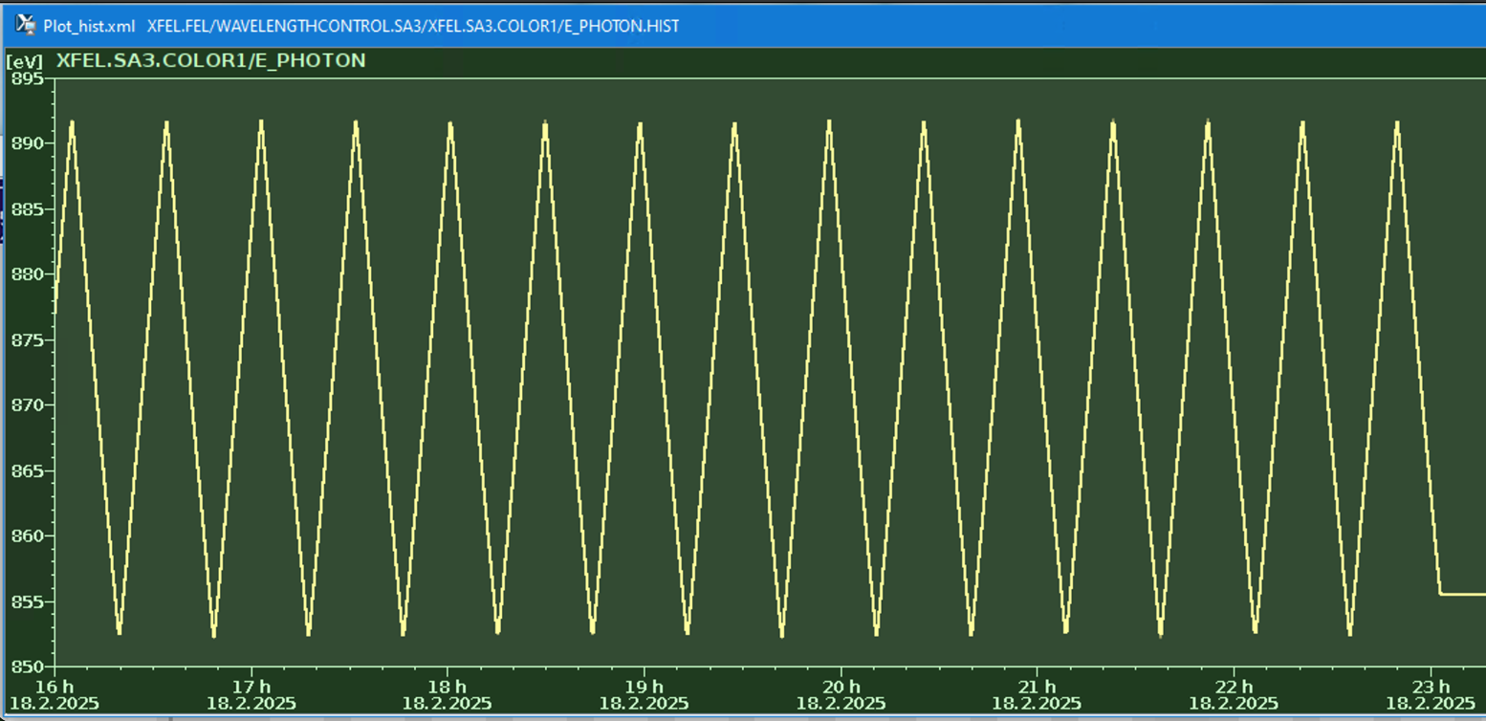
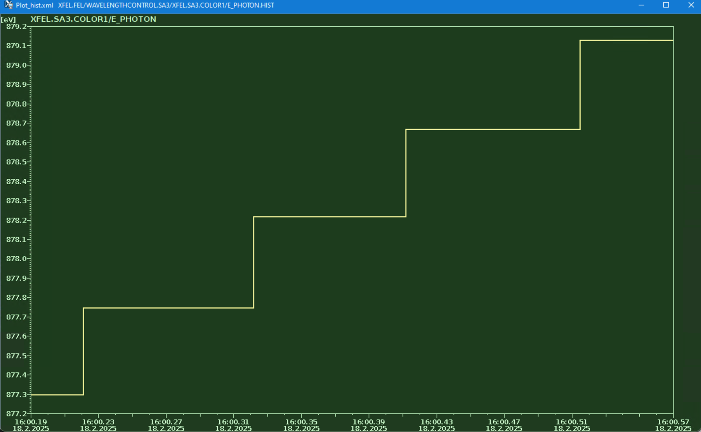
Typical operation modes
Two colors
  + variable polarization
Energy scan mode
  The afterburner is set to main color #1, while the planar undulators are following the photon energy of the color #1
  Typical energy-
    scan range - 50 eV
50 eV
0.5 eV
    step - 0.5 eV

Slide 20
Conclusions
After final commissioning in 2024, the variable polarization afterburner is in stable operation
Number of segments and reverse taper strength are close to simulations from 2013
Maximum achieved contrast is 170
We are working on improving the contrast parameter, in particular using the microbunch rotation method
Thank you for your attention!

