Slide 1
Operation Experience of Insertion Devices at the MAX IV Laboratory
M. Holz
ID25 Workshop 31st May & 1st June 2025
Taipei, Taiwan

Slide 2
Outlook
Universal Mode for EPUs
Machine Learning for Orbit Correction
Other Projects

Slide 3
Universal Mode for EPUs (TUPM066)

Slide 4
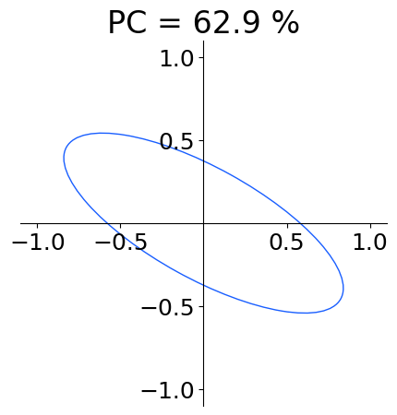
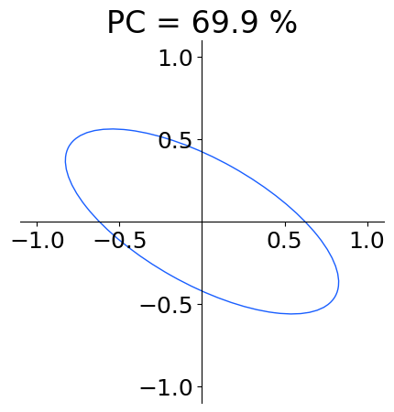
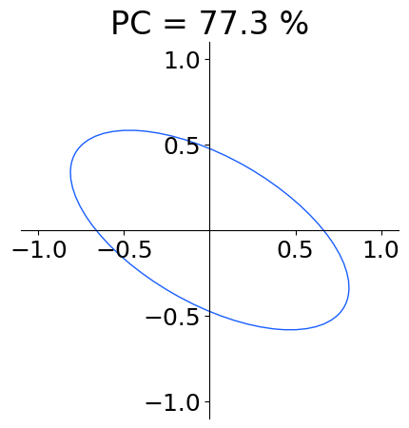
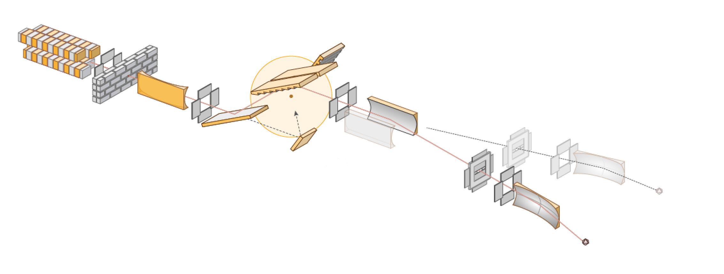
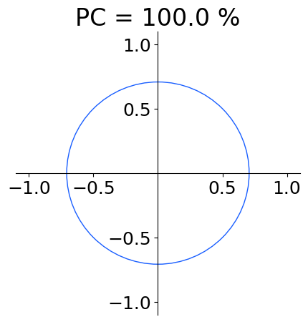
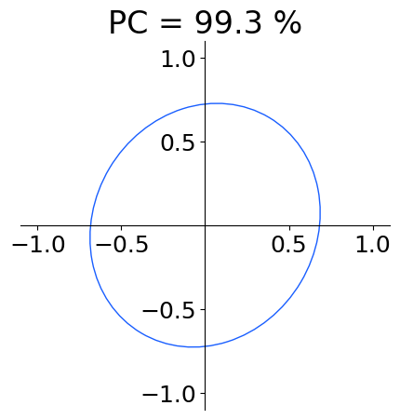
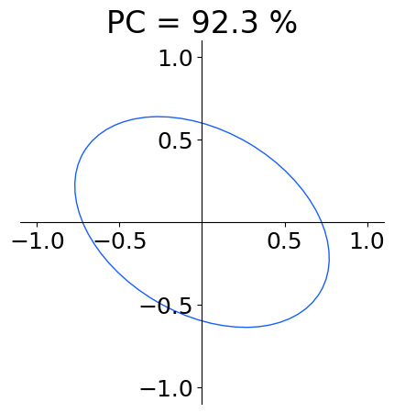
Universal Mode for EPUs (TUPM066)
The Scientific Case
Beamline optics distorts polarization state of light (aggravated at energies < 80 eV)
Example: Circular polarized light
Is there a way to preserve the polarization state other than different beamline optics?
Reasoning: Do the wrong thing at the ID to get it right at the sample! → We need the beamline transfer function for polarization states.
(Mats Leandersson, Kirill Chernenko)
Focus B
Focus A
Source

Slide 5
Universal Mode for EPUs (TUPM066)
Dynamic Multipoles
Maximum effective fields and long undulator periods create strong dynamic multipoles
Low beam energy of 1.5 GeV
Multipole estimation via kick-maps from 3D magnetic models
Multipoles are not symmetric
Parameter | EPU84 | EPU95
Period Length | 84 mm | 95.2 mm
# Periods | 32 | 25
Max. K | 8.65 | 10.4
Max. Eff. Field | 1.10 T | 1.17 T
Min. Magn. Gap | 14 mm | 14 mm
Min. Photon Energy | 8 eV | 4.2 eV
Multipole strength of EPU95 at a gap of 14 mm & phase shifts of -45 mm / -20 mm of helical / inclined
Source

Slide 6
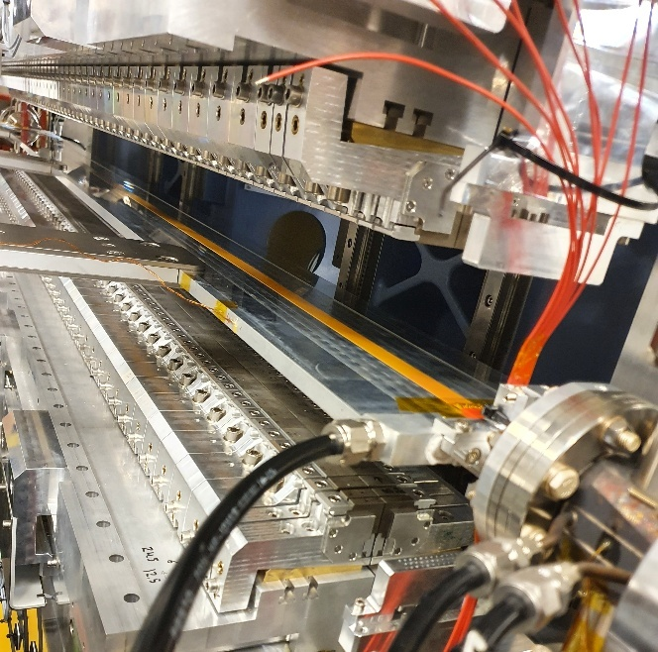

Universal Mode for EPUs (TUPM066)
Dynamic Multipole Correction (1)
Flexible flat cables (8 conductors) mounted on vacuum chambers (top and bottom)
Cables are cross-wired
Enables creation of quadrupole- and octopole field components (both normal and skew)
Uses chamber water cooling
Conductors individually powered
But what currents should we set?
Source

Slide 7
Universal Mode for EPUs (TUPM066)
Dynamic Multipole Correction (2)
Use kick-map estimations as basis for the correction
Multi-objective genetic algorithm (MOGA)
  Objective 1: minimize field integral residuals
  Objective 2: minimize total power/heat load
Dynamic multipole compensation, strip excitation and heat load calculated via
Multi-objective genetic algorithm
Source

Slide 8
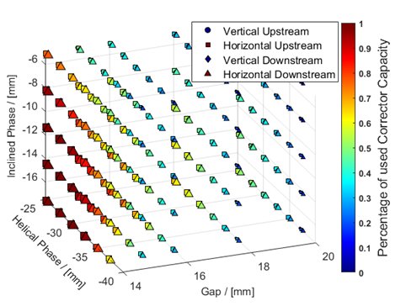
Universal Mode for EPUs (TUPM066)
Static correction
2 local dipole correctors (attached to ID)
Universal Mode creates quite large field integrals
Pushes local correctors close (some cases into) saturation
Leftovers need to be taken care of by the global orbit feedback
Source

Slide 9
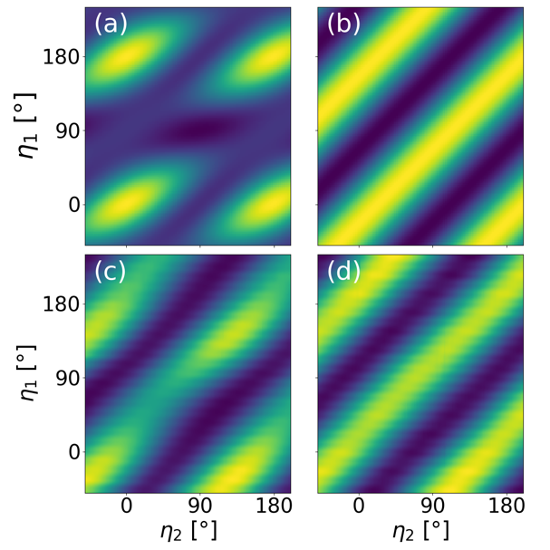
Universal Mode for EPUs (TUPM066)
Experimental Results
EPU84: Simulated intensity maps for a 40 eV photon beam with (a) LP and (b) CP (c) Measured intensity for CP produced by the EPU without compensation. (d) Same measurement with EPU compensation
EPU95: Measured degree of linear polarization for circularly polarized light at FinEstBeams. Lower is better
Source

Slide 10
Machine Learning for ID Orbit Correction
(THPM025)

Slide 11
Machine Learning for ID Orbit Correction
(THPM025)
Motivation:
Beam orbit distortions by Insertion Devices currently corrected with measured feed-forward tables → Very time consuming
Tables might be invalidated over time, or with different machine parameters (e.g. long-term drift, machine upgrades (see MOPS061))
New modes of ID operation can require several hundreds of measurement points e.g. universal mode (see TUPM066)
Prototyping of ML models that effectively replace
measured feed-forward tables

Slide 12
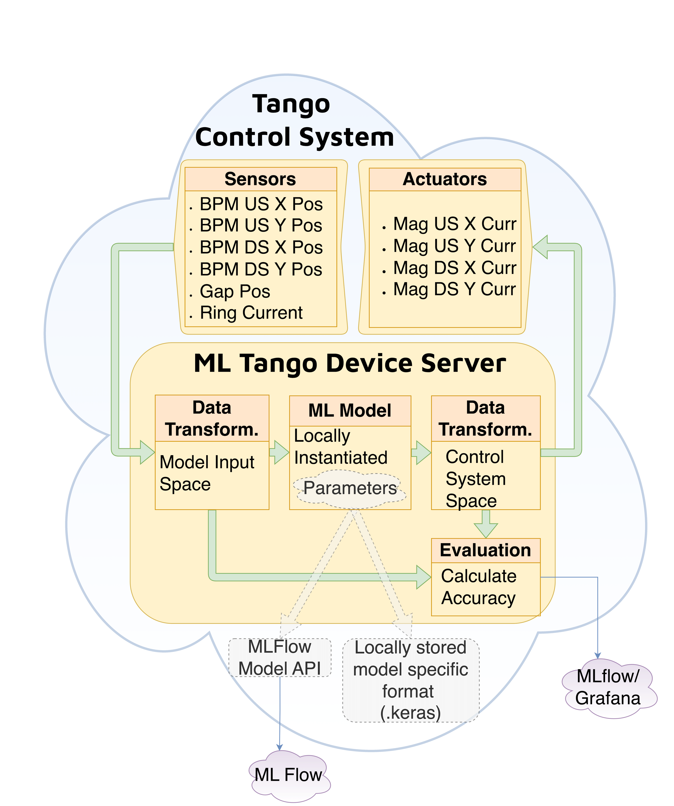
Machine Learning for ID Orbit Correction
(THPM025)
Main developer:
Carla Takahashi
Design & Implementation
MAX IV uses the Tango Control System
ML embedded in a Tango Device Server
Loads models from either local files or MLFlow registry (model tracking)
Use DANMAX IVU as testing ground
Exploratory Data Analysis (EDA) shows strong correlation between flanking BPMs and ID gap
Intention:
Train neural network models to approximate the pre-recorded feed-forward correction behaviour with the potential for continuous refinement through online data

Slide 13
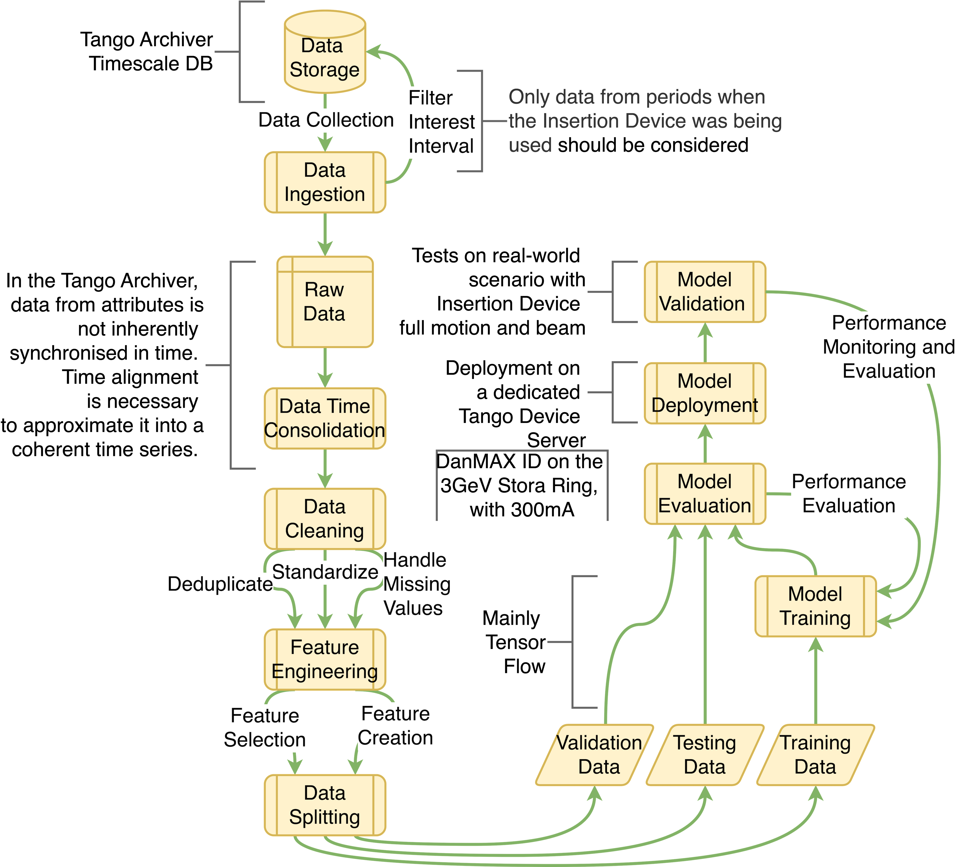
Machine Learning for ID Orbit Correction
(THPM025)
Main developer:
Carla Takahashi
Training Strategy (1)
ML pipeline is standard supervised learning
Data pre-processing: Time consolidation of attributes, de-duplication and filtering
Feature engineering: BPM signals normalized with beam current
Data split into training-, testing-, and validation sets
Recurrent Neural Networks (RNN) trained to minimize mean square error between predicted and measured corrector currents

Slide 14
Machine Learning for ID Orbit Correction
(THPM025)
Main developer:
Carla Takahashi
Training Strategy (2)
Model selection by performance metrics, e.g. robustness to noise
Training is offline using Keras, tracked by MLFlow
best-performing models exported and embedded in the Tango Device Server for real-time inference

Slide 15
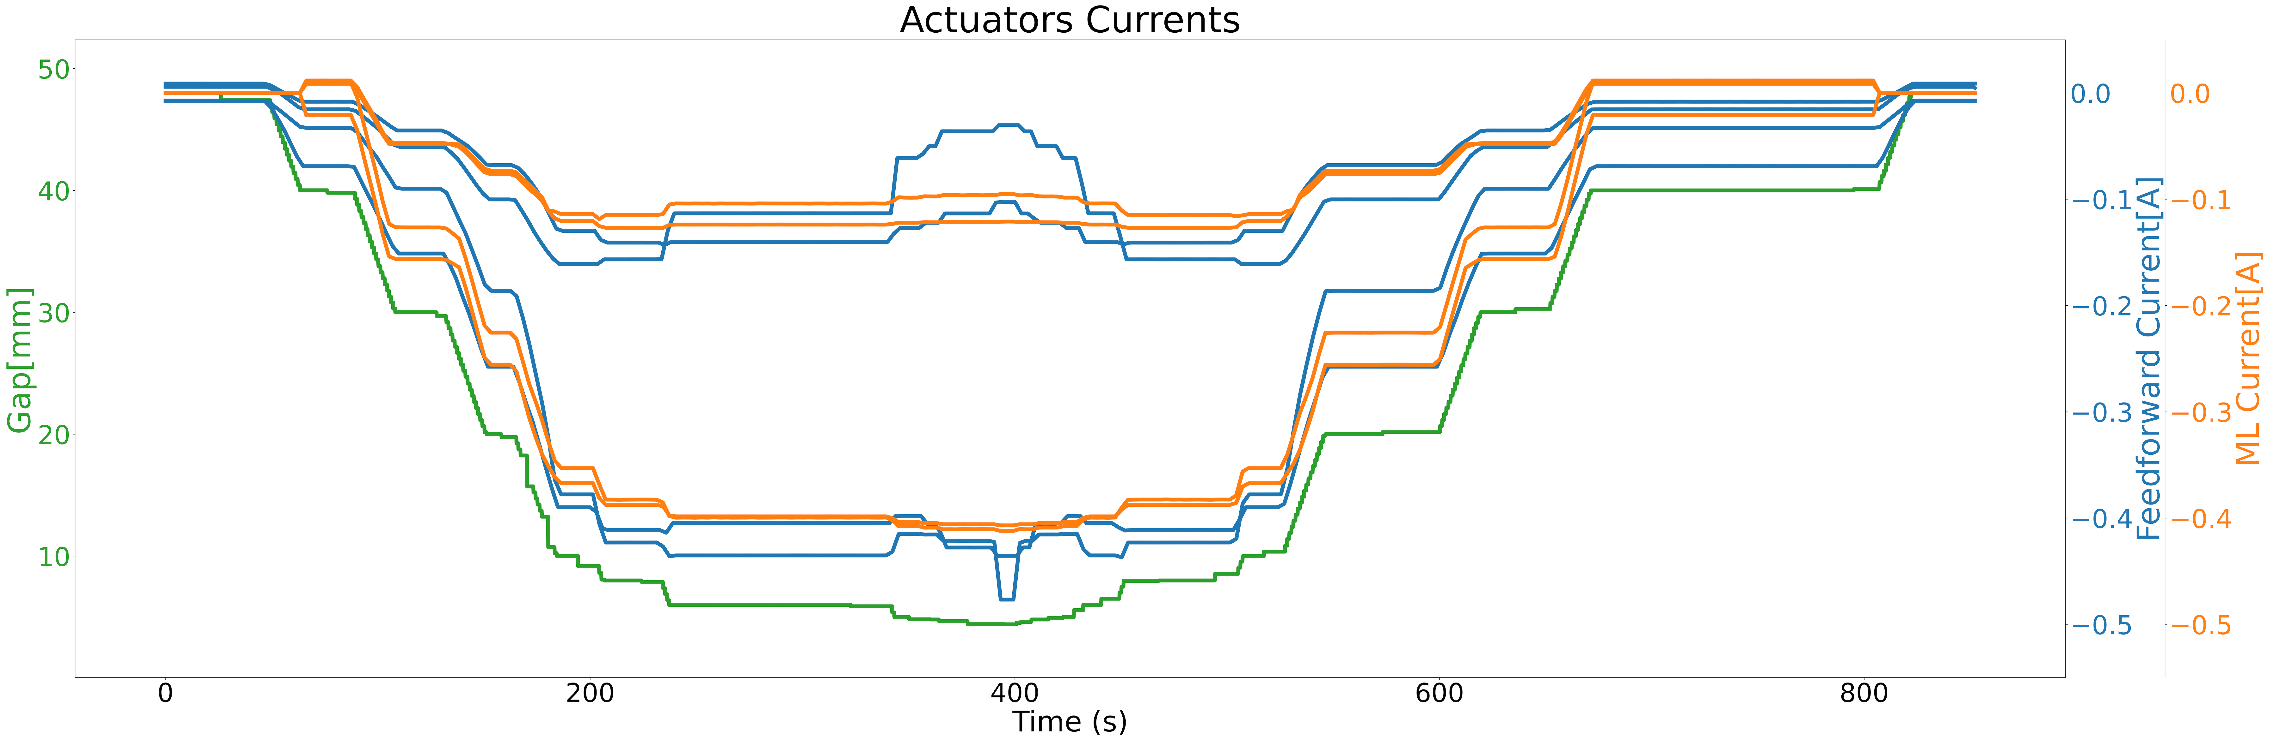
Machine Learning for ID Orbit Correction
(THPM025)
Experimental Results
Test data evaluation shows NN can closely
approximate feed-forward behavior
Peaks in orbit disturbances during ID motion are smaller while maintaining more steady corrector currents
At open gap, the ML model is not yet well-define out of range → some extra distortions

Slide 16
Other Projects
-
Backup

Slide 17
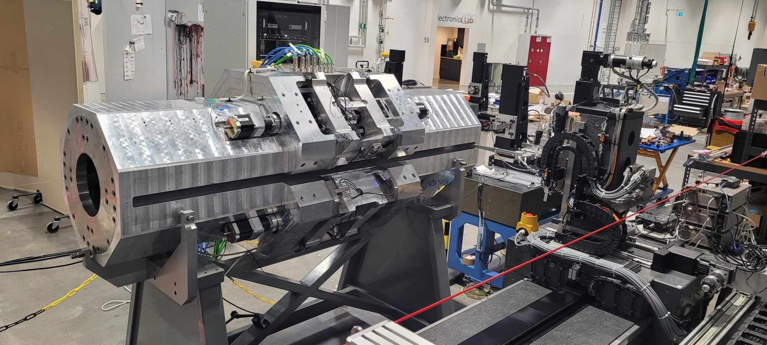
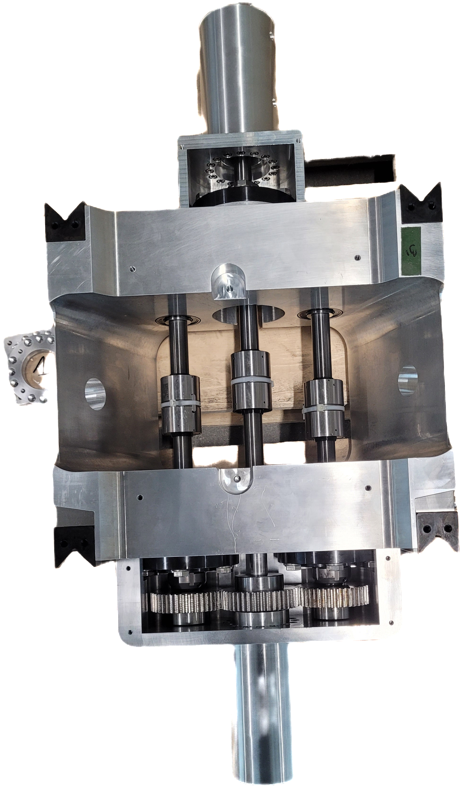
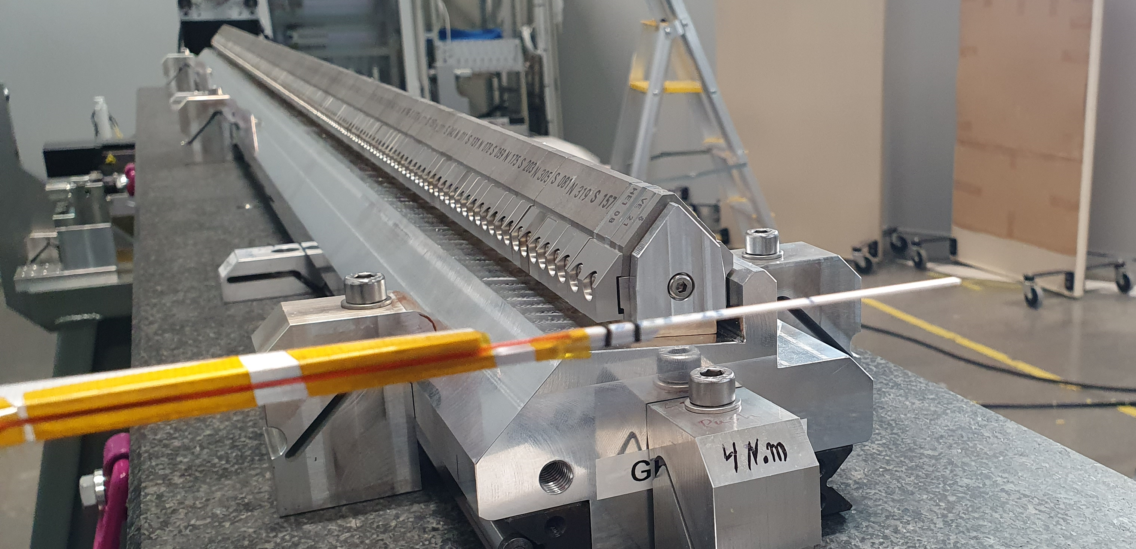
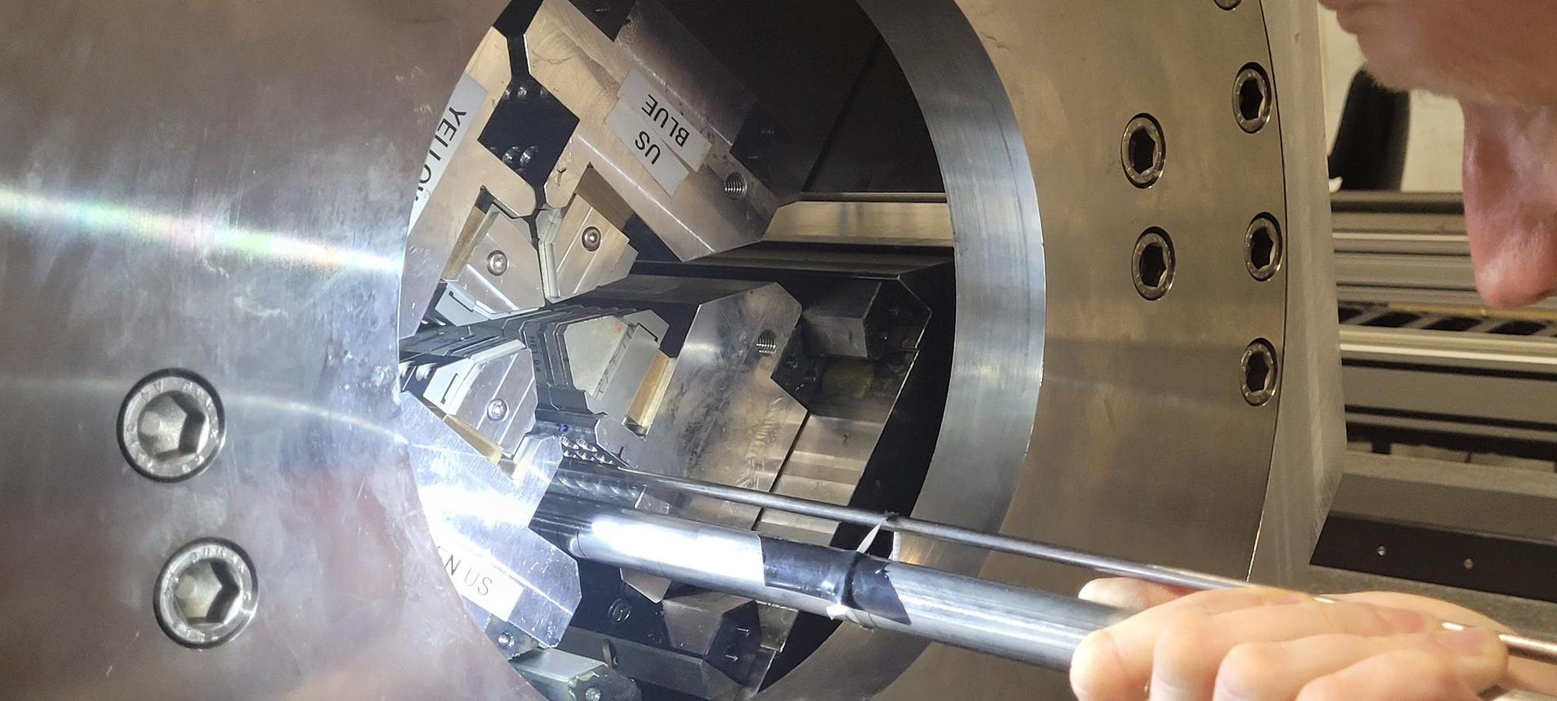
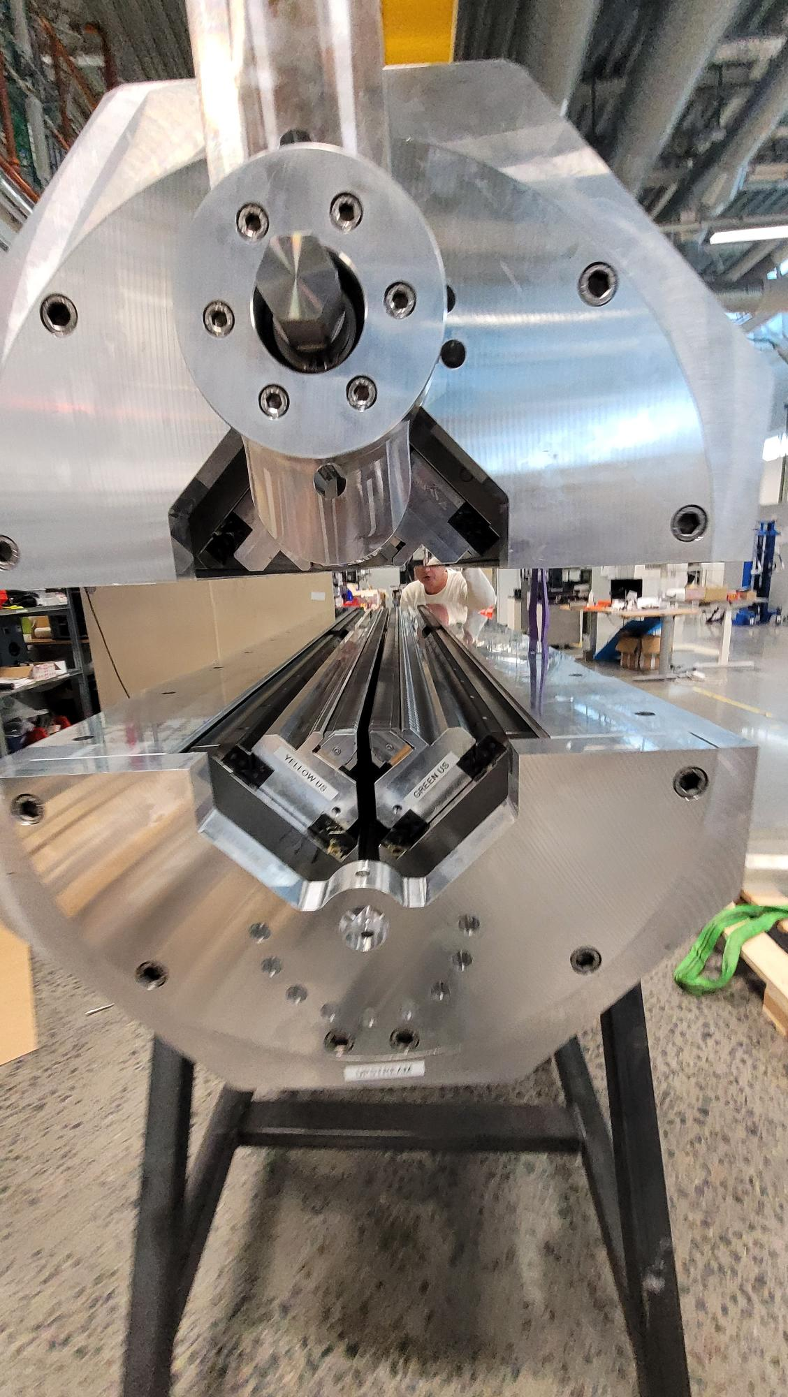
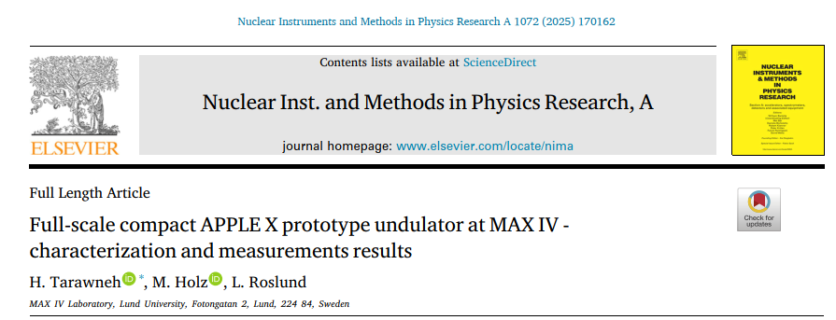
Compact APPLE X Prototype Undulator @ MAX IV
APPLE X in front of the Hall probe bench
The undulator prototype was jointly funded by MAX IV and the EU initiative LEAPS-INNOV.
Full polarization control with a compact mechanical frame and magnetic circuit based on APPLE X configuration;
  A factor of 6 less in weight and 40% less in material cost compared to MAXPEEM APPLE II with similar parameters.
The prototype assembly started Q2 2023 with magnetic tuning and characterization finalized in Q1-Q2 2024.
  The photon energy range has been fulfilled for all polarization modes of operation as specified.

Slide 18
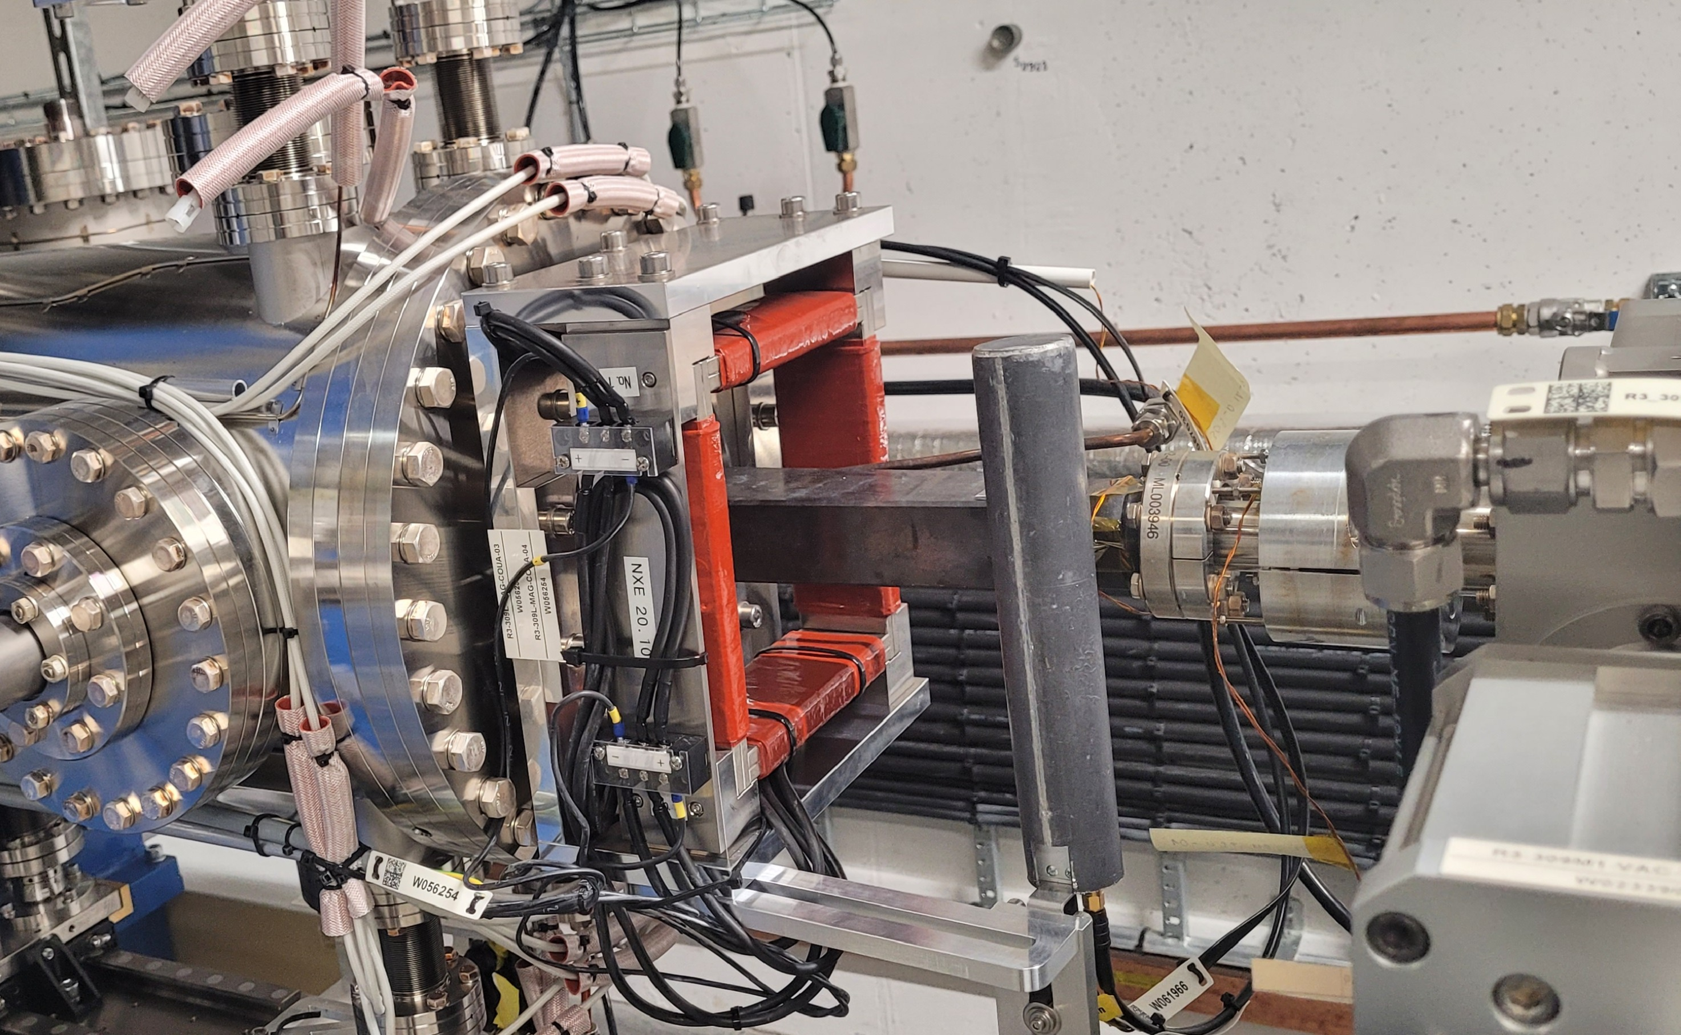
Beam Loss Monitors at ID:s
Set-up
4x Libera BLMs mounted at the exit points of 4 consecutive IVUs
1x Libera box for signal read-out
Studies
Study the impact of scraping down, injection with open/closed insertion devices
Loss rates dangerous for ID magnets?
Operational procedures for scraping down/injecting from 0 to full current, etc.
Scraper positions during operation?
Future: Do we need a collimator system?

Slide 19
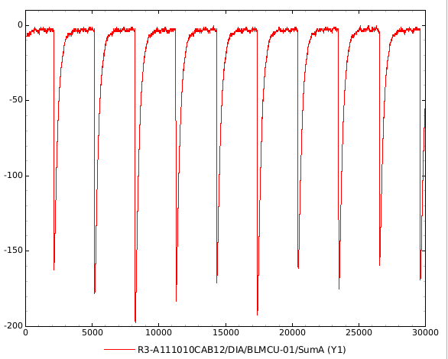
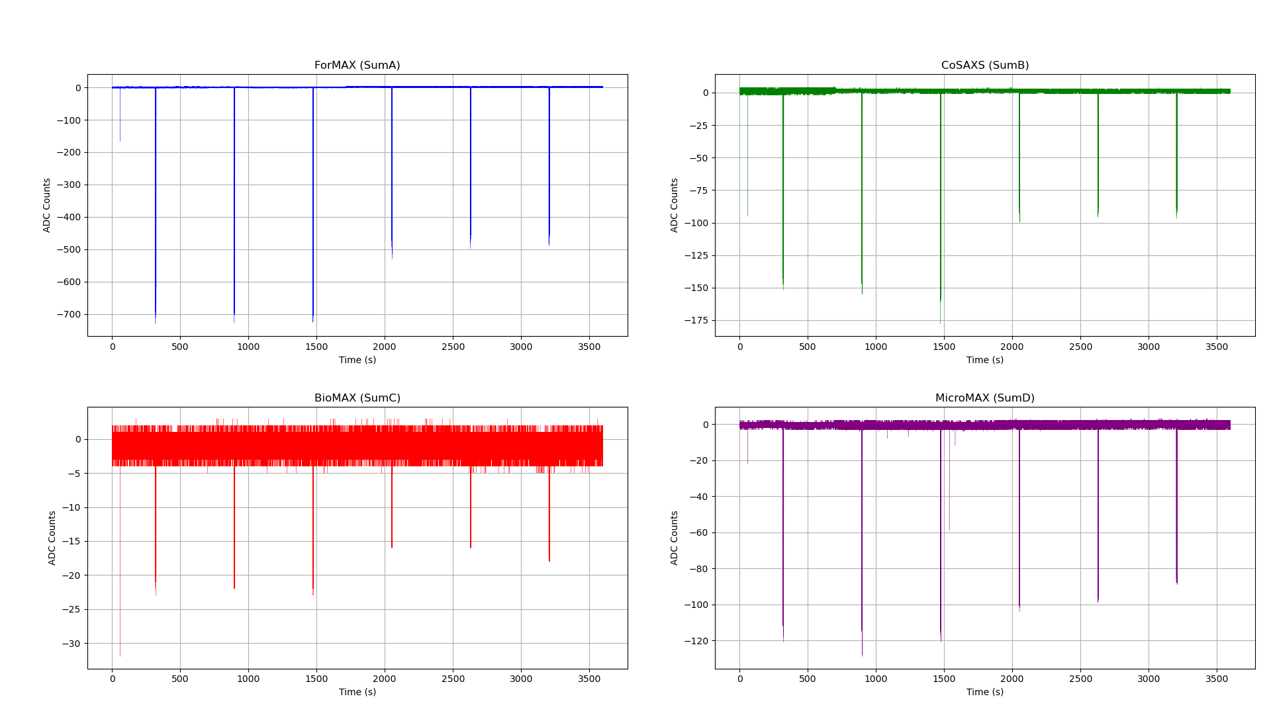
Beam Loss Monitors at ID:s
10 Hz injection pulses during top-ups
Sum signals of many top-ups on a larger time scale

Slide 20
Photon Sources for WISE Beamlines
TomoWISE
HAXPES
Spectroscopy
Photon energy range 2 – 20 keV.
High flux.
Scanning feature over 100-200 eV:
  Wiggler Mode of operation.
  Continuous scanning scheme.
Diffraction
Photon energy range 10 (20) – 65 keV.
High coherent flux.
Beam size on sample:
  Microtomography: 10mm (max.).
  Nanotomography: 0.2mm (max.).
→ CPMU + 3-pole wiggler

