Slide 1
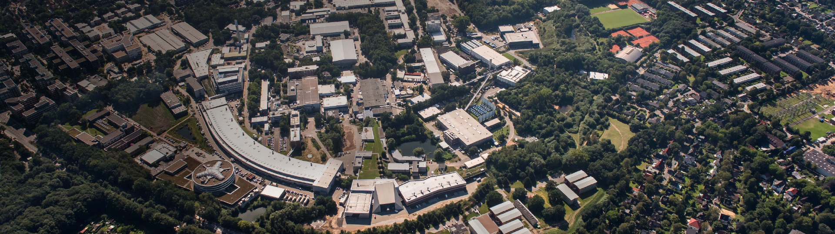
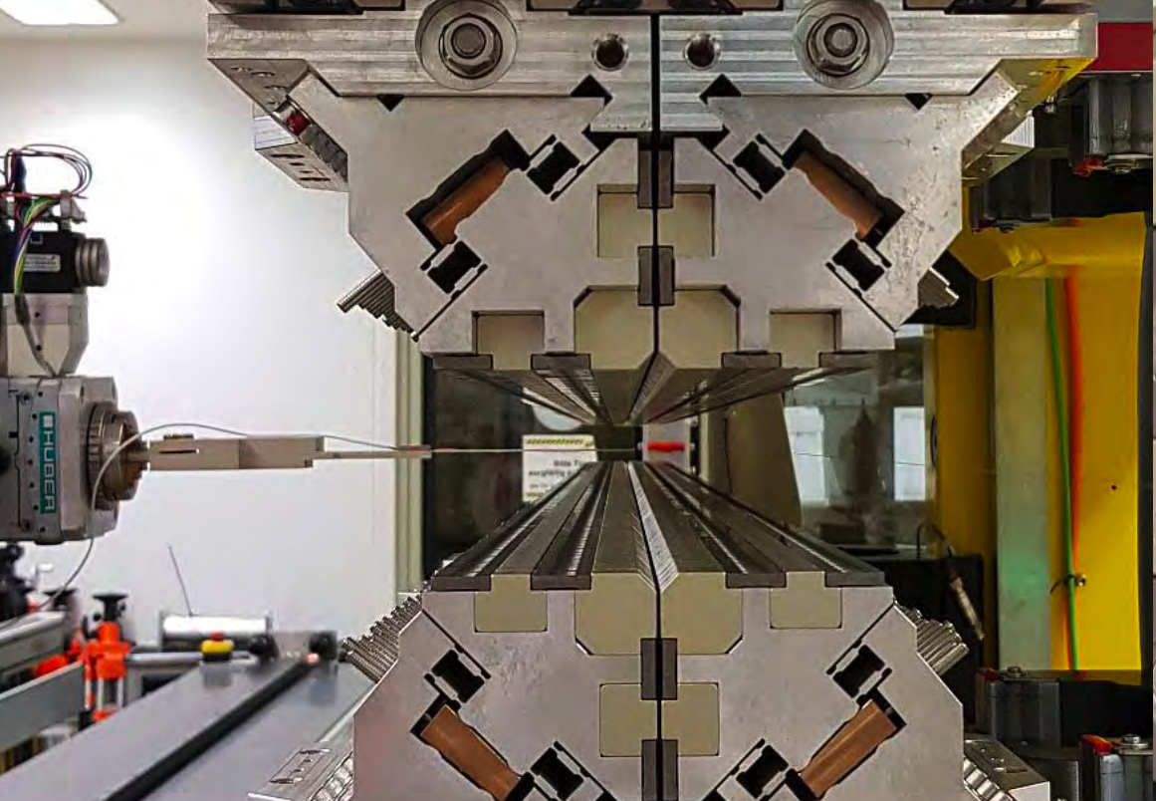
First Experience with the UE17 APPLE3 Afterburner at FLASH2
Markus Tischer
on behalf of DESY’s insertion device group
ID25 Workshop, Taipei, 31.05.2025

Slide 2
Topics
CoWorkers
APPLE3 Afterburner for FLASH2 
is a prototype for 6 FLASH2020+ Seeding IDs
Major Contributions by
Undulator Group FS-US
  Philip Eckoldt
  Mona Gehlot
  Kathrin Götze
  Paul Neumann
  Andreas Schöps
Mechanical Design Department (ZM1)
  Hilmar Bienert
  Hakan Bolat
Production Planning (ZM2)
Photon Science Machine Shop (FS-BT)
FLASH Team (MFL*, FS-FLASH)
* thanks to Juliane Rönsch-Schulenburg for various slides
  Markus Tischer
  Pavel Vagin
  Thorsten Vielitz
  Sumera Yamin
  Torsten Ramm
  Peter Talkovski
Introduction
Commissioning studies
and user experiments
Operation experience
Changes UE17 → UE35

Slide 3
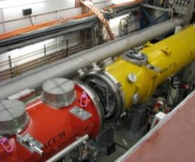
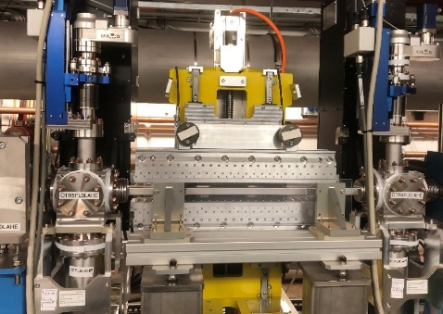
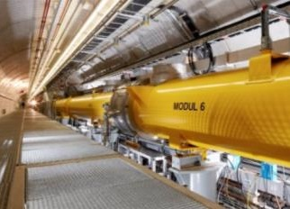
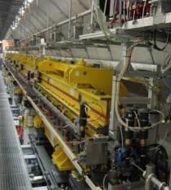
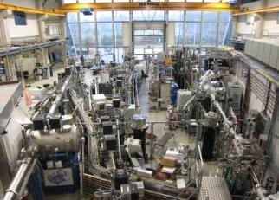
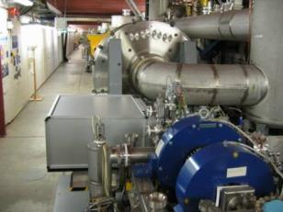
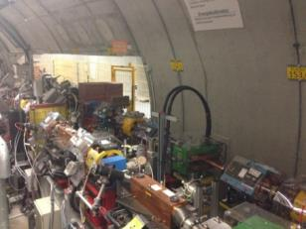
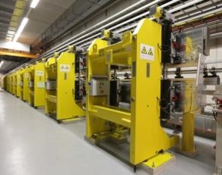
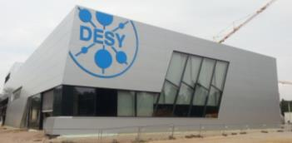
FLASH
3rd harmonic sc module 3.9 GHz
TESLA type superconducting accelerating modules 1.3 GHz
FLASH1 fixed gap undulators
Albert Einstein Hall
Laser heater
RF Stations
Accelerating Structures
Xseed & X-Ray
FLASH1
Photon Diagnostics
Fixed Gap Undulators
THz
RF Gun
Bunch Compressors
FLASH2
Albert Einstein
Lasers
350MeV -
1350 MeV
Variable Gap Undulators
5 MeV
150 MeV
550 MeV
FLASH3
315 m
Kai Siegbahn
FEL Experiments
Normal conducting 1.3 GHz RF gun
Cs₂Te cathode / 2 injector lasers
Extraction to FLASH2
FLASH2 variable gap undulators
Kai Siegbahn Hall
Notes:
FLASH is a 300 m long single-pass high-gain soft x-ray FEL. It is based on a superconducting accelerator using the TESLA/XFEL technology. An here you see a layout of FLASH how it looked like about a year ago. The electron bunches generated in a normal conducting RF gun and are accelerated by the superconducting accelerator modules.

Slide 4
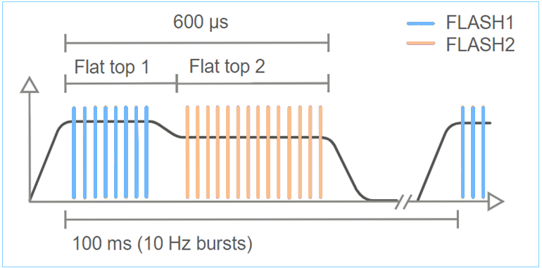
FLASH
3rd harmonic sc module 3.9 GHz
TESLA type superconducting accelerating modules 1.3 GHz
FLASH1 fixed gap undulators
Albert Einstein Hall
Laser heater
RF Stations
Accelerating Structures
Xseed & X-Ray
FLASH1
Photon Diagnostics
Fixed Gap Undulators
THz
RF Gun
Bunch Compressors
FLASH2
Albert Einstein
Lasers
350MeV -
1350 MeV
Variable Gap Undulators
5 MeV
150 MeV
550 MeV
FLASH3
Kai Siegbahn
FEL Experiments
315 m
=> Up to 5000 bunches per second
FLASH2 variable gap undulators
Kai Siegbahn Hall
Notes:
This allows the generation of several thousand bunches per second. The bunches are generated in burst with a repletion rate of 10 Hz.

Slide 5
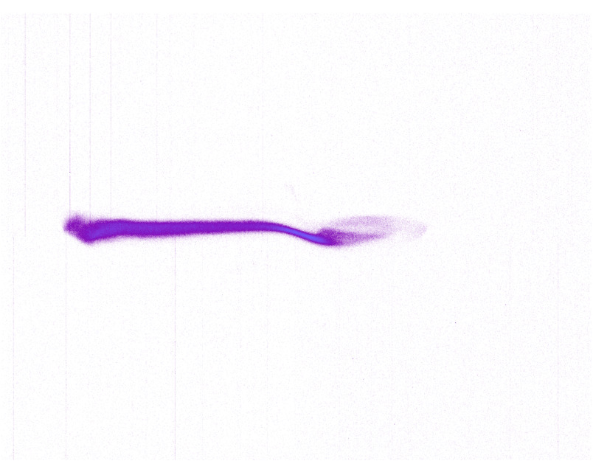
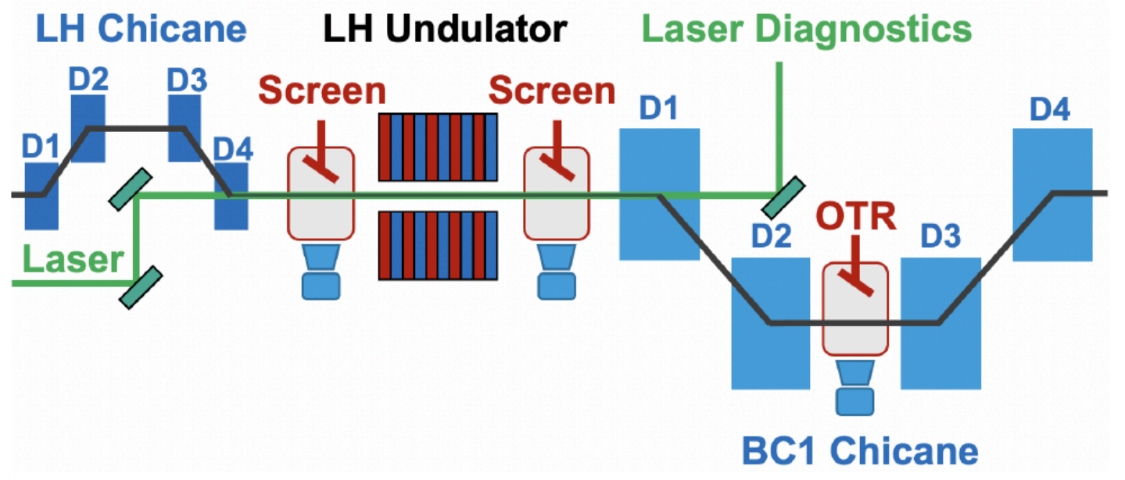
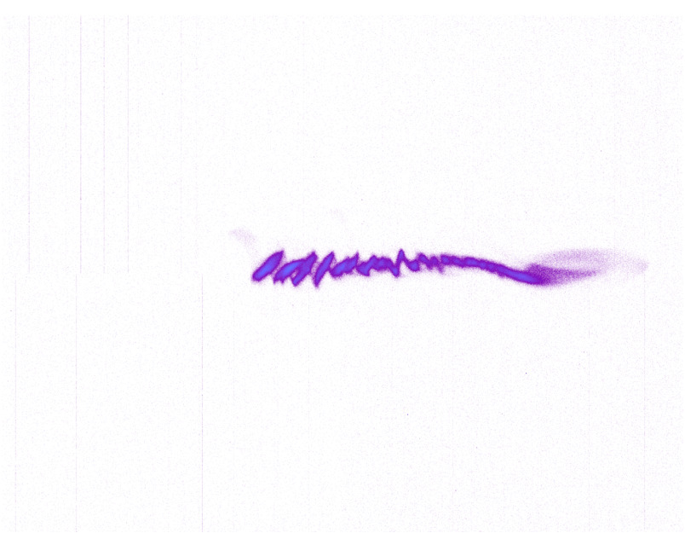
Δp
FLASH
Laser heater
FLASH1 fixed gap undulators
Albert Einstein Hall
t
Δp
t
Photon Diagnostics
Xseed & X-Ray
FLASH1
Fixed Gap Undulators
THz
RF Gun
Bunch Compressors
FLASH2
Albert Einstein
Lasers
350MeV -
1350 MeV
Variable Gap Undulators
5 MeV
150 MeV
550 MeV
FLASH3
Kai Siegbahn
FEL Experiments
315 m
=> Up to 5000 bunches per second
FLASH2 variable gap undulators
Kai Siegbahn Hall
Notes:
A laser heater system minimizes the microbunching instability growth by controlling the uncorrelated energy spread of the beam

Slide 6
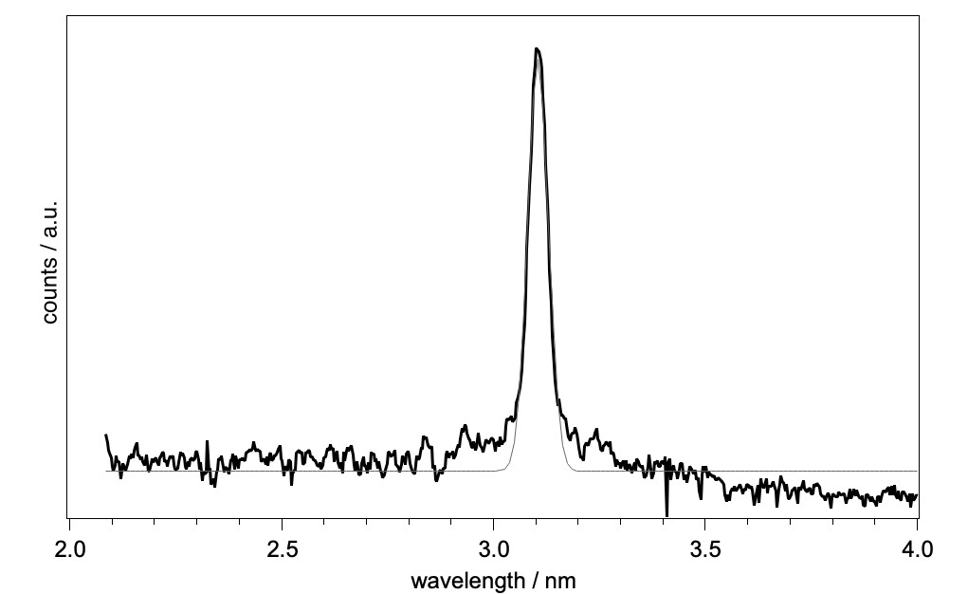
Δp
FLASH
Laser heater
FLASH1 fixed gap undulators
Albert Einstein Hall
t
Δp
t
Photon Diagnostics
Xseed & X-Ray
FLASH1
Fixed Gap Undulators
THz
RF Gun
Bunch Compressors
FLASH2
Albert Einstein
Lasers
350MeV -
1350 MeV
Variable Gap Undulators
5 MeV
150 MeV
550 MeV
FLASH3
Kai Siegbahn
315 m
SASE FLASH2:
Photon energy range: 390 - 14 eV
Pulse duration: 1.3-200 fs
Min. spectral width: 0.5%
Afterburner:
Polarization: variable
Photon energy range: 890 - 80 eV
=> Up to 5000 bunches per second
FLASH2

Slide 7
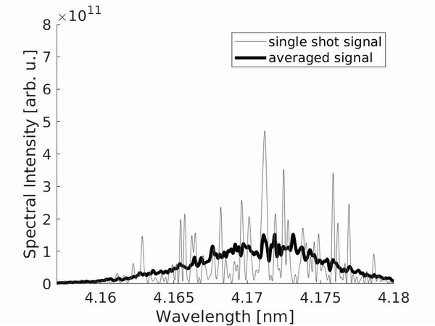
Δp
Future FLASH
Simulation
Laser heater
ext. seeded
Seeded FLASH1:
Photon energy range: 310 – 20.6 eV
Pulse duration: 11- 40 fs
Min. spectral width: 0.05%
Δp
t
t
TDS
THz
FLASH1
RF Gun
Bunch Compressors
FLASH2
Albert Einstein
Lasers
350MeV -
1350 MeV
Variable Gap Undulators
5 MeV
150 MeV
550 MeV
FLASH3
Kai Siegbahn
315 m
SASE FLASH2:
Photon energy range: 390 - 14 eV
Pulse duration: 1.3-200 fs
Min. spectral width: 0.5%
Afterburner:
Polarization: variable
Photon energy range: 890 - 80 eV
=> Up to 5000 bunches per second

Slide 8
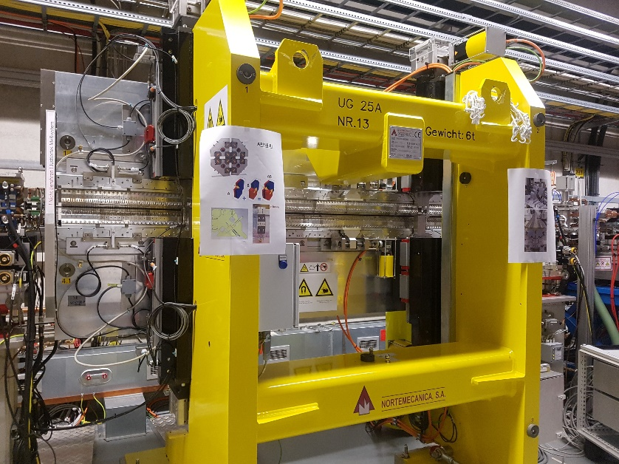
FLASH2
FLASH1
RF Gun
Bunch Compressors
FLASH2
Albert Einstein
Lasers
350MeV -
1350 MeV
Variable Gap Undulators
5 MeV
150 MeV
550 MeV
FLASH3
Kai Siegbahn
FLASH2 Afterburner – UE17 APPLE3 with Force Compensation
Period length | 17.5 mm
K value | 0.92
B₀ | 0.56 T
Gap | 7 mm
N | 137
Length | 2.5 m
Polarization | any
Wavelength range | 1.33 . 1.77 nm
Energy range | 890 – 700 eV
SASE FLASH2:
Photon energy range: 390 - 14 eV
Pulse duration: 1.3-200 fs
Min. spectral width: 0.5%
Afterburner:
Polarization: variable
Photon energy range: 890 - 80 eV
@1.35GeV

Slide 9
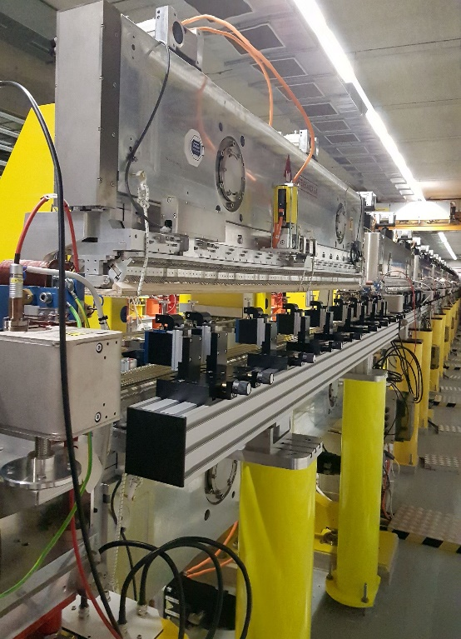
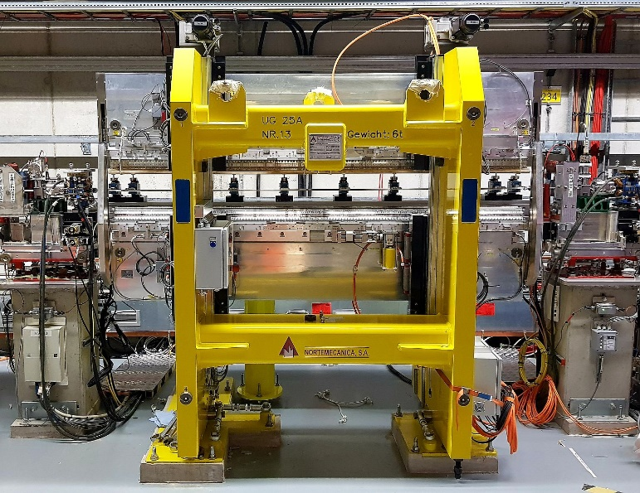
UE17 Afterburner Operation Overview
Sep’23 UE17 installation at FLASH2 (circ. 6mm vac.chamber already in operation since Aug’22)
Oct-Nov’23 2 Commissioning shifts: Beam transport, gap and shift dependent kick errors
          No issues found
Jan-Mar’24 3 shifts to establish 3rd harm radiation
          Slow progress in preparing an intense low wavelength beam with high 3rd harm. bunching
          3rd harm radiation established with S/B ratio ~100
          Optimization of the driving SASE beam (rev. taper, laser heater)
Spring’24 1st user beamtime
Early Jun’24 Begin of FLASH shutdown
          Ending Aug 3rd ‘25

Slide 10
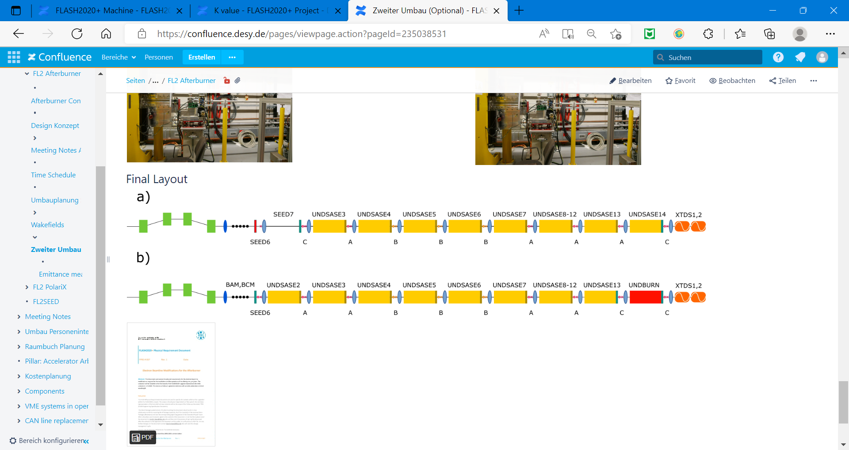
Reverse Taper Experiments
Suppression of radiation of main undulators
Main SASE undulator : U32 planar
Helical afterburner : UE17 APPLE3
Need to get rid of powerful linearly polarized radiation from the main undulator
helical afterburner
2.5 m
planar undulator (saturation)
30 m
reverse-tapered planar undulator (K increases)
Fully micro-bunched electron beam but strongly suppressed radiation power at the exit of reverse-tapered planar undulator
The beam radiates at full power in the helical afterburner tuned to 3rd harmonic

Slide 11
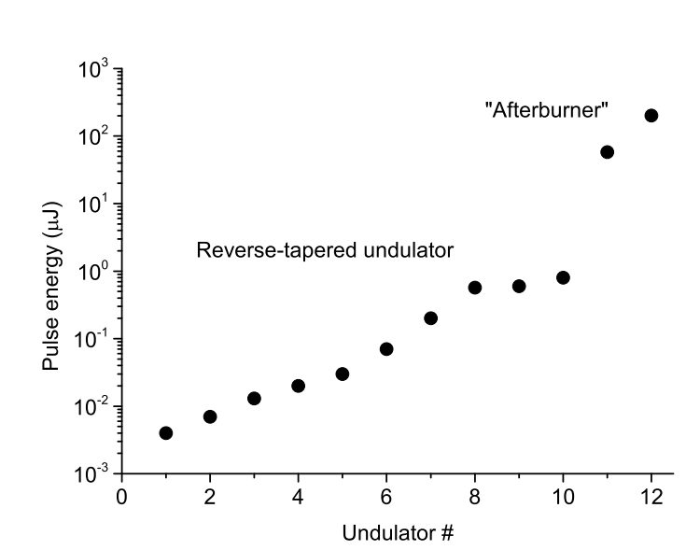
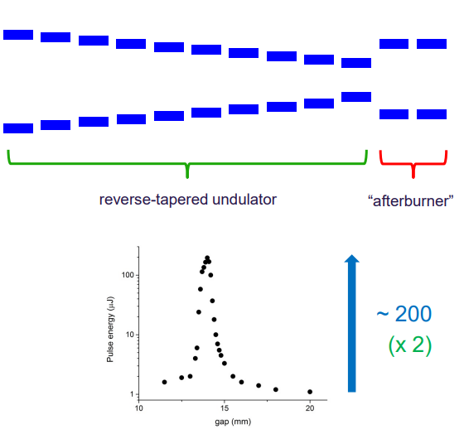
Previous Reverse Taper Experiments
Test with FLASH2 main (SASE) undulators
Reverse Undulator Tapering for Polarization Control and Background-Free Harmonic Production in XFELs: Results from FLASH,- Schneidmiller & Yurkov; DOI: 10.18429/JACoW-FEL2017-MOP032
17 nm
Bunching factor at saturation can be the same as in the case of a non-tapered undulator,
Saturation length increases moderately while the saturation power is suppressed by orders of magnitude
Notes:
In 2016 reverse taper was applied to the 10 undulator segments; the gap of the 11th and 12th segments was scanned. Power ratio of 200 was obtained. For a helical afterburner it would be larger by a factor of 2.
The figure shows the photon pulse energy measured after the respective undulator in FLASH2. Undulators 1 to 10 were set to reverse tapering while the final two act as an afterburner, leading to an increase in pulse energy by a factor of 200.

Slide 12
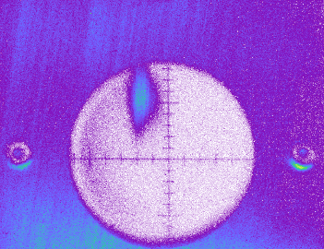
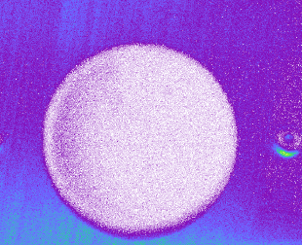
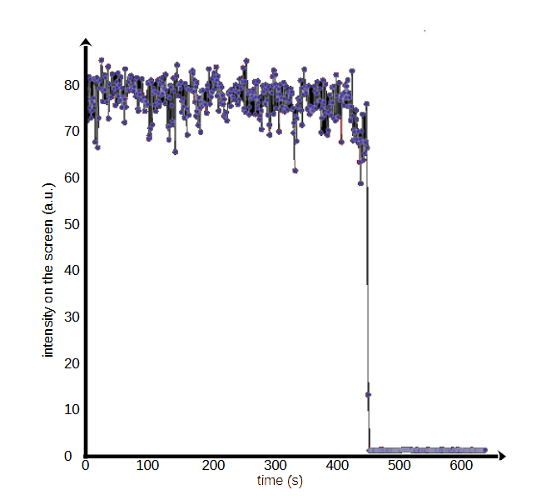
Successful Suppression of Linear Polarization
Suppression of main undulator radiation while obtaining polarized afterburner radiation
Mono
Grating
New double monochromator Beamline FL23 used setup to distinguish fundamental and 3rd harmonic
Helical
Afterburner
Screen
Undulators
Afterburner tuned to 3rd harmonic
Afterburner detuned

Slide 13

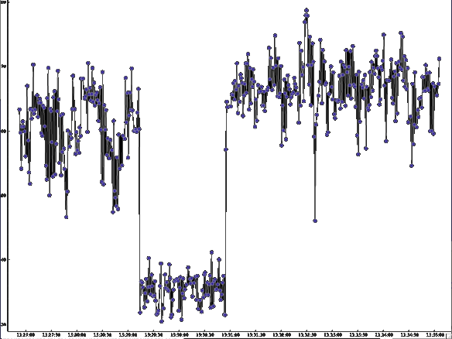
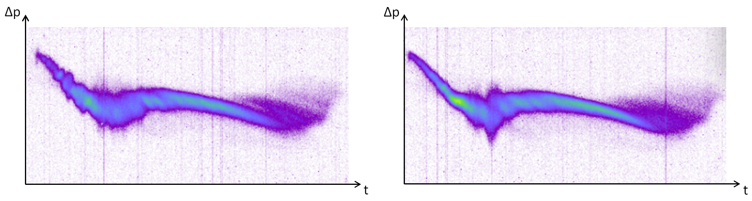
Influence of Electron Beam Quality
Laser heater (LH)
80
70
60
50
40
30
LH optimized
The output power of the afterburner could be doubled by optimizing the longitudinal phase space distribution using the laser heater
Focusing into the afterburner helps to increase the output power especially for short wavelength with long gain length.
Single Pulse energy (a.u.)
LH off
time

Slide 14
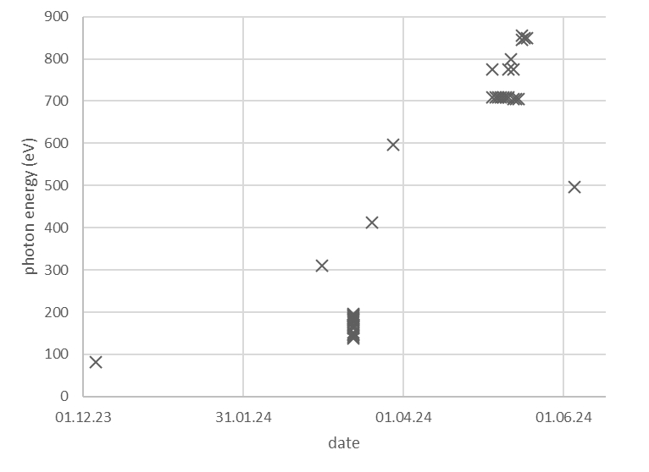
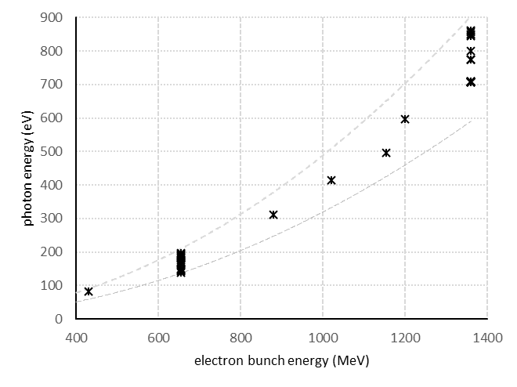
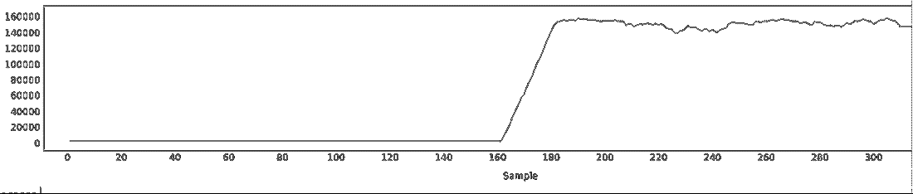
Different Working Points
80 eV – 860 eV demonstrated
~ 2 µJ
amplification by > 100
~ 3 µJ at 3 nm
amplification by a factor of 80
scanned
wavelength
Notes:
amplification by a factor of 80

Slide 15
Recent Experimental Results at FLASH Beamline FL23
Element-specific probe of
ultra-fast magnetic properties
Spectral characterization of the helical afterburner radiation, benchmarking of experimental setup
M. Pavelka et al.,
Struct. Dyn. 12, 024303 (2025)

Slide 16
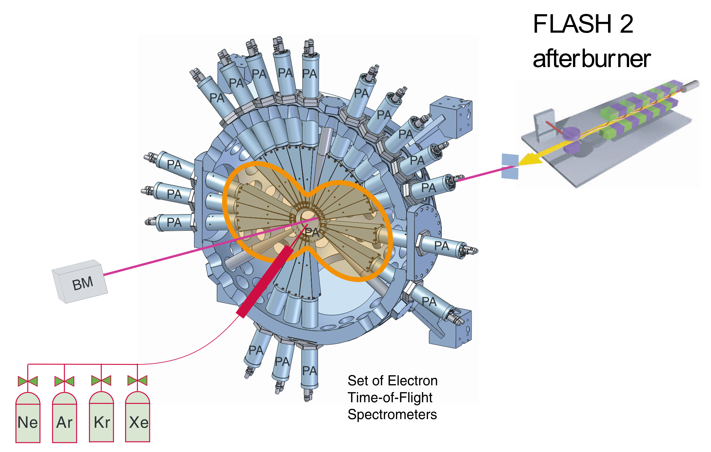
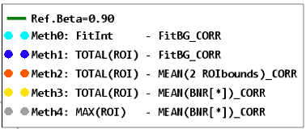
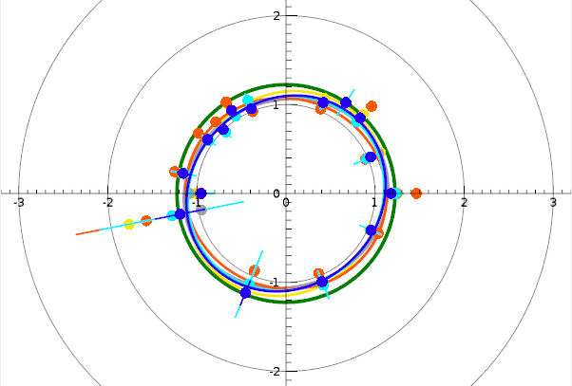
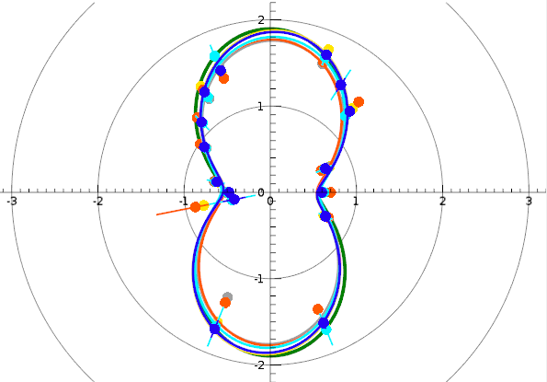
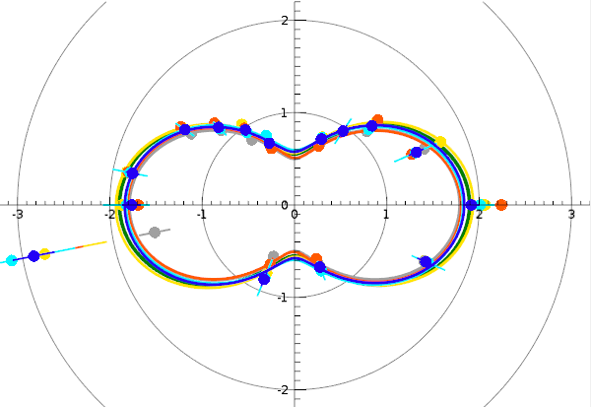
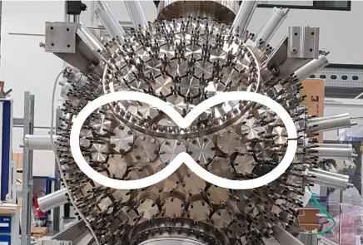
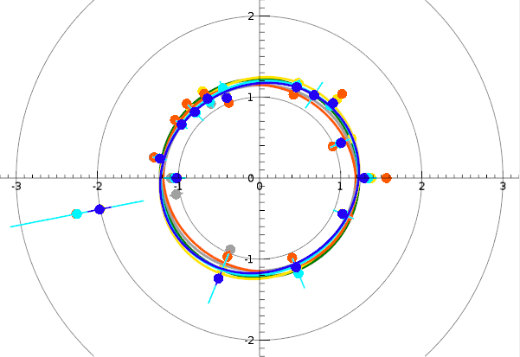
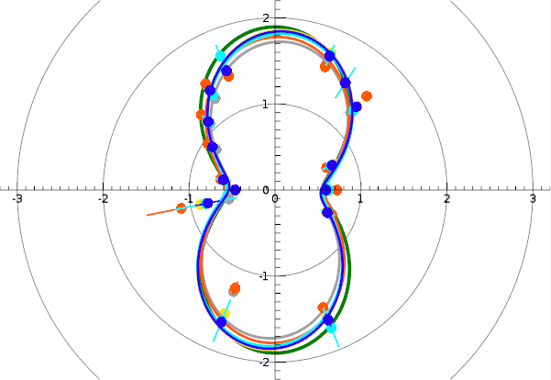
Polarization Diagnostics by Photoelectron TOF Spectrometers
Angular distribution of photoelectron emission of rare gas excitations
Test of different analysis methods for a robust fast analysis tool, ~2% accuracy
Kr 3d
P1= 0.08
P1= 0.98
Courtesy of M. Braune,
proceed. SRI2024
P1= 0.99
E_{e} = 880 MeV
hv = 104.6 eV / 313.8 eV
P1= 0.06
P1= 0.98
ABU shift = 0.0
ABU shift = +/- 0.25
ABU shift = +/- 0.5

Slide 17
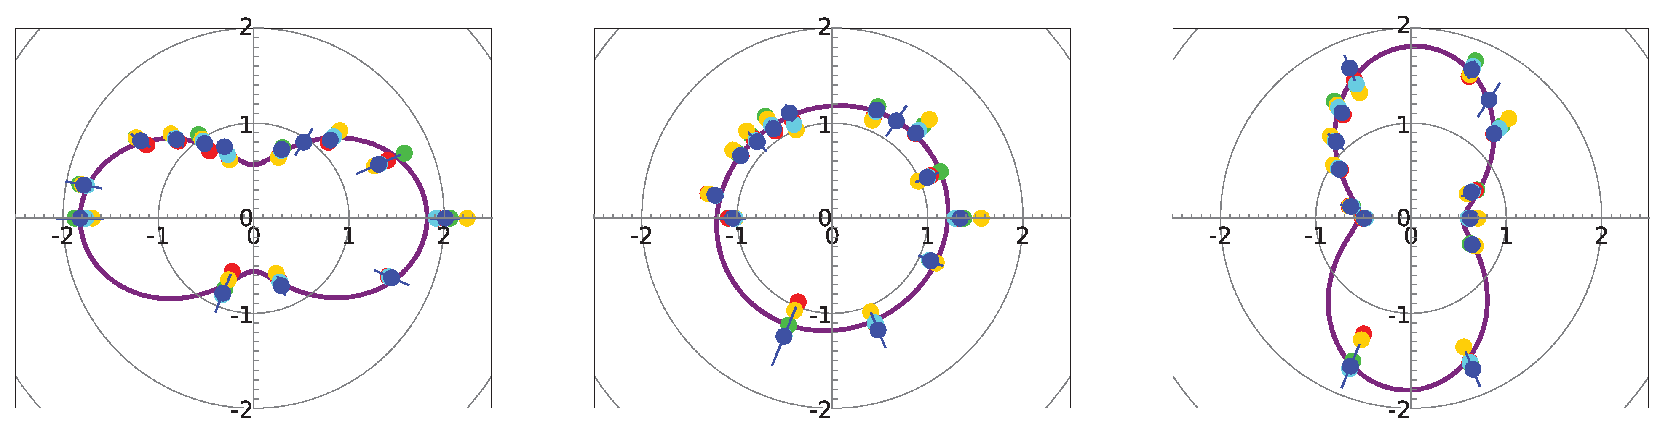
Polarization Diagnostics by Photoelectron TOF Spectrometers
Angular distribution of photoelectron emission of rare gas excitations
Test of different analysis methods for a robust fast analysis tool, ~2% accuracy
More detailed error analysis (E_{3rd} = 318.8 eV)
Kr 3d
P1= 0.08
P1= 0.98
P1= 0.99
Negligible unpolarized component ~ ρ (10⁻³)
E_{e} = 880 MeV
hv = 104.6 eV / 313.8 eV
S. Marotzke et al.,
Struct. Dyn. 12, 034301 (2025);
P1= 0.06
P1= 0.98
ABU shift = 0.0
ABU shift = +/- 0.25
ABU shift = +/- 0.5

Slide 18
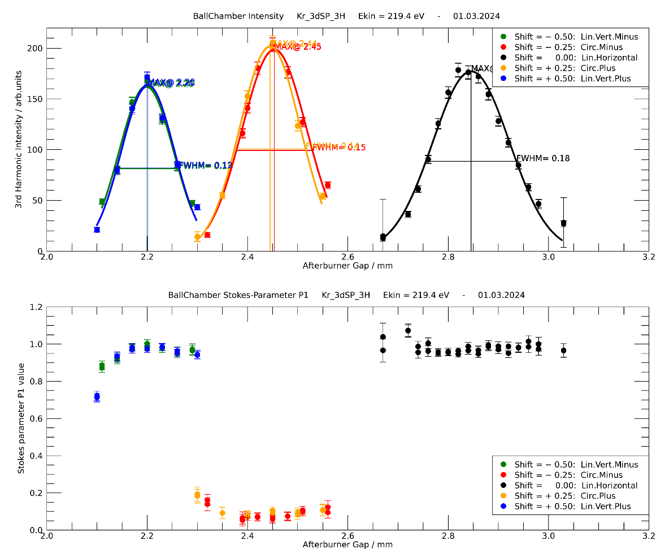
Polarization Diagnostics by Photoelectron TOF Spectrometers
Gap scans
3rd harmonic signal intensity change along afterburner gap variation
→ Verify the optimal gap value
Value of linear Stokes parameter P1 along afterburner gap variation
Courtesy of M. Braune,
proceed. SRI2024

Slide 19
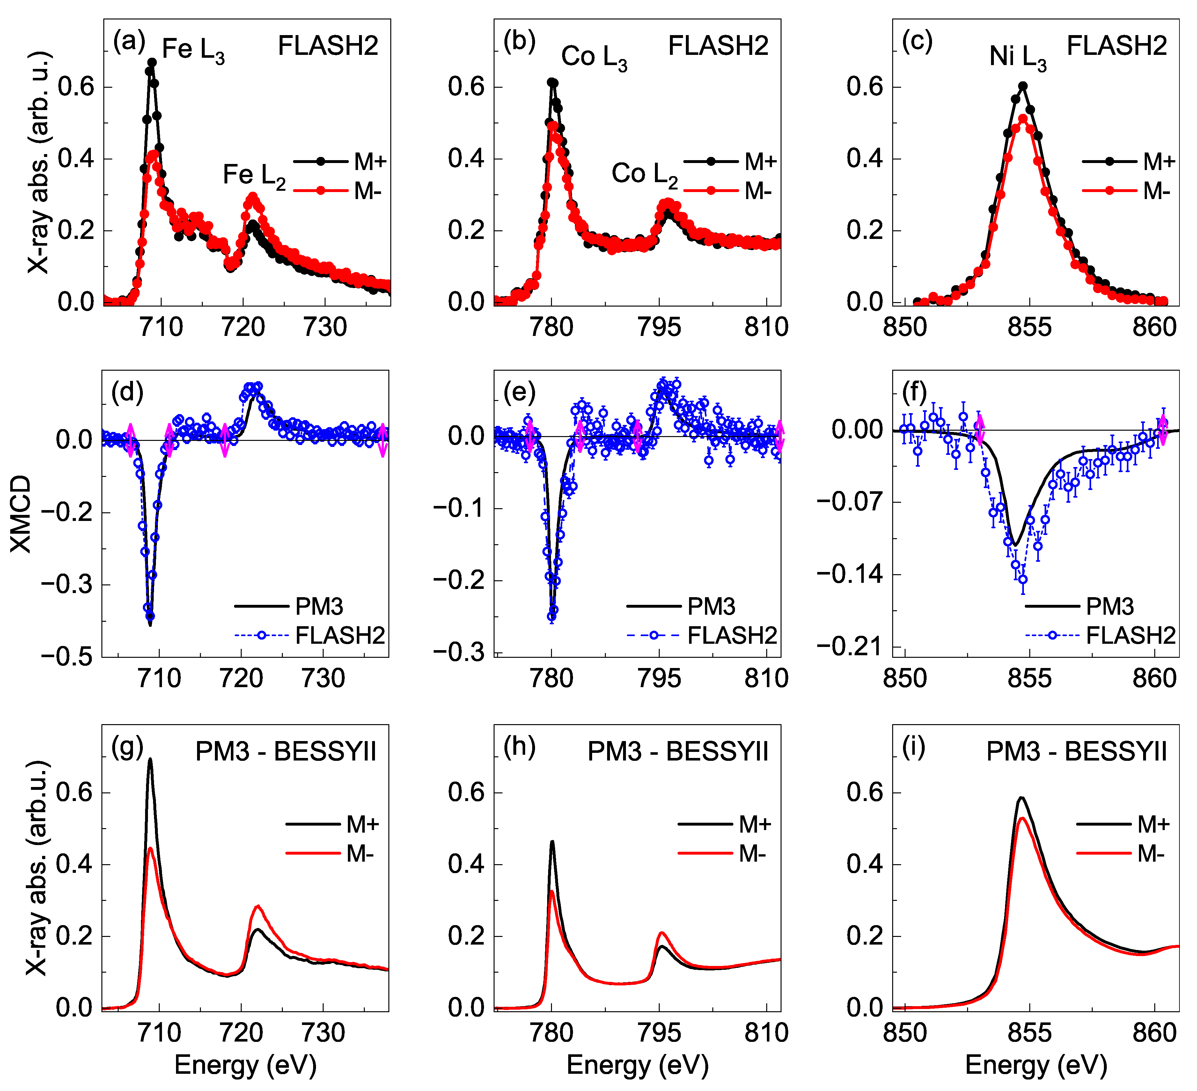
XAFS / XMCD Measurements at 3d L-Edges
Benchmarking by comparison of reference sample measurements
S.Marotzke et al.,
Struct. Dyn. 12, 034301 (2025);

Slide 20
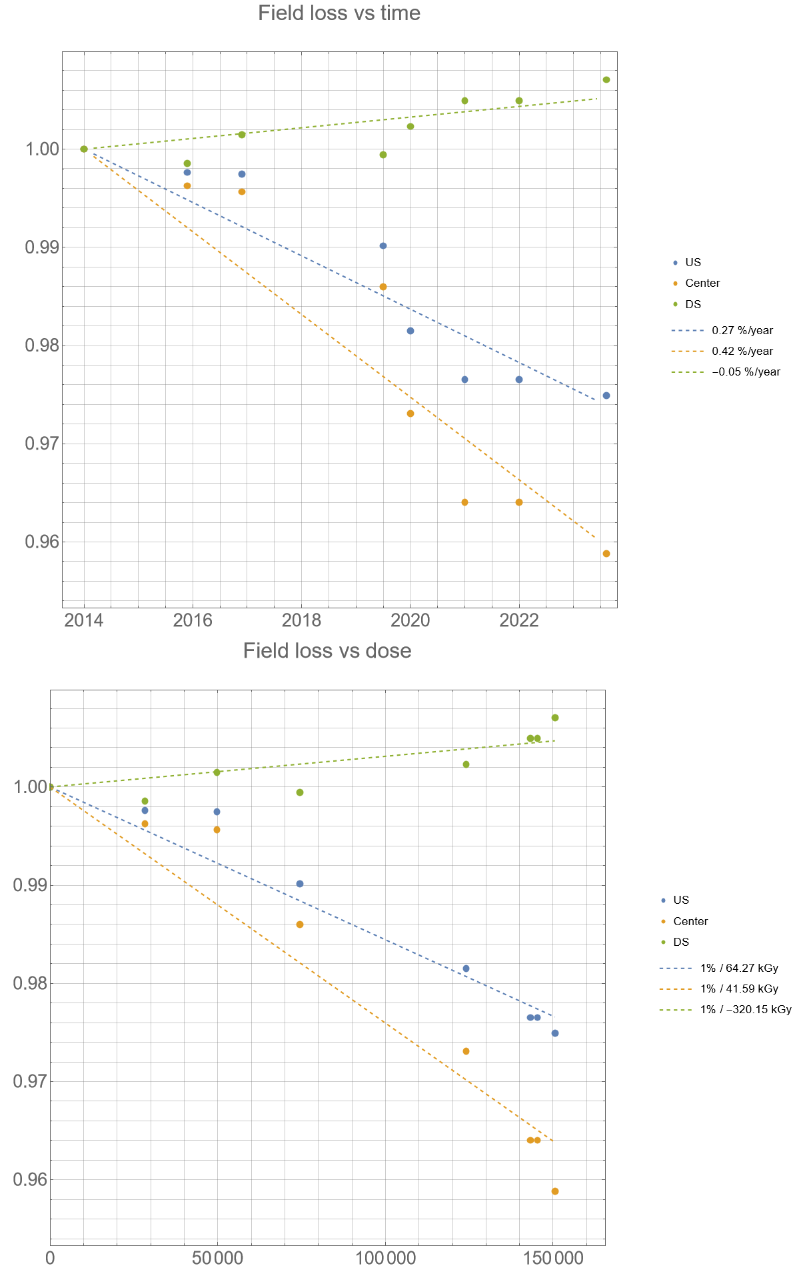
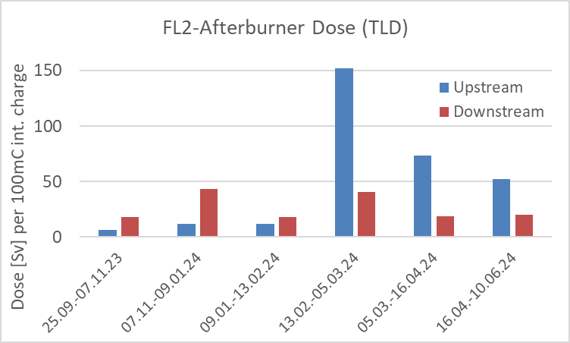

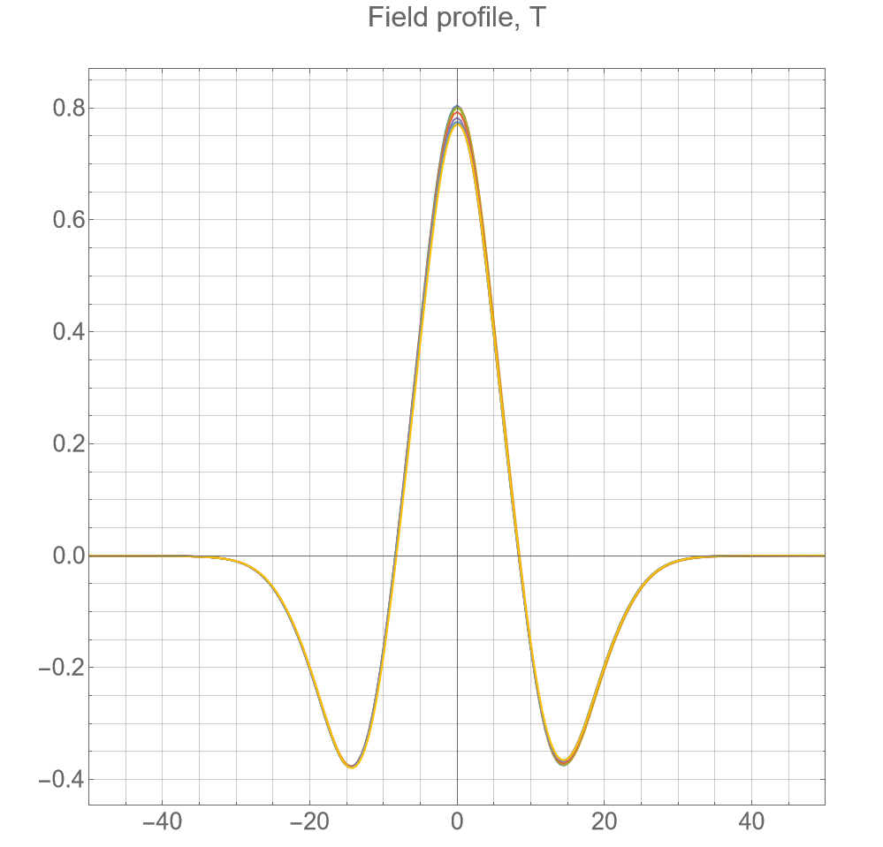

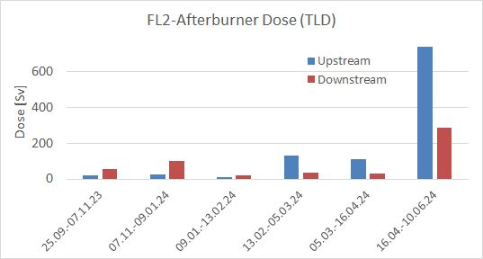
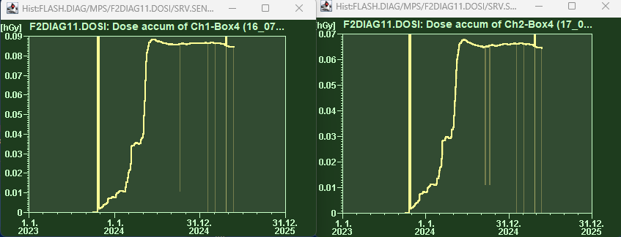
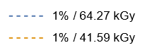
Radiation Dose Measurements
Field loss vs time
Diagnostic undulator at FLASH2
  Based on TLDs
  Total charge (2016-2024) ~7800mC
  Demagnetization rate ~1% / 40 kGy
Average dose at
Sase IDs ~ 4-10 Sv/100mC
Online dose measurement system put to operation
  Based on (shielded) RadFET sensors
  Temporal structure relates to TLDs
  Dose values need to be scaled
Center
US
DS
Field loss vs dose

Slide 21
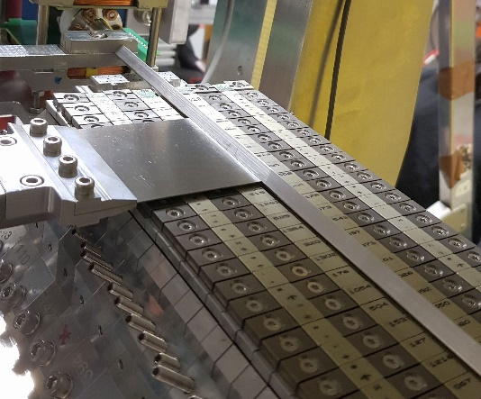
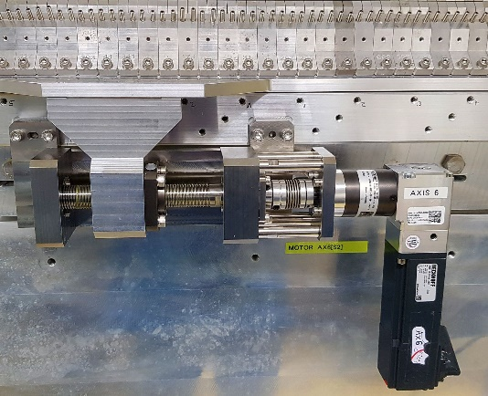


Design “Review” UE17
“Assorted” selection of items
Gap mechanics - 4-axes version, useful for alignment of ID and vacuum chamber
Shift drive: - some elastic deformation, observed by a
sin-like mismatch of lin. vs motor-encoders
Shift girders - poor initial alignment, needed mech. shimming throughout
- requires more precise definition of CMM protocols
Keeper / subgirder interface ok
Keeper design - single period keeper ok, but could be simplified
Force compensation works very well; larger mech. moments expected & ok
Magnets - glued AB-pairs without problems
Single keeper measurements:
- indispensable for sorting
- mech. initialization to be improved
Magnetic sorting, measurements and tuning
- demanding, ok, room for improvement

Slide 22



Design Changes from UE17 to UE35
Gap mechanics - 4-axes version unchanged
Shift drive: - 4-axes as before
- incoupling of shift motion moved closer to the gap
to reduce torque and deformations of drive train
- movable shift girders thickened
Shift rails - unchanged, but qualified another supplier
Period length - 17.5 → 35 mm
Keeper design - mostly unchanged
- gap of comp. magnets enlarged by~0.2mm
to ease alignment of vacuum chamber
Magnet blocks - unchanged, glued AB-pairs

Slide 23







Construction Status of 6 APPLE3 UE35 for FLASH2020+
Impressions…
Single keeper measurements ~80% completed
3 IDs completely constructed
Tuning nearly completed for 2 IDs
3rd device started
Construction of remaining IDs is ongoing

Slide 24
Thank you

Slide 25
Backup

Slide 26



Vacuum Chamber: Resistive Wall & Surface Roughness
Extruded aluminum chamber
  7x7mm² cross-section, Dm 6mm inner bore
  Length ~2.5m
  Support by 0.5mm thick blades in a groove
  Adjustment by movers
Resistive wall wake :
  20 keV E-loss & E-spread for a bunch of 200 pC, 100 fs and 2.5 m chamber length
  ok for Al with (inner) R < 600 nm, and oxide layer < 10 nm
Courtesy of J. Zemella, M. Vogt

Slide 27

Magnetic Performance
(simulated)
Different Gap-dependence of vertical (By) and horizontal (Bz) field components
Condition for circularly polarized radiation deviates from the nominal values for both gap and shift
To be implemented in ID-controls by a 2-dimensional table based on magnetic and x-ray measurements at a later stage

Slide 28

Gap- and Shift-Dependence of K-value

