Slide 1
Insertion Device Development toward SPring-8-II
Takashi Tanaka
RIKEN SPring-8 Center

Slide 2
SPring-8-II Project
New Insertion Devices in SPring-8-II
  IVU-II
  Helical-8 Undulator
  IDs in LSSs
Issues in Tapered IVU-II

Slide 3
SPring-8-II Project
New Insertion Devices in SPring-8-II
  IVU-II
  Helical-8 Undulator
  IDs in LSSs
Issues in Tapered IVU-II

Slide 4
SPring-8-II Project
Overview
  Major upgrade of SPring-8 (since 1997)
  Emittance reduction (< 100pm.rad) by
    Electron energy reduction
    5-bend achromat lattice
Project timeline
  Officially started this year
  Construction of accelerator components in 2 years (~2027)
  Blackout in 2027~2028
  User operation restarts in 2029?

Slide 5
Boundary Conditions and
Basic Policy for IDs in SPring-8-II
Shorter Straight：5.7m⇒4.2m
  Most of running IDs (>30) are no more available
Energy Reduction：8GeV⇒6GeV
Narrower Gap：8mm⇒5mm
  Shorter period needed and possible!
Stronger Effect by Radiation Damping
  Emittance compensation by variable-gap damping wigglers
Price Rise of Everything
  Cost reduction of std. IDs, to complete the project on schedule and on budget

Slide 6
SPring-8-II Project
New Insertion Devices in SPring-8-II
  IVU-II
  Helical-8 Undulator
  IDs in LSSs
Issues in Tapered IVU-II

Slide 7
IVU-II
In-Vacuum Undulator for SPring-8-II
High performance and cost-effective IVU based on 3 key technologies:
  Force cancellation by monolithic multipole magnets
  Modularized magnetic array
  Inclined Halbach configuration
13 IVU-IIs constructed (Mar. 2025)
  5 of them installed in SPring-8, to be continuously used in SP8II

Slide 8
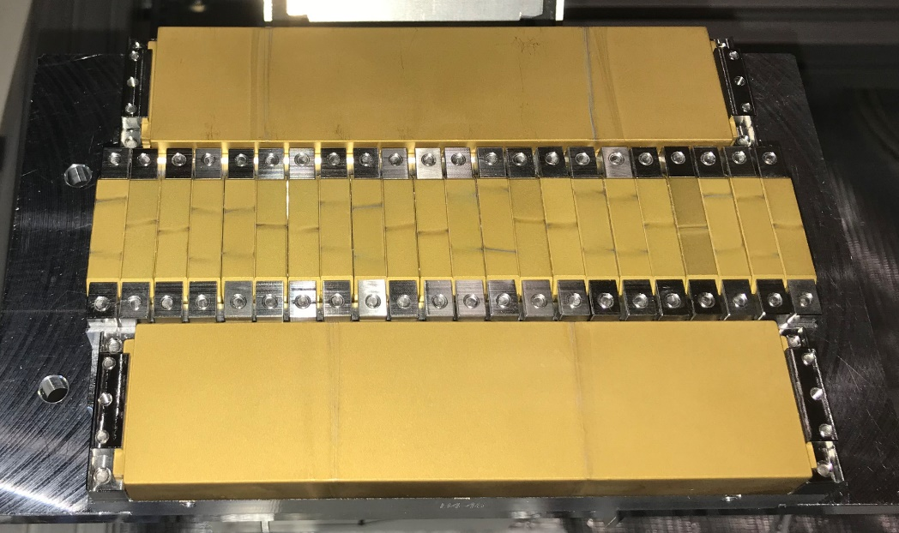
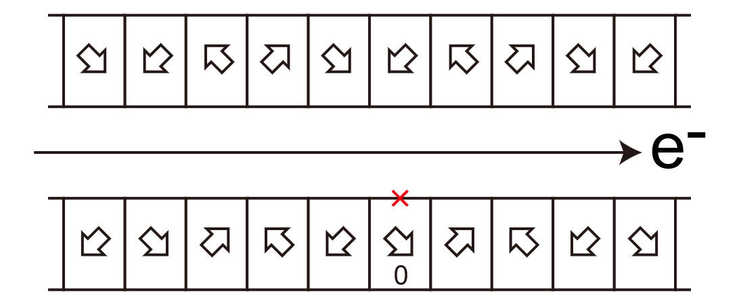
Key Technologies
  Force cancellation by MMM
  45-deg Inclined Halbach
Modularized Magnetic Array

Slide 9
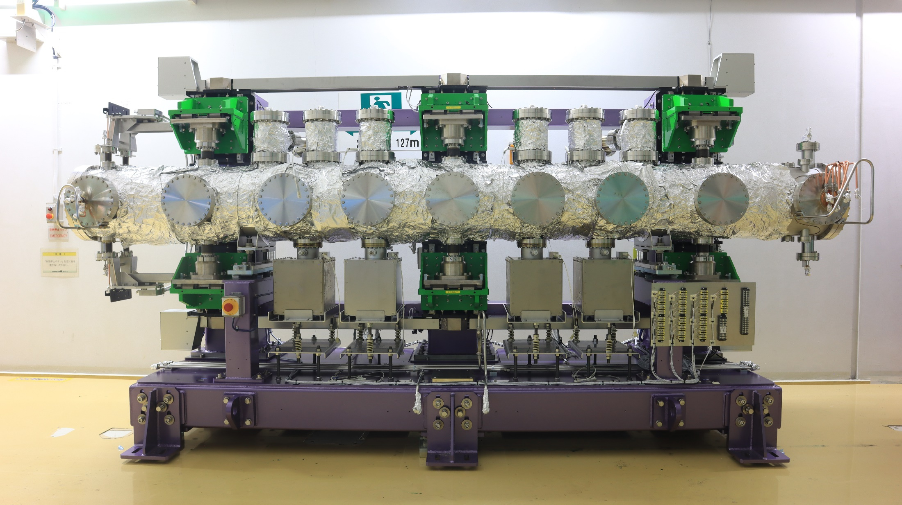
IVU-II Overall Structure
Support Shaft
NEG
NEG
e-
SIP
SIP
ABS.
More than 30 IVU-IIs will be installed in SPring-8-II
Common Base

Slide 10
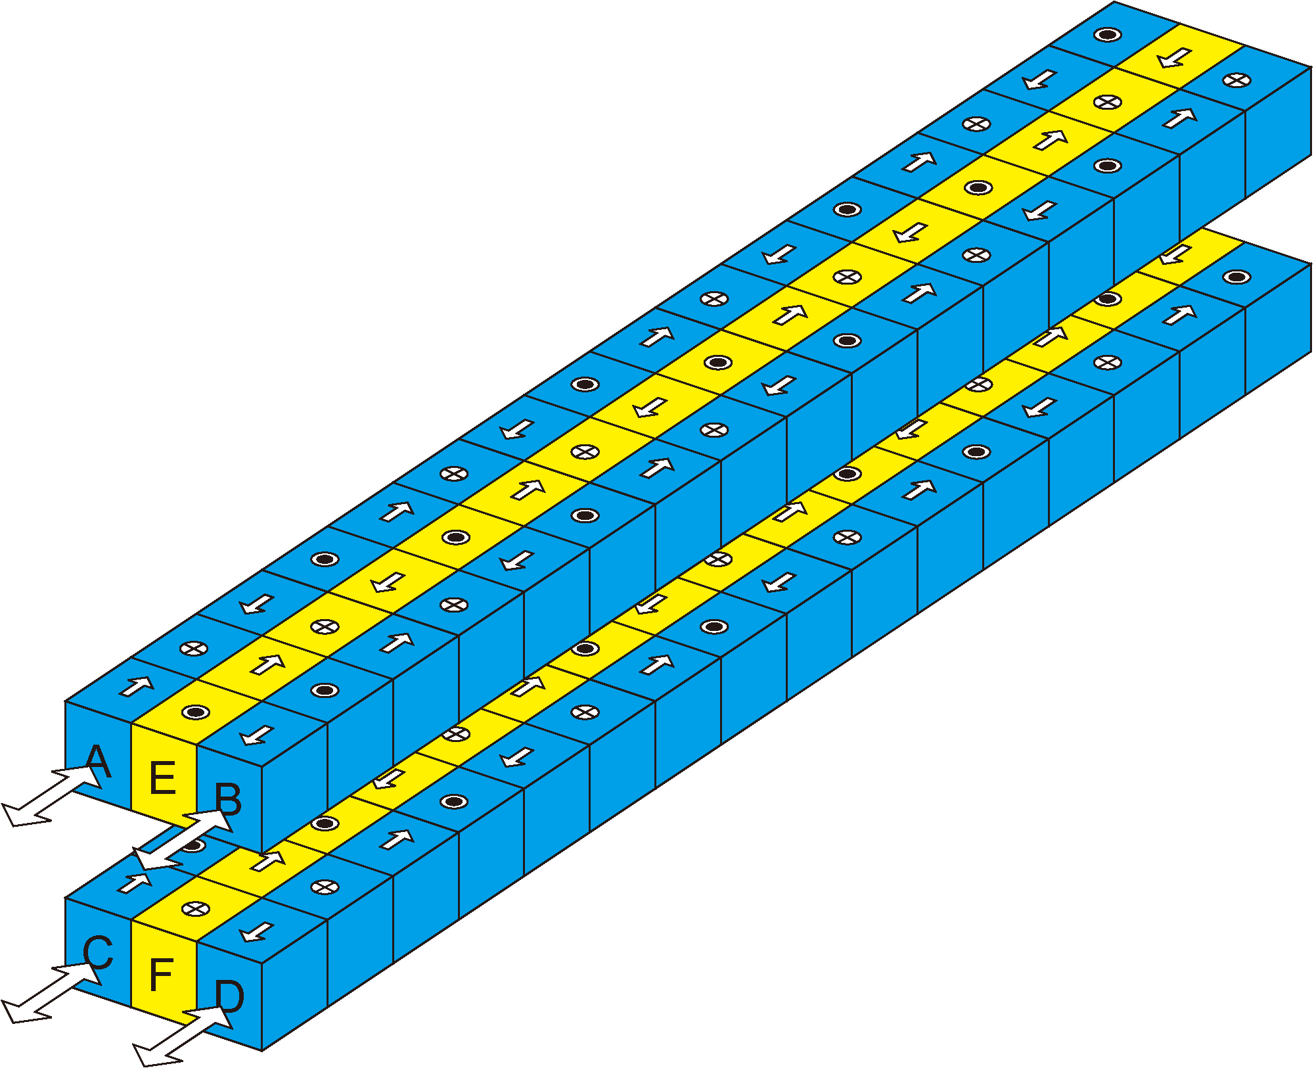
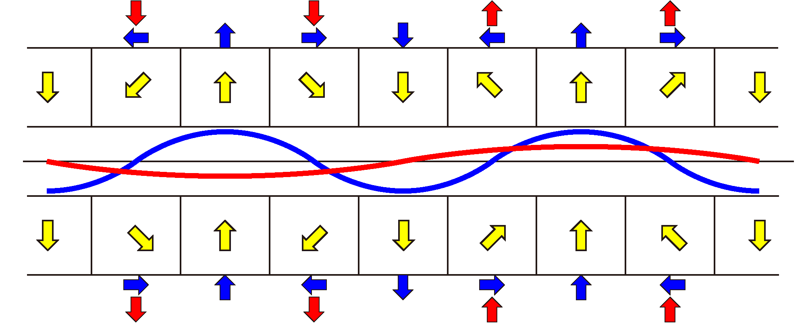
Helical-8 Undulator
SX undulator operational in 2 modes
  Helical Undulator for LCPR/RCPR
  Figure-8 Undulator for HPR/VPR
  Low heat load in any polarization states
Composite period configuration in side arrays enables to switch the operation mode

Slide 11
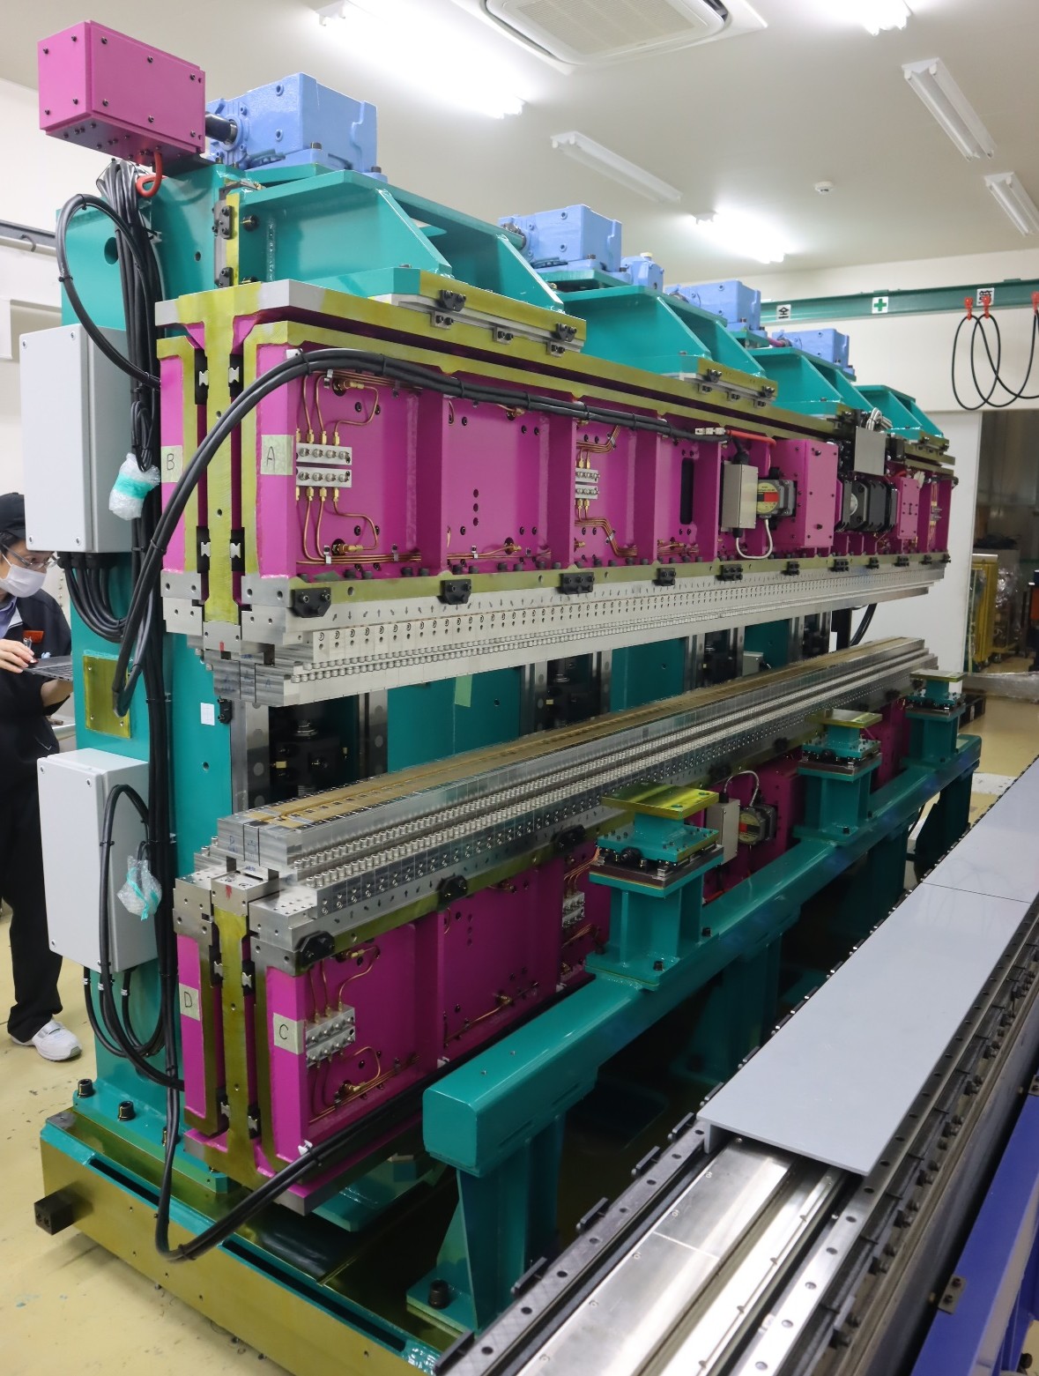
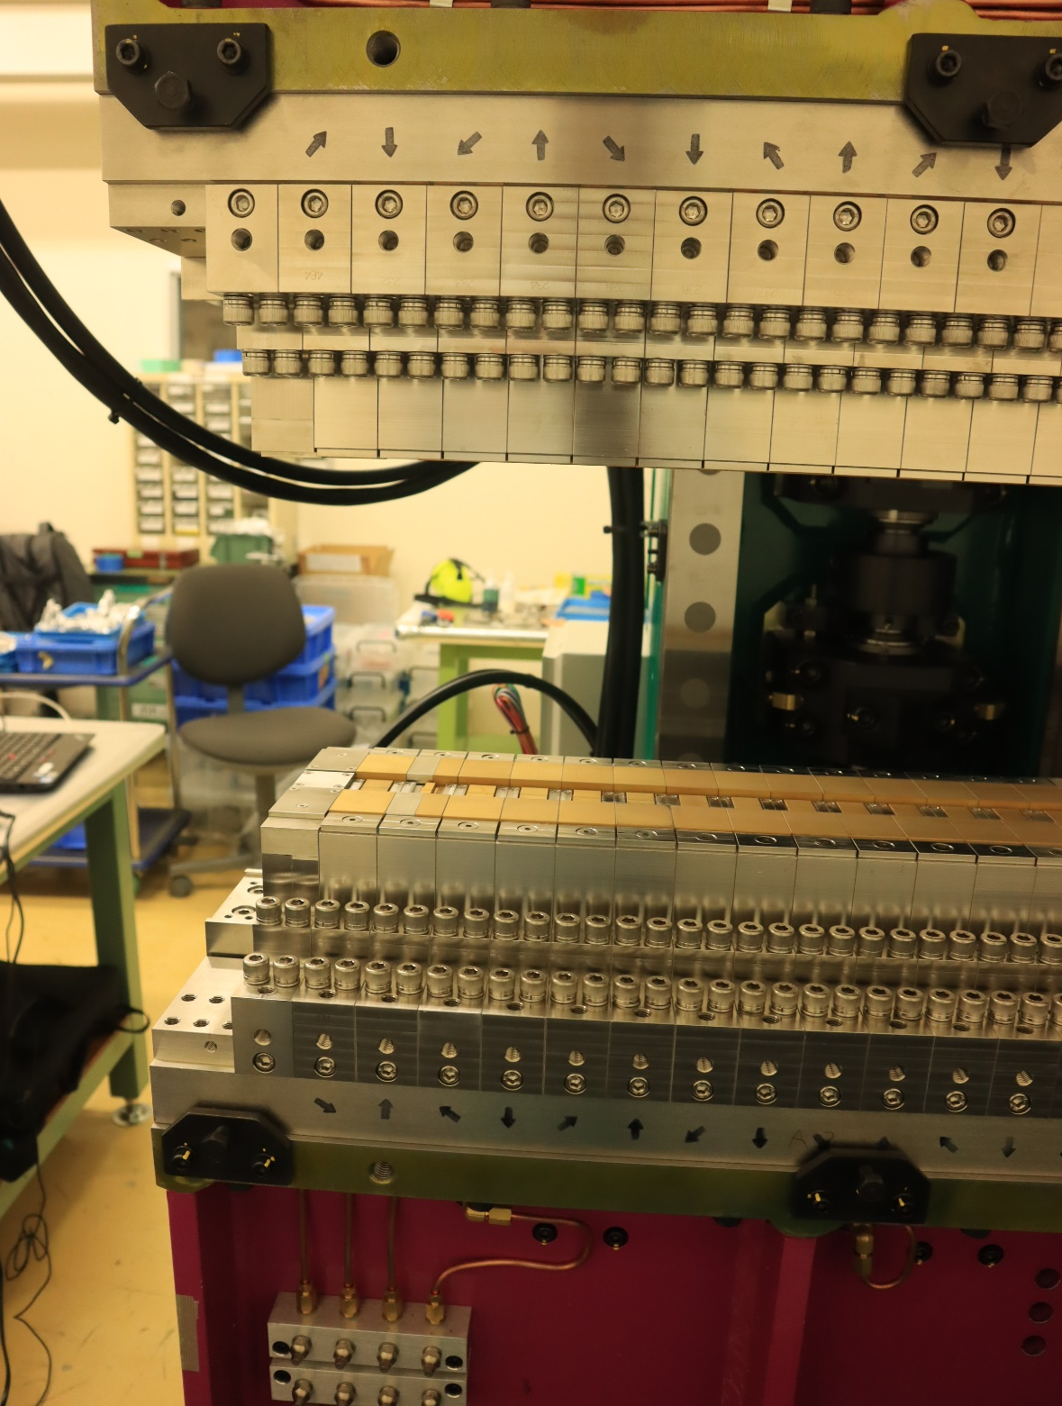
Helical-8 Undulator (λ_{u}=120mm)
in operation in BL17SU

Slide 12
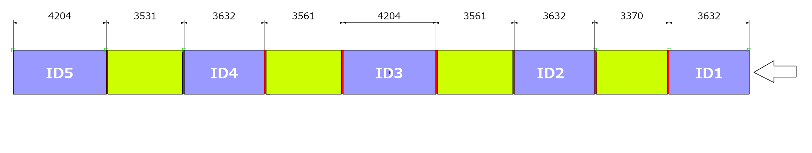
Long Straight Sections
SPring-8-II will have 4 LSSs (33m), each composed of 5 drift sections
IVU-IIs will be installed in LSS#1 and #2, and damping wigglers in LSS#3
LSS#4 will be kept empty, for future options (SSMB?, XFELO?)
33m

Slide 13
IVU-IIs in LSS#1/#2
5 IVU-IIs will be installed in each LSS
  22mm/24mm period
Because of a large number of periods, phase matching between sections have nearly no effect
  No phase shifters will be installed
Optimized lattice enables minimum gap similar to the normal SS (~5mm)
  Heat load issue should be solved (Cu/Ni sheet can be molten)

Slide 14
Phase Matching?

Slide 15
Damping Wigglers in LSS#3
Control the radiation damping, and work as an emittance compensator (rather than emittance reducer)
  Compensate for the variation of the energy loss when opening/closing the gap of other IDs
  This means that the photon flux of DW may fluctuate as well
  Usage of DW is still under discussion
Needs absorbers/masks in the straight section before FE, as in PETRA III

Slide 16
SPring-8-II Project
New Insertion Devices in SPring-8-II
  IVU-II
  Helical-8 Undulator
  IDs in LSSs
Issues in Tapered IVU-II

Slide 17
Tapered IVU-II
To be used for quick XAFS application
Normal IVU-II can be easily converted to tapered one by:
  Reduction of support shafts (3⇒2), supposing that mechanical load is low
  Implementation of drive motors for all supports
Tests with a prototype show that
  Mechanically OK (durability and tapering)
  Undulator quality (phase error) NG in non-tapered mode!

Slide 18
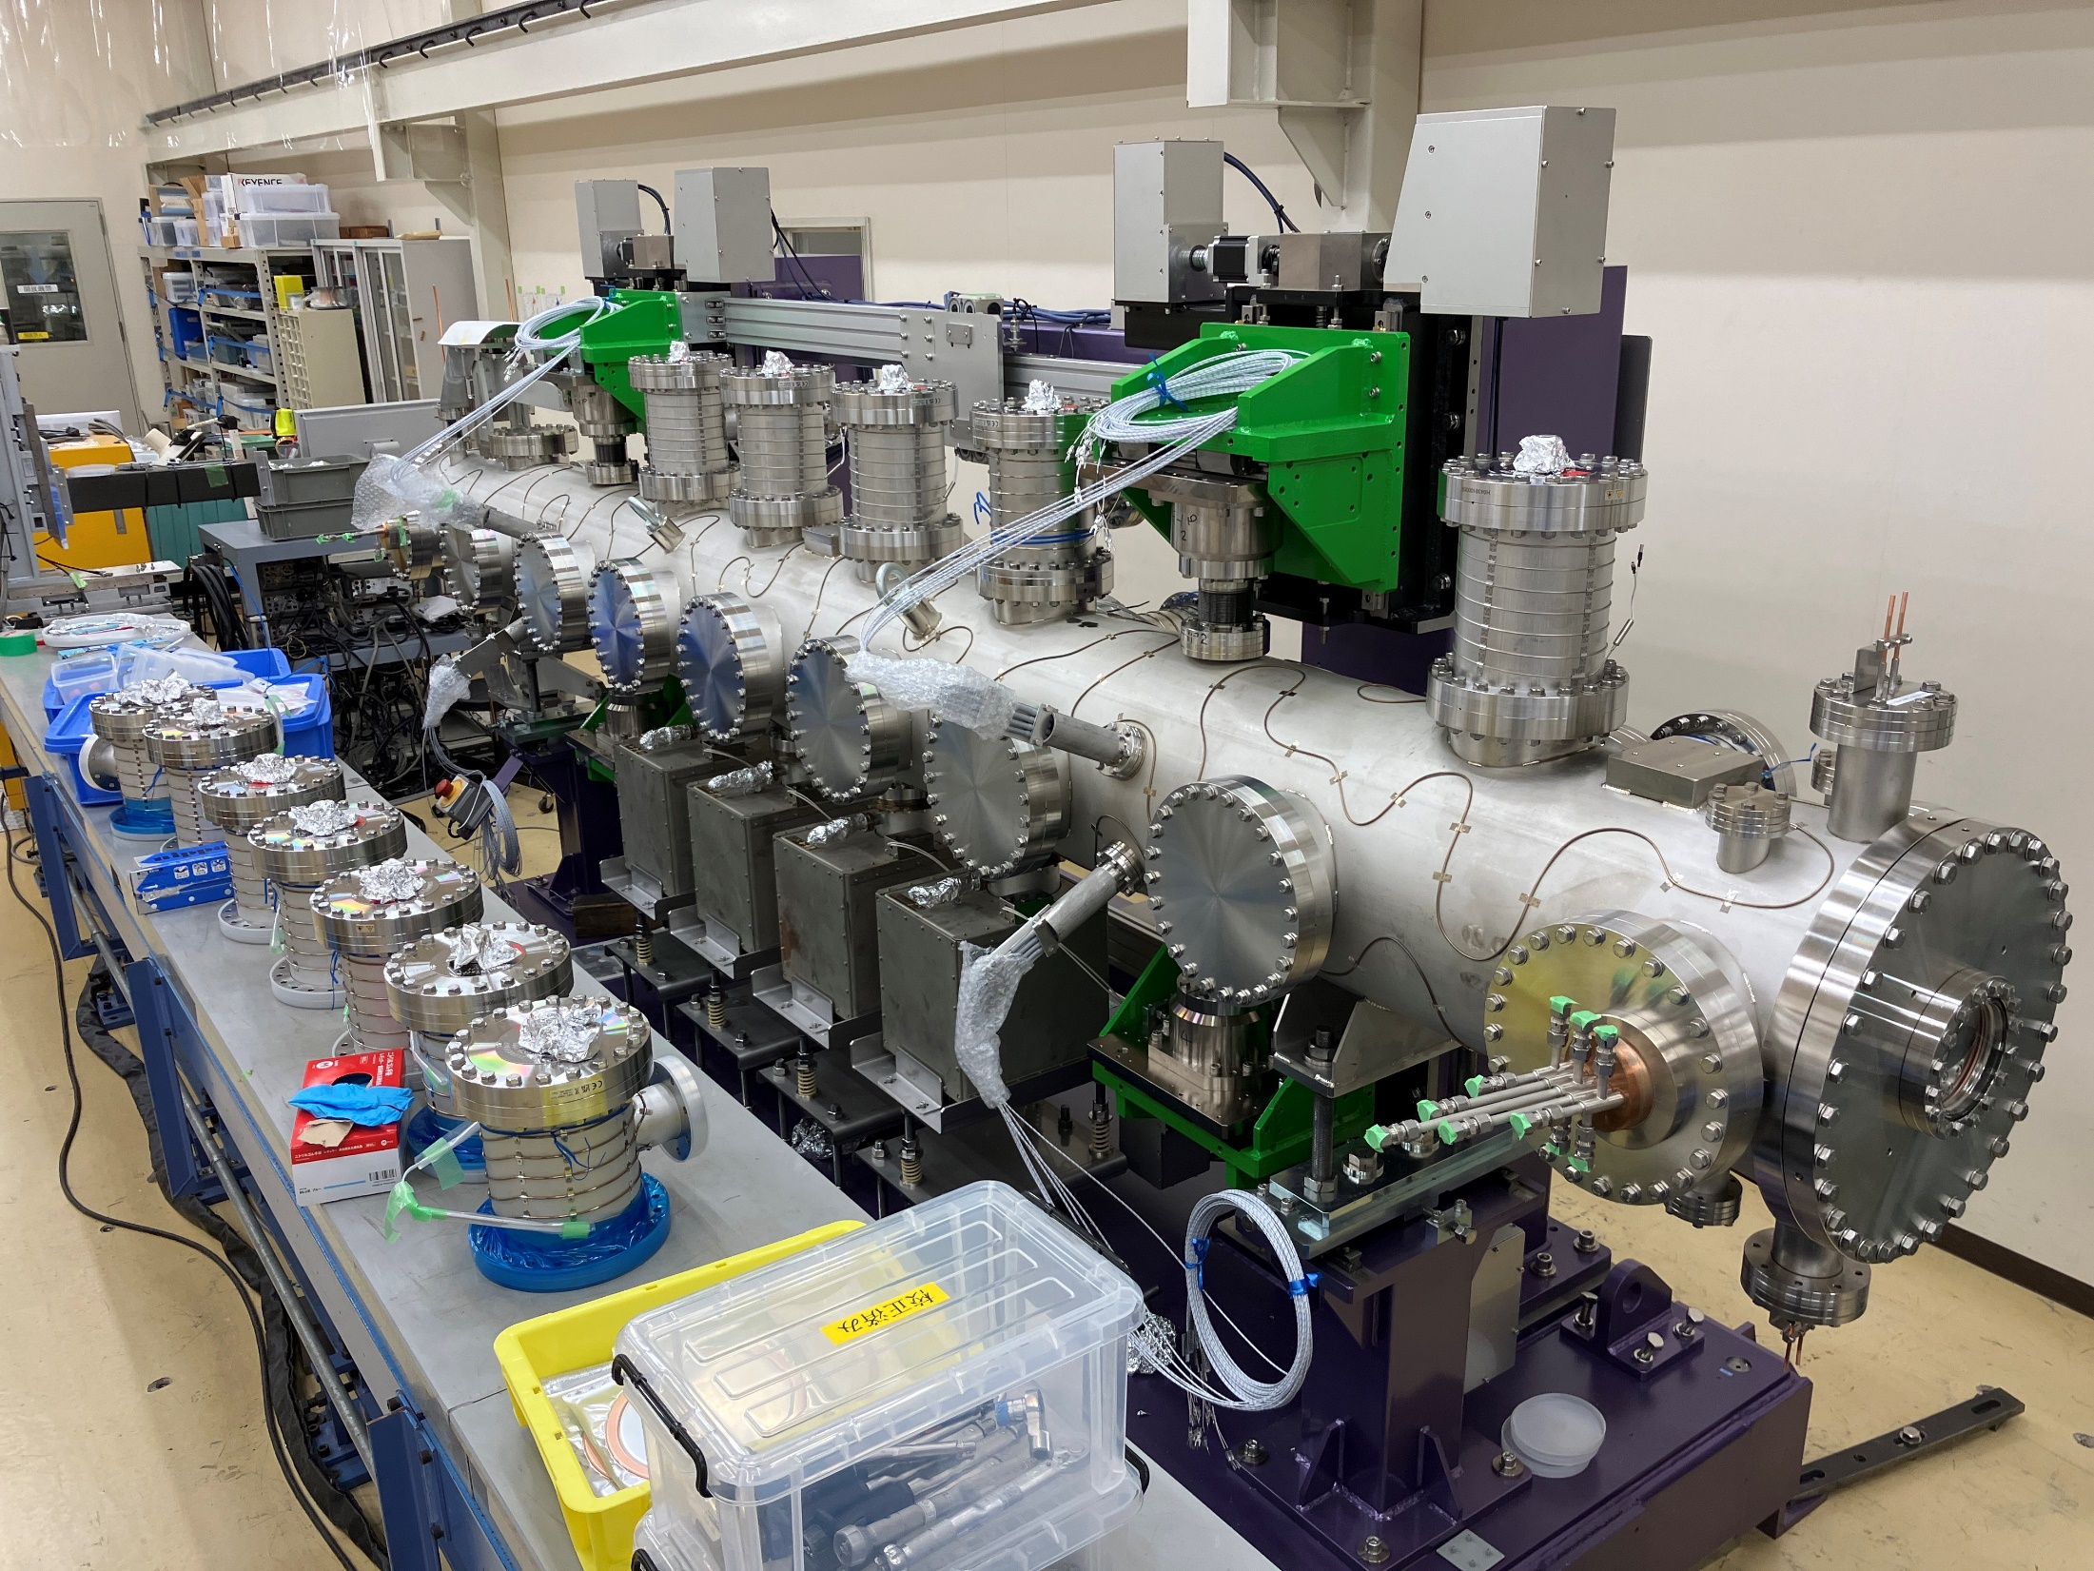
Tapered IVU-II Prototype
28mm period
2 supports

Slide 19
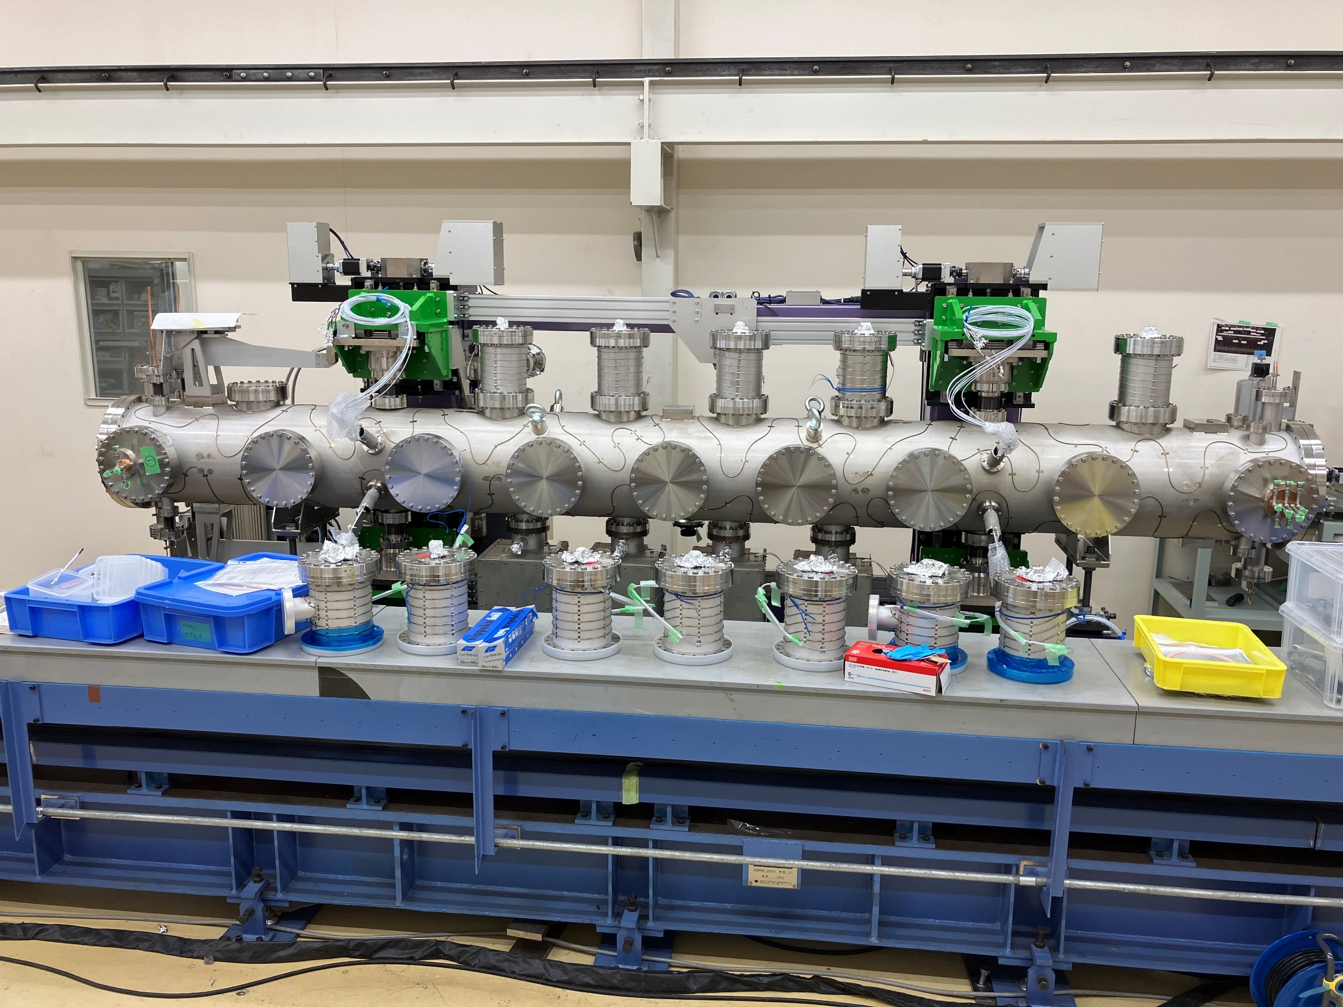
Stepping Motor
Support
Shaft
Fewer supports; magnetic array much more sensitive to a mechanical load than normal IVU-IIs

Slide 20
What Happened?
Field correction completed successfully at the minimum gap of 6 mm
Phase error degradation found during the final check (in-situ measurement by SAFALI)
Two factors can deform mag. array, resulting in worse phase error:
  Tension on Cu/Ni sheet
  Residual magnetic force
Has not been a problem in 3-support structure!

Slide 21
Deformation by Cu/Ni Sheet Tension
tension (30kg/mm)
fixation
Cu/Ni sheet
fixation
Magnets
Al Beam (bottom)
Support Shaft

Slide 22
Deformation by Residual Force
residual force (~30kg)

Slide 23
Effects by Cu/Ni Sheet Tension
Sheet tensioner under discussion
  Proper (not too strong) tension, especially during bakeout (thermal expansion)

Slide 24
Gap-Dependent Phase Error by Residual Force

Slide 25
Gap-Dependent Phase Error by Residual Force

Slide 26
Gap-Dependent Phase Error by Residual Force

Slide 27
Residual Force
F_{r}~30kg is still a problem in 2-support structure;
Further reduction needs to be done, but not so simple…

Slide 28
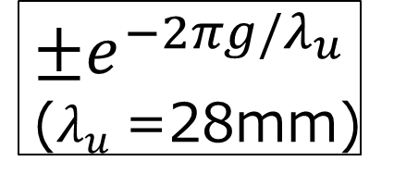
Residual Force
$$±e^{−2πg/λ_{u}}$$
($λ_{u}$=28mm)

Slide 29
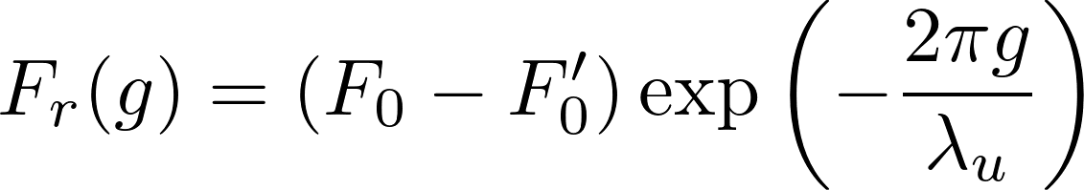
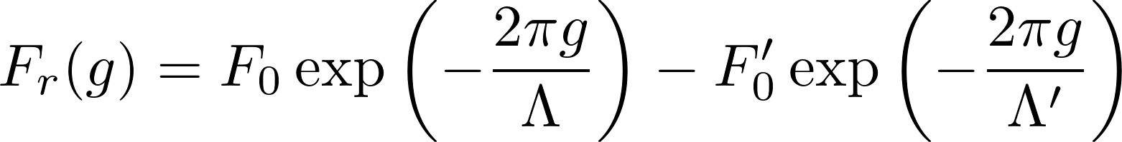


Why Non-Exponential F_{r} is a Problem?
Residual Magnetic Force in IVU-II
In a 2D and ideal case,
Main Magnet
MMM; easily tuned
In reality,
but
F_{r} cannot be reduced only by F₀’

Slide 30
Rough Estimation of Λ and Λ’

Slide 31
How to Improve Tapered IVU-II?
Measure attractive and repulsive forces of a module pair independently, to evaluate Λ and Λ’
Modify the period of the magnetizing yoke so that Λ‘ gets closer to Λ
Swap MMMs with new Λ‘(=Λ)
Adjust F₀’ to reduce F_{r} by optimizing the shim thickness on the bottom of MMMs
Goal: phase error comparable to those in 3-support IVU-IIs

Slide 32
Announcement on SPECTRA/SIMPLEX
Simulation code developed in SPring-8
  SPECTRA: https://spectrax.org/spectra/
    spontaneous and coherent SR
  SIMPLEX: https://spectrax.org/simplex
    FEL simulation and characterization
Non-desktop versions available in the latest versions (SPECTRA>12.0 and SIMPLEX>3.1)
  Web-application: run on a browser without installation
  Python: batch job (pip install available)
Feedback Welcome!

Slide 33
Thank you for attention

