Slide 1
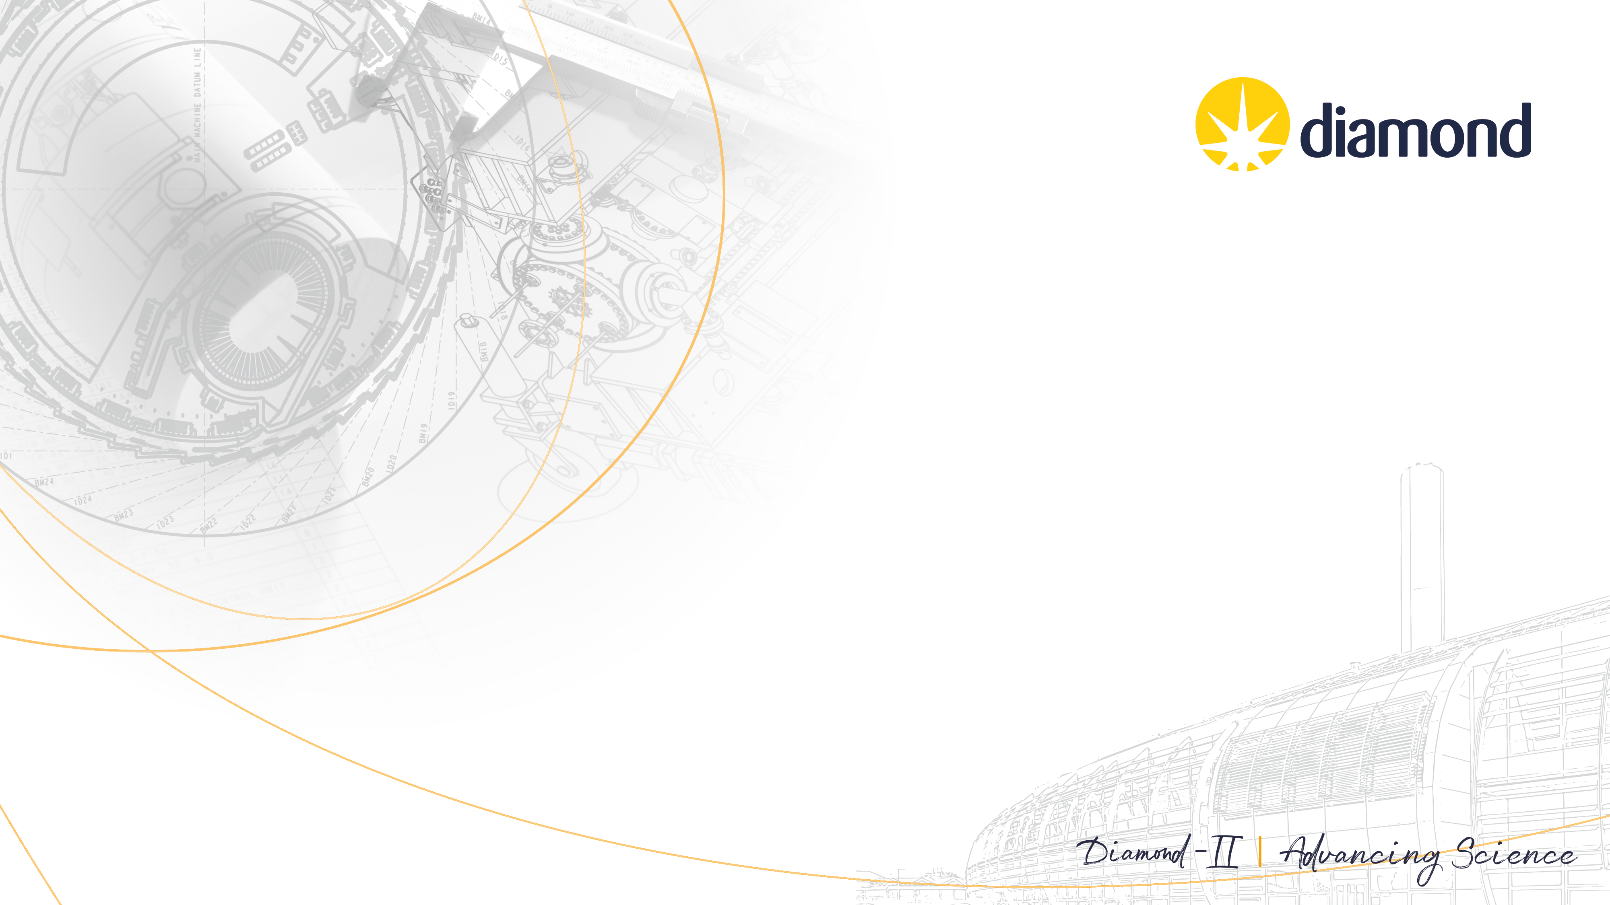
Insertion Devices for Diamond-II
Zena Patel
S. R. Milward, R. Mercado, A. Ramezani Moghaddam,
G. Sharma, S. Tripathi

Slide 2
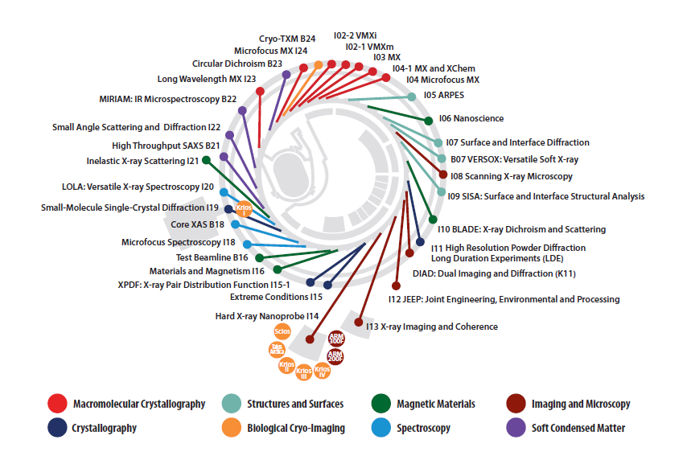
Diamond insertion devices
Diamond is a 3 GeV (medium) energy storage ring
Phase I 2003-2007
8 IDs installed
Phase II 2007-2014
15 IDs installed
Phase III 2014-2018
8 IDs installed
Upgrades 2018-present
1 wiggler in place of a sextupole
5 CPMUs to replace PPMs
1 SCU to replace a PPM
Machine at capacity

Slide 3
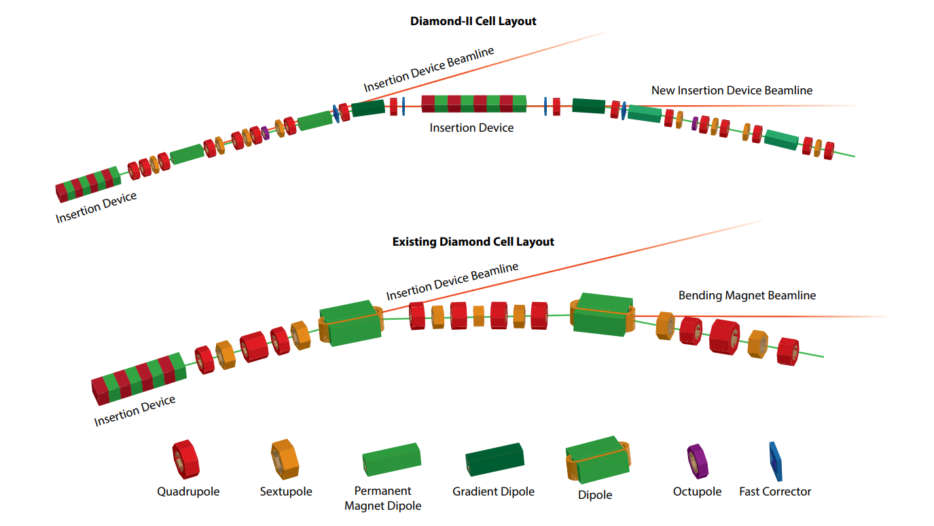
Diamond-II highlights
6BA
To stay competitive
Reduce emittance from 2.7 nm.rad to 161 pm.rad → improved photon brightness & coherence
Energy increase from 3 GeV to 3.5 GeV → improved photon flux at higher energies
Increased number of straight sections → more beamlines
Five flagship beamlines (3 funded)
DBA
Posters on accelerator physics studies available to view at IPAC 2025

Slide 4
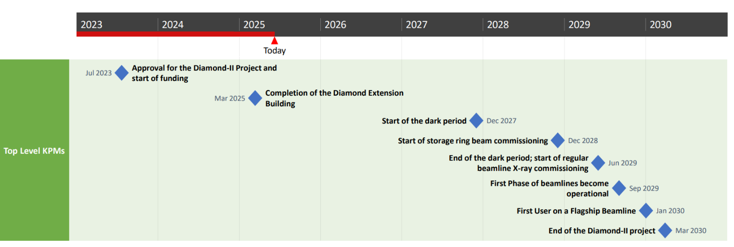
Diamond-II timeline
Diamond Extension Building (DEB) required for magnet measurement lab & girder storage
All IDs to be ready for the start of the dark period except one, which will use the structure from a currently installed device

Slide 5
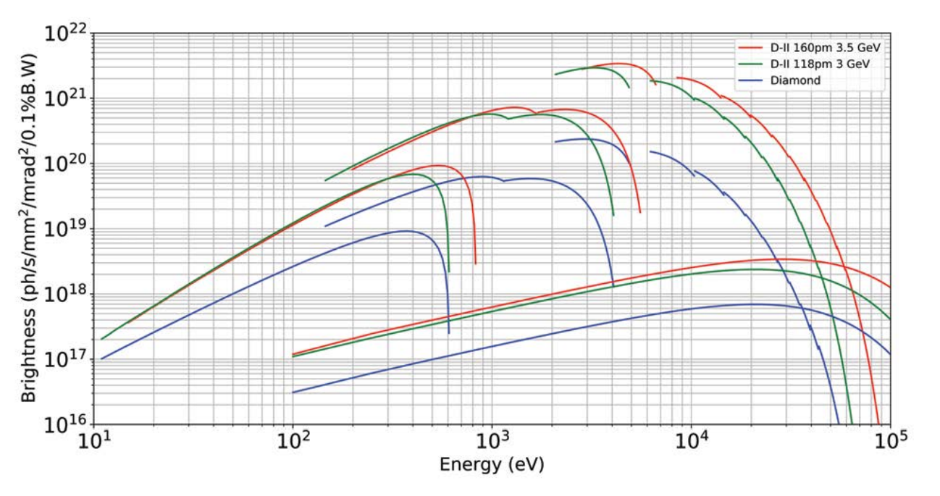
IDs for Diamond-II Overview
New IDs for 2 out of 3 flagship beamlines (1 installed 2022)
Opportunity for new science & novel IDs: APPLE Knot & EMPHU
While the higher energy beamlines will benefit from the new ring without the need of a new ID, two of the lower energy beamlines will require a new ID to reach their lower energies (others will require a reduction in minimum gap)
3 out of 7 bending magnet beamlines require an ID source,
APPLE-II 56
CPMU
APPLE-II 140
SCW 48
1 a 3PW, and 3 will use the dipole radiation from the DQs

Slide 6
IDs for Diamond-II Overview
Type | Buy from industry | Build in-house | Comments/status
CPMU |  | 1 | Short CPMU needed for mid-straight
HPMU | 2 |  | Contract awarded to Kyma
APPLE-II | 4 | 1 | Writing procurement specifications
EMPHU |  | 1 | Prototype coil testing complete
MPW | 1 |  | Writing procurement specification
3PW | 1 |  | Writing procurement specification
Totals | 8 | 3
Pink: flagship beamline
Diamond projects also on-going:
CPMU-1 foil replacement: at cold testing stage. Will replace CPMU-2 in the ring next shutdown (August ‘25)
CPMU-2 foil replacement
APPLE-Knot in-house build
Blue: covered in this presentation

Slide 7
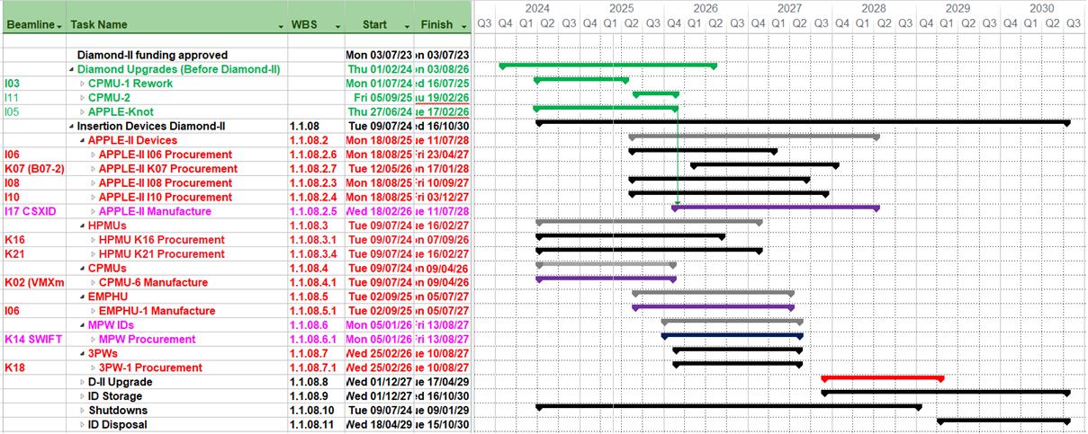
IDs for Diamond-II Schedule
Start of dark period

Slide 8
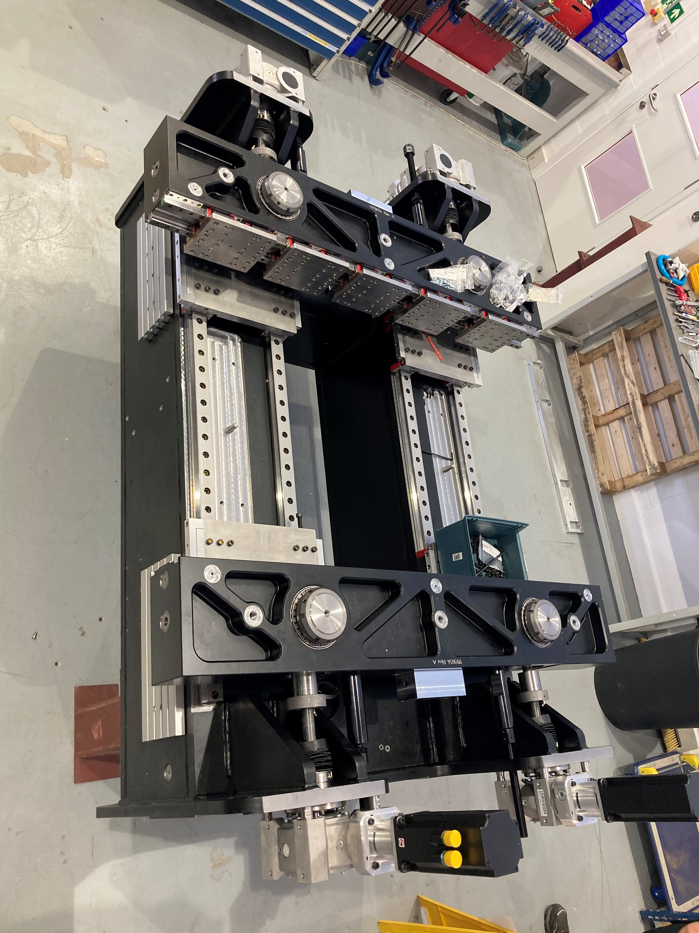
Summary of Diamond-II IDs
CPMU-6 structure
IDs not covered in detail later:
CPMU 17.6: same as existing CPMUs but 1.5 m instead of 2 m. Re-design of structure. Currently being built in-house. Magnets delivered and a sample measured on Helmholtz coil.
2x HPMU 18.7: for 2 mid-straights (1.5 m). PDR completed. Working towards FDR. Diamond will provide the control racks for consistency.
3x APPLE-II 56 (1x 2 m, 2x 4m). Tender August ’25
1x APPLE-II 52, 5 m. Build starts Feb ‘26 but partially built in the dark period as re-using an existing structure.
1x APPLE-II 64, 2m. Tender May ‘26

Slide 9
APPLE Knot for I05

Slide 10
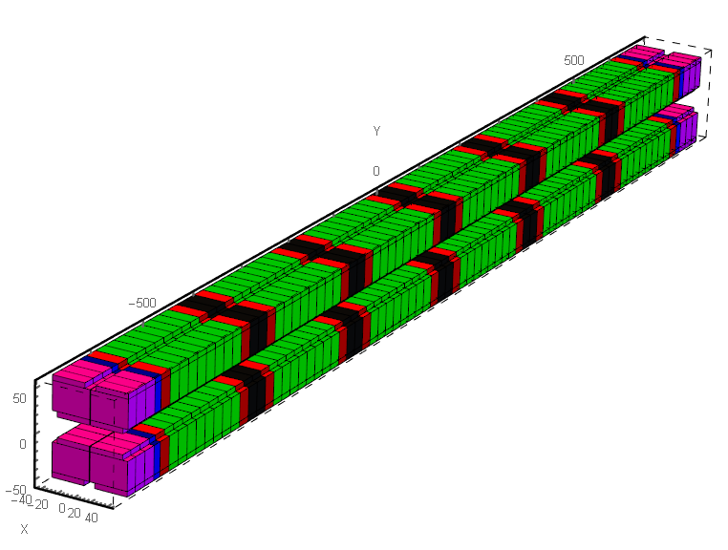
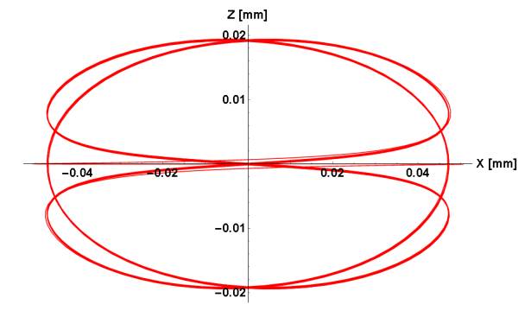
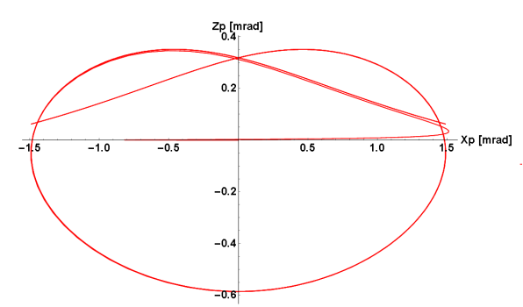
APPLE Knot
Replaces a 5 m APPLE-II. The beamline want to reach 10 eV → higher K value → greater power on beamline optics.
The APPLE Knot design reduces the on-axis power and therefore the heat-load on the beamline optics
(6 out of 22 cells shown)
Red: 1.22 T vertical magnets
Black: 1.22 T horizontal magnets
Green: 1.33 T merged magnets
Pink: 1.22 T horz. or vert. end magnets
Blue: 1.33 T merged end magnets
1 mm transverse separation of quadrants
Transverse projection of trajectory for horizontal polarisation
Transverse projection of angle for horizontal polarisation

Slide 11
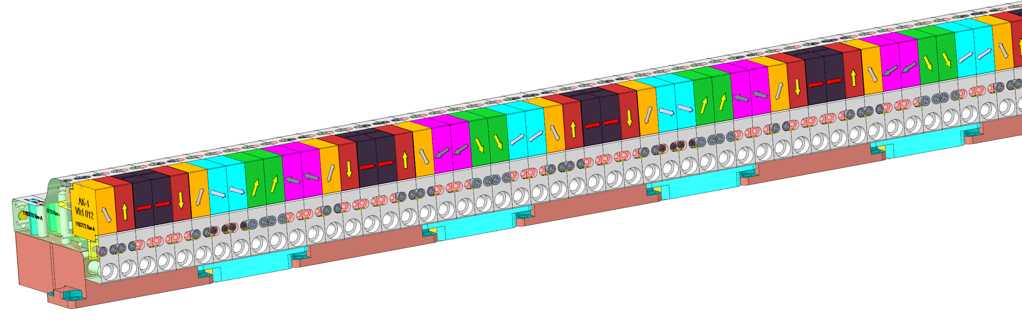
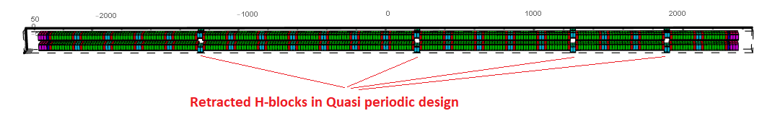
APPLE Knot
Magnetisation angle only in the s-z plane
6 types of main magnets
Black and red: APPLE-II magnets
Others: merged APPLE-II and APPLE Knot magnets
Orange & green: 23.46° angle from z-axis
Blue & pink: 23.46° angle from s-axis
z
s
x
Light blue: 1.22 T H magnets

Slide 12
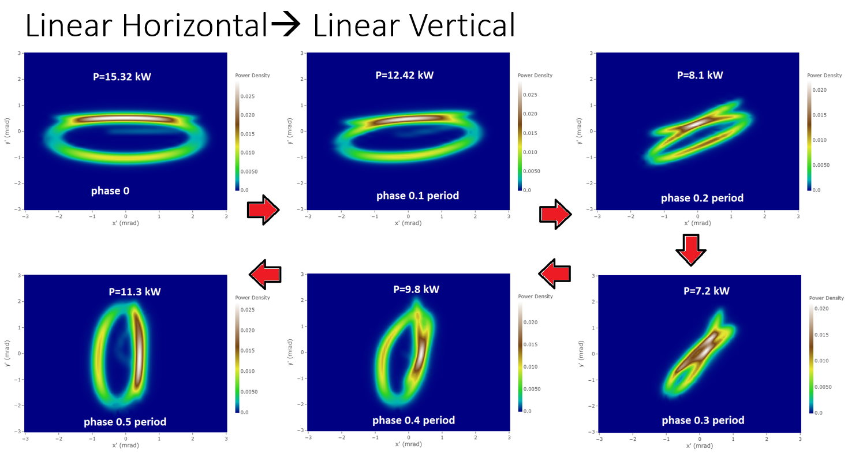
APPLE Knot expected performance
Natural feature of APPLE Knot = asymmetrical power distribution.
Symmetrising degraded trajectory.
Need to open the gap before moving from horizontal to vertical mode as x-ray beam moves on axis.
Plan to implement a stay-clear region in the control system.

Slide 13
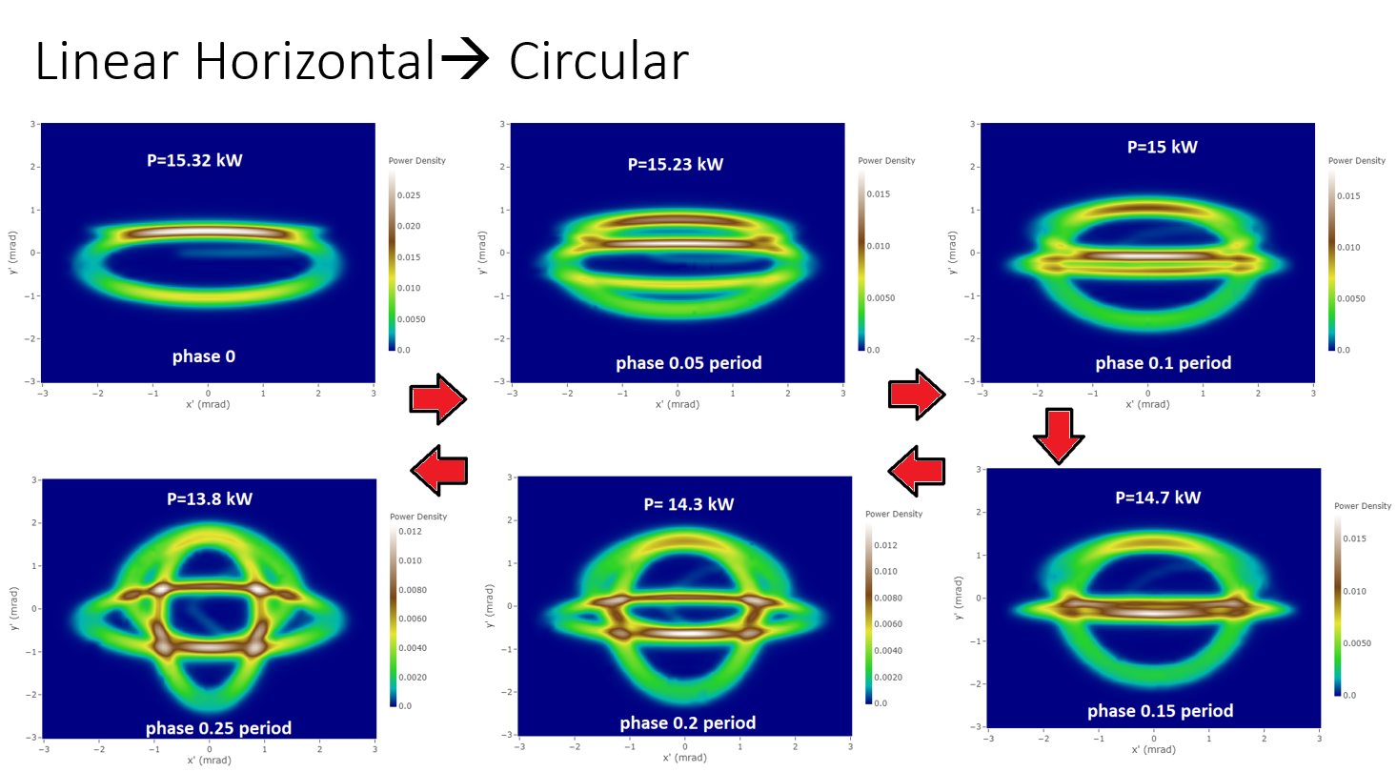
APPLE Knot expected performance
Moving from horizontal to circular mode has the same issue as moving from horizontal mode to vertical mode.
Need to open the gap before moving from horizontal to circular mode as x-ray beam moves on axis.

Slide 14
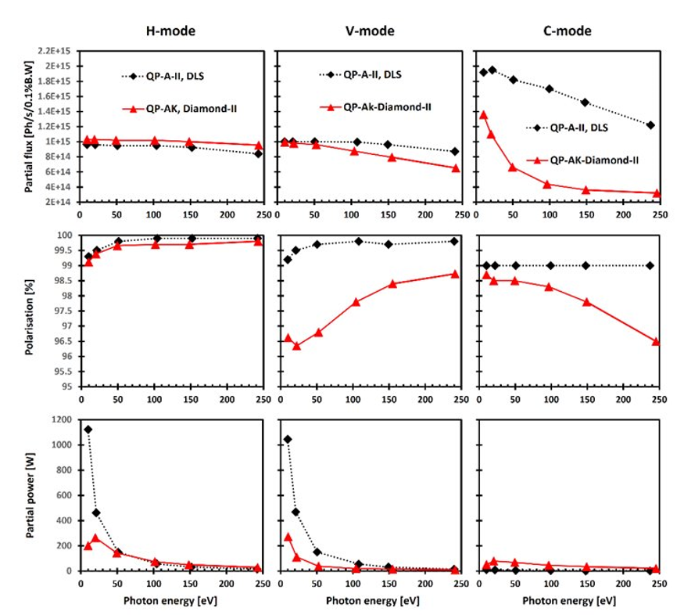
APPLE Knot expected performance
Power significantly reduced at low photon energies while maintaining flux and polarisation % in horizontal mode
Some reduction in polarisation % in vertical mode, but still above 95%
Flux & polarisation % reduced for circular mode but beamline are happy with the trade-off
Data shown for a 5Σ aperture. A fixed aperture would cause a reduction in polarisation %
Power reduction with APPLE Knot

Slide 15
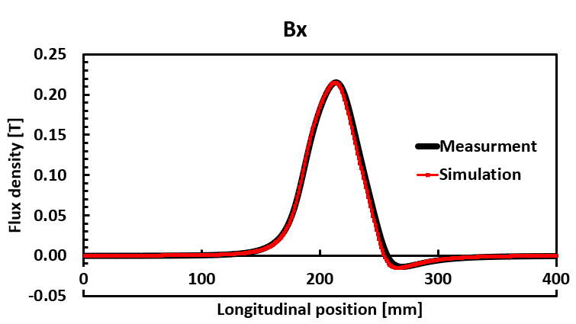
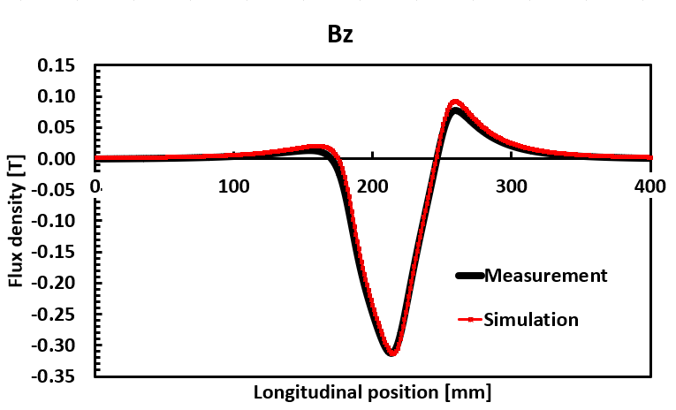
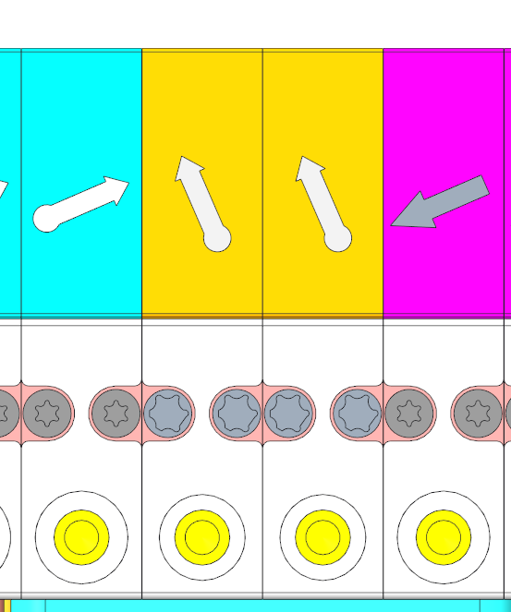
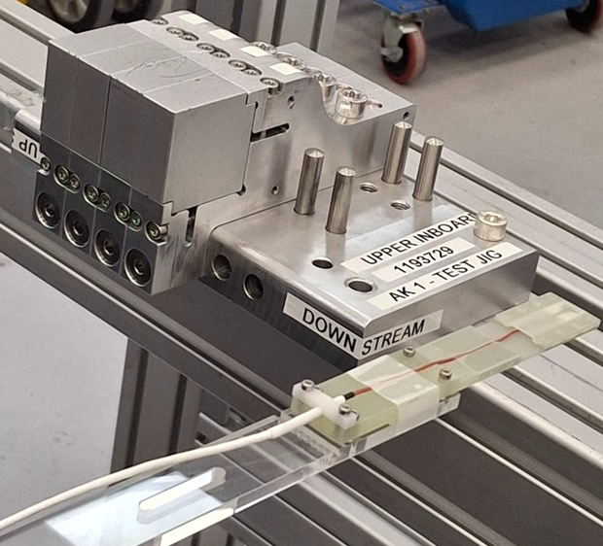
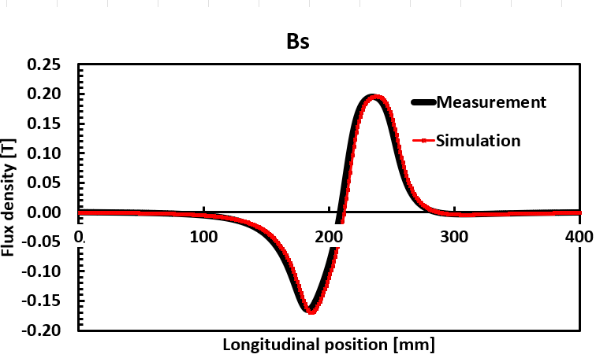
APPLE Knot current status
Magnet samples delivered and measured (supplier: HPMG)
Individual magnets measured on Helmholtz coil. Angle within 1° of manufacturer data. 4-block array measured:
Next step: a 2-quadrant 2-cell prototype. Carriage and rails on order.

Slide 16
EMPHU for I06

Slide 17
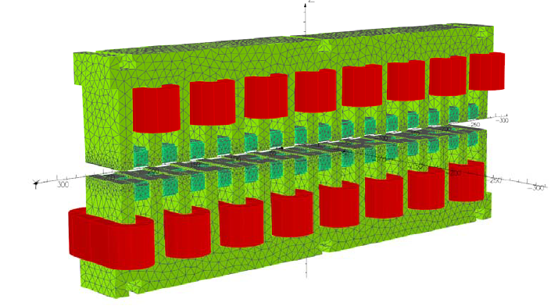
EMPHU
ElectroMagnet Permanent-magnet Helical Undulator for fast switching between right-hand and left-hand circular polarisation down to 500 eV
Replaces an APPLE-II. Beamline will have 1x APPLE-II and 1x EMPHU
Based on a design by SOLEIL (3D models and drawings shared)
Adaptations:
SOLEIL report significant eddy current perturbation from the aluminium vacuum vessel. Diamond will use a stainless steel vessel to reduce eddy currents
SOLEIL added air cooling as indirect water cooling was less effective than expected at stabilising PM temps. Diamond will use hollow conductor coils
Red: coil
Light green: iron
Dark green: NdFeB magnets
Bz from electromagnets | 0.27 T
Bx from permanent magnets | 0.33 T
Min. gap | 12.5 mm
Period length | 65 mm
Magnetic length | 1.75 m
OPERA model for EMPHU; Courtesy- S. Milward
(direct water cooling)

Slide 18
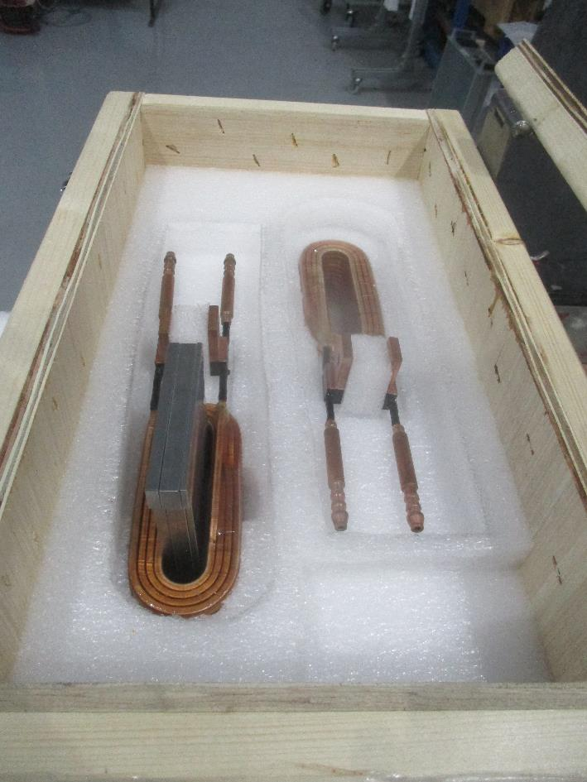
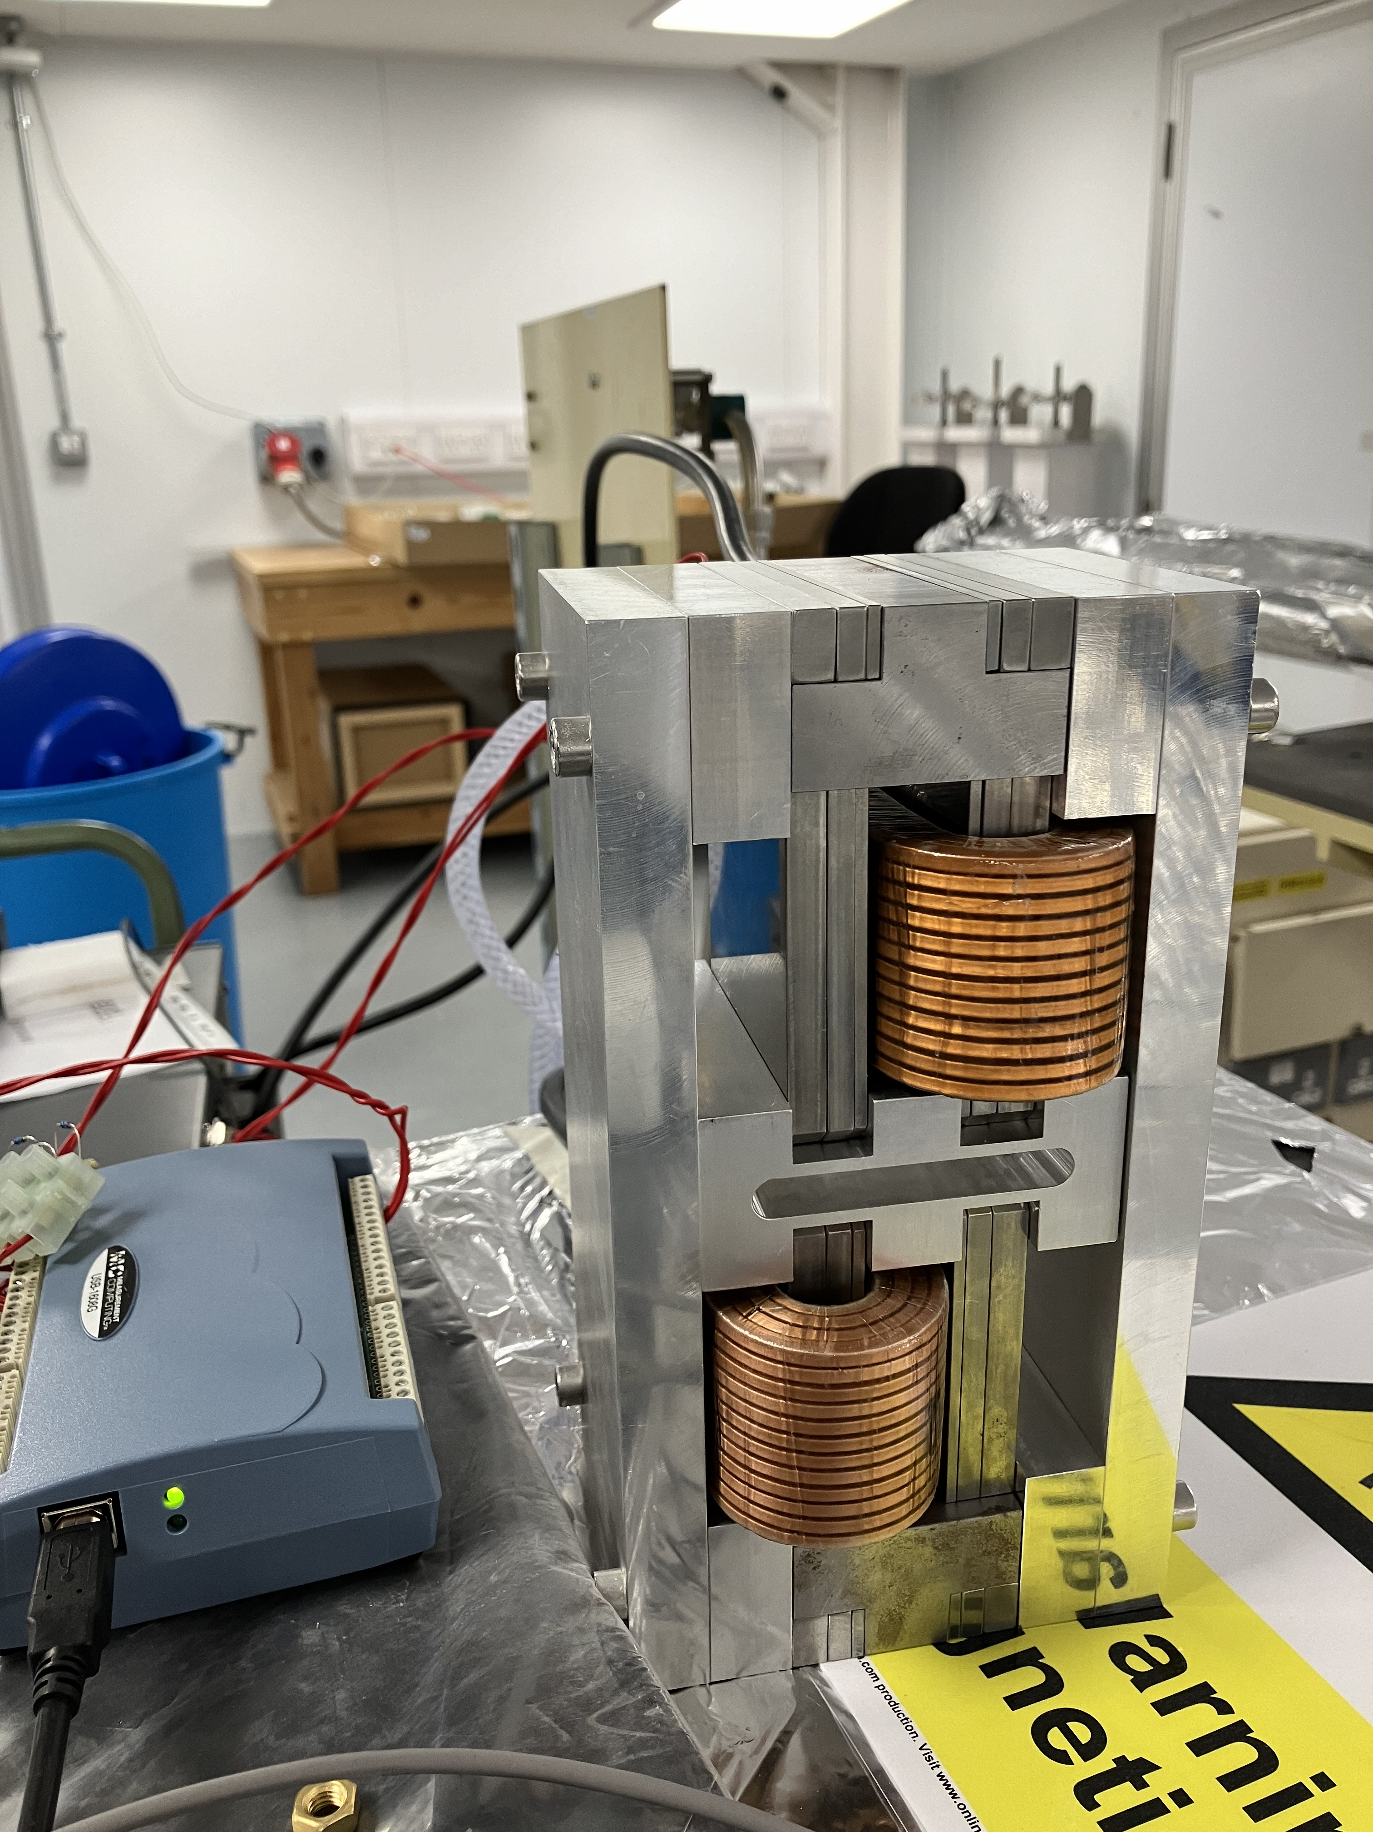
EMPHU test coils
Electrical connections
2 test coils from TESLA engineering
0.27 T magnetic field achieved with 68 A (5.5 V). Original SOLEIL design used 350 A.
68 A on coils for 30 mins showed a 5° temperature rise with water cooling. Water cooling is sufficient.
Water cooling

Slide 19
EMPHU performance
Current switching time ~8 seconds (0.125 mHz) by cycling a pair of IDs in opposite polarisation states to tune & de-tune from a narrow energy band
EMPHU will reduce the cycle time to 360 ms (2.77 Hz)
  40 ms rise & fall time. Limited by the performance of the power supplies.
  100 ms at required voltage. Requested by the beamline.
PSU spec: ±250 V, ±75 A
Next steps: prepare project plan & begin engineering design in the next few months

Slide 20
MPW for K14 SWIFT

Slide 21
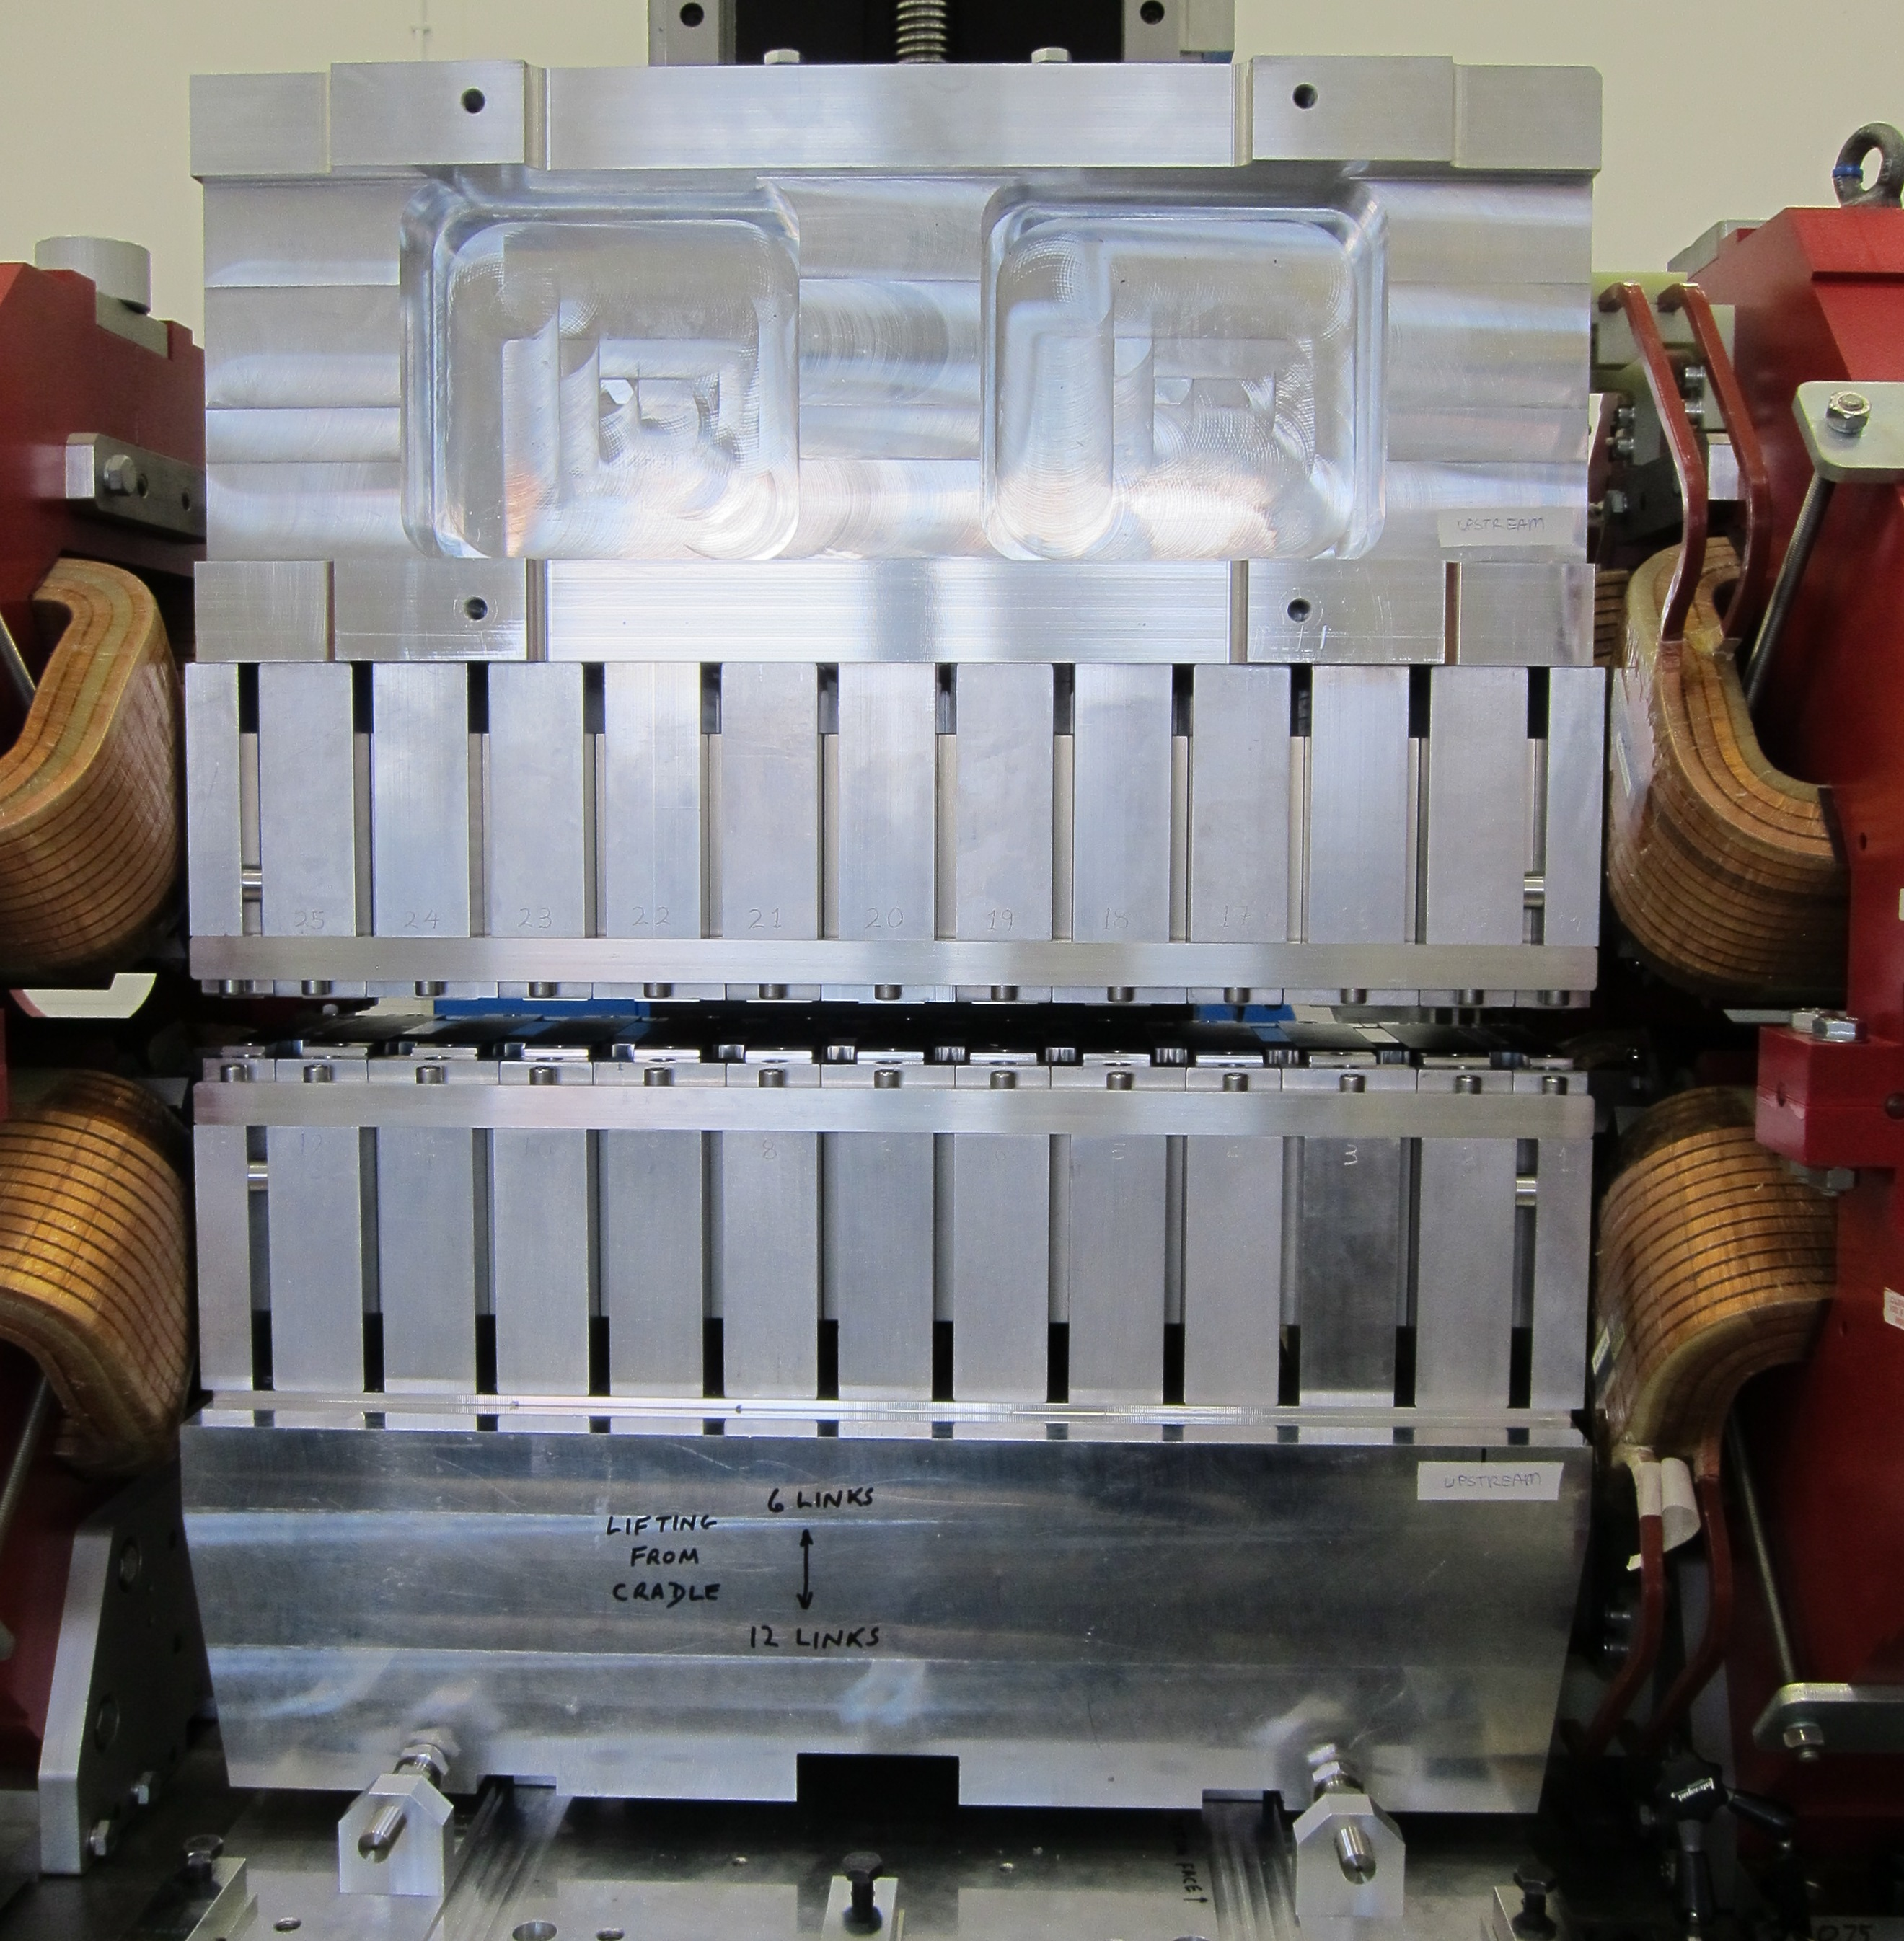
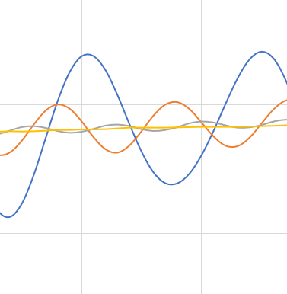
K14 SWIFT (flagship beamline)
DIAD wiggler,
116 mm period,
5.5 periods, 1.5 T
New beamline for Diamond-II in a mid-straight
4 - 35 keV range with <0.5% flux variation
Spectra flux calculations at 1.3 T field
0.5%
zoomed in @ 4 keV
> 103 mm period required. 116 mm chosen to match existing wiggler in Diamond

Slide 22
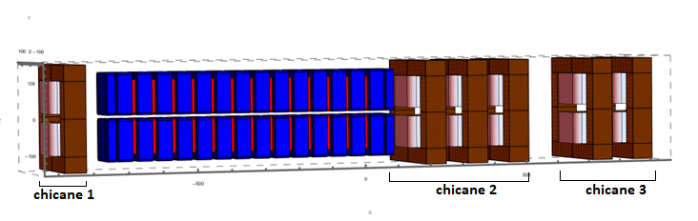
K14 SWIFT
Space constraints in the experimental hall mean the beamline needs to be canted by 5 mrad
Use existing chicane magnet design with smaller gap to reach 6.5 mrad per magnet
Interest from Scanditronix & Tesla Engineering to make the chicane magnets
Originally planned to build the wiggler in-house but now to source from industry
Chicane 1: 5 mrad
Chicane 2: 18 mrad
Chicane 3: 13 mrad
Blue: NdFeB magnets
Red: iron poles
Angle
Trajectory

Slide 23
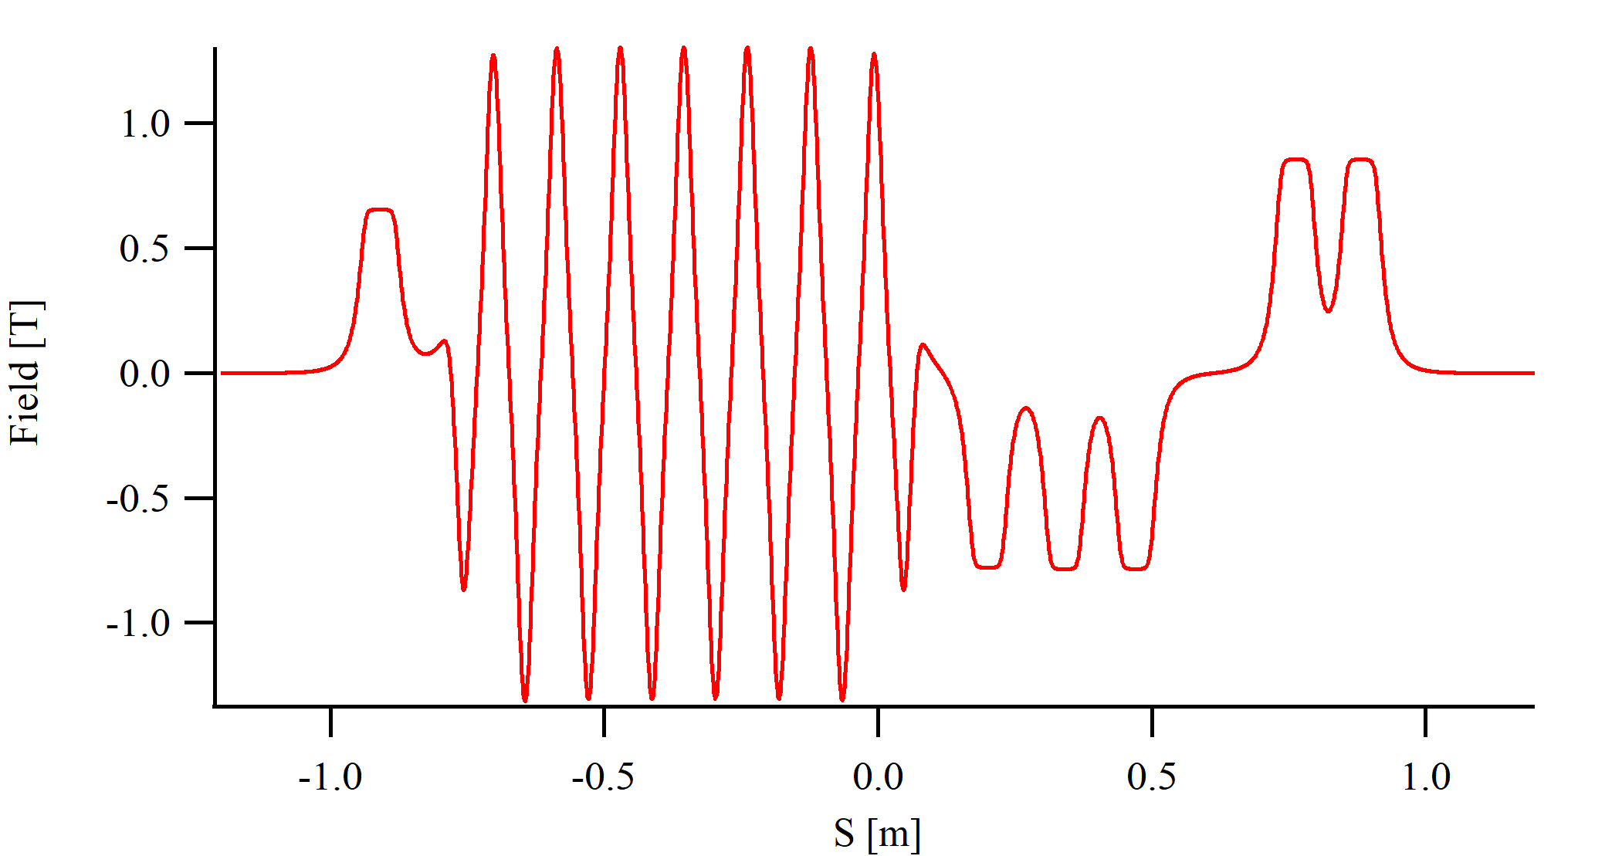
K14 SWIFT
Wiggler requirements: 6.5 periods, 1.3 T
Power from wiggler = 2.8 kW (total power = 3.8 kW)
Field from Radia model
Power & flux calculations from Spectra
Next step: procurement of wiggler & chicane magnets

Slide 24
3PW for K18

Slide 25
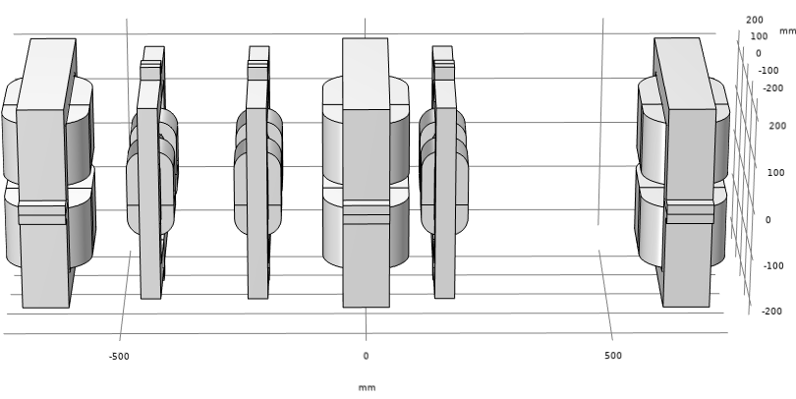
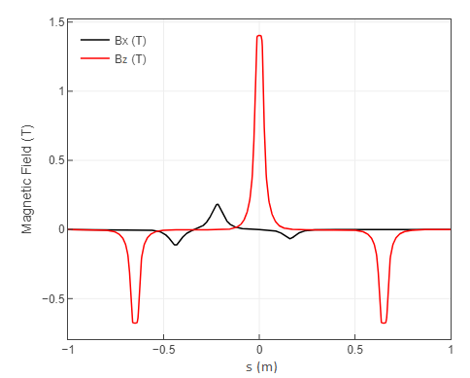
K18 3PW
Replaces a bending magnet source
Needs vertical canting to avoid upstream and downstream DQ magnet radiation and side pole radiation
1.4 T main radiator – CoFe for poles. All return yokes & other poles use soft iron
3-pole wiggler
Field
side pole
side pole
main radiator
vertical canting magnets

Slide 26
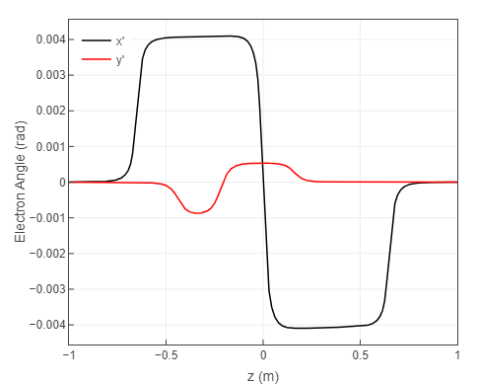
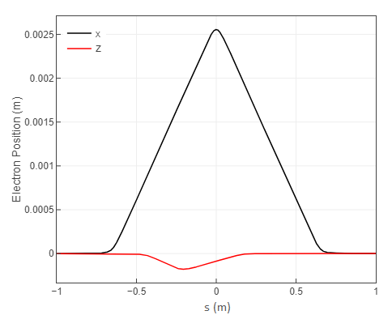
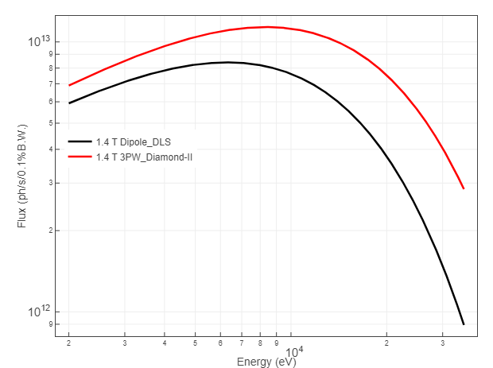
K18 3PW
Improvement in flux compared to existing bending magnet source with same aperture size
Angle
Trajectory
Flux
Vertical canting angle is 0.537 mrad
Quote from Scanditronix for magnets received.
Next steps: procurement specification
Total Power of 3PW | 658 W *
Total power of only radiator | 437 W *
Power delivered to beamline After 1mrad * 0.165 mrad aperture | 48 W *
1 mrad x 0.165 mrad
*at 300 mA

Slide 27
Motion Control System

Slide 28
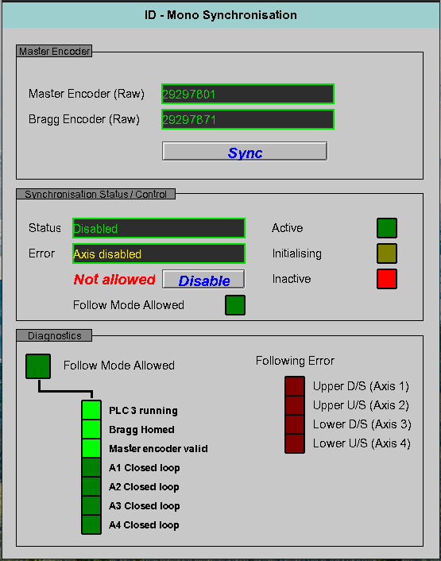
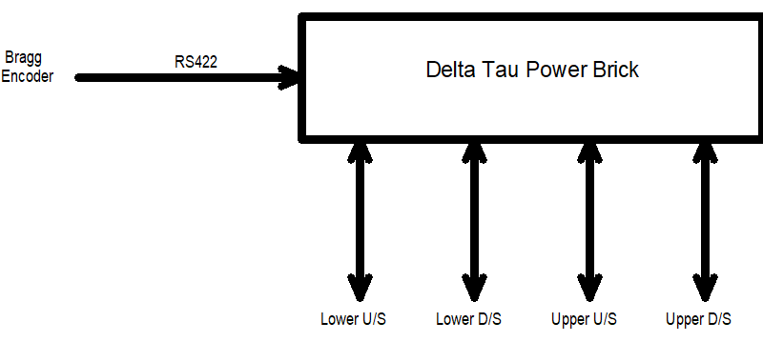
Motion Control
Plan to synchronise the ID gap with the monochromator using Bragg driven compensation tables to speed up data collection (for the I18 microfocus spectroscopy beamline).
The Encoder signal from Mono Bragg axis is taken into the ID motion controller, the Delta Tau Power Brick, which has a master & slave configuration implemented.
EPICS interacts with a process on the power pmac to start and stop synchronisation
EPICS will write the compensation table to the power pmac depending on what harmonic is selected
Concept tested on a CK3M controller with CPMU-5.
Need to upgrade the VME-based controller on I18.

Slide 29
Thank you for your attention

