Slide 1

ID Developments Towards BESSY III
A bright future for HZB
E Rial on behalf of the Undulator Team at HZB
Insertion Devices for Future Light Sources Workshop
Taipei, Taiwan 31.05.2025

Slide 2
Overview
Introduction
BESSY III
Dividing the Spectrum
Who? Where? What?
Very Low Energy to Tender X-Rays…
…and everything in-between
Matching Machine Goals to
User Requirements
Device Rundown
Supporting Activities
Timeline
Available technologies and works in progress
From Modelling to
Manufacture and Measurement
How do we get to a new 4th generation light source in Berlin?
Conclusion and Acknowledgements

Slide 3

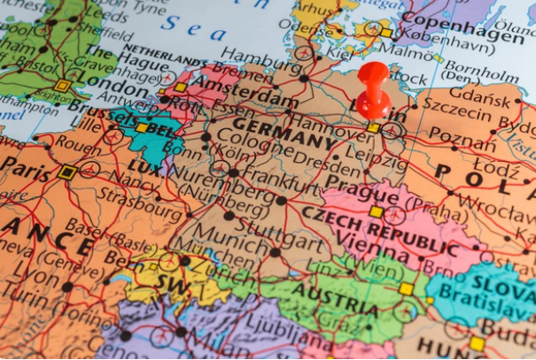
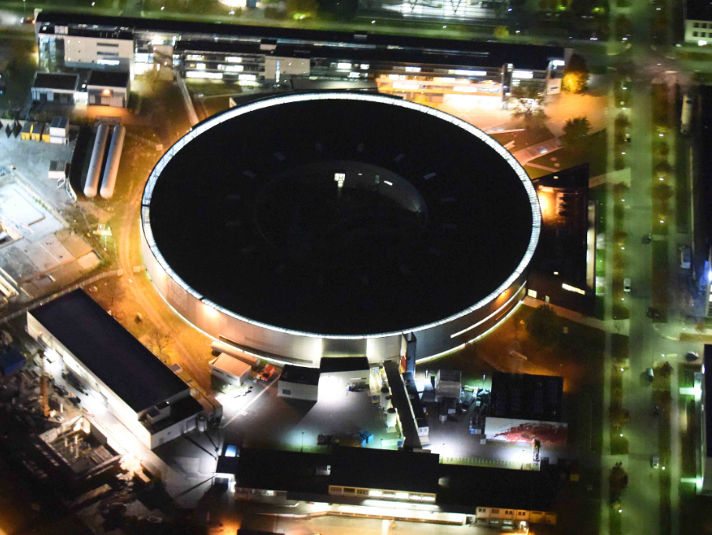
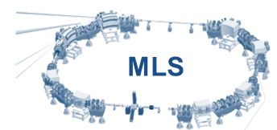
Overview
BESSY II
“Discovering new materials and developing technologies for a climate-neutral energy supply of the future”
Parameter | BESSY II | MLS
Ring Circ. | 240m | 48m
Energy | 1.7 GeV | 105 – 630 MeV
Straights | 16 | 4
Undulators | APPLE II: 8 Hybrid Ex-Vac: 4 CPMU: 1 | Hybrid Ex-Vac: 1
Started Operation | 1998 | 2008

Slide 4

A Successor Facility
BESSY III
The
Materials Discovery Facility

Slide 5
The Five Foundations of BESSY III
Stay in Berlin-Adlershof
Diffraction limited up to 1 keV
1st undulator harmonics polarized up to 1 keV from conventional APPLE-II
Nanometer spatial res. & phase space matching
Retain PTB/BAM metrology capabilities

Slide 6

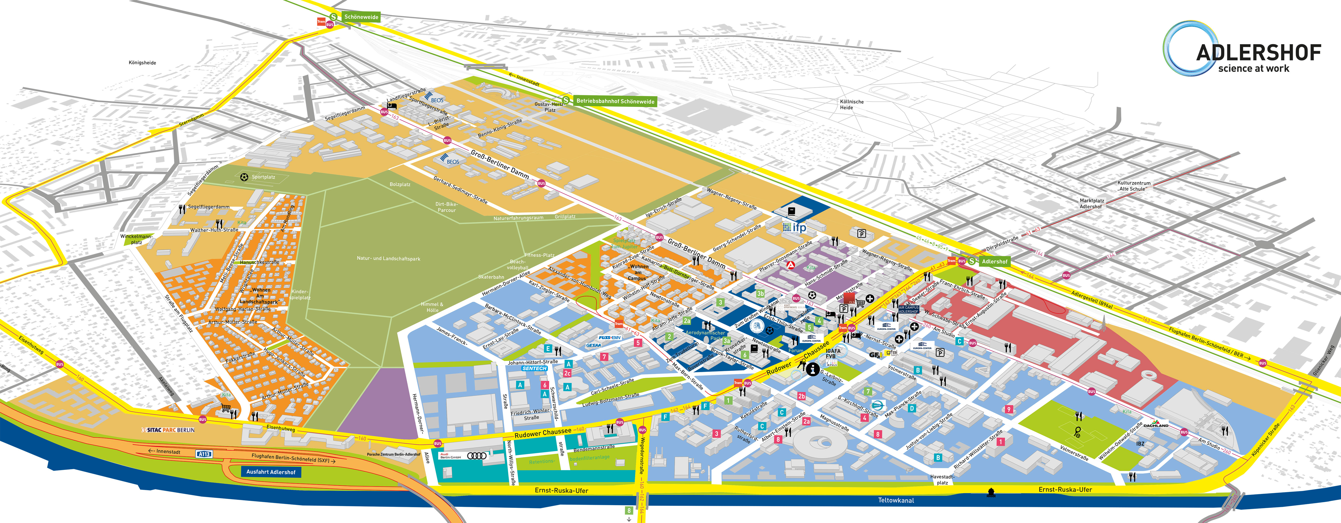
BESSY III: Location, location, location!
Stay in Berlin-Adlershof… but on a green field site!
Circumference ≤ 350 m

Slide 7


BESSY III Machine Parameters
1st undulator harmonics polarized up to 1 keV from conventional APPLE-II
Diffraction limited up to 1 keV
Nanometer spatial res. & phase space matching
Energy 1.722 GeV -> 2.5 GeV | Straights 5.6m -> 5.6m | Emittance 5 nm rad -> 100 pm rad
Low-β straights Round beams | Retain 16 Straights | Mom. Comp. Factor >1.0e-4
Retain PTB/BAM metrology capabilities
Metrology Source Homogenous Bends

Slide 8
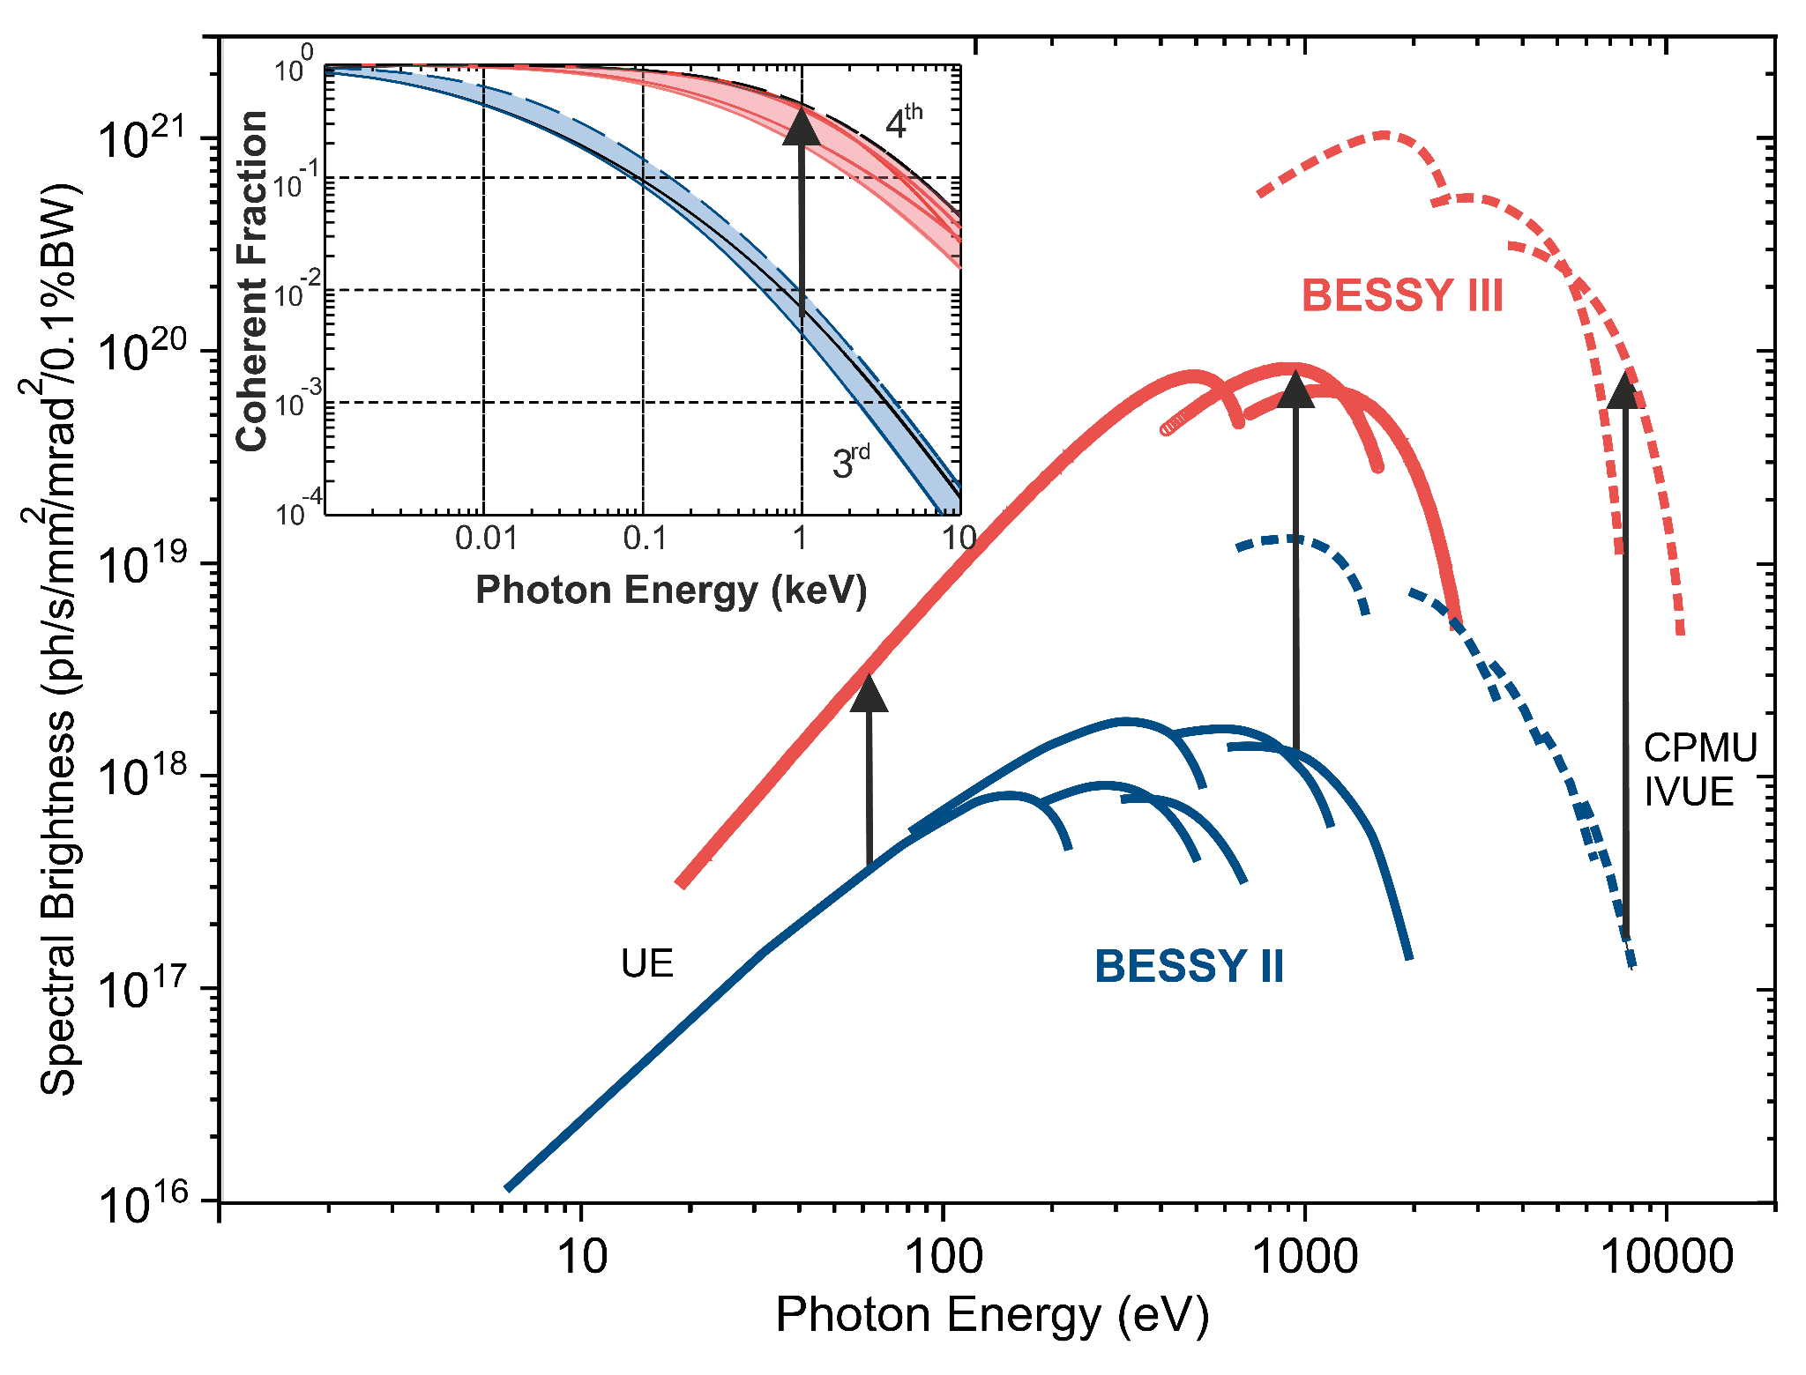
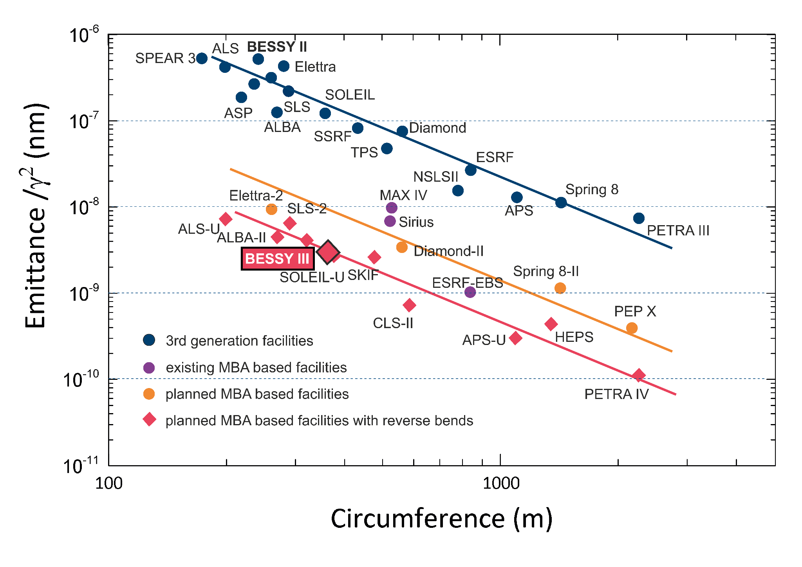
BESSY III: The Management Perspective
  Do the curves on this graph go up?
  Does our marker reach the red trendline?
  Great Job Everyone!

Slide 9
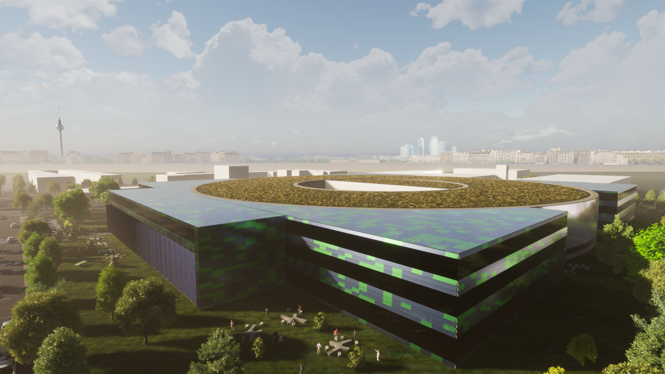
BESSY III: Artist’s Impression

Slide 10
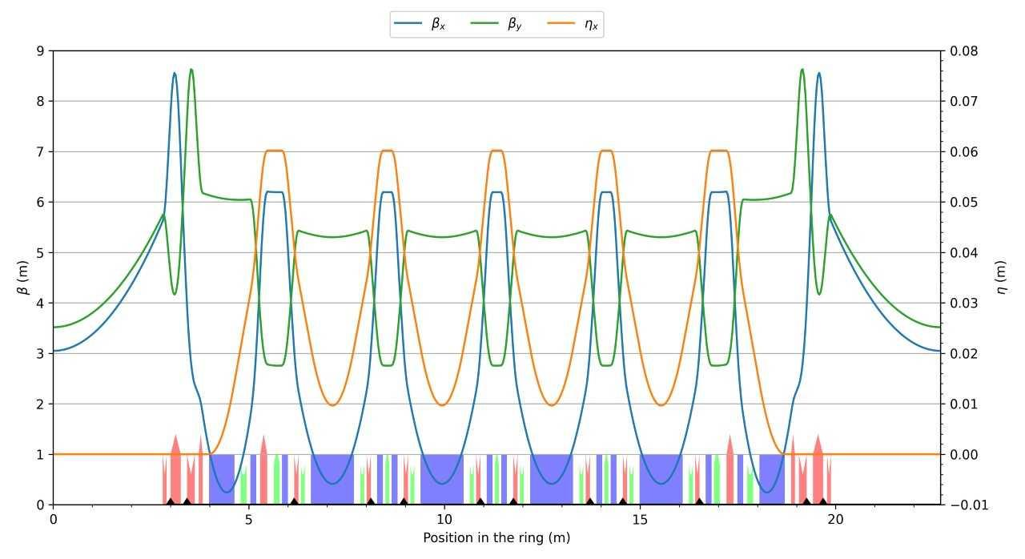
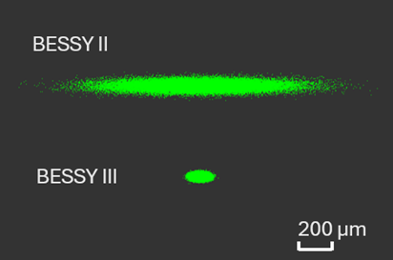
BESSY III Lattice and Implications
  Key Takeaways
        5.6 m Long straights
        Beta function in straights is approximately 3 m in each dimension.
        Goals to maximise dynamic aperture and Touschek lifetime, to retain ring flexibility for special modes.
        Desirable emittance, <100 pm rad achieved.
        Investigation of Non-Linear Kicker for Injection
        Increased Ring Energy
        Design not yet frozen
  Impact
  Minimum Gap 6 mm
        Quite large by 4th Generation Light Source standards.
  High K Devices for Low Photon Energies
        Users requiring 5 eV.
  Double Mini-β possible?
        Requirement for wide spectrum delivery through paired undulators.
  Low Emittance and Higher Ring Energy
        Increased brilliance, coherent fraction and easier to reach higher photon energies
  Non-Linear Kicker
        Allows for a reduced horizontal aperture and easier requirements on transverse good field region

Slide 11
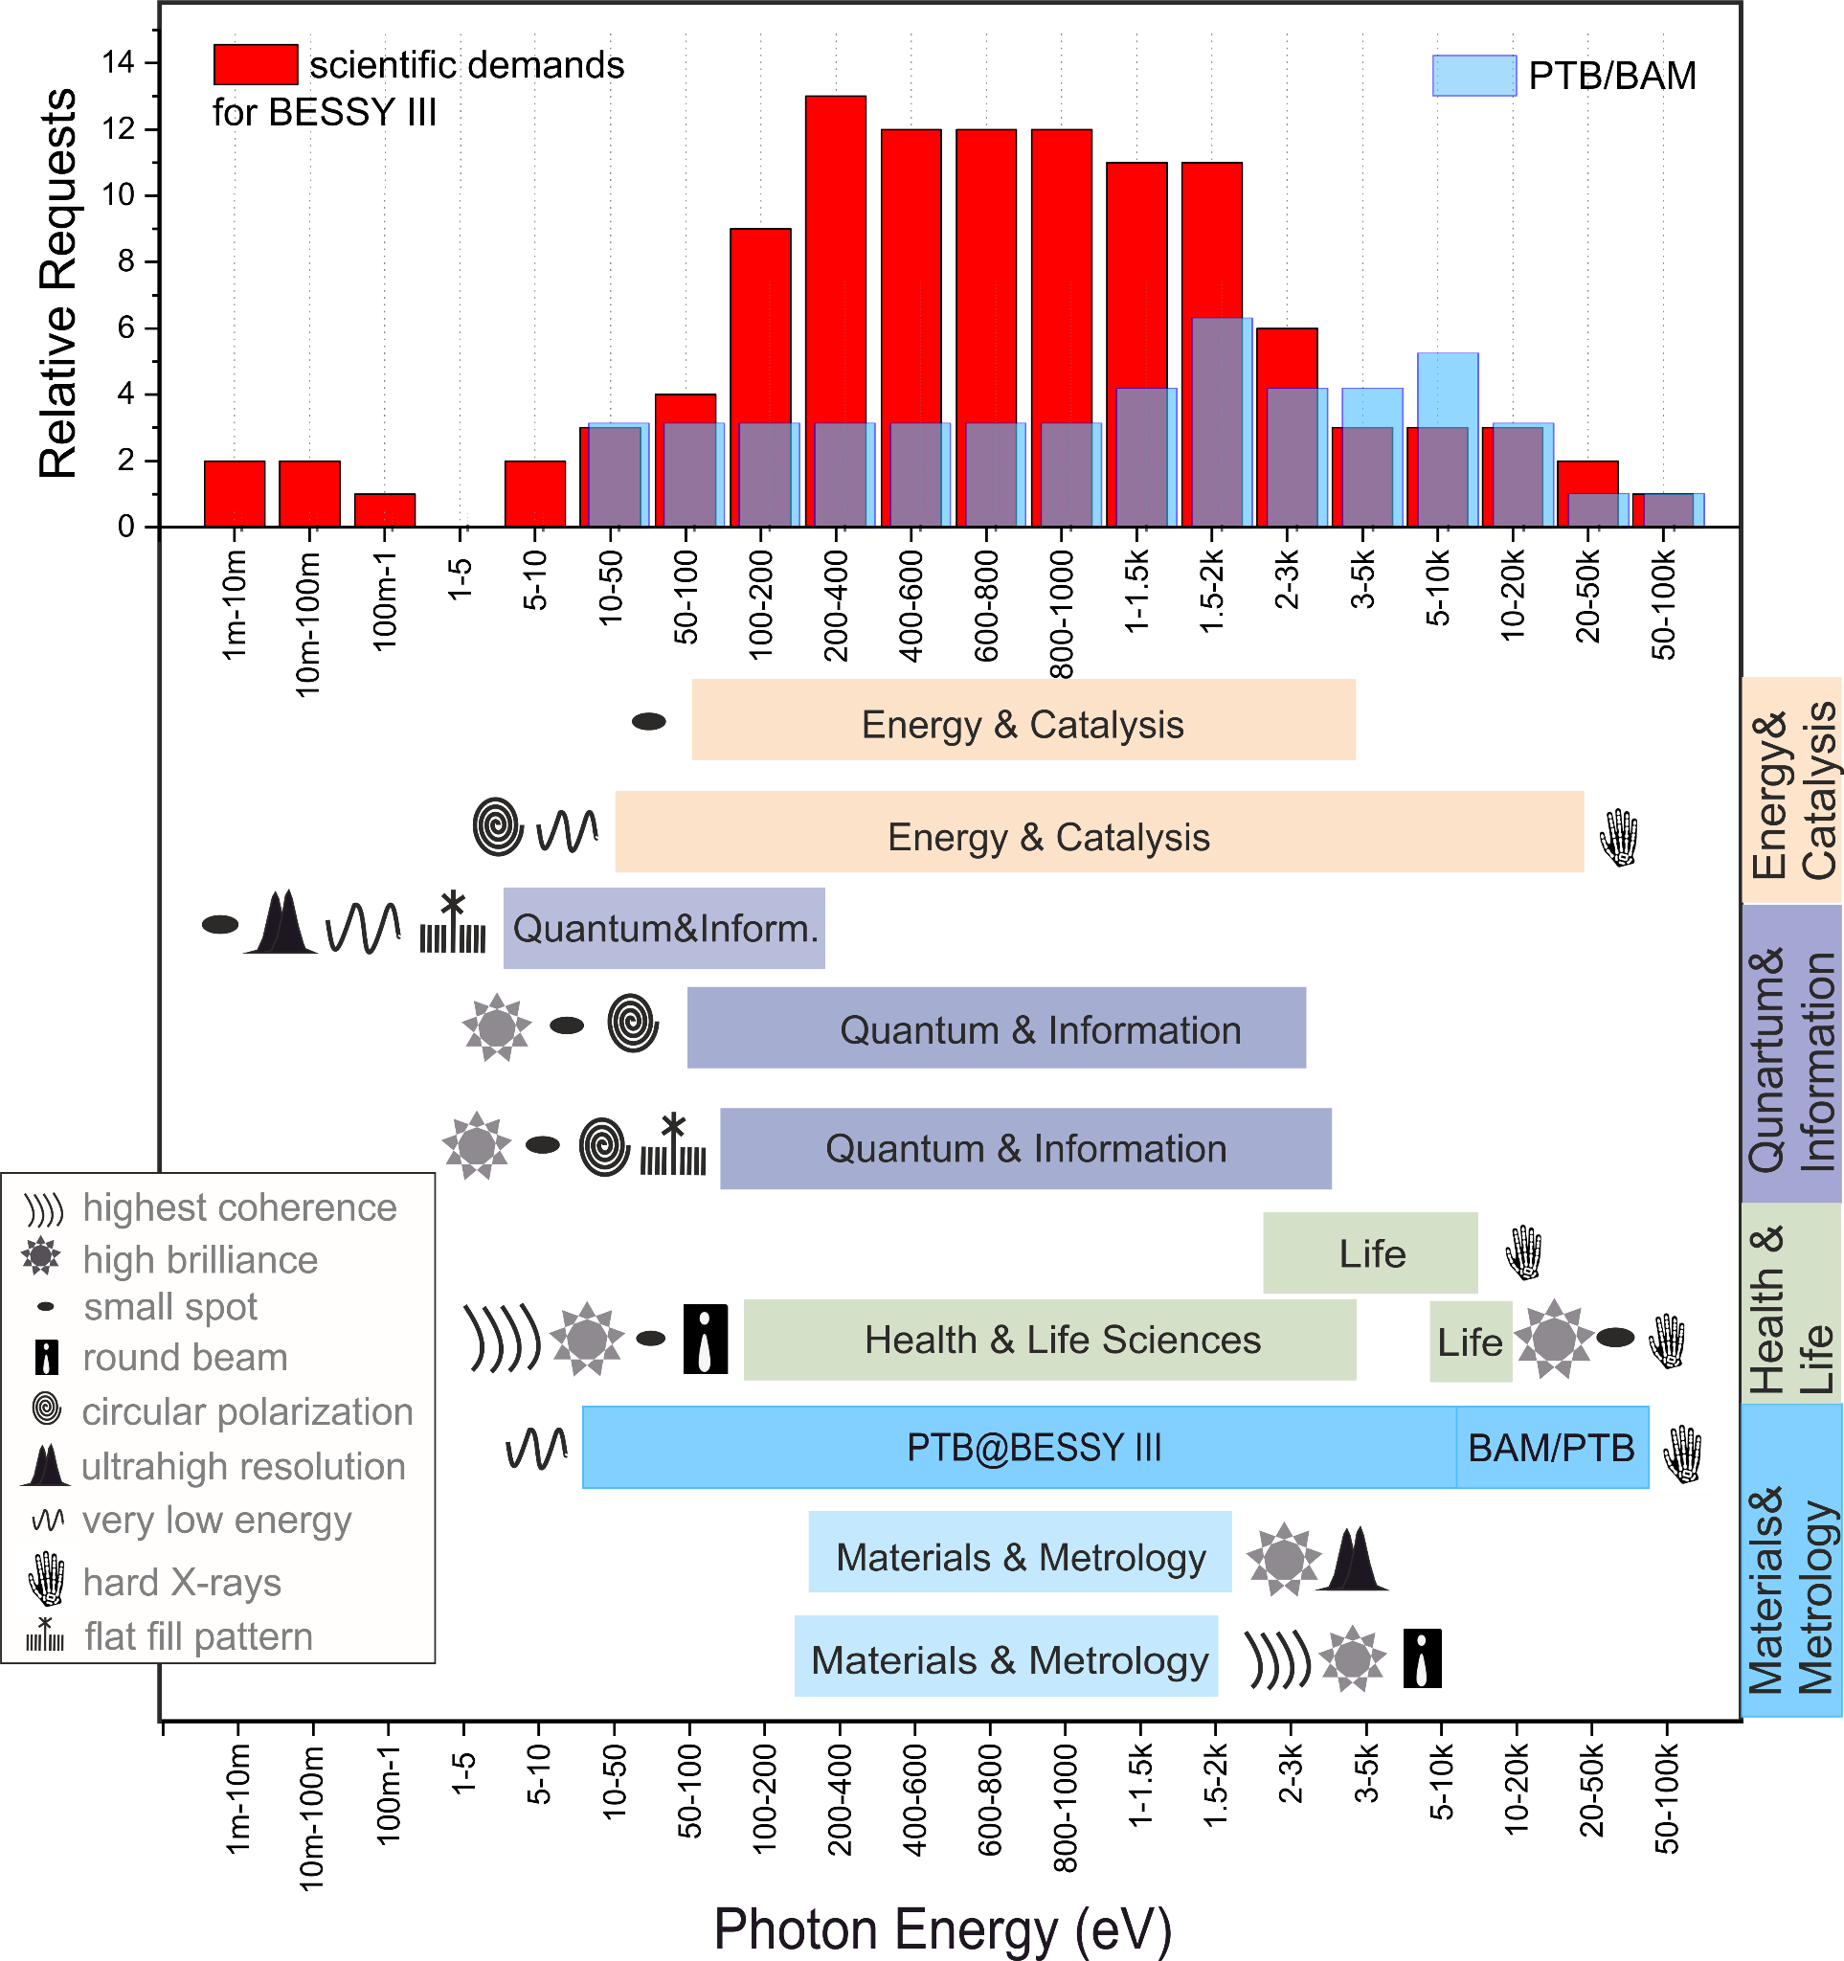
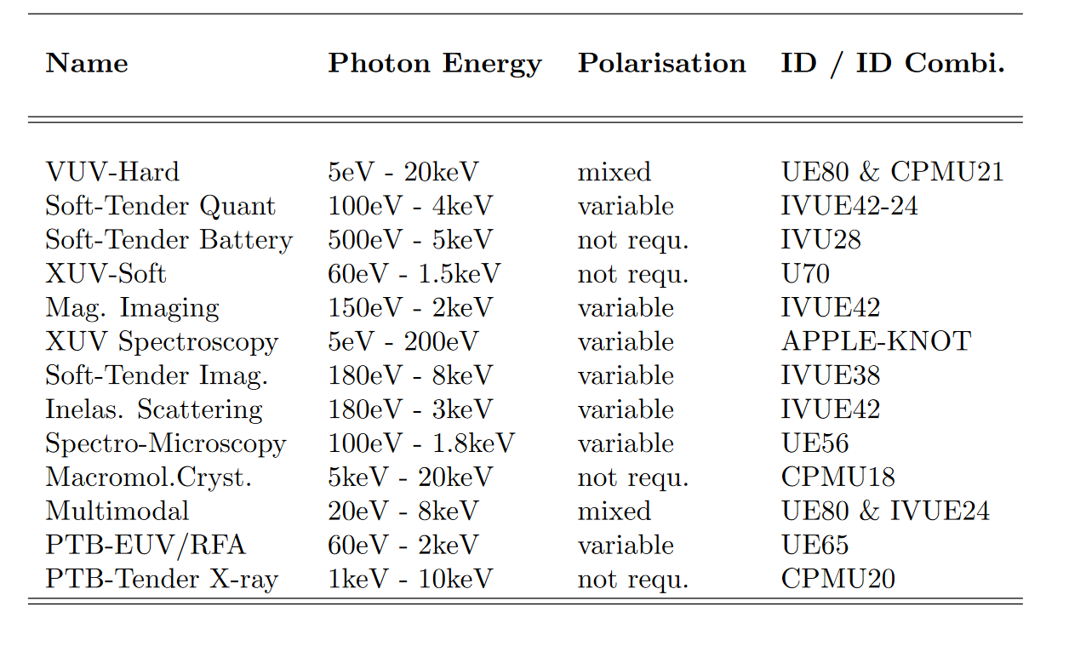
User Requirements to Undulator Portfolio
  Energy Range Classifications
    Very Low: from 5 eV
    Low: from 20 eV to 2 keV
    Medium: 100 eV to 3 keV
    Tender: 1 keV to 20 keV
    Complete Coverage: 5 eV to 20 keV
MOPS060:
Undulators for BESSY III
A. Meseck et al

Slide 12
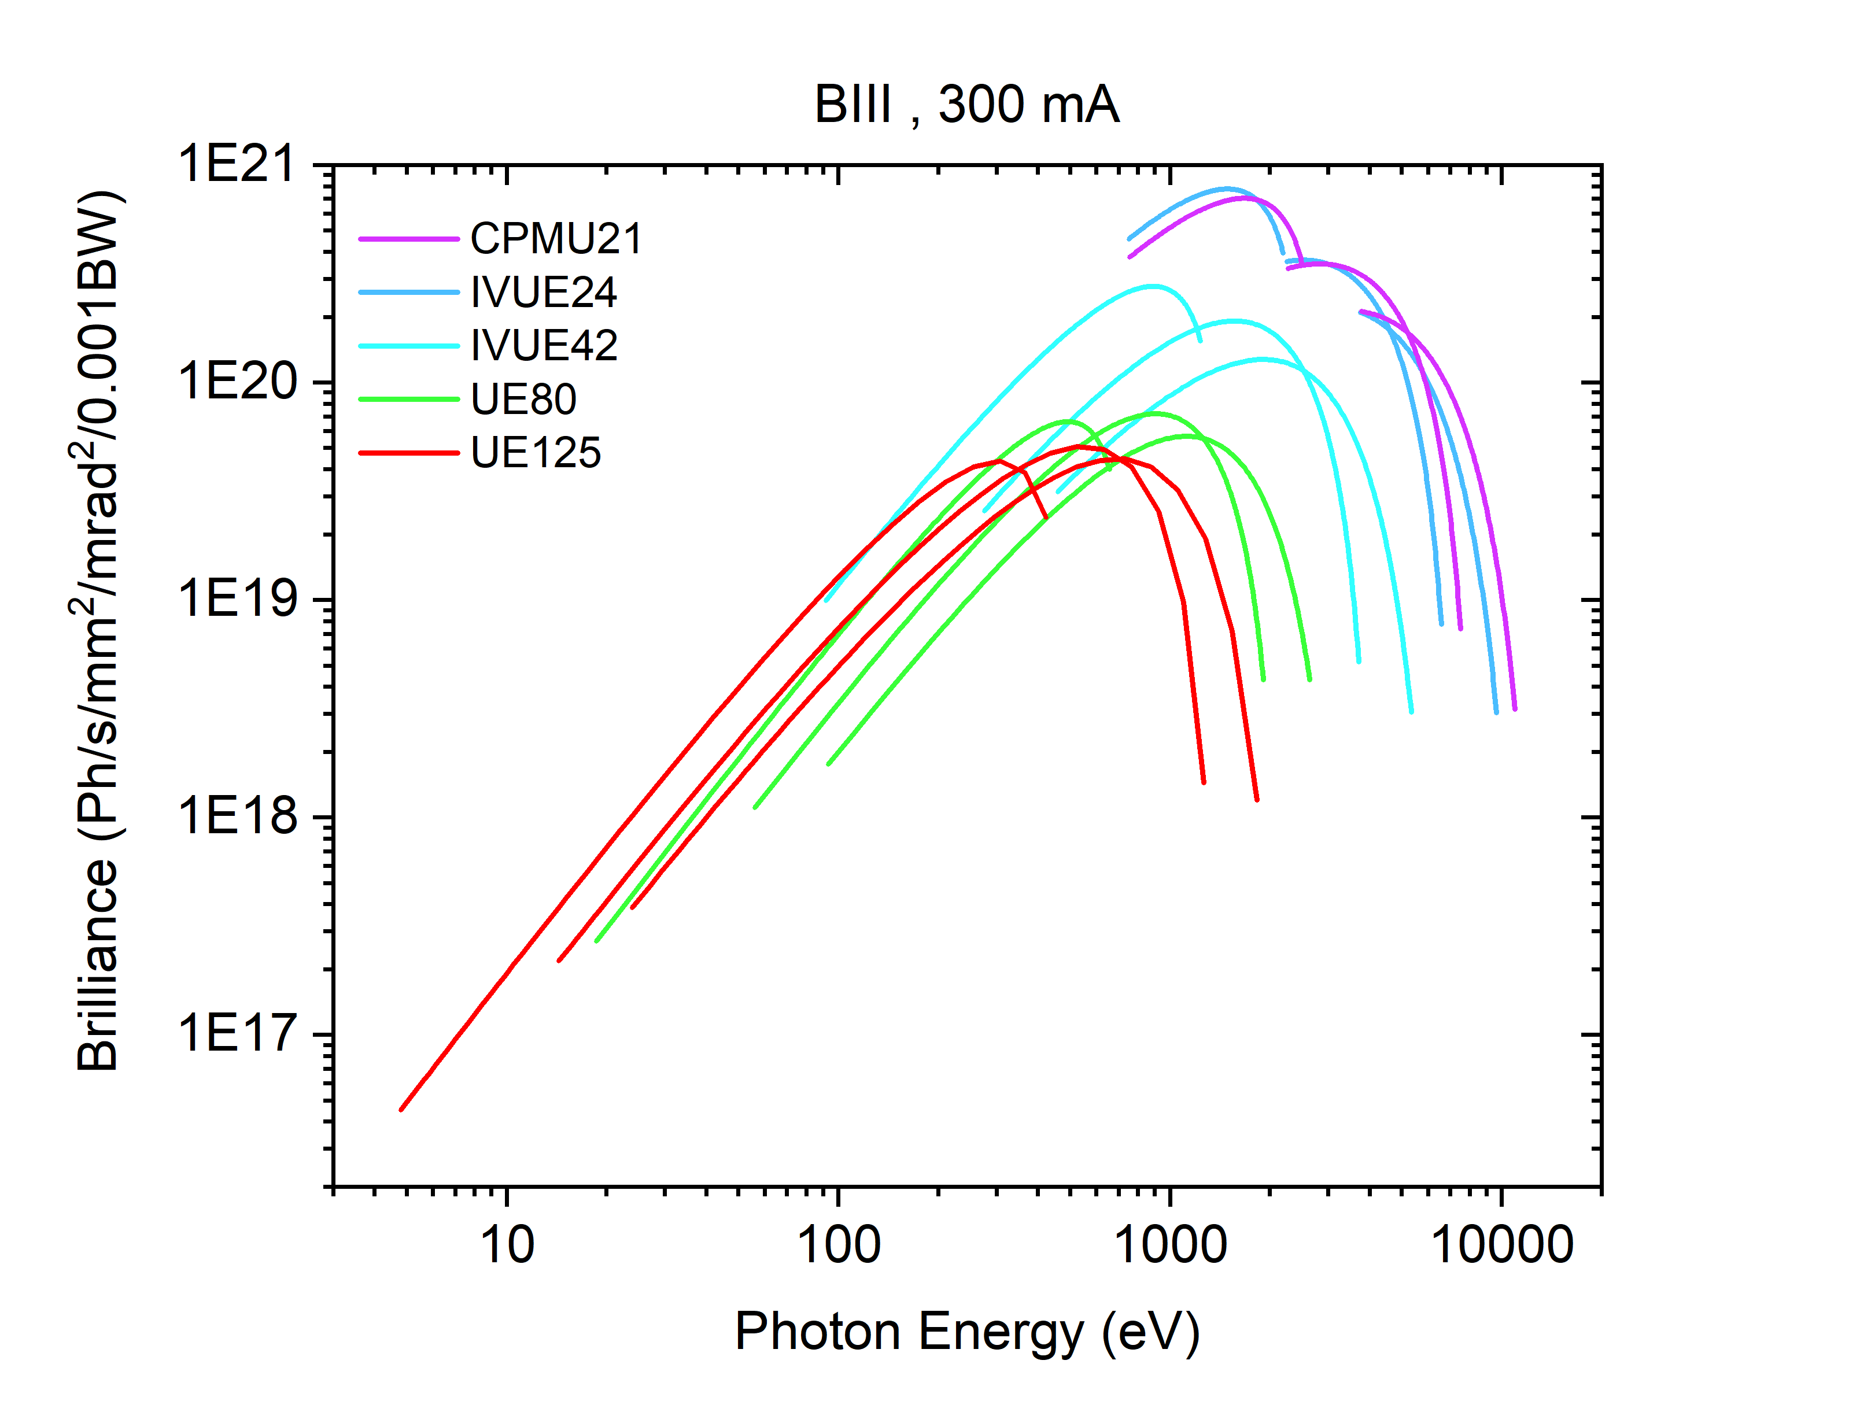
Technology Choices
  Very Low
    APPLE-KNOT
  Low
    APPLE II
  Medium
    In-Vacuum APPLE II
    In-Vacuum Hybrid Planar
  Tender
    CPMU
    Cryogenic APPLE II
  Complete Coverage
    Sequential Undulators
    Double Period Undulator

Slide 13
Covering the Spectrum: Very Low Energy
Energy Range ~ 5 eV to 200 eV

Slide 14
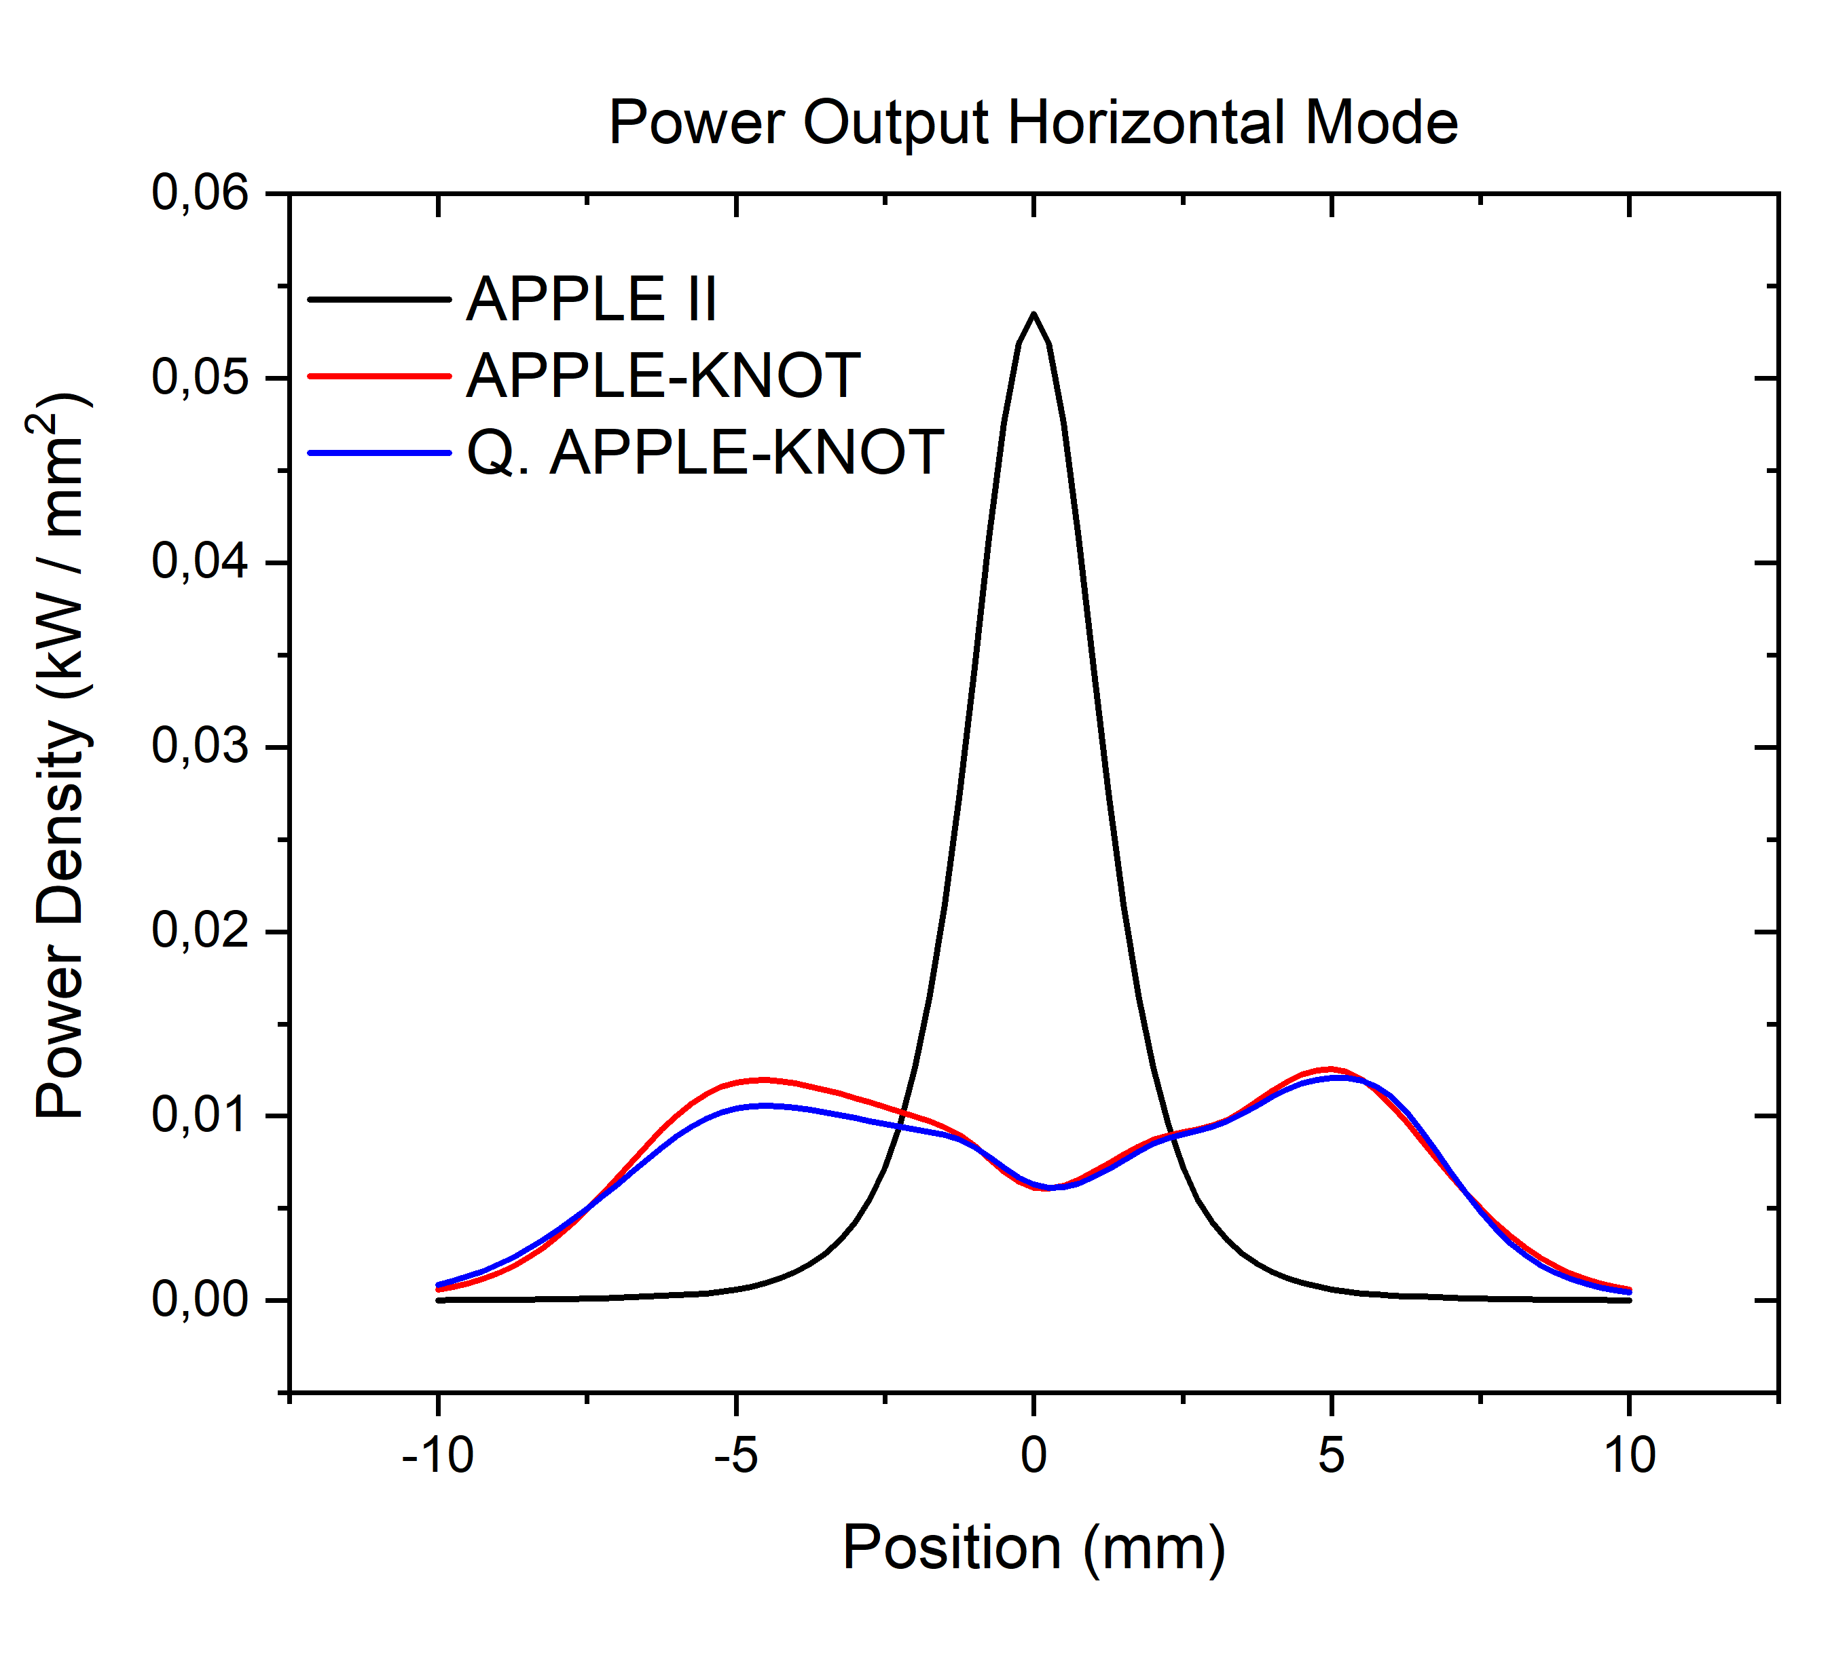
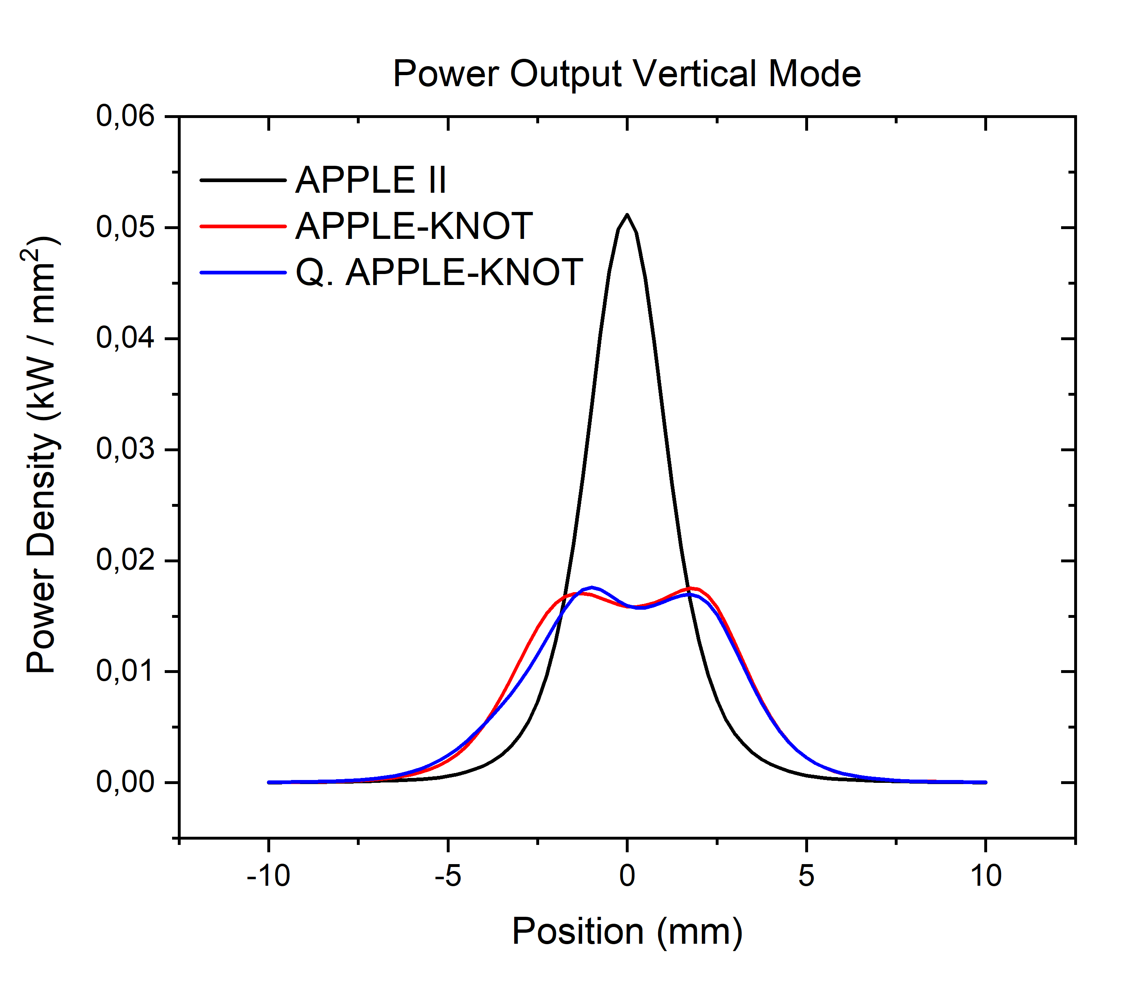
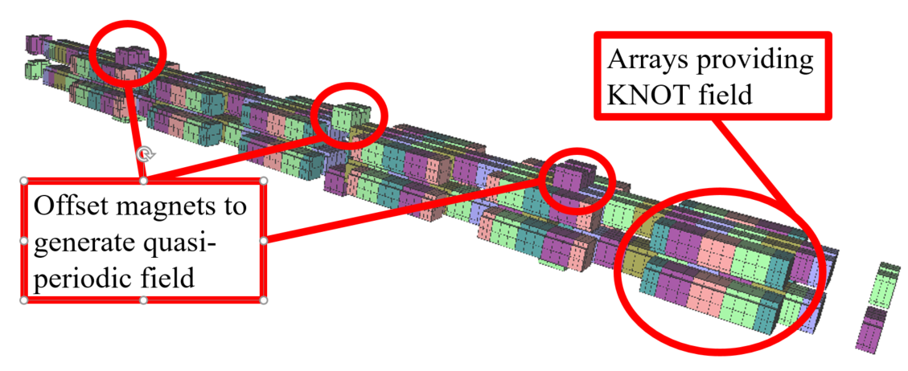
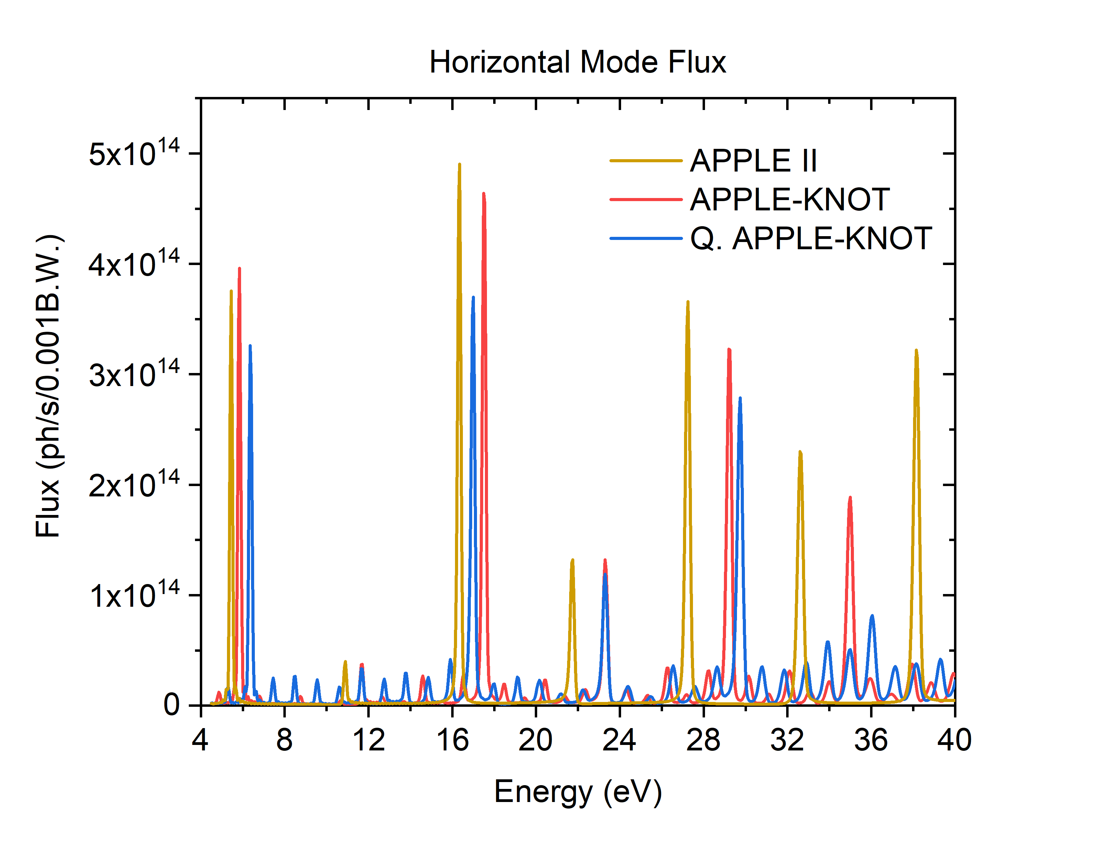
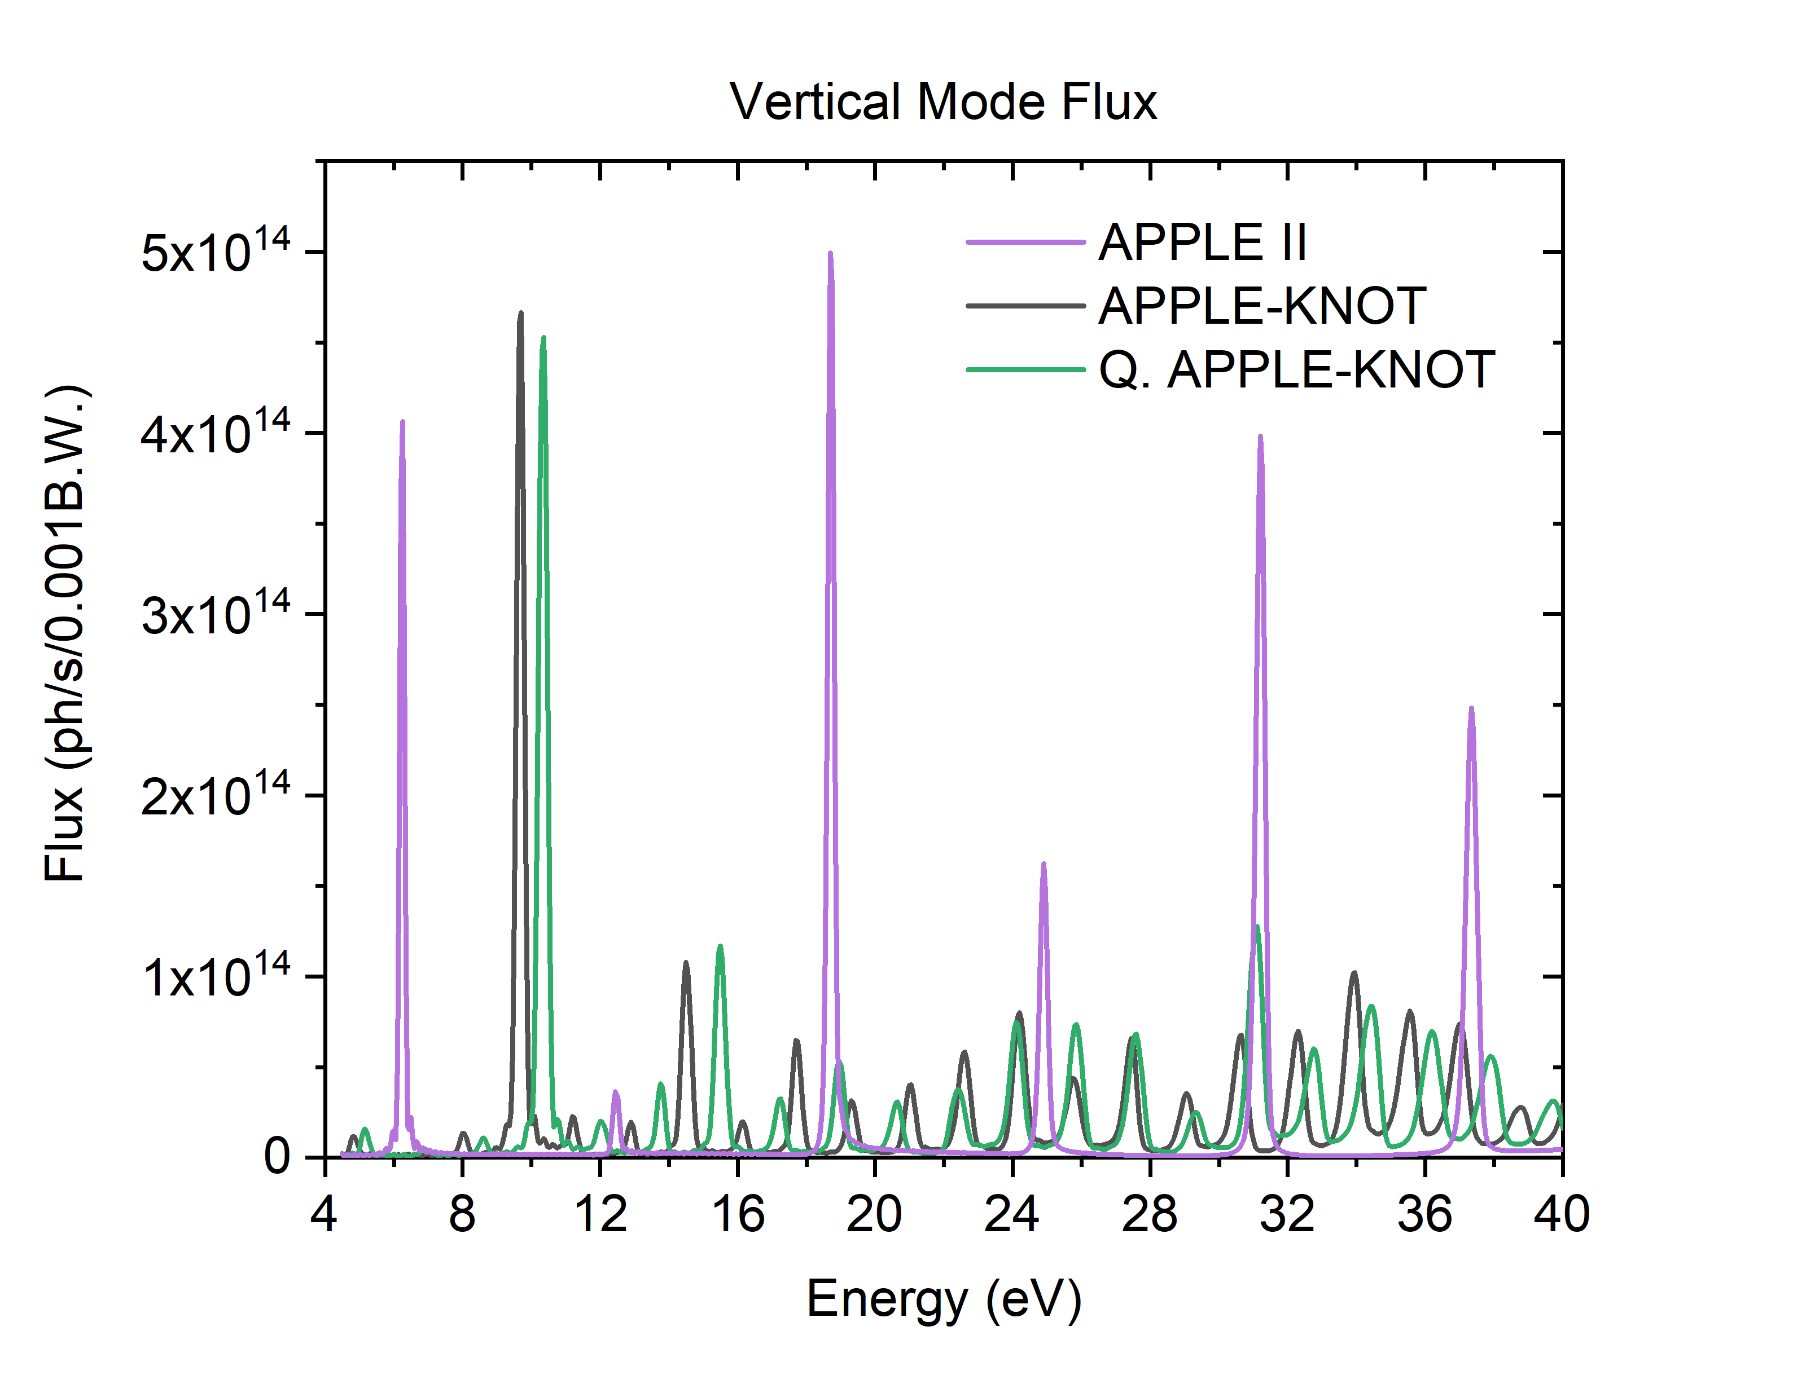
APPLE-KNOT: Overview
  Reaching very low energy
    Undulator with K value ~14 necessary for 5 eV.
    Power output of approximately 11 kW
    Needs to be dissipated off axis
    Quasiperiodic structure to offset higher harmonics
  Next Steps
    Rationalise magnet structure to four arrays

Slide 15
Covering the Spectrum: Low Energy
Energy Range ~ 20 eV to 2 keV

Slide 16
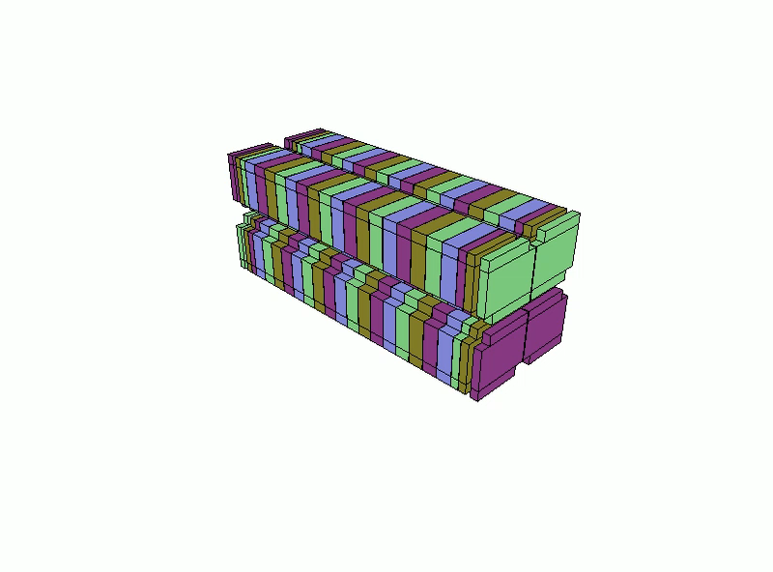
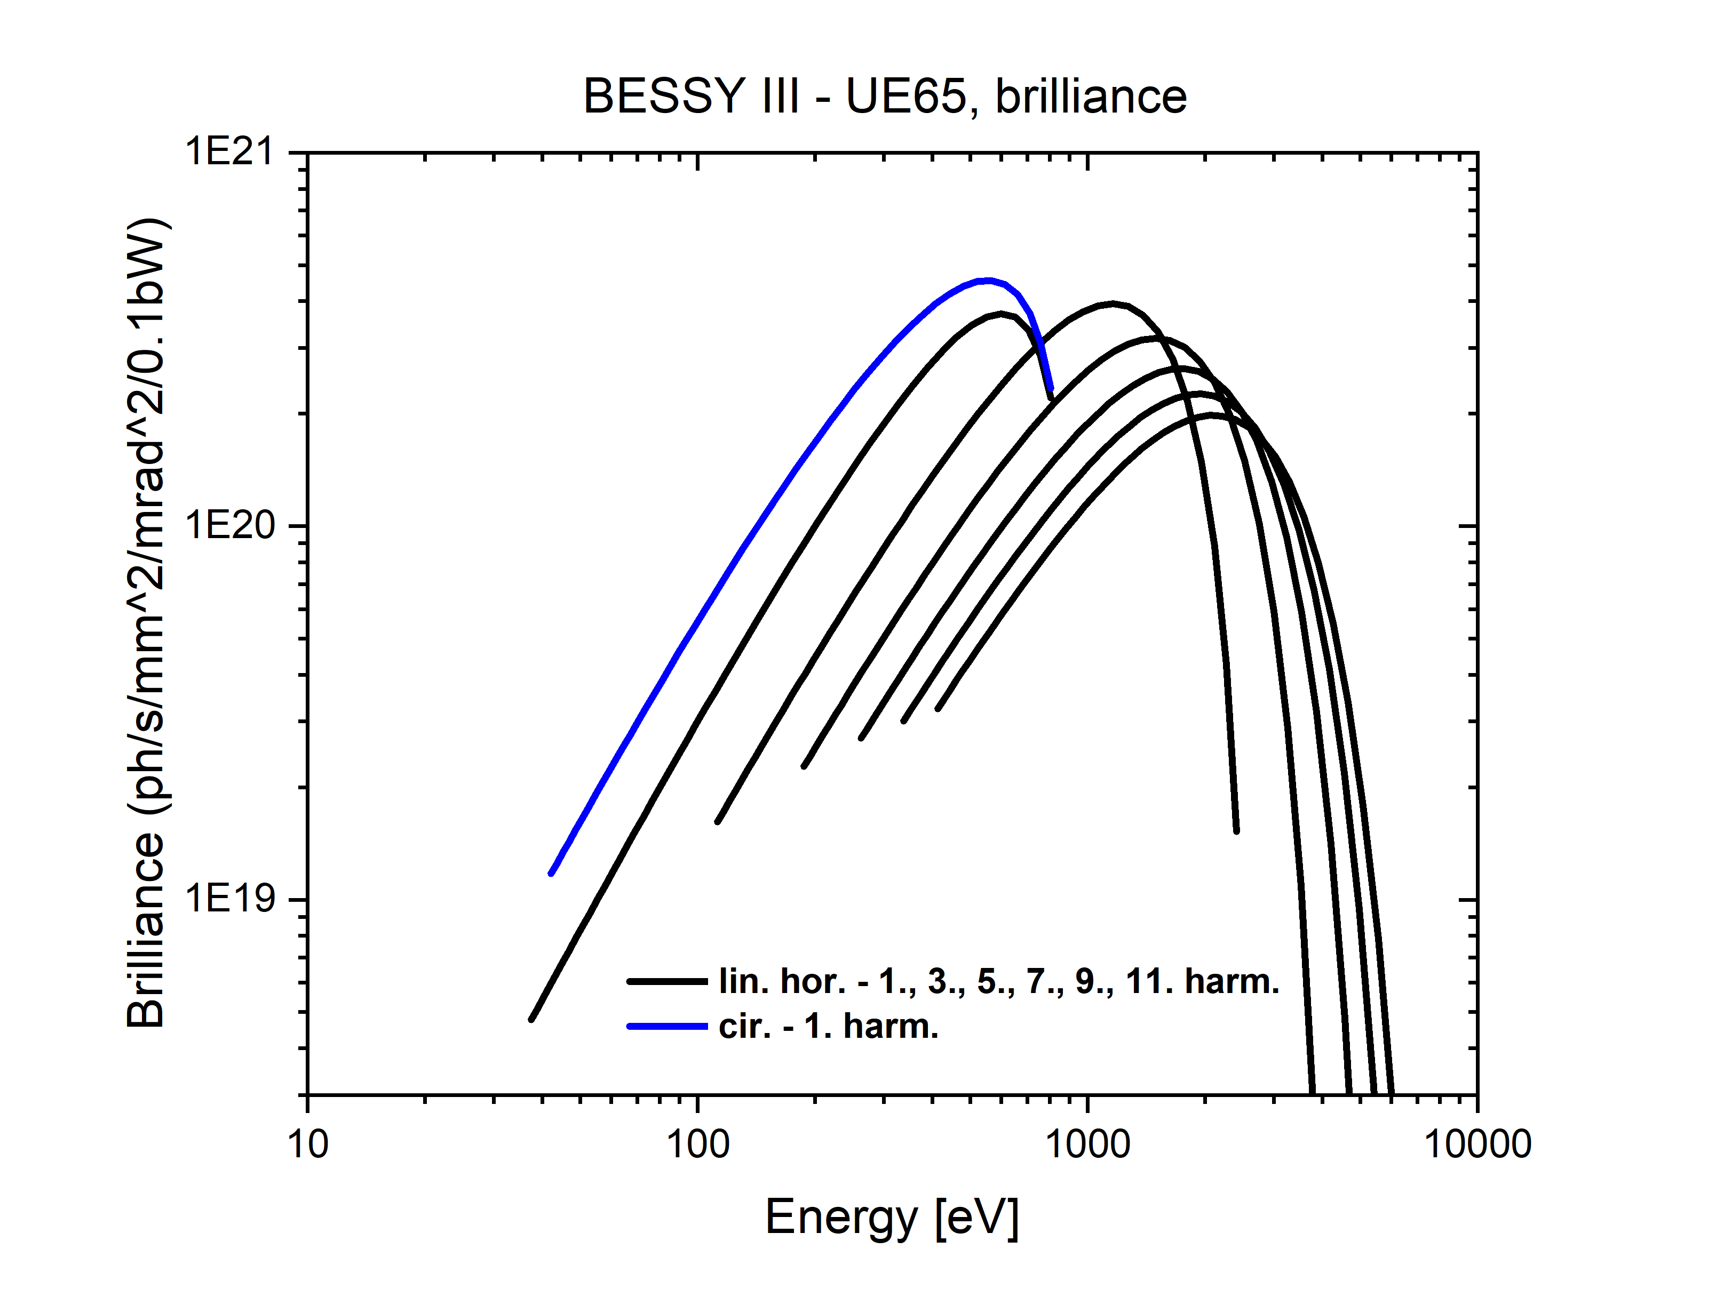
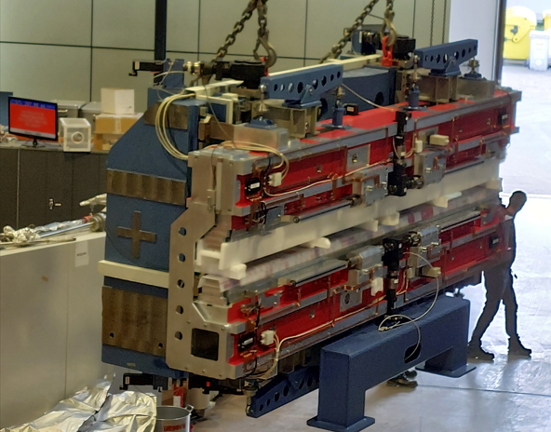
Low Energy: Overview
  Challenge
    Stated goal to reach 1 keV on the first harmonic of a standard APPLE II undulator.
    Non-linear kicker injection opens up possibility of reduced requirement on horizontal aperture.
  Solution
    Established APPLE II design.
    Lower horizontal aperture good field region could loosen the size requirement on APPLE II magnets
Elliptical
Linear

Slide 17
Covering the Spectrum: Medium Energy
Energy Range ~ 100 eV to 3 keV

Slide 18
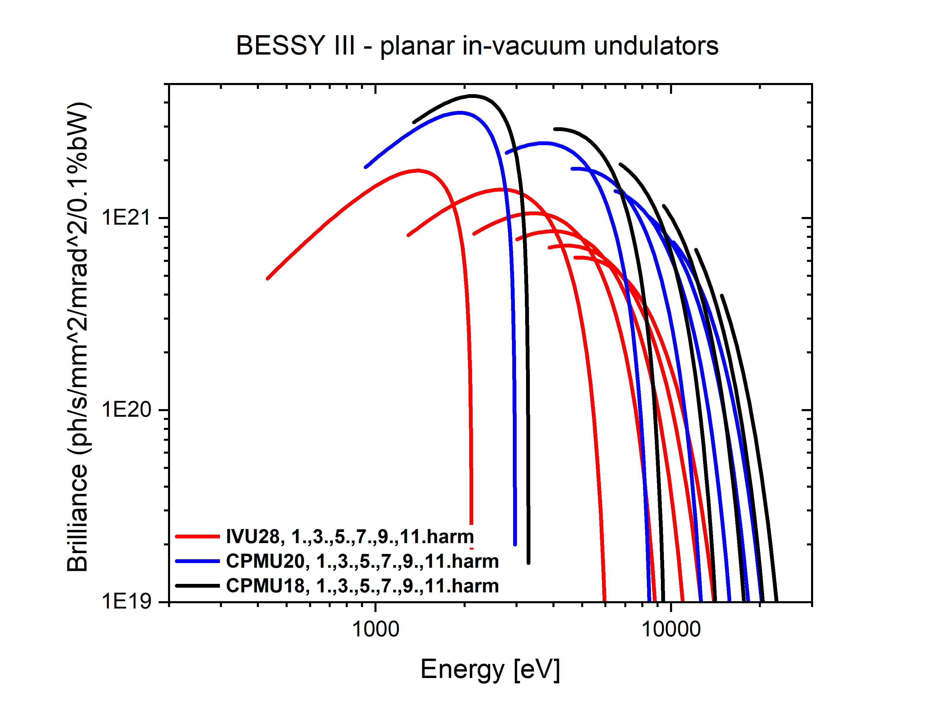
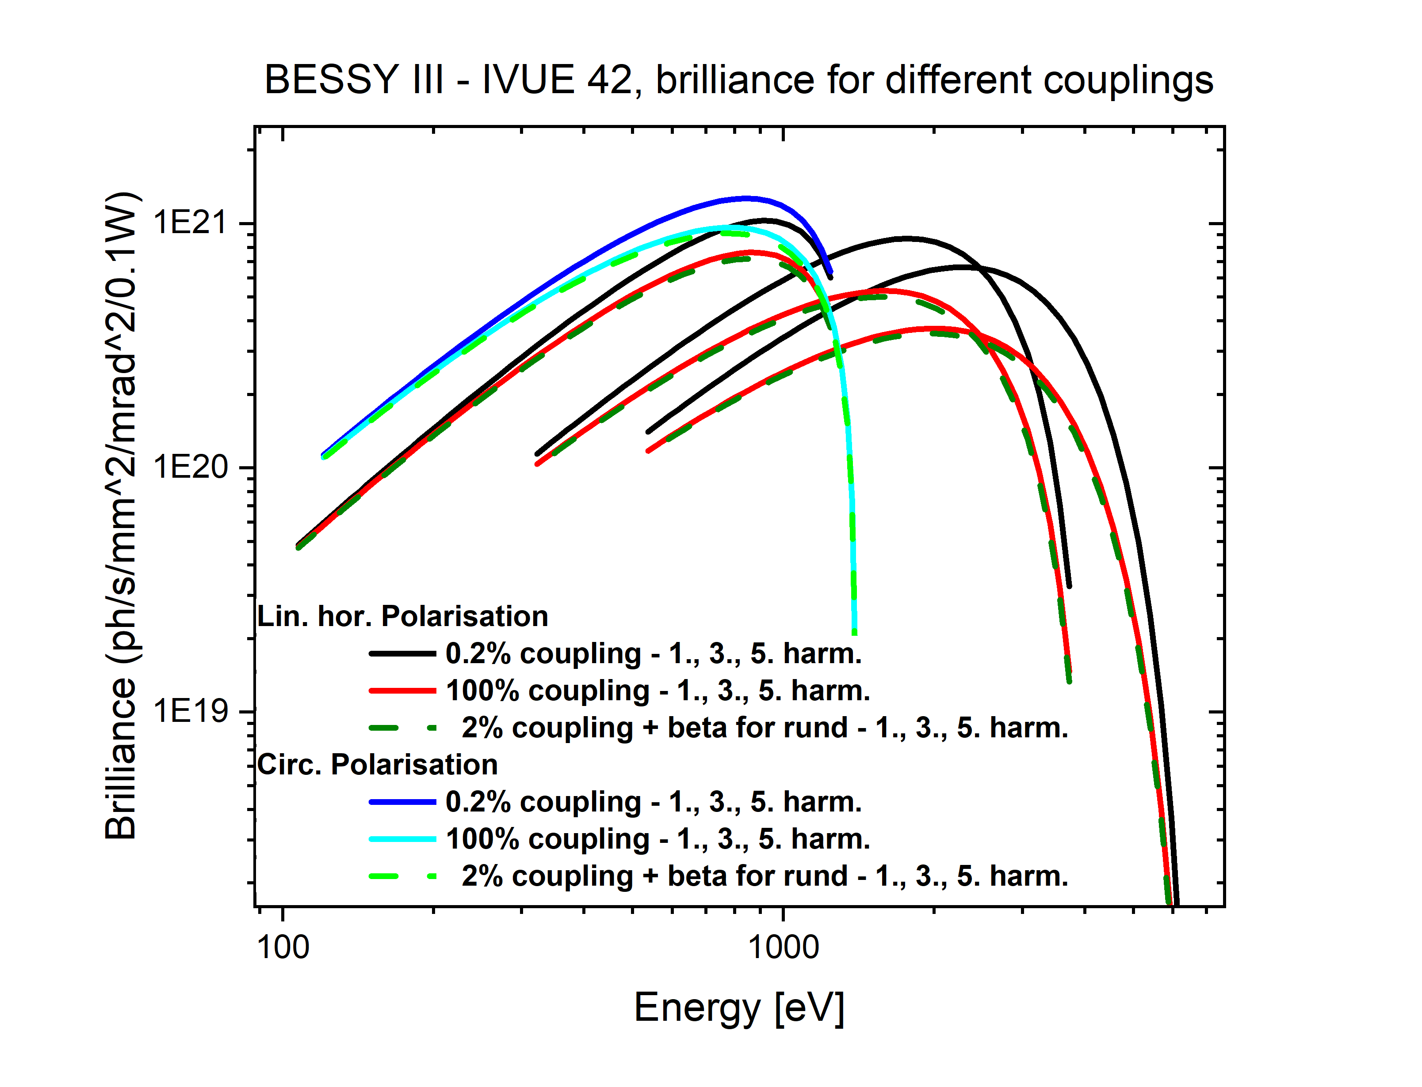
Medium Energy: Overview
  No Polarisation Control: Planar Device
    In-vacuum hybrid device to be sought commercially*.
    *probably
  Elliptical Device: Polarisation Control
    In-house development of in-vacuum APPLE II.

Slide 19
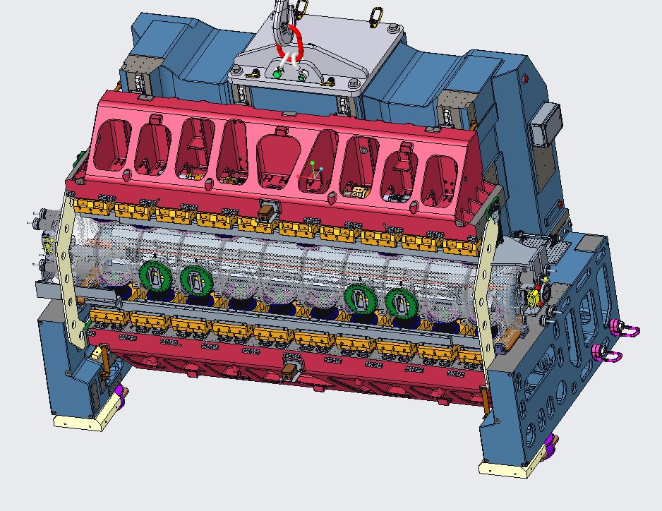
In-Vacuum APPLE II: Overview

Slide 20
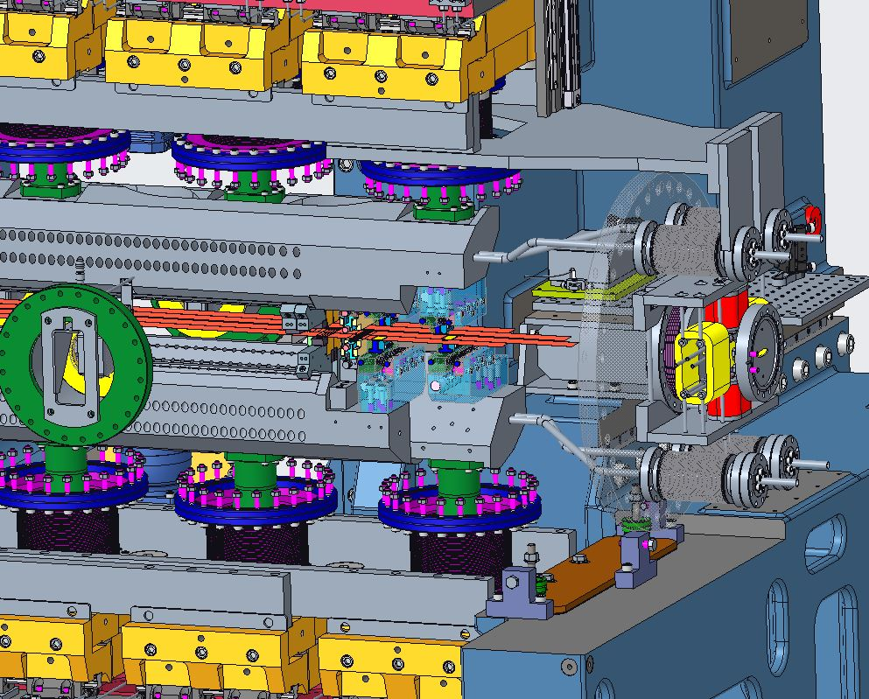
In-Vacuum APPLE II: Key Developments
Force Compensation
RF Foil and Taper Design
Magnet Fixing
Impedance Analysis
Column Shimming

Slide 21
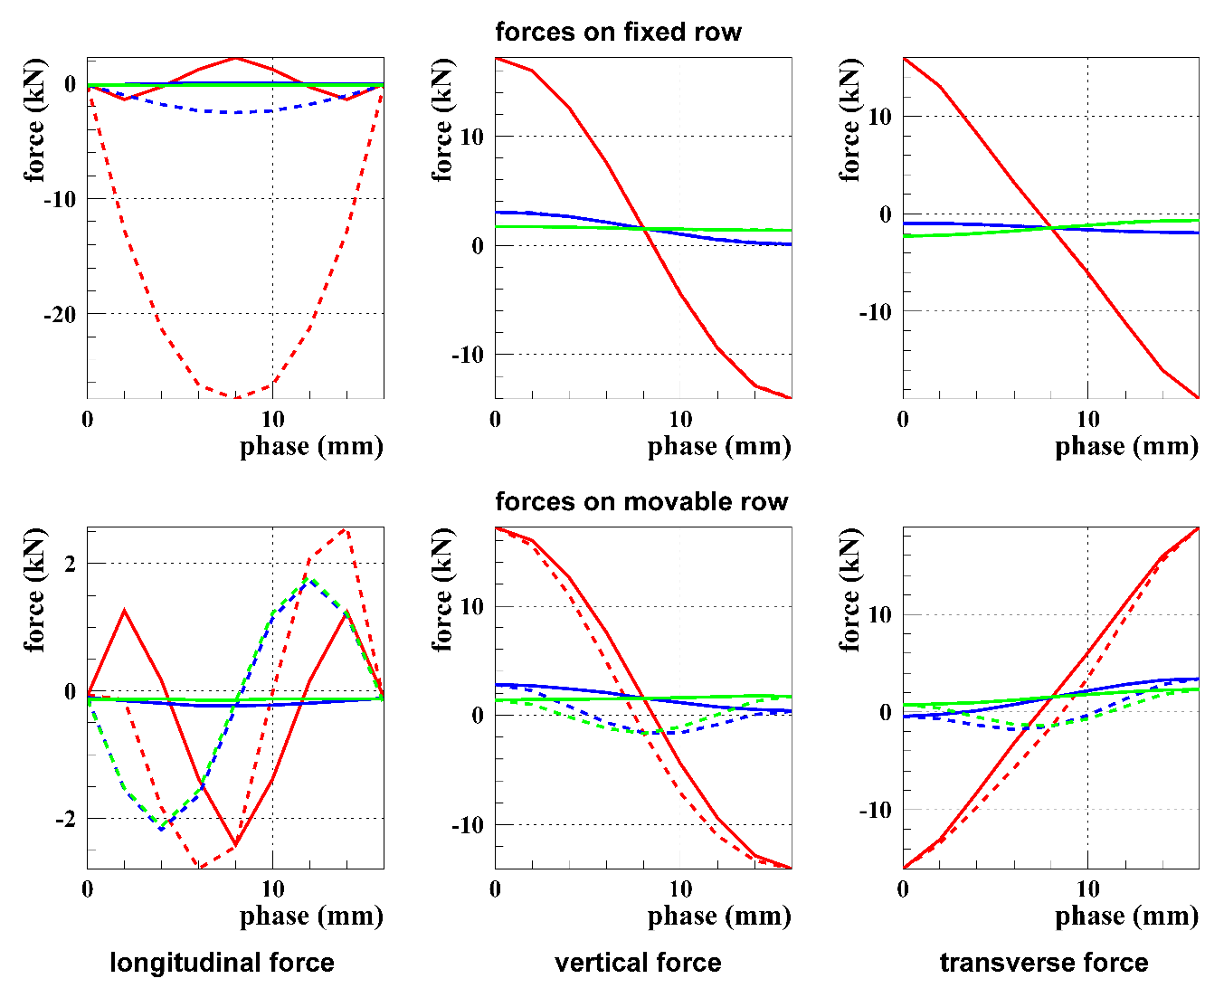
In-Vacuum APPLE II: Force Compensation
  Challenge
    Split-row nature of APPLE II design generate enormous forces that need to be managed.
    Usual “rigid structure” techniques not feasible in UHV.
  Solution
    Neighbouring arrays arranged in reversed Halbach array.
    Forces reduced an order of magnitude.

Slide 22
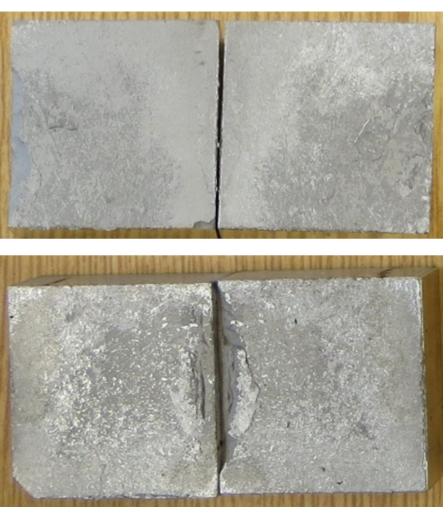
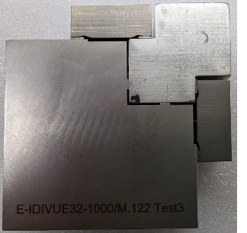
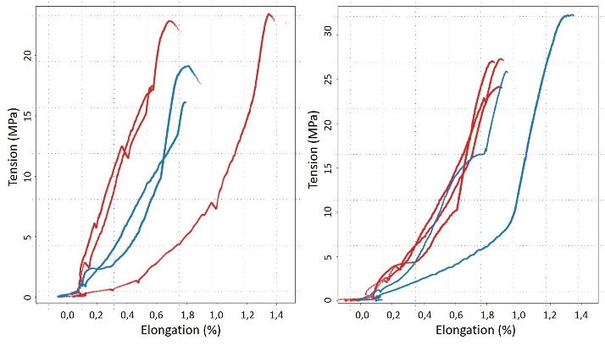
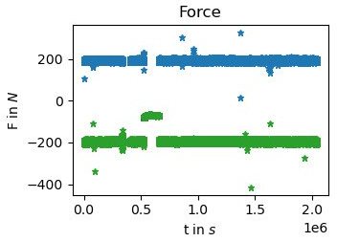

In-Vacuum APPLE II: Magnet Fixing
  Challenge
    Magnets glued as pairs.
    Magnet pairs glued and clamped into keepers.
    Epoxy glues not suitable for UHV environment.
  Solution
    Development and patent of novel soldering techniques with Vacuumschmelze for creation of magnet pairs.
    Magnet pairs solely clamped into keepers.
Sunday ID25
Soldering of Magnetized Permanent Magnets
U. Rohrmann
MOPS055: Magnet Assembly of IVUE32 In-Vacuum APPLE II at BESSY II
J. Bahrdt et al

Slide 23
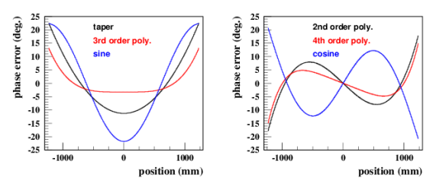
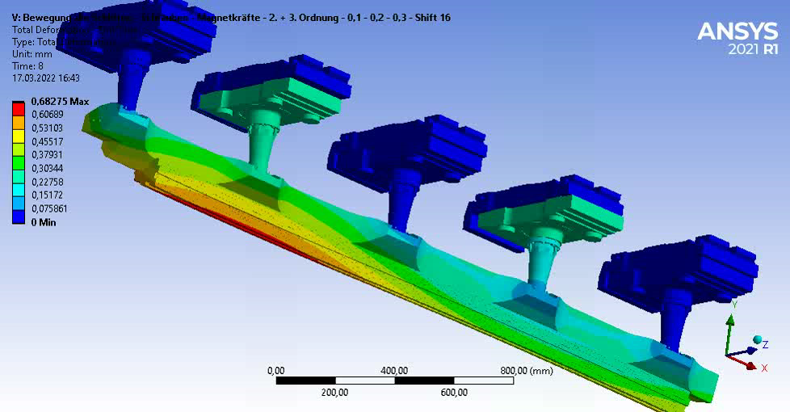
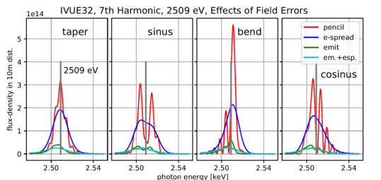
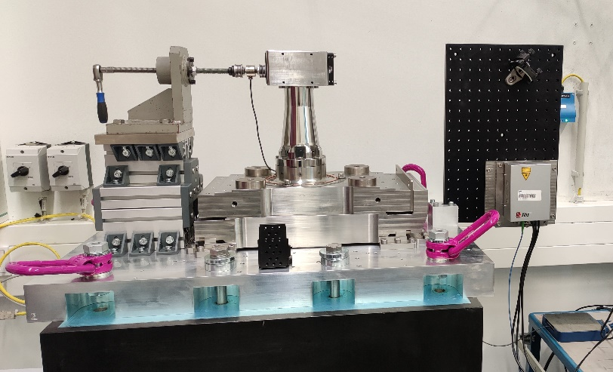
In-Vacuum APPLE II: Column Shimming
  Challenge
    Independent quadrants open up a new dimension for long range systematic phase errors in the transverse direction.
  Solution
    Supporting columns mounted on transverse slides to allow shimming of long-range transverse errors.

Slide 24
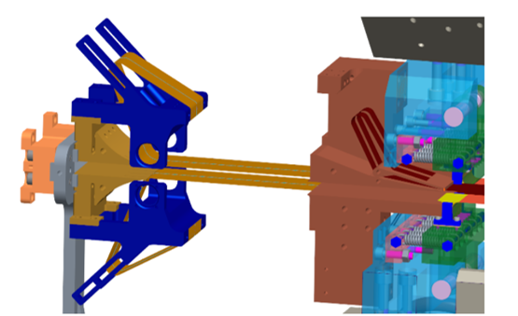
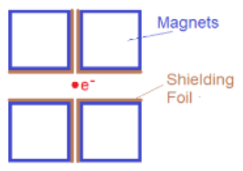
In-Vacuum APPLE II: Foil and Taper Design
  Challenge
    The split row structure of the APPLE II array and the requirement for longitudinal motion requires a more complicated RF foil design to cover the magnets.
    Large longitudinal motion requires a taper with a large accommodation for movement.
  Solution
    Split foil design to cover each magnet row individually.
    Compartmentalised taper design separating function of gap and shift taper.
TUPS092: Wakefield studies of the taper section of the elliptical in-vacuum undulator - IVUE32
S. Grimmer and P. Volz

Slide 25
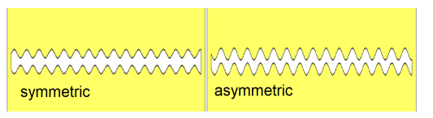
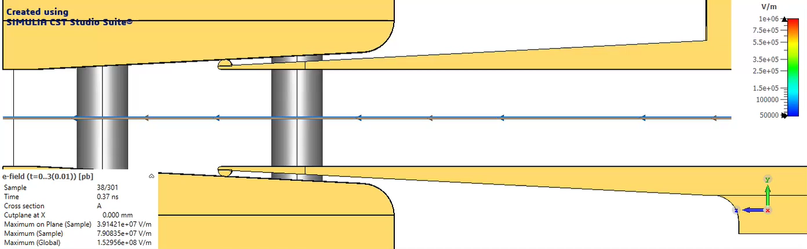
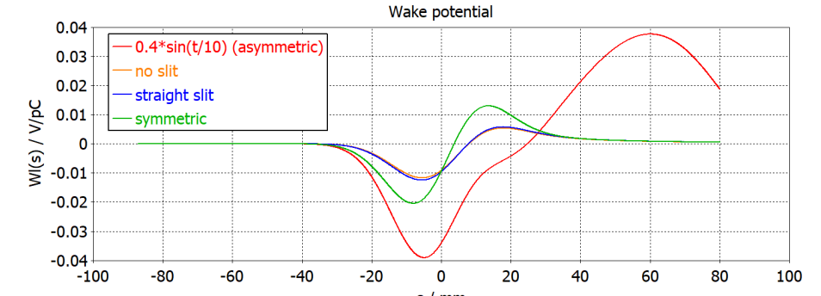
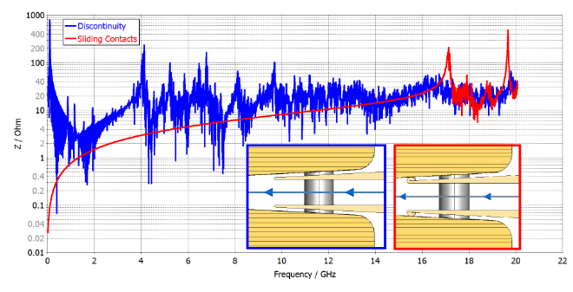
In-Vacuum APPLE II: Impedance Analysis
  Challenge
    Longitudinal slit errors from manufacture could lead to coupled bunch instabilities.
    Complicated taper section geometries causing trapped modes to arise.
  Solution
    Extensive simulation with CST throughout design process.
    Use of Goubau line to test rapid prototypes in air.

Slide 26
Covering the Spectrum: Tender Energy
Energy Range ~ 1 keV to 20 keV

Slide 27
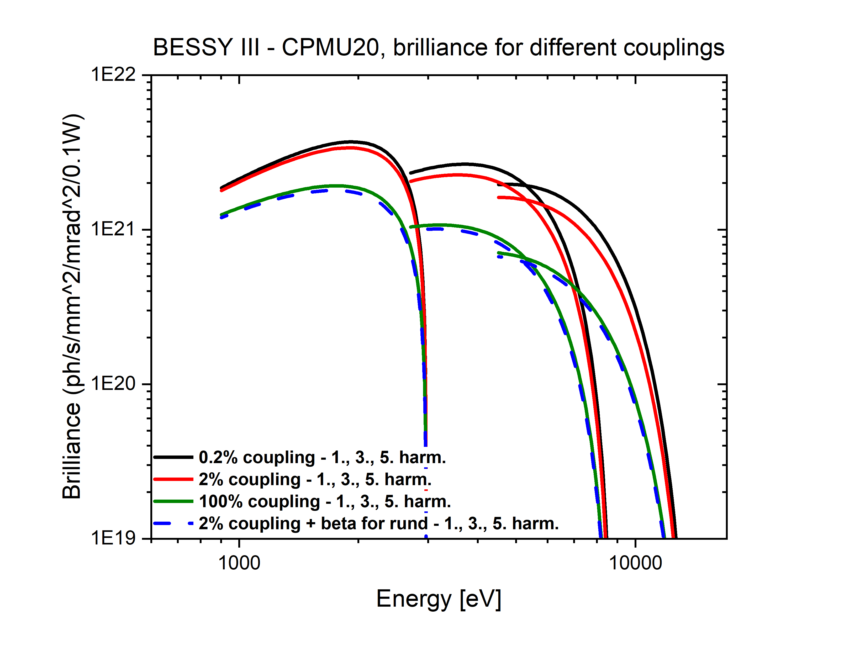
Tender Energy: Overview
  Cryogenic Permanent Magnet Undulator
    Becoming a standard device
    Reaching out to industry partners
  Cryogenic APPLE II Undulator
    Next logical step after in-vacuum APPLE II development
    “Best of both worlds”* high field and polarisation control
    *Most challenging of both worlds!
CPMU
In-Vacuum APPLE
Cryo-APPLE

Slide 28
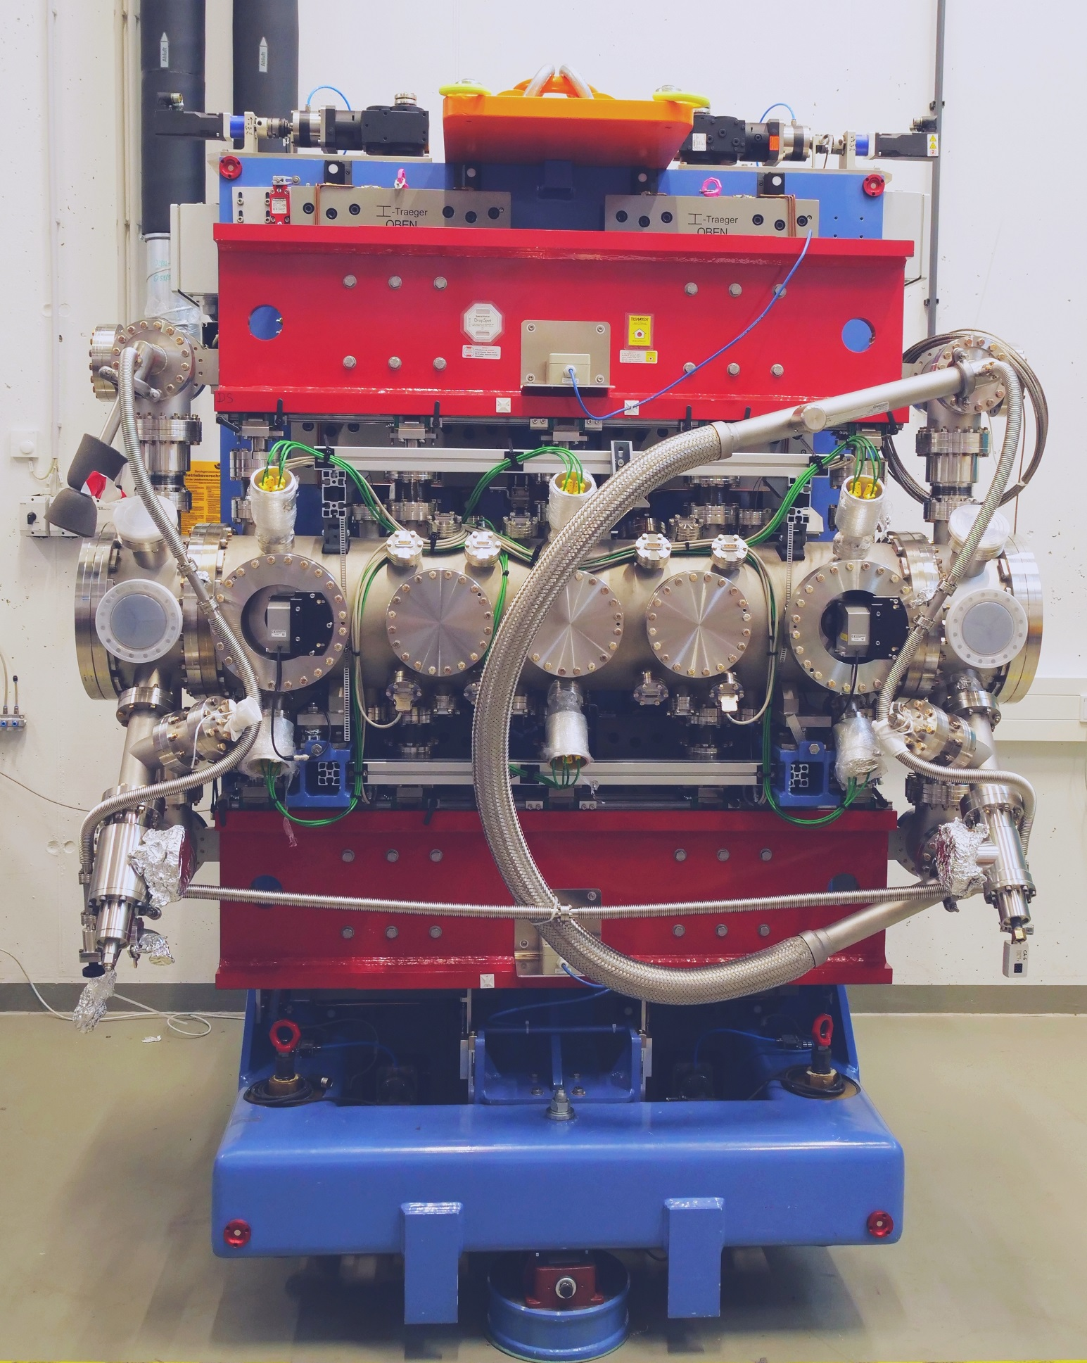
CPMU: Overview
  CPMU17 for EMIL Beamline
    Installed in 2018 as the first CPMU (and first in-vacuum undulator!) in BESSY II.
    Active gap measurement system with Keyence optical micrometer.
    Cooled with Research Instruments closed loop cryocooler.
    Minimum gap 5.6 mm
  Same design will be used for BESSY III
    … with minor improvements.
    At period lengths 18 mm, 20 mm and 21 mm.

Slide 29
Cryogenic APPLE: Overview
  Technology Testbed
    The cryogenic APPLE is being designed as a functional prototype.
    Maximum magnet length of 1 m.
    Minimum Gap 5 mm.
    Lifespan across the end of BESSY II and into BESSY III.
  Goal
    Push polarised light to higher use case scenarios.
    Bring the technology to maturity to be available as a device choice for BESSY III.

Slide 30
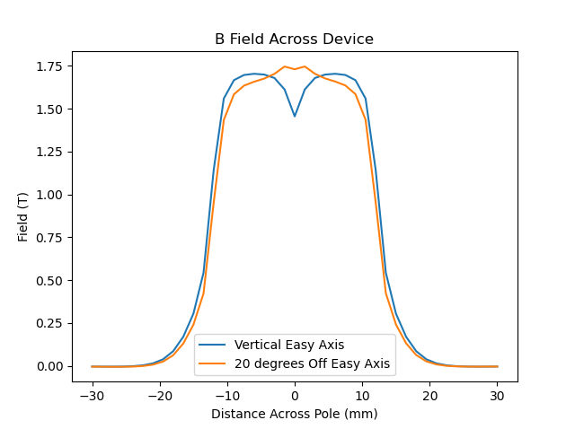
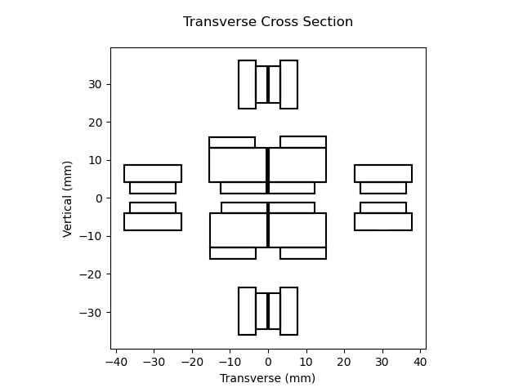
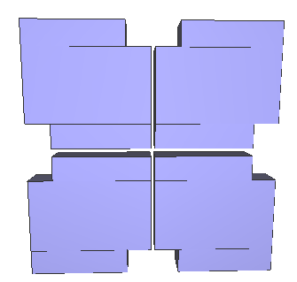
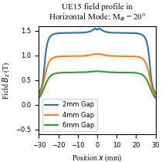
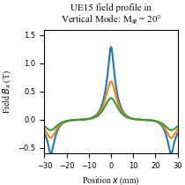
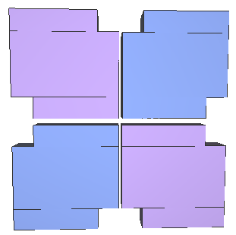
Cryogenic APPLE: Magnet Design
  Small gap field dip
    Originally conceived for 2 mm minimum gap.
    Significant field dip on axis in Horizontal mode recovered by rotating easy axis of ‘vertical’ magnets.
    Effect still large at 5 mm gap, so 20° rotation maintained.
    Minimal effect on field in Vertical mode.
    Fields of force compensation magnets also rotated.

Slide 31
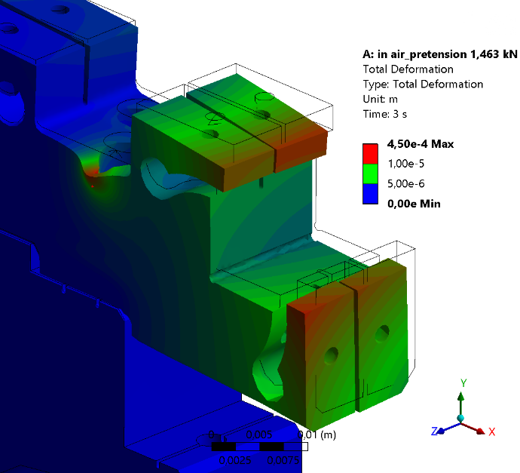
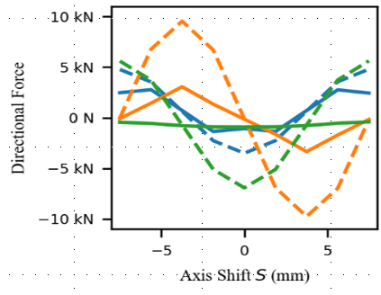
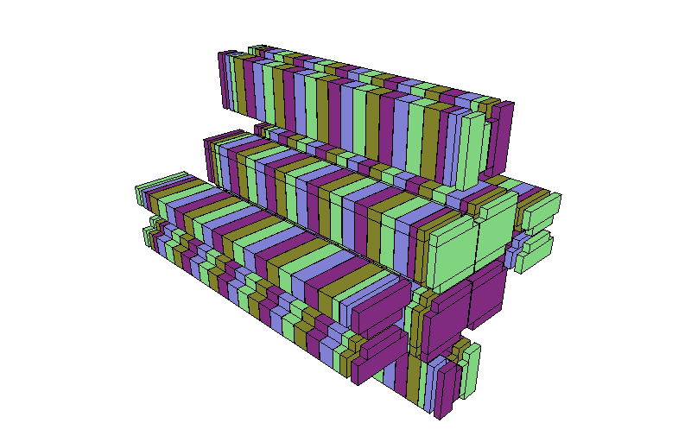




Cryogenic APPLE: Mechanical Design
  Magnets
    Force Compensation Design
    informs mechanical design
  Mechanical Simulations
    Deflection of keeper and support columns under residual magnet forces simulated and fall within acceptable ranges
TUPM064: Cryogenic APPLE Undulator Development at Helmholtz-Zentrum Berlin
E. Rial et al
  Girder
    Two part keeper mounted against on-girder positioning features for easier assembly and shimming
    Central cooling channel
  Thermal Simulations
    Steady state thermal simulations show <1K variation near the magnet

Slide 32
Covering the Spectrum: Complete Coverage
Energy Range ~ 5 eV to 20 keV

Slide 33



Complete Coverage: Overview
  Serial Undulators
    Long straight sections in BESSY III should enable sequential undulators.
    The EMIL straight at BESSY II acts as proof of principle.
    Higher energy device upstream.
    Offset source points – less space per array.
  Double Undulator
    A prospective device to bring two in-vacuum APPLE II arrays side by side.
    Each array has access to the full straight length
    Source point remains constant.
    Practical development starting 2026.

Slide 34




Supporting Activities: M&A
  Measurement
    New device types need new measurement equipment
  In-Vacuum Hall Probe Bench
    Improvements to
    existing hardware
    To be used for
    in-vacuum APPLE II,
    CPMU and Cryo-APPLE
  Pulsed Wire Measurement
    New development
    For small aperture
    devices
    To complement
    Hall Probe
  UHV Assembly
    New clean magnet assembly area in Adlershof
        Shared with accelerator magnet assembly
    70 m² temperature controlled ISO6 clean room
    Measurement and assembly of in-vacuum magnet arrays

Slide 35






Supporting Activities: Software
  UNDUWAVE
    Python package linked to FORTRAN codes UNDUMAG and WAVE
    Permanent and Electromagnet Simulation
    Magnet influence on electron beam
    Spectral output calculations
  Open Source
Unduwave | WAVE and UNDUMAG

Slide 36



Timeline and Conclusion
Courtesy: Markus Sauerborn
Roadmap
Roadmap
Roadmap
Submission & positive review
of pre-CDR
CDR/proposal submission.
Construction Starts
Start of
Full User Operation
A firm foundation for BESSY III, but with lots of work ahead!

Slide 37

WI-AUND – Many hands make light work!
  Front
  Kiarash Karimi
  Johannes Bahrdt
  Ed Rial
  Atoosa Meseck
  Stefan Gottschloch
  Carsten Kuhn
  Back
  Florian Laube
  Jürgen Bakos
  Stefan Grimmer
  Annette
  Rogosch-Opolka
  Paul Volz
  Nasim Fallahi
  Christoph Lorey
  Mario Strehlke
  Not Pictured
  Oliver Reichel
  Stefan Schäfer
  Special Thanks
  Paul Goslawski

Slide 38

The future is bright!
  Thank You!
  uestions, Comments …
E. Rial – Insertion Devices for Future Light Sources Workshop – Taipei, Taiwan 31.05.2025

